Slide 1
3 Nephi 20-26

Slide 3
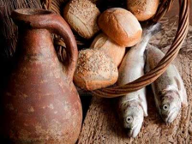
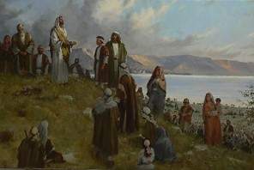
A Miraculous Sacrament
A Sacramental Ordinance:
‘there had been no bread, neither wine, brought by the disciples, neither by the multitude’
Feeding 5,000—12 baskets full
“And he commanded the multitude to sit down on the grass, and took the five loaves, and the two fishes, and looking up to heaven, he blessed, and brake, and gave the loaves to his disciples, and the disciples to the multitude.”
Matthew 14:19
What is the sacred nature of the Sacrament?
Feeding 4,000—7 baskets full
“And he took the seven loaves and the fishes, and gave thanks, and brake them, and gave to his disciples, and the disciples to the multitude.”
Matthew 15:36
3 Nephi 20:1-9

Slide 4
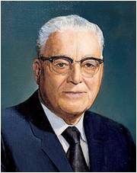
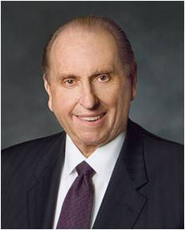
Worthy Aaronic Priesthood Holders
To be personally righteous and to stand approved in the sight of God and his appointed leaders.
“When one becomes a holder of the priesthood, he becomes an agent of the Lord. He should think of his calling as though he were on the Lord’s errand.” President Harold B. Lee
“In order to do so, each must be worthy. Let us have ready hands, clean hands, and willing hands, that we may participate in providing what our Heavenly Father would have others receive from Him. If we are not worthy, it is possible to lose the power of the priesthood; and if we lose it, we have lost the essence of exaltation. Let us be worthy to serve.”
President Thomas S. Monson
Who should or should not partake of the sacrament?
3 Nephi 20:1-9

Slide 5
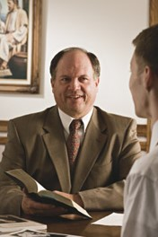
Worthy to Partake of the Sacrament
Should there be anything amiss in your life, there is open to you a way out.
Cease any unrighteousness.
Talk with your bishop.
Whatever the problem, it can be worked out through proper repentance.
You can become clean once again. Said the Lord, speaking of those who repent, “Though your sins be as scarlet, they shall be as white as snow,” (Isaiah 1:18)
“and I, the Lord, remember them no more.” (D&C 58:42)
President Thomas S. Monson
How do we qualify for the Savior’s Promises?
3 Nephi 20:1-9

Slide 6
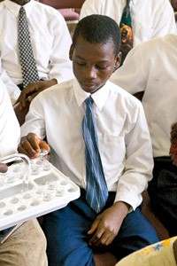
The Promises
“Let us qualify ourselves for our Savior’s promise that by partaking of the sacrament we will ‘be filled’, which means that we will be ‘filled with the Spirit’. That Spirit—the Holy Ghost—is our comforter, our direction finder, our communicator, our interpreter, our witness, and our purifier—our infallible guide and sanctifier for our mortal journey toward eternal life.
“… Out of the seemingly small act of consciously and reverently renewing our baptismal covenants comes a renewal of the blessings of baptism by water and by the Spirit, that we may always have his Spirit to be with us. In this way all of us will be guided, and in this way all of us can be cleansed.”
Dallin H. Oaks
Where should our hearts be during sacrament?
3 Nephi 20:1-9

Slide 7
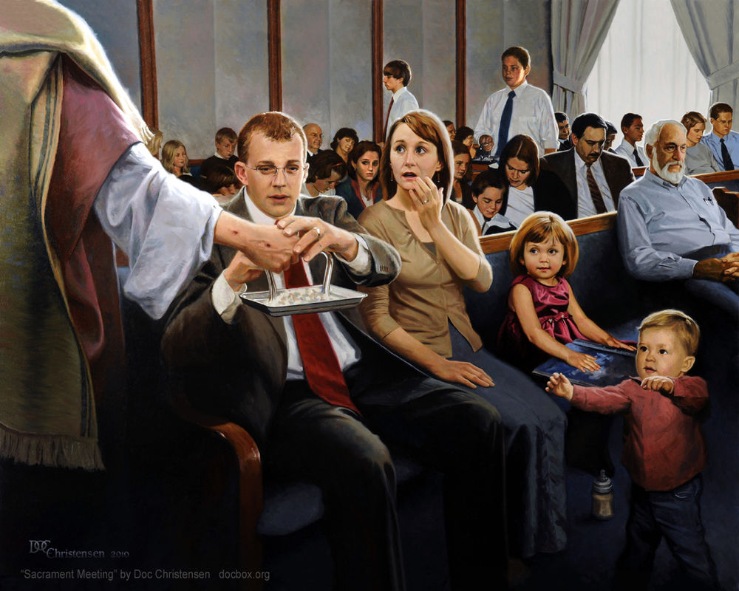
As we prayerfully partake of the sacrament, we can be filled with the Holy Ghost
“[The period before sacrament meeting begins] is not a time for conversation or transmission of messages but a period of prayerful meditation as leaders and members prepare spiritually for the sacrament.”
Russell M. Nelson
Why do you think it is important to avoid talking or transmitting messages to others before or during the sacrament?
How can praying before and during the sacrament help us to be filled with the Holy Ghost?

Slide 8
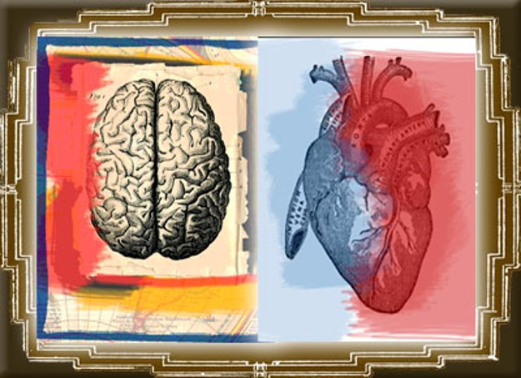
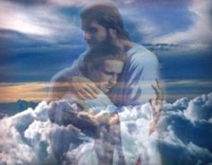
Not Cease to Pray
The sacramental prayers teach how to receive the constant companionship of the Holy Spirit.
When we partake... ...we open our mind and heart...
The Heart and Mind:
A symbol of the mind and will of man and the figurative source of all emotions and feelings
Guide to the Scriptures
“Our hearts can only be drawn out to God when they are filled with love for Him and trust in His goodness…”
Henry B. Eyring
3 Nephi 20:1

Slide 9
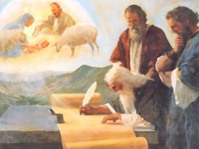
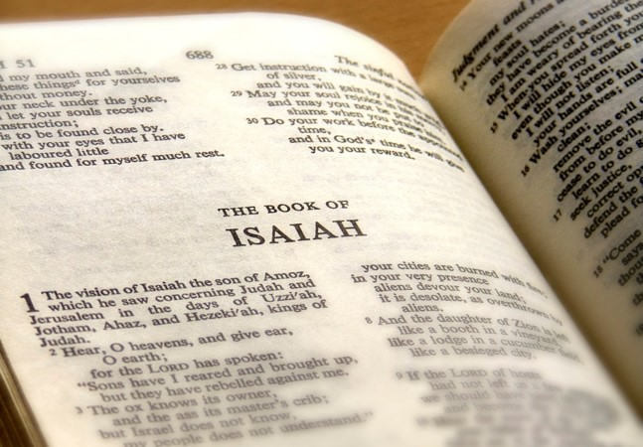
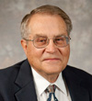
Christ Quotes Isaiah
To the Nephites:
“Ye remember that I spake unto you, and said that when the words of Isaiah should be fulfilled—behold they are written,
ye have them before you, therefore search them—”
For us today:
“You Latter-day Saints have the words of Isaiah; they are written in the Bible, and many of them are in the Book of Mormon; therefore search them!”
Victor L. Ludlow
3 Nephi 20:11

Slide 10
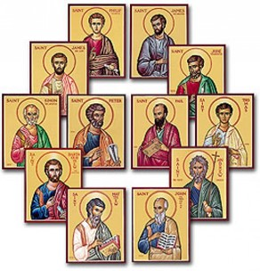
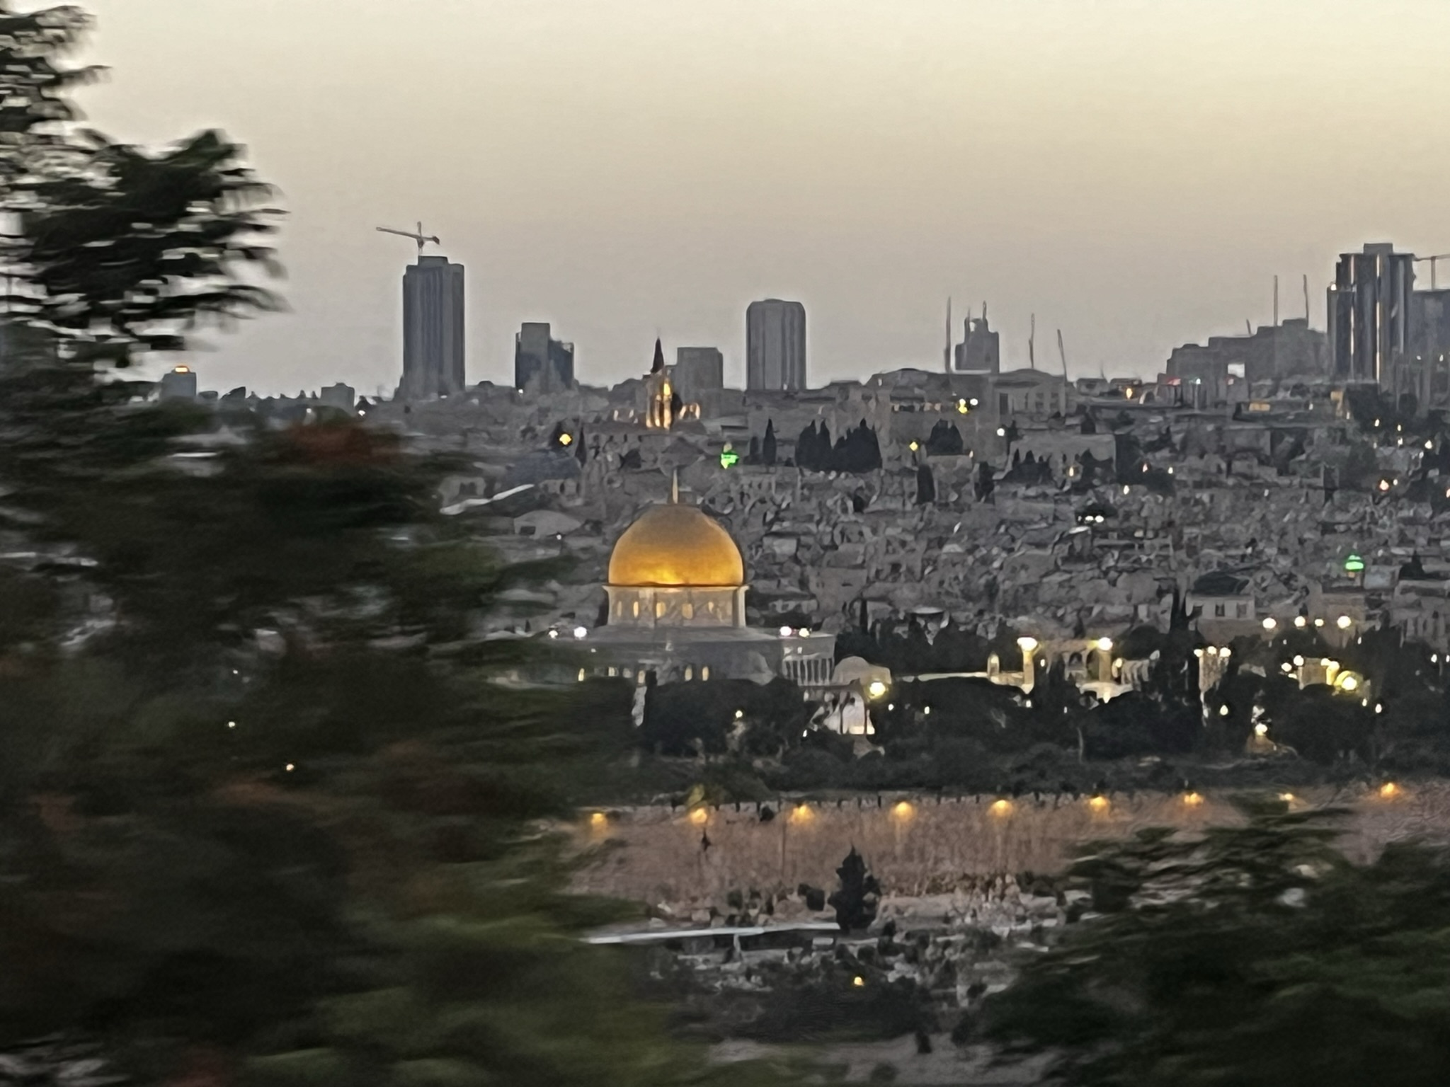
The House of Israel
“By divine command the name [Israel] was applied to the 12 tribes collectively. (Gen 49:28; Ex. 3:36) Hundreds of millions of persons have thus been Israelites, heirs of the promises made to their fathers. This great host, called while on earth to be a peculiar people. Were also a separate and distinct group in the pre-existence.”
Bruce R. McConkie
To be fulfilled in the last days:
“when the words of Isaiah are fulfilled, then God’s covenant with the house of Israel is fulfilled.”
Victor L. Ludlow
3 Nephi 20:11-12

Slide 11
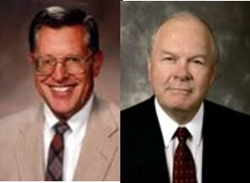
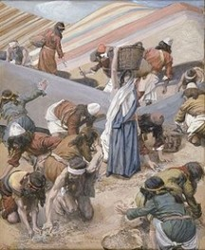
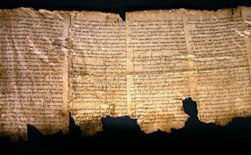
The Scattered to be Gathered
“How is it that they shall be gathered?
By coming to the knowledge of the Lord their God, who hath redeemed them.
1st spiritual to Christ—his gospel and His true Church
Salvation is not a place, but in a person, the person of Christ
We might find that prior to or during the Millennium there would be other scriptural records come forth.
JFM and RLM
God will fulfill His covenant to gather the house of Israel in the last days
“…Lost books are among the treasures yet to come forth…there will also be many more nourishing and inspiring scriptures.
However, we must first feast worthily upon that which we already have!”
Neal A. Maxwell
3 Nephi 20:13

Slide 12
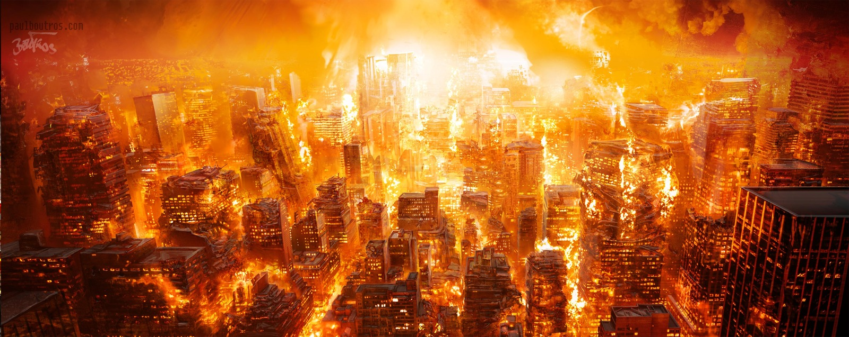
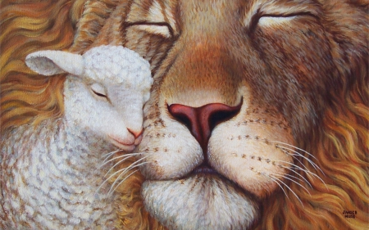
A Young Lion Among the Flocks of Sheep
“These words of our Lord to the Nephites are quoted from Micah 5:8–9 and have reference to the desolations and ultimate burning that shall destroy the wicked at the Second Coming.
Except for a few who are the humble followers of Christ, the Gentiles will not repent.
They will revel in their abominations and sin against the restored gospel, and they will be burned by the brightness of our Lord’s coming while the righteous—here called the remnant of Jacob—shall abide the day.
And then, in the prophetic imagery, it will be as though the remnant of Israel overthrew their enemies as a young lion among the flocks of sheep.”
Bruce R. McConkie
3 Nephi 20:16-17

Slide 13
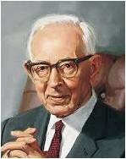
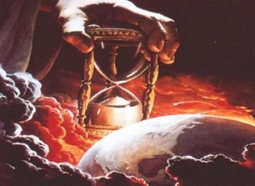
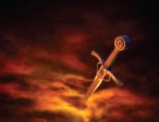
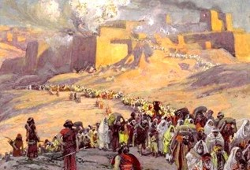
Sheaves, Horns, Hoofs, and Swords
2nd physical gathering—”The gathering of Israel during the thousand years of peace will be of a magnitude that is difficult for us in our present state to conceive.”
“…but the great body of the Jews who are there assembled will not receive Christ as their Redeemer until he comes himself and makes himself manifest unto them.”
Joseph Fielding Smith
Sword of Justice
Justice—wielded by the Almighty, shall fall upon the wayward and rebellious of all nations
Horn iron—hoofs brass
“Symbolic expressions of Might and power
The power of Christ and his destroying angels to cleanse the earth of all wicked persons and all wickedness,
Beat in pieces—those persons who have rejected the greater light of the gospel and gloried in their perversity.”
3 Nephi 20:18-20 and JFM and RLM

Slide 14
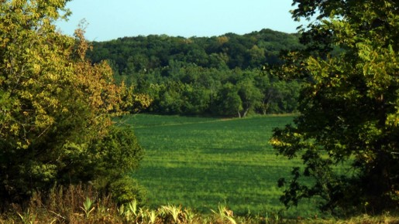
The New Jerusalem
American Continent
(Article of Faith 10):
“Hearken, O ye elders of my
church, saith the Lord your God,
who have assembled yourselves
together, according to my
commandments, in this land,
which is the land of Missouri,
which is the land which I have
appointed and consecrated for
the gathering of the saints.
Wherefore, this is the land of
promise, and the place for the
city of Zion.
And thus saith the Lord your God, if you will receive wisdom here is wisdom. Behold, the place which is now called Independence is the center place; and a spot for the temple is lying westward, upon a lot which is not far from the courthouse.”
D&C 57:1-3
3 Nephi 20:18-20 and JFM and RLM

Slide 15
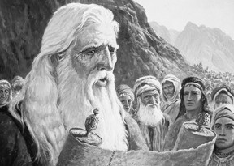
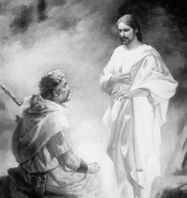
Jesus Testifies Himself
The Prophets knew:
“For Moses truly said unto the fathers, A prophet shall the Lord your God raise up unto you of your brethren, like unto me; him shall ye hear in all things whatsoever he shall say unto you.
And it shall come to pass, that every soul, which will not hear that prophet, shall be destroyed from among the people.
Yea, and all the prophets from Samuel and those that follow after, as many as have spoken, have likewise foretold of these days.”
Acts 3:22-24
Jehovah speaks through Moses:
“I will raise them up a Prophet from among their brethren, like unto thee, and will put my words in his mouth; and he shall speak unto them all that I shall command him.
And it shall come to pass, that whosoever will not hearken unto my words which he shall speak in my name, I will require it of him.”
Deuteronomy 18:18-19
3 Nephi 20:23-24 and JFM and RLM

Slide 16
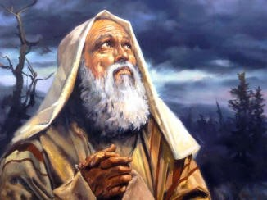
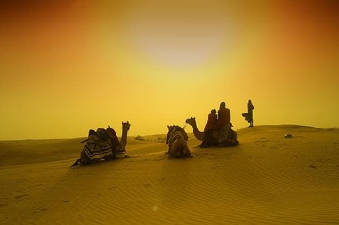
Abrahamic Covenant
Abraham made covenants with God when he received the gospel, when he was ordained a high priest, and when he entered into celestial marriage. In these covenants, God promised great blessings to Abraham and his family. These blessings, which extend to all of Abraham's seed, are called the Abrahamic covenant:
His posterity would be numerous
His seed, or descendants, would receive the gospel and bear the priesthood
Through the ministry of his seed, “all the families of the earth [would] be blessed, even with the blessings of the Gospel, which are the blessings of salvation, even of life eternal”
A person can receive all the blessings of the Abrahamic covenant—even if he or she is not a literal descendant of Abraham—by obeying the laws and ordinances of the gospel
Study Guide—see also Bible Dictionary
As the seed of Abraham, we have a covenant responsibility to bless all the people of the earth.
3 Nephi 20:25-46

Slide 17
Jesus quotes Isaiah Victor L. Ludlow Unlocking Isaiah in the Book of Mormon pgs. 231-240
3 Nephi 20 | Isaiah 52 | Today | Other references
Verses: 32-35 Watchmen works as Lord’s messengers to share the peace and joy that the gospel message brings. Bare His holy arm—power of God | Verses: 8-10 Watchmen-sing-give inheritance-bare His holy arm | These watchmen might be: Prophets, General Authorities, full-time missionaries, or local leaders and members. They all serve as Christ’s representatives as they take the joyous word to the world. Every member a missionary | D&C 18:15 D&C 65:2
Verses: 36-38 A joyful future of Israel when only the righteous and pure will dwell in Jerusalem. Put on the power and authority of the priesthood. Redemption through Christ | Verses: 1-3 Awake, shake off dust, put on thy strength. Loose bands, Redeemed without money.. | Both our clothing and our behavior reveal to others the principles we represent…Spiritual Attire Scattered Remnants of Israel return to the Lord---spiritual freeing through the Atonement of Christ…as sinners we are indebted to the Lord for His mercy | D&C 27:15 2 Nephi 9:14 D&C 113:9-10
Verses: 39-40 Standing on the Lord’s house to receive instruction | Verses: 6-7 I am—mountains of thy feet—brings good tidings | Going to the temple of the Lord. Receiving instruction from the General Authorities and leaders at conference | 2 Nephi 12:2 Isaiah 2:2
Verses: 41-45 They are called to repent after they receive the gospel blessing—if they refuse they will face God’s judgment | Verses: 11-15 Be clean (repent)—God will be your rearward (prudent in judgment)—sprinkle many nations | The need to be clean and pure, virtuous in all things “We counsel you not to pollute your minds with degrading matter…” Ezra Taft Benson Turn away from filth We will be judged upon our actions with Jesus is our mediator | 2 Timothy 2:20-22 Revelation 18:4 D&C 101:94

Slide 18
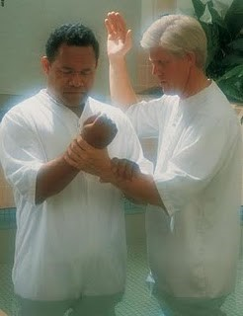
Will Surely Come to Pass
When the words of Isaiah are fulfilled, then the Father’s covenant with His people will be fulfilled, and they will be established in their lands of Inheritance
As latter-day heirs of the covenants made with Abraham, we need to be involved in this marvelous work.
As pure messengers of truth, we share a wonderful opportunity for significant service while we build His kingdom of peace.
Our Savior’s instruction to us:
Understand the words of Isaiah that gives us incentive to work toward their fulfillment”
3 Nephi 20:46

Slide 19
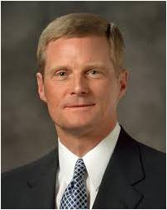
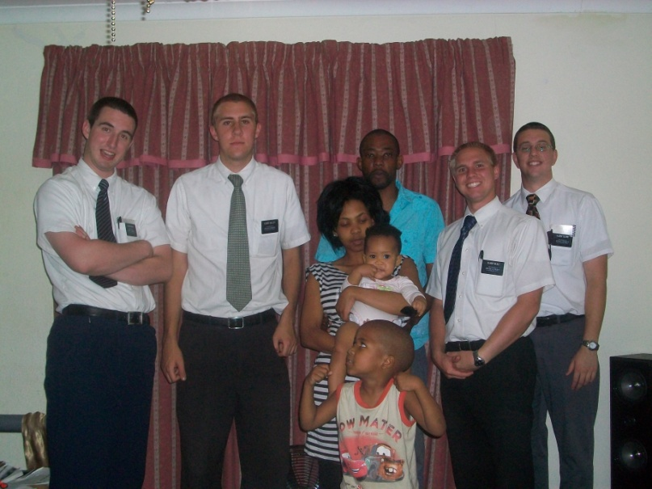
Sharing the Gospel
“You and I, today and always, are to bless all peoples in all the nations of the earth. You and I, today and always, are to bear witness of Jesus Christ and declare the message of the Restoration. You and I, today and always, are to invite all to receive the ordinances of salvation. Proclaiming the gospel is not a part-time priesthood obligation.
It is not simply an activity in which we engage for a limited time or an assignment we must complete as members of The Church of Jesus Christ of Latter-day Saints. Rather, missionary work is a manifestation of our spiritual identity and heritage.
We were foreordained in the premortal existence and born into mortality to fulfill the covenant and promise God made to Abraham. We are here upon the earth at this time to magnify the priesthood and to preach the gospel. That is who we are, and that is why we are here—today and always”
Elder David A. Bednar

Slide 20
Sources:
Feeding Five Thousand art of Brian Jekel
Stand Ye in Holy Places: Selected Sermons and Writings of President Harold B. Lee (1976), 255.
President Thomas S. Monson Willing and Worthy to Serve April 2012 Gen. Conf. and Priesthood Power May 2011 Gen. Conf.
James E. Talmage (Jesus the Christ,3rd ed. [1916], 342; italics added).
Dallin H. Oaks (“Always Have His Spirit,” Ensign, Nov. 1996, 61).
Henry B. Erying Prayer Oct. 2001 Gen. Conf.
Russell M. Nelson, “Worshiping at Sacrament Meeting,” Ensign, Aug. 2004, 27).
Victor L. Ludlow Unlocking Isaiah in the Book of Mormon pgs. 231, 241 (Chart 231-240)
Bruce R. McConkie Mormon Doctrine pg. 389; The Millennial Messiah: The Second Coming of the Son of Man[1982], 248).
Joseph Fielding McConkie and Robert L. Millet Doctrinal Commentary on the Book of Mormon Vol. 4 pg. 139-40
Elder Neal A. Maxwell God Will Yet Reveal CR, October 1986
Joseph Fielding Smith Doctrines of Salvation 3:9
Elder David A. Bednar (“Becoming a Missionary,”Ensign or Liahona, Nov. 2005, 47).
Presentation by ©http://fashionsbylynda.com/blog/

Slide 21
Jesus quotes Isaiah Victor L. Ludlow Unlocking Isaiah in the Book of Mormon pgs. 231-240
3 Nephi 20 | Isaiah 52 | Today | Other references
Verses: 32-35 Watchmen works as Lord’s messengers to share the peace and joy that the gospel message brings. Bare His holy arm—power of God | Verses: 8-10 Watchmen-sing-give inheritance-bare His holy arm | These watchmen might be: Prophets, General Authorities, full-time missionaries, or local leaders and members. They all serve as Christ’s representatives as they take the joyous word to the world. Every member a missionary | D&C 18:15 D&C 65:2
Verses: 36-38 A joyful future of Israel when only the righteous and pure will dwell in Jerusalem. Put on the power and authority of the priesthood. Redemption through Christ | Verses: 1-3 Awake, shake off dust, put on thy strength. Loose bands, Redeemed without money.. | Both our clothing and our behavior reveal to others the principles we represent…Spiritual Attire Scattered Remnants of Israel return to the Lord---spiritual freeing through the Atonement of Christ…as sinners we are indebted to the Lord for His mercy | D&C 27:15 2 Nephi 9:14 D&C 113:9-10
Verses: 39-40 Standing on the Lord’s house to receive instruction | Verses: 6-7 I am—mountains of thy feet—brings good tidings | Going to the temple of the Lord. Receiving instruction from the General Authorities and leaders at conference | 2 Nephi 12:2 Isaiah 2:2
Verses: 41-45 They are called to repent after they receive the gospel blessing—if they refuse they will face God’s judgment | Verses: 11-15 Be clean (repent)—God will be your rearward (prudent in judgment)—sprinkle many nations | The need to be clean and pure, virtuous in all things “We counsel you not to pollute your minds with degrading matter…” Ezra Taft Benson Turn away from filth We will be judged upon our actions with Jesus is our mediator | 2 Timothy 2:20-22 Revelation 18:4 D&C 101:94

Slide 22
“Not many of the Jews…will believe in Christ before He comes. The Book of Mormon tells us that they shall begin to believe in him (2 Nephi 30:7-18), etc.). They are now beginning to believe in him. The Jews today look upon Christ as a great Rabbi. They have accepted him as one of the great teachers; they have said that, ‘He is Jew of Jew, the greatest Rabbi of them all’ as one has stated it. When the gospel was restored in 1830, if a Jew had mentioned the name of Christ in one of the synagogues, he would have been rebuked. Had a rabbi referred to him, the congregation would have arisen and left the building. As so, we see the sentiment has changed. Now I state this on Jewish authority that they are beginning to believe in Christ, and some of them are accepting the gospel.
“But in the main they will gather to Jerusalem, in their unbelief; the gospel will be preached to them; some of them will believe. Not all of the Gentiles have believed when the gospel has been proclaimed to them, but the great body of the Jews who are there assembled will not receive Christ as their Redeemer until he comes himself and makes himself manifest unto them.”
Joseph Fielding Smith Doctrines of Salvation 3:9
“Zion, the New Jerusalem, on American soul? And we hasten to add, so also shall there be Zions in all lands and New Jerusalems in the mountains of the Lord in all the earth. But the American Zion shall be the capital city, the source whence the law shall go forth to govern all the earth. It shall be the city of the Great King. His throne shall be there, and from there he shall reign gloriously over all the earth.”
Bruce R. McConkie Millennial Messiah, pp. 301-2
A Person’s Identity 3 Nephi 20:10-46:
“You may enjoy music, athletics, or be mechanically inclined, and someday you may work in a trade or a profession or in the arts. As important as such activities and occupations can be, they do not define who we are. First and foremost, we are spiritual beings. We are [children] of God and the seed of Abraham” (David A. Bednar, “Becoming a Missionary,”Ensign or Liahona, Nov. 2005, 47).
3 Nephi 20:26–27. Fulfill the Abrahamic covenant
Elder Russell M. Nelson of the Quorum of the Twelve Apostles spoke of a way we can help fulfill the Abrahamic covenant:
“Ours is the responsibility to help fulfill the Abrahamic covenant. Ours is the seed foreordained and prepared to bless all people of the world. That is why priesthood duty includes missionary work. After some 4,000 years of anticipation and preparation, this is the appointed day when the gospel is to be taken to the kindreds of the earth. This is the time of the promised gathering of Israel. And we get to participate! Isn’t that exciting? The Lord is counting on us and our sons—and He is profoundly grateful for our daughters—who worthily serve as missionaries in this great time of the gathering of Israel” (“Covenants,” Ensign or Liahona, Nov. 2011, 88).
3 Nephi 20:26. Children of the covenant
Elder Russell M. Nelson of the Quorum of the Twelve Apostles spoke about the blessings of knowing that we are children of the covenant:
“When we realize that we are children of the covenant, we know who we are and what God expects of us. His law is written in our hearts. He is our God and we are His people. Committed children of the covenant remain steadfast, even in the midst of adversity. When that doctrine is deeply implanted in our hearts, even the sting of death is soothed and our spiritual stamina is strengthened” (“Covenants,” Ensign or Liahona, Nov. 2011, 88).
“The gathering of Israel consists in believing and accepting and living in harmony with all that the Lord once offered his ancient chosen people. It consists of having faith in the Lord Jesus Christ, of repenting, of being baptized and receiving the gift of the Holy Ghost, and of keeping the commandments of God. It consists of believing the gospel, joining the Church, and coming into the kingdom. It consists of receiving the holy priesthood, being endowed in holy places with power from on high, and receiving all the blessings of Abraham, Isaac, and Jacob, through the ordinance of celestial marriage. And it may also consist of assembling to an appointed place or land of worship” (Bruce R. McConkie, A New Witness for the Articles of Faith[1985], 515).
Other Quotes

Slide 23
3 Nephi 21-22
The Sign of Our Father’s Work to Come Forth

Slide 24
What are signs used for?
To prepare, warn, and instruct us
Why is it important that a sign be posted properly and that the message on the sign be easy to understand?

Slide 25
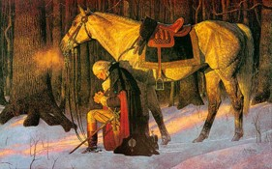
Establishment of a Free People
A
FREE
PEOPLE
America came to be because of define intervention—
The ‘founding fathers’ with the belief in ‘a God’
America was born of God
1 Nephi 13:15-19
“The gospel message comes to those in the great Gentile nation of America. Those who accept it repent of their sins, receive the ordinances of salvation, and come to know “the true points of [Christ’s] doctrine.”
JFM and RLM
THROUGH
As many as the Gentiles and Jews repent they will be of the covenant people (2 Nephi:30:2)
3 NEPHI 21:4-6

Slide 26
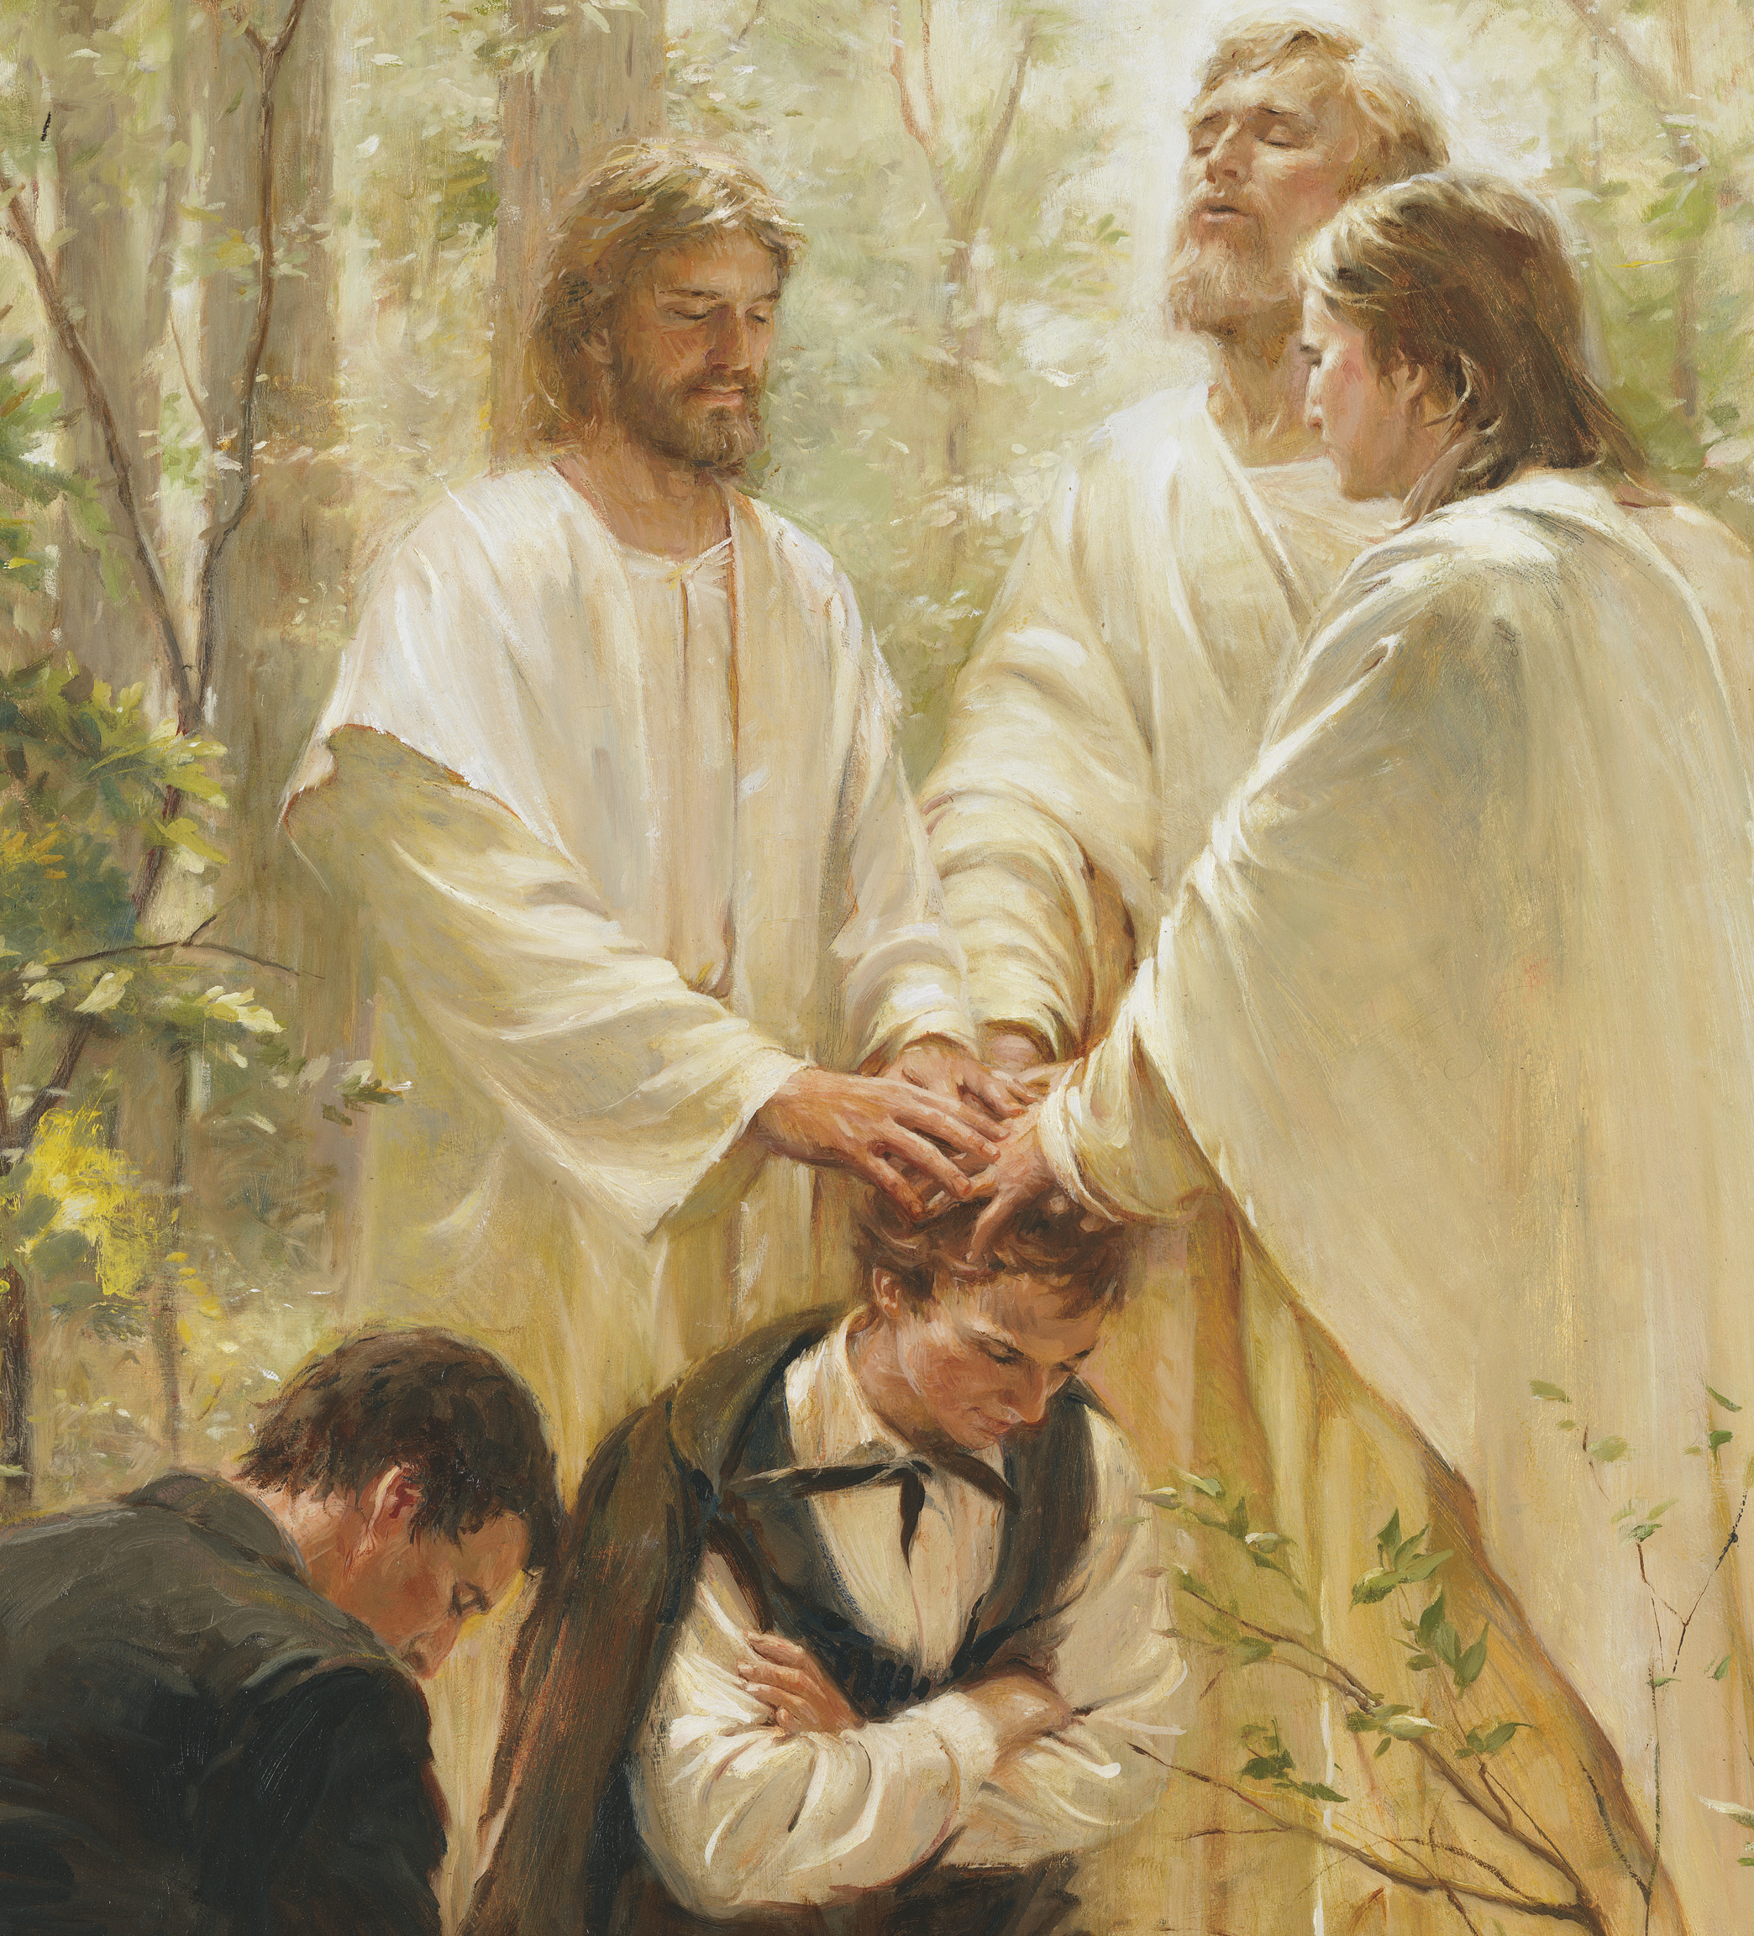
Restoration of Christ’s Gospel
Restoration
Like prophets in earlier dispensations, Joseph Smith was called as the prophet of this last dispensation. Joseph Smith sought for truth and received revelation
THROUGH
3 NEPHI 21:7-9

Slide 27
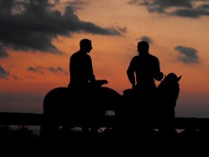
Martyrdom of a Servant
MY
SERVANT
The Lord would watch over his servant Joseph Smith and the work to come forth
Read D&C 122:3-4,9
He shall be marred
I will heal him
“Through cruel and wicked men would murder the head of this final dispensation, yet the work which he would set in motion… would roll forward to eventually fill the whole earth.”
JFM and RLM
CONDEMNATION
To reject the words of Christ in this final stage on earth
3 NEPHI 21:10-11

Slide 28
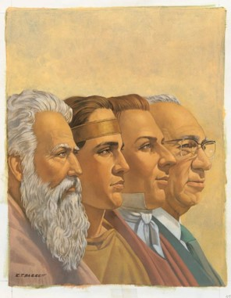
Taking the Gospel to the Lamanites
THE
REMNANT
OF
JACOB
The remnant of the House of Jacob refers to all the House of Israel
“All through the Lord has been speaking for the remnant of Jacob or Israel and of the great promises made to the Gentiles who are on this land and in all other lands, if they will only come into the Church and be numbered with the house of Israel. Their privileges would be to assist in building the New Jerusalem, and if they refuse, then shall the punishments come upon them.”
Joseph Fielding Smith
If individuals will repent, hearken to the Savior’s words, and harden not their hearts, they will be gathered into His Church as part of His covenant people.
3 NEPHI 21:22-28

Slide 29
What it the Sign?
The coming forth of the Book of Mormon
The
Book
of
Mormon
The gathering the house of Israel
THE SIGN
ANOTHER TESTAMENT
OF JESUS CHRIST
THROUGH
Joseph Smith the Gentiles of the last days
The coming forth of the Book of Mormon is a sign that God is fulfilling His covenant to gather Israel in the latter days.
TAKE IT TO
The message of the Restoration to the natural branches of Israel, the Lamanites and the Jews
3 NEPHI 21:1-3

Slide 30
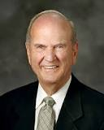
“The Book of Mormon is central to this work. It declares the doctrine of the gathering. It causes people to learn about Jesus Christ, to believe His gospel, and to join His Church.
In fact, if there were no Book of Mormon, the promised gathering of Israel would not occur.”
Elder Russell M. Nelson
The
Book
of
Mormon
ANOTHER TESTAMENT
OF JESUS CHRIST

Slide 31
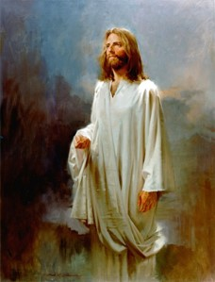
“No one is ever gathered with Israel until they accept the Crucified One. …
The present gathering of the Jews to Palestine is political, not spiritual, and it is not the gathering of Israel of which the prophecies speak.
“The gathering of Israel consists of joining The Church of Jesus Christ of Latter-day Saints, which church is the only true and living church upon the face of the whole earth”
Bruce R. McConkie
Robert A. Boyd

Slide 32
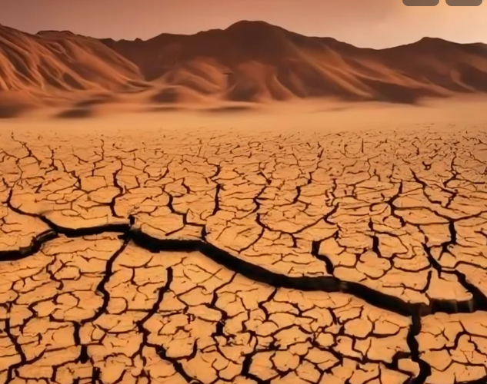
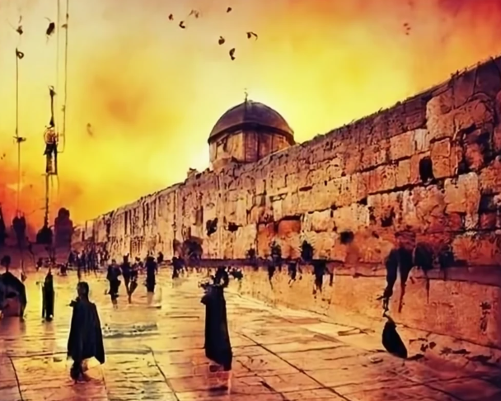
Her-She-Wife-Woman = Israel
Sing O barren = a metaphor for scattered Israel, who hasn’t fulfilled her foreordained destiny because of her inability or unwillingness to produce spiritually strong offspring for the Lord
She is barren because she has been separated from her husband (the Lord) because of her wickedness
The married wife = Covenant Israel-those remaining in the Holy land.
The desolate woman—scattered Israel
And now the Gentiles will come into the Church in greater numbers than Covenant Israel
Isaiah 54: 1
3 NEPHI 22:1

Slide 33
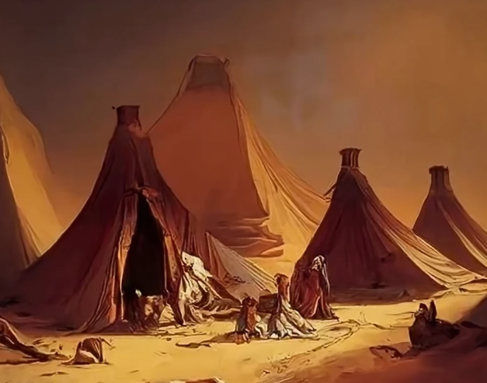
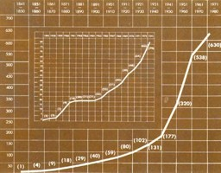
Enlarge Your Tents
Why might this “tent” need to be enlarged and strengthened in the latter days?
The growth of Israel’s conversion will come so rapidly that her dwelling places must be enlarged to accommodate them
Stakes = They are constantly moved to handle the growth but they stabilize the tent
Isaiah phrases:
“Enlarge thy borders forever,” = Proclaim the Gospel
“Strengthen thy stakes” = Perfect the Saints
“Put on thy beautiful garments” = Redeem the Dead
Isaiah 54: 2-3
3 NEPHI 22:2-3

Slide 34
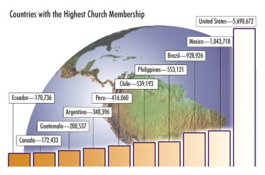
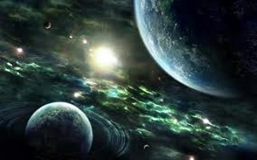
Zion Will Increase
In latter-day revelation, Zion is defined as
“the pure in heart” (D&C 97:21)
“For Zion must increase in beauty, and in holiness; her borders must be enlarged; her stakes must be strengthened; yea, verily I say unto you, Zion must arise and put on her beautiful garments.”
D&C 84:14
Oct 2006 Ensign
”For, behold, I say unto you that Zion shall flourish, and the glory of the Lord shall be upon her;
And she shall be an ensign unto the people, and there shall come unto her out of every nation under heaven.”
D&C 64:41-42
Isaiah 54: 2-3
3 NEPHI 22:2-3

Slide 35
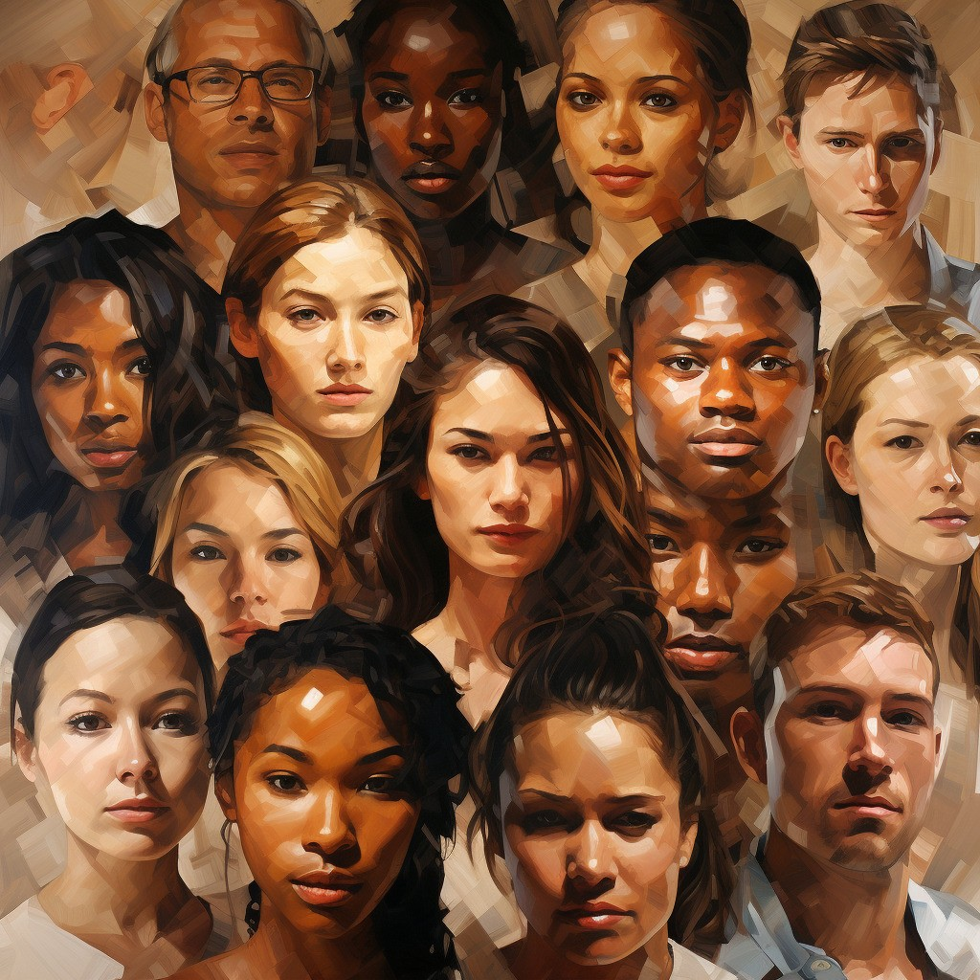
Forget the Shame of Thy Youth
An expression of Jehovah’s tenderness
In the latter days you will be able to put it behind you.
Why?
The Lord shows everlasting kindness and mercy to people who return to Him.
“Scattered Israel’s unfaithfulness—her failure to forsake the ways of Babylon and receive the covenants of Zion—shall be forgiven; Israel’s God will remember her and the promises he able to her. The reproach of her youth, her spiritual sterility, shall be forgotten.”
JFM and FLM
Isaiah 54:4
3 NEPHI 22:4

Slide 36
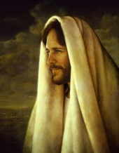
Thy Maker-Husband-Bridegroom
The Savior is the Bridegroom—the Lord of Hosts
Hid my face = When the Savior was rejected He withdrew His Spirit—for a little moment
The Lord’s mercy is every lasting
The Bride is the Church
Prior to His Second Coming and the final gathering
Israel will experience a brief abandonment
A possible prophecy may refer to the restoration of the gospel as well as the “period just before the Second Coming when the Jews seem abandoned by God as the armies of Armageddon come against them.”
Victor L. Ludlow
Isaiah 54:5-8
3 NEPHI 22:5-8

Slide 37
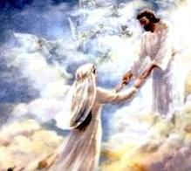
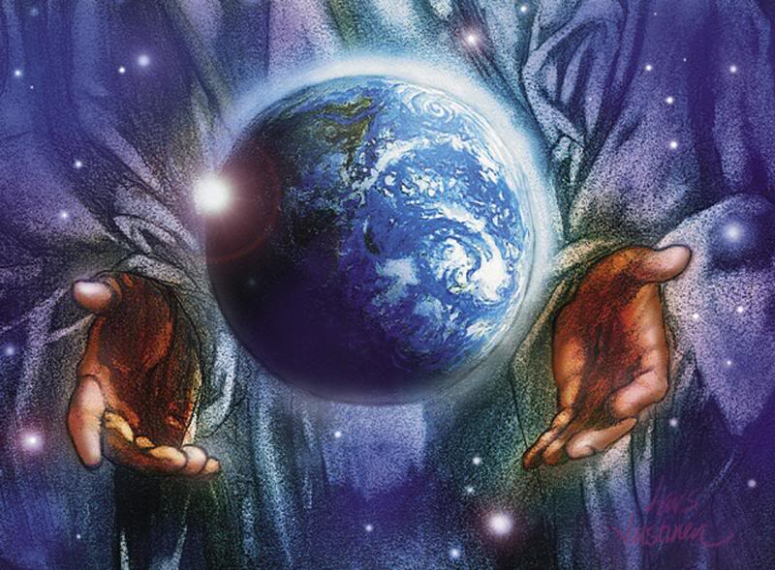
“Even though there has been barrenness and sometimes unfaithfulness, yet will the husband (Christ) reclaim and redeem his bride (Israel). …
“… Christ has, on occasion, been rightfully angry with backsliding Israel, but that has always been brief and temporary—‘a small moment.’ Compassion and mercy always return and prevail in a most reassuring way.
The mountains and the hills may disappear. The water of the great seas may dry up. The least likely things in the world may happen, but the Lord’s kindness and peace will never be taken from his covenant people. He has sworn with a heavenly oath that he will not be wroth with them forever.”
Jeffrey R. Holland

Slide 38
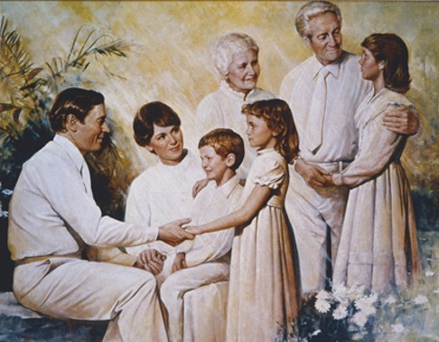
Peace of Thy Children
The relationship of the Lord and all his children during the Millennial Era
All thy children---will be taught and there will be peace
“And the earth shall be given unto them for an inheritance; and they shall multiply and wax strong, and their children shall grow up without sin unto salvation.”
D&C 45:58
“And again, inasmuch as parents have children in Zion, or in any of her stakes which are organized, that teach them not to understand the doctrine of repentance, faith in Christ the Son of the living God, and of baptism and the gift of the Holy Ghost by the laying on of the hands, when eight years old, the sin be upon the heads of the parents.”
D&C 68:25
Isaiah 54:13
3 NEPHI 22:13

Slide 39
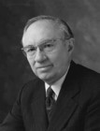
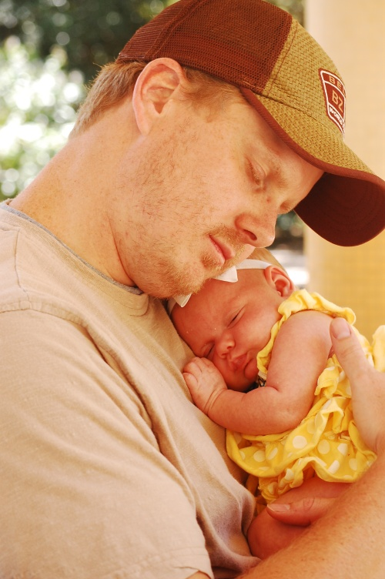
“How much more beautiful would be the world and the society in which we live if every father looked upon his children as the most precious of his assets, if he led them by the power of his example in kindness and love, and if in times of stress he blessed them by the authority of the holy priesthood; and if every mother regarded her children as the jewels of her life, as gifts from the God of heaven who is their Eternal Father, and brought them up with true affection in the wisdom and admonition of the Lord.”
Elder Gordon B. Hinckley

Slide 40
Blessings of the Righteous
The Lord’s promise:
Continual Protection, peace, and freedom from oppression (prolonged cruelty) among the righteous
Satan’s Intent:
Oppressive influences
“smith that bloweth the coals in the fire”—refiners fire
The Lord’s Kanah
Jane Ashley
Jane Ashley
“Behold, the great day of the Lord is at hand; and who can abide the day of his coming, and who can stand when he appeareth? For he is like a refiner’s fire, and like fuller’s soap; and he shall sit as a refiner and purifier of silver, and he shall purify the sons of Levi, and purge them as gold and silver, that they may offer unto the Lord an offering in righteousness…”
D&C 128:24
Isaiah 54:14-16
3 NEPHI 22:14-16

Slide 41
No Weapon Will Prosper
Although Satan will be allowed free reign on the earth, those that follow the Savior will have peace, comfort, and protection.
The Lord does not condone the devil’s work, but he sometimes allows Satan’s evil action to fulfill His own plan: to help purify the Saints for their eventual redemption…all things will eventually be for our good.”
“Every Tongue—both wicked and righteous will declare that Jesus is Lord of the earth. Although some tongues may deny the Savior’s divinity,
all people will eventually recognize and declare his supremacy as the ruler of this earth.” (Isaiah 45:23)
Victor L. Ludlow
Isaiah 54:17
3 NEPHI 22:17

Slide 42
“Yes, ‘the enemy is combined,’ but when we are combined with the Lord’s “chariots of fire,” then “they that be with us are more than they that be with them”!
(2 Kgs. 6:16–17.)
Furthermore, the divine promise is that no weapon formed against the Lord’s work shall finally prosper; this “is the heritage of the servants of the Lord.”
Neal A. Maxwell

Slide 43
Sources:
Elder Russell M. Nelson (“The Gathering of Scattered Israel,” Ensign or Liahona, Nov. 2006, 80).
Joseph Fielding Smith and Robert L. Millet Doctrinal Commentary on the Book of Mormon Vol. Pg.147, 155
Joseph Fielding Smith Doctrines of Salvation 2:247-51
Bruce R. McConkie (A New Witness for the Articles of Faith [1985], 564, 565; see also pages 511, 519–20 and The Millennial Messiah: The Second Coming of the Son of Man[1982], 229).
Victor L. Ludlow Unlocking Isaiah in the Book of Mormon pg. 247, 252
Elder Gordon B. Hinckley Behold Your Little Ones Ensign Nov. 1978
Jeffrey R. Holland, Christ and the New Covenant, 290
Neal A. Maxwell Behold, the Enemy is Combined (D&C 138:12) Ensign May 1993

Slide 44
3 Nephi 22 and Isaiah 54—Victor L. Ludlow Unlocking Isaiah in the Book of Mormon pg. 252
This chapter is a promise to the righteous members of Zion. Its various poetic forms depict the relationship between the Lord and covenant Israel. Like a husband who provides gifts and strengths to his family, the Lord blesses righteous Israel, as seen in the following chart.
Verses | Husband provide wife | The Lord provides Israel
1-3 | Children | Great numbers of posterity
4-8 | Love | Reconciliation
9-10 | Commitment | Covenant relationship
11-12 | Material comfort | Prosperity
13-17 | Protection | Peace

Slide 45
“We are experiencing a combined growth of converts and natural increase
of some 400,000 a year. Every single year that is the equivalent
of 160 new stakes of 2500 people each.” July 1999 Ensign
Speech by President Gordon B. Hinckley at BYU on November 6, 1998

Slide 46
The Lord’s Kanah
For thou shalt worship no other god: for the Lord,
whose name is Jehovah, is a jealous God.
Exodus 34:14
Jealousy = (Heb) Kanah. The word in ancient times did not convey the negative emotion we attach to it today. In our language today it would convey the emotion we feel when a cherished object is threatened and we may lose it. The “mother bear” response to a threat made toward one of our children.
Kanah means filled up with this deep emotion. It is used in the same sense of fabric put in a dye which has reached its maximum point of saturation and can take on no other dye. A common experience would be dying Easter eggs. Little children will dye pastel eggs because they get so excited and take the eggs out before the egg has fully pulled in the dye. Older children or adults will let the eggs sit in the dye until the color is rich and full.
Kanah means to be filled up with strong ardor, a fervent zeal, and an intense emotion toward someone or something important to us.
God’s Kanah has two edges:
To cherish or protect His children, even to bloodshed
A demand for the repentance of His children or retribution when He is offended by them.

Slide 47
Christ Examines the Scriptures
2 Nephi 23

Slide 48
Great are the Words of Isaiah
“…ye ought to search these things. Yea, a commandment I give unto you that ye search these things diligently; for great are the words of Isaiah.”
¶Seek ye out of the book of the Lord, and read: no one of these shall fail, none shall want her mate: for my mouth it hath commanded, and his spirit it hath gathered them.”
Isaiah 34:16
3 Nephi 23:1

Slide 49
Delighting in the Scriptures
“…For my soul delighteth in the scriptures, and my heart pondereth them, and writeth them for the learning and the profit of my children.
“Behold, my soul delighteth in the things of the Lord; and my heart pondereth continually upon the things which I have seen and heard.” (2 Ne. 4:15–16.)
The Savior commands us to give heed to His words and to search diligently the words of the prophets
What I the Lord have spoken, I have spoken, and I excuse not myself; and though the heavens and the earth pass away, my word shall not pass away, but shall all be fulfilled, whether by mine own voice or by the voice of my servants, it is the same.
D&C 1:38
3 Nephi 23

Slide 50
Scriptures Will Influence
“It is my conviction that one of the most powerful influences in the world is the word of God and when the Lord’s words are learned and taught in the right spirit our lives are changed forever.
I am equally certain that when we learn to use a few simple scripture study skills we improve our ability to discover uplifting insights, receive personal revelation, and draw closer to the Lord.”
David B. Marsh
3 Nephi 23

Slide 51
Living Without
During the war in Vietnam, some of our men were taken prisoner and kept in nearly total isolation. Permitted no access to the scriptures, they later told how they hungered for the words of truth, more than for food, more than for freedom itself. What they would have given for a mere fragment of the Bible or Book of Mormon that lay so idly on our shelves! --Spencer W. Kimball

Slide 52
Making Records Complete
When the Savior taught the Nephites, He pointed out that their record keepers had neglected to include an important event that came in fulfillment of prophecy
3 Nephi 23:6-13

Slide 53
Recording Spiritual Blessings
“Some people say, ‘I don’t have anything to record. Nothing spiritual happens to me.’ I say, ‘Start recording, and spiritual things will happen. They are there all the time, but we become more sensitive to them as we write’”
There is something eternal in the very nature of writing, as is so graphically illustrated by the scriptures themselves. In a very real sense, our properly written histories are a very important part of our family scripture and become a great source of spiritual strength to us and to our posterity.”
Elder John H. Groberg
Recording spiritual experiences can help strengthen our faith and the faith of others

Slide 54
How to Study the Scriptures
Read from cover to cover.
Search for answers to personal questions or challenges
Study topics listed in the Topical Guide or Guide to the Scriptures.
Research how the Lord uses a specific word throughout the scriptures
Mark phrases, underline words, or write notes in the margins of your scriptures
“One thing is certain: there is no one right way to study the scriptures.
While there is no one right way to study the scriptures, there are certain skills that can help us get the most out of our scripture study…
The more we master these skills, the more satisfying our scripture study will become.”
David B. Marsh

Slide 55
The Vast Amount Of Tools
Any tools that assist in the reading and studying of the scriptures are useful and are likely to promote familiarity with these sacred volumes. Such activity invariably will lead to an increase not only of knowledge, but also of faith.
Gordon B. Hinckley

Slide 56
What to Ask While Studying
Who Am I?
What can I become?
What prophecies are for me and my future family?
How must I live in order to endure to the end and return to our Heavenly Father with honor?
What are the commandments, laws and ordinances, and covenants I must live by to obtain eternal life?
Robert D. Hales

Slide 57
What About the Scriptures?
“But now hold your peace; study my word which hath gone forth among the children of men, and also study my word which shall come forth among the children of men, or that which is now translating, yea, until you have obtained all which I shall grant unto the children of men in this generation, and then shall all things be added thereto.”
D&C 11:22
Search the scriptures; for in them ye think ye have eternal life: and they are they which testify of me.”
John 5:39
“Wherefore, ye must press forward with a steadfastness in Christ, having a perfect brightness of hope, and a love of God and of all men. Wherefore, if ye shall press forward, feasting upon the word of Christ, and endure to the end, behold, thus saith the Father: Ye shall have eternal life.”
2 Nephi 31:20

Slide 58
“There are certain blessings obtained when one searches the scriptures. As a person studies the words of the Lord and obeys them, he or she draws closer to the Savior and obtains a greater desire to live a righteous life. The power to resist temptation increases, and spiritual weaknesses are overcome. Spiritual wounds are healed”
Elder Merrill J. Bateman
“As with voices from the dust, the prophets of the Lord cry out to us on earth today: take hold of the scriptures! Cling to them, walk by them, live by them, rejoice in them, feast on them. Don’t nibble. They are “the power of God unto salvation” that lead us back to our Savior Jesus Christ.
If the Savior were among us in the flesh today, He would teach us from the scriptures as He taught when He walked upon the earth.”
Robert D. Hales

Slide 59
What Does Jesus Asks of Us?
“Therefore, go ye unto your homes, and ponder upon the things which I have said, and ask of the Father, in my name, that ye may understand, and prepare your minds for the morrow, and I come unto you again.”
3 Nephi 17:3
Marco Aurelio Rodrigues

Slide 60
Sources:
David B. Marsh Getting the Most out of Your Scripture Study Feb. 2009 Ensign
Joel Robinson's “Joy of Reading Scriptures” Photography
Spencer W. Kimball How Rare a Possession—the Scriptures Ensign, Sept. 1976
Elder John H. Groberg “Writing Your Personal and Family History,” Ensign, May 1980, 48).
Gordon B. Hinckley Feasting upon the Scriptures Dec. 1985 Ensign
Robert D. Hales Holy Scriptures: The Power of God unto Our Salvation Oct. 2006 Gen. Conf.
Elder Merrill J. Bateman (“Coming unto Christ by Searching the Scriptures,” Ensign, Nov. 1992, 28).
Jose Manuel Valencia Arellano
Presentation by ©http://fashionsbylynda.com/blog/

Slide 61
The Sumerians in Mesopotamia (southern Iraq) Sumerians' input technology was a stylus that could scratch marks in wet clay.
About 2600 B.C., the Egyptians wrote on the papyrus plant
Around 100 A.D., the Chinese made paper from rags, on which modern-day papermaking is based,
prehistoric petroglythic imagery from Western U.S. Geometric signs (dots, squares, etc.) with no apparent depicted object = ideographs ( symbols to represent ideas or concepts.)
http://www.tcf.ua.edu/Classes/Jbutler/T389/ITHistoryOutline.htm

Slide 62
The English Scriptures have undergone several changes including changes to chapter headings and font styling.
This 2013 version — the first significant revision in more than 30 years — includes improved study aids, new photos and maps, and changes to chapter and section headings as well as many other improvements.
The new digital English version is available now online at scriptures.lds.org. Android and Apple mobile versions are also available. A print edition will be available in August of this year.
- See more at: http://universe.byu.edu/2013/03/01/church-releases-2013-edition-of-english-scriptures-in-digital-formats/#sthash.kR1gmqtn.dpuf

Slide 63
Jesus Teaches the Words of Malachi
3 Nephi 24-26

Slide 64
Malachi—Meaning My Messenger
He was the last of the Old Testament prophets
The Book of Malachi was written around 430 BC
He lived in the Holy Land about 170 years after Lehi and his family left Jerusalem
His purpose was to call the people to repentance and to prepare for the Second Coming and judgments of the Lord
Because his words were not written in the Brass plates Jesus had the Nephites write Malachi’s words in their records
His words included the truths about the law of tithing and the sealing commission of Elijah
He prophesied of “a messenger” speaking of John the Baptist, to prepare the way for the Savior
Moroni also cited the words of Malachi to Joseph Smith concerning the prophet Elijah
He is included among the elect whom President Joseph F. Smith beheld during his vision of the work of salvation going on in the spirit world (D&C 138:46)
Who’s Who

Slide 65
Cleansing Agents
At Christ’s Second Coming He will purify the world
A refiner uses fire to heat a metal like silver or gold until it reaches a liquid state. The heating process allows dross, or impurities, to rise to the surface of the liquid metal, where the refiner can remove them, thus purging the metal of its impurities.
A fuller is someone who cleans or whitens fabrics using soap.
3 Nephi 24:1-3

Slide 66
Priesthood Holders
The “sons of Levi” were priesthood holders in ancient Israel.
They will participate in the “restoration of all things” by once again offering sacrifice D&C 13; 84:31
Today the phrase can refer to modern-day priesthood holders
“For whoso is faithful unto the obtaining these two priesthoods of which I have spoken, and the magnifying their calling, are sanctified by the Spirit unto the renewing of their bodies.
They become the sons of Moses and of Aaron and the seed of Abraham, and the church and kingdom, and the elect of God.”
D&C 84:33-34
3 Nephi 24:5-6

Slide 67
Cleansing the Earth by Fire
Jesus will be against the:
Sorcerers
Adulterers
False swearers
Those who oppress
Those who turn aside the stranger
Those who fear not me
“Yea, I tell thee, that thou mayest know that there is none else save God that knowest thy thoughts and the intents of thy heart.”
D&C 6:16
“…therefore ye sons of Jacob are not consumed.”
3 Nephi 24:5-6

Slide 68
Sons of Jacob
“Every person who embraces the gospel becomes of the house of Israel. In other words, they become members of the chosen lineage, or Abraham’s children through Isaac and Jacob unto whom the promises were made.
The great majority of those who become members of the Church are literal descendants of Abraham through Ephraim, son of Joseph.
Those who are not literal descendants of Abraham and Israel must become such, and when they are baptized and confirmed they are grafted into the tree and are entitled to all the rights and privileges as heirs.”
Joseph Fielding Smith
Ephraim
Judah
Jacob
Issac
Abraham
YAH’SHUA
“That all the ends of the earth may know that we, thy servants, have heard thy voice, and that thou hast sent us; that from among all these, thy servants, the sons of Jacob, may gather out the righteous. … Now these words, O Lord, we have spoken before thee, concerning the revelations and commandments which thou hast given unto us, who are identified with the Gentiles. … And may all the scattered remnants of Israel, who have been driven to the ends of the earth, come to a knowledge of the truth, believe in the Messiah, and be redeemed from oppression, and rejoice before thee.”
Doctrine and Covenants 109:57–58, 60, 67:
3 Nephi 24:6

Slide 69
Gone Away
No Longer Keeping Covenants
Those who drift away from the teachings of Christ = They were no longer keeping the covenants and ordinances of the gospel.
Robin Reith Mayr
3 Nephi 24:7

Slide 70
“Return Unto Me”
What promise did the Lord give to those who were not keeping their covenants?
“Return unto me and I will return unto you.”
“Malachi warns the wicked who continue to blatantly disregard the Lord’s commands and who physically or spiritually stone the prophets, and pleads with them to return unto the Lord.”
JFM and RLM
If we will return unto the Lord, He will return unto us
3 Nephi 24:7

Slide 71
Law of Tithing
“Bring ye all the tithes into the storehouse, that there may be meat in my house; and prove me now herewith, saith the Lord of Hosts, if I will not open you the windows of heaven, and pour you out a blessing that there shall not be room enough to receive it.”
“The imagery of the “windows” of heaven used by Malachi is most instructive. Windows allow natural light to enter into a building. In like manner, spiritual illumination and perspective are poured out through the windows of heaven and into our lives as we honor the law of tithing.”
Elder David A. Bednar
3 Nephi 24:8-12

Slide 72
Can I Afford to Pay My Tithing?
“And there came a certain poor widow, and she threw in two mites, which make a farthing.
“And he called unto him his disciples, and saith unto them, Verily I say unto you, That this poor widow hath cast more in, than all they which have cast into the treasury:
“For all they did cast in of their abundance; but she of her want did cast in all that she had, even all her living”
(Mark 12:41–44).
“We can pay our tithing. This is not so much a matter of money as it is a matter of faith”
President Gordon B. Hinckley
3 Nephi 24:8-12

Slide 73
Where Does My Tithing Go?
“These sacred funds are used in a rapidly growing church to spiritually bless individuals and families by constructing and maintaining temples and houses of worship, supporting missionary work, translating and publishing scriptures, fostering family history research, funding schools and religious education, and accomplishing many other Church purposes as directed by the Lord’s ordained servants.”
Elder David A. Bednar
3 Nephi 24:8-12

Slide 74
Book of Remembrance
Recorded from Revelations 20:12:
“…which was the book of life; but the dead were judged out of those things which were written in the books, according to their works; consequently, the books spoken of must be the books which contained the record of their works, and refer to the records which are kept on the earth.
And the book which was the book of life is the record which is kept in heaven; the principle agreeing precisely with the doctrine which is commanded you in the revelation contained in the letter which I wrote to you previous to my leaving my place—that in all your recordings it may be recorded in heaven.”
D&C 128:7
“And a book of remembrance was kept, in the which was recorded, in the language of Adam, for it was given unto as many as called upon God to write by the spirit of inspiration;…”
Moses 6:5
3 Nephi 24:13-16

Slide 75
Fear Him
fear = reverence or respect
“…Fear God, and give glory to him who sitteth upon the throne, forever and ever; for the hour of his judgment is come.”
D&C 88:104
Interpretation:“…Give reverence to God, and give glory to him who sitteth upon the throne, forever and ever; for the hour of his judgment is come.”
“Serve the Lord with fear, and rejoice with trembling.”
Psalm 2:11
Interpretation: “Serve the LORD with reverence and respect.”
3 Nephi 24:16

Slide 76
Jewels
The Lord then indicated that when He comes again, He will preserve the faithful and reserve them to Himself as a treasure, or “make up [His] jewels.”
“A jewel is a precious stone measured by its intrinsic and extrinsic value in the marketplace of men. God's jewels, as indicated here, are those who keep his ordinances and do not speak against their Lord. This, he says, is the way to "discern between the righteous and the wicked, between him that serveth God and him that serveth him not”
Student Manual
3 Nephi 24:17

Slide 77
Tree = Symbolic = People
What would happen to a tree if we eliminated one of its vital parts?
Branches
Branch = Posterity
Trunk = You
Trunk
Roots = Ancestors
Roots
How can your actions affect your family tree in the eternities?
3 Nephi 25

Slide 78
All Wickedness Removed
“it shall leave them neither root nor branch” means for the wicked?
“For the hour is nigh and the day soon at hand when the earth is ripe; and all the proud and they that do wickedly shall be as stubble; and I will burn them up, saith the Lord of Hosts, that wickedness shall not be upon the earth;”
D&C 29:9
“…and I will not spare any that remain in Babylon.”
D&C 64:24
“Go ye out from among the nations, even from Babylon, from the midst of wickedness, which is spiritual Babylon.”
D&C 133:14
The word root likely refers to ancestors and the word branch to posterity. Thus, in the next life, the wicked will not enjoy the blessings of being sealed to their ancestors and posterity
Student manual
3 Nephi 25:1

Slide 79
Healing in His Wings
The Nephites had just witnessed the wicked being destroyed (3 Nephi 9:3-12)
The preservation of the more ‘righteous part’ and healing with wings—the protection they had received during this destruction and the protection through His Atonement
Wings—Power
The Son of Righteousness came with the power of the Atonement
Calves in the stall—they are safe, well fed, and cared for. The Lord promises that He will similarly protect and care for those who “fear [His] name. (Reverence His name)
They will gather the people of the Lord to Christ into the lands of their inheritance during the restoration of Israel in the Millennium
3 Nephi 25:2-3

Slide 80
The Higher Law Given to Moses
Christ is referring to Moses and the law given even though He had fulfilled that law…Why?
Perhaps “…the Lord (and Malachi) were not referring to the Mosaic code and carnal commandments but rather to a different law that was given to Moses in Horeb—a higher law, even the fulness of the gospel that, because of Israel’s rebelliousness and stiffneckedness, they never were able to fully receive (see JST, Exodus 34:1-2)
Read: D&C 84:23-24
“Therefore, he took Moses out of their midst, and the Holy Priesthood also;
And the lesser priesthood continued, which priesthood holdeth the key of the ministering of angels and the preparatory gospel;”
D&C 84:25-26
Horeb, is the mountain at which the book of Deuteronomy in the Hebrew Bible states that the Ten Commandments were given to Moses by God. It is described in two places (Exodus 3:1, 1 Kings 19:8) as the "Mountain of God". The mountain is also called the Mountain of YHWH (one of the names of the God of Israel).
3 Nephi 25:4

Slide 81
Elijah, the Prophet
Elijah’s return to the earth as part of the Restoration of the gospel.
On April 3, 1836, Elijah appeared to Joseph Smith and Oliver Cowdery in the newly dedicated Kirtland Temple (see D&C 110:13–16).
At that time, Elijah restored the priesthood keys necessary to seal families for eternity in the Lord’s holy temples. Through family history research, we identify family members for whom temple ordinances can be performed.
What do you think it means that Elijah would “turn the heart of the fathers to the children, and the heart of the children to their fathers”?
As our hearts turn to our fathers through family history and temple work, we are helping to prepare the earth for the Second Coming of Jesus Christ
3 Nephi 25:5-6

Slide 82
Elijah
Meaning: Jehovah is my God
He was a Tishbite in a long line of extraordinary prophets
He commenced his ministry around 926 BC among the northern tribes of Israel
Peter, James, and John witnessed Elijah (Elias) and Moses at the Mount of Transfiguration (Matthew 17:1-11)
He restored the keys of sealing power of the priesthood to Joseph Smith (D&C 110:13-16) in the Kirtland Temple on April 3, 1836
He taught the Doctrines of Salvation
He fasted 40 days and his successor Elisha received the priesthood power from him
He held the “keys of the power of turning the hearts of the fathers to the children, and the hearts of the children to the fathers…(D&C 27:9)
Who’s Who

Slide 83
Through the Mouths of Children
”And it shall come to pass afterward, that I will pour out my spirit upon all flesh; and your sons and your daughters shall prophesy, your old men shall dream dreams, your young men shall see visions:”
Joel 2:8
“And now, he imparteth his word by angels unto men, yea, not only men but women also. Now this is not all; little children do have words given unto them many times, which confound the wise and the learned.”
Alma 32:23
“Children come into this world whole, innocent, and pure (see Moses 6:54). “They cannot sin, for power is not given unto Satan to tempt little children, until they begin to become accountable before me” (D&C 29:47).
We are commanded to become like them:
“And Jesus called a little child unto him, and set him in the midst of them,
“And said, Verily I say unto you, Except ye be converted, and become as little children, ye shall not enter into the kingdom of heaven.
“Whosoever therefore shall humble himself as this little child, the same is greatest in the kingdom of heaven” (Matt. 18:2–4.)”
Elder Jay E. Jensen
Del Parson
3 Nephi 25:14-16

Slide 84
All Things in Common
“And they taught, and did minister one to another; and they had all things common among them, every man dealing justly, one with another.
And it came to pass that they did do all things even as Jesus had commanded them.
And they who were baptized in the name of Jesus were called the church of Christ.”
They were united—as the city of Enoch, in the bonds of consecration and stewardship
They were called the Church of Christ—Taking on the name of Christ
A membership of an Earthly Church
“They are they who are the church of the Firstborn.”
D&C 76:54
3 Nephi 25:19-21

Slide 85
For the Future Generations
The Prophecies of Malachi can be found in all the standard works:
Old Testament– Malachi 1-4
New Testament– Luke 1:17
Book of Mormon– 3 Nephi 24, 25
Doctrine and Covenants– 2:1-3
Pearl of Great Price– Joseph Smith—History 1:37-39
Jesus was given to expound ‘all things’ to the Nephite people
From the beginning to the end
3 Nephi 26:1-5

Slide 86
To Be Revealed
“The Lord has promised us greater knowledge, greater understanding than we find in the Book of Mormon, when we are prepared to receive it.” Joseph Fielding Smith
As we believe and act on what God has revealed, we prepare ourselves to receive greater revelation
Stojanovska Emilija
3 Nephi 26:9

Slide 87
Much Has Been Held Back
"Now the Lord has placed us on probation as members of the Church. He has given us the Book of Mormon, which is the lesser part, to build up our faith through our obedience to the counsels which it contains, and when we ourselves, members of the Church, are willing to keep the commandments as they have been given to us and show our faith as the Nephites did for a short period of time, then the Lord is ready to bring forth the other record and give it to us, but we are not ready now to receive it.
Why? Because we have not lived up to the requirements in this probationary state in the reading of the record which had been given to us and in following its counsels."
Joseph Fielding Smith
3 Nephi 26:6-12

Slide 88
Ascended a 2nd Time
“And it came to pass that after he had ascended into heaven—the second time that he showed himself unto them, and had gone unto the Father, after having healed all their sick, and their lame, and opened the eyes of their blind and unstopped the ears of the deaf, and even had done all manner of cures among them, and raised a man from the dead, and had shown forth his power unto them, and had ascended unto the Father—”
3 Nephi 26:15

Slide 89
Sources:
The Book of Mormon Who’s Who by Ed J. Pinegar and Richard J. Allen pgs. 116-117
The Old Testament Who’s Who by Ed. J. Pinegar and Richard J. Allen pgs. 47=48,121-122
Daniel H. Ludlow Of the House of Israel Jan. 1991 Ensign
Joseph Fielding Smith (Doctrines of Salvation, 3 vols., Salt Lake City: Bookcraft, 1954–56, 3:246.)
Joseph Fielding McConkie and Robert L. Millet Doctrinal Commentary on the Book of Mormon Vol. 4 pgs. 163-164
Elder David A. Bednar The Windows of Heaven Oct. 2013 Gen. Conf.
President Gordon B. Hinckley (“Let Us Move This Work Forward,” Ensign, Nov. 1985, 85)
Student Manual of Religion Book of Mormon 121-122 pgs. 435-436
Rock of Horeb by Mariano David Otero artwork
Joseph Fielding Smith in CR, Oct. 1961, p. 20.
Elder Jay E. Jensen Little Children and the Gospel Jan. 1999 Ensign
Presentation by ©http://fashionsbylynda.com/blog/

Slide 90
3 Nephi 24: 3-7 What Is the Offering That the Levites Are to Make?
"It is generally supposed that sacrifice [blood sacrifice] was entirely done away when the Great Sacrifice [i.e.,] the sacrifice of the Lord Jesus was offered up, and that there will be no necessity for the ordinance of sacrifice in future; but those who assert this are certainly not acquainted with the duties, privileges and authority of the Priesthood, or with the Prophets.
"The offering of sacrifice has ever been connected and forms a part of the duties of the Priesthood ....
"These sacrifices, as well as every ordinance belonging to the Priesthood, will, when the Temple of the Lord shall be built, and the sons of Levi be purified, be fully restored and attended to in all their powers, ramifications, and blessings." (Joseph Smith, Teachings of the Prophet Joseph Smith, pp. 172-73.)
3 Nephi 24:8-12. What Blessings Are Promised to Those Who Pay Tithing?
"I bear my testimony ... that if the people will pay their tithes and offerings, they will not only be blessed in their material affairs, but they will be abundantly blessed with increased outpouring of the Spirit of the Lord." (Heber J. Grant, Gospel Standards, p. 106.)
Such is the promise which the Lord makes through his servant Malachi: He will not only open the windows of heaven and pour down spiritual blessings, but he will also preserve our fruits and vegetables (that is, the labor of our hands) from destruction as well. (See Malachi 3:8-12.)
"One of the important things the Lord has told us to do is to be liberal in our payment of fast offerings. I would like you to know that there are great rewards for so doing-both spiritual and temporal rewards. The Lord says that the efficacy of our prayers depends upon our liberality to the poor." (Marion G. Romney, "Fundamental Welfare Services," Ensign, May 1979, p. 95.)
3 Nephi 24:2. What Is "Fuller's Soap"?
"The art of fulling, cleansing, and bleaching cloth was of importance because of the high cost of clothing and the need to cleanse the fibres of their natural oil or gums before dyeing. In some places the fuller was also the dyer.
"It was customary for a fuller to work outside a town within reach of water in which clothes could be cleaned by treading them on a submerged stone. Hence the fuller was characteristically called a 'trampler' (Heb. kabas). At Jerusalem the locality outside the east wall where garments were spread to dry in the sun was called the 'fuller's field' (2 Ki. xviii, 17; Is. vii, 3, xxxvi. 2).
Christ's garments at the transfiguration were described as brighter than it was possible for any fuller (Gk. gnapheus, 'cloth dresser') to whiten them (Mk. ix, 3).
"For cleansing natron (nitre) was sometimes imported from Egypt, where, mixed with white clay, it was used as soap (Pr. xxv. 20; [e. ii. 22). Alkali was plentifully available in plant ash, and 'soap' (Heb. borit, kali) was obtained by burning the soda plant (Salsola kali). The 'fullers' sope' of Mal. iii. 2 was probably' cinders of borit,' since potassium and sodium nitrate do not seem to have been known in Syria or Palestine, though found in Babylonia." (J. D. Douglas, ed., New Bible Dictionary, s.v. "Arts and Crafts.")
Excerpts from Student Manual page 436—Religion 121-122 Book of Mormon

