Slide 1
3 Nephi 27-4 Nephi

Slide 2
“The Good News”
The Gospel of Jesus Christ
3 Nephi 27

Slide 3
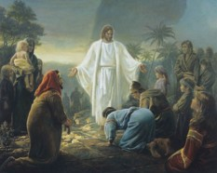
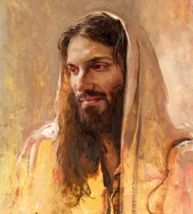
Jesus Returns a Third Time
The Twelve were seeking answers from the Lord on what to call themselves.
There had been disputations (verbal controversy) among themselves.
They were deeply troubled and spiritually turned to their Lord for direction.
Spiritually—Fasting and Praying
This is a process for receiving revelation
Jesus’ response:
“Have they not read the scriptures, which ye must take upon you the name of Christ, which is my name?...”
3 Nephi 27:1-3

Slide 4
What Team Logo Best Represents Its Name?
New Zealand All Black Rugby
Cricket Ireland
German National Football Team
Arizona Cardinals
New York Yankees
Ramona Bulldogs
BYU University

Slide 5
Let Fate Decide?
The name Twitter was picked out of a hat. A small group of employees from Odeo, the San Francisco podcasting startup where Twitter initially began, had a brainstorming session.
They were trying to come up with names that fit with the theme of a mobile phone buzzing an update in your pocket.
After narrowing down the options (which included Jitter and Twitter), they wrote them down, put them in a hat, and let fate decide.
Fate decided on Twitter (because clearly asking someone if they saw your latest "jeep" is just weird).
http://mashable.com/2011/09/05/startup-names/

Slide 6
What is in a Name?
The true Church of Jesus Christ must be called by His name and be built upon His gospel
The official name of the Church is The Church of Jesus Christ of Latter-day Saints. This full name was given by revelation from God to Joseph Smith on April 26,1838.
(D&C 115:3-4)

Slide 7
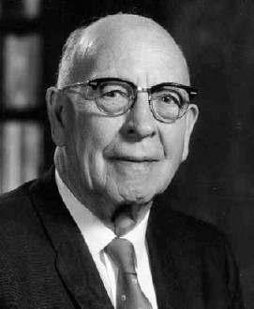
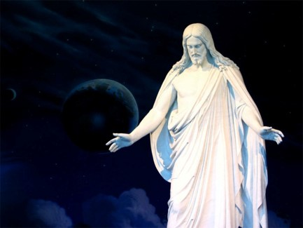
The Church Should Be Called In His Name
“The Matter of the name his Church should bear was of great importance to the Savior. Not only was this name reveled to Joseph Smith…, but also in reporting the visit of Jesus to the Nephites in America, following his ascension, when he had organized his Church among them, the Book of Mormon records their inquiry and the Lord’s rely as to what the name of his Church should be…
Thus the name of the Church was not obtained through study or research, but by revelation direct from the Lord…
“Therefore, whatsoever ye shall do, ye shall do it in my name; therefore ye shall call the church in my name; and ye shall call upon the Father in my name that he will bless the church for my sake.”
“…does it not seem incredible that of all the churches in the world, there was not one that bore his name when the Lord restored his Church in this dispensation?”
LeGrand Richards
3 Nephi 27:7

Slide 8
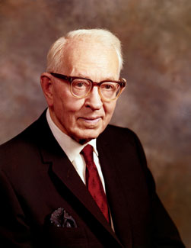
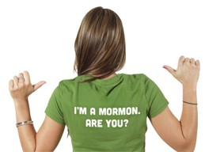
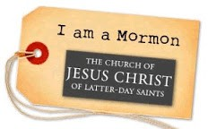
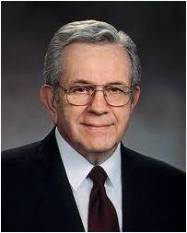
Mormon Nickname
The official name of the Church is The Church of Jesus Christ of Latter-day Saints. This full name was given by revelation from God to Joseph Smith in 1838.
Style Guide
“While there can be no disgrace nor condemnation in being called ‘Mormons,’ and the Church, the ‘Mormon Church,’ the fact remains, and this we should all emphasize, that we belong to the Church of Jesus Christ of Latter-day Saints, the name the Lord has given by which we are to be known and called.”
Joseph Fielding Smith
“… in obedience to revelation, we call ourselves The Church of Jesus Christ of Latter-day Saints rather than the Mormon Church”
Boyd K. Packer

Slide 9
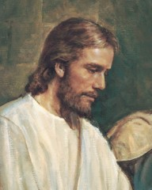
Built Upon His Gospel
“Both in and out of the church people quite commonly refer to “the gospel” when describing or alluding to all of a churches religious teachings.
This probably is the most common use of the word. The reason we use the word this way is that there really isn’t another suitable single word that will say what we are trying to say.”
Student Manual
Gospel = “good news” about Christ, his kingdom, and salvation through Him
3 Nephi 27:10

Slide 10
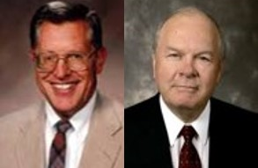
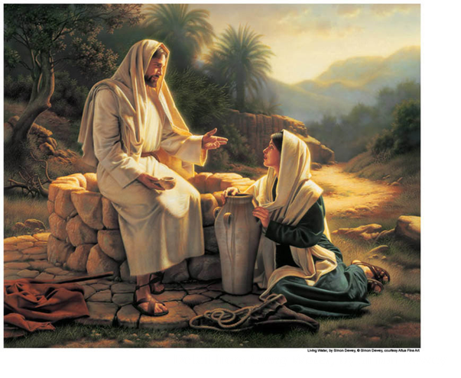
What is His Gospel?
“The gospel is truly the life, mission, teaching, atoning sacrifice, death, and resurrection of Christ…the “good news” and “glad tidings” of the gospel are found in Christ—in his atonement—not just in his teachings.”
JFM and RLM
“And this is the gospel, the glad tidings, which the voice out of the heavens bore record unto us—
That he came into the world, even Jesus, to be crucified for the world, and to bear the sins of the world, and to sanctify the world, and to cleanse it from all unrighteousness;
That through him all might be saved whom the Father had put into his power and made by him;”
D&C 76:40-42
3 Nephi 27:13-15

Slide 11
Principles of the Gospel
“the principles of the gospel –those things which allow us to partake of the powers of the atoning sacrifice
Faith
Repentance
Baptism
Reception of the Holy Ghost
Enduring to the end
Resurrection
Eternal judgments”
“Eternal life is not imposed on us against our will but is held out to us as a spiritual enticement and blessing.
We accept the Atonement and obtain the blessing of eternal life only through our own agency.
We are drawn unto Christ , not dragged”
3 Nephi 27:14 JFM and RLM

Slide 12
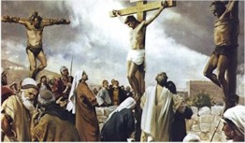
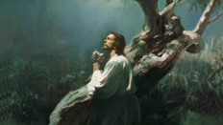
The Foundation
What did Heavenly Father send Jesus Christ into the world to do?
Draw men unto Him
Lifted up –on the cross—and the Atonement symbolism…
An unconditional and universal redemption from the Fall (good or evil) and brought before the Father to be judge of their works
What is the foundation of the gospel?
The foundation of the gospel is that Jesus Christ did the will of His Father in accomplishing the Atonement.
Because the Savior fulfilled the will of His Father, what will happen for all mankind?
We will be lifted up before Him to be judged of our works
3 Nephi 27:14-15

Slide 13
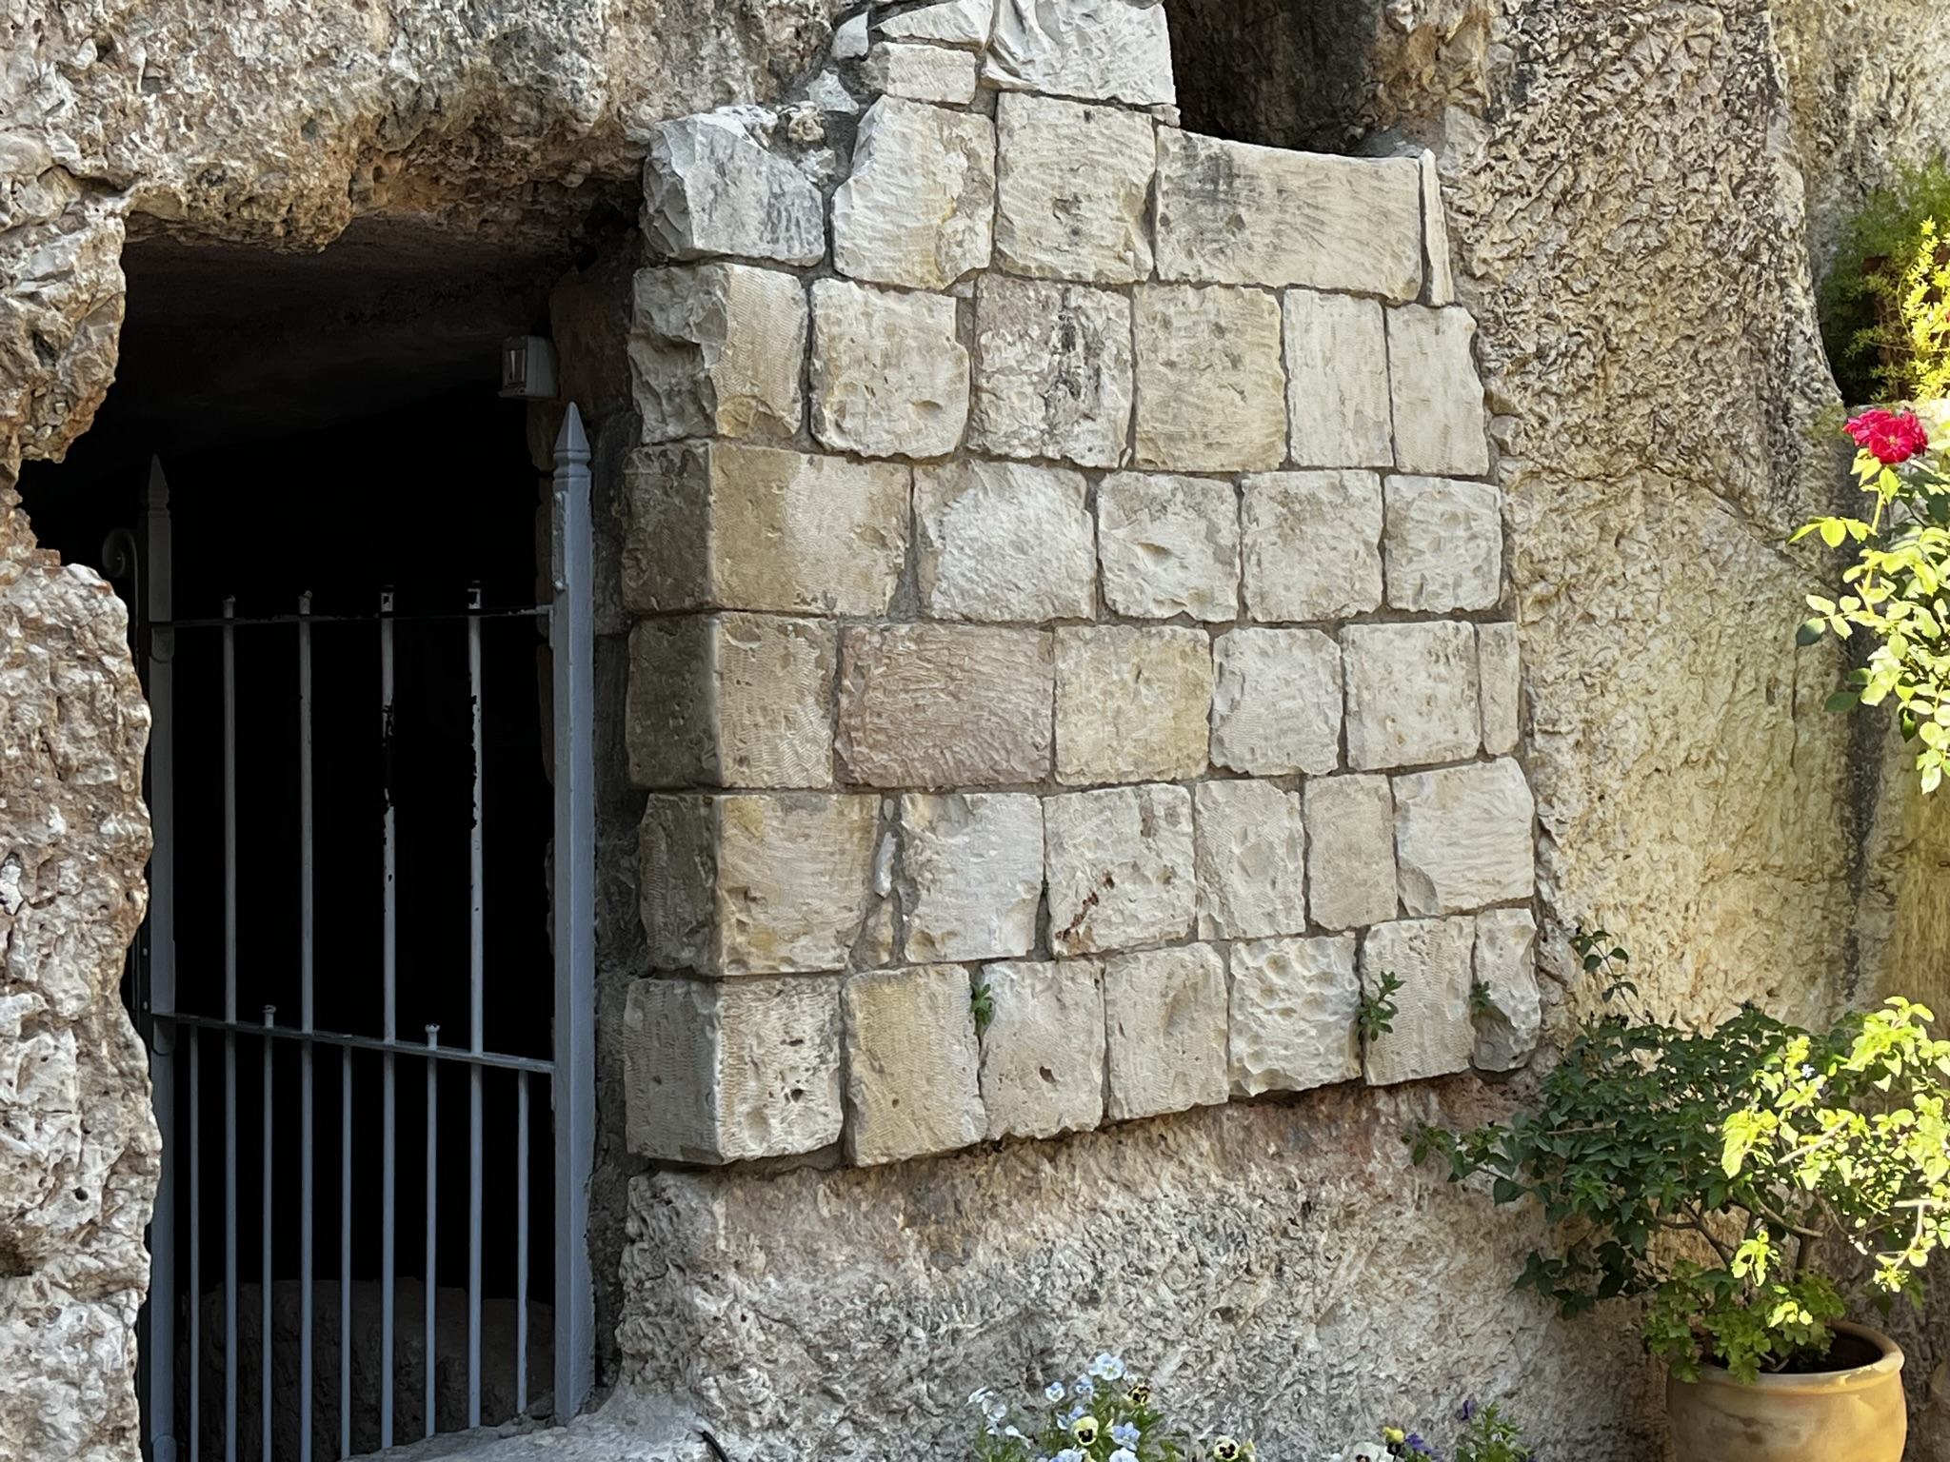
To Stand Before God
If we repent, are baptized, and endure to the end, we will be guiltless when we stand before God to be judged
What good news is there for us as we think about standing before the Lord to be judged?
“The ‘good news’ [is] that death and hell [can] be escaped, that mistakes and sins [can] be overcome, that there [is] hope, that there [is] help, that the insoluble [is] solved, that the enemy [has] been conquered. The good news [is] that everyone’s tomb [will] one day be empty, that everyone’s soul [can] again be pure, that every child of God [can] again return to the Father who gave them life”
Elder Jeffrey R. Holland
3 Nephi 27:17-19

Slide 14
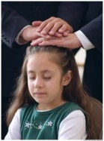
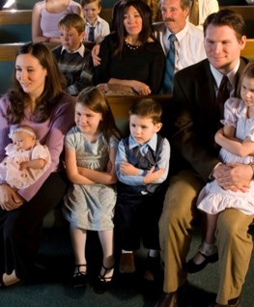
The Savior’s Invitation
Repent and be baptized—sanctified—cleansed from the effects of sin—spiritually renewed
Receive the Holy Ghost---the constant companion
Stand spotless before me at the last day—Prepare to enter into the presence of God
Know of these things—be one of faith and righteousness
Come to church and learn of Him—partake of the sacrament
Be an example to all those around you as He is an example for us—thinking His thoughts, speaking His words
Read D&C 76:40-42
3 Nephi 27:20-21

Slide 15
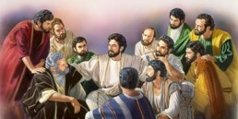
Judgment of the Twelve
“The Nephite twelve along with Jesus' original Twelve, probably coupled with all who have held keys of the priesthood, will be involved in judging the righteous of the house of Israel.
How these Nephite Twelve and all the others will be involved in judging of the righteous has not been fully revealed”
JFM and RLM
“And Jesus said unto them, Verily I say unto you, That ye which have followed me, in the regeneration when the Son of man shall sit in the throne of his glory, ye also shall sit upon twelve thrones, judging the twelve tribes of Israel.”
Matthew 19:28
“And again, verily, verily, I say unto you, and it hath gone forth in a firm decree, by the will of the Father, that mine apostles, the Twelve which were with me in my ministry at Jerusalem, shall stand at my right hand at the day of my coming in a pillar of fire, being clothed with robes of righteousness, with crowns upon their heads, in glory even as I am, to judge the whole house of Israel, even as many as have loved me and kept my commandments, and none else.”
D&C 29:12
3 Nephi 27:27

Slide 16
Doctrinal Mastery
Now this is the commandment: Repent, all ye ends of the earth, and come unto me and be baptized in my name, that ye may be sanctified by the reception of the Holy Ghost, that ye may stand spotless before me at the last day.
3 Nephi 27:20

Slide 17
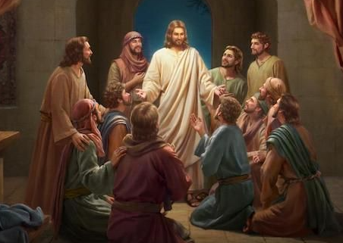
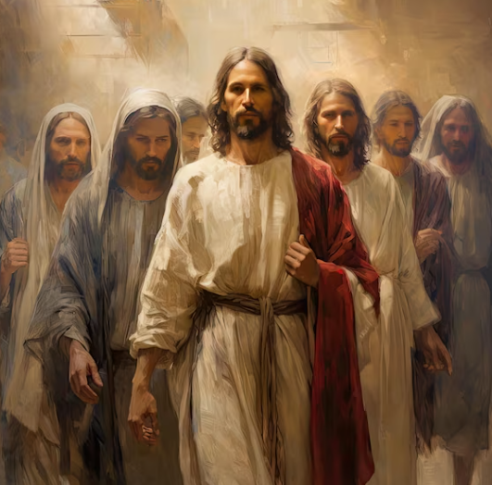
Even As He Is
The Savior gave instructions to His twelve Nephite disciples and taught them about their responsibilities.
He gave the disciples to help them fulfill their role as judges of the people.
The Lord expects His disciples to do His works and become as He is
3 Nephi 27:27

Slide 18
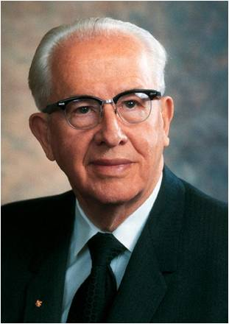
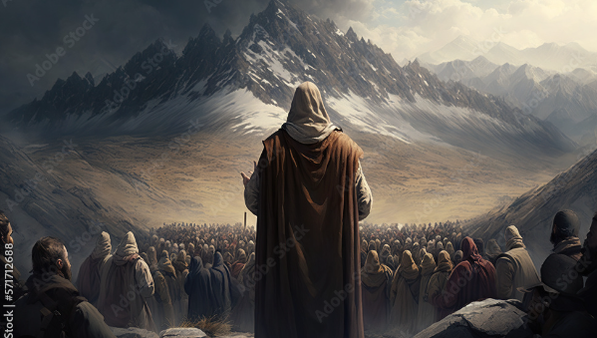
”That man is greatest and most blessed and joyful whose life most closely fits the pattern of the Christ.
This has nothing to do with earthly wealth, power, or prestige.
The only true test of greatness, blessedness, joyfulness is how close a life can come to being like the Master, Jesus Christ.
He is the right way, the full truth, and the abundant life.”
President Ezra Taft Benson
3 Nephi 27:27

Slide 19
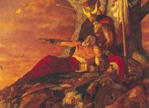
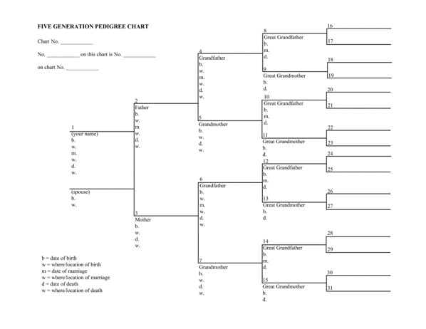
A Generation
“But behold, it sorroweth me because of the fourth generation from this generation, for they are led away captive by him even as was the son of perdition; for they will sell me for silver and for gold, and for that which moth doth corrupt and which thieves can break through and steal. And in that day will I visit them, even in turning their works upon their own heads.”
Generation—a length of time that it takes for a people to reproduce itself…somewhere around fourth years.
“since of measuring time by the lives of men, a generation, since the Abrahamic day, has been about 100 years.
From a generation from the time of Adam to the flood would have been nearly 1000 years.
A generation may be measured in terms of the life of the oldest persons who live in a particular period
Bruce R. McConkie
3 Nephi 27:30-33

Slide 20
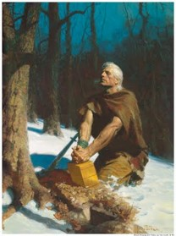
200 Years After the Savior’s Visit
“…Mormon speaks …in reference to the people who turned away with their eyes open, who turned against the truth some 200 years following the coming of Christ. The people rebelled; Mormon speaks about them and their condition beyond the power of redemption because of their wickedness and the hardness of their hearts, which the sprit of the Lord could no penetrate.”
Joseph Fielding Smith
“Behold, four hundred years have passed away since the coming of our Lord and Savior.”
Moroni 8:6
At the end of the Book of Mormon, Moroni figuratively looks out over the last remnant of his people. He knew their extinction could have been avoided if they had not forgotten God’s holy word and lost the Spirit of the Lord. Is it any wonder that Moroni writes personally to us, to you and to me, pleading for us to claim the blessings of the scriptures.
3 Nephi 27:32

Slide 21
Sources:
Joseph Fielding Smith Answer to Gospel Questions 4:174-175. Doctrines of Salvation 2:194-195
Style Guide - http://www.mormonnewsroom.org/style-guide
Boyd K. Packer (“Guided by the Holy Spirit,” Liahona and Ensign, May 2011, 30).
LeGrand Richards A Marvelous Work and a Wonder pgs. 134-136
Student Manual of Religion 121-122 of the Book of Mormon
Joseph Fielding McConkie and Robert L. Millet Doctrinal Commentary on the Book of Mormon Vol. 4 pg. 178
Elder Jeffrey R. Holland (“Missionary Work and the Atonement,” Ensign, Mar. 2001, 8, 10).
President Ezra Taft Benson (“Jesus Christ—Gifts and Expectations” [BYU devotional address, Dec. 10, 1974], 1, speeches.byu.edu
Bruce R. McConkie Mormon Doctrine pg. 310 see Gen. 5, D&C 45:30-31; 84:4-5; 5:8-10
Robert D. Hales Holy Scriptures: The Power of God unto Our Salvation Oct. 2006 Gen. Conf.
Presentation by ©http://fashionsbylynda.com/blog/

Slide 22
Churches established in 1830’s:
Baltimore Hebrew Congregation
Baptist State Convention of North Carolina
Brothers of Our Lady of Lourdes
Cathedral Church of St. Paul (Burlington, Vermont)
Cathedral of the Immaculate Conception (Burlington, Vermont)
Cathedral of the Immaculate Conception (Syracuse, New York)
Church of Christ (Latter Day Saints) The Church of Jesus Christ of Latter-day Saints
Churches of God General Conference (Winebrenner)
Community of Christ
First Unitarian Church (Cincinnati, Ohio)
Kolel Chibas Yerushalayim
Netherlands Reformed Congregations
Remonstrant Synod of Ulster
St. Andrew's Church (Toronto)
St. John the Evangelist's Church (Manhattan)
St. Stephen's Episcopal Church (Olean, New York)
United Methodist Church of the Highlands
Zion Episcopal Church (Douglaston, New York)
From Wikipedia, the free encyclopedia
Not mentioned because they were established earlier
Catholic Methodist
Presbyterian
Baptist and many others
The official name of the Church is The Church of Jesus Christ of Latter-day Saints. This full name was given by revelation from God to Joseph Smith in (April 26, )1838. (D&C 115:3-4)
While the term "Mormon Church" has long been publicly applied to the Church as a nickname, it is not an authorized title, and the Church discourages its use.
When writing about the Church, please follow these guidelines:
In the first reference, the full name of the Church is preferred: "The Church of Jesus Christ of Latter-day Saints."
Please avoid the use of "Mormon Church," "LDS Church" or the "Church of the Latter-day Saints."
When a shortened reference is needed, the terms "the Church" or "the Church of Jesus Christ" are encouraged.
When referring to Church members, the term "Latter-day Saints" is preferred, though "Mormons" is acceptable.
"Mormon" is correctly used in proper names such as the Book of Mormon, Mormon Tabernacle Choir or Mormon Trail, or when used as an adjective in such expressions as "Mormon pioneers."
The term "Mormonism" is acceptable in describing the combination of doctrine, culture and lifestyle unique to The Church of Jesus Christ of Latter-day Saints.
When referring to people or organizations that practice polygamy, the terms "Mormons," "Mormon fundamentalist," "Mormon dissidents," etc. are incorrect. The Associated Press Stylebook notes: "The term Mormon is not properly applied to the other … churches that resulted from the split after [Joseph] Smith's death.“
Style Guide-- STYLE GUIDE NOTE: When reporting about The Church of Jesus Christ of Latter-day Saints, please use the complete name of the Church in the first reference. For more information on the use of the name of the Church, go to our online style guide.
Under the Category: Christian organizations based in the United States from Wikipedia…The Church of Jesus Christ of Latter-day Saints is not on their list…
Why is that?
http://en.wikipedia.org/wiki/Category:Christian_organizations_based_in_the_United_States

Slide 23
3 Nephi 27:4-5
“I say that we need to teach our people to find their answers in the scriptures. If only each of us would be wise enough to say that we aren’t able to answer any question unless we can find a doctrinal answer in the scriptures! And if we hear someone teaching something that is contrary to what is in the scriptures, each of us may know whether the things spoken are false—it is as simple as that. But the unfortunate thing is that so many of us are not reading the scriptures. We do not know what is in them, and therefore we speculate about the things that we ought to have found in the scriptures themselves. I think that therein is one of our biggest dangers of today.”
Harold B. Lee Find the Answers in the Scripture Ensign December 1972
THERE IS A BASIC DOCTRINE ONE MUST UNDERSTAND AND OBEY IN ORDER TO BE SAVED
Perhaps no two people, without a previous discussion, would come up with identical lists of doctrines from the text of 3 Nephi 27:13-22. But their lists would comprehend or cover the same ideas if carefully and thoroughly done. It may be that in place of a short list of doctrines, they would come up with a longer list of ordinances and precepts. These could be collected into or placed under eight main headings commonly called doctrines. The following diagram lists these eight principles and illustrates their interrelationships.
Student Manual—pg 446
THE ATONEMENT OF CHRIST (pays for the sins
of the truly penitent
and brings about)
THE RESURRECTION (of all men)
A UNIVERSAL JUDGMENT (in the flesh)
by which the blessings of eternal life are accorded to those who
exercise FAITH IN CHRIST sufficiently that they
REPENT of all their sins
and fully consummate their repentance in that they
enter the covenant of BAPTISM and thereafter
receive the GIFT OF THE HOLY GHOST
and subsequently maintain this spiritual capacity
in that they
ENDURE in faithfulness TO THE END
"The fulness of the gospel consists in those laws, doctrines, ordinances, powers, and authorities needed to enable men to gain the fulness of salvation. Those who have the gospel fulness do not necessarily enjoy the fulness of gospel knowledge or understand all of the doctrines of the plan of salvation. But they do have the fulness of the priesthood and sealing power by which men can be sealed up unto eternal life. The fulness of the gospel grows out of the fulness of the sealing power and not out of the fulness of gospel knowledge. (Mormon Doctrine, pp. 332-33.)

Slide 24
The Power Over Death
3 Nephi 28

Slide 25
The Desire of Jesus’ Disciples
What would you want Jesus to do for you?
What did His disciples desire?
Nine of them: “We desire that after we have lived unto the age of man, that our ministry, wherein thou hast called us, may have an end, that we may speedily come unto thee in thy kingdom.”
They would live to the age of 72 and promised an inheritance in Christ’s kingdom when they die
3 Nephi 28:1-3

Slide 26
The Desire of Three
Jesus said:
“Behold, I know your thoughts, and ye have desired the thing which John, my beloved, who was with me in my ministry, before that I was lifted up by the Jews, desired of me.”
What was said about John: “Then went this saying abroad among the brethren, that that disciple should not die: yet Jesus said not unto him, He shall not die; but, If I will that he tarry till I come, what is that to thee?”
John 21:23
3 Nephi 28:6

Slide 27
John, The Beloved
“It is to a modern revelation that we turn to learn what really became of John the Apostle, known also as the Beloved and the Revelator. In April of 1829 Joseph Smith and Oliver Cowdery were discussing the mission of John; whether he had died or been allowed to live on. Through the Urim and Thummim the Prophet saw a translated version of a record made by John and hidden up.”
JFM and RLM
Read D&C 7:1-8
3 Nephi 28:6

Slide 28
Never Taste of Death
Jesus said:
“Therefore, more blessed are ye, for ye shall never taste of death; but ye shall live to behold all the doings of the Father unto the children of men, even until all things shall be fulfilled according to the will of the Father, when I shall come in my glory with the powers of heaven.”
John and the 3 Nephites were translated and are allowed to live and minister on the earth until their Lord returns at His Second Coming
3 Nephi 28:7

Slide 29
Transfigured and Translated
Transfiguration is “the condition of persons who are temporarily changed in appearance and nature—that is, lifted to a higher spiritual level—so that they can endure the presence and glory of heavenly beings.”
The scriptures tell of people who have been transfigured, including Jesus Christ, Moses, Peter, James, and John, and Joseph Smith.
Translated beings are “persons who are changed so that they do not experience pain or death until their resurrection to immortality”
Their purpose is to bring souls to Christ. The scriptures contain accounts of people who have been translated, including Enoch, Moses, Elijah, and John the Beloved.
3 Nephi 28:9, 13-17; Guide to Scriptures

Slide 30
Translated Beings
They never taste of death or endure the pains of death (verses 7-8)
They will be changed from mortality to immortality in the twinkling of an eye (verse 8)
They experience no pain while in the flesh and no sorrow except for the sins of the world (verse 9)-- a mortal state
They have power over the evil men of the earth (verse 20)
They are like the angels of God, administering to whomsoever they will (verse 30)
A change is affected on their bodies so that Satan can have no power over them; they are sanctified in the flesh and are holy (verse 39)
They remain in this state until the judgment day of Christ (verse 40)
They were caught up into heaven:
They are also transfigured— “The Three Nephites were transfigured for a time so that they could view the visions of eternity. They were also translated, which condition is of a longer duration, until Judgment Day.” Student Manual
3 Nephi 28:7-40

Slide 31
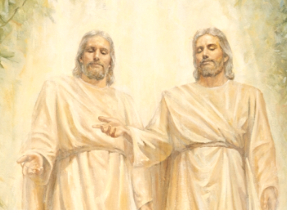
The Father And I Are One
“Without question, Elohim and Jehovah—though separate as personages—are one: one in mind, one in purpose, one in glory. Indeed, they are infinitely more one than they are separate.
The whole plan of salvation centers in our learning to be one with Christ as he is one with the Father.”
JFM and RLM
There are three separate persons in the Godhead: God, the Eternal Father; his Son, Jesus Christ; and the Holy Ghost. We believe in each of them (Article of Faith 1:1).
From latter-day revelation we learn that the Father and the Son have tangible bodies of flesh and bone and that the Holy Ghost is a personage of spirit, without flesh and bone. These three persons are one in perfect unity and harmony of purpose and doctrine.
Guide to the Scriptures
It is generally the Father, or Elohim, who is referred to by the title God. He is called the Father because He is the father of our spirits
Guide to the Scriptures
3 Nephi 28:10

Slide 32
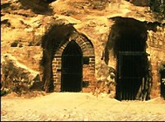
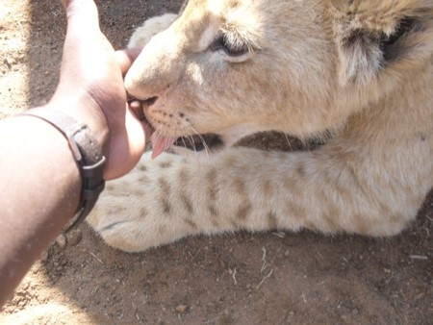
The Three Nephites Are Protected
The prisons could not hold them
They were cast down into the earth but could not be buried (‘not dig pits sufficient to hold them’)
Three times they were cast into a furnace and were not harmed
Two times they were cast into a den of wild beasts which they played ‘as a child with a suckling lamb’ and were not hurt
3 Nephi 28:19-22

Slide 33
Names Not To Be Recorded
Mormon was forbidden to reveal the names of the Three Translated Nephites who remain on the earth
Later around AD 400-421
“And there are none that do know the true God save it be the disciples of Jesus, who did tarry in the land until the wickedness of the people was so great that the Lord would not suffer them to remain with the people; and whether they be upon the face of the land no man knoweth.
But behold, my father and I have seen them, and they have ministered unto us.”
Mormon 8:10-11
3 Nephi 28:25-26

Slide 34
They Shall Minister to All
They will be among the Gentiles and the Gentiles will not know them.
They will be among the Jews and the Jews will not know them.
They shall be as angels of God
They shall pray unto the Father in the name of Jesus
They shall remain on the earth in their terrestrial state until the Coming of the Savior
“Yea even among the Gentiles shall there be a great and marvelous work wrought by them, before that judgment day.”
3 Nephi 28:27-40

Slide 35
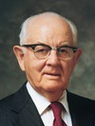
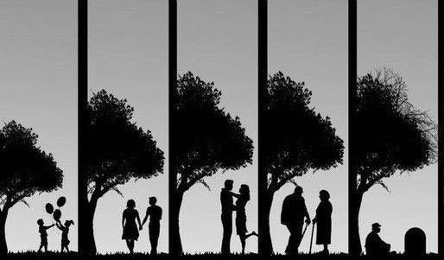
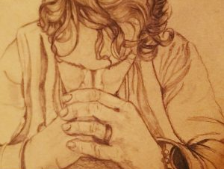
“We each have so much need for his help as we seek to learn gospel truths and then live them, as we seek his help in the major decisions of our lives, decisions involving schooling, marriage, employment, place of residence, raising our families, serving with each other in the work of the Lord, and seeking his forgiveness and continual guidance and protection in all we do. Our list of needs is long and real and heartfelt. …
“After a lifetime of prayers, I know of the love and power and strength that comes from honest and heartfelt prayer. I know of the readiness of our Father to assist us in our mortal experience, to teach us, to lead us, to guide us. Thus, with great love, our Savior has said, ‘What I say unto one I say unto all; pray always.’ (D&C 93:49.)”
Spencer W. Kimball
3 Nephi 28:27-40

Slide 36
Sources:
Joseph Fielding McConkie and Robert L. Millet Doctrinal Commentary on the Book of Mormon Vol. 4 pg. 188.190-191
Transfigured ” (Guide to the Scriptures, “Transfiguration,” scriptures.lds.org; see also D&C 67:11; Moses 1:11). Moses (see Moses 1:9–11); Jesus Christ, Peter, James, and John (see Matthew 17:1–8); and Joseph Smith (see Joseph Smith—History 1:14–20).
Translated (Guide to the Scriptures, “Translated Beings,” scriptures.lds.org; see also 3 Nephi 28:7–9, 20–22, 37–40). Enoch (see Genesis 5:24; Hebrews 11:5), Moses (see Alma 45:19), Elijah (see 2 Kings 2:11), and John the Beloved (see John 21:22–23; D&C 7).
Student Manual Religion 121-122 pg. 127, 444
Spencer W. Kimball, “Pray Always,” Ensign, Oct. 1981, 3, 6
Presentation by ©http://fashionsbylynda.com/blog/

Slide 37
"Transfiguration is a special change in appearance and nature which is wrought upon a person or thing by the power of God: This divine transformation is from a lower to a higher state; It results in a more exalted, impressive, and glorious condition ....
"By the power of the Holy Ghost many prophets have been transfigured so as to stand in the presence of God and view the visions of eternity. Speaking of such an occasion In his life, Moses recorded: 'Now mine own eyes have beheld God; but not my natural, but my spiritual eyes, for my natural eyes could not have beheld; for I should have withered and died in his presence; but his glory was upon me; and I beheld his face, for I was transfigured before him.' (Moses 1:11; D. & C. 67:11.) ...
"Similarly, when the Three Nephites 'were caught up into heaven, and saw and heard unspeakable things,’ they were transfigured."
Bruce R. McConkie (Mormon Doctrine p. 803)
“We are telestial mortals, translated being are terrestial mortals, while exalted resurrected beings are celestial immortals.”
Richard Cowan (Alma, The testimony of the word, ed. By Nyman and Tate, pp. 201-202
5 By faith Enoch was translated that he should not see death; and was not found, because God had translated him: for before his translation he had this testimony, that he pleased God.
Hebrews 11:5
5 ¶So Moses the servant of the Lord died there in the land of Moab, according to the word of the Lord.
6 And he buried him in a valley in the land of Moab, over against Beth-peor: but no man knoweth of his sepulchre unto this day.
Deutoronmy 34:5-6
19 Behold, this we know, that he was a righteous man; and the saying went abroad in the church that he was taken up by the Spirit, or buried by the hand of the Lord, even as Moses. But behold, the scriptures saith the Lord took Moses unto himself; and we suppose that he has also received Alma in the spirit, unto himself; therefore, for this cause we know nothing concerning his death and burial.
Alma 45:19
13 After this vision had closed, another great and glorious vision burst upon us; for Elijah the prophet, who was taken to heaven without tasting death, stood before us, and said:
D&C 110:13

Slide 38
Jesus’ Final Words to the Nephites
3 Nephi 29-30

Slide 39
Fill in the Correct Answer
c
Gentiles_______
House of Israel_______
Spurn_______
The Lord’s Covenant with Israel_____
Wo_______
Two meanings:
1. The descendants of the Old Testament Prophet Jacob (Israel), with whom the Lord made covenants
2. True believers in Jesus Christ who have made covenants with God
A promise to the faithful that included gospel blessings, priesthood authority, eternal families, and a land of inheritance
Two meanings:
1. People of non-Israelite or non-Jewish lineages
2. People without the gospel
Deep sadness and regret
To disregard or reject with disdain or contempt
a
e
b
d
3 Nephi 29

Slide 40
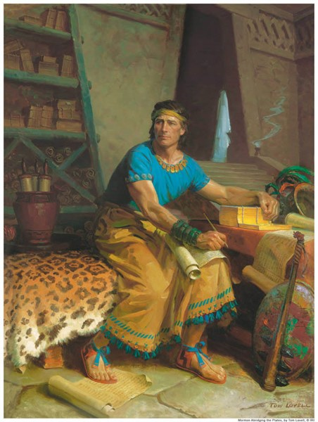
Divine Promises
After Mormon wrote about the Savior’s visit to the Nephites, he prophesied of the fulfillment of the Lord’s promises in the last days.
Have you ever experienced the fulfillment of a divine promise, whether given in the scriptures, by a prophet, through the Holy Ghost, or through a priesthood blessing?
Why do you think some people might doubt that God will keep His promises?
How do you know that God keeps His promises?
The coming forth of the Book of Mormon is a sign that the Lord is fulfilling His covenant to gather Israel in the latter days.
3 Nephi 29:1-2

Slide 41
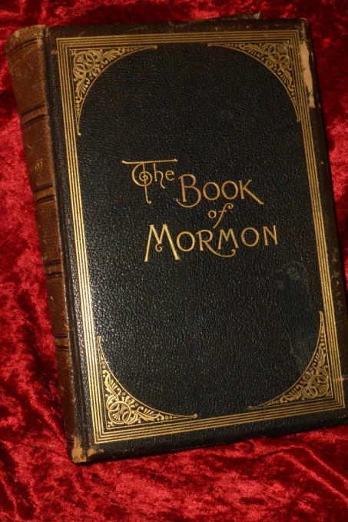
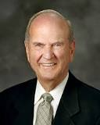
The Fulfillment
This is the fulfillment of Mormon’s prophecy
We can be assured that the Lord is preparing His people for His coming.
“The Book of Mormon is a tangible sign that the Lord has commenced to gather His children of covenant Israel. …
“Indeed, the Lord has not forgotten! He has blessed us and others throughout the world with the Book of Mormon. …
It helps us to make covenants with
God. It invites us to remember Him
and to know His Beloved Son. It is
another testament of Jesus Christ”
Elder Russell M. Nelson
3 Nephi 29:1-2

Slide 42
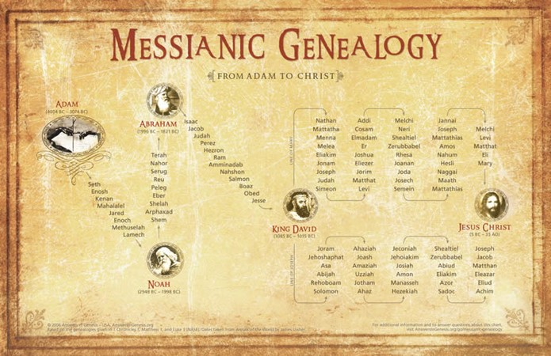
Why are Latter-day Saints interested in the Lord’s covenant with the House of Israel?
“The covenant God made with Abraham and later reaffirmed with Isaac and Jacob … contained several promises, including:
•Jesus the Christ would be born through Abraham’s lineage.
•Abraham’s posterity would be numerous, entitled to an eternal increase, and also entitled to bear the priesthood.
•Abraham would become a father of many nations.
•Certain lands would be inherited by his posterity.
•All nations of the earth would be blessed by his seed.
•And that covenant would be everlasting—even through ‘a thousand generations.’
3 Nephi 29:1-2

Slide 43
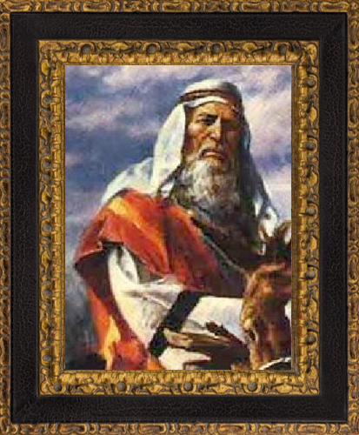
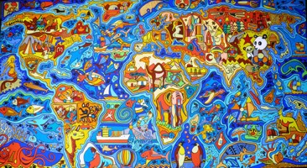
“Some of these promises have been fulfilled; others are still pending. …
“Some of us are the literal seed of Abraham; others are gathered into his family by adoption. The Lord makes no distinction. Together we receive these promised blessings—if we seek the Lord and obey His commandments. …
“… Brigham Young said: ‘All Latter-day Saints enter the new and everlasting covenant when they enter this Church.’”
Elder Russell M. Nelson
Latter-day Saints are part of the Lord’s covenant people, and we carry the responsibility to bless all nations
3 Nephi 29:1-2

Slide 44
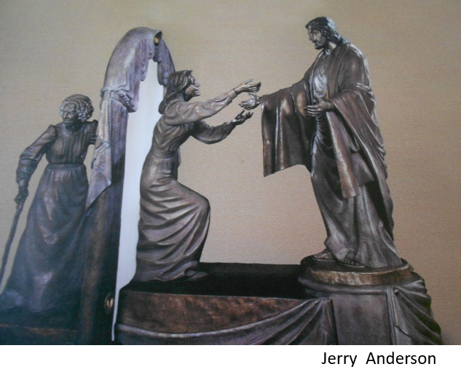
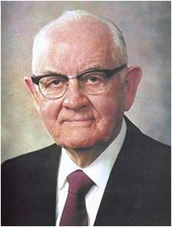
“The gathering of Israel consists of joining the true church and their coming to a knowledge of the true God. …
Any person, therefore, who has accepted the restored gospel, and who now seeks to worship the Lord in his own tongue and with the Saints in the nations where he lives, has complied with the law of the gathering of Israel and is heir to all of the blessings promised the Saints in these last days.”
President Spencer W. Kimball
“Gathering of Souls on the Other Side of the Veil. Mercifully, the invitation to “come unto Christ” can also be extended to those who died without a knowledge of the gospel. Part of their preparation requires earthly efforts of others. We gather pedigree charts, create family group sheets, and do temple work vicariously to gather individuals unto the Lord and into their families.”
^{Russell M. Nelson}

Slide 45
Spurn and Wo
Mormon knew that in the last days there would be those who would spurn the Book of Mormon and other evidences of the fulfillment of the Lord’s covenant with His people.
Sorrow will come to those who deny Jesus Christ and His works.
Why is sorrow a natural consequence of spurning the Savior and His works?
How would you respond to someone who says that the Lord does not speak to man or perform miracles?
How can we better recognize and appreciate the Lord and His works in our lives?
3 Nephi 29:4-9

Slide 46
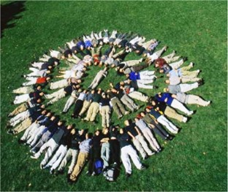
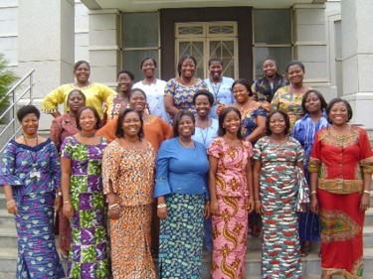
Gentiles Repent
Mormon fulfilled a commandment from the Lord to record an invitation from Jesus Christ specifically to the Gentiles, or people without the gospel.
Which of these invitations do you think could be a summary of all the others?
The invitation to come unto Christ includes repentance, baptism, the reception of the Holy Ghost, and being numbered among the Lord’s people.
What blessings does Jesus Christ promise to the Gentiles if they will come unto Him?
Remission of sins, being filled with the Holy Ghost, and being numbered among His people.
Why is it a blessing to be numbered among the Lord’s people?
If we come unto Christ, we will be numbered among His people.
3 Nephi 30:1-2

Slide 47
How Often Do I Do This?
Lying and deceiving
Secret abominations
Idolatries
Priestcrafts
Envying
Strife
Leading someone to believe something that is not true
Private actions that are sinful or offensive to God
Giving priority to the things of the world over the things of God
Participating in religious activities to glorify oneself rather that to serve God and others
Being jealous or resentful of what someone else has
Contention, fighting, or quarreling
3 Nephi 30:2

Slide 48
Sources:
Elder Russell M. Nelson (“Covenants,” Ensign or Liahona, Nov. 2011, 88).
Elder Russell M. Nelson (“Covenants,” 87–88; quoting Teachings of Presidents of the Church: Brigham Young [1997], 62).
Elder Russell M. Nelson The Gathering of Scattered Israel Oct. 2006 Gen. Conf.
Art work of world http://www.hongkiat.com/blog/creative-world-maps/
President Spencer W. Kimball (The Teachings of Spencer W. Kimball, ed. Edward L. Kimball [1982], 439).
Presentation by ©http://fashionsbylynda.com/blog/

Slide 49
“Evil doings” mentioned in 3 Nephi 30:2 | I do this often. I sometimes do this. I never do this.
Lying and deceiving (leading someone to believe something that is not true)
Secret abominations (private actions that are sinful or offensive to God)
Idolatries (giving priority to the things of the world over the things of God)
Priestcrafts (participating in religious activities to glorify oneself rather than to serve God and others)
Envyings (being jealous or resentful of what someone else has)
Strifes (contention, fighting, or quarreling)
“Evil doings” mentioned in 3 Nephi 30:2 | I do this often. I sometimes do this. I never do this.
Lying and deceiving (leading someone to believe something that is not true)
Secret abominations (private actions that are sinful or offensive to God)
Idolatries (giving priority to the things of the world over the things of God)
Priestcrafts (participating in religious activities to glorify oneself rather than to serve God and others)
Envyings (being jealous or resentful of what someone else has)
Strifes (contention, fighting, or quarreling)

Slide 50
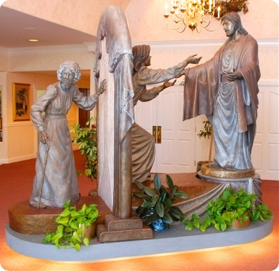
Sculpture---Spilsbury Mortuary in St. George Utah
An internationally-renowned artist and bronze sculptor, Jerry Anderson, had a desire to magnify his talent in a spiritual environment. The original life-size bronze sculpture of 'Come Unto Me' came forth with the expectations of being a comfort to grieving families experiencing the loss of a loved one. Before commissioned by Ted Spilsbury, Jerry Anderson shared his desire to present an inspirational piece of art that would touch the hearts of all who gazed upon it.
Together, Jerry and Ted discussed various ideas. It was strictly in the planning stages with no real indication that the monument would ever be realized. Jerry mentioned to Ted that he prays for inspiration in all of his art. It was agreed that after prayerful consideration they would meet again.
Two weeks passed quickly. As Jerry discussed his vision of what the sculpture should be; Ted, with tears in his eyes, knew that he had received divine confirmation. The 'Come Unto Me' bronze sculpture took more than a year to make its first appearance. Unveiled in the year 2000; today, the original life-sized bronze monument stands in the grand foyer of the Spilsbury Mortuary in St. George Utah, it has become a scenic attraction, in addition to a comfort to countless families at a most tender time of their lives. It portrays the spiritual journey from mortality to immortality. It is a portrayal of an aged woman's body, returning to its symbolic prime, and back to the arms of our Saviour.
It is our prayer that it's divine destiny will be portrayed and preserved according to our Heavenly Father's mind and will; revealing to all mankind that we all live eternally; that death is not the end. We all, as 'Come Unto Me' portrays, "have an eternal destiny." 'The Come Unto Me' crystals that are now available through Inspirational Good works are more than either Jerry or Ted dreamed possible. Truly the manifestation of deity...profound in beauty, most sacred and comforting; coming forth in the latter days in hopes to lift the hearts of all mankind.

Slide 51
Happiness Into Pride
All Within 200 Years
4th Nephi

Slide 52
What is This Book About?
The blessings that come to people who are united in living the gospel of Jesus Christ.
Following the Savior’s ministry among the descendants of Lehi, all the people throughout the land were converted.
As they obeyed the commandments, they enjoyed peace, prosperity, and marvelous spiritual blessings.
Also:
The people’s gradual decline into a state of wickedness.

Slide 53
Who Wrote the Book?
The first of these was Nephi, for whom the book was named.
Nephi was the son of Nephi, who was one of the twelve disciples chosen by the Lord during His ministry among the descendants of Lehi.
Mormon compiled and abridged the records of four writers to create the book of 4 Nephi.
The other three authors were Nephi’s son Amos and Amos’s sons, Amos and Ammaron.

Slide 54
Who is This Book Written For?
Mormon did not address the book of 4 Nephi to a particular audience, and he did not state why he wrote it.
However, this book contributes to the overarching purposes of the Book of Mormon—to witness that Jesus is the Christ and to make known the covenants of the Lord.
The 4th Book of Nephi
When Was It Written?
The original records used as sources for the book of 4 Nephi were likely written between A.D. 34 and A.D. 321.
Mormon abridged those records sometime between A.D. 345 and A.D. 385.
Mormon did not say where he was when he compiled this book.

Slide 55
In only 49 verses, the book of 4 Nephi narrates a period of nearly 300 years—almost one-third of the entire Nephite history covered by the Book of Mormon.
It highlights the contrast between the people’s righteousness immediately following the Savior’s ministry among them and their wickedness four generations later.
The book’s first 18 verses illustrate the blessings enjoyed by a society that is built upon the gospel of Jesus Christ.
Later verses provide a witness of the destructiveness of pride, showing how this society gradually weakened until it was almost entirely consumed in sin.

Slide 56
All Things In Common
100 Years of Unity
The Children of Christ—United
All converted to the Lord—both Nephites and Lamanites
There were no contentions
They dealt with each other justly
There was no rich, or poor, bond or free—all were made free
They were partakers of the heavenly gift—Gifts of God
They all experience peace and happiness
4 Nephi 1-4

Slide 57
What Makes You Truly Happy?
Temporary Happiness
Lasting Happiness
Eternal Happiness
True happiness cannot be found in temporal things like popularity, riches, and material belongings.

Slide 58
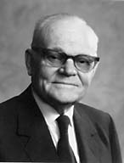
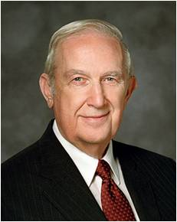
What Made the People Happy?
The people repented, were baptized, received the Holy Ghost, and were “all converted unto the Lord.”
President [Marion G.] Romney describes the steps you must follow:
“‘Membership in the Church and conversion are not necessarily synonymous. Being converted and having a testimony are not necessarily the same thing either.
A testimony comes when the Holy Ghost gives the earnest seeker a witness of the truth. A moving testimony vitalizes faith. That is, it induces repentance and obedience to the commandments. Conversion is the fruit or the reward for repentance and obedience.’ [In Conference Report, Guatemala Area Conference 1977, 8–9.]
“Your happiness now and forever is conditioned on your degree of conversion and the transformation that it brings to your life. How then can you become truly converted?
“Stated simply, true conversion is the fruit of faith, repentance, and consistent obedience. …
“True conversion yields the fruit of enduring happiness that can be enjoyed even when the world is in turmoil and most are anything but happy.”
Richard G. Scott
When we are converted unto the Lord, we avoid contention.

Slide 59
“Conversion is effected by divine forgiveness, which remits sins. The sequence is something like this.
An honest seeker hears the message. He asks the Lord in prayer if it is true.
The Holy Spirit gives him a witness.
This is a testimony.
If one’s testimony is strong enough, he repents and obeys the commandments. By such obedience he receives divine forgiveness which remits sin.
Thus he is converted to a newness of life. His spirit is healed.”
President Marion G. Romney
When we are converted unto the Lord, we are blessed with happiness and unity as the children of Christ
4 Nephi 5, 14

Slide 60
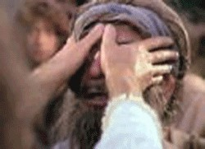
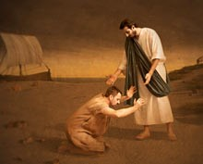
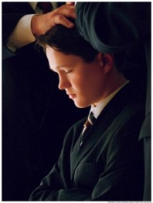
In the Name of Jesus
The disciples performed miracles:
They healed the sick
They raised the dead
They caused the lame to walk
They caused the blind to see
They passed away by the 100th year
Other disciples were ordained in their stead
4 Nephi 5, 14

Slide 61
Rebuilding Their Lives
They rebuilt Cities--Zarahemla
They prospered and had many children
They were a ‘fair and delightsome’ people
They married and were given in marriage after the promise which the Lord gave to them—Temple marriages?
They kept the higher Law of Christ and abandoned the Law of Moses
No jealousy, strifes, tumults, lyings, murders
They were One--United
They were blessed
When people work together to be converted to the Lord, they become unified and experience increased happiness
110 years passed away—first generation
4 Nephi 7-13, 16-18

Slide 62
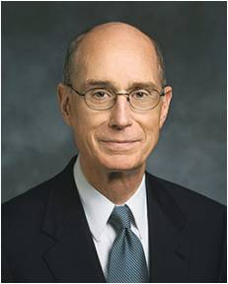
“The Lord’s prophets have always called for unity. The need for that gift to be granted to us and the challenge to maintain it will grow greater in the days ahead, in which we will be prepared as a people for our glorious destiny. …
“… We know from experience that joy comes when we are blessed with unity. We yearn, as spirit children of our Heavenly Father, for that joy which we once had with Him in the life before this one. His desire is to grant us that sacred wish for unity out of His love for us.
“He cannot grant it to us as individuals. The joy of unity He wants so much to give us is not solitary. We must seek it and qualify for it with others. It is not surprising then that God urges us to gather so that He can bless us. He wants us to gather into families. He has established classes, wards, and branches and commanded us to meet together often. In those gatherings, which God has designed for us, lies our great opportunity. We can pray and work for the unity that will bring us joy and multiply our power to serve”
President Henry B. Eyring
4 Nephi 5, 14

Slide 63
Our Happiness—Other’s Happiness
Our conversion and righteous actions contribute not only to our own happiness but also to the happiness and well-being of others.
When members of
a family, quorum,
class, or other group
are unified in
righteousness, they can experience greater happiness than they would be able to experience on their own.
Happiness
comes from true conversion and being united in righteousness.

Slide 64
Amos
He was the Son of Nephi, the grandson of Nephi
He received charge of the sacred records around AD 110 upon his father’s death… this means that Nephi was not one of the three disciples to remain on the earth
The counsel of the sacred records and preserving them were probably given to Amos as well as Nephi
Amos lived during a time of peace and prosperity—except for some small reports of revolts among the people who had departed from the church and assumed the name of Lamanites
Before Amos’ death he passed the records on to his son, Amos
Who’s Who

Slide 65
Amos II and Ammaron
They were the Sons of Amos
Amos received the records around AD 194
Amos traced the decline of the spiritual character of the people for several generations
Amos turned the records over to his brother Ammaron
Amos died around AD 305
Ammaron took the records around AD 306 about the time the Gadianton Robbers had taken over the entire land
Later Ammaron hid the plates and went to young Mormon (24) and gave Mormon charge of plates of Nephi and to write on them, butto leave the remaining records that were hidden-- around AD 321-325
Who’s Who

Slide 66
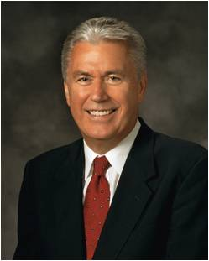
Destroying the Society
“Pride is the great enemy of unity”
“At its core, pride is a sin of comparison, for though it usually begins with ‘Look how wonderful I am and what great things I have done,’ it always seems to end with ‘Therefore, I am better than you.’
“When our hearts are filled with pride, we commit a grave sin, for we violate the two great commandments.
Instead of worshipping God and loving our neighbor, we reveal the real object of our worship and love—the image we see in the mirror” President Dieter F. Uchtdorf
President Henry B. Eyring
4 Nephi 7:24; Matthew 22:36-40

Slide 67
Taking on the Lamanite Name Again
A small part of the people began to take upon themselves the name of ‘Lamanite’ who revolted against the Church
They began to divide into classes
“And this church did multiply exceedingly because of iniquity, and because of the power of Satan who did get hold upon their hearts.”
The sin of pride creates division and leads to wickedness
4 Nephi 7:20, 26-28

Slide 68
How can the pride of a few people affect the happiness of a whole group?
Despite the encouragement of his family, an older brother decides to pursue selfish interests rather than serve a mission.
A member of a Young Women class or Aaronic Priesthood quorum is purposely disruptive, refuses to participate in class, and resists following instructions.
A young man or woman persistently teases or belittles another member of his or her group of friends.
4 Nephi 7:24

Slide 69
The New Names
Taking on the names of the unrighteous and willfully rebellious
They taught their children to hate the Nephites
They waxed strong and they were more numerous than the Nephites
They built churches unto themselves
The started ‘secret combinations’ a sign of the Gadianton robbers
Lamanites
Lemuelites
Ishmaelites
4 Nephi 7:38-43

Slide 70
Sorrow From the 3 Nephites
“And from this time the disciples began to sorrow for the sins of the world.”
More and more did the Nephites become unrighteous
4 Nephi 7:44

Slide 71
Sacred Record Hid
“And it came to pass that after three hundred and five years had passed away, (and the people did still remain in wickedness) Amos died; and his brother, Ammaron, did keep the record in his stead.”
“And he did hide them up unto the Lord, that they might come again unto the remnant of the house of Jacob, according to the prophecies and the promises of the Lord. And thus is the end of the record of Ammaron.”
“And it came to pass that when three hundred and twenty years had passed away, Ammaron, being constrained by the Holy Ghost, did hide up the records which were sacred—yea, even all the sacred records which had been handed down from generation to generation, which were sacred—even until the three hundred and twentieth year from the coming of Christ.
thus is the end of the record of Ammaron.”
4 Nephi 7:47-49

Slide 72
Sources:
Richard G. Scott (“Full Conversion Brings Happiness,” Ensign, May 2002, 25, 26).
President Marion G. Romney(in Conference Report, Oct. 1963, 24).
President Henry B. Eyring (“Our Hearts Knit as One,” Ensign or Liahona, Nov. 2008, 68, 69).
Book of Mormon Who’s Who by Ed J. Pinegar and Richard J. Allen pgs. 19, 23
President Dieter F. Uchtdorf (“Pride and the Priesthood,” Ensign or Liahona, Nov. 2010, 56).
Presentation by ©http://fashionsbylynda.com/blog/

