Slide 1
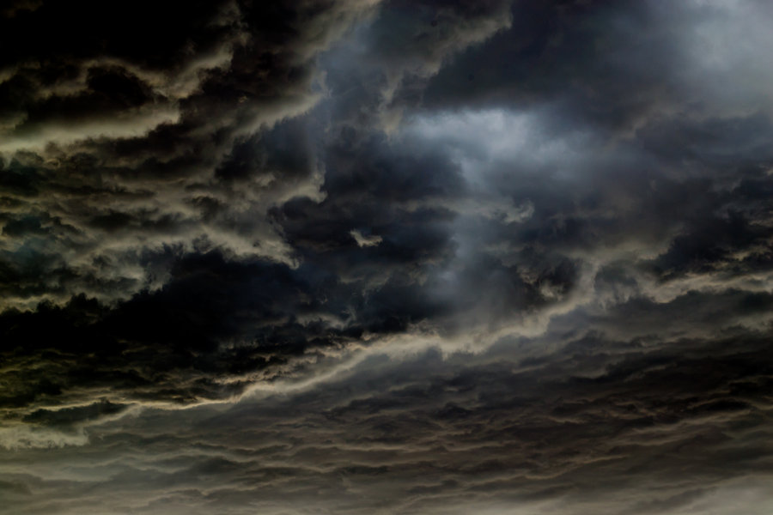
3 Nephi 8-11

Slide 2
The coming of the Savior
3 Nephi 8-11
In the Americas, extreme destruction and darkness marked the Savior’s crucifixion. Sometime during the three days of penetrating darkness, Jesus Christ spoke to the people. Then and now, natural disasters, suffering, and trials can be opportunities to learn about and turn to Jesus Christ.

Slide 3
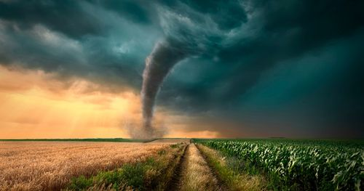
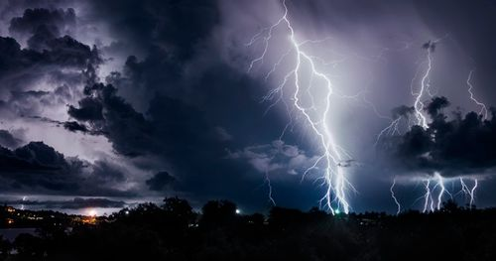
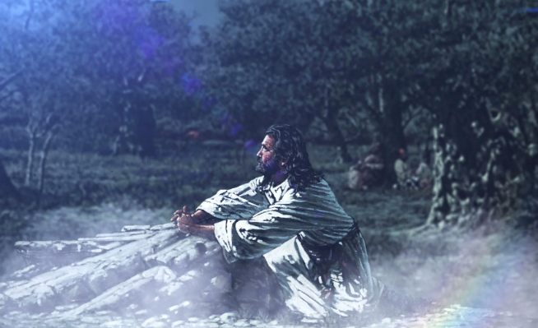
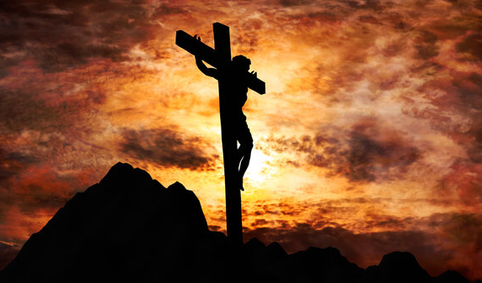
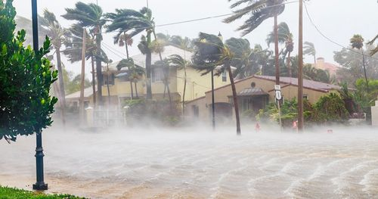
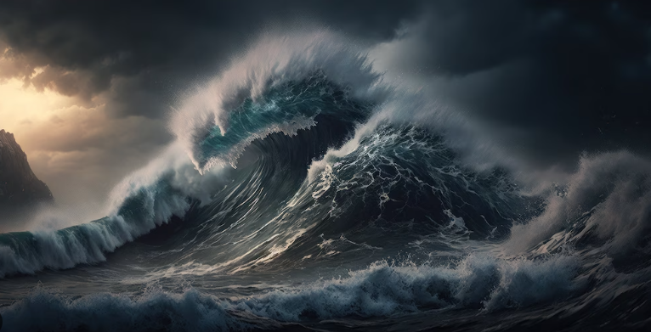
A Great Storm
When Jesus Christ was crucified in Jerusalem, a terrible storm and earthquake in the Americas caused great destruction. These events fulfilled Samuel the Lamanite’s prophecies about the signs of the Savior’s death.
Helaman 14:20-27

Slide 4
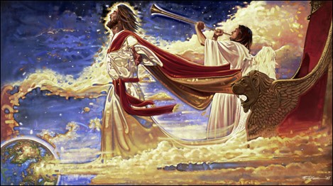
Looking for Signs
He who is righteous may know of the signs of heaven.
Those who were righteous began to look for the signs told of by Samuel
Those who did not believe had doubts
“But no man is possessor of all things except he be purified and cleansed from all sin.”
D&C 50:28
What are the signs of today for the Savior’s Second Coming?
Many prophecies, such as the Restoration of the gospel, the coming of the prophet Elijah, and the gospel being preached throughout the world, have been fulfilled or are being fulfilled.
3 Nephi 8:1-4

Slide 5
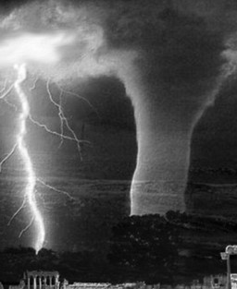
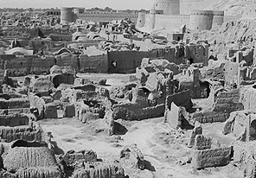
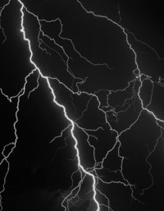
The Times
3 Nephi 8:1-10
Page 1
1/4/0034
Prophecy of Samuel, the Lamanite To Come True
Destruction Leaves Many Dead
The Great Storm lasting 3 hours
Man on a Wall
39 years ago, Samuel, who was a Lamanite and the first Lamanite prophet to speak on repentance, stood on the wall in Zarahemla and preached to the Nephites and the Lamanites.
His speech included a prophecy of a day without a night.
He also prophesied of days of terrible destruction.
33 years ago, after seeing the sign of the Savior’s birth the Nephites now begin to look for signs that Samuel had said about the Savior’s death.
Terrible tempest crossed over the land today. Lasting three hours.
Reports of thunders, lightnings, earthquakes, and whirlwinds have destroyed much of the land southward and more so in the north.
Many people of both the Nephite and Lamanite nations have died. Many people have gone missing.
Major Cities Destroyed
Zarahemla, the capital, has caught on fire. The City of Moroni, reporters say, have sunk into the depths of the sea and there are no survivors. The City of Moronihah has had its earth carried up and has risen into a mountain. There have been reports throughout the land that the land has changed its formation, many cities have sunken, and buildings have fallen, and the people have been ‘slain’. There have been cases of some individuals who were carried away in the whirlwind. There has been no sign of the people carried away.

Slide 6
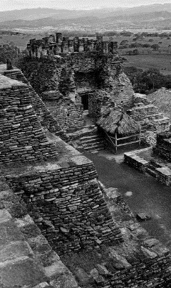
Page 2
Across the World
The Day in Which the Light Did Shine
The Voice From Above
Jesus, son of Mary, was born 34 years ago. When there was no darkness for a night. Many prophets of the Old Testament prophesied of His birth and many prophets testified of His upcoming birth in the Book of Mormon, including Lehi, Nephi, King Benjamin, Samuel, the Lamanite, and many more.
The crucifixion of Jesus occurred during the 1st century AD. Jesus, whom Christians believe to be the Son of God as well as the Messiah, was arrested, tried, and sentenced by Pontius Pilate to be scourged, and finally crucified.
Once at Golgotha, Jesus was offered wine mixed with gall to drink. Matthew's and Mark's Gospels record said he refused this. He was then crucified and hung between two convicted thieves. According to Mark's Gospel, he endured the torment of crucifixion for some six hours from the third hour, at approximately 9 am, until his death at the ninth hour, corresponding to about 3 pm. The soldiers affixed a sign above his head stating "Jesus of Nazareth, King of the Jews" in three languages, divided his garments and cast lots for his seamless robe. The Roman soldiers did not break Jesus' legs, as they did to the other two men crucified (breaking the legs hastened the crucifixion process), as Jesus was dead already. Each gospel has its own account of Jesus' last words, seven statements altogether. In the Synoptic Gospels, various supernatural events accompany the crucifixion, including darkness, an earthquake, and (in Matthew) the resurrection of saints. Following Jesus' death, his body was removed from the cross by Joseph of Arimathea and buried in a rock-hewn tomb, with Nicodemus assisting. According to the Gospels, Jesus then rose from the dead two days later ("the third day").
--Wikipedia
According to author Moroni, of the Book of Mormon, after Christ ascended from the earth, leaving his apostles behind, he visited the Lamanites and the Nephites, descendant of the Israelite Nation.
“Wo, wo, wo” is heard from a voice. The voice is asking the people to repent.
The voice announces He has destroyed Zarahemla by fire, caused the city of Moroni to be sunk in the sea, and the death of those that lived there, the city of Moronihah He has covered with earth, and other cities that have been destroyed, including:
Gilgal
Onihah
Mocum
Jerusalem
Gadiandi
Gadiomnah
Jacob
Gimgimno
Jacobugath
Laman
Josh
Gad
and Kishkumen.
The Voice announces that He is Jesus Christ, the Son of God, the creator of all things on earth and heaven.
Darkness Upon the Face of the Land
According to the Book of Mormon author, darkness covered the whole earth. For three days, Jesus hung on the cross. This was one of the signs spoken of by Samuel, the Lamanite. Torches, candles, or fire could be kindled, nor stars in the sky would shine. The people who survived the devastation mourned for their salvation and their loss in darkness.
Those Who Survived
“O all ye that are spared because ye were more righteous that they, will ye not now return unto me, and repent of your sins, and be converted, that I may heal you?” These are the words of the Lord, Jesus Christ
3 Nephi 9:13

Slide 7
The Cities Destroyed
Cities that were destroyed | How destroyed | The reason for them being destroyed
Zarahemla | By fire | Slaying of fair sons and daughters, iniquity and abominations
Moroni | Caused to be sunk in the sea | Slaying of fair sons and daughter, iniquity and abominations
Moronihah | Covered with earth | Wickedness and abominations
Gilgal | Sunken and buried | Not mentioned…but probably wickedness
Onihah Mocum Jerusalem | Tsunami—waters | Wickedness and abominations, slaying of the prophets and saints
Gadiandi Gadiomnah Jacob Gimgimno | Sunken, and made hills and valley..buried in the earth | Wickedness and abominations, slaying of the prophets and saints
Jacobugath, inhabitated by the people of king Jacob | Burned with fire | Wickedness, secret murders and combinations…they had destroyed the people and government
Laman Josh Gad Kishkumen | Burned with fire | Wickedness, casting out prophets, Stoning of prophets
3 Nephi 8:5
3 Nephi 9:1-12

Slide 8
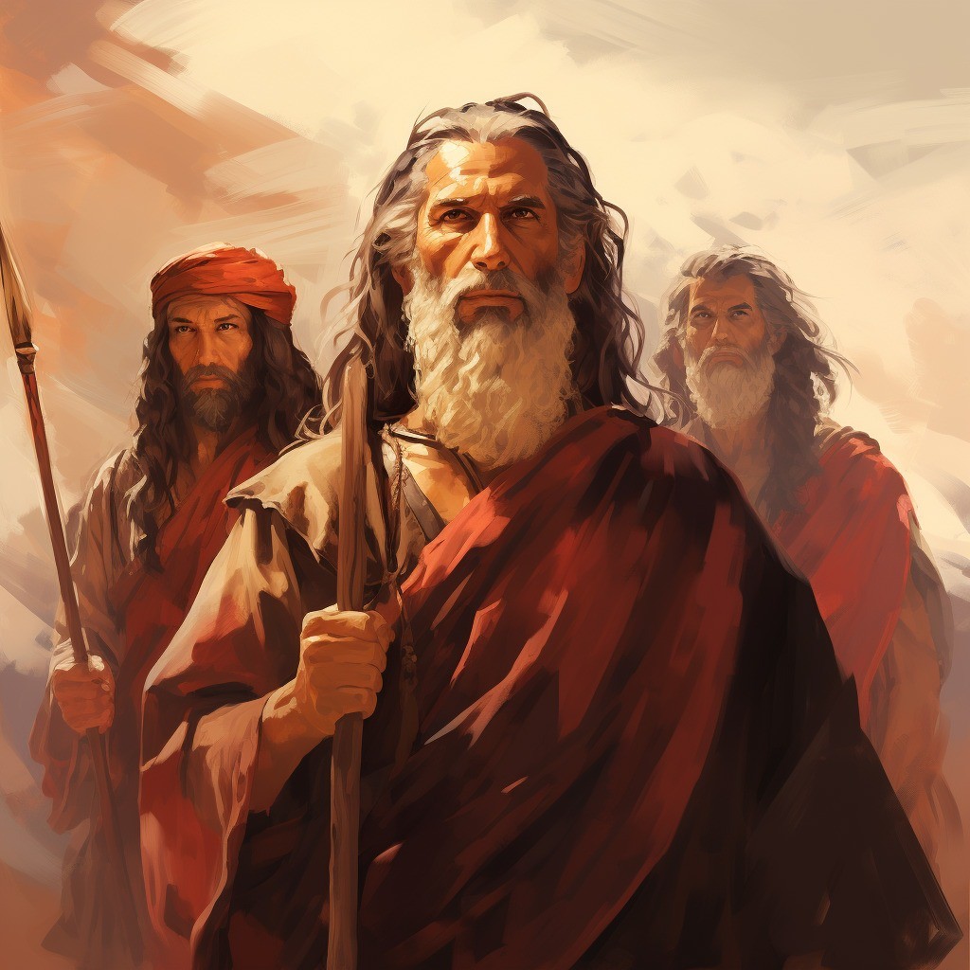
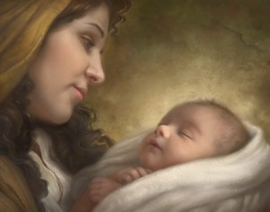
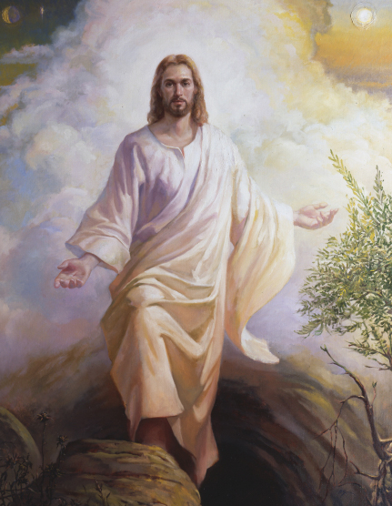
I Am
“And God said unto Moses, I AM THAT I AM: and he said, Thus shalt thou say unto the children of Israel, I AM that sent me unto you.” (Exodus 3:13-14)
Nephi: “And he said unto me: Behold, the virgin whom thou seest is the mother of the Son of God, after the manner of the flesh.”
1 Nephi 11:18
“And because he dwelleth in flesh he shall be called the Son of God, and having subjected the flesh to the will of the Father, being the Father and the Son—
The Father, because he was conceived by the power of God; and the Son, because of the flesh; thus becoming the Father and Son—”
Mosiah 15:2-3
To Know…To Do…To Be
“If I am to become Christlike, I must be lifted to fully accept Christ’s name, “I Am.”
3 Nephi 9:15

Slide 9
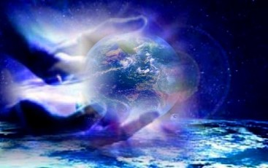
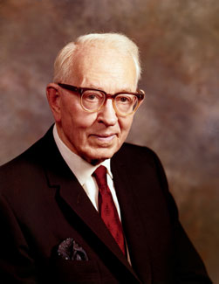
I Created the Heavens and the Earth
And all things that in them are…
“Under the direction of his Father, Jesus Christ created this earth. No doubt others helped him, but it was Jesus Christ, our Redeemer, who, under the direction of his Father, came down and organized matter and made this planet, so that it might be inhabited by the children of God.”
Joseph Fielding Smith
3 Nephi 9:15

Slide 10
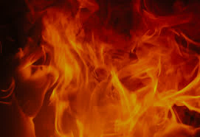
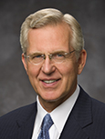
Baptized With Fire
If we come unto Christ with a broken heart and contrite spirit, He will bless us with the companionship of the Holy Ghost.
“You can offer the Lord the gift of your broken, or repentant, heart and your contrite, or obedient, spirit. In reality, it is the gift of yourself—what you are and what you are becoming.
“Is there something in you or in your life that is impure or unworthy?
When you get rid of it, that is a gift to the Savior. Is there a good habit or quality that is lacking in your life?
When you adopt it and make it part of your character, you are giving a gift to the Lord.” D. Todd Christofferson
3 Nephi 9:20

Slide 11
The Law of Moses Fulfilled—His divine Role
He came unto my own
Those who receive Him
Those who believe in Him
He is the light and life of the world
He is Alpha and Omega
There is to be no more shedding of blood for sacrifices
He will accept the broken hearted and contrite spirit for the sins of all
He comes to bring redemption to the
world
He will accept those who become “as a little child unto repentance”
His own received me not
He has given to men to become the sons of God
Redemption comes through Him
He is the source of truth
The beginning and the end— eternal
He has shed his blood for all mankind
There will be a baptism of fire (The Holy Spirit)
To save the world from sin
Being innocent and humble…To be teachable
3 Nephi 9:16-22

Slide 12
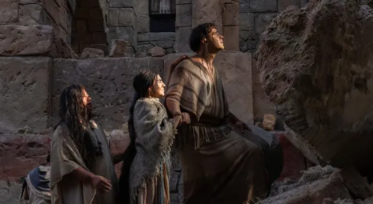
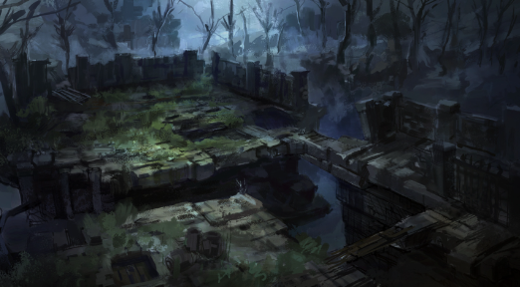
Silence
For the space of many hours
“…so great was the astonishment of the people that they did cease lamenting and howling for the loss of their kindred which had been slain; therefore there was silence in all the land for the space of many hours.”
3 days did pass away
3 Nephi 10:1-2,9

Slide 13
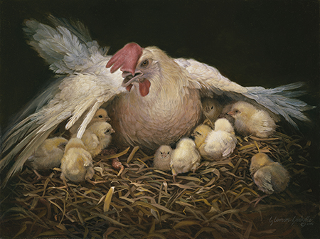
Jesus Reminds Them and Us
How oft have I gathered you as a hen gathereth her chickens under her wings, and nourished you?
“Jesus’ reminder that he had gathered and sheltered them in the past (vs. 4) as well as of his many efforts to gather them that had been rebuffed is not unique to the Nephites and Lamanite. He used similar language in Jerusalem as he lamented the impending destruction of the Jews.
In our day he has again used this phrase as a beckoning call to repentance and as a warning of the consequences of rejecting his invitation.”
JFM and RLM
He will continue to seek to gather us home…through our faith, repentance, submission to gospel ordinances, and continually obedience.
If we repent and return to the Savior, He will gather and protect us.
3 Nephi 10:5-6

Slide 14
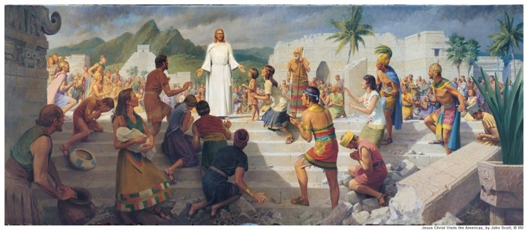
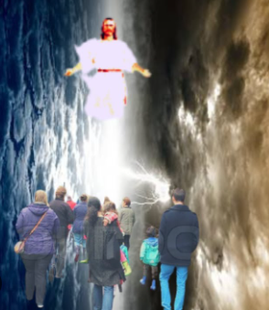
Darkness did Cease
All the noises and trembling did cease
Their mourning was turned to joy
Their lamentations into praise and thanksgiving unto the Lord, Jesus Christ, their Redeemer
They knew the scriptures had been fulfilled
Isaiah declares about our future:
“He will swallow up death in victory; and the Lord God will wipe away tears from off all faces; and the rebuke of his people shall he take away from off all the earth;: for the lord hath spoken it. And it shall be said in that day (our day), Lo, this is our god; we have waited for him, we will be glad and rejoice in his salvation.”
Isaiah 25:8-9 See also: Revelation 7:14-17
3 Nephi 10:9-11

Slide 15
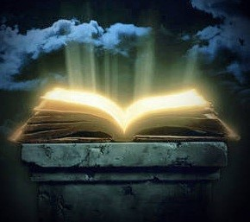
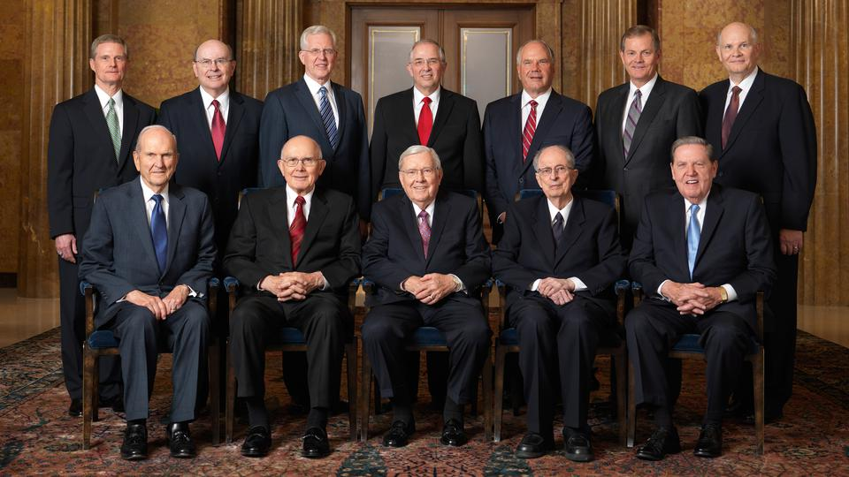
Written in the Lamb’s Book
They had received the prophets
Their names are added to the Book of Life
“In our day, the Lord declared that the righteous—…are those who hear and heed the Lord’s chosen servants
“For he that receiveth my servants receiveth me;
And he that receiveth me receiveth my Father;
And he that receiveth my Father receiveth my Father’s kingdom; therefore all that my Father hath shall be given unto him.”
D&C 84:36-38
3 Nephi 10:12-19

Slide 16
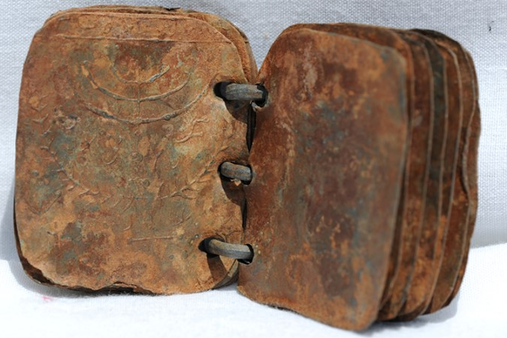
The council to the people
Read the scriptures
Those who readeth, let him understand
Search them…understand the prophecies that have taken place
Remember the testimony of Zeno, Zenock, Jacob (the seed of Joseph) written on the brass plates
Remember those who were slain because they had testified of Christ
What are we counseled to do today concerning the gospel?
3 Nephi 10:14-

Slide 17
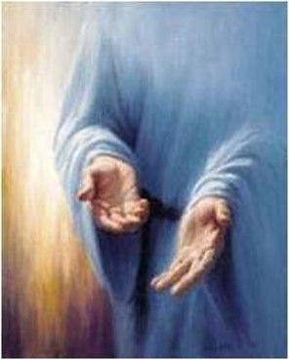
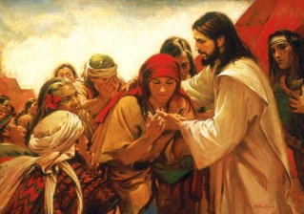
Mormon’s Commentary
“And it came to pass that in the ending of the thirty and fourth year, behold, I will show unto you that the people of Nephi who were spared, and also those who had been called Lamanites, who had been spared, did have great favors shown unto them, and great blessings poured out upon their heads, insomuch that soon after the ascension of Christ into heaven he did truly manifest himself unto them—
Showing his body unto them, and ministering unto them; and an account of his ministry shall be given hereafter. Therefore for this time I make an end of my sayings.”
3 Nephi 10:18-19

Slide 18
Sources:
Christ Brings Light Where There Is Darkness (0:37)
Signs of the Times Handouts—Lesley Meachum and Becky Davies Poway Institute (Ridges)
http://en.wikipedia.org/wiki/Crucifixion_of_Jesus
Joseph Fielding Smith Doctrines of Salvation 1:74
D. Todd Christofferson, “When Thou Art Converted,” Ensign or Liahona, May 2004, 12).
Joseph Fielding McConkie and Robert L. Millet Doctrinal Commentary on the Book of Mormon Vol. 4 pg 47
Presentation by ©http://fashionsbylynda.com/blog/

Slide 19
Spirit to be poured out on all flesh. (Joel 2:28-32)
Discovery and use of printing.
Protestant Reformation and age of Renaissance.
Discovery and colonization of America (Ne. 13:1-19
Establishment of the American nation. (3 Ne. 21:4 and 2 Ne. 10:9-19)
Translation and printing of Bible.
Establishment of the U. S. Constitution (D&C 98:4-10;134) (D&C 101:76,80)
Latter Day revelation.
Coming forth of the Book of Mormon (Isaiah, 29; Ezek. 37)
Opposition to the Book of Mormon.
Restoration of keys and priesthood (D&C 13:27; 128)
Restoration of the gospel. (Rev. 14:6-8) (Isaiah, 2; 4; 5; 10; 11; 13)
Messenger to precede Second Coming. (Mal. 3: 1-6) (D & C 45:9)
Church and kingdom set up again. (Dan. 2:31-45) (D&C 20)
Growth of the church. (Dan. 2:44) (D&C 65)
Gathering of Israel. (Acts 1: 6-11) (D&C 110:11)
Ten tribes to return. (D&C 133:26-34)
Times of Gentiles being fulfilled. (1 Ne. 13:42) (Luke 21 :24)
Return of Judah to Jerusalem. (D&C 133:13)
Jews to begin to believe in Christ. (D&C 45: 51-52) (Zech. 12: 8-14)
Building of latter-day temples. (Isa, 2: 1-5) (Ezekiel 37)
Lord to come suddenly to temple (Mal. 3:1) (D&C 110: 1-10)
Spirit of Elijah and genealogical research.
Persecution of the Saints.
Persecution of the Jews (Luke 21:20-24)
True gospel to be preached in all the world (D&C 113:37)
Worldly knowledge to increase (2 Tim. 3: 1-7)
Scientific and inventive progress. (Rev. 9: 5-10)
Disease, plague, pestilence to sweep earth(Luke 21:26)
Elements in commotion. (Joseph Smith 1 :29)
Disasters and calamities to abound. (D&C 61: 4-5)
Strikes, anarchy, violence, to increase. (D&C 45:26)
Latter-day wickedness (Joseph Smith 1 :30) (Luke 23:29)
Spirit ceasing to strive with wicked. (D&C 63:32)
Peace taken from the earth (to resume at Second Coming).
Angels now reaping the earth. (D&C 38:12)
Wars and rumors of wars. (D&C 63:33 and 97:22-24)
Famines, depressions and economic turmoil.
Apostate darkness covers earth. (2 Tim. 3: 1 -5)
Many false churches in latter days. (Rev. 13:13~14)
Refusal of men to believe signs of time (Matt. 16: 1-4)
Signs on Earth and in heavens. (D&C 45:39-42).
Lamanites to blossom as the rose. (D&C 49: 24-25)
Gathering at Adam-Ondi-Ahman. (2 Thess. 1 :8) (Dan 10) (D&C 115)
Final great war to attend Second Coming, (Zech 12; 13; 14) (Ezek. 38; 39)
Sorrow and fear precede and accompany the Second Coming. (D&C 29:15)
Fall of the great and abominable church. (D&.C 88:94)
Special mission in Jerusalem of two latter-day prophets. (D&C 77:15)
Wicked to be burned as stubble. (D&C 29: 9 & 10)
Final restitution of all things to be completed (new earth, heaven) (D&C 100:23-31)
Christ to reign personally upon the earth. (Rev. 11) (D&C 29:11)
Signs of the Times

Slide 20
Sign | State of Fulfillment | Notes
Apostate darkness covers the earth | Fulfilled | The Great Apostasy before the Restoration
2 Pet.2:1-2, 2 Thess.2:1-12, Mor. 8:28-31
Many false churches D&C 112:23, 2 Ne | Fulfilled | 41,000 Christian denominations worldwide
26:20-29
Spirit to be poured out on all flesh | Fulfilled | Science, discoveries, explorations, progression
Dan. 12:4, D&C 88:73
Discovery and use of printing | Fulfilled | Gutenberg press 1439 | Gutenberg Bible 1455
The invention of printing is credited to |  | Freedom of press 1789
Johannes Gutenberg in 1450
Discovery of America 1 Ne 13:12-16 | Fulfilled | Columbus
Protestant Reformation & Age | Fulfilled | Martin Luther
of Renaissance |  | Art, Science, Religion
Translation of Bible | Fulfilled | Wycliffe
Colonization of America 1 Ne 13: 16-19 |  | Pilgrims, Puritans
Establishment of US Constitution | Fulfilled | Founding Fathers
adopted on September 17, 1787 |  | Agency & Inalienable Rights
Latter-day Revelation | Fulfilled | The First Vision & Moroni
 |  | Holy Ghost poured out
Coming forth of the Book of Mormon | Fulfilled | The Plates, the printing of the Book
Ezek 37:15-19,3 N 21:1-2
Opposition to the Book of Mormon | Fulfilled | Prof Anthon
 |  | Clergy & Mobs
Restoration of keys and priesthood | Fulfilled | John the Baptist
D&C 20: 73, 138: 30 |  | Peter James & John
Spirit of Elijah and genealogical | Fulfilled | Elijah restored keys
research Sealing keys, D&C 110: 13-16, | & in Progress | Kirtland Temple April 3,1836
Mal 4:5-6
Restoration of the Gospel, Church to be | Fulfilled | April 6, 1830 - Incorporation
established, Isa 2: 2-3
Messenger to precede second coming | Fulfilled | Joseph Smith
Lord to come suddenly | Fulfilled | Christ appeared Kirtland Temple April 3, 1836
to His temple | & Yet Future | Dual: New Jerusalem Temple
Kingdom set up | Fulfilled | 1830 = 6 | 1852 = 60,000
Growth of the church. Church will fill |  | 1950 = 1 + mil 2000 = 14+mil
the whole earth, Dan 2: 35, 44-45
Gathering of Israel Return: Elder | Fulfilled | Spiritual Gathering
Morris, CR, April 1960, p. 100 -101, |  | Ephraim & Manasseh
D&C 133: 13,45:24-25
Times of the Gentiles Luke 21:24, D&C | Fulfilled | Gentiles receive the Gospel before the Jews
45:22-28
Building of latter-day temples Marv | Fulfilled | 140 Operating
Work and a Wonder, p. 33, Isa 2:2, | & in Progress | 14 under construction & 14 announced
D&C 133:13 |  | ZO\~

Slide 21
Persecution of the Saints | Fulfilled | Mobbed from place to place
Persecution of the Jews | Fulfilled | Pogroms & Holocaust
 | & in Progress | Middle East attacks
True gospel to be preached to all the | Fulfilled | Missionary work
world | & in Progress | Every member a missionary
Worldly & Scientific knowledge | Fulfilled | Science, Technology, Space age
increases Dan 121:4 | & in Progress | Explosion of inventions
Ten tribes to return D&C 133:26-33, | Fulfilled | Spiritual return
Talmage, A of F, p. 308 | & in Progress | Patriarchal blessings from every tribe
Lamanites to blossom as the rose D&C | Fulfilled | Conversion of American Indians,
49:24 | & in Progress | Central & South Americans
 |  | Spanish # 1 language in Church
Jews to begin to believe in Christ and | Fulfilled | Jews for Jesus
accept the gospeL 2 N 30:7, Zech 12: 7-10 | & in Progress | Some Jews join LDS Church
Pouring out of the Spirit JSM 1:39 | Fulfilled | Dreams and visions by "Servants" & "handmaids."
 | & in Progress | Gifts of the Spirit
Latter-day wickedness | Fulfilled | Crime, juvenile delinquency
 | & in Progress | Dissolution of the Family
Withdrawal of the Spirit from wicked | Fulfilled | God's organizing spirit is withdrawing
D&C 63:32, 95:4, Joel 2:28-29, Rom 1: 29-32 | & in Progress | from mankind
Elements in commotion D&C 45:323, | Fulfilled | Tsunamis, earthquakes, volcanoes, tornadoes
88:88-91, | & in Progress
Calamities to abound D&C 109:30,84: | Fulfilled | Man-made disasters
97, 2N 6:14-15, D&C 45:31 | & in Progress | Increase of murder, rape, abuse
Social unrest, corruption, violence | Fulfilled | Labor troubles, Political movements
Isa 3:5, 2 Tim 3:1-4, HeI4:21-23 | & in Progress | Terrorism, oppression
 |  | Drug & sex trafficking, Violence
Peace taken from the earth D&C 1 :35- | Fulfilled | Love of many waxes cold
36, 115:6 | & in Progress | Contention in homes and society
Wars and rumors of wars Matt 24:6, | Fulfilled | Frequency of wars has doubled since WWII
JSM 23, D&C 45:26; D&C 87 | & in Progress
Famines, depressions, & | Fulfilled | Govt instability, corruption & spending
economic turmoil | & in Progress | Entitlement, deficits, loss of incomes
Apostate darkness | Fulfilled | Sifting of members of Church
 | & in Progress | Deception by the philosophies of men
 |  | Even the very elect are deceived
Many False churches JSM 1:22, Rev | Fulfilled | Anti-Christs and false prophets
13:13-15 | & in Progress | Priestcraft increasing
Angels now reaping the earth | Fulfilled | Wilford Woodruff 1894 -
 | & in Progress | Angels were at the portals. | Now are reaping.
Constitution Hanging by a Thread | In Progress | US Constitution in danger of destruction
JSPapers Mar 10, 1844 |  | Will be saved by righteous citizens
Dangers upon the waters | Fulfilled | The Destroyer, toxins, pollution, storms,
D&C 61:4-6, 13-19,22 | & in Progress | acid rain, warships, tsunamis

Slide 22
Baptize with Fire 3 Nephi 9:20:
“We were baptized by immersion in water for the remission of sins. We must also be baptized by and immersed in the Spirit of the Lord, ‘and then cometh a remission of your sins by fire and by the Holy Ghost’ (2 Nephi 31:17).
“As we gain experience with the Holy Ghost, we learn that the intensity with which we feel the Spirit’s influence is not always the same. Strong, dramatic spiritual impressions do not come to us frequently. Even as we strive to be faithful and obedient, there simply are times when the direction, assurance, and peace of the Spirit are not readily recognizable in our lives. In fact, the Book of Mormon describes faithful Lamanites who ‘were baptized with fire and with the Holy Ghost, and they knew it not’ (3 Nephi 9:20).
“The influence of the Holy Ghost is described in the scriptures as ‘a still small voice’ (1 Kings 19:12; see also 3 Nephi 11:3) and a ‘voice of perfect mildness’ (Helaman 5:30). Thus, the Spirit of the Lord usually communicates with us in ways that are quiet, delicate, and subtle” (David A. Bednar, “That We May Always Have His Spirit to Be with Us,” Ensign or Liahona, May 2006, 29).
The Savior’s perfect submission to the Eternal Father is the very essence of a broken heart and a contrite spirit. Christ’s example teaches us that a broken heart is an eternal attribute of godliness. When our hearts are broken, we are completely open to the Spirit of God and recognize our dependence on Him for all that we have and all that we are. The sacrifice so entailed is a sacrifice of pride in all its forms. Like malleable clay in the hands of a skilled potter, the brokenhearted can be molded and shaped in the hands of the Master. …
… Those who have a broken heart and a contrite spirit are willing to do anything and everything that God asks of them, without resistance or resentment. We cease doing things our way and learn to do them God’s way instead. (Bruce D. Porter, “A Broken Heart and a Contrite Spirit,” Ensign or Liahona, Nov. 2007, 32)
Forgiveness:
God doesn’t care nearly as much about where you have been as He does about where you are and, with His help, where you are willing to go. (Jeffrey R. Holland, “The Best Is Yet to Be,” [Brigham Young University devotional, Jan. 13, 2009], 27, speeches.byu.edu)
Broken Heart and Contrite Spirit 3 Nephi 9:19-20:
“Real, personal sacrifice never was placing an animal on the altar. Instead, it is a willingness to put the animal in us upon the altar and letting it be consumed! Such is the ‘sacrifice unto the Lord … of a broken heart and a contrite spirit’ (D&C 59:8)” (Neal A. Maxwell, “Deny Yourselves of All Ungodliness,” Ensign, May 1995, 68).
True repentance involves a change of heart and not just a change of behavior (see Alma 5:13). Part of this mighty change of heart is to feel godly sorrow for our sins. This is what is meant by a broken heart and a contrite spirit. God’s gifts are sufficient to help us overcome every sin and weakness if we will but turn to Him for help. Most repentance does not involve sensational or dramatic changes, but rather is a step by step, steady and consistent movement toward godliness. (Teachings of Ezra Taft Benson [1988], 71.)
Letters come from those who have made tragic mistakes. They ask, “Can I ever be forgiven?”
The answer is yes!
The gospel teaches us that relief from torment and guilt can be earned through repentance. Save for those few who defect to perdition after having known a fulness, there is no habit, no addiction, no rebellion, no transgression, no offense exempted from the promise of complete forgiveness. (Boyd K. Packer, “The Brilliant Morning of Forgiveness,” Ensign, Nov. 1995, 19)
Repentance and Forgiveness quotes

Slide 23
Hear Him
3 Nephi 11:1-17

Slide 24
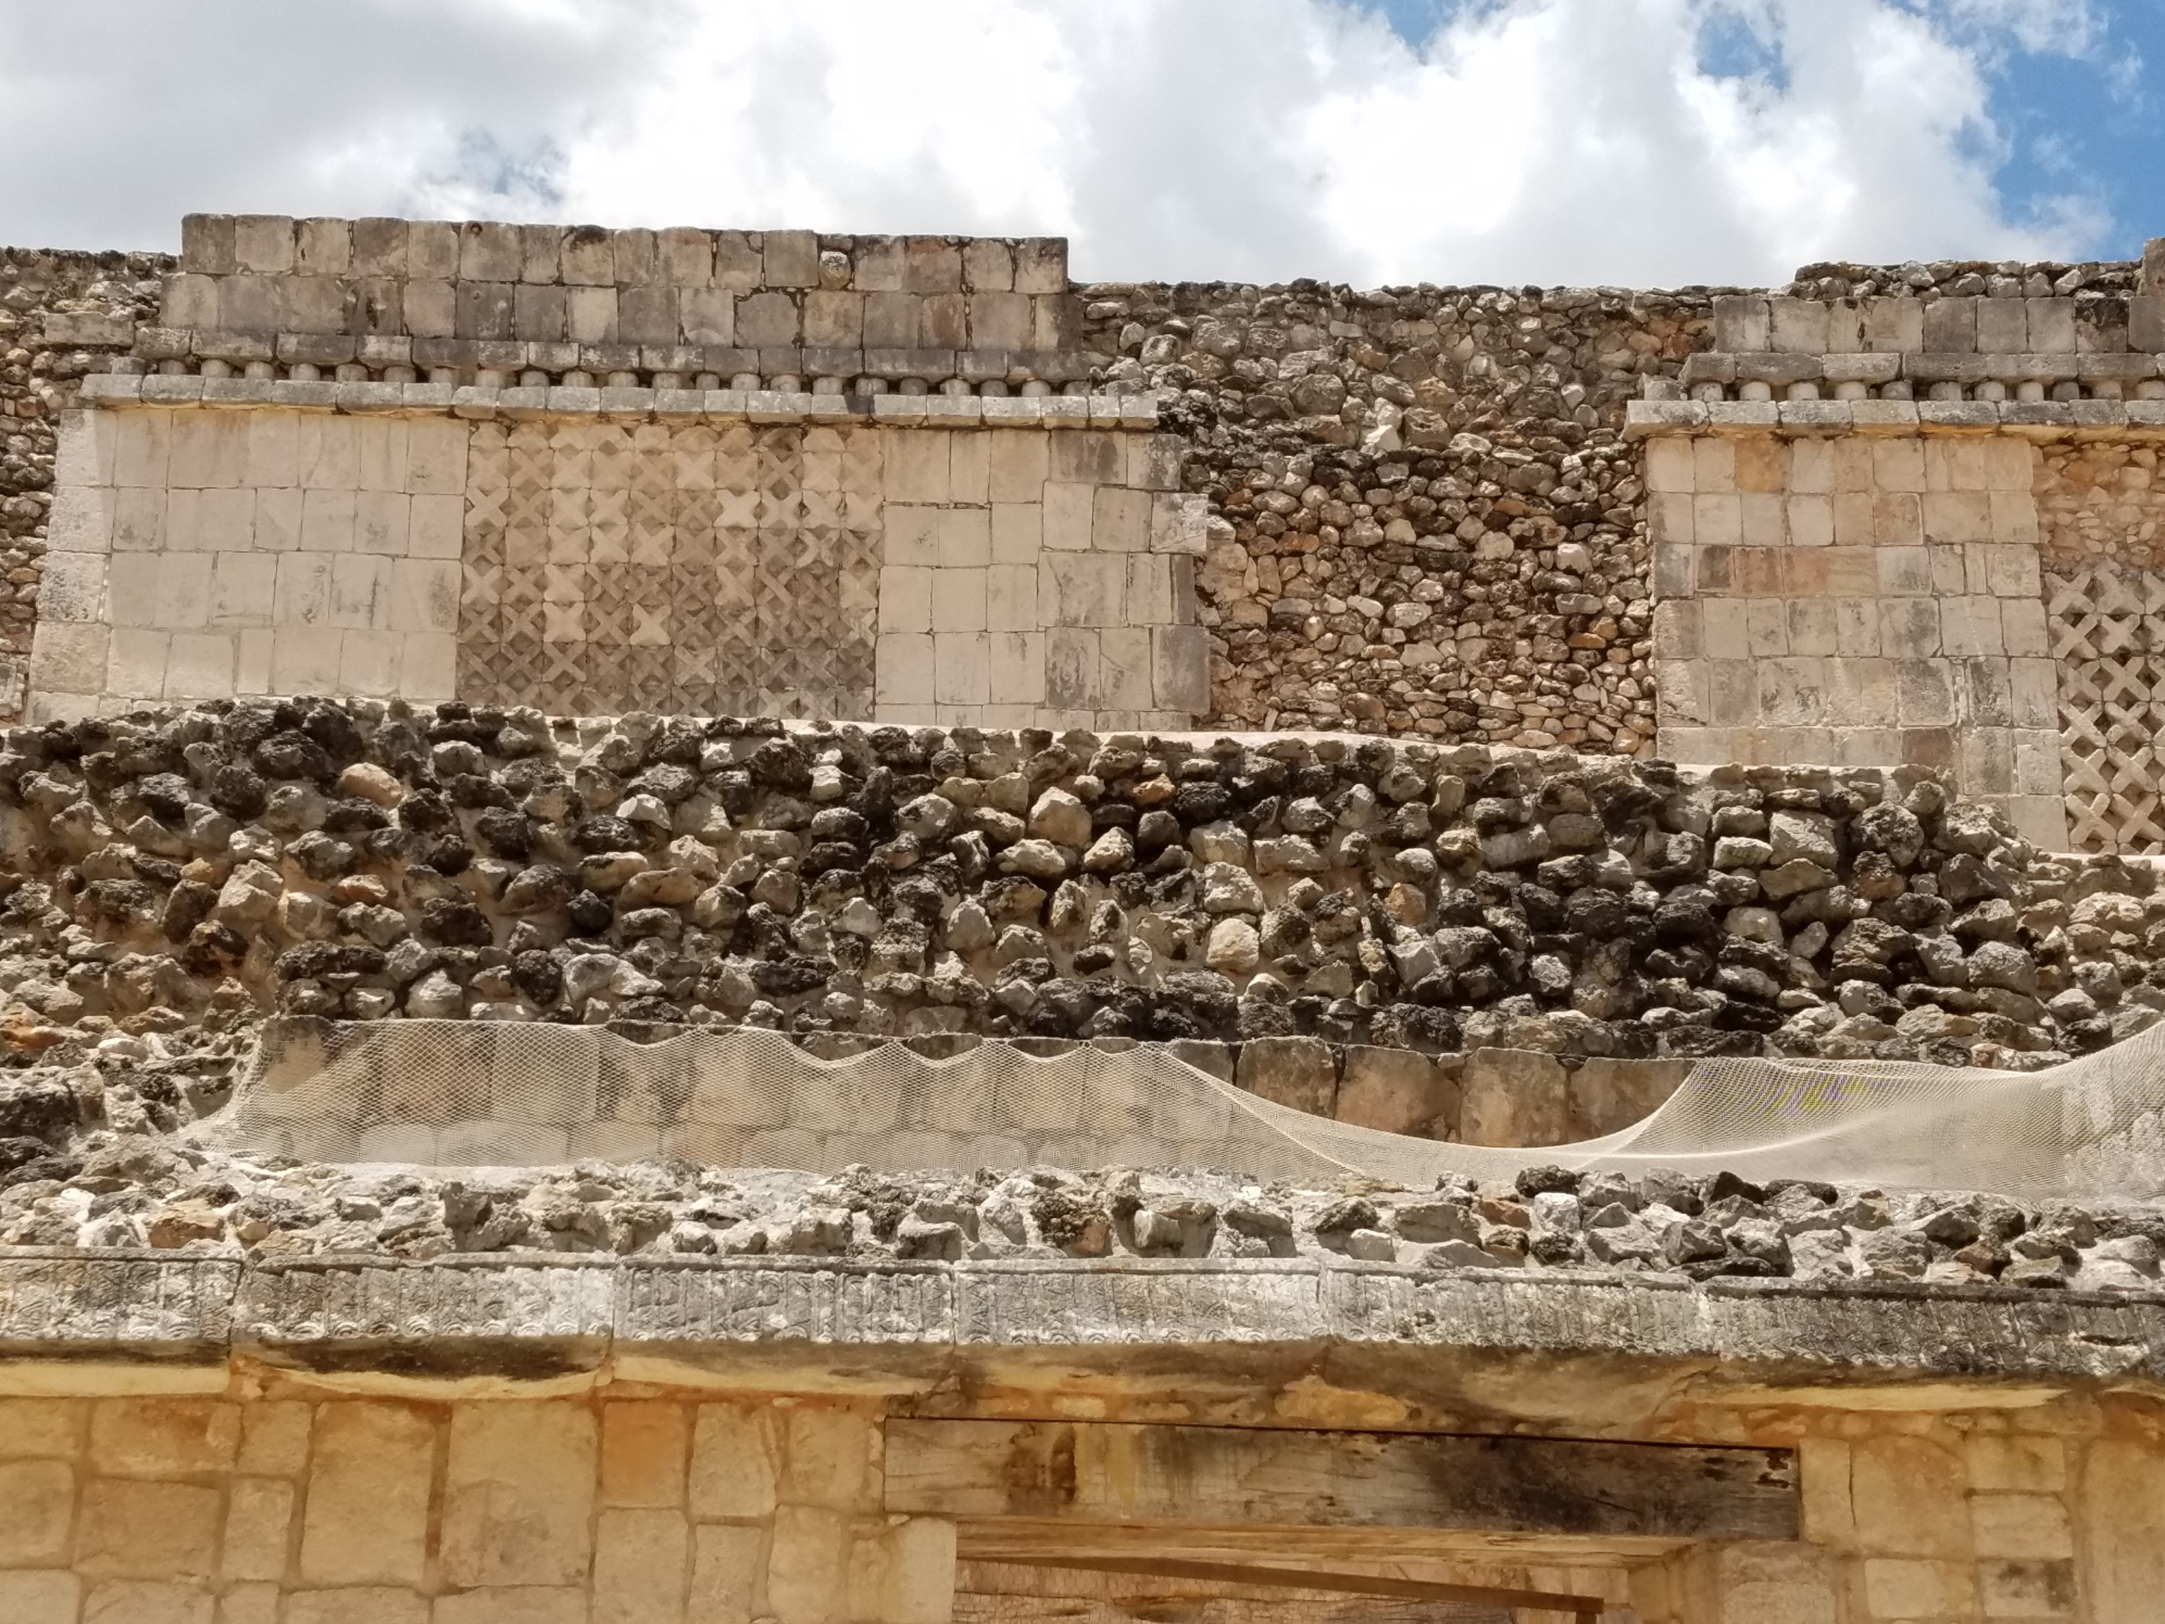
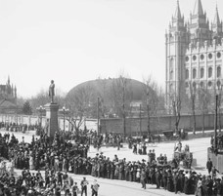
The Gathering
2,500 Nephite men, women and children
Why would the people gather around the temple?
Where would you gather if you had witnessed a miraculous event?
3 Nephi:1-3

Slide 25
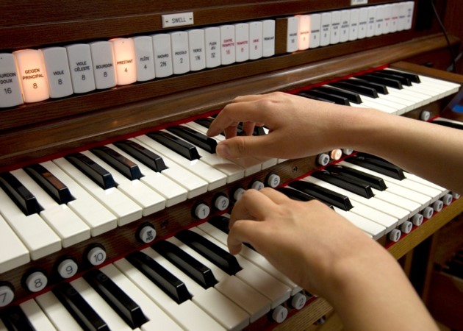
The Voice
What would be the message of the song before the starting of a sacrament meeting?
(Prelude Music)
How often do you listen to the music before a meeting?
What must a person do to hear and understand a soft voice?
3 Nephi 11:3-5

Slide 26
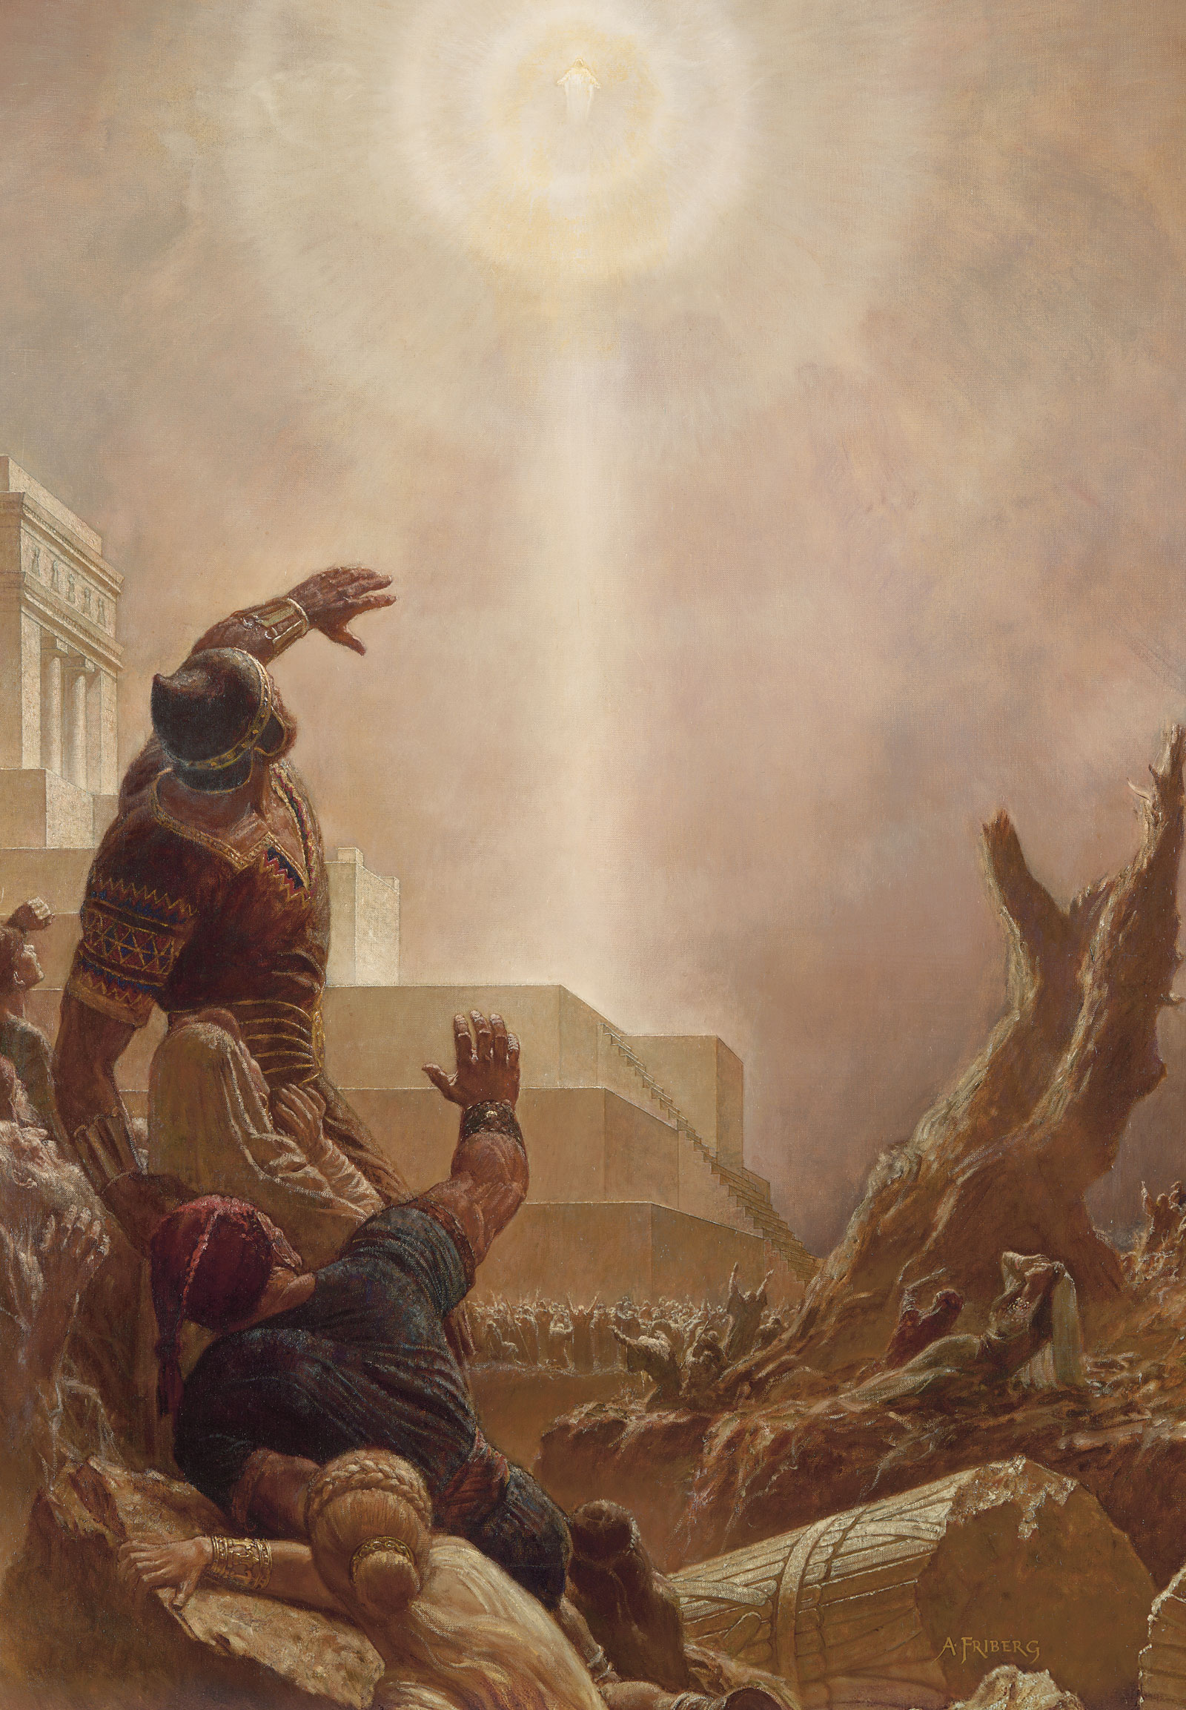
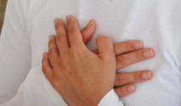
The Sound of the Voice
“And it came to pass when they heard this voice, and beheld that it was not a voice of thunder, neither was it a voice of a great tumultuous noise, but behold, it was a still voice of perfect mildness, as if it had been a whisper, and it did pierce even to the very soul—”
Helaman 5:30
Not a harsh voice, neither was it a loud voice
A small voice, piercing them that did hear to the center…their very soul…causing their heart to burn—a testimony
The Holy Ghost often speaks to us through our feelings
3 Nephi 11:3

Slide 27
“The Spirit does not get our attention by shouting. It never shakes us with a heavy hand. The Spirit whispers. It caresses so gently, indeed, that if we are preoccupied, we can’t feel it at all.
“Occasionally, the Spirit will press just firmly enough or often enough for us to pay attention; but from my experience, most of the time, if we do not heed the gentle feeling, if we do not listen with those feelings, the Spirit will withdraw and wait until we come seeking and listening, in our manner and our expression.”
Boyd K. Packer
As we learn how to listen to the voice of the Lord through the Holy Ghost, we will be able to understand the communication He gives us

Slide 28
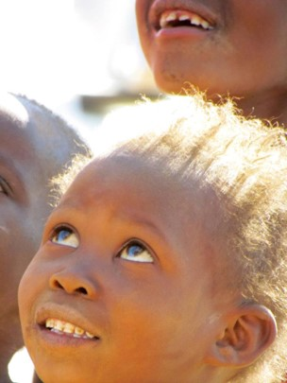
Looking to Heaven
The third time the voice came:
They did open their ears toward the sound
They did look toward where the sound came from
They did understand, this time, thinking what they saw was an angel.
Try this sometime:
In a crowded area look up, then look around and see how many look up also.
3 Nephi 11:5-8

Slide 29
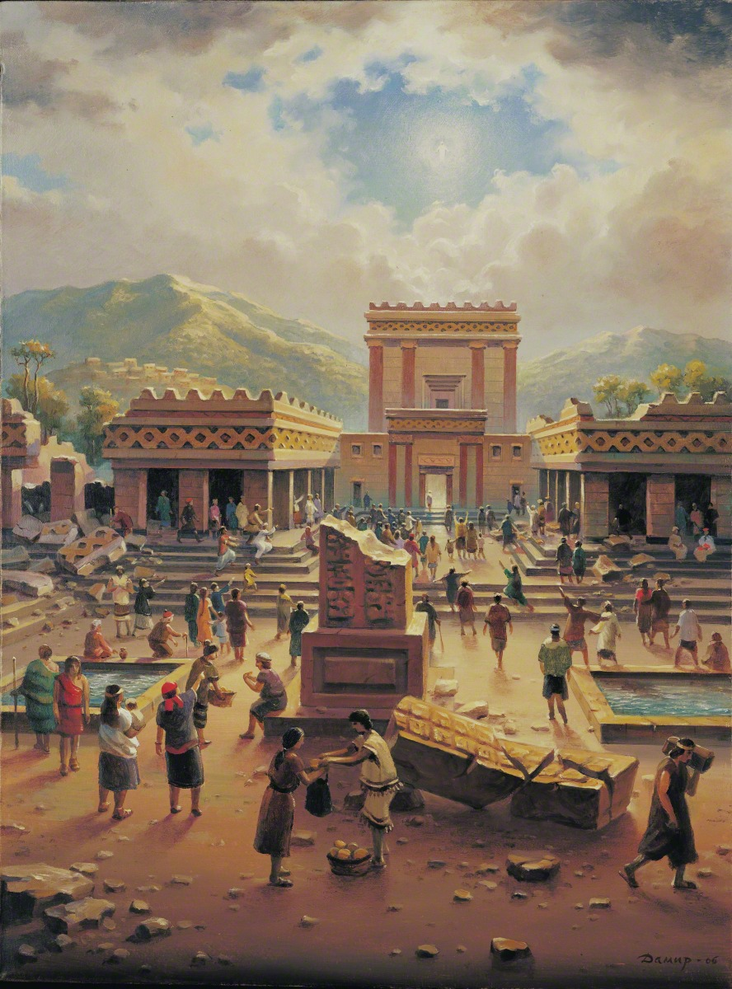
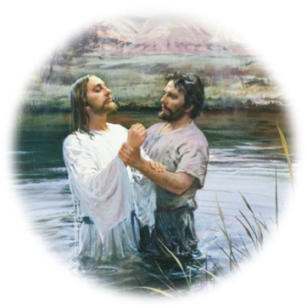
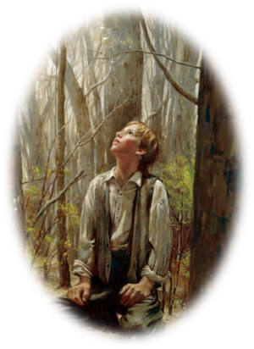
“Hear Him”
The voice of Heavenly Father announces His Son:
“Behold my Beloved son, in whom I am well please, in whom I have glorified my name—hear ye him.”
After Jesus was baptized:
“And lo a voice from heaven, saying, This is my beloved Son, in whom I am well pleased.”
Matthew 3:17
To Joseph Smith: “…One of them spake unto me, calling me by name and said, pointing to the other—This is My Beloved Son. Hear Him!”
Joseph Smith History 1:17
3 Nephi 11:7-8

Slide 30
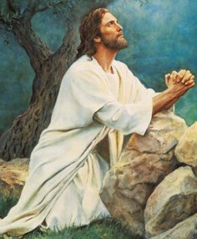
Glorified My Name
“…Christ’s fulfillment of the atoning sacrifice that makes immortality and eternal life possible for mankind—which is the “work and glory” of the Father.”
JFM and RLM
He is the Christ, the Messiah who every prophet had testified would come into the world:
“And I said unto him: Then ye do not understand them; for they truly testify of Christ. Behold, I say unto you that none of the prophets have written, nor prophesied, save they have spoken concerning this Christ.”
Jacob 7:11
“Yea, even six hundred years from the time that my father left Jerusalem, a prophet would the Lord God raise up among the Jews—even a Messiah, or, in other words, a Savior of the world.”
1 Nephi 10:4
“For behold, this is my work and my glory—to bring to pass the immortality and eternal life of man.”
Moses 1:39
3 Nephi 11:7

Slide 31
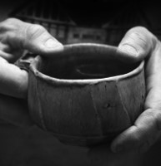
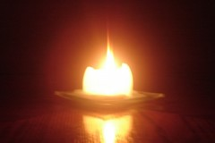
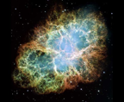
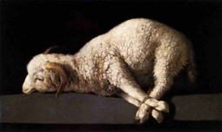
“I Am Jesus Christ”
I am the Light—the truth
I have drunk out of that bitter cup—The painful demands of justice that had to be met in order for the infinite and eternal sacrifice to be fulfilled
(see Matthew 26:36-46)
I have glorified the Father in taking upon the sins of the world—demonstrating His infinite love for every person.
I have suffered the will of the Father in all things from the beginning—He has suffered for not only the repentant people but all the people from the beginning of Adam.
Jesus Christ did the will of the Father in taking upon Himself the sins of the world.
3 Nephi 11:9-11

Slide 32
Doctrinal Mastery
Behold, I am Jesus Christ, whom the prophets testified shall come into the world.
And behold, I am the light and the life of the world; and I have drunk out of that bitter cup which the Father hath given me, and have glorified the Father in taking upon me the sins of the world, in the which I have suffered the will of the Father in all things from the beginning.
3 Nephi 11:10-11

Slide 33
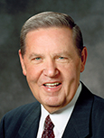
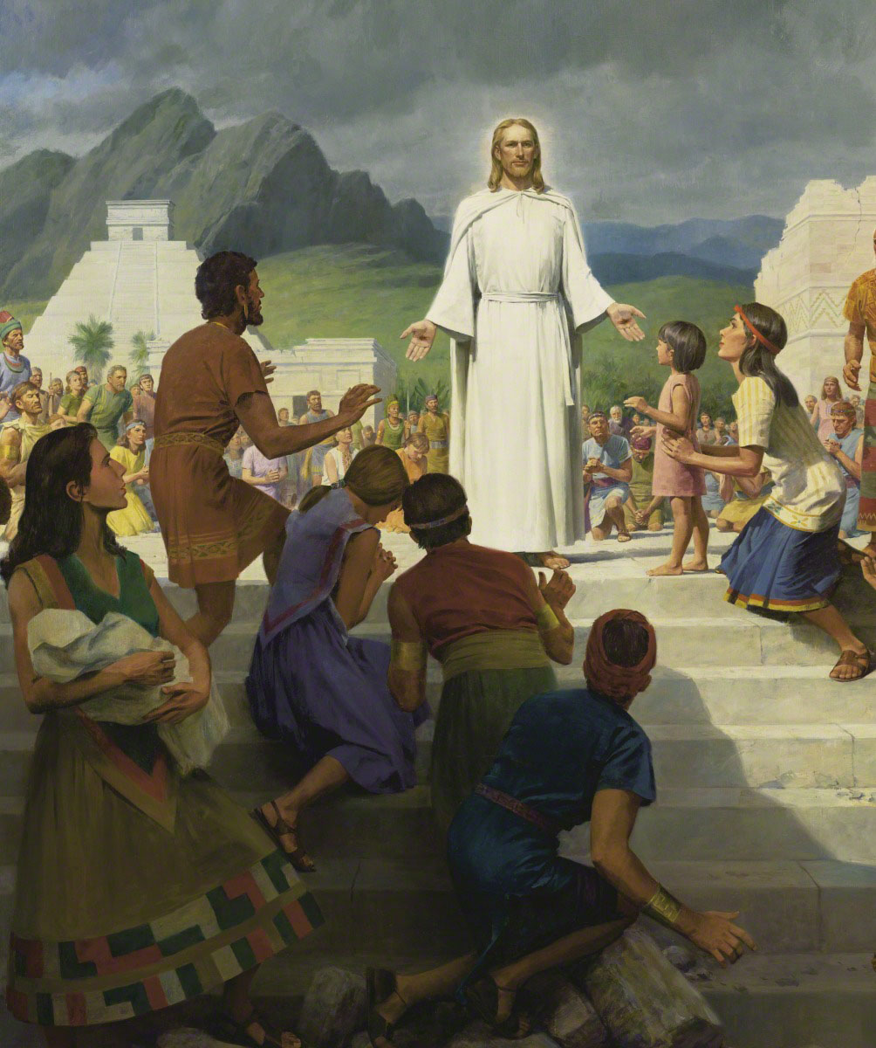
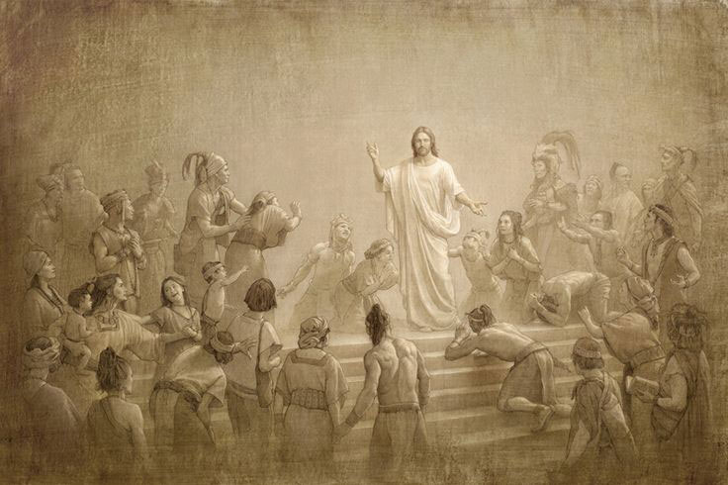
“Fall to the Earth”
“That appearance and that declaration constituted the focal point, the supreme moment, in the entire history of the Book of Mormon.
It was the manifestation and the decree that had informed and inspired every Nephite prophet for the previous six hundred years, to say nothing of their Israelite and Jaredite forefathers for thousands of years before that.
“Everyone had talked of him, sung of him, dreamed of him, and prayed for his appearance—but here he actually was. The day of days! The God who turns every dark night into morning light had arrived.”
Elder Jeffrey R. Holland
3 Nephi 11:12

Slide 34
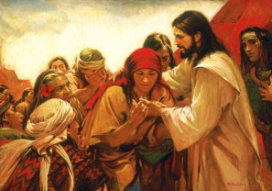
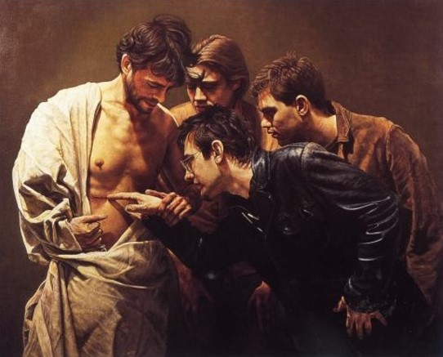
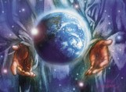
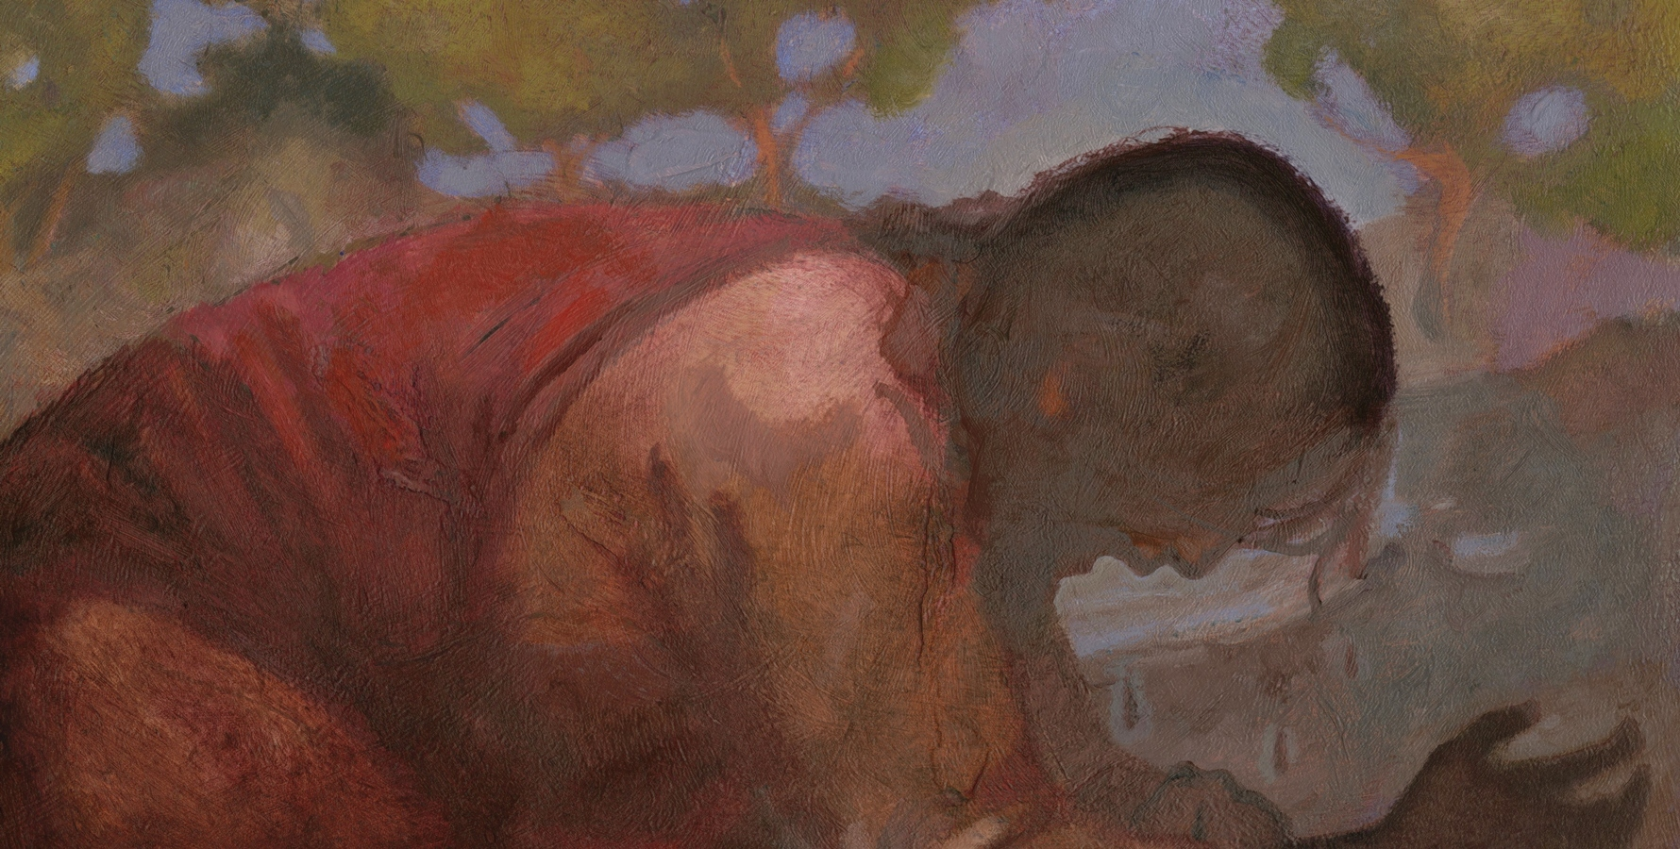
“Come Forth”
Feel my sides and see my hands…
I am the God of Israel – from Abinadi: “…come down among the children of men, and shall redeem his people.” Mosiah 15:1
I am the God of the whole earth.
I have been slain for the sins of the world.
J. Kirk Richards
3 Nephi 11:14-15

Slide 35
Inviting
Jesus Christ invites me to receive a personal testimony that He is my Savior.
3 Nephi 11:13-15

Slide 36
One By One
The sacrament is given individually
If each person took 10 seconds with the Savior, it would have taken 7 hours
He greets them one by one, he gives them the signs and tokens one by one, he converses with them one by one, he blesses the children one by one.
Hugh Nibley
When Christ died, He died for you individually just as much as if you'd been the only man in the world. C.S. Lewis
3 Nephi 11:15

Slide 37
“Hosanna”
Meaning— “Save now, save we pray”
Deep reverence and worship
Psalm 118:25 “Save now, I beseech thee, O Lord: O Lord, I beseech thee, send now prosperity.”
“It was commonly used in ancient times in connection with the worship of Jehovah at the Feast of Tabernacles. Shouting Hosannas and waving palm branches was a means of worshipping the Messiah and acknowledging his saving power.” JFM and RLM
“And the multitudes that went before, and that followed, cried, saying, Hosanna to the Son of David: Blessed is he that cometh in the name of the Lord; Hosanna in the highest.”
Matthew 21:9
3 Nephi 11:17

Slide 38
Personal Testimony
What did the people do after they had seen and felt the Savior’s wounds?
When we receive a personal testimony of Jesus Christ, it is our responsibility to bear record of Him
Why do we not need to see and touch the Savior to know that He lives?
And by the power of the Holy Ghost ye may know the truth of all things.
Mosiah 10:5

Slide 39
Sources:
Joseph Fielding McConkie and Robert L. Millet Doctrinal Commentary on the Book of Mormon Vol. 4 pg. 52-53
Boyd K. Packer (“How Does the Spirit Speak to Us?” New Era, Feb. 2010, 3).
Jeffrey R. Holland, Christ and the New Covenant: The Messianic Message of the Book of Mormon [1997], 250–51.
Hugh Nibley “Book of Mormon Commentary” Volume 2
C.S. Lewis quote
Presentation by ©http://fashionsbylynda.com/blog/

Slide 40
“What is the Hosanna Shout?”
Answer/ Reed Durham
On March 27, 1836, the Kirtland Temple was dedicated, and at the close of the dedicatory services the pattern for giving the Hosanna Shout was given. The Prophet Joseph wrote: “President Rigdon then made a few appropriate closing remarks, and a short prayer, at the close of which we sealed the proceedings of the day by shouting hosanna, hosanna, hosanna to God and the Lamb, three times sealing it each time with amen, amen, and amen.” (Documentary History of the Church vol. 2, pp. 427–8.) This pattern of “hosanna,” to “God and the Lamb,” and “amen” repeated three times formed the basic pattern of the Hosanna Shout throughout all of Church history to the present.
From time to time some modifications were made upon the basic pattern, such as striking the right hand into the palm of the left hand at the end of each word, which was done on the occasion of the reorganization of the First Presidency with President Brigham Young on December 27, 1847. (“Journal of Norton Jacob,” Journal History, September 5, 1848, p. 4.)
On another occasion the Church members stood up on their feet while giving the shout (Millennial Star, vol. 24, p. 758); clapped hands while shouting; added the words “forever and ever, worlds without end” after the regular words “God and the Lamb” (B. H. Roberts, Life of John Taylor, p. 365); and often, especially since 1893, the Saints waved white handkerchiefs while shouting (James E. Talmage, House of the Lord, p. 150; Conference Report, April 1930, pp. 21–22).
Often after the shout the congregation or choirs sang a song (“America,” “The Spirit of God,” or the Evan Stephen “Hosanna Anthem.”) But with these different modifications made from time to time during Church history, the basic pattern, repeated three times while waving white handkerchiefs, has persisted until the present.
Today, the shout is conducted at temple dedications and at solemn assemblies. However, in the past several other occasions and events were honored with the congregational Hosanna Shout:
1. At the close of the famous Sidney Rigdon Salt Sermon at Missouri in 1838
2. By the twelve before leaving for their missions to England, 1838
3. Upon arrival on English soil, Brigham Young and the rest of the Twelve with him, April 6, 1840
4. At a secret council of fifty meeting in Nauvoo, March 11, 1844, and April 11, 1844
5. At the laying of the capstone of the Nauvoo Temple, May 24, 1845
6. Upon entering the Salt Lake Valley for the first time
7. At several general conferences—April 11, 1852; October 6, 1862; April 9, 1882
8. At a 24th of July celebration in Brigham City—July 24, 1875
9. Occasionally, at a ward or stake conference
Page 1

Slide 41
When the proper occasion arises for this spirituous congregational shout of praise and rejoicing (and it is now used only on rather special occasions), when the spirit guides the proper ecclesiastical authority, and when the congregation has been properly tutored and instructed in the sacredness and pattern of it, the Hosanna Shout is one of the most dramatic and impressive ceremonies in the Church.
“It is impossible to stand unmoved on such an occasion. It seems to fill the prairies or woodland, mountain wilderness or tabernacle, with mighty waves of sound; and the shout of men going into battle cannot be more stirring. It gives wonderful vent to religious emotions and is followed by a feeling of reverential awe—a sense of oneness of God.” (B. H. Roberts, Comprehensive History of the Church, vol. 3, p. 317.) The word hosannaas we know it originated from two Hebrew words found in Psalm 118:25, and roughly means “Save us, we beseech thee.” [Ps. 118:25] (See also 2 Sam. 14:4; Ps. 20:9.)
This psalm was recited by one of the priests every day during the procession around the altar during the seven-day holiday called the Feast of Tabernacles, when the people were commanded to “rejoice before the Lord. …” (Lev. 23:40). On the seventh day it was sung seven times, and when the priest reached verses 25 and 26, the trumpet sounded and all the people waved their branches of palms, myrtles, and willows (their lulab), and shouted the Hosanna many times. In fact, this seventh day of the feast was called the Great Hosanna.
The Feast of Tabernacles was a season of great rejoicing for the Jewish people, and hence the Hosanna, though supplicatory at first, came to be equated with rejoicing. It was apparently used in this way in the New Testament.
The Hosanna became an acclamation of the multitude on the occasion of Jesus’ triumphal entry into Jerusalem. It occurs six times in the Gospels. It is used alone in Mark 11:9 and John 12:13; it is twice followed by the dative “to the Son of David” in Matthew 21:9, 15 [Matt. 21:9, 15]; and it is used twice with the phrase “in the highest” in Matthew 21:9 [Matt 21:9] and in Mark 11:10. The element of rejoicing and praise even in an ejaculation or shout was present on this occasion as was the lulab or waving of branches or leaves.
The earliest actual use of the Hosanna Shout in the Church is not known. But it was most likely used from the very beginning. Indeed, the Lord commanded its use even before the Church was officially organized.
In March 1830 the Prophet received a revelation for Martin Harris in which the Lord commanded him to preach the gospel “even with a loud voice, with a sound of rejoicing, crying—Hosanna, hosanna, blessed be the name of the Lord God!” (D&C 19:37.) On several other occasions in the beginning years of the Church, the Lord commanded the use of the Hosanna Shout (D&C 36:3; D&C 39:19), and it is known that it was practiced. (Millennial Star, vol. 26, p. 504.) But in 1836 with the completing of the Kirtland Temple, the Hosanna Shout became well established in the Church. The Lord gave specific instructions pertaining to it for priesthood and general Church practice. (D&C 109:79–80;Documentary History of the Church vol. 2, pp. 381–92.)
Director of the Institute of Religion University of Utah
Page 2

Slide 42
The Hosanna Shout
In the Latter Day Saint movement, a hosanna shout is an organized ritual by a congregation of shouting hosanna. It was first performed as a ritual in the dedication of the Kirtland Temple, and was a part of the Kirtland Endowment ceremony. It continues to be practiced by some Latter Day Saint denominations, most notably The Church of Jesus Christ of Latter-day Saints (LDS Church), which practices the ritual at the dedication of each of its temples.
When the ordinance of the washing of feet was introduced at Kirtland, shouts of hosanna were viewed as a sealing benediction on both private and quorum prayer and then on the dedicatory prayer. At prayer meetings in the Kirtland Temple, the Saints sometimes used related phrases such as "Blessed is the name of the Most High God" and "Glory to God in the highest" (HC 2:386).
The Hosanna shout is intended to be whole-souled and given to the full limit of one's strength. The congregation stands and in unison shouts three times the words "Hosanna, Hosanna, Hosanna to God and the Lamb," then concludes with "Amen, Amen, and Amen." This is done while waving white handkerchiefs with uplifted hands.[The epithet "Lamb" relates to the condescension and Atonement of Jesus Christ.
The Hosanna shout memorializes the pre-earthly Council in Heaven, as "when ... all the sons of God shouted for joy" (Job 38:7). It also recalls the hosannas and the waving of palm branches accorded Jesus as he entered Jerusalem, and the hosannas that welcomed him as he appeared to the Nephites in the Book of Mormon. President of the LDS Church Lorenzo Snow taught that this shout will herald the Messiah when he comes in the glory of the Father (cf. 1 Thes. 4:16). The word Hosanna means "save, rescue" or "save", which concisely summarizes the purpose of the temple in Latter-day theology as a place where saving ordinances are performed for both the living and the dead.
http://en.wikipedia.org/wiki/Hosanna_shout

Slide 43
Baptism, The True Way
3 Nephi 18-41

Slide 44
The Power to Baptize
Who has the power baptize?
Baptism must be performed by a person who holds proper authority
Aaronic Priesthood, or Melchizedek Priesthood
“The priest’s duty is to preach, teach, expound, exhort, and baptize, and administer the sacrament,”
D&C 20:46
“The duty of the elders, priests, teachers, deacons, and members of the church of Christ—An apostle is an elder, and it is his calling to baptize;
And to ordain other elders, priests, teachers, and deacons;”
D&C 20:38-39
3 Nephi 11:18-22

Slide 45
The Baptismal Words
“Having authority given me of Jesus Christ, I baptize you in the name of the Father, and of the Son, and of the Holy Ghost, Amen.
D&C 20:46
What if the words are spoken incorrectly?
Why is it important that baptisms be performed precisely in the manner set forth by the Lord?
Baptism must be done in the manner set forth by the Lord
What other ordinances are done in a set manner?
Sacrament Blessing of water and bread
All Temple Ordinances
3 Nephi 11:25

Slide 46
Rebaptism
“There is nothing strange in the fact that when the Lord came to the Nephites, Nephi was baptized and so was everybody else although they had been baptized before. The Church among the Nephites before the coming of Christ was not in its fulness and was under the law of Moses. The Savior restored the fulness and gave them all the ordinances and blessing of the gospel. Therefore, it actually became a new organization, and through baptism they came into it.
The Prophet Joseph Smith and Oliver Cowdery were baptized by command of the Angel John the Baptist. Several others were baptized before the organization of the church, However, on the day the Church was organized, all who had been previously baptized were baptized again, not for the remission of sins, but for entrance into the Church.”
Joseph Fielding Smith

Slide 47
Contention is of the Devil
Thought:
There must have been an argument over how baptism was preformed by the Nephites.
The spirit of contention is not of God, but is of the devil
Why is it important to avoid contention when discussing the gospel with others?
Why is arguing the wrong way to teach the gospel?
“When there is contention, the Spirit of the Lord will depart, regardless of who is at fault”
President James E. Faust
“It matters not to Satan what the contention is all about…it only matters that contention and conflict be created in the hearts of men.”
JFM and RLM
3 Nephi 11:25-30

Slide 48
Steps for Personal Peace
“What can we do to combat this canker of contention?
What steps may each of us take to supplant the spirit of contention with a spirit of personal peace?
Show compassionate concern for others.
Control the tongue, the pen, and the word processor.
Whenever tempted to dispute, remember this proverb:
“He that is void of wisdom despiseth his neighbour: but a man of understanding holdeth his peace.” (Prov. 11:12; ).
Russell M. Nelson

Slide 49
“This is My Doctrine”
Actions
Consequences
3 Nephi 11:32–34
Believe in Him and be baptized
Believe not and not be baptized
Be saved and inherit the kingdom of God
Shall be damned
Nephi 11:35–36
Believe in Him and the Father
Will be visited with fire and with the Holy Ghost
3 Nephi 11:37–38
Repent, be baptized in my name, become as a little child
Inherit the kingdom of God
3 Nephi 11:39–40
Build upon my rock
Do not seek to alter my doctrines—false teachings
The gates of hell shall
not prevai against them
Floods come and beat upon them
To enter the kingdom of God, we must repent, believe in Jesus Christ, be baptized, and receive the Holy Ghost

Slide 50
“And who is a false teacher, a false minister, a false prophet?
Anyone who does not teach the truth, minister the elements of true religion, or prophesy truly of that which is yet to be.
... A true preacher is one who belongs to the true Church, believes the true gospel, holds that priesthood which is in fact the power of God delegated to man on earth, and who receives revelation from the one true Spirit Being who is the Holy Ghost…”
Bruce R. McConkie
See Galatians 1:6-8

Slide 51
Sources:
Joseph Fielding Smith answers to Gospel Question 3:205-6 see also 4:96-97
President James E. Faust “What I Want My Son to Know before He Leaves on His Mission,” Ensign, May 1996, 41).
Joseph Fielding McConkie and Robert L. Millet Doctrinal Commentary on the Book of Mormon Vol. 4 pg. 57
Russell M. Nelson Ensign May 1989 THE CANKER OF CONTENTION
Bruce R. McConkie Doctrinal New Testament Commentary 2:457-59
Presentation by ©http://fashionsbylynda.com/blog/

Slide 52
Russell M. Nelson: “My concern is that contention is becoming accepted as a way of life. From what we see and hear in the media, the classroom, and the workplace, all are now infected to some degree with contention. How easy it is, yet how wrong it is, to allow habits of contention to pervade matters of spiritual significance, because contention is forbidden by divine decree:
Divine doctrine of the Church is the prime target of attack by the spiritually contentious. Well do I remember a friend who would routinely sow seeds of contention in Church classes. His assaults would invariably be preceded by this predictable comment: “let me play the role of devil’s advocate.” Recently he passed away. One day he will stand before the Lord in judgment. Then, I wonder, will my friend’s predictable comment again be repeated?
Such contentious spirits are not new. In an epistle to Timothy, the Apostle Paul gave this warning, “that the name of God and his doctrine be not blasphemed.” (1 Tim. 6:1.)
“If any man teach otherwise, and consent not to wholesome words, even the words of our Lord Jesus Christ, and to [his] doctrine … doting about questions and strifes of words, … supposing that gain is godliness: from such withdraw thyself.” (1 Tim. 6:3–5; see also Isa. 29:21; 2 Ne. 27:32;D&C 19:30 ; D&C 38:41; D&C 60:14.)
Dissecting doctrine in a controversial way in order to draw attention to oneself is not pleasing to the Lord. He declared:
“Bring to light the true points of my doctrine, yea, and the only doctrine which is in me.”
Ensign May 1989 THE CANKER OF CONTENTION
PS the whole article is great
Authority to Baptize 3 Nephi 11:19-22:
“Although these Nephites had authority to baptize in the old Mosaic dispensation, Christ invited Nephi forward to affirm his priesthood authority to baptize in the new gospel dispensation, and perhaps to ordain him to the apostleship at the same time [see 3 Nephi 11:18–21; History of the Church, 4:538; D&C 20:38]. Then he called another group forward, instructing them how to baptize and noting that there would be ‘no disputations’ among them on this crucial doctrine” (Jeffrey R. Holland, Christ and the New Covenant: The Messianic Message of the Book of Mormon [1997], 259–60).
Contention 3 Nephi 11:28:
““Because … power resides in the Spirit of the Lord, we must never become contentious when we are discussing our faith. As almost every missionary learns, Bible bashing always drives the Spirit away. The Savior has said, ‘He that hath the spirit of contention is not of me’ (3 Nephi 11:29). More regrettable than the Church being accused of not being Christian is when Church members react to such accusations in an un-Christlike way! May our conversations with others always be marked by the fruits of the Spirit—‘love, joy, peace, longsuffering, gentleness, goodness, faith, meekness, [and] temperance’ (Galatians 5:22–23)” (Robert D. Hales, “Christian Courage: The Price of Discipleship,” Ensign or Liahona, Nov. 2008, 73)
Baptism 3 Nephi 11:30-34:
“Baptism is a sign to God, to angels, and to heaven that we do the will of God, and there is no other way beneath the heavens whereby God hath ordained for man to come to Him to be saved, and enter into the kingdom of God, except faith in Jesus Christ, repentance, and baptism for the remission of sins, and any other course is in vain; then you have the promise of the gift of the Holy Ghost (Teachings of Presidents of the Church: Joseph Smith[2007], 91).

