Slide 1
Alma 1-4

Slide 2
Following What is Popular
Alma 1-2
The Book of Alma

Slide 3
Alma
He was the son of Alma the Elder
He was ‘numbered among the unbelievers’ (Mosiah 27:8)
He was visited by a heavenly messenger about 100-92 BC
He had a spiritual transformation and redirected his life to the service of God
He was appointed chief judge of the land around 91 BC
He defeated a conspirator Amlici
He was consecrated high priest of the Church by his father (Alma 4:4; 5:3)
He later delegated his office to another to serve on a mission
He reformed the church in Zarahemla
He was rejected by the city of Ammonihah around 82 BC but stayed with Amulek and eventually converted Zeezrom
He made a safe haven for the Anti-Levi-Nephites
He went to the land of Melek, but was never heard of again…presumable being translated like Moses (Alma 45:18-19)
Who’s Who

Slide 4
Book of Alma
Mormon compiled and abridged records from the large plates of Nephi to create the Book of Alma.
The book is named for Alma, who, as the son of Alma, is often called Alma the Younger.
When King Mosiah instituted the reign of the judges among the Nephites, Alma the Younger became the first chief judge and succeeded his father as high priest over the Church (see Mosiah 29:42).
Alma eventually resigned his position as chief judge to dedicate himself “wholly to the high priesthood” and “to deliver the word of God unto the people” throughout the land of the Nephites (Alma 4:20;5:1).
Mormon used the records of Alma’s ministry
(see Alma 1–44) and the writings of Alma’s sons Helaman (see Alma 45–62) and Shiblon (see Alma 63)
to compose the Book of Alma.
The original records used as sources for the Book of Alma were likely written between 91 B.C. and 52 B.C.
Mormon abridged those records sometime between A.D. 345 and A.D. 385.
Mormon did not record where he was when he compiled this book.
The Book of Alma

Slide 5
Mission Statement
Although the Book of Alma is the longest in the Book of Mormon, it covers a period of only 39 years—approximately 91 B.C. to 52 B.C. The book recounts the first instance of successful missionary labors among the Lamanites. It also highlights the faithfulness of the converted Lamanites in keeping their covenants
The Book of Alma includes teachings about the doctrine of foreordination and the ministry of Melchizedek, the power of the word of God, how to develop faith in Jesus Christ, the severity of breaking the law of chastity ,the state of our spirits following death, the doctrines of resurrection and restoration, and the roles of justice and mercy in Heavenly Father’s plan of redemption
This book also contains the Lord’s instructions concerning self-defense and the justification for war
The book’s numerous teachings on the redeeming mission of Jesus Christ contribute to a central purpose of the Book of Mormon, which is to testify “that Jesus is the Christ, the Eternal God”

Slide 6
Nehor
He was brought before Alma during Alma’s first year as chief judge
about 91 BC—He was a large man of strength
He tried to persuade the people in Zarahemla that the ministry should be professional, supported out of public coffers (stored money)
He testified that all mankind should be saved, they should not fear, and rejoice in the Lord that had created all men.
He wanted all to be redeemed and all men to obtain have eternal life
He began to build his own church
He met with resistance from the faithful, including Gideon—from the colony of Limhi
He killed Gideon
He was condemned for priestcraft and murder
He confessed later of his wrongful preaching
He suffered an “ignominious” death.

Slide 7
Popular
What are some dangers of seeking popularity?
What are some dangers of following people just because they are popular?

Slide 8
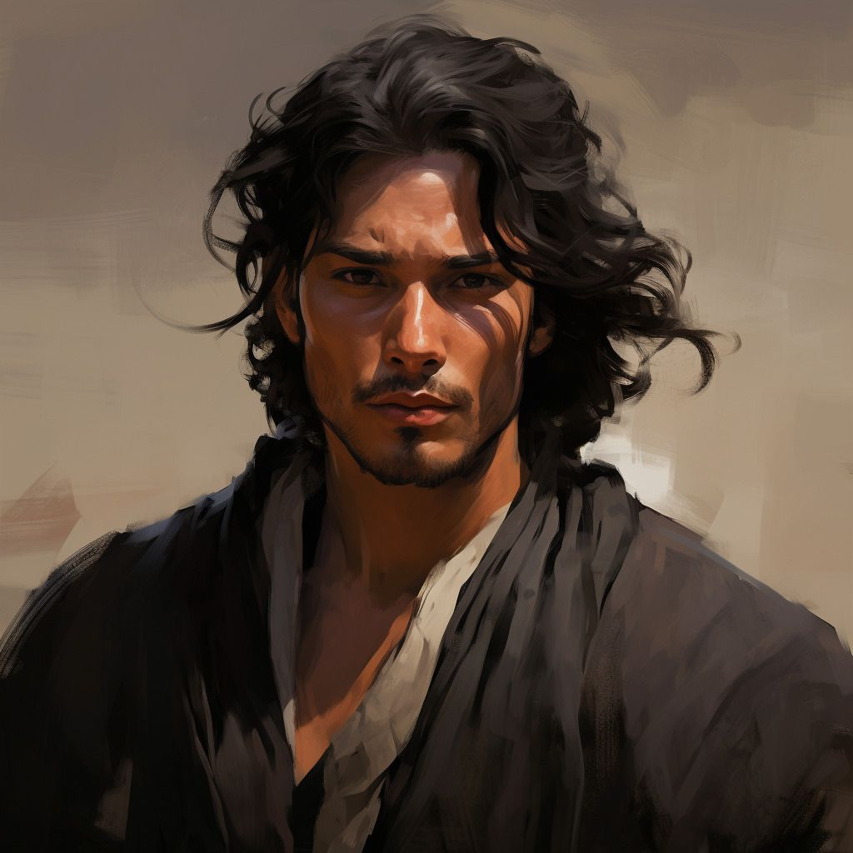
1st Year of the Reign of the Judges
Nehor became popular with some people in Zarahemla.
He preached his own gospel
He created his own set of values contrary to the teachings of King Mosiah
He preached salvation for all, no matter what
Alma 1:1-3

Slide 9
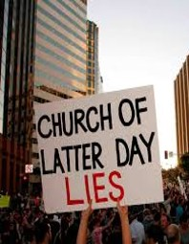
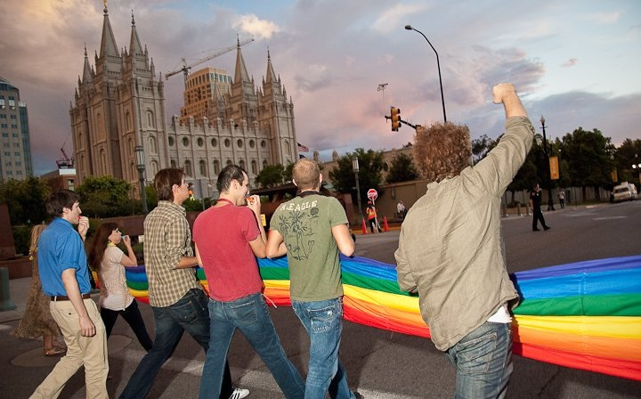
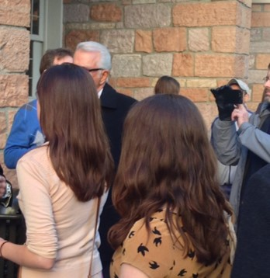
An Object of Ridicule
The Church is in constant attack of the public and ridiculed for many things
Signs held up during Conference
Family Values
Women and the priesthood sessions
Prop “8”

Slide 10
Priestcraft—Labor for Money
The Book of Mormon says, "Priestcrafts are that men preach and set themselves up for a light unto the world, that they may get gain and praise of the world; but they seek not the Welfare of Zion…. But the laborer in Zion shall labor for Zion; for if they labor for money they shall perish".
Inherent in this definition is the concern that Church leaders must labor to build Zion into the hearts of the people, and not for their personal aggrandizement or reward. When leaders "make merchandise" of men's souls, they turn religion into a business, and pride, materialism, and unrighteous dominion follow.
Bible Dictionary
Those:
Eager to get gain
Eager to receive applause of the crowd
Eager for recognition and reward
Alma 1:3; 2 Nephi 26:29, 31; 2 Peter 2:3

Slide 11
Priestcraft VS Priesthood
Those who practice priestcraft
Alma 1:3
Seek popularity
Alma 1:6
Wear costly apparel
Alma 1:16
Teach false doctrines to gain riches and honor
Alma 1:19-20
Persecute the righteous
Those who exercise the priesthood
Alma 1:20
Live with humility and share the gospel without seeking personal gain
Alma 1:26
View others as equal to themselves
Alma 1:27
Do not wear costly apparel but dress neatly (and within their means)
Alma 1:30
Treat all people kindly and compassionately
Those who did not belong to the Church
Those who practiced their faith

Slide 12
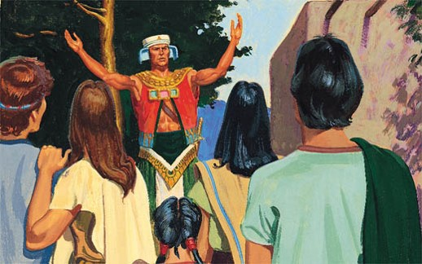
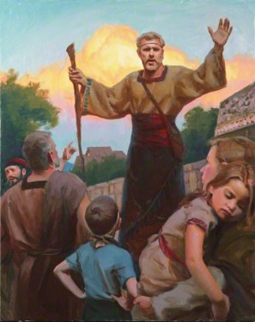
Salvation to All
“Nehor’s doctrine would be very popular among many of our own day.
Nehor preached against guilt and shame
People in Ammonihah:
“But as to the people that were in the land of Ammonihah, they yet remained a hard-hearted and a stiffnecked people; and they repented not of their sins, ascribing all the power of Alma and Amulek to the devil; for they were of the profession of Nehor, and did not believe in the repentance of their sins.”
Alma 1:4; Alma 15:15

Slide 13
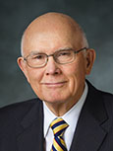
Satan uses lies mixed with truth to deceive people
“Satan is the great deceiver, the father of lies.
This is not because Satan tells only lies. His most effective lies are half-truths or lies accompanied by the truth.”
Alma 1:4; John 8;44
Dallin H. Oaks

Slide 14
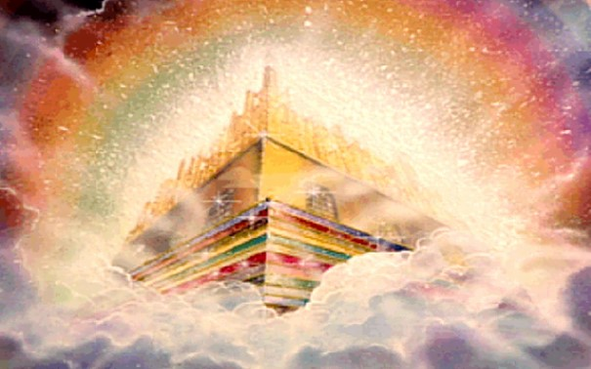
“Pleasing to the Carnal Mind”
Why would people believe him?
Perhaps it was his system of salvation was so easy, his promise of eternal reward was so attractive, his demands so few.
He denied prophecy and revelation and thus found no place for absolute values or absolute truth.
What consequences could come to a person who believes this doctrine?
How did Nehor’s success affect him?
Alma 1:5

Slide 15
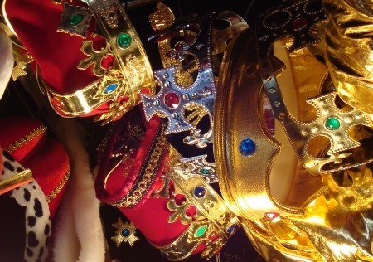
Consequences
In the true Church, doctrines and beliefs and practices are based not upon the whims and ways of the congregants, or even of its leaders, but rather upon prophecy and revelation, upon truth, upon things as they were and are and are to come D&C 93:24
False Churches are built upon false principles and false practices
Lifted up in Pride
Wear costly apparel—symbol of submission to the world’s standards
Alma 1:6

Slide 16
Gideon
He was strong military leader in the army of King Noah
He rose to take action against evil
He came with King Limhi and his people to the Land of Zarahemla
He became a teacher of the people in the Church of God
Around 91 BC he challenged arrogant zealot Nehor “with the words of God” (Alma 1:9)
Nehor slew Gideon with the sword
He gave his life in defending the truth
Who’s Who

Slide 17
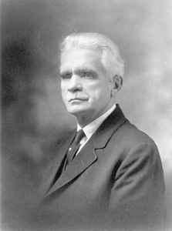
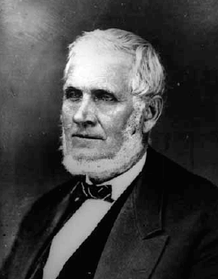
Defenders of the Truth
Gideon defends truth and righteousness
B.H. Roberts
A Great Defender of the Book of Mormon
Born in 1857— Wolverhampton, England
At age 5 his covenant mother left him in foster care and immigrated to the states
At age 10 he too reached Utah and moved from one mining camp to another, remaining illiterate until his mid-teens.
His only formal schooling was one year at the University of Deseret.
He became the author of the 6 volume, 3,400-page Comprehensive History of the Church of Jesus Christ of Latter-day Saints: Century I
John Taylor
Defender of the principles of the gospel
He became known as ‘Defender of the Faith’ and also as the ‘Champion of Liberty’”
In his courage and faithfulness, we learn how to respond, how to be faithful, and we find how to become defenders of the faith and champions of righteousness ourselves.
Alma 1:7

Slide 18
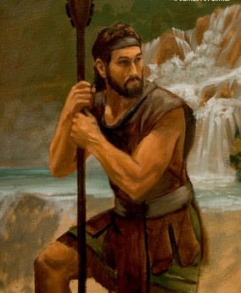
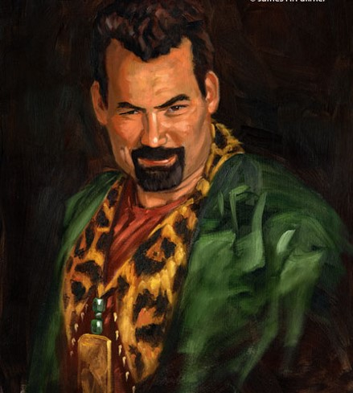
Gideon Defends the Truth
“…he [Nehor] met a man who belonged to the church of God, yea, even one of their teachers; and he began to contend with him sharply, that he might lead away the people of the church; but the man withstood him, admonishing him with the words of God.
James H. Fullmer
Now the name of the man was Gideon; and it was he who was an instrument in the hands of God in delivering the people of Limhi out of bondage.
Now, because Gideon withstood him with the words of God he was wroth with Gideon, and drew his sword and began to smite him. Now Gideon being stricken with many years, therefore he was not able to withstand his blows, therefore he was slain by the sword.”
James H. Fullmer
Alma 1:7-9

Slide 19
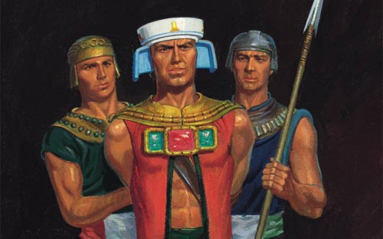
Punishment for Murder
Nehor was taken for murder to stand in judgment to Alma
Alma had said that this was the first time that priestcraft had been introduced to the people.
Alma condemns Nehor to die according to the laws—he suffered an “ignominious” death.
Alma 1:11-15

Slide 20
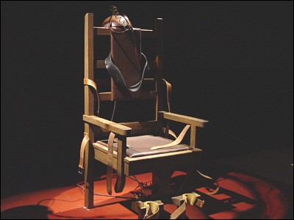
Capital Punishment
In 1889 the First Presidency and the Quorum of the Twelve Apostles published an official declaration on capital punishment:
“We solemnly make the following declarations, viz.:
“That this Church views the shedding of human blood with the utmost abhorrence. That we regard the killing of human beings, except in conformity with the civil law, as a capital crime which should be punished by shedding the blood of the criminal, after a public trial before a legally constituted court of the land. …
“… Offenders against life and property [should] be delivered up to and tried by the laws of the land”
The Church has recently published the following official statement on capital punishment: “The Church of Jesus Christ of Latter-day Saints regards the question of whether and in what circumstances the state should impose capital punishment as a matter to be decided solely by the prescribed processes of civil law. We neither promote nor oppose capital punishment” July 23, 2012
(“Official Declaration,” Millennial Star, Jan. 20, 1890, 33–34).

Slide 21
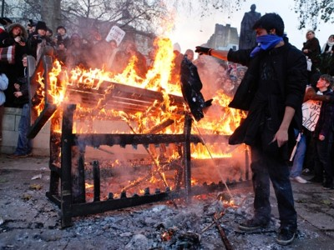
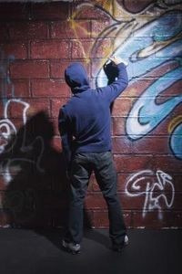
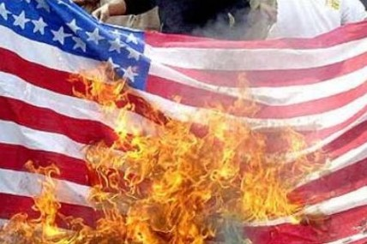
Separate
The law could have no power on any man for his belief…
Although one could believe as one pleased, it appears that when one’s false teachings were translated into actions that violated the laws of society, such a person was liable to prosecution.
Alma 1:17

Slide 22
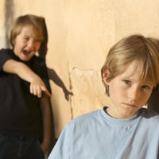
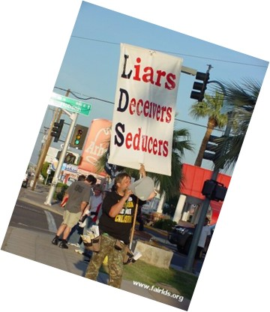
Contention and Persecution
When have you seen people tease, mock, or persecute those who keep the commandments of God?
Have you ever felt teased, mocked, or persecuted for keeping the commandments? If so, how did you respond?
Those who did not belong to the Church began to persecute those that belonged to the Church by their words
Alma 1:19-20

Slide 23
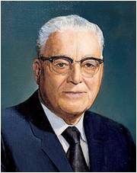
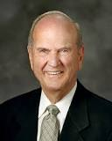
“To be persecuted for righteousness sake in a great cause where truth and virtue and honor are at stake is god-like. … The great harm that may come from persecution is not from the persecution itself but from the possible effect it may have upon the persecuted who may thereby be deterred in their zeal for the righteousness of their cause. Much of that persecution comes from lack of understanding, for men are prone to oppose that which they do not comprehend. Some of it comes from men intent upon evil. But from whatever cause, persecution seems to be so universal against those engaged in a righteous cause. …
“… If you stand firmly for the right despite the jeers of the crowd or even physical violence, you shall be crowned with the blessedness of eternal joy. Who knows but that again in our day some of the saints or even apostles, as in former days, may be required to give their lives in defense of the truth? If that time should come, God grant they would not fail!” Harold B. Lee
“Difficult days are ahead. Rarely in the future will it be easy or popular to be a faithful Latter-day Saint. Each of us will be tested. The Apostle Paul warned that in the latter days, those who diligently follow the Lord ‘shall suffer persecution’ [2 Timothy 3:12]. That very persecution can either crush you into silent weakness or motivate you to be more exemplary and courageous in your daily lives”
Russell M. Nelson

Slide 24
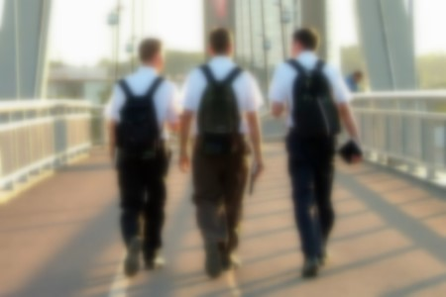
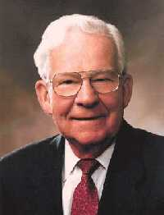
Truth Stands on it’s Own
Saints are not called to malign or attack the faith and religious persuasions of others.
“Therefore, strengthen your brethren in all your conversation, in all your prayers, in all your exhortations, and in all your doings.”
D&C 108:7
Hand in Hand
We claim the privilege of worshiping Almighty God according to the dictates of our own conscience, and allow all men the same privilege, let them worship how, where, or what they may.
We believe in being subject to kings, presidents, rulers, and magistrates, in obeying, honoring, and sustaining the law.
or persecute those who keep the commandments of God?
Articles of Faith 1:11-12
“We have no time for contention. We only have time to be about our Father’s business”
Marvin J. Ashton
Alma 1:21

Slide 25
For Arguments Sake?
It is the spirit of pride that motivates some of the Saints to contend warmly with nonmembers
To argue and debate the meaning of scriptures, to fight and quarrel with those of our Father’s children who might choose not to affiliate with the true Church…
Such a spirit is not of God but is indeed of the devil, who stirs up people to contend one with another.
Even though our message to the world is true; even though what we declare will sanctify and save all who accept and follow it; even though the Lord himself is in this work—notwithstanding all this, the spirit cannot and will not abide with those who seek by argument or heated discussion to establish the truth of spiritual matters.
Alma 1:22-24; 3 Nephi 11:28-30 JFM and RLM

Slide 26
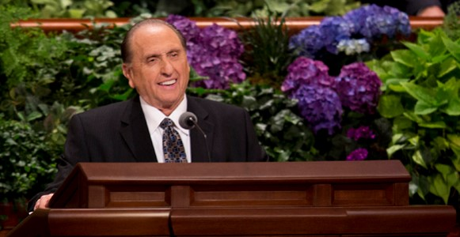
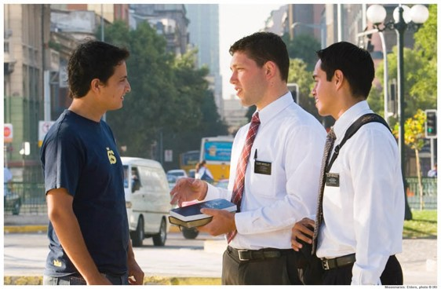
What Can We Do?
We teach and we testify.
We bear witness.
We speak with sincerity.
We plead with our listeners to give heed to our words, to ponder them, and to petitions the heavens…the truth,
…but we do not…argue endlessly and quarrel…
these lose the Spirit of God and become an
easy prey to the arch-deceiver. Before they are
aware, they lose their souls.
Alma 1:22-24 JFM and RLM

Slide 27
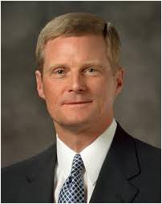
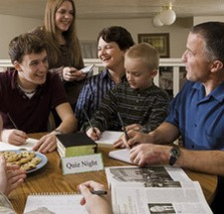
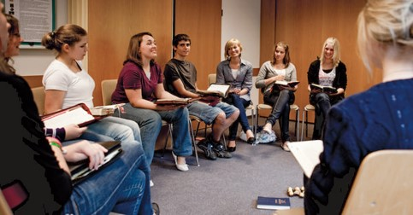
“Anything you or I do as instructors that knowingly and intentionally draws attention to self—in the messages we present, in the methods we use, or in our personal demeanor—is a form of priestcraft that inhibits the teaching effectiveness of the Holy Ghost”
David A. Bednar
Where Can You Teach and Testify?
Seminary
Quorums and classes
Family Home Evening
Sacrament talks
Home teaching
Share the gospel with friends

Slide 28
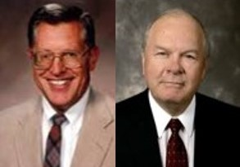
Individual Agency of Others
It is not easy to stand by and watch friends and loved ones, former members of the household of faith, lose the Spirit and eventually forsake the faith.
It is painful to observe people as they spiritually self destruct, but after all efforts to plead and persuade have failed we must allow for individual agency.
We must bear with patience the persecutions and taunts of others.
JFM and RLM
Alma 1:25

Slide 29
Choosing to contend with those who are not members of the Church can bring afflictions and trials upon the Church
If we are humble during persecution, our hearts will not be hardened by our experiences
Even when people around us are being disobedient, we can be steadfast and immovable in keeping the commandments
We can choose to bear persecution with patience
Alma 1:25

Slide 30
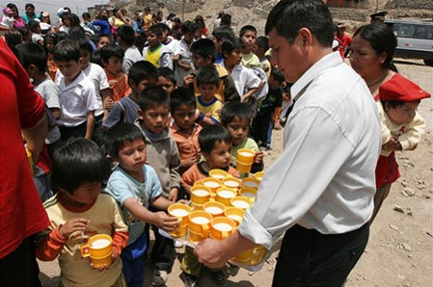
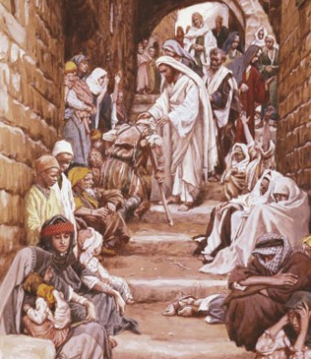
The Priest’s Labors
The people left their labors to hear the word of God
“And they did impart of their substance, every man according to that which he had, to the poor, and the needy, and the sick, and the afflicted; and they did not wear costly apparel, yet they were neat and comely.
And thus they did establish the affairs of the church; and thus they began to have continual peace again, notwithstanding all their persecutions.”
Alma 1:27-28

Slide 31
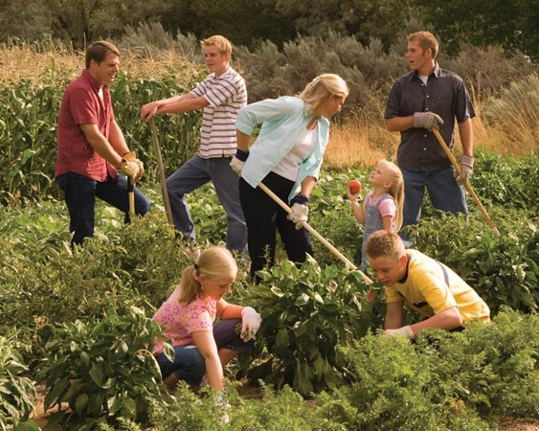
Steadfastness of the Faithful
They began to prosper
“…they did not send away any who were naked, or that were hungry, or that were athirst, or that were sick, or that had not been nourished; and they did not set their hearts upon riches; therefore they were liberal to all, both old and young, both bond and free, both male and female, whether out of the church or in the church, having no respect to persons as to those who stood in need.
And thus they did prosper and become far more wealthy than those who did not belong to their church.”
Alma 1:30-31

Slide 32
Those Not of the Church
Indulged in:
Sorceries
Idolatry
Idleness
Babbling
Envying
Strife
Wore costly apparel
Lifted up in pride
Persecuted
Lied
Stole
Committed whoredoms
Murdered
The Law was put into force:
Everyman suffered according to that which he had done…
Because of this the wicked became “more still, and durst not commit any wickedness if it were known”
--the unknown crime
There was peace with the Nephites until the 5th year of the reign of the judges
Alma 1:32-33

Slide 33
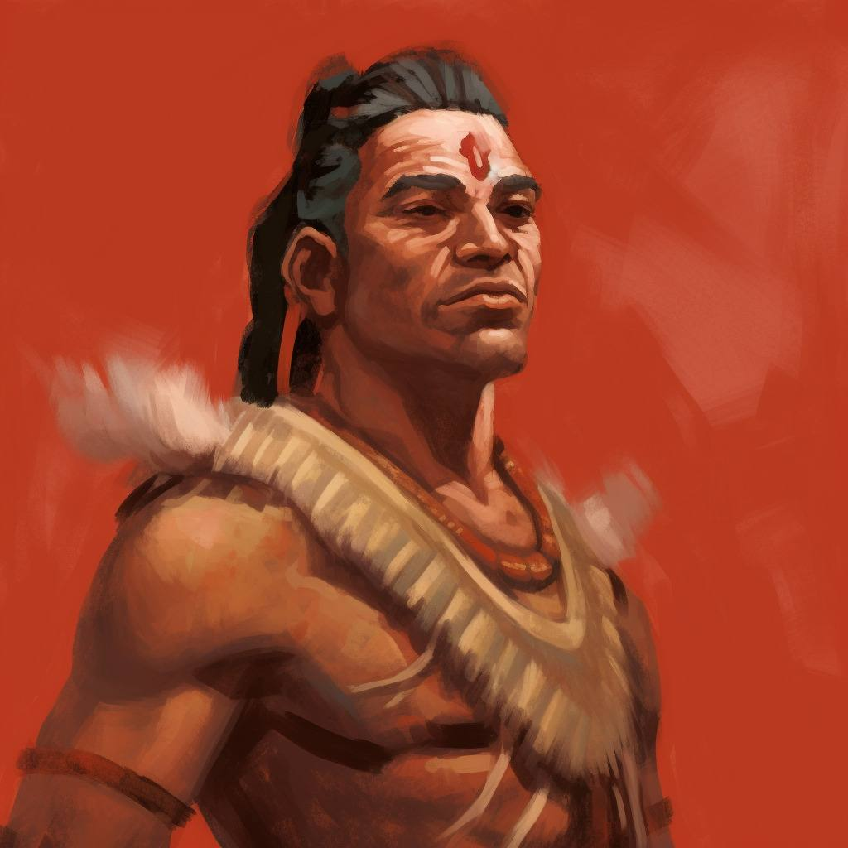
Four Years of Peace
There was much peace with the Nephites until the 5th year of the reign of the judges
However, after Nehor’s death, the Nephites face another wicked man
“…for a certain man, being called Amlici, he being a very cunning man, yea, a wise man as to the wisdom of the world, he being after the order of the man that slew Gideon by the sword, who was executed according to the law—
Now this Amlici had, by his cunning, drawn away much people after him; even so much that they began to be very powerful; and they began to endeavor to establish Amlici to be a king over the people.”
Alma 2:1-2

Slide 34
Amlici
He was a Nephite dissenter during Alma the Younger’s time
He was a man after the “order of Nehor”
He was cunning and wise of the wisdom of the world
He attracted a powerful group who wanted to make him their king
The voice of the Nephites rose up against him
He rose up arms against them, but Alma’s army, after many prayers, were “strengthen”
He made an alliance with the Lamanites
The people who followed him were called “Amlicites”
The Amlicites and Lamanites battled against the Nephites
He was killed by the sword of Alma
Who’s Who

Slide 35
Zeram, Amnor, Manti, and Limher
They were the watchmen (spies) sent by Alma to discover the location of Amlici in about 87 BC
They all returned to inform Alma that Amlici had united with the Lamanites who were descending with a massive army upon the Nephites
Who’s Who

Slide 36
v
The Daily News
Page 1
87 BC
Persecutions Arise
Amlici Gains Followers—Wants to Be King
Alma Takes Action
Church Alarmed
Amlici, he being after the order of Nehor, who had killed Gideon by the sword, has gained followers and they, the followers, want Amlici to be their king.
The people who follow Amlici want to be known as the Amlicites instead of Nephites.
The Amlicites went before the judge, Alma, to be a voice concerning this matter. The Nephites also went before the judge to petition Alma to not have Amlici as their king. Despite the outcome, the Amlicites consecrated Amlici to be their king.
Due to the uprising of the Amlicites preparing for war with the Nephites, Alma also prepares for battle.
Since the Amlicites moved themselves to Hill Amnihu to prepare for war the Nephites with the “strength of God” killed 12,532 Amlicites, while 6,562 men were killed from the Nephite army.
Alma sends Zeram, Amnor, Manti, and Limher to spy on the Amlicites. They discover the people have joined with the Lamanites.
People of the church express their opinions in a much heated debate about the persecutions of Amlici and his followers.
The people express their rights as a voice of the people according to the law. They fear if Amlici gains favor of many he and his followers will deprive them of their rights and privileges of the church, and they fear that Amlici would destroy the church of God.
Alma Kills Amlici
Alma fought with Amlici with the sword, face to face. After a long battle, Alma prays, “O Lord, have mercy and spare my life, that I may be an instrument in they hands to save and preserve this people.” With strength Alma kills Amlici. His prayers are heard, and he and his people were able to drive back the army of the Lamanites and the Amlicites. They fled into the wilderness where the bodies of the dead were devoured by beasts, and vultures of the air. There were many bones found in heaps on the earth.

Slide 37
Calling on the Lord for Strength
When we call upon God to help us stand against wickedness, He will strengthen us
Why do you think it is important to receive strength from God to stand against wickedness rather than having wicked influences removed completely from our lives?
How can you follow Alma’s example when you stand against wickedness?
How has the Lord strengthened you as you have faced wickedness?
What is one way you can stand against wickedness now?

Slide 38
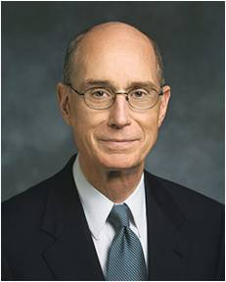
Test of Strength
“Knowing why we are tested and what the test is tells us how to get help. We have to go to God. He gives us the commandments. And we will need more than our own strength to keep them.
…The first, the middle, and the last thing to do is to pray.
…Another simple thing to do, which allows God to give us strength, is to feast on the word of God: read and ponder the standard works of the Church and the words of living prophets.
There is a promise of help from God that comes with that daily practice. Faithful study of scriptures brings the Holy Ghost to us. The promise is given in the Book of Mormon, but it applies as well to all the words of God that He has given and will give us through His prophets.
…There is another simple thing to do. The Lord’s Church has been restored, and so any call to serve in it is a call to serve Him.”
Henry B. Eyring

Slide 39
Sources:
Who’s Who In the Book of Mormon Ed J. Pinegar and Richard J. Allen pgs. 17, 22. 58-59, 112-113, 117,136-137
Truman G Madsen about B.H. Roberts Comprehensive History of the Church (1930), the editor of the seven-volume “documentary” History of the Church (1902–1932), and the author of the three-volume New Witnesses for God (1909)
(Emerson Roy West, Profiles of the Presidents, rev. ed. [Salt Lake City: Deseret Book Co., 1980], p. 90).
John Taylor The Presidents of the Church: Teacher’s Manual (Emerson Roy West, Profiles of the Presidents, rev. ed. [Salt Lake City: Deseret Book Co., 1980], p. 90).
Dallin H. Oaks, “Reading Church History” [address to Church Educational System religious educators, Aug. 16, 1985], 3
Joseph Fielding McConkie and Robert L. Millet Doctrinal Commentary on the Book of Mormon Vol. 3 Pgs. 5-8
Truman G. Madsen B. H. Roberts after Fifty Years: Still Witnessing for the Book of Mormon December 1983 Ensign
"Lesson 13: John Taylor—Defender of the Faith," The Presidents of the Church: Teacher’s Manual, (1996)
1889 Official Declaration on Capital Punishment (newsroom.lds.org/official-statement/capital-punishment; accessed July 23, 2012).
Marvin J. Aston Conference Report April 1978, p. 9
David A. Bednar (“Seek Learning by Faith,” Ensign, Sept. 2007, 66–67).
Harold B. Lee (Decisions for Successful Living [1973], 61–62).
Russell M. Nelson(“Face the Future with Faith,” Ensign or Liahona, May 2011, 35–36).
Henry B. Eyring In the Strength of the Lord April 2004 General Conference
Presentation by ©http://fashionsbylynda.com/blog/

Slide 40
The Daily News
Page 1
87 BC

Slide 41
The Choice is Yours
Alma 3-4

Slide 42
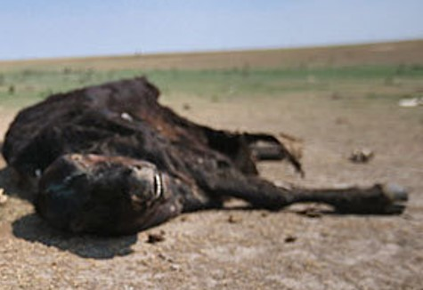
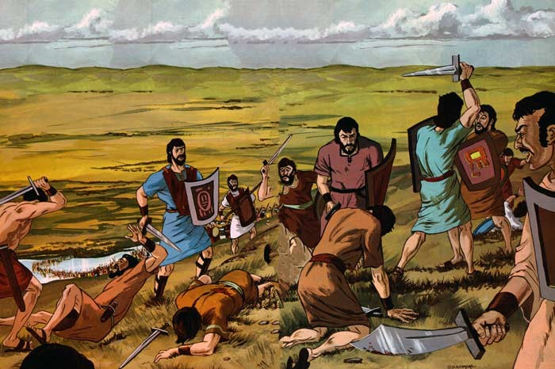
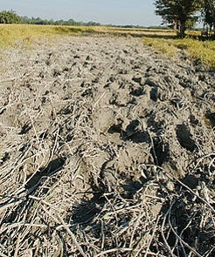
Trodden Down by the Hosts of Men
Many women and children had been slain, their flocks and their herds, and the fields of grain were destroyed
Alma 3:2

Slide 43
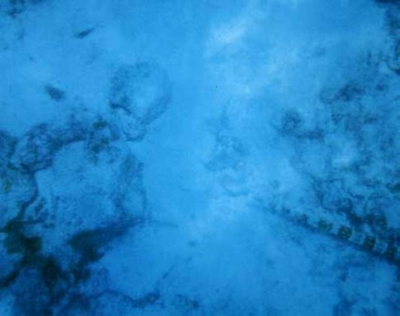
The Waters of Sidon
Many Lamanites and Amlicites who were slain were cast into the River
Alma 3:3

Slide 44
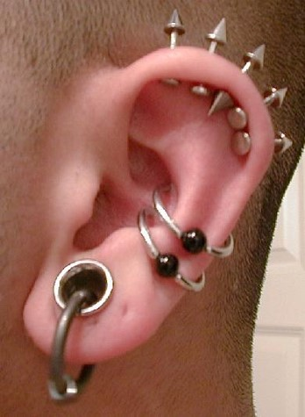
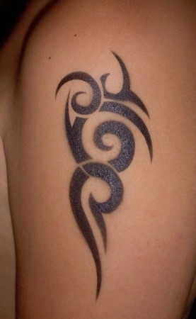
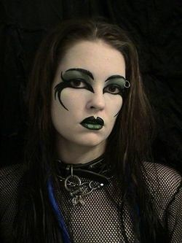
Messages
What Messages might one send, either intentionally or unintentionally

Slide 45
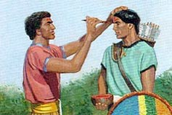
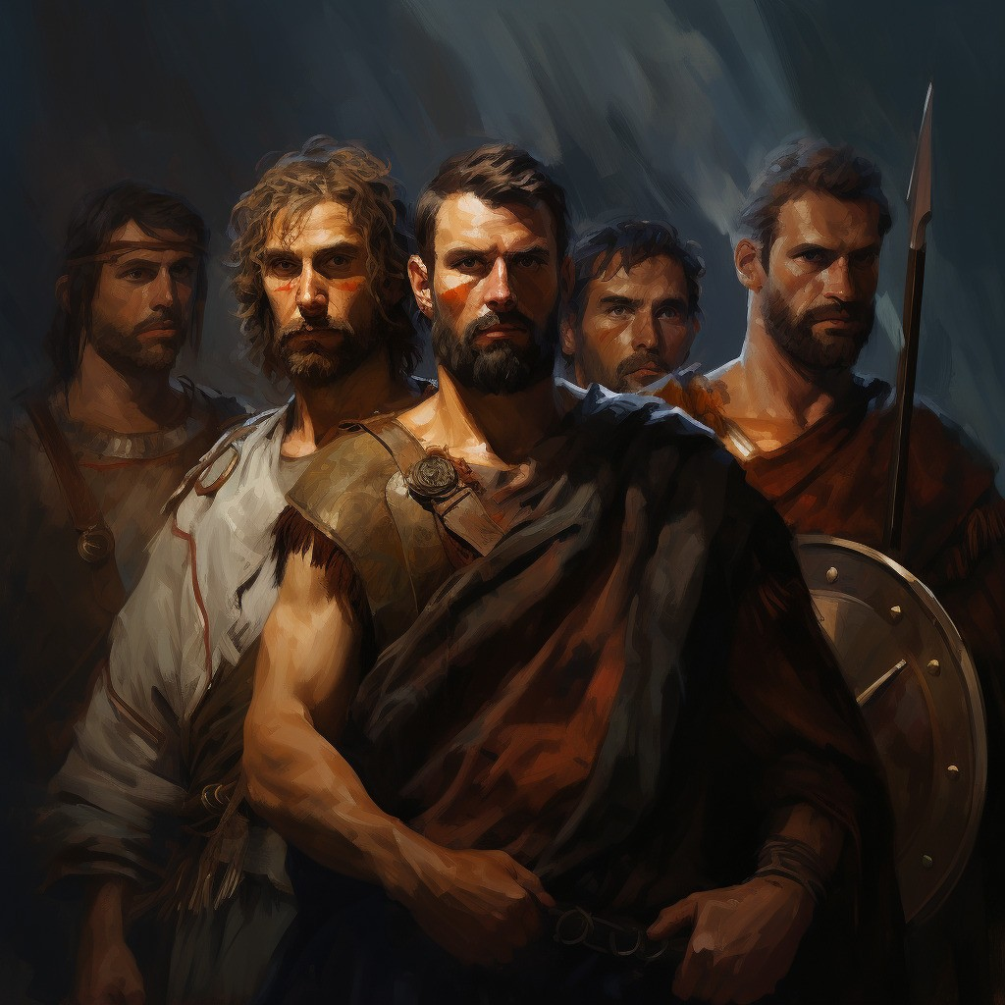
Change of Appearance
The Amliciites had marked themselves with red in their foreheads after the manner of the Lamanites
Alma 3:4

Slide 46
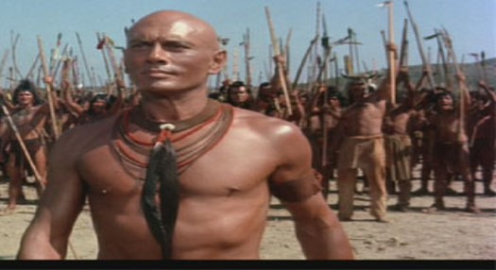
The Appearance of the Lamanites
“Now the heads of the Lamanites were shorn; and they were naked, save it were skin which was girded about their loins, and also their armor, which was girded about them, and their bows, and their arrows, and their stones, and their slings, and so forth.
And the skins of the Lamanites were dark, according to the mark which was set upon their fathers, which was a curse upon them because of their transgression and their rebellion against their brethren, who consisted of Nephi, Jacob, and Joseph, and Sam, who were just and holy men.”
Alma 3:5-6

Slide 47
The Curse — their own doing
Those who mingled with the seed of the Lamanites brought that same curse upon themselves
God set the mark of the dark skin upon the Lamanites
While the people of Amlici marked themselves with red
Those who come out in open rebellion against God bring negative consequences upon themselves
Alma 3:5-6

Slide 48
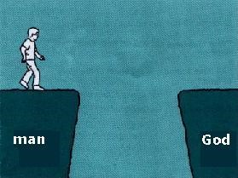
Curses-- Opposite of Blessings
“Now I would that ye should see that they brought upon themselves the curse; and even so doth every man that is cursed bring upon himself his own condemnation.”
If we are separated from God, it is because we have separated ourselves from Him
Alma 3:19

Slide 49
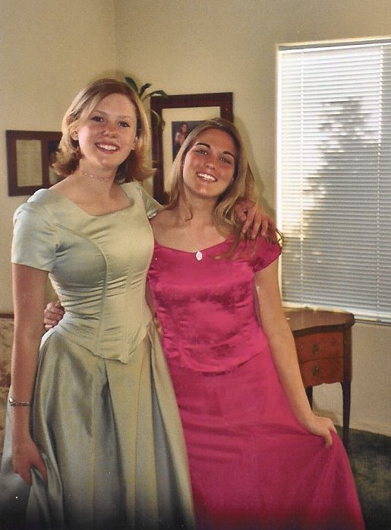
Our Own Appearance
What are some ways we can show through our dress and appearance that we are disciples of Jesus Christ?
Alma 3:19

Slide 50
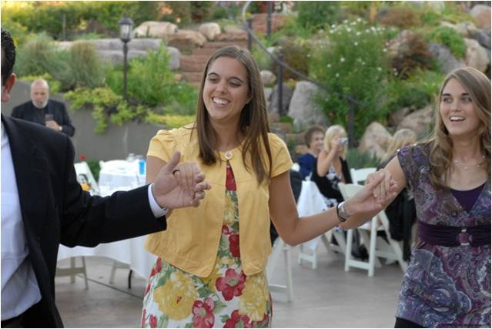
For the Strength Youth
Your body is sacred. Respect it and do not defile it in any way. Through your dress and appearance, you can show that you know how precious your body is. You can show that you are a disciple of Jesus Christ and that you love Him.
Prophets of God have continually counseled His children to dress modestly. When you are well groomed and modestly dressed, you invite the companionship of the Spirit and you can be a good influence on others. Your dress and grooming influence the way you and others act.
Never lower your standards of dress. Do not use a special occasion as an excuse to be immodest. When you dress immodestly, you send a message that is contrary to your identity as a son or daughter of God. You also send the message that you are using your body to get attention and approval.
Page 6-8

Slide 51
Choosing Sides
“And in one year were thousands and tens of thousands of souls sent to the eternal world, that they might reap their rewards according to their works, whether they were good or whether they were bad, to reap eternal happiness or eternal misery, according to the spirit which they listed to obey, whether it be a good spirit or a bad one.
For every man receiveth wages of him whom he listeth to obey, and this according to the words of the spirit of prophecy; therefore let it be according to the truth…”
We receive happiness or misery depending on whom we choose to obey
Alma 3:26-27

Slide 52
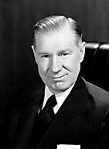
We as individual members of the Church also have identity of our own. Each of us stands for something, either strong or not strong; either good or not so good.
In Revelation there is a strong warning to the fence sitters:
“I know thy works, that thou art neither cold nor hot: I would thou wert cold or hot.
“So then because thou art lukewarm, and neither cold nor hot, I will spue thee out of my mouth.” (Rev. 3:15, 16)
From that and many other experiences, I learned that even though others do not share your beliefs, in fact may be hostile to them, they will respect you if you are willing to stand up and be counted.
Almost. What a heartbreaking sound is the word “almost”! Almost some of our good members keep the Word of Wisdom, or just about go to priesthood meeting and sacrament meeting, or almost hold family home evening. Some of us almost but not quite—pay our tithing.
Elder James E. Faust

Slide 53
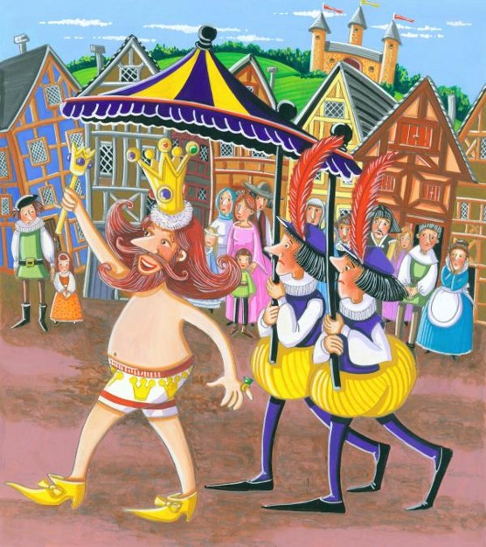
Inward Appearances
We cannot hide what we are, try as we will. It shines from within us. We are transparent. When we attempt to deceive, we deceive only ourselves. We are like the emperor in the fairy tale who was deceived into thinking he was arrayed in beautiful garments, but he was in fact unclothed.
Those who stand firm, steadfast, and immovable are given great inner hidden powers and unseen strengths. They will be endowed with full and potent spiritual resources.
Elder James E. Faust

Slide 54
6th Year of the Reign of the Judges
‘Afflicted and caused to morn’
It is normal and natural when things go wrong to begin to search for causes, to begin to look careful at one’s attitudes and behaviors to ascertain whether one has offended God. If a person is sincere in his searching, if he asks God to reveal his weakness, if he is indeed open enough to ask, “What lack I yet?” the Lord can awaken him to a remembrance of his duty.
The Spirit of Jesus Christ can bring a remembrance of commitments and covenants.
JFM and RLM
Alma 4:1-3

Slide 55
Humble--Teachable
To be teachable and to recognize with gratitude our dependence on the Lord—to understand that we have constant need for His support
God will have a humble people. Either we can choose to be humble or we can be compelled to be humble. Alma said, “Blessed are they who humble themselves without being compelled to be humble.” (Alma 32:16.)
We must yield “to the enticings of the Holy Spirit,” put off the prideful “natural man,” become “a saint through the atonement of Christ the Lord,” and become “as a child, submissive, meek, humble.”
(Mosiah 3:19; see also Alma 13:28.)
Alma 4:1-5

Slide 56
We can choose to humble ourselves by conquering enmity toward our brothers and sisters, esteeming them as ourselves, and lifting them as high or higher than we are.
We can choose to humble ourselves by receiving counsel and chastisement.
We can choose to humble ourselves by forgiving those who have offended us.
We can choose to humble ourselves by rendering selfless service.
We can choose to humble ourselves by going on missions and preaching the word that can humble others.
We can choose to humble ourselves by getting to the temple more frequently.
We can choose to humble ourselves by confessing and forsaking our
sins and being born of God.
We can choose to humble ourselves by loving God, submitting our
will to His, and putting Him first in our lives.
Ezra T. Benson

Slide 57
8th Year of the Reign of the Judges
Pride
People who are proud place themselves in opposition to each other and to God. They place themselves above those around them and follow their own desires rather than God’s will.
“Some prideful people are not so concerned as to whether their wages meet their needs as they are that their wages are more than someone else’s. Their reward is being a cut above the rest. This is the enmity of pride.
When pride has a hold on our hearts, we lose our independence of the world and deliver our freedoms to the bondage of men’s judgment. The world shouts louder than the whisperings of the Holy Ghost. The reasoning of men overrides the revelations of God, and the proud let go of the iron rod. ”
Ezra T. Benson
Alma 4:6

Slide 58
Pride is a sin that can readily be seen in others but is rarely admitted in ourselves.
“Pride is:
Faultfinding, gossiping, backbiting, murmuring, living beyond our means, envying, coveting, withholding gratitude and praise that might lift another, and being unforgiving and jealous.
Disobedience is essentially a prideful power struggle against someone in authority over us. It can be a parent, a priesthood leader, a teacher, or ultimately God.
A proud person hates the fact that someone is above him. He thinks this lowers his position.
Selfishness is one of the more common faces of pride. “How everything affects me” is the center of all that matters—self-conceit, self-pity, worldly self-fulfillment, self-gratification, and self-seeking.
Contentions and arguments, fights, unrighteous dominion, generation gaps, divorces, spouse abuse, riots, and disturbances all fall into this category of pride.
The proud do not receive counsel or correction easily. Defensiveness is
used by them to justify and rationalize their frailties and failures.
Depending upon the world to tell them whether they have value or not.”
Ezra T. Benson

Slide 59
An Example
If we set an unrighteous example, our actions can hinder others from accepting the gospel
Our best example is the way Jesus Christ led His life.
Alma 4:10-12

Slide 60
Calling People to Repent
Alma Resigns as Chief Judge
He remains High Priest
He commits himself to preaching the word of God
He appoints Nephihah over the judgment seat
Alma 4:15-20

Slide 61
Nephihah
He is the 2nd chief judge in Zarahemla around 83 BC
He was a wise man who was among the elders of the Church
Alma gave him power by the authority of the voice of the people
He served in his public leadership until his death around 67 BC
He was involved in the invasion of the Lamanite, and in the Lamanite conversion
During his tenure the people increase in their commercial ventures and prosperity
He declined Alma’s offer to manage the sacred records, so the records were conferred upon Alma’s son, Helaman
Pahoran, son of Nephihah, succeeded his father as chief judge and governor of the land
Who’s Who

Slide 62
Bear Down in Pure Testimony
“Alma was determined to bear down in pure testimony against the people. His expressions were not motivated by anger or spite, nor directed against the people in the spirit of condemnation. Rather, his heart—motivated by the pure love of Christ—was bent upon saving their souls. He loved them and simply could not stand by and allow them to destroy themselves.”
JFM and RLM
Would you change your position or your circumstances for the betterment of someone else's salvation?
Alma 4:20

Slide 63
Sources:
Elder James E. Faust Stand Up and Be Counted 1982 Feb. Ensign
Joseph Fielding McConkie and Robert L. Millet Doctrinal Commentary on the Book of Mormon Vol. 3 pg. 18-19
Ezra Taft Benson Beware of Pride April 1989 Conf. Report (Read whole Article)
Who’s Who in the Book of Mormon Ed. J. Pinegar and Richard J. Allen pg 145
Presentation by ©http://fashionsbylynda.com/blog/

