Slide 1
Alma 53-63

Slide 2
Alma 53-55

Slide 3
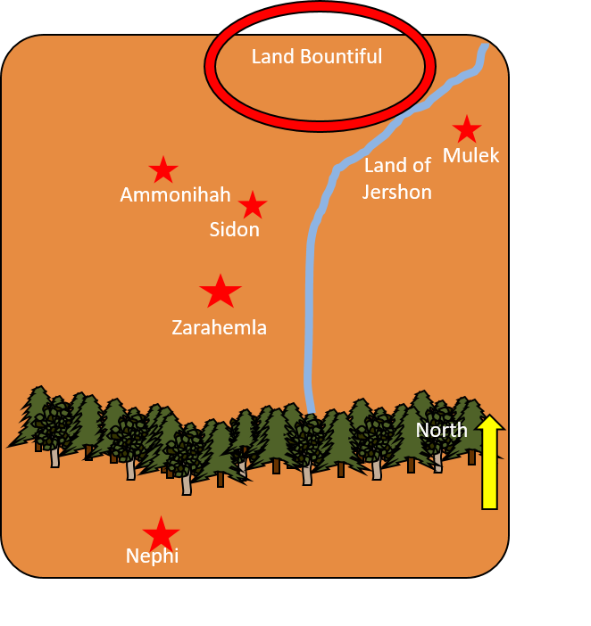
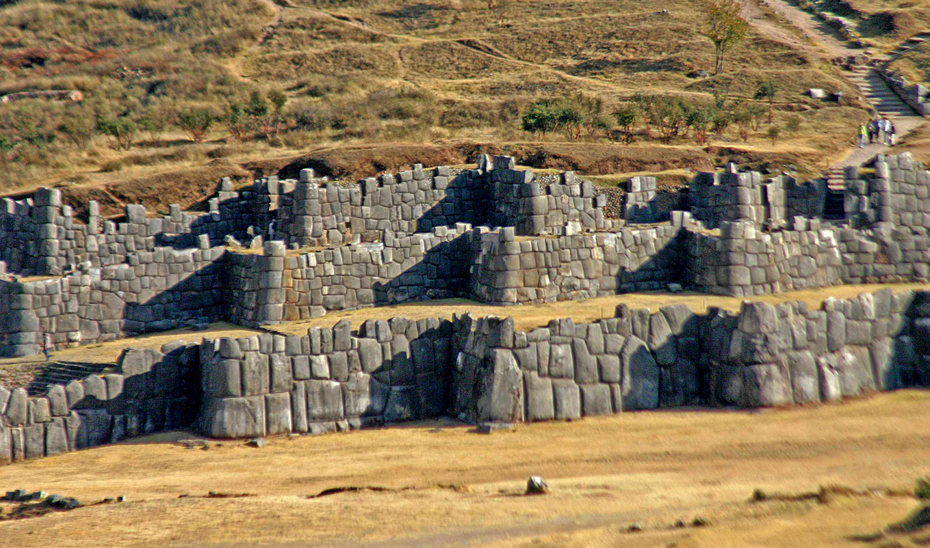
Keeping the Prisoners Busy
Moroni had the Lamanites bury their dead and the dead of the Nephites and placed guards over them
Moroni and Lehi went to the city of Mulek
Building the Stronghold of the Land Bountiful
The prisoners also labored in digging a ditch around the land Bountiful
They also built timbers upon the inner bank of the ditch
The three-tiered, zig-zagged defensive walls at Sacsayhuaman, overlooking the city of Cuzco
Moroni had a stronghold built to retain the prisoners
Alma 53:1-9

Slide 4
The People Of Ammon
Recap:
They were Lamanites converted by Ammon and his brethren and they were brought to the land of Zarahemla and given the land of Jershon to live. They refused to go into battle, ‘taking an oath’ having buried their weapons of war.
They were moved back to Zarahemla during the war between the Nephites and the Lamanites into the city of Zarahemla and protected by the Nephites.
Alma 53:10-15

Slide 5
Sons of the people of ammon
“But behold, it came to pass they had many sons, who had not entered into a covenant that they would not take their weapons of war to defend themselves against their enemies; therefore they did assemble themselves together at this time, as many as were able to take up arms, and they called themselves Nephites.”
“And they entered into a covenant to fight for the liberty of the Nephites, yea, to protect the land unto the laying down of their lives; yea, even they covenanted that they never would give up their liberty, but they would fight in all cases to protect the Nephites and themselves from bondage.”
Alma 53:16-18

Slide 6
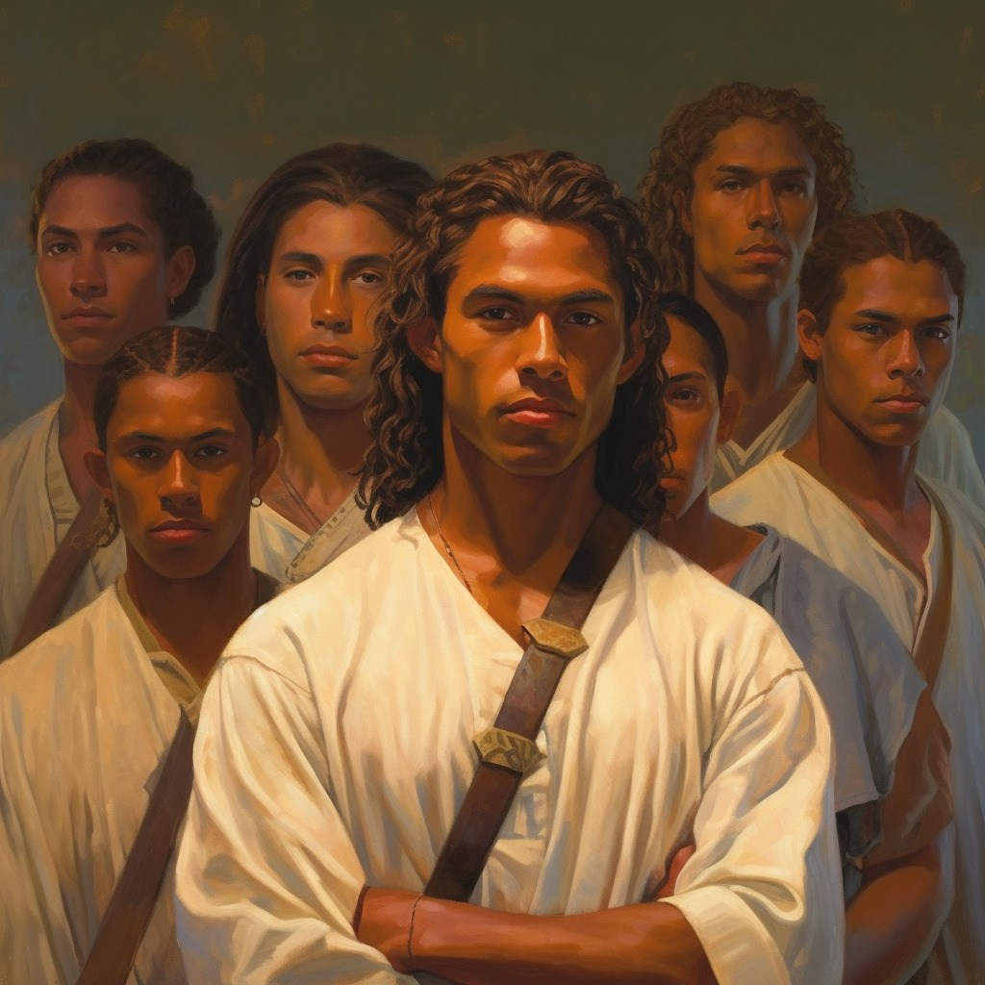
2,000—Helaman the Leader
“And they were all young men, and they were exceedingly valiant for courage, and also for strength and activity; but behold, this was not all—they were men who were true at all times in whatsoever thing they were entrusted.”
“Yea, they were men of truth and soberness, for they had been taught to keep the commandments of God and to walk uprightly before him.”
Alma 53:18-21

Slide 7
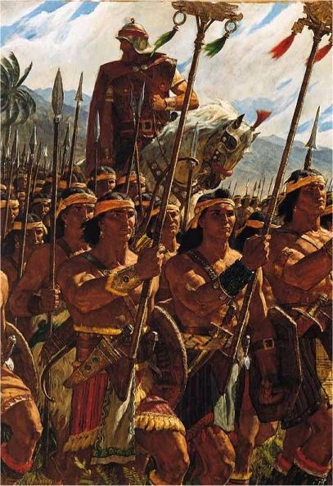
Ending of the 28th Year of the Reign of the Judges
“And now it came to pass that Helaman did march at the head of his two thousand stripling soldiers, to the support of the people in the borders of the land on the south by the west sea.”
Stripling: "a youth," late 14c., possibly from strip (n.) "long, narrow piece," on the
notion of "one who is slender as a strip, whose figure is not yet filled out.“
Etymology: Middle English 1350-1400
See notes*
Alma 53:22

Slide 8
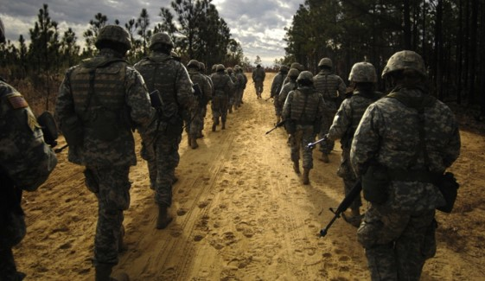
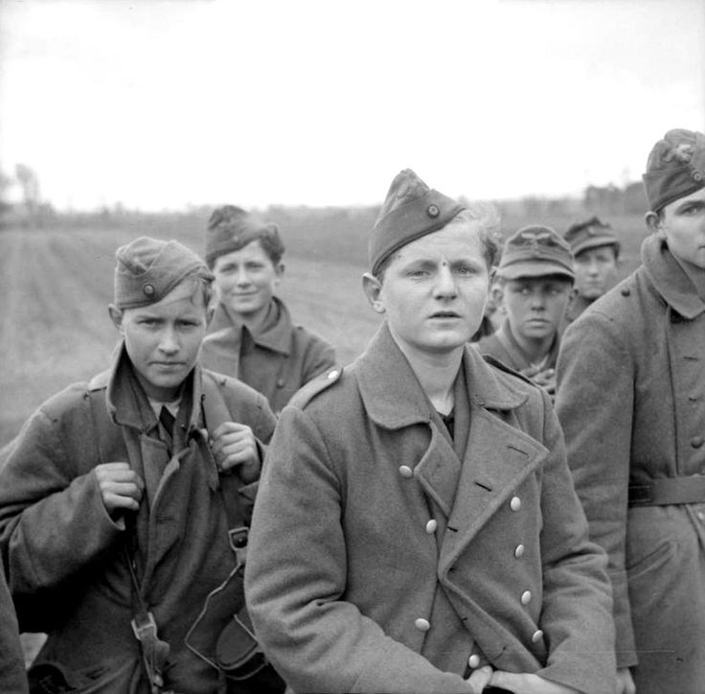
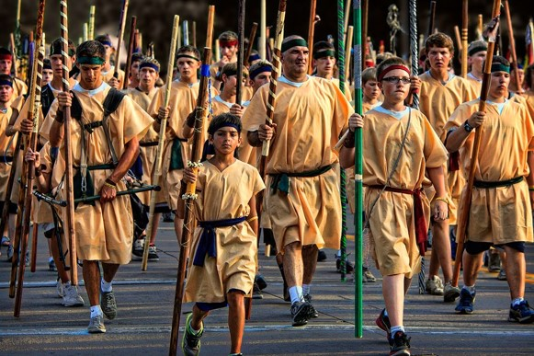
Young Soldiers
“Throughout history it has been commonplace for many of the men in the military to engage in wickedness both in and out of battle.
But the young Ammonite warriors who went to battle in place of their fathers were exemplary in many ways.
They were men of trust, truth, and righteousness.
They were committed to the defense of their country.
They were fearless in the face of death and courageous in battle.
God rewarded them their faith with amazing protection. Not one of them died in battle
This is not always the case with righteous
young men in war. Sometimes they must
give their lives…
They exemplified the type of manhood
which all of God’s sons should emulate.”
Student Manual 121-122

Slide 9
An Exchange of Prisoners
The 29th Year of the Reign of the Judges
Ammoron desires an exchange of prisoners—They had taken many women and children
Moroni desires to get as many Nephites back as possible
Alma 54:1-3

Slide 10
The Epistle—Alma 54:4-13
“…we are prepared to receive you; yea, and except you withdraw your purposes, behold, ye will pull down the wrath of that God whom you have rejected upon you, even to your utter destruction.”
Alma 54:9

Slide 11
However
“If ye seek to destroy us more we will seek to destroy you”
Alma 54:13

Slide 12
Response from Ammoron
Alma 54:16-24
“…Ye have murdered my brother…I will avenge his blood upon you.”
Alma 54:16

Slide 13
So:
“…if ye lay down your arms and become subject to be governed…I will cause that my people shall lay down their weapons and shall be at war no more.”
Alma 54:18

Slide 14
Nevertheless…
“…I will grant to exchange prisoners…subjecting the Nephites to our authority or to their eternal extinction.”
“…we know not such a being (God)”
Alma 54:20

Slide 15
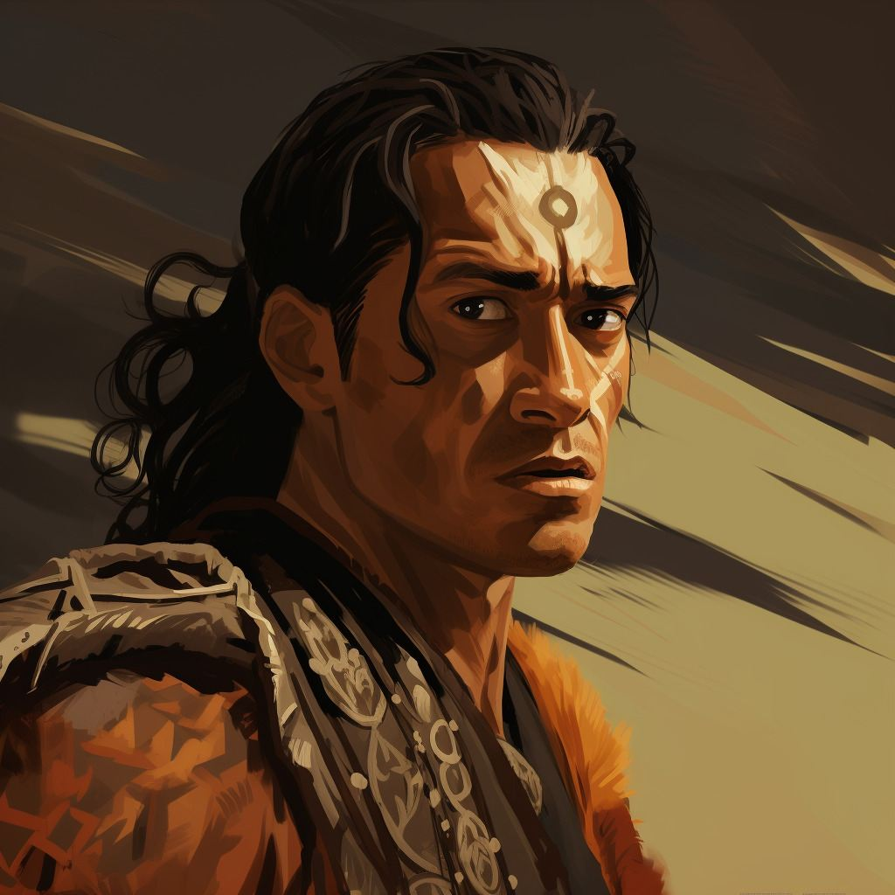
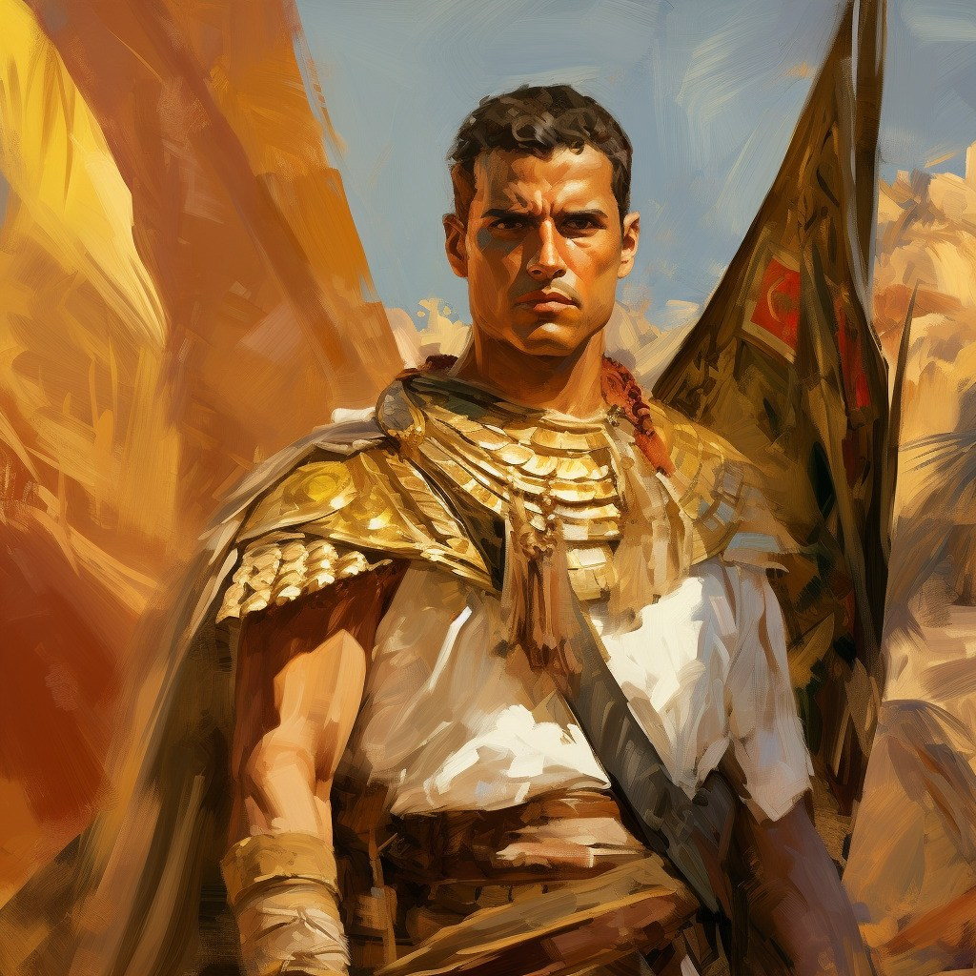
Different Strategies
Moroni was concerned about families
Ammoron was only concerned about his men of war and wanted to destroy the Nephites or take control

Slide 16
Perfect Knowledge of Fraud
Moroni knew of the lies that Ammoron was telling
Moroni withdrew his ‘purpose’ and said, “I will seek death among them until they shall sure for peace.”
However:
We are not to delight in murder or bloodshed; rather, we are to delight in saving people from destruction
A search was made to find a man who was a descendant of Laman…
They found a servant of named Laman
Alma 55:1-19

Slide 17
Laman, Nephite Soldier
He was a servant of the king of the Lamanites, the same king who was murdered by servants of the dissenter Amalickiah around 72 BC.
He fled to the Nephite side and joined the military under command of Captain Moroni.
Ten years later during the warfare between the Nephites and the Lamanites he helped Moroni with his plan to disable the Lamanite guards in order to free the Nephite captives.
Laman and a small group of men went to the encampment at Gid.
He told the Lamanites he was a “Lamanite”.
He gave the Lamanites wine, and they got drunk, and Moroni and his men entered into the camp.
Who’s Who

Slide 18
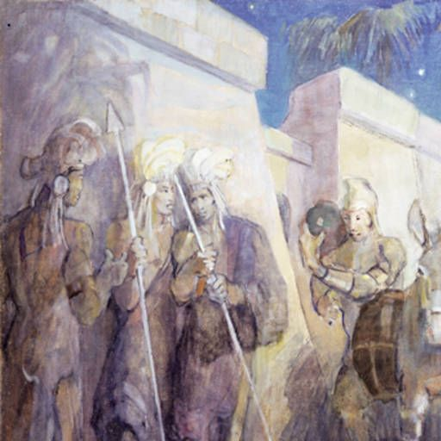
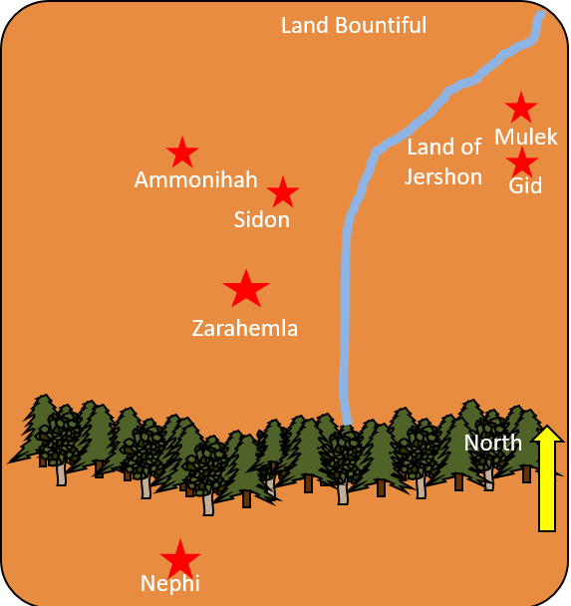
Fortifying Gid
After the Lamanites were drunken, Moroni gathered the weapons and gave them to the Nephite prisoners.
The prisoners were taken out of the city of Gid and returned to the city Bountiful.
They had taken Gid and fortified it by having the Lamanites labor.
Many times, the Lamanites tried to use the tactics of getting the Nephites drunk, but to no avail.
The Nephites were “not slow to remember the Lord their God in this their time of affliction.”
Minerva Teichert
The Lamanites in the city of Gid surrendered and the Nephites who had been imprisoned joined Moroni’s army.
Alma 55:25-31

Slide 19
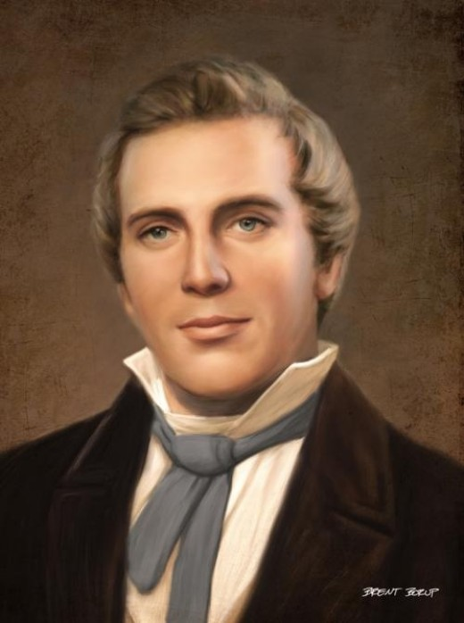
As we stand firm for what is right, we can prevent evil influences from gaining power over us
“Satan cannot seduce us by his enticements unless we in our hearts consent and yield.”
“The devil has no power over us only as we permit him.”
Brent Borup
Joseph Smith Alma 55:32-35

Slide 20
Sources:
The Book of Mormon Who’s Who by Ed J. Pinegar and Richard J. Allen pg. 21-22, 76-77, 102-103
Boyd K. Packer (“Counsel to Youth,” Ensign or Liahona, Nov. 2011, 18).
Student Manual of Book of Mormon Religion 121-122 pg. 338
Joseph Smith (Teachings of Presidents of the Church: Joseph Smith [2007], 213, 214).
Presentation by ©http://fashionsbylynda.com/blog/

Slide 21
“Stripling” refers to a teenage boy at a very particular time in his physical development. You know when a teenage boy of 14-16 years suddenly shoots up a foot or two in what seems like 2 weeks? It’s a super awkward time physically because they are suddenly much taller and they’re sort of graceless in the way they carry themselves. At this stage of life they are lanky and a little clumsy.
A youth in the state of adolescence, or just passing from boyhood to manhood; a lad.
Webster’s Dictionary 1820
“To our young men who go into service, no matter whom they serve or where, we say live clean, keep the commandments of the Lord, pray to Him constantly to preserve you in truth and righteousness, live as you pray, and then whatever betides you the Lord will be with you and nothing will happen to you that will not be to the honor and glory of God and to your salvation and exaltation. There will come into your hearts from the living of the pure life you pray for, a joy that will pass your powers of expression or understanding. The Lord will be always near you; He will comfort you; you will feel His presence in the hour of your greatest tribulation; He will guard and protect you to the full extent that accords with His all-wise purpose. Then, when the conflict is over and you return to your homes, having lived the righteous life, how great will be your happiness—whether you be of the victors or of the vanquished—that you have lived as the Lord commanded. You will return so disciplined in righteousness that thereafter all Satan’s wiles and stratagems will leave you untouched. Your faith and testimony will be strong beyond breaking. You will be looked up to and revered as having passed through the fiery furnace of trial and temptation and come forth unharmed. Your brethren will look to you for counsel, support, and guidance. You will be the anchors to which thereafter the youth of Zion will moor their faith in man” (Heber J. Grant, J. Reuben Clark Jr., and David O. McKay, in Conference Report, Apr. 1942, 96).
Other Quotes:
President George Albert Smith shares wise counsel given by his grandfather George A. Smith:
“My grandfather used to say to his family, ‘There is a line of demarcation well defined between the Lord’s territory and the devil’s territory. If you will stay on the Lord’s side of the line you will be under his influence and will have no desire to do wrong; but if you cross to the devil’s side of that line one inch you are in the tempter’s power and if he is successful, you will not be able to think or even reason properly because you will have lost the Spirit of the Lord.’
“When I have been tempted sometimes to do a certain thing, I have asked myself, ‘Which side of the line am I on?’ If I determined to be on the safe side, the Lord’s side, I would do the right thing every time. So when temptation comes think prayerfully about your problem and the influence of the Lord will aid you to decide wisely. There is safety for us only on the Lord’s side of the line” (“A Faith Founded upon Truth,” Deseret News, June 17, 1944, Church section, 9).

Slide 22
Helaman’s Epistle to Moroni
Honor the Mothers
Alma 56-58

Slide 23
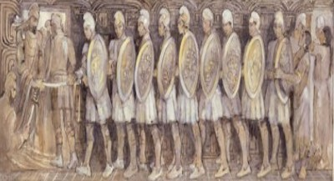
Helaman’s Epistle to Moroni
The 30th Year of the Reign of the Judges—Moroni received the epistle
Verse 1, about 62 B.C.
Verses 2–19, about 66 B.C.
Verses 20–57, about 65–64 B.C.
The state of the war with the Lamanites
Antipus and Helaman’s victory over the Lamanites in the city of Antiparah
The miraculous power of the 2,000 stripling sons fight in which none of them were slain
Alma 56

Slide 24
Antipus
He served as a general in the Nephite armies when Moroni was commander and Helaman was leading his 2,ooo warriors.
He was the leader in the city of Judea.
The city of Judea’s people were depressed trying to maintain their cities from Ammoron’s grasp.
With the aid of Helaman’s forces, Antipus and his forces were able to deadlock the Lamanites.
During this time additional provisions and reinforcements came to strengthen the Nephite cause.
Antipus ordered Helaman and his army to march forth as if delivering supplies to a neighboring city which lured the Lamanites away from their strongest station.
Antipus besieged the Lamanites to the rear.
After a three-day battle Antipus came upon the Lamanites, the battle ensued and as Helaman’s army retraced their steps and they arrived in time to assist.
Antipus had fallen by the sword in battle leaving his men in disarray, but eventually the Nephites defeated the Lamanites
Who’s Who

Slide 25
Places of War
Land Bountiful
Ammonihah
Land of Jershon
These are the cities that Helaman and Anitpus were trying to fight for—Anitpus was in Judea
These are the cities that the Lamanites had a hold of
Zarahemla
Judea
North
Antiparah
Cumeni
Zeezrom
Manti
Nephi
Alma 56:14-15,33

Slide 26
Helaman’s Army
1.Descendants of Laman, eldest son of Lehi
2.Their father’s covenanted to not take up their weapons of war against their brethren
3.Helaman, as leader, marches to aid Antipus
4.Helaman calls them “my two thousand sons”
5.Helaman’s army brought provisions to Antipus
6.Helaman calls his army “my little sons”
7.They were taught by their mothers
8.Not one soul is lost
a. Alma 56:9
b. Alma 56:10,46
c. Alma 56:3
d. Alma 56:30,39
e. Alma 56:6
f. Alma 56:47
g. Alma 56:56
h. Alma 56:28
Alma 56

Slide 27
T
What does it mean to be true to the faith? That word true implies commitment, integrity, endurance, and courage. It reminds us of the Book of Mormon’s description of the 2,000 young warriors:
“And they were all … exceedingly valiant for courage, and also for strength and activity; but behold, this was not all—they were men who were true at all times in whatsoever thing they were entrusted.“Yea, they were men of truth and soberness, for they had been taught to keep the commandments of God and to walk uprightly before him” (Alma 53:20–21).
In the spirit of that description I say to our returned missionaries—men and women who have made covenants to serve the Lord and who have already served Him in the great work of proclaiming the gospel and perfecting the Saints—are you being true to the faith?
Do you have the faith and continuing commitment to demonstrate the principles of the gospel in your own lives, consistently?
You have served well, but do you, like the pioneers, have the courage and the consistency to be true to the faith and to endure to the end?
Dallin H. Oaks
R
U
E

Slide 28
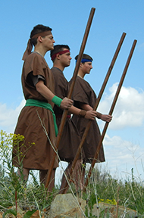
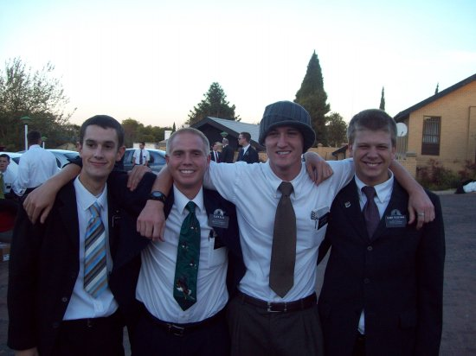
To Be A Stripling Warrior
“In the spiritual battles you are waging, I see you as today’s sons of Helaman”
“Before the final triumphal return of the Lord, the question as to whether we may save our constitutional republic is simply based on two factors—the number of patriots and the extent of their obedience.” ---Teachings of Ezra T. Benson

Slide 29
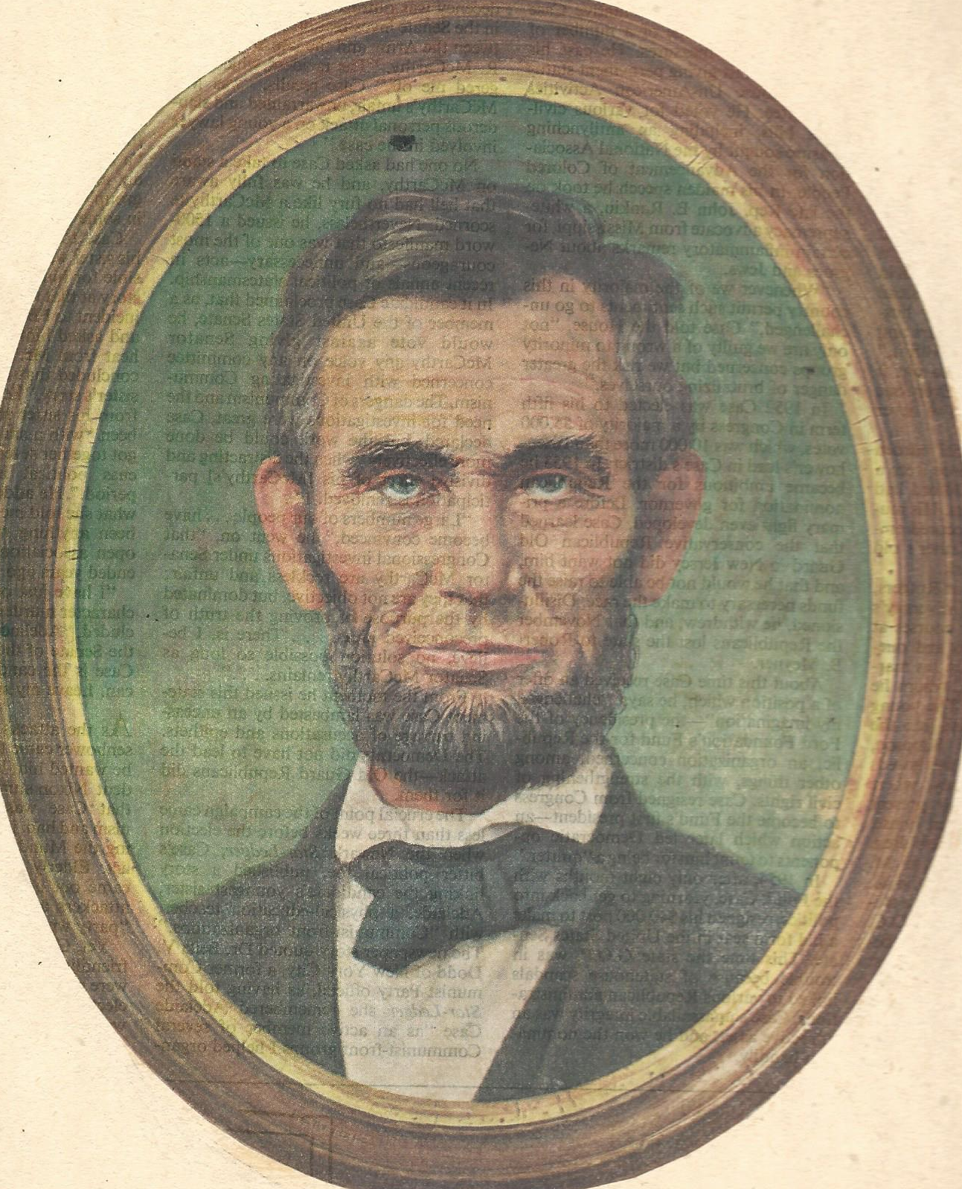
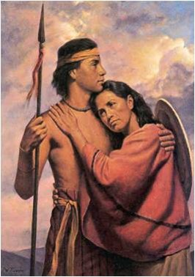
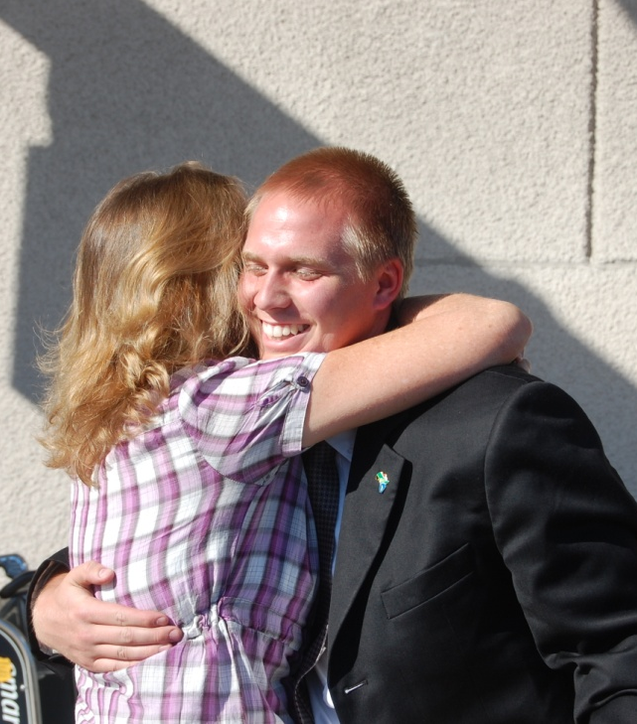
To Be A Mother
“All that I am, or hope to be I owe to my angel mother.” --Abraham Lincoln
“The noblest calling in the world is that of mother. True motherhood is the most beautiful of all the arts, the greatest of all professions. She who can paint a masterpiece or who can write a book that will influence millions deserves the plaudits and admiration of mankind; but she who rears successfully a family of…sons and daughters whose immortal souls will be exerting an influence throughout the ages long after paintings shall have faded, and books and statues shall have been destroyed, deserves the highest honor that man can give.”
David O. McKay
Alma 56:47-48

Slide 30
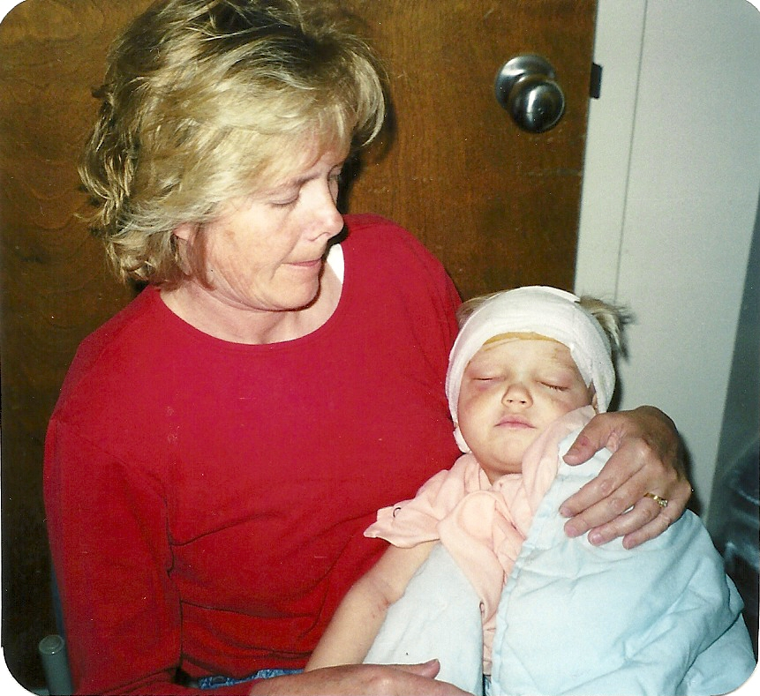
“Your mother is your best friend. Never forget that. She gave you life. She cared for you, nurtured you, nursed you when you were sick, and looked after your every need. Listen to her now. Talk with her candidly and confidentially. You will find that she will keep your confidence and that her wisdom will prove to be wonderful.” Gordon B. Hinckley
Righteous mothers can bless their children by teaching them to trust in God.

Slide 31
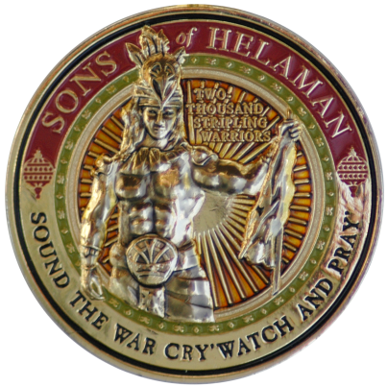
To Act in Faith
"[You are] out there as the sons of Helaman in a world that is full of destructive influences. . . . But if you put your trust in the Almighty and follow the teachings of this Church and cling to it notwithstanding your wounds, you will be preserved and blessed and magnified and made happy." Gordon B. Hinckley
If we act in faith and do not doubt, then we will receive strength from God
"Men and women who turn their lives over to God will discover that He can make a lot more out of their lives than they can. He will deepen their joys, expand their vision, quicken their minds, strengthen their muscles, lift their spirits, multiply their blessings, increase their opportunities, comfort their souls, raise up friends, and pour out peace." Ezra Taft Benson
Alma 56:56

Slide 32
6,000 Men
About 63 BC
29th Year of the Reign of the Judges
The prisoners of the Nephites did ‘raise up in numbers’ causing riots that the Nephites had to slay 2,000 of them.
The prisoners were taken to Zarahemla by Helaman’s young soldiers—with Gid as their leader
Ammonihah
The Nephites desire to battle with the Lamanites at Cumeni—the Lamanites are low on provisions.
When the provisions arrived, the Nephites confiscated them and took the provisions to Judea
Zarahemla
Judea
North
Antiparah
Cumeni
Zeezrom
Manti
The Lamanites received new supply from Ammoron and they were “upon” them
Nephi
Alma 57:1-18

Slide 33
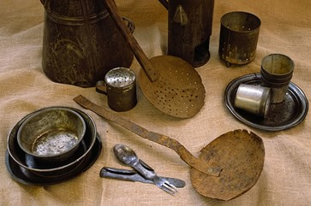
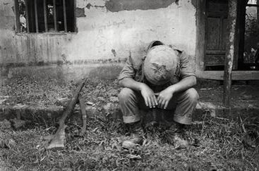
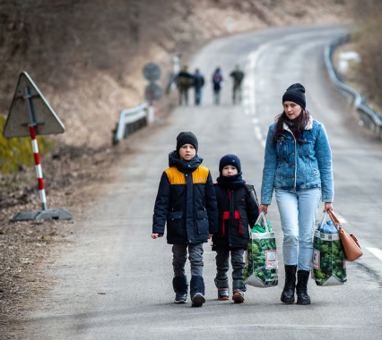
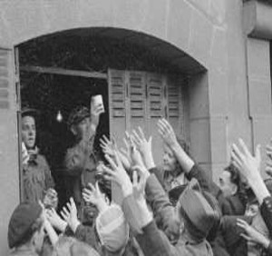
Hardships of War
No sleep, no food, sleeping in the rain, snow, on hard ground; no toilets, no baths, no proper hygiene for one's teeth; etc. Those are the hardships of fighting men.
What were some of the hardships of the Revolutionary war?
Some of the greatest hardships during the revolutionary war:· Harsh weather
· Lack of food
· Lack of clothing
· Lack of sanitation
· Sickness
· Exposure
· Desertions
shortage of goods, prices of beef and wheat doubled, the colonists face an inflation, and there was a falling value of colonial money
Russia's brutal invasion has driven millions into poverty and debilitated – but not quite destroyed – Ukraine's economy. Many have left their homes for other countries leaving behind their fathers, husbands, and grandfathers. Meanwhile, sanctions are straining the Russian economy, but they are yet to end a war that has sown financial turmoil and personal hardship in the region and across the globe.
Oct 24, 2023 (Economic Observatory)

Slide 34
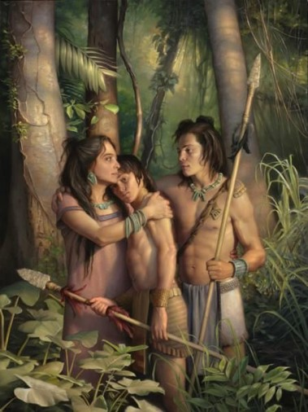
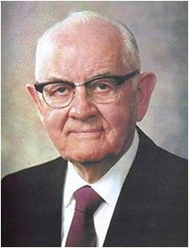
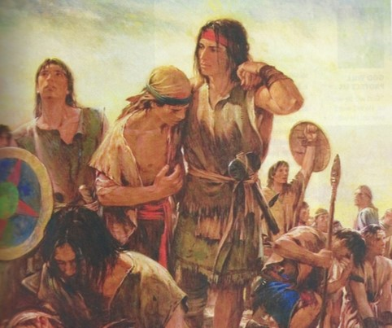
“Is there not wisdom in his giving us trials that we might rise above them, responsibilities that we might achieve, work to harden our muscles, sorrows to try our souls? Are we not exposed to temptations to test our strength, sickness that we might learn patience, death that we might be immortalized and glorified? …
“[Orson F. Whitney said:] ‘No pain that we suffer, no trial that we experience is wasted. It ministers to our education, … builds up our characters, purifies our hearts, expands our souls, and makes us more tender and charitable, more worthy to be called the children of God.’ …
“We knew before we were born that we were coming to the earth for bodies and experience and that we would have joys and sorrows, ease and pain, comforts and hardships, health and sickness, successes and disappointments, and we knew also that after a period of life we would die. We accepted all these eventualities with a glad heart, eager to accept both the favorable and unfavorable. We eagerly accepted the chance to come earthward even though it might be for only a day or a year”
President Spencer W. Kimball

Slide 35
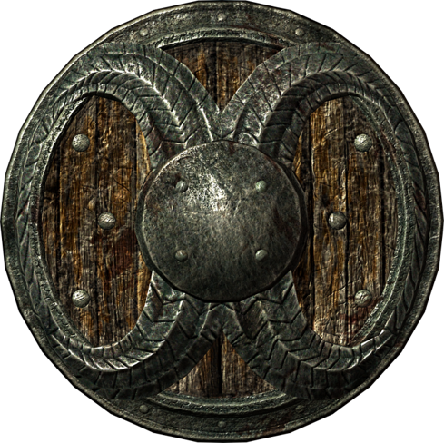
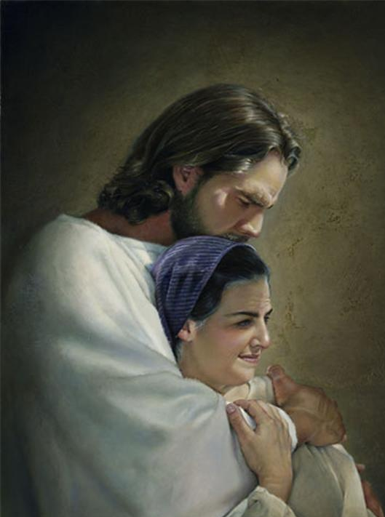
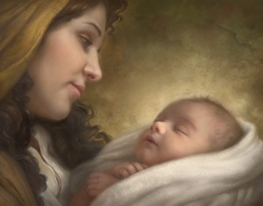
If we obey the commands of God with exactness and put our trust in Him continually, then He will bless us by His marvelous power.
Howard Lyon
Liz Lemon Swindle

Slide 36
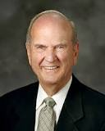
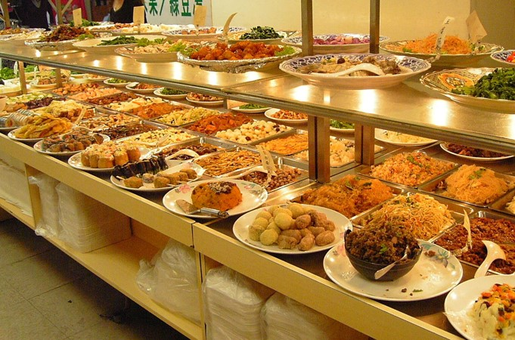
The Obedience—With Exactness
“[You] will encounter people who pick which commandments they will keep and ignore others that they choose to break.
I call this the cafeteria approach to obedience.
This practice of picking and choosing will not work. It will lead to misery.
To prepare to meet God, one keeps all of His commandments.
It takes faith to obey them, and keeping His commandments will strengthen that faith.”
Russell M. Nelson
Alma 57:21

Slide 37
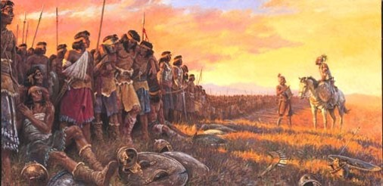
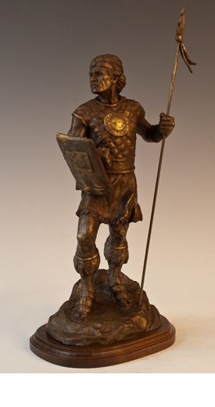
Why Did the Lord Preserve the 2,000?
“And it came to pass that there were two hundred, out of my two thousand and sixty, who had fainted because of the loss of blood; nevertheless, according to the goodness of God, and to our great astonishment, and also the joy of our whole army, there was not one soul of them who did perish; yea, and neither was there one soul among them who had not received many wounds.”
”And now, their preservation was astonishing to our whole army, yea, that they should be spared while there was a thousand of our brethren who were slain.
And we do justly ascribe it to the miraculous power of God, because of their exceeding faith in that which they had been taught to believe—that there was a just God, and whosoever did not doubt, that they should be preserved by his marvelous power.
Now this was the faith of these of whom I have spoken; they are young, and their minds are firm, and they do put their trust in God continually.”
Alma 57:25-27

Slide 38
Gid And Teomner
Gid was a captain under Helaman
Helaman had taken many prisoners during the recovery of the cities of Antiparah and Cumeni around 63 BC—the numbers were so large that Helaman commissioned Gid to be chief captain over the band to guard the prisoners to the land of Zarahemla
He and his band returned quickly, as the Lamanites had received provisions, and aided Helaman…as a result the Lamanites were forced to retreat to the city of Manti.
Gid had to take matters into his own hands of the revolt of the prisoners and slew many of them, the remainder escaped.
Gid and another Nephite military leader, Teomner, took over the city Manti
Who’s Who Alma 57:29-36 and Alma 58:1-27

Slide 39
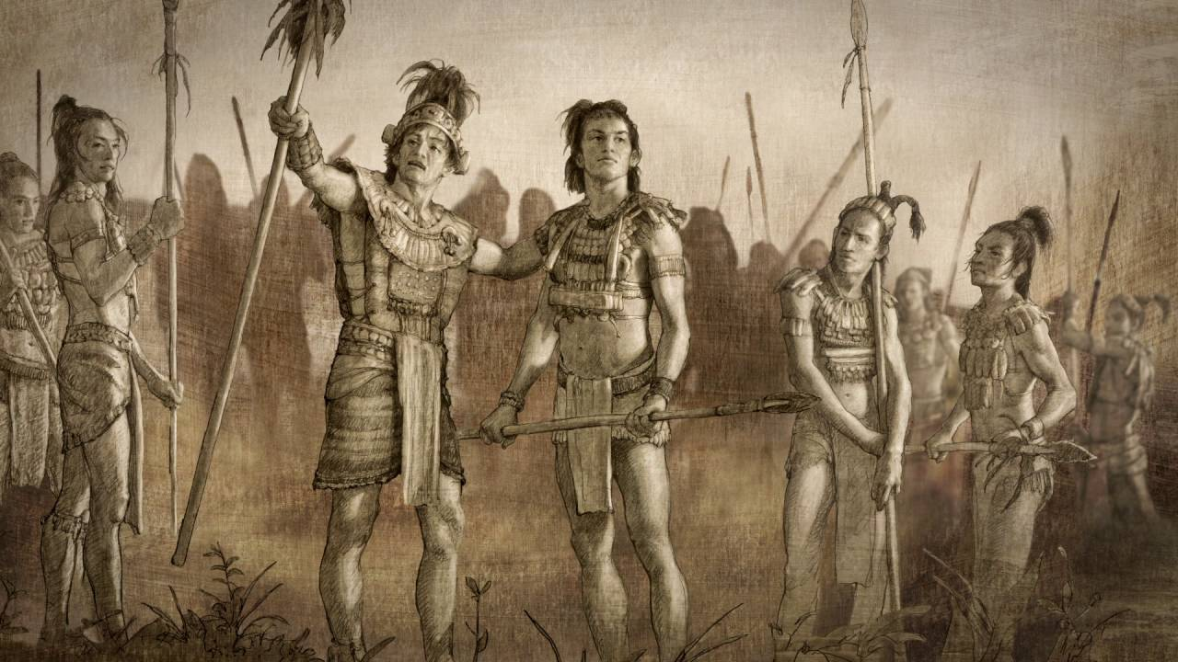
The Nephite army’s successful efforts to retake the cities that had been captured by the Lamanites
How did Helaman’s young warriors show their faith in God, despite the “many wounds” they received?
As you face challenges in life, how can you benefit from following the example of the sons of Helaman?
If we turn to God in times of difficulty, we can receive divine assurance that can strengthen our faith and give us hope
Alma 58:31-40

Slide 40
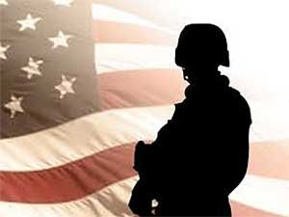
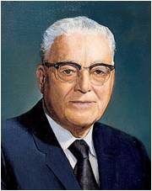
“It is my conviction that the present devastating scourge of war in which hundreds of thousands are being slain, many of whom are no more responsible for the causes of the war than are our own boys, is making necessary an increase of missionary activity in the spirit world and that many of our boys who bear the Holy Priesthood and are worthy to do so will be called to that missionary service after they have departed this life.
Harold B. Lee

Slide 41
Sources:
Book of Mormon Who’s Who by Ed J. Pinegar and Richard J. Allen p. 29,56, 179
Dallin H. Oaks Following the Pioneers Ensign Nov. 1997
Teachings of Ezra Taft Benson pg. 344, 520
Abraham Lincoln Lincoln's Life—Stories and Speeches, Selby, pg. 221
David O. McKay Secrets of a Happy Life p 2-4
Gordon B. Hinckley (LDS Church News, 09/21/96)
Ezra Taft Benson ("Jesus Christ-Gifts and Expectations," Christmas Devotional, Salt Lake City, Dec. 7, 1986).
President Spencer W. Kimball (Faith Precedes the Miracle [1972], 97–98, 106).
Russell M. Nelson (“Face the Future with Faith,” Ensign or Liahona, May 2011, 34).
Harold B. Lee Conference Report, Oct. 1942 Pg. 72-73
Presentation by ©http://fashionsbylynda.com/blog/

Slide 42
Issued by the First Presidency:
“The Church is and must be against war. The Church itself cannot wage war, unless and until the Lord shall issue new commands. It cannot regard war as a righteous means of settling international disputes; these should and could be settled—the nations agreeing—by peaceful negotiation and adjustment.
“But the Church membership are citizens or subjects of sovereignties over which the Church has no control. The Lord Himself has told us to ‘befriend that law which is the constitutional law of the land’ [see D&C 98:4–7]. …
“… When, therefore, constitutional law, obedient to these principles, calls the manhood of the Church into the armed service of any country to which they owe allegiance, their highest civic duty requires that they meet that call. If, harkening to that call and obeying those in command over them, they shall take the lives of those who fight against them, that will not make of them murderers, nor subject them to the penalty that God has prescribed for those who kill” (in Conference Report, Apr. 1942, 94).
“In the Book of Mormon we read about 2,000 exemplary young men who were exceedingly valiant, courageous, and strong. ‘Yea, they were men of truth and soberness, for they had been taught to keep the commandments of God and to walk uprightly before him’ (Alma 53:21). These faithful young men paid tribute to their mothers. They said, ‘Our mothers knew it’ (Alma 56:48). …
“The responsibility mothers have today has never required more vigilance. More than at any time in the history of the world, we need mothers who know. … When mothers know who they are and who God is and have made covenants with Him, they will have great power and influence for good on their children” (Julie B. Beck, “Mothers Who Know,” Ensign or Liahona, Nov. 2007, 76).
“If I were asked to name the world’s greatest need, I should say unhesitatingly wise mothers” (David O. McKay, Secrets of a Happy Life, comp. Llewelyn R. McKay [1967], 2).
Alma 57:20: War
We can only imagine Moroni's delight in reading this epistle from Helaman. More than anyone else, Moroni understood that wars are not won by superior armor, stronger fortifications, larger armies, and superior strategy. He understood that wars are won by those internal qualities which were exemplified so vividly among the stripling warriors. They were perfectly obedient (v. 21); they had remembered their spiritual heritage (v. 21); they exercised exceeding faith (v. 26); they did not doubt (v. 26); their minds were firm, and they had learned to put their trust in God. Our spiritual wars are won using just the same principles.
Alma 57: The Battle
Elder M. Russell Ballard of the Quorum of the Twelve Apostles:
“Today we are fighting a battle that in many ways is more perilous … than the battle between the Nephites and the Lamanites. Our enemy is cunning and resourceful. We fight against Lucifer, the father of all lies, the enemy of all that is good and right and holy. …
“… We battle literally for the souls of men. The enemy is unforgiving and relentless. He is taking eternal prisoners at an alarming rate. And he shows no sign of letting up.
“While we are profoundly grateful for the many members of the Church who are doing great things in the battle for truth and right, I must honestly tell you it still is not enough. We need much more help. … We need you. Like Helaman’s 2,000 stripling warriors, … you too can be endowed with power to build up and defend His kingdom. We need you to make sacred covenants, just as they did. We need you to be meticulously obedient and faithful, just as they were” (“The Greatest Generation of Missionaries,” Ensign or Liahona, Nov. 2002, 46–47).
Alma 58:3 Provisions
"So now they settle down to a long wait. They say the war should be over by now. What's wrong? Now this long and painful wait starts, and it's the biggest trial of all. They waited for provisions from Zarahemla, but they were just a little trickle. They weren't getting any at all. The Lamanites were receiving great strength from day to day on their part. This is beginning to look bad. What about ending this war? The Lamanites began sallying forth against them, taking courage and giving them a bad time. They waited and waited many months. They were just stuck in this particular place for many months. Remember what Clausewtiz said? The longer a war drags on, the greater the losses and the greater the uncertainty of what's going to happen. It's a terrible thing, and wars have that habit of dragging on whether you like them to or not. This inaction became terrible." Hugh Nibley (Teachings of the Book of Mormon, p. 178.)
Alma 58:11:
One of the best descriptions of how the Lord responds to us, again through thoughts or feelings. He seems to do these four things:
He visits us with assurances that he will deliver us.
He speaks peace to our souls.
He grants us great faith.
He causes us that we should hope for our deliverance in him.
Gene R. Cook Raising Up a Family to the Lord, p. 127-8

Slide 43
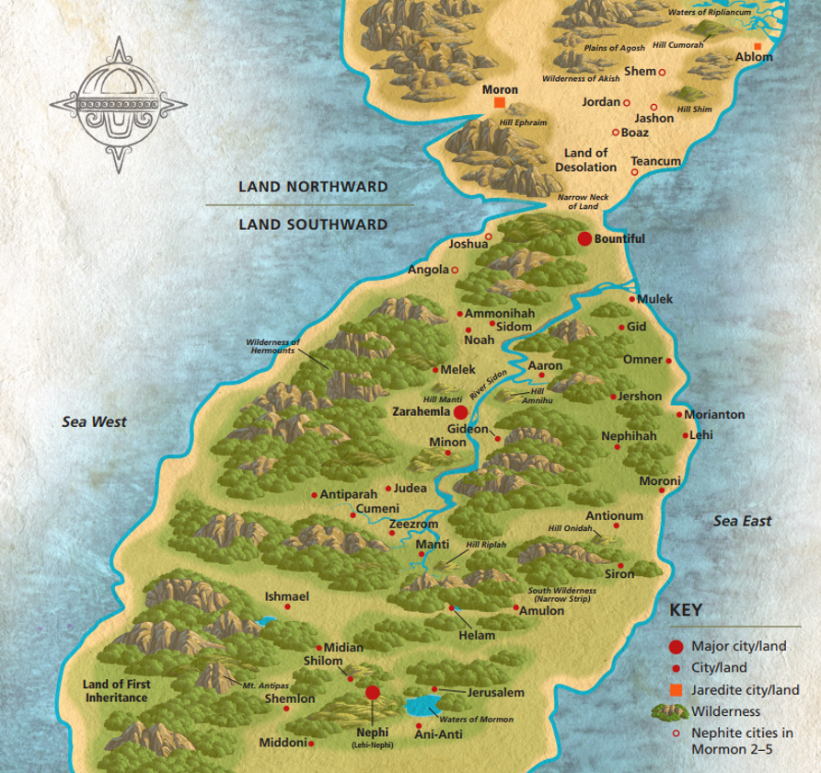
Possible Book of Mormon sites in relation to each other
Possible Book of Mormon sites in relation to each other

Slide 44
Possible Book of Mormon sites in relation to each other
Possible Book of Mormon sites in relation to each other

Slide 46
The Loss of a City
Mulek
“And now, when Moroni saw that the city of Nephihah was lost he was exceedingly sorrowful, and began to doubt, because of the wickedness of the people, whether they should not fall into the hands of their brethren.”
Gid
Ammonihah
Valley of Gideon
Zarahemla
Nephihah
Moroni
Antionum
It was easier to keep the city from falling into the hands of the Lamanites than to retake it from them
Manti
North
Nephi
Alma 59:11-13

Slide 47
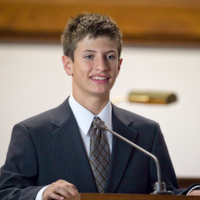
Keeping Your Faith
It is easier and better to remain faithful than it is to return to the faith after going astray
Why is staying faithful in the Church easier than returning to the Church after a period of being less active?
Why is it easier to maintain a testimony than it is to regain a testimony after falling away?

Slide 48
Trials of Miscommunication
Captain Moroni rejoiced in Helaman’s success in regaining some of the Nephite cities that had been lost to the Lamanites.
However, when he learned that the city of Nephihah had been captured by the Lamanites, he was angry at the government for neglecting to send reinforcements.
I am very, very disappointed
In a letter to Pahoran, the chief judge, he lamented the suffering of the righteous and rebuked Pahoran for not supporting the cause of freedom.
Alma 59-60

Slide 49
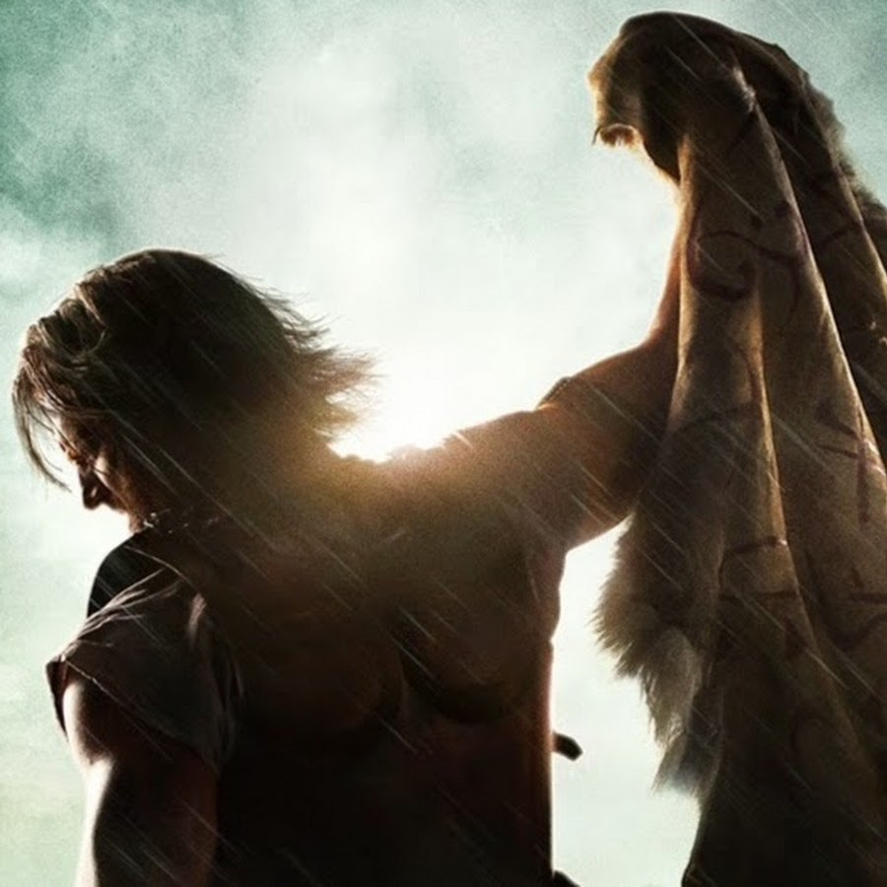
Moroni’s Passionate Complaints
We have suffered:
Hunger, thirst, fatigue, and all manner of afflictions
Our people have been slaughtered
The Lamanites are upon us
The king-men fight among us
We have looked to your government for protection:
But you are slothful and idle
You are “traitors to your country”
We ask you to send help:
Provisions
Men
We ask you to defend your freedoms
Alma 59-60

Slide 50
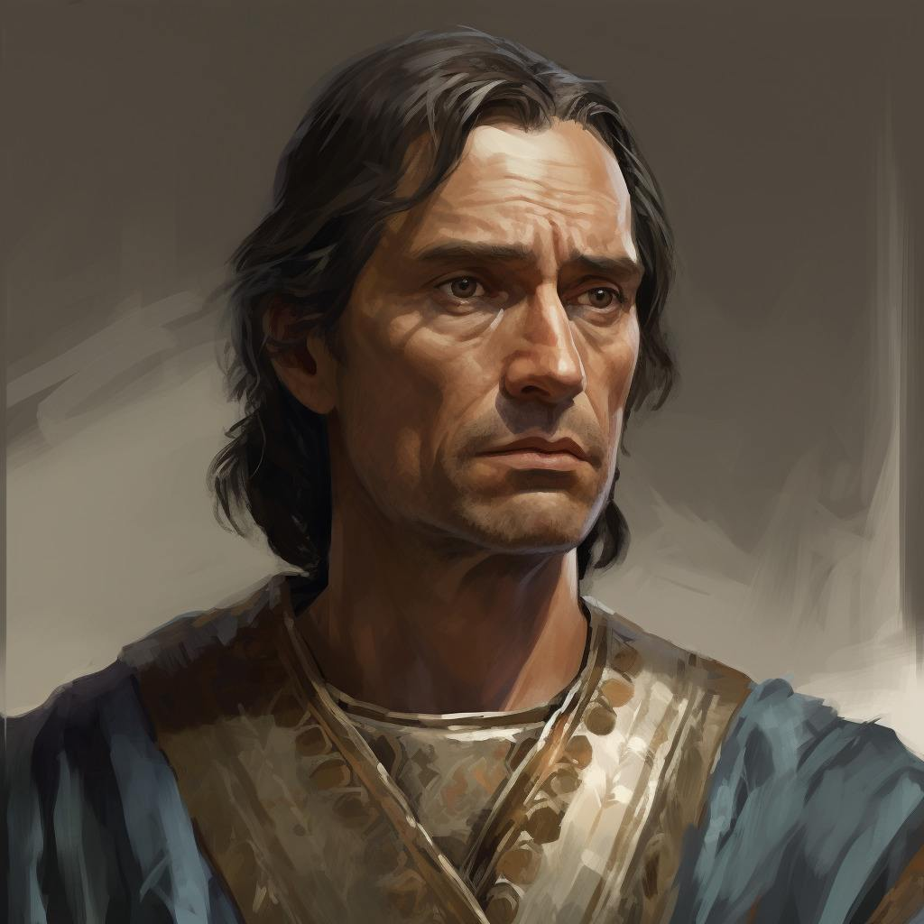
Understanding
Unknown to Moroni, Pahoran had fled to the land of Gideon because of the rebellion of the Nephite king-men.
Mulek
Gid
Ammonihah
Valley of Gideon
Zarahemla
Nephihah
Moroni
Manti
Antionum
North
Pahoran did not take offense at Moroni’s chastisement; rather, he rejoiced in Moroni’s love of liberty.
Nephi
Alma 61

Slide 51
We can choose to not be offended by the words and actions of others.
We should avoid making unkind judgments about others
When we unite in righteousness with others, we are stronger in our battles against evil.
How can we choose not to be offended?

Slide 52
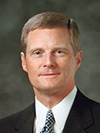
“Pahoran might easily have resented Moroni and his message, but he chose not to take offense. …
“One of the greatest indicators of our own spiritual maturity is revealed in how we respond to the weaknesses, the inexperience, and the potentially offensive actions of others. A thing, an event, or an expression may be offensive, but you and I can choose not to be offended—and to say with Pahoran, ‘it mattereth not.’ …
“… If a person says or does something that we consider offensive, our first obligation is to refuse to take offense and then communicate privately, honestly, and directly with that individual.
Such an approach invites inspiration from the Holy Ghost and permits misperceptions to be clarified and true intent to be understood.”
David A. Bednar

Slide 53
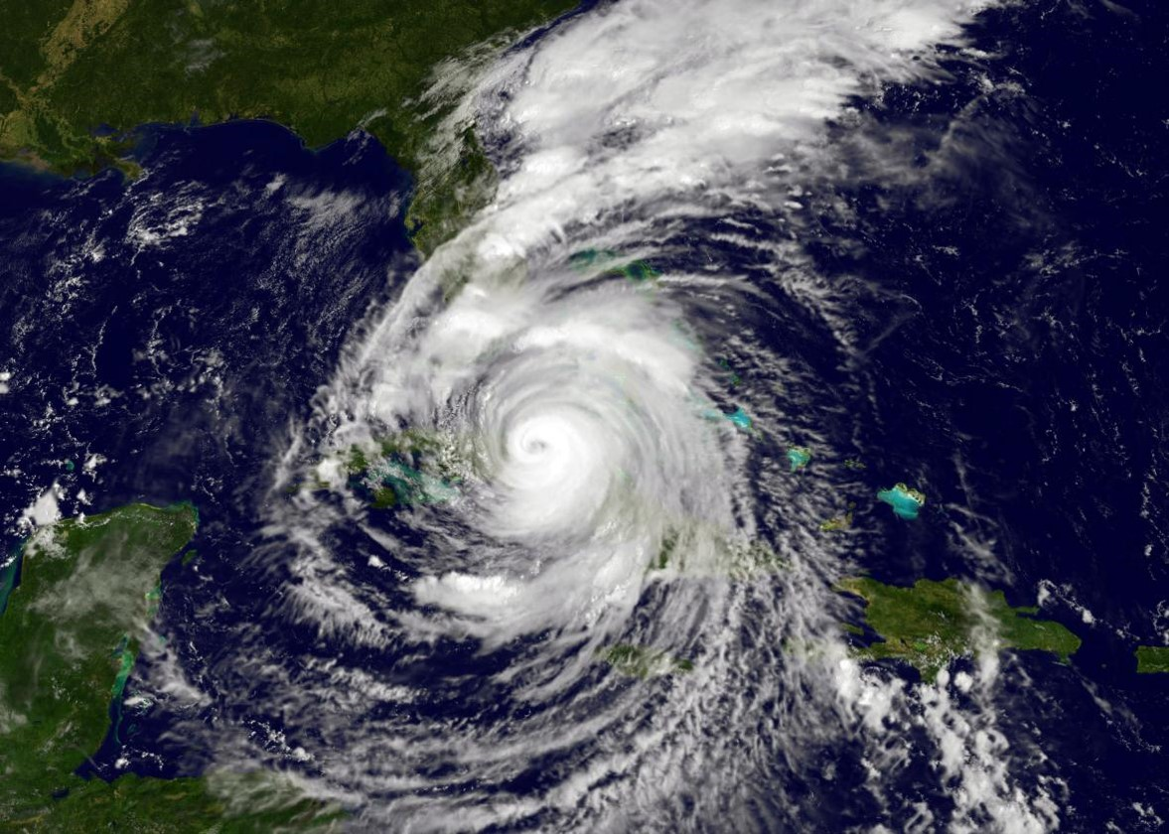
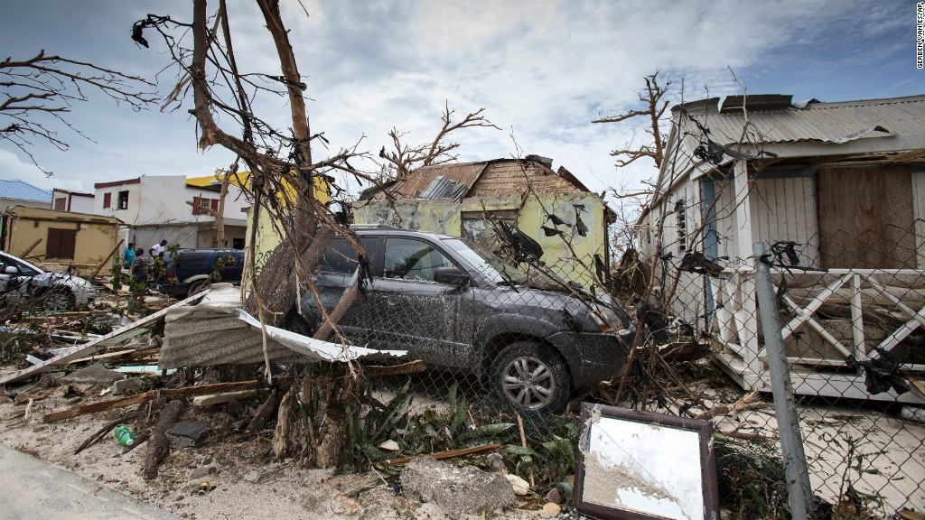
In times of adversity, some people humble themselves before God while others become hardened
“A news account quoted two different persons who had suffered the same tragedy and received the same blessing: each of their homes had been totally destroyed, but each of their family members had been spared death or injury.
One said that this tragedy had destroyed his faith; how, he asked, could God allow this to happen? The other said that the experience had strengthened his faith. God had been good to him, he said. Though the family’s home and possessions were lost, their lives were spared and they could rebuild the home. … The gift of moral agency empowers each of us to choose how we will act when we suffer adversity”
Dallin H. Oaks

Slide 54
Pahoran’s Epistle
I do not ‘joy’ in your afflictions
The king-men have risen against me and driven the freemen out
They have sought to take the judgment seat and have a king—Tyranny--Pachus
The king wants to ally with the Lamanites—which eventually we would lose our lands and come into bondage
I have been driven out of Zarahemla and fled to Gideon
I am not angry with your words
“God made us free”
We need to resist evil with our swords
Alma 61

Slide 55
The Need to Take Possession of Zarahemla
Pahoran asks Moroni to leave Lehi and Teancum in charge and come to aid him
“And we will take possession of the city of Zarahemla, that we may obtain more food to send forth unto Lehi and Teancum; yea, we will go forth against them in the strength of the Lord, and we will put an end to this great iniquity.”
“See that ye strengthen Lehi and Teancum in the Lord; tell them to fear not, for God will deliver them, yea, and also all those who stand fast in that liberty wherewith God hath made them free. And now I close mine epistle to my beloved brother, Moroni.”
Alma 61:15-21

Slide 56
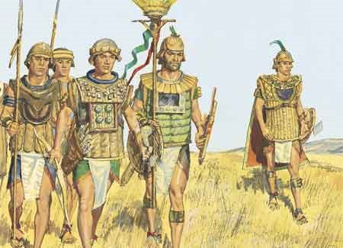
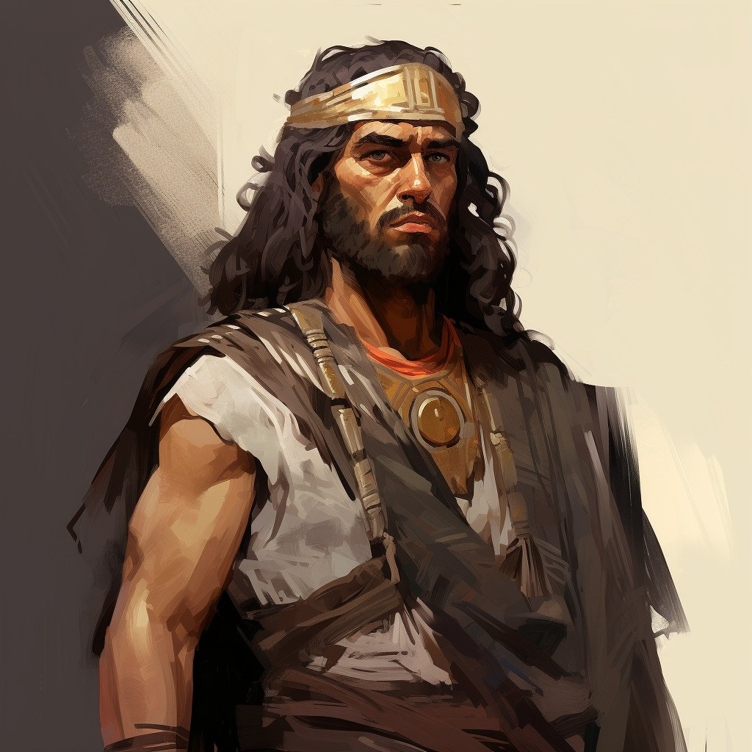
Renewed Vigor
Captain Moroni brought a portion of his army to help Pahoran overthrow the king-men in Zarahemla.
Then, with their united army and the help of other Nephite forces, Moroni and Pahoran retook the remaining cities that had been lost to the Lamanites.
They drove the Lamanites from the land and established peace among the people.
“And it came to pass that Moroni and Pahoran went down with their armies into the land of Zarahemla, and went forth against the city, and did meet the men of Pachus, insomuch that they did come to battle.
And behold, Pachus was slain and his men were taken prisoners, and Pahoran was restored to his judgment-seat.”
Alma 62:3-8

Slide 57
Pachus
He was the lead of the Nephite dissenters who revolted against Pahoran—king for a time
He drove the “freemen” from Zarahemla
Moroni and Pahoran combined their forces and invaded Zarahemla and killed Pachas and placed his followers under arrest
Those dissenters who denied having freedom were executed according to the law (Alma 62:9-10)
Who’s Who

Slide 58
The Law
“And the men of Pachus received their trial, according to the law, and also those king-men who had been taken and cast into prison; and they were executed according to the law; yea, those men of Pachus and those king-men, whosoever would not take up arms in the defense of their country, but would fight against it, were put to death.
And thus it became expedient that this law should be strictly observed for the safety of their country; yea, and whosoever was found denying their freedom was speedily executed according to the law.”
The end of the 30th Year of the Reign of the Judges
Alma 62:9-10

Slide 59
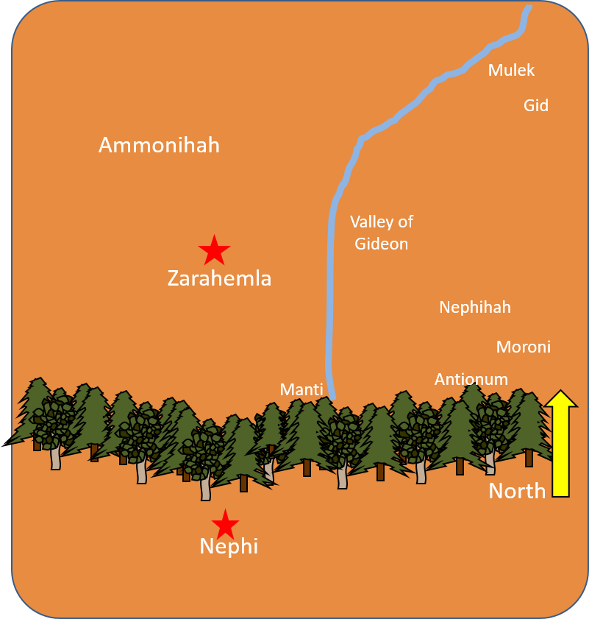
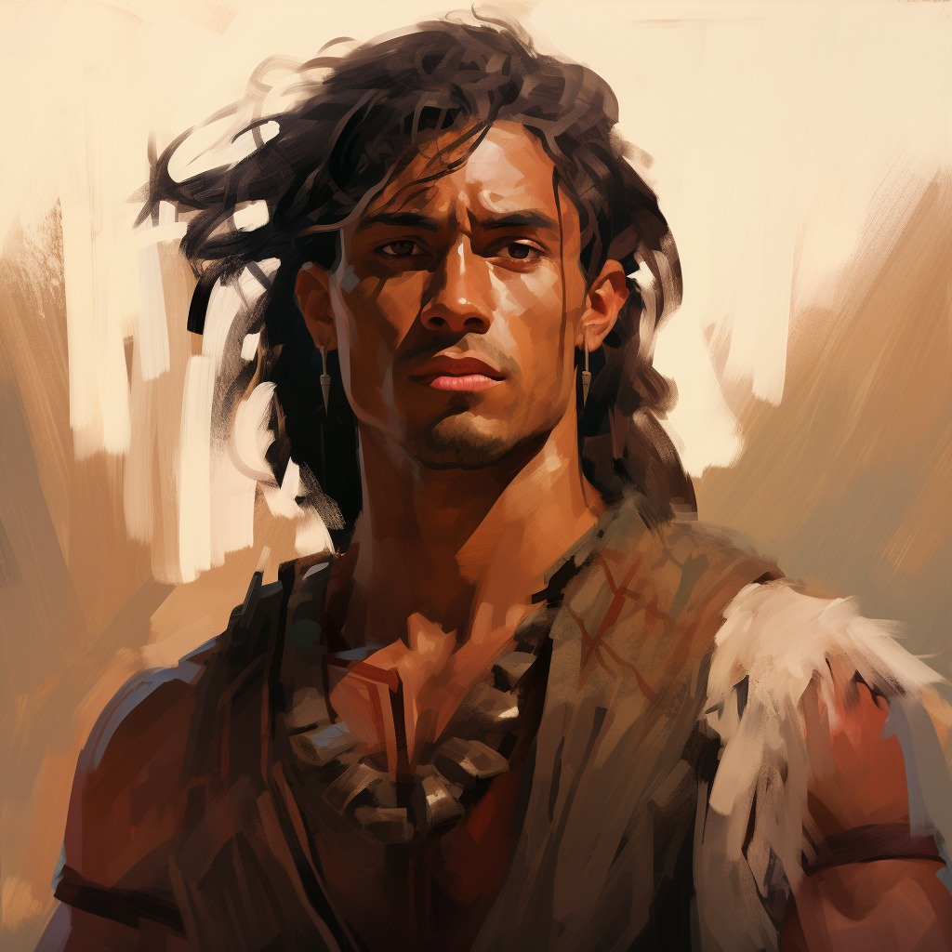
Combined Forces
Then, with their united army and the help of other Nephite forces, Moroni and Pahoran retook the remaining cities that had been lost to the Lamanites.
Some Lamanites joined with the People of Ammon.
They went to the land of Moroni and camped around the borders.
The Fate of Teancum
“…he did cast a javelin at him (Ammoron), which did pierce him near the heart. But behold, the king did awaken his servants before he died, insomuch that they did pursue Teancum, and slew him.”
They drove the Lamanites from the land and established peace among the people
Alma 62:14-42

Slide 60
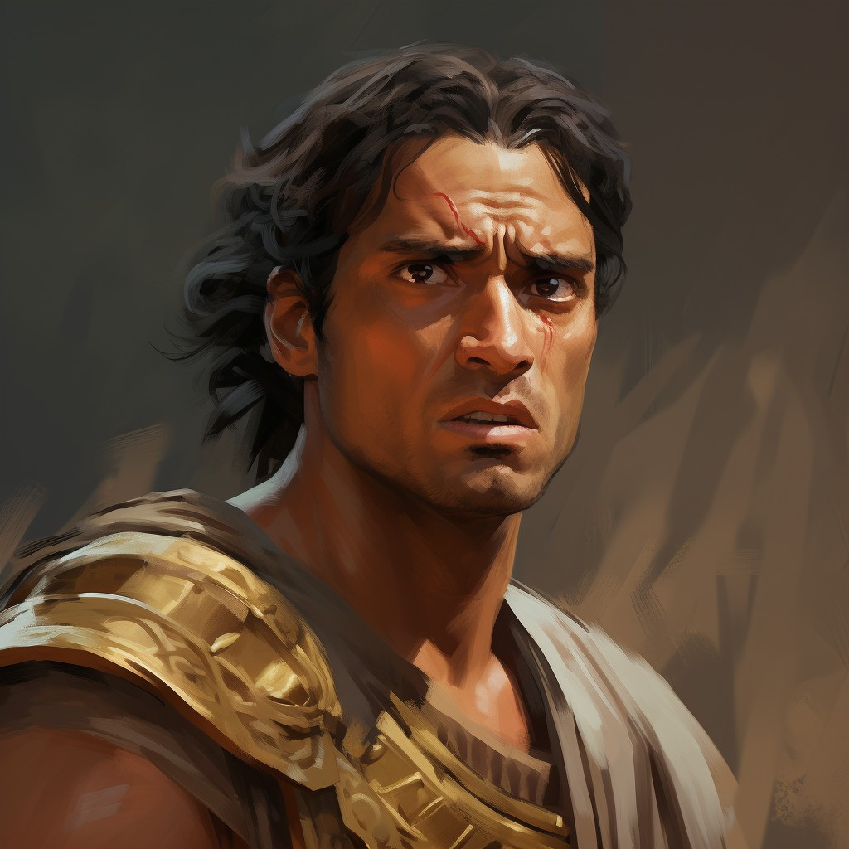
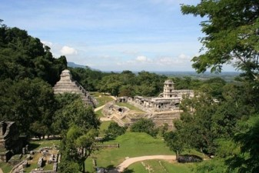
What Happened To…
And Moroni yielded up the command of his armies into the hands of his son, whose name was Moronihah; and he retired to his own house that he might spend the remainder of his days in peace.
And Pahoran did return to his judgment-seat; and Helaman did take upon him again to preach unto the people the word of God; for because of so many wars and contentions it had become expedient that a regulation should be made again in the church.
Therefore, Helaman and his brethren went forth, and did declare the word of God with much power unto the convincing of many people of their wickedness, which did cause them to repent of their sins and to be baptized unto the Lord their God.
He died in the 35th year of the Reign of the Judges
And it came to pass that they did establish again the church of God, throughout all the land.
Alma 62:43-46
James H. Fullmer

Slide 61
Prosper in the Land
Alma 62:48-51

Slide 62
Alma to Helaman then to Shiblon
Alma 63:1

Slide 63
Migrating Northward
Many Nephites started to migrate northward, by land and by sea.
Shiblon conferred the sacred records to Helaman.
Captain Moroni died, and his son Moronihah led an army that drove back another Lamanite attack.
North
Alma 63

Slide 64
Moronihah
He was the son of Captain Moroni
He succeeded his father as commander of the Nephite armed forces around 60 BC
He received superior training from his father—in strategy, leadership, and love of God and liberty.
His initial battle came when the Lamanites, under the Nephite dissenter Coriantum, succeeded in overpowering the capital city of Zarahemla in the year 51 BC
He and Lehi were able to repel the Lamanites and expel them from the land, Coriantum was killed during this time
In 34 BC , again the dissenters and the Lamanites started to battle and forced Moronihah upward toward Bountiful
The Nephites were able to regain half of their cities
He and the sons of Helaman, Nephi and Lehi, preached repentance to the people---there was a decline of spirituality and faith among the Nephites
Who’s Who

Slide 65
Hagoth
He was a Nephite who migrated with 4,400 men women and children north around 56 BC
He built a large ship on the borders of the land Bountiful by the land Desolation and launched it forth into the west sea
Many Nephites set sail northward on this ship, carrying abundant provisions.
1 year later he built other ships and carried many more people northward but was not heard from again.
It is not clear that he was among the passengers of the ships he built
Who’s Who

Slide 66
Hagoth and His Descendant
Latter-day prophets have said that Hagoth’s people settled on the islands that are now known as New Zealand.
To Saints in New Zealand:
“You brothers and sisters from New Zealand, I want you to know that you are from the people of Hagoth”
Joseph F. Smith
In the dedicatory prayer for the Hamilton New Zealand Temple: “We express gratitude that to these fertile Islands Thou didst guide descendants of Father Lehi, and hast enabled them to prosper”
President David O. McKay
“It is reasonable to conclude that Hagoth and his associates were about nineteen centuries on the islands, from about 55 B.C. to 1854 before the gospel began to reach them. They had lost all the plain and precious things which the Savior brought to the earth, for they were likely on the islands when the Christ was born in Jerusalem.”
President Spencer W. Kimball
Alma 63:4-10

Slide 67
The End of the Account of Alma
39th Year of the Reign of the Judges
Many people went forth into the land northward.
Shiblon died
Corianton had gone northward also in a ship carrying provisions
There were numerous wars against the people of Moronihah
“And thus ended the account of Alma, and Helaman his son, and also Shiblon, who was his son.”
Alma 63:9-17

Slide 68
Sources:
Book of Mormon Who’s Who by Ed J. Pinegar and Richard J. Allen pg. 61, 129-130, 152-153
David A. Bednar, “And Nothing Shall Offend Them,” Ensign or Liahona, Nov. 2006, 91, 92
Dallin H. Oaks, “Adversity,” Ensign, July 1998, 8.
Artist: James H. Fullmer
Joseph F. Smith about New Zealand (quoted by Spencer W. Kimball in Joseph Fielding McConkie and Robert L. Millet, Doctrinal Commentary on the Book of Mormon, vol. 3 [1991], 329).
David O. McKay (“Dedicatory Prayer Delivered by Pres. McKay at New Zealand Temple,” Church News, May 10, 1958, 2).
President Spencer W. Kimball (Temple View Area Conference Report, February 1976, 3; quoted in Joseph Fielding McConkie and Robert L. Millet, Doctrinal Commentary on the Book of Mormon, vol. 3, 329).
Presentation by ©http://fashionsbylynda.com/blog/

Slide 70
Referring to Alma 62:39–41, President Boyd K. Packer of the Quorum of the Twelve Apostles taught:
“The same testing in troubled times can have quite opposite effects on individuals. …
“Surely you know some whose lives have been filled with adversity who have been mellowed and strengthened and refined by it, while others have come away from the same test bitter and blistered and unhappy” (“The Mystery of Life,” Ensign, Nov. 1983, 18).
Elder Dallin H. Oaks of the Quorum of the Twelve Apostles explained that we choose how we will respond to adversity:
“Surely these great adversities are not without some eternal purpose or effect. They can turn our hearts to God. … Even as adversities inflict mortal hardships, they can also be the means of leading men and women to eternal blessings.
“Such large-scale adversities as natural disasters and wars seem to be inherent in the mortal experience. We cannot entirely prevent them, but we can determine how we will react to them. For example, the adversities of war and military service, which have been the spiritual destruction of some, have been the spiritual awakening of others. The Book of Mormon describes the contrast:
“‘But behold, because of the exceedingly great length of the war between the Nephites and the Lamanites many had become hardened, because of the exceedingly great length of the war; and many were softened because of their afflictions, insomuch that they did humble themselves before God, even in the depth of humility’ (Alma 62:41).
“I read of a similar contrast after the devastating hurricane that destroyed thousands of homes in Florida some years ago. A news account quoted two different persons who had suffered the same tragedy and received the same blessing: each of their homes had been totally destroyed, but each of their family members had been spared death or injury. One said that this tragedy had destroyed his faith; how, he asked, could God allow this to happen? The other said that the experience had strengthened his faith. God had been good to him, he said. Though the family’s home and possessions were lost, their lives were spared and they could rebuild the home. For one, the glass was half empty. For the other, the glass was half full. The gift of moral agency empowers each of us to choose how we will act when we suffer adversity” (“Adversity,” Ensign, July 1998, 7–8).
Dedication of Hamilton New Zealand Temple:
“We express gratitude that to these fertile Islands Thou didst guide descendants of Father Lehi, and hast enabled them to prosper” (David O. McKay, “Dedicatory Prayer Delivered by Pres. McKay at New Zealand Temple,” Church News, May 10, 1958, 2).

