Slide 1
Alma 8-12

Slide 2
Quickly I’ll Obey
Alma 8
Aaron
Ammonihah

Slide 3
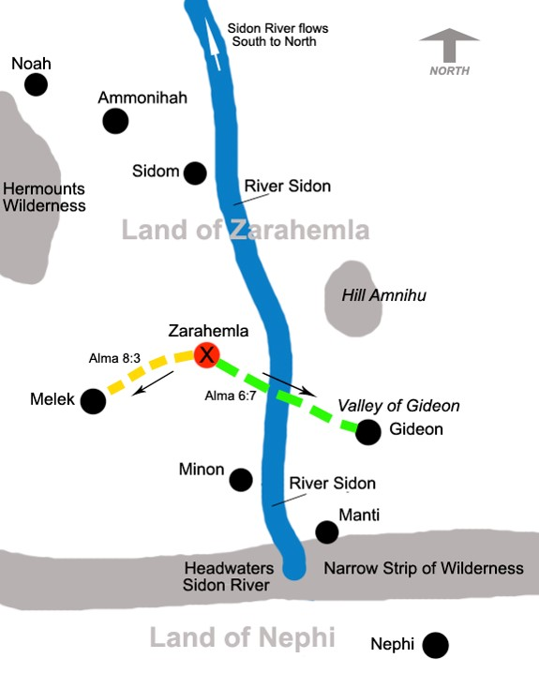
The 10th Year of the Reign of the Judges
Alma preaches in Zarahemla, Gideon, Melek
Alma baptizes many
Alma 8:1-5

Slide 4
Ammonihah
Alma goes to Ammonihah
Ammonihah was a cosmopolitan city with both Nephite and non-Nephite citizens— the religion was possibly after the order of Nehor—see article
Alma 8:1-5

Slide 5
Ammonihahites
They were those who dwelled in the city of Ammonihah
The inhabitants of the city rejected the gospel delivered by Alma and Amulek
The wicked population was destroyed in 81 BC by invading Lamanites (Alma 16:9)
Ammonihah was a cosmopolitan city with both Nephite and non-Nephite citizens. (see article)
Who’s Who

Slide 6
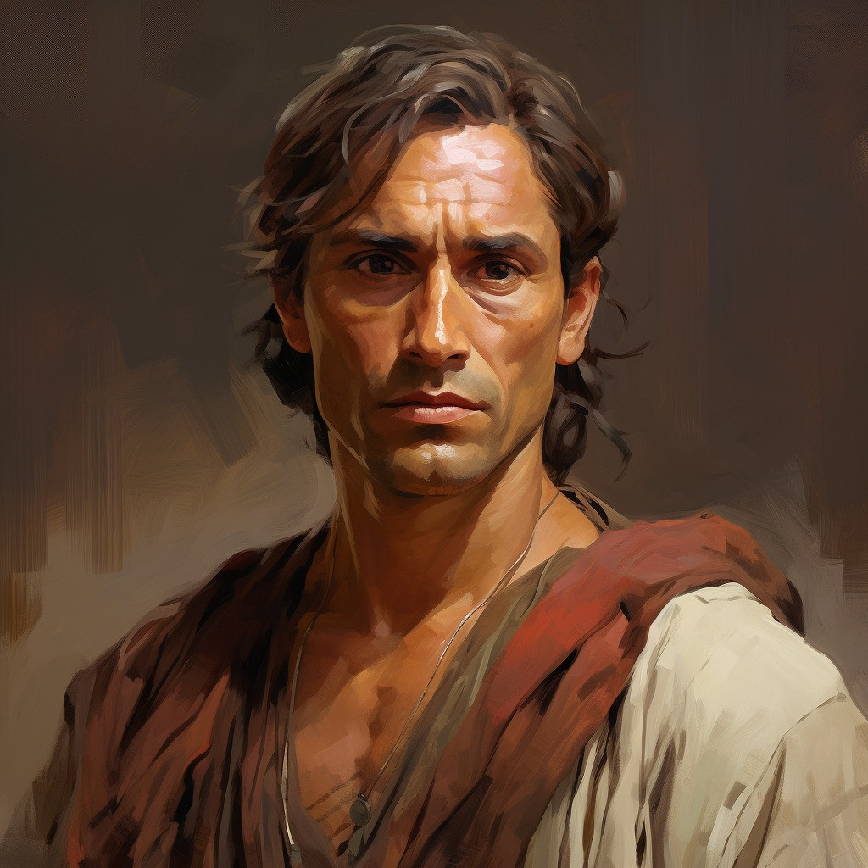
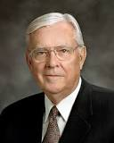
Ammonihah
Alma goes to Ammonihah and is rejected
Satan had a “Great Hold” upon the hearts of the people
Alma labored much in the spirit…wrestling with God in mighty prayer
For their repentance
Mighty Prayer
“I recognize that, on occasion, some of our most fervent prayers may seem to go unanswered. We wonder, ‘Why?’ I know that feeling! I know the fears and tears of such moments. But I also know that our prayers are never ignored. Our faith is never unappreciated. I know that an all-wise Heavenly Father’s perspective is much broader than is ours. While we know of our mortal problems and pain, He knows of our immortal progress and potential.”
Elder Russell M. Nelson
Alma 8:7-18

Slide 7
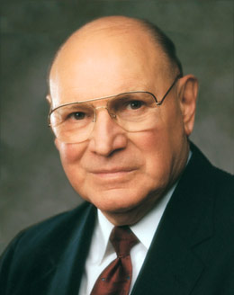
Effectiveness of Prayers
How close do you feel to your Heavenly Father?
Do you feel that your prayers are answered?
Do you feel that the time you spend in prayer enriches and uplifts your soul?
Is there room for improvement?

Slide 8
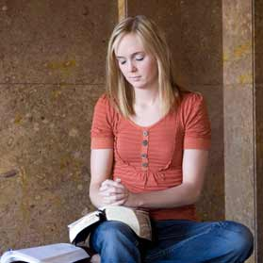
Vain Repetitions
“There are many reasons our prayers lack power. Sometimes they become routine. Our prayers become hollow when we say similar words in similar ways over and over so often that the words become more of a recitation than a communication. This is what the Savior described as ‘vain repetitions’ (Matthew 6:7). Such prayers, He said, will not be heard. …
“Do your prayers at times sound and feel the same? Have you ever said a prayer mechanically, the words pouring forth as though cut from a machine? Do you sometimes bore yourself as you pray?
“Prayers that do not demand much of your thought will hardly merit much attention from our Heavenly Father. When you find yourself getting into a routine with your prayers, step back and think. Meditate for a while on the things for which you really are grateful.”
Joseph B. Wirthlin

Slide 9
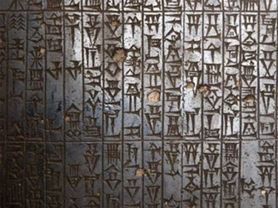
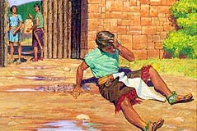
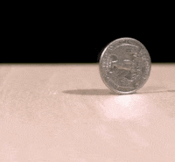
Revile, Spit Upon, and Cast Out
Where righteousness reigned in a Nephite society the people were allowed to worship or believe as they chose, as long as their behavior stayed within legal bounds
The Law:
“Nevertheless, they durst not lie, if it were known, for fear of the law, for liars were punished; therefore they pretended to preach according to their belief; and now the law could have no power on any man for his belief.”
Alma 1:17
Weighed Down With Sorrow
Alma has been on “two sides of the coin”. He has known of sin and the repentance process and the remittance of sin. His sorrow is for the wicked and knows of the unspeakable joy of restoration to righteousness which he desires the people to have.
Alma 8:14-16

Slide 10
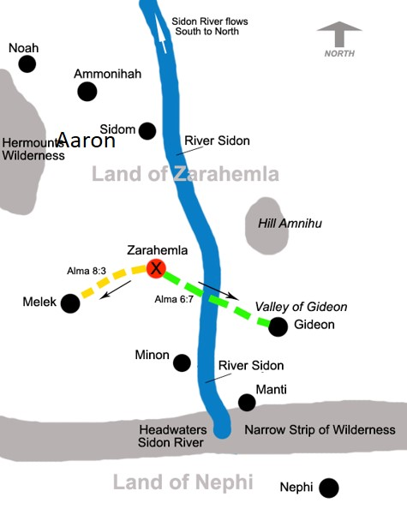
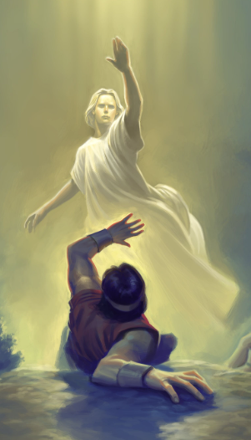
Alma’s Return
Alma is cast out and heads toward the city called Aaron
An Angel appears to Alma
“Blessed art thou, Alma; therefore, lift up thy head and rejoice, for thou hast great cause to rejoice; for thou hast been faithful in keeping the commandments of God from the time which thou receivedst thy first message from him. Behold, I am he that delivered it unto you.”
“And behold, I am sent to command thee that thou return to the city of Ammonihah, and preach again unto the people of the city; yea, preach unto them. Yea, say unto them, except they repent the Lord God will destroy them.”
Alma returns Speedily and enters by another way into the city of Ammonihah
Alma 8:14-16

Slide 11
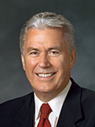
When individuals choose to turn away from the Lord, we can ask God in mighty prayer that He will pour out His Spirit upon them.
“Faith is powerful, and often it does result in miracles. But no matter how much faith we have, … it cannot violate another person’s agency.
“One woman prayed for years that her wayward daughter would return to the fold of Christ and felt discouraged that her prayers had seemingly gone unanswered. This was especially painful when she heard stories of other prodigal children who had repented of their ways.
“The problem was not a lack of prayers or a shortage of faith. She needed only to understand that, as painful as it might be for our Father in Heaven, He will not force anyone to choose the path of righteousness. …
“God will invite, persuade. God will reach out tirelessly with love and inspiration and encouragement. But God will never compel—that would undermine His great plan for our eternal growth”
Dieter F. Uchtdorf
Alma 8:11-13

Slide 12
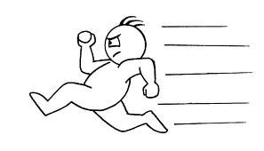
“However much faith to obey God we now have, we will need to strengthen it continually and keep it refreshed constantly. We can do that by deciding now to be more quick to obey and more determined to endure. Learning to start early and to be steady are the keys to spiritual preparation. …
“… A loving Heavenly Father and His Beloved Son have given us all the help They can to pass the test of life set before us. But we must decide to obey and then do it.
We build the faith to pass the tests of obedience over time and through our daily choices. We can decide now to do quickly whatever God asks of us. And we can decide to be steady in the small tests of obedience which build the faith to carry us through the great tests, which will surely come”
President Henry B. Eyring

Slide 13
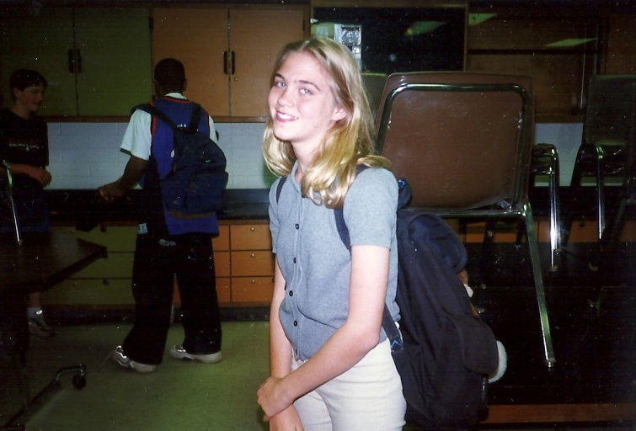
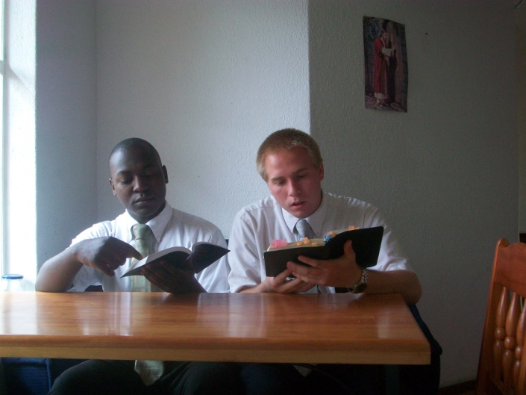
How Quick Are We to Obey?
1. As a young woman is leaving for school, her mother asks her to wear a more modest shirt.
2. In an interview with his bishop, a new priest is challenged to earn the Duty to God Award.
If we choose to obey the Lord’s direction promptly, then we can bring blessings into the lives of others
3. Two missionaries feel impressed during their daily planning session to visit a less-active family in which the mother is not a member of the Church.

Slide 14
Amulek
He was the son of Giddonah, who was the son of Ishmael, a descendant of Aminadi…who interpreted the writing which was upon the wall of the temple…and Aminadi was a descendant of Nephi. (Alma 10:2-3)
He was a Nephite in the city of Ammonihah
He was a prominent citizen and wealthy
He received a visit from an angel about Alma around 82 BC
He offered Alma food and shelter
Amulek and Alma preached repentance to the people in the city of Ammonihah
Amulek assisted Alma in confounding the lawyer Zeezrom through inspiration.
Amulek and Alma were cast into prison
They were delivered out of their enemies' hands by the Lord
The Lord commanded them to leave the city of Ammonihah
Amulek and Alma were companions preaching among the Nephites
Who’s Who

Slide 15
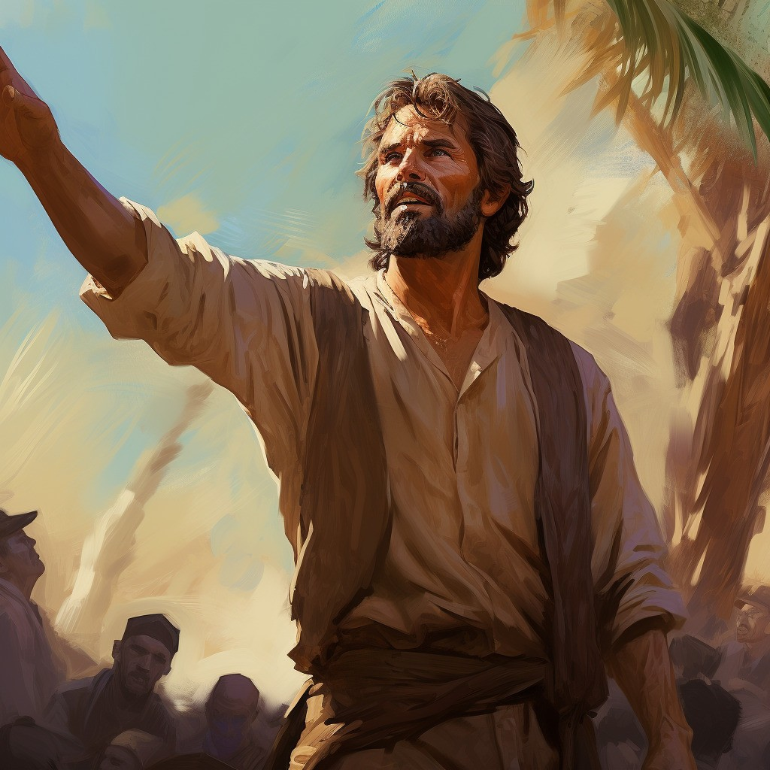
Repent Ye, For Thus Saith the Lord
Alma and Amulek Preach Repentance
“And Alma went forth, and also Amulek, among the people, to declare the words of God unto them; and they were filled with the Holy Ghost.
And they had power given unto them, insomuch that they could not be confined in dungeons; neither was it possible that any man could slay them; nevertheless they did not exercise their power until they were bound in bands and cast into prison. Now, this was done that the Lord might show forth his power in them.
And it came to pass that they went forth and began to preach and to prophesy unto the people, according to the spirit and power which the Lord had given them.”
Alma 8:30-32

Slide 16
Sources:
Ammonihah—see article
Who’s Who Book of Mormon by Ed J. Pinegar and Richard J. Allen pg. 21 and 23-24
Elder Russell M. Nelson (“Jesus Christ—the Master Healer,” Ensign or Liahona, Nov. 2005, 86).
Dieter F. Uchtdorf, “Fourth Floor, Last Door,” Ensign or Liahona, Nov. 2016, 16–17
Joseph B. Wirthlin, “Improving Our Prayers” [Brigham Young University devotional, Jan. 21, 2003], 2, speeches.byu.edu
President Henry B. Eyring(“Spiritual Preparedness: Start Early and Be Steady,” Ensign, Nov. 2005, 38, 40).
Presentation by ©http://fashionsbylynda.com/blog/

Slide 17
The name Ammonihah is a Book of Mormon toponym referenced 26 times in the text. 1 of those references is in the book of Helaman. The other 25 citations are all in the book of Alma. Ammonihah first appears by name in Mormon's compendium in the 10th year of the reign of the judges (ca. 82 BC). The city was obliterated in a brutal Lamanite invasion in the 11th year of the reign of the judges (ca. 81 BC) and it lay unoccupied and in ruins for several years as required by the law of apostate cities in Deuteronomy 13:12-16. (See John W. Welch, "The Destruction of Ammonihah and the Law of Apostate Cities" in Reexploring The Book of Mormon, Salt Lake City: Deseret Book & FARMS, 1992, chapter 50. By the 19th year of the reign of the judges (ca. 72 BC) the city had been partially rebuilt. It figures in the war with the Lamanites under Amalickiah and is never mentioned again except as an historical referent. Another name for Ammonihah is "Desolation of Nehors"Alma 16:11. Nehor and his successor, Amlici, are both important in the discussion. The locus of their power base centered in Ammonihah Alma 15:15. The recent realization (by Royal Skousen) that all 19 occurrences of the word "Amalekites" in the 1981 LDS text should read "Amlicites" (see the blog article entitled "Peripatetic Amlici") opens up a number of interesting implications for Ammonihah that have yet to be fully explored. The city of Ammonihah was in the land of Ammonihah Alma 8:18.
Ammonihah was a cosmopolitan city with both Nephite and non-Nephite citizens. This implies a trade route location 6 with non-Nephite enclaves or proximity to a major non-Nephite region. Alma 8:20. Amulek's comment also reflects the Amlicite partition Alma 2:11 five years earlier and its aftermath Alma 3:11 with religious connotations.
The economy was flourishing in Ammonihah. This is evidenced by Amulek's comment that he had neglected spiritual matters because he was so busy making money. Alma 10:4, 5. It is further evidenced by the extreme hubris of the natives Alma 16:9 and the strength of the local legal profession Alma 10:31, 32.
Nehor was executed for the murder of Gideon in the first year of the reign of the judges (ca. 91 BC) Alma 1:15, but his apostate belief system survived him Alma 1:16. At the time of his death, Nehor had recently founded a church Alma 1:6. Where was Nehor's church located? It was in the city of Ammonihah Alma 14:16, 18; Alma 15:15; Alma 16:11. Therefore, when Nehor was travelling to preach to his believers & supporters Alma 1:7, he was headed to Ammonihah. We previously established that Nehor slew Gideon in the valley of Gideon (see the article entitled "Gideon" in this blog) because Gideon was a church leader Alma 1:7 in his eponymous valley defending his fellow church members from heresy and apostasy. We know that Gideon was one of the seven churches founded by Alma₁ ca. 120 B.C. (see the blog article "The Church in Zarahemla"). From this we deduce that the valley of Gideon was en route from the local land of Zarahemla to Ammonihah. 7 This means Ammonihah was east of river Sidon 8. See the article "The Usumacinta/Sidon Correlation" in this blog for a great deal more information about Ammonihah east of Sidon and the implications of that important discovery first noted by V. Garth Norman.
http://bookofmormonresources.blogspot.com/2011/12/ammonihah.html

Slide 18
Alma and Amulek Confirming Witness
Alma 9-10

Slide 19
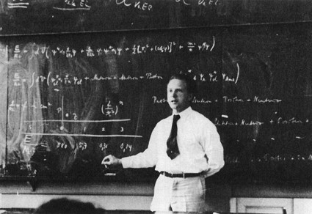
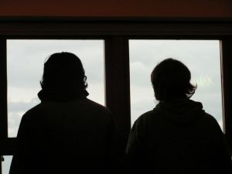
A Surprise Test
A teacher announces that there is a surprise test
Student A has been in class everyday
Student B has been absent the last two weeks
Which Student will do better on the test?
Why?
How well did the people of Ammonihah understand the gospel and the power of God?
Alma 9

Slide 20
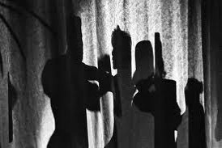
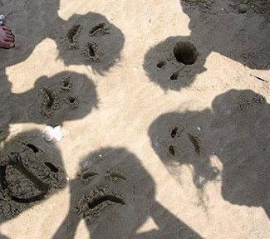
What They Did Not Understand:
The prophecy that the Lord would destroy the city one day--‘knew not that the earth should pass away’
They had forgotten ‘the tradition of their fathers’
They had forgotten the commandments of God
They had forgotten how they had been delivered out of the hands of their enemies
What are some reasons you forget what you have learned?
Too young
Not paying attention…focused on other things
Struggling with your testimony and faith
Not being patient with yourself, others, and Heavenly Father
Not praying for the Holy Spirit
Alma 9:1-10

Slide 21
The difference between the Lamanites and the People of Ammonihah in their dealings with the Lord
The Spiritual Background of the People
What the Lord Expected of the People
What the Lord Promised the People
Lamanites
Alma 9:14-17
Cut off from Lord
They will learn of their incorrect traditions and repent
The Lord will be more merciful and prolong their existence
People of Ammonihah
Alma 9:18-24
They knew of the commandments but did not keep them
To not live in their iniquities, and repent
He would send the Lamanites upon them if they did not repent
Alma 9:14-24

Slide 22
Higher Expectations
For Those Who: sin against the light
For Those Who: walk in paths of wickedness when one has been enlightened by the spirit, has enjoyed its gifts, and has been heir to the promises of the Almighty—is to place oneself in a precarious position.
The Lord expects greater obedience from those who have received the knowledge and blessings of the gospel
“For of him unto whom much is given much is required; and he who sins against the greater light shall receive the greater condemnation.”
D&C 82:3
The more you know, the more you will be held accountable for
Alma 9:19-24

Slide 23
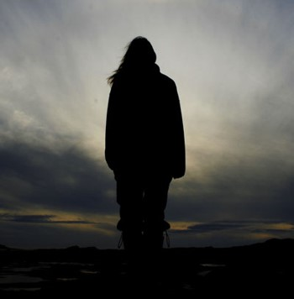
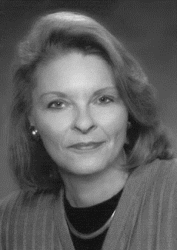
We are unique. We are unique because of our covenants, our spiritual privileges, and the responsibilities attached to both. We are endowed with power and gifted with the Holy Ghost. We have a living prophet to guide us, ordinances that bind us to the Lord and to each other, and the power of the priesthood in our midst.
We understand where we stand in the great plan of happiness. And we know that God is our Father and that His Son is our unfailing Advocate.
“With these privileges comes great responsibility, for ‘unto whom much is given much is required’”
Sheri L.Dew

Slide 24
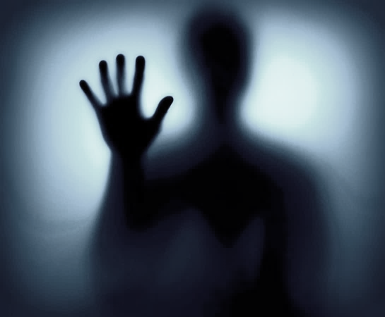
Highly Favored People
They were visited by the Spirit of God
They conversed with angels
They were spoken unto by the voice of the Lord
They had the spirit of prophecy
They had the spirit of revelation
They had the gift of speaking with tongues
They had the gift of preaching
They had the gift of the Holy Ghost
They had the gift of translation
Alma 9:20-21

Slide 25
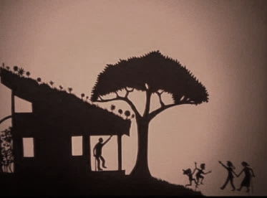
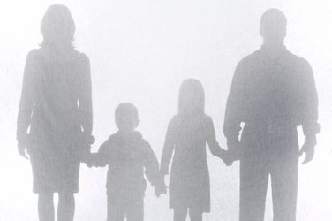
Gifts and Blessings of Today
What Gifts have you been given because you are a member of the Church of Jesus Christ of Latter-day Saints?
When have you felt that you were blessed because you obeyed a call from the Lord?
How have you seen blessings come to others because you or someone else responded to the Lord’s call?
How do these experiences influence your desire to listen for and obey calls from the Lord?

Slide 26
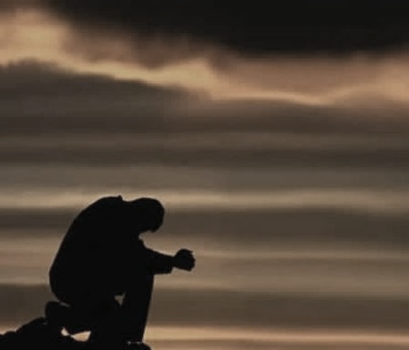
Quick to Hear
Alma:
“And not many days hence the Son of God shall come in his glory; and his glory shall be the glory of the Only Begotten of the Father, full of grace, equity, and truth, full of patience, mercy, and long-suffering, quick to hear the cries of his people and to answer their prayers.”
“Proper prayers are made to the Father, in the name of the Son, by the power of the Holy Ghost. The Father answers prayers, but he does it through the Son, into whose hands he has committed all things.”
Bruce R. McConkie
Alma 9:26

Slide 27
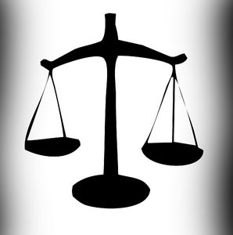
To Redeem—A Reward
“…that ye are willing to repent of your sins and enter into a covenant with him to keep his commandments, and witness it unto him this day by going into the waters of baptism.”
Alma 7:15
Those who have been baptized…to take upon themselves the name of Christ..to accept and apply their lives to His atoning sacrifice
A Law of Justice:
“Each individual would be judged by his individual acts. If he did well, then he would receive the reward of exaltation, and those who were faithful and true would become the sons and daughters of God and dwell eternally with him as his hears entitled to the fulness of his kingdom.”
Joseph Fielding Smith
Alma 9:27-28; Romans 8:12-18

Slide 28
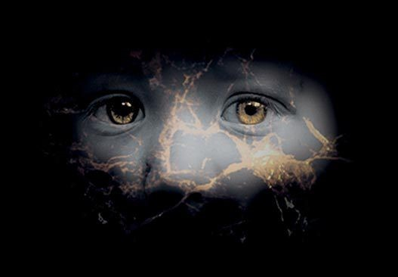
Lost and Fallen
Angel’s voice:
“And now, my beloved brethren, for ye are my brethren, and ye ought to be beloved, and ye ought to bring forth works which are meet for repentance, seeing that your hearts have been grossly hardened against the word of God, and seeing that ye are a lost and a fallen people.”
Lehi:
“Wherefore, all mankind were in a lost and in a fallen state, and ever would be save they should rely on this Redeemer.”
1 Nephi 10:6
Alma 9:29-30

Slide 29
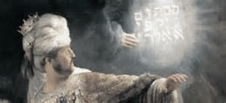
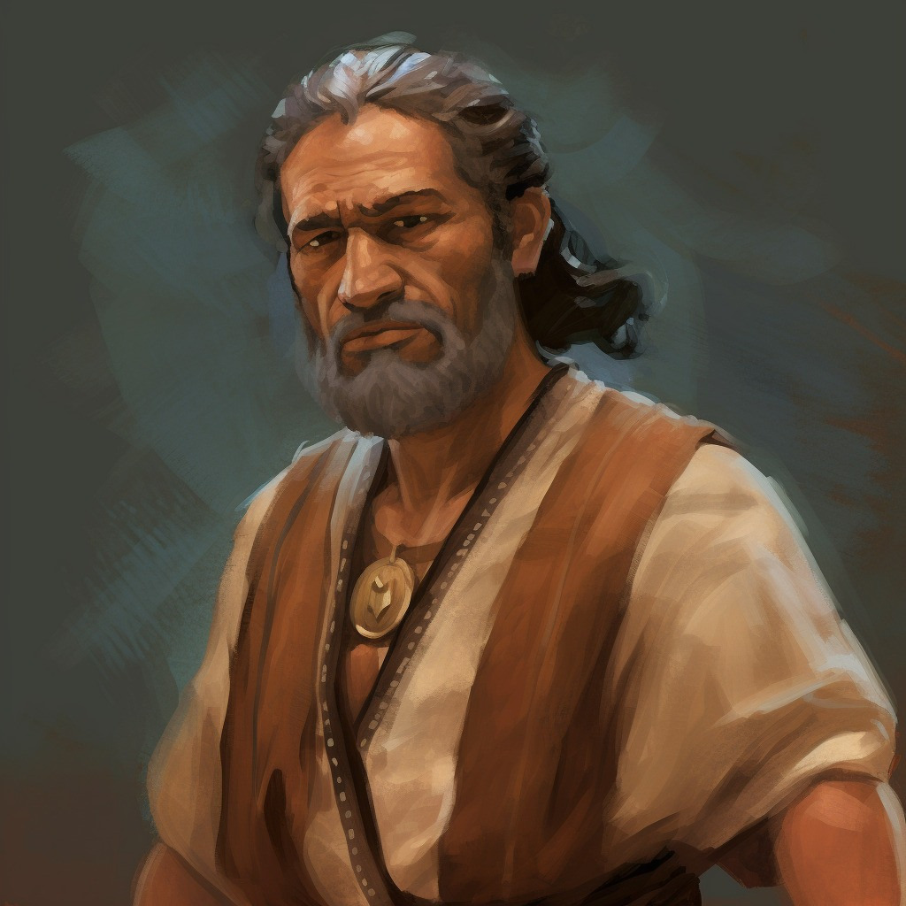
Amulek’s Witness
Amulek gives an account of his genealogy and reminds them of who he is…his reputation
Amulek mentions his ancestor Aminadi who interpreted the writing which was upon the wall of the temple, which was written by the finger of God
Aminadi was a descendant of Nephi, Lehi, Manasseh who was son of Joseph (the one sold into Egypt)
Alma 10:2-4

Slide 30
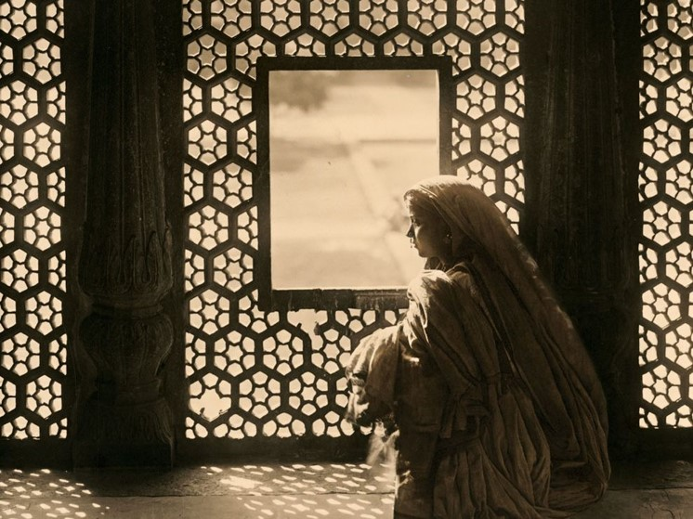
An Influence
Would it be helpful in a community to be well known and have a good reputation?
“I prefer not to think of reputation as a superficial facade, attempting to indicate depth where there is only shallowness, honesty where there is deceit, or virtue where there is unrighteousness. Rather, I like to think of reputation as a window, clearly exhibiting the integrity of one’s soul. It is through this integrity of thought and integrity of conduct that we become pure and holy before the Lord. It is in this state that we can be most effective in serving our fellowmen.”
O. Lesley Stone
Alma 10:2-4

Slide 31
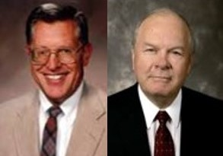
Wake-Up Calls
I would not hear and I would not know?
“The voice of the Lord calls to us regularly. It is not wickedness which keep us from feeling and hearing the word; it is preoccupation.”
JFM and RLM
Keeping focused on the things of the Lord will help us in our daily endeavors.
Sometimes we need an alarm to remind us of who we are and what we represent
Alma 10:5-6

Slide 32
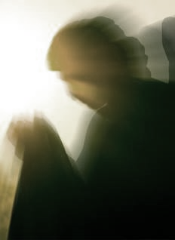
Amulek’s Angel
“As I was journeying to see a very near kindred, behold an angel of the Lord appeared unto me and said: Amulek, return to thine own house, for thou shalt feed a prophet of the Lord; yea, a holy man, who is a chosen man of God; for he has fasted many days because of the sins of this people, and he is an hungered, and thou shalt receive him into thy house and feed him, and he shall bless thee and thy house; and the blessing of the Lord shall rest upon thee and thy house.”
Alma was the Holy Man the angel had spoken of
Alma had blessed Amulek’s household…”the Lord hath rested upon us according to the words which he spake…”
Alma 10:7-11

Slide 33
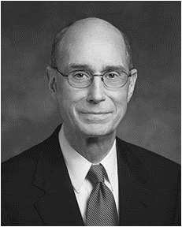
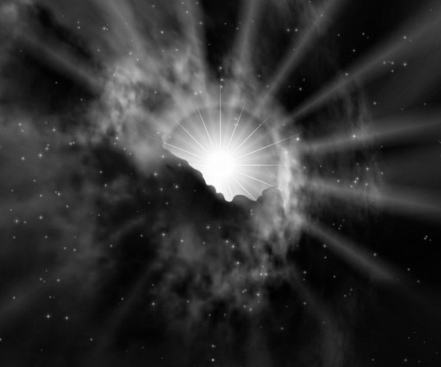
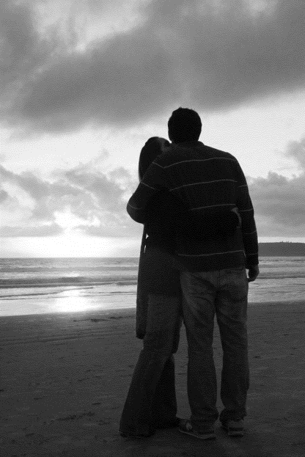
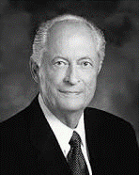
When the Spirit Dwells With Us
You have felt the quiet confirmation in your heart and mind that something was true. And you knew that it was inspiration from God. …
The Holy Ghost is the Spirit of Truth. You feel peace, hope, and joy when it speaks to your heart and mind that something is true. Almost always I have also felt a sensation of light.
Any feeling I may have had of darkness is dispelled. And the desire to do right grows.
Henry B. Eyring
“The key to strengthening our families is having the Spirit of the Lord come into our homes. The goal of our families is to be on the strait and narrow path.”
Robert D. Hales

Slide 34
When we hear and obey the Lord’s call, blessings come to us and to others.
Alma 10:11-12

Slide 35
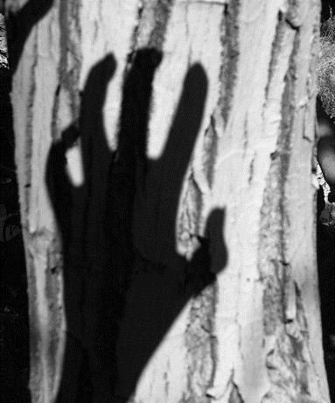
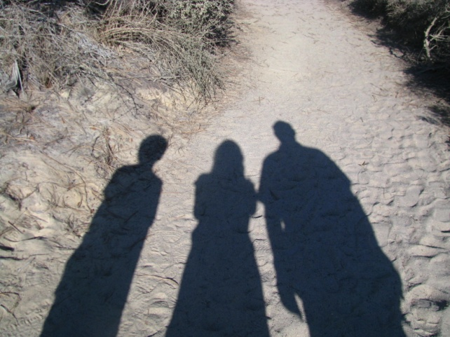
Those Who Oppose
1. Become angry and defensive
2. Doubt the importance of the counsel
3. Criticize the person who gave the counsel
4. Question or debate the counsel
How do you respond to being corrected by a:
Parent?
Teacher?
Church Leader?
Alma 10:7-11

Slide 36
Responding to the Messages
Alma 9:2-3
Alma 9:4-5
Alma 10:13
Alma 10:16-17
Alma 10:24
Alma 10:28-30
They did not believe in the testimony of one man, and they did not understand the words
They did not believe their city could be destroyed…they did not believe God would do this ‘marvelous’ thing
They thought they could catch their words by trickery…that they might find false against them…to slay them or put them in prison
That they might find their words contradictory
They said that they reviled against their laws
They called Amulek a ‘child of the devil’ and that he lied to them

Slide 37
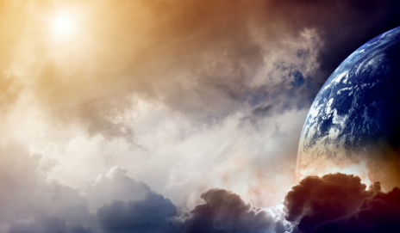
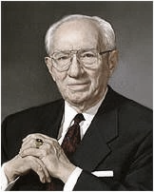
“There is so much of evil everywhere. Temptation, with all its titillating influences, is about us everywhere. We lose some to these destructive forces, unfortunately. We sorrow over every one that is lost.
We reach out to help them, to save them, but in too many cases our entreaties are spurned. Tragic is the course they are following. It is the way which leads down to destruction.”
Gordon B. Hinckley

Slide 38
Sources:
Sheri L. Dew (D&C 82:3)” (“We Are Women of God,” Ensign, Nov. 1999, 98)
Joseph Fielding Smith Answers to Gospel Questions Vol 2 pg. 194
O. Leslie Stone The Importance of Reputation Oct. 1975 General Conf.
Joseph Fielding McConkie and Robert L. Millet Doctrinal Commentary on the Book of Mormon Vol. 3 pg. 68
Robert D. Hales Strengthening Families: Our Sacred Duty April 1999 Gen. Conf
Henry B. Eyring Sep. 10, 2006 • Devotional Gifts of the Spirit for Hard Times
Gordon B. Hinckley (“My Testimony,” Ensign, May 2000, 69).
Presentation by ©http://fashionsbylynda.com/blog/

Slide 39
 | The Spiritual Background of the People | What the Lord Expected of the People | What the Lord promised the People
Lamanites Alma 9:14-17
People of Ammonihah Alma 9:18-24

Slide 40
Amulek and Zeezrom
Alma 11

Slide 41
Zeezrom
He was a lawyer in the city of Ammonihah
He was introduced in the Book of Mormon around 82 BC
He was in business to ‘stir up the people to riotings…’ against Alma and Amulek
He questioned Alma and Amulek, to catch Alma and Amulek in contradictory statements
After much debate he grew more fearful that he had been wrong in his position
He recognized the truth of the gospel and repented along with many others
While Zeezrom lay with a burning fever, Alma and Amulek gave him a blessing
He was baptized by Alma and later went with Alma and Amulek to preach to the Zoramites in the land of Antionum, then to Zarahemla
Who’s Who

Slide 42
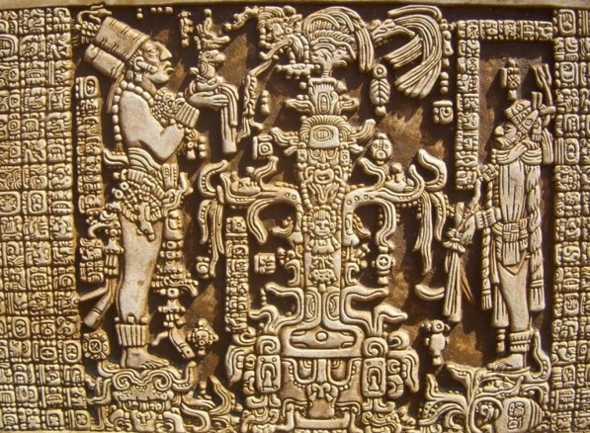
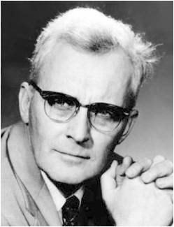
Judges and Laws
Lesson 76
The Man Was Compelled to Pay That Which He Owed, or Be Stripped, or Be Cast out from among the People:
The Judge Received for His Wages . . . a Senine of Gold . . . according to the Law:
Lesson 76
“It seems that in the ancient court the judge had to be paid before you were let out of prison. It says here that the judges' pay was one senine a day. Later on it tells us in 3 Nephi 12:26 that you won't come out of prison until you have paid the last senine. They won't let you out until you have paid the judges. The judge is paid if nothing else. That's exactly the system we have in the Book of Mormon.”
Hugh W. Nibley
Alma 11:2-3

Slide 43
A Measure of Money
Lesson 76
The Nephites had adopted their own money system according to their weights and not by the customary Jewish monetary system around the time of King Mosiah and the Reign of the Judges
Lesson 76
Alma 11:4-19 see handouts

Slide 44
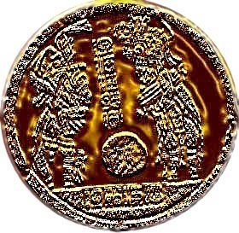
Expert in the Devil
Lesson 76
Zeezrom’s offer to Alma and Amulek:
Lesson 76
An onti was a piece of silver with the greatest value One onti was equal to approximately one week’s wages for a judge, which means that six onties was equal to about six weeks of wages for a judge.
A Lawyer would get more money based on the number of cases he participated in; as such lawyers would purposely cause disturbances among the people to initiate more court cases.
Alma 11:21

Slide 45
Lesson 76
When we rely on the Holy Ghost, we can overcome temptation.
Lesson 76
“It is not expected that you go through life without making mistakes, but you will not make a major mistake without first being warned by the promptings of the Spirit. This promise applies to all members of the Church. …
“If you are slipping into things that you should not slip into or if you are associating with people who are pulling you away in the wrong direction, that is the time to assert your independence, your agency. Listen to the voice of the Spirit, and you will not be led astray.
“… As a servant of the Lord, I promise that you will be protected and shielded from the attacks of the adversary if you will heed the promptings that come from the Holy Spirit.”
President Boyd K. Packer
Alma 11:22

Slide 46
The Dialogue
Lesson 76
Will you answer me a few questions?
According to the Spirit of God which is in me.
I will pay you 6 onties of silver to deny the existence of a Supreme Being
You can not tempt the righteous. I know you know that there is a God. 6 onties is a lot of money but I can not deny a true and living God.
Is there a true and living God?
Yes!
Is there more than one God?
No!
How do you know?
An angel has told me.
Lesson 76
Alma 11:21-31

Slide 47
Lesson 76
Who will come? Is it the Son of God?
Yes.
Can he save his people in their sins?
He can not.
See, he says there is one God, but the Son of God shall come and not save his people—as though he had authority to command God.
You have contradicted me…you said I have authority to command God…I said He will not save His people in their sins.
He can not save them in their sins…for I can not deny His word.
No unclean thing can enter into the Kingdom of Heaven
Is the Son of God the very Eternal God?
Yes…He is the very Eternal God of heaven and earth, and all things, He is the beginning and the end, the first and the last.
Lesson 76
Alma 11:32-39

Slide 48
Lesson 76
Exaltation
Eternal Life
One who qualifies to dwell with and be part of the Church of the Firstborn
Lesson 76
Salvation—to be saved
Salvation
Eternal Life
Life in the highest heaven with the Gods and angels
One’s saved condition—through the atoning sacrifice of Jesus Christ
Alma 11:40

Slide 49
Lesson 76
When we believe in Jesus Christ, we can be redeemed from our sins.
Lesson 76
“We need a strong faith in Christ to be able to repent. Our faith has to include a ‘correct idea of [God’s] character, perfections, and attributes.’
If we believe that God knows all things, is loving, and is merciful, we will be able to put our trust in Him for our salvation without wavering. Faith in Christ will change our thoughts, beliefs, and behaviors that are not in harmony with God’s will.”
President Dieter F. Uchtdorf
Alma 11:40

Slide 50
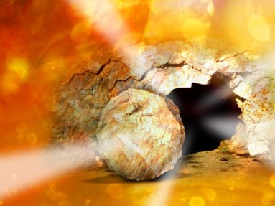
Resurrection and Judgment
Lesson 76
All people who live on the earth will eventually be resurrected.
“They can die no more; their spirits uniting with their bodies, never to be divided.”
Lesson 76
All people will be resurrected and will stand before God to be judged according to their works.
Alma 11:41-45

Slide 51
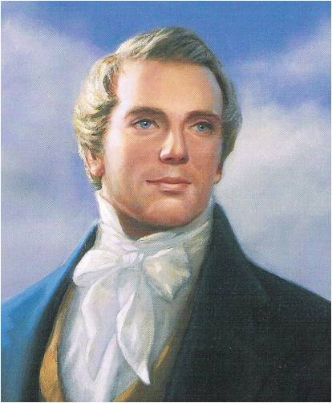
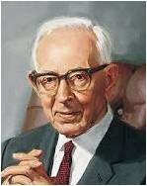
Lesson 76
“As concerning the resurrection, I will merely say that all men will come from the grave as they lie down, whether old or young; there will not be ‘added unto their stature one cubit.’ neither taken from it ; all will be raised by the power of God, having spirit in their bodies, and not blood.”
Joseph Smith
Lesson 76
The body will come forth as it is laid to rest, for there is no growth or development in the grave. As it is laid down, so will it arise, and changes to perfection will come by the law of restitution. But the spirit will continue to expand and develop, and the body, after the resurrection will develop to the full stature of man.”
Joseph Fielding Smith
“These changes will come naturally, of course but almost instantly.”
Alma 11:43

Slide 52
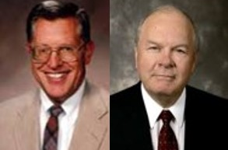
Lesson 76
“The resurrected body is physical, tangible, substantial. And yet it is spiritual, meaning immortal, not subject to death.”
JFM and RLM V3 pg 80
Lesson 76
“So also is the resurrection of the dead. It is sown in corruption; it is raised in incorruption:
It is sown in dishonour; it is raised in glory: it is sown in weakness; it is raised in power:
It is sown a natural body; it is raised a spiritual body. There is a natural body, and there is a spiritual body.”
1 Corinthian 15:42-44
Alma 11:45

Slide 53
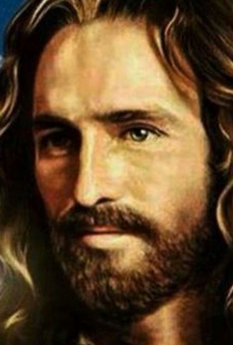
Lesson 76
“[Jesus Christ] acts as the Father in that he is the Creator of heaven and earth. …
“… The Savior himself made this triumphant announcement as he appeared to the Nephites in the New World:
“‘Behold, I am Jesus Christ the Son of God. I created the heavens and the earth, and all things that in them are. I was with the Father from the beginning. I am in the Father, and the Father in me; and in me hath the Father glorified his name’.
“Clearly, Christ—under the direction of his Father—is the Father of creation, the Creator of heaven and earth and all things that in them are.” Jeffrey R. Holland
Lesson 76
3 Nephi 9:15

Slide 54
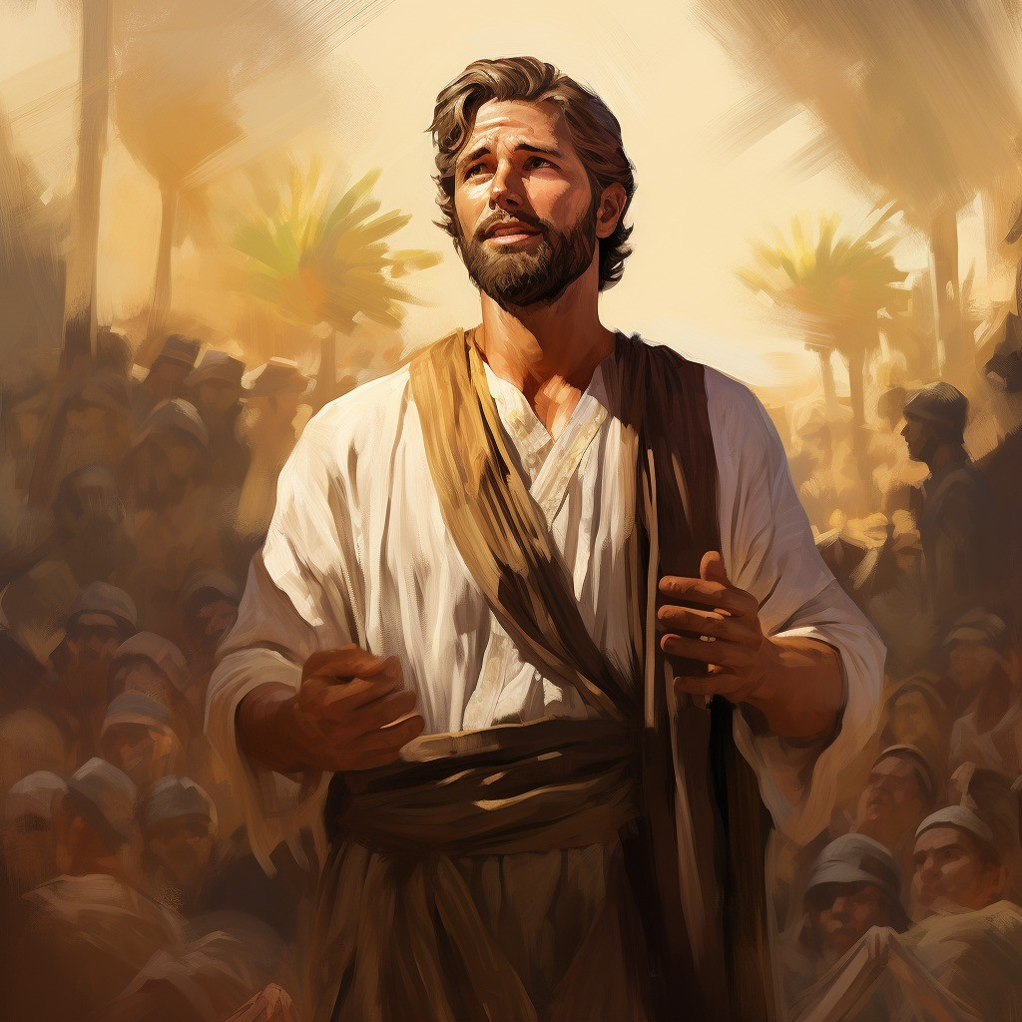
The Silence
Lesson 76
“Now, when Amulek had finished these words the people began to be astonished, and also Zeezrom began to tremble. And thus ended the words of Amulek, or this is all that I have written?”
Lesson 76
Alma 11:46

Slide 55
Sources:
Who’s Who in the Book of Mormon Ed J. Pinegar and Richard J. Allen pg. 191-192
Hugh W. Nibley, Teachings of the Book of Mormon, Semester 2, p. 316] Notes on John Welch, a teacher at BYU Law School
President Boyd K. Packer (“Counsel to Youth,” Ensign or Liahona, Nov. 2011, 18).
President Dieter F. Uchtdorf: (“Point of Safe Return,” Ensign or Liahona, May 2007, 100). Lectures on Faith [1985], 38
Joseph Smith Teachings pg. 199-200
Joseph Fielding Smith Improvement Era June 1904 and Doctrines of Salvation 2:293-94
Jeffrey R. Holland, Christ and the New Covenant: The Messianic Message of the Book of Mormon [1997], 184, 186.
Presentation by ©http://fashionsbylynda.com/blog/

Slide 56
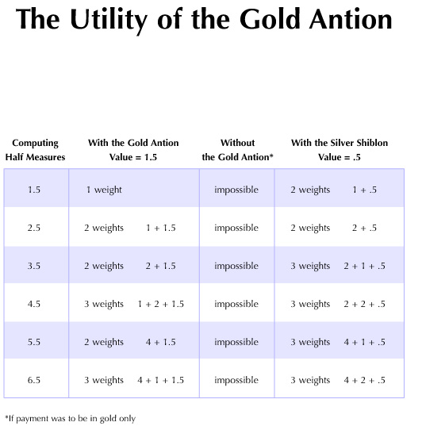
http://byustudies.byu.edu/book_of_mormon_charts/charts/111.aspx
http://byustudies.byu.edu/book_of_mormon_charts/charts/111.aspx

Slide 57
IS THERE MORE THAN ONE GOD? Alma 11:28
The Latter-day Saint doctrine of the Godhead (that the Father, the Son, and the Holy Ghost are three separate Personages who are perfectly unified in purpose and doctrine) has come under attack in the modern Christian world. Christians who trace their conception of God to fourth- and fifth-century creeds that declare the doctrine of the Trinity (that the Father, the Son, and the Holy Ghost are not separate beings) often question members of the Church about our unique conception of God. The question raised with its given answer in Alma 11:28–33 has also left many questioning the doctrine of the Godhead as outlined in the restored Church. Roy W. Doxey (1908–1992), assistant in the office of the Council of the Twelve and dean emeritus of Religious Instruction, Brigham Young University, explained a possible reason for Amulek’s answer that there is but one God:
“Is there more than one God? The question is often raised in response to Alma chapter 11, where Zeezrom, a critic, is contending with the missionary Amulek. …
“In order to understand Amulek’s statement [that there is but one true and living God], we must look at the full context. Throughout most of their history, many Israelites (forefathers of the Nephites) were eager to accept the numerous pagan gods of the Egyptians and Canaanites. Although the Book of Mormon is silent about the specific apostate notions held by the people in Zeezrom’s city of Ammonihah, it is clear that some apostate Nephites of Alma’s time were idolatrous—as some of their Israelite fathers had been. When Alma, Amulek’s missionary companion, was chief judge as well as high priest over the Church, he helped to establish a strong and faithful body of church members. Nevertheless, ‘those who did not belong to their church did indulge themselves in sorceries, and in idolatry.’ (Alma 1:32.) Apostasy was such a problem that Alma later gave up the judgment seat, ‘that he himself might go forth among his people, or among the people of Nephi, that he might preach the word of God unto them.’ (Alma 4:19.)
“As a missionary, Alma found that many of the people were steeped in idolatry. He discovered, for example, that the people in the city of Zoram ‘were perverting the ways of the Lord, and that Zoram, who was their leader, was leading the hearts of the people to bow down to dumb idols.’ (Alma 31:1.)
“This is the context, then, of the discussion Alma and Amulek had with Zeezrom. Seen in this light, Amulek’s answer is completely understandable and, of course, correct: There is only one ‘true and living God’—who shares none of his godhood with the hosts of false gods invented by man” (Roy W. Doxey, “I Have a Question” Ensign, Aug. 1985, 11).
Traditional Christian Trinity:
“Our first and foremost article of faith in The Church of Jesus Christ of Latter-day Saints is ‘We believe in God, the Eternal Father, and in His Son, Jesus Christ, and in the Holy Ghost’ [Articles of Faith 1:1]. We believe these three divine persons constituting a single Godhead are united in purpose, in manner, in testimony, in mission. We believe Them to be filled with the same godly sense of mercy and love, justice and grace, patience, forgiveness, and redemption. I think it is accurate to say we believe They are one in every significant and eternal aspect imaginable except believing Them to be three persons combined in one substance, a Trinitarian notion never set forth in the scriptures because it is not true. …
“In the year a.d. 325 the Roman emperor Constantine convened the Council of Nicaea to address—among other things—the growing issue of God’s alleged ‘trinity in unity.’ What emerged from the heated contentions of churchmen, philosophers, and ecclesiastical dignitaries came to be known (after another 125 years and three more major councils) [Constantinople, a.d. 381; Ephesus, a.d. 431; Chalcedon, a.d. 451] as the Nicene Creed, with later reformulations such as the Athanasian Creed. These various evolutions and iterations of creeds—and others to come over the centuries—declared the Father, Son, and Holy Ghost to be abstract, absolute, transcendent, immanent, consubstantial, coeternal, and unknowable, without body, parts, or passions and dwelling outside space and time. In such creeds all three members are separate persons, but they are a single being, the oft-noted ‘mystery of the trinity.’ They are three distinct persons, yet not three Gods but one. All three persons are incomprehensible, yet it is one God who is incomprehensible.
“We agree with our critics on at least that point—that such a formulation for divinity is truly incomprehensible. …
“We declare it is self-evident from the scriptures that the Father, the Son, and the Holy Ghost are separate persons, three divine beings, noting such unequivocal illustrations as the Savior’s great Intercessory Prayer … , His baptism at the hands of John, the experience on the Mount of Transfiguration, and the martyrdom of Stephen—to name just four [see John 17; Matthew 3:13–17; 17:1–6; and Acts 7:54–60]” (Jeffrey R. Holland, “The Only True God and Jesus Christ Whom He Hath Sent,” Ensign or Liahona, Nov. 2007, 40–41).
Elder Jeffrey R. Holland

Slide 59
Alma 11:5 A Limnah:
According to Diane Wirth, the term Limnah (Alma 11:5), a gold standard, has not an Egyptian, but a Hebrew meaning of "to count or weigh." (Brown, Driver, and Briggs, "A Hebrew and English Lexicon of the Old Testament"). These terms appear to be quite fitting since we know that the Nephites used a combination of Egyptian and Hebrew in the language they referred to as "reformed Egyptian." [Diane E. Wirth, A Challenge to the Critics, pp. 47-48]
Alma 11:6 A Senum:
According to Diane Wirth, if we take the word senum, referred to in Alma 11:3, we come up with an Egyptian word with a Nephite ending. Nephite endings to words were no doubt a grammatical device to change Egyptian words to their language. Sen in Egyptian means "one-half" or "doubling." Jesclard noted "This would also tend to fit into the Nephite method, because a senum is doubled each time to make the next highest amount." [Diane E. Wirth, A Challenge to the Critics, p. 47]
http://stepbystep.alancminer.com/alma_11

Slide 60
Alma 11:13 An Onti Was As Great As Them All:
According to Diane Wirth, Alma 11:13 refers to "an onti," which is an Egyptian word meaning "small amount" or "short of an amount." [Diane E. Wirth, A Challenge to the Critics, p. 47]
Although Alma 11:13 states that "an onti was as great as them all," the idea that might be grasped is that the word "onti" was associated with value.
Alma 11:15 Therefore, a Shiblon for Half a Measure of Barley:
The reader should note that in Alma 11:15 that things were measured in terms of "barley." According to Hugh Nibley, this is very interesting because the first Babylonian and the first Egyptian money were always the amount of silver necessary to buy a measure of barley. It was always barley. It wasn't emer wheat or the other grains they had. And it's very interesting that barley doesn't grow wild in Egypt as emer wheat and other things do. But barley was it. It was the word for money and it was what they used. . . . This reference to barley is very striking because nobody knew about this custom in Joseph Smith's day. It wasn't discovered until the 1850s. [Hugh W. Nibley, Teachings of the Book of Mormon, Semester 2, p. 317]

Slide 61
Alma 11:16 A Shiblum [Shilum]:
According to Diane Wirth, an interesting observation has been made by John Welch. In Alma 11:16 we come across a unit of measurement called shiblum. Checking an original fragment and the Printer's Manuscript of the Book of Mormon, it was found that the word was actually shilum, not shiblum. Shilumjust happens to be a Hebrew word meaning "payment, reward, or retribution." [Diane E. Wirth, A Challenge to the Critics, p. 48]
Alma 11:22 All These (Six Onties of Silver) Will I Give Thee If Thou Wilt Deny the Existence of a Supreme Being:
One might ask, Why did Mormon take up space on his abridgment to show the Nephite money scale? Do we find the answer in Alma 11:22? In other words, did Mormon only show the money scale in order to help the reader appreciate the enormity of Zeezrom's bribe? ("All these will I give thee if thou wilt deny the existence of a supreme being") Or is the answer tied to a number of things. One possible insight is that in the scriptures, certain numbers are symbolic. The bribe of six onties was equal to 42 Senums, or 42 days pay for a judge. The number 42 is a product of 6 X 7. The number "6" is symbolic of Satan. The number "7" is symbolic the perfection, or the combination of "4" man + "3" God. However, Satan can imitate the ways of God: "And I stood upon the sand of the sea, and saw a beast rise up out of the sea, having seven heads and ten horns, and upon his horns ten crowns, and upon his heads the name of blasphemy" (see Revelation 13:1). Thus we might ask, Is the amount of Zeezrom's bribe an allusion to Satan?

Slide 62
Zeezrom's big issue was the need for this "Son of God" to "save the people in their sins" (Alma 11:34). Apparently, according to Zeezrom's philosophy, salvation was a given (Nehor doctrine--see Alma 1:4). Beyond that, the object of life "was to get gain; and they got gain according to their employ" (Alma 10:31). Mormon notes that "the foundation of the destruction of this people is beginning to be laid by the unrighteousness of your lawyers and your judges" (Alma 10:27). Amulek's response was a discourse on the role of the Son of God (The Eternal Judge)--"all shall rise from the dead and stand before God and be judged according to their works" (Alma 11:41).
Thus, if the issue has to do with judgment, why does Amulek speak on resurrection? Unlike an unjust society where men get gain according to their unrighteous works, the resurrection will be perfectly just--"everything shall be restored to its perfect frame, as it is now, or in the body, and shall be brought and be arraigned before the bar of Christ the Son, and God the Father, and the Holy Spirit, which is one Eternal God, to be judged according to their works, whether they be good or whether they be evil" (Alma 11:44). [Alan C. Miner, Personal Notes]
Alma 11:24 Lucre:
While the meaning of the word "lucre" is riches or money, there is a connotation of worldliness. Titus 1:10-11 says the following: "For there are many unruly and vain talkers and deceivers, specially they of the circumcision; Whose mouths must be stopped, who subvert whole houses, teaching things which they ought not, for filthy lucre's sake."

Slide 63
Judgment and Resurrection
Alma 12

Slide 64
Zeezrom’s Intentions
Whose plan was Zeezrom following?
What did Alma say were the devil’s intentions?
What enabled Alma to see through this plan?
“When the great council was held in heaven, in which all of us were involved, the Father presented his plan for peopling the earth, and for the salvation of man. Lucifer wanted to amend the plan. He proposed to destroy the agency of man and to save all mankind, that not one soul would be lost. This he would accomplish through outright force and coercion, denying all persons the right of choice.
Satan’s proposal of compulsion was rejected by
the Father, and Lucifer “was angry, and kept not
his first estate; and, … many followed after him.”
(Abr. 3:28.)
Elray L. Christiansen
Alma 12:1-7

Slide 65
The Snares of Satan
How does Satan operate? What are his tactics? Using his superior knowledge, his unique powers of persuasion, half-truths, and complete lies, the evil one uses the spirit children who followed him (which were many), plus mortal beings who have yielded to his evil ways, to wage war against Jehovah and his followers; and they will, if they can, influence us to become critical and to rebel against God and his work. Thus he destroys the souls of men.
The scriptures tell us: “Satan stirreth them up, that he may lead their souls to destruction.” (D&C 10:22.)
“Yea, he saith unto them: Deceive and lie in wait to catch, that ye may destroy; behold, this is no harm. …
“And thus he flattereth them, and leadeth them along until he draggeth their souls down to hell; and thus he causeth them to catch themselves in their own snare.
“And thus he goeth up and down, to and fro in the earth, seeking to destroy the souls of men.” (D&C 10:25–27.) Elray L. Christiansen

Slide 66
Overcoming Deceptions
One way Satan seeks to deceive us is by confusing our understanding of Jesus Christ.
To overcome a temptation or deception, we must first recognize it and the harm it can cause us.
Then we must do all we can to avoid it.
When has the Holy Ghost helped you recognize and avoid temptation?

Slide 67
What is the Truth?
The adversary has many cunning strategies for keeping mortals from the truth. He offers the belief that truth is relative; appealing to our sense of tolerance and fairness, he keeps the real truth hidden by claiming that one person’s “truth” is as valid as any other.
Some he entices to believe that there is an absolute truth out there somewhere but that it is impossible for anyone to know it.
For those who already embrace the truth, his primary strategy is to spread the seeds of doubt.
Dieter F. Uchtdorf
You don’t have to wonder about what is true. You do not have to wonder whom you can safely trust. Through personal revelation, you can receive your own witness … borne to your heart and mind about what is true.
Russell M. Nelson

Slide 68
“Just as the Holy Ghost strengthens us against evil, He also gives us the power to discern truth from falsehood. …
Our human reason and the use of our physical senses will not be enough. We live in a time when even the wisest will be hard-pressed to distinguish truth from clever deception. …
“… Since falsehoods and lies may be presented to us at any time, we need a constant influence of the Spirit of Truth to spare us moments of doubt.”
Henry B. Eyring

Slide 69
He knows all our thoughts—
“Yea, I tell thee, that thou mayest know that there is none else save God that knowest thy thoughts and the intents of thy heart.”
D&C 6:16
Where does Satan get his power?
From Us
“The Devil has no power over us only as we permit him.”
Joseph Smith
Alma 12:1-7

Slide 70
If we do not harden our hearts and we diligently give heed to God’s word, we can come to know God’s mysteries.
If we harden our hearts, we will receive less of God’s word until we know nothing about God’s mysteries

Slide 71
Evaluate Your Own Heart
__ I want guidance from Heavenly Father in all aspects of my life.
__ I am willing to obey Heavenly Father.
__ I accept correction.
__ I feel a need for the Savior’s help in my life.
__ I am willing to turn to the Savior and repent.
Carefully assessing the condition of our hearts is one of the most essential things we can do in this life. …
… The condition of our hearts directly affects our sensitivity to spiritual things. Let us make it a part of our everyday striving to open our hearts to the Spirit. Since we are the guardians of our hearts, we can choose to do so. We choose what we let in or hold out. Fortunately, the Lord is anxious to help us choose wisely. Gerald N. Lund

Slide 72
Harden Hearts Softened
A marvelous transformation of character took place with Zeezrom because of the power of the word—the Holy Spirit
“When faith is properly understood and used, it has dramatically far-reaching effects. Such faith can transform an individual’s life from maudlin, common everyday activities to a symphony of joy and happiness. …Faith (has) the capacity to discover hidden characteristics and traits that can transform life. Truly, faith in the Savior is a principle of action and power.”
Richard G. Scott
“God uses your faith to mold your character.
• Character is the manifestation of what you are becoming.
• Strong character results from consistent correct choices.
• The bedrock of character is integrity.
• The more your character is fortified, the more enabled you are to exercise the power of faith.”
“Humility is that quality that permits us to be taught from on high through the Spirit or to be taught from sources whose origin was inspiration from the Lord…”
Alma 12:7-8

Slide 73
Spiritual Tuition
In order to gain knowledge and skills required to become successful in a career:
Estimate how much you might pay in tuition at a college, university, or trade school
“Spiritual understanding … simply cannot be given to [us]. The tuition of diligence and of learning by study and also by faith must be paid to obtain and personally ‘own’ such knowledge. Only in this way can what is known in the mind also be felt in the heart”
David A. Bednar
God reveals spiritual truths to us according to the heed and diligence we give unto Him
Zeezrom asked Alma about resurrection
Alma taught him about gaining a spiritual knowledge.
“The mysteries of God are spiritual truths known only by revelation … to those who are obedient to the gospel”
Alma 12:9

Slide 74
Greater and Lesser Portions
“It is a remarkable thing how two people can be seated beside one another, hear exactly the same message preached, and come away with two different conclusions…
“To one listener the presentation is as the gibberish of alien tongues; to another, as manna from heaven.”
“What is mystery to one man may not be a mystery to another”
For those who are prepared and ready for the Spirit to guide and direct them are capable of understanding the word of God
Alma 12:10 JRM and RLM

Slide 75
Held Accountable
“There is another record that will be used to judge us. The Apostle Paul taught that we ourselves are a record of our life (see Romans 2:15).
Stored in our body and mind is a complete history of everything we have done.
President John Taylor taught this truth: “[The individual] tells the story himself, and bears witness against himself. … That record that is written by the man himself in the tablets of his own mind, that record that cannot lie will in that day be unfolded before God and angels, and those who shall sit as judges”
Gospel Principles
We will be held accountable before God for our thoughts, words, and actions
Alma 12:14

Slide 76
Covered By Rocks
Why do you think those who do not repent would rather be covered by rocks and mountains than stand before God?
Satan uses media to deceive you by making what is wrong and evil look normal, humorous, or exciting.
You live in a day of marvelous technologies that give you easy access to a wide variety of media
The information and entertainment provided through these media can increase your ability to learn, communicate, and become a force for good in the world. However, some information and entertainment can lead you away from righteous living.
Alma 12:14 For the Strength of Youth

Slide 77
Antionah
He was a chief ruler among the people of Ammonihah around 82 BC
He challenged Alma concerning the doctrine of immortality through the Resurrection
He rejected the word Alma taught along with the remaining leadership of the city—with the exception of Zeezrom
Who’s Who

Slide 78
Mortal to Immortality
“God prevented Adam and Eve in Eden from partaking of the fruit of the tree of life (and thereby prevented them from living in mortality forever)…
Alma explained that God did not desire our first parents to live forever in their fallen condition, but rather made know a plan whereby they could be made ready, after a life of mortality, to enter through Christ into resurrection immortality.”
If we repent and do not harden our hearts, then we can receive a remission of our sins and enter into God’s rest
Alma 12:20-21 Seminary Manual 2013

Slide 79
To Answer Antionah’s Questions
Effects of the Fall
Alma 12:22, 24
What God Has Done to Bring About Our Redemption
Alma 12:24-25, 28-33
What we Must Do to Be Redeemed
Alma 12:24, 30, 34, 37
Repent, and harden not your hearts having faith in the Lord and keeping all the commandments
All mankind became subject to death
The plan of salvation—the resurrection of the dead
How does the Atonement of Jesus Christ allow us to overcome the effects of the Fall?
Because of the Atonement of Jesus Christ, we will all overcome physical death through resurrection. And through the Savior’s Atonement and our repentance, we can return to God from our “lost and fallen” state.

Slide 80
The Purpose of This Life
A probationary state--A space (time) granted in which man can repent
A time to prepare to meet God
A time to prepare for that endless state which is after resurrection of the dead
“The main purpose of earth life is to allow our spirits, which existed before the world was, to be united with our bodies for a time of great opportunity in mortality. The association of the two together has given us the privilege of growing, developing, and maturing as only we can with spirit and body united.
With our bodies, we pass through a certain amount of trial in what is termed a probationary state of our existence. This is a time of learning and testing to prove ourselves worthy of eternal opportunities. It is all part of a divine plan our Father has for His children”
Elder L. Tom Perry
Alma 12:24

Slide 81
Decisions for Eternity
“The aging process is . . . a gift from God, as is death. The eventual death of your mortal body is essential to God’s great plan of happiness. Why?
Because death will allow your spirit to return home to Him. From an eternal perspective,
death is only premature for those who are not prepared to meet God.”
Elder Russell M. Nelson

Slide 82
Entering Into My Rest
“A person enters into the rest of God when he enters into the personal presence of the Lord or encounters the fulness of the Glory of God. The rest of God is also that which one enters when one has lived a faithful life and is received into paradise in the postmortal spirit world.
“In the ultimate sense, to enter the rest of the Lord is to enter into what some scriptures call the Church of the Firstborn, the Church of the exalted, that organization beyond the veil whose membership is composed of those who have received the promise of eternal life.”
Joseph Fielding Smith
Alma 12:34

Slide 83
Why Keep the Commandments?
Speaking to teachers of youth:
“Young people wonder ‘why?’—Why are we commanded
to do some things, and why we are commanded not to do
other things? A knowledge of the plan of happiness, even
in outline form, can give young minds a ‘why.’ …
“Most of the difficult questions we face in the Church right now, and we could list them—abortion and all the rest of them, all of the challenges of who holds the priesthood and who does not—cannot be answered without some knowledge of the plan as a background.
“Alma said this, and this is, I think of late, my favorite scripture, although I change now and again: ‘God gave unto them commandments, after having made known unto them the plan of redemption’ (Alma 12:32; emphasis added). …
“… If you are trying to give [students] a ‘why,’ follow that pattern: ‘God gave unto them commandments, after having made known unto them the plan of redemption”
President Boyd K. Packer

Slide 84
Sources:
Elray L. Christiansen Power Over Satan Oct. 1974 General Conf.
Henry B. Eyring, “The Holy Ghost as Your Companion,” Ensign or Liahona, Nov. 2015, 104, 105
Joseph Smith Teachings pg. 181
Richard G. Scott The Transforming Power of Faith and Character Oct. 2010 Gen. Conf.
David A. Bednar (“Watching with All Perseverance,” Ensign or Liahona, May 2010, 43).
Joseph Fielding McConkie and Robert L. Millet Doctrinal Commentary on the Book of Mormon Vol. 3 pg. 83
Elder Russell M. Nelson Decisions for Eternity Oct Gen. Conf 2013
Gospel Principles Manual Chapter 46 The Final Judgment (Deseret News, Mar. 8, 1865, 179).
Who’s Who in the Book of Mormon Ed J. Pinegar and Richard J. Allen pg. 28
Elder L. Tom Perry (“Proclaim My Gospel from Land to Land,” Ensign, May 1989, 14).
President Boyd K. Packer (“The Great Plan of Happiness” [address to CES religious educators, Aug. 10, 1993], si.lds.org).
Joseph Fielding Smith Gospel Doctrine pg. 58, 126
Dieter F. Uchtdorf, “What Is Truth?” [Brigham Young University devotional, Jan. 13, 2013], 5, speeches.byu.edu
Russell M. Nelson, “Revelation for the Church, Revelation for Our Lives,” Ensign or Liahona, May 2018, 95
Gerald N. Lund, “Opening Our Hearts,” Ensign or Liahona, May 2008, 33–34)
Presentation by ©http://fashionsbylynda.com/blog/

