Slide 1
Ether 1-5

Slide 2
Pray a Little Longer
Introduction and Ether 1

Slide 3
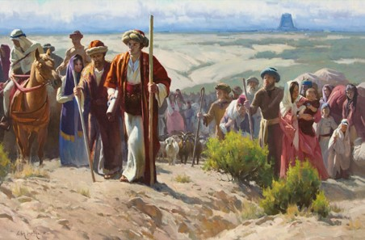
Who Were the Jaredites?
The descendants of Jared.
They were led away from the Tower of Babel by the Lord.
A group of people who traveled to the Western Hemisphere and lived there for many centuries before the arrival of the people of Lehi.

Slide 4
The Book of Ether
Moroni abridged this book from 24 gold plates called the plates of Ether.
The book is named for the prophet Ether, who was the last prophet of the Jaredites and who created a record of their history (see Ether 15:33–34).
About 500 years before Moroni made his abridgment of the sacred records, some of the people of Limhi discovered the plates of Ether as they were searching for the land of Zarahemla (see Mosiah 8:7–11; Ether 1:2).
Nephite prophets and record keepers passed the plates of Ether down until they came into Moroni’s possession. Moroni stated that he did not include even “the hundredth part” of the record in his abridgment (Ether 15:33).
The Book of Ether

Slide 5
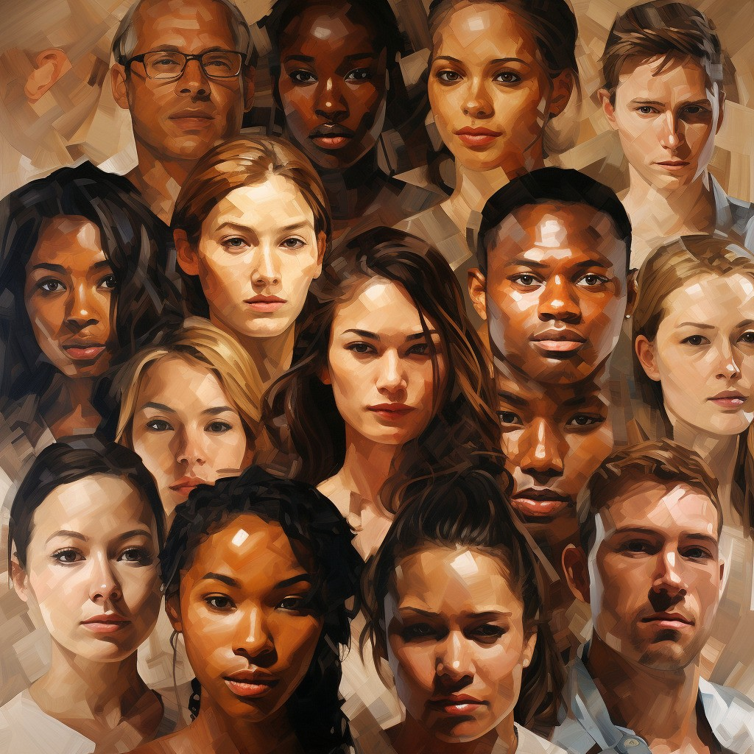
To Whom Was This Book Written?
Because Moroni abridged the plates of Ether after the Jaredites and his own people had been destroyed, he intended this book for the people of our day.
Moroni admonished latter-day Gentiles to repent, serve God, and do away with secret combinations (see Ether 2:11–12; 8:23).
He also recorded the words of Jesus Christ, inviting “all ye ends of the earth” to repent, come unto Him, be baptized, and receive the knowledge that is withheld from the world because of unbelief (see Ether 4:13–18).

Slide 6
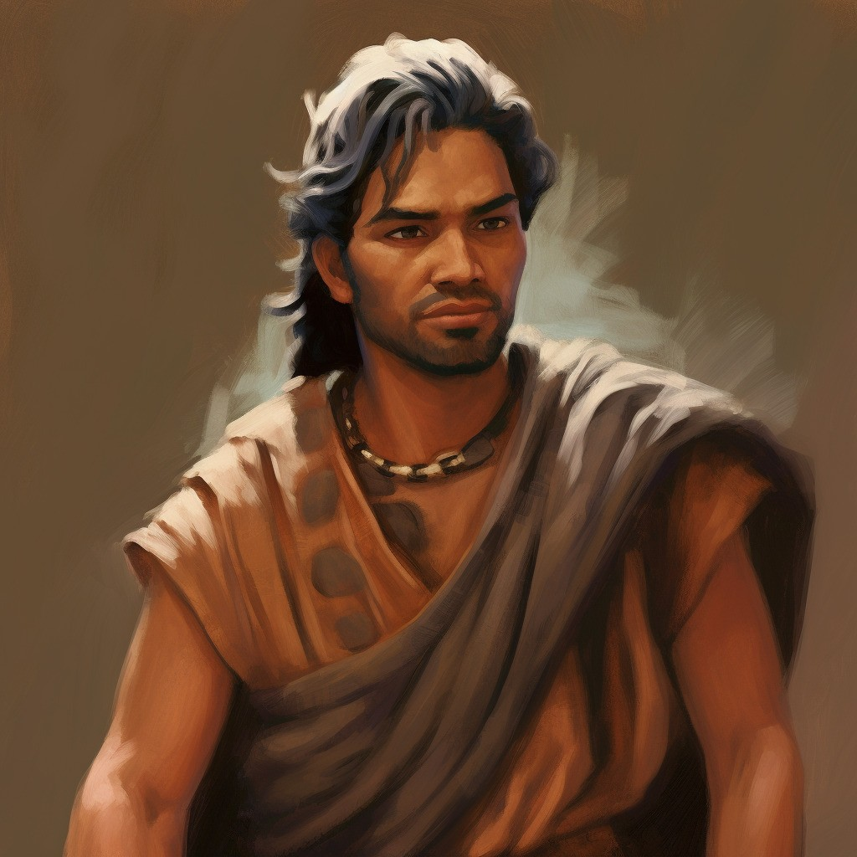
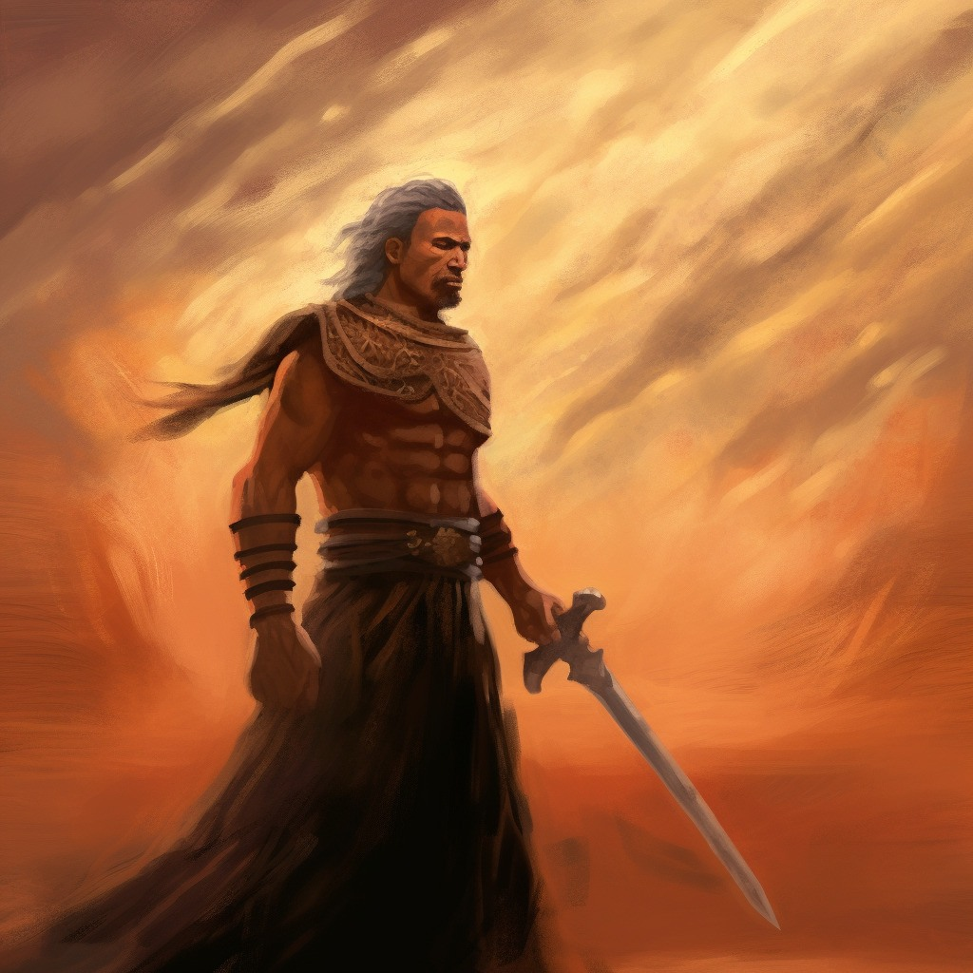
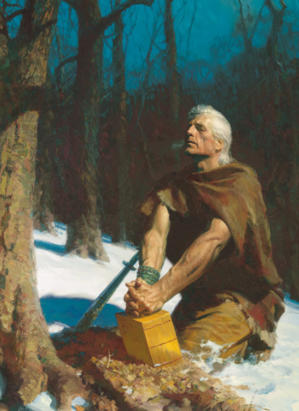
Where and When Was The Record Written?
Ether completed the record of his people during and after the final great battle that killed all but two of the Jaredites—himself and Coriantumr
He then hid his writings “in a manner that the people of Limhi did find them”
Moroni abridged the record of Ether between A.D. 400 and A.D. 421
Moroni wrote that the Jaredites were destroyed in “this north country”), indicating he may have been in the land where they were destroyed when he abridged their record.
Ether 13:13–14; 15:32–33; Mosiah 8:7-9; Mormon 8:3-6; Moroni 10:1; Ether 1:1

Slide 7
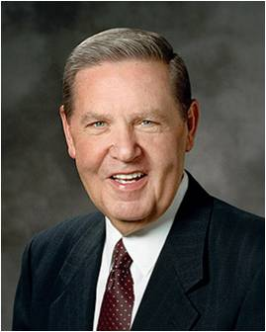
The Book of Ether
Unlike other books in the Book of Mormon, the book of Ether does not relate the history of the descendants of Lehi.
The book recounts how the Jaredites came forth from the Tower of Babel and traveled to the land of promise, where eventually they were destroyed.
The book of Ether is a second witness to the record of the Nephites illustrating that “whatsoever nation shall possess [the promised land] shall serve God, or they shall be swept off … when they are ripened in iniquity” (Ether 2:9).
Jesus Christ’s premortal appearance to the brother of Jared “ranks among the greatest moments in recorded history.”
This event “established the brother of Jared among the greatest of God’s prophets forever”
Jeffrey R. Holland
The Book of Ether
The Book of Ether

Slide 8
Timeline
3000 B.C.
2200 B.C.
600 B.C.
34 A.D.
400 A.D.
Noah
Brother of Jared
Lehi
Jesus Christ visits the America’s
Moroni

Slide 9
Ether
He was the last of the Jaredite prophets
He was a descendant of Coriantor
His ministry was in the Northern part of the land
The people rejected Ether’s words
He had to hide himself in the cavity of a rock by day and venture forth to make his observations only at night
He witnessed the fate of the Jaredite nation
He hid the records he kept, and later would be discovered by Limhi
The records were of the 24 plates found by the people of Limhi in the days of King Mosiah in about 120-121 BC

Slide 10
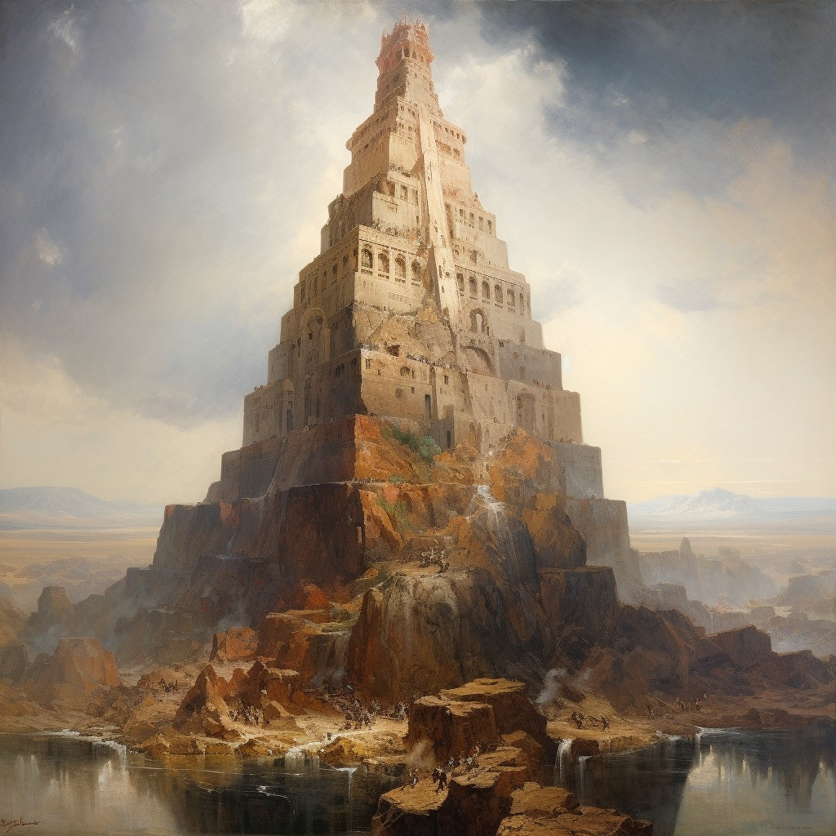
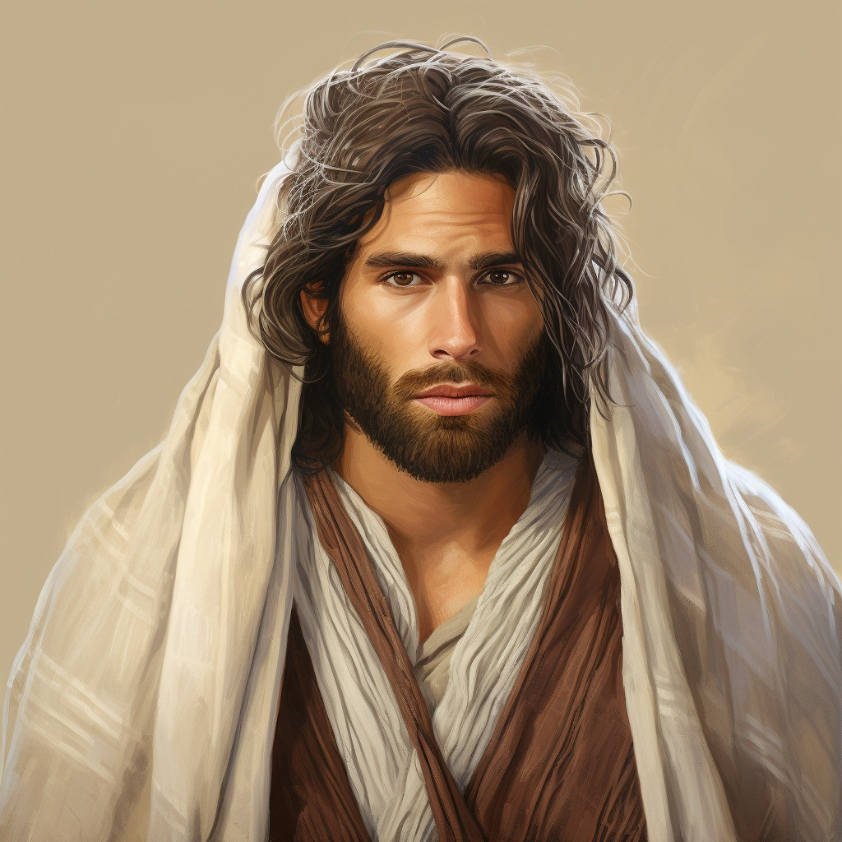
Nimrod and the Great Tower
Nimrod was the son of Cush, grandson of Ham, and great-grandson of Noah; and as "a mighty one in the earth" and "a mighty hunter before the Lord

Slide 11
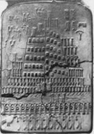
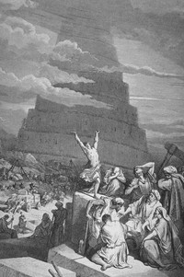
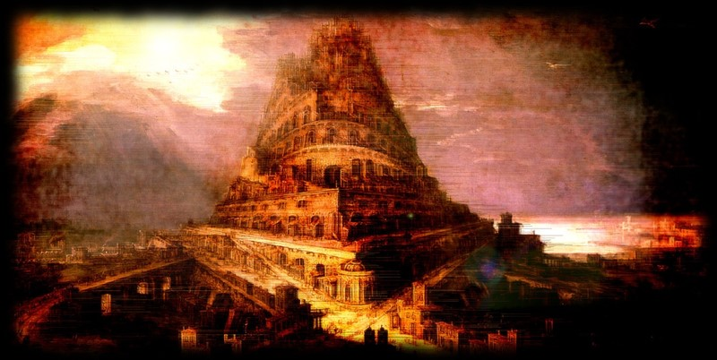
The Tower of Babel
“But behold, I give not the full account, but a part of the account I give, from the tower down until they were destroyed.”
Babel was founded by Nimrod and was one of the oldest cities in the land of Mesopotamia, or Shinar (Gen. 10:8–10). The Lord confounded the languages at the time the people were building the Tower of Babel (Gen. 11:1–9; Ether 1:3–5, 33–35). Babylon later became Nebuchadnezzar’s capital. He built an enormous city of which the ruins still remain. Babylon became a very wicked city and has since come to symbolize the wickedness of the world.
Bible Dictionary
Jared and his family lived during this time
Somewhere around 2000 years before the birth of the Savior

Slide 12
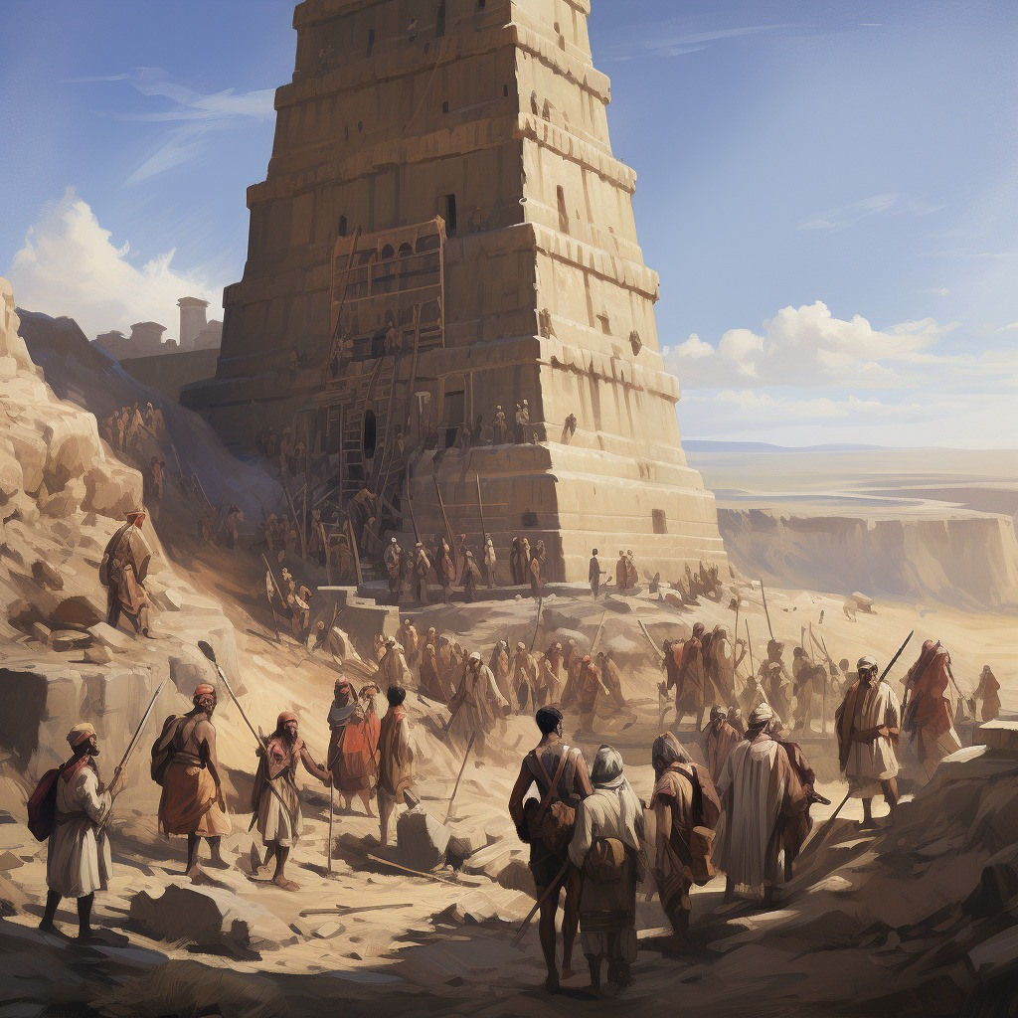
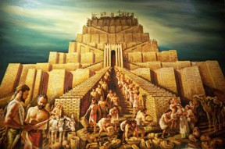
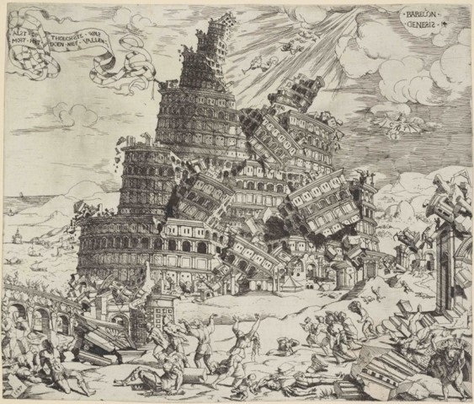
Scattered and Confounding the Language
“And they said, Go to, let us build us a city and a tower, whose top may reach unto heaven; and let us make us a name, lest we be scattered abroad upon the face of the whole earth.
And the Lord came down to see the city and the tower, which the children of men builded.
And the Lord said, Behold, the people is one, and they have all one language; and this they begin to do: and now nothing will be restrained from them, which they have imagined to do.
Go to, let us go down, and there confound their language, that they may not understand one another’s speech.
So the Lord scattered them abroad from thence upon the face of all the earth: and they left off to build the city.
Therefore is the name of it called Babel; because the Lord did there confound the language of all the earth: and from thence did the Lord scatter them abroad upon the face of all the earth.”
Genesis 11:4-9

Slide 13
Jared
Orihah
Kib
Sule
Omer
Emer
Coriantum
Com
Heth
Shez
Riplakish
Morianton (descendant of)
Kim
Levi
Corom
Kish
Lib
Hearthom
Heth
Aaron (descendant of)
Amnigaddah
Coriantum
Com
Shiblon
Ether’s Genealogy
Ether 1:6-32
Seth
Ahah
Ethem
Moron
Coriantor
Ether

Slide 14
Brother of Jared
He was a large and mighty man and highly favored of the Lord
He petitioned the Lord as to where his family and friends should go after the confounding of the languages during the time of the ‘Tower of Babel’
The Lord gave a promise to him that his seed and his brother’s seed will go to a great nation and build it up
He was chastened by the Lord for not preparing for their journey across the sea
He sought help in preparing the 8 barges that would carry them to another land
He spoke with the Lord for three hours
He gathered stones for the barges and the Lord extended his finger to impart radiance to the stones
The Lord showed him a vision of the divine plan for the immortality and eternal life of mankind, from the beginning to the end
He was commanded to keep a record and seal them up with 2 interpreting stones to come forth at a later time
Who’s Who

Slide 15
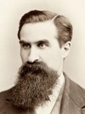
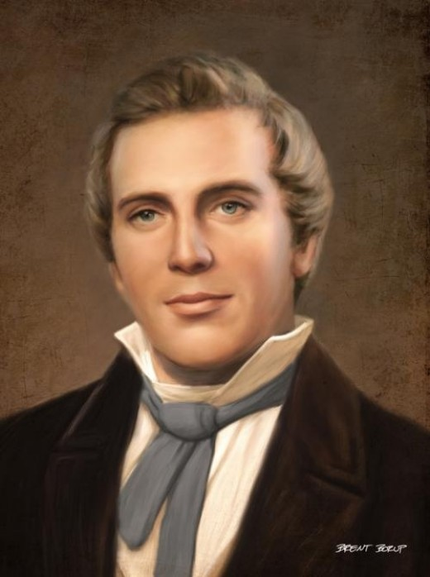
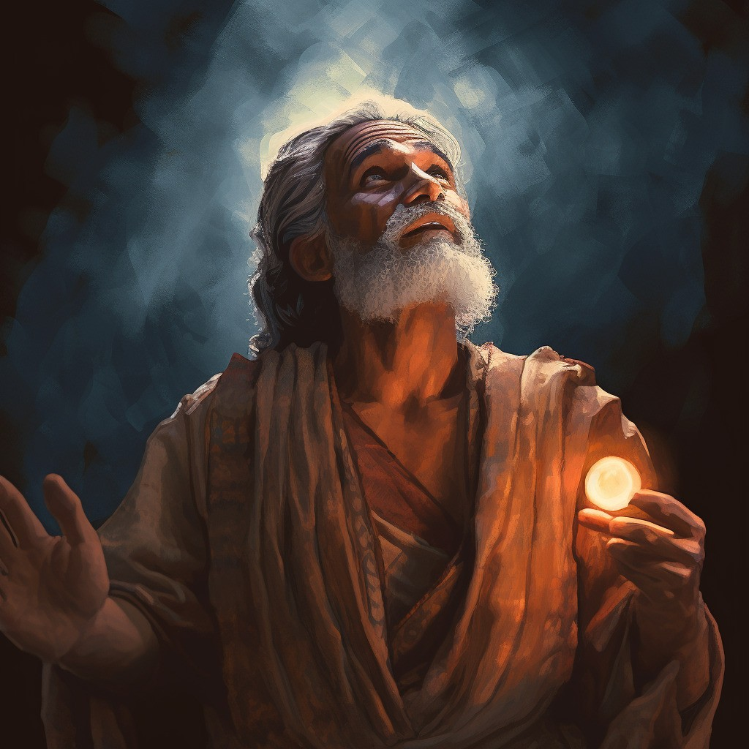
Mahonri Moriancumer
Although the brother of Jared is not identified by proper name in the Book of Mormon:
“While residing in Kirtland Elder Reynolds Cahoon had a son born to him. One day when President Joseph Smith was passing his door, he called the Prophet in and asked him to bless and name the baby. Joseph did so and gave the boy the name of Mahonri Moriancumer.
When he had finished the blessing he laid the child on the bed, and turning to Elder Cahoon he said, ‘The name I have given your son is the name of the brother of Jared; the Lord has just shown [or revealed] it to me.’ Elder William F. Cahoon … heard the Prophet make this statement to his father; and this was the first time the name of the brother of Jared was known in the Church in this dispensation.”
George Reynolds

Slide 16
Jared
He was the first leader associated with the civilization known as the “Jaredites”
He came forth with his brother and their families and others from the great tower at the time the Lord confounded the language of the people
Jared asked his brother to appeal to the Lord to spare their families and friends from the confounding of the languages
Jared asked his brother to petition the Lord in guidance concerning their journey and destination which they took provisions to a valley northward to wait for instructions
They were led by the Lord 344 days on the water until they reached the shores of the New World
Jared had four sons: Jacom, Gilgah, Maha, and Orihah
Jared, in his old age, and his brother’s warning, he advised against having a king
Who’s Who

Slide 17
Jacom, Gilgah, Maha, and Orihah
The Son’s of Jared
Jacom, Gilgah, and Maha declined the invitation of the people to become their king.
They heeded the prophetic warning of the brother of Jared against a monarchy “Surely this thing leadeth into captivity.” Ether 6:23
Orihah was chosen to be the Jaradite King
He was humble and righteous
Who’s Who

Slide 18
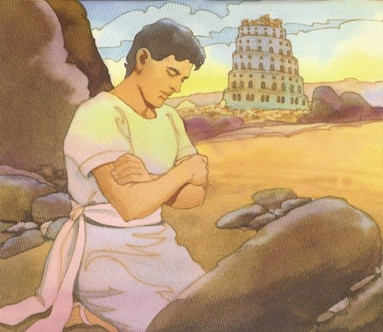
Cry Unto the Lord
A mighty prayer—in faith and sincerity
As we consistently cry unto God in faith, He will have compassion on us
Jared and his brother’s concern:
They would not be able to speak to each other and their friends in the same language
Where should they go?
When have you felt Heavenly Father’s compassion in answer to prayer?
When have family members or friends told you of Heavenly Father’s compassion in answer to prayer?
What do God’s answers to our prayers teach us about His feelings for us?
What can you do to make your prayers more meaningful?
Ether 1:34-37

Slide 19
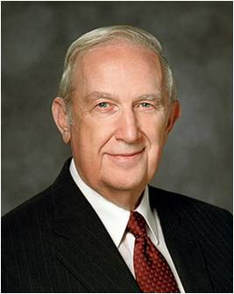
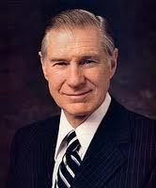
Improving Our Prayers
“A fervent, sincere prayer is a two-way communication which will do much to bring [the Savior’s] Spirit flowing like healing water to help with the trials, hardships, aches, and pains we all face.
What is the quality of our secret prayers when only He listens?
As we pray, we should think of Him as being close by, full of knowledge, understanding, love, and compassion, the essence of power, and as having great expectations of each of us.”
President James E. Faust
“Let your Father in Heaven know of your feelings, your needs, your concerns, your hopes and aspirations. Speak to Him with total confidence, knowing that He will hear and respond. Then patiently go forth in your life doing those things you know are correct, walking with confidence born of faith and righteousness, patiently waiting for the response that will come in the manner and at the time the Lord considers most appropriate.” Elder Richard G. Scott
Ether 1:34-43

Slide 20
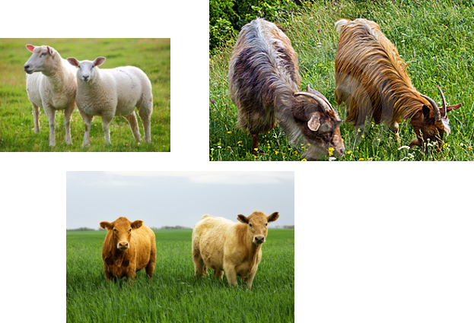
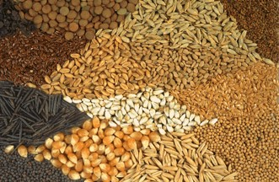
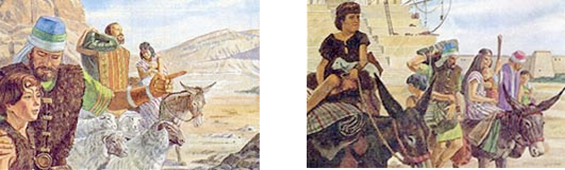
Preparations to Leave
Gathering flocks—male and female of every kind
Seeds of every kind
Family and friends
Ether 1:41

Slide 21
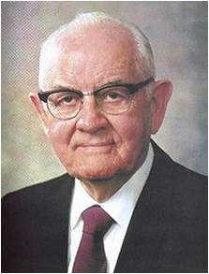
“This long time ye have cried unto me”
“Do you get answers to your prayers? If not, perhaps you did not pay the price. Do you offer a few trite words and worn-out phrases, or do you talk intimately to the Lord? Do you pray occasionally when you should be praying regularly, often, constantly? Do you offer pennies to pay heavy debts when you should give dollars to erase that obligation?
“When you pray, do you just speak, or do you also listen? Your Savior said, ‘Behold, I stand at the door, and knock: if any man hear my voice, and open the door, I will come in to him, and will sup with him, and he with me.’ ”
President Spencer W. Kimball
If we pray regularly to God with faith, we can receive blessings beyond those we request.
Ether 1:43; Rev. 3:20

Slide 22
Sources:
Jeffrey R. Holland, Christ and the New Covenant: The Messianic Message of the Book of Mormon [1997], 17.
Who’s Who in the Book of Mormon by Ed J. Pinegar and Richard J. Allen pgs. 33-31, 49-50, 60, 79, 80, 116, 151
Name of Mahonri Moriancumer (George Reynolds, “The Jaredites,” Juvenile Instructor, 1 May 1892, 282). Book of Mormon: Gospel Doctrine Teacher manual LESSON 45
President James E. Faust (“A Personal Relationship with the Savior,” Ensign, Nov. 1976, 58).
Elder Richard G. Scott (“The Power of a Strong Testimony,” Ensign, Nov. 2001, 88).
President Spencer W. Kimball (“Prayer,” New Era, Mar. 1978, 17).
Etymology
The phrase "Tower of Babel" does not appear in the Bible; it is always, "the city and its tower" or just "the city. “ Babel" means the "Gate of God", from Akkadian bab-ilu, "Gate of God" (from bab "gate" + ilu "god")." According to the Bible, the city received the name "Babel" from the Hebrew word balal, meaning to jumble. Wikipedia- Tower of Babel
Presentation by ©http://fashionsbylynda.com/blog/

Slide 23
The Wandering Nephites
200 B.C. to 121 B.C.
Destroyed Jaredite Nation
Land of Zarahemla
Mulek 589 BC
Mosiah l
King Benjamin
Mosiah ll
Jaredite plates discovered and returned to Limhi…5
Alma & his people escape back to Zarahemla…8
2
Ammon and Limhi escape to Zarahemla…7
Mosiah I…1
Zeniff…3
Ammon…6
Jerusalem
Lehi & Nephi 600 BC
Mosiah 1 and righteous Nephites
Zeniff
King Noah
King Limhi
Land of Lehi-Nephi
City of Helam
About 200 BC
Alma escapes…4
Waters of Mormon
1. Mosiah I leads the few remaining righteous Nephites from the original land settled by Lehi to the Land of Zarahemla (Omni 1:3)
2. (About 200 BC ill fated expedition to return to Lehi-Nephi. Contention and infighting. All slain in the wilderness except 50 who return to Zarahemla (Omni 1:28) (Mosiah 9:1-3)
3. Zeniff leads a second expedition (abt. 200 BC) to Lehi-Nephi and settles there with the permission of King Laman (Mosiah 9: 3-10)
4. (about 148 BC) Alma flees King Noah to the Waters of Mormon (Mosiah 17 and 18)
5. (about 121 BC) King Limhi sends expedition of 43 men to find Zarahemla in hopes of escaping Lamanite bondage. They find remnants of Jaredites and 24 gold plates and return to Land of Lehi-Nephi (Mosiah 6: 7-8)
6. (About 121 BC) Ammon’s expedition (16 “Strong Men”) to find Zeniff’s colony (Mosiah 7)
7. (About 121-120 BC) King Limhi’s people get the Lamanites drunk and escape back to Zarahemla (Mosiah 22)
8. (Between 145 and 121 BC) Alma and his people escape Lamanites and return to Zarahemla (Mosiah 24)

Slide 24
Jared
Orihah
Kib
Shule
Omer
Emer
Coriantum
Com
Heth
Shez
Riplakish
Morianton (descendant of)
Kim
Levi
Corom
Kish
Lib
Hearthom
Heth
Aaron (descendant of)
Amnigaddah
Coriantum
Com
Shiblon
Ether’s Genealogy
Ether 1:6-32
Seth
Ahah
Ethem
Moron
Coriantor
Ether

Slide 25
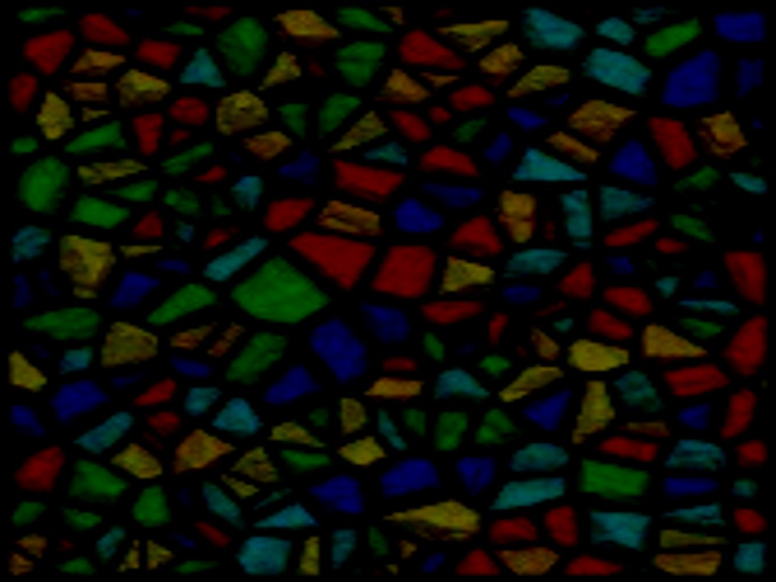
Leaving Babel
Ether 2

Slide 26
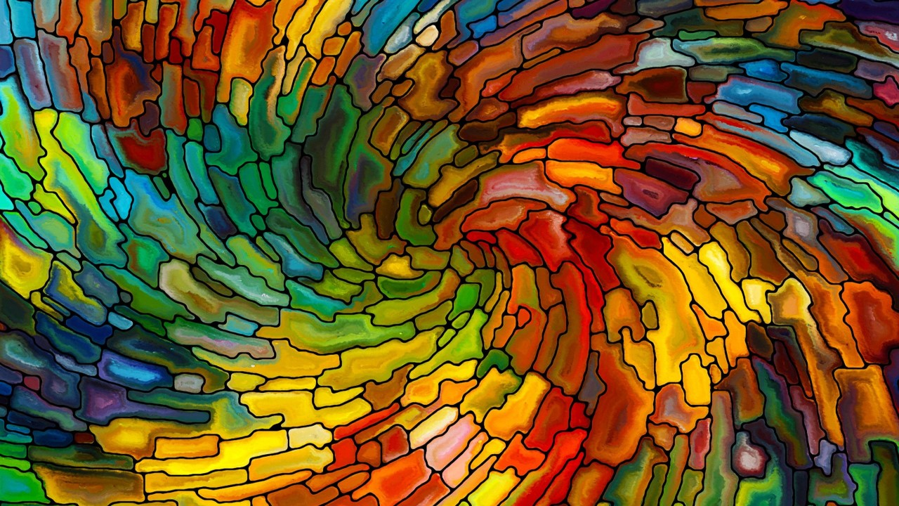
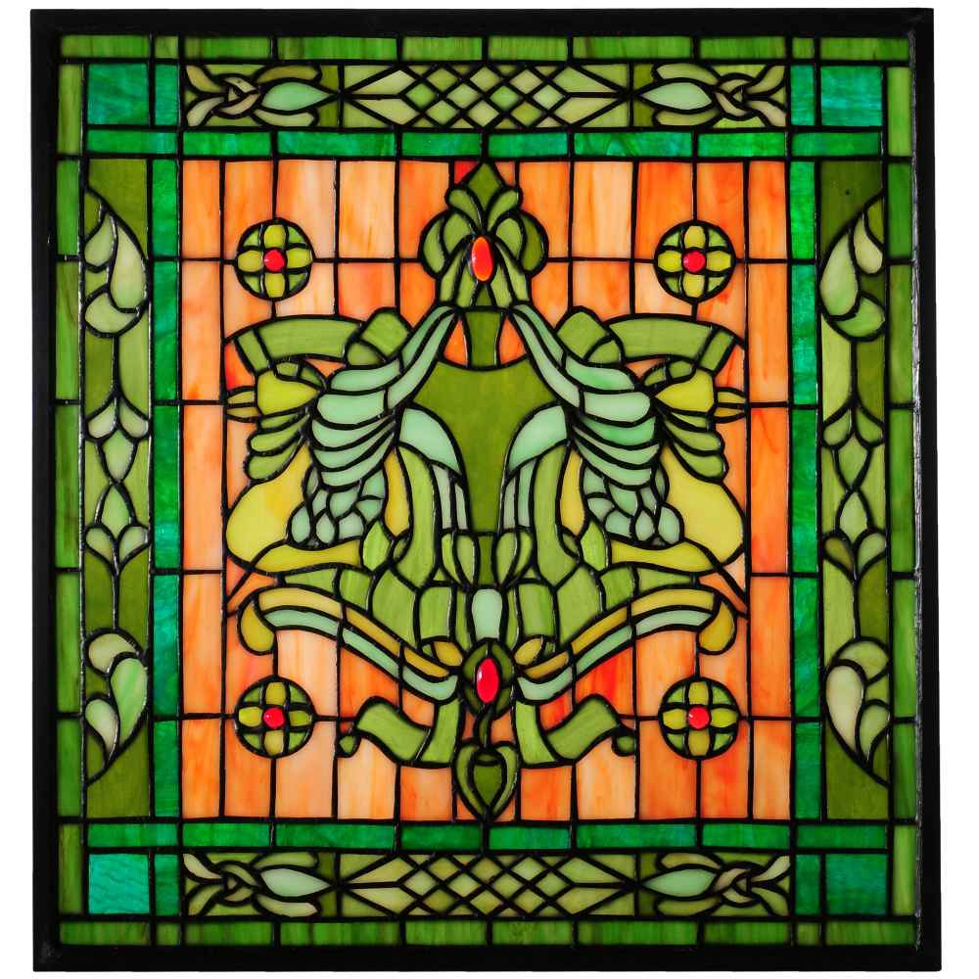

“It will come a piece at a time, in packets, so that you will grow in capacity.
As each piece is followed in faith, you will be led to other portions until you have the whole answer.
That pattern requires you to exercise faith in our Father’s capacity to respond. While sometimes it’s very hard, it results in significant personal growth.” Richard G. Scott
As we act in faith on direction the Lord has given us, we can receive further guidance from Him.
Ether 2:2-3

Slide 27

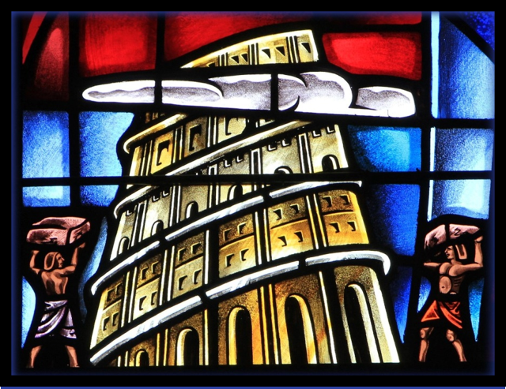

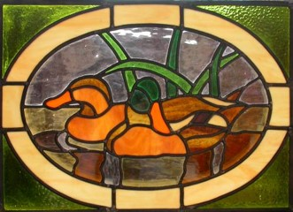
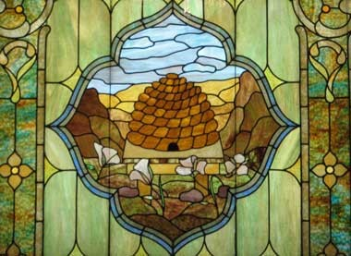
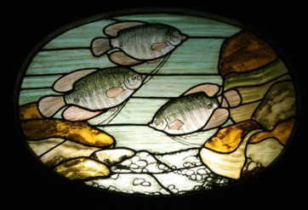
A Time To Leave
And they did also lay snares and catch fowls of the air; and they did also prepare a vessel, in which they did carry with them the fish of the waters.
And they did also carry with them deseret, which, by interpretation, is a honey bee; and thus they did carry with them swarms of bees, and all manner of that which was upon the face of the land, seeds of every kind.
Ether 2:2-3

Slide 28
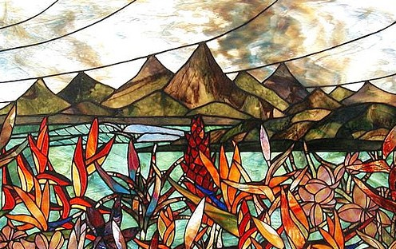
Valley of Nimrod
The brother of Jared and his family and friends were directed to go to the Valley of Nimrod.
“…The Lord came down and talked with the brother of Jared; and he was in a cloud, and the brother of Jared saw him not.”
Ether 2:4-5

Slide 29
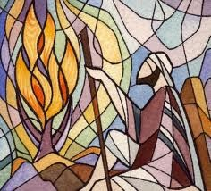
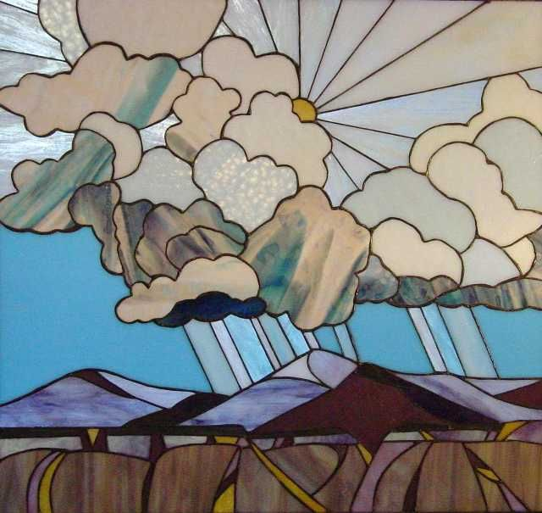
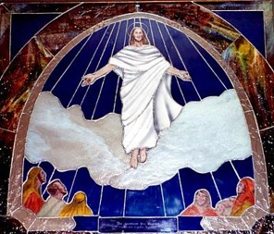
Cloud of Glory
The cloud will surround Him when He again returns to earth and appears to man
Moses:
The Lord led the children of Israel in the wilderness in a cloud by day and in a pillar of fire at night
Exodus 13:21
Jaredites:
The Lord led them by a cloud to the wilderness
“For behold, verily, verily, I say unto you, the time is soon at hand that I shall come in a cloud with power and great glory.”
D&C 34:7
Ether 2:4-5

Slide 30

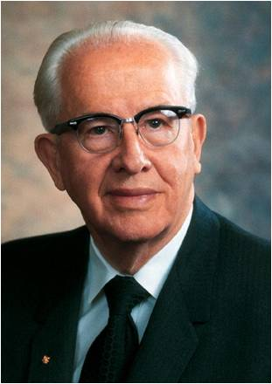
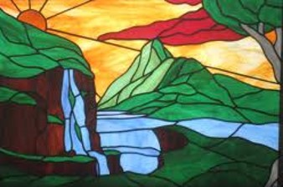
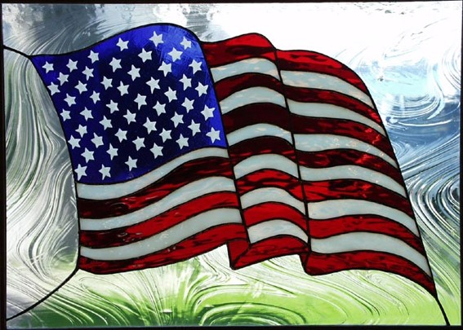
A Choice Land
“This consecrated land has been placed under the everlasting decree of God. That decree is recorded in the sacred Book of Mormon, a new witness for Christ, in these words:
“‘For behold, this is a land which is choice above all other lands; wherefore he that doth possess it shall serve God or shall be swept off; for it is the everlasting decree of God. …
“Righteousness exalteth a nation (Proverbs 14:34). This is the key to understanding our heritage and this is the key to maintaining it. The foundations of America are spiritual…”
Ezra Taft Benson
Ether 2:7-12

Slide 31
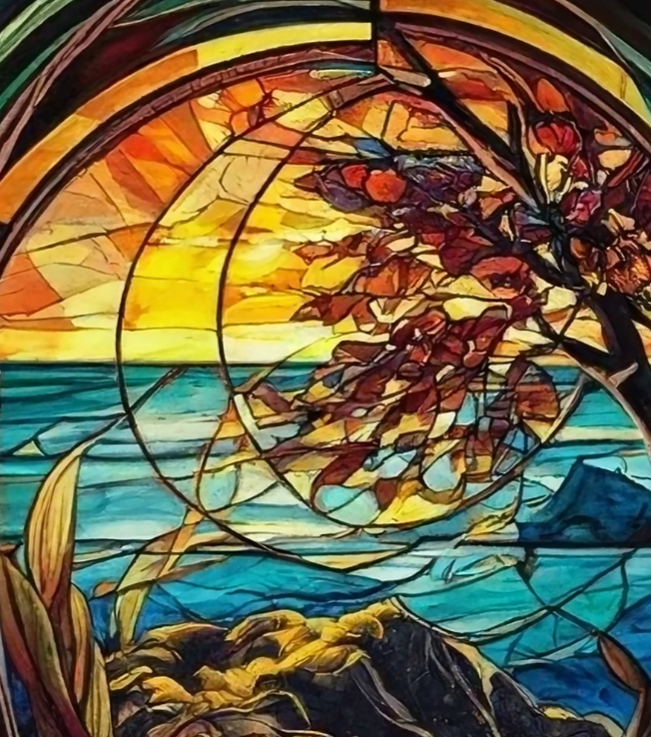
Moriancumer
They pitched their tents by the sea
They stayed there for 4 years
Ether 2:7-13

Slide 32

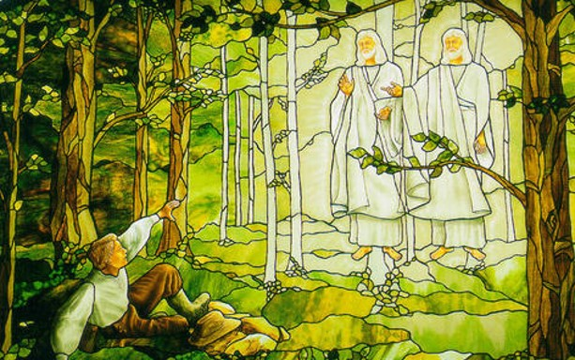

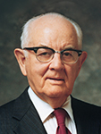
Chastening
The brother of Jared is chastened by the Lord:
They may have waited too long (4 years) to proceed to their next destination, which was across the ocean
Or
The brother of Jared’s prayers became trite
“We would not ask a Church leader for advice, then disregard it. We must never ask the Lord for blessings, then ignore the answer.”
Spencer W. Kimball
Ether 2:7-13

Slide 33

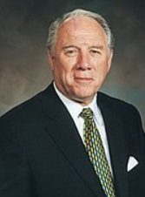
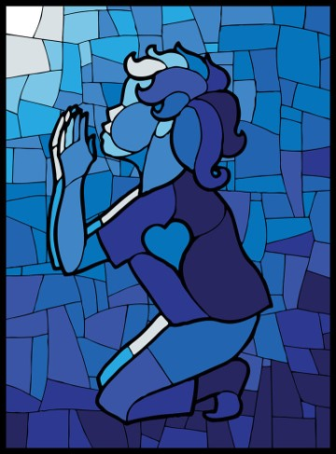
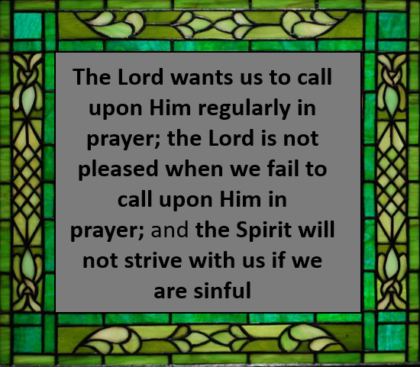
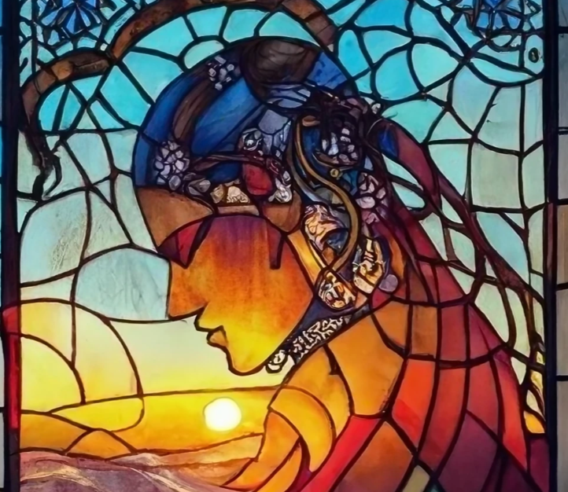
Fervent Prayer
“Daily fervent prayers seeking forgiveness and special help and direction are essential to our lives and the nourishment of our testimonies. When we become hurried, repetitive, casual, or forgetful in our prayers, we tend to lose the closeness of the Spirit, which is so essential in the continual direction we need to successfully manage the challenges of our everyday lives” Elder Donald L. Staheli
Ether 2:14-15

Slide 34
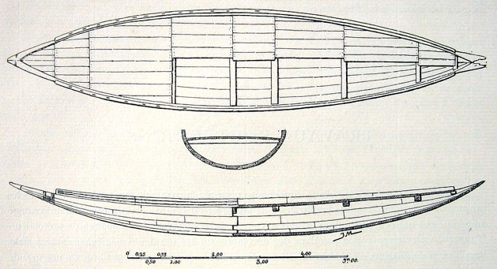
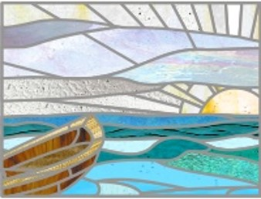
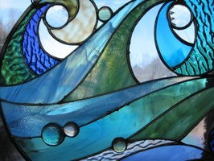
What Did the Barges Look Like?

Slide 35
Preparing to Leave
Problem with the barges
No air
No steering
No light
The Solution
Make holes that can be opened and closed in the top and bottom of the barges
Wind will blow the barges toward the promised land
Prepare special stones and ask the Lord to touch them so they will shine
What the Lord Did
Gave Jared instructions
Caused the wind to blow
Advised the brother of Jared about things that would not work and instructed him to find a solution that would work.
Touched the stones after the brother of Jared prepared them
What the brother of Jared did
Made the holes
Trusted in the Lord
Prepared the stones and asked the Lord to touch them so they would shine in the dark
Ether 2:16-25

Slide 36


Based on the solution to the concern about air, how does the Lord sometimes help us solve our problems or answer our questions?
Sometimes the Lord tells us how to solve a problem and expects us to follow His instructions
Based on the solution to the concern about steering, how does the Lord sometimes help us solve our problems or answer our questions?
Sometimes the Lord takes care of the solution Himself
Based on the solution to the concern about light, how does the Lord sometimes help us solve our problems or answer our questions?
Sometimes the Lord requires us to come up with a solution and ask for His approval and help in carrying it out
Ether 2:16-25

Slide 37

As we call upon the Lord and do our part to solve our problems, we can receive the Lord’s help.

Slide 38
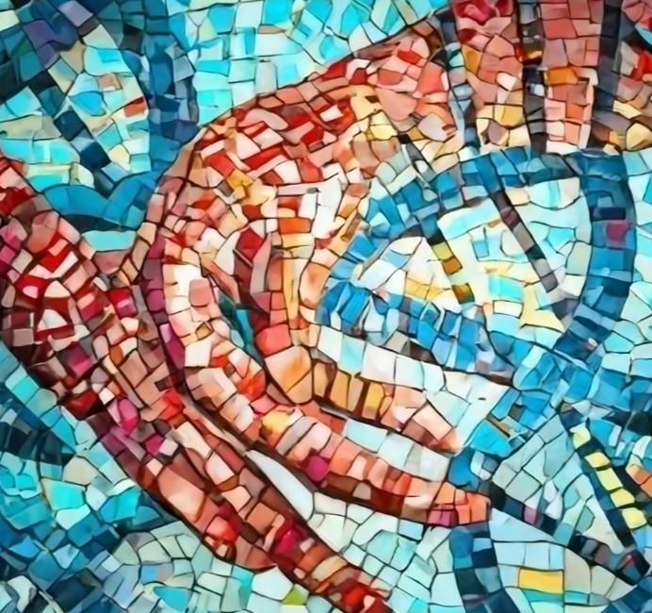
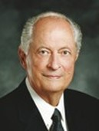

“The fate of [the Jaredites and Nephites], as recorded in scripture, is a testimony to all the world: if we don’t have the word of God or don’t cling to and heed the word of God, we will wander off in strange paths and be lost as individuals, as families, and as nations”
Elder Robert D. Hales

Slide 39

Sources:
Video: The Faith and Diligence of the Brother of Jared (2:26)
Richard G. Scott, “Using the Supernal Gift of Prayer,” Ensign or Liahona, May 2007, 9
Ezra Taft Benson (“A Witness and a Warning,” Ensign, Nov. 1979, 31, 33).
The Teachings of Ezra Taft Benson pp. 569, 580
Spencer W. Kimball Prayer pg. 19
Elder Donald L. Staheli (“Securing Our Testimonies,” Ensign or Liahona, Nov. 2004, 39).
Elder Robert D. Hales(“Holy Scriptures: The Power of God unto Our Salvation,” Ensign or Liahona, Nov. 2006, 26).
How to Make Stained Glass
https://www.youtube.com/watch?v=0NIC_qvadEw
Presentation by ©http://fashionsbylynda.com/blog/

Slide 40
Directions: You have a 5 minute time limit to complete the parts of this test. Carefully read all of the parts of the test before doing anything. In order to ensure the accuracy of this exam, you should not use more than the allotted time of 5 minutes. You may start the timer and begin whenever you choose.
1. Write today's date--month-day-year in the top right hand corner of your test paper.
2. Write the answer to the following multiplication problem directly underneath the date on your test paper--6 X 5 = ?
3. Write the name of the month that begins with the letter "D" in the top left hand corner of your test paper.
4. Add 15 to the answer you got in part #2, and write this new total directly underneath your answer for part #3.
5. In the lower left hand corner of your test paper, write the names of your favorite singer and your favorite group.
6. Just above your answer to part #5, write "This test is very easy."
7. In the lower right hand corner of your test paper, draw a rectangle and inside the rectangle draw a five pointed star. The size of these drawings is not important.
8. Directly above your answer to part #7, draw a row of three small circles. Once again, size is not important.
9. Write the name of the first president of the United States on the back of your test paper anywhere you choose. If you don't know who this is, write your own name instead.
10.Write the name of any country that begins with the letter "I" directly underneath you answer to part #2.
11. Take the number of dwarfs in the Snow White story and add it to the number of bears in the Goldilocks story. Divide by 2. Write this total in the approximate center of your test paper.
12. Think of a number between 1 and 50. Double that number. Add 20. Add 6. Subtract 17. Subtract 9. Divide by 2. Write this number on your test paper directly underneath your answer to part #11.
13. Now that you have carefully read all of the parts so far, and you have not carried out any of the actual work, read the next 2 parts just to see what they say and then go back and only complete part #3.
14. The name of the first president of the United States is George Washington. He was president from 1789 until 1797. Add the 2 dates together to see if the total is less than 5000.
15. You should not be reading the end of the exam before the beginning of the exam, but now that you are here, you have just wasted some of the time you may need to complete the test.
http://www.justriddlesandmore.com/direct.html

Slide 41
Problem with the barges | The Solution | What the Lord Did | What the brother of Jared did
No air | Make holes that can be opened and closed in the top and bottom of the barges | Gave Jared instructions | Made the holes
No Steering | Wind will blow the barges toward the promised land | Caused the wind to blow | Trusted in the Lord
No Light | Prepare special stones and ask the Lord to touch them so they will shine | Advised the brother of Jared about things that would not work and instructed him to find a solution that would work. Touched the stones after the brother of Jared prepared them | Prepared the stones and asked the Lord to touch them so they would shine in the dark

Slide 43


Slide 44




Mount Shelem
The brother of Jared went to great effort to prepare the stones.
“… and did molten out of a rock sixteen small stones; and they were white and clear, even as transparent glass; and he did carry them in his hands upon the top of the mount, and cried again unto the Lord, saying:”
Ether 3:1

Slide 45




8 Vessels
“This first recorded ocean crossing was about forty centuries ago, of seaworthy, ocean-going vessels without known sails, engines, oars, or rudders—eight barges like and near contemporary with Noah’s ark, long as a tree, tight as a dish, peaked at the end like a gravy boat, corked at top ad bottom, illuminated by molten stones, perhaps with radium or some other substance not yet rediscovered by our scientists.
Light and like a fowl upon the water, this fleet of barges was driven by winds and ocean currents, landing at a common point in North America probably on the west shores.”
Spencer W. Kimball
Ether 3:1

Slide 46

Understanding God
The brother of Jared understood the Doctrine of the Fall
He also understood the character and attributes of God:
All-powerful
“…because of the fall our natures have become evil continually; nevertheless, O Lord, thou hast given us a commandment that we must call upon thee, that from thee we may receive according to our desires.”
Ether 3:2-5

Slide 47
“It is a basic premise of Latter-day Saint theology that God ‘knoweth all things, and there is not anything save he knows it.’ [2 Nephi 9:20.]
The scriptures, both ancient and modern, are replete with this assertion of omniscience. Nevertheless, God has frequently asked questions of mortals, usually as a way to test their faith, measure their honesty, or develop their knowledge”
Elder Jeffrey R. Holland
As we humbly exercise faith in the Lord, we will come closer to Him

Slide 48


Conversation With The Lord
“It is true that the Savior appeared to the Prophets before the flood, but it is evident that he did not reveal himself in the fulness as he did to the Brother of Jared.”
“Talking ‘face to face,’ as stated in this revelation, does not mean that the Lord did not appear in a cloud; or, that his body was partially hidden from the view of the prophet.”
“…The Brother of Jared knew that the Lord was there, but evidently he did not understand that the Lord had a body apparently of flesh and bones. Through his great faith he was able to see the finger of the Lord when the Lord touched the stones.”
Ether 3:6-20 Joseph Fielding Smith

Slide 49





What Did The Brother of Jared Learn About Christ?
Ether 3:14
Jesus Christ was prepared from the foundation of the world to redeem us
Ether 3:15
God created us in His own image
Ether 3:16
Jesus Christ showed Himself in the spirit before He was born in the flesh
Ether 3:17
Jesus Christ’s physical body is in the likeness of His spirit body
Ether 3:18
Jesus Christ ministers to people to help them know that He is God
As we exercise faith in Jesus Christ, we will come to know Him better.

Slide 50


“Christ was saying to the brother of Jared, ‘Never have I showed myself unto man in this manner, without my volition, driven solely by the faith of the beholder.’ As a rule, prophets are invited into the presence of the Lord, are bidden to enter his presence by him and only with his sanction.
The brother of Jared, on the other hand, seems to have thrust himself through the veil, not as an unwelcome guest but perhaps technically as an uninvited one. …
Obviously the Lord himself was linking unprecedented faith with this unprecedented vision. If the vision itself was not unique, then it had to be the faith and how the vision was obtained that was so unparalleled. The only way that faith could be so remarkable was its ability to take the prophet, uninvited, where others had been able to go only with God’s bidding”
Jeffrey R. Holland
James H. Fullmer
Ether 3:15

Slide 51



The Finger of the Lord
“Nowhere in the scriptures is a clearer account given of the nature of the spirit body of the Lord Jesus Christ and, indeed, of the characteristics of our own spirits.
The brother of Jared not only saw the finger of the antemortal Jesus Christ but indeed perceived His entire spirit body (see Ether 3:6, 13).
Understanding the premortal godhood of Jesus Christ together with our own spiritual identities prior to our births in the flesh is a great blessing and advantage. These insights breaching traditional boundaries were the direct result of the brother of Jared’s non-boundaried faith”
Elder Cecil O. Samuelson
Ether 3:16

Slide 52


Write These Things
“In a language that cannot be read”
Possibly Adamic—the language of Adam or the language of God
Ether 3:22

Slide 53


“These Two Stones”
“Now, behold, I say unto you, that because you delivered up those writings which you had power given unto you to translate by the means of the Urim and Thummim, into the hands of a wicked man, you have lost them.”
D&C 10:1
“…you shall have a view of the plates, and also of the breastplate, the sword of Laban, the Urim and Thummim, which were given to the brother of Jared upon the mount, when he talked with the Lord face to face, and the miraculous directors which were given to Lehi while in the wilderness, on the borders of the Red Sea.”
D&C 17:1
The two stones that the Lord gave to the brother of Jared were part of what is called a Urim and Thummim.
The scriptures refer to more than one Urim and Thummim, but we are informed that Joseph Smith had the one used by the brother of Jared.
In Joseph Smith—History 1:35, the Prophet Joseph provides a partial description of this Urim and Thummim. He used it in translating the Book of Mormon and in obtaining other revelations.
Ether 3:23-24

Slide 54




Interpreters
“King Mosiah possessed ‘two stones which were fastened into the two rims of a bow,’ called by the Nephites Interpreters, with which he translated the Jaredite record.
“And now Limhi was again filled with joy on learning from the mouth of Ammon that king Mosiah had a gift from God, whereby he could interpret such engravings; yea, and Ammon also did rejoice.”
Mosiah 21:28
Mosiah had this gift before the people of Limhi discovered the record of Ether.
They may have been received when the ‘large stone’ was brought to Mosiah with engravings upon it.
“And it came to pass in the days of Mosiah, there was a large stone brought unto him with engravings on it; and he did interpret the engravings by the gift and power of God.”
Omni 1:20
Coriantumr was discovered by the people of Zarahemla
Joseph Fielding Smith

Slide 55



Urim and Thummin
“…or two stones, given to the Brother of Jared were those in the possession of Mosiah appears evident from Book of Mormon teachings.”
“The Brother of Jared was commanded to seal up his writing of the vision he had when Christ appeared to him, so that they could not be read by his people.”
“This vision was recorded in a language which was confounded, for it was not to go forth until after the resurrection of Christ.”
“The Urim and Thummim were also sealed up so that they could not be used for the purpose of interpreting those sacred writings of this vision, until such time as the Lord should grant to man to interpret them.”
Joseph Fielding Smith

Slide 56

How Many Stones?
18
…and did molten out of a rock sixteen small stones… Ether 3:1
And behold, these two stones will I give unto thee, Ether 3 :23

Slide 57

In The Lord’s Own Due Time
“And it came to pass that the Lord commanded him that he should seal up the two stones which he had received, and show them not, until the Lord should show them unto the children of men.”
Ether 3:27-28

Slide 58
Sources:
Spencer W. Kimball Conf. Report April 1963 pp. 63-64
Joseph Fielding Smith Questions and Answers 2:124-25 and (Interpreters)--Doctrines of Salvation 3:223-24
Elder Jeffrey R. Holland (Christ and the New Covenant: The Messianic Message of the Book of Mormon [1997], 19–20, 23 ).
Elder Cecil O. Samuelson (“The Brother of Jared,” in Heroes from the Book of Mormon [1995], 185).
Brother of Jared and Stones artwork by (Nathan Florence, 2002)
Presentation by ©http://fashionsbylynda.com/blog/

Slide 59

Where the Jaredites Traveled
Recently, someone sent me the following from an internet site regarding the Jaredites who: “were directed by the Lord to "go forth into the wilderness, yea into that quarter where there never had man been" (Ether 2:5). They built barges on which to cross "many waters." They continued until they came to "that great sea which divideth the lands." They remained on the seashore for four years during which time they constructed eight vessels for crossing the sea. How far they traveled we can only guess. That guess places the terminus of their land journey on the Pacific shores of the Asian continent. From there the prevailing winds "never cease to blow towards the promised land."
First of all, a few comments on the above statement:
1. They did not build their barges during the four years they stayed on the seashore after reaching it. “And it came to pass at the end of four years that the Lord came again unto the brother of Jared, and stood in a cloud and talked with him (Ether 2:14) and “And the Lord said: Go to work and build, after the manner of barges which ye have hitherto built” (Ether 2:16). Obviously, they did not begin building the barges until after the four year period—which might have taken them another year to complete and ready all their supplies.
http://nephicode.blogspot.com/2010/12/where-jaredites-traveled.html

Slide 60

2. The “prevailing winds” do not blow out into the Pacific Ocean from the “Pacific shores of the Asian continent.” In fact, along the shore, those winds blow north into the Sea of Japan, or south into the Taiwan Straits. Out in the Pacific, they blow in toward land, moving all the way from the bulge of Peru westerly across the Pacific, then turn southward and blow toward Indonesia, then turn eastward in the Southern Ocean and blow toward South America in what is called the South Equatorial Current.
3. Winds that “never cease to blow towards the promised land” from the Pacific shores of the Asian continent would actually blow south in the South Equatorial Current gyre as mentioned in #2 above.
Nibley has the Jaredites crossing the Steppes (green) from Mesopotamia to the Pacific Ocean. Look how much more economically in time, effort, and travel it would have been to take them down the Persian Gulf shore, across the water hole trail, to where Lehi called Bountiful
4. The eastern Steppes of Asia, and down through China near present-day Beijing, which is the only way to get from the Mesopotamia to the Pacific Ocean, would not have been considered “that quarter where there never had man been” since those eastern lands along China’s eastern shore were occupied during the time of the Jaredites by Japheth's descendants.
5. By going across the Steppes, which the above would have to suggest, and the course Hugh Nibley suggested, would not have encountered “many waters” along the way. Nibley had to invent such waterways by saying that there were lakes along this route left over from the last ice age, but that is merely supposition, not provable by any modern knowledge.
http://nephicode.blogspot.com/2010/12/where-jaredites-traveled.html

Slide 61


6. There simply is no “sea in the wilderness” in the mid- to eastern portion of the Steppes along the path this direction would have had to go. A sea in the wilderness suggests a very large body of water, and since the word “yam” meaning sea in the Hebrew language (yamha means lake) was used specifically for salt water bodies of water, almost always attached to the ocean directly or through some narrow passage (Persian Sea, Red Sea, Mediterranean Sea—the Sea of Galilee was actually called Lake Gennesaret, and the Sea of Death (Dead Sea) was a descriptive term originally, not a name).
7. Such a route would have taken the Jaredites over a series of mountains at the eastern end of the Steppes that separate the Steppes from the Gobi Desert and the eastern lands of China. Those mountain passes (only two existed anciently) are higher than the pass Hannibal used to cross the Alps where he lost half his experienced soldiers and most of his elephants despite having engineers to make roads for him. No Jaredite colony of men, women, and children, as well as animals, bees, and fish, could have possibly made such a crossing that even today is so dangerous that even with modern clothing, warmers, maps, etc., usually proves fatal to many in the trek.
Thus, we can see that such flippant and arbitrary routes as some claim simply because they look at a map, are actually impossible routes, especially for the Jaredites to have taken with families and animal entourage.
Possible route
http://nephicode.blogspot.com/2010/12/where-jaredites-traveled.html

Slide 62

Do Rocks Glow in the Dark?
Many rocks and minerals can absorb incoming photons and release light. The emitted light is of longer wavelength/lower energy than the absorbed light, again due to conservation of energy (some energy of the absorbed photon is lost to heat; the rest is emitted as a lower energy photon). The absorbed light excites electrons in the fluorescent material to a higher energy level, which can then fall back down to the ground energy level and emit light in the process. The most familiar fluorescent objects are those that absorb ultraviolet light and emit visible light. Common fluorescent objects include highlighters, white clothes, and cat urine - they glow readily under a blacklight. Some common fluorescent minerals include many types of calcite, willemite, some agate, sodalite, rubies, and fluorite ("fluorescence" is named after fluorite). Fluorescence is often due to impurities in minerals (or lack thereof) and therefore varies - a sample of calcite from one locality might fluoresce yellow, that from another locality might glow pink, and that from a third locality might not fluoresce at all. There are a few exceptions - some minerals containing the uranyl ion (eg. autunite) are always fluorescent.
Fluorescence involves light being absorbed and then emitted very quickly (for pure fluorescence, the emission lasts a few nanoseconds after the excitation light is turned off). However, some materials - notably glow-in the-dark toys - will keep glowing long after the excitation light is turned off. This is due to a related phenomenon called phosphorescence. Phosphorescent minerals do exist as well, but they are rarer than fluorescent ones. Much fluorescent calcite will exhibit short phosphorescence - not really what you'd call glow in the dark, but you can certainly see the glow fading out after turning off the blacklight. The most spectacular phosphorescence I've seen from a mineral is in sphalerite (zinc sulfide) from Franklin, New Jersey, which can keep glowing for a minute or two (interestingly, zinc sulfide containing traces of other metals is used in glow-in-the-dark toys).
On a side note, some phosphors will glow when excited by radiation, as Rickster notes. Glowing watch dials in the past were made by mixing radium bromide with a zinc sulfide phosphor. Note that it is unlikely that you would get a strongly radioactive source next to a good phosphor in nature, so radioactive rocks don't glow. Finally, fluorite has an unusual property - when exposed to radiation from nearby radioactive minerals, fluorite will develop numerous crystal defects, often turning dark purple or black. When heated, some irradiated fluorite will emit light ("thermoluminescence") and become colorless again.
Microscopic Look at Rocks
Source:
http://en.wikipedia.org/wiki/Fluorescenc...
http://en.wikipedia.org/wiki/Phosphoresc...

Slide 63


Slide 64



Putting Out of Reach
Sealing up the record of the Brother of Jared
Truths of the gospel are valuable to the Lord. He wants to share all of them with us, but He waits until we are ready to receive them.
“…and they were forbidden to come unto the children of men until after that he should be lifted up upon the cross; and for this cause did king Mosiah keep them, that they should not come unto the world until after Christ should show himself unto his people.”
Ether 4:1-5

Slide 65


When Will We Receive the Records?
“But the words which are sealed he shall not deliver, neither shall he deliver the book. For the book shall be sealed by the power of God, and the revelation which was sealed shall be kept in the book until the own due time of the Lord, that they may come forth; for behold, they reveal all things from the foundation of the world unto the end thereof.”
2 Nephi 27:10

Slide 66


Probation
“Now the Lord has placed us on probation as members of the church. He has given us the Book of Mormon, which is the lesser part, to build up our faith through our obedience to the counsels which it contains…
Because we have not lived up to the requirements in this probationary state in the reading of the record which had been given to us and in following its counsels.”
How are we doing so far?
Why?
…and when we ourselves, members of the Church, are willing to keep the commandments as they have been given to us and show our faith as the Nephites did for a short period of time, then the Lord is ready to bring forth the other record and give it to us, but we are not ready now to receive it.”
Joseph Fielding Smith

Slide 67



To Receive Revelation
We must:
Repent—come clean before the Lord..in all things
Exercise Faith
Be sanctified in Him
Sanctification is the act or process of acquiring sanctity, of being made or becoming holy. "Sanctity" is an ancient concept widespread among religions, a property of a thing or person sacred or set apart within the religion, from temple vessels to days of the week, to a human believer who achieves this state. To sanctify is literally "to set apart for special use or purpose", figuratively "to make holy or sacred", and etymologically from the Latin verb sanctificare which in turn is from sanctus "holy" and facere "to make".
Wikipedia
Ether 4:6-7

Slide 68




To Receive Revelation
Why do you think we need to repent and become clean in order to receive additional revelation?
To properly prepare to receive personal revelation, we must repent, ask through prayer, be obedient, search the scriptures, fast, think pure thoughts, and develop a spirit of reverence.”
Elder L. Lionel Kendrick

Slide 69


God Reveals Himself
“God reveals himself to the humble, to those who know their weakness and their limits, who gladly acknowledge them, and who earnestly open themselves to further light and knowledge from him who is eternal.”
JFM and RLM
Veil
What kind of veil did the Lord refer to?
A “veil of unbelief”
How is unbelief like a veil?
The word rend means to tear or divide.
What do you think it means to “rend [the] veil of unbelief”?
Ether 4:8-15

Slide 70




Exercising Faith By:
personal scripture study
following promptings from the Holy Ghost
following local Church leaders
studying the scriptures in church and seminary
following the words of latter-day prophets.
Ether 4:11

Slide 71



All To Be Revealed
“And then shall my revelations which I have caused to be written by my servant John be unfolded in the eyes of all the people. Remember, when ye see these things, ye shall know that the time is at hand that they shall be made manifest in very deed.”
“Adam, Enoch, Abraham, and John the Revelator all saw the panoramic vision. And that which Nephi say, but which was to be written by John [1 Nephi 14:18-28], shall be shown forth.”
JFM and RLM
“Nephi refers to the book of Revelation found in our present Bible. The sealed portion evidently describes the same general things and thus will help us more fully understand John’s revelation”
Student Manual
Ether 4:16

Slide 72


Kingdom Prepared For Him
“Those who kept the statues and commandments of God in their first estate, who were true and faithful to every trust in the premortal existence, were promised certain blessings, in life and everlasting continuation of the family…
When they come to earth, receive the gospel and its attendant covenants and ordinances, and live in such a manner as to merit the gifts and blessings of the Spirit, they qualify in time to receive unconditionally what they had been promised before they came here.
That is to say, their calling and election to eternal life—which had its origin in the first estate—is made sure.”
JFM and RLM
Calling and Election Sure:
Righteous followers of Christ can become numbered among the elect who gain the assurance of exaltation. This calling and election begins with repentance and baptism. It becomes complete when they “press forward, feasting upon the word of Christ, and endure to the end”
(2 Ne. 31:19–20). (2 Pet. 1:4–11; D&C 131:5–6).
Guide to the Scriptures
Ether 4:19

Slide 73


Touch Not
Moroni to Joseph Smith:
A specific charge to Joseph Smith that he is not to translate or touch the sealed portions of the record.
“Touch not the things which are sealed, for I will bring them forth in mine own due time; for I will show unto the children of men that I am able to do mine own work.”
2 Nephi 27:21
However:
He may show the plates to those who assist him in bringing forth the work
Ether 5

Slide 74


Three Witnesses
“The Three Witnesses never denied their testimony of the Book of Mormon. They could not because they knew it was true.
They made sacrifices and faced difficulties beyond what most people ever know. Oliver Cowdery gave the same testimony about the divine origin of the Book of Mormon as he lay dying.
… That they continued to affirm what they saw and heard in that marvelous experience, during long periods of estrangement from the Church and from Joseph, makes their testimony more powerful”
President Henry B. Eyring
Ether 5

Slide 75

Sources:
Joseph Fielding Smith Conference Report Oct. 1961, pp. 9-20
Elder L. Lionel Kendrick Personal Revelation Sept. 1999 Ensign
Joseph Fielding McConkie and Robert L. Millet Doctrinal Commentary on the Book of Mormon Vol. 4 pgs. 282-284
Student Manual Religion 121-122 of the Book of Mormon pg. 481
President Henry B. Eyring (“An Enduring Testimony of the Mission of the Prophet Joseph,” Ensign or Liahona, Nov. 2003, 90).

Slide 76

President James E. Faust of the First Presidency said:
“As a young Aaronic Priesthood boy, I received a firsthand confirmation of the remarkable testimony of the Three Witnesses concerning the truthfulness of the Book of Mormon. My stake president was President Henry D. Moyle, and his father was James H. Moyle. In the summertime Brother James H. Moyle would visit his family, and he would worship with us in our little ward in the southeast of the Salt Lake Valley.
“One Sunday, Brother James H. Moyle shared with us a singular experience. As a young man he went to the University of Michigan to study law. As he was finishing his studies, his father told him that David Whitmer, one of the witnesses of the Book of Mormon, was still alive. The father suggested to his son that he stop on his way back to Salt Lake City to visit with David Whitmer face-to-face. Brother Moyle’s purpose was to ask him about his testimony concerning the golden plates and the Book of Mormon.
“During that visit, Brother Moyle said to David Whitmer: ‘Sir, you are an old man, and I’m a young man. I have been studying about witnesses and testimonies. Please tell me the truth concerning your testimony as one of the witnesses of the Book of Mormon.’ David Whitmer then told this young man: ‘Yes, I held the golden plates in my hands, and they were shown to us by an angel. My testimony concerning the Book of Mormon is true.’ David Whitmer was out of the Church, but he never denied his testimony of the angel’s visitation, of handling the golden plates, or of the truthfulness of the Book of Mormon. Hearing with my own ears this remarkable experience directly from Brother Moyle’s lips had a powerful, confirming effect upon my growing testimony. Having heard it, I felt it was binding upon me” (“A Growing Testimony,” Ensign, Nov. 2000, 54).
The Witnesses:
In the late 1830s a spirit of faultfinding spread among the members of the Church. During this period, many Saints left the Church, including the Three Witnesses. Although David Whitmer never returned, Oliver Cowdery and Martin Harris later rejoined the Church. But even while the Three Witnesses were not members of the Church, none of them ever denied the experience they had had with the golden plates, and they continued to testify that the Book of Mormon is the word of God. (See Dallin H. Oaks “The Witness: Martin Harris,” Ensign, May 1999, 36–37.)

