Slide 1

Helaman 1-6

Slide 2
Contention and Secret Combinations
Helaman 1-2

Slide 3
The book is named for Helaman, who was a son of Helaman and a grandson of Alma the Younger.
Helaman received the records from Shiblon, his uncle, and served as a righteous chief judge over the Nephites.
Mormon compiled and abridged records from the large plates of Nephi to create the
Book of Helaman
He taught his sons, Nephi and Lehi, to keep the commandments and to remember their Redeemer and make Him the foundation of their lives
Introduction
Inspired by these teachings and concerned about the wickedness of the people, Nephi and Lehi preached repentance to the Nephites and the Lamanites.
After thousands of Lamanites were converted, a Lamanite prophet named Samuel was inspired to preach repentance and prophesy among the Nephites.
The book of Helaman draws from the records kept during the reigns and ministries of Helaman and Nephi.
Nephi gave up his position as chief judge to do so.

Slide 4


The Book of Helaman
To whom was this book written and why?
Mormon wrote the book of Helaman for the people in the latter days who would receive his record. Like his other abridgments from the large plates of Nephi, the Book of Helaman testifies of the divinity and redeeming mission of Jesus Christ.
When and where was it written?
The original records used as sources for the Book of Helaman were likely written between 52 B.C. and 1 B.C. Mormon abridged those records sometime between A.D. 345 and A.D. 385. Mormon did not record where he was when he compiled this book.
Introduction

Slide 5
Interesting Details
The book of Helaman portrays the Nephites fluctuating between righteousness and wickedness with greater frequency than at any other time in their history.
The book relates multiple instances of dissension, war, murder, and secret combinations. It also introduces and describes the activities of the Gadianton robbers, whose works of darkness eventually brought about the destruction of the Nephites.
The Book of Helaman is also unique because it describes a period when “the more part” of the Lamanites were converted and “their righteousness did exceed that of the Nephites”.
The book demonstrates the power God gives to His prophets, such as when Nephi revealed the murder of a chief judge and prophesied the confession of the judge’s brother, and when Nephi received the sealing power from the Lord and then exercised it to induce and revoke a famine.
This book contains the only record of a sermon of a Lamanite prophet delivered to the Nephites. In this sermon, Samuel prophesied the signs of the birth and death of Jesus Christ.
Introduction

Slide 6
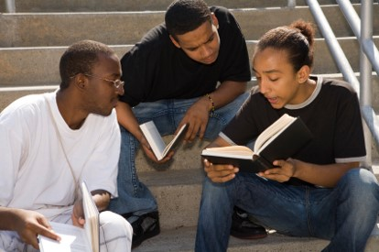

Discussing VS Contending
Discussing
Contending
1. To explain your position through friendly persuasion and facts
2. To show respect for others' opinions
3. To remain calm about issues that you are passionate about
1. To argue or state (something) in a strong and definite way
2. To show disrespect toward a person whose views are different from yours
3. To feel that winning an argument is more important than another person’s well-being
Contention-can be like a path that leads to other sins and negative consequences
Helaman 1:1-9

Slide 7
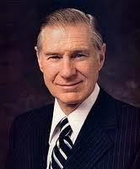
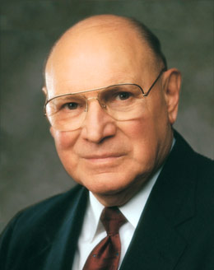
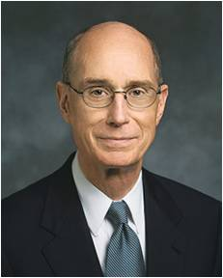
Contention makes us vulnerable to the influence of the adversary
“When there is contention, the Spirit of the Lord will depart, regardless of who is at fault.” President James E. Faust
“Where people have that Spirit with them, we may expect harmony. The Spirit puts the testimony of truth in our hearts, which unifies those who share that testimony. The Spirit of God never generates contention.
It never generates the feelings of distinctions between people which lead to strife.
It leads to personal peace and a feeling of union with others.
It unifies souls.
A unified family, a unified Church, and a world at peace depend on unified souls.”
President Henry B. Eyring
“The sins of corruption, dishonesty, strife, contention, and other evils in this world are not here by chance. They are evidences of the relentless campaign of Satan and those who follow him.
He uses every tool and device available to him to deceive, confuse, and mislead.”
Elder Joseph B. Wirthlin
3 Ne. 11:29
Joseph F. Smith, Gospel Doctrine, 13th ed. [1963], 131

Slide 8
Contention Divides a Nation
Pahoran had many sons:
About 52 BC
After Pahoran’s death, who would take the role of chief judge and governor over the people of Nephi?
Pahoran II
The people elected him
Kishkumen, a follower of Paanchi, assassinated him
Paanchi
He tried to destroy the liberty of the people and was arrested and condemned to death--treason
His followers laid the foundation for the secret works of Gadianton—a collaborator
Pacumeni
He accepted the vote
After the death of Pahoran II. He was installed as chief judge and governor for a year
He was killed by invading Lamanites under Coriantumr
Helaman 1:1-13
Who’s Who

Slide 9
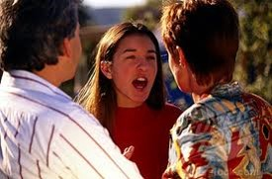
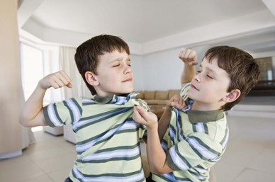

Contention Divides People
If a young woman has been arguing with her parents about her friends, how might it affect her attitude toward her parents’ counsel in other areas of her life?
If siblings have been contentious, how might their behavior affect their long-term relationship? How might it affect the entire family?
How can contention in a ward or branch make Church members more vulnerable to Satan’s attacks?
If a young man has angry feelings toward someone in his priesthood quorum, how might his feelings affect his actions at church? How might they affect his attendance at church?
How might contentious feelings weaken us when we face temptation?

Slide 10
Kishkumen
He was an assassin around 52 BC
Paanchi, son of Pahoran I, revolted against the decision of the people to have his brother Pahoran II as the chief judge and governor of the people of Nephi so he hired one of his followers, Kishkumen, to murder Pahoran I
He fled from the forces of Pahoran and made his sponsors take a secret oath not to expose who he was
Because Kishkumen went in a disguise, no one ever found him
He founded the band of Kishkumen who became the Gadiaton Robbers, with Gadiaton as their leader
He attempted to murder Helaman II, son of Helaman
He died by the sword of one of Helaman’s servants
The band had fled into the wilderness and could not be found
Helaman 1:9-12
Who’s Who

Slide 11
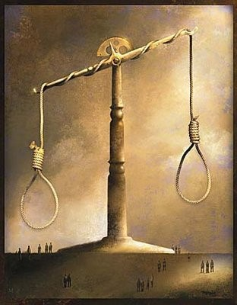
Setting the Stage for a Downfall
The contention helped to set the stage for much evil and the eventual downfall of the Nephite nation
Capital punishment was the accepted punishment for treason
Those who seek to circumvent the law for power are willing to resort to violence to get their ways
The contention over the judgment seat gave the attacking Lamanites a decided advantage against the Nephites
Helaman 1:8

Slide 12
Tubaloth
He was the son of Ammoron
He was king of the Lamanites after his father’s death around 51 BC
He stirred up his people in anger against the Nephites
He placed Coriantumr in charge of his army
His forces came up against Moronihah and Lehi
The Lamanites were defeated and Coriantumr was killed
He is not mentioned again
Helaman 1:16-17
Who’s Who

Slide 13
Coriantumr
He was a Nephite dissenter and a descendent of Zarahemla of Mulekite heritage
He was placed in charge of the Lamanite armies by the Lamanite King Tubaloth, son of Ammoron (a Zoramite)
He plunged his army into the heart of the Nephite territories and took control of the capital city Zarahemla in the year 51 BC
He killed Pacumeni
Overconfident, Coriantumr’s army soon were defeated by the Nephites with the leadership of generals Moronihah and Lehi
He was killed in the battle around 51 BC
Helaman 1:17-30
Who’s Who

Slide 14
Helaman
He was the Son of Helaman, and grandson of Alma the Younger
He was chief judge in Zarahemla around 50 BC
He survived an assassination attempt by Kishkumen, one of Gadianton’s accomplices
He brought spiritual rejuvenation to the people of Nephi
He presided over a period of great economic development and growth within the church
He had two sons, Nephi and Lehi, whom he named after two of their ancestors, the prophets Nephi and Lehi
He bestowed upon Nephi and Lehi the patriarchal blessing
Helaman 2:2
Who’s Who

Slide 15
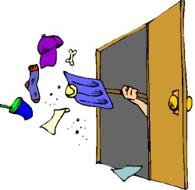

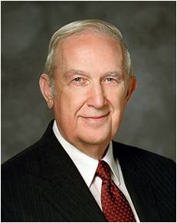
Keeping a Secret
Why is it better to clean up a mess rather than to cover it up?
Why might someone want to cover up something he or she has done?
“If you have seriously transgressed, you will not find any lasting satisfaction or comfort in what you have done. Excusing transgression with a cover-up may appear to fix the problem, but it does not. The tempter is intent on making public your most embarrassing acts at the most harmful time. Lies weave a pattern that is ever more confining and becomes a trap that Satan will spring to your detriment.”
Elder Richard G. Scott
Helaman 2:2-3

Slide 16
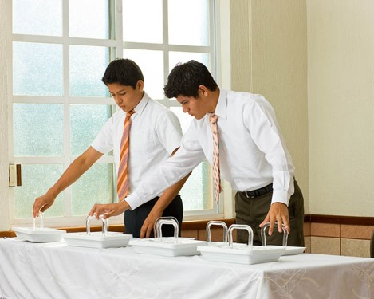
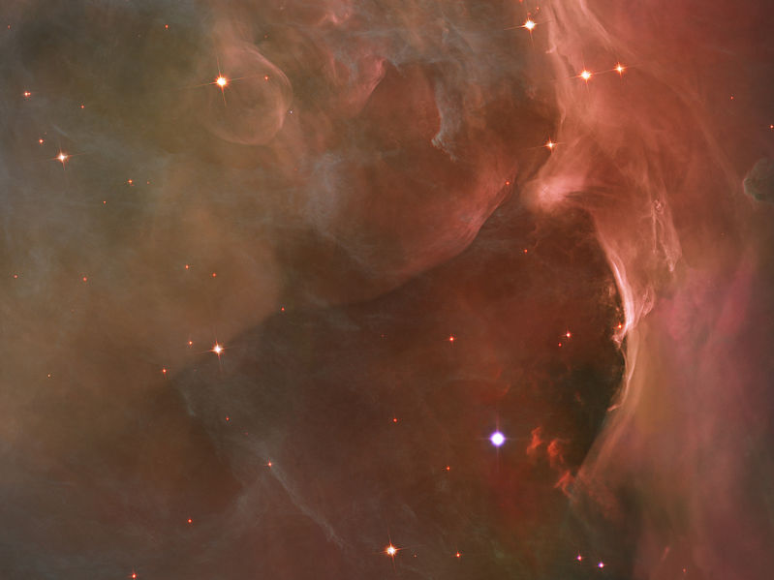
To Cover Up—The Rights of the Priesthood
“Behold, there are many called, but few are chosen. And why are they not chosen?
Because their hearts are set so much upon the things of this world, and aspire to the honors of men, that they do not learn this one lesson—
That the rights of the priesthood are inseparably connected with the powers of heaven, and that the powers of heaven cannot be controlled nor handled only upon the principles of righteousness.”
“That they may be conferred upon us, it is true; but when we undertake to cover our sins, or to gratify our pride, our vain ambition, or to exercise control or dominion or compulsion upon the souls of the children of men, in any degree of unrighteousness, behold,
the heavens withdraw themselves; the Spirit of the Lord is grieved; and when it is withdrawn, Amen to the priesthood or the authority of that man.”
D&C 121:34-37

Slide 17
Gadianton
He was associated with trying to overthrow the free government during the time of Captain Moroni
Over the years the band grew and Kishkumen was one of the men who was in the revolt against the government
He was the successor of Kishkumen around 50 BC
He was the promoter of slavery and destruction
He was a destroyer bent on deceiving people into using secret combinations to allow evil to triumph over good and to empower Satan to enslave the Lord’s people
His goal was to undermine the Nephite nation
He and his band murdered Cezoram and his son around 26 BC
His band overcame the government
The band, along with others, were eventually destroyed with the coming of the Savior
His doctrine rose again among the Nephites, and it eventually led to the destruction of the Nephites
Who’s Who

Slide 18
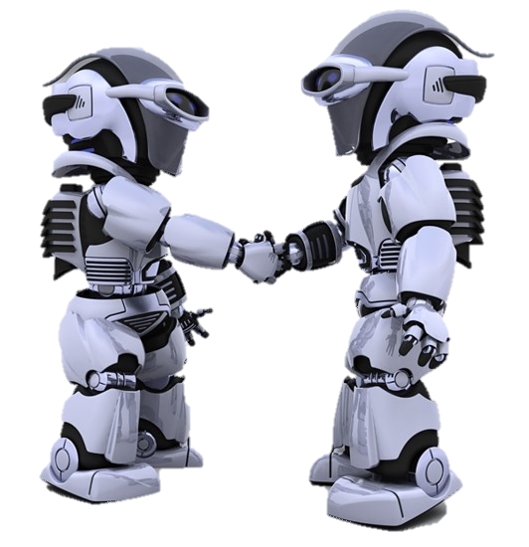

Giving a Sign
Gadianton’s band is an example of a secret combination society
Secret combinations can lead to the destruction of societies
Secret combinations led to the destruction of the Jaredites.
(Ether 8:20–21.)
Helaman 2:7

Slide 19
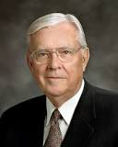


“The Book of Mormon teaches that secret combinations engaged in crime present a serious challenge, not just to individuals and families but to entire civilizations. Among today’s secret combinations are gangs, drug cartels, and organized crime families. …
“If we are not careful, today’s secret combinations can obtain power and influence just as quickly and just as completely as they did in Book of Mormon times. …
“… [The devil] uses secret combinations, including gangs, ‘from generation to generation according as he can get hold upon the hearts of the children of men.’ His purpose is to destroy individuals, families, communities, and nations.
To a degree, he was successful during Book of Mormon times. And he is having far too much success today. That’s why it is so important for us … to take a firm stand for truth and right by doing what we can to help keep our communities safe”
Elder M. Russell Ballard
WANTED

Slide 20
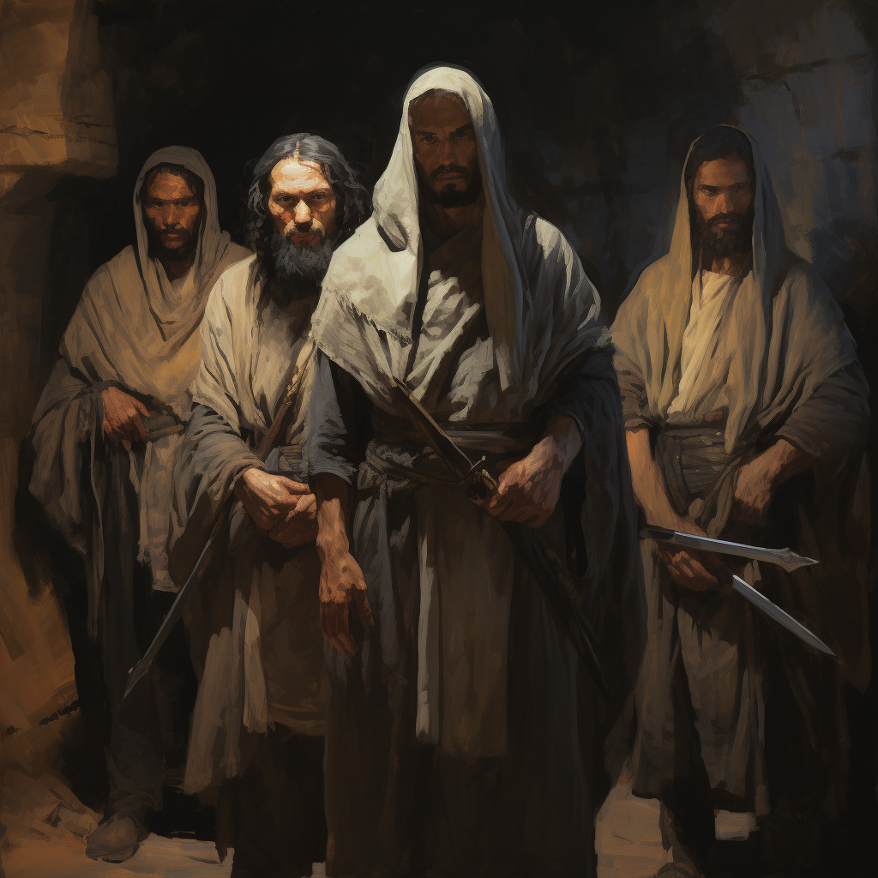
The Destruction of the Nephites
The end of the 42nd year of the Reign of the Judges
“And behold, in the end of this book ye shall see that this Gadianton did prove the overthrow, yea, almost the entire destruction of the people of Nephi.
Behold I do not mean the end of the book of Helaman, but I mean the end of the book of Nephi, from which I have taken all the account which I have written.”
Helaman sent forth to take Gadianton’s band, but they secretly went into the wilderness
Helaman 2:10-14

Slide 21
Sources:
Book of Mormon Who’s Who by Ed J. Pinegar and Richard J. Allen pg 41, 54-55, 65-66, 94, 152-154, 181-182
President James E. Faust (“What I Want My Son to Know before He Leaves on His Mission,” Ensign, May 1996, 41).
Elder Joseph B. Wirthlin (“Deep Roots,” Ensign, Nov. 1994, 76).
President Henry B. Eyring (“That We May Be One,” Ensign, May 1998, 67).
Richard G. Scott (“Finding Forgiveness,” Ensign, May 1995, 77).
Elder M. Russell Ballard (“Standing for Truth and Right,” Ensign, Nov. 1997, 38).
March madness chart http://justifiedbythescriptures.wordpress.com/tag/duke/
Presentation by ©http://fashionsbylynda.com/blog/

Slide 22
Contention weakens our collective witness to the world of Jesus Christ and the redemption that comes through His “merits, … mercy, and grace” [2 Nephi 2:8]. … His latter-day work is compromised when contention or enmity exists among His disciples. … [Contention] is spiritually unhealthy for us as individuals. We are robbed of peace, joy, and rest, and our ability to feel the Spirit is compromised. (Dale G. Renlund, “The Peace of Christ Abolishes Enmity,” Liahona, Nov. 2021, 83–84)
Peace Makers:
By the shield of our faith in Jesus Christ, we become peacemakers, quenching—meaning to calm, cool, or extinguish—all the fiery darts of the adversary. …
How does a peacemaker calm and cool the fiery darts? Certainly not by shrinking before those who disparage us. Rather, we remain confident in our faith, sharing our beliefs with conviction but always void of anger or malice. …
We genuinely love and care for all our neighbors, whether or not they believe as we do. Jesus taught us in the parable of the Good Samaritan that those of different beliefs should sincerely reach out to help anyone in need, being peacemakers, pursuing good and noble causes. (Neil L. Andersen, “Following Jesus: Being a Peacemaker,” Liahona, May 2022, 18–19)

Slide 23
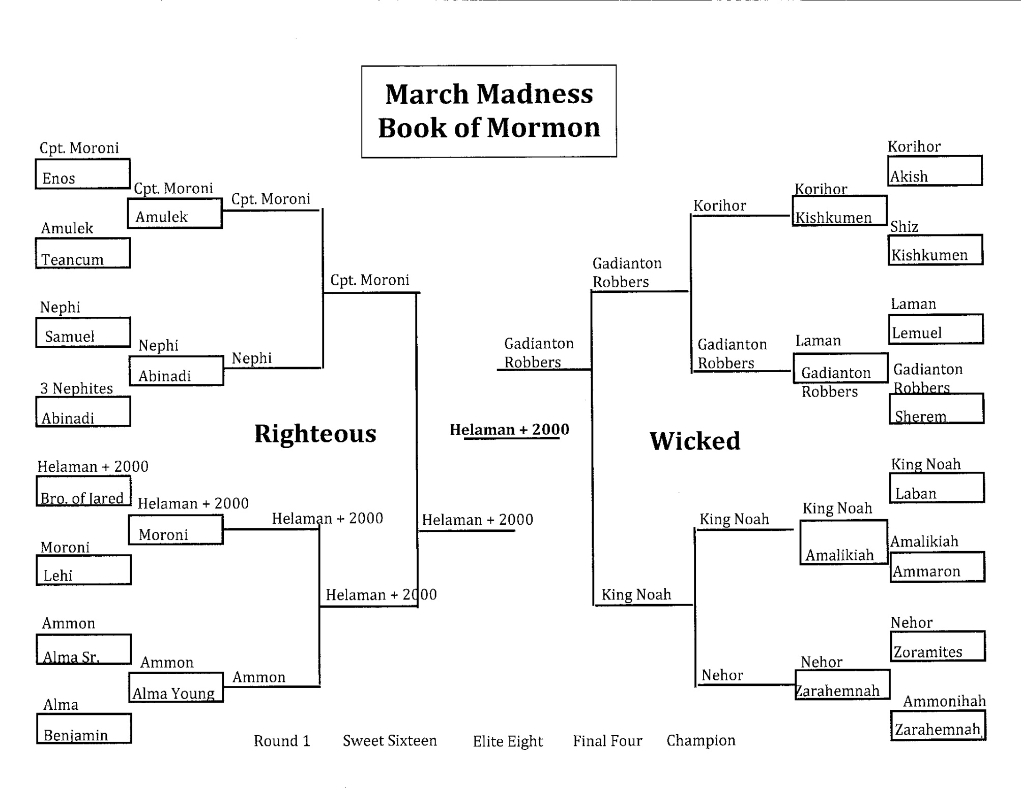

Slide 24
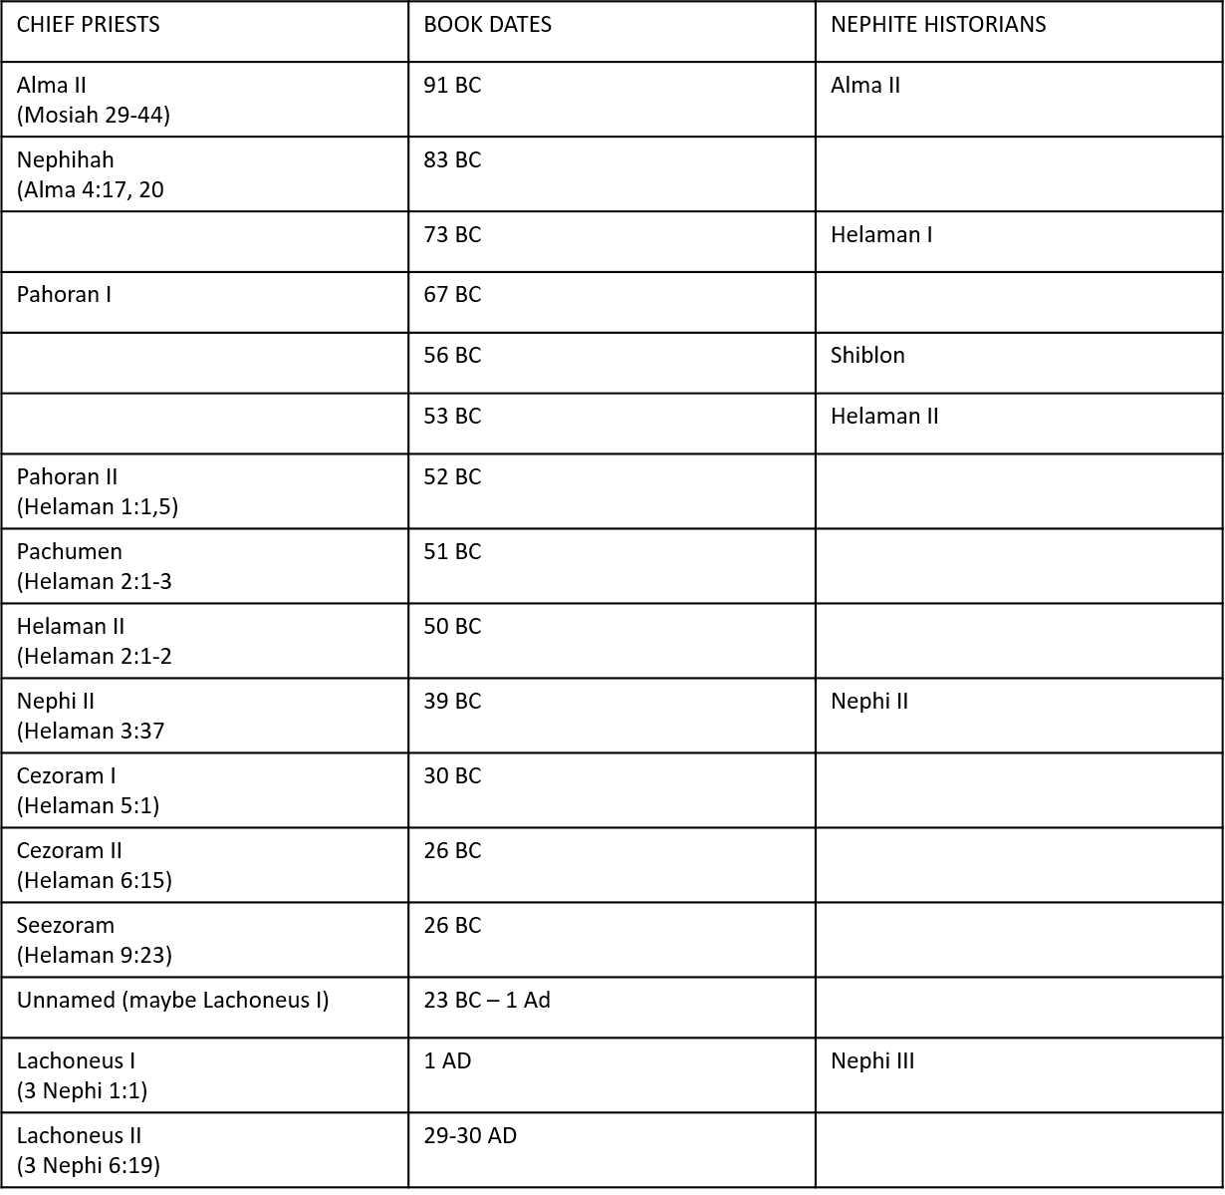

Slide 25
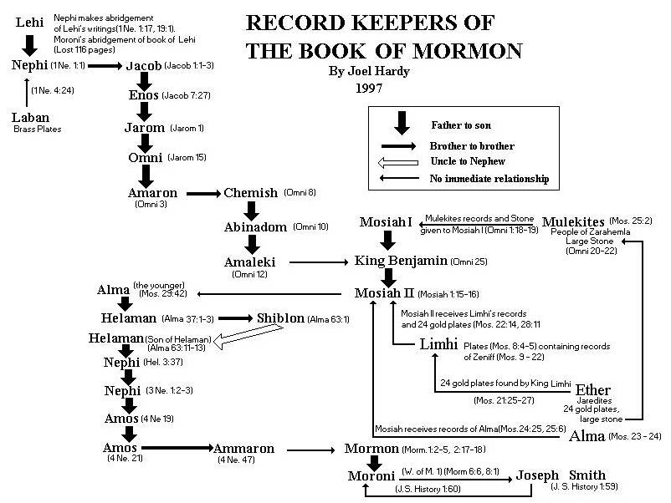

Slide 26
Record Keeper | Dates approximate | Comments | Reference
Nephi | 615 B.C. 600 B.C. 540 B.C. | Born in Jerusalem Begins record when about 15 years old Dies about 75 years old | 1 Nephi 1:4 1 Nephi 1:1
Jacob | 592 B.C 544 B.C. 495 B.C. | Born son of Lehi, brother of Nephi Becomes record keeper Dies about 97 years old | 1 Nephi 18:7 Jacob 1:1 Jacob 7:27 Jacob 7:27
Enos | 515 B.C. 420 B.C. 417 B.C. | Born son of Jacob About to die Dies about 98 years old | Jacob 7:27 Enos 1:25
Jarom | 440 B.C. 420 B.C. 361 B.C. 355 B.C. | Born son of Enos Becomes record keeper Gives plates to Omni Dies about 85 years old | Jarom 1:1 Jarom 1:1 Jarom 1:15
Omni | 390 B.C. 361 B.C. 317 B.C. 315 B.C. | Born son of Jarom Becomes record keeper Write 3 verses on plates in 44 years Dies about 75 years old | Omni 1:1 Jarom 1:15 Omni 1:1-3 Omni:3
Amaron | 350 B.C. 317 B.C 277 B.C. | Born son of Omni Becomes record keeper Dies about 73 years old | Omni 1:4 Omni 1:4 Omni 1:8
Chemish | 330 B.C. 279 B.C. 250 B.C. | Born son of Omni, brother of Amaron Becomes record keeper Dies about 80 years old | Omni 1:9 Omni 1:9 Omni 1:9
Abinadom | 270 B.C. 180 B.C. | Born son of Chemish Dies about 90 years old | Omni 1:10 Omni 1:10
Amaleki | 210 B.C. 150 B.C. 138 B.C. | Born son of Abinadom Nephites move to Sarahemla Dies about 72 years old | Omni 1:12 Omni 1:13 Omni 1:30
Record Keeper | Dates approximate | Comments | Reference
Benjamin | 190 B.C. 140 B.C. 121 B.C. | Born son of Mosiah Becomes record keeper Dies 69 years old | Omni 1:25 Omni 1:25 Mosiah 6:5
Mosiah II | 154 B.C. 91 B.C. | Born son of Benjamin Dies about 63 years old | Mosiah 6;4 Mosiah 29:46
Alma I | 174 B.C. 149 B.C. 120 B.C 91 B.C. | Born a descendant of Nephi “young man” at 25 years old Abinadi martyred Becomes high priest over church in Zarahemla Dies about 83 years old | Jacob 7:27 Enos 1:25 Mosiah 23:16 Mosiah 29:47
Alma II | 126 B.C. 91 B.C. 73 B.C. | Born son of Alma I Becomes record keeper Departs out of land; assumed to have been translated | Mosiah 27:8 Mosiah 29:42 Alma 45:18-19
Helaman II | 97 B.C. 73 B.C. 64 B.C. 57 B.C. | Born son of Alma II Becomes high priest Leads 2,000 Ammonite warriors at 33 years old Dies about 40 years old | Alma 36:3 Alma 4520 Alma 53:22 Alma 62:52
Shiblon | 95 B.C. 57 B.C. 53 B.C. | Born son of Alma II brother of Helaman Becomes record keeper Dies about 42 years old | Alma 63:1 Alma 63:1 Alma 63:13
Helaman III | 76 B.C. 53 B.C. 39 B.C. | Born son of Helaman II Becomes record keeper Dies about 37 years old | Helaman 2:2 Helaman 2:2 Helaman 3:37
Nephi II | 54 B.C A.D. 1 A.D. 13 | Born son of Helaman III Departs out of land Dies about 67 years old | Helaman 3:37 3 Nephi 1:3
Record Keepers of the Book of Mormon

Slide 27
Record Keeper | Dates approximate | Comments | Reference
Nephi III | 30 B.C. A.D.1 A.D. 34 A.D. 60 A.D. 100. | Born son of Nephi II Becomes record keeper One of the 12 disciples Dies about 90 years old All but 3 disciples have passed away | 3 Nephi 1:1 3 Nephi 1:1 3 Nephi 12:1 4 Nephi 1:14
Nephi IV | A.D. 50 | Born son of Nephi III
Amos I | A.D. 90 A.D. 110 A.D. 194 | Born son of Nephi IV Becomes record keeper for 84 years Dies about 104 years old | 4 Nephi 1:19 4 Nephi 1:21
Amos II | A.D. 174 A.D. 194 A.D. 305 | Born son of Amos I Becomes record keeper Dies about 132 years old | 4 Nephi 1:21 4 Nephi 1:47
Ammaron | A.D. 190 A.D. 305 A.D. 320 | born son of Amos, brother of Amos II Becomes record keeper Dies about 130 years old | 4 Nephi 1:48 Mormon 1:5
Mormon II | A.D. 311 A.D. 321 A.D. 326 A.D. 335 A.D. 385 A.D. 401 | born Told by Ammaron that at 24 he would become record keeper Visited by Lord: leads Nephite armies Become record keeper Delivered plates to Moroni; buried others in hill Cumorah Dies about 90 years old at the hands of Lamanites | Mormon 1:2 Mormon 1:2 Mormon 1:15 Mormon 2:18 Mormon 8:1 Mormon 8:3
Moroni | A.D. 360 A.D. 385 A.D. 421 | Born son of Mormon Becomes record keeper “soon go to rest” about 61 years old | Mormon 8:1 Mormon 8:1 Moroni 10:34

Slide 28

Who’s on the Lord’s Side
Helaman 3-4

Slide 29

Actions of Others
Of all the people listed on the board, who do you feel that you can control?
Have you ever been discouraged because of others’ actions?
Have you been been discouraged recently because of the unrighteous actions of others?
People in the … (Country)
People in…(City)
People in the ward or branch…
People in my family
Myself

Slide 30
Helaman
Righteousness
6:1-8
Reign of Judges
61st and 62nd Year
Humility and Repentance
Prosperity and Blessings
4:15-17
Reign of Judges
61st and 62nd Year
3:22, 24-25
Reign of Judges
49th Year
1st Cycle of Nephite Disease
Destruction and Suffering
Pride
4: 10-13
Reign of Judges
61st Year
3:33-34, 36
Reign of Judges
51st Year
Wickedness
4:1-10
Reign of Judges
54th Year
Postscript to the war
3:23 Secret Combinations
4:24 Spirit Withdrawal
5:2 Most Choose Evil

Slide 31
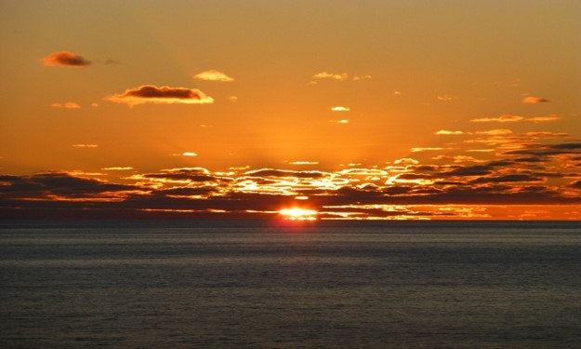
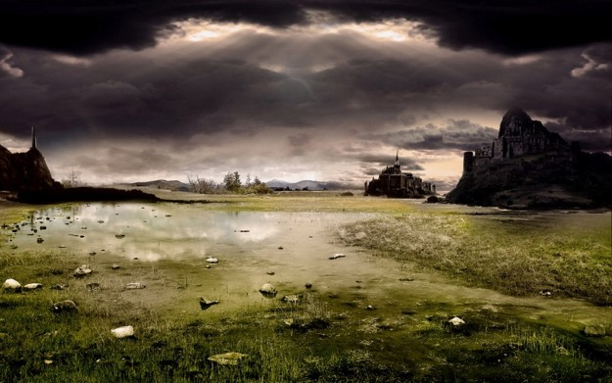
A Time to Leave
In the 43rd - 45th Year of the Reign of the Judges there was no contention
However: In the 46th Year there began to be ‘much contention’
Many of the Nephites, including the people of Ammon, migrated north for a safer haven…
Alma 63:1-17 Helaman 3:1-12

Slide 32
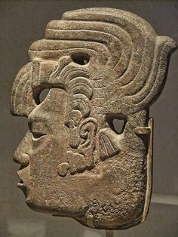
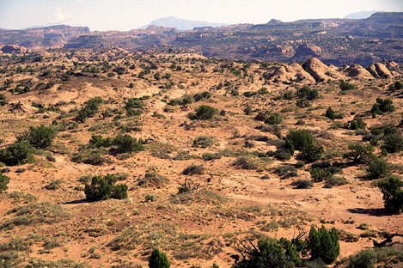
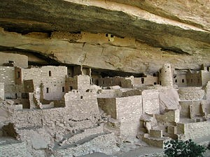
Concrete Homes
They pitched their tents and made concrete homes because timber was scarce
Helaman 3:9

Slide 33

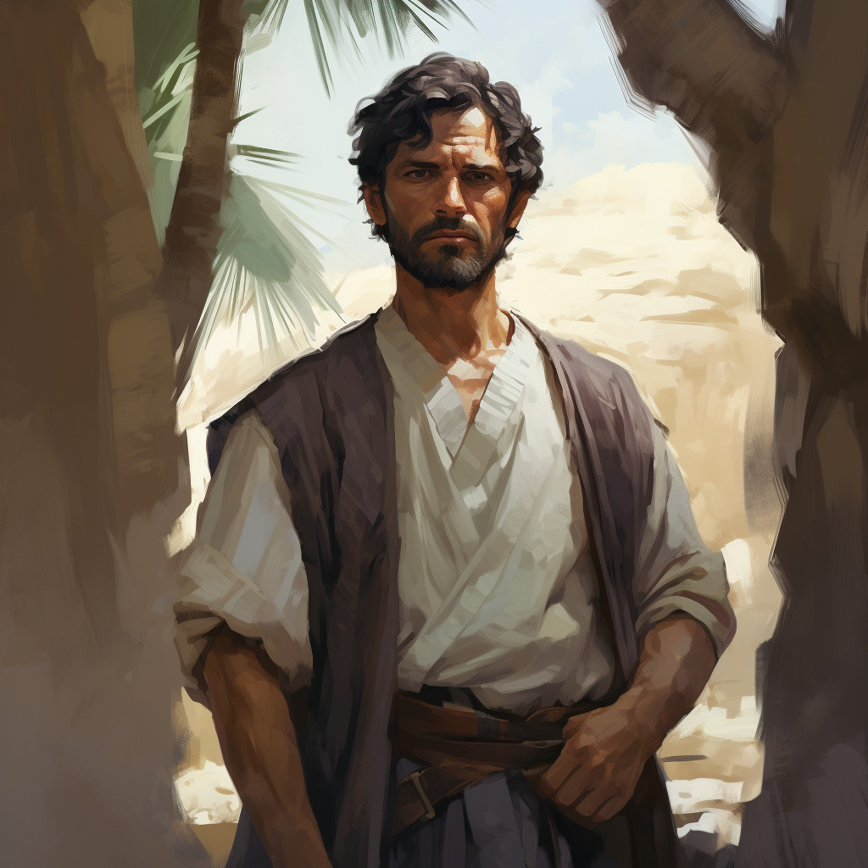
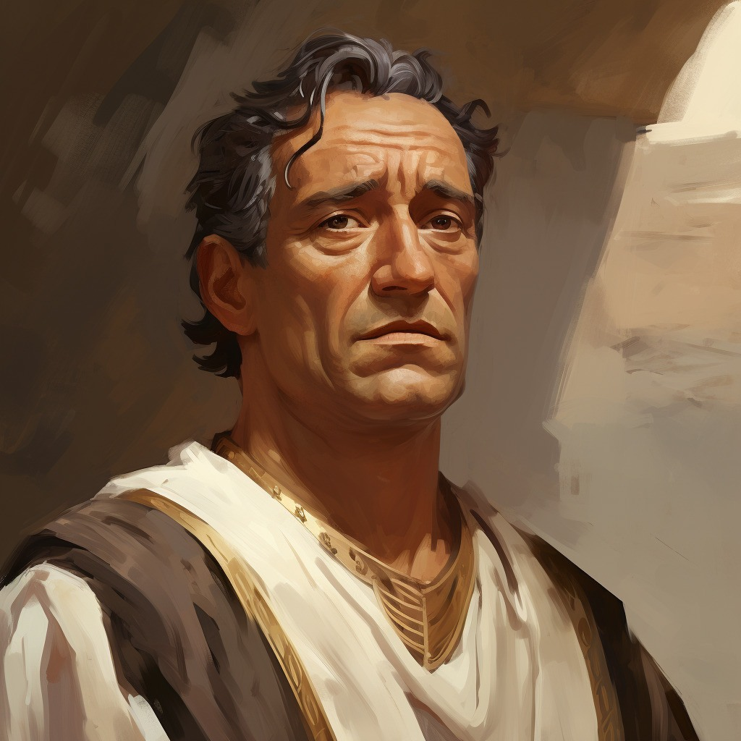
Helaman II
Helaman was chief judge and also kept the sacred records
He had two sons:
Nephi and Lehi
The unbelievable peace “…for I will work a work in your days, which ye will not believe, though it be told you.”
Habakkuk 1:5
47th – 49th year-- very little contention---much prosperity
Helaman 3:20-28

Slide 34
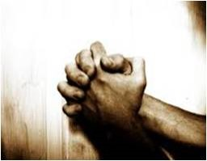
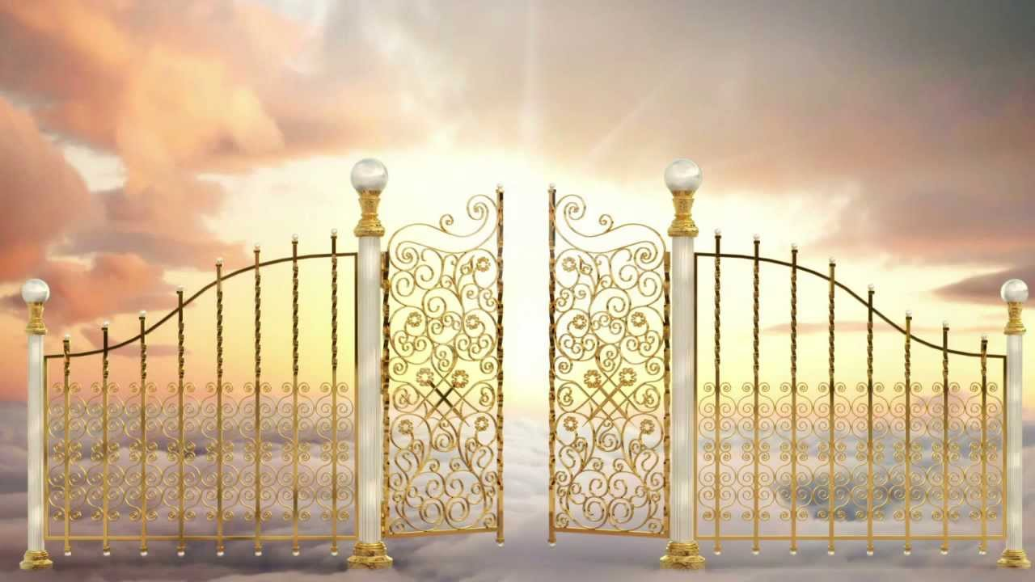
Thus We See
The Lord is merciful to those who, in sincerity, call on his holy name
The gate of heaven is open to all who believe in Jesus Christ’
The word of God has three effects:
It divides asunder the cunning and the wiles of the devil
It leads the “man of Christ” in a straight and narrow course across the gulf of misery
It helps to land faithful men’s immortal souls at the right hand of God
Helaman 3:17-30—Student Manual

Slide 35
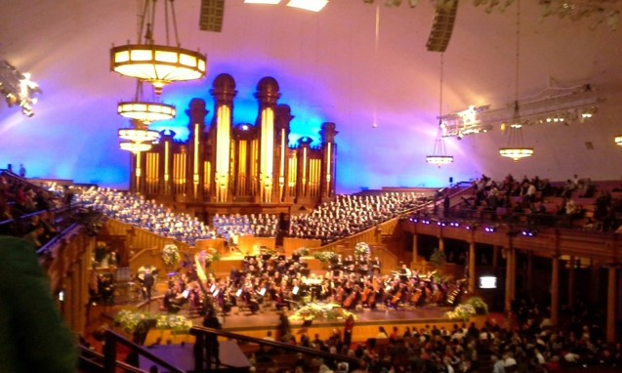
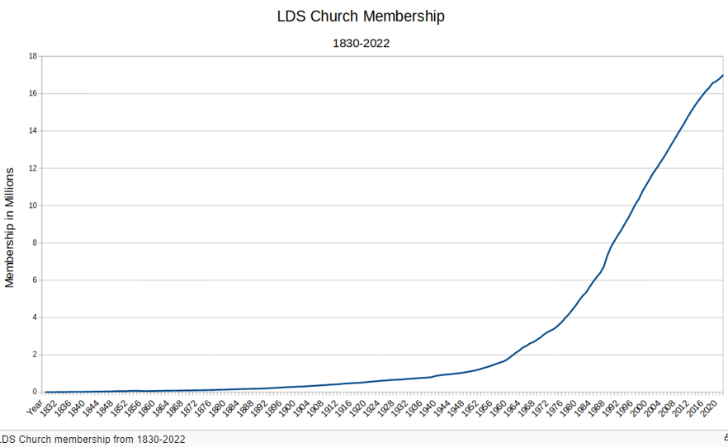
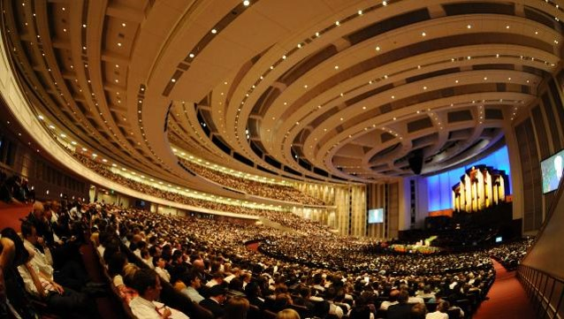
Prosperity
Not only in the temporal—worldly things but also in the spiritual aspects
Helaman 3:24

Slide 36
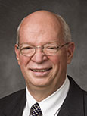
Mormon Wants Us to Learn
The Lord is merciful unto all who will call upon His name in the sincerity of their hearts
The gate of heaven is open unto all who will believe on the name of Jesus Christ
Whosoever will may lay hold upon the word of God, which will lead them to the kingdom of God
“The God of heaven is not a heartless referee looking for any excuse to throw us out of the game. He is our perfectly loving Father, who yearns more than anything else to have all of His children come back home and live with Him as families forever.
He truly gave His Only Begotten Son that we might not perish but have everlasting life. Please believe, and please take hope and comfort from, this eternal truth. Our Heavenly Father intends for us to make it! That is His work and His glory.
“… None of us will ever be ‘good enough,’ save through the merits and mercy of Jesus Christ but because God respects our agency, we also cannot be saved without our trying.”
J. Devn Cornish
Helaman 3:27-30; John 3:16; Moses 1:39; 2 Nephi 2:6-8

Slide 37


Pride and Persecution
“The Great Evil”— Saints against Saints
Many humble members experience persecution
1. A young woman makes fun of another girl in her ward.
2. A young man teases a member of his quorum for being too eager to answer questions in class or to volunteer for priesthood duties.
3. A group of young men in a ward exclude another young man from their conversations and activities outside of church.
4. A group of young women make hurtful remarks about the clothes that other young women wear.
“For of him unto whom much is given much is required; and he who sins against the greater light shall receive the greater condemnation.”
D&C 82:3
Helaman 3:33-34

Slide 38

The Spirit is the Sanctifier
Fast and pray oft
Be strong in humility
Increase firmness of faith in Christ
Yield your hearts unto God
Helaman 3:35 Student Manual

Slide 39
The Rebellious
“And the rebellious part were slain and driven out of the land, and they did go unto the king of the Lamanites.
And it came to pass that they did endeavor to stir up the Lamanites to war against the Nephites; but behold, the Lamanites were exceedingly afraid, insomuch that they would not hearken to the words of those dissenters.”
54th Year of the Reign of the Judges
The Work of Death---They lost Zarahemla and even up to the Land Bountiful
Moronihah helped in regaining back half of the cities
57th - 61st Year of the Reign of the Judges
Helaman 4:2-3

Slide 40
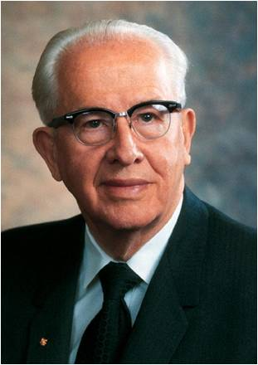
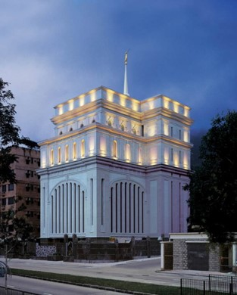
“Think of what pride has cost us in the past and what it is now costing us in our own lives, our families, and the Church.
“Think of the repentance that could take place with lives changed, marriages preserved, and homes strengthened, if pride did not keep us from confessing our sins and forsaking them.
“Think of the many who are less active members of the Church because they were offended and their pride will not allow them to forgive or fully sup at the Lord’s table.
“Think of the tens of thousands of additional young men and couples who could be on missions except for the pride that keeps them from yielding their hearts unto God.
Pride and wickedness separate us from the Spirit of the Lord and leave us to our own strength
“Think how temple work would increase if the time spent in this godly service were more important than the many prideful pursuits that compete for our time.”
Ezra Taft Benson
Helaman 4:2-3

Slide 41

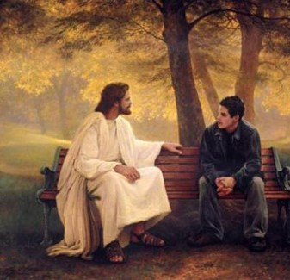
The Key—winning the Battle
What do you think your chances of winning the battle would be if you had the Lord on your side?
In the Nephites’ experience, being left to their own strength meant losing battles and lands.
What “battles” might we lose if we
do not have the Holy Ghost with us?

Slide 42
Sources:
Book of Mormon Student Manual Religion 121-122 Pg. 355
Ezra Taft Benson (“Beware of Pride,” Ensign, May 1989, 6).
J. Devn Cornish, “Am I Good Enough? Will I Make It?” 33, 34
Nephite Disease Cycle—Ezra Taft Benson (God, Family, country, pg 363-364 quoted in Latter-day Commentary on the Book of Mormon compiled by K. Douglas Bassett
Presentation by ©http://fashionsbylynda.com/blog/

Slide 43
Helaman
Righteousness
6:1-8
Reign of Judges
61st and 62nd Year
Humility and Repentance
Prosperity and Blessings
4:15-17
Reign of Judges
61st and 62nd Year
3:22, 24-25
Reign of Judges
49th Year
1st Cycle of Nephite Disease
Destruction and Suffering
Pride
4: 10-13
Reign of Judges
61st Year
3:33-34, 36
Reign of Judges
51st Year
Wickedness
4:1-10
Reign of Judges
54th Year
Postscript to the war
3:23 Secret Combinations
4:24 Spirit Withdrawal
5:2 Most Choose Evil

Slide 44



A Pillar of Fire
Helaman 5

Slide 45
Your Name.
Parents.
The Atonement of Jesus Christ
Was it easy or hard to remember these words and phrases?
Prophets.
Repentance.
Keep the commandments
What difference do you think it made that you were told in advance that you needed to remember what was on the paper strips?

Slide 46
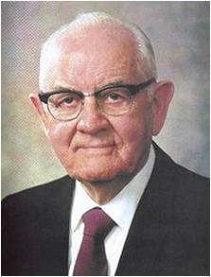


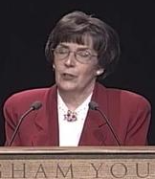
Remember
“When you look in the dictionary for the most important word, do you know what it is?
It could be-- remember.
Because all of you have made covenants—you know what to do and you know how to do it—our greatest need is to remember.”
Spencer W. Kimball
“Satan wants us to be slow to remember what we have received and heard. He wants us to minimize and even forget the quiet witnesses of the Spirit that have told us who we really are.”
Susan L. Warner

Slide 47
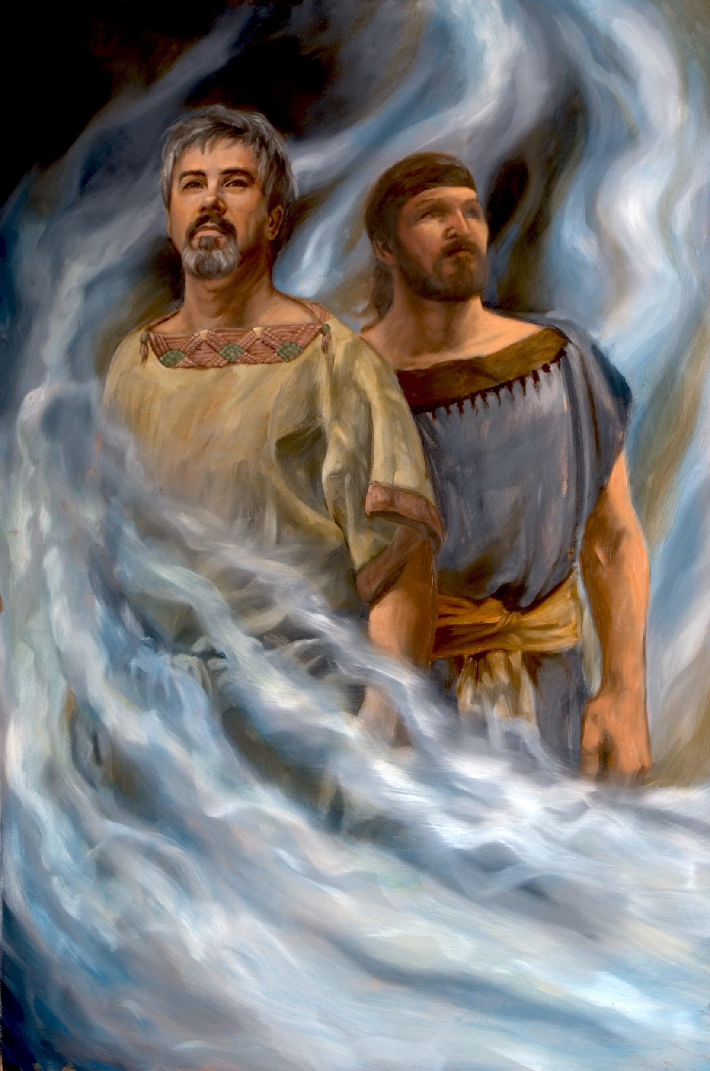
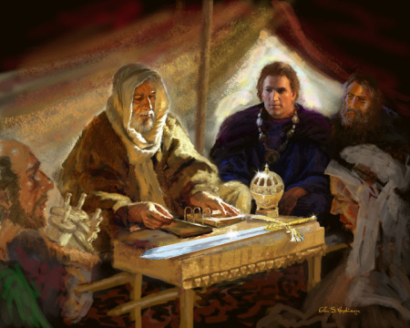
What’s In a Name?
Remembering our ancestors and their good works can inspire us to do good.
Glen S. Hopkinson
James H. Fullmer
Helaman 5:5-7

Slide 48
Nephi And Lehi
They were the son’s of Helaman, grandsons of Alma
They were taught by their father whose leadership was anchored in the Redeemer, Jesus Christ
Nephi succeeded his father as chief judge around 39 BC until 30 BC and had kept the sacred record
Nephi gave up the judgment seat to Cezoram in order to serve the Lord, Lehi also went with Nephi
They went from city to city preaching repentance
Through Nephi and Lehi’s endeavors some 8,000 Lamanites were brought into the fold living in the vicinity of Zarahemla
They labored 6 years and witnessed that pride had crept in among the people
They endured prison and fire but were not burned (Helaman 5)
Nephi was granted sealing powers (Helaman 10:7)
Around AD 1 Nephi’s ministry was completed and he turned the sacred records over to his eldest son Nephi
Lehi served in Zarahemla
Nephi left the land and ‘whither he went, no man knoweth’
Who’s Who

Slide 49
Cezoram I and Cezoram II
He was the chief judge of the land for the Nephite people in around 30 BC following Helaman, son of Helaman
At this time the laws had become corrupt
He was murdered by an ‘unknown hand’ in around 26 BC on the judgment seat
His son, Cezoram, was appointed by the people after his father’s death
He was also assassinated by the Gadianton conspiracy who were rapidly gaining power
Who’s Who

Slide 50

Laws Corrupt
A corrupt government is when the people choose corrupt leaders
King Mosiah had warned against:
“And if the time comes that the voice of the people doth choose iniquity, then is the time that the judgments of God will come upon you; yea, then is the time he will visit you with great destruction even as he has hitherto visited this land.”
Mosiah 29:27
“We have learned by sad experience that it is the nature and disposition of almost all men, as soon as they get a little authority, as they suppose, they will immediately begin to exercise unrighteous dominion.
Hence many are called, but few are chosen.”
D&C 121:39-40
Helaman 5:3

Slide 51

What makes a Good Leader?
John MacArthur

Slide 52
?
When you are looking for a leader, you want someone who asks lots of questions.
A leader is someone who asks the right questions and genuinely looking for answers.
Curiosity is critical for leadership.
Leaders have a need, or hunger, for answers.
Knowledge is power (whoever has the information has the lead)
The best problem solvers are those who are driven by an unquenchable enthusiasm for knowing and understanding things.
Inquisitiveness
?
?
?
?
?
People who are content with what they don’t know, happy to remain ignorant about what they don’t understand, complacent about what they haven’t analyzed, and comfortable living with problems they haven’t solved…such people can not lead.

Slide 53
Initiative
A leader has drive, ambition, and energy.
A true leader must be the kind of person who makes things happen.
He/she is a starter.
A leader should be physically fit and spiritually sound.
People who are passive and hesitant do not make strong leaders.

Slide 54
Involvement
True leaders are always in the middle of the action.
They do not sit on the background and tell others what to do.
A true leader goes around with a cloud of dust around them.
A true leader must show the way.
A true leader goes before his followers into battle.
A true leader has courage.
People can not follow someone who is distant or ignores problems around them.
People who bail out of problems instead of facing them do not make good leaders.
People who blame others for their mistakes do not make good leaders.

Slide 55
Integrity
Making a commitment and being consistent.
Taking ownership of your mistakes.
Being a good role model.
Following ethical standards and rules.
Committing to your core values.
Being honest with family and associates
Having strong moral principles
What makes a Righteous Leader?

Slide 56
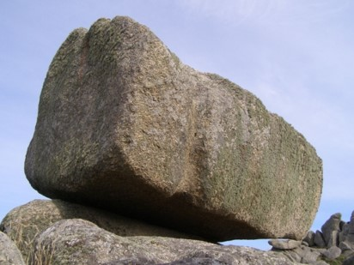

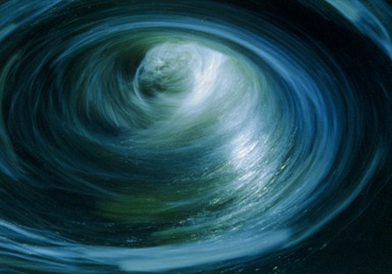
Doctrinal Mastery
“And now, my sons, remember, remember that it is upon the rock of our Redeemer, who is Christ, the Son of God, that ye must build your foundation; that when the devil shall send forth his mighty winds, yea, his shafts in the whirlwind, yea, when all his hail and his mighty storm shall beat upon you, it shall have no power over you to drag you down to the gulf of misery and endless wo, because of the rock upon which ye are built, which is a sure foundation, a foundation whereon if men build they cannot fall.”
Helaman 5:12

Slide 57

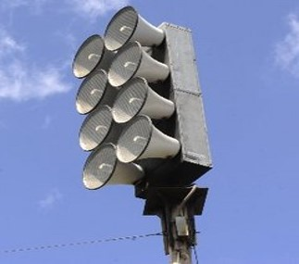
“We, too, are faced with powerful, destructive forces unleashed by the adversary. Waves of sin, wickedness, immorality, degradation, tyranny, deceitfulness, conspiracy, and dishonesty threaten all of us. They come with great power and speed and will destroy us if we are not watchful.
“But a warning is sounded for us. It behooves us to be alert and to listen and flee from the evil for our eternal lives. Without help we cannot stand against it. We must flee to high ground or cling fast to that which can keep us from being swept away. That to which we must cling for safety is the gospel of Jesus Christ. It is our protection from whatever force the evil one can muster.
An inspired Book of Mormon prophet counseled his people: ‘Remember that it is upon the rock of our Redeemer, who is Christ, the Son of God, that ye must build your foundation; that when the devil shall send forth his mighty winds, yea, his shafts in the whirlwind, yea, when all his hail and his mighty storm shall beat upon you, it shall have no power over you to drag you down to the gulf of misery and endless wo’ (Hel. 5:12).”
President Spencer W. Kimball

Slide 58

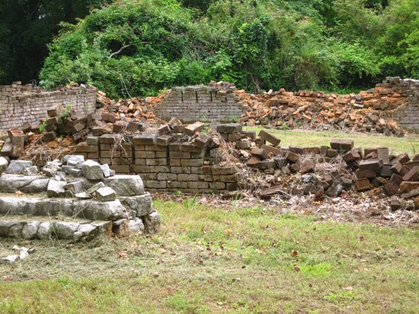
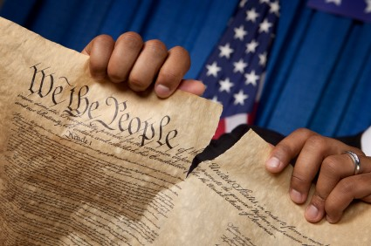
If we build our foundation on Jesus Christ, Satan will have no power over us.
Do you recognize when Satan is trying to destroy your foundation?

Slide 59
Helaman 5:20-21
Helaman 5:22-25
Helaman 5:26-28
Helaman 5:29-34
Helaman 5:35-41
Helaman 5:42-44
Repent Ye,
Repent Ye

Slide 60
Aminadab
He was a Nephite dissenter who had gone over to the Lamanite side during the days of Nephi and Lehi
While Nephi and Lehi were in prison Aminadab observed the radiant faces of the prisoners as they were encircled by fire
He told the crowd , who were encircled by a dark cloud, that the prisoners were in ‘converse with the angels of God’
The crowd asked Aminadab what to do, and he responded, “You must repent…”
Aminadab knew of the words preached by Alma, Amulek, and Zeezrom
The crowd immediately followed Aminadab’s suggestion, and the darkness left, and they were filled with ‘that joy which is unspeakable and full of glory’
There were about 300 people converted at that time
Who’s Who

Slide 61

Encircled By Fire
The Lord’s Protection
This particular experience could refer to a general protective influence of the Spirit or, more likely, to the presence of heavenly beings in the prison with Lehi and Nephi”
JFM and RLM
“Lo, I see four men loose, walking in the midst of the fire, and they have no hurt; and the form of the fourth is like the Son of God.”
(See Daniel 3:19-27)
Joseph Smith sees his brother Alvin
“I saw the transcendent beauty of the gate through which the heirs of that kingdom will enter, which was like unto circling flames of fire;”
D&C 137:2
Helaman 5:23-24

Slide 62
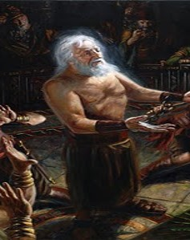
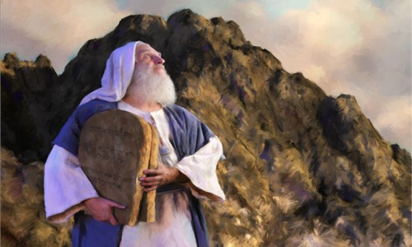
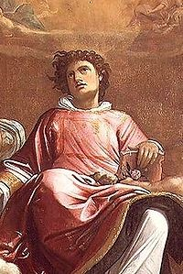
Faces of Angels
“Now it came to pass after Abinadi had spoken these words that the people of king Noah durst not lay their hands on him, for the Spirit of the Lord was upon him; and his face shone with exceeding luster, even as Moses’ did while in the mount of Sinai, while speaking with the Lord.”
Mosiah 13:5
“…that Moses wist not that the skin of his face shone while he talked with him… And the children of Israel saw the face of Moses, that the skin of Moses’ face shone:”
Exodus 24:29, 35
Stephen
“And all that sat in the council, looking steadfastly on him, saw his face as it had been the face of an angel.”
Acts 6:15
Helaman 5:36

Slide 63
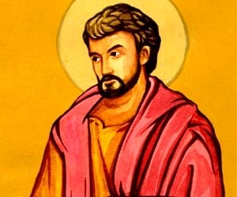
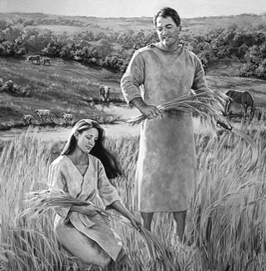
Filled as if with Fire
“The reception of the Holy Ghost is the baptism of fire spoken of in the scriptures”
JFM and RLM
John the Baptist
“I indeed baptize you with water unto repentance: but he that cometh after me is mightier than I, whose shoes I am not worthy to bear: he shall baptize you with the Holy Ghost, and with fire:”
Matthew 3:11
Adam
“And he heard a voice out of heaven, saying: Thou art baptized with fire, and with the Holy Ghost. This is the record of the Father, and the Son, from henceforth and forever;”
Moses 6:66
Helaman 5:45

Slide 64
The 4th Article of Faith—Doctrine of Christ
“Wherefore, my beloved brethren, I know that if ye shall follow the Son, with full purpose of heart, acting no hypocrisy and no deception before God, but with real intent, repenting of your sins, witnessing unto the Father that ye are willing to take upon you the name of Christ, by baptism—yea, by following your Lord and your Savior down into the water, according to his word, behold, then shall ye receive the Holy Ghost; yea, then cometh the baptism of fire and of the Holy Ghost; and then can ye speak with the tongue of angels, and shout praises unto the Holy One of Israel.”
2 Nephi 31:13
Faith
Repentance
Baptism
The Gift of the Holy Ghost
Helaman 5:45

Slide 65
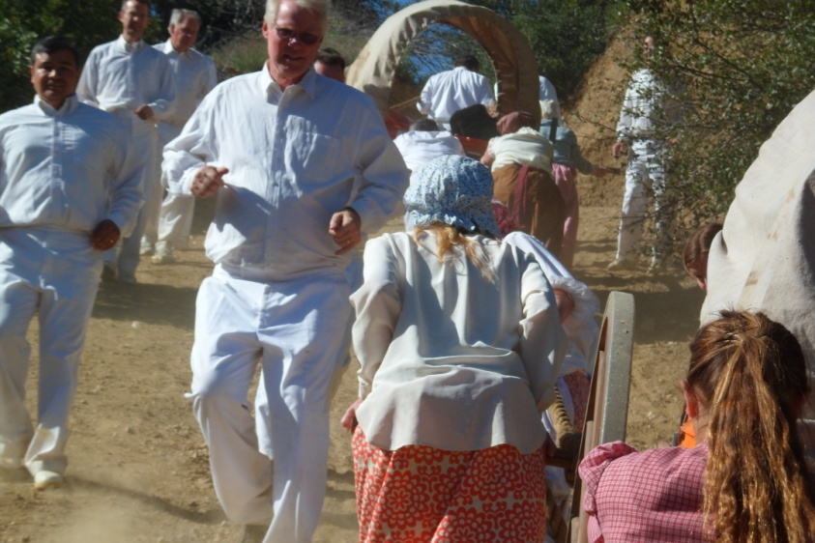
Ministering Angels
When we exercise faith in Jesus Christ and repent of our sins, the Holy Ghost will fill our hearts with peace and joy
Peace unto you because of your faith
“And now, when they heard this they cast up their eyes as if to behold from whence the voice came; and behold, they saw the heavens open; and angels came down out of heaven and ministered unto them.”
“And it came to pass that they did go forth, and did minister unto the people, declaring throughout all the regions round about all the things which they had heard and seen, insomuch that the more part of the Lamanites were convinced of them, because of the greatness of the evidences which they had received.”
“But there are no angels who minister to this earth but those who do belong or have belonged to it.
The angels do not reside on a planet like this earth;
But they reside in the presence of God, on a globe like a sea of glass and fire, where all things for their glory are manifest, past, present, and future, and are continually before the Lord.”
D&C 130:5-7
Helaman 5:47-52

Slide 66
Sources:
Spencer W. Kimball (“Circles of Exaltation” [address to CES religious educators, June 28, 1968], 5, si.lds.org). (“Hold Fast to the Iron Rod,” Ensign, Nov. 1978, 6).
Susan L. Warner Ensign May 1996 PP. 78-79
Book of Mormon Who’s Who by Ed J. Pinegar and Richard J. Allen pg. 16-17, 37-38, 109-110. 140-142
Elder Paul E. Koelliker Recognizing Righteous Leadership July 2010 Ensign
Joseph Fielding McConkie and Robert L. Millet Doctrinal Commentary on the Book of Mormon Vol. 3 pg. 158
Saint Stephen in Glory (detail) (1601) by Giacomo Cavedone
What makes a good leader? John MacArthur Twelve Ordinary Men pg 39-43
Presentation by ©http://fashionsbylynda.com/blog/

Slide 67
Helaman 5:21–25 | Helaman 5:26–28 | Helaman 5:29–34 | Helaman 5:35–41 | Helaman 5:42–45
Helaman 5:21–25 | Helaman 5:26–28 | Helaman 5:29–34 | Helaman 5:35–41 | Helaman 5:42–45
Draw a Picture Activity—set of 2

Slide 68

Loss of a Society
Helaman 6

Slide 69
What attitudes and actions can increase in the influence of the Holy Ghost in your life?
Mormon recorded that the Lord withdrew His Spirit from the Nephites and began to pour out His Spirit on the Lamanites
The Influence of the Spirit of the Holy Ghost
What attitudes and actions can decrease the Holy Ghost’s influence in your life?
The Nephites had “become weak, because of their transgression”
“The Spirit of the Lord did no more preserve them”
They were “ripening for destruction”
Helaman 4:26, 4:24, 5:2, 6:35-36

Slide 70
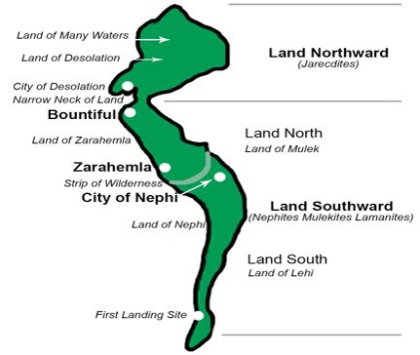
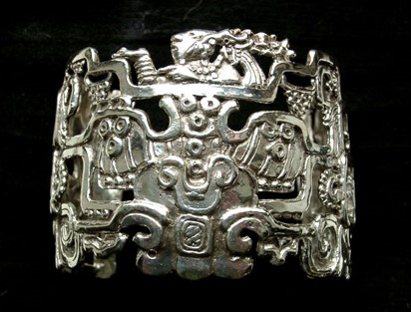


Peace and Prosperity
62nd – 65th Year of the Reign of the Judges
Both Lamanites and Nephites shared in peace and gained much wealth in the land north and in the land south
Helaman 6:7-14

Slide 71
Two Chief Judges Murdered
66th Year of the Reign of the Judges
Cezoram and his son, Cezoram were murdered in the same year
Helaman 6: 16-17

Slide 72


The Heart
The heart is essential to our physical survival.
It pumps blood through our bodies so oxygen and other nutrients can reach all our cells.
About the size of a fist, the average adult heart pumps 2,000 gallons (7,570 liters) of blood daily.
It beats about 70 times per minute, or 100,000 beats per day.
Knowing the vital nature of your physical heart, what would you be willing to do to keep it healthy?
Helaman 16-17

Slide 73
Righteousness
Helaman
11:18-19
Reign of Judges
76th Year
Humility and Repentance
Prosperity and Blessings
11:6-9
Reign of Judges
75th Year
6: 1, 6-14
Reign of Judges
63rd Year
2nd Cycle of Nephite Disease
Destruction and Suffering
Pride
11:1-5
Reign of Judges
72nd Year
6: 15-17
Reign of Judges
66th and 67thYear
Wickedness
6:15-18
Reign of Judges
67th Year
Postscript to the war
6:18 Secret Combinations
6:31 Most Choose Evil
6:35 Spirit Withdrawal

Slide 74

To Enable Satan
Helaman 6:17
Helaman 6:21
Helaman 6:26
Helaman 6:28-31
Hearts set on riches of the world, seek to get gain
Satan stirs up the heart and the Nephites unite with band of robbers
The heart of Gadianton…same who enticed our first parents
Put into their hearts to build a tower to get to heaven---biblical Tower of Babel…Carry on in darkness…to get a hold of the hearts of the children of men

Slide 75


The Hearts of Two Groups
“Ye are of your father the devil, and the lusts of your father ye will do. He was a murderer from the beginning, and abode not in the truth, because there is no truth in him. When he speaketh a lie, he speaketh of his own: for he is a liar, and the father of it.”
John 8:44
The Plot with Cain
The story of the origin and rise of secret combinations on earth was once contained in the record of Old Testament times. …And the manner in which Cain plotted with Satan to become Master Mahan, master of the great secret, that he could murder and get gain—these matters were deleted from the Bible records before that book was compiled.
These were known among the Nephites through that scriptural record we know as the brass plates…(See Moses 5)
JFM and RLM
The Nephites lost the Spirit because …
The Lord poured out His Spirit on the Lamanites because …
Helaman 6:27-36

Slide 76





Satan Tries to Plant Temptation in Our Hearts
“There can be counterfeit revelations, promptings from the devil, temptations!
As long as you live, in one way or another the adversary will try to lead you astray. …
“If ever you receive a prompting to do something that makes you feel uneasy, something you know in your mind to be wrong and contrary to the principles of righteousness, do not respond to it!”
President Boyd K. Packer
Helaman 6:17-31

Slide 77



Satan carries on his works of darkness by getting hold upon the hearts of the children of men
If we are wicked and harden our hearts, then the Spirit of the Lord will withdraw from us.
If we choose to willingly believe in the Lord’s words, then He will pour out His Spirit upon us.
Helaman 6:17-31

Slide 78


Secret Combinations
The devil is the inspiration and source of all such organizations. Mormon clearly points out who is the grand conspirator, the real organizer of all such organizations.
Student Manual

Slide 79

Secret Combinations
Such organizations are viewed by the Lord as constituting wickedness “above all the wickedness of the whole earth.”
(3 Nephi 9:9)
While individuals may rob, steal, plunder, and murder, the truly vast crimes of mankind involved plunder and killing on a national or an international scale involving millions of lives.
Student Manual

Slide 80

Secret Combinations
Such combinations flourish and thrive when the “more part” (Helaman 6;21) of the people are wicked and seek to benefit from the spoils of such wickedness
Student Manual

Slide 81

Secret Combinations
Secrecy is one of the basic operating tenets (code of belief) of such organizations
Student Manual

Slide 82

Secret Combinations
Joined with the idea of secrecy is the idea of covenant making. An oath of loyalty to the organization is made which involves a vow to maintain the secret of the conspiracy.
After a murder of the chief judge, Kishkumen “went unto those that sent him, and they all entered into a covenant, yea, swearing by their everlasting Maker, that they would tell no man.”
(Helaman 1:11)
Student Manual

Slide 83

Secret Combinations
The objectives of such secret combinations are power or gain or both. Since the government is a source of great power, it is not surprising that often the target of their action is to take over the reins of government.
Student Manual

Slide 84

Secret Combinations
These combinations use immorality, money, and violence to achieve their ends. Assassinations of government leaders to bring their own people to power is the common tale of the Book of Mormon.
Student Manual

Slide 85
Secret Combinations
The only way to stamp out these organizations, once they are established and begin to flourish, is through conversion of the people to righteousness
Righteousness
“Righteousness exalteth a nation: but sin is a reproach to any people.”
Proverbs 14:34
Student Manual

Slide 86
Sources:
Video:
Secret Combinations (0:46)
Book of Mormon Student Manual Religion 121-122 pg. 359-360
President Boyd K. Packer(“Personal Revelation: The Gift, the Test, and the Promise,” Ensign, Nov. 1994, 61)
Joseph Fielding McConkie and Robert L. Millet Doctrinal Commentary on the Book of Mormon Vol. 3 pg. 366-369
Elder David A. Bednar (“That We May Always Have His Spirit to Be with Us,” Ensign or Liahona, May 2006, 30).
President Spencer W. Kimball What is True Repentance? May 1974 Ensign
The Nephite Cycle—Ezra Taft Benson (God, Family, Country pg 363-364)
Joy D. Jones BYU Devotional April 2018 “Look unto Him in Every Thought”
Presentation by ©http://fashionsbylynda.com/blog/

Slide 87
Righteousness
Helaman
11:18-19
Reign of Judges
76th Year
Humility and Repentance
Prosperity and Blessings
11:6-9
Reign of Judges
75th Year
6: 1, 6-14
Reign of Judges
63rd Year
2nd Cycle of Nephite Disease
Destruction and Suffering
Pride
11:1-5
Reign of Judges
72nd Year
6: 15-17
Reign of Judges
66th and 67thYear
Wickedness
6:15-18
Reign of Judges
67th Year
Postscript to the war
6:18 Secret Combinations
6:31 Most Choose Evil
6:35 Spirit Withdrawal

Slide 88
Characteristics of a Prophet
Helaman 7:17–19 (Prophets exhort people to repent.)
Helaman 7:29 (A prophet’s message is not his own. It comes from the Lord.)
Helaman 8:1–7 (Prophets are not popular with the wicked.)
Helaman 8:13–19 (Prophets testify of Jesus Christ.)
Helaman 8:27–9:38 (The words of prophets are all fulfilled.)
Helaman 10:5–7 (The Lord gives prophets the sealing power.)
Helaman 11:18 (Prophets are esteemed by righteous people.)

