Slide 1
Helaman 13-16

Slide 2
Those Who Believe VS Those Who Do Not
Those who believe and follow the prophet
Those who do not believe and criticize the prophet

Slide 3
Samuel
He was sent by the Lord in 6 BC to call the people of Zarahemla to repentance
This was on the eve of the birth of the Savior in the Holy Land (Helaman 13:2)
He quoted an angel who had been sent to instruct him and spoke on top of a city wall
He prophesied of a day and a night and a day without darkness at the time of the Savior’s birth
He prophesied of three days of darkness between the death of the Savior and the Resurrection of the Savior
He prophesied of many catastrophic upheavals across the land at the moment of the Savior’s death
He prophesied of many who would rise from their graves and appear to the people
Many people believed Samuel and sought out Nephi to baptize them
Some unbelievers threw stones and shot arrows at him, but he was protected by the Spirit of the Lord
He found himself under assault from their captains and was force to flee back to his own land
He was never heard of again
Who’s Who

Slide 4
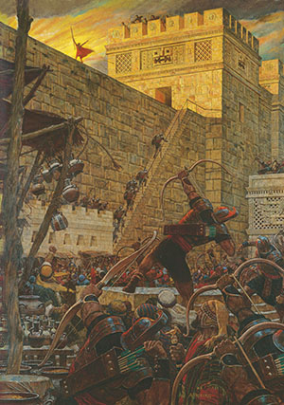
The Prophet Samuel
86th Year of the Reign of the Judges
Samuel declares that because of the Nephites’ wickedness, the Lord will curse the land so the wicked will not be able to retain the riches they hide in the earth.
The Lord calls Samuel the Lamanite to preach to the Nephites.
Samuel warns the people of the consequences of rejecting the prophets and refusing to repent.
Samuel Warns the Nephites that they will be destroyed within 400 years if they do not repent.
Helaman 13:1–4
Helaman 13:5-16
Helaman 13:17-23
Helaman 13:24-39
The prophet Samuel did not take it upon himself to decide what to preach to the Nephites.

Slide 5
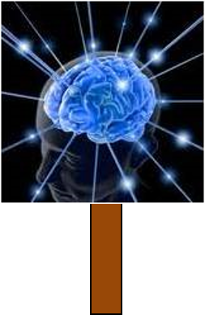
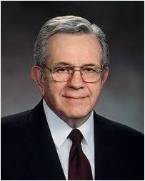
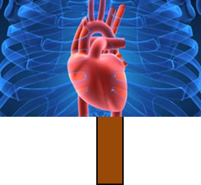
Whatsoever Things Should Come Into His Heart
Expressions of Revelation:
‘The veil was taken from our minds, and the eyes of our understanding were opened
‘I will tell you in your mind and in your heart,’
‘I did enlighten thy mind,’
‘Speak the thoughts that I shall put into your hearts.’
Prophets speak the messages God puts into their hearts.
“Revelation comes as words we feel more than hear.
Nephi told his wayward brothers, who were visited by an angel, ‘Ye were past feeling, that ye could not feel his words.’
There are hundreds of verses which teach of revelation.”
President Boyd K. Packer
Helaman 13:1-4

Slide 6
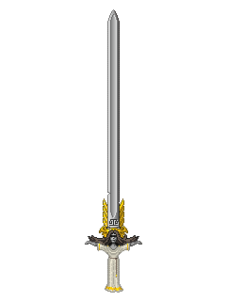
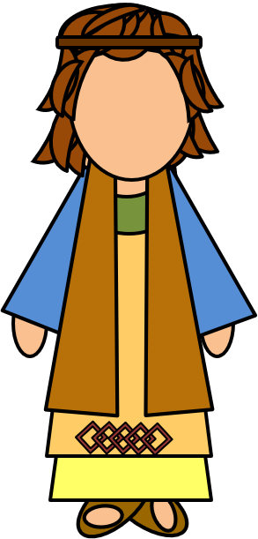
The Sword of Justice Hangeth Over This People
Prophesied by Alma:
But behold, I have somewhat to prophesy unto thee; but what I prophesy unto thee ye shall not make known; yea, what I prophesy unto thee shall not be made known, even until the prophecy is fulfilled; therefore write the words which I shall say.
And these are the words: Behold, I perceive that this very people, the Nephites, according to the spirit of revelation which is in me, in four hundred years from the time that Jesus Christ shall manifest himself unto them, shall dwindle in unbelief.
Yea, and then shall they see wars and pestilences, yea, famines and bloodshed, even until the people of Nephi shall become extinct
Helaman 13:5 and Alma 45:9-11

Slide 7
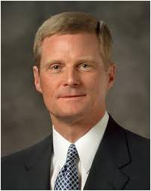
Spirit Taken Away
If we do not repent, then the Lord will withdraw the Holy Spirit from us
“We should also endeavor to discern when we “withdraw [ourselves] from the Spirit of the Lord, that it may have no place in [us] to guide [us] in wisdom’s paths that [we] may be blessed, prospered, and preserved”
(Mosiah 2:36).
Precisely because the promised blessing is that we may always have His Spirit to be with us, we should attend to and learn from the choices and influences that separate us from the Holy Spirit.”
David A. Bednar
Helaman 13:8

Slide 8
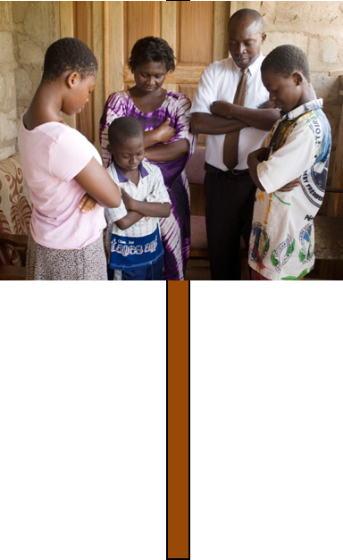
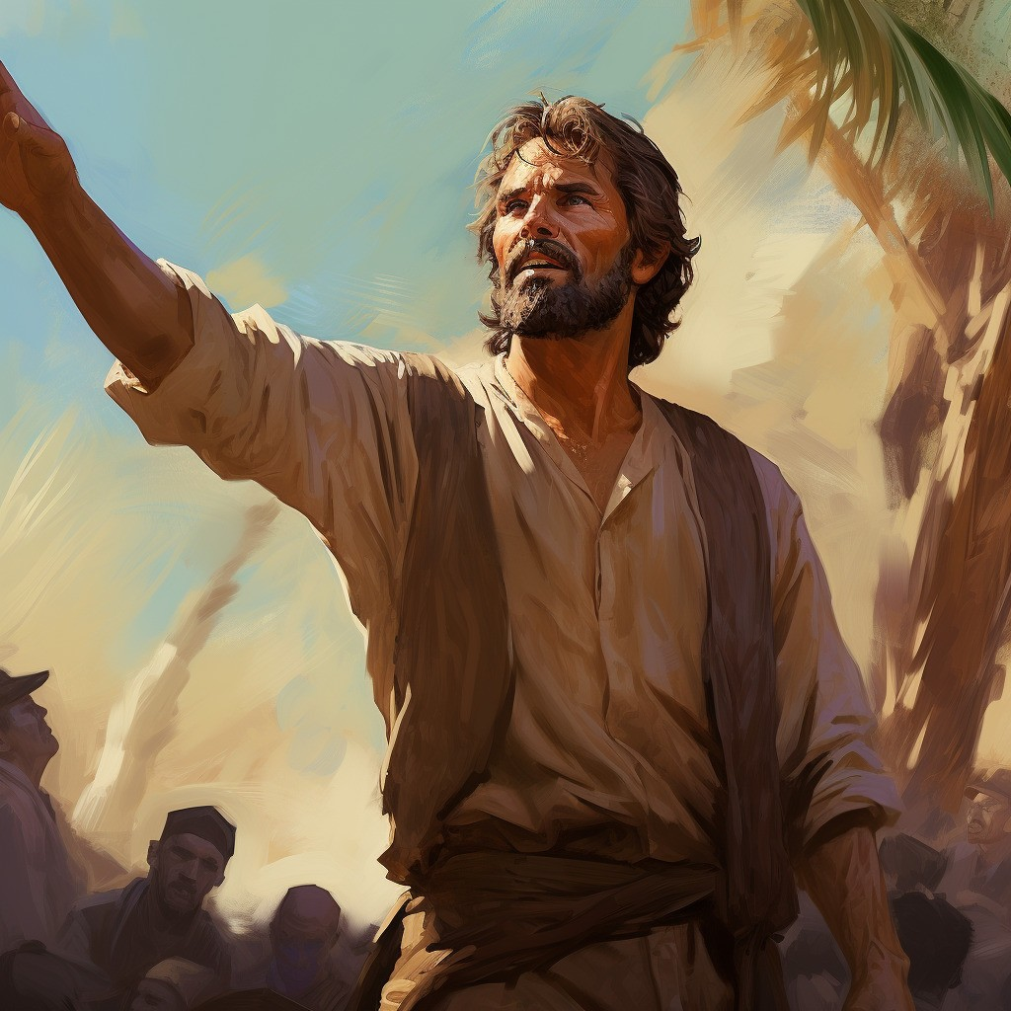
The Wicked are Spared Because of the Righteous
The Righteous will suffer because of the transgressions of others,
Nevertheless, the Lord goes to great lengths to protect and spare the righteous.
Amulek:
“But it is by the prayers of the righteous that ye are spared; now therefore, if ye will cast out the righteous from among you then will not the Lord stay his hand; but in his fierce anger he will come out against you; then ye shall be smitten by famine, and by pestilence, and by the sword; and the time is soon at hand except ye repent.”
Alma 10:23
If we repent and return unto the Lord, then we will be blessed
Helaman 13:10-14

Slide 9
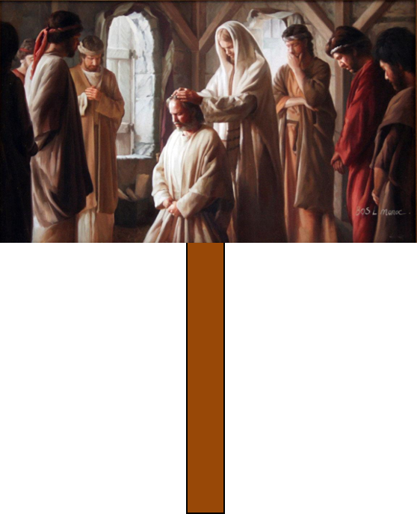
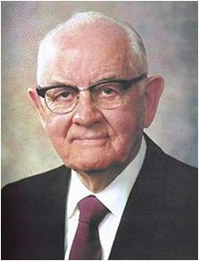
Prophets Rejected
“Sometimes people let their hearts get so set upon things and the honors of this world that they cannot learn the lessons they most need to learn. Simple truths are often rejected in favor of the much less demanding philosophies of men, and this is another cause for the rejection of the prophets. ..
Jesus said to his newly appointed apostles “And ye shall be hated of all men for my name’s sake: but he that endureth to the end shall be saved.”
The holy prophets have not only refused to follow erroneous human trends, but have pointed out these errors. No wonder the response to the prophets has not always been one of indifference. So often the prophets have been rejected because they first rejected the wrong ways of their own society.”
Spencer W. Kimball
Helaman 13:24-29

Slide 10
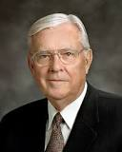
“My dear brothers and sisters, please pay attention to those things that the leaders of the Church have taught. …
Apply the teachings that will help you and your family. Let all of us, regardless of our family circumstances, bring into our homes the teachings of the prophets and the apostles to strengthen our relationships with each other and with our Father in Heaven and with the Lord Jesus Christ.
I promise you in the name of the Lord that if you will listen not just with your ears but also with your heart, the Holy Ghost will manifest the truth unto you of the messages delivered by [the President of the Church], his counselors, the Apostles, and other leaders of the Church.
The Spirit will prompt you to know what you should do as individuals and as families in order to follow our counsel, that your testimonies might be strengthened and that you might have peace and joy.”
Elder M. Russell Ballard
Helaman 13:27

Slide 11
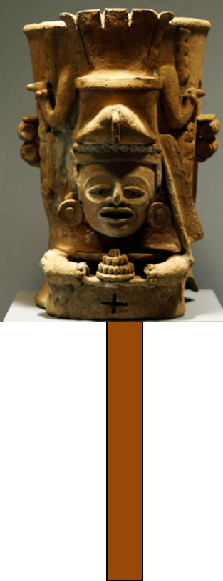
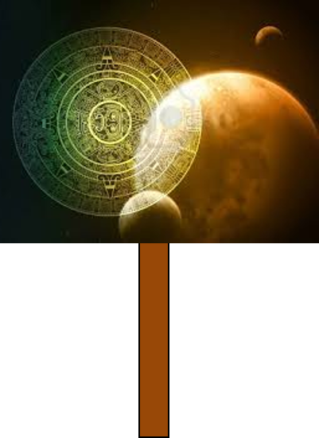
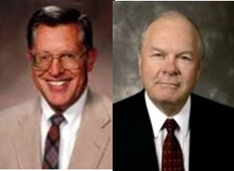
Treasures Are To Be Buried
“Because the Nephites had become worshippers of worldly things and had made gold, silver, and other precious things to the god to whom they bowed and to whom they rendered their praise and their offering of homage; the true and living God threatened that a curse would come upon the land, causing their riches to vanish and their buried treasures to disappear, never to be found again.”
JFM and RLM
Helaman 13:17-23

Slide 12
Procrastinate
“As the day will come when every corruptible thing upon the earth will be destroyed, so the day will come when every individual must account for that which he chose to do, as well as for that which he chose to leave undone. Those who chose to forget the Lord their God will have a bright recollection restore to them of all their forgetfulness.”
JFM and RLM
“And they shall be servants of the Most High; but where God and Christ dwell they cannot come, worlds without end.”
D&C 76:112
These are those who use their mortal probation on earth unwisely--
“Though they may accept the gospel there, to their everlasting benefit; they will have forfeited the chance for exaltation”
See D&C 76:73-75
If we reject the words of the Lord’s prophets, we will experience regret and sorrow
Helaman 13:30-39

Slide 13
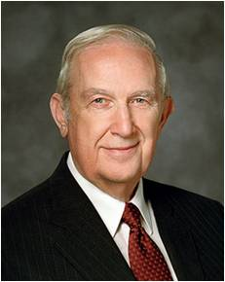
“Have you noticed how Satan works to capture the mind and emotions with flashing images, blaring music, and the stimulation of every physical sense to excess? He diligently strives to fill life with action, entertainment, and stimulation so that one cannot ponder the consequences of his tempting invitations. Think of it.
Some are tempted to violate the most basic commandments of God because of seductive actions portrayed as acceptable. They are made to seem attractive, even desirable. There seems to be no serious consequence, rather apparent lasting joy and happiness. But recognize that those performances are controlled by scripts and actors. The outcome of decisions made is likewise manipulated to be whatever the producer wants.
“Life is not that way. Yes, moral agency allows you to choose what you will, but you cannot control the outcome of those choices. Unlike the false creations of man, our Father in Heaven determines the consequences of your choices. Obedience will yield happiness, while violation of His commandments will not”
Elder Richard G. Scott
Helaman 13:38

Slide 14
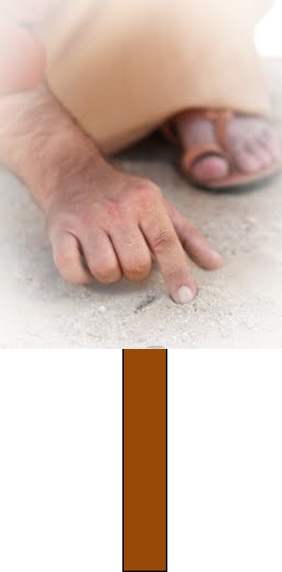
President Spencer W. Kimball taught:
“It is true that the great principle of repentance is always available, but for the wicked and rebellious there are serious reservations to this statement. For instance, sin is intensely habit-forming and sometimes moves men to the tragic point of no return.
Without repentance there can be no forgiveness, and without forgiveness all the blessings of eternity hang in jeopardy. As the transgressor moves deeper and deeper in his sin, and the error is entrenched more deeply and the will to change is weakened, it becomes increasingly near-hopeless, and he skids down and down until either he does not want to climb back or he has lost the power to do so.”
Helaman 13:38

Slide 15
Sources:
Book of Mormon Who’s Who by Ed J. Pinegar and Richard J. Allen pg. 162-162
President Boyd K. Packer(“Personal Revelation: The Gift, the Test, and the Promise,” Ensign, Nov. 1994, 60).
David A. Bednar That We May Always Have His Spirit to Be with Us April 2006
Joseph Fielding McConkie and Robert L. Millet Doctrinal Commentary on the Book of Mormon Vol. 3 pg.403
Spencer W. Kimball Listen to the Prophets Ensign, May 1978 and (The Miracle of Forgiveness [1969], 117).
Elder M. Russell Ballard (“His Word Ye Shall Receive,” Ensign, May 2001, 67).
Elder Richard G. Scott (“How to Live Well amid Increasing Evil,” Ensign or Liahona, May 2004, 102).
Presentation by ©http://fashionsbylynda.com/blog/

Slide 16
Helaman 13:30-33:
“How we respond to the words of a living prophet when he tells us what we need to know, but would rather not hear, is a test of our faithfulness” (Ezra Taft Benson, “Fourteen Fundamentals in Following the Prophet” [Brigham Young University devotional, Feb. 26, 1980], 3–4, speeches.byu.edu).
The Lord Speaks through His prophets and others today:
I give you my witness that Jesus is the Christ, that He guides the affairs of this sacred work, and that general conference is one of the very important times He gives direction to His Church and to us personally.
… We anticipate hearing “the will of the Lord, … the mind of the Lord, … the voice of the Lord, and the power of God unto salvation” (Doctrine and Covenants 68:4). We trust in the Lord’s promise: “Whether by mine own voice or by the voice of my servants, it is the same” (Doctrine and Covenants 1:38). …
I promise you that as you prepare your spirit and come with the anticipation that you will hear the voice of the Lord, thoughts and feelings will come into your mind that are customized especially for you. (Neil L. Andersen, “Hearing the Voice of the Lord at General Conference” [digital-only article], Liahona, Mar. 2019, ChurchofJesusChrist.org)
Helaman 13:38-39:
“During my training to become an airline captain, I had to learn how to navigate an airplane over long distances. Flights over huge oceans, crossing extensive deserts, and connecting continents need careful planning to ensure a safe arrival at the planned destination. Some of these nonstop flights can last up to 14 hours and cover almost 9,000 miles.
“There is an important decision point during such long flights commonly known as the point of safe return. Up to this point the aircraft has enough fuel to turn around and return safely to the airport of departure. Having passed the point of safe return, the captain has lost this option and has to continue on. That is why this point is often referred to as the point of no return.
“… Satan wants us to think that when we have sinned, we have gone past a ‘point of no return’—that it is too late to change our course. …
“… To make us lose hope, feel miserable like himself, and believe that we are beyond forgiveness, Satan might even misuse words from the scriptures that emphasize the justice of God, in order to imply that there is no mercy. …
“Christ came to save us. If we have taken a wrong course, the Atonement of Jesus Christ can give us the assurance that sin is not a point of no return. A safe return is possible if we will follow God’s plan for our salvation” (Dieter F. Uchtdorf, “Point of Safe Return,” Ensign or Liahona, May 2007, 99).
When we reject the counsel which comes from God, we do not choose to be independent of outside influence. We choose another influence. We reject the protection of a perfectly loving, all-powerful, all-knowing Father in Heaven, whose whole purpose, as that of His Beloved Son, is to give us eternal life, to give us all that He has, and to bring us home again in families to the arms of His love. In rejecting His counsel, we choose the influence of another power, whose purpose is to make us miserable and whose motive is hatred. (Henry B. Eyring, “Finding Safety in Counsel,” Ensign, May 1997, 25)

Slide 17
The Signs of the Birth and Death of the Savior
Helaman 14
Helaman 14:2-8
Helaman 14:14-15,
20-27

Slide 18
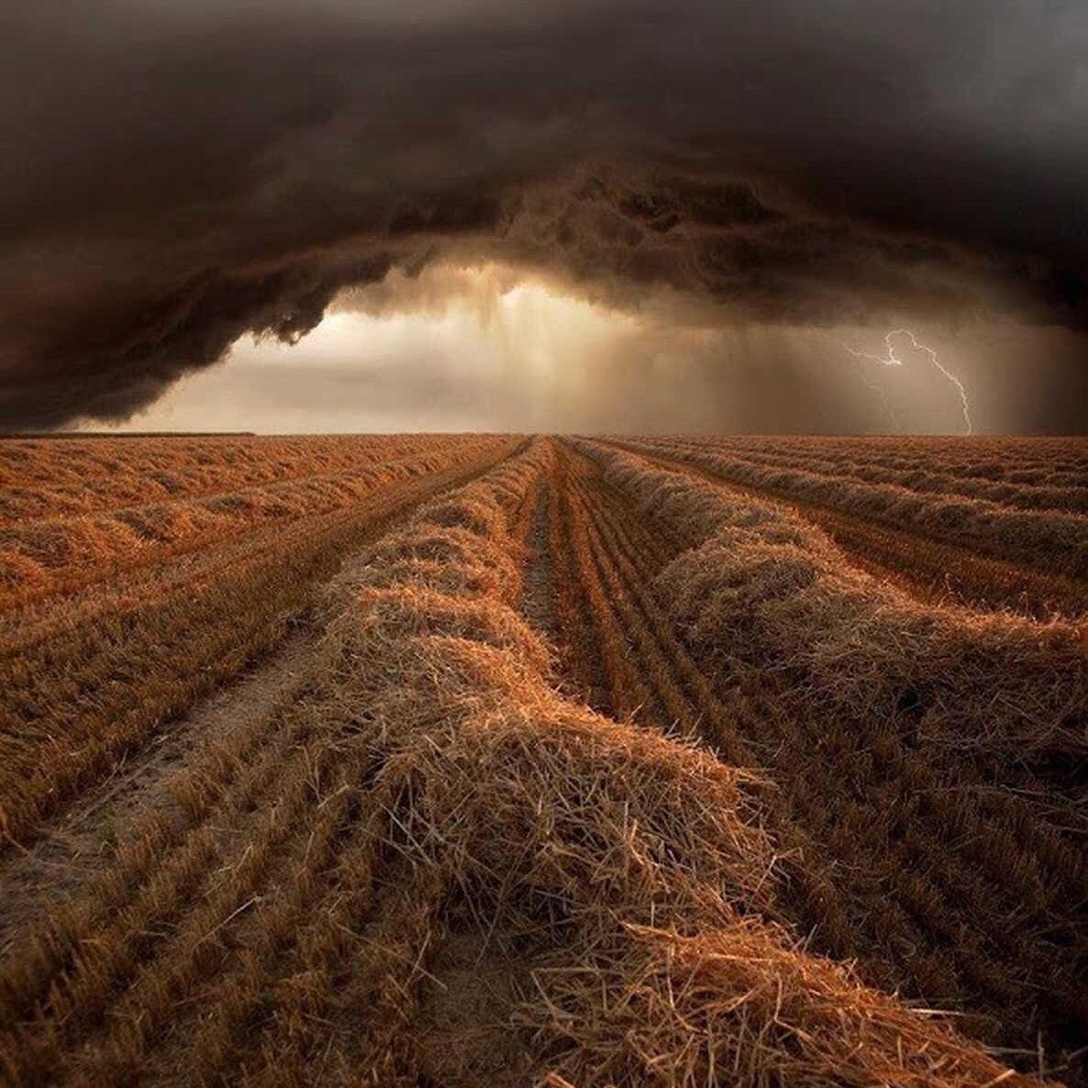
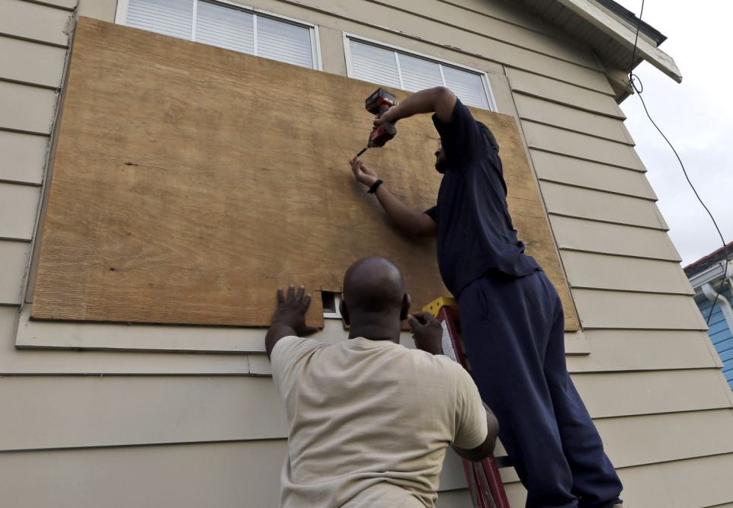
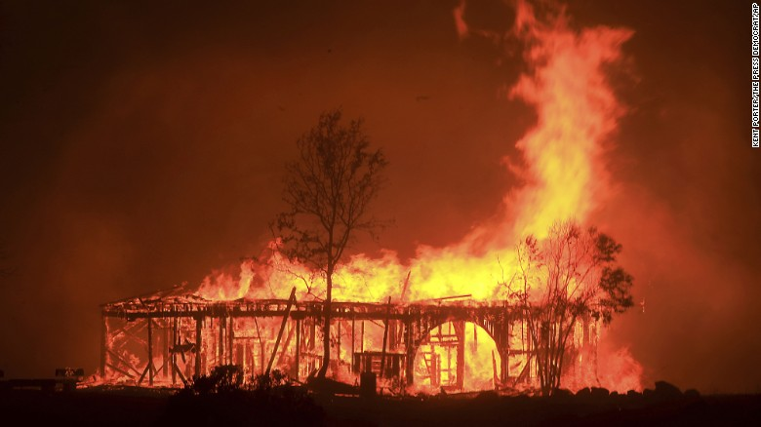
What are some signs that can indicate that a storm is coming?
How do people respond when they see these signs?
What kind of signs does God give?
Why do you think He gives signs?
What could be the danger in not recognizing or paying attention to these signs?

Slide 19
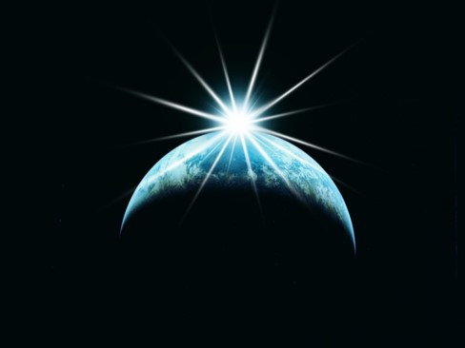
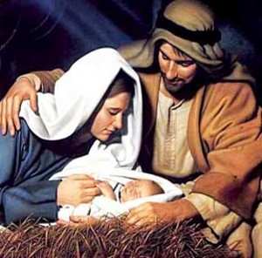
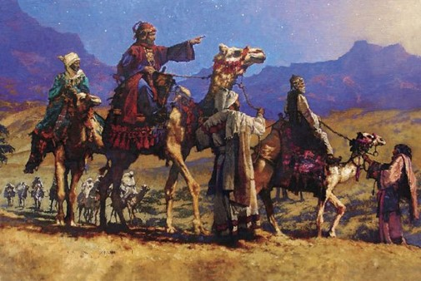
The Signs
A Great Light in the Heavens—no darkness—the Son of God is born
A new star arise—many wonders in heaven—”We have seen a star in the east and we have come to worship him”
(JST Matthew 3:2)
“When they had heard the king, they departed; and, lo, the star, which they saw in the east, went before them, till it came and stood over where the young child was.
When they saw the star, they rejoiced with exceeding great joy.”
Matthew 2:9-10
“And it shall come to pass that ye shall all be amazed, and wonder, insomuch that ye shall fall to the earth”
Helaman 14:1-7

Slide 20
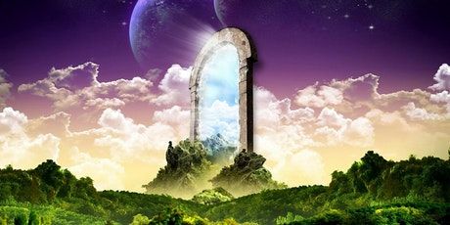
Everlasting Life
And, if you keep my commandments and endure to the end you shall have eternal life, which gift is the greatest of all the gifts of God.
D&C 14:7
For behold, this is my work and my glory—to bring to pass the immortality and eternal life of man.
Moses 1:39
Helaman 14:7-10

Slide 21
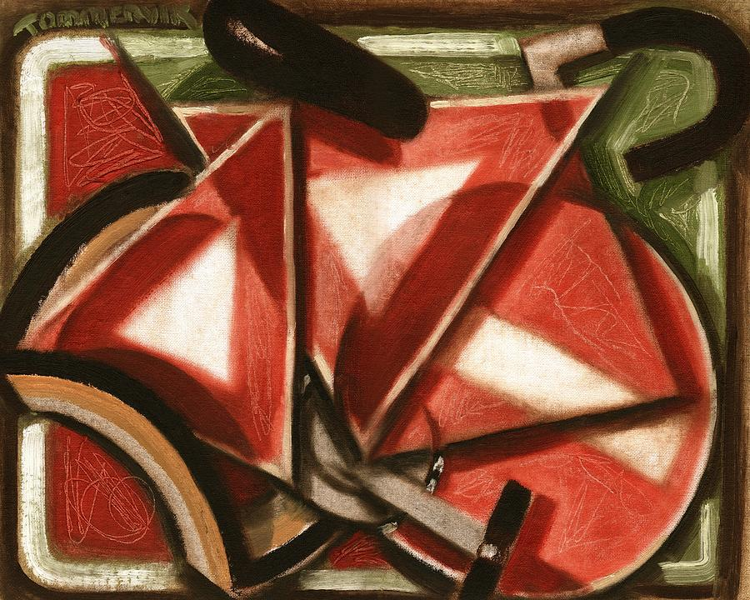
Recognizing Signs
Recognizing signs from God can help us believe on the name of Jesus Christ and repent of our sins.
Many scripture passages caution us not to seek signs.
When prophets warn against seeking signs, they refer to people who refuse to believe unless they are shown signs, not to people who exercise faith in seeking miracles according to the Lord’s will.
Tommervik
Helaman 14:11-14

Slide 22
Signs Preceding the Second Coming
3
___ People from all nations will be drawn to the temple of God
1. 1 Nephi 14:14
2
___ A descendant of Joseph of Egypt (Joseph Smit) will bring forth God’s word (the book of Mormon)
2. 2 Nephi 3:6
3. Isaiah 2:2-3
4
___ The gospel will be preached in all the world
4. Matthew 24:14
1
___ The Lord’s people will be found all over the earth and will be blessed with God’s power
5. 2 Timothy 3:1-7
“Signs are events or experiences that demonstrate the power of God. They are often miraculous. They identify and announce great events, such as the Savior’s birth, death, and Second Coming. …
5
___ People will be selfish and sinful and will turn away from God

Slide 23
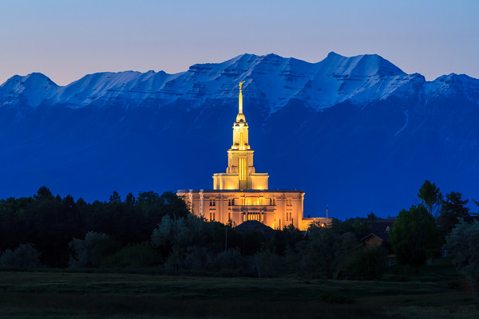
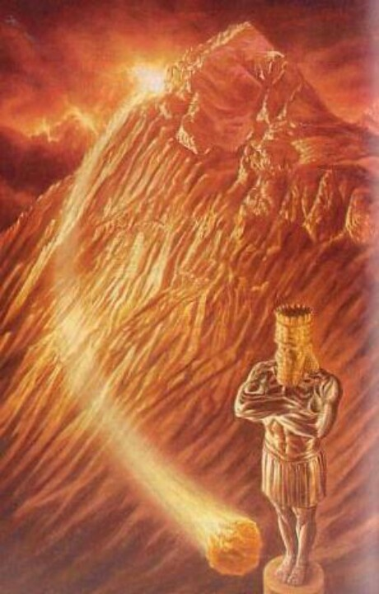
Signs of the Coming of the Savior
And in the days of these kings shall the God of heaven set up a kingdom, which shall never be destroyed: and the kingdom shall not be left to other people, but it shall break in pieces and consume all these kingdoms, and it shall stand for ever.
Daniel 2:44
The prophecy of the church covering the entire earth, a stone cut “out of a mountain without hands”, meaning that it is Gods’ work, not man’s.
Payson
And it shall come to pass in the last days, when the mountain of the Lord’s house shall be established in the top of the mountains, and shall be exalted above the hills, and all nations shall flow unto it.
And many people shall go and say, Come ye, and let us go up to the mountain of the Lord, to the house of the God of Jacob; and he will teach us of his ways, and we will walk in his paths; for out of Zion shall go forth the law, and the word of the Lord from Jerusalem.
2 Nephi 12:2-3

Slide 24
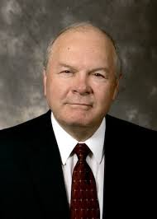
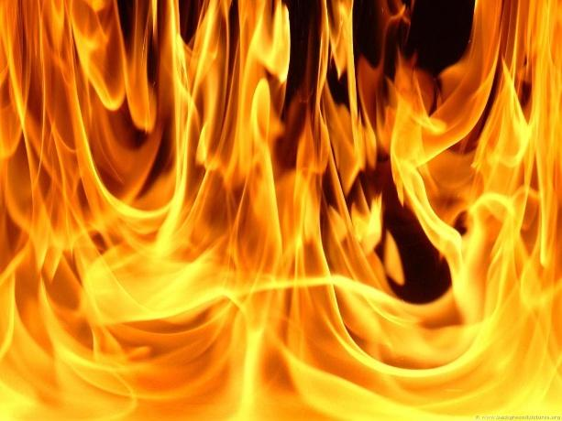
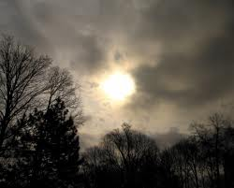
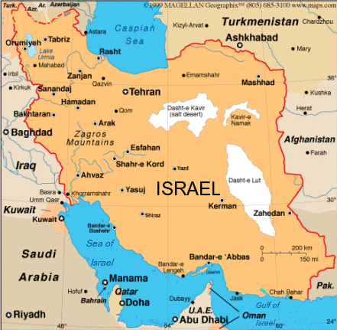
D&C 45:24-25, 28, 39-44
Blood, fire, and vapors of smoke—destructive agencies of modern warfare and their death-dealing effects
The sun shall be darkened
The remnant shall be gathered—return of the Jews to Jerusalem.
The spirit of gathering accompanies the acceptance of the gospel.
Those who received the glad message generally have a desire to go where the people of god dwell.
Look for me---many will be prepared
"The day will come when the Gentiles will sin against the fullness of the gospel and reject its supernal blessings, and the Lord will take away these privileges from the Gentile nations and once again make them available primarily to his ancient covenant people. In the purest sense this will not take place until Jesus sets His foot upon Olivet and the Jews acknowledge their long-awaited Messiah. Thus the fullness of the Gentiles is millennial."
Robert Millet

Slide 25
Personal Signs
The Lord may also bless us with signs that are personal to us.
Personal Repentance
Personal witness from reading the Book of Mormon
Personal Spiritual Experience
mission
Personal Revelation
The Lord provides signs and sends prophets, like Samuel, in our day to persuade people to believe in Him.

Slide 26
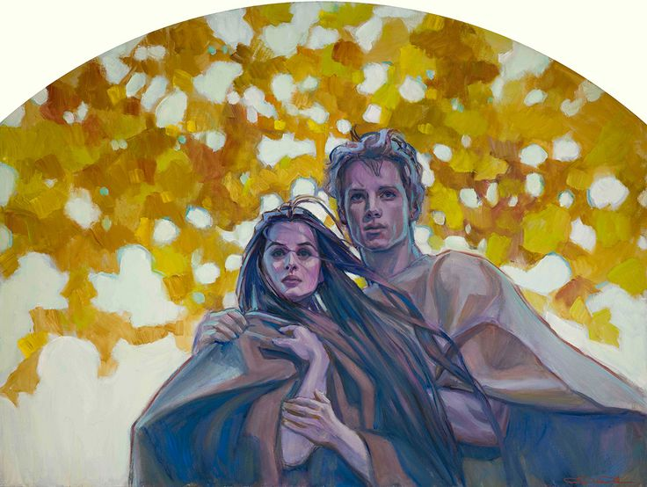
First Spiritual Death
Because of the Fall of Adam and Eve, we are born into a world where we are separated from the presence of God.
Through His Resurrection, Jesus Christ redeems all mankind from the first spiritual death, which was caused by the Fall, and brings us back into God’s presence
The Savior was resurrected, all people will be resurrected and brought back into God’s presence to be judged. In this way, the first spiritual death, which was caused by the Fall, is overcome for all mankind.
Rose Datoc Dall
Helaman 14:15-16

Slide 27
Second Spiritual Death
Those who do not repent will be cut off from the Father’s presence again.
If we repent, then we will not experience the second spiritual death
Helaman 14:17-18

Slide 28
However…
condemnation refers to being pronounced guilty or worthy of punishment
If we receive a knowledge of the truth but choose not to believe it, then we bring upon ourselves our own condemnation
Helaman 14:28-29

Slide 29
Taking a Test
Imagine you are preparing to take a difficult test in a math class and the teacher informs you that in order to pass the test you will need to understand and use a certain equation.
The teacher then gives you the equation to study.
What would you choose to do in this situation?
What would be the consequence of choosing to not believe your teacher and rejecting the knowledge he or she is offering?
Helaman 14:28-29

Slide 30
Sources:
Robert Millet (The Second Coming of Christ: Questions & Answers
Presentation by ©http://fashionsbylynda.com/blog/

Slide 31
The Birth of Jesus Christ | Samuel Prophecies | The Fulfillment
1. Christ to be born in five years | Helaman 14:2 | 3 Nephi 1:13
2. No darkness for two day | Helaman 14:3-4 | 3 Nephi 1:15
3. A new star to arise | Helaman 14:5 | 3 Nephi 1:21
4. Other signs a. Many signs and wonders in heaven b. People to fall to the earth | Helaman 14:6 Helaman 14:7 | No mention
The Death of the Lord
1. Sun to be darkened, moon and stars not to give light for three days | Helaman 14:20, 27 | 3 Nephi 8:19-23
2. Signs of the earth a. Thunderings, lightnings for many hours b. Earth to shake and tremble and be broken up c. Tempests, mountains to be laid low, valleys raised d. Highways to be broken up, cities to become desolate | Helaman 14:21 Helaman 14:21-22 Helaman 14:23 Helaman 14:24 | 3 Nephi 8:6,7 3 Nephi 8:12, 17, 18 3 Nephi 8:5-6 3 Nephi 8:8-11, 13
3. Many graves to be opened and people resurrected, who shall appear unto many | Helaman 14:25 | 3 Nephi 23:9-14

Slide 32
Signs:
"In listing the signs to attend the birth of Jesus, Samuel the Lamanite prophesied: 'There shall a new star arise, such an one as ye never have beheld.' (Hela. 14:5.) That this new star was seen by the whole Nephite nation at the actual time of the heavenly birth, is also recorded in the Book of Mormon. (3 Ne. 1:21.) There is, however, no comparable Messianic prophecy in the Bible as we now have it. The nearest allusion to such is found in the prophecy of Balaam who, speaking of Messiah himself, said: 'There shall come a Star out of Jacob, and a Sceptre shall rise out of Israel.' (Num. 24:17.)
"But there can be little doubt that others besides the Nephites knew by revelation that great signs and wonders, including the rise of a new star, were to attend Messiah's birth. The language of the wise men, upon reaching Jerusalem, clearly assumes that the Jews were just as aware that a new star would bear record of the holy birth as they were that the birth itself should take place in Bethlehem." Bruce R. McConkie (Doctrinal New Testament Commentary, p. 103-4)
Spiritual death was introduced into the world by the Fall of Adam and Eve. As we are born into a fallen world, we inherit this condition—we are separated from the presence of God. Samuel the Lamanite referred to this condition as “the first death” (Helaman 14:16).
Samuel the Lamanite taught that all of Heavenly Father’s children who lived in mortality will overcome physical death and the first spiritual death through the power of the Atonement of Jesus Christ (see Helaman 14:17). Many other scriptures also testify of this truth (see 2 Nephi 2:9–10; 9:15, 22, 38; Alma 11:43–44; 12:12–15, 24; 42:23; 3 Nephi 26:4–5).
The second spiritual death. The second death is an ultimate or final spiritual death—being cast out of God’s presence forever because of unrepented personal sin (see D&C 76:37).
The Savior has also provided help to overcome this second spiritual death. He suffered for our sins so He could offer us the opportunity to repent. But to those who do not repent, “there cometh upon them again a spiritual death, yea, a second death, for they are cut off again as to things pertaining to righteousness” (Helaman 14:18). This means that a person with unresolved sin cannot remain in God’s presence after he or she is brought back to Him for judgment.
“Physical death is the separation of the spirit from the physical body. Because of the Fall of Adam, all mankind will suffer physical death” (Earl C. Tingey, “The Great Plan of Happiness,” Ensign or Liahona, May 2006, 73).
The first spiritual death. Spiritual death is being “cut off from the presence of the Lord” (Alma 42:9).
Spiritual Death:
“Our first parents, Adam and Eve, disobeyed God. By eating the forbidden fruit, they became mortal. Consequently, they and all of their descendants became subject to both mortal and spiritual death (mortal death, the separation of body and spirit; and spiritual death, the separation of the spirit from the presence of God and death as pertaining to the things of the spirit)” (Spencer W. Kimball, “The True Way of Life and Salvation,” Ensign, May 1978, 6).

Slide 34
Believe it or Not
Samuel’s final Words
Helaman 15-16

Slide 35
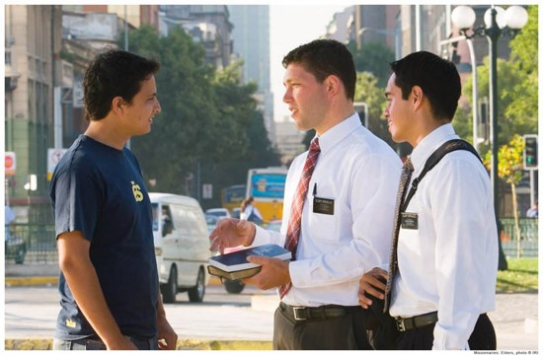
Young Man #1
One young man was raised by parents who were not members of the Church and did not emphasize the teachings of Jesus Christ.
They allowed him to drink alcohol, a practice he continued in college.
Then he met the Latter-day Saint missionaries.
After meeting with the missionaries a few times, he pledged to give up alcohol.
A few days later, he was with a group of friends. They offered him an alcoholic drink.
2013 Seminary Manual

Slide 36
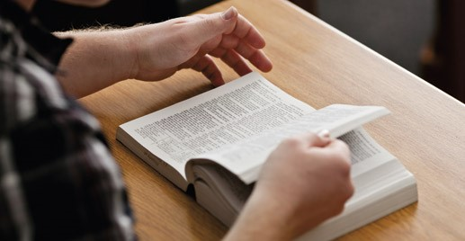
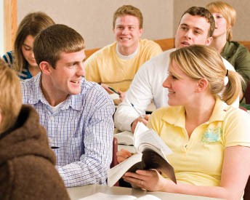
Young Man #2
Another young man was raised in a Latter-day Saint family. His parents held family home evening and family scripture study.
He developed a habit of daily scripture study and personal prayer.
He attended Primary, served in Aaronic Priesthood quorums, and graduated from seminary, gaining knowledge of the commandments and ways of the Lord. While attending college, he developed new friendships.
One night a friend offered him an alcoholic drink.
2013 Seminary Manual

Slide 37
Would accepting the alcoholic drink be a more serious offense for the first young man or the second?
Why or why not?
If people become unbelieving after having received the fulness of the gospel, they will receive greater condemnation
Helaman 15:9-17

Slide 38
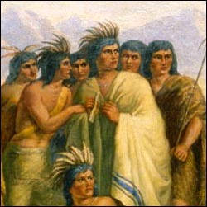
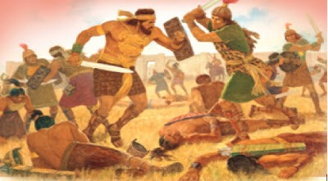
Spiritual condition of the Lamanites
Helaman 15:4-6
They were observing the commandments
Spiritual condition of the Nephites
Helaman 15:1-3, 17
They had become unbelieving, wicked, and unrepentant
Helaman 15:1-6, 17

Slide 39
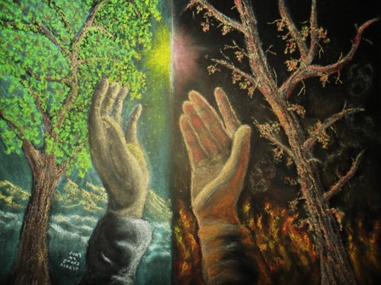
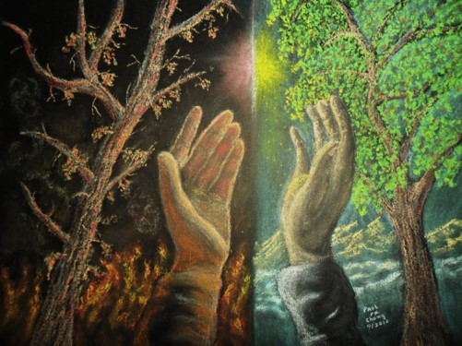
Spiritual condition of the Nephites
Helaman 15:1-3, 17
They had once been a chosen people.
However,
They had become unbelieving, wicked, and unrepentant
The Lord chastened them for their unrighteousness
Spiritual condition of the Lamanites
Helaman 15:4-6
They had once been the more wicked of the people
However,
They had become more believing, righteous, and repentant
The Lord blessed them
Helaman 15:1-6, 17

Slide 40
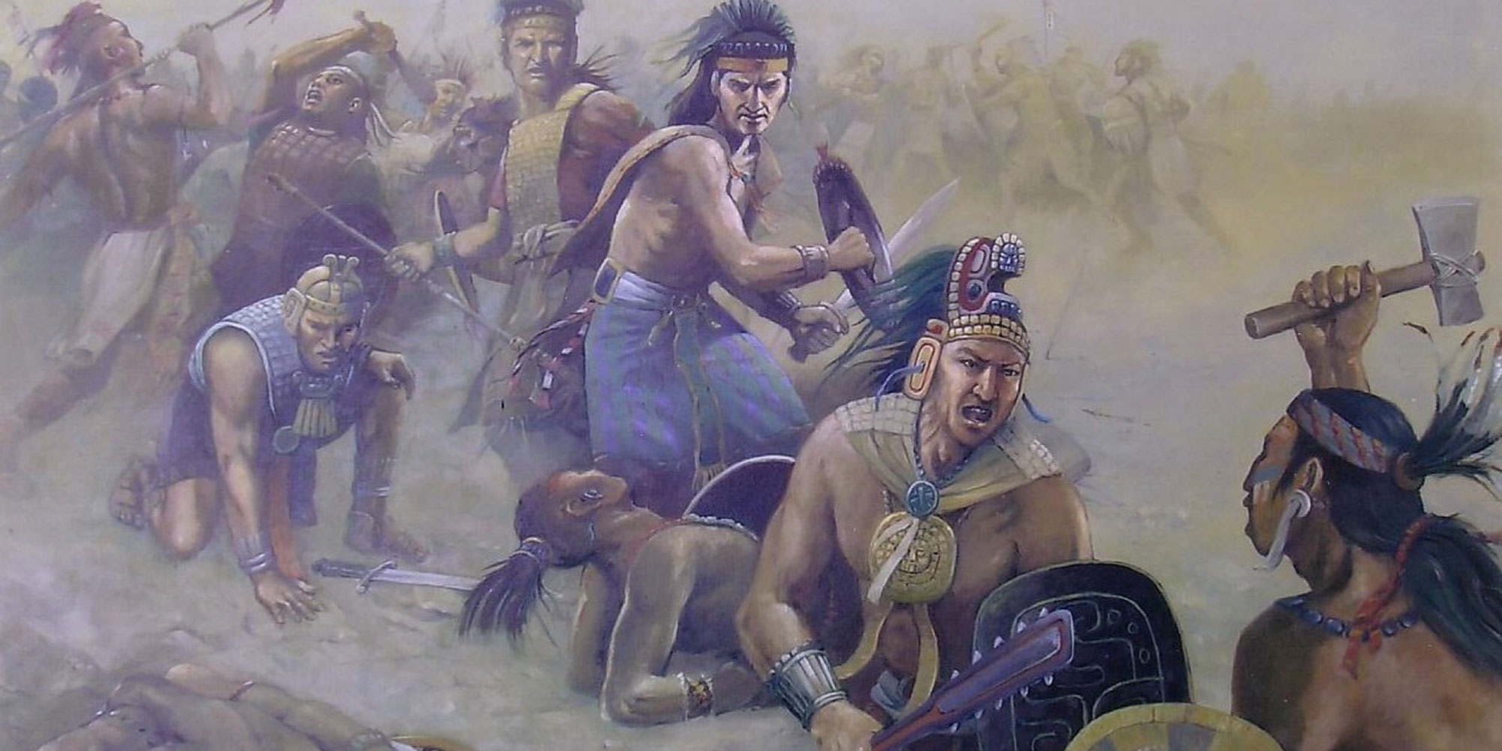
Why were the Nephites in danger of being destroyed?
Although the Lamanites had a long history of wickedness, why were they able to receive so many blessings?
Chasten means to correct someone through punishment or suffering of some kind.
How is the Lord’s chastening a sign of His love?
When people know the truth and believe the scriptures, they are led to faith and repentance, which bring a change of heart
Helaman 15:7

Slide 41
A Change of Heart
Bringing the remainder of their brethren to the knowledge of the truth
Those who are truly converted are compelled to share the gospel with others
Faith in the scriptures and knowledge of the truth
Faith comes by hearing the words of leaders and reading the scriptures then believing on those words
Firm and steadfast
To be constant, consistent, and vigilant in one’s faith and approach to living the gospel
Helaman 15:6-10

Slide 42
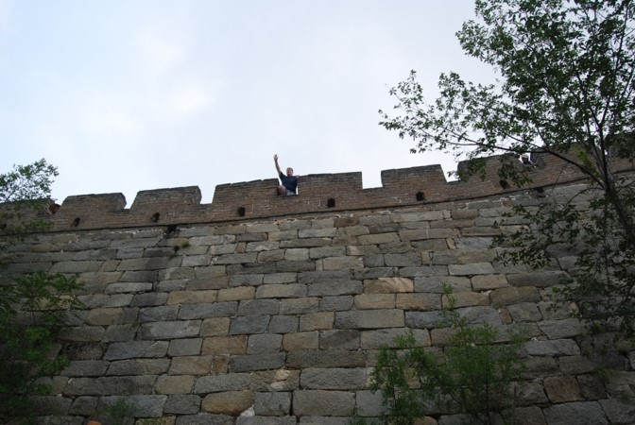
Those who Believed Samuel
Sought to be baptized by Nephi
Confessed their sins
Denied not—to be opened to counsel, direction, and the promptings of the Spirit
When we see or feel evidence of God’s power upon His prophets, we can choose to either believe or dismiss that evidence
Helaman 16:3-8

Slide 43
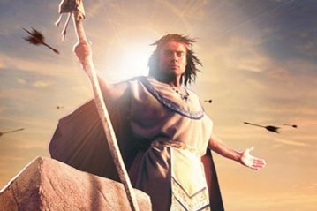
Those Who Did Not Believe
They were angry with Samuel
Sought to take Samuel life by throwing stones and arrows at him
They did not believe in the words of Samuel
Realizing they could not bind him, Samuel got off the wall and fled, and preached among his own people
Helaman 16:6-7

Slide 44
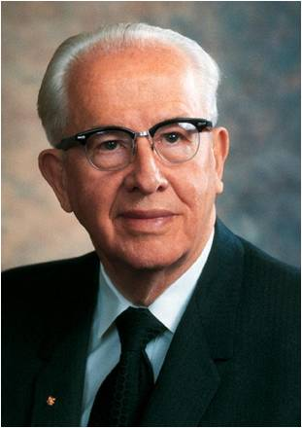
“When the prophet points out the sins of the world, the worldly, rather than repent of their sins, either want to close the mouth of the prophet or else act as if the prophet didn’t exist. Popularity is never a test of truth.
Many a prophet has been killed or cast out. As we come closer to the Lord’s second coming, you can expect that as the people of the world become more wicked, the prophet will be less popular with them.”
Ezra Taft Benson
Helaman 16:6-7

Slide 45
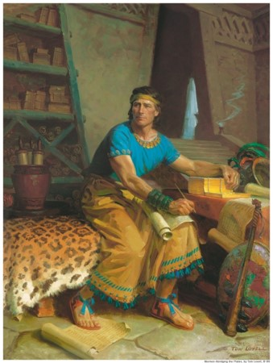
Rejecting the Signs
86th - 89th Year of the Reign of the Judges
There was little change in the people
90th Year of the Reign of the Judges
The signs and prophesies began to be fulfilled
nevertheless—
The people harden their heart, except for some
Some rejected the prophecies of a Christ
“This ended the book of Helaman, according to the record of Helaman and his sons.”
Helaman 16:9-25

Slide 46
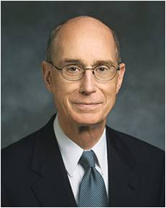
When we reject the Lord’s witnesses, we allow Satan to get hold upon our hearts
“When we reject the counsel which comes from God, we do not choose to be independent of outside influence. We choose another influence.
We reject the protection of a perfectly loving, all-powerful, all-knowing Father in Heaven, whose whole purpose, as that of His Beloved Son, is to give us eternal life, to give us all that He has, and to bring us home again in families to the arms of His love.
In rejecting His counsel, we choose the influence of another power, whose purpose is to make us miserable and whose motive is hatred.
We have moral agency as a gift of God. Rather than the right to choose to be free of influence, it is the inalienable right to submit ourselves to whichever of those powers we choose.”
President Henry B. Eyring
Helaman 15:9-17

Slide 47
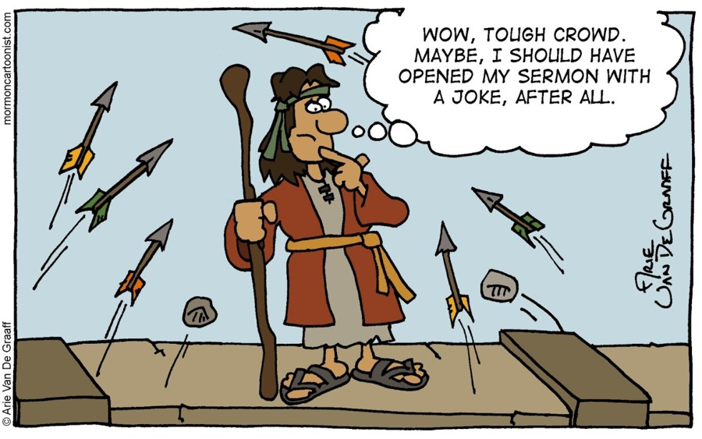
Sources:
Suggested Hymn 183 In Remembrance of Thy Suffering
Ezra Taft Benson (The Teachings of Ezra Taft Benson [1988], 133).
President Henry B. Eyring (“Finding Safety in Counsel,” Ensign, May 1997, 25).
Chart—Book of Mormon Student Manual Religion 121-122 pg. 375
Presentation by ©http://fashionsbylynda.com/blog/

Slide 48
The Birth of Jesus Christ | Samuel Prophecies | The Fulfillment
1. Christ to be born in five years | Helaman 14:2 | 3 Nephi 1:13
2. No darkness for two day | Helaman 14:3-4 | 3 Nephi 1:15
3. A new star to arise | Helaman 14:5 | 3 Nephi 1:21
4. Other signs a. Many signs and wonders in heaven b. People to fall to the earth | Helaman 14:6 Helaman 14:7 | No mention
The Death of the Lord
1. Sun to be darkened, moon and stars not to give light for three days | Helaman 14:20, 27 | 3 Nephi 8:19-23
2. Signs of the earth a. Thunderings, lightnings for many hours b. Earth to shake and tremble and be broken up c. Tempests, mountains to be laid low, valleys raised d. Highways to be broken up, cities to become desolate | Helaman 14:21 Helaman 14:21-22 Helaman 14:23 Helaman 14:24 | 3 Nephi 8:6,7 3 Nephi 8:12, 17, 18 3 Nephi 8:5-6 3 Nephi 8:8-11, 13
3. Many graves to be opened and people resurrected, who shall appear unto many | Helaman 14:25 | 3 Nephi 23:9-14

