Slide 1
Alma 7-12
1.
Forgetting the Lord:
Pride and Wickedness
4.
Righteousness and Prosperity
2.
Suffering and Destruction
3.
Remembering the Lord:
Humility and Repentance

Slide 2
Alma 7

Slide 3
Wickedness of the People
Helaman 7:4
Who had filled the judgment seats by the time Nephi returned to Zarahemla?
Helaman 7:1
Who returned from the land northward?
Helaman 7:2
What did Nephi teach the people in the land northwards?
Helaman 7:3
Why did Nephi leave the land northward?
The Word of God
Rejected
The Word of God

Slide 4
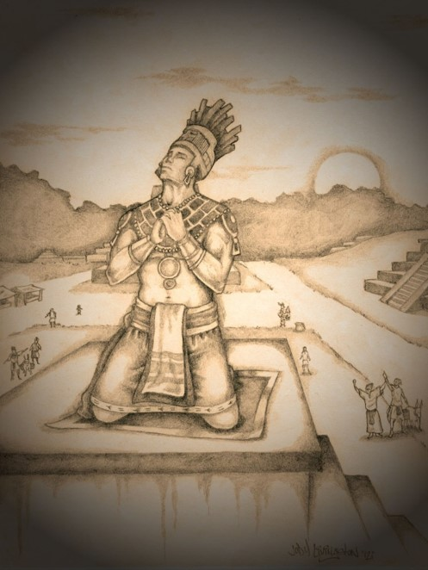
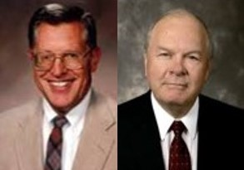
Pouring Out His Soul
The Prayer of Nephi
“bowed himself upon the tower”
“There are some prayers, some pleading to God, in which the supplicant truly bends and stretches his soul…Nephi is pained over the sins and iniquities of his day and raises his voice high that it reaches the heavens”
JFM and RLM
Prophets of God invite people to repent
Nosmelone
Helaman 7:10-11

Slide 5
Entice
…how could you have given way to the enticing of him who is seeking to hurl away your souls down to everlasting misery and endless wo?
Do you recognize someone or something who wants to entice us?
Our tempters are those who entice to be impatient, frustrated, doubtful, fearful, or angry
“…inherent in every enticement to do wrong is a spiritual growth opportunity to do right…
Every enticement can be a blessing to us if we allow it to be.” Joy D. Jones
Helaman 7:16

Slide 6
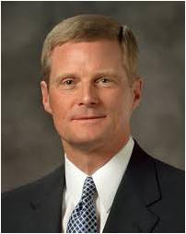
Spiritually Unattended
“We should also endeavor to discern when we ‘withdraw [ourselves] from the Spirit of the Lord, that it may have no place in [us] to guide [us] in wisdom’s paths that [we] may be blessed, prospered, and preserved’ (Mosiah 2:36).
Precisely because the promised blessing is that we may always have His Spirit to be with us, we should attend to and learn from the choices and influences that separate us from the Holy Spirit.
“The standard is clear. If something we think, see, hear, or do distances us from the Holy Ghost, then we should stop thinking, seeing, hearing, or doing that thing. If that which is intended to entertain, for example, alienates us from the Holy Spirit, then certainly that type of entertainment is not for us.
Because the Spirit cannot abide that which is vulgar, crude, or immodest, then clearly such things are not for us. Because we estrange the Spirit of the Lord when we engage in activities we know we should shun, then such things definitely are not for us.”
Elder David A. Bednar
Helaman 7:17

Slide 7
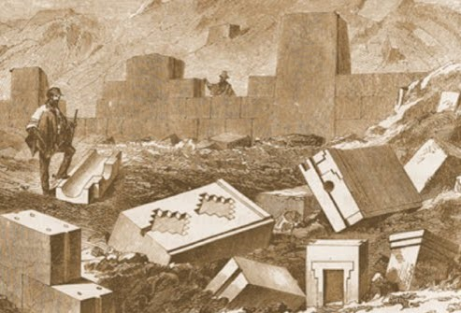
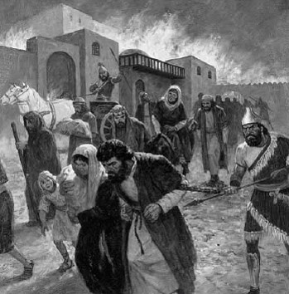
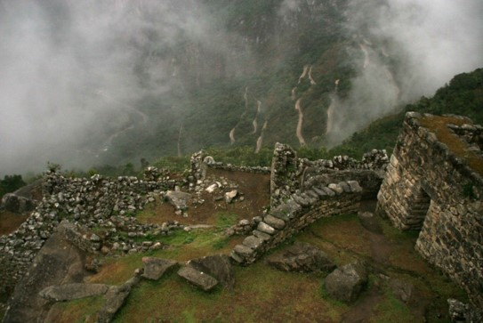
Knowledge from God
Those who do not repent:
The city will be taken away from you and the land
You will not have a place to live
You will not have the strength to withstand the enemy
You will be destroyed from off the face of the earth
Helaman 7:17-28

Slide 8
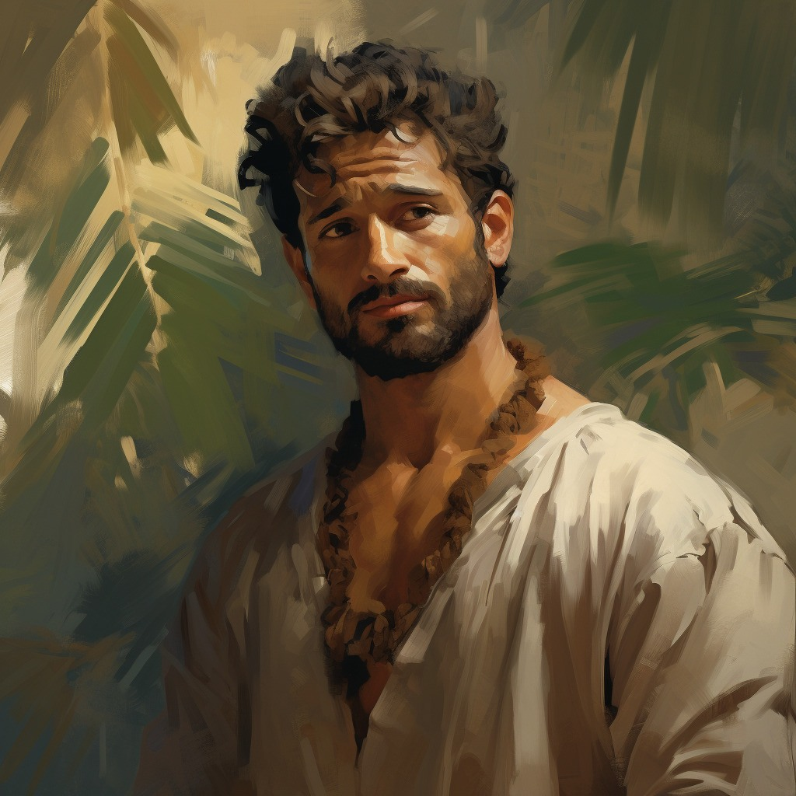
If we refuse to repent of our sins, we will lose the Lord’s protection and the blessings of eternal life.
“ Behold now, I do not say that these things shall be, of myself, because it is not of myself that I know these things; but behold, I know that these things are true because the Lord God has made them known unto me, therefore I testify that they shall be.”
The Seal of a Testimony
Helaman 7:29

Slide 9
Sources:
Joseph Fielding McConkie and Robert L. Millet Doctrinal Commentary on the Book of Mormon Vol. 3 pg. 366-369
Elder David A. Bednar (“That We May Always Have His Spirit to Be with Us,” Ensign or Liahona, May 2006, 30).
President Spencer W. Kimball What is True Repentance? May 1974 Ensign
Presentation by ©http://fashionsbylynda.com/blog/

Slide 10
Unrighteous Judgments
Helaman 8-9

Slide 11
Previously on the Prophet Nephi:
“Yea, wo be unto you because of your wickedness and abominations!
And except ye repent ye shall perish; yea, even your lands shall be taken from you, and ye shall be destroyed from off the face of the earth.”
A prophet’s message is not his own. It comes from the Lord
Nephi 7:27-29

Slide 12
Influences
What are some influences that try to persuade you not to believe the words of prophets?
One sip won’t hurt
But you look so cute in it
Just take one look…that won’t hurt
We are just friends

Slide 13
Judges
Some Judges were part of Gidianton’s band
“Those whose wickedness was exposed by Nephi responded with the ferociousness of a trapped animal”
JFM and RLM
We are angry with your words
Why wouldn’t the judges punish Nephi?
Helaman 8:1-8

Slide 14
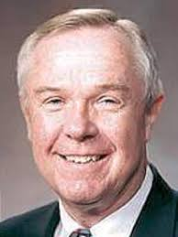
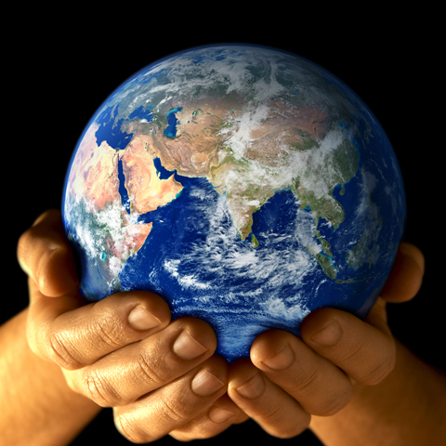
Unpopularity
The teachings of a living prophet are often contrary to the trends of the world. We, as Latter-day Saints… must understand that there is an expanding gulf between the standards of the world and those of the gospel and kingdom of God, and that living prophets will always teach the standards of God.
As much as we may want the gospel to accommodate to the world, it can’t, it won’t, it never has, and it never will.
Dennis B. Neuenschwander
How can we resist influences that attempt to persuade us against the words of prophets?
What are some appropriate ways to speak out against evil influences and in favor of the words of prophets?
Prophets are not popular with the wicked

Slide 15
Does the World Dictate How you live…
…Or Do You dictate Your own destiny?

Slide 16
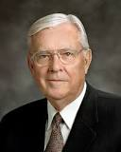
Raising Our Voices
We can raise our voices in support of the prophet, even when it is not the popular thing to do.
What difference did it make when some people supported the prophet?
Why do you think it is important for us to do this today?
“We need to raise our voices with other concerned citizens throughout the world in opposition to current trends.
We need to tell the sponsors of offensive media that we have had enough.
We need to support programs and products that are positive and uplifting. Joining together with neighbors and friends who share our concerns, we can send a clear message to those responsible”
Elder M. Russell Ballard
Helaman 8:7-9

Slide 17
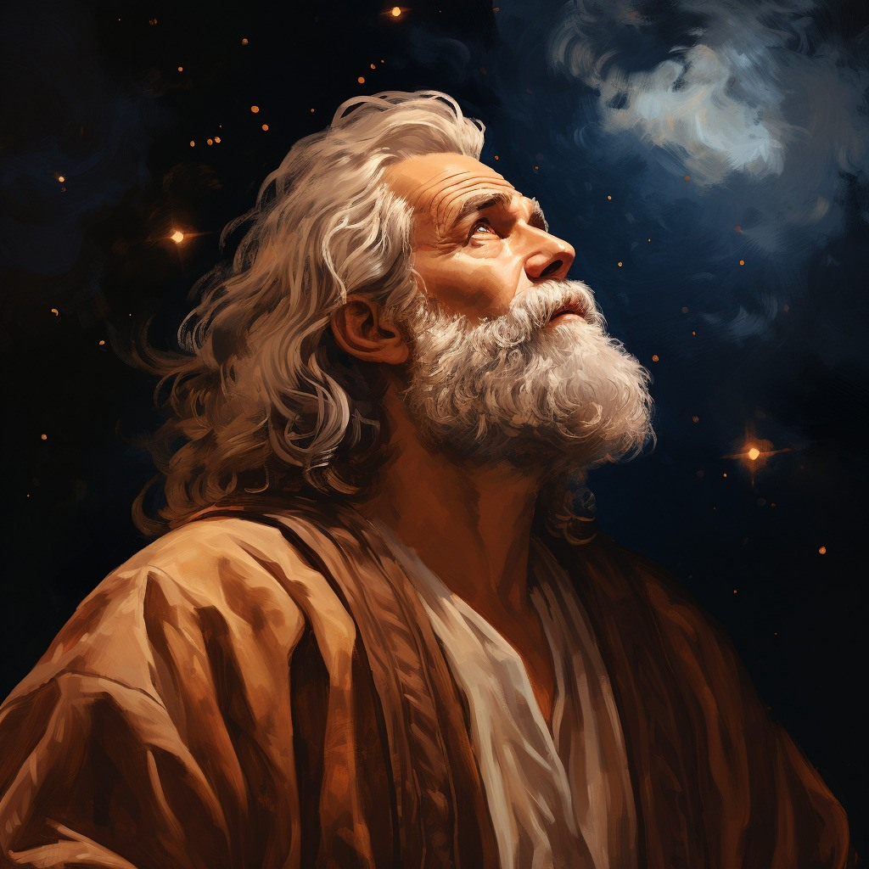
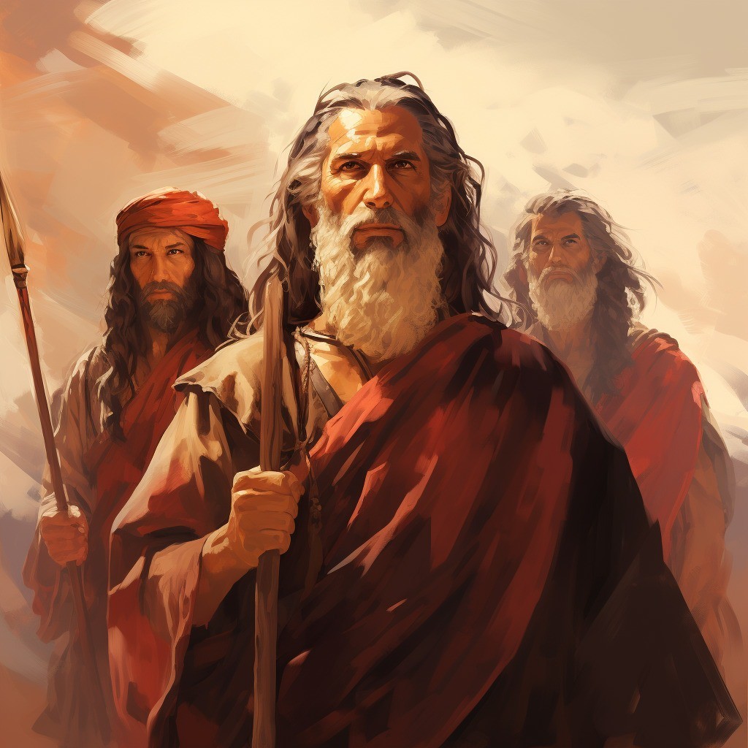
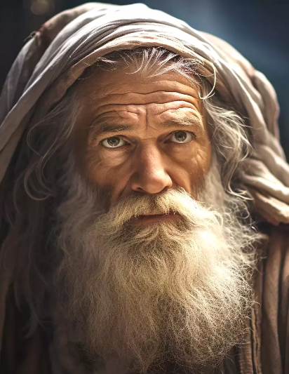
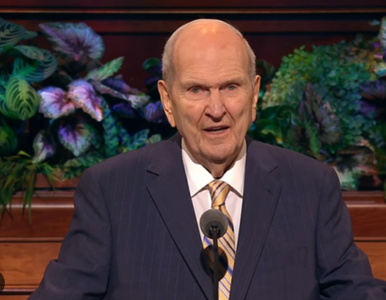
Prophets testify
Abraham (JST Genisis 15:12)
Zenos
Zenock
Ezias
Isaiah
All the sons of Zedekiah (Mulek)
(2 Kings 25:7)
Jeremiah (same prophet that testified of destruction of Jerusalem)
Lehi
Prophets of today testify of Jesus Christ
Moses 1:11
“But now mine own eyes have beheld God; but not my natural, but my spiritual eyes, for my natural eyes could not have beheld; for I should have withered and died in his presence; but his glory was upon me; and I beheld his face, for I was transfigured before him.”
Recorded in brass plates
Helaman 8:11-24

Slide 18
Testimonies of Prophets
Abraham:
Abraham 3:22–24;
Joseph Smith Translation,
Genesis 15:12 (in the Bible appendix)
Isaiah:
Isaiah 7:14; 9:6;
53:3–5
Moses:
Exodus 15:2;
Deuteronomy 18:15 (see also 3 Nephi 20:23–24)
Moses
Jeremiah:
Jeremiah 33:14–16; 50:34
Lehi:
1 Nephi 1:14–15;
2 Nephi 2:6–8
Nephi, son of Lehi: 1 Nephi 19:9–11;
2 Nephi 25:19, 23–26

Slide 19
Prophets of Old
Zenos
Zenock
Ezias
Moses
Zenos, Zenock, and Ezias were prophets who are mentioned in the Book of Mormon. Their teachings and testimonies would have come from the brass plates, which we do not have now. Book of Mormon prophets have recorded that each of them testified of Jesus Christ.
1 Nephi 19:10; Alma 33:15–16; 34:7; Helaman 8:19–20).
The prophet Jacob credited Zenos as the author of the parable of the olive tree (see Jacob 5:1–77).
Helaman 8:19-20

Slide 20
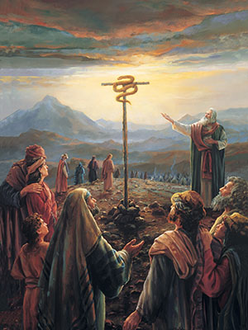
Look Upon With Faith
If we look upon the Son of God with faith, having a contrite spirit, then we will receive eternal life
Contrite Spirit= to be humble, repentant, and receptive to the Lord’s will
Helaman 8:15

Slide 21
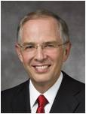
The most important role of the Lord’s prophet is to teach us of the Savior and lead us to Him. …
A prophet does not stand between you and the Savior.
Rather, he stands beside you and points the way to the Savior.
A prophet’s greatest responsibility and most precious gift to us is his sure witness, his certain knowledge, that Jesus is the Christ.
Neil L. Andersen

Slide 22
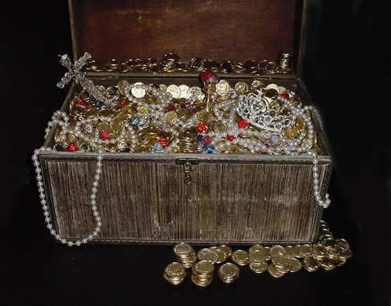
corruption
But behold, ye have rejected the truth, and rebelled against your holy God; and even at this time, instead of laying up for yourselves treasures in heaven, where nothing doth corrupt, and where nothing can come which is unclean, ye are heaping up for yourselves wrath against the day of judgment.
“Lay not up for yourselves treasures upon earth, where moth and rust doth corrupt, and where thieves break through and steal:
“But lay up for yourselves treasures in heaven, where neither moth nor rust doth corrupt, and where thieves do not break through nor steal:
“For where your treasure is, there will your heart be also.”
Matthew 6:19-21
Helaman 8:25

Slide 23
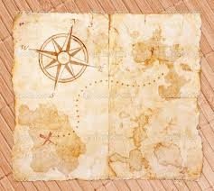
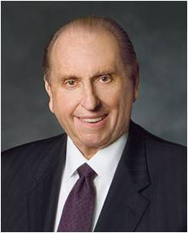
Treasures in Heaven
“The promised reward was not a treasure of ivory, gold, or silver. Neither did it consist of acres of land or a portfolio of stocks and bonds. The Master spoke of riches within the grasp of all—even joy unspeakable here and eternal happiness hereafter.
Today I have chosen to provide the three pieces of your treasure map to guide you to your eternal happiness.
They are:
1. Learn from the past.
2. Prepare for the future.
3. Live in the present.”
President Thomas S. Monson
Helaman 8:25

Slide 24
An Investigation
Day One of the Investigation:
1. When five people investigated Nephi’s claims, what did they find? Why did they fall to the ground? (See Helaman 9:1–5.)
2. Who did the people suspect were the murderers?
(See Helaman 9:7–9.)
Day Two of the Investigation:
3. Who was set free?
(See Helaman 9:10–13, 18.)
4. Who was accused?
(See Helaman 9:16–17, 19.)
5. What additional information did Nephi share?
(See Helaman 9:25–36.)
6. Who was the murderer?
(See Helaman 9:37–38.)
Helaman 9

Slide 25
Seezoram & Seantum
He was chief judge during the ministry of Nephi, son of Helaman
He was murdered by his brother, Seantum
He was the brother of Seezoram from about 23 to 20 BC
He murdered Seezoram
Nephi had announced this while preaching repentance to the people from his garden tower
Helaman 9:12-40 Who’s Who

Slide 26
Those who Believe
“And there were some of the Nephites who believed on the words of Nephi; and there were some also, who believed because of the testimony of the five, for they had been converted while they were in prison.
And now there were some among the people, who said that Nephi was a prophet.
And there were others who said: Behold, he is a god, for except he was a god he could not know of all things. For behold, he has told us the thoughts of our hearts, and also has told us things; and even he has brought unto our knowledge the true murderer of our chief judge.”
Nephi is a prophet
Nephi is a God
I believe the five testimonies
Helaman 9:39-41

Slide 27
Sources:
Joseph Fielding McConkie and Robert L. Millet Doctrinal Commentary of the Book of Mormon Vol. 3 pg. 373
http://www.ldsliving.com/story/72742-10-ways-to-support-your-bishop
Dennis B. Neuenschwander Living Prophets, Seers, and Revelators Oct. 2002 Gen. Conf.
Edmund Burke statement: [Attributed in John Bartlett, comp., Familiar Quotations, 15th ed. (1980), ix.]
Elder M. Russell Ballard (“Let Our Voices Be Heard,” Ensign or Liahona, Nov. 2003, 18).
First Counselor in the First Presidency Thomas S. Monson In Search of Treasure April 2003 Gen. Conf.
Book of Mormon Who’s Who by Ed J. Pinegar and Richard J. Allen pg 166-167
Neil L. Andersen, “The Prophet of God,” Ensign or Liahona, May 2018, 25, 27
Video Presentation Option:
Instead of using the investigation activity in the lesson, you may want to show the video presentation titled “The Pride Cycle,” which is a depiction of the account in Helaman 7–9 and the first few verses in Helaman 10.
The presentation is available on Book of Mormon DVD Presentations 1–19 (54011) and LDS.org.
Presentation by ©http://fashionsbylynda.com/blog/

Slide 28
What if we don’t agree with what the Prophet says?
You may not like what comes from the authority of the Church. It may conflict with your political views. It may contradict your social views. It may interfere with some of your social life. … Your safety and ours depends upon whether or not we follow the ones whom the Lord has placed to preside over His Church. … Let’s keep our eye on the President of the Church. (Harold B. Lee, in Conference Report, Oct. 1970, 152–53.)
Sometimes we will receive counsel that we cannot understand or that seems not to apply to us, even after careful prayer and thought. Don’t discard the counsel, but hold it close. If someone you trusted handed you what appeared to be nothing more than sand with the promise that it contained gold, you might wisely hold it in your hand awhile, shaking it gently. Every time I have done that with counsel from a prophet, after a time the gold flakes have begun to appear and I have been grateful. (Henry B. Eyring, “Finding Safety in Counsel,” Ensign, May 1997, 26)
Unpopular Truths:
Sometimes we are accused of being uncaring as we teach the Father’s requirements for exaltation in the celestial kingdom. But wouldn’t it be far more uncaring for us not to tell the truth—not to teach what God has revealed?
It is precisely because we do care deeply about all of God’s children that we proclaim His truth. We may not always tell people what they want to hear. Prophets are rarely popular. But we will always teach the truth! (Russell M. Nelson, “The Love and Laws of God” [Brigham Young University devotional, Sept. 17, 2019], speeches.byu.edu)

Slide 30
10 ways to support a bishop: (this could also be 10 ways to support the prophets)
1. Pray for him specifically, just as you would the prophet. A prayer uttered on behalf of someone, by name, can yield great results.
2. Magnify your calling. When members anxiously go about serving as they are assigned, the Lord blesses not only them but the entire ward with an outpouring of inspiration and unity.
3. The most difficult calling in the ward belongs to the bishop’s wife. Often times, my wife feels like the loneliest person in my ward. I am happy when my ward recognizes my wife’s (and my children’s) sacrifices.
4. Earnestly prepare when asked to speak in Sacrament meeting. Teach with the Spirit.
5. Never ask to be released. If circumstances change that are making it difficult for you to serve, inform your bishop and then allow him to seek inspiration. Don’t short-change yourself of heaven’s blessings because life gets a little hectic. 6. Make temple attendance a priority. When you go to the temple often, you are able to be a more effective instrument in the Lord’s hands, and you have a greater resistance to temptation and sin. Every bishop wants his ward to be unified, charitable, obedient, and willing to sacrifice. The temple helps in all those areas.
7. Don’t murmur or be contentious.
8. Be reverent, especially during the Sacrament.
9. Don’t just do your duty as a home or visiting teacher. Rather, truly minister to those you are called to serve. This is the first line of defense for a family, and an engaged home and visiting teacher can literally change a family’s life.
10. Follow his counsel—even when you see things a little differently. There is power and protection in following your leaders. This isn’t blind obedience; it is obedience founded on faith and trust. Those two things are very different.
Helaman 8:14-15 Brazen Serpent:
When Nephi spoke of Moses lifting up a “brazen serpent,” he referred to a time when the children of Israel were plagued by “fiery serpents” (see Numbers 21:6–9; note that the word brazen means brass). The prelude to the Israelites’ trouble was that they had spoken evil of God and His prophet (see Numbers 21:5). Those who looked at the brazen serpent were healed, and those who chose not to look at it perished (see Numbers 21:9; 1 Nephi 17:41).
Like those Israelites, many of the people in Nephi’s day spoke against God and His prophet. When Nephi referred to the account of the brazen serpent, he emphasized that his people should “look upon the Son of God with faith” and live (Helaman 8:15; see also John 3:14–15, in which Jesus Christ Himself referred to the brazen serpent as a symbol of His coming Crucifixion). Nephi then reminded the people that all the prophets had testified of Christ (see Helaman 8:16–23).

Slide 31
Keys to Sealing Powers
Helaman 10

Slide 32
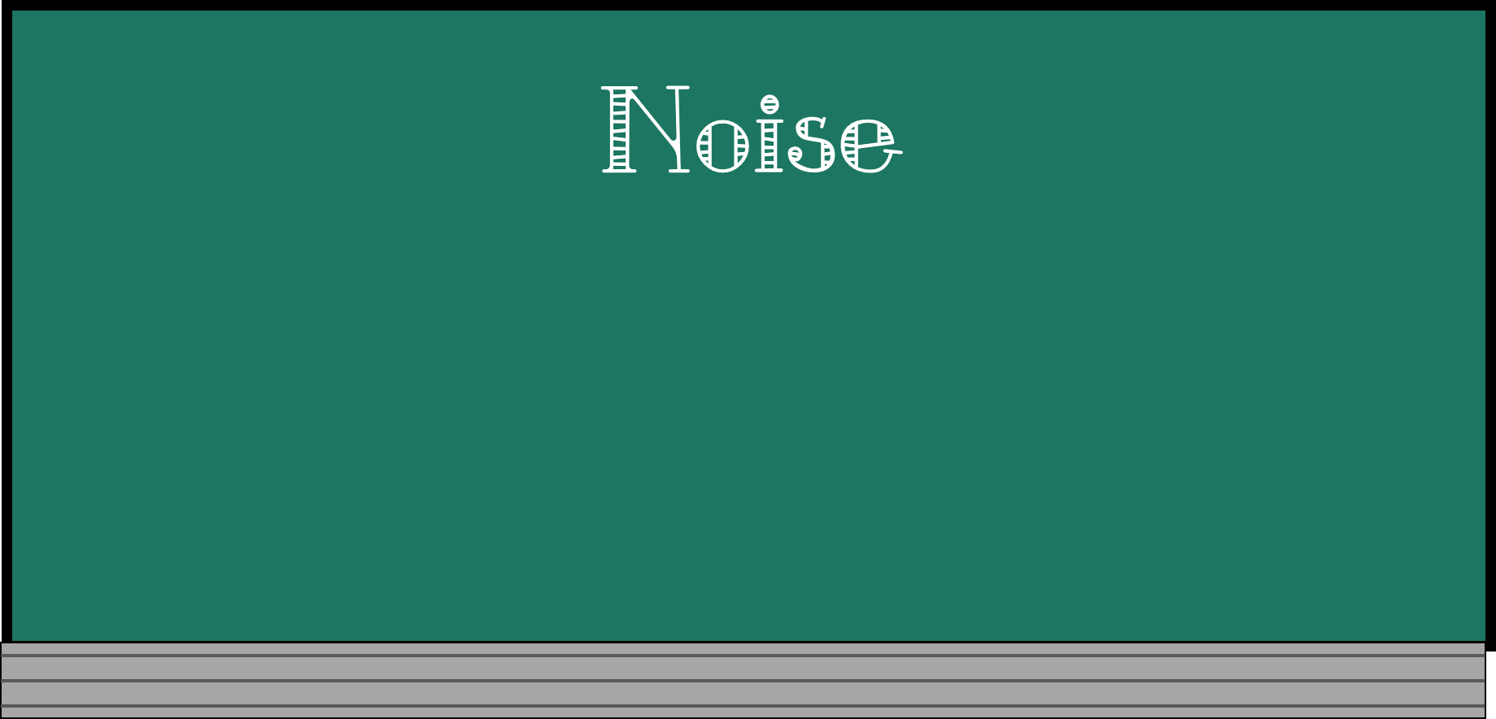
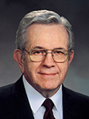
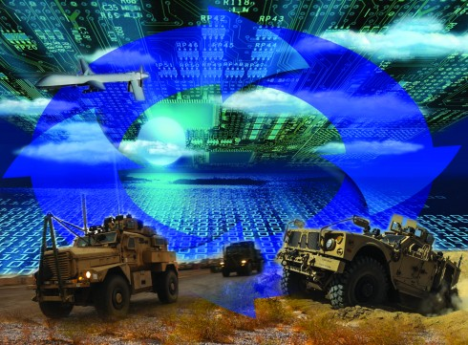
“something that attracts attention”
“This trend to more noise, more excitement, more contention, less restraint, less dignity, less formality is not coincidental nor innocent nor harmless.
“The first order issued by a commander mounting a military invasion is the jamming of the channels of communication of those he intends to conquer.”
Boyd K. Packer
Helaman 10:1-3

Slide 33
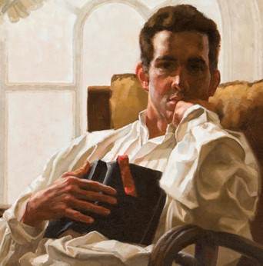
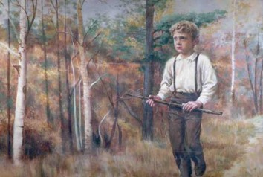
Pondering
Nephi realizes the division among the people
Pondering things of the Lord prepares us to receive revelation
To Ponder: to give serious reflection and thought to something.
Jessica Pingel
“Never did any passage of scripture come with more power to the heart of man than this did at this time to mine. It seemed to enter with great force into every feeling of my heart. I reflected on it again and again, knowing that if any person needed wisdom from God, I did; for how to act I did not know, and unless I could get more wisdom than I then had, I would never know;
for the teachers of religion of the different sects
understood the same passages of scripture so
differently as to destroy all confidence in settling
the question by an appeal to the Bible.”
Joseph Smith History 1:12
Helaman 10:1-3

Slide 34
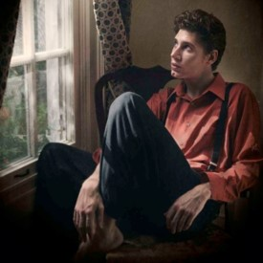
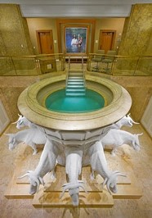
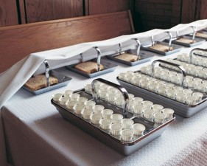
Receiving Your Own Revelations
When has pondering helped you receive personal revelation?
Receiving personal revelation is not usually as dramatic as some of the examples in the scriptures.
Revelatory experiences are usually moments of sudden enlightenment, such as when we suddenly understand something we have struggled with before.
During and after sacrament meeting
Before and after personal prayers and scripture study
After watching or listening to general conference
While fasting
While serving in the temple
While honoring the Lord on the Sabbath
What are times or situations when pondering the things of the Lord would be especially appropriate?

Slide 35
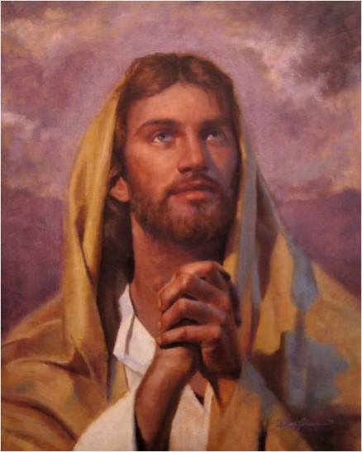
Seeking God’s Will
An eye single to the glory of God seek to only do which is pleasing to God. They strive to know the will of God.
Nephi had no desire to “do his own thing”
Jesus said, “And he that sent me is with me: the Father hath not left me alone; for I do always those things that please him.”
John 8:29
The Lord entrusts us with blessings and responsibilities when we seek His will and keep His commandments
Helaman 10:4

Slide 36
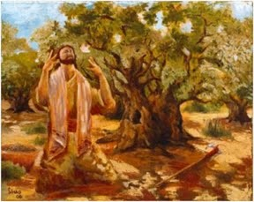
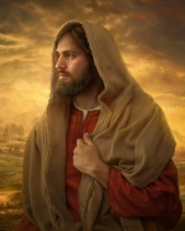
A Blessing Forever
“Even the timeless waves of eternity will not be able to wear away the blessings that God will place on the head of his faithful servant.”
JFM and RLM
A Representative of God:
Nephi’s words were God’s words, and his works were to be God’s works.
All things were done according to the Word
The Word—Jesus Christ
“He that asketh in the Spirit asketh according to the will of God; wherefore it is done even as he asketh.”
D&C 46:30
Helaman 10:5

Slide 37
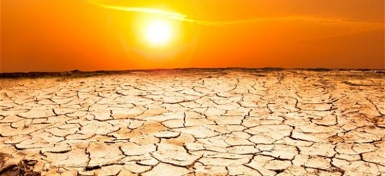
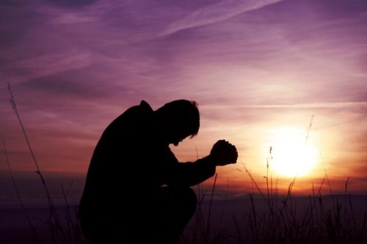
The Power
To have power over the people—smite the earth with famine, pestilence, and destruction---according to the wickedness of the people
“Beloved, if our heart condemn us not, then have we confidence toward God.
And whatsoever we ask, we receive of him, because we keep his commandments, and do those things that are pleasing in his sight.”
1 John 21-22
However:
“And it came to pass that after I had prayed and labored with all diligence, the Lord said unto me: I will grant unto thee according to thy desires, because of they faith.”
Enos 1:12
Helaman 10:5

Slide 38
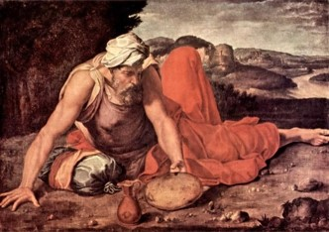
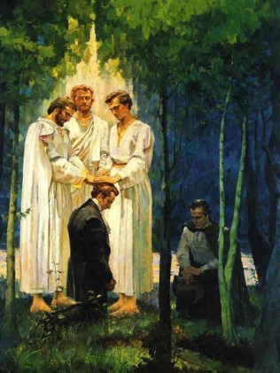
Keys of the Sealing Power
Same keys held by the prophet Elijah
The Lord gives His prophet the sealing power
This authority is to bring forth blessings or to bring forth disasters
To seal (bind) on earth and in the heavens
The authority of these keys that Elijah sealed the heavens for three and half years, and by the same authority broke that seal and brought forth rain
(1 King 17: 1, 18:1, 45)
This authority was conferred upon Peter, James, and John on the Mount of Transfiguration
(Matthew 17:3)
And also, on Joseph Smith and Oliver Cowdery
(D&C 110:13-16)
Helaman 10:6-7

Slide 39
Nephi Was Given This Same Power
To Joseph Smith
“For I have conferred upon you the keys and power of the priesthood, wherein I restore all things, and make known unto you all things in due time.
And verily, verily, I say unto you, that whatsoever you seal on earth shall be sealed in heaven; and whatsoever you bind on earth, in my name and by my word, saith the Lord, it shall be eternally bound in the heavens; and whosesoever sins you remit on earth shall be remitted eternally in the heavens; and whosesoever sins you retain on earth shall be retained in heaven.
And again, verily I say, whomsoever you bless I will bless, and whomsoever you curse I will curse, saith the Lord; for I, the Lord, am thy God.”
(D&C 132:45-47)
Even though it is not mentioned more than likely others had same power:
Lehi
Nephi
Jacob
Mosiah
Alma
Mormon
Moroni
How do we know this?
“And I, Nephi, did build a temple…”
2 Nephi 5:16—(see also Helaman 10:8)
“The fact that temples were established, sealings, marriages, and ordinances of the Melchizedek Priesthood were a part of their religious life”
JFM and RLM
Helaman 10:6-8
Phoenix-Kakashi19

Slide 40
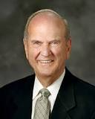
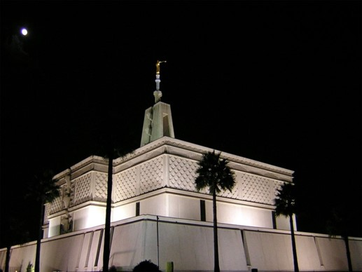
Responsibility of Church Presidents
The keys of this same power are held today by the President of The Church of Jesus Christ of Latter-day Saints. Like Nephi, the Presidents of the Church have served unwearyingly and shown that the Lord can entrust them with great blessings and responsibilities.
We most often refer to the sealing power in relation to the sealing of families through temple ordinances.
“Temples, ordinances, covenants, endowments, and sealings have been restored, precisely as prophesied.
Ordinances of the temple provide for reconciliation with the Lord and seal families together forever. Obedience to the sacred covenants made in temples qualifies us for eternal life—the greatest gift of God to man.”
Elder Russell M. Nelson

Slide 41
Nephi Returns to Preach
The power of God was with him
The people hardened their hearts
They sought to slay him
God protected him—he was ‘taken by the Spirit and conveyed away out of the midst of them’
With the Spirit he declared the word of God
The people hardened their hearts
The people began to be contentious and slay one another
What message might we send to others when we delay doing what they ask of us?
What do we show the Lord when we respond quickly to His counsel and commandments?
What does Nephi’s example teach us?
How can you show your determination to serve the Lord?
How did the Lord help Nephi?
When we respond promptly to the Lord’s direction, we will have His power to help us.
Helaman 10:11-19

Slide 42
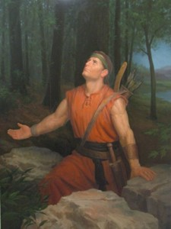
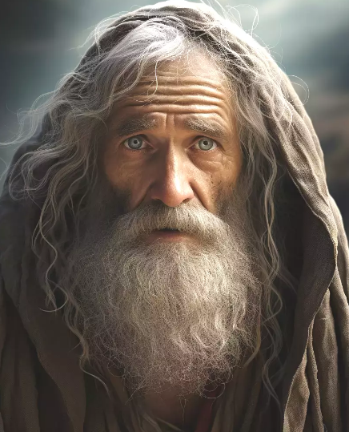
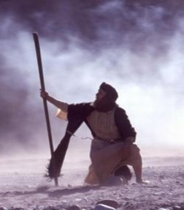
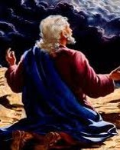
For He Was Taken By the Spirit
Ezekiel:
“In the visions of God brought he me into the land of Israel, and set me upon a very high mountain, by which was as the frame of a city on the south.”
Ezekiel 40:2—transported from captivity in Babylon to the temple mount in Jerusalem
The other Nephi:
“And upon the wings of his Spirit hath my body been carried away upon exceedingly high mountains. And mine eyes have beheld great things, yea, even too great for man; therefore I was bidden that I should not write them.”
2 Nephi 4:25
John the Revelator:
“And he carried me away in the spirit to a great and high mountain, and shewed me that great city, the holy Jerusalem, descending out of heaven from God,”
Revelation 21:10
Moses:
“The words of God, which he spake unto Moses at a time when Moses was caught up into an exceedingly high mountain,”
Moses 1:1
Helaman 10:16-17

Slide 43
Sources:
Boyd K. Packer “Reverence Invites Revelation,” Ensign, Nov. 1991, 22).
Joseph Fielding McConkie and Robert L. Millet Doctrinal Commentary on the Book of Mormon Vol. 3 pg. 285-287
Elder Russell M. Nelson (“Prepare for the Blessings of the Temple,” Ensign, Oct. 2010, 42).
The end of the 71st year of the Reign of the Judges
Presentation by ©http://fashionsbylynda.com/blog/

Slide 44
Let Us Remember
Helaman 11-12
“…let there be famine--
…so they might remember”
Reoccurring cycles of wickedness

Slide 45
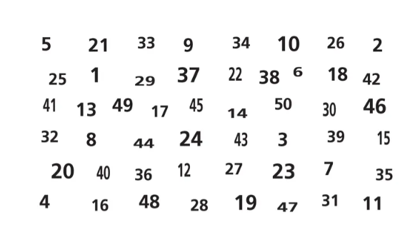
Activity—Identifying Patterns
Look at the following numbers. In 30 seconds, find as many numbers as you can in numerical order, beginning with “1.”
How many numbers were you able to find in 30 seconds?
Did you notice a pattern to where the numbers are located?

Slide 46
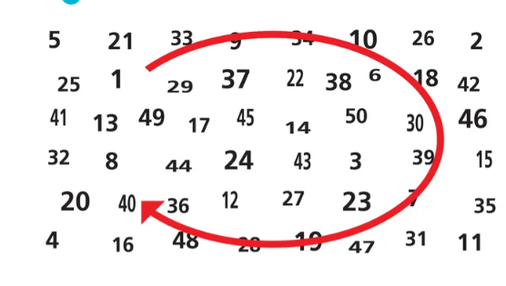
If you insert a vertical and a horizontal line in the center of the chart to create four equal quadrants, you will find that the numbers follow a clockwise pattern, like the arrow shows. For example, “1” is in the top left quadrant, “2” is in the top right, and so on.
Being able to identify patterns is a skill that can enhance your scripture study. Doing so can help you better apply what is in the scriptures to your life.

Slide 47
The Cycle
1.
Forgetting the Lord:
Pride and Wickedness
4.
Righteousness and Prosperity
2.
Suffering and Destruction
If we choose to remember the Lord, humble ourselves, and repent, we can avoid pride and its consequences
3.
Remembering the Lord:
Humility and Repentance

Slide 48
Helaman 11
The people rejoice and glorify God. They are righteous, and they begin to prosper again
Verses 21-23
Stage 3,4
Because of Nephi’s request to the Lord, famine replaced war, and thousands begin to perish with hunger
Verses 3-6
The robbers kill many people and carry some people, including women and children, captive into the wilderness. The trials lead the people to remember the Lord
Verse 27-35
Prosperity and peace are restored. Contentions are small, and they are resolved by revelations and gospel teaching
Verse 21-23
Stage 2,3
Stage 2,3
The Reign of the Judges
Stage 4,1
72-73
73-75
75
76
77-79
80
80-81
Contention and wars increase, and the secret band of robbers carries on the work of destruction
Verses 1-2
The People begin to remember the Lord and humble themselves, and they sweep the band of Gadianton from
among them
Verses 17-20
The people become prideful angry, and wicked again. A Wicked band of robbers develops again among the people, with their murders and secret plans.
The robbers cause havoc and destruction, and the armies of the Nephites and Lamanites are unable to destroy the wicked band
Verses 24-26
Stage 3,4
Stage 2,3
Stage 1
Description of the People’s Condition
Helaman 11

Slide 49
Recurring Cycles of Nations
“Great nations rise and fall—the people go from bondage to spiritual faith,
from spiritual faith to great courage,
from courage to liberty,
from liberty to abundance,
from abundance to selfishness,
from selfishness to complacency,
from complacency to apathy,
from apathy to dependency,
from dependency back again into bondage.”
Robert Muntzel
74th year
Helaman 11

Slide 50
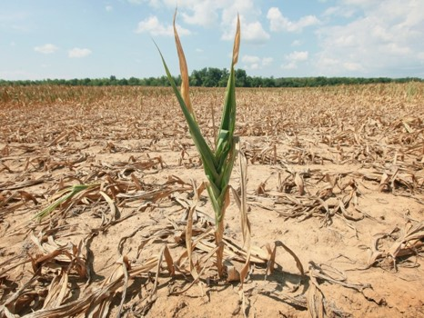
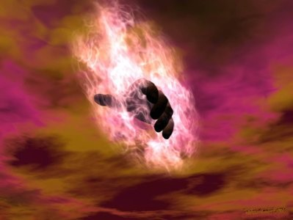
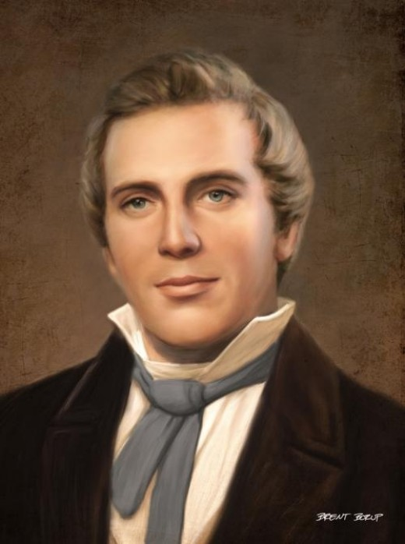
Famine—Getting the Attention of the Rebellious
A famine is a widespread scarcity of food, caused by several factors including crop failure, population unbalance, or government policies. This phenomenon is usually accompanied or followed by regional malnutrition, starvation, epidemic, and increased mortality.
Nearly every continent in the world has experienced a period of famine throughout history. Some countries, particularly in sub-Sahara Africa, continue to have extreme cases of famine.
74th year
Nephi had the power from God to send famine among the people
“Behold I speak for mine elect’s sake; for nation shall rise against nation, ad kingdom against kingdom; there shall be famines, and pestilences, and earthquakes, in divers places”
Joseph Smith—Matthew 1:29
Read D&C 43:25
Helaman 11:1-23
Helaman 11

Slide 51
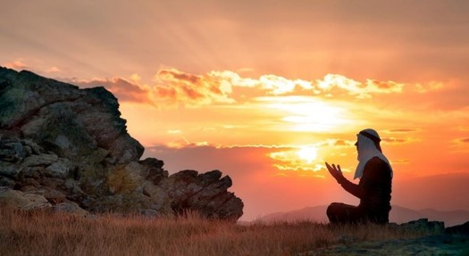
Getting Back on Track
Through humility and repentance, we can avoid pride and destruction.
74th year
The Nephites could have lived righteously and humbly always, repenting without delay whenever they sinned. If they had lived this way, they still would have experienced some trials, but they would not have needed to endure the terrible suffering and destruction that came as a result of their wickedness.
How long after remembering the Lord did it take for the Nephites to be “ripening again for destruction”?
4 years
Helaman 11

Slide 52
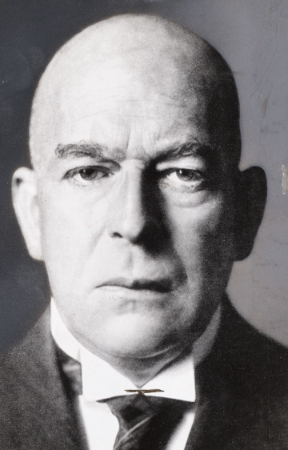
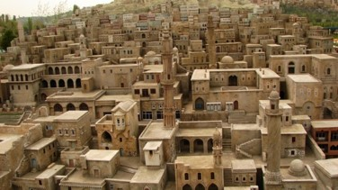
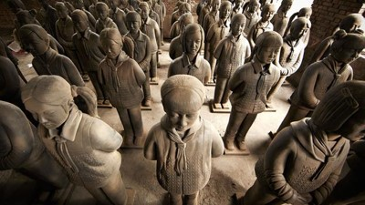
Nations Decline
Worship of money
Loss of idealism
Good men staying away from politics
The lessening of national pride as people become concerned with only their private affairs
A preponderance of the great cities
A general desire to limit the number of children
The loss of respect for representative government
The substitution of ‘unparliamentary methods’ such as economic pressure
Above all—anti-national peace movements which mean the abdication of the nation not in favor of everlasting peace
Oswald Spengler
74th year
Helaman 11

Slide 53
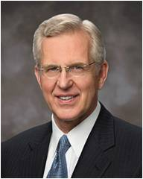
Chasten
If we are not careful, our prosperity can lead us to forget the Lord; the Lord chastens His people to stir them up in remembrance of Him
74th year
Chasten means to correct someone through punishment or suffering of some kind
“Divine chastening has at least three purposes:
(1) to persuade us to repent,
(2) to refine and sanctify us, and
(3) at times to redirect our course in life to what God knows is a better path”
Elder D. Todd Christofferson
Why do you think people who are prosperous sometimes forget the Lord?
Why do you think people sometimes need to be chastened before they remember the Lord?
Helaman 12:2-3
Helaman 11

Slide 54
Quick or Slow
How r u?
How quick are you to reply a text from a friend?
74th year
How quick are you at trying something new?
How quick are you at getting up in the morning?
How quick are you at completing an assignment?
Helaman 12:4-6
Helaman 11

Slide 55
Easy to Forget
“We so easily forget that we came into life with nothing. Whatever we get soon seems our natural right, not a gift. And we forget the giver. Then our gaze shifts from what we have been given to what we don’t have yet. …
74th year
“Confronting death and difficulty does return memory and therefore gratitude to righteous people as well as the wicked. But there must be another way to remember, one we can choose. …
“You can choose to remember the greatest gift of all.
Next week, you can go to a meeting where the sacrament is administered. You will hear the words, ‘Always remember him.’ You can pledge to do that, and the Holy Ghost will help you” Henry B. Eyring
Helaman 11

Slide 56
Less Than the Dust
Why could such people be considered “less than the dust of the earth”?
Mormon was not teaching that people are of less worth to Heavenly Father than the dust of the earth. Rather, he was drawing attention to the fact that dust always obeys God’s commands, but people often do not.
74th year
“For behold, if the knowledge of the goodness of God at this time has awakened you to a sense of your nothingness, and your worthless and fallen state—”
Mosiah 4:5
Helaman 12:7
Helaman 11

Slide 57
The Power of God
Mormon reminds us of the Lord’s great power—that the Lord can command physical elements to move or change and that He can cause a sinful person to be cut off from His presence.
74th year
“Every valley shall be exalted, and every mountain and hill shall be made low: and the crooked shall be made straight, and the rough places plain:”
Isaiah 40:4
“And it shall be a voice as the voice of many waters, and as the voice of a great thunder, which shall break down the mountains, and the valleys shall not be found.
He shall command the great deep, and it shall be driven back into the north countries, and the islands shall become one land;
And the land of Jerusalem and the land of Zion shall be turned back into their own place, and the earth shall be like as it was in the days before it was divided.”
D&C 133:22-24
Helaman 12:9-13
Helaman 11

Slide 58
All Men Might Be Saved
“No person came into this life incapable of gaining salvation”
JFM and RLM
74th year
“We believe that through the Atonement of Christ all mankind may be saved by obedience to the laws and ordinances of the Gospel.”
Articles of Faith 1:3
“The contention in heaven was—Jesus said there would be certain souls that would not be saved; and the devil said he could save them all.”
Joseph Smith
“And I pray the Father in the name of Christ that many of us, if not all, may be saved in his kingdom at that great and last day.”
2 Nephi 33:12
Helaman 12:25
Helaman 11

Slide 59
Everlasting Damnation
74th year
“The phrase “everlasting life” describes more than a life that does not end; it is descriptive of the kind and quality of life enjoyed by the obedient and faithful, the life of exalted and glorified beings.
Conversely, “everlasting damnation” is not properly understood to mean an endless stint in hell, but rather is descriptive of the kind of punishment—Gods’ punishment—which will be meted out to the defiant”
JFM and RLM
Read D&C 19:4-12
Helaman 12:26
Helaman 11

Slide 60
Let Us Remember Our God
“…be not faithless, but believing” John 20:27
“Let us not personally be diverted from our course
Let us seek the Lord to establish his righteousness (D&C 1:16)
Let us prove worthy to live with him eternally in the heavens.
Let us not be deceived by the learning and sophistries and the wickedness of this world
Let us not forget that God lives, that we are his children, that his purpose is to bring us to immortality and eternal life.
Let us love the Lord our God with all our heart, soul, mind, and strength.
Let us be constantly aware that we are living in the last gospel dispensation and that Satan has all his forces for war in this final premillennium stage
Let us understand that the Church of Jesus Christ of Latter-day Saints is the literal kingdom of God in the earth”
Excerpts from Marion G. Romney
74th year
Helaman 11

Slide 61
Sources:
Robert Muntzel (Manage Magazine, January 1961) from Student Manual Religion 121-122 pg 369
Elder D. Todd Christofferson (“As Many as I Love, I Rebuke and Chasten,” Ensign or Liahona, May 2011, 98).
Oswald Spengler (Today and Destiny: vital Excerpts from Decline of the West of Oswald Spengler, arranged by Edward F. Dakin.) (Ernest L. Wilkinson, BYU commencement address, 21 Aug. 1970, p. 6.) from Student Manual Religion 121-122 pg. 370
Excerpts from Marion G. Romney, Look to God and Live pp. 12-13---from Student Manual Religion 121-122 pg. 371
Joseph Smith McConkie and Robert L. Millet Doctrinal Commentary on the Book of Mormon Vol. 3 pg. 397
Henry B. Eyring, “Remembrance and Gratitude,” Ensign, Nov. 1989, 12, 13).
Joseph Smith Teachings pg. 357
Ladder of Divine Ascent Sinai 12th century.jpg
http://en.wikipedia.org/wiki/Famine
Presentation by ©http://fashionsbylynda.com/blog/

Slide 62
Helaman 11
The people rejoice and glorify God. They are righteous, and they begin to prosper again
Verses 21-23
Stage 3,4
Because of Nephi’s request to the Lord, famine replaced war, and thousands begin to perish with hunger
Verses 3-6
The robbers kill many people and carry some people, including women and children, captive into the wilderness. The trials lead the people to remember the Lord
Verse 27-35
Prosperity and peace are restored. Contentions are small, and they are resolved by revelations and gospel teaching
Verse 21-23
Stage 2,3
Stage 2,3
The Reign of the Judges
Stage 4,1
72-73
73-75
75
76
77-79
80
80-81
Contention and wars increase, and the secret band of robbers carries on the work of destruction
Verses 1-2
The People begin to remember the Lord and humble themselves, and they sweep the band of Gadianton from
among them
Verses 17-20
The people become prideful angry, and wicked again. A Wicked band of robbers develops again among the people, with their murders and secret plans.
The robbers cause havoc and destruction, and the armies of the Nephites and Lamanites are unable to destroy the wicked band
Verses 24-26
Stage 3,4
Stage 2,3
Stage 1
Description of the People’s condition

Slide 63
Righteousness
Helaman 11-13
11:18-19
Reign of Judges
76th Year
Humility and Repentance
Prosperity and Blessings
Remembering the Lord
11:7-11
End in peace
11:20-21
Reign of Judges
76th Year
3rd Cycle of Nephite Disease
Destruction and Suffering
Pride
Start
11:24 (War)
11:37
Reign of Judges
80th-85th Year
Secret robbers/famine
11:2-6
Reign of Judges
72nd - 76th Year
11:6 earth smitten
11:6 death toll high
Wickedness
13:1
Reign of Judges
86th Year
11:26 Secret Combinations
13:8 Spirit Withdrawal
Prophecy of Samuel the Lamanite
16:10 Majority Choose Evil

Slide 64
“In 1787 Edward Gibbon completed his noble work The Decline and Fall of the Roman Empire. Here is the way he accounted for the fall.
The undermining of the dignity and sanctity of the home, which is the basis of human society.
2 Higher and higher taxes and the spending of public monies for free bread and circuses for the populace.
3. The mad craze for pleasure, sports becoming every year more and more exciting and brutal.
4. The building of gigantic armaments when the real enemy was within the decadence of the people.
5. The decay of religion—faith fading into mere form, losing touch with life, and becoming impotent to warn and guide the people.
Is there a parallel for us in America today? Could the same reasons that destroyed Rome destroy America?...The lessons of history, many of them very sobering, ought to be turned to during this hour of our great achievements, because during the hour of our success is our greatest danger. Even during the hour of our great prosperity, a nation may sow the seeds of its own destruction. History reveals that rarely is a great civilization conquered from without unless it has weakened or destroyed itself within.”
--Ezra Taft Benson (God, Family, Country, pp. 363-364)

