Slide 1
Mormon 1-6

Slide 2
Mormon and the Sacred Records
Introduction and Mormon 1-2
The Large Plates of Nephi
The Small Plates of Nephi

Slide 3
Mormon and the Sacred Records
When Mormon was about 10 years old, the record keeper, Ammaron, charged him to take responsibility for the sacred records when he came of age.
He was to record everything he observed concerning the people.
At age 15, Mormon was “visited of the Lord, and tasted and knew of the goodness of Jesus”. In the same year, the Nephites appointed Mormon to lead their armies.
Obedient to Ammaron’s counsel, he later obtained the large plates of Nephi and began to make his record.
He also abridged the large plates of Nephi, which included writings from prophets and record keepers from Lehi through Ammaron, and inserted the small plates of Nephi into that abridgement.
The Large Plates of Nephi
The Small Plates of Nephi
Mormon wrote the first seven chapters of this book as a brief account of the wickedness and wars among the Nephites and Lamanites in his day.
He also made a full account of the events from his lifetime on the large plates of Nephi.
Mormon 1:4, 15; Mormon 2:1, 18; 5:9

Slide 5
To Be Stored in a Hill
Near the end of his life, Mormon deposited all the records in the Hill Cumorah, except for a few plates that he gave to his son Moroni.
He then led the Nephites in their last great battle against the Lamanites.
Before Mormon died, he directed Moroni to complete his record.
Moroni added the words that make up chapters 8–9 of this book.
Mormon 6:6

Slide 6
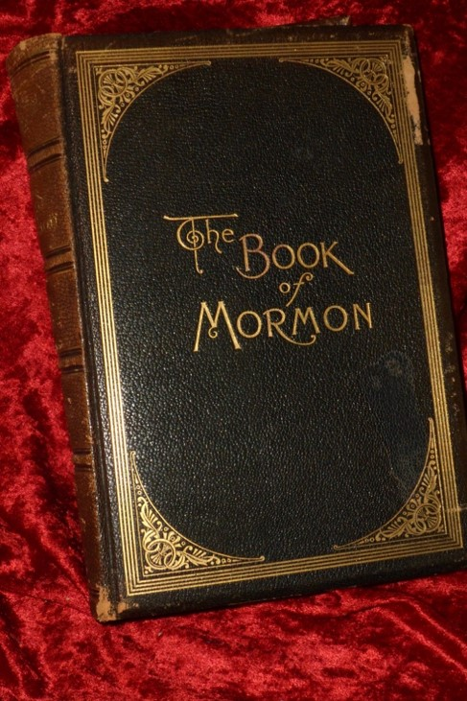
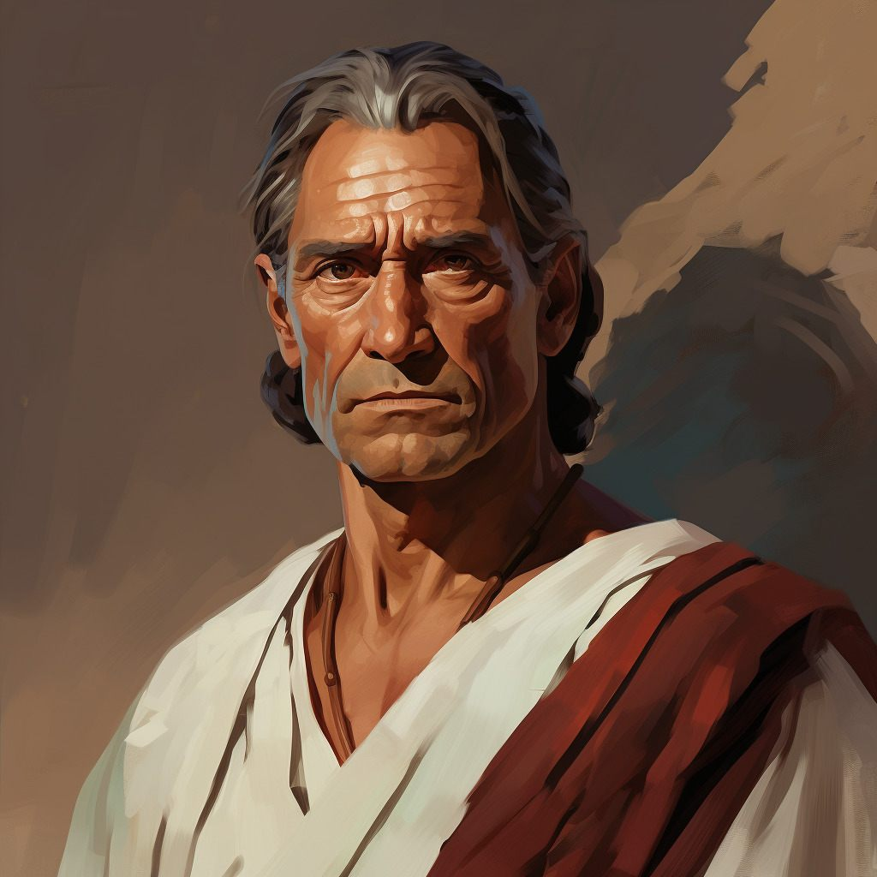
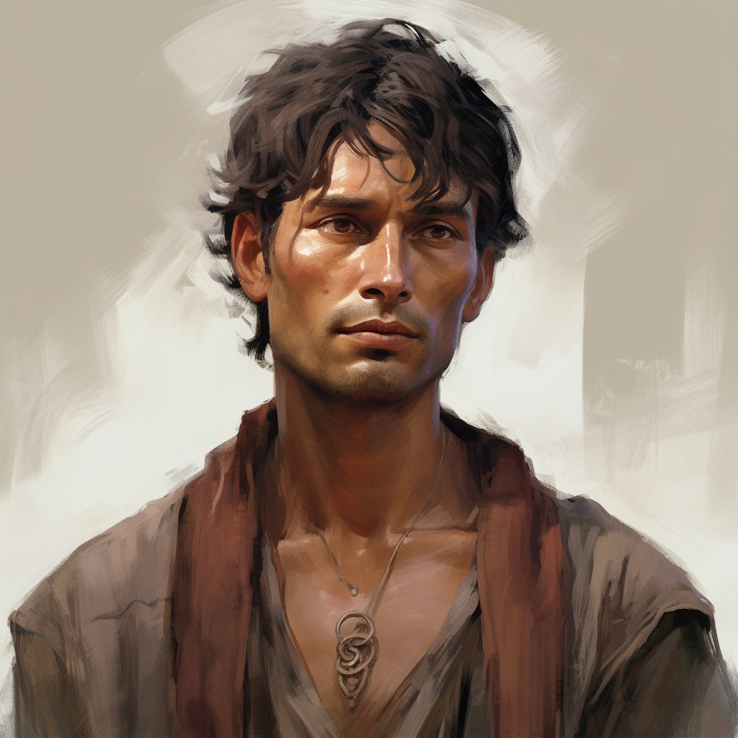
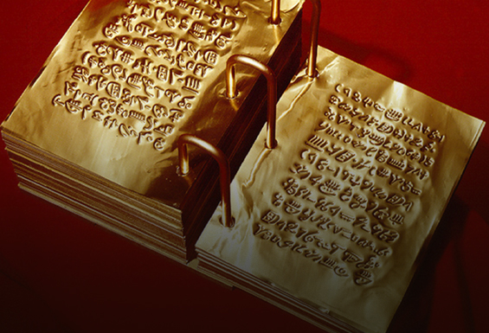
A Book For Us Today
Mormon wrote to Gentiles and members of the house of Israel in the latter days, desiring to “persuade all [the] ends of the earth to repent and prepare to stand before the judgment-seat of Christ”.
As Moroni concluded his father’s book, he directly addressed those who would read his words.
He warned them of the consequences of their sins and invited them to “come unto the Lord with all [their] heart”
Mormon 3:22; Mormon 9:27

Slide 7
Time Line of the Sacred Records
AD
320
321-327
345-401
401-402, 421
Feb. 1828
Ammaron
Hides records
Moroni
Chapter 8-9
Wandered for the safety of his life
Joseph Smith receives the Sacred Plates at Hill Cumorah Palmyra, New York
Ammaron finds Mormon at age 10.
At age 24 Mormon is to take the plates of Nephi
Mormon writes
Chapters 1-7
He is finished after final battle at Cumorah
Mormon 2:15-17;8:5-6; 6:10-15

Slide 8
The Writings Include…
The fulfillment of prophecies by Nephi, Alma, Samuel the Lamanite, and Jesus Christ regarding the destruction of the Nephites
Mormon refers to some of his writings as “my record of the destruction of my people” (Mormon 6:1).
He showed that the downfall of the Nephites was a consequence of their wickedness
1 Nephi 12:19; Alma 45:9-14; Helaman 13:8-10; 3 Nephi 27:32
Mormon 4:12; 6:15-18

Slide 9
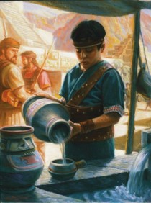
Young Mormon
At age 15, he was “visited of the Lord” desired to help the Nephites repent, but because of their willful rebellion he was forbidden by the Lord to preach to them.
At this young age, he was appointed to lead the Nephite army.
Although Mormon grew up in a time of great wickedness, he chose to be faithful.
Because of his faithfulness, he was told that he would be entrusted with the people’s sacred records later in his life.
Mormon 1:5-6, 15

Slide 10
Calling You “Mormon”
How do you feel when people call you a Mormon?
“While I sometimes regret that people do not call this church by its proper name, I am happy that the nickname they use is one of great honor made so by a remarkable man and a book which gives an unmatched testimony concerning the Redeemer of the world.
“Anyone who comes to know the man Mormon, through the reading and pondering of his words, anyone who reads this precious trove of history which was assembled and preserved in large measure by him, will come to know that Mormon is not a word of disrepute, but that it represents the greatest good—that good which is of God”
President Gordon B. Hinckley
Mormon 1:5-6, 15

Slide 11
Standing Out as a Disciple
“True disciples of Jesus Christ are willing to stand out, speak up, and be different from the people of the world. They are undaunted, devoted, and courageous. …
There is nothing easy or automatic about becoming such powerful disciples. Our focus must be riveted on the Savior and His gospel. It is mentally rigorous to strive to look unto Him in every thought. But when we do, our doubts and fears flee.”
Russell M. Nelson

Slide 12
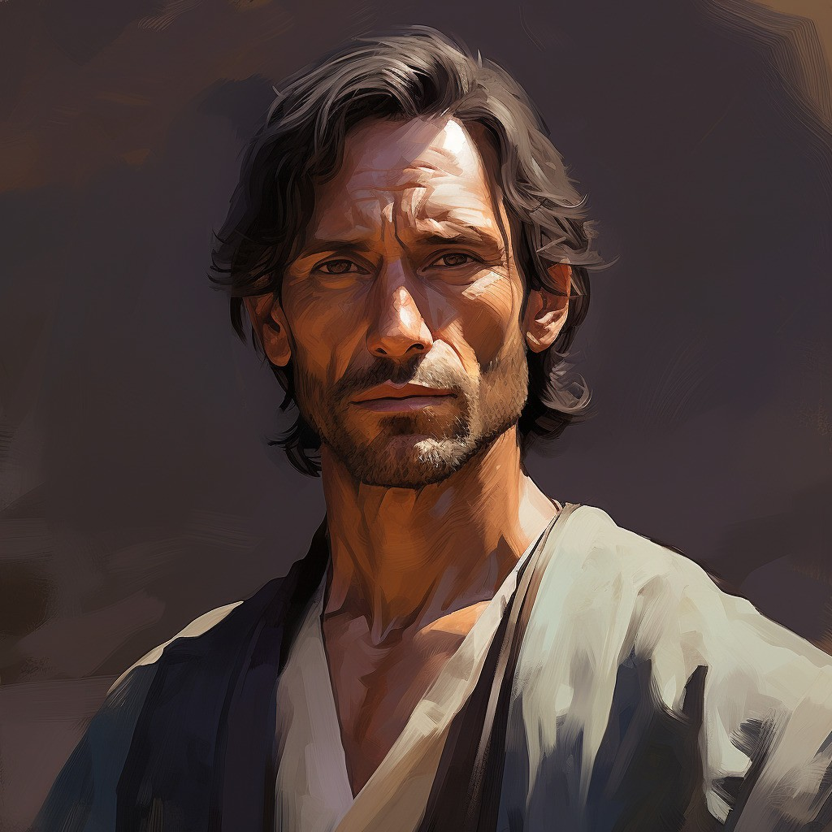
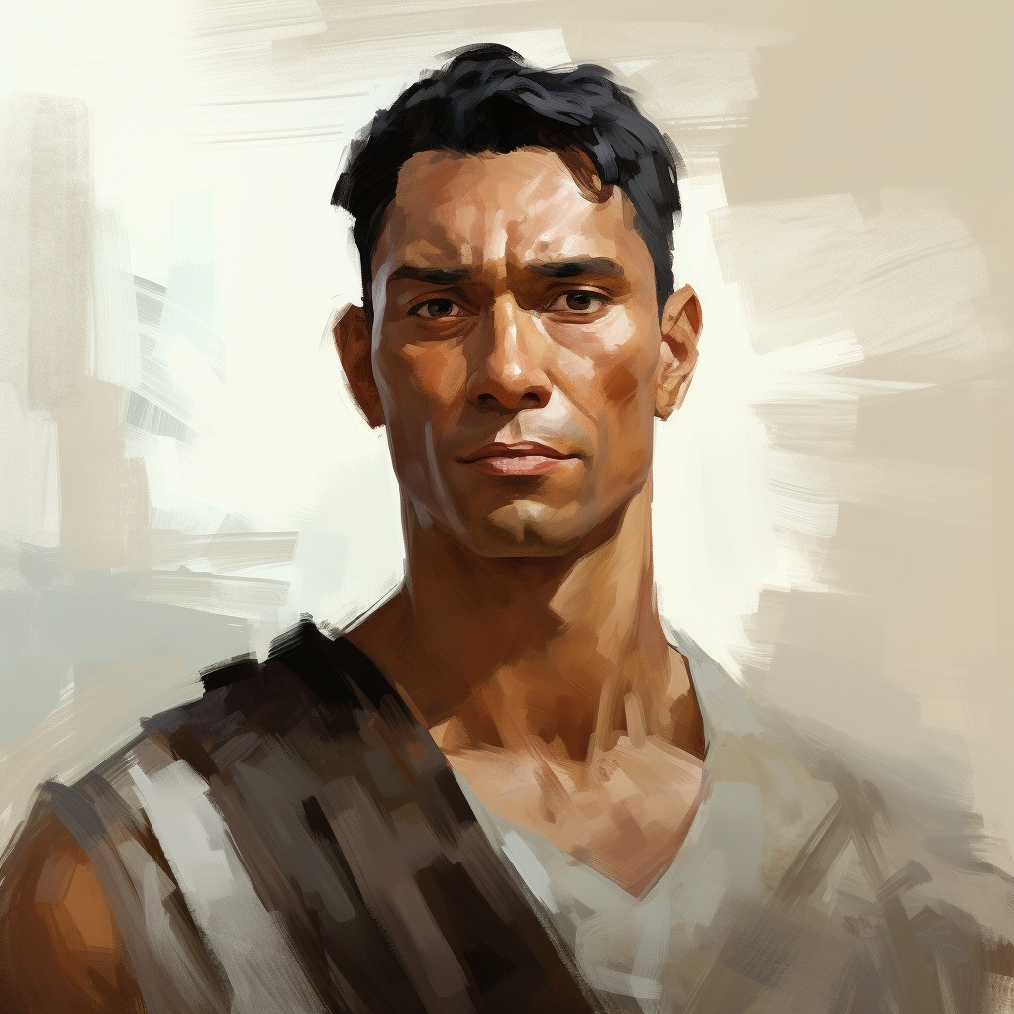
The Responsibility
Sober child--Trustworthy
Ammaron instructed Mormon to take the plates of Nephi when he became 24 years of age and record on them the things he observed among the people.
He was instructed to not only record the history but the workings of the Lord among the people.
Quick to observe—insightful, perceptive in recognizing what should be recorded to warn and bless the latter-day readers…us.
The father of Mormon, also named Mormon, ‘carried’ Mormon to the land southward, ‘even to the land of Zarahemla, that land being covered with buildings and many people.
Mormon 1:1-7

Slide 13
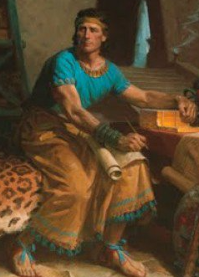
Mormon Stands As A Disciple
The righteous civilization that was established after the Savior’s visit to the Americas lasted nearly 200 years.
Sadly, the Nephites and Lamanites began to be prideful.
Eventually, they became very wicked and contentious.
Even as a young man, Mormon had to decide if he would follow what many around him were doing or if he was willing to stand out as a disciple of Jesus Christ.
4 Nephi 1:24-49; Mormon 1:1-5

Slide 14
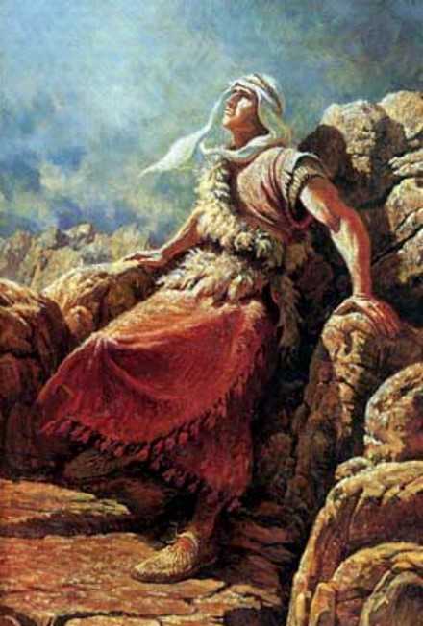
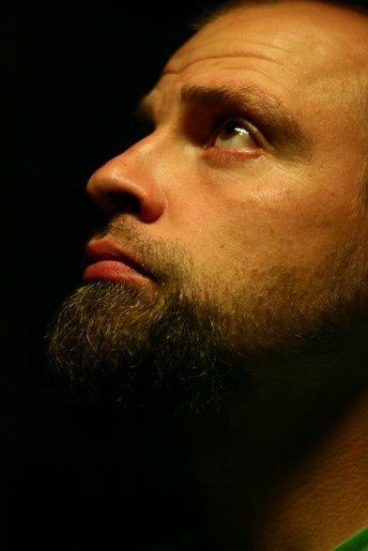
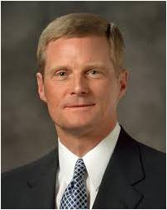
“When we are quick to observe, we promptly look or notice and obey. Both of these fundamental elements—looking and obeying—are essential to being quick to observe. And the prophet Mormon is an impressive example of this gift in action. …
“… The spiritual gift of being quick to observe is so vital for us in the world in which we do now and will yet live.”
Elder David A. Bednar

Slide 15
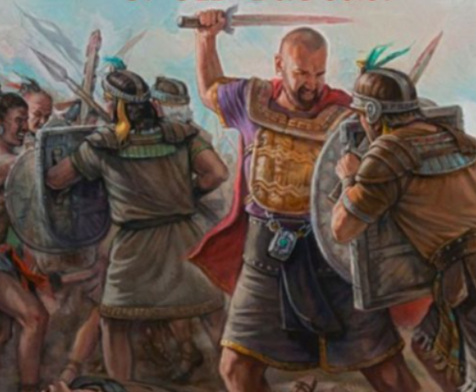
Wickedness Among the People
During the Savior’s visit there were no “ites” the people being united as one (4 Nephi 1:17)
Nephites:
Nephites
Jacobites
Josephites
Zoramites
They gathered to fight at the borders of Zarahemla
Exceeding 30,000 who died in bloodshed
The Nephites beat the Lamanites and the Lamanites withdrew and there was peace for 4 years
Lamanites:
Lamanites
Lemuelites
Ishmaelites
Mormon 1:8-12

Slide 16
Consequences of Spiritual Darkness
The Lord removed ‘gifts’ from the Nephites
The Lord takes away the 3 Nephites
The spirit (Holy Ghost) was withdrawn
Miracles cease
Healings cease
Revelation and visions stopped
They cut themselves off from the companionship of the Holy Ghost
When people are wicked and unbelieving, they lose spiritual gifts from the Lord and the influence of the Holy Ghost
Mormon 1:13-14

Slide 17
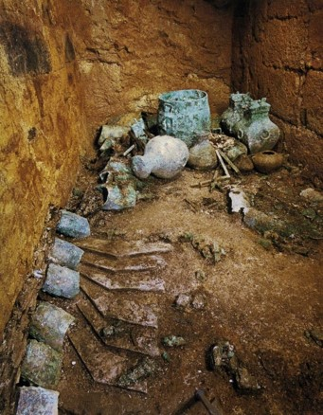
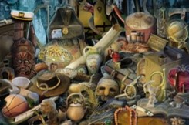
Abinadi and Samuel’s Prophecy Fulfilled
Gadianton robbers returned among the Lamanites and infested the land
People began to hide up their treasures
The Lord cursed the land and that their treasures they ‘could not hold them, nor retain them again’
Slippery—thievery and dishonesty of the Gadiantons and others with similar motives
The power of evil:
Sorcerers, witchcrafts, and magicians
“Oh My”
Mormon 1:18-19

Slide 18
Mormon -- Leader of Nephite Army
Mormon’s responsibility at age 16:
Head of the army against the Lamanites
Took possession of city of Angola
Fortified the city but the Lamanites drove them out to the city of David
Withstood a troop of 42,000 against King Aaron of the Lamanites
Mormon 2:1-9

Slide 19
Aaron—King of the Lamanites
He was king of the Lamanites around AD 331
He brought an army of 44,000 against Mormon’s 42,000
Mormon defeated the Lamanites and they retreated
10 years later the king returned and sent an epistle to Mormon announcing an attack upon the Nephites
This attack was the battle at Hill Cumorah
The Nephites fled to the army of Aaron and became victims of brutal deaths which was the prophecy of Lehi some 1,000 years previous
(2 Nephi 1:9-10)
Who’s Who

Slide 20
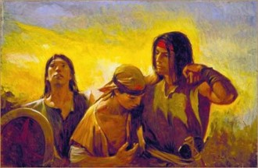
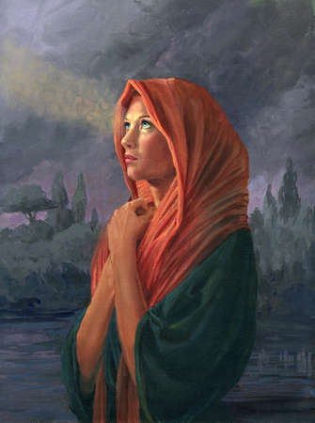
Sorrow
The Lamanites attacked the Nephite armies with such force that the Nephites were frightened and retreated.
The Lamanites drove them from one place to another until the Nephites gathered in one place.
They sorrowed because they were unable to keep their belongings. In other words, they sorrowed only because of the consequences of their sins, not because they regretted their actions.
“sorrowing … unto repentance” and the “sorrowing of the damned,”
Those who sorrow unto repentance …
Those who sorrow only because of the consequences of sin …
Mormon 2:3-13

Slide 21
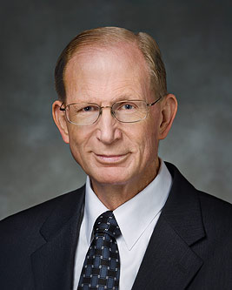
Those who sorrow unto repentance recognize the goodness of God and come unto Christ with humble hearts.
Those who sorrow only because of the consequences of sin continue to rebel against God.
“A broken heart and a contrite spirit mean to experience ‘godly sorrow [that] worketh repentance’ (2 Corinthians 7:10). This comes when our desire to be cleansed from sin is so consuming that our hearts ache with sorrow and we yearn to feel at peace with our Father in Heaven.
Those who have a broken heart and a contrite spirit are willing to do anything and everything that God asks of them, without resistance or resentment.
We cease doing things our way and learn to do them God’s way instead. In such a condition of submissiveness, the Atonement can take effect and true repentance can occur.
The penitent will then experience the sanctifying power of the Holy Ghost, which will fill them with peace of conscience and the joy of reconciliation with God.”
Elder Bruce D. Porter

Slide 22
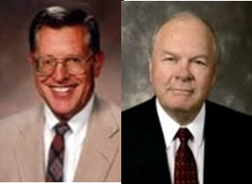
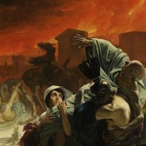
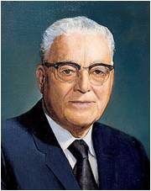
The Day of Grace Had Passed
“One of the greatest principles of the gospel of Jesus Christ is the principle of repentance.”
JFM and RLM
33 …do not procrastinate the day of your repentance until the end; for after this day of life, which is given us to prepare for eternity, behold, if we do not improve our time while in this life, then cometh the night of darkness wherein there can be no labor performed.
34 Ye cannot say… that I will repent, that I will return to my God. Nay, ye cannot say this; for that same spirit which doth possess your bodies at the time that ye go out of this life, that same spirit will have power to possess your body in that eternal world.
35 For behold, if ye have procrastinated the day of your repentance even until death, behold, ye have become subjected to the spirit of the devil, and he doth seal you his; therefore, the Spirit of the Lord hath withdrawn from you, and hath no place in you, and the devil hath all power over you; and this is the final state of the wicked.
Alma 34:33-35
“…if one has sinned so seriously and becomes habitually a sinner, the spirit of repentance leaves, and he may or may not be able to repent.”
President Harold B. Lee
Mormon 2:15

Slide 23
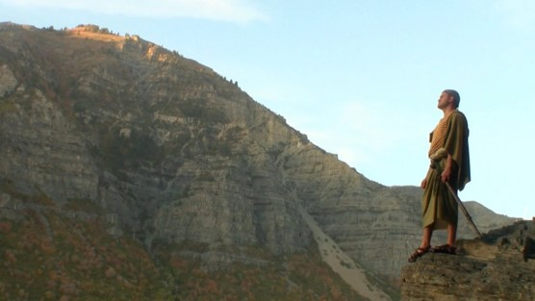
By the Hills of Shim
Mormon found himself near a hill called Shim, where Ammaron had hidden the Nephite records. He removed the plates of Nephi and began to record what he had observed among the people since the time he was a child.
Jashon
Hills of Shim
Land of Desolation
Land Bountiful
West Sea
Small Narrow Neck of Land
East Sea
River Sidon
Zarahemla
“And now, the city of Jashon was near the land where Ammaron had deposited the records unto the Lord, that they might not be destroyed. And behold I had gone according to the word of Ammaron, and taken the plates of Nephi, and did make a record according to the words of Ammaron.”
Jerusalem
Land of Nephi
Mormon 2:17-20

Slide 24
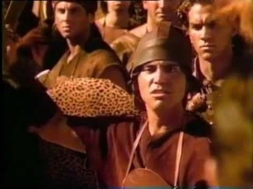
Choosing to Live Righteously in a Wicked Society
“To ensure that we do not disqualify ourselves from having the strength of the Lord we must live our lives in such a way as not to repel the Spirit. “
JFM and RLM
“Being righteous when we are surrounded by unrighteous influences is a challenge we all face. Given that reality, what can we do to prepare for—and pass—the test of living righteously in a wicked world?
Personal revelation often includes insights into specific ways we can more fully follow the Savior. These insights safeguard and guide us, help us master our thoughts and desires, and strengthen us to live in conformity with the commandments.
Today the word discriminate has been co-opted by those who would have us believe that discrimination is a bad thing. But we all discriminate on a daily basis whenever we make a choice.
Living righteously in a wicked world requires that we not be afraid to make right choices.”
Elder Charles Didier
We can choose to live righteously, even in a wicked society

Slide 25
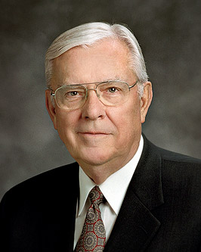
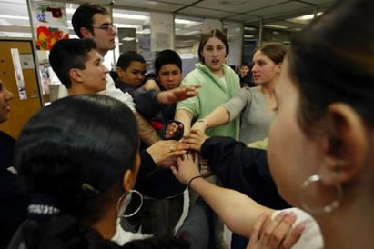
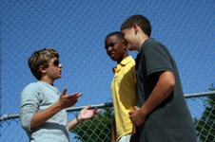
“In the Church, we often state the couplet: ‘Be in the world but not of the world.’ As we observe television shows that make profanity, violence, and infidelity commonplace and even glamorous, we often wish we could lock out the world in some way and isolate our families from it all. …
“Perhaps we should state the couplet … as two separate admonitions. First, ‘Be in the world.’ Be involved; be informed. Try to be understanding and tolerant and to appreciate diversity. Make meaningful contributions to society through service and involvement. Second, ‘Be not of the world.’ Do not follow wrong paths or bend to accommodate or accept what is not right.”
“We need to influence more than we are influenced. We should work to stem the tide of sin and evil instead of passively being swept along by it. We each need to help solve the problem rather than avoid or ignore it.”
I testify that as we seek personal revelation, keep our eye on the Lord’s anointed, hold fast to righteous standards, and strive to make a difference through our example and influence, we will find joy in this life and in the next.
“The word of God, as found in the scriptures, in the words of living prophets, and in personal revelation, has the power to fortify the Saints and arm them with the Spirit.”
Elder M. Russell Ballard

Slide 26
Mormon Highlights Major Problems That Lead to Their Downfall
1. Groups begin to break off.
2. Exceeding prosperity-costly clothing and adornments.

Slide 27
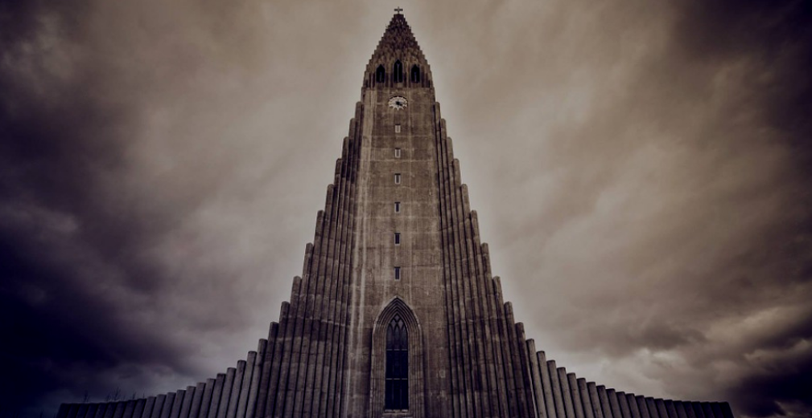
3. Divided into classes or tribes.
4. False churches getting gain.

Slide 28
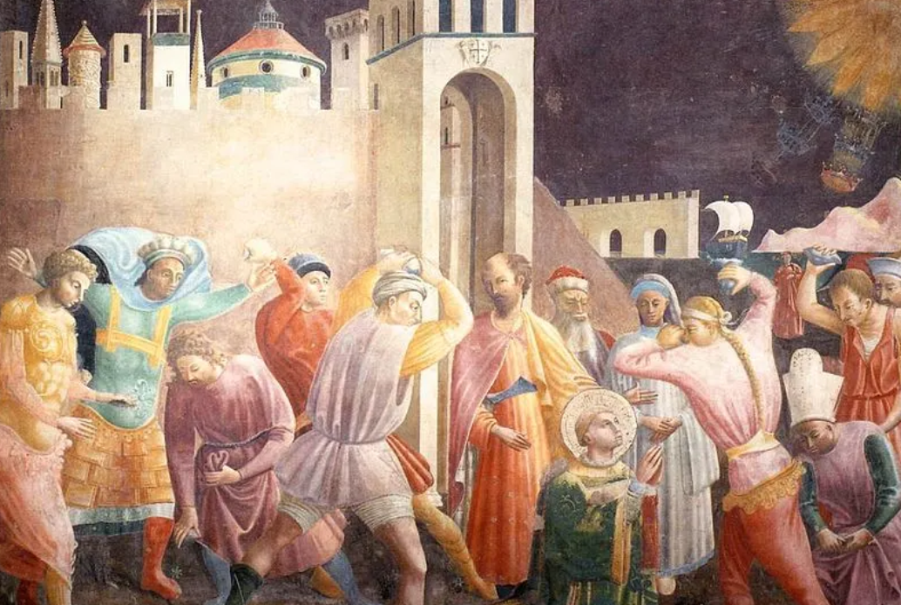
5. Persecution of believers.
6. Great division among the people.

Slide 29
7. Children taught to reject what is true.
8. Believers become as wicked as the others.

Slide 30
9. Secret society conspiracies overrun the whole land

Slide 31
Sources:
Sources:
Russell M. Nelson, “Drawing the Power of Jesus Christ into Our Lives,” Ensign or Liahona, May 2017, 40–41
President Gordon B. Hinckley(“Mormon Should Mean ‘More Good,’” Ensign, Nov. 1990, 52–53)
Elder David A. Bednar (“Quick to Observe,” Ensign, Dec. 2006, 34).
Joseph Fielding McConkie and Robert L. Millet Doctrinal Commentary on the Book of Mormon Vol. 4 pgs. 211-212, 219-220
The Book of Mormon Who’s Who by Ed J. Pinegar and Richard J. Allen pgs. 1-2
Elder Bruce D. Porter (“A Broken Heart and a Contrite Spirit,” Ensign or Liahona, Nov. 2007, 32).
President Harold B. Lee Church News March 3, 1973 p. 4
Elder Charles Didier Choosing Right When the World Is Wrong Feb. 2010 Ensign
Elder M. Russell Ballard, “The Effect of Television,” Ensign, May 1989, 80
Presentation by ©http://fashionsbylynda.com/blog/

Slide 32
Mormon 1
The following list highlights aspects of Mormon’s life and ministry:
1. His father was named Mormon (see Mormon 1:5).
2. He was named after the land of Mormon, where Alma established the Church (see 3 Nephi 5:12).
3. He named a son Moroni (see Mormon 6:6).
4. He was a pure descendant of Lehi (see 3 Nephi 5:20).
5. He was visited by the Savior (see Mormon 1:15).
6. He was a disciple of Jesus Christ (see 3 Nephi 5:13).
7. He was a commander of Nephite armies (see Mormon 2:1).
8. He wrote according to God’s will (see 3 Nephi 5:14).
9. He witnessed the downfall of the Nephites (see Mormon 2:18–19; 3:16; 6:8–22).
Mormon 1
The following list highlights aspects of Mormon’s life and ministry:
1. His father was named Mormon (see Mormon 1:5).
2. He was named after the land of Mormon, where Alma established the Church (see 3 Nephi 5:12).
3. He named a son Moroni (see Mormon 6:6).
4. He was a pure descendant of Lehi (see 3 Nephi 5:20).
5. He was visited by the Savior (see Mormon 1:15).
6. He was a disciple of Jesus Christ (see 3 Nephi 5:13).
7. He was a commander of Nephite armies (see Mormon 2:1).
8. He wrote according to God’s will (see 3 Nephi 5:14).
9. He witnessed the downfall of the Nephites (see Mormon 2:18–19; 3:16; 6:8–22).
Mormon 1
The following list highlights aspects of Mormon’s life and ministry:
1. His father was named Mormon (see Mormon 1:5).
2. He was named after the land of Mormon, where Alma established the Church (see 3 Nephi 5:12).
3. He named a son Moroni (see Mormon 6:6).
4. He was a pure descendant of Lehi (see 3 Nephi 5:20).
5. He was visited by the Savior (see Mormon 1:15).
6. He was a disciple of Jesus Christ (see 3 Nephi 5:13).
7. He was a commander of Nephite armies (see Mormon 2:1).
8. He wrote according to God’s will (see 3 Nephi 5:14).
9. He witnessed the downfall of the Nephites (see Mormon 2:18–19; 3:16; 6:8–22).
Mormon 1
The following list highlights aspects of Mormon’s life and ministry:
1. His father was named Mormon (see Mormon 1:5).
2. He was named after the land of Mormon, where Alma established the Church (see 3 Nephi 5:12).
3. He named a son Moroni (see Mormon 6:6).
4. He was a pure descendant of Lehi (see 3 Nephi 5:20).
5. He was visited by the Savior (see Mormon 1:15).
6. He was a disciple of Jesus Christ (see 3 Nephi 5:13).
7. He was a commander of Nephite armies (see Mormon 2:1).
8. He wrote according to God’s will (see 3 Nephi 5:14).
9. He witnessed the downfall of the Nephites (see Mormon 2:18–19; 3:16; 6:8–22).

Slide 33
The hill Shim is in the land of Antum (which is next to the land of Jashon). The hill Shim is eastward of the city of Boaz, northward of the narrow neck, southward of the hill Ramah/hill Cumorah, and westward of Ablom. The hill Shim is several days' travel from the lands of Nehor and Heth.
Commentaries .
IV NEPHI 1:57 [1:48]: And it came to pass that when three hundred and twenty years had passed away, Ammoron, being constrained by the Holy Ghost, did hide up the records which were sacred;
Commentary: This verse references the place of the hill Shim. Ammoron hid up the records in Hill Shim.
MORMON 1:2 [1:2]: And about the time that Ammoron hid up the records unto the Lord, he came unto me, (I being about ten years of age; and I began to be learned somewhat after the manner of the learning of my people,) and Ammoron said unto me, I perceive that thou art a sober child, and art quick to observe;
Commentary: This verse references the place of the hill Shim. Ammoron had hid up the records in Hill Shim. The term 'I' refers to Mormon.
MORMON 1:4 [1:3]: And when ye are of that age, go to the land of Antum, unto a hill, which shall be called Shim; and there have I deposited unto the Lord, all the sacred engravings concerning this people.
Commentary: This verse references the places of Antum and the hill Shim. In this verse, Ammoron is talking to Mormon. The hill Shim is located in the land of Antum.
MORMON 1:43 [2:17]: And now the city of Jashon was near the land where Ammoron had deposited the records unto the Lord, that they might not be destroyed.
Commentary: This verse references the places of Antum, the hill Shim, and Jashon. The hill Shim is where Ammoron deposited the records in the land of Antum. The phrase 'was near' means the land around the city of Jashon is next to the land of Antum.
MORMON 2:25 [4:23]: And now I, Mormon, seeing that the Lamanites were about to overthrow the land, therefore I did go to the hill Shim, and did take up all the records which Ammoron had hid up unto the Lord.
Commentary: This verse references the places of Antum, Boaz, the hill Shim, and the Sea West. Mormon went to the hill Shim (in the land of Antum) from the city Boaz. There is no indication how close the two were together. It may imply that the way to the hill Shim from the land of Boaz is through an area where there were few, if any, Lamanites. If the Lamanites were pursuing the Nephites generally northward from the land Desolation, the route from the city Boaz to the hill Shim would then have to be eastward (westward would be the Sea West). This would also imply that the hill Shim is northward of the narrow neck where Lamanites had control.
ETHER 4:3 [9:3]: And the Lord warned Omer in a dream that he should depart out of the land; wherefore Omer departed out of the land with his family, and traveled many days, and came over and passed by the hill of Shim,
Commentary: This verse references the places of Heth, hill Shim, Nehor, and a ridge between Heth and the hill Shim. Omer traveled many days from the land of Nehor and passed by the hill of Shim. To travel many days, the hill Shim is not very near the land of Nehor or the land of Heth. The phrase 'came over' means over a ridge before getting to the hill Shim (in order to pass by the hill Shim).
ETHER 4:4 [9:3]: And came over by the place where the Nephites were destroyed, and from thence eastward, and came to a place which was called Ablom, by the sea-shore, and there he pitched his tent, and also his sons and his daughters, and all his household, save it were Jared and his family.
Commentary: This verse references the places of the land of Ablom, hill Cumorah, hill Ramah, hill Shim, ridge between hill Shim and hill Cumorah, and the Sea East. 'He' refers to Omer. The phrase 'where the Nephites were destroyed' means the hill Cumorah. From Ether 6:83 [15:11], the hill Ramah is the same as the hill Cumorah. The term 'thence' indicates Ablom is outside the area around hill Cumorah. Traveling eastward to the sea indicates that Ablom is eastward from hill Ramah/hill Cumorah and on the Sea East shore. The phrase 'came over' means they traveled over elevated terrain from the hill Shim to get to the hill Cumorah. So, there is a ridge between the hill Shim and the hill Ramah/hill Cumorah. Hill Shim is south of the hill Ramah/Cumorah since they were traveling north when they passed the hill Shim and then turned east at the hill Ramah/Cumorah.
https://sites.google.com/site/bomgeography/internal-map/new-world-commentary/h/hill-shim

Slide 34
Mormon 1:2, Quick to Observe:
When we are quick to observe, we promptly look or notice and obey. Both of these fundamental elements—looking and obeying—are essential to being quick to observe. And the prophet Mormon is an impressive example of this gift in action. (David A. Bednar, “Quick to Observe,” Ensign, Dec. 2006, 32)
Mormon 1:15, Being Sober:
We have watched patterns of reverence and irreverence in the Church. While many are to be highly commended, we are drifting. We have reason to be deeply concerned. …
Irreverence suits the purposes of the adversary by obstructing the delicate channels of revelation in both mind and spirit. (Boyd K. Packer, “Reverence Invites Revelation,” Ensign, Nov. 1991, 22)
Mormon 1:16-17, Forbidden to Preach:
As God occasionally does when those with so much light reject it, Mormon literally had his mouth shut. He was forbidden to preach to a nation that had wilfully rebelled against their God. These people had rejected the miracles and messages delivered them by the three translated Nephite disciples, who had now also been silenced in their ministry and been taken from the nation to whom they had been sent. (Jeffrey R. Holland, Christ and the New Covenant [1997], 318)

Slide 35
A Chance for Repentance
Mormon 3-4

Slide 36
How Does the Lord Get Your Attention?

Slide 37
How Could the Lord Get Your Attention?
OR
The
Book
of
Mormon
ANOTHER TESTAMENT
OF JESUS CHRIST
Paying attention to what the prophets teach and testify of
Reading and studying the scriptures
Prayer
Attending Church Meetings

Slide 38
The Plea
10 Years of peace ---while the Nephites prepare for battle against the Lamanites
The Lord gives us sufficient opportunities to repent of our sins.
“And I did cry unto this people, but it was in vain; and they did not realize that it was the Lord that had spared them, and granted unto them a chance for repentance. And behold they did harden their hearts against the Lord their God.”
Mormon 3:1-3

Slide 39
“Satan wants you to think that you cannot repent, but that is absolutely not true.
The Savior has promised you forgiveness if you will humble yourself and make the effort that repentance requires.
If you have sinned, the sooner you repent, the sooner you begin to make your way back and find the peace and joy that come with forgiveness.”
Mormon 3:1-3

Slide 40
The Lord’s Protection
Rather than recognizing the Lord’s protection the Nephites boasted about their own strength and glorified their own works.
Did you see what we did to the Lamanites?
Yea man, we were the bomb ☺
“Fear thou not; for I am with thee: be not dismayed; for I am thy God: I will strengthen thee; yea, I will help thee; yea, I will uphold thee with the right hand of my righteousness.”
(Isa. 41:10).
Mormon 3:4-9

Slide 41
A Chance to Repent
Have you been willing to repent and make the changes God wants you to make?
Are there changes you can make now to become the person God wants you to be?
God is kind and patient in giving us opportunities to repent
Mormon 3:3

Slide 42
But No Avail
The Nephites ‘swear by the heavens’ and ‘also by the throne’
Let’s totally crush those Lamanites
I’m with you man
After 30 years Mormon refuses to be their commander and leader from that point on.
Mormon 3:10-11

Slide 43
Avenge—Seeking Revenge
“And thrice have I delivered them out of the hands of their enemies, and they have repented not of their sins.”
You shall be avenged!!!
“Now, I speak unto you concerning your families—if men will smite you, or your families, once, and ye bear it patiently and revile not against them, neither seek revenge, ye shall be rewarded;”
D&C 98:23
“Those enlivened by the Spirit of the Lord have no room in their hearts for hatred, bitterness, and the seeking of revenge against those who offend and harm them.”
“When one understands and accepts the atonement of Jesus Christ there will be greater love, compassion, and forgiveness of others.”
Mormon 3:15 JFM and RLM

Slide 44
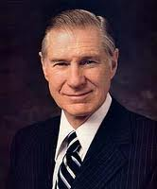
“We need to recognize and acknowledge angry feelings. It will take humility to do this, but if we will get on our knees and ask Heavenly Father for a feeling of forgiveness, He will help us. The Lord requires us ‘to forgive all men’ [D&C 64:10] for our own good because ‘hatred retards spiritual growth.’ [Orson F. Whitney, Gospel Themes (1914), 144.]
Only as we rid ourselves of hatred and bitterness can the Lord put comfort into our hearts. …
“… When tragedy strikes, we should not respond by seeking personal revenge but rather let justice take its course and then let go. It is not easy to let go and empty our hearts of festering resentment. The Savior has offered to all of us a precious peace through His Atonement, but this can come only as we are willing to cast out negative feelings of anger, spite, or revenge”
President James E. Faust

Slide 45
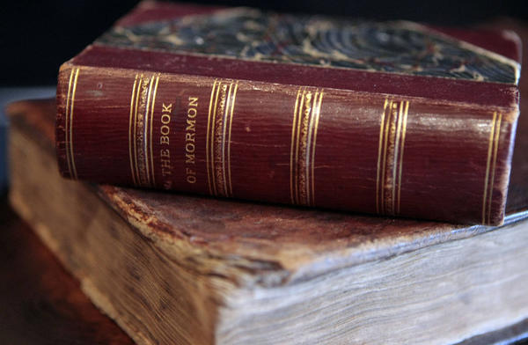
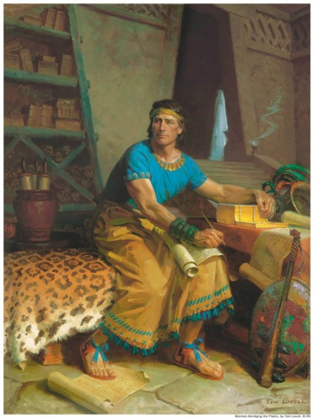
Witness to the World
“The Lord commanded Mormon to witness to the world all the things he had seen and heard and also all the prophecies and revelations that came by the power of the Holy Ghost.
Not only to witness…but words and warnings.”
JFM and RLM
“And also that ye may believe the gospel of Jesus Christ, which ye shall have among you; and also that the Jews, the covenant people of the Lord, shall have other witness besides him whom they saw and heard, that Jesus, whom they slew, was the very Christ and the very God.
And I would that I could persuade all ye ends of the earth to repent and prepare to stand before the judgment-seat of Christ.”
Mormon 3:21-22

Slide 46
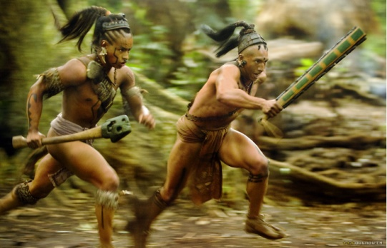
Wicked Punish Wicked
As the Nephites began to sink further and further into wickedness, the Lamanites began to sweep them off the face of the earth
Despite all the killings the Nephites would not repent or turn to the Lord
“It is by the wicked that the wicked are punished”
“Often, very often, we are punished as much by our sins as we are for our sins.”
Elder Boyd K. Packer
Mormon 4:1-5

Slide 47
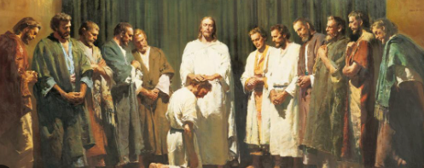
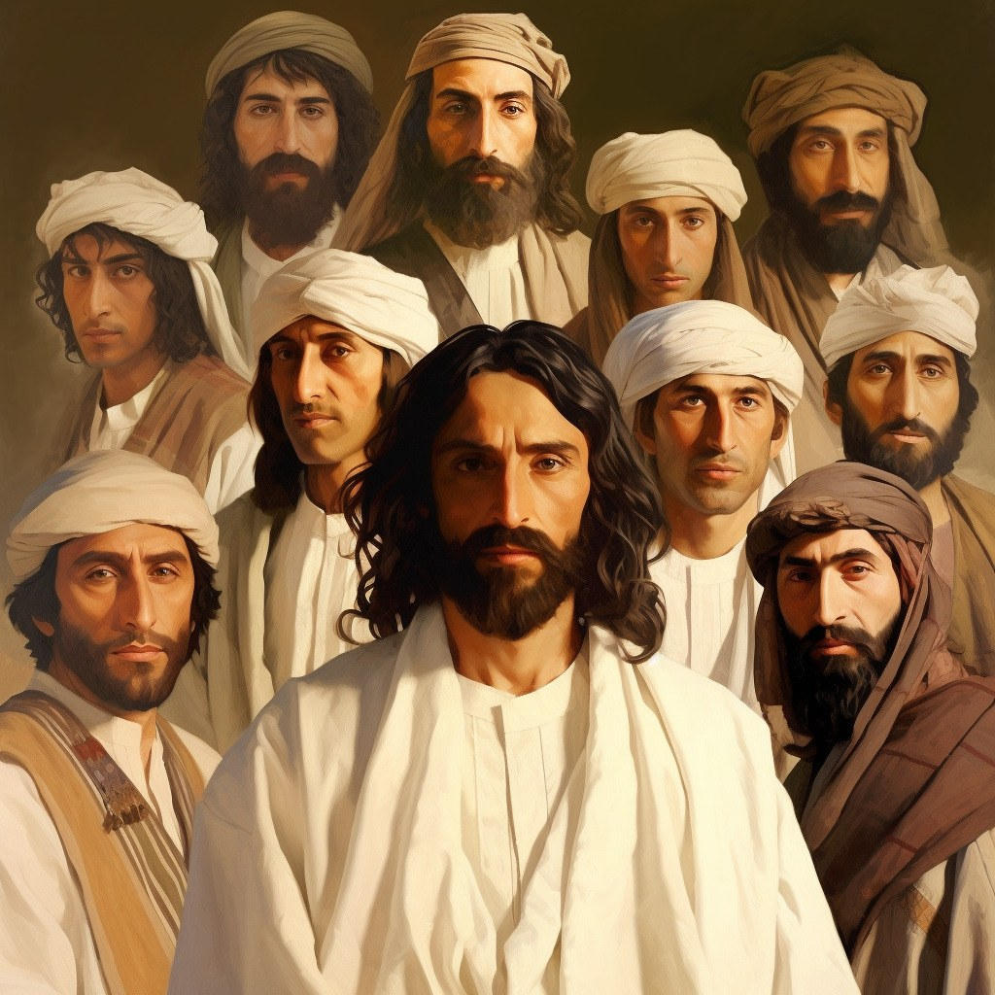
Judgement
We will all stand before the judgment seat of Christ to be judged of our works, whether they be good or evil.
Who will judge?
Yea, behold, I write unto all the ends of the earth; yea, unto you, twelve tribes of Israel, who shall be judged according to your works by the twelve whom Jesus chose to be his disciples in the land of Jerusalem.
And I write also unto the remnant of this people, who shall also be judged by the twelve whom Jesus chose in this land; and they shall be judged by the other twelve whom Jesus chose in the land of Jerusalem.
Who will judge me?
Mormon 3:18-19

Slide 48
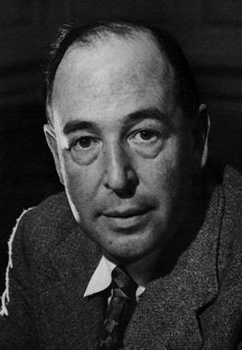
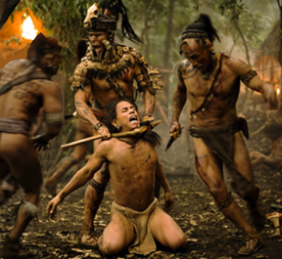
Actions of Men—Judgments of God
“It is men, not God, who have produced racks, whips, prisons, human stupidity, not by the churlishness of nature, that we have poverty and overwork.”
C.S. Lewis
The Nephites delighted in the shedding of blood
The judgments of God will overtake the wicked
“Delighting in bloodshed epitomizes the awful depths to which a person or society can fall when they are spiritually ‘past feeling’”. (Nephi 17:45)
JFM and RLM
Mormon 4:10-12

Slide 49
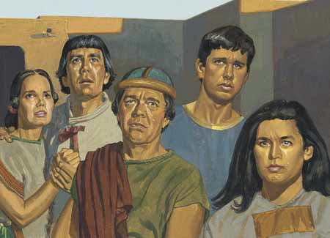
Possession of the Nephite Lands
The Lamanites gained possession of the land of Desolation and were more numerous than the Nephites.
They marched toward the city of Teancum and drove them out, taking women and children prisoners, and offering them up as sacrifices to their idol gods.
“Even as the dew before the sun”
Mormon 4:13-22

Slide 50
“If you have made covenants, keep them. If you haven’t made them, make them.
If you have made them and broken them, repent and repair them. It is never too late so long as the Master … says there is time.
Please listen to the prompting of the Holy Spirit telling you right now, this very moment, that you should accept the atoning gift of the Lord Jesus Christ and enjoy the fellowship of His labor.
Don’t delay. It’s getting late.”
Jeffrey R. Holland
Mormon 4:22

Slide 51
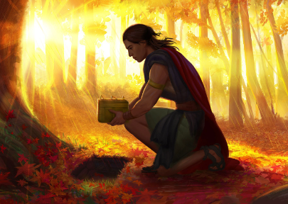
Hill Shim
“And now I, Mormon, seeing that the Lamanites were about to overthrow the land, therefore I did go to the hill Shim, and did take up all the records which Ammaron had hid up unto the Lord.”
Mormon 4:23

Slide 52
Sources:
(For the Strength of Youth [booklet, 2011], 28).
Joseph Fielding McConkie and Robert L. Millet Doctrinal Commentary on the Book of Mormon pg. 223
President James E. Faust (“The Healing Power of Forgiveness,” Ensign or Liahona, May 2007, 69).
Elder Boyd K. Packer Teach Ye Diligently pg. 262
Jeffrey R. Holland, “The Laborers in the Vineyard,” Ensign or Liahona, May 2012, 33.
Presentation by ©http://fashionsbylynda.com/blog/

Slide 53
“This matter of swearing with an oath in ancient days was far more significant than many of us have realized.
“For instance: Nephi and his brethren were seeking to obtain the brass plates from Laban. Their lives were in peril. Yet Nephi swore this oath: ‘As the Lord liveth, and as we live, we will not go down unto our father in the wilderness until we have accomplished the thing which the Lord hath commanded us.’ (1 Ne. 3:15)
“Thus Nephi made God his partner. If he failed to get the plates, it meant God had failed. And because God does not fail, it was incumbent upon Nephi to get the plates or lay down his life in the attempt” (“The Doctrine of the Priesthood,” by Elder Bruce R. McConkie Ensign, May 1982, 33
“In a business law class at the university I attended, I remember that one particular classmate never prepared for the class discussions. I thought to myself, ‘How is he going to pass the final examination?’
“I discovered the answer when he came to the classroom for the final exam on a winter’s day wearing on his bare feet only a pair of sandals. I was surprised and watched him as the class began. All of our books had been placed upon the floor, as per the instruction. He slipped the sandals from his feet; and then, with toes that he had trained and had prepared with glycerin, he skillfully turned the pages of one of the books which he had placed on the floor, thereby viewing the answers to the examination questions.
“He received one of the highest grades in that course on business law. But the day of reckoning came. Later, as he prepared to take his comprehensive exam, for the first time the dean of his particular discipline said, ‘This year I will depart from tradition and will conduct an oral, rather than a written, test.’ Our favorite trained-toe expert found that he had his foot in his mouth on that occasion and failed the exam” President Thomas S. Monson:(“Preparation Brings Blessings,” Ensign or Liahona, May 2010, 65).
Judgement
There will be a whole hierarchy of judges who, under Christ, shall judge the righteous. He alone shall issue the decrees of damnation for the wicked. (Bruce R. McConkie, The Millennial Messiah: The Second Coming of the Son of Man [1982], 520)
The Final Judgment is not just an evaluation of a sum total of good and evil acts—what we have done. It is an acknowledgment of the final effect of our acts and thoughts—what we have become. It is not enough for anyone just to go through the motions. The commandments, ordinances, and covenants of the gospel are not a list of deposits required to be made in some heavenly account. The gospel of Jesus Christ is a plan that shows us how to become what our Heavenly Father desires us to become. (Dallin H. Oaks, “The Challenge to Become,” Ensign or Liahona, Nov. 2000, 32)
If Time:
Forgiveness: My Burden Was Made Light
Forgiveness and the power of Jesus Christ enable a man to survive losing his wife and several children in a car accident—and allow the offending driver to begin rebuilding his own life. (8:24)
Our ultimate quest in life is to prepare to meet our Maker. We do this by striving daily to become more like our Savior, Jesus Christ. And we do that as we repent daily and receive His cleansing, healing, and strengthening power. (Russell M. Nelson, “Opening Message,” Ensign or Liahona, May 2020, 6)

Slide 54
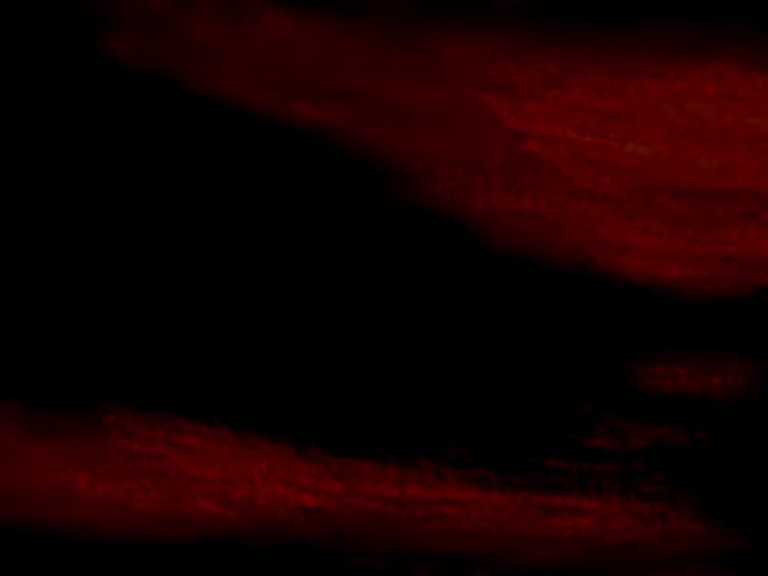
Final Stages of the Nephite Downfall
Mormon 5-6

Slide 55
Previously on Mormon…
After retaking their lands from the Lamanites, the Nephites prepared again for battle.
Mormon pleaded with the Nephites to repent. Instead, they boasted in their own strength and swore to avenge their fallen brethren.
Because the Lord had forbidden His people to seek revenge, Mormon refused to lead the Nephite army and they were defeated.
As the Nephites persisted in wickedness, God poured out His judgments upon them, and the Lamanites began to sweep them from the earth.

Slide 56
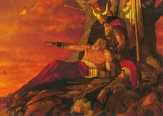
Mormon ‘Repents’ of the Oath
The Nephites last hope:
With compassion for his people, he relented and again took up the command of their armies.
Not only could Mormon see that their efforts were futile but also he was well aware of the prophecies, as to the final fate of his people.
Read: 1 Nephi 12
Mormon 5:1-8 JFM and RLM

Slide 57
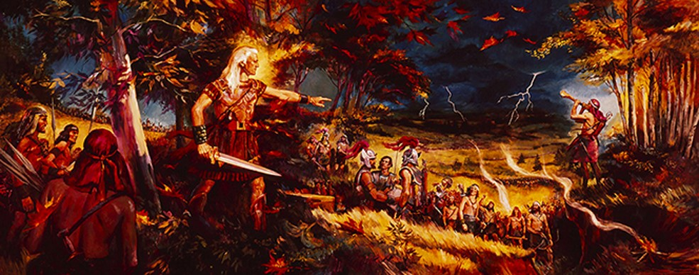
Lamanites Defeat the Nephites
AD 375-380
Eventually the Lamanites “did tread the people of the Nephites under their feet”.
As the Nephites retreated, those who could not flee quickly enough were destroyed.
Mormon 5:1-8

Slide 58
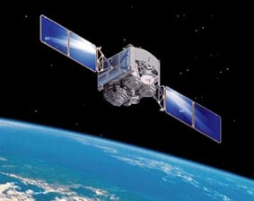
Revealed Upon the Housetops
AD 375-380
“…and that all things which are hid must be revealed upon the house-tops—
“…therefore I write a small abridgment, daring not to give a full account of the things which I have seen, because of the commandment which I have received, and also that ye might not have too great sorrow because of the wickedness of this people.”
“As this record which is ‘sealed by the power of God” comes to light in the last days, all the working of God will be revealed, and the deeds and destructions of the Nephites and the Lamanites which Mormon could not describe will indeed “be reveled upon the house-tops”
JFM and RLM
Mormon 5:8-9

Slide 59
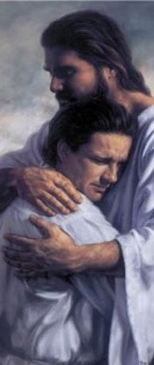
Clasped in the Arms of Jesus
To be held tightly or securely or to be embraced
Through repentance, we can be “clasped in the arms of Jesus
Mormon 5:11

Slide 60
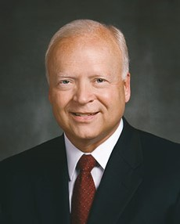
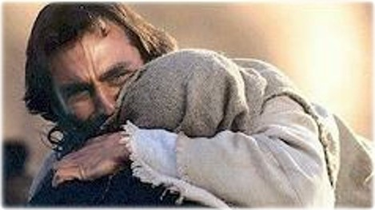
“All that will come may be ‘clasped in the arms of Jesus.’ [Mormon 5:11.] All souls can be healed by His power. All pain can be soothed. In Him, we can ‘find rest unto [our] souls.’ [Matthew 11:29.] Our mortal circumstances may not immediately change, but our pain, worry, suffering, and fear can be swallowed up in His peace and healing balm”
Elder Kent F. Richards
“Rich meaning is found in study of the word atonement in the Semitic languages of Old Testament times. In Hebrew, the basic word for atonement is kaphar, a verb that means ‘to cover’ or ‘to forgive.’ Closely related is the Aramaic and Arabic word kafat, meaning ‘a close embrace’—no doubt related to the Egyptian ritual embrace.
References to that embrace are evident in the Book of Mormon. One states that ‘the Lord hath redeemed my soul … ; I have beheld his glory, and I am encircled about eternally in the arms of his love.’ [2 Nephi 1:15.] Another proffers the glorious hope of our being ‘clasped in the arms of Jesus.’ [Mormon 5:11.]” Elder Russell M. Nelson

Slide 61
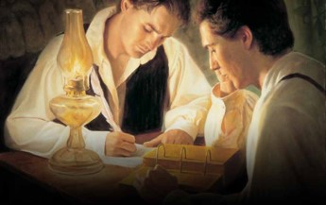
Hidden and Brought Forth
To be read by all people
In His wisdom--When He shall see fit to bring the writings to the people
Written to persuade all people that Jesus is the Christ, to help God fulfill His covenant with the house of Israel, and to help descendants of the Lamanites believe the gospel more fully
The Purpose of the Book of Mormon
Mormon 5:12-15

Slide 62
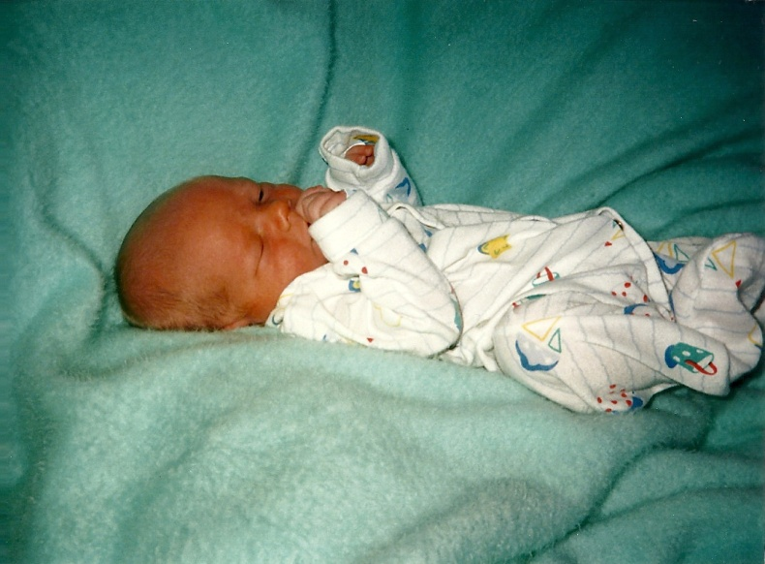
“without Christ and God in the world”
Refusal to repent--The spirit will cease to be present
To live without faith in Jesus Christ or Heavenly Father and without divine influence and guidance.
“…it seems clear to me that what he (Mormon) was talking about was not merely the inability to have the companionship of or the gift of the Holy Ghost, but he was talking of the light of truth to which every one born into the world is entitled and which will never cease in strive with the individual unless he loses it through his own sinning.” President Harold B. Lee
Mormon 5:16

Slide 63
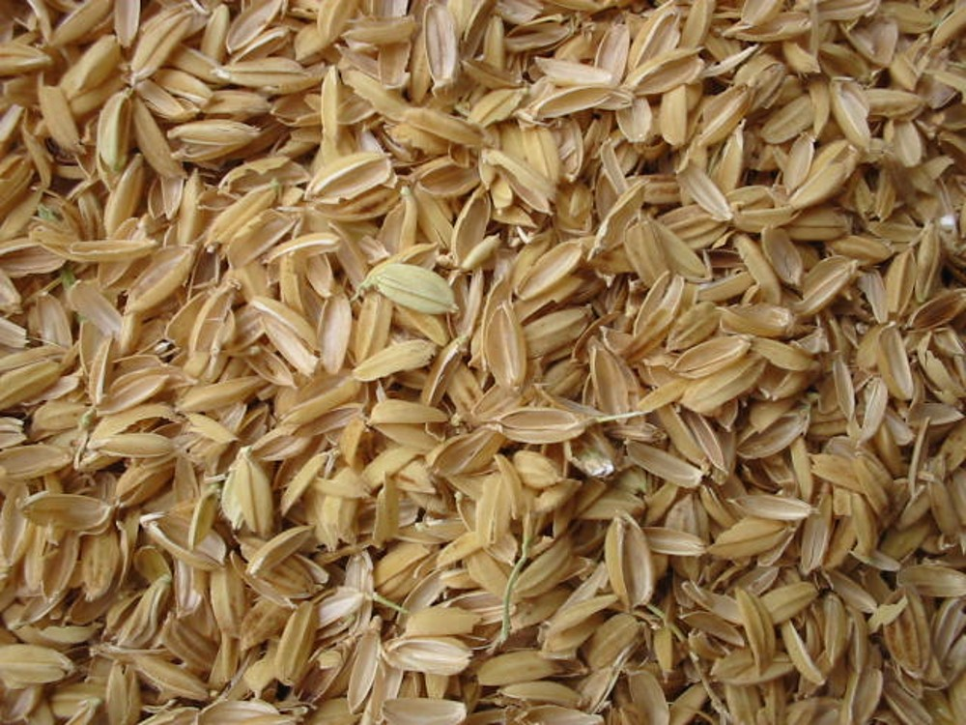
“driven about as chaff before the wind”
Chaff is a light husk on the outside of grain. When the grain is harvested, the chaff is discarded.
If we refuse to repent, the Spirit will withdraw, and we will lose the Lord’s guidance.
Mormon 5:16-18

Slide 64
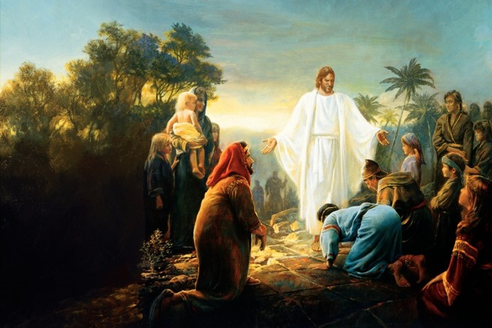
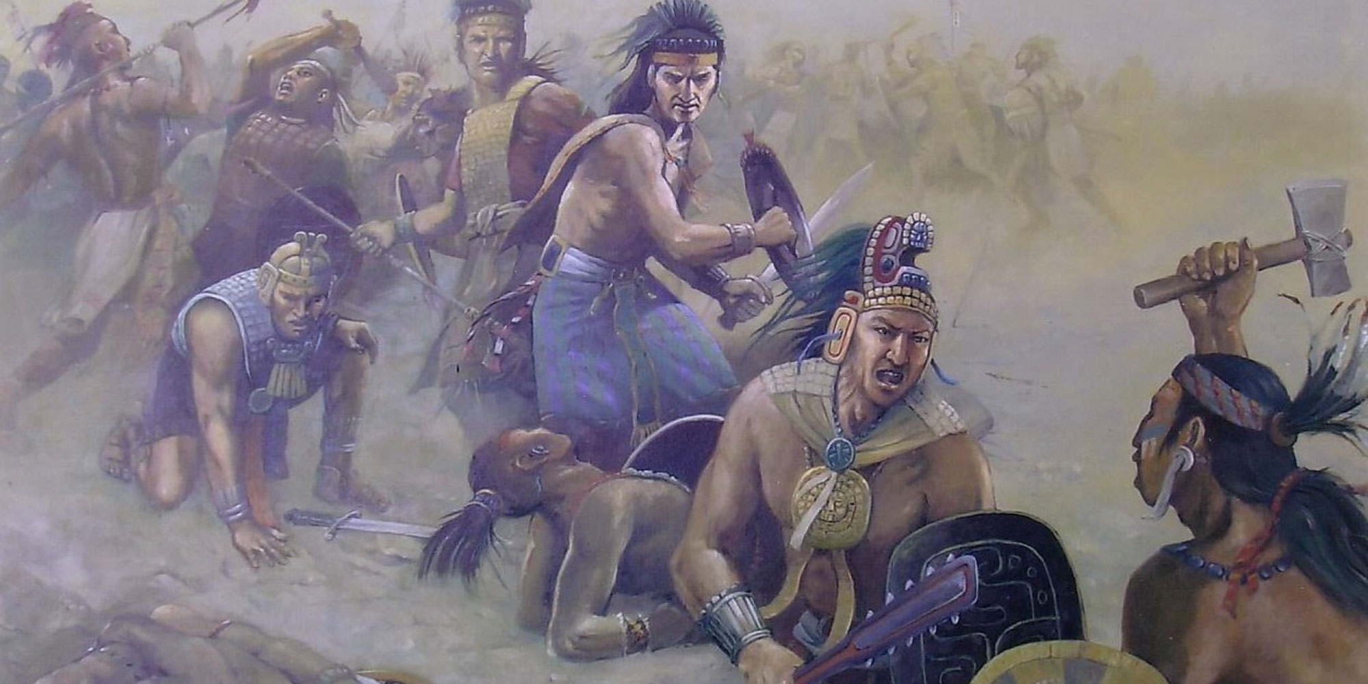
Remembering How They Used To Be
“They were once a delightsome people, and they had Christ for their shepherd; yea, they were led even by God the Father.”
“But now, behold, they are led about by Satan, even as chaff is driven before the wind, or as a vessel is tossed about upon the waves, without sail or anchor, or without anything wherewith to steer her; and even as she is, so are they.”
Mormon 5:17-18

Slide 65
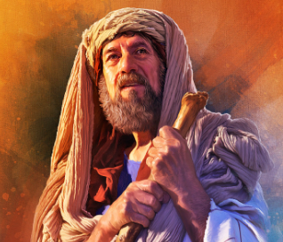
The Prayers of the Righteous
“Speaking specifically of the record that will be preserved to come forth for the Lord’s righteous purposes, it is clear that the prayers of the righteous that the Lord will remember will be those of the prophets who preceded Mormon and who had fervently prayed that their records would be preserved.”
JFM and RLM
“…the Lord said unto me: I will grant unto thee according to thy desires, because of thy faith.”
To Enos:
“And I had faith, and I did cry unto God that he would preserve the records; and he covenanted with me that he would bring them forth unto the Lamanites in his own due time.” (Enos 1:12-18)
Mormon 5:21

Slide 66
‘The Earth shall be rolled together as a scroll’
“Before his death, Mormon wrote that his record would, of course, be a warning to those he called Gentiles, but that it would be a blessing to the Lamanites.
Also he said that it would come with a special message to the Jews.
For them it was published that they “may be persuaded that Jesus is the Christ, the Son of the living God; that the Father may bring about, through his most Beloved, his great and eternal purpose, in restoring the Jews, or all the house of Israel, to the land of their inheritance, which the Lord their God hath given them, unto the fulfilling of his covenant” (Morm. 5:14).
Consider the current significance of that scripture!”
Mark E. Peterson
Mormon 5:23

Slide 67
The Death of a Loved One
How might you feel at the death of a loved one who was faithful to God throughout his or her life?
How might you feel at the death of a loved one who was disobedient to God’s commandments throughout his or her life?
Mormon felt great sorrow at the death of all his people because he knew they were not prepared to meet God.
Mormon 6:1-6
James H. Fullmer

Slide 68
Gathering At Hill Cumorah
“It is known that the Hill Cumorah where the Nephites were destroyed is the hill where the Jaredites were also destroyed.
This hill was known to the Jaredites as Ramah.
It was approximately near the waters of Ripliancum, which the Book of Ether says, ‘by interpretation, is large, or to exceed all.’ (Ether 15:8-11).
It must be conceded that this description fits perfectly the land of Cumorah in New York, as it has been know since the visitation of Moroni to the Prophet Joseph Smith, for the hill is in the proximity of the Great lakes and also in the land of many rivers and fountains.
Moreover, the Prophet Joseph Smith himself is on record, definitely declaring the present hill called Cumorah to be the exact hill spoken of in the Book of Mormon.”
Joseph Fielding Smith
Mormon 6:1-6

Slide 69
Entrusting the Records
Mormon entrusted a few of the sacred records to his son Moroni, and hid the rest of the records in the Hill Cumorah.
He recorded what he witnessed of the final destruction of his people.
Fearing death–
“And it shall come to pass that those that die in me shall not taste of death, for it shall be sweet unto them;
And they that die not in me, wo unto them, for their death is bitter.”
D&C 42:46-47
Joseph Brickey
Mormon 6:6-7

Slide 70
Moroni
He was the son of Mormon and lived about 350 to 421 AD
Because Moroni refused to deny Jesus Christ, he was forced to wander wherever he could to find safety and stay hidden from the Lamanites.
He was the protector and additional author to ancient records given to him by his father Mormon
He made an Abridgement of the Jaradites –Book of Ether and the Book of Moroni
He wrote the title page for the entire Book of Mormon
He was entrusted with the keys of restoring the divine message of hope and exaltation in the latter-days.
He was viewed by John the Revelator “And I saw another angel fly in the midst of heaven, having the everlasting gospel to preach unto them that dwell on the earth, and to every nation, and kindred, and tongue, and people…”
Revelation 14:6-7
He buried the records in a vault, then in the ground
He was an Angelic messenger who visited the young Joseph Smith on Sept 21, 1832
His image appears on spires of modern-day temples throughout the world
After his father’s slaying by the Lamanites, Moroni was left alone to wander and protect his own life for 35 years

Slide 71
Those That Fell In Death
Mormon fell wounded but did not die
Twenty four saved: Mormon and Moroni included fled to the south
Those who died led by Moroni:
10 thousand each ‘tribe’
Gidgiddonah
Lamah
Gilgal
Jeneum
Cumenihah
Moronihah
Antionum
Shiblom
Shem
Josh
And 10 more with 10,000 each
Mormon 6:9-15
Walter Rane

Slide 72
Do Not Reject His Open Arms
Mormon mourned the deaths of his people and sorrowed that they had not changed their ways. He said that if they had set aside their pride and repented of their sins, their reunion with the Savior would have been joyful.
“We long for the ultimate blessing of the Atonement—to become one with Him, to be in His divine presence, to be called individually by name as He warmly welcomes us home with a radiant smile, beckoning us with open arms to be enfolded in His boundless love. How gloriously sublime this experience will be if we can feel worthy enough to be in His presence!
The free gift of His great atoning sacrifice for each of us is the only way we can be exalted enough to stand before Him and see Him face-to-face. The overwhelming message of the Atonement is the perfect love the Savior has for each and all of us. It is a love which is full of mercy, patience, grace, equity, long-suffering, and, above all, forgiving.
“The evil influence of Satan would destroy any hope we have in overcoming our mistakes. He would have us feel that we are lost and that there is no hope. In contrast, Jesus reaches down to us to lift us up. Through our repentance and the gift of the Atonement, we can prepare to be worthy to stand in His presence.”
President James E. Faust
James H. Fullmer
Mormon 6:16-22

Slide 73
Why do prophets and priesthood leaders encourage us so diligently to repent?
How does the hope of the Lord’s embrace help you to repent?
(See Mormon 6:17.)
In what ways do you feel the Lord wants you to improve right now?

Slide 74
Sources:
Joseph Fielding McConkie and Robert L. Millet Doctrinal Commentary on the Book of Mormon pgs. 229,230
Elder Kent F. Richards (“The Atonement Covers All Pain,” Ensign or Liahona, May 2011, 16).
Elder Russell M. Nelson (“The Atonement,” Ensign, Nov. 1996, 34).
President Harold B. Lee CR, April 1956 pg. 108
Mark E. Peterson The Last Words of Moroni Conf Report October 1978
Joseph Fielding Smith Doctrines of Salvation 3:233-34
President James E. Faust (“The Atonement: Our Greatest Hope,” Ensign, Nov. 2001, 20).
Seminary Teacher Manual, Institute Manual. 2017-2018
Presentation by ©http://fashionsbylynda.com/blog/

Slide 75
Hugh Nibley adds an important insight about the Nephite society at this time.
"The Nephites foolishly took the offensive and as a result lost both the land and the city of Desolation. 'And the remainder did flee and join the inhabitants of the city of Teancum .... '
(Morm. 4:3) This makes it clear that we are still reading only of Mormon's band of Nephites, and not a history of the whole nation, for the people of Teancum, which was' ... in the borders by the seashore ... near the city Desolation' (Morm. 4:3) had up to then taken no part in the fighting. It must always be borne in mind that by this time the Nephite people had become broken up into 'tribes,' each living by itself and following its own tribal laws. (Hel. 7:2-4,11.) So what Mormon gives us is only a sampling of the sort of thing that was going on.
" ... Here you have a clear picture of Nephite society. Separate 'lands' living their own lives, now in this last crisis terribly reluctant to move and join the swelling host in the retreat to the north. Those who refused to pull up stakes were one by one completely wiped out by the Lamanites. This was no planned migration but a forced evacuation, like dozens of such we read about in the grim and terrible times of the 'Invasion of the Barbarians' that destroyed the classic civilizations of the Old World. In this case Mormon's people were only part of the general and gradual evacuation of the whole land." (An Approach, pp. 361-62.)
Further information on Hill Cumorah by Joseph Fielding Smith:
“Further, the fact that all of his associates from the beginning down have spoken of it as the identical hill where Mormon and Moroni hid the records, must carry some weight. It is difficult for a reasonable person to believe that such men as Oliver Cowdery, Brigham Young, Parley P. Pratt, Orson Pratt, David Whitmer, and many others, could speak frequently of the spot where the prophet Joseph Smith obtained the plates as the Hill Cumorah, and not be corrected by the Prophet, if that were not the fact. That they did speak of this hill in the days of the Prophet in this definite manner is an established record of history.” Doctrines of Salvation 3:233-34
Mormon 6:7-11. How Long Did the Battle of the Hill Cumorah Last?
"The Book of Mormon is not absolutely clear on this point. It states that the battle of Cumorah started when 'three hundred and eighty and four years had passed away,' that is, A.D. 385. (Mormon 6:5.) After the battle was completed and the Lamanites had killed most of the Nephites, Mormon took the Nephite survivors with him and they' did behold on the morrow, when the Lamanites had returned unto their camps,' the terrible scene of destruction. (Mormon 6:11,15.) This could mean 'on the morrow' after the battle was completed, regardless of how long the battle lasted. (Ludlow, Companion, p. 302.)
Note that both Mormon and his son Moroni were among the "twenty and four" (vs. 11) Nephites who survived the last great Nephite-Lamanite conflict. What happened to each of these people is not known. Moroni does inform us later that "the Nephites who had escaped into the country southward were hunted by the Lamanites, until they were all destroyed." (Mormon 8:2; see also Mormon 6:15.)
These people may have been among those thus killed, for Moroni sadly adds: "And my father also was killed by them, and I even remain alone to write the sad tale of the destruction of my people.“(Mormon 8:3.)
Later Moroni says of his solitary state: "I make not myself known to the Lamanites lest they should destroy me ... wherefore, I wander whithersoever I can for the safety of mine own life." (Moroni 1:1, 3.)
(48-19) Mormon 6:10-22
Mormon here records the number of the dead in terms of his military leaders, each of whom commanded ten thousand men. What is the total of the number killed? The scene of carnage must have been one of inexpressible horror. How does Mormon express himself as he views the slaughtered dead "from the top of the hill Cumorah" (vs. 11)? What one thing could have prevented "this great destruction" (vs. 22)? Mormon's lament (see vss. 16-22) is one of those beautiful and moving pieces of literature that we find so often being written by inspired men of God.
Student Manual Religion 121-122 Book of Mormon

