Slide 1
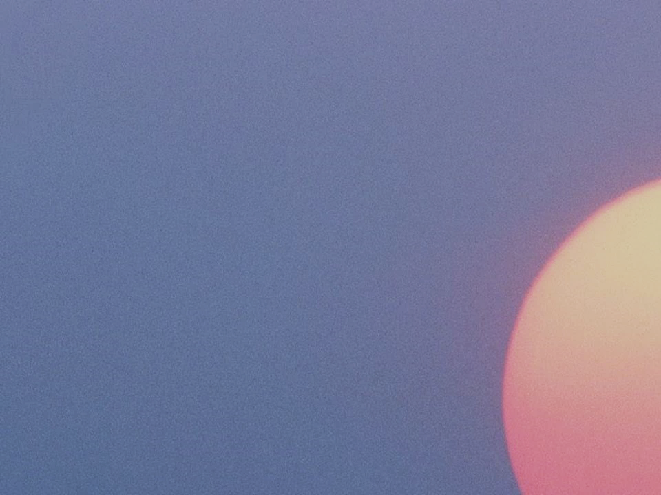
Mormon 7-9

Slide 2
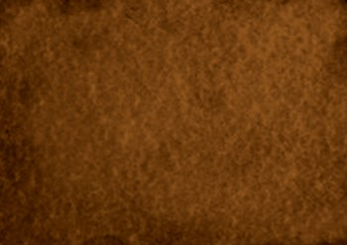
Mormon’s Testimony
To the Future
Mormon 7

Slide 3
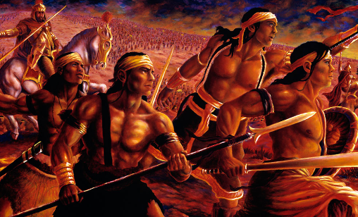
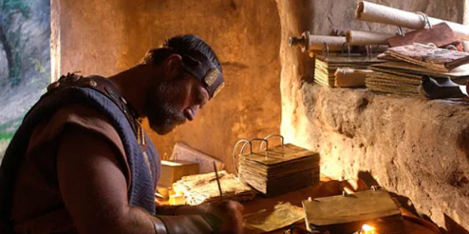
Conclusion of Mormon’s Life
Mormon witnessed the sorrow and destruction caused by the final battles between the Nephites and Lamanites.
This war eventually cost Mormon his life (Mormon 8:3)
Before these battles claimed his own life, Mormon concluded his writings by teaching of Jesus Christ and the eternal happiness that awaits those who follow Him.
Mormon had the responsibility to abridge, write, and preserve the sacred scripture we now know as the Book of Mormon.
Prior to passing the sacred records to his son Moroni, Mormon wrote his final message to future readers of the Book of Mormon.

Slide 4
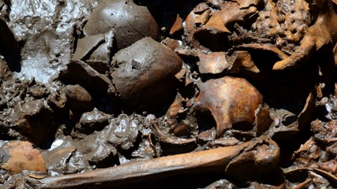
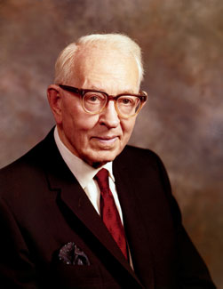
230,000
The number of Nephite soldiers who died in the final battle, recorded in Mormon 6
“Don’t you think the Lord has given us these things that we might know and we might prepare ourselves through humility, through repentance, through faith, that we might escape from these dreadful conditions that are portrayed by these ancient prophets?”
Elder Joseph Fielding Smith

Slide 5
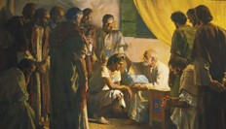
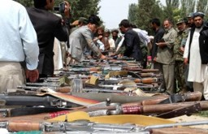
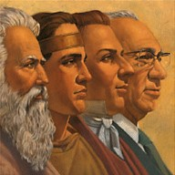
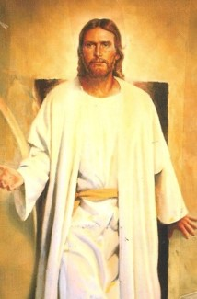
What Must You Know?
Knowledge that you are of the house of Israel
Knowledge that you must repent or you cannot be saved
Knowledge that you must ‘lay down your weapons of war’
Knowledge that you must know of the prophets before you
Knowledge and understanding that Jesus is the Son of God and was slain by the Jews and has been resurrected
Mormon 7:1-6

Slide 6
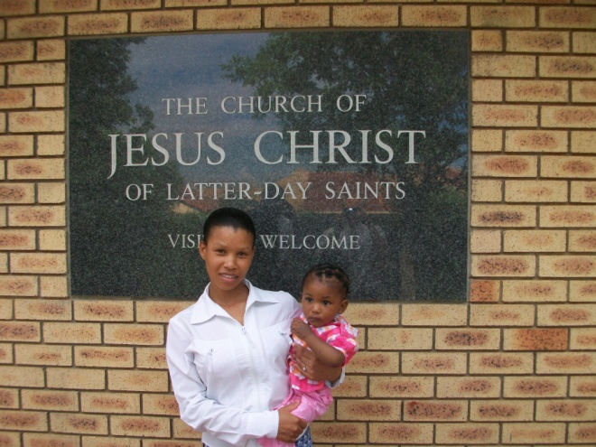
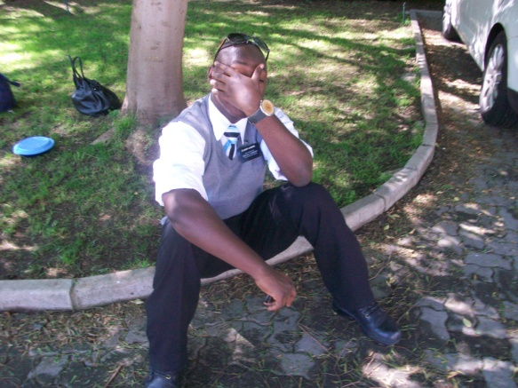
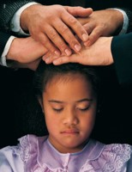
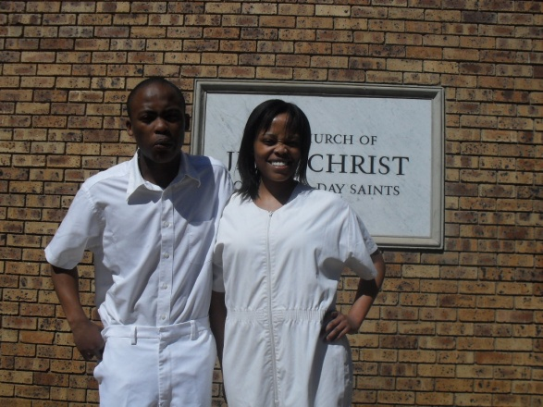
Prerequisite for eternal Happiness
Repentance
Faith in the Lord Jesus Christ
Baptism by immersion
Receive the Gift of the Holy Ghost
You will be numbered among the people of the first covenant
Mormon 7:7-10

Slide 7
Rate Yourself
1
2
3
4
5
Never
Always
I strive to repent daily
I lay hold upon the gospel of Christ through daily scripture study.
I strive to follow the example of the Savior in all I do.

Slide 8
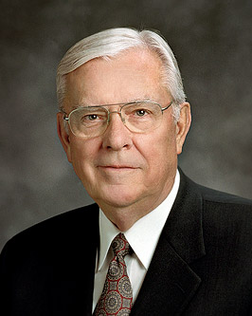
“Live the doctrine of Christ, the simple and basic principles of the gospel, each day—have faith in the Lord Jesus Christ, repent, honor the covenant of baptism, live worthy of the Holy Ghost as your companion, and endure to the very end.
Do this every day, and the Spirit of the Lord will be with you to keep you safely on the pathway that leads to eternal life.”
M. Russell Ballard
All who accept and obey the principles and ordinances of the gospel of Jesus Christ will receive eternal life
Mormon 7:5-10

Slide 9
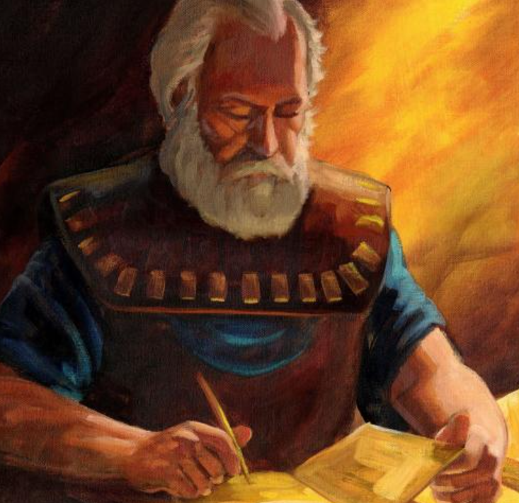
The Doctrine of Christ
Mormon bids farewell with words of the Doctrine of Christ
7:10: …believe in Christ
7:8: Therefore repent
7:10: …baptized first with water
7:10: …and the Holy Ghost…
Mormon 7:10

Slide 10
“In a soliloquy of death, Mormon reached across time and space to all, especially to that ‘remnant of the house of Israel’ who would one day read his majestic record.
Those of another time and place must learn what those lying before him had forgotten—that all must ‘believe in Jesus Christ, that he is the Son of God,’ that following his crucifixion in Jerusalem he had, ‘by the power of the Father … risen again, whereby he hath gained the victory over the grave; and also in him is the sting of death swallowed up.
“‘And he bringeth to pass the resurrection of the dead … [and] the redemption of the world.’ Those who are redeemed may then, because of Christ, enjoy ‘a state of happiness which hath no end.’ [Mormon 7:2, 5–7.] …
“To ‘believe in Christ,’ especially when measured against such tragic but avoidable consequences, was Mormon’s last plea and his only hope. It is the ultimate purpose of the entire book that would come to the latter-day world bearing his name”
Elder Jeffrey R. Holland
Mormon 7:7-10

Slide 11
Sources:
Elder Joseph Fielding Smith The Signs of the Times pg. 154-155
M. Russell Ballard, “Follow the Doctrine and Gospel of Christ” [Brigham Young University fireside, Nov. 7, 2010], 8, speeches.byu.edu
Elder Jeffrey R. Holland (Christ and the New Covenant: The Messianic Message of the Book of Mormon [1997], 321–22).
2017-2018 Seminary Teacher Manual and Institute Manual
Presentation by ©http://fashionsbylynda.com/blog/

Slide 12
Mormon 7:2 Know You Are of the House of Israel
One of the Hebraic meanings of the word Israel is “let God prevail.” Thus the very name of Israel refers to a person who is willing to let God prevail in his or her life. That concept stirs my soul! …
When your greatest desire is to let God prevail, to be part of Israel, so many decisions become easier. So many issues become nonissues! You know how best to groom yourself. You know what to watch and read, where to spend your time, and with whom to associate. You know what you want to accomplish. You know the kind of person you really want to become. (Russell M. Nelson, “Let God Prevail,” Ensign or Liahona, Nov. 2020, 92, 94)
Being a part of the house of Israel means that you have a covenant relationship with Heavenly Father and Jesus Christ. It means that you, like Abraham, are meant to “be a blessing” to God’s children (Genesis 12:2; Abraham 2:9–11). It means, in the words of Peter, that “ye are a chosen generation, a royal priesthood, an holy nation, a peculiar people; that ye should shew forth the praises of him who hath called you out of darkness into his marvellous light” (1 Peter 2:9). It means that you are one who “perseveres with God” as you honor your covenants with Him. (Come, Follow Me—For Individuals and Families: Old Testament 2022, 41)

Slide 13
True Believers
True believers are settled in their views of Christ. Despite their weaknesses, their spirituality is centered on the Savior, so their views of everything else are put in that precious perspective.
True believers gladly perform their duties in the kingdom. These duties are usually measurable and straightforward. They include partaking worthily of the sacrament, rendering Christian service, studying the scriptures, praying, fasting, receiving ordinances, attending to family duties, paying tithes and offerings…
True believers are humble. They are ‘meek and lowly of heart’ [Moroni 7:43]… They are not easily offended. They do not resist counsel.
True believers are willing to do what Christ wants. … Are we willing to let the Lord lead us into further development experiences? Or do we shrink back? The things which enlarge the soul inevitably involve stretching.
True believers have a balanced contentment. They strike a balance between being too content and wishing for a more important role…
True believers truly pray. Their prayers are sincere… The true believer’s prayers, at least some of the time, are inspired.
True believers have both right conduct and right reasons for that conduct. They are so secure in their relationship with the Lord that their goodness would continue even if nobody were watching…
True believers rejoice in the success of others… They don’t regard colleagues as competitors.
True believers remember that forgetting is part of forgiving. They follow the Lord’s example: ‘I [will] remember [their sins] no more’ (D&C 58:42)….
True believers are innocent as to sin, but not naïve. They are kind, but candid. They love their fellowmen…
True believers are happy. Instead of a ‘woeful countenance,’ true believers in Christ have a disciplined enthusiasm to work righteousness. They are serious about how they live life but are also of good cheer.
--Neal A. Maxwell, “True Believers,” New Era, Apr. 1994, 20-24

Slide 14
Example: Mormon 7:8-10
Doctrine of Christ Experiment
If you highlight or circle these words:
Believe/Faith,
Repent/Repentance,
Baptism/Water,
Holy Ghost/Fire/Spirit
You will most likely find they are clumped together throughout the Book of Mormon.
This is the Doctrine of Christ
8 Therefore repent, and be baptized in the name of Jesus, and lay hold upon the gospel of Christ, which shall be set before you, not only in this record but also in the record which shall come unto the Gentiles from the Jews, which record shall come from the Gentiles unto you.
9 For behold, this is written for the intent that ye may believe that; and if ye believe that ye will believe this also; and if ye believe this ye will know concerning your fathers, and also the marvelous works which were wrought by the power of God among them.
10 And ye will also know that ye are a remnant of the seed of Jacob; therefore ye are numbered among the people of the first covenant; and if it so be that ye believe in Christ, and are baptized, first with water, then with fire and with the Holy Ghost, following the example of our Savior, according to that which he hath commanded us, it shall be well with you in the day of judgment. Amen.

Slide 16
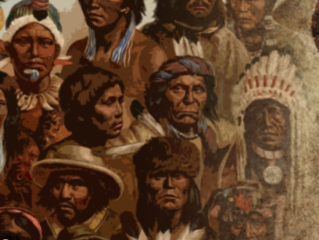
Moroni Remains Alone
AD 400-421
He knew that his words would come forth in the last days that give a special meaning to the Lamanites of our day, whom he called “the remnant of this people who are spared,…”
The Lamanites of today are descendants of great Book of Mormon leaders. Therefore, they are the house of Israel.
Alone to witness and write the destruction of his people
Lamanites
Lamanites
The Lord visited the American continent
The Lamanites today are descendants of the people who lived after the appearance of Christ
Lehi
Of the House of Israel
Great wickedness begins again
No Lamanites or Nephites; all were called children of Christ
(4 Nephi 1:17)
Destroyed in approximately AD 400
Nephites
Nephites
BC 600
AD 34
AD 400
AD 201
Mormon 8

Slide 17
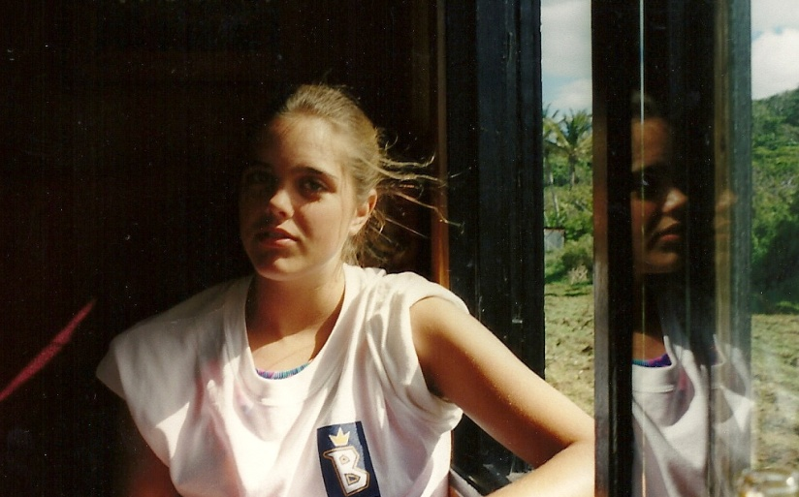
Challenging Your Faith
Even when you are alone you can choose to remain faithful
If we are faithful to God in lonely or difficult circumstances, He will help us remain faithful.
Mormon 8:1-3

Slide 18
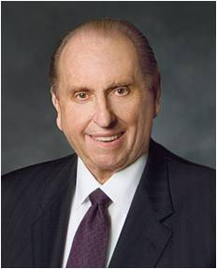
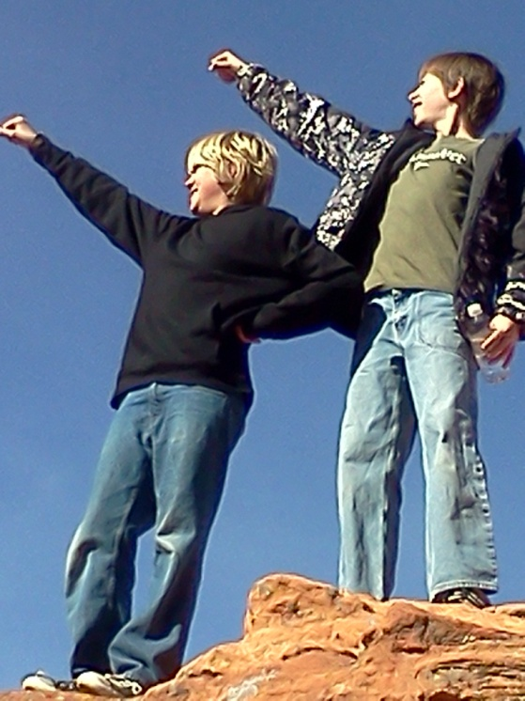
“As we go about living from day to day, it is almost inevitable that our faith will be challenged.
We may at times find ourselves surrounded by others and yet standing in the minority or even standing alone concerning what is acceptable and what is not.
Do we have the moral courage to stand firm for our beliefs, even if by so doing we must stand alone? …
May we ever be courageous and prepared to stand for what we believe, and if we must stand alone in the process, may we do so courageously, strengthened by the knowledge that in reality we are never alone when we stand with our Father in Heaven”
President Thomas S. Monson

Slide 19
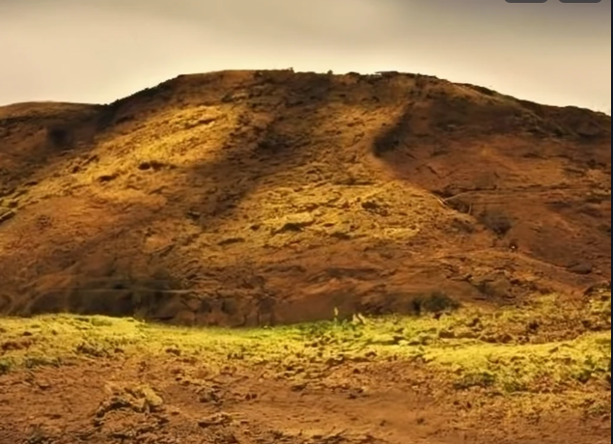
Moroni Recalls
The Book of Mormon was preserved for our day to convince us that Jesus is the Christ.
Moroni finishes the record commanded by his father
The Battle of Cumorah leads the Nephites south as the Lamanites hunt them down and destroy all
Moroni’s father, Mormon, is killed in this battle and Moroni remains alone to write as commanded
The
Book
of
Mormon
Moroni is about to hide up the records “in the earth”
ANOTHER TESTAMENT
OF JESUS CHRIST
Moroni does not know what will become of him
Mormon 8:1-5

Slide 20
“I would like to speak about one of the most significant gifts given to the world in modern times. The gift I am thinking of is more important than any of the inventions that have come out of the industrial and technological revolutions.
This is a gift of greater value to mankind than even the many wonderful advances we have seen in modern medicine. It is of greater worth to mankind than the development of flight or space travel. I speak of the gift of …”
President Ezra Taft Benson

Slide 21
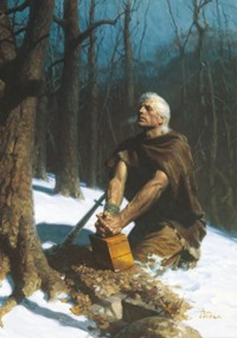
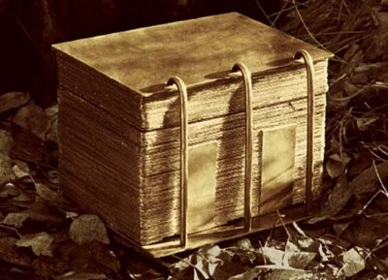
“And whoso receiveth this record, and shall not condemn it because of the imperfections which are in it, the same shall know of greater things than these. Behold, I am Moroni; and were it possible, I would make all things known unto you.”
Moroni 8:12

Slide 22
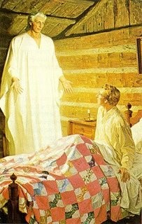
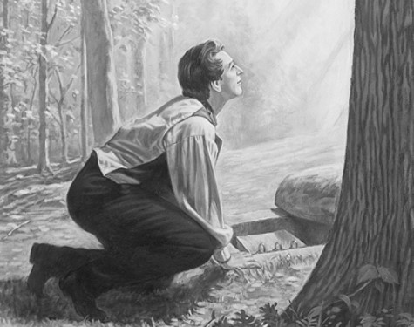
Records Are Not There To Get Gain
The Lord’s commandment is that no one was to use the plates to get gain.
“During his third appearance to Joseph Smith Moroni told Joseph that Satan would tempt him to use the plates for the purpose of getting rich.”
Joseph Smith—History 1:46
“Later, when Joseph Smith went to the hill to obtain the plates, he was beset by conflicting emotions. The adversary sorely tempted him to desire the plates to relieve his family’s poor financial situation.
When the Prophet attempted to get the plates, he was forbidden to do so because, as Moroni stated, “You have not kept the commandments of the Lord.”
Joseph Fielding Smith
Moroni 8:14

Slide 23
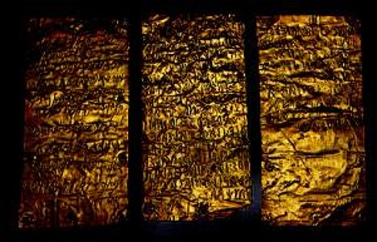
The Records Are of Great Worth
Monetarily the plates are of little worth to mortal man
However, eternally the message in the Book of Mormon is vital and indispensable
It is up to us to decide whether we accept or reject the message contained in the Book of Mormon.
So:
What is written is of more worth to the souls of men that the plates that they are made on
Moroni 8:14

Slide 24
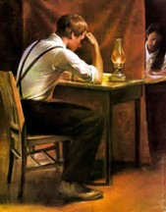
None Can Have the Power—A Seer
“For none can have power to bring it to light save it be given him of God; for God wills that it shall be done with an eye single to his glory, or the welfare of the ancient and long dispersed covenant people of the Lord.”
Joseph Smith brought forth the Book of Mormon by the power of God
Ammon to King Limhi:
“O king, of a man that can translate the records; for he has wherewith that he can look, and translate all records that are of ancient date; and it is a gift from God. And the things are called interpreters, and no man can look in them except he be commanded, lest he should look for that he ought not and he should perish. And whosoever is commanded to look in them, the same is called seer.”
Mosiah 8:13
Moroni 8:15

Slide 25
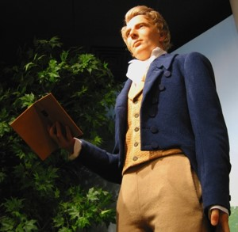
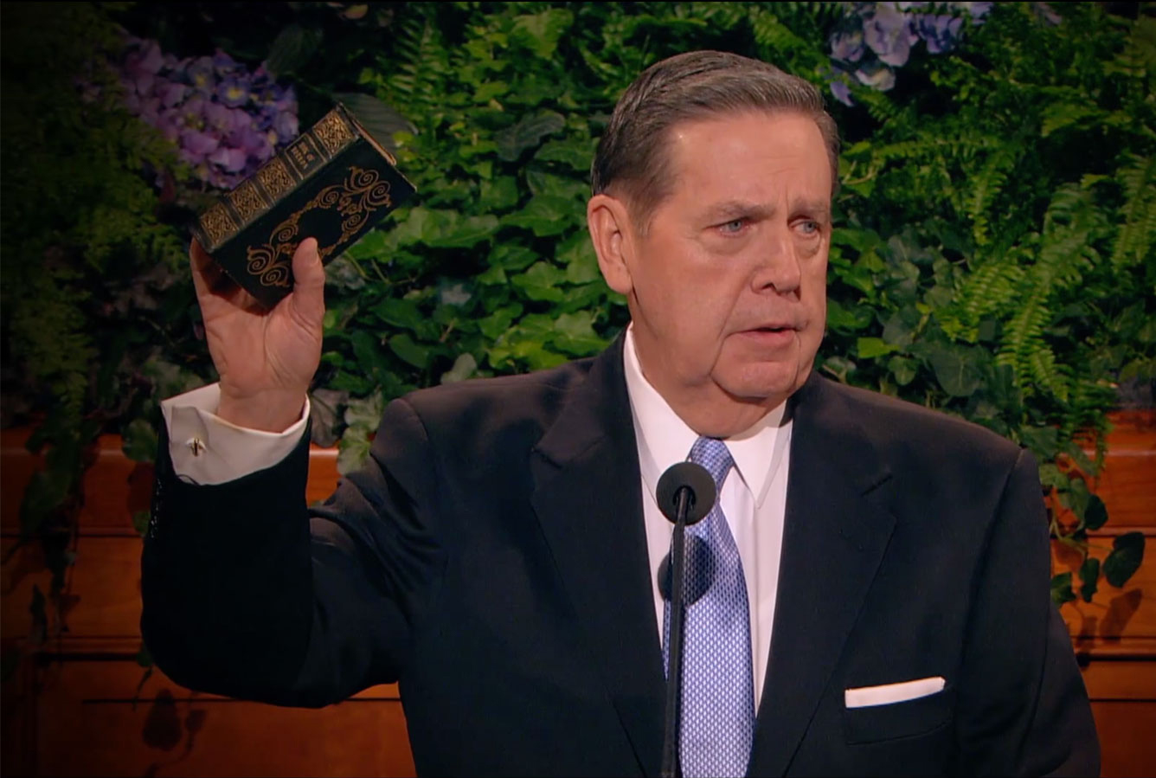
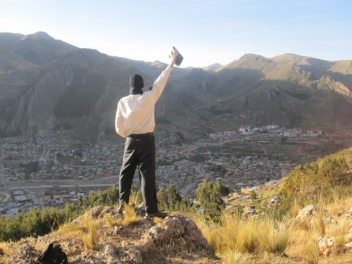
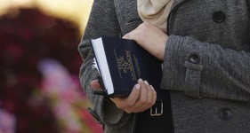
Blessed Is He
“And blessed be he that shall bring this thing to light; for it shall be brought out of darkness unto light, according to the word of God; yea, it shall be brought out of the earth, and it shall shine forth out of darkness, and come unto the knowledge of the people; and it shall be done by the power of God.”
Moroni 8:16

Slide 26
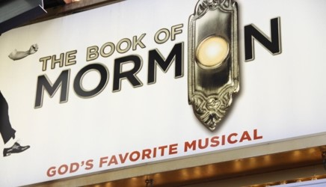
Those Who Criticize or Condemn
“Moroni assured us that if there were faults in this record they were the faults of men.”
Student Manual
“And if they are not the words of Christ, judge ye—for Christ will show unto you, with power and great glory, that they are his words, at the last day; and you and I shall stand face to face before his bar; and ye shall know that I have been commanded of him to write these things, notwithstanding my weakness.”
2 Nephi 33:11
Moroni 8:17

Slide 27
Moroni’s Warnings and Advice
Do not seek for signs
“Yea, signs come by faith, unto mighty works, for without faith no man pleaseth God; and with whom God is angry he is not well pleased; wherefore, unto such he showeth no signs, only in ^{c} wrath unto their condemnation.”
D&C 63:11
Judgment is up to the Lord, not men
“Now it is better that a man should be judged of God than of man, for the judgments of God are always just, but the judgments of manare not always just.”
Mosiah 29:12
“Ye remember that I spake unto you, and said that when the words of Isaiah should be fulfilled—behold they are written, ye have them before you, therefore search them—”
3 Nephi 20:11
Study Isaiah
Moroni 8:18-23

Slide 28
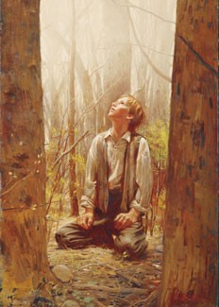
“The truth is, simply, that he was a prophet of God—nothing more and not one whit less!
The scriptures did not come so much from Joseph Smith as they did through him. He was a conduit through which the revelations were given. …
The Prophet Joseph Smith was an unschooled farm boy. To read some of his early letters in the original shows him to be somewhat unpolished in spelling and grammar and in expression.
“That the revelations came through him in any form of literary refinement is nothing short of a miracle.”
President Boyd K. Packer
Moroni 8:23-25

Slide 29
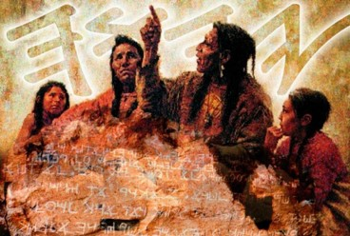
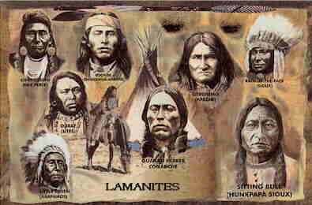
Ancient Saints Pray
“And he knoweth their prayers, that they were in behalf of their brethren. And he knoweth their faith, for in his name could they remove mountains; and in his name could they cause the earth to shake; and by the power of his word did they cause prisons to tumble to the earth; yea, even the fiery furnace could not harm them, neither wild beasts nor poisonous serpents, because of the power of his word.”
To the Lamanites:
“Now, this is not all—their faith in their prayers was that this gospel should be made known also, if it were possible that other nations should possess this land;”
D&C 10:46
Moroni 8:24

Slide 30
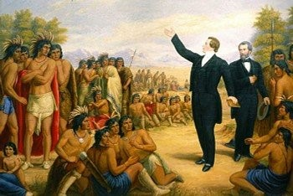
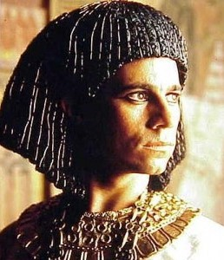
Moroni’s Vision of the Future
“The Ancients Prayer for Joseph Smith. They knew of him. They were aware of his noble and vital mission in the earth. They looked to the time of the coming of the “Choice seer” of the Lord.”
JFM and RLM
Lehi to Jacob, Joseph of Egypt about Joseph Smith in the latter days:
“A seer shall the Lord my God raise up, who shall be a choice seer unto the fruit of my loins.”
See 2 Nephi 3
Moroni 8:25

Slide 31
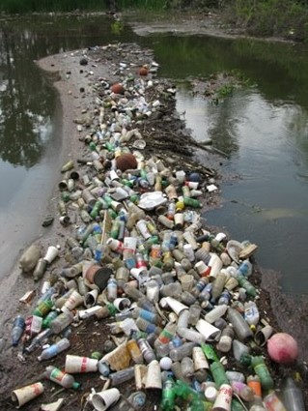
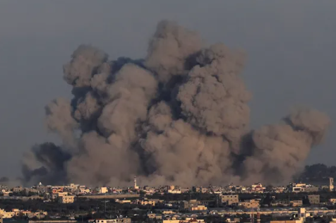
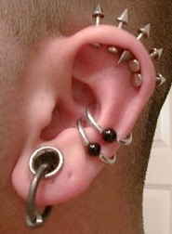
The Book of Mormon will come forth by the power of God during a day of great wickedness
In a day that miracles are done away
The blood of saints shall cry unto the Lord
Envying of them who belong to their churches
A time period between opening of the heaven and the millennial era would be a time of war, hatred and natural disaster
Great pollutions—the wicked ways of men—murders, robbing, lying, and deceiving
A day when men and women are thoughtless and careless about their bodies, dress, manners, appearance, and care of the earth
Moroni 8:26-41

Slide 32
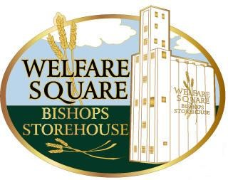
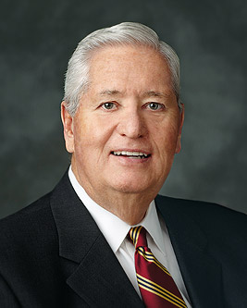
“The purpose, promises, and principles that reinforce our work of caring for the poor and needy extend far beyond the bounds of mortality.
This sacred work is not only to benefit and bless those who suffer or are in need. As sons and daughters of God, we cannot inherit the full measure of eternal life without being fully invested in caring for each other while we are here on earth.
It is in the benevolent practice of sacrifice and giving of ourselves to others that we learn the celestial principles of sacrifice and consecration”
Bishop H. David Burton
Moroni 8:37-39

Slide 33
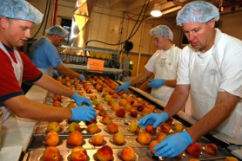
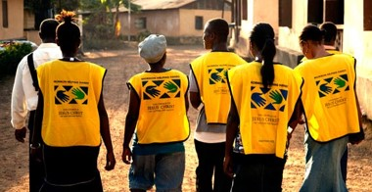
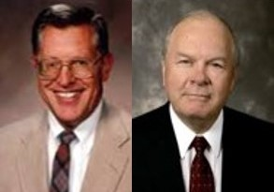
“This prophecy is a solemn warning, not just to the Christian world in general but also to the Latter-day Saints, particularly those in the United States.
The Saints of God need to labor day and night to retain purity of heart and thus propriety in their dealing with God and one another.
Zion can only be established among a people who are pure in heart, a people who search out the poor and needy, who see to those needs, and who focus their attention, their loyalties, and their time on people and on things which have eternal relevance and worth.”
JFM and RLM
Moroni 8:37-39

Slide 34
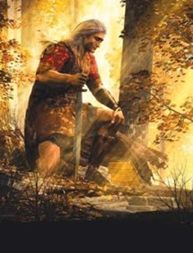
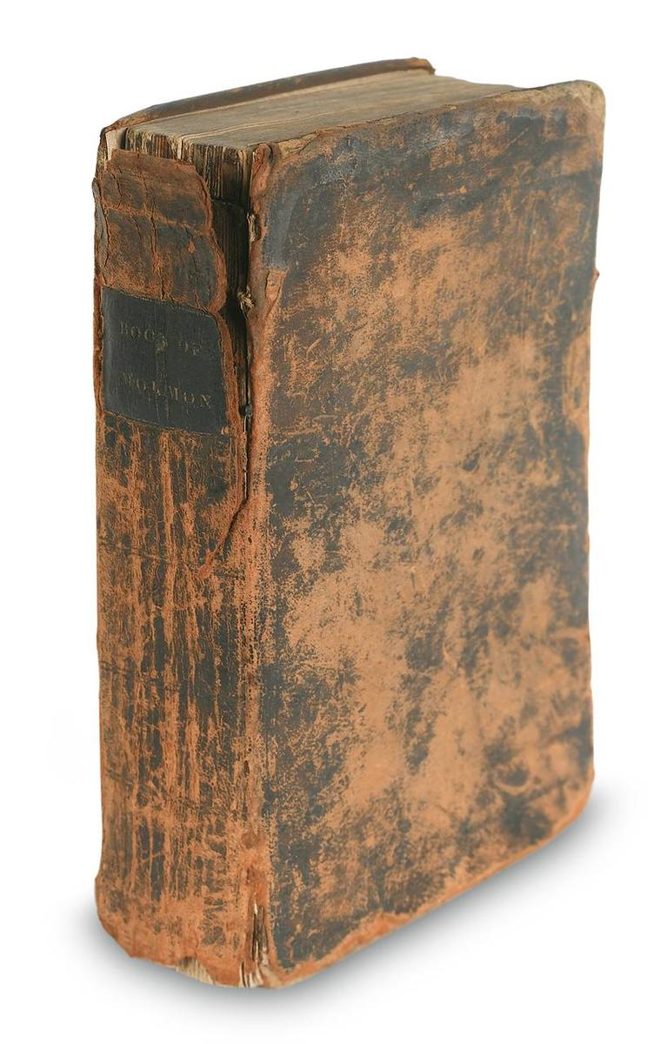
All Will Be Fulfilled
The revelations of God will all be fulfilled.
“If they saw our day, and chose those things which would be of greatest worth to us, is not that how we should study the Book of Mormon?
We should constantly ask ourselves, ‘Why did the Lord inspire Mormon (or Moroni or Alma) to include that in his record? What lesson can I learn from that to help me live in this day and age?’”
Ezra Taft Benson

Slide 35
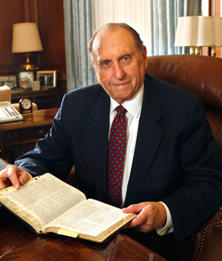
“I implore each of us to prayerfully study and ponder the Book of Mormon each day. As we do so, we will be in a position to hear the voice of the Spirit, to resist temptation, to overcome doubt and fear, and to receive heaven’s help in our lives. I so testify with all my heart.”
Thomas S. Monson

Slide 36
Sources:
President Thomas S. Monson(“Dare to Stand Alone,” Ensign or Liahona, Nov. 2011, 60, 67). ; “The Power of the Book of Mormon,” Ensign or Liahona, May 2017, 87
President Ezra Taft Benson(“The Book of Mormon—Keystone of Our Religion,” Ensign, Nov. 1986, 4).
Joseph Fielding Smith (as cited by) Essentials in Church History pg. 49
Student Manual Religion 121-122 Book of Mormon pg. 471
President Boyd K. Packer (“We Believe All That God Has Revealed,” Ensign, May 1974, 94).
Joseph Fielding McConkie and Robert L. Millet Doctrinal Commentary on the Book of Mormon Vol 4 pgs. 246, 250
Bishop H. David Burton (“The Sanctifying Work of Welfare,” Ensign or Liahona, May 2011, 81–82).
Presentation by ©http://fashionsbylynda.com/blog/

Slide 37
Some events which prophesied are outlined below.
The Book of Mormon accurately describes the conditions of the Christian world at the time of its publication and shortly thereafter (vss, 26-33).
1. Religious apostasy and perversion
2.Absence of divine power of miracles among the people
3.Persecution of the Saints
4.Crime, violence, and widespread iniquity
5.Warfare
6.Natural disasters
7.Great evil among the people
8.Perversion of the churches for money and gain
B. Next the Book of Mormon examines the conditions of a day a little later "when these things [ the above prophecies] shall come forth among you." (Mormon 8:34.) And here, accurately depicted, are conditions present today. (See Mormon 8;35-40.)
1.People will become fashionable, status I conscious, and competitive.
2.Common vices will be vanity, intolerance, and lack of charity.
3.People will ignore the needs of the poor.
4.There will be hypocrites who use religion to get gain.
5.Some will be ashamed to be known as disciples of Christ.
6.Some will not respond to the needs of their less fortunate brothers and sisters.
C. But all is not gloom and darkness. After having denounced the disbelief of latter-day gentiles, Moroni cites the promises of the Lord that signs and miracles will follow the true and faithful. (Read Mormon 9:24, 25.) What is the promise to the righteous of the latter days?
Student Manual Religion 121-122 Book of Mormon pg 475

Slide 38
Lamanites
Lamanites
The Lord visited the American continent
The Lamanites today are descendants of the people who lived after the appearance of Christ
Lehi
Of the House of Israel
Great wickedness begins again
No Lamanites or Nephites; all were called children of Christ
(4 Nephi 1:17)
Destroyed in approximately AD 400
Nephites
Nephites
BC 600
AD 34
AD 400
AD 201
Lamanites
Lamanites
The Lord visited the American continent
The Lamanites today are descendants of the people who lived after the appearance of Christ
Lehi
Of the House of Israel
Great wickedness begins again
No Lamanites or Nephites; all were called children of Christ
(4 Nephi 1:17)
Destroyed in approximately AD 400
Nephites
Nephites
BC 600
AD 34
AD 400
AD 201

Slide 39
Witness to Miracles of God
Mormon 9

Slide 40
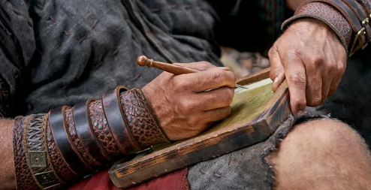
Turn To the Lord
Moroni experienced what it would be like to live today; the Lord showed him our day.
Moroni described sins and attitudes that would be prevalent in the last days.
O then ye unbelieving, turn ye unto the Lord; cry mightily unto the Father in the name of Jesus, that perhaps ye may be found spotless, pure, fair, and white, having been cleansed by the blood of the Lamb, at that great and last day.
Mormon 9:6

Slide 41
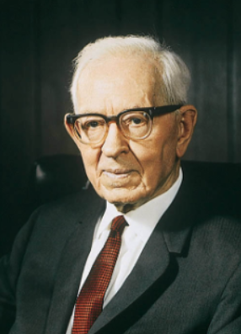
Repentance
“There can be no salvation without repentance. A man cannot enter into the kingdom of God in his sins. It would be a very inconsistent thing for a man to come into the presence of the Father and to dwell in God’s presence in his sins. …
“I think there are a great many people upon the earth, many of them perhaps in the Church—at least some in the Church—who have an idea they can go through this life doing as they please, violating the commandments of the Lord and yet eventually they are going to come into his presence. They think they are going to repent, perhaps in the spirit world.
“They ought to read these words of Moroni [quoting Mormon 9:3–5].
“Do you think that a man whose life has been filled with corruption, who has been rebellious against God, who has not had the spirit of repentance, would be happy or comfortable should he be permitted to come into the presence of God?”
Joseph Fielding Smith
Those who turn from their unbelief to the Lord can be cleansed from their sins through the Atonement of Jesus Christ
Mormon 9:1-6

Slide 42
Those Who Reject Christ
The day of your visitation = The day the Lord visits the earth (The Millennium)
The elements shall melt with fervent heat = The bodies of those who are in the telestial or lower status will be consumed in the fires of glory and their spirits sent immediately to hell in the spirit world…They will remain for a time until the second resurrection at the end of the Millennium.
Ron DiCiann
Ye shall be brought to stand before the Lamb of God = Judgment Day
When your souls are racked with a consciousness of guilt = eternal torment, pains of hell, become extinct in body and soul (Alma 36:12-16)
A flame of unquenchable fire = inner torment
Why do we need to repent of our sins today and not wait until the Judgment?
Mormon 9:1-6

Slide 43
Moroni’s Plea
Moroni’s plea is that all people – including those who have to that point rejected Christ—come unto Christ now, in the light of day, partake of his goodness and grace, be cleansed by his atoning blood, and come to know the sweet joy of his redemption; all this that the final day of judgment may be glorious and great rather than awful and terrible.”
JFM and RLM
Jesus Christ inspired Book of Mormon prophets to write with our day in mind.
Mormon 9:1-5

Slide 44
An important element in the work of Jesus Christ, being not only divine acts, but forming also a part of the divine teaching. Christianity is founded on the greatest of all miracles, the Resurrection of our Lord.
If that be admitted, other miracles cease to be improbable. Miracles should not be regarded as deviations from the ordinary course of nature so much as manifestations of divine or spiritual power. Some lower law was in each case superseded by the action of a higher.
They were intended to be a proof to the Jews that Jesus was the Christ (Matt. 11:4–5; John 2:11;10:25; 20:30–31). Many of them were also symbolic, teaching such divine truths as the result of sin and the cure of sin; the value of faith; the curse of impurity; and the law of love.
The miracles of healing also show how the law of love is to deal with the actual facts of life. Miracles were and are a response to faith and its best encouragement. They were never wrought without prayer, felt need, and faith.
Bible Dictionary
God has always performed miracles, and because He is unchangeable, He still works miracles according to our faith.

Slide 45
Miracles
Moroni Speaks to Those Who Say That God Is Not a God of Miracles
The Creation of Heaven and Earth (vs. 17)
The Creation of Man
(vs. 17)
The Scriptural Testimonies of the Miracles of Jesus and His Apostles (vs. 18)
Mormon 9:7-26

Slide 46
Miracles Cease When We:
Dwindle in unbelief
Know not the God in whom we should trust
Depart from the right way
Mormon 9:7-26

Slide 47
Miracles Can happen When We:
Increase our faith
Live in the right way, or keep God’s commandments
Come to know and trust in God
Mormon 9:7-26 Student Manual

Slide 48
God has always performed miracles, and because He is unchangeable, He still works miracles according to our faith.
“I have learned … that the Lord will help us in every aspect of our lives when we are trying to serve Him and do His will.
“I believe that all of us can bear witness to these small miracles. We know children who pray for help to find a lost item and find it. We know of young people who gather the courage to stand as a witness of God and feel His sustaining hand.
We know friends who pay their tithing with the last of their money and then, through a miracle, find themselves able to pay their tuition or their rent or somehow obtain food for their family.
We can share experiences of prayers answered and priesthood blessings that gave courage, brought comfort, or restored health. These daily miracles acquaint us with the hand of the Lord in our lives”
Sister Sydney S. Reynolds

Slide 49
Moroni’s Counsel to the latter-day readers:
Doubt not but be believing (vs. 27)
Come unto the Lord with all your heart (vs. 27)
Strip yourself of all uncleanness (vs.28)
Pray for the strength to meet temptation (vs. 28)
Do not be baptized unworthily (vs. 29)
Do not partake of the sacrament unworthily (vs. 29)
Endure to the end (v.29)
Mormon 9:27-31 Student Manual

Slide 50
Moroni’s Promise
If we pray in faith and in the name of Christ, Heavenly Father will give us whatever we ask for.
Brooks Crandell
“…whatsoever he shall ask the Father in the name of Christ it shall be granted him; and this promise is unto all,…”
¶Ask, and it shall be given you; seek, and ye shall find; knock, and it shall be opened unto you:”
Matthew 7:7
Del Parson
Mormon 9:21-37

Slide 51
However:
Remembering that God’s “ways [are] higher than [our] ways” can help us be open to the different ways Heavenly Father might be answering our prayers.
For as the heavens are higher than the earth, so are my ways higher than your ways, and my thoughts than your thoughts. Isaiah 55:9
“It is important to understand that His healing can mean being cured, or having your burdens eased, or even coming to realize that it is worth it to endure to the end patiently, for God needs brave sons and daughters who are willing to be polished when in His wisdom that is His will.”
Richard G. Scott
Mormon 9:21-37 Brittany Beattie

Slide 52
Moroni’s Promise to the Disciples
^{Those who tarry---}
Go and preach– and those who believe are to be baptized and saved
They shall cast out devils
They shall speak in new tongues
They will not be hurt
They shall heal the sick
Mormon 9:21-37

Slide 53
Did the Nephites Speak Hebrew?
"Moroni's statement in Mormon 9:32-34 pertains to the plates of Mormon and does not necessarily pertain to the small plates of Nephi from which we get the first 132 pages in our present Book of Mormon.
Concerning the script of the plates of Mormon, Moroni says: ' ... We have written this record according to our knowledge, in the characters which are called among us the reformed Egyptian, being handed down and altered by us, according to our manner of speech.' (Mormon 9:32.)
He seems to indicate in the following verse that the Nephites are still speaking a version of Hebrew, for he admits that 'if our plates had been sufficiently large we should have written in Hebrew; but the Hebrew hath been altered by us also.' (Mormon 9:33.)" (Ludlow, Companion, p. 307.)
Mormon 9:32-37

Slide 54
Sources:
Joseph Fielding Smith (Doctrines of Salvation, ed. Bruce R. McConkie, 3 vols. [1954–56], 2:195–96; italics in original removed).
Joseph Fielding McConkie and Robert L. Millet Doctrinal Commentary on the Book of Mormon Vol. 4 pg. 252
Sister Sydney S. Reynolds (“A God of Miracles,” Ensign, May 2001, 12).
(Ludlow, Companion, p. 307.) Religion 121-122 Book of Mormon Student Manual pg. 472
Plates of gold (an interesting article http://www.bmaf.org/articles/plates_of_gold__johnson
Richard G. Scott, “To Be Healed,” Ensign, May 1994, 7.
What If My Prayers Don’t Seem to Be Answered?
By Brittany Beattie
Presentation by ©http://fashionsbylynda.com/blog/

Slide 55
“Many miracles happen every day in the work of our Church and in the lives of our members. Many of you have witnessed miracles, perhaps more than you realize.
“A miracle has been defined as ‘a beneficial event brought about through divine power that mortals do not understand and of themselves cannot duplicate’ [Encyclopedia of Mormonism (1992), “Miracles,” 2:908]. The idea that events are brought about through divine power is rejected by most irreligious people and even by some who are religious. …
“… Miracles worked by the power of the priesthood are always present in the true Church of Jesus Christ [see George Q. Cannon, Gospel Truth, sel. Jerreld L. Newquist (1987), 151–52]. The Book of Mormon teaches that ‘God has provided a means that man, through faith, might work mighty miracles’ (Mosiah 8:18). The ‘means’ provided is priesthood power (see James 5:14–15; D&C 42:43–48), and that power works miracles through faith (see Ether 12:12; Moro. 7:37)” (Dallin H. Oaks, “Miracles,” Ensign, June 2001, 6, 8).
Hebrew and Egyptian:
Moroni stated that he had the ability to write in at least two languages: Hebrew and reformed Egyptian. He noted that if the “plates had been sufficiently large,” he would have written in Hebrew; however, those who kept the record used “reformed Egyptian” due to the lack of space (see Mormon 9:32–33). Previously in the Book of Mormon, both Nephi and King Benjamin acknowledged their use of Egyptian. Nephi stated that he wrote in “the language of the Egyptians” when he engraved the small plates (1 Nephi 1:2).
When speaking to his sons about the importance of the brass plates, King Benjamin noted that Lehi could read the record because he had “been taught in the language of the Egyptians” (Mosiah 1:4). Therefore, we understand that Lehi taught both the gospel and the Egyptian language “to his children, that thereby they could teach them to their children” (Mosiah 1:4). Evidently, this pattern continued through the generations of record keepers who followed until Moroni learned the language from his father. However, Moroni acknowledged that he wrote in “reformed Egyptian” that had been “handed down and altered … according to [their] manner of speech” (Mormon 9:32),
indicating that some adaptations in the use of the language had occurred over the thousand years since the time of Lehi. This could explain why Moroni concluded with the comment that “none other people knoweth our language” but that God had “prepared means for” the eventual interpretation and translation of the record (Mormon 9:34).
Egyptian was commonly used in Lehi’s day, especially by merchants and traders who traveled widely throughout the region around Jerusalem. If, as some have suggested, Lehi’s profession required him to travel throughout the region, he likely would have made sure his sons learned the language of the Egyptians to support the family occupation.
Do you realize that the Book of Mormon was written for you—and for your day? This book is one of the blessings of living in what we call the dispensation of the fulness of times. Although the Book of Mormon was written by inspired, ancient authors—many of whom were prophets—they and the people of their day did not have the benefit of possessing the whole book. You now have easily within your reach the sacred record that prophets, priests, and kings treasured, embraced, and preserved! You have the benefit of holding in your hands the complete Book of Mormon. Interestingly, one of the Book of Mormon prophets, Moroni, saw our day—your day. He even saw you, in vision, many hundreds of years ago! (Gary E. Stevenson, “Look to the Book, Look to the Lord,” Ensign or Liahona, Nov. 2016, 46)

Slide 56
Prayers not always answered the way you want them to be:
“Not all of our prayers will be answered as we might wish. Occasionally the answer will be no. We should not be surprised. Loving mortal parents do not say yes to every request of their children. …
Russell M. Nelson, “Sweet Power of Prayer,” Liahona, May 2003, 9.
“prayers … seem to go unanswered and unanswered and unanswered, … you need faith.” That faith, he said, needs to be “powerful faith, faith that sustains us here and now, not just on the day of judgment or somewhere in celestial glory.”
Jeffrey R. Holland, “A Saint Through the Atonement of Christ the Lord” (Brigham Young University devotional address, Jan. 18, 2022), 4, 5, speeches.byu.edu.

