Slide 1
Moroni 1-6

Slide 3
The Book of Moroni
Moroni wrote:
Words of his own
The words of Jesus Christ to His twelve Nephite disciples
Words of his father, Mormon
The Book of Moroni
The Book was written about AD 401 to AD 421
Moroni did not say where he was when he wrote it—only that he wandered wherever he could for the safety of his life
(see Moroni 1:1–3).

Slide 4
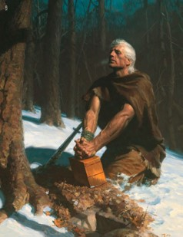
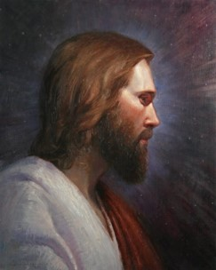
Moroni
Before the Nephites were destroyed, Moroni served among them as a military leader and a Church leader
Moroni was a witness of the Savior.
He testified, “I have seen Jesus, and … he hath talked with me face to face”
(Ether 12:39).
Moroni was faithful to his testimony, refusing to deny Christ during a time when the Lamanites were killing every Nephite who would not deny Him
(see Moroni 1:1–3).

Slide 5
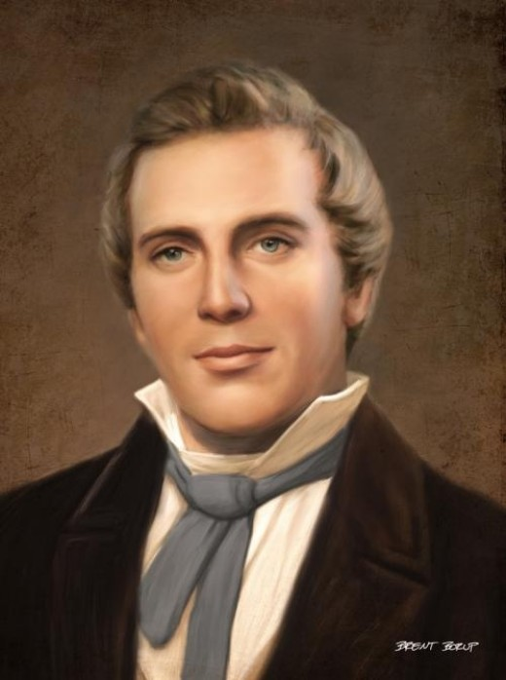
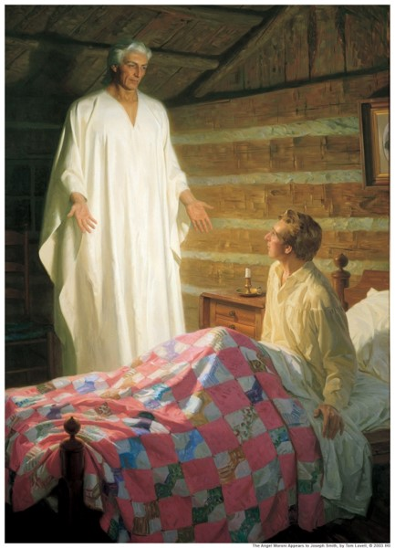
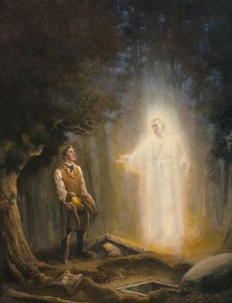
1,400 Years Later
In 1823, approximately 1,400 years after completing the record of the Book of Mormon, Moroni appeared to the Prophet Joseph Smith as a resurrected being and informed Joseph that the record was deposited in a hill near his home
(Joseph Smith—History 1:29–35).
At that time and periodically during the next four years, Moroni instructed Joseph Smith “respecting what the Lord was going to do, and how and in what manner his kingdom was to be conducted in the last days”
(Joseph Smith—History 1:54).

Slide 6
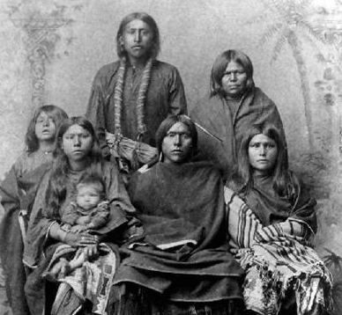
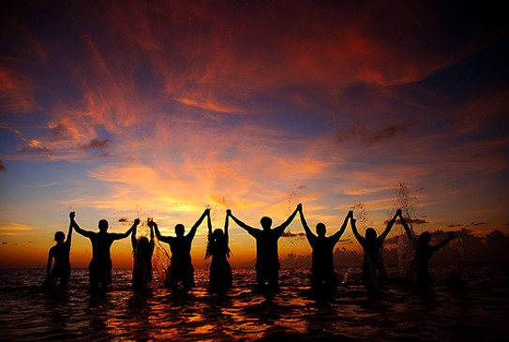
To Whom is the Book For?
Moroni stated, “I write a few more things, that perhaps they may be of worth unto my brethren, the Lamanites, in some future day.”
He also declared that he spoke “unto all the ends of the earth,” warning that at the judgment bar of God, all would be held accountable for the words he had written.
In preparation for this event, Moroni invited all to “Come unto Christ.”

Slide 7
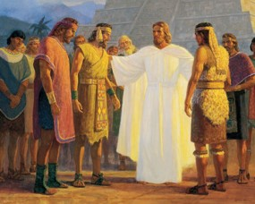
Moroni’s Teachings Include:
Details concerning Jesus Christ’s instructions to His twelve Nephite disciples as He gave them power to confer the gift of the Holy Ghost.
The only instructions in the Book of Mormon regarding the performance of priesthood ordinations and the prayers used in the ordinance of the sacrament.
Mormon’s teachings on discerning good from evil, the ministering of angels, charity as the pure love of Christ, and the salvation of little children.
Mormon’s description of the depravity of the Nephites and Lamanites before their final battle at Cumorah.
Moroni’s own teachings on gifts of the Spirit.

Slide 8
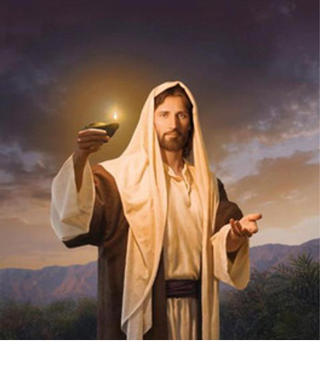
The Key Contribution
An invitation to “Come Unto Christ”
“The Book of Mormon is the only book that contains within its covers a promise that by divine power the reader may know with certainty of its truth”
President Gordon B. Hinckley

Slide 9
Opposition
The colors in this diagram will help you imagine different levels of opposition that a disciple of Jesus Christ might face. Green represents no opposition. Yellow and orange suggests increasing levels of opposition, while red symbolizes the most difficult opposition.
What Color Do You Represent?

Slide 10
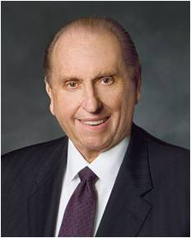
Not Afraid To Stand Out
One which I shall never forget was the quiet courage of an 18-year-old seaman—not of our faith—who was not too proud to pray.
Of 250 men in the company, he was the only one who each night knelt down by the side of his bunk, at times amidst the jeers of bullies and the jests of unbelievers.
With bowed head, he prayed to God. He never wavered. He never faltered. He had courage.
Thomas S. Monson

Slide 11
Standing Up, Standing Out
“My teacher was in the front of the class, talking about a snippet of a movie we were about to watch. … My teacher … nonchalantly explained that … the movie had a mature rating. I was stunned. … I never thought this would happen.
We can choose to stand as a witness of Jesus Christ, especially in difficult circumstances
“I sat in my chair, thinking about what I should do. A thought kept coming into my head: We have been asked not to watch offensive movies. I tried to rationalize that because I was in school, the part of the movie we were going to watch would be appropriate. But the thought of not watching offensive movies trumped my rationalizations.

Slide 12
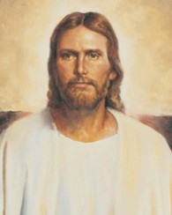
“I calmly raised my hand, and in front of my whole class, I asked to sit outside of class while the movie played. I felt everyone’s eyes on me as I pushed in my chair and grabbed my book. I saw the looks on their faces; they simply didn’t understand.
“While sitting in the hallway, I felt very happy. I knew I had done the right thing, no matter what my peers or teacher said. I felt stronger too. I knew I didn’t have to watch an inappropriate movie clip just because my teacher had presented it to us.
“… I believe that when we are faced with moments of adversity and we stand up to them, we are made stronger than if we had sat down and let them happen.
“This is an inner strength that is found through our Savior. If we look to Him in our times of difficulty, we will be made strong. Our faith in Him can help us face adversity”
Catherine Hall

Slide 13
Moroni Stands Alone
Hunted by the Lamanites and wandering for safety
Perhaps they (the records) will be of worth unto my brethren
After Moroni finished the history of the Jaredite people he added a few more words for the Lamanites in the last days
Revelation through Urim and Thummim:
“And for this very purpose are these plates preserved, which contain these records—that the promises of the Lord might be fulfilled, which he made to his people;
And that the Lamanites might come to the knowledge of their fathers, and that they might know the promises of the Lord, and that they may believe the gospel and rely upon the merits of Jesus Christ, and be glorified through faith in his name, and that through their repentance they might be saved. Amen.”
D&C 3:19-20
We can be true to Jesus Christ in any circumstance and not deny Him
Moroni 1:1-4

Slide 14
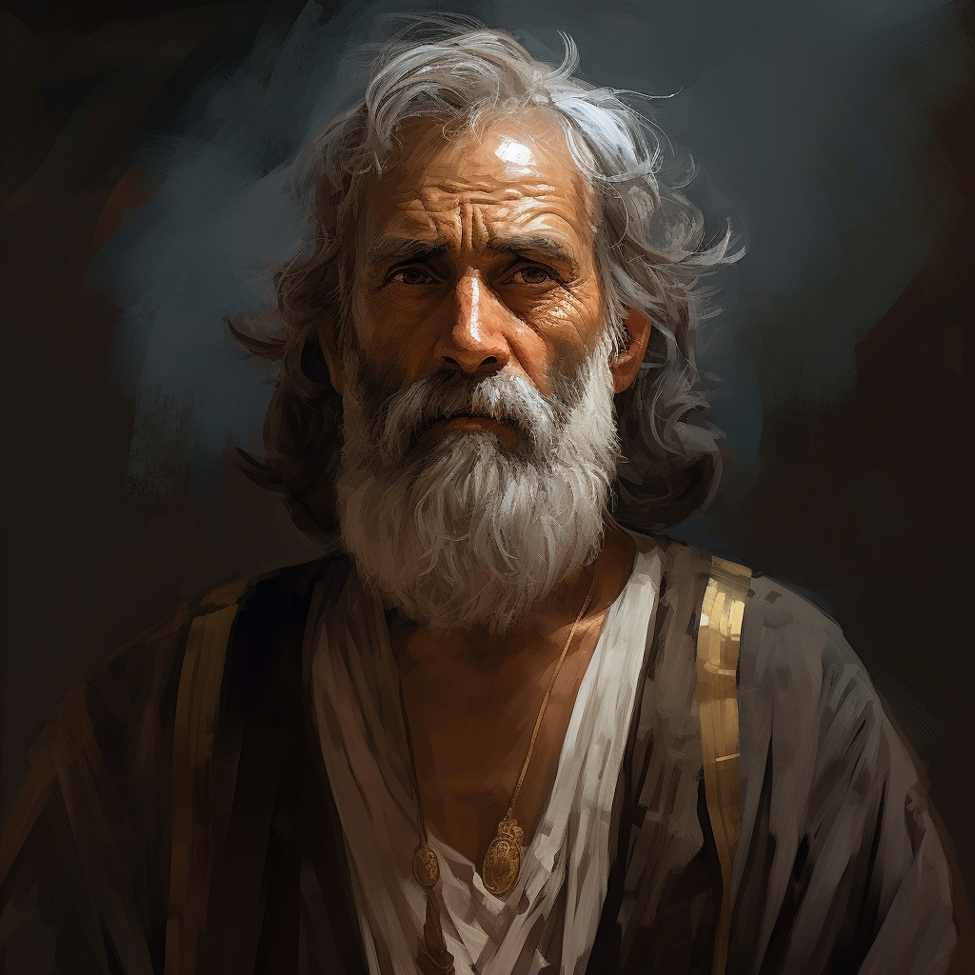
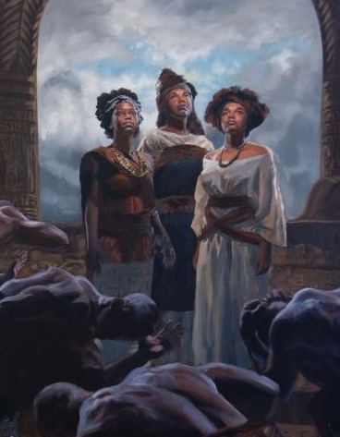
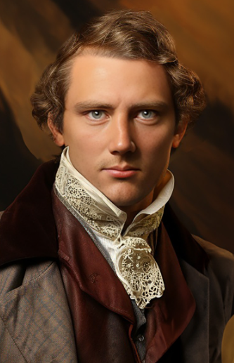
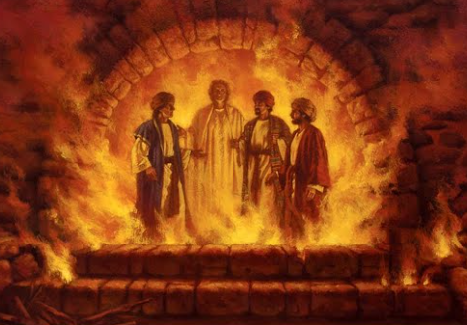
Scripture Figures Stand Alone
Queen Esther
Esther 4:16
Abinadi
Mosiah 17:20
Daughters of Onitah
Abraham 1:11
Joseph Smith
Doctrine and Covenants 135:4-5
Shadrach, Meshach, and Abed-nego
Daniel 3:17-18
James H. Fulmer
Kim Marshall

Slide 15
Prophets Speak to the Future
About Joseph Smith:
“And his name shall be called after me; and it shall be after the name of his father. And he shall be like unto me; for the thing, which the Lord shall bring forth by his hand, by the power of the Lord shall bring my people unto salvation.”
2 Nephi 3:15
Alma to his son Helaman:
“And now behold, one purpose hath he fulfilled, even to the restoration of many thousands of the Lamanites to the knowledge of the truth; and he hath shown forth his power in them, and he will also still show forth his power in them unto future generations; therefore they shall be preserved.”
Alma 37:19
Mormon to the Lamanite future:
“And ye will also know that ye are a remnant of the seed of Jacob; therefore ye are numbered among the people of the first covenant; and if it so be that ye believe in Christ, and are baptized, first with water, then with fire and with the Holy Ghost, following the example of our Savior, according to that which he hath commanded us, it shall be well with you in the day of judgment. Amen.”
Mormon 7:10
Ether to the Jaredites:
“And it is by faith that my fathers have obtained the promise that these things should come unto their brethren through the Gentiles; therefore the Lord hath commanded me, yea, even Jesus Christ.”
Ether 12:22

Slide 16
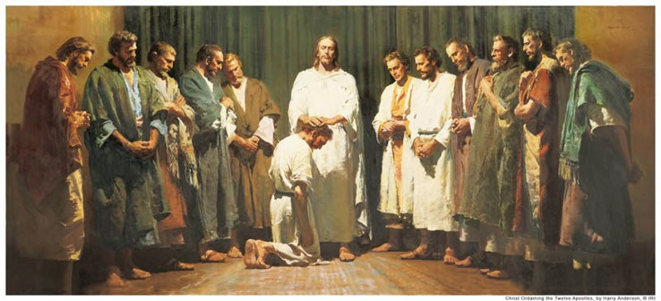
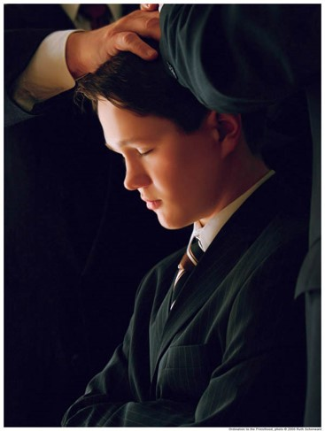
Preparing for an Ordinance
What might you do to prepare to perform this ordinance?
Jesus to his disciples:
“And when he had said this, he breathed on them, and saith unto them, Receive ye the Holy Ghost:”
John 20:22
“And the multitude heard not the words which he spake, therefore they did not bear record; but the disciples bare record that he gave them power to give the Holy Ghost. And I will show unto you hereafter that this record is true.”
3 Nephi 18:37
Moroni 2

Slide 17
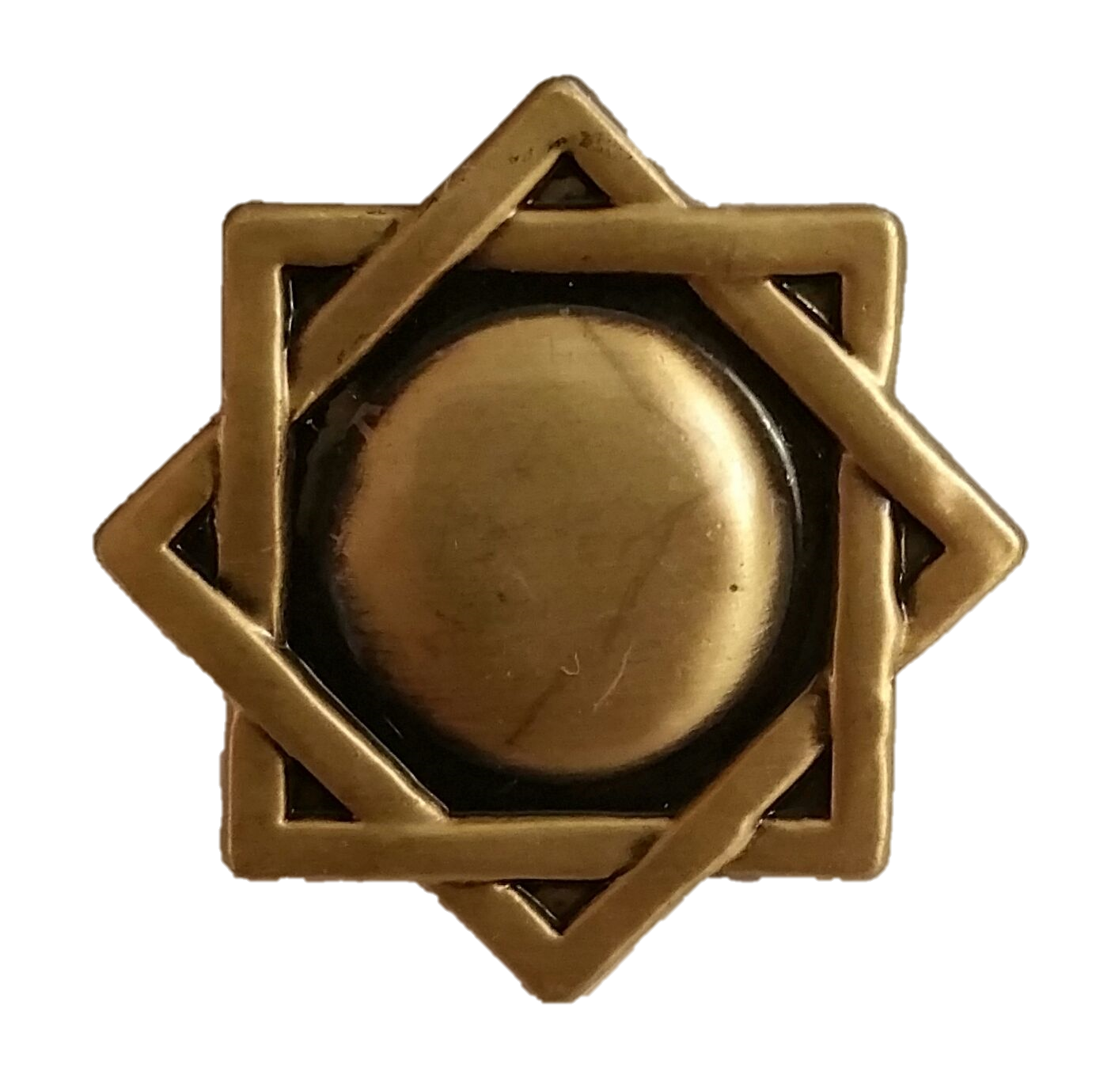
The Priesthood
What Priesthood do you need to hold to perform these ordinances?
Brethren who perform ordinances and blessings should prepare themselves by living worthily and striving to be guided by the Holy Spirit. They should perform each ordinance or blessing in a dignified manner, making sure it meets the following requirements:
1. It should be performed in the name of Jesus Christ.
2. It should be performed by the authority of the priesthood.
3. It should be performed with any necessary procedures, such as using specified words or using consecrated oil.
4. It should be authorized by the presiding authority who holds the proper keys (normally the bishop or stake president), if necessary according to the instructions in this chapter.
Handbook
The Melchizedek Priesthood
Moroni 2

Slide 18
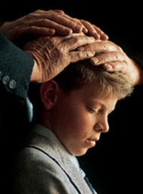
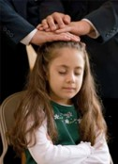
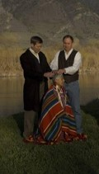
The Confirmation
Under the direction of the bishopric, one or more Melchizedek Priesthood holders may participate in a confirmation. They place their hands lightly on the person’s head. Then the person who performs the ordinance:
1. States the person’s full name.
2. States that the ordinance is performed by the authority of the Melchizedek Priesthood.
3. Confirms the person a member of The Church of Jesus Christ of Latter-day Saints.
4. Uses the words “Receive the Holy Ghost” (not “receive the gift of the Holy Ghost”).
5. Gives words of blessing as the Spirit directs.
6. Closes in the name of Jesus Christ.
Handbook
Moroni 2

Slide 19
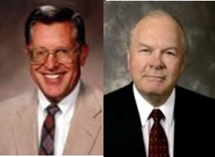
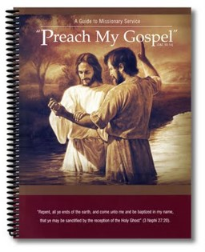
Priesthood Service
“The mission of the Church and the ministry of all priesthood representatives is to proclaim the gospel, to testify of the atoning sacrifice of Jesus Christ .”
“Yea, verily, verily, I say unto you, that the field is white already to harvest; wherefore, thrust in your sickles, and reap with all your might, mind, and strength.”
D&C:33:7
“Yea, open your mouths and spare not, and you shall be laden with sheaves upon your backs, for lo, I am with you.”
D&C 33:9
“All principles of the gospel and all priesthood ordinances are intended to lead men unto Christ. It is through him that all principles and ordinances of the gospel have any enduring efficacy.”
Moroni 3 JFM and RLM

Slide 20
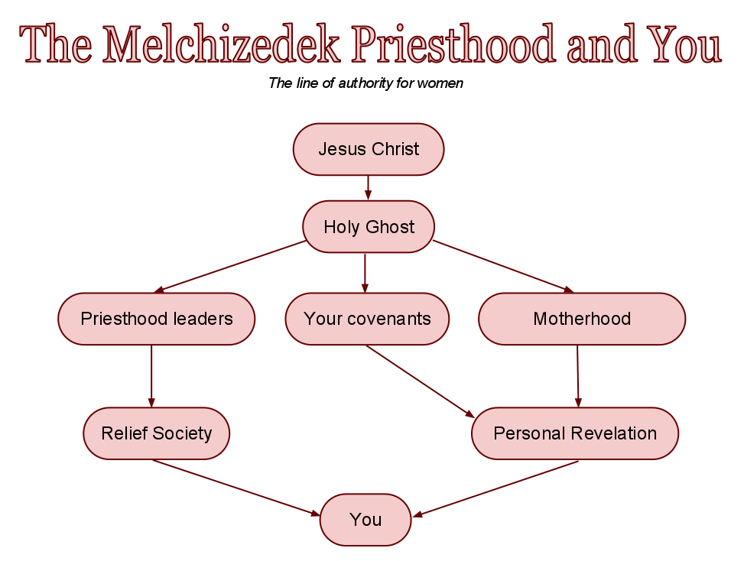
Divine Authority
“Acting with divine authority requires more than mere social contract. It cannot be generated by theological training or a commission from the congregation. No, in the authorized work of God there has to be power greater than that already possessed by the people in the pews or in the streets or in the seminaries—a fact that many honest religious seekers had known and openly acknowledged for generations leading up to the Restoration. …
“… We in the restored Church of Jesus Christ can trace the priesthood line of authority exercised by the newest deacon in the ward, the bishop who presides over him, and the prophet who presides over all of us. That line goes back in an unbroken chain to angelic ministers who came from the Son of God Himself, bearing this incomparable gift from heaven”
Elder Jeffrey R. Holland

Slide 21
Priesthood Duties
Read D&C 20:38-84
Duties of a Deacon
1. Pass the sacrament.
2. Watch over the Church.
3. Warn, expound, exhort, and teach, and invite all to come unto Christ.
4. Assist the bishop with temporal things.
5. Fellowship quorum members and other young men.
Duties of a Teacher:
Worthy brethren may be ordained teachers when they are at least 14 years old. A teacher has all the responsibilities
of a deacon. He also has additional responsibilities.
“The teacher’s duty is to watch over the church always, and be with and strengthen them;” D&C 53
Duties of a Priest
1. Teach the gospel.
2. Baptize.
3. Administer the sacrament.
4. Visit the members.
5. Ordain others to the Aaronic Priesthood.
6. Assist in missionary work.
Other Duties of All:
Set a Proper Example
Be a Good Home Teacher
Greet the Members at Church
Prepare the Sacrament
Help at Home
Be a Peacemaker
Lesson Manual--Priesthood

Slide 22
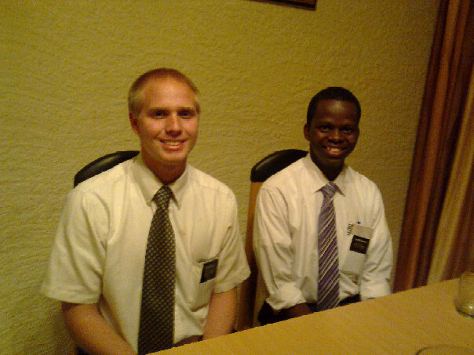
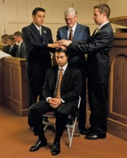
Priesthood Duties
Read D&C 20:38-84
Elder and High Priest:
When we are given the Melchizedek Priesthood, we are given the power to bless the spiritual lives of others.
The Melchizedek Priesthood “administereth the gospel and holdeth the key … of the knowledge of God. Therefore, in the ordinances thereof, the power of godliness is manifest” (see D&C 84:19–21).
Through the power of the Melchizedek Priesthood, we can consecrate oil, bless the sick, confer the priesthood and the gift of the Holy Ghost, ordain others to priesthood offices, dedicate graves, give blessings of comfort, bestow father’s blessings on our children, and participate in the higher temple ordinances.
Melchizedek Priesthood holders bestow the gift of the Holy Ghost on baptized Church members by the laying on of hands.
Lesson Manual--Priesthood

Slide 23
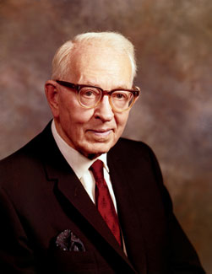
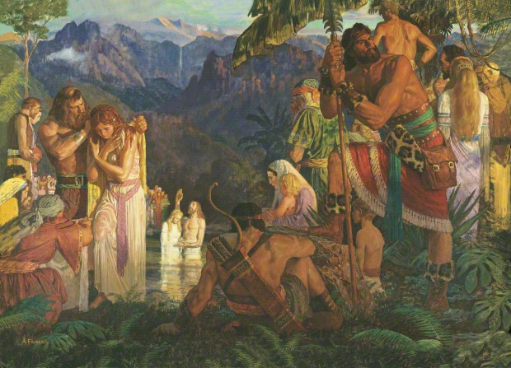
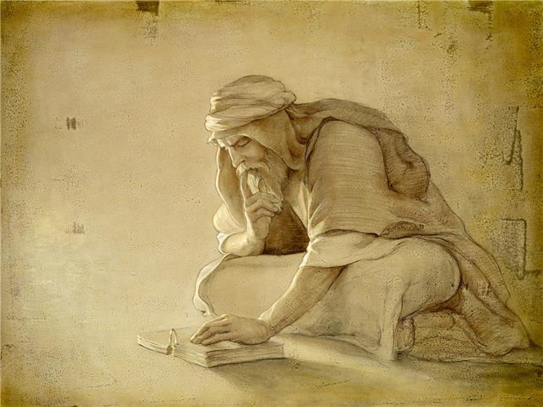
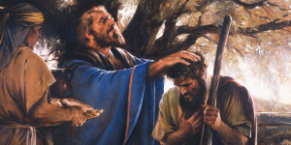
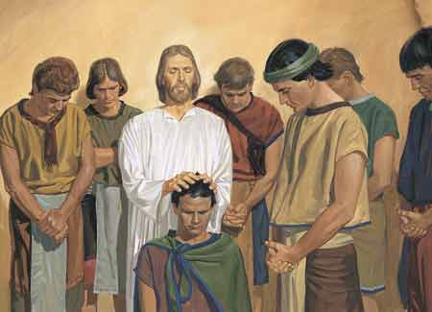
Priesthood Holders Among the Descendants of Levi
“The Nephites were descendants of Joseph. Lehi discovered this when reading the brass plates. … There were no Levites who accompanied Lehi to the Western Hemisphere.
Under these conditions the Nephites officiated by virtue of the Melchizedek Priesthood from the days of Lehi to the days of the appearance of our Savior among them. …
“When the Savior came to the Nephites, he established the Church in its fulness among them. …
Therefore we are justified in the belief that not only was the fulness of the Melchizedek Priesthood conferred, but also the Aaronic, just as we have it in the Church today; and this Aaronic Priesthood remained with them from this time until, through wickedness, all priesthood ceased.
We may be assured that in the days of Moroni the Nephites did ordain teachers and priests in the Aaronic Priesthood; but before the visit of the Savior they officiated in the Melchizedek Priesthood.”
President Joseph Fielding Smith

Slide 24
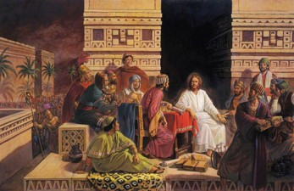
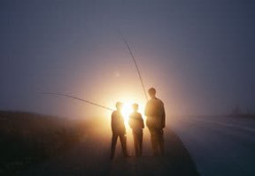
Did the 12 Nephite Disciples Serve as Apostles?
“This book [the Book of Mormon] also tells us that our Savior made His appearance upon this continent after His resurrection; … that they had Apostles, Prophets, Pastors, Teachers, and Evangelists; the same order, the same priesthood, the same ordinances, gifts, powers, and blessings, as were enjoyed on the eastern continent”
Prophet Joseph Smith
“While in every instance the Nephite Twelve are spoken of as disciples, the fact remains that they had been endowed with divine authority to be special witnesses for Christ among their own people. Therefore, they were virtually apostles to the Nephite race”
President Joseph Fielding Smith
Moroni 2:1

Slide 25
Sources:
Video: Blessings of the Priesthood
Thomas S. Monson, “Be Strong and of a Good Courage,” Ensign or Liahona, May 2014, 67)
President Gordon B. Hinckley (“A Testimony Vibrant and True,” Ensign, Aug. 2005, 4).
(Catherine Hall, “Standing Up, Standing Out,” New Era, Feb. 2012, 11).
Handbook 2 Administering the Church 20.1, 20.3.10
Joseph Fielding McConkie and Robert L. Millet Doctrinal Commentary on the Book of Mormon Vol. 4 pg. 323
Elder Jeffrey R. Holland (“Our Most Distinguishing Feature,” Ensign or Liahona, May 2005, 44).
Duties and Blessings of the Priesthood: Basic Manual for Priesthood Holders, Part A Lessons 5,6,7, and 9
President Joseph Fielding Smith (Answers to Gospel Questions, comp. Joseph Fielding Smith Jr., 5 vols. [1957–66], 1:124, 126
Prophet Joseph Smith(History of the Church, 4:538).
President Joseph Fielding Smith (Doctrines of Salvation, comp. Bruce R. McConkie, 3 vols. [1954–56], 3:158).
Presentation by ©http://fashionsbylynda.com/blog/

Slide 26
Being True to the Faith:
While some are neglecting their faith, others are searching for the truth. We have taken upon ourselves the name of the Savior. What more are we to do? …
You and I speak of Jesus Christ, but maybe we can do a little better. If the world is going to speak less of Him, who is going to speak more of Him? We are! Along with other devoted Christians! …
As the world speaks less of Jesus Christ, let us speak more of Him. As our true colors as His disciples are revealed, many around us will be prepared to listen. As we share the light we have received from Him, His light and His transcendent saving power will shine on those willing to open their hearts. Jesus said, “I … come [as] a light into the world” [John 12:46]. (Neil L. Andersen, “We Talk of Christ,” Ensign or Liahona, Nov. 2020, 88–90)
Priesthood Blessings:
We all know that the priesthood is much more than just a name or title. The Prophet Joseph taught that “the Priesthood is an everlasting principle, and existed with God from eternity … to eternity, without beginning of days or end of years” [Teachings of Presidents of the Church: Joseph Smith (2007), 104]. It holds “even the key of the knowledge of God” [Doctrine and Covenants 84:19]. In fact, through the priesthood the very “power of godliness is manifest” [Doctrine and Covenants 84:20].
The blessings of the priesthood transcend our ability to comprehend. Faithful Melchizedek Priesthood holders can “become … the elect of God” [Doctrine and Covenants 84:34]. They are “sanctified by the Spirit unto the renewing of their bodies” [Doctrine and Covenants 84:33] and can ultimately receive “all that [the] Father hath” [Doctrine and Covenants 84:38]. This may be hard to comprehend, but it is beautiful, and I testify that it is true. (Dieter F. Uchtdorf, “Your Potential, Your Privilege,” Ensign or Liahona, May 2011, 58)
Jesus Christ enters into our heart:
To persevere firm and steadfast in the faith of Christ requires that the gospel of Jesus Christ penetrate one’s heart and soul, meaning that the gospel becomes not just one of many influences in a person’s life but the defining focus of his or her life and character. …
Most of us find ourselves at this moment on a continuum between a socially motivated participation in gospel rituals on the one hand and a fully developed, Christlike commitment to the will of God on the other. Somewhere along that continuum, the good news of the gospel of Jesus Christ enters into our heart and takes possession of our soul. It may not happen in an instant, but we should all be moving toward that blessed state. (D. Todd Christofferson, “Firm and Steadfast in the Faith of Christ,” Ensign or Liahona, Nov. 2018, 31–32)
Men and Women (Priesthood Keys):
Unlike priesthood keys and priesthood ordinations, the blessings of the priesthood are available to women and to men on the same terms. The gift of the Holy Ghost and the blessings of the temple are familiar illustrations of this truth. (Dallin H. Oaks, “The Keys and Authority of the Priesthood,” Ensign or Liahona, May 2014, 52)
Divine Authority:
Acting with divine authority requires more than mere social contract. It cannot be generated by theological training or a commission from the congregation. No, in the authorized work of God there has to be power greater than that already possessed by the people in the pews or in the streets or in the seminaries—a fact that many honest religious seekers had known and openly acknowledged for generations leading up to the Restoration. …
… [The priesthood line of authority of each priesthood holder in the Church] goes back in an unbroken chain to angelic ministers who came from the Son of God Himself, bearing this incomparable gift from heaven. (Jeffrey R. Holland, “Our Most Distinguishing Feature,” Ensign or Liahona, May 2005, 44)

Slide 28
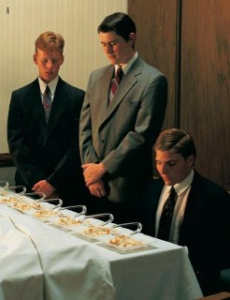
The Ordinance of the Sacrament
“O God, the Eternal Father,
we ask thee in the name of thy Son, Jesus Christ,
to bless and sanctify this bread to the souls of all those who partake of it;
that they may eat in remembrance of the body of thy Son, and witness unto thee, O God, the Eternal Father,
that they are willing to take upon them the name of thy Son, and always remember him,
and keep his commandments which he hath given them,
that they may always have his Spirit to be with them. Amen.
Moroni 4:3

Slide 29
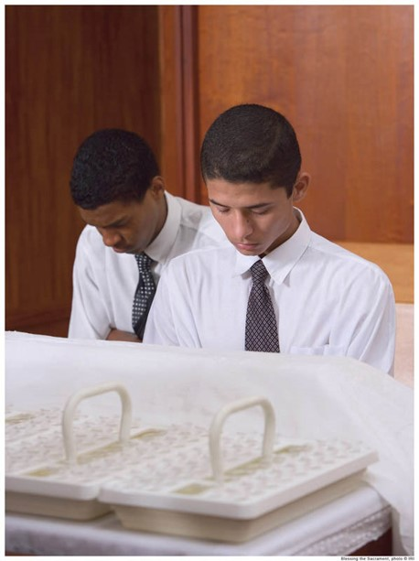
The Ordinance of the Sacrament
O God, the Eternal Father,
we ask thee, in the name of thy Son, Jesus Christ,
to bless and sanctify this wine to the souls of all those who drink of it,
that they may do it in remembrance of the blood of thy Son, which was shed for them;
that they may witness unto thee, O God, the Eternal Father,
that they do always remember him,
that they may have his Spirit to be with them. Amen.
Moroni 5:2

Slide 30
These words from the sacrament prayer should then describe our daily life: “Always remember him.” “Him” refers to Jesus Christ.
The next words, “and keep his commandments,” suggest what it means for us to remember Him.
As we remember Jesus Christ always, we might ask in silent prayer, “What would He have me do?”
Henry B. Eyring
Doctrine and Covenants 20:77

Slide 31
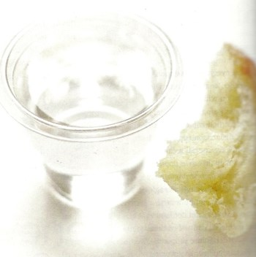
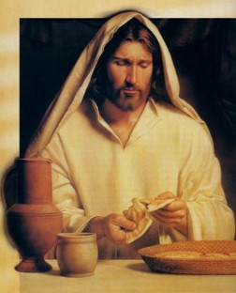
Eternal Atonement
“Emblems of the Sacrament are symbols of the sacrifice of the Savior’s flesh and body that were broken and his blood that was spilt in the course of the infinite and eternal Atonement.”
JFM and RLM
¶And as they did eat, Jesus took bread, and blessed, and brake it, and gave to them, and said, Take, eat: this is my body.
And he took the cup, and when he had given thanks, he gave it to them: and they all drank of it.
And he said unto them, This is my blood of the new testament, which is shed for many.
Mark 14:22-24
The emblems of the sacrament help us remember the Savior Jesus Christ and His atoning sacrifice
Moroni 4:3

Slide 32
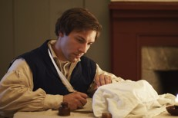
Changing Wine to Water
The Church uses water for wine in the blessing as given to Joseph Smith in revelation:
“For, behold, I say unto you, that it mattereth not what ye shall eat or what ye shall drink when ye partake of the sacrament, if it so be that ye do it with an eye single to my glory—remembering unto the Father my body which was laid down for you, and my blood which was shed for the remission of your sins.”
D&C 27:2

Slide 33
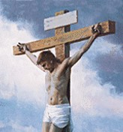
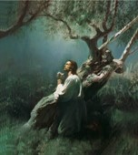
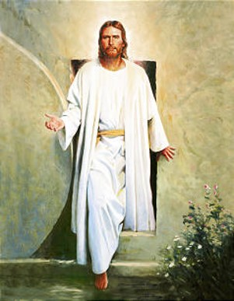
Explaining the Sacrament to Others
If a friend of another faith decided to attend sacrament meeting with you, how would you explain the meaning of the sacrament and its importance to you?
Bread--- Jesus Christ’s Body
Water (Wine)---Jesus Christ’s Blood
Symbolic of:
The Savior’s physical suffering and death on the cross
His Resurrection, when His body was reunited with His spirit
three days after He took death upon Himself.
His intense spiritual suffering and anguish when He took our
sins upon Himself, causing Him to bleed from every pore.
Because He took physical death upon Himself, all people will be
resurrected.
Because He suffered for our sins, we can be forgiven of our sins when we repent.

Slide 34
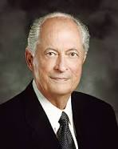
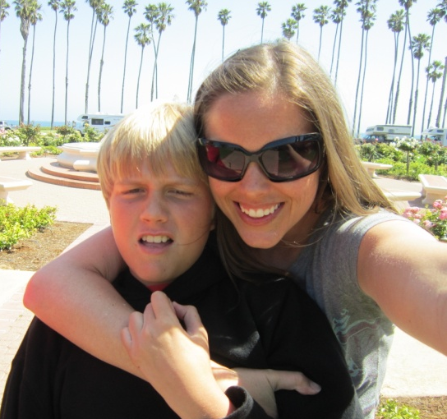
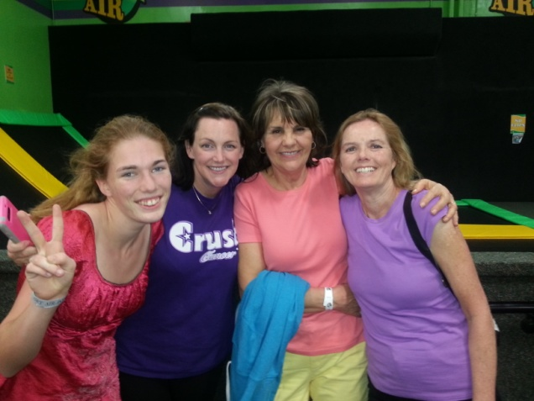
How We Conduct Our Lives
“How we treat our family members, our neighbors, business associates, (people at school), and all we meet will reveal if we have taken His name upon us and do always remember Him. How we conduct our lives, all we do and all we say, reflects on how we remember Him”
Robert D. Hales
Moroni 4:3

Slide 35
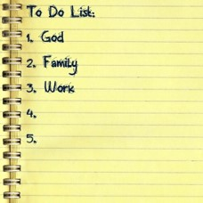
Covenants--Agreements and Promises
“We promise to take His name upon us.
That means we must see ourselves as His.
We will put Him first in our lives.
We will want what He wants rather than what we want or what the world teaches us to want”
Henry B. Eyring
As we partake of the sacrament, we promise to be willing to take upon ourselves the Lord’s name, always remember Him, and keep His commandments.

Slide 36
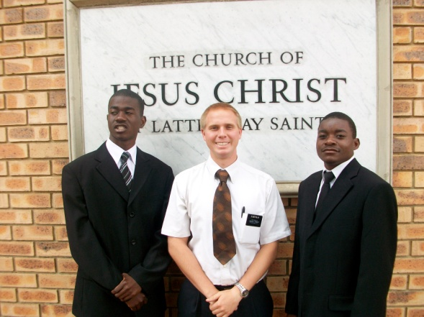
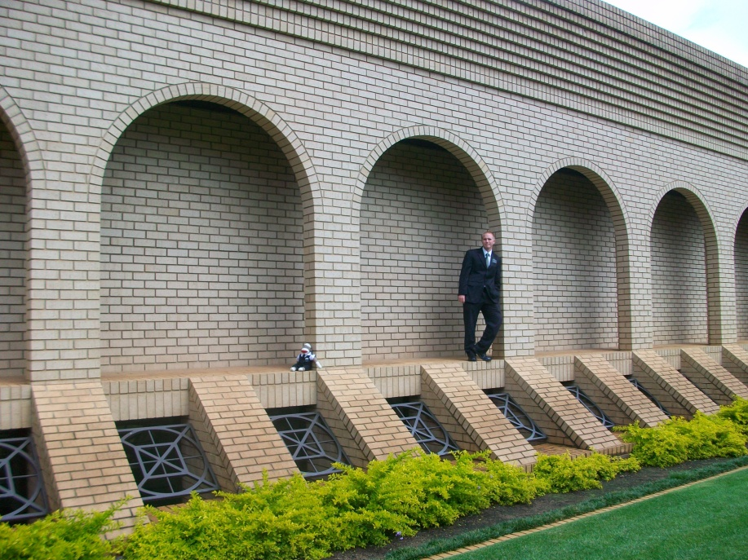
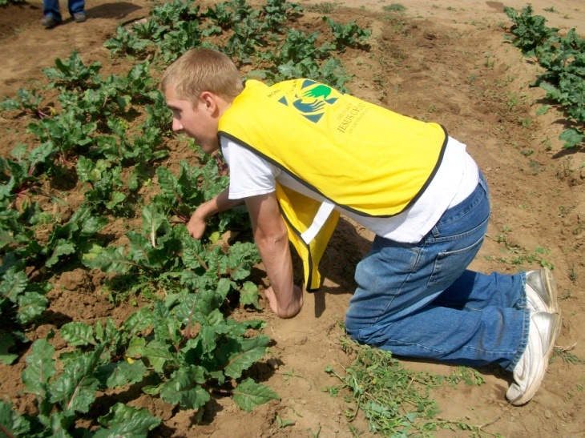
Witness---Promises
When we witness our willingness to take upon ourselves the name of Jesus Christ, we commit to live as His disciples.
We promise that we will not bring shame or reproach upon His name.
We commit to serve Him and our fellowman.
We also show that we are willing to be identified with Him and His Church.
As we faithfully keep the covenant we make during the sacrament, we can always have the Lord’s Spirit to be with us.

Slide 37
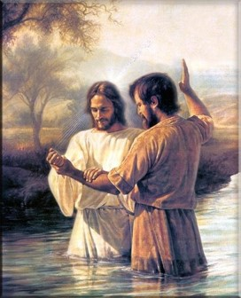
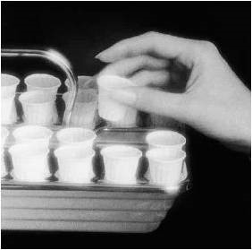
Renewing the Effects of Baptism
“The renewal of our covenants by partaking of the sacrament should also be preceded by repentance, so we come to that sacred ordinance with a broken heart and a contrite spirit…Then, as we renew our baptismal covenants and affirm that we will “always remember him’ the Lord will renew the promised remission of our sins, under the conditions and at the time he chooses…”
Dallin H. Oaks

Slide 38
Always Remember Him—Not Just Sundays
“We should first put in place the things that make it possible to always remember Him—frequent prayer and scripture study, thoughtful study of apostolic teachings, weekly preparation to partake of the sacrament worthily, Sunday worship, and recording and remembering what the Spirit and experience teach us about discipleship.
“Other things may come to your mind particularly suited to you at this point in your life. …
“… I can attest that over time our desire and capacity to always remember and follow the Savior will grow. We should patiently work toward that end and pray always for the discernment and divine help we need”
Elder D. Todd Christofferson

Slide 39
That They May Have His Spirit
To Be With Them
“The Spirit of the Lord can be our guide and will bless us with direction, instruction, and spiritual protection during our mortal journey”
Elder David A. Bednar
“If we have done wrong; if there is a feeling in our souls that we would like to be forgiven then the method to obtain forgiveness is not through rebaptism; it is not to make confession to man; but it is to repent of our sins, to go to those against whom we have sinned or transgressed and obtain their forgiveness, and then repair to the sacrament table where, if we have sincerely repented and put ourselves in proper condition, we shall be forgiven , and spiritual healing will come to our souls. It will really enter into our being.”
Elder Melvin J. Ballard

Slide 40
Spiritual Healing
”And ye are called to do this by prayer and thanksgiving, as the Spirit shall give utterance in all your doings in the house of the Lord, in the school of the prophets, that it may become a sanctuary, a tabernacle of the Holy Spirit to your edification.”
D&C 88:137
Nothing is so bitter as to lose the privilege of partaking of the sacrament.
However---through repentance:
Nothing is so sweet as the partaking of the sacrament and experiencing the Holy Spirit and the renewed promise of our Heavenly Father.
Alma 36:21

Slide 41
True To Our Covenants
The Spirit helps us to:
Speak with the power
Brings things to our remembrance
Gives us Peace and Joy
Opens up revelations to our minds
Shows us all things that we should do
Strengthens body, mind and spirit
Comforts us in times of sorrow
Unfolds to us the mysteries of the kingdom
Brings us many other spiritual blessing
D&C 88:137
John 14:26
Galatians 5:22
John 14:26; Moroni 10:5
Alma 5:46
2 Nephi 32:5
Romans 8:26
Acts 9:31
1 Nephi 10:19

Slide 42
Checking Our Own Status with Our Covenants
When have you received guidance, direction, instruction, or protection because of the companionship of the Holy Ghost?
Each week during the sacrament, we have the opportunity to consider how well we are keeping the covenant described in the sacrament prayers. How can this help us in our efforts to always have the Spirit with us?
As you ponder what you have learned today about partaking of the sacrament, what part of the sacrament prayers is especially meaningful to you? Why?

Slide 43
Sources:
Henry B. Eyring, “Prayers of Faith,” Ensign or Liahona, May 2020, 28
Joseph Fielding Smith and Robert L. Millet Doctrinal Commentary on the Book of Mormon Vol. 4 pg. 125
Robert D. Hales Ensign May 1995
Henry B. Eyring (“That We May Be One,” Ensign, May 1998, 67).
Elder D. Todd Christofferson (“To Always Remember Him,” Ensign, Apr. 2011, 51).
Dallin H. Oaks Ensign Nov 1996
Elder David A. Bednar (“That We May Always Have His Spirit to Be with Us,” Ensign or Liahona, May 2006, 31).
Presentation by ©http://fashionsbylynda.com/blog/

Slide 44
WHAT I COVENANT TO DO | WHAT I THINK IT MEANS TO KEEP THIS PART OF MY COVENANT | WHAT I CAN DO TO KEEP THIS PART OF MY COVENANT
1. Be willing to take upon myself the Lord’s name
2. Always remember Him
3. Keep His commandments

Slide 45
Sacrament and covenant breakers:
“I have wondered how members of the Church can go to the sacrament service and partake of these emblems, and make these solemn covenants, and then immediately after the close of the meeting go out to some place of amusement, to attend a picture show, a baseball game, or some resort, …. When any of these things is done, the… person violates this sacred covenant so recently made or renewed….The fact remains, however, that when we indulge in habits of this kind we are covenant breakers…If a man fully realized what it means when he partakes of the sacrament, that he covenants to take upon him the name of Jesus Christ and to always remember him and keep his commandments, and this vow is renewed week by ...”
Joseph Fielding Smith Doctrines of Salvation 2:345-346
Baptism Covenants:
”One’s faithfulness to the covenants made in baptism and renewed with worthy partaking of the sacrament binds the renewed with worthy partaking of the sacrament binds the Lord to his part of the covenant agreement. He has promised that we may have the influence of the Holy Ghost as a constant companion.
The Holy Ghost is a sanctifier, as a result we are forgiven of our sins and cleansed by the Holy Spirit through worthy partaking of the sacrament.”
JFM and RLM Doctrinal Commentary on the Book of Mormon Vol 4 pg 237
Enter into Covenants:
We enter the covenant path by being baptized and making our first covenant with God. Each time we partake of the sacrament, we promise again to take the name of the Savior upon us, to remember Him, and to keep His commandments. In return, God assures us that we may always have the Spirit of the Lord to be with us. (Russell M. Nelson, “The Power of Spiritual Momentum,” Liahona, May 2022, 98)
Sacramental Prayer:
“All of us face different family circumstances and home situations. All of us need strength in dealing with them. This strength come from faith in the Savior’s love and in the power of his atonement. If we trustingly put our hand in the Savior’s, we can claim the promise of the sacramental prayer to always have his Spirit with us. All problems are manageable with that strength, and all other problems are secondary in urgency to maintaining a strong spiritual life.”
Cheiko N. Okazaki Ensign Nov 1993

Slide 46
Baptism and Membership
Moroni 6

Slide 47
Requirements For Baptism
A broken heart and a contrite spirit
A witness that they have truly repented
Taking upon His name and willing to serve Him to the end
Worthiness to be baptized:
They are to live in obedience to God’s commandments, showing that they are ready to make and keep the baptismal covenant
Through baptism, we covenant to take upon ourselves the name of Jesus Christ and serve Him to the end
Moroni 6:1-3

Slide 48
Waters of Baptism
“Sins are remitted not in the waters of baptism, as we say in speaking figuratively, but when we receive the Holy Ghost.
It is the Holy Spirit of God that erases carnality and brings us into a state of righteousness. We become clean when we actually receive the fellowship and companionship of the Holy Ghost.
It is then that sin and dross and evil are burned out of our souls as though by fire. The baptism of the Holy Ghost is the baptism of fire.”
Elder Bruce R. McConkie

Slide 49
Responsibility
We have a responsibility to remember other members of the Church and to nourish them spiritually by the good word of God
We have a responsibility to help each other be continually watchful unto prayer
We have a responsibility to help each other rely on the Savior and His Atonement
Moroni 6:4

Slide 50
Care and Nourishment For Others
Spiritually Nourish
“…they were numbered among the people of the church of Christ; and their names were taken, that they might be remembered and nourished by the good word of God, to keep them in the right way, to keep them continually watchful unto prayer, relying alone upon the merits of Christ, who was the author and the finisher of their faith.”
Numbered—Might mean a record of the people baptized.
“Keeping a record of the members of the Church was not done for sake of reporting statistics or “boasting” in numbers but rather so that each member could be identified and remembered. ..Members are remembered in that priesthood leaders are kept aware of all those in their units in order that they can be spiritually Ministered to and encouraged to live the gospel…”
JFM and RLM
Moroni 6:4

Slide 51
“It is not an easy thing to become a member of this Church. In most cases it involves setting aside old habits, leaving old friends and associations, and stepping into a new society which is different and somewhat demanding.
“With the ever-increasing number of converts, we must make an increasingly substantial effort to assist them as they find their way. Every one of them needs three things: a friend, a responsibility, and nurturing with ‘the good word of God’ (Moro. 6:4).

Slide 52
It is our duty and opportunity to provide these things. …
“This is a work for everyone. It is a work for home teachers and visiting teachers. It is a work for the bishopric, for the priesthood quorums, for the Relief Society, the young men and young women, even the Primary.
“I was in a fast and testimony meeting only last Sunday. A 15- or 16-year-old boy stood before the congregation and said that he had decided to be baptized.
“Then one by one boys of the teachers quorum stepped to the microphone to express their love for him, to tell him that he was doing the right thing, and to assure him that they would stand with him and help him. It was a wonderful experience to hear those young men speak words of appreciation and encouragement to their friend”
President Gordon B. Hinckley

Slide 53
Our Responsibility
We have a responsibility to remember other members of the Church and to nourish them spiritually by the word of God. They may also say that we should help each other be continually watchful unto prayer and that we should help each other rely on the Savior and His Atonement.
“Most people don’t come to church looking merely for a few new gospel facts or to see old friends, though all of that is important. They come seeking a spiritual experience. They want peace. They want their faith fortified and their hope renewed. They want, in short, to be nourished by the good word of God, to be strengthened by the powers of heaven. Those of us who are called upon to speak or teach or lead have an obligation to help provide that, as best we possibly can”
Elder Jeffrey R. Holland
Moroni 6:4

Slide 54
Moroni 6:4-9
Remember other members of the church
V. 4
Nourish one another spiritually by the good word of God
V. 4
Forgive others when they repent
Vs. 7-8
Watch over and pray for each other
V. 4
Teach and pray according to the power of the Holy Ghost
V. 9
Partake of the sacrament in remembrance of Jesus Christ
V. 6
Help one another rely on the Savior and His Atonement
V. 4
Meet together often to fast and pray together
V. 5
Strengthen one another spiritually
V. 5

Slide 55
The Purpose of Church Meetings
As Church members, we are to meet together often to fast and to pray
As Church member, we are to meet together often to strengthen each other spiritually
As Church members, we are to meet together often to partake of the sacrament in remembrance of Jesus Christ
Moroni 6:5-6

Slide 56
Joy in Attending Church
“Years ago, I changed my attitude about going to church. No longer do I go to church for my sake, but to think of others. I make a point of saying hello to people who sit alone, to welcome visitors, … to volunteer for an assignment. …
“In short, I go to church each week with the intent of being active, not passive, and making a positive difference in people’s lives. Consequently, my attendance at Church meetings is so much more enjoyable and fulfilling”
Elder Dallin H. Oaks

Slide 57
Do You or Could You?

Slide 58
What role could the Holy Ghost have in helping you meet other members’ needs?
What do you think it means that the Holy Ghost could “lead” you in serving others?
What could that look like in your quorum or class?
How do you think following the Spirit could help you do what the Savior would do?
What obstacles might hinder how you feel the Spirit in Church meetings and activities? How could you help overcome these obstacles?

Slide 59
If Sin Occurs--Disobedience
“And they were strict to observe that there should be no iniquity among them; and whoso was found to commit iniquity, and three witnesses of the church did condemn them before the elders, and if they repented not, and confessed not, their names were blotted out, and they were not numbered among the people of Christ.”
“Church disciple…is not for the purpose of punishment only, but is intended to heal and renew.”
Richard E. Poelman
As often as we repent and seek forgiveness with real intent, we will be forgiven
Moroni 6:7

Slide 60
Forgiveness Can Be Obtained
“But as oft as they repented and sought forgiveness, with real intent, they were forgiven.”
“And him that repenteth not of his sins, and confesseth them not, ye shall bring before the church, and do with him as the scripture saith unto you, either by commandment or by revelation.
And this ye shall do that God may be glorified—not because ye forgive not, having not compassion, but that ye may be justified in the eyes of the law, that ye may not offend him who is your lawgiver—”
D&C 64:12-13
Moroni 6:8

Slide 61
Meetings Led by the Spirit
“And their meetings were conducted by the church after the manner of the workings of the Spirit, and by the power of the Holy Ghost; for as the power of the Holy Ghost led them whether to preach, or to exhort, or to pray, or to supplicate, or to sing, even so it was done.”
“But notwithstanding those things which are written, it always has been given to the elders of my church from the beginning, and ever shall be, to conduct all meetings as they are directed and guided by the Holy Spirit.”
D&C 46:2
“Meetings should be conducted in a reverential manner that will be conducive to the spirit of true worship.
Speakers and teachers should like wise prayerfully seek inspiration that their part will be “led by the Spirit.” Congregation members, too, have a sacred obligation to spiritually prepare for meetings and attend them in the proper frame of mind so as to be touched by the power of the Holy Ghost.”
JFM and RLM
Moroni 6:9

Slide 62
Sources:
Elder Bruce R. McConkie
(A New Witness for the Articles of Faith [1985], 290; see also page 239).
President Gordon B. Hinckley (“Converts and Young Men,” Ensign, May 1997, 47–48).
Joseph Fielding McConkie and Robert L. Millet Doctrinal Commentary on the Book of Mormon Vol. 4 pgs. 329, 332
Elder Jeffrey R. Holland (“A Teacher Come from God,” Ensign, May 1998, 26).
Elder Dallin H. Oaks (quoted in “Unselfish Service,” Ensign or Liahona, May 2009, 96).
Richard E. Poelman Ensign Nov 1993

Slide 63
Elder James E. Faust:
Church discipline is not limited to sexual sins but includes other acts such as murder, abortions, burglary, theft, fraud, and other dishonesty, deliberate disobedience to the rules and regulations of the Church, advocating or practicing polygamy, apostasy, or any other unchristianlike conduct, including defiance or ridicule of the Lord’s anointed, contrary to the law of the Lord and the order of the Church…
Among the activities considered apostate to the Church include when members “(1) repeatedly act in clear, open, and deliberate public opposition to the Church or its leaders; (2) persist in teaching as Church doctrine information that is not Church doctrine after being corrected by their bishops or higher authority; or (3) continue to follow the teachings of apostate cults (such as those that advocate plural marriage) after being corrected by their bishops or higher authority”
(General Handbook of Instructions, 1989, p. 10-3).
Nov. 1993 Ensign Keeping Covenants and Honoring the Priesthood
Disciplinary:
“Those who misunderstand the mission of the church and the indispensable role of discipline in fulfilling that mission may view excommunication, disfellowshipment, or other formal disciplinary measures as unfairly punitive and humiliating.
On the contrary, Elder Theodore m. Burton noted that “The most loving action the church can take at times is to disfellowship or excommunicate a person: (to Forgive is Divine., Ensign May 1983 pg. 70)
When deemed necessary through inspiration, these repentance remedies can help the sinner fully realize the seriousness of his transgression. If a serious offense is treated too lightly it is more likely to be repeated. Such Church actions can ensure that the necessary price for repentance is paid.
Through Church discipline a wrongdoer can demonstrate to the Lord, to the church, and to others a sincere desire to repent and be forgiven, whatever the cost. This period of discipline is an opportunity to be retained as a disciple of him who made our repentance possible. Joseph Fielding McConkie and Robert L. Millet Doctrinal Commentary Vol 4 pg. 331
What can I do if I feel like church is not for me?
Some say that attending church meetings is not helping them. Some say, “I didn’t learn anything today” or “No one was friendly to me” or “I was offended.” Personal disappointments should never keep us from the doctrine of Christ, who taught us to serve, not to be served. With this in mind, another member described the focus of his Church attendance:
“Years ago, I changed my attitude about going to church. No longer do I go to church for my sake, but to think of others. I make a point of saying hello to people who sit alone, to welcome visitors, … to volunteer for an assignment. …
“In short, I go to church each week with the intent of being active, not passive, and making a positive difference in people’s lives.” (Dallin H. Oaks, “The Need for a Church,” Liahona, Nov. 2021, 24–25)
Broken Heart and contrite spirit:
Elder D. Todd Christofferson of the Quorum of the Twelve Apostles explained what it means to offer a broken heart and a contrite spirit unto the Lord:
“As you seek the blessing of conversion, you can offer the Lord the gift of your broken, or repentant, heart and your contrite, or obedient, spirit. In reality, it is the gift of yourself—what you are and what you are becoming” (“When Thou Art Converted,” Ensign or Liahona, May 2004, 12).

