Slide 1
Moroni 7-9

Slide 3
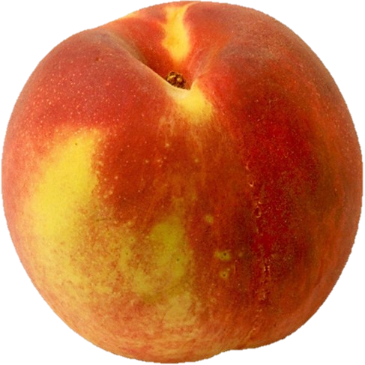
Righteous In Our Hearts
In what ways might a person be like a piece of fruit that appears good on the outside but is rotten on the inside?

Slide 4
Real Intent—Inner Spirituality
The fruit worthy of baptism is seen in action
The broken heart and contrite spirit are reflected in one’s attitudes and desires
“To have a broken heart and contrite spirit is to be broken down with deep sorrow for sin, to be humbly and thoroughly penitent, to have attained sincere and purposeful repentance.”
Bruce R. McConkie
“We must not only do what is right. We must act for the right reasons. The modern term is good motive. The scriptures often signify this appropriate mental attitude with the words full purpose of heart or real intent.
“The scriptures make clear that God understands our motives and will judge our actions accordingly”
Dallin H. Oaks

Slide 5
Motives For Righteousness
“…if a man being evil giveth a gift, he doeth it grudgingly; ”
”if he shall pray and not with real intent of heart”
“…it is right to pay one’s tithing or to engage in prayer, but if one does these things to “be seen of men,” they are not counted as righteous acts.”
Student Manual
Is it possible to do the right thing for the wrong reason?
To be blessed for our good works, we must act with real intent
Moroni 7:4-11

Slide 6
Because I Had To
“Have you ever found yourself doing something
you thought was right, but doing it because
you ‘had’ to?
Did you ever keep a commandment of God with
an attitude of resentment?
Do you think such feelings will be ignored by a Father in Heaven who gave us the willpower we call agency?
We are accountable for our feelings and desires as well as our acts.
Acts that seem to be good bring blessings only when they are done with real and righteous intent.
On the positive side, we will be blessed for the righteous desires of our hearts even though some outside circumstance has made it impossible for us to carry those desires into action.”
Dallin H. Oaks
Moroni 7:4-11

Slide 7
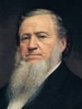
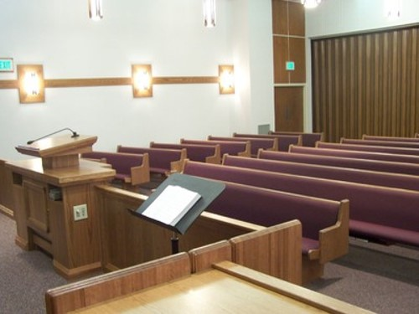
I Don’t Feel Like It
“It matters not whether you or I feel like praying, when the time comes to pray, pray. If we do not feel like it, we should pray till we do”
Brigham Young
Some people might not attend church with real intent. However, if they continue attending church and do all they can to participate and worship, they will have experiences that will help them find joy in attending church. Their reasons for attending will change. They will attend because they want to be there—they want to worship God, renew their covenants, and serve others.
Moroni 7:9

Slide 8
Evil Good, Good Evil
Woe unto them that call evil good, and good evil; that put darkness for light, and light for darkness; that put bitter for sweet, and sweet for bitter!
(Isaiah 5:20)
Wo unto them that call evil good, and good evil, that put darkness for light, and light for darkness, that put bitter for sweet, and sweet for bitter!
2 Nephi 15:20
Moroni 7:12-14

Slide 9
How to Judge Good From Evil
All things cometh from God are good
How can we know that something comes from God?
All things cometh from Satan are bad
How can we know that something comes from the devil?
That which is of God invites us to do good, believe in Jesus Christ, and love and serve God
Anything that persuades us to do evil, deny Jesus Christ, or fight against God comes from the devil
Moroni 7:12-14

Slide 10
Ways God entices us to do good
Ways Satan entices us to do evil
Moroni 7:12-14

Slide 11
The Appearance of Good
A misjudgment
If ninety-nine truths are told to perpetrate one lie, the one hundred statement taken together constitute a falsehood.
The scriptures never credit Lucifer with good intent in anything he does.
The devil persuades no one to do good…he may seek to make it appear that he leads one to good so that he can entrap a person in an evil deed.
However….
Can the devil make us do evil?
Only we allow ourselves to be persuaded by Satan
Moroni 7:12-14 Student Manual

Slide 12
“Satan, or Lucifer, or the father of lies—call him what you will—is real, the very personification of evil.
His motives are in every case malicious. …
He is eternally opposed to the love of God, the Atonement of Jesus Christ, and the work of peace and salvation.
He will fight against these whenever and wherever he can.
He knows he will be defeated and cast out in the end, but he is determined to take down with him as many others as he possibly can.”
Elder Jeffrey R. Holland

Slide 13
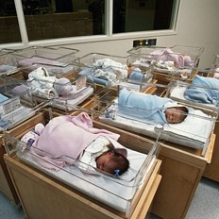
Spirit of Light Given to All
“Every man or woman born into this world is born with what the scriptures call the Light of Christ or the Spirit of Jesus Christ…
“And the Spirit giveth light to every man that cometh into the world; and the Spirit enlighteneth every man through the world, that hearkeneth to the voice of the Spirit.”
D&C 84:46
…This same light is planted in the spirit of man by a benevolent God and serves as the source of reason and conscience and discernment. It is a moral monitoring device.”
Moroni 7:14-19 Boyd K. Packer

Slide 14
“The Holy Ghost and the Light of Christ are different from each other. …
“Regardless of whether this inner light, this knowledge of right and wrong, is called the Light of Christ, moral sense, or conscience, it can direct us to moderate our actions—unless, that is, we subdue it or silence it. …
“Every man, woman, and child of every nation, creed, or color—everyone, no matter where they live or what they believe or what they do—has within them the imperishable Light of Christ.”
President Boyd K. Packer
As we search diligently in the Light of Christ, we can discern between good and evil. If we lay hold upon every good thing, we will be children of Christ.

Slide 15
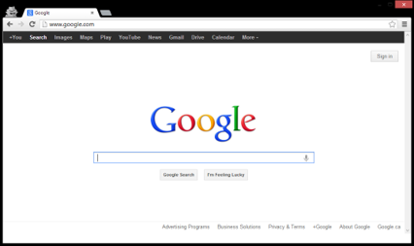
How well do these things invite you to do good, to believe in Jesus Christ, and to love God and serve Him?
Do any of these things try to persuade you to do evil, to doubt Jesus Christ, or to stop serving God?
Do you feel that you should eliminate any of these things from your life? If so, how will you do it?
Sometimes it may be difficult to do what we know is right when it requires giving up something we enjoy

Slide 16
Sources:
Bruce R. McConkie Mormon Doctrine pg 161
Dallin H. Oaks Pure in Heart [1988], 15).
(BYU 1985-86 Devotional & Fireside Speeches pp. 29, 31)
Student Manual Book of Mormon Religion 121-122 pg 516
(Teachings of Presidents of the Church: Brigham Young [1997], 45)
Joseph Fielding McConkie and Robert L. Millet Doctrinal Commentary on the Book of Mormon Vol. 4 pg. 335
President Boyd K. Packer (“The Light of Christ,” Ensign, Apr. 2005, 8–10).
Elder Jeffrey R. Holland (“We Are All Enlisted,” Ensign or Liahona, Nov. 2011, 44).
Presentation by ©http://fashionsbylynda.com/blog/

Slide 17
"We do not find this doctrine so clearly defined in the New Testament as in the Doctrine and Covenants and the Book of Mormon. But we discover this: The Lord has not left men (when they are born into this world) helpless, groping to find the light and truth, but every man that is born into the world is born with the right to receive the guidance, the instruction, the counsel of the Spirit of Christ, or Light of Truth, sometimes called the Spirit of the Lord in our writings.
"If a man who has never heard the gospel will hearken to the teachings and manifestations of the Spirit of Christ, or the Light of Truth, which come to him, often spoken of as conscience-every man has a conscience and knows more or less when he does wrong, and the Spirit guides him if he will hearken to its whisperings-it will lead him eventually to the fulness of the gospel. That is, he is guided by the Light, and when the gospel comes he will be ready to receive it. This is, he is guided by the Light, and when the gospel comes he will be ready to receive it. This is what the Lord tells us in section 84 of the Doctrine and Covenants.
"This Spirit of Truth, or Light of Christ, also has other functions. We read this in the revelation: 'This ... glory is that of the church of the Firstborn, even of God, the holiest of all, through Jesus Christ, his Son-He that ascended up on high, as also he descended below all things, in that he comprehended all things, that he might be in all and through all things, the light of truth; Which truth shineth. This is the light of Christ.' " (Joseph Fielding Smith, Doctrines of Salvation, 1:51.)

Slide 19
Good Blessings From Heavenly Father
Who is the source of all good things?

Slide 20
“All That He Has”
He wants us to “lay hold upon every good thing”, and He wants to give us all that He has.
How is it possible that ye can lay hold upon every good thing?
“And he that receiveth my Father receiveth my Father’s kingdom; therefore all that my Father hath shall be given unto him.”
D&C 84:38
Moroni 7:19, 20

Slide 21
All good things come because of Jesus Christ
Aaron to Lamoni’s Father:
“And since man had fallen he could not merit anything of himself; but the sufferings and death of Christ atone for their sins, through faith and repentance, and so forth; and that he breaketh the bands of death, that the grave shall have no victory, and that the sting of death should be swallowed up in the hopes of glory; and Aaron did expound all these things unto the king.” Alma 22:14
The doctrine taught in Moroni:
As descendants of Adam and Eve, we are “fallen” and unable to receive any blessings on our own.
Without Jesus Christ and His Atonement, “there could no good thing come unto [us].” Everything good that we have ever received from our Heavenly Father has come through the Savior and His Atonement.
The Brother of Jared:
“O Lord, thou hast said that we must be encompassed about by the floods. Now behold, O Lord, and do not be angry with thy servant because of his weakness before thee; for we know that thou art holy and dwellest in the heavens, and that we are unworthy before thee; because of the fall our natures have become evil continually; nevertheless, O Lord, thou hast given us a commandment that we must call upon thee, that from thee we may receive according to our desires.” Ether 3:2
Moroni 7:24

Slide 22
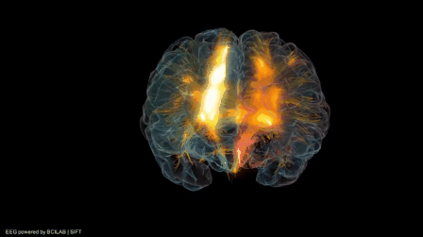
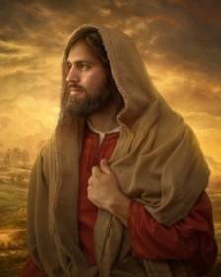
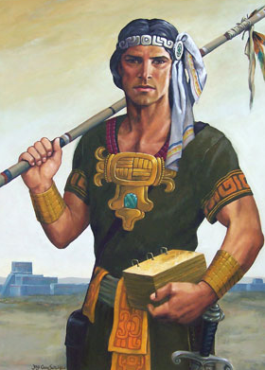
What Makes Faith Possible?
The knowledge of God
The ministering of angels which is one way in which the knowledge and authority of God comes
The reality of Christ
The Prophets of God
Moroni 7:26

Slide 23
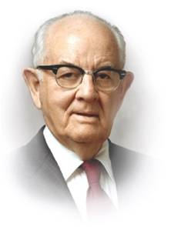
Miracles
Because Jesus has ascended to heaven…Have miracles ceased?
“Some churches teach that the day of miracles ended with the ministry of Jesus Christ and his apostles in Jerusalem.
Not so with The Church of Jesus Christ of Latter-day Saints.
For us the day of miracles has not passed. Many still have faith and have miracles follow in their lives.” Student Manual
For it is by faith that miracles are wrought;…wherefore if these things have ceased, then has faith ceased also?”
“The Lord will not force himself upon people; and if they do not believe, they will receive no visitation. If they are content to depend upon their own limited calculations and interpretations, then, of course, the Lord will leave them to their chosen fate.”
Spencer W. Kimball
The greatest of all miracles is the Atonement.
Moroni 7:27-39

Slide 24
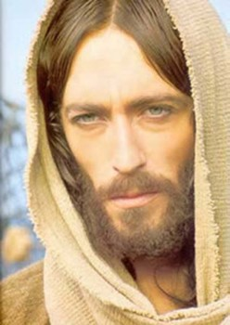
"In faith we plant the seed, and soon we see the miracle of the blossoming. Men have often misunderstood and have reversed the process.
They would have the harvest before the planting, the reward before the service,
the miracle before the faith.
Even the most demanding labor unions would hardly ask the wages before the labor.
But many of us would have the vigor without the observance of the health laws,
Prosperity through the opened windows of heaven without the payment of our tithes.
We would have the close communion with our Father without fasting and praying;
we would have rain in due season and peace in the land without observing the Sabbath and keeping the other commandments of the Lord.
We would pluck the rose before planting the roots;
we would harvest the grain before sowing and cultivating."
Elder Spencer W. Kimball

Slide 25
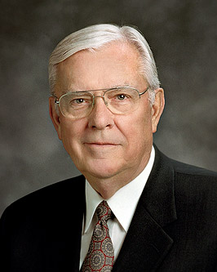
Hope
“faith is the substance of things hoped for, the evidence of things not seen” Hebrews 11:1
“And now abideth faith, hope, charity, these three; but the greatest of these is charity.”
1 Corinthians 13:13
FAITH
CHARITY
HOPE
“Three divine principles form a foundation upon which we can build the structure of our lives. … Together they give us a base of support like the legs of a three-legged stool”
Elder M. Russell Ballard
Moroni 7:40-48

Slide 26
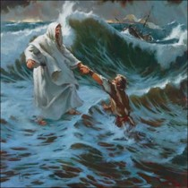
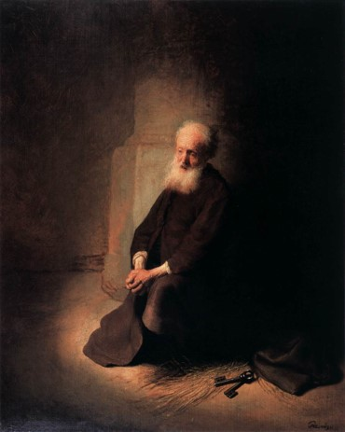
“Hope is a gift of the Spirit. …
“Hope is not knowledge, but rather the abiding trust that the Lord will fulfill His promise to us.
It is confidence that if we live according to God’s laws and the words of His prophets now, we will receive desired blessings in the future.
It is believing and expecting that our prayers will be answered. It is manifest in confidence, optimism, enthusiasm, and patient perseverance.”
President Dieter F. Uchtdorf

Slide 27
Charity—The Pure Love of Christ
“there must be faith; and if there must be faith there must also be hope; and if there must be hope there must also be charity.” Moroni 10:20
“and except ye have charity ye can in nowise be saved in the kingdom of God…(faith and hope included)” Moroni 10:21

Slide 28
Doctrinal Mastery
“And charity suffereth long, and is kind, and envieth not, and is not puffed up, seeketh not her own, is not easily provoked, thinketh no evil, and rejoiceth not in iniquity but rejoiceth in the truth, beareth all things, believeth all things, hopeth all things, endureth all things.
Wherefore, my beloved brethren, if ye have not charity, ye are nothing, for charity never faileth. Wherefore, cleave unto charity, which is the greatest of all, for all things must fail—
Moroni
7:45-46

Slide 29
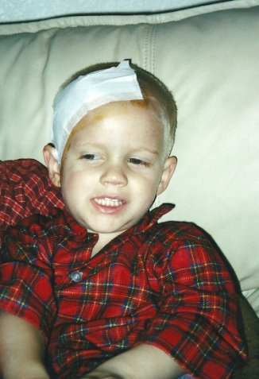
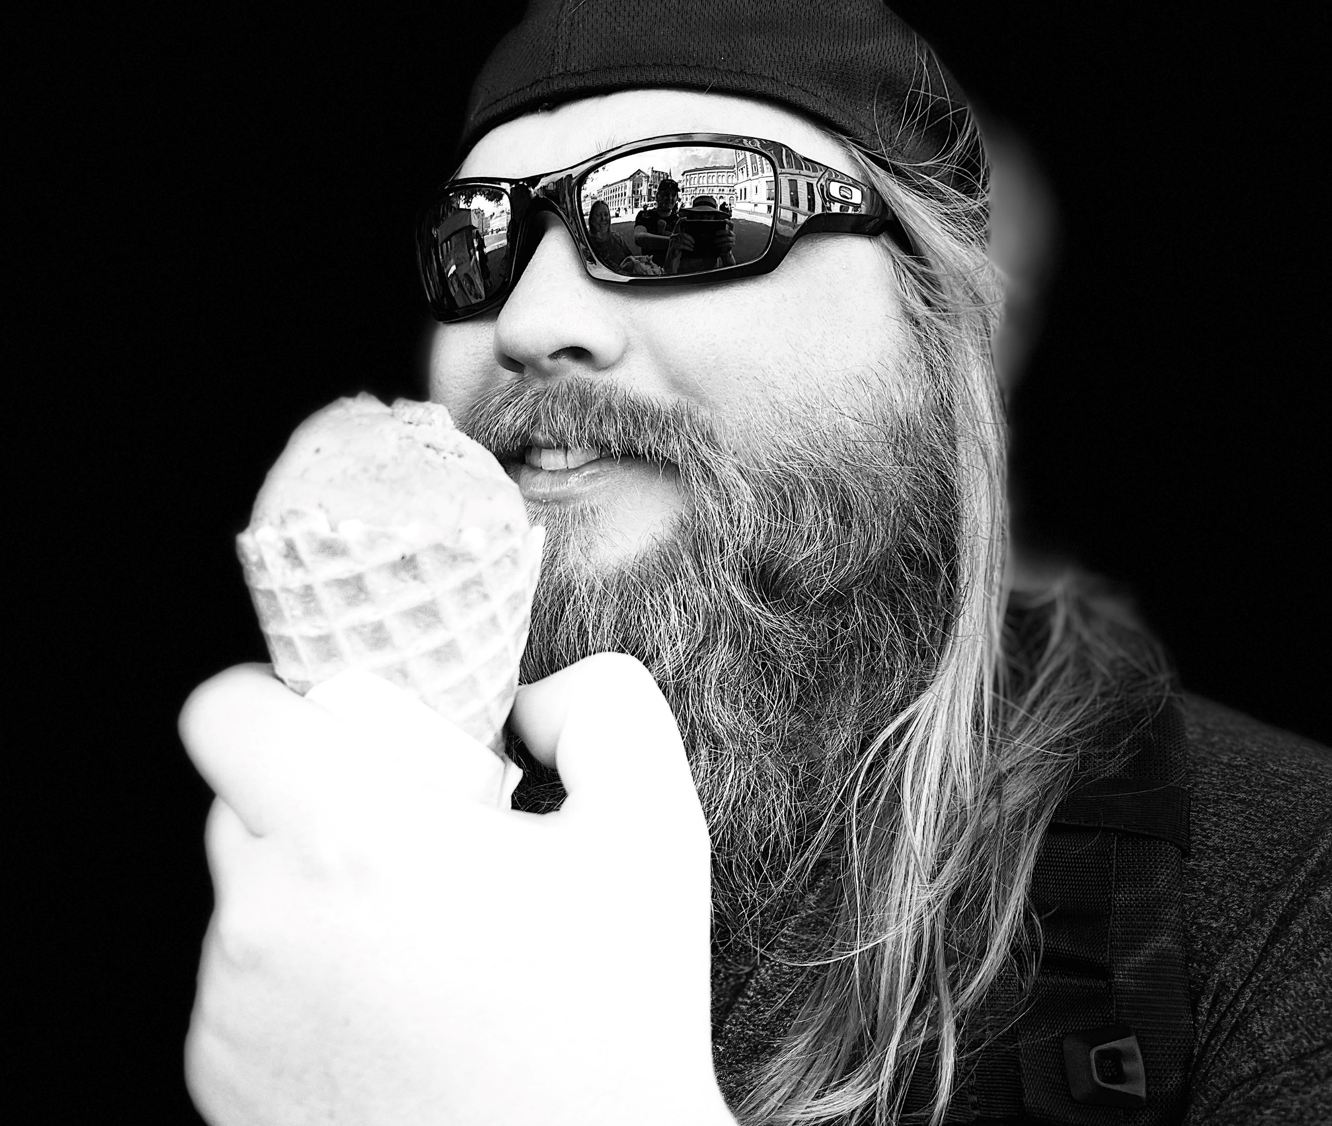
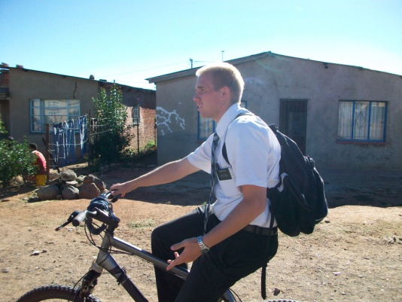
Moroni 7:45
“suffereth long” means that someone endures trials patiently.
“Envieth not” means that a person is not jealous of others.
“Not puffed up” means that someone is humble.
“Seeketh not her own” describes the quality of putting God and others before self.
“Not easily provoked” means not angered easily.
“Believeth all things” describes someone who accepts all truth

Slide 30
Doctrinal Mastery
“But charity is the pure love of Christ, and it endureth forever; and whoso is found possessed of it at the last day, it shall be well with him.
Wherefore, my beloved brethren, pray unto the Father with all the energy of heart, that ye may be filled with this love, which he hath bestowed upon all who are true followers of his Son, Jesus Christ; that ye may become the sons of God; that when he shall appear we shall be like him, for we shall see him as he is; that we may have this hope; that we may be purified even as he is pure. Amen.”
Moroni 7:47-48

Slide 31
“[Charity] is shown perfectly and purely in Christ’s unfailing, ultimate, and atoning love for us. … It is Christ’s love for us that ‘beareth all things, believeth all things, hopeth all things, endureth all things.’ It is as demonstrated in Christ that ‘charity never faileth.’ It is that charity—his pure love for us—without which we would be nothing, hopeless, of all men and women most miserable.
Truly, those found possessed of the blessings of his love at the last day—the Atonement, the Resurrection, eternal life, eternal promise—surely it shall be well with them.”
Jeffrey R. Holland

Slide 32
If you were filled with Charity…
What would you do?
1. People make fun of you or someone else at school.
2. You have a brother or sister who frequently annoys you.
3. Someone you know has committed a serious sin.
4. You do not like a new quorum or class adviser as much as you liked a previous adviser.

Slide 33
If we pray unto the Father with all the energy of heart and live as true followers of Jesus Christ, we can be filled with charity.

Slide 34
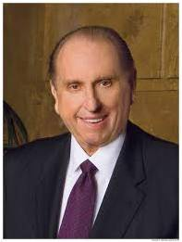
“There is a serious need for the charity that gives attention to those who are unnoticed, hope to those who are discouraged, aid to those who are afflicted. True charity is love in action. The need for charity is everywhere. …
“Charity is having patience with someone who has let us down. It is resisting the impulse to become offended easily. It is accepting weaknesses and shortcomings. It is accepting people as they truly are. It is looking beyond physical appearances to attributes that will not dim through time. It is resisting the impulse to categorize others. …
“… Life is perfect for none of us. Rather than being judgmental and critical of each other, may we have the pure love of Christ for our fellow travelers in this journey through life. …
“… May [charity] guide you in everything you do. May it permeate your very souls and find expression in all your thoughts and actions”
President Thomas S. Monson

Slide 35
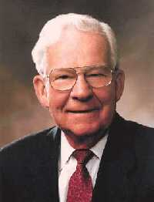
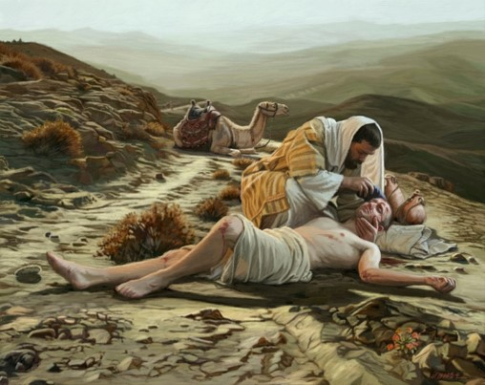
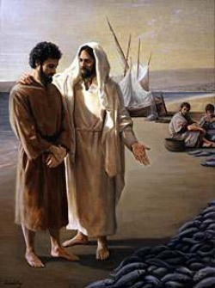
“Real charity is not something you give away; it is something that you acquire and make a part of yourself. …
“Perhaps the greatest charity comes when we are kind to each other, when we don’t judge or categorize someone else, when we simply give each other the benefit of the doubt or remain quiet.
Charity is accepting someone’s differences, weaknesses, and shortcomings; having patience with someone who has let us down; or resisting the impulse to become offended when someone doesn’t handle something the way we might have hoped.
Charity is refusing to take advantage of another’s weakness and being willing to forgive someone who has hurt us. Charity is expecting the best of each other”
Elder Marvin J. Ashton

Slide 36
Sources:
Spencer W. Kimball Conf. Report Oc. 1966
Elder Spencer W. Kimball (Faith Precedes the Miracle, p. 4.)
Student Manual Book of Mormon Religion 121-122 pg. 518
Elder M. Russell Ballard (“The Joy of Hope Fulfilled,” Ensign, Nov. 1992, 33).
President Dieter F. Uchtdorf (“The Infinite Power of Hope,” Ensign or Liahona, Nov. 2008, 21–22).
Jeffrey R. Holland, Christ and the New Covenant: The Messianic Message of the Book of Mormon [1997], 336).
President Thomas S. Monson (“Charity Never Faileth,” Ensign or Liahona, Nov. 2010, 124–25).
Elder Marvin J. Ashton (“The Tongue Can Be a Sharp Sword,” Ensign, May 1992, 19).
Presentation by ©http://fashionsbylynda.com/blog/

Slide 37
On Hope:
"From this we learn that faith is the assurance which men have of the existence of things which they have not seen, and the principle of action in
all intelligent beings.. .
" ... Faith ... is the moving cause of all action
in [intelligent beings]. . . . .
"And as faith is the moving cause of all action in temporal concerns, so it is in spiritual. ...
" ... But faith is not only the principle of action, but of power also, in all intelligent beings, whether in heaven or on earth ....
"Faith, then, is the first great governing principle which has power, dominion, and authority over all things; by It they exist, by It . they are upheld, by it they are changed, or by It they remain, agreeable to the will of. God. Without it there is no power, and Without power there could be no creation nor existence! ...
"How would you define faith in its most unlimited sense? It is the first great governing principle which has power, dominion, and authority over all things." Joseph Smith (Lectures on Faith, pp. 7-12.)
Elder Dallin H. Oaks of the Quorum of the Twelve Apostles described the ministry of angels:
“‘The word “angel” is used in the scriptures for any heavenly being bearing God’s message’ (George Q. Cannon, Gospel Truth, sel. Jerreld L. Newquist [1987], 54). The scriptures recite numerous instances where an angel appeared personally. Angelic appearances to Zacharias and Mary (see Luke 1) and to King Benjamin and Nephi, the son of Helaman (see Mosiah 3:2; 3 Ne. 7:17–18) are only a few examples. …
“… The ministering of angels can also be unseen. Angelic messages can be delivered by a voice or merely by thoughts or feelings communicated to the mind. President John Taylor described ‘the action of the angels, or messengers of God, upon our minds, so that the heart can conceive … revelations from the eternal world’ (Gospel Kingdom, sel. G. Homer Durham [1987], 31).
“Nephi described three manifestations of the ministering of angels when he reminded his rebellious brothers that (1) they had ‘seen an angel,’ (2) they had ‘heard his voice from time to time,’ and (3) also that an angel had ‘spoken unto [them] in a still small voice’ though they were ‘past feeling’ and ‘could not feel his words’ (1 Ne. 17:45). The scriptures contain many other statements that angels are sent to teach the gospel and bring men to Christ (see Heb. 1:14; Alma 39:19; Moro. 7:25, 29, 31–32; D&C 20:35). Most angelic communications are felt or heard rather than seen” (“The Aaronic Priesthood and the Sacrament,” Ensign, Nov. 1998, 38–39).
Elder Jeffrey R. Holland of the Quorum of the Twelve Apostles taught:
“It is instructive to note that the charity, or ‘the pure love of Christ,’ we are to cherish can be interpreted two ways. One of its meanings is the kind of merciful, forgiving love Christ’s disciples should have for one another. That is, all Christians should try to love as the Savior loved, showing pure, redeeming compassion for all. Unfortunately, few, if any, mortals have been entirely successful in this endeavor, but it is an invitation that all should try to meet.
“The greater definition of ‘the pure love of Christ,’ however, is not what we as Christians try but largely fail to demonstrate toward others but rather what Christ totally succeeded in demonstrating toward us. True charity has been known only once. It is shown perfectly and purely in Christ’s unfailing, ultimate, and atoning love for us. It is Christ’s love for us that ‘suffereth long, and is kind, and envieth not.’ It is his love for us that is not ‘puffed up … , not easily provoked, thinketh no evil.’ It is Christ’s love for us that ‘beareth all things, believeth all things, hopeth all things, endureth all things.’ It is as demonstrated in Christ that ‘charity never faileth.’ It is that charity—his pure love for us—without which we would be nothing, hopeless, of all men and women most miserable. Truly, those found possessed of the blessings of his love at the last day—the Atonement, the Resurrection, eternal life, eternal promise—surely it shall be well with them.
“This does not in any way minimize the commandment that we are to try to acquire this kind of love for one another. We should ‘pray unto the Father with all the energy of heart, that [we] may be filled with this love.’ [1 Corinthians 13:4–5, 7–8; Moroni 7:48.] We should try to be more constant and unfailing, more longsuffering and kind, less envious and puffed up in our relationships with others. As Christ lived so should we live, and as Christ loved so should we love. But the ‘pure love of Christ’ Mormon spoke of is precisely that—Christ’s love. With that divine gift, that redeeming bestowal, we have everything; without it we have nothing and ultimately are nothing, except in the end ‘devils [and] angels to a devil.’ [2 Nephi 9:9.]
“Life has its share of fears and failures. Sometimes things fall short. Sometimes people fail us, or economies or businesses or governments fail us. But one thing in time or eternity does not fail us—the pure love of Christ. …
“… The miracle of Christ’s charity both saves and changes us. His atoning love saves us from death and hell as well as from carnal, sensual, and devilish behavior. That redeeming love also transforms the soul, lifting it above fallen standards to something far more noble, far more holy. Wherefore, we must ‘cleave unto charity’—Christ’s pure love of us and our determined effort toward pure love of him and all others—for without it we are nothing, and our plan for eternal happiness is utterly wasted. Without the redeeming love of Christ in our lives, all other qualities—even virtuous qualities and exemplary good works—fall short of salvation and joy” (Christ and the New Covenant: The Messianic Message of the Book of Mormon[1997], 336–37).
Elder Bruce R. McConkie has written this:
"As used in the revelations, hope is the desire of faithful people to gain eternal salvation in the kingdom of God hereafter. It is not a flimsy, ethereal desire, one without assurance that the desired consummation will be received, but a desire coupled with full expectation of receiving the coveted reward. Paul, for instance, was not hesitant in affirming that he lived, 'In hope of eternal life, which God, that cannot lie, promised before the world began' (Tit. 1:2), and Peter assured all the elect that 'by the resurrection of Jesus Christ from the dead,' their 'lively hope' of 'an inheritance incorruptible, and undefiled, and that fadeth not away; reserved in heaven' for the saints, had been renewed or 'begotten' again. (1 Pet. 1:1-5.)" (Mormon Doctrine, p. 365.)

Slide 38
Little Children Are Alive in Christ
Moroni 8

Slide 39
Salvation of Little Children
Mormon counseled his son, Moroni, about disputations that had arisen among the Nephites about the baptism of little children. Later in his life, Moroni added this letter to his record in the gold plates.
Do little children need to be baptized?
Moroni 8:1-5

Slide 40
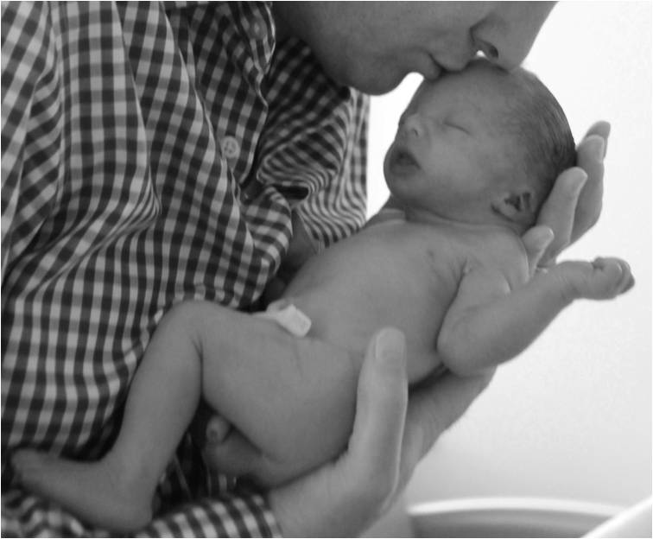
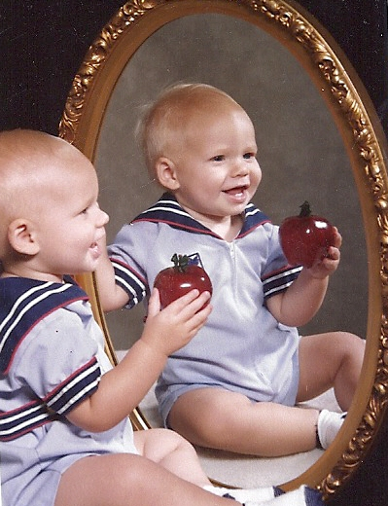
The ordinance of Baptism is “for remission of sins”
Little Children have no sins
“Repent and be baptized in the name of Jesus Christ, according to the holy commandment, for the remission of sins;” D&C 49:13
They are not capable of committing sin, nor does the devil have power to tempt them “until they begin to become accountable” before the Lord
“Wherefore, they cannot sin, for power is not given unto Satan to tempt little children, until they begin to become accountable before me;” D&C 29:47
Moroni 8:1-5

Slide 41
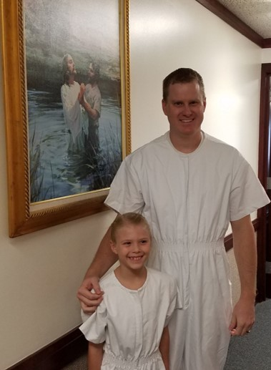
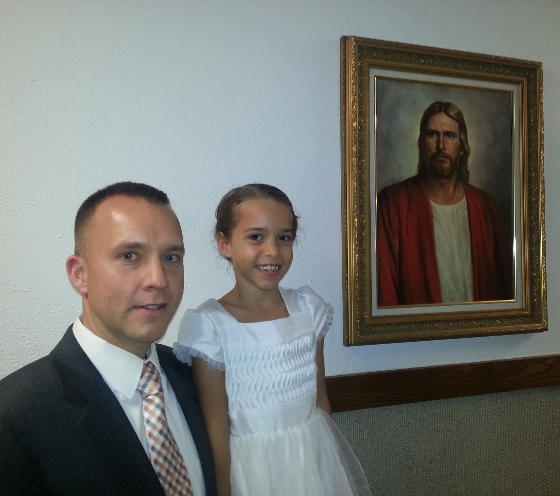
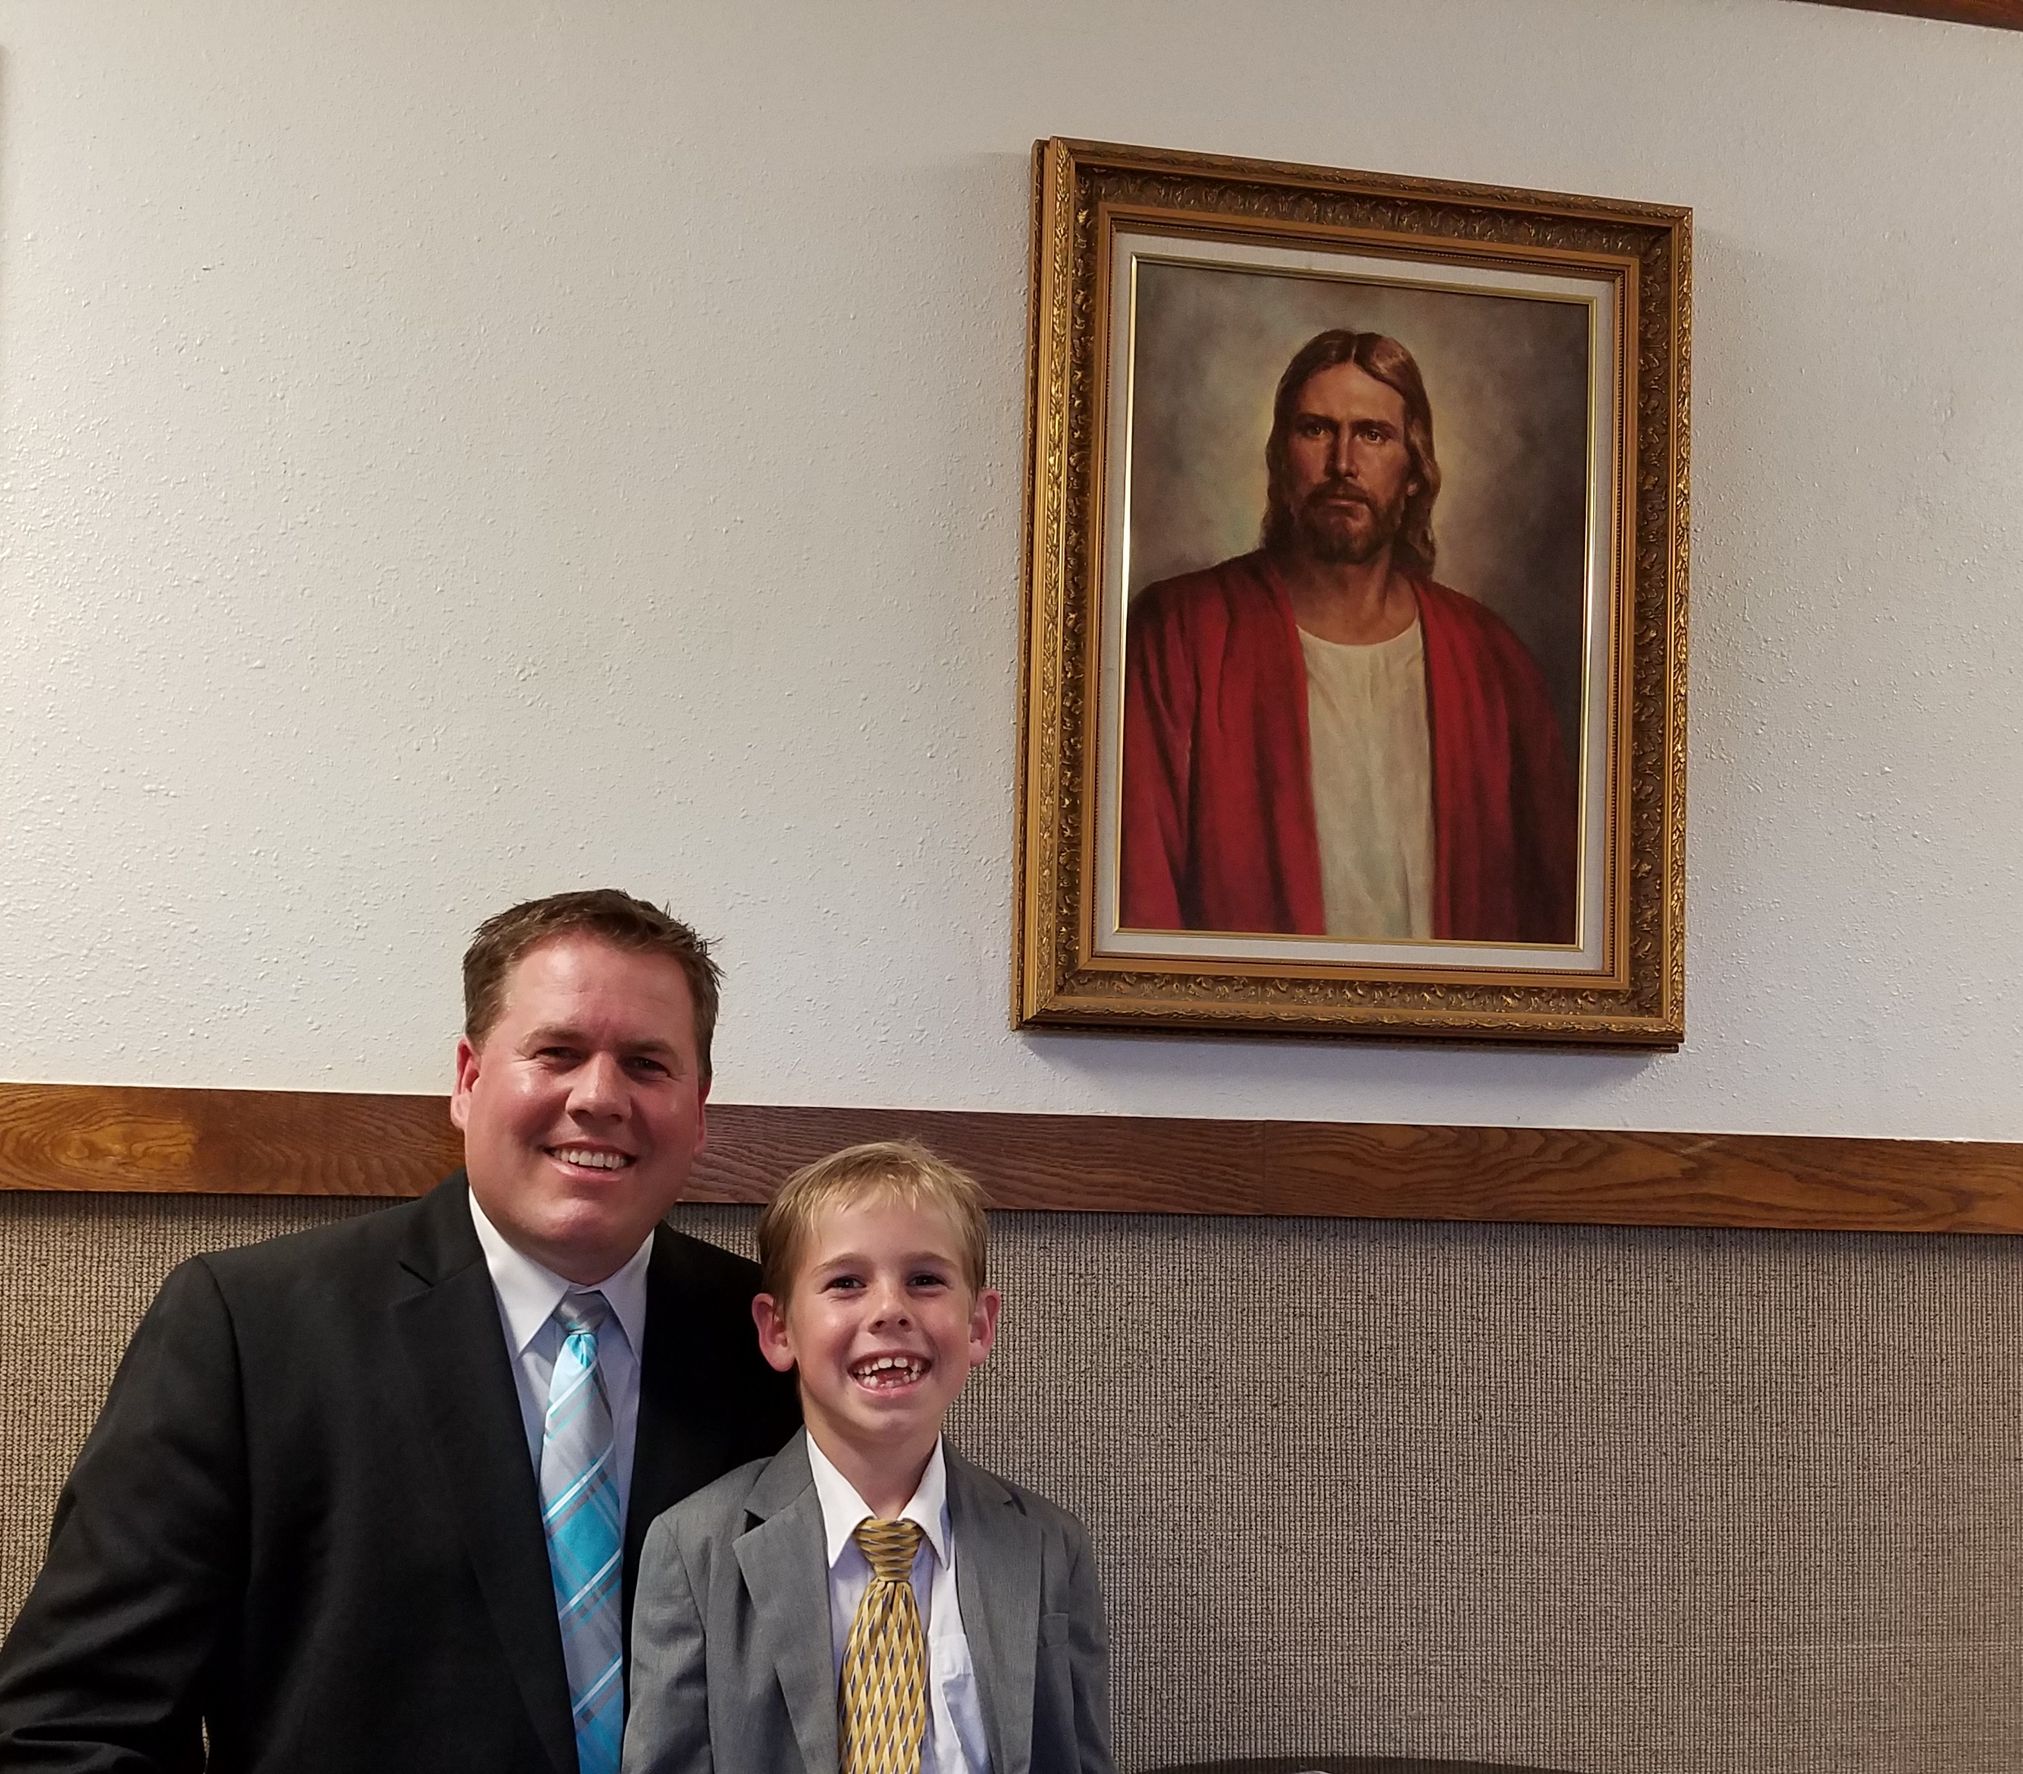
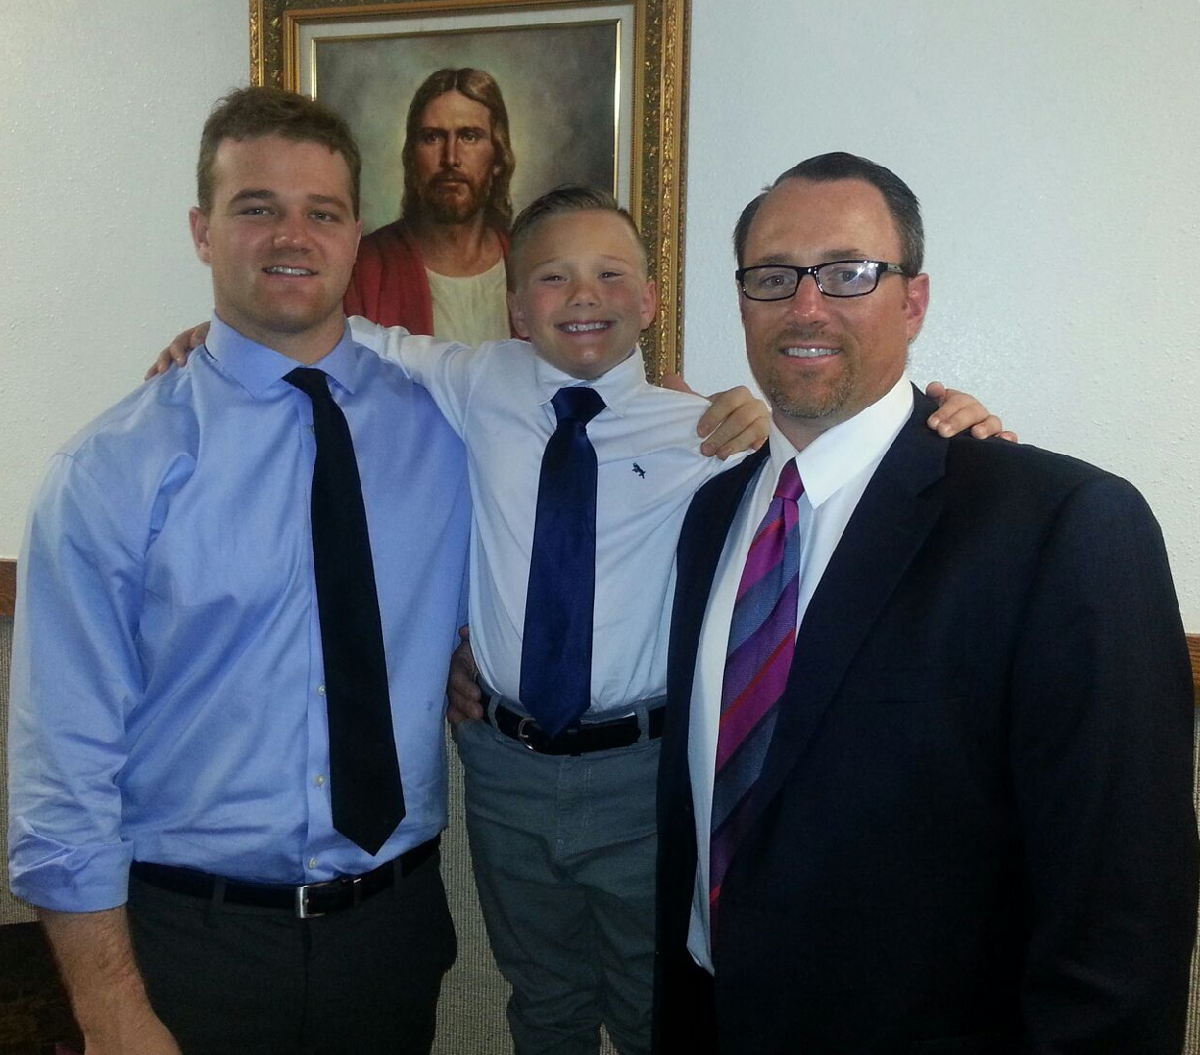
“Accountability does not burst full-bloom upon a child at any given moment in his life. Children become accountable gradually, over a number of years. Becoming accountable is a process, not a goal to be attained when a specified number of years, days, and hours have elapsed. In our revelation the Lord says, ‘They cannot sin, for power is not given unto Satan to tempt little children, until they begin to become accountable before me.’ (D&C 29:47.)
There comes a time, however, when accountability is real and actual and sin is attributed in the lives of those who develop normally. It is eight years of age, the age of baptism. (D&C 68:27.)”
Bruce R. McConkie

Slide 42
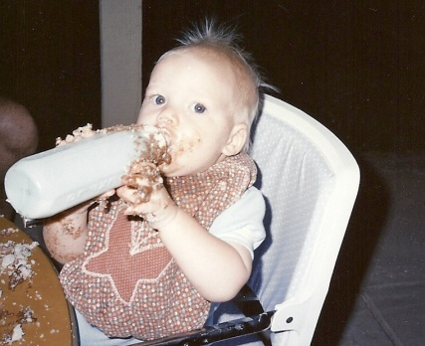
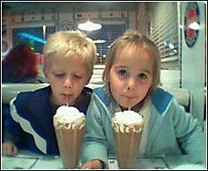
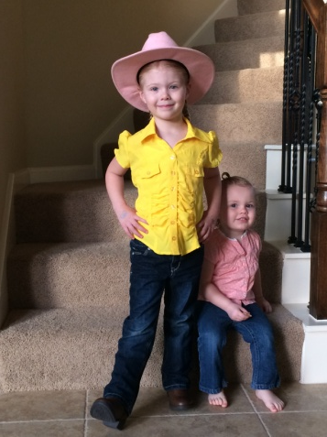
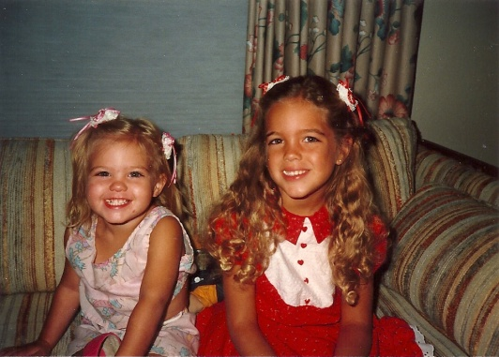
Little Children Are Whole
“…little children are whole, for they are not capable of committing sin; wherefore the curse of Adam is taken from them in me, that it hath no power over them; and the law of circumcision is done away in me.”
“They are “whole” and incapable of committing sin not because of any inherent perfection or goodness on their part but by reason of the Atonement. They are incapable of sinning because they are not accountable for their actions.”
JFM and RLM
Little children are made whole through the Atonement of Jesus Christ.
Moroni 8:7

Slide 43
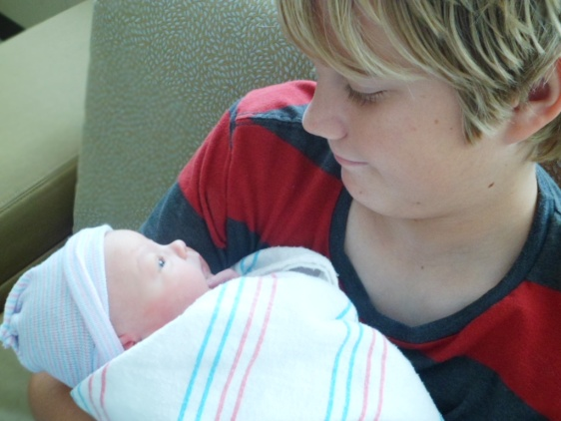
We understand from our doctrine that before the age of accountability a child is “not capable of committing sin”
During that time, children can commit mistakes, even very serious and damaging ones that must be corrected, but their acts are not accounted as sins.
Dallin H. Oaks
Are Children Pure?
“Little children are subject to the pull of and the effects of the Fall, just as everyone else is. They are not, however, held accountable for their acts….little children are saved without any preconditions—without faith, repentance, or baptism. Their innocence is decreed and declared by and through the tender mercies of an all-loving Lord—innocent through the Atonement”
Robert L. Millet
“…wherefore the curse of Adam is taken from them in me, that it hath no power over them; and the law of circumcision is done away in me.”
Moroni 8:8

Slide 44
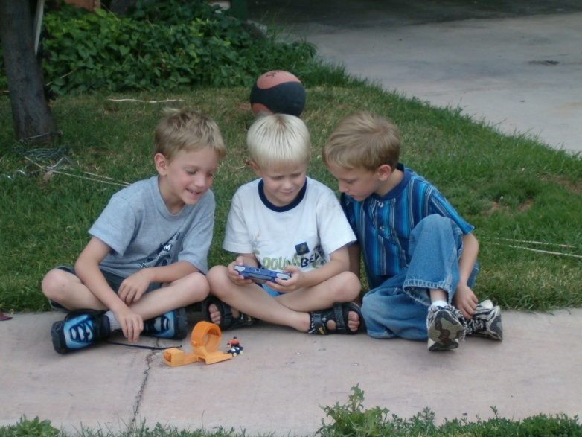
Pure and Innocent Behavior
“During these formative, innocent years, (Prior to age eight) a child may learn wrong behavior; but such is not the result of Satan’s temptations but comes from the wrong teachings and the bad example of others.”
Elder Merlin R. Lybbert
Moroni 8:8-11

Slide 45
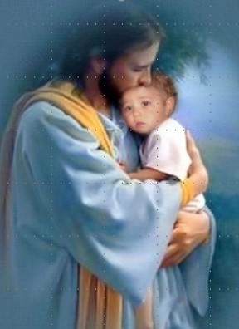
Little Children are Alive in Christ
“But little children are alive in Christ, even from the foundation of the world; if not so, God is a partial God, and also a changeable God, and a respecter to persons; for how many little children have died without baptism”
“The doctrine of baptizing children, or sprinkling them, or they must welter in hell, is a doctrine not true, not supported in Holy Writ, and is not consistent with the character of God.
All children are redeemed by the blood of Jesus Christ, and the moment that children leave this world, they are taken to the bosom of Abraham.”
Joseph Smith
“Little children who die before the age of accountability are saved in the celestial kingdom…Serious thinking would tell us that if these children are saved, they are not subject to a later trial by the temptation and buffeting of Satan.”
Joseph Fielding Smith
Moroni 8:12-14

Slide 46
“It would be an injustice to little children who die in early life to deprive them of the opportunity to obtain all the blessings that are promised to adults who are faithful and true in this life.” Joseph Fielding Smith
Depriving Children of Blessings
The main purpose of mortal life…is to obtain tabernacles of flesh and bones, and then to be tried and proved through our deeds in the body. If an infant dies, it has obtained its body. The body does not grow in the grave, but the spirit returns to await the resurrection. Following the resurrection the infant will grow to the full stature of its spirit.”
Joseph Fielding Smith
“…our beloved friends who are now deprived of their little ones have great cause for joy and rejoicing..such children are in the bosom of the Father. They will inherit their glory and their exaltation, and they will not be deprived of the blessings that belong to them.”
Joseph F. Smith
Moroni 8:15-20

Slide 47
Repentance is baptism
Love endureth to the end by prayer
Baptism comes by faith
In Order to Dwell with God
The Comforter fills us with hope and love
Remission of sins brings meekness
Meekness brings the Holy Ghost
Moroni 8:25-26

Slide 48
Results of Pride
Has proven the destruction of the people
They have rejected the knowledge
The spirit has ceased to be with them
They have denied the Holy Ghost
The prophecies have been fulfilled
They must perish
Moroni 8:27-30

Slide 49
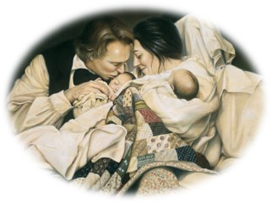
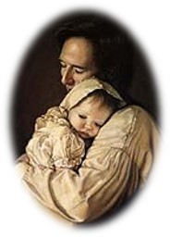
“You will have the joy, the pleasure, and satisfaction of nurturing this child, after its resurrection, until it reaches the full stature of its spirit.”
Joseph Smith

Slide 50
Presentation by ©http://fashionsbylynda.com/blog/
Sources:
Video: Children Are Alive in Christ (1:07)
Dallin H. Oaks, “Sins and Mistakes,” Ensign, Oct. 1996, 65
Joseph Fielding McConkie and Robert L. Millet Doctrinal Commentary on the Book of Mormon Vol. 4 pg. 351
Robert L. Millet Life in Christ pg. 32-33
Bruce R. McConkie, “The Salvation of Little Children,” Ensign, Apr. 1977, 6
Elder Merlin R. Lybbert The Special Status of Children Ensign May 1994
Joseph Smith History of the Church 4:5
Joseph Fielding Smith Answers to Gospel Questions Vol. 1 pg.56-57, 59
Joseph F. Smith Gospel Doctrin pg. 452-456
Art of Joseph Smith-- Liz Lemon Swindle

Slide 51
In a day when one of “the greatest problem[s] in our society is the abandonment of children through the abandonment of parental leadership” (Richard Lloyd Anderson, Understanding Paul, Salt Lake City: Deseret Book Co., 1983, p. 354), the First Presidency has asked that “we reemphasize the need for all adult members to focus on our children in an ongoing effort to help them learn to follow the teachings of the Savior.” Also they have asked each of us to “rededicate ourselves to nourish and bless them temporally and spiritually” (First Presidency Letter, 1 Aug. 1993; see Ensign, Jan. 1994, p. 80).
It may be helpful to review some of the doctrines as contained in the scriptures pertaining to the special status of children. These doctrines provide direction for those who are raising children and comfort to those of us who have lost a child in death at an early age.
Heavenly Father intended that each child should have the combined loving protection and guidance of caring parents. The pattern was established by Adam and Eve, our first parents. Joseph, the descendant of David, agreed to become the surrogate father of Jesus, the Son of God, when he accepted Mary as his wife, following a visitation of the angel Gabriel. In Nazareth, Joseph was regarded as the father of Jesus (see Matt. 13:55).
The Christ child grew and developed in a modest home, where Joseph earned a humble living as a carpenter, and where Jesus also learned this craft (see Mark 6:3). There were other members of the family. Mary and Joseph had four other sons and at least two daughters, all of whom were referred to in the community as the brothers and sisters of Jesus (see Matt. 13:55–56; Mark 6:3). The example of Joseph and Mary in providing a suitable home for their large family was such that Luke recorded that Jesus “grew, and waxed strong in spirit, filled with wisdom: and the grace of God was upon him” (Luke 2:40).
The Lord extends special protection to children and shares jurisdiction with earthly parents, even as we enjoy their presence. They cannot sin until they reach the age of accountability, which the Lord has declared to be eight years (see D&C 18:42; D&C 29:47). In fact, the power to even tempt them to commit sin has been taken from Satan. The prophet Mormon taught that “little children are whole, for they are not capable of committing sin. …
“Little children are alive in Christ, even from the foundation of the world; if not so, God is a partial God, and also a changeable God, and a respecter to persons; for how many little children have died without baptism!” (Moro. 8:8, 12.)
Because they cannot sin, they have no need of repentance, neither baptism. Adam’s original transgression has no claim as a result of the atonement of Jesus Christ. Mormon declared the practice of baptizing little children to be a “solemn mockery before God” (Moro. 8:9), for repentance and baptism apply to those who are “accountable and capable of committing sin” (Moro. 8:10).
Because all children who die before the age of accountability are pure, innocent, and wholly sin-free, they are saved in the celestial kingdom of heaven (see D&C 137:10; Mosiah 3:18). Understanding the special status of little children before God, because of their pure and innocent nature, brings understanding of the Lord’s commandment to “repent, and become as a little child, and be baptized in [His] name” (3 Ne. 11:37). The childlike qualities the Lord had reference to are developed by yielding to “the enticings of the Holy Spirit,” so as to become “submissive, meek, humble, patient, full of love, willing to submit to all things which the Lord seeth fit to inflict upon him, even as a child doth submit to his father.” Truly, such a person “becometh a saint” as spoken by Mosiah (Mosiah 3:19).
Parents in Zion have the special responsibility of teaching and training their children in righteousness. They are to be taught “to understand the doctrine of repentance, faith in Christ the Son of the living God, and of baptism and the gift of the Holy Ghost by the laying on of the hands, when eight years old.” Otherwise, the Lord declared, “the sin be upon the heads of the parents” (D&C 68:25). This teaching is to be done before a child reaches the age of accountability, and while innocent and sin-free. This is protected time for parents to teach the principles and ordinances of salvation to their children without interference from Satan. It is a time to dress them in armor in preparation for the battle against sin. When this preparation time is neglected, they are left vulnerable to the enemy. To permit a child to enter into that period of his life when he will be buffeted and tempted by the evil one, without faith in the Lord Jesus Christ and an understanding of the basic principles of the gospel, is to set him adrift in a world of wickedness. During these formative, innocent years, a child may learn wrong behavior; but such is not the result of Satan’s temptations, but comes from the wrong teachings and the bad example of others. In this context, the Savior’s harsh judgment of adults who offend children is better understood, wherein he said, “It were better for him that a millstone were hanged about his neck, and he cast into the sea, than that he should offend one of these little ones” (Luke 17:2).
We offend a child by any teaching or example which leads a little one to violate a moral law; causes him to stumble, or go astray; excites him to anger; creates resentment; or perhaps even leads him to become displeasing and disagreeable. Certainly, in the context of the Savior’s harsh indictment concerning anyone who “offends” a child, one guilty of such conduct is in serious jeopardy.
Every child is entitled to live in a home, as Jesus did, where there is an environment permitting growth in gospel understanding, where each can wax strong in spirit and his life be filled with wisdom, so that the grace of God will be upon him (see Luke 2:40). These precious little ones are as angels among us.
Elder Merlin R. Lybbert The Special Status of Children Ensign May 1994

Slide 52
Continued
Fulfilling this opportunity of teaching is not dependent upon social status, wealth, or position. In fact, the most effective instruction may well be done at the humblest fireside. Some may rationalize their failure to follow this God-given instruction by assuming that children of tender years are not capable of understanding gospel principles. Parents who have followed the practice of teaching their children know otherwise. Family home evening presents a special opportunity to teach the gospel to the family. The parents of a five-year-old were concerned about how they should teach of Nephi’s encounter with the wicked Laban. Laban had repeatedly refused to make the precious brass plates containing a religious record available to Nephi and had sought to kill him and his brothers after confiscating their family wealth. When Nephi encountered the drunken Laban, the Spirit directed Nephi to slay him:
“Behold the Lord slayeth the wicked to bring forth his righteous purposes. It is better that one man should perish than that a nation should dwindle and perish in unbelief” (1 Ne. 4:13).
As this young boy, my grandson, knelt beside his bed that evening, his prayer demonstrated his understanding and personal application of the lesson. He said, “And help me, Heavenly Father, to be obedient like Nephi, even when it’s hard.”
Demonstration of these principles of truth as taught in the scriptures, and applied in the various settings of life, is a sure way of developing understanding and obedience in the lives of children. The Primary of the Church also teaches children the gospel of Jesus Christ. This is a valuable support the Church gives to parents and their children.
It is my witness that our kind and loving Heavenly Father has made special allowances for little children, consistent with their innocence and the eternal principle of agency. It is also my witness that he gave parents, and all adults, the responsibility of properly teaching and protecting them. Offenders of these little ones face a divine wrath. The Savior’s injunction to become as a little child is an invitation to purify our lives that we also may stand blameless before Him. In the name of Jesus Christ, amen.

Slide 53
Innocent:
“Every spirit of man was innocent in the begging; and God having redeemed man from the fall, men became again, in their infant state, innocent before God. D&C 93:38
Tainted with original sin:
“All those who believe that man, yes, even newly born infants, are tainted with ‘original sin,’ (in other words the transgression of Adam,) deny the mercies of the atoning blood of Jesus Christ. The Bible (as well as our modern scripture) teaches that Jesus Christ is in very deed, the Redeemer of mankind from the fall. He paid the debt that mankind became heir to through Adam’s transgression. The mortgage upon our souls was fully paid. It left no hangover penalty which required some act by, or in behalf of, any living creature, to free him from ‘original sin.’ The doctrine that infants come into this world under the curse of ‘original sin,’ is an abominable doctrine in the sight of God, and denies the greatness and mercy of the atonement. (See Moroni Chapter 8.)” (Joseph Fielding Smith, Church History and Modern Revelation: A Course of Study for the Melchizedek Priesthood Quorums [1949], 4:99).
The whole article, “Lead Me, Guide Me”: Dealing with Children with Behavior Disorders March 1994 Ensign
Advice for parents with misbehavior children:
“Some researchers think that certain behavior disorders may be linked to significant disruptions or “breaks” in the process by which infants and young children form strong bonds of trust and love with their primary caretakers. It seems that some children who undergo such breaks—often through abuse, neglect, or separation from a parent at a critical point in the attachment process—may later develop conduct disorders, an especially serious type of behavior disorder.”
Jan U. Pinborough
Children have no sins:
“‘Do you believe in the baptism of infants?’ … No. … Because it is nowhere written in the Bible. … Baptism is for remission of sins. Children have no sins. … Children are all made alive in Christ, and those of riper years through faith and repentance” (Manuscript History of the Church, vol. E-1, p. 1666 josephsmithpapers.org, capitalization, punctuation, and spelling standardized).
Children Cannot Commit Sin:
“We understand from our doctrine that before the age of accountability a child is ‘not capable of committing sin’ (Moro. 8:8). During that time, children can commit mistakes, even very serious and damaging ones that must be corrected, but their acts are not accounted as sins” (Dallin H. Oaks, “Sins and Mistakes,” Ensign, Oct. 1996, 65).

Slide 54
Mormon’s Final Epistle
Moroni 9
Words to His Son, Moroni

Slide 55
The Condition of the Nephites
Mormon’s writes final letter to Moroni during a great battle with the Lamanites
“Archeantus has fallen by the sword, and also Luram and Emron”—the great Nephite men who battled with the Lamanites
Moroni 9:1-2

Slide 56
To Labor Among the People
We are to labor diligently in God’s service, even if those we serve do not respond positively.
“It is a covenant we make with God to keep all His commandments and give service as He would give it if He were personally present. Living up to that standard as best we can builds the strength we will need to endure to the end.
“Great priesthood trainers have shown me how to build that strength: it is to form a habit of pushing on through the fatigue and fear that might make you think of quitting. The Lord’s great mentors have shown me that spiritual staying power comes from working past the point when others would have taken a rest. …
“… I promise you if you do all that you can, God will magnify your strength and your wisdom”
President Henry B. Eyring
Moroni 9:4

Slide 57
The Lamanites
Moroni 9:2-5
Loss of many great men
Satan stirs up them continually
Mormon labors continually
They are angry with Mormon
Mormon fears the Spirit has left them
They have no fear of death
They have lost their love one for another
They thirst for blood and revenge
The Nephites
Moroni 9:7-10
Many men, women, and children are prisoners of the Lamanites
The husbands and fathers have been slain
They feed the women and children the flesh of the men
They give them very little water
The Nephites have taken the daughters of the Lamanites prisoners—they lost their chastity and virtue
They have murdered and tortured them and devoured their bodies
Both Lamanites and Nephites
Moroni 9:16-19
Many widows and daughters wander and are left to die
The army of the Nephites are weak
Many of the armies have fallen to an awful brutality
They are without order
They are without mercy
They delight in everything wicked
Mormon has no strength and cannot enforce his commands
They have become strong in wickedness

Slide 58
What do you think it means to be “without civilization”?
To act uncivilized—without refinement or restraint; to have no respect for other individuals; to disregard laws that govern society
What do you think it means to be “without principle”?
To live without standards and without honoring and keeping the commandments of God
What do you think it means to be “past feeling”?
To be hard-hearted against the Spirit of the Lord and the Light of Christ and to not distinguish between right and wrong
What evidence do you see in the world today that some people are without civilization, are without principle, and are past feeling?
Moroni 9:11, 20

Slide 59
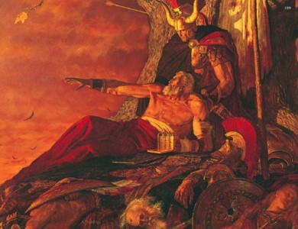
“Atay”
“Atay”—Greek
Introduced in playwrights to allow the audience to
see the consequences and forces as a result of the
choices made by the hero.
As the play progresses the hero approaches the
moment of Ate.
At any moment they could speak—as to repent, they could turn around, back out and undo their crisis.
If they chose right, there was hope. But if they chose wrong—usually of so many poor decisions in the past—the audience could do nothing but watch them destroy themselves.
“They “reached the point of no return”
So it is with the Nephites (and the Jaredites)…that they proved to be at the point of no return. They had known and been taught to repent of their sins but they chose to lose that power and so the Lord could not receive them back.
Mormon watches as the Nephites are destroyed—Student Manual

Slide 60
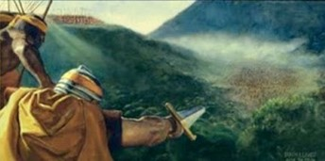
Past Feeling—without Principle
The Failure to respond to the promptings of the Holy Spirit:
“Our capacity to feel controls our behavior in many ways, and by inaction when our feelings prompt us to do good, we deaden that capacity to feel. It was Jesus’ striking sensitivity to the needs of those about him that made it possible for Him to respond in action.
“At the other end of the spiritual spectrum are individuals such as Nephi’s erring brothers; Nephi noted their increasing insensitivity to things spiritual: ‘[God] hath spoken unto you in a still small voice, but ye were past feeling, that ye could not feel his words’.
Moroni 9:18-20

Slide 61
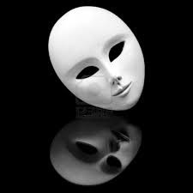
“When we become too encrusted with error, our spiritual antennae wilt and we slip beyond mortal reach. This can happen to entire civilizations. In his lamentation to his son Moroni, Mormon notes the deterioration of the Nephite society. The symptoms include a wickedness so profound that Mormon’s people were described by him as being ‘past feeling’.
The Apostle Paul lamented the destructive lasciviousness of Church members in Ephesus because they had developed such insensitivity in their satiation that they were ‘past feeling’.
A sex-saturated society cannot really feel the needs of its suffering members because, instead of developing the love that looks outward, it turns man selfishly inward. Imperviousness to the promptings of the still small voice of God will also mean that we have ears but cannot hear, not only the promptings of God, but also the pleas of men.”
Neal A. Maxwell
Moroni 9:18-20

Slide 62
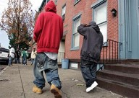
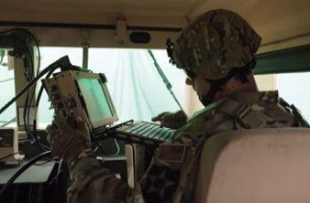
“The world grows increasingly noisy. Clothing and grooming and conduct are looser and sloppier and more disheveled. Raucous music, with obscene lyrics blasted through amplifiers while lights flash psychedelic colors, characterizes the drug culture. Variations of these things are gaining wide acceptance and influence over our youth. …
“This trend to more noise, more excitement, more contention, less restraint, less dignity, less formality is not coincidental nor innocent nor harmless.
“The first order issued by a commander mounting a military invasion is the jamming of the channels of communication of those he intends to conquer.
“Irreverence suits the purposes of the adversary by obstructing the delicate channels of revelation in both mind and spirit”
President Boyd K. Packer

Slide 63
Trustful and Faithful
What causes you to be discouraged?
Trust that thou wilt be saved and God will spare thy life
Be faithful in Christ for He will lift thee up
If we are faithful in Jesus Christ, He will lift us up even when difficulties and wickedness surround us.
Moroni 9:21-22

Slide 64
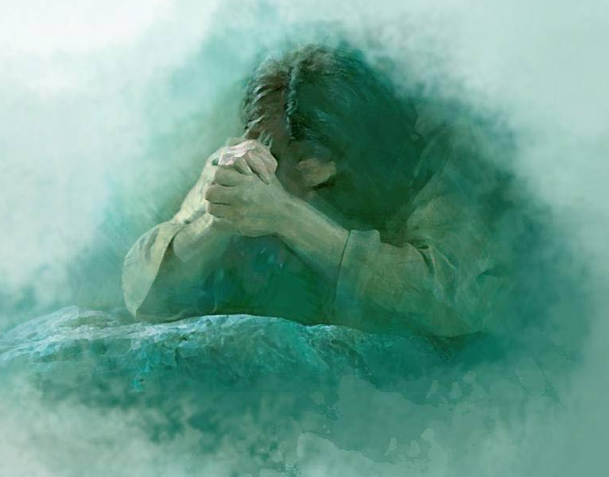
”…may his sufferings and death, and the showing his body unto our fathers, and his mercy and long-suffering, and the hope of his glory and of eternal life, rest in your mind forever.”
Yongsung Kim
Moroni 9:25-26

Slide 65
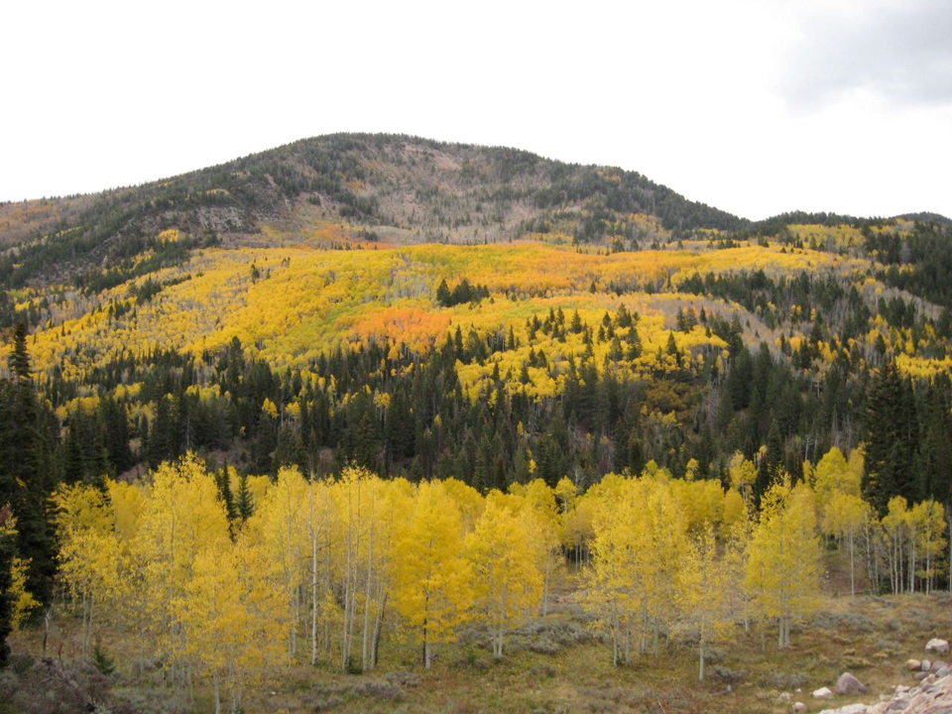
Mormon’s Final Words
“And may the grace of God the Father, whose throne is high in the heavens, and our Lord Jesus Christ, who sitteth on the right hand of his power, until all things shall become subject unto him, be, and abide with you forever. Amen.”
Moroni 9:26

Slide 66
Sources:
President Henry B. Eyring (“Preparation in the Priesthood: ‘I Need Your Help,’” Ensign or Liahona, Nov. 2011, 58–59).
Neal A. Maxwell (A Time to Choose [1972], 59–60).
Atay—Student Manual Religion 121-122 Book of Mormon pg. 463
President Boyd K. Packer (“Reverence Invites Revelation,” Ensign, Nov. 1991, 22).
Presentation by ©http://fashionsbylynda.com/blog/

Slide 67
The Lamanites
Moroni 9:2-5
Loss of many great men
Satan stirs up them continually
Mormon labors continually
They are angry with Mormon
Mormon fears the Spirit has left them
They have no fear of death
They have lost their love one for another
They thirst for blood and revenge
The Nephites
Moroni 9:7-10
Many men, women, and children are prisoners of the Lamanites
The husbands and fathers have been slain
They feed the women and children the flesh of the men
They give them very little water
The Nephites have taken the daughters of the Lamanites prisoners—they lost their chastity and virtue
They have murdered and tortured them and devoured their bodies
Both Lamanites and Nephites
Moroni 9:16-19
Many widows and daughters wander and are left to die
The army of the Nephites are weak
Many of the armies have fallen to an awful brutality
They are without order
They are without mercy
They delight in everything wicked
Mormon has no strength and cannot enforce his commands
They have become strong in wickedness

