Slide 1

Mosiah 1-3

Slide 2
Previously in Mosiah 1

Slide 3
Mosiah
Mosiah was the father to King Benjamin and grandfather to Mosiah II and a descendent of Lehi
He lived in the southern area of the country where Lehi and his group from Jerusalem had first settled in the Promised Land.
He was warned of the Lord to leave the land (the land of Nephi) and fled north to Zarahemla
He and his followers discovered a people who were descendants of Mulek, the lone surviving son of King Zedekiah of Judah (Omni 1:16)
Mosiah carried the sacred records to preserve the written language of his forebears and the record of God’s dealing with His people
He was active around 279 BC to 130 BC and the people brought to him a “large stone” displaying engravings that Mosiah was able to interpret. The stone told of the last days of Coriantumr, the final Jaredite ruler, who had been discovered by the people of Zarahemla and dwelt among them for the better part of a year
He was appointed king over the people and his son, King Benjamin, was his successor
Who’s Who

Slide 4


King Benjamin
He was the son of the first Mosiah who was commanded of the Lord to depart from the land of Nephi.
He received custody of the sacred records from Amaleki and established peace in the land of Zarahemla
He taught his three sons, Mosiah II, Helorum, and Helaman the importance of the scriptures
He led armies to battle against the Lamanites and wielded the sword (the sword of Laban) with his own arm in their defense
He was one of the most beloved and oft-quoted personalities in the Book of Mormon
His discourse to his people, given about 124 BC, describes a Christ-centered life of service and spiritual integrity
Through revelation, his discourse is one of the most celebrated gospel sermons ever recorded (Mosiah 2:17)
Before his death he appointed Mosiah II to be king of the land and he gave the people a new name: “The name of Christ”
Who’s Who

Slide 5
Mosiah ll
Mosiah was a son of King Benjamin.
He was named after his grandfather Mosiah, who was also a king of Zarahemla (see Omni 1:12–13, 19).
He was 30 years old when he began his reign as king, and he was the last of the Nephite kings.
He was taught by his father in the ways of the Lord
Mosiah was a prophet, seer, revelator, and king who ruled in Zarahemla from approximately 124 to 91 BC
Because of his gift to translate ancient records his people benefited from the history of God’s peoples over the ages
He gave authority to Alma the Elder to organize 7 congregations in Zarahemla (Mosiah 25:19-24)
He had 4 sons—Ammon, Aaron, Omner, and Himni
He originated the program to have governing judges instead of kings
He died at age 63 (Mosiah 29:46)

Slide 6
Book of Mosiah
The book is named for Mosiah, who was a son of King Benjamin.
Mormon compiled and abridged the records of several other writers to create
the Book of Mosiah.
Mormon drew from a number of records to compile the Book of Mosiah. He abridged and quoted from the record kept by Mosiah on the large plates of Nephi, which detailed the history of the Nephites in the land of Zarahemla (see Mosiah 1–7; 25–29).
He also drew from the record of Zeniff, which recounts the history of Zeniff’s people from the time they left Zarahemla until they returned (see Mosiah 7–22).
Mormon quoted from and abridged portions of the writings of Alma, who preserved the words of Abinadi and kept a record of his own people (see Mosiah 17:4; 18; 23–24).
The Book of Mosiah
Written about 200 to 91 BC

Slide 7
The Mission Statement
The book of Mosiah includes two discourses on the mission of Jesus Christ:
The words of King Benjamin in Mosiah 2–5
and the words of Abinadi in Mosiah 12–16.
Mosiah is the first book that is an abridgement from the large plates of Nephi
The Book of Mosiah teaches about the abilities of a seer
The Book of Mosiah teaches about separate Nephite groups—those in Zarahemla, and in the Land of Nephi—Zeniff, Noah, Limhi, Alma, and Abinidi
The Book of Mosiah introduces the “Reign of the Judges”

Slide 8
King Benjamin Teaches His Sons
To learn from the scriptures in the language of his fathers
To learn about the commandments of God
That the records are true
To search them diligently
Keep the commandments and
Prosper in the land
The Brass Plates
The Best Memory is no match for the written word
Mosiah 1:2-8

Slide 9
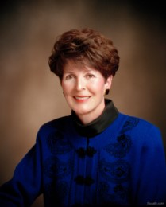
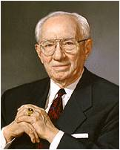
Responsibility of Parents
Teach their children the commandments of God
“Parenting is a godly responsibility necessary for the salvation of Father’s children and important for our preparation for eternal blessings.”
Patricia P. Pinegar
“You need more than your own wisdom in rearing [your children]. You need the help of the Lord. Pray for that help and follow the inspiration which you receive”
Gordon B. Hinckley
“And they shall also teach their children to pray, and to walk uprightly before the Lord”
(D&C 68:28).
“But ye will teach them to walk in the ways of truth and soberness; ye will teach them to love one another, and to serve one another”
(Mosiah 4:15).
Our Family Book
Passing the torch:
Each generation passes the “truth and light” to their children
Mosiah 1:4

Slide 10
Last Blessings
“And this is the blessing, wherewith Moses the man of God blessed the children of Israel before his death.”
Deut. 33
“…that he waxed old, and he saw that he must very soon go the way of all the earth; therefore, he thought it expedient that he should confer the kingdom upon one of his sons.
Therefore, he had Mosiah brought before him; and these are the words which he spake unto him, saying: My son, I would that ye should make a proclamation throughout all this land among all this people, or the people of Zarahemla,…”
Mosiah 1:9-10

Slide 11
To Be A King and A Ruler
Mosiah is asked to make a proclamation to all his people—the people of Zarahemla
He was asked to gather all the people in the land
Then Mosiah was designated a king and a ruler
Mosiah 1:10

Slide 12
A Name Be Given
A name that they may be distinguished above all the people
Christ—
”anointed one”
Those upon whom the title is properly conferred are rightful heirs of the powers and privileges associated with the name
Conditions of acquiring this name:
Those who are righteous and keep the law of all covenant, contracts, bonds, etc that are sealed by the Holy Spirit of promise.
See D&C 132:7
Mosiah 1:11-12

Slide 13
Sources:
Who’s Who in the Book of Mormon by Ed J. Pinegar and Richard J. Allen
If you had missed Mosiah 1 as a whole chapter, see previous lesson Enos - Words of Mormon
Presentation by ©http://fashionsbylynda.com/blog/

Slide 14
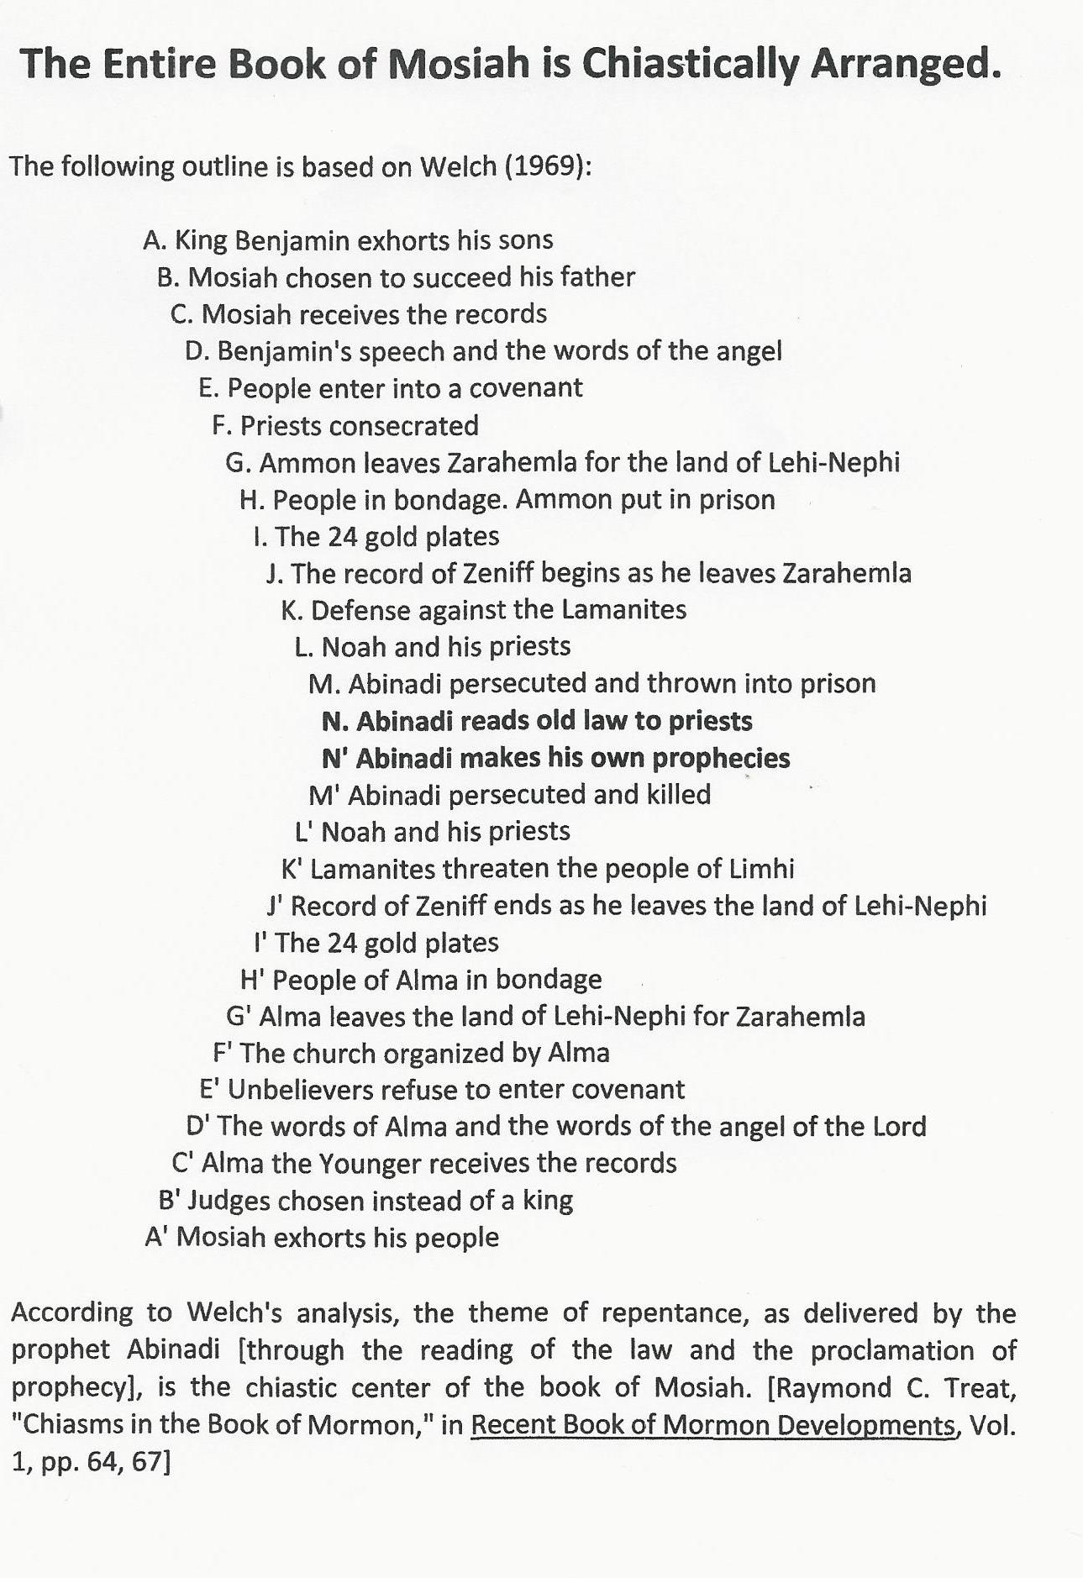

Slide 15
King’s Speech From on High
Mosiah 2
King Benjamin was one who served God by serving his people and teaching them to serve one another.

Slide 16

The Gathering
Who gathered?
Why did they gather?
What did they bring?
Where did they gather?
Mosiah 2:1-6

Slide 17
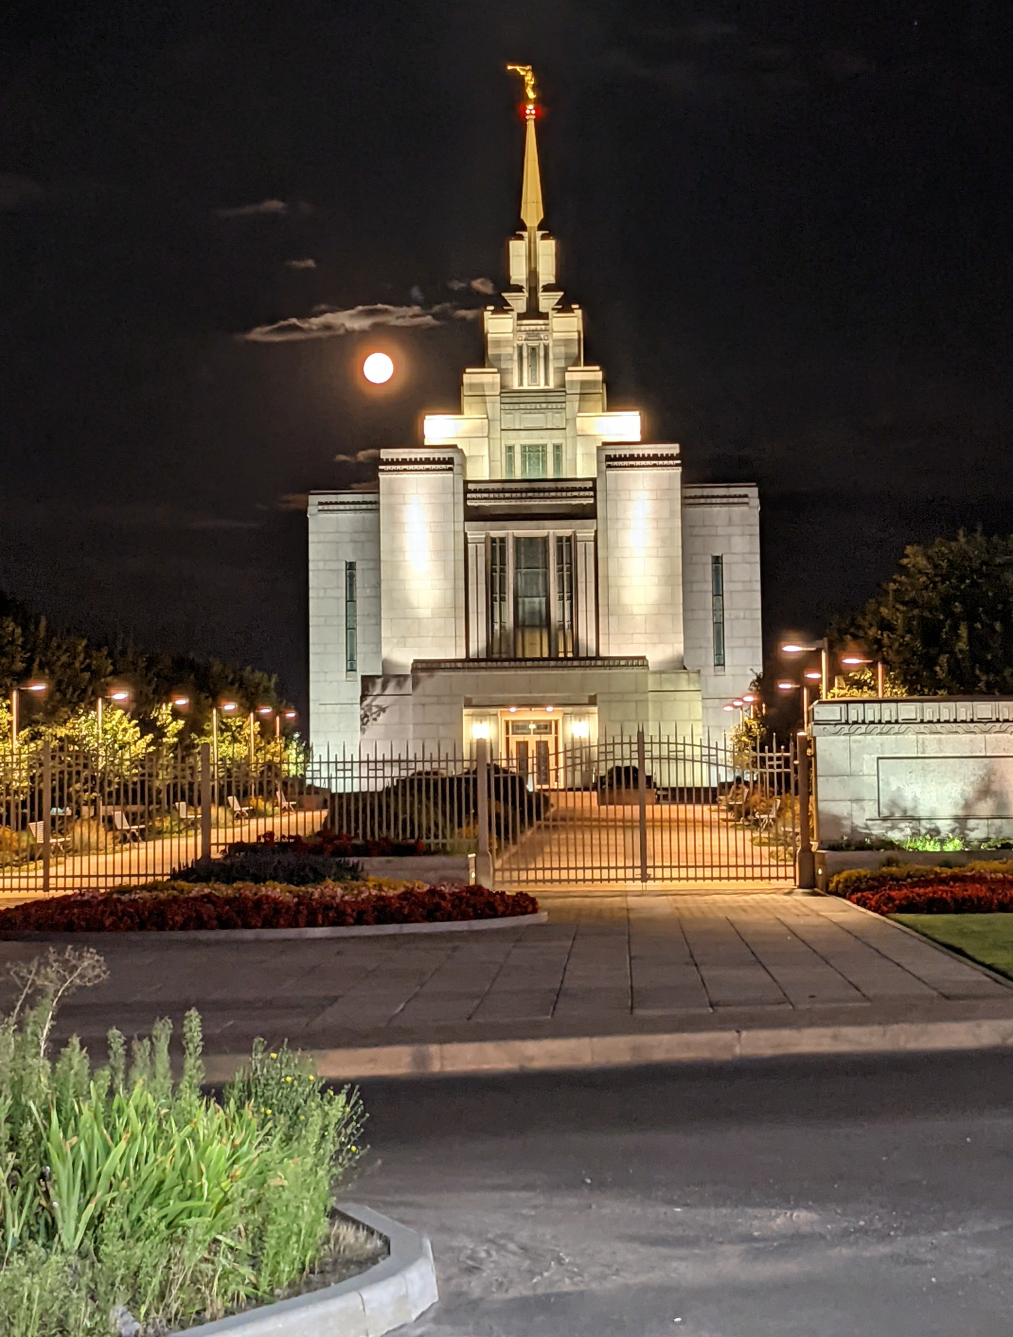
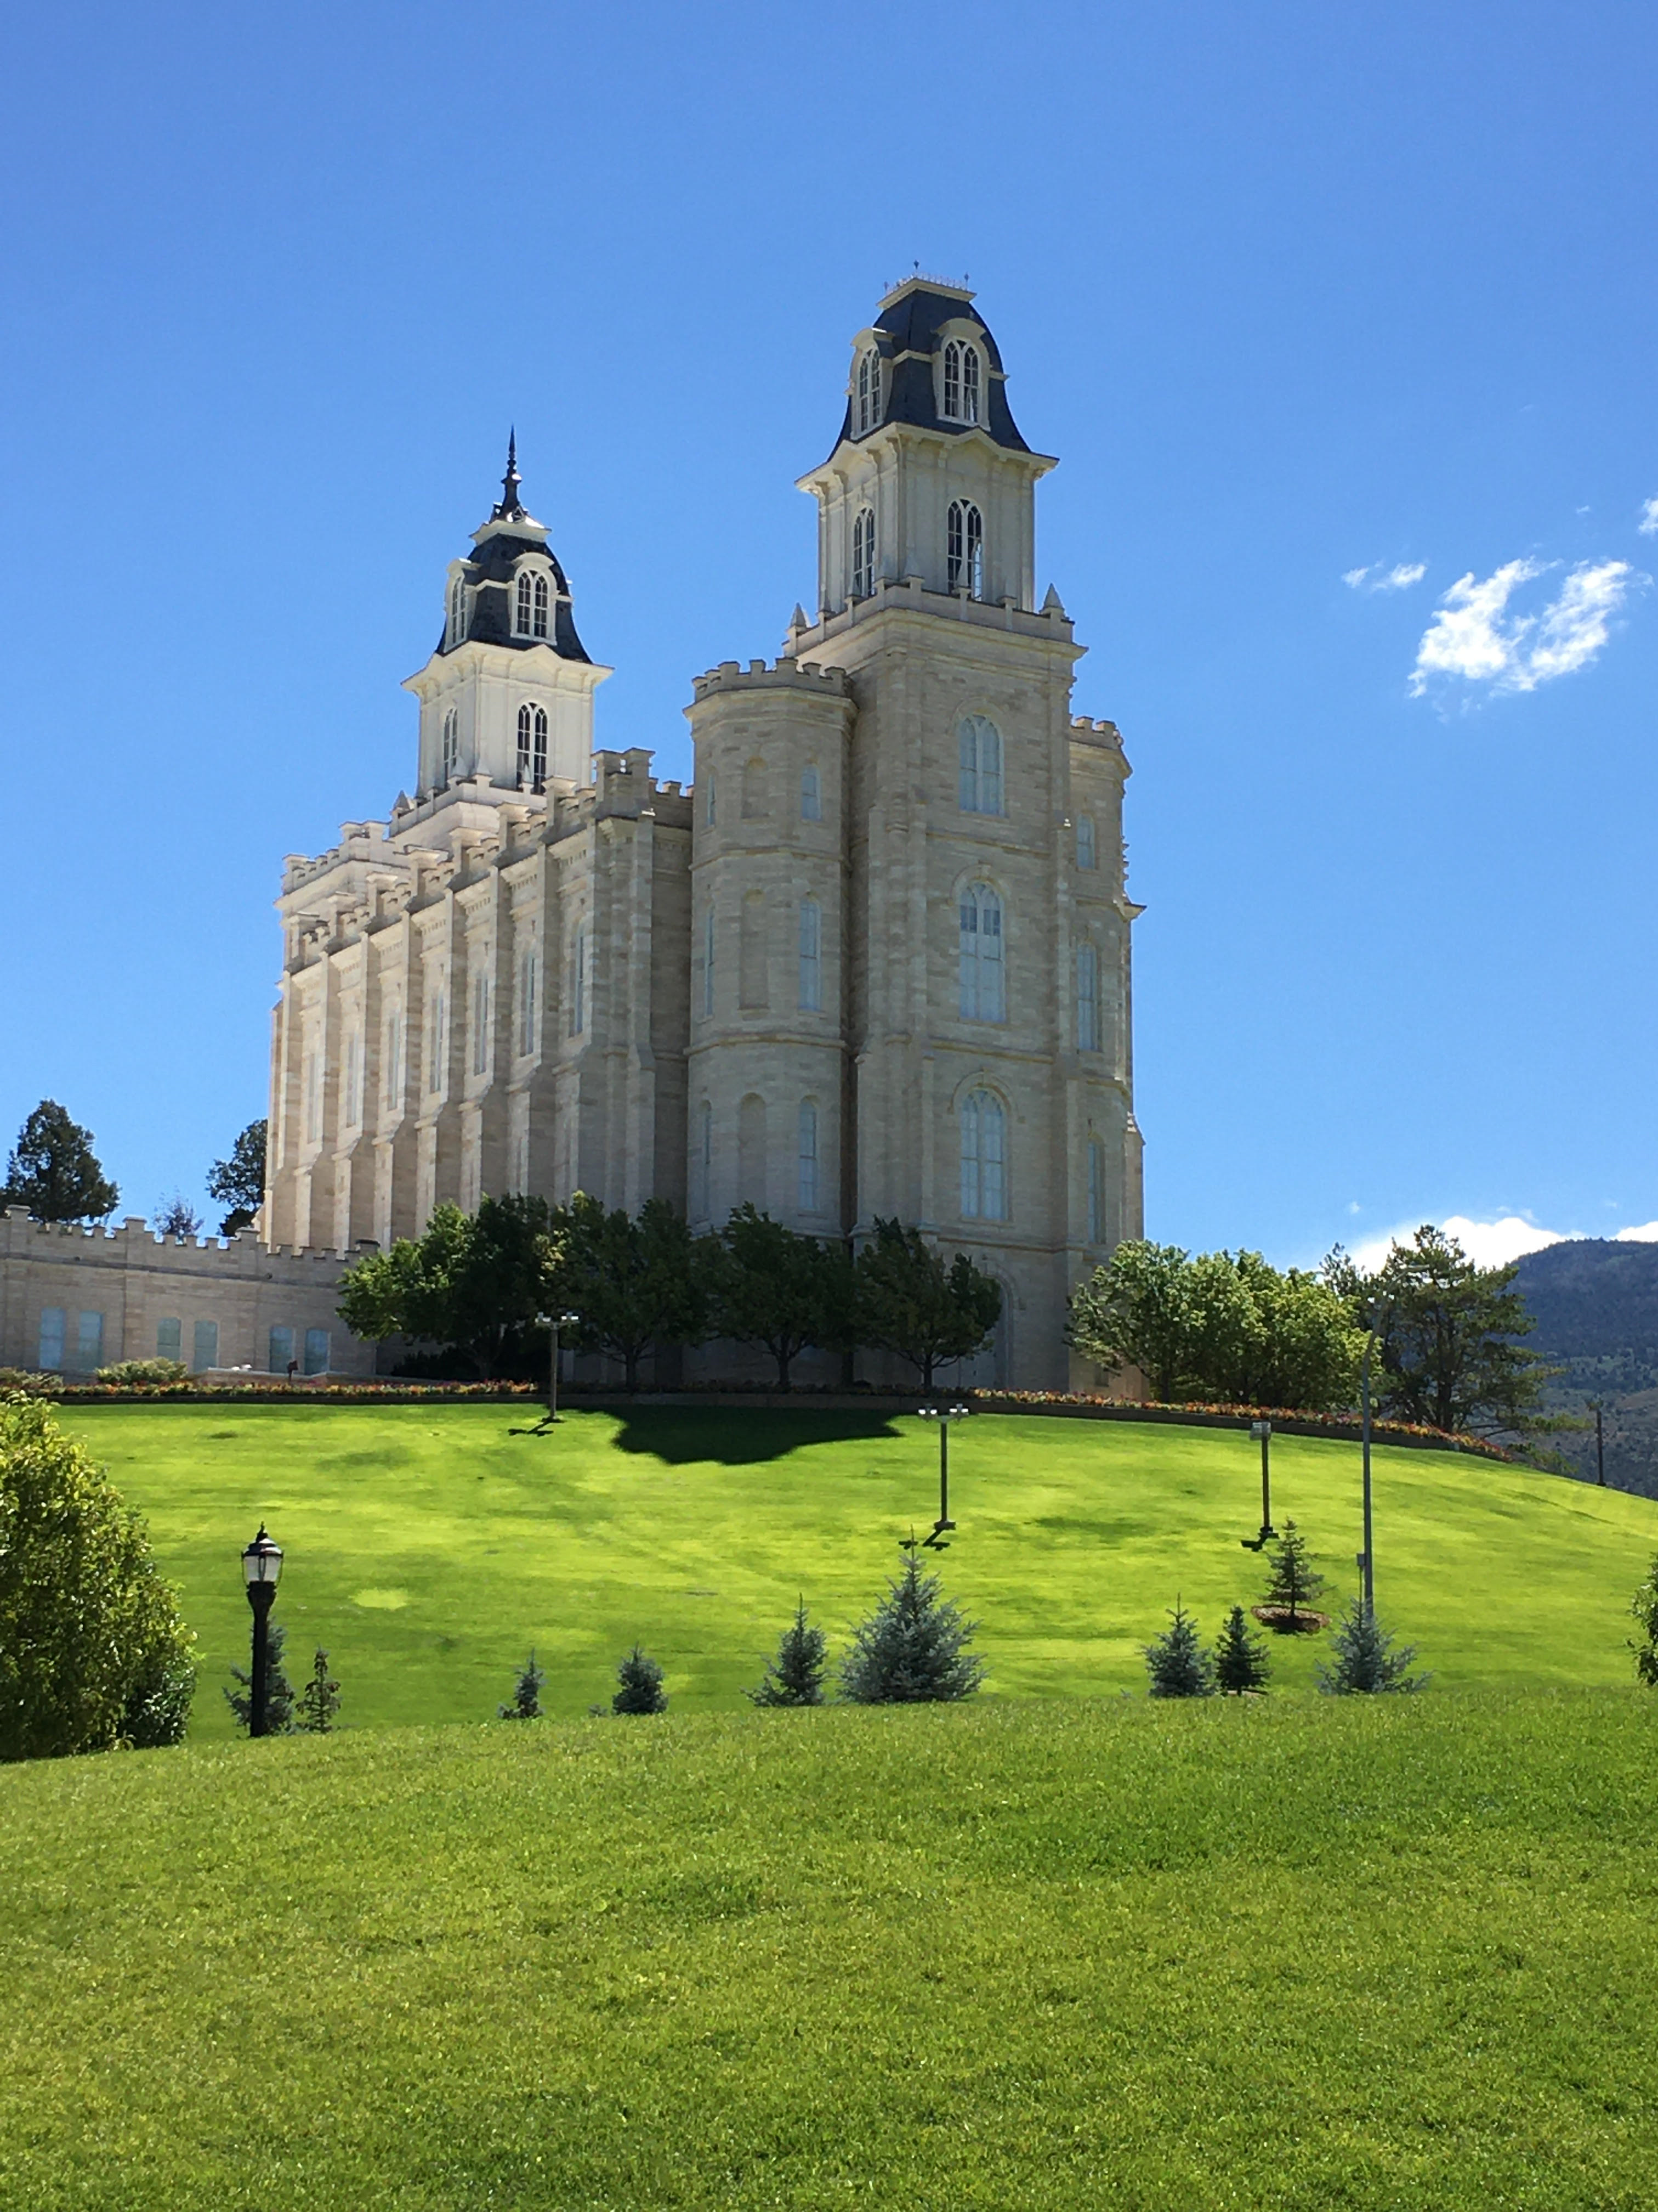
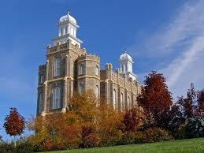
Mount of the Lord’s House
One always went “up” to the temple suggesting that the temples were built on a hill, or higher than where the people lived
Isaiah 2:2
“…that the mountain of the Lord’s house shall be established in the top of the mountains, and shall be exalted above the hills; and all nations shall flow unto it.”
Mosiah 2:1
Ukraine Temple
Logan Temple
Manti Temple

Slide 18
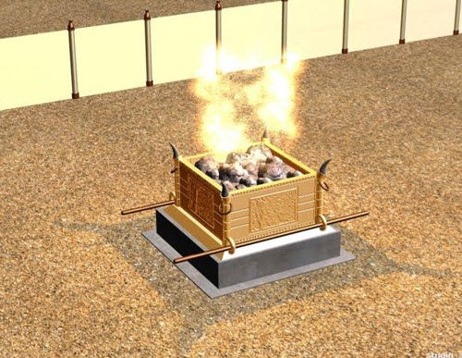
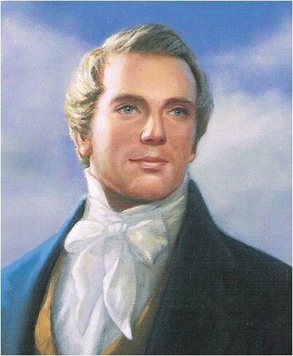
Burnt Offerings
An ordinance practiced in Adam’s time
Moses 5:7
This same offering will be offered again in our dispensation by the sons of Levi in fulfillment of the prophecies of Malachi and John the Baptist, and the promise of Joseph Smith
Malachi 3:3-4
D&C 13
Joseph Smith
Also
“That they might give thanks to the Lord their God, who had brought them out of the land of Jerusalem…”
Mosiah 2:-3-4

Slide 19
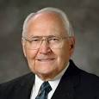
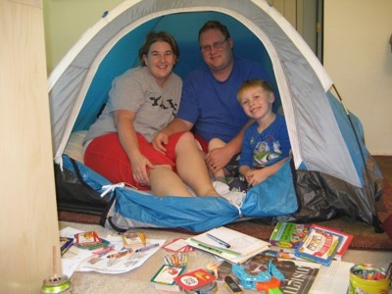
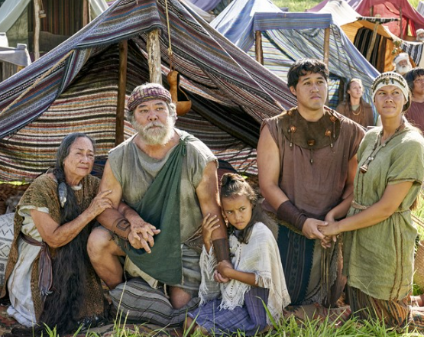
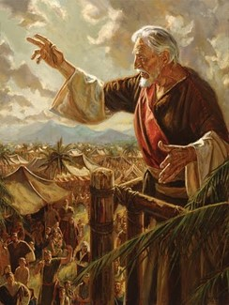
Patriarchal Organization
“According to his family:”
Including all members of their family
“…it is more important than ever to make our families the center of our lives and the top of our priorities. Families lie at the center of our Heavenly Father’s plan.”
L. Tom Perry
“And Adam and Eve blessed the name of God, and they made all things known unto their sons and their daughters.”
Moses 5:12
King Benjamin desired all the people, with their families, to hear the words of the Lord
Mosiah 2:5

Slide 20
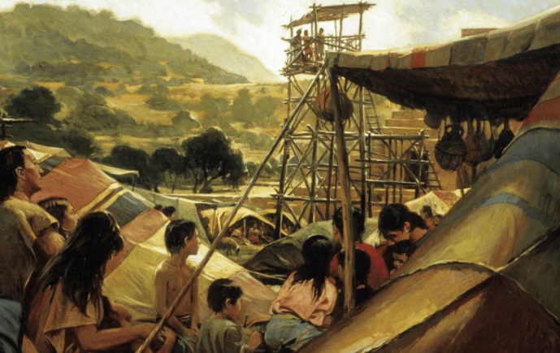
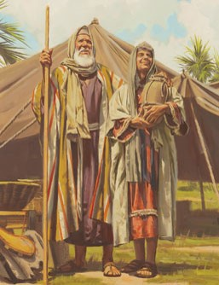
Pitch Their Tents
“They pitched their tents with their doors toward the temple so that they might hear the words of King Benjamin as he instructed them in the doctrine of eternal life.”
L. Tom Perry
Two Meanings:
Where your home is
Where your passions lie
Where your passions lie:
Genesis 13:12
“Abram dwelled in the land of Canaan, and Lot dwelled in the cities of the plain, and pitched his tent toward Sodom.”
Where your home is:
1 Nephi 2:15
And my father dwelt in a tent.
Mosiah 2:6

Slide 21
A Tower
King Benjamin could not teach within the walls of the temple because all could not hear him.
But because there so many people he had his words written and sent forth to those who could not hear.
Mosiah 2:6

Slide 22
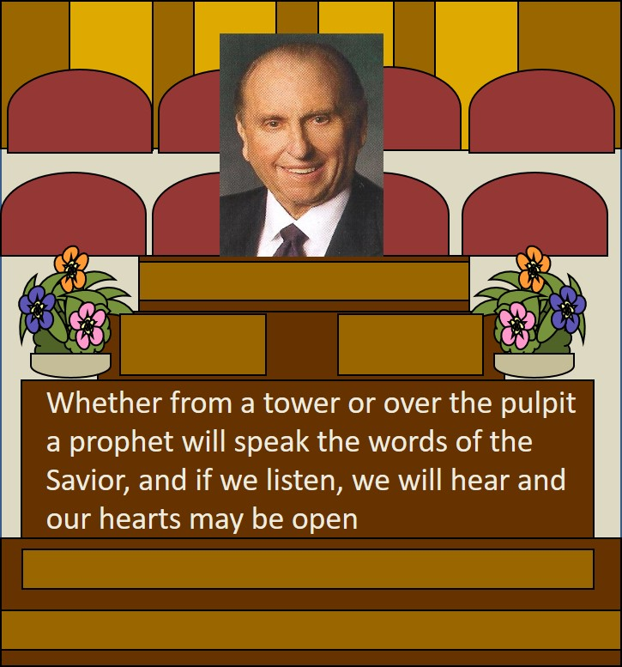
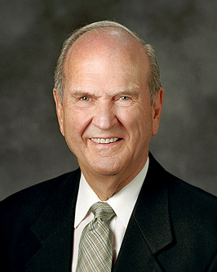
To Hear the Words
“Hearken unto me, and open your ears that ye may hear”
If we open our ears, hearts, and minds to the teachings of God’s servants, we can be blessed with understanding and personal revelation
Mosiah 2:9

Slide 23
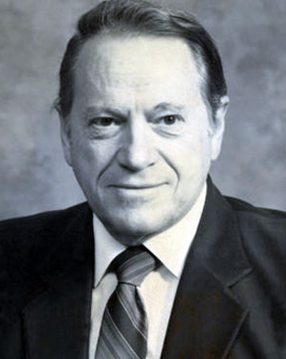
The Speech
You have chosen me to be ruler and king over this land
I will serve you with all my might; I have not asked for riches
Fear me not; I am a mortal man; I am like you
I have not made you slaves and ask you not to make slaves of one another
I have taught you to keep the commandments
I will not burden you with taxes
“Burdensome, unjust taxation is a form of theft. King Benjamin realized that a government has no more right to steal from its citizens than the citizens have to steal from one another.”
Rodney Turner
Mosiah 2:10-14

Slide 24
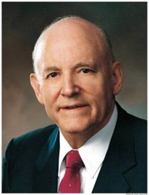
Labored With Mine Own Hands
“When we understand why we serve we will not worry about where we serve”
Mosiah 2:14

Slide 25
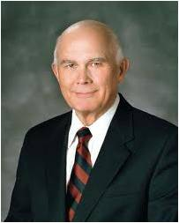
Reasons for Service
Some serve for hope of earthy reward
Some serve to obtain good companionship…these persons are more selective in choosing their friends than the Master was in choosing his servants
Some serve out of fear of punishment
Some serve out of a sense of duty or out of loyalty to family, friends, or traditions— ‘the good soldier’
The higher reason for service is the hope of an eternal reward…this hope is one of our most powerful motivations…
Each of the above is self-centered…
Those who follow the Savior’s example must lose themselves in their service to others…if our service is to be most efficacious, it must be unconcerned with self and heedless of personal advantage. In order to stand blameless before God at the last day, we must also serve him with all our heart and mind.”
Dallan H. Oaks
Mosiah 2:14-19

Slide 26
Where Do I Stand?
I look for opportunities to serve.
I respond willingly when I’m asked to help.
I tend to think that someone else will do the service.
I want to serve but find it difficult to prioritize service in my life.
I like serving but worry about how I might be perceived by others.
I like serving but struggle with the desire to be noticed or recognized by others.

Slide 27
Doctrinal Mastery
“And behold, I tell you these things that ye may learn wisdom; that ye may learn that when ye are in the service of your fellow beings ye are only in the service of your God.”
Mosiah 2:17
When we serve others, we serve God.

Slide 28
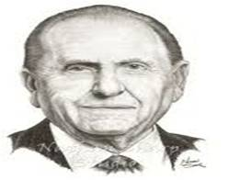
As we look heavenward, we inevitably learn of our responsibility to reach outward.
To find real happiness, we must seek for it in a focus outside ourselves.
No one has learned the meaning of living until he has surrendered his ego to the service of his fellow man. …
The New Testament teaches that it is impossible to take a right attitude toward Christ without taking an unselfish attitude toward men. …
We look to the Savior as our example of service. Although He came to earth as the Son of God, He humbly served those around Him.
He came forth from heaven to live on earth as mortal man and to establish the kingdom of God.
His glorious gospel reshaped the thinking of the world. He blessed the sick;
He caused the lame to walk, the blind to see, the deaf to hear. He even raised the dead to life. Thomas S. Monson,

Slide 29
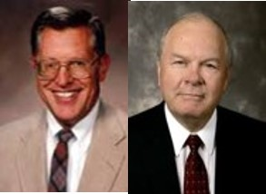
Unprofitable Servants
People make a profit when they receive more than they give. We are unprofitable servants to our Heavenly Father because the value of the blessings He gives us will always greatly exceed the value of the service He receives from us.
We can repay them by obedience and service (helping)
What is the greater debt we owe to God?
We can repay God through obedience and faithful service
How does one repay his parent for raising them in righteousness?
“In our relationship with God we are at best unprofitable servants”
JFM and RLM
Mosiah 2:21-24

Slide 30
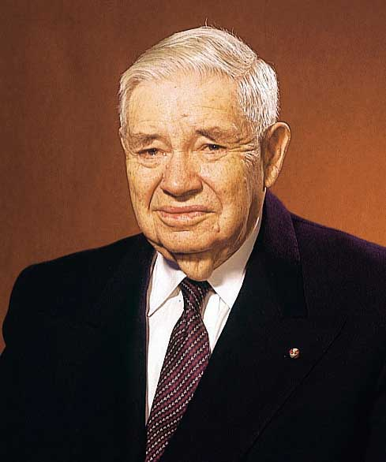
Dust of the Earth
We did not create nor do we own the elements of the earth
King Benjamin talks about the indebtedness to God by noting that even our bodies are made of borrowed materials
JFM and RLM
All mankind, according to our restored text, are born into mortality “by water, and blood, and the spirit.: and so become “of dust” living souls
Moses 6:59
We were born of the dust of the earth in the same manner that our first earthly father was born of dust.
Our bodies, like his, were formed from the elements of this earth and at death will return to those elements from which they were taken, until the glorious day of resurrection
“All who have inhabited the earth since Adam have take bodies and become souls in like manner”
James R. Clark
Adam, the first of all men, was formed from the ground
Genesis 2:7
Mosiah 2:25-26

Slide 31
Responsibility of Teaching
Should the King Benjamin, the messenger, fail to deliver the message, he then assumes a responsibility for the sins of those who went unwarned because he shrugged his duty.
What message do we have to give?
Who are we responsible for?
“Behold, I sent you out to testify and warn the people, and it becometh every man who hath been warned to warn his neighbor.
Therefore, they are left without excuse, and their sins are upon their own heads.”
D&C 88:81-82
Mosiah 2:27-28

Slide 32
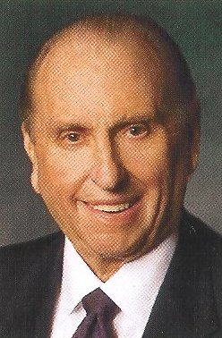
Responsibility of the People:
To accept Mosiah as their king and ruler
Keep the commandments
Keep from falling into the enemies' hands
Keep the commandments that Mosiah will teach
Keep peace among yourselves
“We have an opportunity to sustain—support, help, pray for—each of these people in their callings. We indicate our willingness to do so by raising our right hands when their names are read to us in general conference, stake conference, ward or branch conference, or sacrament meeting. Raising our hands is a sign to us, to them, and to the Lord that we will sustain them.”
Thomas S. Monson
Mosiah 2:27-28

Slide 33
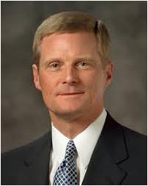
“We should … endeavor to discern when we ‘withdraw [ourselves] from the Spirit of the Lord, that it may have no place in [us] to guide [us] in wisdom’s paths that [we] may be blessed, prospered, and preserved’ …
“… If something we think, see, hear, or do distances us from the Holy Ghost, then we should stop thinking, seeing, hearing, or doing that thing.
If that which is intended to entertain, for example, alienates us from the Holy Spirit, then certainly that type of entertainment is not for us.
Because the Spirit cannot abide that which is vulgar, crude, or immodest, then clearly such things are not for us.
Because we estrange the Spirit of the Lord when we engage in activities we know we should shun, then such things definitely are not for us.”
David A. Bednar
WISDOM’S PATH
EXIT NOW
Mosiah 2:36-38

Slide 34
A State of Never-Ending Happiness
If we keep the commandments, we will receive temporal and spiritual blessings in this life and eventually live with Heavenly Father in a state of never-ending happiness.
All, except the little children, had been taught since Lehi had left Jerusalem
Those who desire to keep the commandments will be blessed and happy
Those who rebel
Those who die in their sins
Will have no place with the Lord
Everlasting punishment
Mosiah 2:33-41

Slide 35
Doctrinal Mastery
And moreover, I would desire that ye should consider on the blessed and happy state of those that keep the commandments of God. For behold, they are blessed in all things, both temporal and spiritual; and if they hold out faithful to the end they are received into heaven, that thereby they may dwell with God in a state of never-ending happiness. O remember, remember that these things are true; for the Lord God hath spoken it.
Mosiah 2:41

Slide 36
Sources:
Joseph Smith Teaching of Joseph Smith p 172-173
L. Tom Perry The Importance of Family April 2003 Gen. Conf.
Tents--Thou Shalt Give Heed unto All His Words April 2000
Rodney Turner (Studies in Scriptures, ed. By K. Jackson 7:211)
Dallin H. Oak Pure in Heart p 38-49
Joseph Fielding McConkie and Robert L. Millet Doctrinal Commentary on the Book of Mormon Vol. 2 p 139-140
James R. Clark Messages of the First Presidency 4:205
Thomas S. Monson We Sustain Our Leaders March 2012 Ensign; “The Joy of Service,” New Era, Oct. 2009, 4, 6)
David A. Bednar, “That We May Always Have His Spirit to Be with Us,” Ensign or Liahona, May 2006, 30
Presentation by ©http://fashionsbylynda.com/blog/

Slide 37
Sometimes we may initially serve from a sense of duty or obligation, but even that service can lead us to draw on something higher within us, leading us to serve in “a more excellent way” [1 Corinthians 12:31]. …
When we focus on all that God has done for us, our service flows from a heart of gratitude. As we become less concerned about our service magnifying us, we realize instead that the focus of our service will be on putting God first. (Joy D. Jones, “For Him,” Ensign or Liahona, Nov. 2018, 50–51)
Service quotes
Can you think back on a time when you lovingly reached out with sincere effort to help someone in need and felt that your efforts went unnoticed or perhaps were unappreciated or even unwanted? In that moment, did you question the value of your service? If so, may the words of King Benjamin replace your doubt and even your hurt: “Ye are only in the service of your God” [Mosiah 2:17].
Rather than building resentment, we can build, through service, a more perfect relationship with our Heavenly Father. Our love for and devotion to Him preempts the need for recognition or appreciation and allows His love to flow to and through us. (Joy D. Jones, “For Him,” Ensign or Liahona, Nov. 2018, 50)
Sometimes we think we have to do something grand and heroic to “count” as serving our neighbors. Yet simple acts of service can have profound effects on others—as well as on ourselves. What did the Savior do? Through His supernal gifts of the Atonement and Resurrection … “none other has had so profound an influence [on] all who have lived and who will yet live upon the earth” [“The Living Christ: The Testimony of the Apostles,” ChurchofJesusChrist.org]. But He also smiled at, talked with, walked with, listened to, made time for, encouraged, taught, fed, and forgave. He served family and friends, neighbors and strangers alike, and He invited acquaintances and loved ones to enjoy the rich blessings of His gospel. Those “simple” acts of service and love provide a template for our ministering today. (Jean B. Bingham, “Ministering as the Savior Does,” Ensign or Liahona, May 2018, 104)
In your morning prayer each new day, ask Heavenly Father to guide you to recognize an opportunity to serve one of His precious children. Then go throughout the day with your heart full of faith and love, looking for someone to help. … If you do this, your spiritual sensitivities will be enlarged and you will discover opportunities to serve that you never before realized were possible. (M. Russell Ballard, “Be Anxiously Engaged,” Ensign or Liahona, Nov. 2012, 31)

Slide 38

Prophecy:
The Coming of the Savior
Mosiah 3

Slide 39
The Taste Test
How much water would you pour into the glass for someone who wants only a taste of the water?
Joy
How much water would you pour for someone who wants to be filled?
If the water was Joy, how much water would you want?

Slide 40
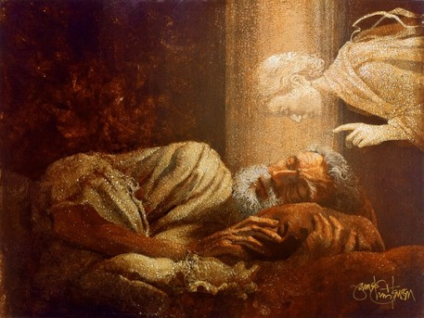
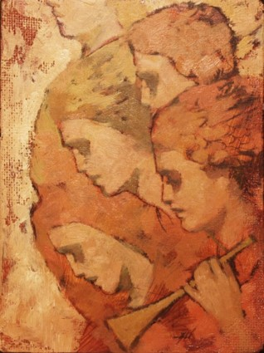
Angel’s Declaration
Awake
Angels have played an important part in teaching the gospel to the children of men since the days of Adam
Moses 5:58
Angels are messengers of God and frequently come to instruct and prophesy relative to the gospel of Jesus Christ
Bringing glad tidings of great joy.
Mosiah 3:2-3
Annie Henrie Nadar Artwork

Slide 41
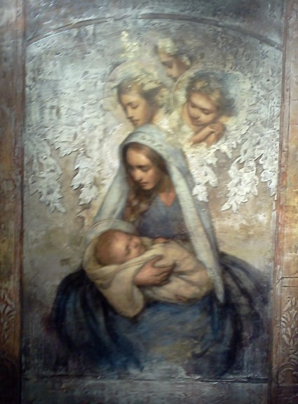
Glad Tidings of Great Joy
Through out ancient history the phrase is in reference to the prophecies of the birth of Christ and His mortal ministry
Alma 13:22
“And angels did appear unto men, wise men, and did declare unto them glad tidings of great joy; thus in this year the scriptures began to be fulfilled.”
Helaman 16:14
“And the angel said unto them, Fear not: for, behold, I bring you good tidings of great joy, which shall be to all people.”
Luke 2:10
Mosiah 3:3
Annie Henrie Nadar Artwork

Slide 42
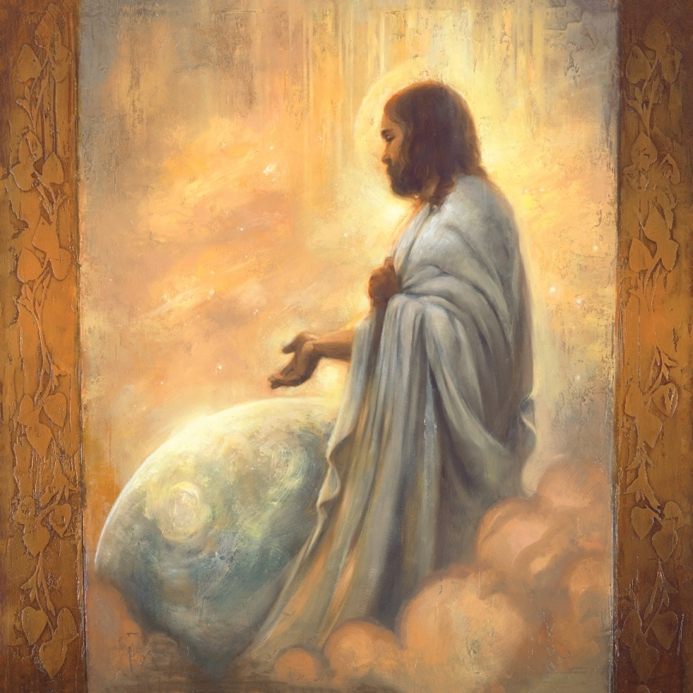
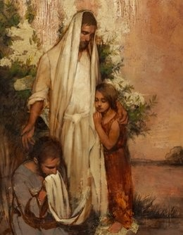
The Mission of Christ
Omnipotent—Having all power
Working miracles—
Healing the sick
Raising the dead
Causing the lame to walk
The blind to receive their sight The deaf to hear
Curing all manner of diseases
Obtaining a mortal body—tabernacle of clay
He shall cast out devils or evil spirits that dwell in the hearts of men
He shall suffer:
Temptations
Physical pain and hunger
Mosiah 3:5-6
Annie Henrie Nadar Artwork

Slide 43
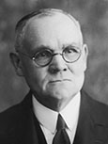
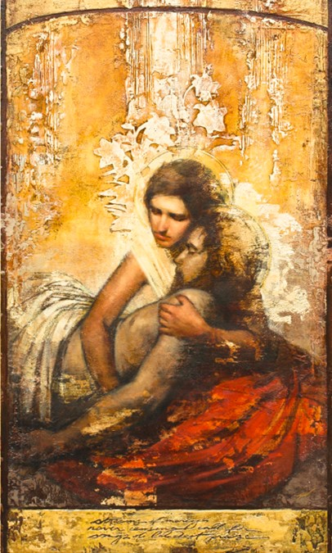
Christ's Ultimate Mission
“Christ’s agony in the garden is unfathomable by the finite mind, both as to intensity and cause. …
He struggled and groaned under a burden such as no other being who has lived on earth might even conceive as possible. It was not physical pain, nor mental anguish alone, that caused Him to suffer such torture as to produce an extrusion of blood from every pore; but a spiritual agony of soul such as only God was capable of experiencing. …
In that hour of anguish Christ met and overcame all the horrors that Satan, ‘the prince of this world,’ could inflict. …
In some manner, actual and terribly real though to man incomprehensible, the Savior took upon Himself the burden of the sins of mankind from Adam to the end of the world”
James E. Talmage
As part of His Atonement, Jesus Christ suffered more than man can suffer
Mosiah 3:7
Annie Henrie Nadar Artwork

Slide 44
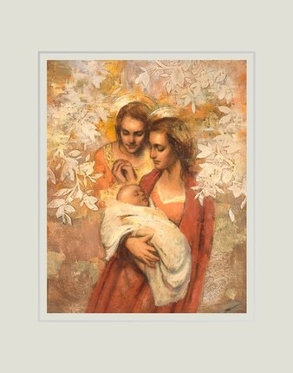
His Name
“And he shall be called Jesus Christ, the Son of God, the Father of heaven and earth, the Creator of all things from the beginning; and his mother shall be called Mary.”
Jesus (Hebrew=Joshua)
Meaning Jehovah saves
Christ is a title meaning “anointed” or “anointed one”
Greek-Mary
Hebrew-Miriam
Mosiah 3:8
Annie Henrie Nadar Artwork

Slide 45
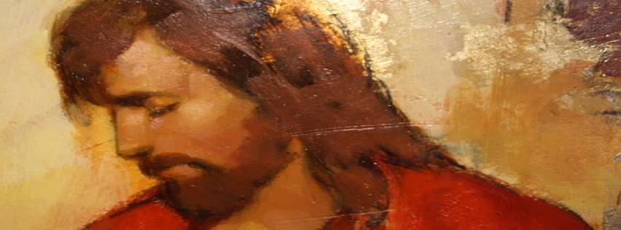
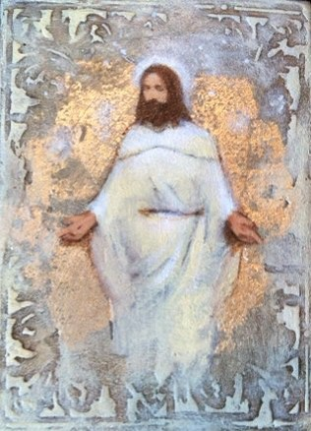
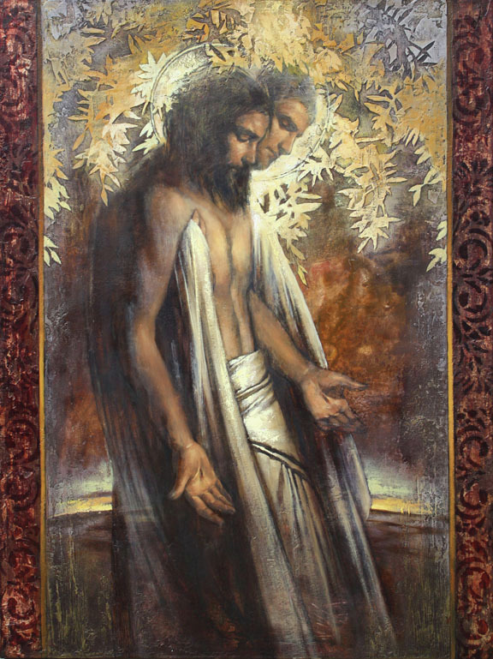
Salvation--Exaltation
Jesus will be scourged, crucified and the rise the 3rd day and stand to judge the world
His blood will atone for the sins of those who have transgressed
Mosiah 3:9-11
Annie Henrie Nadar Artwork

Slide 46
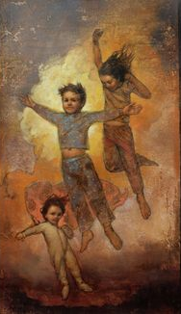
Application of Atonement
How does the Atonement apply to those who die without a knowledge of the gospel?
D&C 137:7 “Thus came the voice of the Lord unto me, saying: All who have died without a knowledge of this gospel, who would have received it if they had been permitted to tarry, shall be heirs of the celestial kingdom of God;”
To those who rebel against God and deliberately sin?
D&C 137:9 “For I, the Lord, will judge all men according to their works, according to the desire of their hearts.”
To children who die before they reach the age of accountability?
D&C 137:10 “And I also beheld that all children who die before they arrive at the years of accountability are saved in the celestial kingdom of heaven.”
Mosiah 3:11-13
Annie Henrie Nadar Artwork

Slide 47
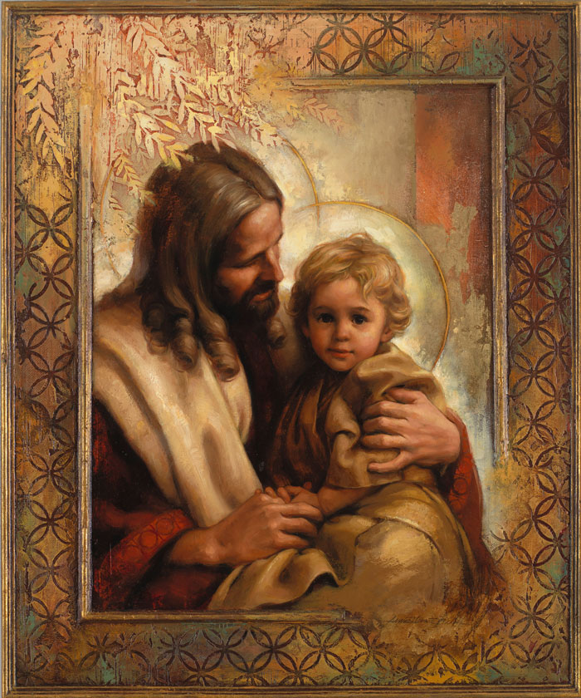
“We … read that ‘his blood atoneth for the sins of those … who have died not knowing the will of God concerning them, or who have ignorantly sinned’ (Mosiah 3:11). Similarly, ‘the blood of Christ atoneth for [little children]’ (Mosiah 3:16).
These teachings that the resurrecting and cleansing power of the Atonement is for all contradict the assertion that the grace of God saves only a chosen few. His grace is for all.
These teachings of the Book of Mormon expand our vision and enlarge our understanding of the all-encompassing love of God and the universal effect of His Atonement for all men everywhere”
Dallin H. Oaks
Annie Henrie Nadar Artwork

Slide 48
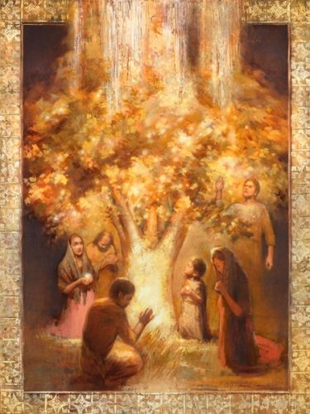
If we knowingly rebel against God’s commandments, we will not be saved unless we exercise faith in Jesus Christ and repent
“Some people knowingly break God’s commandments, planning to repent later, such as before they go to the temple or serve a mission. Such deliberate sin mocks the Savior’s Atonement.”
(For the Strength of Youth [booklet, 2011], 29)
“But wo, wo unto him who knoweth that he rebelleth against God! For salvation cometh to none such except it be through repentance and faith on the Lord Jesus Christ.”
Mosiah 3:12
Annie Henrie Nadar Artwork

Slide 49
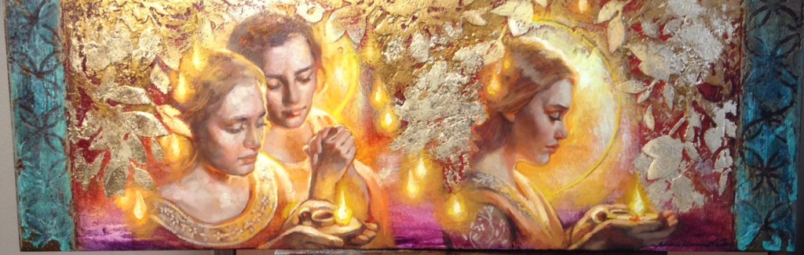
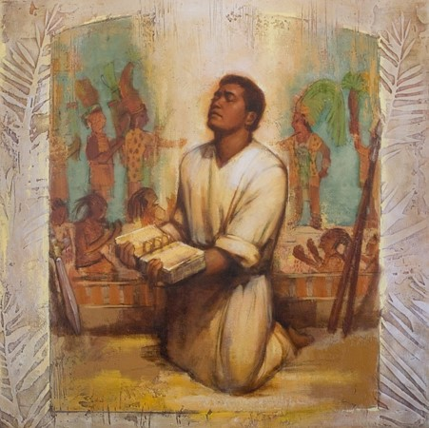
Natural Man
A natural man is “a person who chooses to be influenced by the passions, desires, appetites, and senses of the flesh rather than by the promptings of the Holy Spirit.
…Such a person can comprehend physical things but not spiritual things. All people are carnal, or mortal, because of the fall of Adam and Eve. Each person must be born again through the atonement of Jesus Christ”
Guide to the Scriptures
Mosiah 3:19
Annie Henrie Nadar Artwork

Slide 50
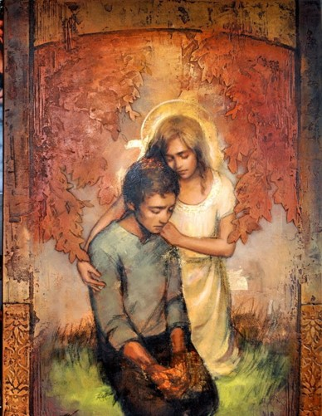
Becoming a Saint
Through the Atonement of Jesus Christ, a person does more than just stop being a “natural man.” He or she “becometh a saint.” In addition to saving us from our sins, the Savior changes us into better people than we could ever be on our own. He helps us become more like Him.
Separating ourselves from the world and becoming obedient to the laws and ordinances of the gospel
“Both clean hands and a pure heart are required to ascend into the hill of the Lord and to stand in His holy place.”
[see Psalm 24:3–4].
Through the Atonement of Jesus Christ, we can overcome the natural man as we yield to the enticings of the Holy Spirit and become as a little child.
Mosiah 3:19
Annie Henrie Nadar Artwork

Slide 51
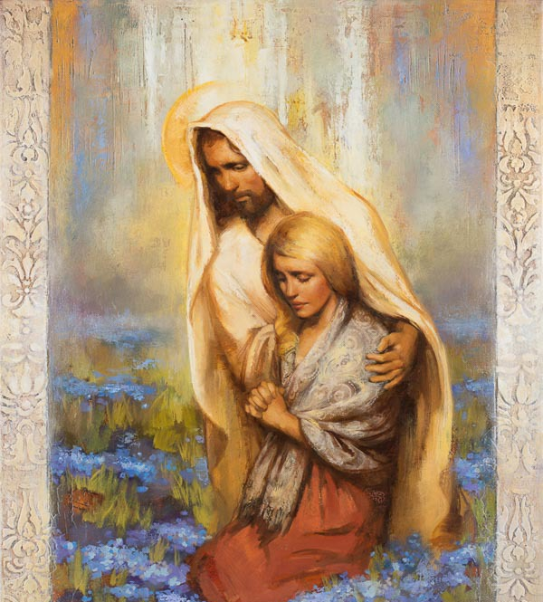
“Let me suggest that hands are made clean through the process of putting off the natural man and by overcoming sin and the evil influences in our lives through the Savior’s Atonement.
Hearts are purified as we receive His strengthening power to do good and become better.
All of our worthy desires and good works, as necessary as they are, can never produce clean hands and a pure heart.
It is the Atonement of Jesus Christ that provides both a cleansing and redeeming power that helps us to overcome sin and a sanctifying and strengthening power that helps us to become better than we ever could by relying only upon our own strength.
The infinite Atonement is for both the sinner and for the saint in each of us”.
David A. Bednar

Slide 52
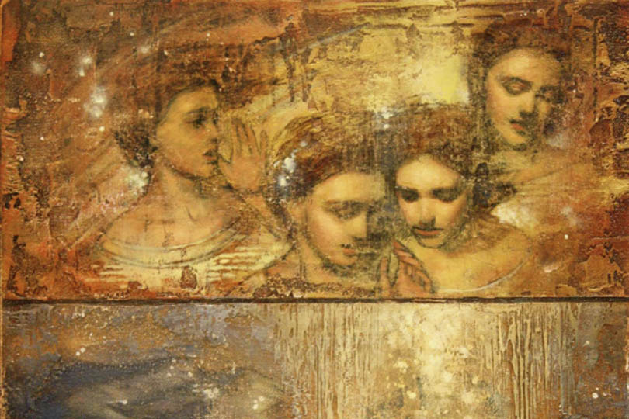
Receiving the Word
King Benjamin received the word from an angel
His people received the word from him
Both have the same obligation to embrace and live it
Those who have heard the word and have been taught will be held accountable to live the commandments taught by King Benjamin
Those who are wicked will be judged
Endless Torment—the quality or nature of the punishment rather than the duration
Mosiah 3:21-27
Annie Henrie Nadar Artwork

Slide 53
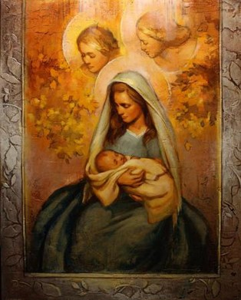
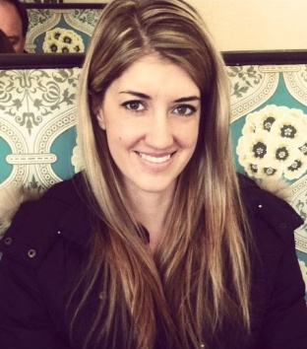
Sources:
James E. Talmage (Jesus the Christ, 3rd ed. [1916], 613).
Dallin H. Oaks (“All Men Everywhere,” Ensign or Liahona, May 2006, 77).
Guide to the Scriptures, “Natural Man,” scriptures.lds.org.
David A. Bednar (“Clean Hands and a Pure Heart,” Ensign or Liahona, Nov. 2007, 82).
Inspired thoughts by Joseph Fielding McConkie and Robert L. Millet Doctrinal Commentary on the Book of Mormon Vol. 2 (see Mosiah 3)
Annie Henrie Nadar Artwork
Presentation by ©http://fashionsbylynda.com/blog/
Annie Henrie Nadar Artwork

Slide 54
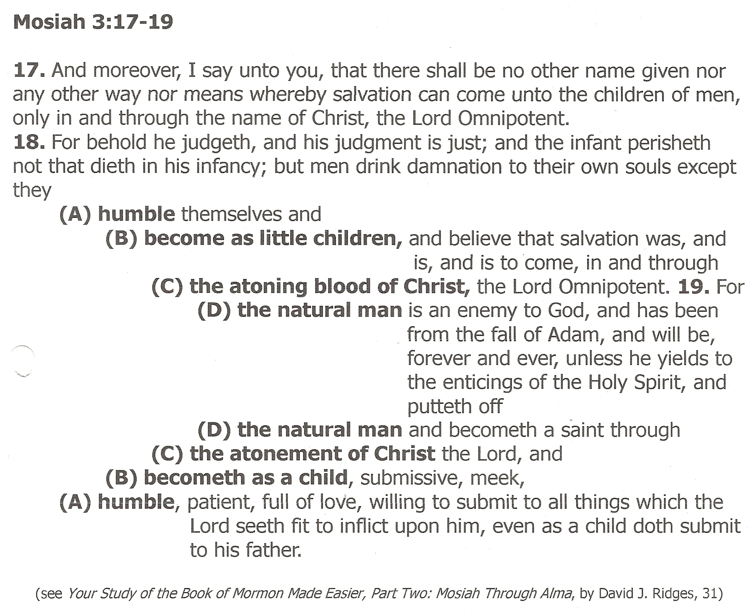

Slide 55
Understanding the Atonement of Christ
Elder Richard G. Scott of the Quorum of the Twelve Apostles taught that we should seek to understand all we can about the Atonement of Jesus Christ:
“None of us can ever adequately appreciate in mortality the full beneficial consequences of the Atonement.
“There is an imperative need for each of us to strengthen our understanding of the significance of the Atonement of Jesus Christ so that it will become an unshakable foundation upon which to build our lives. As the world becomes more devoid of foundational standards and as honor, virtue, and purity are increasingly cast aside in the pursuit of appetite, our understanding of and faith in the Atonement of Jesus Christ will provide strength and capacity needed for a successful life. It will also bring confidence in times of trial and peace in moments of turmoil.
“I energetically encourage you to establish a personal study plan to better understand and appreciate the incomparable, eternal, infinite consequences of Jesus Christ’s perfect fulfillment of His divinely appointed calling as our Savior and Redeemer. Profound personal pondering of the scriptures accompanied by searching, heartfelt prayer will fortify your understanding of and appreciation for His priceless Atonement. Another powerful way to learn of Jesus Christ and His Atonement is through consistent temple attendance” (“He Lives! All Glory to His Name!” Ensign or Liahona, May 2010, 77).

Slide 56
The Atonement Mosiah 2:19:
“None of us can ever adequately appreciate in mortality the full beneficial consequences of the Atonement.
“There is an imperative need for each of us to strengthen our understanding of the significance of the Atonement of Jesus Christ so that it will become an unshakable foundation upon which to build our lives. As the world becomes more devoid of foundational standards and as honor, virtue, and purity are increasingly cast aside in the pursuit of appetite, our understanding of and faith in the Atonement of Jesus Christ will provide strength and capacity needed for a successful life. It will also bring confidence in times of trial and peace in moments of turmoil.
“I energetically encourage you to establish a personal study plan to better understand and appreciate the incomparable, eternal, infinite consequences of Jesus Christ’s perfect fulfillment of His divinely appointed calling as our Savior and Redeemer. Profound personal pondering of the scriptures accompanied by searching, heartfelt prayer will fortify your understanding of and appreciation for His priceless Atonement. Another powerful way to learn of Jesus Christ and His Atonement is through consistent temple attendance” (Richard G. Scott, “He Lives! All Glory to His Name!” Ensign or Liahona, May 2010, 77).
ANNIE HENRIE graduated with a bachelor of fine arts degree from Brigham Young University in April 2012, and since the age of sixteen she has shown her work in galleries, including Bronze Coast Gallery in Cannon Beach, Oregon; Authentique Gallery in St. George, Utah; and Deseret Book stores. Annie grew up in Bountiful, Utah, and is the daughter of Cary and Sauni Henrie. Her father, also a professional artist, has taught his daughter how to paint and draw since she was in kindergarten. Annie's work is inspired by her experiences serving as a missionary in southern England and studying Renaissance art in Italy. She currently resides in Salt Lake City, Utah.
You served a mission in England and studied in Europe. How did those experiences shape your voice as an artist?
My studies abroad through BYU were incredibly influential and were some of the best things I did as a student there. In England and Italy, I saw A LOT of art- I saw the difference between overly sexualized and explicit art and art that meant to lift and inspire others to be better and greater human beings. I found my style there, and in many ways, found who I was. My mind was opened to the many different types of people and cultures there are in the world, and loved learning about the history of art.
Serving in England was pivotal in so many ways. There I met real life saints and angels- people who had gone through hard things but had risen above them and embraced the light of Christ. I met people who had been tried and tested in every way but were serving and ministering- by every definition they were angels. I also saw how silly it would be to just make art for decoration’s sake- there was so much need for help, compassion, and the Gospel in the world. However, I knew that art was my one natural talent, and the mission inspired me to work to find how to apply it, how to help the world on an everyday basis. It has been a powerful motivation to create and promote this type of art, and in a way, has continued the mission of spreading the Gospel.
http://www.thekrakens.com/2015/08/annie-henrie-nader-modern-spirituality/
Sacrament Mosiah 2:19:
“Sacrament meeting is the most sacred and holy of all the meetings in the Church. After His Resurrection, the Savior instituted the sacrament among the Nephites [see 3 Nephi 18:1–11]. If we are to be His disciples and to be committed members of His Church, we must remember and reverence the sacrament. It allows each of us to express with broken hearts and contrite spirits our willingness to follow the Savior, to repent, and to become a Saint through the Atonement of Christ [see Mosiah 3:19]” (Quentin L. Cook, “We Follow Jesus Christ,” Ensign or Liahona, May 2010, 84).

