Slide 1
Mosiah 11-17

Slide 2
Abinadi and King Noah
Mosiah 11-12
Warnings and Repentance

Slide 3
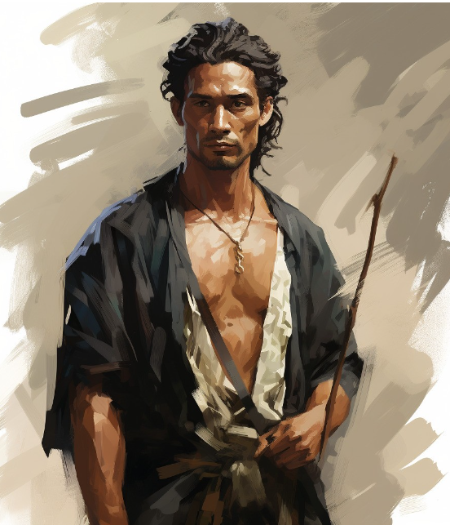
Previously…
Zeniff, a Nephite from Zarahemla, led an army expedition around 200 BC intent on returning southward to reclaim the land of Nephi from whence their ancestors-led by Mosiah I-had fled according to the command of God.
Zeniff was “taught in all the language of the Nephite, and having had knowledge of the land of Nephi, or of the land of our fathers’ first inheritance.”
He refused to participate in the destruction of the Lamanites saying, “When I saw that which was good among them, I was desirous that they should not be destroyed”.
Before Zeniff died, he conferred the kingdom on his son Noah
Mosiah 9:1; https://bookofmormon.online/people

Slide 4
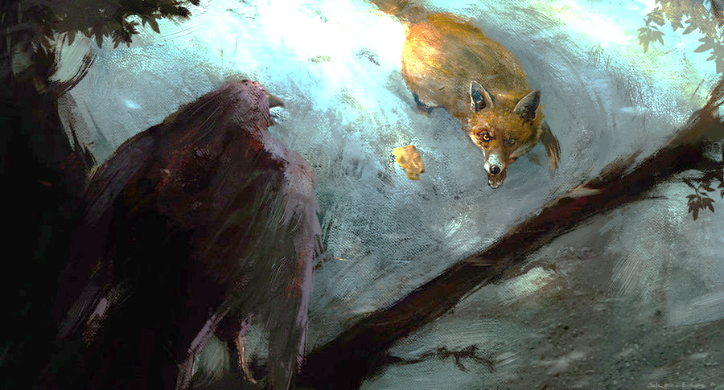
The Crow and The Fox
A crow sat in a tree with a piece of cheese in her beak. A fox came along and began telling the crow how noble and beautiful she was.
What was the fox able to do through flattery?
Sabastien Ecosse
When the fox asked if her voice was as beautiful as her feathers, the crow opened her beak to sing for the fox. As the crow let out a noisy “Caw!” the cheese dropped to the ground and the fox took it and ran.

Slide 5
Noah
He was the son of Zeniff
He was the second of the Nephite kings in the colony established by Zeniff and reigned around 160 BC
Because of his wicked ways, he led the Nephite people into bondage
The Lord sent a prophet (around 150 BC) to call Noah and his priests to repent
After Abinidi’s death Noah fled into the wilderness out of fear
His son, Limhi, did not flee and stayed to protect the people while Gideon, a strong soldier, rebelled against King Noah and attempted to kill him
Gideon searched for Noah and the others and found that Noah had suffered death by fire—which was a prophecy of Abinadi’s
Who’s Who

Slide 6
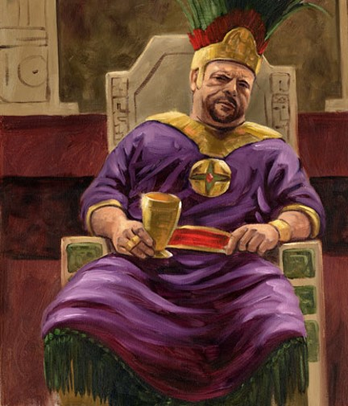
A Corrupt Kingdom
Noah did not “walk in the ways” of his father by:
Not keeping the commandments of God
Going after his own desires
Having many wives and concubines—a wicked practice of a man living with more than one woman in or out of marriage without God’s approval
Causing his people to commit sins
Changing the affairs of the kingdom
James H. Fullmer
No longer did the people walk in the lighted path of goodness but chose instead to follow a dark and crooked road
Mosiah 11:1-4

Slide 7
Bad Influences
Friends who don’t respect your standards
Advertisement that sells inappropriate morals
Inappropriate lyrics in music
Inappropriate online viewing or socializing
Friends who tempt you to do something wrong
Friends or dates with immoral values
Inappropriate movies or television
Parties with alcohol or drugs

Slide 8
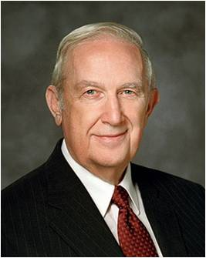
If we allow ourselves to be influenced by the vain and flattering words of others, we can be deceived into committing sin
“You can’t please God without upsetting Satan, so you will get pressure from those he tempts to do wrong.
Individuals who do wrong want you to join them because they feel more comfortable in what they are doing when others do it also…
One of the hardest things for you to recognize is how truly strong you already are and how others silently respect you.
You don’t need to compromise your standards to be accepted by good friends.
No one intends to make serious mistakes. They come when you compromise your standards to be more accepted by others. You be the strong one. You be the leader. Choose good friends and resist peer pressure together.”
Richard G. Scott
Mosiah 11:1-2

Slide 9
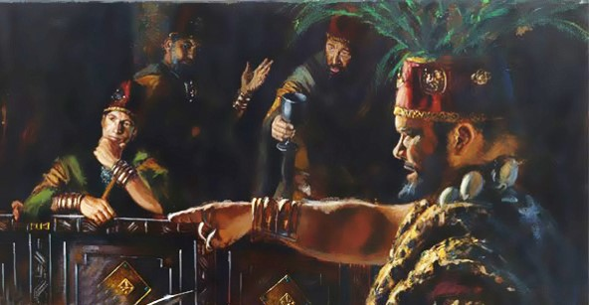
Noah’s Priests
The Priests, consecrated by Zeniff had been replaced by Noah’s own men and caused them to do as he did, by having wives and concubines and do all manner of wickedness.
The priests were corrupt, and their priesthood defiled.
A righteous government is essential to the preservation of society, and leadership is a sacred trust. All who have led others in the paths of wickedness will be rewarded according to their works.
Mosiah 11:5-7 Manual

Slide 10
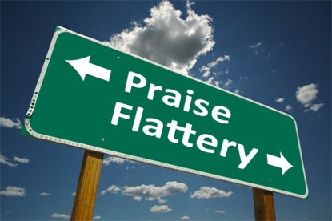
Why do you think the people were willing to support Noah in his wickedness?
Why can “vain and flattering words” lead people to be deceived?
Flattery is false praise, usually given
to manipulate the person being
praised.
When we believe the vain and flattering words of others, we open ourselves to be misled
What can we do when people all around us are living unrighteously?
Mosiah 11:5-7

Slide 11
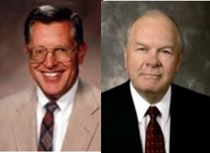
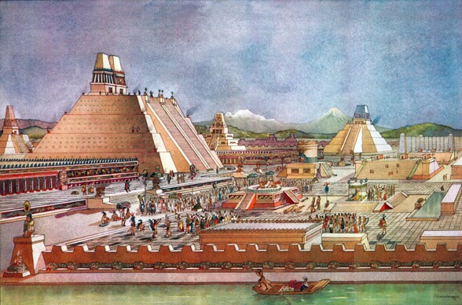
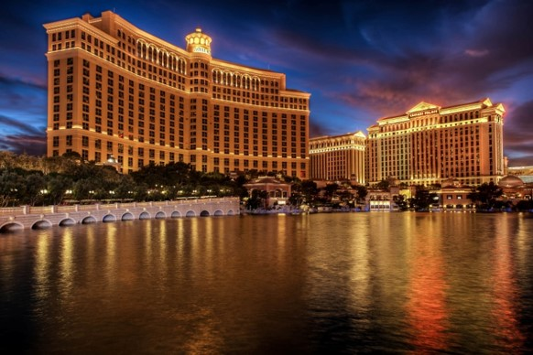
Noah’s Empire
An earmark of false religion is its attempt to hide its emptiness in such things as pomp and ceremony, grandeur and elegance. JFM and RLM
The purpose of great and spacious buildings, ornate in décor, is to create a sense of reverence and awe that otherwise would be lacking.
However…
These are the kingdoms of the world
Mosiah 11:8-15

Slide 12
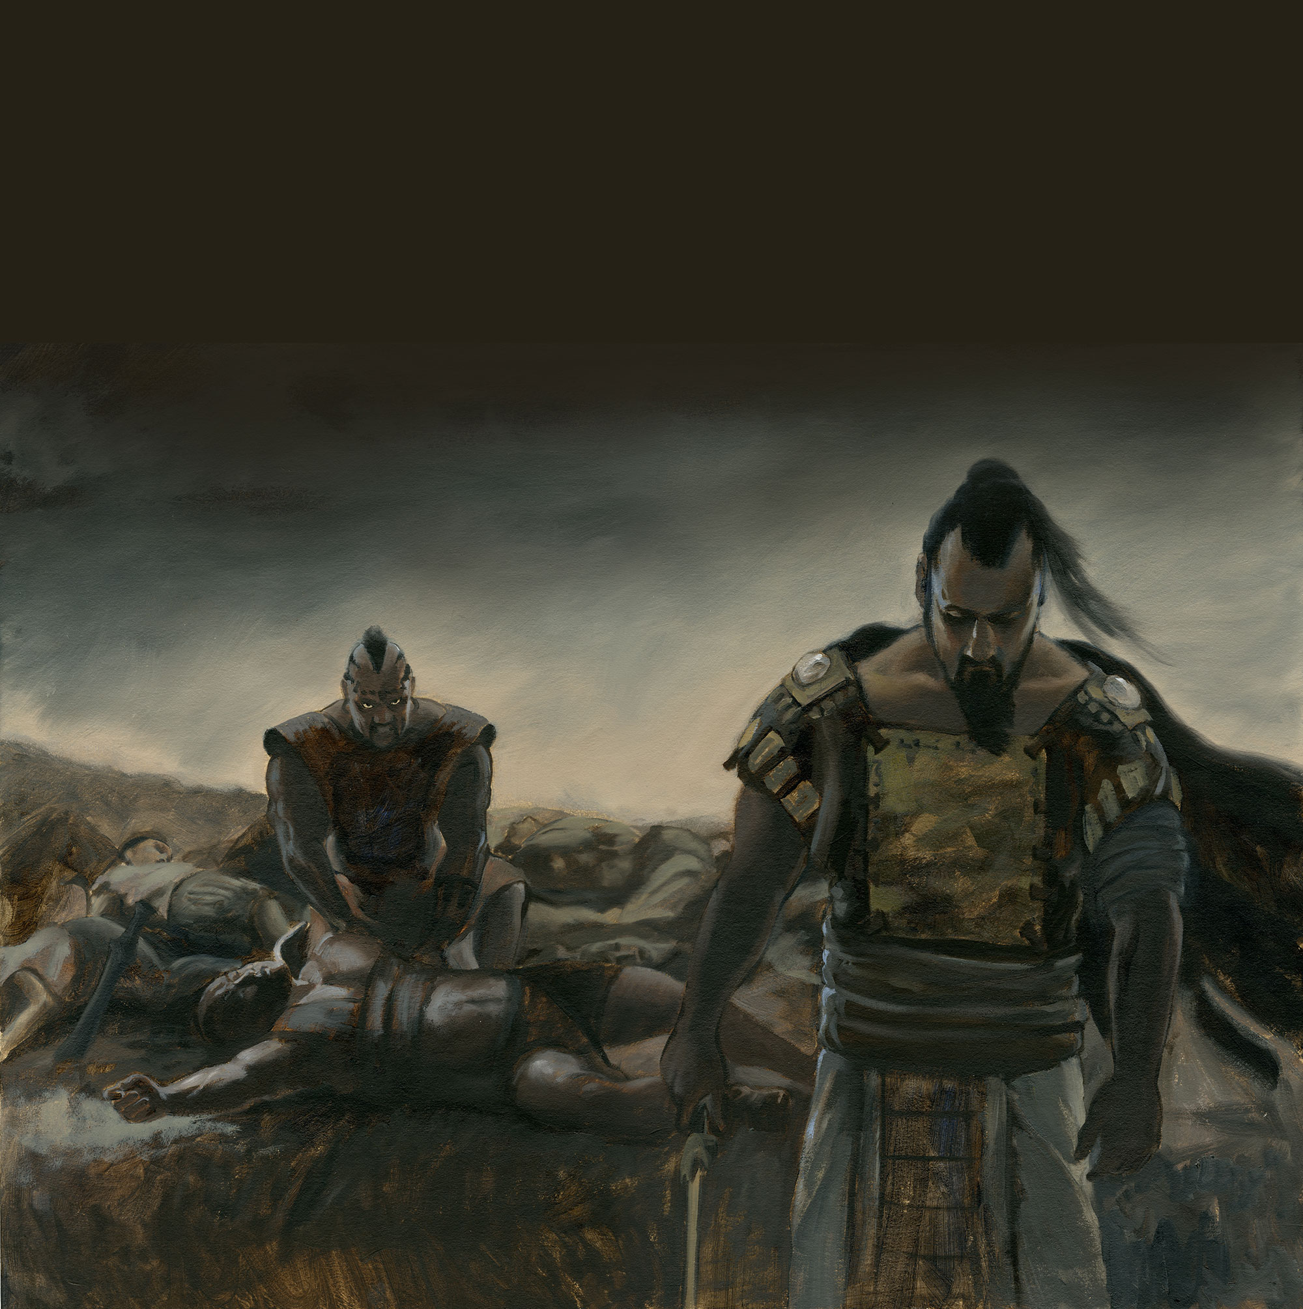
Boasting in Their Own Strength
The Lord told Nephi that if the day ever came that the Nephites rebelled against the commandments, the Lamanites would be given power to scourge them “to stir them up in the ways of remembrance.”
1 Nephi 2:21-24
The Lamanites, little by little began attacking the flocks and fields of the Nephites.
Some of the Nephites were killed and Noah’s army fought back and drove them back temporarily---
“…and thus they did boast, and did delight in blood, and the shedding of the blood of their brethren, and this because of the wickedness of their king and priests.”
Mosiah 11:16-19

Slide 13
Abinadi
He was a Nephite
The Lord sent him to the Nephites in the land of Lehi-Nephi during the reign of King Noah to warn the people of their destruction if they don’t repent or their unrighteous living
Around 150 BC
His words were rejected, and he was forced to flee
After 2 years he returned, in disguise, to teach about the Lord
He was found and bound before Noah’s court
His mission was to teach about the Savior
He was surrounded by the Spirit and taught from Isaiah
He prophesied of King Noah’s death
They rejected him again, except one man, and he was burned at the stake
Who’s Who

Slide 14
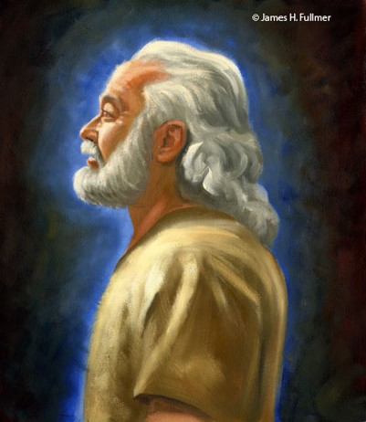
Abinadi’s First Warning
The Lord does not discipline a people unless he first warns them of that which is to come and with great patience invites them to repent.
We know of no instance in which the nation of Israel or any of its remnants have been placed in bondage to their enemies that was not the result of their own wickedness and in which they were not forewarned by prophets sent specifically for that purpose.
As disobedience brings bondage and sorrow to nations, so it does to individuals.
James H. Fullmer
Jealous God—Man cannot serve two masters—a manifestation of his desire to save all his children
Matthew 6:24
Mosiah 11:20-23 JFM and RLM

Slide 15
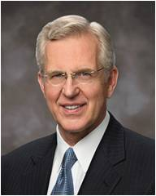
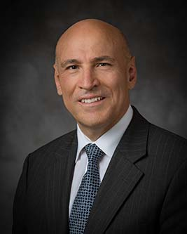
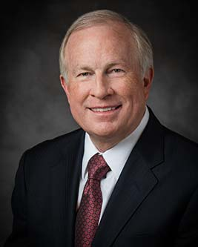
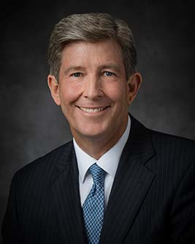
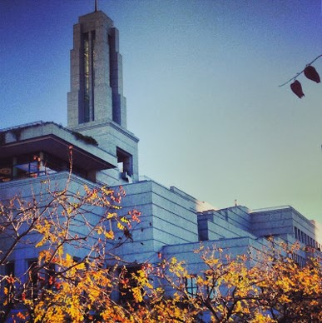
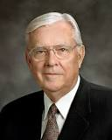
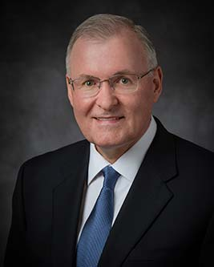
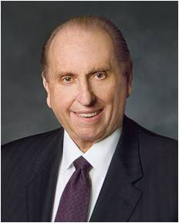
Prophet’s Warnings of Today
Peace will come to those who read the scriptures—Elder Boyd K. Packer
Follow the Holy Spirit—Elder D. Todd K. Christofferson
Share the Gospel--Elder S. Gifford Nielsen, M. Russell Ballard, and Randy D. Funk
God calls prophets to call people to repentance and warn of the consequences of sin
Let us reach out to others with faith and with love-- Elder Arnulfo Valenzuela
As we repent and become converted to the Lord, we become whole, and our guilt is swept away– Elder Timothy J. Dyches
Repent and be faithful-- President Dieter F. Uchtdorf
Give priesthood service-- President Henry B. Eyring
Home teaching…Become stronger to survive trials… May we show increased kindness toward one another, and may we ever be found doing the work of the Lord—
President Thomas S. Monson

Slide 16
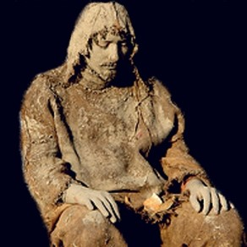
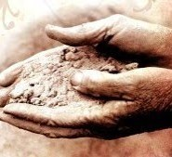
Except They Repent
“They were slow to hearken unto the voice of the Lord their God; therefore, the Lord their God is slow to hearken unto their prayers, to answer them in the day of their trouble.
In the day of their peace they esteemed lightly my counsel; but, in the day of their trouble, of necessity they feel after me.”
D&C 101:7-8
Repent in sackcloth ---an appropriate symbol for the godly sorrow and contrition of soul that is part of true repentance
Ashes—The strewing of ashes upon oneself was also a symbolic gesture representing the depth of humility and the fullness of penitence
1 Kings 20:31-32
They will be put in bondage
The Lord will not hear their prayers
The Lord will not deliver them out of their afflictions
They will be smitten by their enemies
Mosiah 11:21-25

Slide 17
Sin can blind us from recognizing the truth of prophets’ words
“The message of repentance is often not welcomed. …
“… When prophets come crying repentance, it ‘throws cold water on the party.’ But in reality the prophetic call should be received with joy. Without repentance, there is no real progress or improvement in life.
Pretending there is no sin does not lessen its burden and pain.
Suffering for sin does not by itself change anything for the better.
Only repentance leads to the sunlit uplands of a better life.
And, of course, only through repentance do we gain access to the atoning grace of Jesus Christ and salvation.”
D. Todd Christofferson
Mosiah 11:21-25

Slide 18
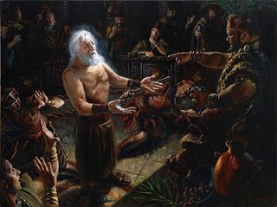
Noah Seeks Abinadi’s Life
The Prophet’s message of truth brought anger in their hearts—Abinadi flees
Anger within
Who is Abinadi?
Who is the Lord?
Who is it that they should judge me and my people?
“The last days will be rampant with the cardinal sins, just “as in the days of Noah.” Society in the days of Noah, scriptures advise, was “corrupt before God” and “filled with violence…
Corruption and violence—sound familiar? Both of these awful conditions crest because of surging individual selfishness. When thus engulfed, no wonder men’s hearts in our day will fail them because of fear.”
Neal A. Maxwell
Mosiah 11:26-29

Slide 19
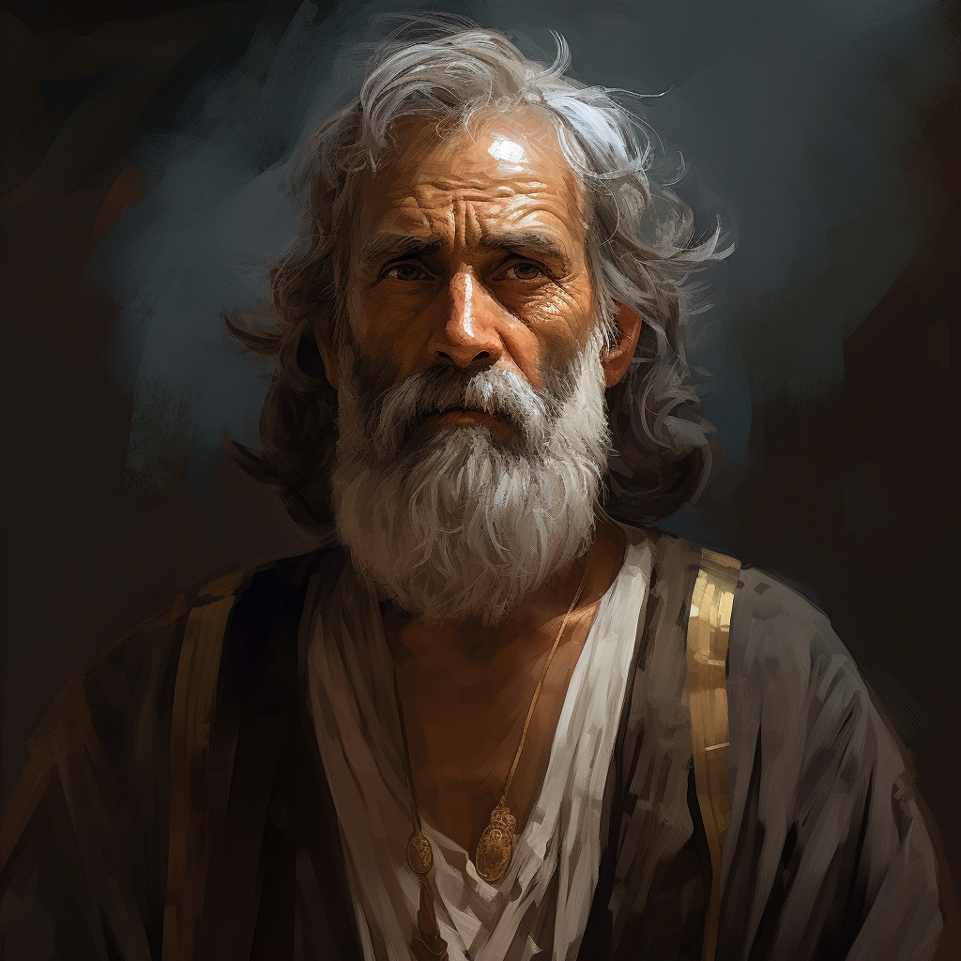
Two Years
While Abinadi was gone for two years.
The Lord mercifully gave the people time to turn to Him and repent of their sins.
How much time do we need to repent of our sins?
Mosiah 12:1

Slide 20
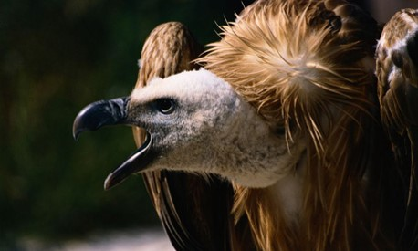
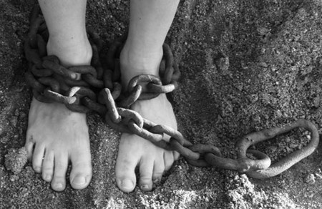
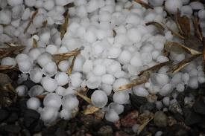
Second Warning and Prophecy
Brought into bondage
They shall be smitten on the cheek-- to be smitten on the cheek is a reproach itself, and is a suffering not very patiently endured.
They shall be driven by man
They shall be slain
Animals will devour them
They will have sore afflictions—famine, pestilence, They shall howl—mourn, weep
They shall have burdens lashed on their backs—slavery
There will be hail from the east wind and insects shall pester and devour their crops
Except they repent—they will be destroyed off the face of the earth
After two years Abinadi returns in disguise and prophesies of God’s wrath
Mosiah 12:1-7

Slide 21
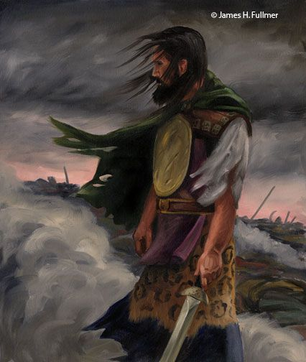
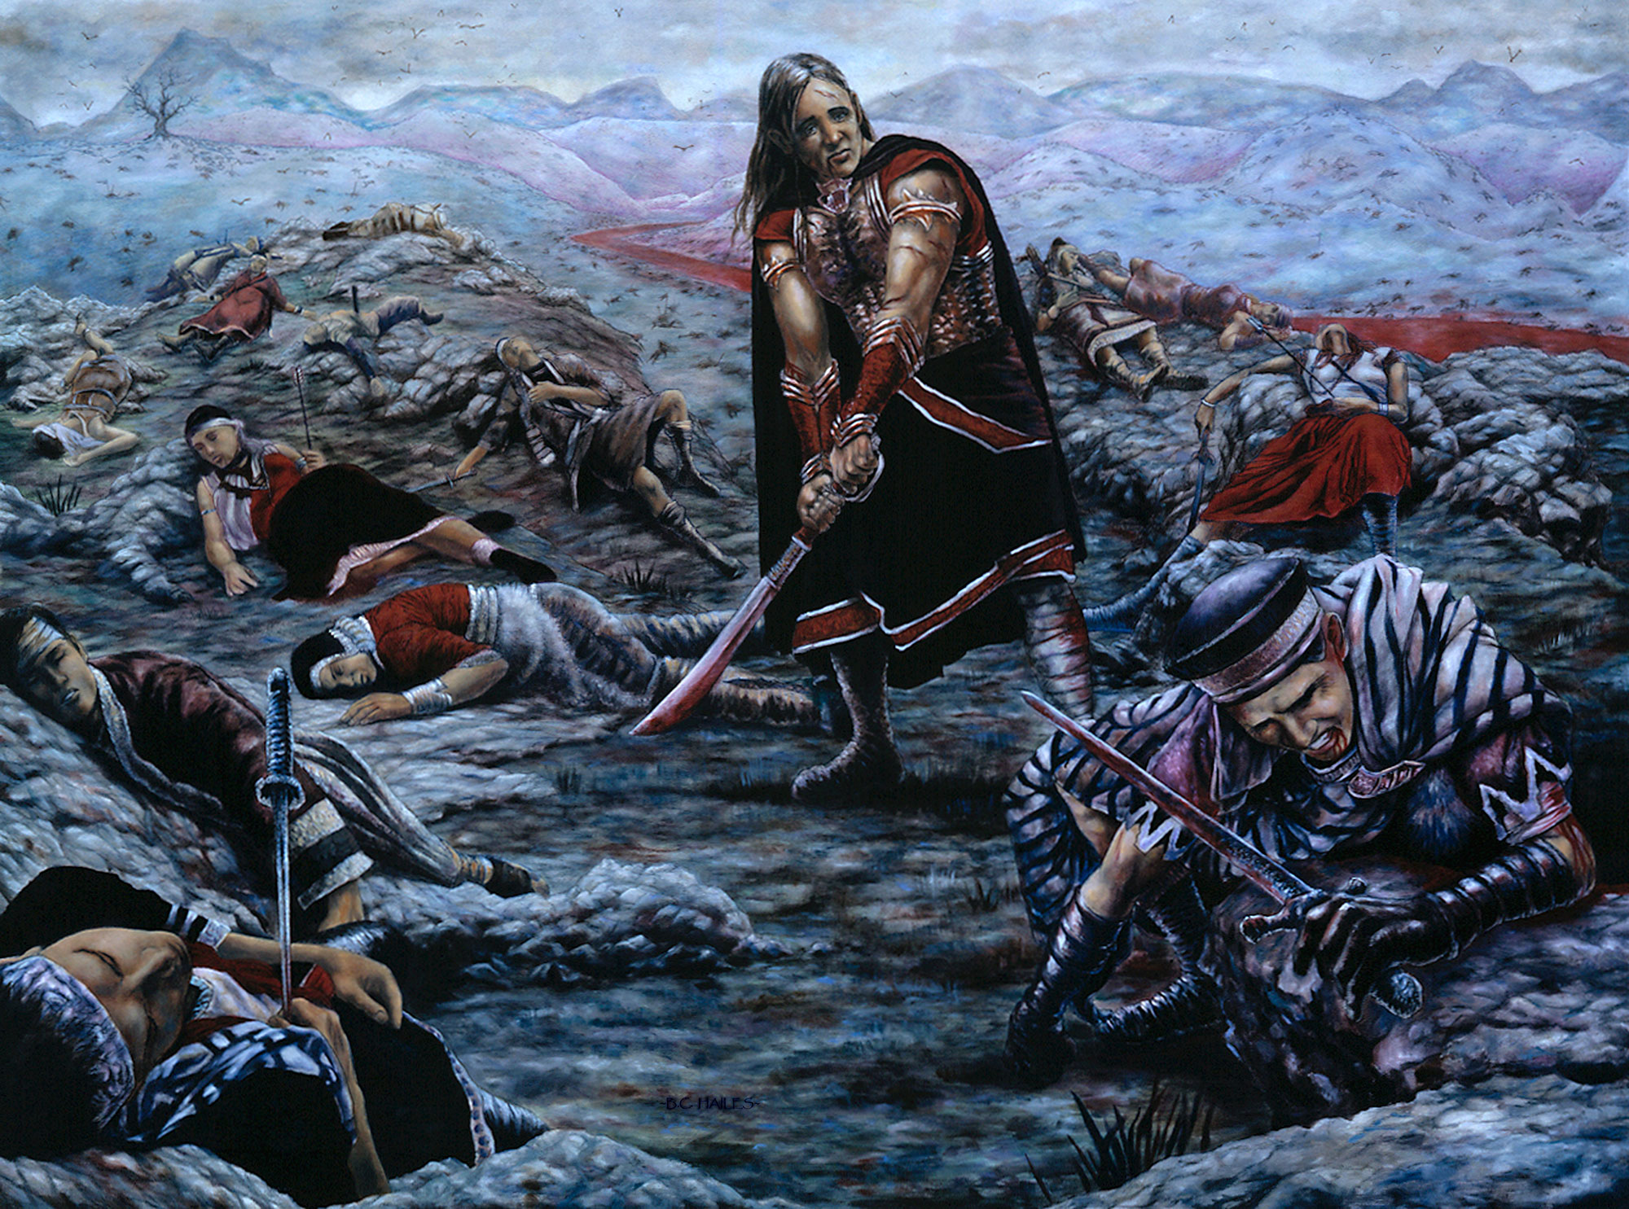
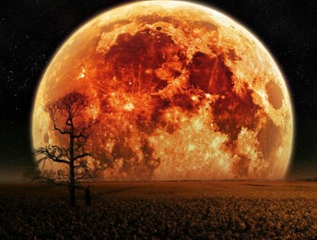
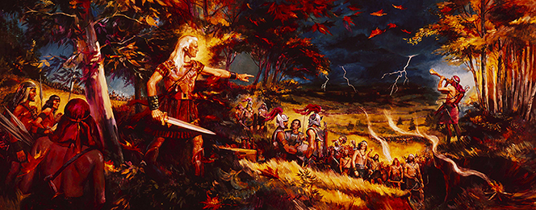
History of Destruction
The testimony of history is most eloquent in warnings against wickedness. Within the Book of Mormon we have the testimony of three civilizations:
The Jaredites
The Mulekites
The Nephites
All of which God will indeed destroy the wicked from off the face of the earth.
A prelude to destruction that will precede the great millennial day
JFM and RLM
Mosiah 12:8

Slide 22
Sources:
Richard G. Scott Making the Right Choices Oct. 1994 General Conf.
Joseph Fielding McConkie and Robert L. Millet Doctrinal Commentary on the Book of Mormon Vol 2. p. 201,203, 206
Manual---Book of Mormon Student Manual Religion 121-122
D. Todd Christofferson, “The Divine Gift of Repentance,” Ensign or Liahona, Nov. 2011, 38).
Neal A. Maxwell Put off the Natural Man and Come Off Conqueror Oct. 1990 Gen. Conf.
Presentation by ©http://fashionsbylynda.com/blog/

Slide 23
Abinadi as a type of Christ
Abinadi | Type/Shadow | Christ
Mosiah 11:20 | Called to preach repentance to those sinning | Matthew 9:13
Mosiah 11:21–23; 12:1–8 | To deny message was to be afflicted by the hand of enemies and brought into bondage | Matthew 23:37–38; 24:3–51
Mosiah 11:20–25 | Denounced unbelievers in public discourse | Matthew 23:9
Mosiah 12:9 | Stood alone against accusers | Matthew 26:56
Mosiah 12:17–18 | Bound and taken before religious priests and political ruler | John 18:12–40
Mosiah 12:19 | Cross-examined | Matthew 26:59–60
Mosiah 13:1 | Dismissed as mad | John 10:20
Mosiah 13:6 | Spoke with power and authority | Matthew 7:28–29
Mosiah 13:7 | Could not be slain until message/ mission was completed | John 10:17–18
Mosiah 17:6 | Three-day imprisonment (entombment) | Luke 24:4–8, 46
Mosiah 17:8 | Condemned for blasphemy | Matthew 26:63–66
Mosiah 17:9 | Would not recall words | Matthew 27:12–14
Mosiah 17:10 | Innocent blood | Matthew 27:24
Mosiah 17:11–12 | Leader tempted to release him but yielded to detractors and delivered him to be slain | John 18:4–25
Jeffrey R. Holland, Christ and the New Covenant: The Messianic Message of the Book of Mormon [1997], 171–172.

Slide 24
Abinadi Brought Before King Noah
Mosiah 12-13

Slide 25
Survey
I KNOW what it means to live the gospel of Jesus Christ.
I LIVE the gospel of Jesus Christ.
How well do these statements describe yourself?
Using a scale of 1 to 10 (with 10 representing that the statement describes you very well)
Mosiah 12:18-24

Slide 26
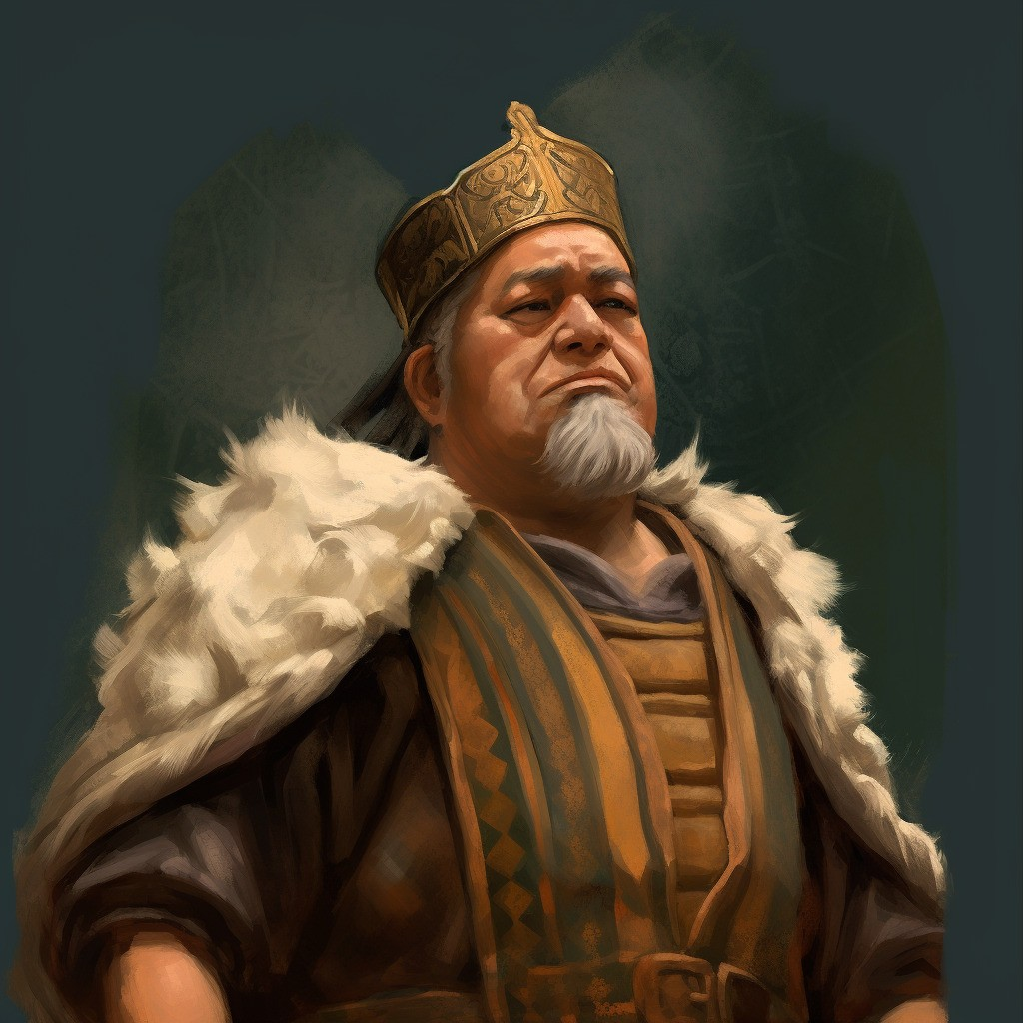
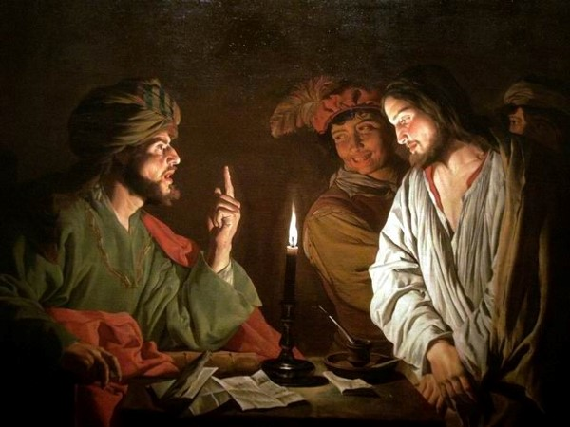
Cross Examination
After Abinadi was in prison he was later brought before King Noah and his priests. The priests questioned him, trying to confuse him into saying something they could use against him. Then one of them asked him to explain a scripture passage.
They used the same tactics that the Sanhedrin used on the Savior. They attempted to “cross him” in his words
See Mark 14:55-64
Mosiah 12:18-19

Slide 27
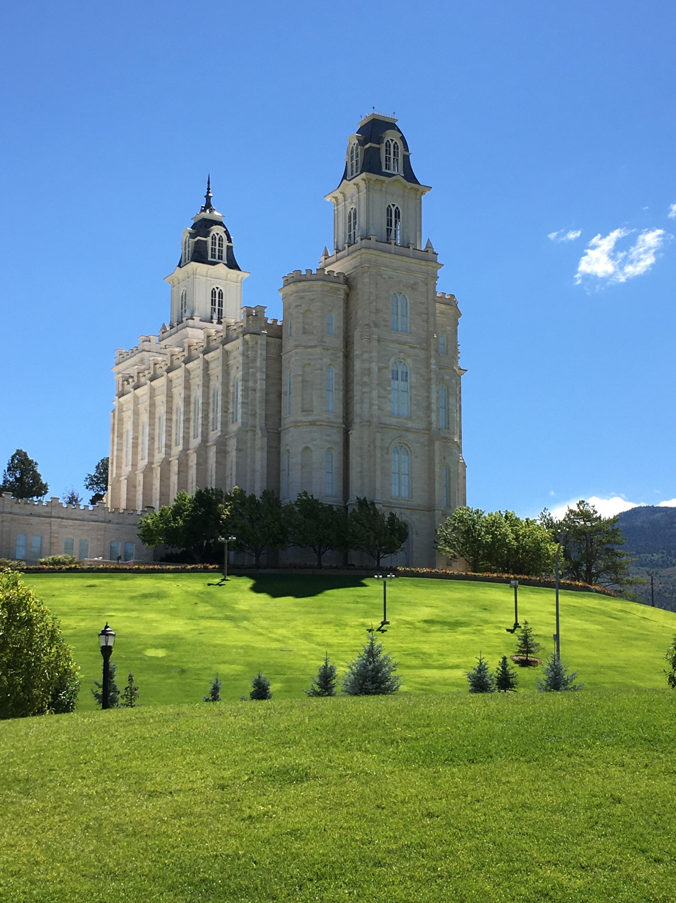
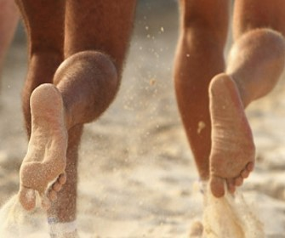
How Beautiful on the Mountains
“How beautiful upon the mountains are the feet of him that bringeth good tidings; that publisheth peace; that bringeth good tidings of good; that publisheth salvation; that saith unto Zion, Thy God reigneth;”
Mountains—temples—a place of worship
Feet--In the ancient world, before electronic communications were available, important messages were often brought by runners traveling on foot. Isaiah uses the messengers’ feet to symbolize the messengers themselves
Old Testament Manual
Published--it is a message of good tidings, a message of peace and salvation. The messengers described by Isaiah include the prophets and also the Lord himself
Mosiah 12:20 and Isaiah 52:7

Slide 28
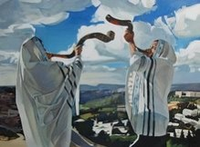
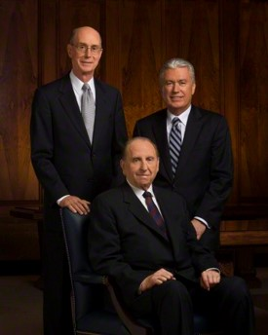
The Watchmen
“Thy watchmen shall lift up the voice; with the voice together shall they sing; for they shall see eye to eye when the Lord shall bring again Zion;”
Eye to eye—same faith—same God
And set watchmen round about them, and build a tower, that one may overlook the land round about, to be a watchman upon the tower, that mine olive trees may not be broken down when the enemy shall come to spoil and take upon themselves the fruit of my vineyard.
D&C 101:45
As watchmen on the tower of Zion, it is our obligation and right as leaders to speak out against current evils—evils that strike at the very foundation of all we hold dear as the true church of Christ and as members of Christian nations.
Ezra Taft Benson
Mosiah 12:21 and Isaiah 52:8

Slide 29
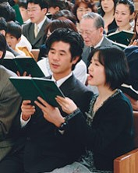
Break Forth Into Joy
“Break forth into joy; sing together ye waste places of Jerusalem; for the Lord hath comforted his people, he hath redeemed Jerusalem;”
The song to be sung in Zion will be a new song, sung when all will know Christ (i.e., during the Millennium).
The words of the song, which will include parts of verse 8, are recorded in Doctrine and Covenants 84:99–102.”
(“Great Are the Words of Isaiah,”p. 199.)
Mosiah 12:23 and Isaiah 52:9

Slide 30
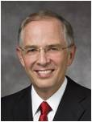
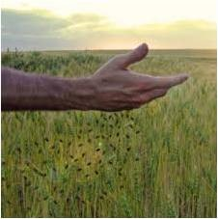
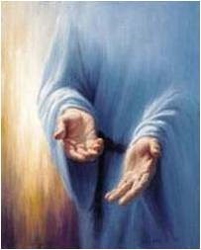
His Holy Arm
“The Lord hath made bare his holy arm in the eyes of all the nations, and all the ends of the earth shall see the salvation of our God?”
“The scriptures speak of His arms being open, extended, stretched out, and encircling. They are described as mighty and holy, arms of mercy, arms of safety, arms of love, “lengthened out all the day long.”
We have each felt to some extent these spiritual arms around us. We have felt His forgiveness, His love and comfort. The Lord has said, “I am he [who] comforteth you.”
The Lord’s desire that we come unto Him and be wrapped in His arms is often an invitation to repent. “Behold, he sendeth an invitation unto all men, for the arms of mercy are extended towards them, and he saith: Repent, and I will receive you.”
^{Neil L. Andersen}
Mosiah 12:24 and Isaiah 52:10

Slide 31
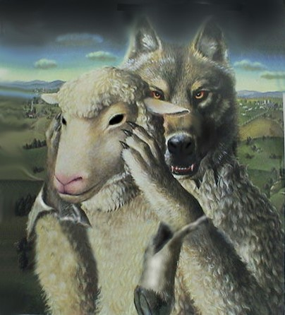
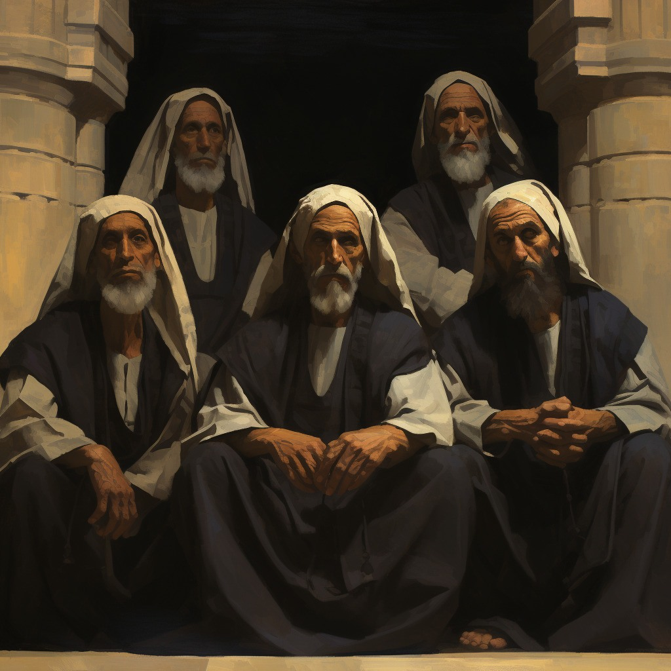
Profess to be the Watchmen
Not only did the Priests fail to keep a watch over their people, but they became instigators of the very evils from which they were to protect their people.
They became the wolves in sheep’s clothing
They had the knowledge of God and professed to act in his name, but they had take the Lord in vain. D&C 63:62
They added to their own darkness by their own works and evil example.
Abinadi says, “Wo be unto you for perverting the ways of the Lord.”
Mosiah 12:25-26 JFM and RLM

Slide 32
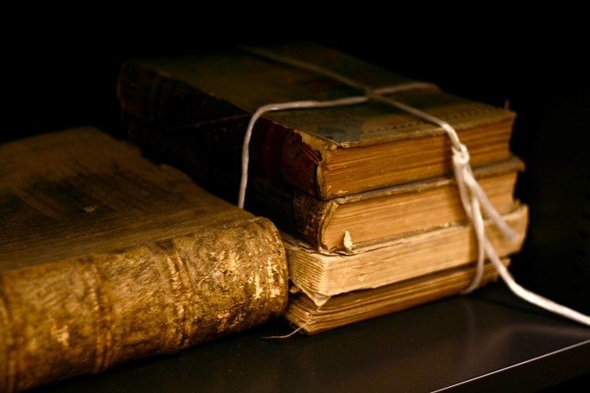
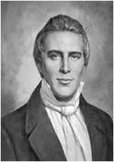
Apply Your Hearts to Understanding
The Priest’s of Noah were men of learning and intellect, yet they had no wisdom and understanding of the heart.
In our day:
“It was of professors of religion that the Lords said, “They draw near to me with their lips, but their hearts are far from me, they teach for doctrines the commandments of men, having a form of godliness, but they deny the power thereof:”
Joseph Smith
Mosiah 12:25-26 JFM and RLM

Slide 33
Abinadi VS The Priests
What do you teach?
The Law of Moses
If you teach the Law of Moses, why don’t you keep the commandments?
Why do you set your hearts on riches?
Why do you commit whoredoms and spend your strength with harlots and cause the people to commit sin?
You know that I speak the truth
Mosiah 12:28-30

Slide 34
Does Salvation come by the Law of Moses?
Yes
I know if ye keep the commandments of God ye shall be save
The Lord said to me: “I am the Lord thy God who delivered you our of the land of Egypt, out of bondage…Thou shalt have no other God before me. Thou shalt not make unto thee any graven image.”
Have ye done all this?
Have you taught the people the commandments
No, you haven’t
Mosiah 12:31-37

Slide 35
They Do Not Understand
Abinadi charges Noah and his priests with their idolatry. They profess salvation through observance of ritual, the meaning of which they do not understand.
They have not fulfilled their obligations as priests to teach these things to the people.
Abinadi now comes to them as Moses did to Israel
Mosiah 12:37

Slide 36
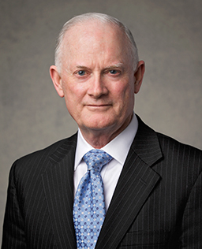
The priests [of King Noah] had the scriptures, and they knew about the law and the prophets, but they had not applied their hearts to understanding. The heart is the symbolic center of our will, our desires, our commitments, our values and priorities, our feelings, and our testimony of the truth.
Understanding the gospel is much more than a cognitive experience. It’s a spiritual experience in which the Holy Ghost witnesses of the truth, enlightens our minds, and changes our hearts. Understanding of the heart is a gift of the Spirit.
When [a student] desires to apply her heart to understanding a gospel principle like faith in Jesus Christ, she must exercise her agency to choose Jesus Christ and live that principle. Her experience with the principle is the gateway to her heart. Her action authorizes the Holy Ghost to testify, enlighten, and change the way her heart embraces the Lord and that principle.
As she continues to live the principle, reflect on her experience, and testify of what she knows is true, her understanding of faith will grow, and her heart will change.”
Kim B. Clark

Slide 37
Away With This Fellow
King Noah and his priests cannot rest until they have put Abinadi to rest
Touch me not God shall smite you if ye lay your hands upon me
He is Mad
The Lord’s purpose had not been fulfilled yet so they could not take him away. Abinadi was sent there to fulfill the commandment of God by preaching to them of their wickedness—
The Spirit of the Lord was with Abinadi
Mosiah 13:1-5

Slide 38
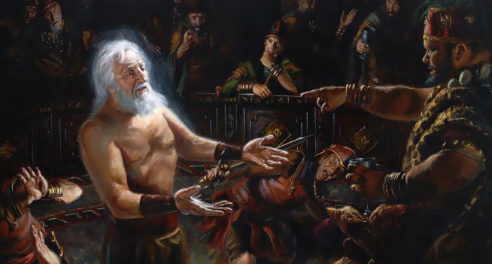
A Type and A Shadow of Things To Come
They had not the power to slay him until he was finished with his message
“Therefore, hold on thy way, and the priesthood shall remain with thee; for their bounds are set, they cannot pass. Thy days are known, and thy years shall not be numbered less; therefore, fear not what man can do, for God shall be with you forever and ever”
D&C 122:9
By slaying Abinadi, Noah and his priests condemned themselves to death. In killing him with fire they chose the manner of their own or their descendants’ deaths.
If they had chosen to repent an accept his message, then their eternal reward would have been the same as Abinadi’s.
JFM and RLM
Mosiah 13:7-10

Slide 39
Abinadi Has 10 Commandments
Some may wonder how Abinadi received the Ten Commandments which God had given to Moses.
The Brass plates obtained by Nephi contained the five books of Moses (1 Nephi 5:11)
These records would have been passed down by Nephite prophets and record keepers
The records were common knowledge to Noah and his priests
Institute manual
Mosiah 13:12-24

Slide 40
The Ten Commandments
“[The] Ten Commandments [were] written by the finger of Jehovah on tablets of stone for the salvation and safety, for the security and happiness of the children of Israel, and for all of the generations which were to come after them.”
Gordon B. Hinckley
Thou shalt have no other gods before me
Thou shalt not make unto thee any graven image
Thou shalt not take the name of the Lord God in vain
Remember the Sabbath day, to keep it holy
Honour thy father and thy mother
Thou shalt not kill
Thou shalt not commit adutery
Thou shalt not steal
Thou shalt not bear false witness
Thou shalt not covet
Mosiah 13:11-24 Exodus 20:3-17

Slide 41
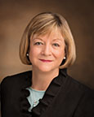
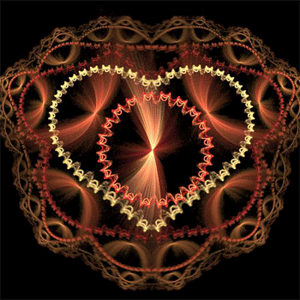
If the commandments of God are not written in our hearts, we will not seek to obey them with real intent
“We need to get the gospel from our heads into our hearts! It is possible for us to merely go through the motions of living the gospel because it is expected or because it is the culture in which we have grown up or because it is a habit. …
“We all need to seek to have our hearts and very natures changed so that we no longer have a desire to follow the ways of the world but to please God.”
Bonnie L. Oscarson
Mosiah 13:11

Slide 42
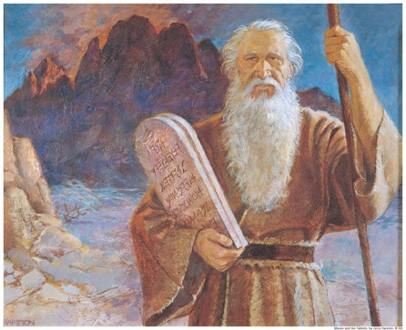
“The modern reader should not see the Mosaic code—anciently or in modern times—as simply a tedious set of religious rituals slavishly (and sometimes militantly) followed by a stiffnecked people who did not accept the Christ and his gospel.
This historic covenant, given by the hand of God himself and second only to the fulness of the gospel as an avenue to righteousness, should be seen rather as the unparalleled collection of types, shadows, symbols, and prefigurations of Christ that it is. For that reason it was once (and still is, in its essence and purity) a guide to spirituality, a gateway to Christ, a path of strict commandment-keeping that would, through the laws of duty and decency, lead to higher laws of holiness on the way to immortality and eternal life. …
“… It is crucial to understand that the law of Moses was overlaid upon, and thereby included, many basic parts of the gospel of Jesus Christ, which had existed before it. It was never intended to be something apart or separated from, and certainly not something antagonistic to, the gospel of Jesus Christ. … Its purpose was never to have been different from the higher law. Both were to bring people to Christ”
Jeffrey R. Holland

Slide 43
Teaching Salvation
Salvation is in Christ, not in law
Salvation does not come by law alone
“After all our obedience and good works, we cannot be saved from death or the effects of our individual sins without the grace extended by the atonement of Jesus Christ.
The Book of Mormon makes this clear. It teaches that ‘salvation doth not come by the law alone’ (Mosiah 13:28).
In other words, salvation does not come simply by keeping the commandments. …
Even those who try to obey and serve God with all their heart, might, mind, and strength are ‘unprofitable servants’ (Mosiah 2:21). Man cannot earn his own salvation”
Dallin H. Oaks
Mosiah 13:27-28

Slide 44
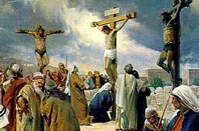
Understanding the Role of Jesus Christ
No one can be saved except through the Atonement of Jesus Christ
Jesus Christ has carried my sorrows, such as …
Jesus Christ was wounded and bruised for my transgressions, such as …
Mosiah 13:27-28

Slide 45
All Prophets Testify of Christ
A prophet is a man called by God to be His representative on earth. When a prophet speaks for God, it is as if God were speaking (see D&C 1:38).
A prophet is also a special witness for Christ, testifying of His divinity and teaching His gospel. A prophet teaches truth and interprets the word of God.
He calls the unrighteous to repentance. He receives revelations and directions from the Lord for our benefit. He may see into the future and foretell coming events so that the world may be warned.
Gospel Principles
Mosiah 14:1-12 Isaiah 53

Slide 46
Sources:
Gordon B. Hinckley (“Our Solemn Responsibilities,” Ensign, Nov. 1991, 51).
Old Testament: Gospel Doctrine Teacher’s Manual, (2001), 187–89
Ezra Taft Benson “Watchman, Warn the Wicked” Ensign July 1973
Neil L. Andersen “Repent … That I May Heal You” October 2009 General Con.
Joseph Fielding McConkie and Robert L. Millet Doctrinal Commentary on the Book of Mormon Vol. 2 pg. 209, 214
Joseph Smith--History 1:9
Dallin H. Oaks (“Another Testament of Jesus Christ,” Ensign, Mar. 1994, 67).
Bonnie L. Oscarson, “Do I Believe?” Ensign or Liahona, May 2016, 88).
Jeffrey R. Holland (Christ and the New Covenant: The Messianic Message of the Book of Mormon [1997], 136–37, 147; see also2 Nephi 11:4; Mosiah 16:14–15).
Student Manual Institute of Religion 121-122 Book of Mormon pg 192
Gospel Principles Chapter 9 Prophets of God (2011); 39-43
Kim B. Clark, “Apply Your Hearts to Understanding” [evening with a General Authority, Feb. 8, 2019], Salt Lake City Tabernacle
Presentation by ©http://fashionsbylynda.com/blog/

Slide 47
How well do I Keep the Commandments? | Almost Never | Some of the time | Much of the time | Almost always
1. I love God and put Him first in my life (before friends, hobbies, my own desires, and so on).
2. I avoid worshipping graven images or idols (including entertainers, sports stars, material possessions, and so on).
3. I speak the Lord’s name with reverence.
4. I keep the Sabbath day holy by recognizing it as the Lord’s day, not mine.
5. I honor my parents by being obedient and respectful.
6. I control my anger and do not act violently toward others.
7. I remain sexually pure. I avoid inappropriate images, language, and actions.
8. I refrain from stealing and cheating.
9. I tell the truth.
10. I avoid coveting (which means to intensely desire something that belongs to someone else).

Slide 48
Song of the Suffering Servant
Mosiah 14 and Isaiah 53
Presentation by ©http://fashionsbylynda.com/blog/

Slide 49
Abinadi’s 2nd Message
The Great Suffering Servant Song
Isaiah had a clear understanding of the mission and suffering of the Savior more than 700 years before His birth
The Servant Songs (also called the Servant poems or the Songs of the Suffering Servant) are songs in the Book of Isaiah.
“These verses are known among biblical scholars as a ‘servant’s song.’ This is a major poetic passage wherein a servant of the Lord is described, although not specifically identified. There are differences of opinion among commentaries regarding the identity of this Servant. ..”
Hoyt W. Brewster, Jr.
Isaiah 53 is often called the “Song of the Suffering Servant,” who is Jesus Christ.

Slide 50
The Messiah
Who hath believed our report?—Many did not believe the report about the works and mission of Christ (John 12:37-41)
For he--Christ
Shall grow up before him--God
As a tender plant—Child, humble innocent. God would watch over the young Jesus as a careful gardener watches a tender plant
As a root out of dry ground—You wouldn’t expect a root to grow out of dry ground. Spiritual barrenness of the Jewish Apostasy, grew up in Nazareth, a nowhere town
When this Messiah comes, he will come tenderly, quietly, obscurely from an unexpected source.
What kind of Messiah were they expecting?
What kind of Messiah will come for the Millennium?
Mosiah 14:1-2 Isaiah 53:1-2

Slide 51
Despised/Rejected
He hath no form or comeliness/no beauty that we should desire him—He will look like an ordinary man. People will have to recognize him by who hi is and what he teaches and not by his physical countenance
Despised/Rejected—They knew the mortal Messiah would be largely rejected. He was excommunicated by the people of Nazareth
We hid…our faces from him—an expression used concerning a person’s reaction to a leper—shunning in disgust and fear.
Despised/esteemed him not—most viewed him as one of no worth
Mosiah 14:3 Isaiah 53:3

Slide 52
Smitten of God
Borne our grief/sorrows—In Gethsemane he took upon himself our grief and sorrow, as well as our sins
Stricken—in Hebrew/ OT—suffering the emotional pain of having leprosy and the isolation that come with it.
Beginning in Gethsemane and fully felt on the cross, for the first time in Jesus’ moral ministry, God withdrew His presence. Christ had to feel all that we would suffer which included complete isolation
Smitten of God/afflicted—Anciently it was believed if a person suffered it was because they were being punished by God. They believed Jesus was being punished for sin.
Ironically, they are correct
But whose sin caused him to suffer?
All of ours
Mosiah 14:4 Isaiah 53:4

Slide 53
“The utter loneliness and excruciating pain of the Atonement begun in Gethsemane reached its zenith when, after unspeakable abuse at the hands of Roman soldiers and others, Christ cried from the cross, “Eli, Eli, lama sabachthani? That is to say, My God, my God, why hast thou forsaken me?”
In the depths of that anguish, even nature itself convulsed. “There was a darkness over all the earth. … And the sun was darkened.”
“And, behold, the veil of the temple was rent in twain from the top to the bottom; and the earth did quake, and the rocks rent ”causing many to exclaim, “The God of nature suffers.” Finally, even the seemingly unbearable had been borne, and Jesus said, “It is finished.”
“Father, into thy hands I commend my spirit.” Someday, somewhere, every human tongue will be called upon to confess as did a Roman centurion who witnessed all of this, “Truly this was the Son of God.”
Jeffrey R. Holland
Mosiah 14:4 Isaiah 53:4

Slide 54
Wounded
Wounded for our transgressions—Hebrew word—Pierced fatally
Bruised for our iniquities—Hebrew word—Crushed (olive press)
Chastisement of our peace was upon him—He suffered the chastisement that brings us peace
With his stripes we are healed—paradox—Through the wounding of one person (Christ's whipping), another’s wounds are healed
Are we automatically healed?
No. We must return to Christ, repent, be converted and
then he heals us.
Mosiah 14:5 Isaiah 53:5

Slide 55
The Olive Press
When Olives are crushed for the first time it comes out red
With each pressing the color gets lighter and lighter, the less pressed, the more pure
Mosiah 14:5 Isaiah 53:5

Slide 56
All We Like Sheep
Have gone astray way—All of us
Sheep:
They wander with no direction
Are helpless
Are fragile and defenseless
They need living water
They need to be touched (daily)
They need to be anointed (sunburns)
Once a sheep is sheered it is vulnerable (the repentance process)
Sheepherder VS Shepherd
A sheepherder moves from behind pushing them along
Whereas:
The sheep follow their Master, the Shepherd
“Seeing ourselves as sheep helps us appreciate our dependence on the Lord. Just as sheep require a shepherd to watch over them and provide for their needs, so we need the Lord’s tender care.” See Isaiah 40:11 Victor L. Ludlow
Mosiah 14:6 Isaiah 53:6

Slide 57
Silent Suffering—Submitting His Will
Oppressed/afflicted—refers mainly to the abuse of the arrest and false trial
Brought as a lamb/opened not his mouth—Standing before Herod and much of his interview with Pilate, Jesus did not speak instead he submitted himself.
Jesus submitted His will the that of His Father
“Not my will, but thine, be done”
Luke 22:42
“…even more than man can suffer”
Mosiah 3:7
Did Jesus suffer for the 3rd part of heaven who went with Satan?
Mosiah 14:7 Isaiah 53:7

Slide 58
Unfair Trial
Taken from prison/Judgment—taken forcibly and denied a fair trial
Who shall declare his generation?—who are His descendants?—Who shall testify of His life’s mission?
Implying that because He was “cut off” He had none….But Christ became our Spiritual Father
Mosiah 15:10-11
Gethsemane—how did an angel strengthen Christ?
He saw us in a vision. In some small way we each helped Christ endure and complete the Atonement.
Mosiah 14:8 Isaiah 53:8

Slide 59
The Savior’s Death and Burial
Grave with the wicked--Jesus was crucified between two thieves.
With the rich—Joseph of Arimathea, believed to be a member of the Sanhedrin and a wealthy follower of Christ, buried Jesus in his own tomb.
Any deceit in his mouth—The mouth often represents how God’s word is delivered…the Savior’s mouth symbolizes the importance of the words that he preached during His ministry—God of Truth
Victor L. Ludlow
Mosiah 14:9 Isaiah 53:9

Slide 60
The Acceptance—The Obedience
Pleased the Lord to bruise him---Did it please God to see his Son suffer?
The Father was pleased that His Son would obediently offer such a sacrifice according to His will.
The Father was pleased because of the magnificent love his Son showed to us.
Have you ever been “pleased” when someone has made the right choice to become clean (repent of a sin) and to see them suffer at the same time?
“Satan will have his victories; he will “bruise the heel” of God’s son; yet the ultimate victory will be with Christ, who will bruise the head of the adversary”
JFM and RLM
“God made it possible for His spirit children to return to Him as purified, resurrected beings.”
Victor L. Ludlow
Mosiah 14:10 Isaiah 53:10

Slide 61
The Righteous Servant
Travail of his soul—a childbirth image—Literally Christ suffers as a woman suffers in laboring to deliver her child.
As he dies he “gives birth’ to us as his spiritual offspring.
His knowledge shall justify many—His knowledge was gained through the experience of the Atonement.
To justify means to be judged and found innocent
We will not be judged and found righteous through our own merits but because of Christ's suffering, and through that experience he now knows how to reach each one of us and rebuild our lives so we may become innocent again.
Mosiah 14:11 Isaiah 53:11

Slide 62
The Rewards
Divide him a portion/the spoil—All victors win the right to take the spoils which in this case means to inherit all the Father has.
Christ divides this with tall those who are his spiritually begotten.
D&C 88
Because he poured out his soul—Pouring out our souls in prayer—expressing our deepest, most heartfelt desires to the lord—holding nothing back.
Christ poured out his soul to the Father and fully yielded to His will, even to death.
Intercession for the transgressors—Christ stand between us and the Father and speaks as our defense and requests mercy for those of us who are repentant.
Mosiah 14:12 Isaiah 53:12

Slide 63
The Believer
When the prophet Abinadi quoted this Isaianic prophecy to wicked King Noah’s court, at least one young priest believed Abinadi’s teaching.
Alma not only believed, but he also declared Christ message and mission to many others who came into the shepherd's fold.
Mosiah 17:2

Slide 64
The Redeemer
Among the most significant of Jesus Christ’s descriptive titles is Redeemer. …
The word redeem means to pay off an obligation or a debt. Redeem can also mean to rescue or set free as by paying a ransom.
If someone commits a mistake and then corrects it or makes amends, we say he has redeemed himself. Each of these meanings suggests different facets of the great Redemption accomplished by Jesus Christ through His Atonement, which includes, in the words of the dictionary, “to deliver from sin and its penalties, as by a sacrifice made for the sinner.”
D. Todd Christofferson

Slide 65
Sources:
Hoyt W. Brewster, Jr. Isaiah Plain and Simple p. 209
Notes from Poway Institute by Lesley Meacham and Becky Davies
Jeffrey R. Holland The Atonement of Christ
http://jesuschrist.lds.org/SonOfGod/eng/his-life-and-teachings/articles/the-atonement-of-jesus-christ
Victor L. Ludlow Unlocking Isaiah in the Book of Mormon p. 223
Joseph Fielding McConkie and Robert L. Millet Doctrinal Commentary on the Book of Mormon Vol. 2 p. 224
D. Todd Christofferson, “Redemption,” Ensign or Liahona, May 2013, 109.
Presentation by ©http://fashionsbylynda.com/blog/

Slide 66
Olive oil is a fat obtained from the olive (the fruit of Olea europaea; family Oleaceae), a traditional tree crop of the Mediterranean Basin. The oil is produced by pressing whole olives.
It is commonly used in cooking, cosmetics, pharmaceuticals, and soaps and as a fuel for traditional oil lamps. Olive oil is used throughout the world, but especially in the Mediterranean countries and, in particular, in Greece, which has the highest consumption per person.
http://en.wikipedia.org/wiki/Olive_oil

Slide 67
The Ultimate Inheritance—An Allegory— Cree L. Kofford Conference Report 1991 Oct
“I desire to teach you concerning matters of eternal significance. In doing so I shall speak allegorically, which simply means that I will teach by using a story which has symbolic meanings.
In an allegorical sense, I am here today as a member of the trial team assembled by your chief advocate. We have now received the legal action in which each of you has been named as a party defendant. I and others of the trial team have reviewed the pleadings carefully and have confirmed that the real purpose of opposing counsel is to prove that you are not eligible to receive your ultimate inheritance. Our adversary’s trial team is even now working tirelessly to assemble the facts necessary to bring about your defeat.
By virtue of motions made, heard, and previously decided, we have been compelled to produce, on behalf of each of you, all records relating to your business and personal transactions. These include a schedule of your neighbors, friends, and business acquaintances. Additionally, full disclosure concerning your spouse, your children, your parents, and members of your extended family has been made.
You should know that our adversary is prepared to spend such time, effort, and money as is necessary to deprive you of your inheritance. They have already expended untold millions of dollars in preparing their case against each of you. They have hired gifted, talented, and experienced people to work for them. They intend to win!
Fortunately, you are represented by the most skilled, capable, and diligent counsel I have ever seen. It’s amazing to watch him as he argues on your behalf before the Supreme Judge.
For example, our adversary brought a motion seeking an order that some of you have already forfeited your rights to your ultimate inheritance and therefore a summary judgment should be entered against you. I must admit he was brilliant in his presentation. For a time it seemed to me that he would prevail. Many of the court personnel were nodding their heads in seeming agreement with him. His argument was powerful.
Citing several of you by name, he said, “If these defendants have lived this long and have not yet taken serious steps to qualify for their ultimate inheritance, why should we waste further time of the court? Let us simply enter judgment against them now and be done with it.” So powerful was his presentation that many in the public gallery applauded when he concluded.
You could have heard a pin drop when your chief advocate arose. The suspense in the courtroom was electrifying. What arguments could he possibly make that would overcome those just presented? I wish you could have been there.
In contrast to the bombastic and cynical arguments of opposing counsel, your advocate began your defense as a trickle and built to the force of a mighty river. Humbly, softly, meaningfully, and compellingly, he pled your case. I knew the impact he was having when I saw tears streaming down the cheeks of many in the courtroom. I don’t remember all of his arguments and logic, but I do remember him saying that man is a little lower than the angels (see Ps. 8:5) and that the worth of souls is great (see D&C 18:10). In one of the most majestic moments, his eyes filled with compassion and his voice quivering with indignation, he admonished, “He that is without sin among you, let him first cast a stone.” (John 8:7.)
He went on to argue that “this life is the time for men to prepare to meet God” (see Alma 34:32) and closed with a breathtaking summary in which he said no one has the right to judge the sum total of a man’s life until that life has been lived.
There was silence in the room when he finished, silence broken only by the voice of the Supreme Judge announcing his decision: “Motion of counsel for the plaintiffs is denied. The issues sought to be summarily decided here are better left until trial of this matter on the merits,” he said.
Now, in preparation for your appearance on the witness stand, you should be advised that, in the law, we have what are known as threshold questions. These are simply questions that are the point of beginning, or the starting place. The threshold question in your trial is, Do you love the Lord God with all your heart and with all your soul and with all your mind? (See Matt. 22:37.) If the answer is no, there will be a motion for judgment against you. That motion will be granted.

Slide 68
Continued:
On the other hand, if you answer yes, opposing counsel will immediately test the validity of your answer with the question, Do you keep his commandments? (See John 14:15.) A negative response will reveal your fraud, and you will stand judged by your own testimony. If your answer is in the affirmative, there will then follow hours, perhaps days, of questions, each designed to prove that you do not, in fact, keep his commandments. Among those questions will be the following:
1. Do you love your neighbor as yourself? (See Matt. 22:39.)
2. Do you place worldly pursuits or personal pleasures above your service to God? (See Ex. 20:3.)
3. Do you take the name of the Lord God in vain? (See Ex. 20:7.)
4. Do you keep the Sabbath day holy? (See Ex. 20:8.)
5. Do you honor your father and mother? (See Ex. 20:12.)
6. Do you commit adultery or fornication? (See Ex. 20:14.)
7. Do you steal? (See Ex. 20:15.)
8. Do you bear false witness? (See Ex. 20:16.)
9. Do you covet? (See Ex. 20:17.)
Remember, opposing counsel and his trial team will be fully conversant with your conduct and behavior. Witnesses will have been subpoenaed by them to testify against you. Your neighbors will present their testimony concerning your conduct with them. Those who have observed your Sabbath day activity will be called to the stand. On each point where you are vulnerable, witnesses will be produced to contradict your sworn testimony.
As your counsel we will, of course, be equally well prepared. Your chief counsel will produce every witness favorable to you and elicit from them every fact which may be used on your behalf.
However, one thing is clear—the ultimate outcome of your case is dependent upon the facts which you provide. There’s an old adage among trial lawyers that says, “We don’t make the facts, we only present them.” The facts which represent your life are the facts that will ultimately determine your victory or your defeat.
That is one of the reasons I have come today. I have been asked to see that you are clearly informed concerning this matter and to urge you, where necessary, to create facts which will allow the Supreme Judge to find on your behalf. Fortunately for you, your life’s facts can still be created. No matter how long you have lived, no matter how many mistakes you have made, your life’s story can still be changed. It can still be written. It is not too late. Please, I plead with you, help him to help you win your ultimate inheritance.
Now before closing, I should like to express my deep love to all, who is my sweetheart and my heartbeat. I honor her and the womanhood which she so elegantly represents. I love our five children, who are my best friends, and our twelve grandchildren, who regularly teach me the joy of unconditional love.
In the name of the Lord Jesus Christ, amen.

Slide 69
The Role of the Redeemer
Mosiah 15-16

Slide 70
The Ministry--Elohim
Elohim as the Father of spirits
Is the Father of the spirits of all men, including Jesus Christ
(Hebrews 12:9; Numbers 16:22)
He is the ultimate object of our worship
Elohim is our Father because He gave us life—spiritual birth
Mosiah 15:1-4 James E. Talmage

Slide 71
The Ministry--Christ
Christ as the Father
The Father of Creation
Jesus is known as Father by virtue of his role as Creator. Long before he became mortal he was directly involved in creation
“While yet in the premortal existence Jehovah advanced and progressed until he became like unto God. Under the direction of the Father he became the creator of worlds without number, and thus was himself the Lord Omnipotent”
Bruce R. McConkie
Mosiah 15:1-4 James E. Talmage see also: Moses 1:31-33; Moses 7:30

Slide 72
The Father of Heaven and Earth
Jehovah in Book of Mormon
The Nephite and Jaredite prophets came to know full well that the Messiah the only Begotten Son of the Father in the flesh, was the same being who had created all things
Mosiah 15:1-4 James E. Talmage see also 2 Nephi 25:12 Alma 11:38-39 3 Nephi 9:15

Slide 73
Spiritual Rebirth
Those who are “born again”
Those who are changed from their carnal and fallen state to a state of righteousness, are received into a new family relationship—they become the sons and daughters of Jesus Christ by adoption.
Spiritual rebirth is an absolute necessity for one who aspires to the celestial kingdom.
Jesus Christ becomes the Covenant Father
D&C 66:2; 133:57
Mosiah 15:1-4 James E. Talmage see also Moses 6:59

Slide 74
Divine Investiture of Authority
“I am come in my Father’s name”
John 5:43
Christ acted and spoke on behalf of his Father
“My doctrine is not mine, but his that sent me”
John 7:16
“The Father, Elohim, has placed his name upon the Son, has given him his own power and authority, had has authorized him to speak in the first person as though he were the original or primal Father.”
Bruce R. McConkie
Mosiah 15:1-4 James E. Talmage

Slide 75
“All revelation since the fall has come through Jesus Christ, who is the Jehovah of the Old Testament. In all scriptures, where God is mentioned and where he has appeared, it was Jehovah…The Father has never dealt with man directly and personally since the fall, and he has never appeared except to introduce and bear record of the son.”
Joseph Fielding Smith
Mosiah 15:1-4

Slide 76
Authority
Abinadi taught that our Father in Heaven not only places his name upon his Son but also invests his Son with his powers and attributes.
“How is our Lord the Father?”
“It is because of the atonement, because he received power form his Father to do that which is infinite and eternal. This is a matter of his Eternal Parent investing him with power from on high so that he becomes the Father because he exercises the power of that Eternal Being.
Bruce R. McConkie
Mosiah 15:1-4 James E. Talmage

Slide 77
Flesh Being Subject to the Spirit
Flesh, Son, and man —The Mortal Messiah will subject himself to the will of the Spirit, man can put off the natural man and become a saint
The Savior was tempted like we are, yet without sin
Hebrew 4:15
“…is called the Son because of the flesh, and descended in suffering below that which man can suffer; or , in other words, suffered greater suffering, and was exposed to more powerful contradictions than any man can be. But, notwithstanding all this, he kept the law of God, and remained without sin, showing thereby that it is in the power of man to keep the law and remain also without sin…”
Joseph Smith
Mosiah 15:5

Slide 78
Breaketh the Bands of Death
He who knew the shame of the cross arose with healing in his wings, that he might raise up all men in like manner---Resurrection
“…All shall rise from the dead and stand before God, and be judged according to their works.”
Alma 11:40-41
Victory
The effects of the atonement will pass upon all who are the descendants of Adam and Eve…all of us
Mosiah 15:8

Slide 79
Importance in a Word
Redeem---Redeemeth---Redeemed---Redemption
Fine and punishment—
a large sum of money
A family member pays the fine
How would you feel about that person?
Offender
To Redeem is to release from debt or paying a ransom
Mosiah 15:9

Slide 80
Justice
Fine and punishment—
JUSTICE
Offender
US
“Justice … requires that every broken law be satisfied. When you obey the laws of God, you are blessed, but there is no additional credit earned that can be saved to satisfy the laws that you break. If not resolved, broken laws can cause your life to be miserable and would keep you from returning to God”
Richard G. Scott
Mosiah 15:9

Slide 81
Fines and Punishment
Misery and Shut Out From Presences of God
intersession
A person coming between two people or groups of people to help them become reconciled—in other words, to come to harmony with one another.
Mosiah 15:9

Slide 82
Demands of Justice
Justice demands that we be punished for our sins.
The Savior does not erase the demands of justice; He stands between us and justice to satisfy justice’s demands by taking the punishment for us. He has paid the price to redeem us—to release us from punishment.
Mosiah 15:8-9

Slide 83
Bowels of Mercy
Jesus’ compassion for His children (the offenders)---Father of Grace
“The seat of pity or kindness; hence, tenderness compassion”
Webster’s 1828 Dictionary
Mercy and Grace—Companion Doctrines
Mercy mentioned 396 times in Standard Works and Grace 252 times
Lifeguard and Swimmer Analogy
Mercy—when a lifeguard stretches a pole out for a drowning victim, the victim must reach out and hold on if he desires to be rescued.
Grace--Both the lifeguard and the victim must fully participate if the swimmer’s life is to be saved.
Mosiah 15:9 Tad R. Calllister

Slide 84
Betwixt---the Mediator
“…for there is one God, and one mediator between God and men, the man Christ Jesus.”
1 Timothey 2:5
“…to appear in the presence of God for us”
Hebrews 9:24
He is our “..advocate with the Father”
1 John 2:1
D&C 38:4 “…pleaded before the Father for them”
D&C 110:4 “…I am your advocate with the Father”
Hebrews 7:25 “…seeing he ever liveth to make intercession for them.”
Mosiah 15:9

Slide 85
His Seed
Those who hear the words of the prophets and prophesied of the coming of the Lord
Those who have listened to the prophets’ words
Those that believe that the Lord will redeem them
Those that look forward to the day of remission of their sins
Those who have published peace
A Prophet is one who has the testimony of Jesus, one who knows by the spirit of prophecy and revelation that Jesus is Lord and that salvation is in Him.
JFM and RLM
Mosiah 15:10-14

Slide 86
Mountains of Peace
Those who publish peace
“But learn that he who doeth the works of righteousness shall receive his reward, even peace in this world, and eternal life in the world to come.”
D&C 59:23
Many people think of peace as the absence of war. But we can feel peace even in times of war, and we can lack peace even when no war is raging.
The mere absence of conflict is not enough to bring peace to our hearts.
Peace comes through the gospel—through the Atonement of Jesus Christ, the ministration of the Holy Ghost, and our own righteousness, sincere repentance, and diligent service.
lds.org---Peace
Mosiah 15:15-19

Slide 87
Inner Peace
Even when the world is in turmoil all around us, we can receive the blessing of inner peace. This blessing will continue with us as we stay true to our testimony of the gospel and as we remember that Heavenly Father and Jesus Christ love us and watch over us.
In addition to feeling peace ourselves, we can be an influence for peace in our families, our community, and the world. We work for peace when we keep the commandments, give service, care for family members and neighbors, and share the gospel. We work for peace whenever we help relieve the suffering of another.
Mosiah 15:15-19

Slide 88
Prince of Peace
Search inward--Peace cannot be imposed. It must come from the lives and hearts of men.
Reach outward--service, to be acceptable to the Savior, must come from willing minds, ready hands, and pledged hearts.
Look heavenward--through prayer, that path to spiritual power—even a passport to peace.
“We are reminded of His Beloved Son, the Prince of Peace, that pioneer who literally showed the way for others to follow. His divine plan can save us from the Babylons of sin, complacency, and error.
His example points the way. When faced with temptation, He shunned it. When offered the world, He declined it. When asked for His life, He gave it.”
Thomas S. Monson
Mosiah 15:15-19

Slide 89
First Resurrection
Bands of Death Broken—resurrection
The Son Reignth—”Alleluia: for the Lord God omnipotent reigneth” Revelation 1:6
Power over death—The effects of Christ’s resurrection will pass upon all
The Resurrection of the Just—The Resurrection of the Celestial
Abinadi was referring to the resurrection of all celestial persons from the days of Adam to the time that Christ was to rise from the tomb.
“…those who have been, and who are, and who shall be, even until the resurrection of Christ” vs 21
Mosiah 15:20-25

Slide 90
All Part of the First Resurrection
Joseph Smith—a specific event reserved for the just ---faithful saints from the time of the Savior to the second coming
Millennial---those living in the Millennium as spoken of as coming forth as the first resurrection
Mosiah 15:20-25; D&C 88:96-98; D&C 132:19

Slide 91
Resurrection for Others
Those who died without a knowledge of the gospel
Those who do not have the opportunity to hear the gospel in this life will have the opportunity in the world to come
Those who “died without law”
They will come for in the resurrection but in the terrestrial glory
Little children also have eternal life
“…little children shall be saved. They are alive in Christ an shall have eternal life. For them the family unit will continues, and the fulness of exaltation is theirs. No blessing shall be withheld. They shall rise in immortal glory, grow to full maturity, and live forever in the highest heaven of the celestial kingdom.”
Bruce R. McConkie
Dan Freed
Mosiah 15:20-25; D&C 76:71-72

Slide 92
Rebel Against God
Fear—humble reverence
Those who “rebel against God and die in their sins” will not and cannot be redeemed unto salvation
Those who reject the higher counsel from God and his prophets are natural enemies to God.
Those who are liars, sorcerers, adulterers, whoremongers will suffer the “wrath of God”
These are they “who shall not be redeemed from the devil until the last resurrection, until the Lord, even Christ eh lamb, shall have finished his work.”
Mosiah 15:26; Mosiah 2:37: D&C 76:81-85

Slide 93
Refuse to Repent
For behold, I, God, have suffered these things for all, that they might not suffer if they would repent;
But if they would not repent they must suffer even as I;
D&C 19:16-17
Resurrection is universal
Redemption—the atonement brings a general redemption, only those who repent and live fully the gospel will be redeemed and return to the presence of the Father
Mosiah 15:26 and Mosiah 16:2-5

Slide 94
Glory and Exaltation
“Salvation consists in the glory, authority, majesty, power and dominion which Jehovah possesses and in nothing else; and no being can possess it but himself or one like him.”
Joseph Smith
Salvation is eternal life—highest in the heavens
Exaltation—the glories of celestial kingdom—eternal life—salvation
To be saved is to be exalted—qualifies to be part of the Church of the Firstborn, the Church of the Exalted
Life Beyond
Mosiah 15:27

Slide 95
Abinadi Quotes Isaiah
Isaiah 52:8-10
Abinadi rejoices in the coming glory of the Millennium, that era of consummate peace when Christ will have won the victory and when that old serpent, even Satan, will have been bound and consigned to the bottomless pit for a thousand years
See eye to eye—To be united
Being of one mind
In the Millennial day those of every nation, kindred, and tongue will feel compelled to acknowledge the power of Israel’s God.
Mosiah 15:28-31 and Mosaih 16:1; Mosiah 27:31: D&C 88:104

Slide 96
Savior to Redeem Us
From death
Because of the Atonement of Jesus Christ, all people will be resurrected.
The Righteous will be in the State of Happiness
Mosiah 16: 6-11

Slide 97
Abinadi’s Testimony
Teach—
The law of Moses
That it is a shadow to come
That redemption comes through Christ the Lord who is the Eternal Father
“It matters not how well the farmer cultivates, nourishes, and tends his field, if he has forgotten to plant his seed.”
Mosiah 16:14-15; Mosiah 12:27-28 JFM and RLM

Slide 98
Sources:
James E. Talmage The Articles of Faith p. 465-73
Bruce R. McConkie The Mystery of Godliness p 52
Promised Messiah p. 63,371
The Salvation of Little Children p. 3,7 also the Life Beyond, chapter 8, 134
Joseph Fielding Smith Doctrines of Salvation 1:27
Joseph Smith Lectures on Faith 5:2, 7:9
Joseph Fielding McConkie and Robert L. Millet Doctrinal Commentary on the Book of Mormon Vol. 2 p. 225-243
Tad R. Callister Infinite Atonement p.310
Richard G. Scott “The Atonement Can Secure Your Peace and Happiness,” Ensign or Liahona, Nov. 2006, 42).
Thomas S. Monson Finding Peace March Liahona 2004
Presentation by ©http://fashionsbylynda.com/blog/

Slide 99
Alma and Abinadi’s Testimony
Mosiah 17

Slide 100
Fire of Testimony and Death
Abinadi ‘s words kindle a fire of testimony
Spiritual--Conversion is always a miraculous matter, particularly in the midst of wickedness and among a people who are smitten with hardheartedness, as a result of their iniquities
JFM and RLM
Physical--Deliberately causing death through the effects of combustion has a long history as a form of capital punishment. Many societies have employed it as an execution method for such crimes as treason, heresy, and witchcraft. The form of this type of execution in which the condemned is bound to a large wooden stake is usually called burning at the stake
Wikipedia
Abinadi is sentenced to death by fire
Mosiah 17:1

Slide 101
Alma
He was a descendant of Nephi—One of the son’s of colonizer Zeniff
He was a young man and a priest at King Noah’s court—about 25 years old
He repented of his sins and had a mighty change of heart because of Abinadi’s words
He pled for Abinadi’s release and King Noah ordered Alma’s execution
Alma fled for his life and gathered secretly to teach the words of Abinadi baptizing many at the Waters of Mormon
He and many people made their way to Zarahemla—around 120 BC and joined Mosiah and his people
He baptized Limhi, son of Noah
He established the Church throughout Zarahemla—Mosiah 25:21-22
He had a son, Alma the younger, and consecrated him High Priest
He died at age 82 years of age around 91 BC
Who’s Who

Slide 102
Alma Believes
Alma knew of the things which Abinadi had testified of and plead that King Noah would not be angry with Abinadi
“…the guilty taketh the truth to be hard…”
1 Nephi 16:2
In King Noah’s eyes Alma added insult to injury, not only had Abinadi delivered a message which tore away at his kingdom, but Abinadi had converted a soul in the process
Mosiah 17:2-4
James H. Fullmer

Slide 103
Standing for Truth
Have you ever seen someone stand up for what is right when it was difficult for them to do so?
What happened?
“Be strong—in standing for the right. We live in an age of compromise. … In situations with which we are daily confronted, we know what is right. … We must cultivate the strength to follow our convictions”
Gordon B. Hinckley
Consequences of Alma’s Actions:
The king was angrier and sought more to cast him out
Alma fled and hid himself and began to write all the words which Abinadi had spoken—sometimes you need to remove yourself from the situation
Mosiah 17:2-4

Slide 104
A Martyr’s Death
King Noah judges Abinadi with treason
Abinadi bound and cast into prison for 3 days
Abinadi refuses to recall all that he has said to King Noah and the priests…He has come to do what he was sent to do
Abinadi’s last words “Oh God, receive my soul.”
Mosiah 17:5-20

Slide 105
Shedding Innocent Blood
To murder—to take the life of one who is innocent
“sin unto death”
1 John 5:16-17
A crime against humanity, a heinous offense to heaven for which there is no forgiveness
2 Nephi 9:35
Other Martyrdoms:
Joseph and Hyrum Smith D&C 135:1
Women and Children when Alma and Amulek were taken prisoners Alma 14:10
John the Baptist Mark 6:16
James Acts 12:1
Stephen Acts 7:59-60
Paul—see sources
Zenock Alma 33:17
Abel The first Martyr
D&C 138:40 and Genesis 4:8
“…and the blood of the innocent shall stand as a witness against them, yea, and cry mightily against them at the last day.
Alma 14:11
Mosiah 17:10

Slide 106
Those Who Know
King Noah knew that Abinadi was innocent and feared him and the priests
Pontius Pilate knew that Jesus was innocent and feared him and the people
“…on the basis that he does not know they are true, because everything the Lord does or says has within itself the evidence of its own authenticity, and every person is divinely endowed with the means to discover that evidence and know for himself that it is true.”
Marion G. Romney
If we remain true to God in all circumstances, we can help others recognize the truth
Mosiah 17:11

Slide 107
Testament Lives On
“It is not easy to die, even to die for one’s testimony, but the taste of death is so much sweeter to those whose lives and words bear fervent witness of him whose servants they are. Frequently the Lord requires certain of his representative to shed their own blood in a martyr’s death that their testament might be in full force.”
D&C 135:5
Hebrews 9:16-17
JFM and RLM
“And I will give power unto my two witnesses and they shall prophesy a thousand two hundred and threescore days, clothed in sackcloth...
and when they shall have finished their testimony, the beast that ascendeth out of the bottomless pit shall make war against them, and shall overcome them, and kill them…
After 3 days… “And they ascended up to heaven in a cloud; and their enemies beheld them.”
Mosiah 17:13-20 and Revelation 11:3,7,12

Slide 108
Shall Rise First
“For the Lord himself shall descend from heaven with a shout, with the voice of the archangel, and with the trump of God: and the dead in Christ shall rise first:”
1 Thessalonians 4:16

Slide 109
Sources:
Joseph Fielding McConkie and Robert L. Millet Doctrinal Commentary on the Book of Mormon Vol. 2 pg 248
http://en.wikipedia.org/wiki/Death_by_burning
Gordon B. Hinckley (“Building Your Tabernacle,” Ensign, Nov. 1992, 52).
Marion G. Romney Conference Report April 1976
Book of Mormon Who’s Who Ed J. Pinegar and Richard J. Allen p. 11-12
Presentation by ©http://fashionsbylynda.com/blog/

Slide 110
PAUL
See also Pauline Epistles--traditionally
An Apostle in the New Testament. Paul’s Hebrew name was Saul, and he went by this name until the beginning of his mission to the Gentiles. He had previously persecuted the Church but was converted to its truth after seeing a vision of Jesus Christ. Paul went on three major missionary journeys and wrote many letters to the Saints. Fourteen of these letters form a part of the New Testament today. He was finally taken as a prisoner to Rome and was killed, probably in the spring of A.D. 65.
LDS Guide to the Scriptures
Neither the Bible nor other sources say how or when Paul died, but Ignatius, probably around 110, writes that Paul was martyred. Christian tradition holds that Paul was beheaded in Rome during the reign of Nero around the mid-60s at Tre Fontane Abbey (English: Three Fountains Abbey).By comparison, tradition states that Peter, who was not a Roman citizen, was given the more painful death of being crucified upside-down.
In June 2009, Pope Benedict announced excavation results concerning the tomb of Paul at the Basilica of Saint Paul Outside the Walls. The sarcophagus was not opened but was examined by means of a probe, which revealed pieces of incense, purple and blue linen, and small bone fragments. The bone was radiocarbon dated to the 1st or 2nd century. According to the Vatican, these findings are consistent with the tradition that the tomb is Paul's.[The sarcophagus was inscribed in Latin saying, "Paul apostle martyr".
http://en.wikipedia.org/wiki/Paul_the_Apostle

Slide 111
The Mediator--- Boyd K. Packer------Let me tell you a story—a parable.
There once was a man who wanted something very much. It seemed more important than anything else in his life. In order for him to have his desire, he incurred a great debt.
He had been warned about going into that much debt, and particularly about his creditor. But it seemed so important for him to do what he wanted to do and to have what he wanted right now. He was sure he could pay for it later.
So he signed a contract. He would pay it off some time along the way. He didn’t worry too much about it, for the due date seemed such a long time away. He had what he wanted now, and that was what seemed important.
The creditor was always somewhere in the back of his mind, and he made token payments now and again, thinking somehow that the day of reckoning really would never come.
But as it always does, the day came, and the contract fell due. The debt had not been fully paid. His creditor appeared and demanded payment in full.
Only then did he realize that his creditor not only had the power to repossess all that he owned, but the power to cast him into prison as well.
“I cannot pay you, for I have not the power to do so,” he confessed.
“Then,” said the creditor, “we will exercise the contract, take your possessions, and you shall go to prison. You agreed to that. It was your choice. You signed the contract, and now it must be enforced.”
“Can you not extend the time or forgive the debt?” the debtor begged. “Arrange some way for me to keep what I have and not go to prison. Surely you believe in mercy? Will you not show mercy?”
The creditor replied, “Mercy is always so one-sided. It would serve only you. If I show mercy to you, it will leave me unpaid. It is justice I demand. Do you believe in justice?”
“I believed in justice when I signed the contract,” the debtor said. “It was on my side then, for I thought it would protect me. I did not need mercy then, nor think I should need it ever. Justice, I thought, would serve both of us equally as well.”
“It is justice that demands that you pay the contract or suffer the penalty,” the creditor replied. “That is the law. You have agreed to it and that is the way it must be. Mercy cannot rob justice.”
There they were: One meting out justice, the other pleading for mercy. Neither could prevail except at the expense of the other.
“If you do not forgive the debt there will be no mercy,” the debtor pleaded.
“If I do, there will be no justice,” was the reply.
Both laws, it seemed, could not be served. They are two eternal ideals that appear to contradict one another. Is there no way for justice to be fully served, and mercy also?
There is a way! The law of justice can be fully satisfied and mercy can be fully extended—but it takes someone else. And so it happened this time.
The debtor had a friend. He came to help. He knew the debtor well. He knew him to be shortsighted. He thought him foolish to have gotten himself into such a predicament. Nevertheless, he wanted to help because he loved him. He stepped between them, faced the creditor, and made this offer.
The Mediator Continued:
“I will pay the debt if you will free the debtor from his contract so that he may keep his possessions and not go to prison.”
As the creditor was pondering the offer, the mediator added, “You demanded justice. Though he cannot pay you, I will do so. You will have been justly dealt with and can ask no more. It would not be just.”
And so the creditor agreed.
The mediator turned then to the debtor. “If I pay your debt, will you accept me as your creditor?”
“Oh yes, yes,” cried the debtor. “You save me from prison and show mercy to me.”
“Then,” said the benefactor, “you will pay the debt to me and I will set the terms. It will not be easy, but it will be possible. I will provide a way. You need not go to prison.”
And so it was that the creditor was paid in full. He had been justly dealt with. No contract had been broken. The debtor, in turn, had been extended mercy. Both laws stood fulfilled. Because there was a mediator, justice had claimed its full share, and mercy was fully satisfied.
Each of us lives on a kind of spiritual credit. One day the account will be closed, a settlement demanded. However casually we may view it now, when that day comes and the foreclosure is imminent, we will look around in restless agony for someone, anyone, to help us.
And, by eternal law, mercy cannot be extended save there be one who is both willing and able to assume our debt and pay the price and arrange the terms for our redemption.
Unless there is a mediator, unless we have a friend, the full weight of justice untempered, unsympathetic, must, positively must fall on us. The full recompense for every transgression, however minor or however deep, will be exacted from us to the uttermost farthing.
But know this: Truth, glorious truth, proclaims there is such a Mediator.
Elder Boyd K. Packer
For Full Talk
May Ensign 1977

