Slide 1
Mosiah 25-28
Including Mosiah 29

Slide 2
Uniting the People of Zarahemla
Mosiah 25

Slide 3
Assembly
By studying the records of God’s dealings with others, we can feel joy and gratitude for the goodness of God
Zeniff
Alma
King Mosiah read the records of:
Zeniff
Alma
Wonder and Amazement
Sorrowful
Mosiah 25:1-11
Raised voices and gave thanks
Pain and anguish

Slide 4
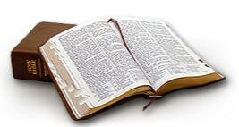
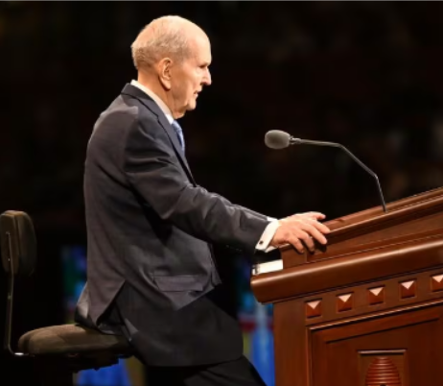
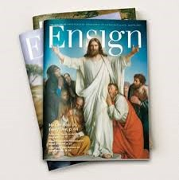
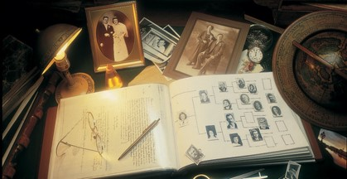
Learning From Other’s Experiences
Can we learn from other’s experiences?
What sources can we turn to learn of others’ experiences with the goodness of God?
The scriptures
General conference addresses
Church magazines
Biographies of Church leaders and others
Family histories
How do you think the people, from hearing the records of Zeniff and Alma, increased their testimony of Jesus Christ?
Can you think of an experience that has helped you with your testimony?
Mosiah 25:5

Slide 5
Previously…
The children of Amulon
Amulon:
One of King Noah’s priests.
The priests took the daughters of the Lamanites and lived in the land of Amulon.
Lost Lamanites found land and chose not to go to battle with Amulon and his people and joined forces.
They wandered and found the city of Helam where Alma and his people were.
Some of Amulon’s people went back to land of Nephi where the Lamanite kingdom was and some stayed with Alma having escaped from bondage to Zarahemla.
Mosiah 25:12

Slide 6
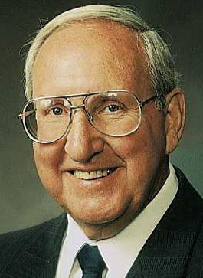
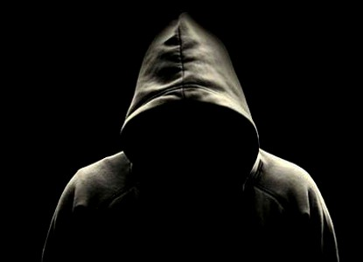
Dishonored Name
Honor--As usually used in the scriptures, to show respect and reverence to someone or something.
“When we dishonor ourselves or others, we dishonor our Father in Heaven and our Savior. They have blessed us with gifts, talents, and intelligence to bless mankind, but some misuse this.”
Vaughn J. Featherstone
“No one wants to bear a name that has been dishonored. Their action typifies that which is to happen in the world to come. Those whose fathers have no place in the kingdom of God will, like links of a chain, be removed, while their righteous seed will unite themselves with those of their progenitors worthy of that honor.”
JFM and RLM
Mosiah 25:12

Slide 7
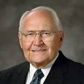
A Good Name
“…a good name is rather to be chosen than great riches, and loving favour rather than silver and gold.” (Proverbs 22:1).
We cannot isolate ourselves from those around us. Our good name can be a special valued asset worth more than the riches of the world.
Your good name connects you with your past family history. Your righteous living, your example, your teachings, and your worthwhile service will bless numerous people with your vision. It is almost impossible to comprehend the number.
May the Lord bless you with a greater understanding of his great plan of happiness and your special role in it. I add my witness that families are important.
Your name is special. It is recorded in the histories of our Father in Heaven, and how you value that, how you treat it, will literally affect generations to come. God bless you with the vision that is yours of who you are and the great privilege that is yours to belong to the Church of Jesus Christ.
L. Tom Perry

Slide 8
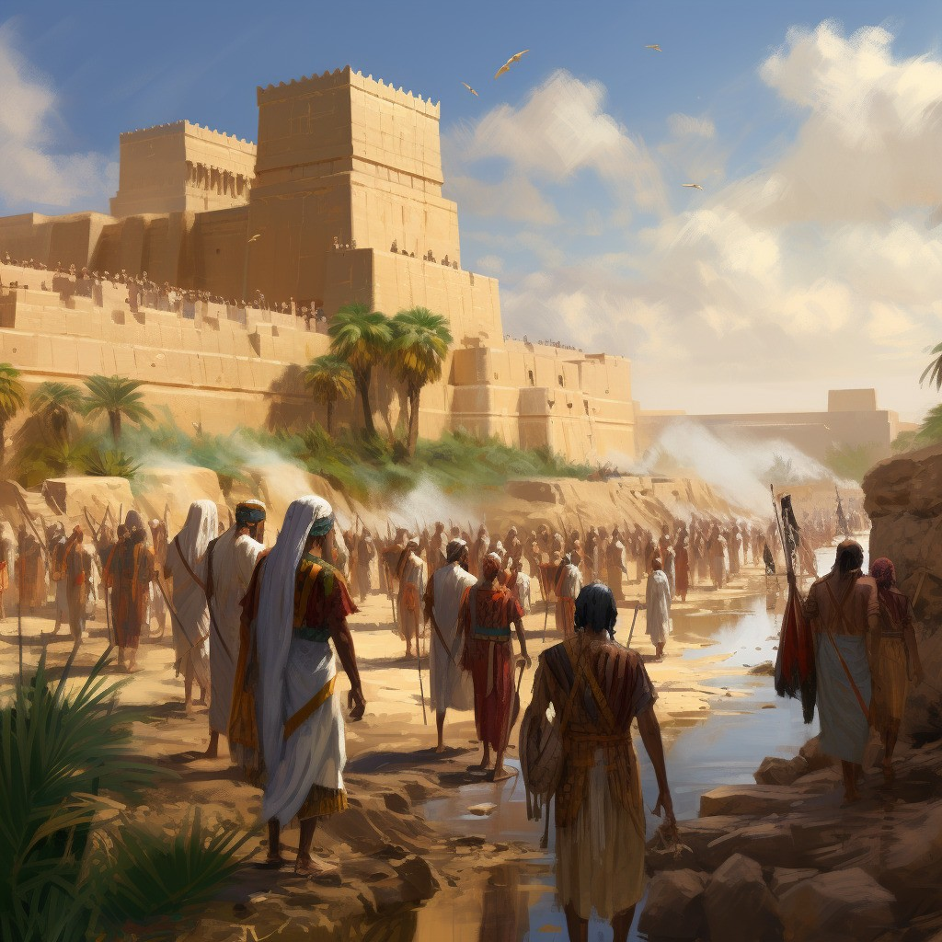
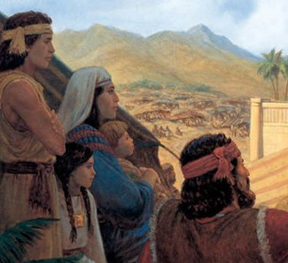
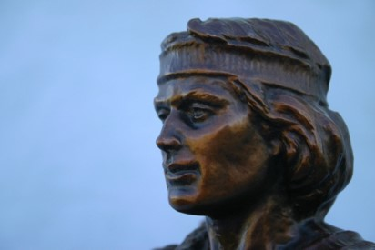
The Union – Taking the Name of Nephi
The Children of Amulon take upon themselves the name of Nephi
Though the Mulekites were more numerous they chose to call themselves Nephites
“Wherefore, the people were desirous to retain in remembrance his (Nephi’s)name. And whoso should reign in his stead were called by the people, second Nephi, third Nephi, and so forth, according to the reigns of the kings; and thus they were called by the people, let them be of whatever name they would.”
Jacob 1:11
Mosiah 25:12-13

Slide 9
Alma Establishes Church
Mosiah desires Alma to teach
Alma preaches “repentance and faith on the Lord”
Alma exhorts the people to remember their bondage and deliverance
The people of Limhi were desirous to be baptized
Mosiah granted unto Alma to establish churches throughout all the land of Zarahemla
Mosiah 25:14-19

Slide 10
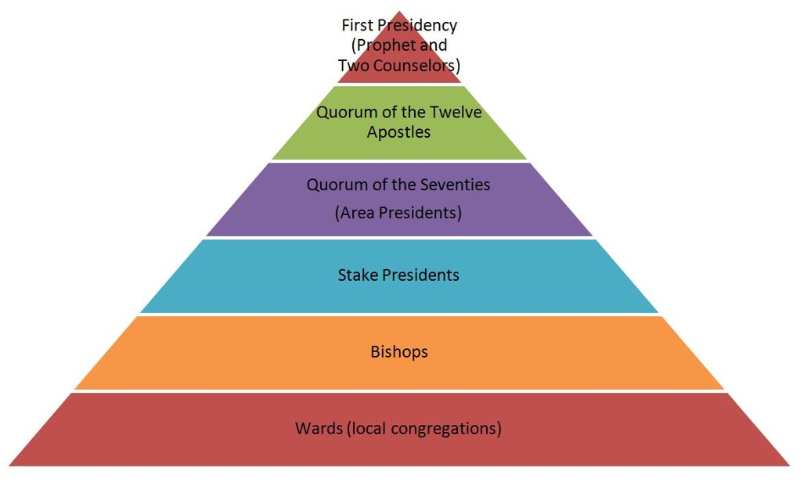
Organization
Mosiah held the keys of the kingdom
Alma could take no action in organizing various bodies of the church except under his direction.
One man cannot teach and preach to a vast number of people.
In organizing a church there must be authority and order.
The Lord organizes His Church so that all members may be taught and receive His word
Mosiah 25:21-22

Slide 11
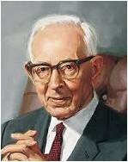
“The Book of Mormon does not give specific details about the priesthood held by prophets and other brethren among the Nephites and Lamanites. However, the references to ordinances and the manner in which the Church was conducted provide sufficient evidence that they held the Melchizedek Priesthood.
President Joseph Fielding Smith taught that “the priesthood which [the Nephites] held and under which they officiated was the Priesthood after the holy order, the order of the Son of
God. This higher
priesthood can officiate in every
ordinance of the gospel.”
Bruce R. McConkie
Alma 13:1–20

Slide 12
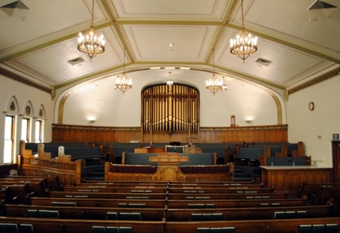
Seven Churches
It was necessary to divide the Church into various congregations because there were so many people
“Those who have entered into the waters of baptism have been commanded to meet together often ‘to fast and to pray, and to speak one with another concerning the welfare of their souls.”
Moroni 6:5
“As there was a unity of doctrine among all the churches in Zarahemla, so there has been a unity of doctrine among all the churches in all times and in al dispensations.”
Today:
When a people outgrow a ward, the ward or Stake is divided.
What is the criteria for a Ward or Stake to be divided? See statement*
Mosiah 25:21-22 JFM and RLM

Slide 13
The People of God
“And they were called the people of God…”
“…And the Lord did pour out his Spirit upon them, and they were blessed, and prospered in the Land.”
As we take upon ourselves the name of Jesus Christ and live accordingly, the Lord will pour out His Spirit upon us.
Mosiah 25:24 JFM and RLM

Slide 14
Sources:
Vaughn J. Featherstone Secret of the Second Mile May Ensign 1990
Joseph Fielding McConkie and Robert L. Millet Doctrinal Commentary on the Book of Mormon Vol. 2 p. 289,291
L. Tom Perry The Value of a Good Name Feb. Ensign 2009
Joseph Fielding Smith and Bruce R. McConkie (Doctrines of Salvation, ed. Bruce R. McConkie, 3 vols. [1954–56], 3:87).
Presentation by ©http://fashionsbylynda.com/blog/

Slide 15
*Criteria for a Ward or Stake to be divided: (2024)
The unified requirements used to create a stake will now include the need for each stake to have 2,000 total members in the stake. Stakes in the U.S. and Canada previously needed to have 3,000 members. Those outside these two countries needed 1,900.
Stakes will need 150 active, full-tithe-paying Melchizedek Priesthood holders capable of serving in leadership positions. They will also need a total of 500 participating adults.
The new requirements also mean wards will need 250 members and 20 active, full-tithe-paying Melchizedek Priesthood holders capable of serving in leadership positions. Each will need 100 participating adults, as well.

Slide 17
Test Your Testimony
Never Sometimes Always
When someone asks a question about the Church do you bear your testimony?
How often do you do something nice for someone?
How often do you take the advice from your parents?
How often do you take council from the prophets?
How often do you pray?
How often do you read and study the scriptures?
How often do you bear your testimony?
How often do you feel of the Holy Spirit?
How would you describe your testimony today?

Slide 18
The Rising Generation
The Children during King Benjamin’s time grew up and:
Did not believe in traditions of their fathers
Did not believe in the resurrection
Did not believe in the coming of Christ
Not understanding the word of God
Hardened Hearts
Not be baptized or join the Church
Separated themselves—did not associate with the things of God
Mosiah 26:1-4

Slide 19
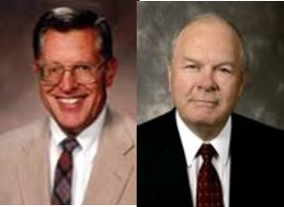
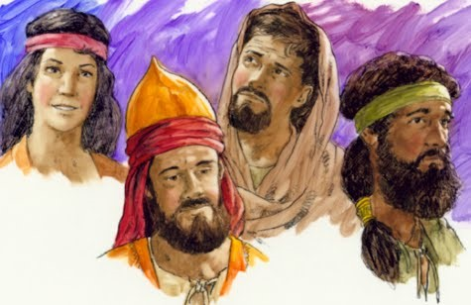
A Foundation Laid
“When a generation of young people grows to maturity without a proper doctrinal foundation—whether because of parental negligence or through rebellion on the part of the youth—then a foundation has indeed been laid, a foundation, unfortunately, for faithlessness and immorality…”
JFM and RLM
The rising generation grew into adulthood without the same beliefs the parents had during King Benjamin’s time.
Mosiah 26:5-6

Slide 20
Develop and Maintain
“Testimony requires the nurturing by the prayer of faith, the hungering for the word of God in the scriptures, and the obedience to the truth we have received. There is danger in neglecting prayer. There is danger to our testimony in only casual study and reading of the scriptures. They are necessary nutrients for our testimony. …
“Feasting on the word of God, heartfelt prayer, and obedience to the Lord’s commandments must be applied evenly and continually for your testimony to grow and prosper.”
Henry B. Eyring
To develop and maintain a testimony, we need to feast on the word of God, pray in faith, and obey the Lord’s commandments

Slide 21
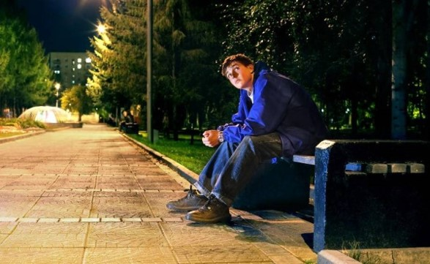
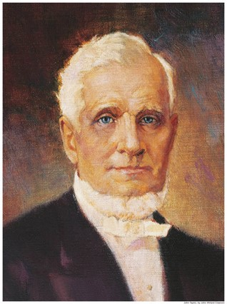
Sins That Go Unchecked
“It became expedient that those who committed sin, that were in the church, should be admonished by the church”.
It was necessary for Church members who had sinned to be judged and held accountable.
When sins go unchecked the spirit ceases to thrive.
Some live in their sins and hide their iniquities
“…if any man who tampers with iniquity, he will have to bear that iniquity, and if any of you want to partake of the sins of men, and uphold them you will have to bear them…”
Pres. John Taylor
Mosiah 26:5-6

Slide 22
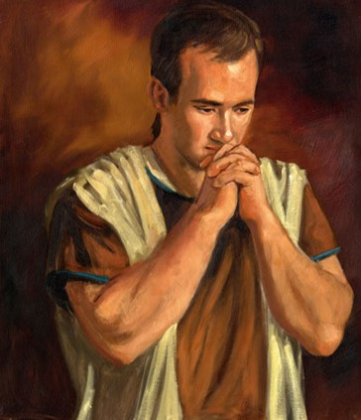
Brought Before Alma
Alma was High Priest at that time and Mosiah had given him authority over the church
The offenders seem to be guilty of crimes of the law and the church
Alma was troubled and told to judge them
Alma goes to the Lord seeking advise
Today
Disciplinary Council:
Bishops and branch presidents and stake, mission, and district presidents have a responsibility to help members overcome transgression through repentance. The most serious transgressions, such as serious violations of civil law, spouse abuse, child abuse, adultery, fornication, rape, and incest, often require formal Church discipline. Formal Church discipline may include restriction of Church membership privileges or loss of Church membership.
Church Handbook
They also seek the guidance of the Lord
James H. Fullmer
Mosiah 26:7-13

Slide 23
The Lord’s Advice to Alma
The Lord blesses Alma because of his faith
“For behold, this is my church; whosoever is baptized shall be baptized unto repentance. And whomsoever ye receive shall believe in my name; and him will I freely forgive.”
“Therefore I say unto you, Go; and whosoever transgresseth against me, him shall ye judge according to the sins which he has committed; and if he confess his sins before thee and me, and repenteth in the sincerity of his heart, him shall ye forgive, and I will forgive him also.”
Those who will repent—He will forgive
Those who do not repent—will not be numbered with His people
Mosiah 26:22-32

Slide 24
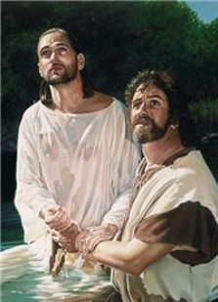
Membership in the Church
“Membership in the Church is more than a badge of belonging, more than conformity to socially acceptable standard. It is sign of one’s commitment to the Lord and his gospel, an evidence of his willingness to take and put on the name of Christ in very deed.
Only persons willing to abide by the terms of the baptismal covenant—those willing to “come forth with broken hearts and contrite spirits, and witness before the church that they have truly repented of all their sins.” those who have a “determination to serve” the Lord “to the end,” those willing to bear the burden of discipleship—should be received into the Church of Jesus Christ”
D&C 20:37
Mosiah 26:22-32 JFM and RLM

Slide 25
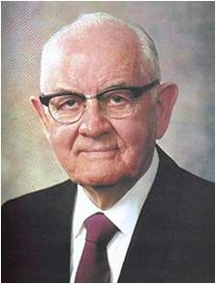
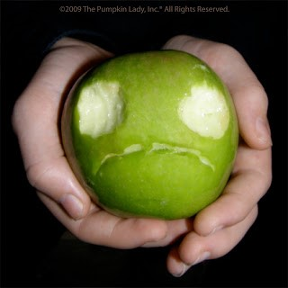
Confession of sins leads to forgiveness
“The confession of Sin is a necessary element in repentance and therefore in obtaining forgiveness. It is one of the tests of true repentance.”
“Perhaps confession is one of the hardest of all the obstacles for the repenting sinner to negotiate. His shame often restrains him from making known his guilt and acknowledging his error.
Sometime his assumed lack of confidence in mortals to who he should confess his sin justifies in his mind his keeping the secret locked in his own heart.”
Mosiah 26:35-36 Spencer W. Kimball

Slide 26
The Lord will forgive those who repent in the sincerity of their hearts.
“When the apples in a barrel rot, it is not enough to throw away half of the spoiled apples from the barrel and replace them with fresh apples on top. This would result in all the apples rotting. Instead it would be necessary to empty the barrel and completely clean…the entire inside.”
“The Lord knows whether or not one is making but a show of repentance. Feigning repentance or bluffing is futile, for both the transgressor and the Lord know the degree of sincerity.”
“..with all his heart”
Repentance must involve an all-out, total surrender to the program of the Lord.”
Mosiah 26:29 Spencer W. Kimball

Slide 27
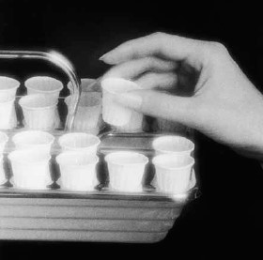
Matthew 6: 12,14-15
“And forgive us our debts, as we forgive our debtors.”
“For if ye forgive men their trespasses, your heavenly Father will also forgive you:”
“But if ye forgive not men their trespasses, neither will your Father forgive your trespasses.”
We must forgive others to receive the Lord’s forgiveness.
“I can forgive but I cannot forget is another way of saying I cannot forgive.”
Henry Ward Beecher
“I may add that unless a person forgives his brother his trespasses with all his heart he is unfit to partake of the sacrament?”
Spencer W. Kimball
For he that eateth and drinketh unworthily, eateth and drinketh damnation to himself, not discerning the Lord’s body.”
1 Corinthians 11:29
“I, the Lord, will forgive whom I will forgive, but of you it is required to forgive all men.”
D&C 64:10
Mosiah 26:31

Slide 28
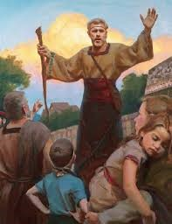
Alma Judges
Alma writes down the things he heard from the Lord
Alma judges:
Those that repented he did number them among the people of the Church
Those that did not repent their names were blotted out—cut off from the Church—no promises given
Alma regulated the affairs of the church
Many were baptized
They began to have peace and prosper in the affairs of the church
Mosiah 26:33-39

Slide 29
Prosperity and Peace
When there is wickedness among a people, what happens to their economic and social status?
When there is righteousness among a people what is their economic and social status?
Mosiah 26:39

Slide 30
Sources:
Henry B. Eyring (“A Living Testimony,” Ensign or Liahona, May 2011, 127).
John Taylor April Conf. 1880
Joseph Fielding McConkie and Robert L. Millet Doctrinal Commentary on the Book of Mormon Vol. 2 p. 298
Spencer W. Kimball Miracle of Forgiveness p. 177, 203-204, 263
Presentation by ©http://fashionsbylynda.com/blog/

Slide 31
Test Your Testimony
Never Sometimes Always
When someone asks a question about the Church do you bear your testimony?
How often do you do something nice for someone?
How often do you take the advice from your parents?
How often do you take council from the prophets?
How often do you pray?
How often do you read and study the scriptures?
How often do you bear your testimony?
How often do you feel of the Holy Spirit?
How would you describe your testimony today?

Slide 32
“Jesus Christ has prescribed a very clear method for us to repent and find healing in our lives. The cure for most mistakes can be found by seeking forgiveness through personal prayer. However, there are certain spiritual illnesses, particularly those dealing with violations of the moral law, which absolutely require the assistance and treatment of a qualified spiritual physician. …
“If you ‘awake to a sense of your awful situation’ [Ether 8:24] and wish to return to full spiritual health, see your bishop. He holds the keys and can help you along the pathway of repentance” (Boyd K. Packer, “The Key to Spiritual Protection,” Ensign or Liahona, Nov. 2013, 28).
“Spencer W. Kimball [gave] a superb guide to forgiveness through repentance. It has helped many find their way back. He [identified] five essential elements of repentance.
“Sorrow for sin. Study and ponder to determine how serious the Lord defines your transgression to be. That will bring healing sorrow and remorse. It will also bring a sincere desire for change and a willingness to submit to every requirement for forgiveness. …
“Abandonment of sin. This is an unyielding, permanent resolve to not repeat the transgression. By keeping this commitment, the bitter aftertaste of that sin need not be experienced again. …
“Confession of sin. You always need to confess your sins to the Lord. If they are serious transgressions, such as immorality, they need to be confessed to a bishop or stake president. Please understand that confession is not repentance. It is an essential step, but is not of itself adequate. Partial confession by mentioning lesser mistakes will not help you resolve a more serious, undisclosed transgression. Essential to forgiveness is a willingness to fully disclose to the Lord and, where necessary, His priesthood judge all that you have done. …
“Restitution for sin. You must restore as far as possible all that which is stolen, damaged, or defiled. Willing restitution is concrete evidence to the Lord that you are committed to do all you can to repent.
“Obedience to all the commandments. Full obedience brings the complete power of the gospel into your life with strength to focus on the abandonment of specific sins. It includes things you might not initially consider part of repentance, such as attending meetings, paying tithing, giving service, and forgiving others. …
“I would add a sixth step: Recognition of the Savior. Of all the necessary steps to repentance, I testify that the most critically important is for you to have a conviction that forgiveness comes because of the Redeemer. It is essential to know that only on His terms can you be forgiven” (Richard G. Scott, “Finding Forgiveness,” Ensign, May 1995, 76).
“Church discipline is an inspired process that takes place over a period of time. Through this process and through the Atonement of Jesus Christ, a member can receive forgiveness of sins, regain peace of mind, and gain strength to avoid transgression in the future. Church disciplinary action is not intended to be the end of the process. It is designed to help Heavenly Father’s children continue in their efforts to return to full fellowship and the full blessings of the Church. The desired result is that the person make whatever changes are necessary to repent completely” (“Church Disciplinary Councils,” True to the Faith: A Gospel Reference [2004], 38).

Slide 33
Youth Articles: Questions about Bearing Your Testimony The Church of Jesus Christ of Latter-day Saints
ELYSE ALEXANDRIA HOLMES
If you’ve ever asked yourself these questions, here are some answers.
Do I have to share a story or experience when I bear my testimony?
People often share stories or personal experiences when they bear their testimonies, and these can be a great way of describing how a testimony grew. But a story is not a testimony. A short, relevant story can help you illustrate a point, but make sure to include how that story enlarged your testimony and what gospel truths you learned from that experience. A testimony is what you know about the gospel, not about where you’ve been or what you’ve done.
Elder David A. Bednar of the Quorum of the Twelve Apostles taught: “A testimony is what we know to be true in our minds and in our hearts by the witness of the Holy Ghost (see D&C 8:2). As we profess truth rather than admonish, exhort, or simply share interesting experiences, we invite the Holy Ghost to confirm the verity of our words.”
Also, be careful about the experiences you share. Some are deeply personal to yourself or others, including stories about sin, repentance, and sacred spiritual experiences. Stories like these should not be shared in a public setting unless you feel prompted to. When you do feel prompted, keep them general, focusing on what you learned from the experience rather than the specific details of what happened.
Do I have to express thanks or love in my testimony?
While it is not inappropriate to express love or appreciation when you bear your testimony, these expressions are not considered a testimony. Testimonies focus on what you have learned spiritually about the gospel. Expressions of love or gratitude should not replace a testimony.
Elder M. Russell Ballard of the Quorum of the Twelve Apostles said, “[I] worry that too many of our members’ testimonies linger on ‘I am thankful’ and ‘I love,’ and too few are able to say with humble but sincere clarity, ‘I know.’”
Do I have to cry or show emotion to have a real testimony?
Many people cry or show emotion when they bear testimony or feel the Spirit strongly, but not everyone has the same emotional reaction when he or she feels the Spirit. You do not have to express emotion the same way as others when you bear testimony.
President Howard W. Hunter (1907–95) said: “I get concerned when it appears that strong emotion or free-flowing tears are equated with the presence of the Spirit. Certainly the Spirit of the Lord can bring strong emotional feelings, including tears, but that outward manifestation ought not to be confused with the presence of the Spirit itself.”
If I’m not sure I have a testimony, do I still try to share it?
It’s easy to feel like your testimony isn’t strong enough or worth sharing, but as you share your testimony, you will find how much of a testimony you really have! Do not be afraid to bear your testimony. You will find that the more you share your testimony, the more it grows.
President Boyd K. Packer, President of the Quorum of the Twelve Apostles, said:
“It is not unusual to have a missionary say, ‘How can I bear testimony until I get one? How can I testify that God lives, that Jesus is the Christ, and that the gospel is true? If I do not have such a testimony, would that not be dishonest?’
“Oh, if I could teach you this one principle: a testimony is to be found in the bearing of it!
“Somewhere in your quest for spiritual knowledge, there is that ‘leap of faith,’ as the philosophers call it. It is the moment when you have gone to the edge of the light and stepped into the darkness to discover that the way is lighted ahead for just a footstep or two.”

Slide 34
Born Again Through the Atonement of Christ
Mosiah 27

Slide 35
Unbelievers Persecute
Complaints from the members to Alma
Alma goes to Mosiah
Mosiah consults the priests
Decisions about issues are not made by one person. It takes a quorum to make decisions through prayer and fasting
Mosiah 27:1

Slide 36
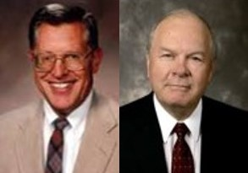
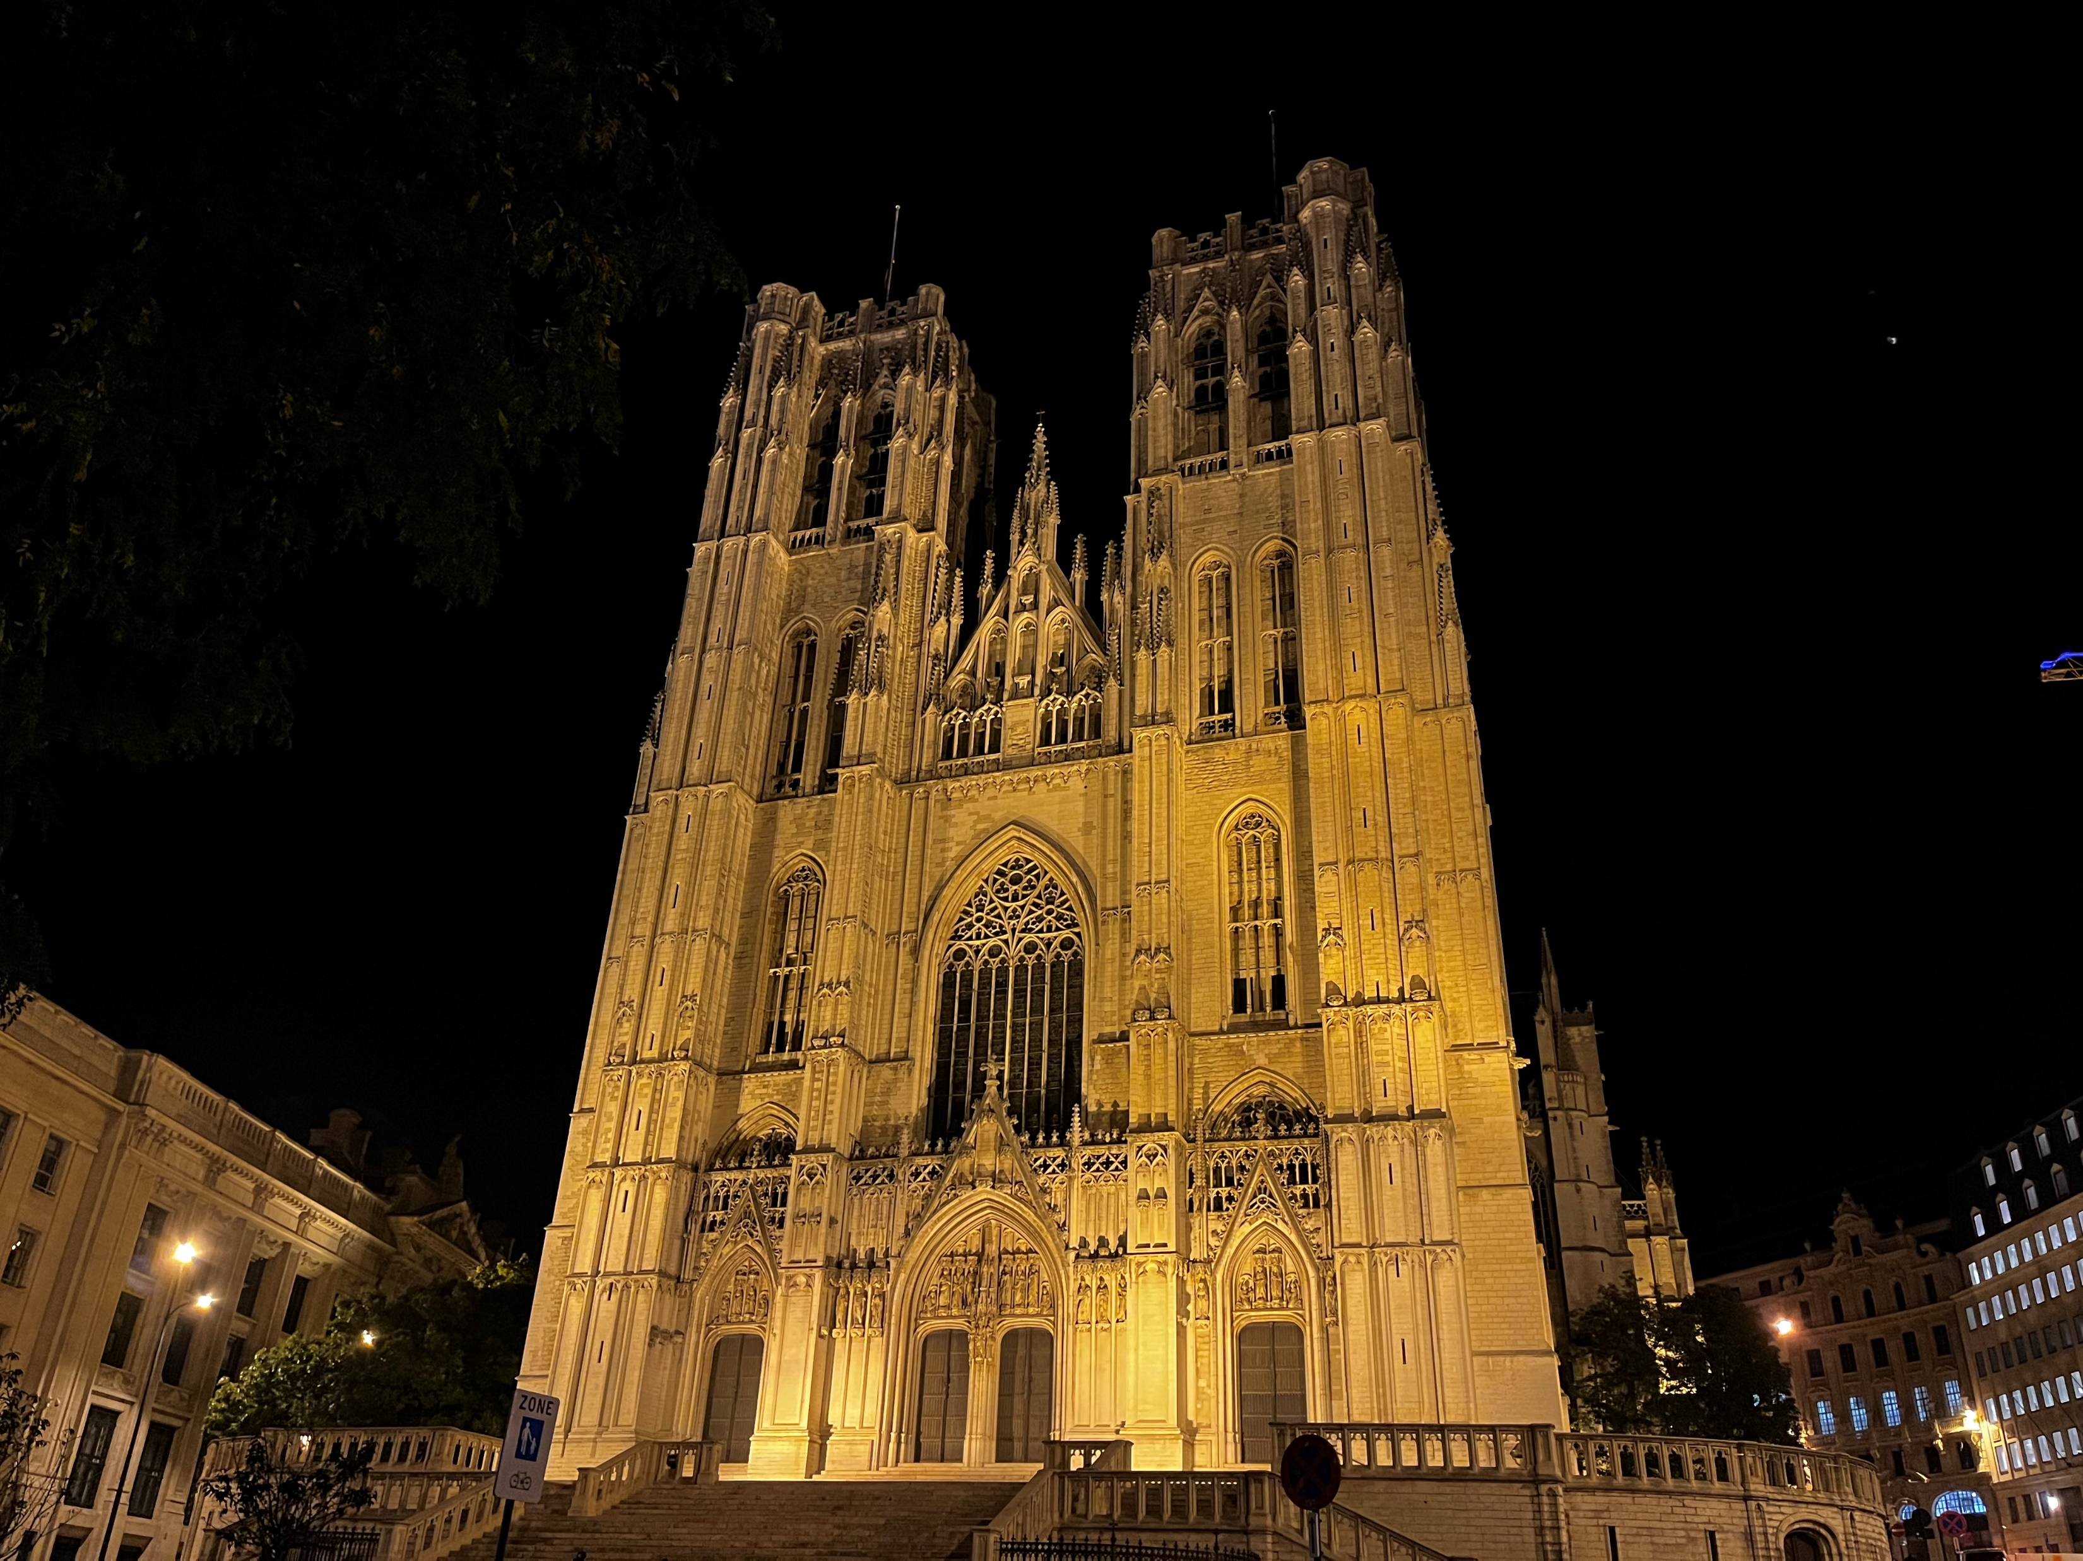
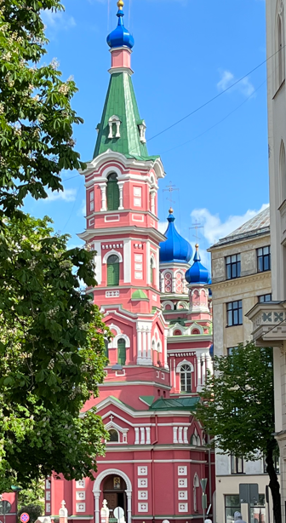
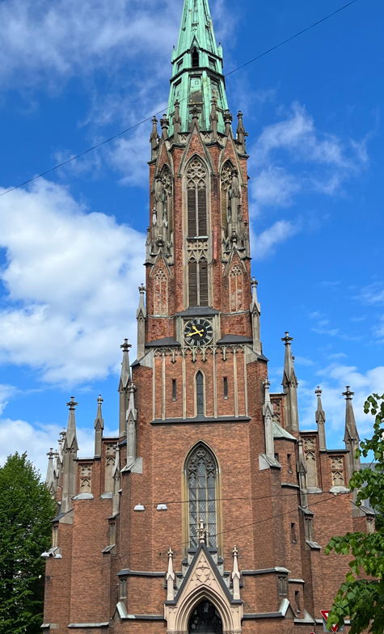
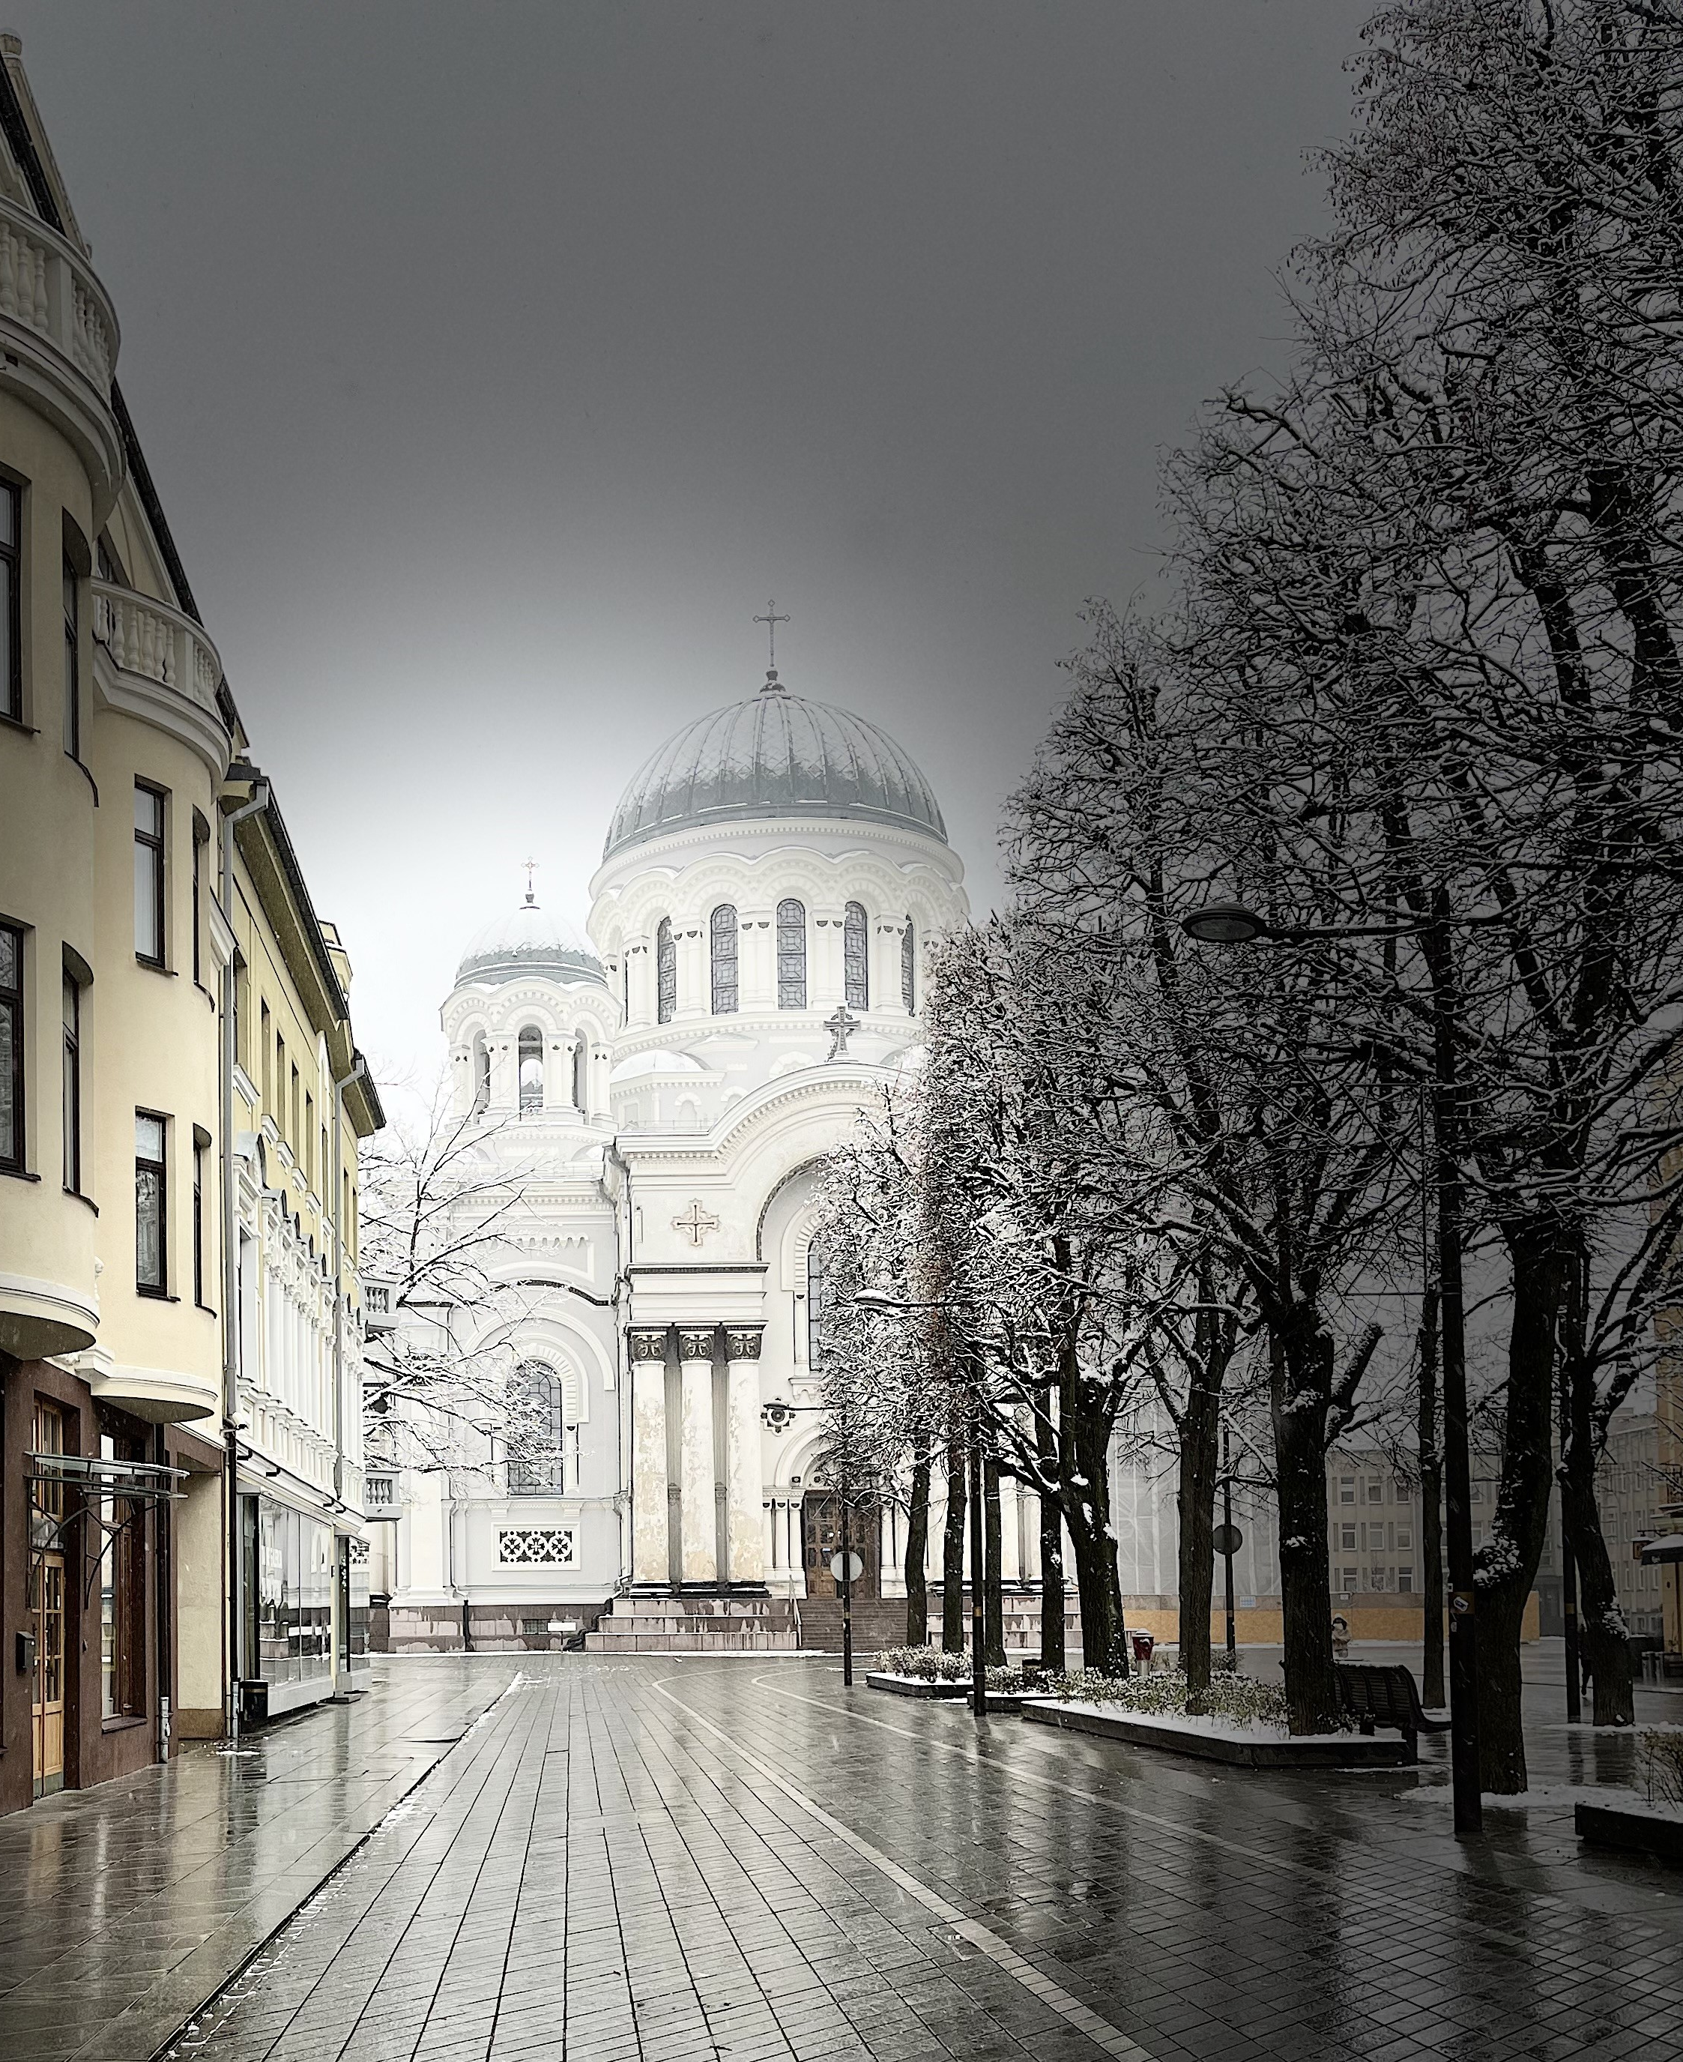
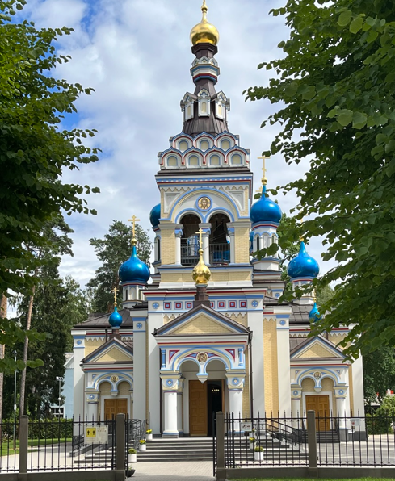
Proclamation Sent by Mosiah
“We claim the privileged of worshipping the Almighty God according to the dictates of our own conscience, and allow all men the same privilege, let them worship how, where, or what they may”
Article of Faith 1:11
Any unbelievers should not persecute any of those who belong to the church of God
“The spirit of one is peace, the spirit of the other is contention. Persecution is often born of the fear of detection, while patience and long-suffering are born of the confidence of the Spirit”
JFM and RLM
Mosiah 27:2-3

Slide 37
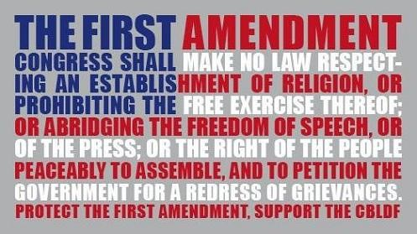
Part of the 1st Amendment
Freedom of religion or Freedom of belief is a principle that supports the freedom of an individual or community, in public or private, to manifest religion or belief in teaching, practice, worship, and observance; the concept is generally recognized also to include the freedom to change religion or not to follow any religion. The freedom to leave or discontinue membership in a religion or religious group —in religious terms called "apostasy" — is also a fundamental part of religious freedom, covered by Article 18 of the Universal Declaration of Human Rights.
Freedom of religion is considered by many people and nations to be a fundamental human right. In a country with a state religion, freedom of religion is generally considered to
mean that the government permits
religious practices of other sects
besides the state religion, and does
not persecute believers in other
faiths.

Slide 38
Equality
There should be no pride or haughtiness disturb their peace--having or showing the insulting attitude of people who think that they are better, smarter, or more important than other people.
They should esteem his neighbor as himself—all souls of men are of equal worth. It is contrary to the spirit of heaven to hold one in greater esteem than another.
Priests and teachers should labor with their own hands for their support—the servants of the Lord in all ages have been called and provide for themselves and their families.
Members are organized into local congregations called wards or branches. These congregations are organized geographically, and members attend a ward or branch near their home. Congregations meet together on Sundays to worship. The leader of a congregation is a bishop or a branch president. He is not paid for his service, but he donates his time to serve the congregation.
Mormon.org
Mosiah 27:4-5

Slide 39
Alma, the Younger
He was the son of Alma the Elder
He was ‘numbered among the unbelievers’ (Mosiah 27:8)
He was visited by a heavenly messenger about 100-92 BC
He had a spiritual transformation and redirected his life to the service of God
He was appointed chief judge of the land around 91 BC
He defeated a conspirator Amlici
He was consecrated high priest of the Church by his father (Alma 4:4; 5:3)
He later delegated his office to another to serve on a mission
He reformed the church in Zarahemla
He was rejected by the city of Ammonihah around 82 BC but stayed with Amulek and eventually converted Zeezrom
He made a safe haven for the Anti-Levi-Nephites
He went to the land of Melek, but was never heard of again…presumable being translated like Moses (Alma 45:18-19)
Who’s Who

Slide 40
Ammon
He was the son of King Mosiah
He was ‘numbered among the unbelievers’ (Mosiah 27:8)
He was visited by a heavenly messenger and called to repent
He had a desire to serve a mission to declare the gospel to “every creature”
He went with the others to the Lamanites for 14 years from around 92-77 BC
(Alma 17:4)
He went to the land of Ishmael and gained the respect of King Lamoni and defended the royal flocks and herds
King Lamoni was converted
He was sent to free his brethren who were in the land of Middoni
He set the stage for King Lamoni’s father (king over all the Lamanites) to be converted
He assisted in the conversion of the Anti-Lehi-Nephites—becoming the people of Ammon
Who’s Who

Slide 41
Aaron
He was the son of Mosiah
He was ‘numbered among the unbelievers’ (Mosiah 27:8)
He was visited by a heavenly messenger which brought about a transformation
Rather than accept the voice of the people as first choice to succeed his father as king, he embarked on a missionary journey that lasted 14 years (Mosiah 29:2-3)
He and his other brothers went to the Lamanites to preach the gospel
After persecuted and imprisoned he eventually was led by the spirit to present the gospel plan to the great king over all the Lamanites
As a missionary, he and his brothers brought thousands of Lamanites into the gospel of Christ and they “became a righteous people”
(Alma 23:7)
He served faithfully throughout his life
Who’s Who

Slide 42
Omner
He was the son of King Mosiah
He was ‘numbered among the unbelievers’ (Mosiah 27:8)
He was visited by a heavenly messenger about 100-92 BC
He had a spiritual transformation and redirected his life to the service of God
He accompanied his three brothers on a 14-year mission to the Lamanites
He assisted to secure an area south of Bountiful where those Lamanites (called Anti-Lehi-Nephites) from the assaults of their former countrymen
Who’s Who

Slide 43
Himni
He was the son of King Mosiah
He was ‘numbered among the unbelievers’ (Mosiah 27:8)
He was visited by a heavenly messenger and was transformed along with his brothers
He also traveled with his brothers to the Lamanites for 14 years
He assisted in the safety of the Anti-Lehi-Nephites in securing the Land Bountiful as their new home near the Nephites
Who’s Who

Slide 44
The Privilege
Called to Repentance by an angel:
If all rebellious souls were accorded a personal visit from an angel assuring the reality of the world to come with its rewards and punishments, there would be little need for faith on anyone's part.
2. Such appearances of angels would create the temptation to obtain a testimony by negative behavior rather than through righteousness. Given that few among the faithful are privileged to enjoy the ministering of angels, it would seem a strange system of theology that freely granted such a privilege to the wicked.
3. Some appreciable number of people have had such an experience and have rejected the divine counsel and chosen not to repent, and thus we have no record of the experience. Example: Laman and Lemuel had an experience from an angel and there is no evidence of their conversion
The Savior explained that those who reject the testimony of scripture and living prophets would also reject the testimony of angel were they to appear to them
(Luke 16:31)
Mosiah 27:10-17 JFM and RLM

Slide 45
The Privilege
5. Testimony of scripture “some have entertained angels unawares” (Hebrews 13:2) We might suppose that many instances angels have sought to entice transgressors from their course in unobserved or less dramatic ways than this appearance to Alma and the sons of Mosiah
The prayers of the righteous cannot go unheard. Alma the Elder and Mosiah were both men of great faith who no doubt implored the heavens night and day with a plea of help to save their wayward sons. Nor did they pray alone, for their pleading were joined by those of all the faithful of the Church in and around Zarahemla
It needs to be remembered that the Lord, who can manifest his power in a great variety of ways, is hardly limited to angelic ministration or open visions. Many have had conversion experiences of spiritual impact and consequence equal to Alma’s experiences …those who have had divinely received a life-changing experience involving such things as a confrontation with death, an inspired sermon, a caring parent or relative, or a sensitive priesthood leader.
Mosiah 27:10-17 JFM and RLM

Slide 46
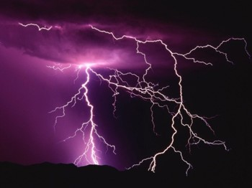
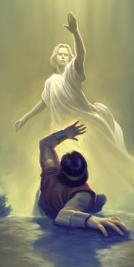
The Thunder of the Earth
Alma knew it was the Lord—for he probably heard his father’s sermons growing up
Alma became dumb—could not open his mouth—and he became weak
Most people become weak (physically) when they have experienced such a powerful message.
Saul:
“And he was three days without sight, and neither did eat nor drink…And when he had received meat, he was strengthened.:
Acts 9:9,19
Joseph Smith:
“… When I came to myself again, I found myself lying on my back, looking up into heaven. When the light had departed, I had no strength; …”
Mosiah 27:10-17

Slide 47
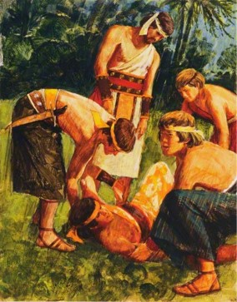
A Witness of the Lord’s Hand
Because Alma was weak, he was carried and laid before his father
Alma, the elder, caused that his people should assemble together for them to see what the Lord had done
The priests and teachers were also to assemble to fast and to pray that Alma might be able to speak and that his “limbs might receive their strength”
2 days and 2 nights they fasted and prayed
Alma, then received his strength and began to speak— “bidding them to be of good comfort”
Thought:
Do you think that there could have been countless others that received a vision, or a visit from an angel but refused to repent?
We, of course, would not have a record of it.
King Lamoni—
Lay as if dead for 2 days and 2 nights
Alma 18:43
Saul—
3 days without sight
Acts 9:9
Mosiah 27:18-21

Slide 48
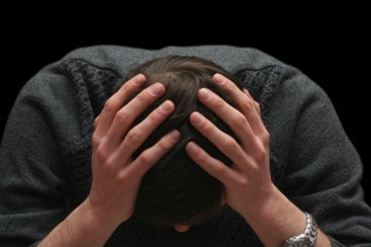
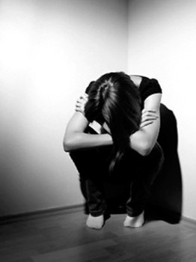
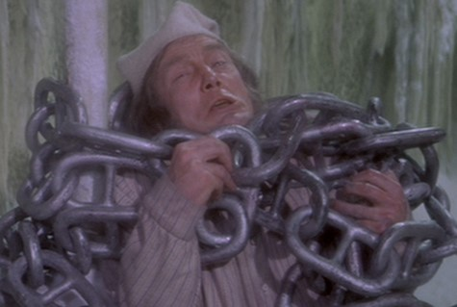
Anguish and Inner Pain
Alma had experienced:
“racked with eternal torment”—a remnant of something destroyed
“suffered pains of hell”—experience something bad or intolerable
“inexpressible horror”-- An intense, painful feeling
“gall of bitterness”-- expressive of severe grief, anguish
“encircled about by the everlasting chains of death”-- Captivity or oppression; spiritual bondage
Alma 36:12-19

Slide 49
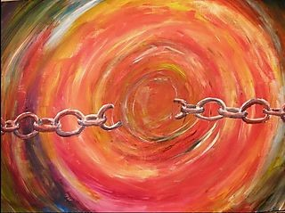
Born of the Spirit
“For, said he, I have repented of my sins, and have been redeemed of the Lord; behold I am born of the Spirit.”
“Because of Christ’s atonement, Alma could, through his own repentance…be redeemed of the Lord. That is, he could be freed from the dominion and power of Satan to enjoy the peace and love of heaven”
“As the man of sin is to die and be buried in the watery grave of baptism, thus allowing his spirit to come forth into a newness of life, so Alma came forth, as it were from his own grave with a new spirit. Alma, whose life had been consumed with wickedness, was as a prisoner released from prison seeking to right the wrongs of his life.”
Mosiah 27:24 JFM and RLM

Slide 50
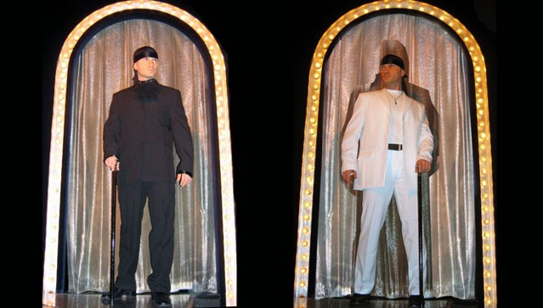
“The very process of being born again spiritually is not a one-time occurrence. Hence, Paul said that he died ‘daily’ (1 Cor. 15:31). Such is the process of putting off the old self as one becomes a woman or a man of God.
Quick change artists are rare.
I have not seen many put off the old and put on the new very rapidly.”
Neal A. Maxwell
We must be born again in order to inherit the kingdom of God.
Mosiah 27:24

Slide 51
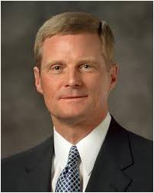
“We begin the process of being born again through exercising faith in Christ, repenting of our sins, and being baptized by immersion for the remission of sins by one having priesthood authority.
“… After we come out of the waters of baptism, our souls need to be continuously immersed in and saturated with the truth and the light of the Savior’s gospel. Sporadic and shallow dipping in the doctrine of Christ and partial participation in His restored Church cannot produce the spiritual transformation that enables us to walk in a newness of life. Rather, fidelity to covenants, constancy of commitment, and offering our whole soul unto God are required if we are to receive the blessings of eternity. …
“Total immersion in and saturation with the Savior’s gospel are essential steps in the process of being born again”
David A. Bednar

Slide 52
Born Again
Basic Doctrinal concepts:
Both the baptism of the water and the baptism of the spirit symbolize birth
One must be born again to “see” and “enter” the kingdom of God—”Born again comes by the Spirit of God through ordinances” Joseph Smith
The new birth (baptism and receiving the Holy Ghost) brings a change of attitude and character “Water baptism is only a preparatory cleansing…whereas, the baptism of fire and the Holy Ghost cleanses more thoroughly…” Orson Pratt
The new birth brings new knowledge, new insights, and new direction to life
Those who are born again are received into a new family; they become the sons and daughters of Jesus Christ
Birth is just a beginning—the journey of faith lies ahead
Though the new birth is a result of a definite time of decision—a desire for the things of righteousness—it is usually a quiet but powerful process
JFM and RLM

Slide 53
“We are born again as we die as pertaining to unrighteousness and when we live as pertaining to the things of the Spirit. But that doesn’t happen in an instant, suddenly. That … is a process. Being born again is a gradual thing, except in a few isolated instances that are so miraculous that they get written up in the scriptures. As far as the generality of the members of the Church are concerned, we are born again by degrees, and we are born again to added light and added knowledge and added desires for righteousness as we keep the commandments. …
“As members of the Church, if we chart a course leading to eternal life; if we begin the processes of spiritual rebirth, and are going in the right direction; if we chart a course of sanctifying our souls, and degree by degree are going in that direction; if we chart a course of becoming perfect, and, step by step and phase by phase, are perfecting our souls by overcoming the world, then it is absolutely guaranteed—there is no question whatever about it—we shall gain eternal life. Even though we have spiritual rebirth ahead of us, perfection ahead of us, the full degree of sanctification ahead of us, if we chart a course and follow it to the best of our ability in this life, then when we go out of this life we’ll continue in exactly that same course”
Bruce R. McConkie

Slide 54
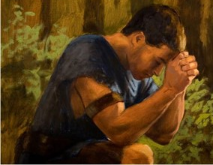
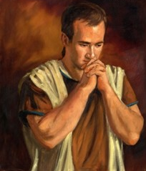
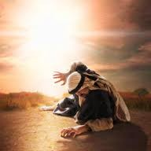
“We must be careful, as we seek to become more and more godlike, that we do not become discouraged and lose hope. Becoming Christlike is a lifetime pursuit and very often involves growth and change that is slow, almost imperceptible. The scriptures record remarkable accounts of men whose lives changed dramatically, in an instant, as it were:
Alma the Younger, Paul on the road to Damascus, Enos praying far into the night, King Lamoni. Such astonishing examples of the power to change even those steeped in sin give confidence that the Atonement can reach even those deepest in despair.
James H. Fullmer
James H. Fullmer
“But we must be cautious as we discuss these remarkable examples. Though they are real and powerful, they are the exception more than the rule. For every Paul, for every Enos, and for every King Lamoni, there are hundreds and thousands of people who find the process of repentance much more subtle, much more imperceptible. Day by day they move closer to the Lord, little realizing they are building a godlike life. They live quiet lives of goodness, service, and commitment”
Ezra T. Benson
Mosiah 27:24

Slide 55
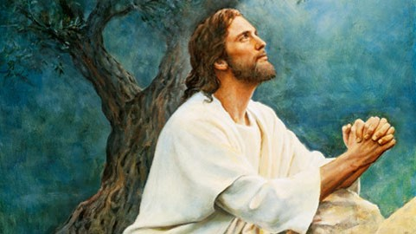
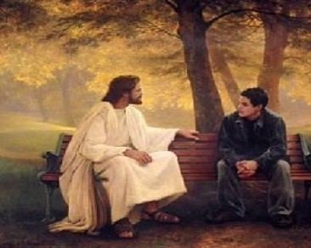
Changing Through the Atonement
How have you been changed through the Atonement as you have repented and done your best to follow the Savior?
What is one thing you can do to more fully come to the Lord so that you can be changed through the Atonement?
Mosiah 27:24

Slide 56
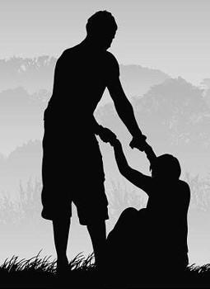
Restitution
restitution = to the act of repairing damage that has been done and correcting our unwise choices
Right the Wrong--Restitution
“The true spirit of repentance demands that he who injures [another] shall do everything in his power to right the wrong.”
Spencer W. Kimball
Even those who rebel against the Lord and His teachings can be forgiven.
To truly repent, a person must do everything possible to repair the damage he or she has done.
Through the Atonement of Jesus Christ, we can be changed to a state of righteousness.
Mosiah 27:32-37

Slide 57
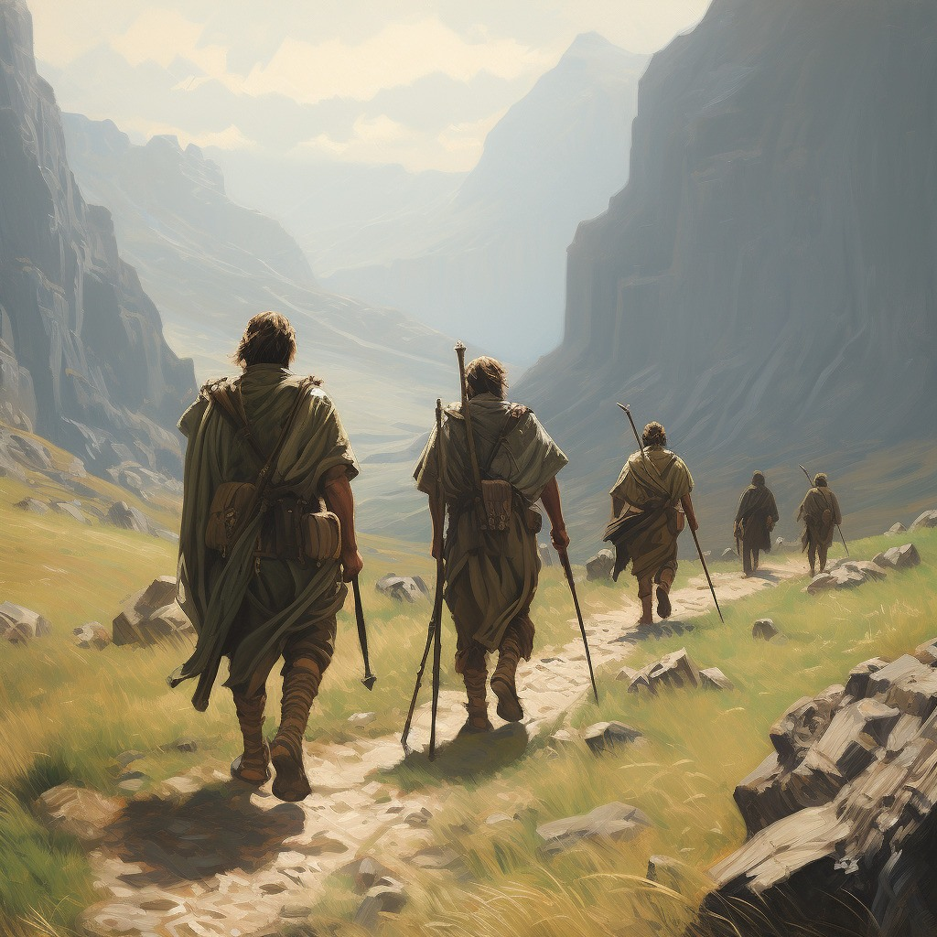
To Truly Repent
To truly repent, a person must do everything possible to repair the damage he or she has done
Alma the Younger and the sons of Mosiah travel throughout the land, striving to repair the injuries they had done and then try to strengthen the Church
Mosiah 27:35

Slide 58
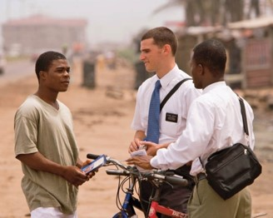
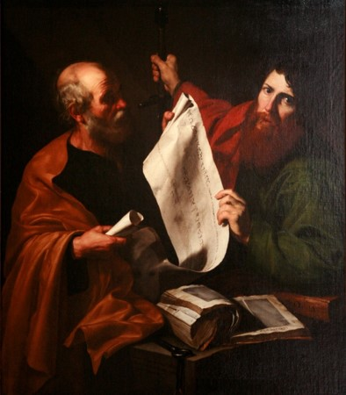
Labored Without Ceasing
Strengthening the Church—Alma and the 4 brothers devoted their labors in preaching to the Lamanites throughout the land
Example:
Apostle Paul—after he was converted he dwelt in Arabia for 3 years, then returned with full force to the teachings of the Savior and the Gospel
“But by the grace of God I am what I am: and his grace which was bestowed upon me was not in vain; but I laboured more abundantly than they all: yet not I, but the grace of God which was with me.”
1 Corinthians 15:10
To the Brethren of the church:
“Let him know, that he which converteth the sinner from the error of his way shall save a soul from death, and shall hide a multitude of sins.”
James 5:20
The Hidden sins—the one who is doing the labors of conversion
Mosiah 27:32-37

Slide 59
Sources:
http://en.wikipedia.org/wiki/Freedom_of_religion
http://mormon.org/faq/no-paid-clergy
Joseph Fielding McConkie and Robert L. Millet Doctrinal Commentary on the Book of Mormon Vol. 2 p. 302, born again: 169-274
Who’s Who In the Book of Mormon Ed J. Pinegar and Richard J. Allen pp. 2-3, 12-13, 20, 150,
Joseph Smith History 1:20 Joseph Smith Teachings p. 162
Neal A. Maxwell BYU Fireside 12/2/84 Orson Pratt The Holy Spirit pp. 56-57
David A. Bednar (“Ye Must Be Born Again,” Ensign or Liahona, May 2007, 21).
Bruce R. McConkie (“Jesus Christ and Him Crucified,” Brigham Young University 1976 Speeches, Sept. 5, 1976, 5–6, speeches.byu.edu).
Ezra T. Benson (“A Mighty Change of Heart,” Ensign, Oct. 1989, 5).
Spencer W. Kimball Miracle of Forgiveness p. 195

Slide 60
Mission to the Lamanites
Mosiah 28-29

Slide 61
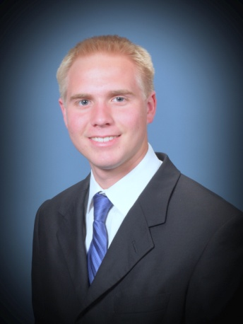
Can I Really Serve a Mission?
Questions of an upcoming Missionary:
When should I go?
Why should I go?
How can I afford to go?
What will happen to my friends/girlfriend/boyfriend if I leave for 2 years or 18 months?
What will I miss?
Will I be able to withstand the change in my daily routine? The food? The culture?
Will I be able to wake up early?
Will I be able to handle the rejections?
What if I don’t get along with my companion?
Will I be able to be spiritual all the time?
The question really is:
How can I serve the Lord?

Slide 62
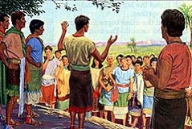
A Sincere Desire
Alma and the sons of Mosiah desire:
To go to the Lamanites in the Land Of Nephi and preach the gospel
That they might “cure them” of their hatred towards the Nephites
That there might be peace between them
That salvation be declared to “every creature” for they could not bare that “any human soul should perish”
Why did these men desire to serve a mission?
They were filled with love for all mankind
Mosiah 28:1-4

Slide 63
Bearing the Hardships
What difficulties might Alma and the sons of Mosiah face in Lamanite territory?
Imprisonment
Torture
Bondage
Killed
“Having become true Christians, the sons of Mosiah considered the gospel to be the solution to political, social, and economic problems as well as to religious problems.
Risking their very lives they went down into the southland among a savage and barbaric people to cure the enmity between the two nations by teaching them the gospel.
They did not go to disrupt them or to change their government or to preach politics or to do anything else offensive or subversive.
They went to serve and save. No war or insurrection comes out of the missionary work of true saints in foreign lands.”
Book of Mormon Student Manual
Mosiah 28:1-4

Slide 64
Inquiring of the Lord
Alma and the sons of Mosiah plead to go on this mission
How are missionaries called?
Every missionary who is called and assigned or reassigned to a particular mission is called by revelation through the Lord's servants, the prophets. A member of the Quorum of the Twelve assigns prospective missionaries to one of more than three hundred missions of the Church.
Frequently Asked Questions
“And the Lord said unto Mosiah: Let them go up, for many shall believe on their words, and they shall have eternal life; and I will deliver thy sons out of the hands of the Lamanites.”
Update 2020 (July):
407 missions
Mosiah 28:5-7

Slide 65
Bringing Salvation to Their Own Souls
Therefore, O ye that embark in the service of God, see that ye serve him with all your heart, might, mind and strength, that ye may stand blameless before God at the last day.
Therefore, if ye have desires to serve God ye are called to the work;…
As our conversion deepens, our desire to share the gospel increases
…For behold the field is white already to harvest; and lo, he that thrusteth in his sickle with his might, the same layeth up in store that he perisheth not, but bringeth salvation to his soul;”
D&C 4:2-4

Slide 66
“The key to successful member missionary work is the exercise of faith.
One way to show your faith in the Lord and His promises is to prayerfully set a date to have someone prepared to meet with the missionaries.
I have received hundreds of letters from members who have exercised their faith in this simple way. Even though families had no one in mind with whom they could share the gospel, they set a date, prayed, and then talked to many more people.
The Lord is the Good Shepherd, and He knows His sheep who have been prepared to hear His voice. He will guide us as we seek His divine help in sharing His gospel.”
M. Russell Ballard

Slide 67
The Caretaker of the Records
The Brass Plates of Laban
Records:
The Plates of Brass
The Plates of Nephi
The Plates of Gold found by the people of Limhi
Conferred them on Alma, the younger
The Large Plates of Nephi
The Plates of Gold—translated by King Mosiah using two stones fastened into the two rims of a bow—gave an account of the Jaredites.
Sacred revelation kept secret:
Until after the resurrection of Christ (Alma 63:12)
The vision of the brother of Jared was revealed during the appearance of the Savior to the Nephites
Mosiah 28:10-20

Slide 68
Sealed Portions of the Records
“After the appearing of the Savior to the Nephites, the vision of the brother of Jared was revealed to the Nephites.
When Moroni made his abridgment of the record of Ether, he copied on his record the vision of the brother of Jared. At the command of the lord, however, Moroni also sealed up the greater things in this vision and the “interpreter’—which were the same ‘two stones’ had by the brother of Jared, so hat this vision should not be made known even in our day among the Gentiles, in the day of their wickedness (2 Nephi 27:80)’
…until the day that they shall repent of their iniquity, and become clean before the lord.” (Ether 4:6).
So we today do not have the fulness of the account written and
sealed up by the brother of Jared and again sealed by Moroni.
This part of the record the Prophet Joseph Smith was forbidden
to translate. We have, then, received but the ‘lesser part.’
(3 Nephi 26:8-11)
Student Manual

Slide 69
The Voice of the People
The People desired Aaron to be their king
“Now I declare unto you that he to whom the kingdom doth rightly belong has declined, and will not take upon him the kingdom.”
“Therefore I will be your king the remainder of my days; nevertheless, let us appoint judges, to judge this people according to our law; and we will newly arrange the affairs of this people, for we will appoint wise men to be judges, that will judge this people according to the commandments of God.
Now it is better that a man should be judged of God than of man, for the judgments of God are always just, but the judgments of man are not always just.”
Mosiah 29:1-47

Slide 70
Citizenship Shares Responsibility
“For what happens in cultural decline both leaders and followers are really accountable. … It is easy to criticize bad leaders, but we should not give followers a free pass”
Neal A. Maxwell
Why is it important for both leaders and followers to be accountable for their actions?
What can you do to support righteous laws and leaders? (Articles of Faith 1:12.)
Not every country in the world has the
opportunity to choose their own leaders,
the Lord will always help those who trust in Him, no matter where they live.

Slide 71
Upholding the Law
Unrighteous leadership can bring contention and sin.
It is not common for the voice of the people to choose something that is not right.
If the people choose iniquity, the judgments of God will come upon them.
Each person has a duty to uphold righteous
laws and leaders.

Slide 72
A System of Judges
“And now I desire that this inequality should be no more in this land, especially among this my people; but I desire that this land be a land of liberty, and every man may enjoy his rights and privileges alike, so long as the Lord sees fit that we may live and inherit the land, yea, even as long as any of our posterity remains upon the face of the land.”
Though the judges were to be selected ‘by the voice of the people,’ the Nephites were to be governed according to the laws which have been given to them by their fathers.
King Mosiah knew the personal experience the loneliness and the bitter burdens of a monarch “all the trials and troubles of a righteous king, yea, all the travails of soul for their people, and also all the murmurings of the people to their king; and he explained it all unto them.” (vs 33)
Mosiah 29:1-47 JFM and RLM

Slide 73
Righteous Judgments
According to the law Mosiah had given them, and that the lower judges and higher judges were to judge one another as needed to ensure that righteous judgments would be made.
Now it came to pass that in the first year of the reign of the judges over the people of Nephi, from this time forward, king Mosiah having gone the way of all the earth, having warred a good warfare, walking uprightly before God, leaving none to reign in his stead; nevertheless he had established laws, and they were acknowledged by the people; therefore they were obliged to abide by the laws which he had made.
Mosiah 29:1-47; Alma 1:1

Slide 74
Benefits and Consequences
Mosiah 29:26–27
Mosiah 29:30–34
Mosiah 29:37–39
The voice of the people generally does not desire things that are “contrary to that which is right,
There is a need for all citizens to share in the burden of their government and to answer for their own sins.
Because of their unrighteous choices their consequences would be the judgments of God would come upon them and they would be destroyed
If the voice of the people chooses iniquity, then the judgments of God will come upon them.

Slide 75
Alma—First Judge
Alma was appointed the first chief judge and governor over the and was at the same time the high priest over the Church, having been called to serve as successor to his father in the latter capacity.
Their judges, for the most part, men not only with political acumen but also with priestly and prophetic stature.
Each person has a duty to uphold righteous principles, laws, and leaders
The chief judge received his office “with an oath and sacred ordinance to judge righteously, and to keep the peace and the freedom of the people, and to grant unto them their sacred privileges to worship the Lord their God, yea, to support and maintain the cause of God all his days, and to bring the wicked to justice according to their crime.”
Mosiah 29:1-47; Alam 2:16; 60:1; Alma 50:39 JFM and RLM

Slide 76
The Reign of the Judges
The change in the government instituted through King Mosiah was so significant that from then until the birth of Christ (see 3 Nephi 2:8) the Nephites recorded their time in relation to the beginning of the reign of the judges. Previously the Nephites kept track of time from the year Lehi left Jerusalem.
“After Lehi left Jerusalem, time was reckoned according to the date of his departure. With establishment of the system of the judges we encounter a new reckoning of time among the Nephites—the “first year of the reign of the judges,” and so on.
This system would be in effect until the sign of the birth of Christ would be given, when they would begin reckoning their time from that point (see 3 Nephi 3:8)
Mosiah 29:44

Slide 77
Death of Alma, King Mosiah and Alma
“And now it came to pass that his [Alma’s] father died, being eighty and two years old, having lived to fulfil the commandments of God.
And it came to pass that Mosiah died also, in the thirty and third year of his reign, being sixty and three years old; making in the whole, five hundred and nine years from the time Lehi left Jerusalem.
And thus ended the reign of the kings over the people of Nephi; and thus ended the days of Alma, who was the founder of their church.”
Mosiah 29:44-47

Slide 78
Sources:
M. Russell Ballard, “Creating a Gospel-Sharing Home,” Ensign or Liahona, May 2006, 86).
Book of Mormon Student Manual Religion 121-122 pg 203
Frequently Asked Questions The Divine Call of a Missionary,” Elder Ronald A. Rasband's April 2010 general conference address.
Neal A. Maxwell (“Repent of [Our] Selfishness,” Ensign, May 1999, 24).
Presentation by ©http://fashionsbylynda.com/blog/

Slide 79
Preparing to Serve
Frequently asked questions from prospective missionaries and their parents
See:
https://www.lds.org/callings/missionary/faqs
Who should serve a mission?
President Thomas S. Monson said: “We affirm that missionary work is a priesthood duty—and we encourage all young men who are worthy and who are physically able and mentally capable to respond to the call to serve. Many young women also serve, but they are not under the same mandate to serve as are the young men. We assure the young sisters of the Church, however, that they make a valuable contribution as missionaries, and we welcome their service.” (Thomas S. Monson, "Welcome to Conference," Liahona, November 2012, 4).
Learn more by watching President Monson’s Saturday morning address from the October 2012 general conference.
President Monson also said: “To the mature brothers and sisters of the Church, I remind you that the Lord needs many, many more of you to serve as full-time missionaries. If you are not yet at the season of life to serve a couple’s mission, I urge you to prepare now for the day when, as your circumstances allow, you and your spouse might do so. There are few times in your lives when you will enjoy the sweet spirit and satisfaction that come from giving full-time service together in the work of the Master.”

