Slide 1
Mosiah 4-6

Slide 2
Retaining a Remission of Sins
Mosiah 4
After we have received forgiveness from Jesus Christ, we must make efforts to retain a remission of our sins.

Slide 3
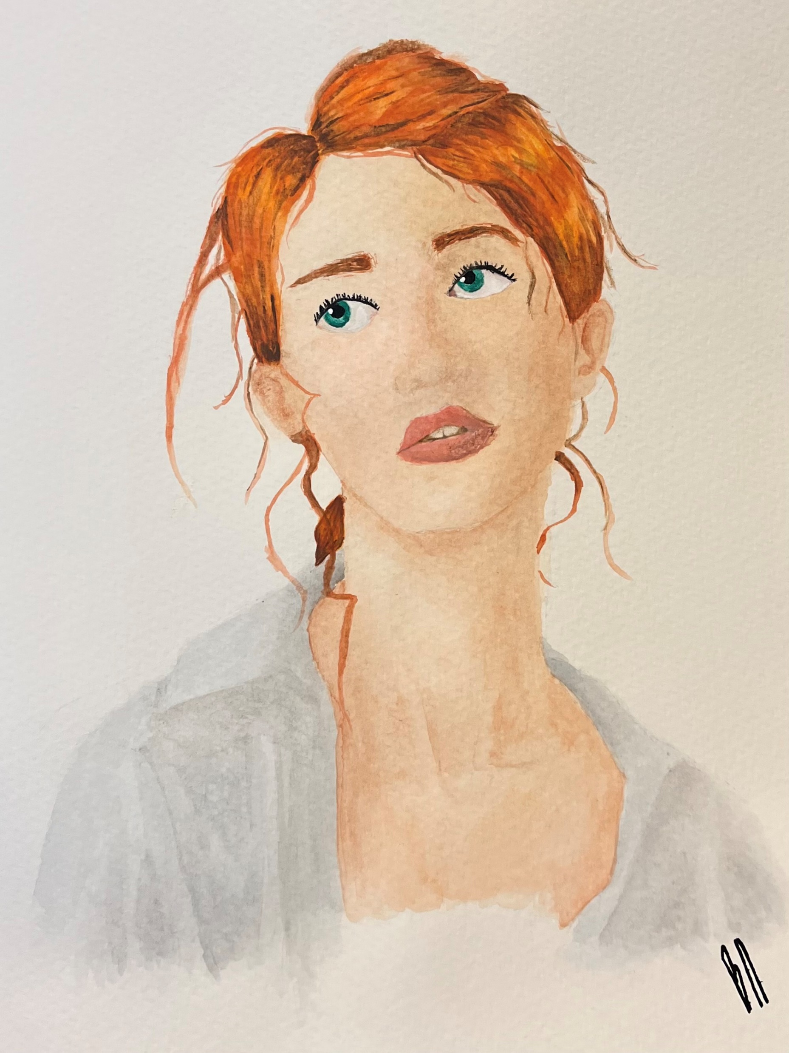
What would happen to this plant if it were kept in a dark room or never watered?
How might this relate to our spiritual health and needs?
Like caring for a plant, keeping ourselves spiritually healthy requires consistent effort.
Brylee Neild

Slide 4
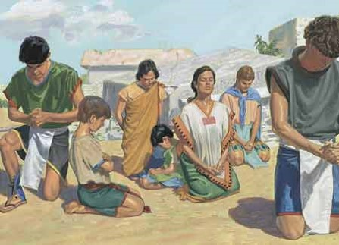
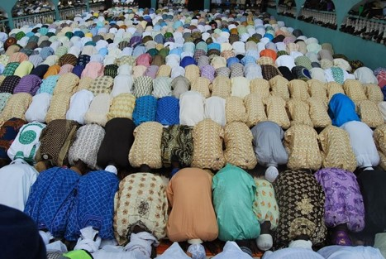
Fallen To The Earth
“…for fear of the Lord had come upon them.”
Fear—Hebrew (Yirah)
Reference or respect…the righteous long to attain the divine presence.
In many cultures of the ancient world, prostration was a manifestation of reverence, respect, or overwhelming awe.
Mosiah 4:1 JFM and RLM

Slide 5
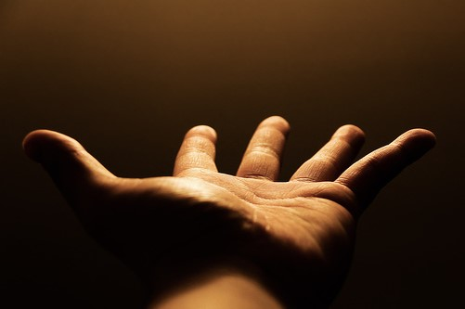
A Carnal State
Opposite of Spiritual
In Eden—Adam and Eve were in a state of: incorruptible, immortal, and free from all taint of sin
With the Fall came the consuming lusts of the flesh…the birth of carnal man
A Carnal Man is one who yields to the flesh
It refers to our physical appetites rather than our spiritual desire to draw nearer to the Lord.
See Alma 41:11
However:
There is one plan of redemption—one system of remission of sins
Mosiah 4:2 JFM and RLM

Slide 6
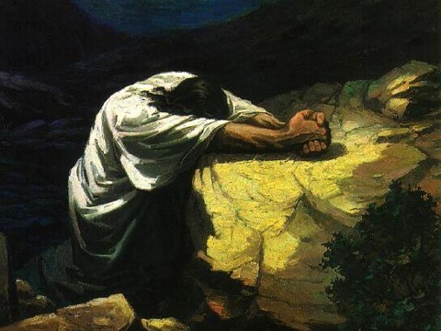
Believe in Christ
Any and all efforts toward Godly sorrow and ultimate forgiveness must center in that redemption that is found only in Christ and his atoning blood.
The blood of Christ is central to the remission of sins.
No matter what the degree of remorse
“A religion that does not require the sacrifice of all things never has power sufficient to produce the faith necessary unto life and salvation.”
Lectures on Faith 6:7
Mosiah 4:2 JFM and RLM

Slide 7
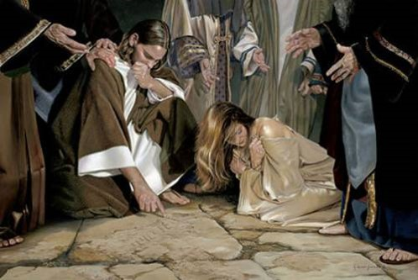
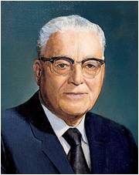
Remission of Sins
King Benjamin’s people received a remission of their sins
How can we know that we have been forgiven of our sins?
“…becometh a saint through the atonement of Christ the Lord, and becometh as a child, submissive, meek, humble, patient, full of love, willing to submit to all things which the Lord seeth fit to inflict upon him, even as a child doth submit to his father.” Mosiah 3:19
“If the time comes when you have done all that you can to repent of your sins, whoever you are, wherever you are, and have made amends and restitution to the best of your ability; if it be something that will affect your standing in the Church and you have gone to the proper authorities, then you will want that confirming answer as to whether or not the Lord has accepted of you. In your soul-searching, if you seek for and you find that peace of conscience, by that token you may know that the Lord has accepted of your repentance”.
Harold B. Lee
Mosiah 4:3

Slide 8
How do you know when you have been forgiven?
Where is the grove that I might pray?
Have I walked around it?
I can not find it
Where is my grove where I need to find peace?
How long is my walk?
How long do I anguish?
Can’t the adversary just release me?
Doesn't he know that I don’t desire his words?
Doesn’t he know he can’t have me?
He knows me well, but my God knows me better.
So where is my grove that I might pray
That I might have the peace and love with me
That I might feel of His love
That I might be released from this bondage in my mind
I have found that grove that I might pray
I have walked around it and through it and found it
I have found that grove and I have found peace
My walk is still but a short way off
I anguish only a little now
The adversary is not easily part of me
He still knows me well, but he can’t have me
My Savior knows me better and He has reached out for me
I know Him now and what He has done for me
I have found that grove and wish to stay and feel of presence and His love
My mind will be forever free from sorrow
—anonymous

Slide 9
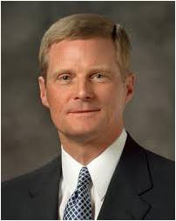
As members of the Lord’s restored Church, we are blessed both by our initial cleansing from sin associated with baptism and by the potential for an ongoing cleansing from sin made possible through the companionship and power of the Holy Ghost. …
Sometimes Latter-day Saints express the wish that they could be baptized again—and thereby become as clean and worthy as the day on which they received their first saving gospel ordinance.
May I respectfully suggest that our Heavenly Father and His Beloved Son do not intend for us to experience such a feeling of spiritual renewal, refreshment, and restoration just once in our lives.
The blessings of obtaining and always retaining a remission of our sins through gospel ordinances help us understand that baptism is a point of departure in our mortal spiritual journey; it is not a destination we should yearn to revisit over and over again.
David A. Bednar

Slide 10
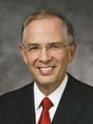
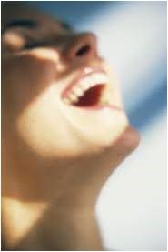
Filled With Joy
“As we honestly confess our sins, restore what we can to the offended, and forsake our sins by keeping the commandments, we are in the process of receiving forgiveness. With time, we will feel the anguish of our sorrow subside, taking ‘away the guilt from our hearts’ (Alma 24:10) and bringing ‘peace of conscience’ (Mosiah 4:3).
“For those who are truly repentant but seem unable to feel relief: continue keeping the commandments. I promise you, relief will come in the timetable of the Lord. Healing also requires time.”
Neil L. Anderson
Feelings of Remission:
Peace and Joy
Enjoying being with others of the same faith
Knowing that favors and blessings are restored
Wanting to serve
Wanting to study and gain a knowledge of light and truth
As we exercise faith in Jesus Christ and sincerely repent, we can be filled with joy, receive a remission of our sins, and have peace of conscience.
Mosiah 4:3

Slide 11
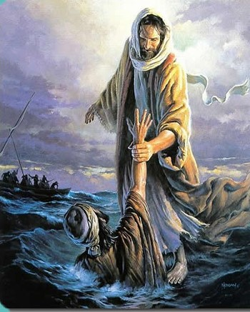
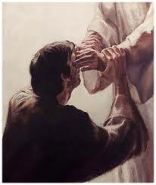
How can we be saved?
Know the goodness of God by:
His Power
His Wisdom
His Patience
His Long-suffering
His Atonement
Then :
Trust in Him
Be diligent in keeping His commandments
Continue in Faith to the end
Mosiah 4:4-8

Slide 12
Doctrinal Mastery
Believe in God; believe that he is, and that he created all things, both in heaven and in earth; believe that he has all wisdom, and all power, both in heaven and in earth; believe that man doth not comprehend all the things which the Lord can comprehend.
Mosiah 4:9
Mosiah 4:4-8

Slide 13
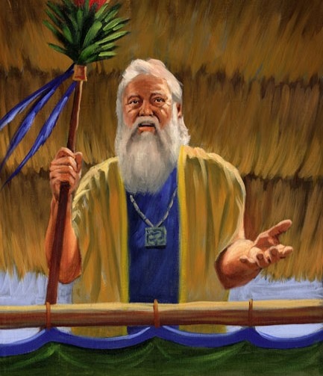
Retain a Remission of Sins
King Benjamin told his people they must “Believe in God”
That they needed to remember the greatness of God
That He created all things
That they were to humble themselves
That they were to pray daily
That they were to stand steadfastly in the faith.
James H. Fullmer
Nevertheless :
“…he that repents and does the commandments of the Lord shall be forgiven;”
D&C 1:32
God created all things and has all power and wisdom
Mosiah 4:9-12

Slide 14
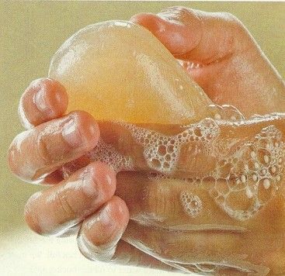
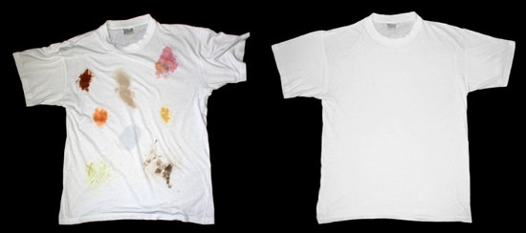
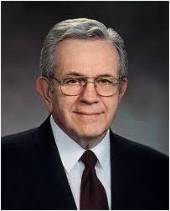
Knowing Your Forgiven
“It is one thing to be adorned in clean clothing It is quite another to keep it clean.
“…It is one thing to be baptized for the remission of sins and quite another to retain that state of purity.”
Humility and reliance upon the Lord are as the soap and water with which the Saints cleanse their garments.
“For those who truly desire it, there is a way back. Repentance is like unto a detergent. Even ground-in stains of sin will come out.”
Boyd K. Packer
Mosiah 4:11-12

Slide 15
God’s Greatness
If we remember God’s greatness, humble ourselves, pray daily, and stand steadfastly in the faith, then we will be filled with God’s love, retain a remission of our sins, and grow in knowledge.
How might humbling ourselves help us grow in knowledge?
How has praying daily helped you retain a remission of your sins?
How can worthily partaking of the sacrament help us to humble ourselves and retain a remission of our sins?
When has doing one of the things listed in the left column of the chart helped you to feel God’s love for you?
Mosiah 4:11-12

Slide 16
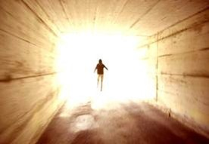
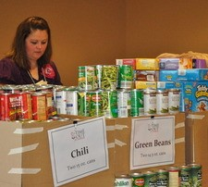
To Have the Lord’s Spirit
Paul Taught:
“But the fruit of the Spirit is love, joy peace, longsuffering, gentleness, goodness, faith,
Meekness, temperance: against such there is no law.”
Galatians 5:22-23
Those who live in the Spirit walk in the Spirit
One who is filled with the Spirit of God:
They will seek to live peaceably with one another.
They will fulfill their sacred family responsibilities
They will help the needy. (succor=give aid, help, or relief)
Book of Mormon Student Manual
Mosiah 4:13-16

Slide 17
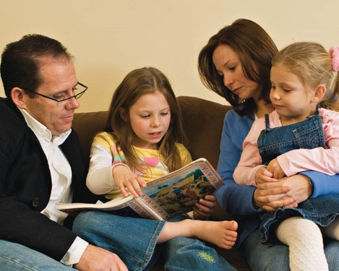
A Great Responsibility
To the parents
“But if any provide not for his own, and specially for those of his own house, he hath denied the faith, and is worse than an infidel.”
1 Timothy 5:8
“And again, verily I say unto you, that every man who is obliged to provide for his own family, let him provide, and he shall in nowise lose his crown; and let him labor in the church.”
D&C 75:28
“But I have commanded you to bring up your children in light and truth.” D&C 93:40
We have no more right to neglect the spiritual welfare of our families than to refuse them food and clothing.
Mosiah 4:14-15

Slide 18
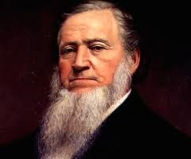
Sharing
For those who stand in need:
“Suppose that in this community there are ten beggars who beg from door to door for something to eat, and that nine of them are imposters who beg to escape work… (What is your choice?) To give food to the ten,…or to repulse the ten because you do not know which is the worthy one?
You will all say, administer charitable gifts to the ten, rather than turn away the only truly worthy…person among them.
If you do this, it will make no difference in your blessings, whether you administer to worthy or unworthy persons, inasmuch as you give alms with a single eye to assist the truly needy.”
Brigham Young
Mosiah 4:16-18

Slide 19
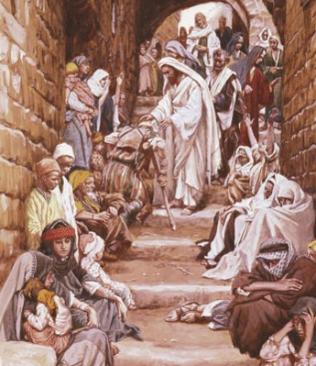
To the Rich and the Poor
King Benjamin speaks to both the rich and the poor
To the rich: That they should give to the poor
To the poor: That they should not covet
“…I give not because I have not, but if I had I would give…”
Coveting = not just wanting something that doesn’t belong to you, but it is an attitude.
It is setting one’s heart on the things of the world more than on the things of God
Mosiah 4:17-25

Slide 20
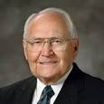
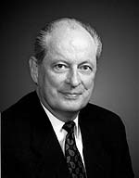
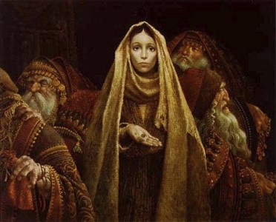
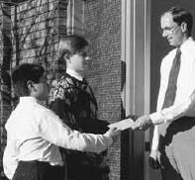
Fast Offerings
“An important reason for fasting is to contribute the amount saved from the meals not eaten to care for the poor and the needy.”
L. Tom Perry
“Showing compassion to those in need and giving of our abundance to help others is an ancient principle. The Lord commanded Moses, “Thou shalt not harden thine heart, nor shut thine hand from thy poor brother: But thou shalt open thine hand wide unto him, and shalt surely lend him sufficient for his need.” (Deut. 15:7–8).
Neil K. Newell
In the Church today:
How can you participate in fast offerings?
We can fast
We can contribute fast offerings
Aaronic Priesthood holders can gather
fast offerings from ward or branch
members
Mosiah 4:26

Slide 21
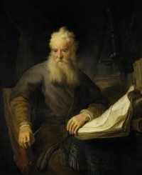
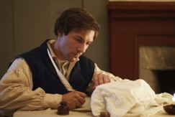
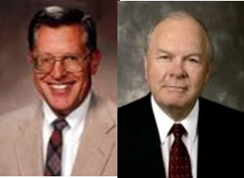
Wisdom and Order
“Behold, mine house is a house of order, saith the Lord God, and not a house of confusion.”
D&C 132:8
Paul
Let all things be done decently and in order.
I Corinthians 14:40
“The Lord’s people are always commanded to search out and care for the poor. They are, however, to do so in wisdom and order—to see to it that such efforts do not neglect the needs of their families. Nor can our obligation to extend temporal aid overshadow eternal covenants…”
JFM and RLM
Joseph Smith
“Do not run faster or labor more than you have strength and means provided to enable you to translate; but be diligent unto the end.”
D&C 10:4
Mosiah 4:26

Slide 22
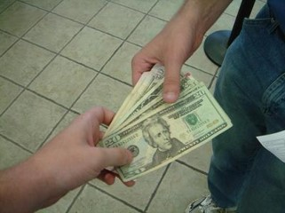
Borrowing
“And I would that ye should remember, that whosoever among you borroweth of his neighbor should return the thing that he borroweth, according as he doth agree, or else thou shalt commit sin; and perhaps thou shalt cause thy neighbor to commit sin also.”
Law of Moses
“And if a man borrow ought of his neighbour, and it be hurt, or die, the owner thereof being not with it, he shall surely make it good.”
Exodus 22:14
Borrowing Money:
If there is any one here intending to go into debt for speculation, … I would advise him to hesitate, pray over it, and carefully consider it before he obligates himself by borrowing money and going into debt. In other words, keep out of debt if you can. Pay your debts as soon as you can.
Money is something that a man ought to be able to take care of and use wisely
if he has it; if he does not know how to take care of it, it will escape from his pockets, it will take the wings of the morning and flee away.
I again admonish the Latter-day Saints to aim and diligently endeavor to free themselves from debt. Get out of debt and keep out of debt, and then you will be financially as well as spiritually free.
Mosiah 4:28

Slide 23
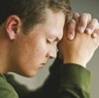
Watch and Pray
“Verily, verily, I say unto you, ye must watch and pray always, lest ye be tempted by the devil, and ye be led away captive by him.”
3 Nephi 18:15
“For our words will condemn us, yea, all our works will condemn us; we shall not be found spotless; and our thoughts will also condemn us; and in this awful state we shall not dare to look up to our God; and we would fain be glad if we could command the rocks and the mountains to fall upon us to hide us from his presence.”
Alma 12:14
However:
“But that ye would humble yourselves before the Lord, and call on his holy name, and watch and pray continually, that ye may not be tempted above that which ye can bear, and thus be led by the Holy Spirit, becoming humble, meek, submissive, patient, full of love and all long-suffering;”
Alma 13:28
If we are not careful about our thoughts, words, and deeds and do not keep the commandments or continue in the faith of Jesus Christ throughout our lives, we will perish.
Mosiah 4:30

Slide 24
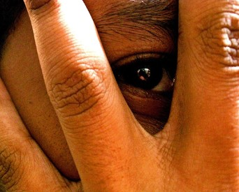
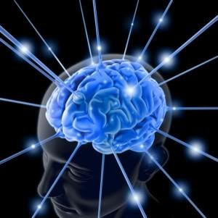
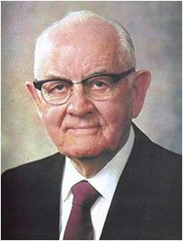
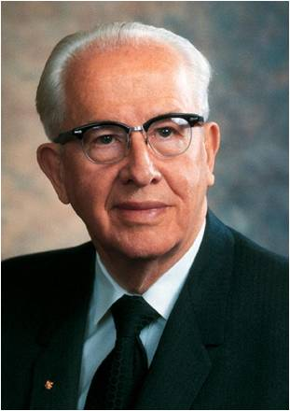
Secret Thoughts
“If men’s secret acts shall be reveled it is likely that their secret thoughts will also be reveled…
The one who harbors evil thoughts sometimes feels safe in the conviction that these thoughts are unknown to others…
Accordingly, men’s deeds and thoughts must be recorded in heaven, and recording angels will not fail to make complete recordings of our thoughts and actions.”
Spencer W. Kimball
“Think clean thoughts. Those who think clean thoughts do not do dirty deeds. You are not only responsible before God for your acts but also for controlling your thoughts. So live that you would not blush with shame if your thoughts and acts could be flashed on a screen in your church.
The old adage is still true that you sow thoughts and
you reap acts, you sow acts and you reap habits, you
sow habits and you reap a character, and your
character determines your eternal destiny.
‘As a man thinketh, so is he.’” Ezra T Benson
Mosiah 4:30

Slide 25
Filling Our Lives With Light
Light and darkness cannot occupy the same space at the same time.
Light Dispels Darkness
For example:
Appropriate music
Uplifting visual images
Wholesome activities
Clean thoughts and words
All of these will invite the Spirit into our lives and push unworthy thoughts out of our minds.
What can you do to keep your thoughts, words, and deeds clean?

Slide 26
Sources:
Joseph Fielding McConkie and Robert L. Millet Doctrinal Commentary on the Book of Mormon Vol. 2 p. 156
Harold B. Lee (“Stand Ye in Holy Places,” Ensign, July 1973, 122).
Neil L. Anderson (“Repent … That I May Heal You,” Ensign or Liahona, Nov. 2009, 42).
See also Luke 15:8-10 “Rejoice with Me” Parable of the Lost Coin
Boyd K. Packer Cleansing the Inner Vessel Oct 2010 Gen. Conf.
Brigham Young Discourses of Brigham Young p. 274
Book of Mormon Student Manual Religion 121-122 p. 165
L. Tom Perry Conference Report, Apr. 1986, 39; or Ensign, May 1986, 31.
Neil K. Newell Fast Offerings: Blessings We Give, Blessings We Receive Oct. 1998 Conf. Report
Barrowing: In Conference Report, Oct. 1911, 128–29.
Deseret News: Semi-Weekly, 8 Aug. 1884, 1.
In Conference Report, Oct. 1903, 5.
Spencer W. Kimball Miracle of Forgiveness pg. 108
Ezra T Benson (in Conference Report, Oct. 1964, 60; quoting Proverbs 23:7).
Other Good Reads: Gordon B. Hinckley “Thou Shalt Not Covet” Ensign March 1990
David A. Bednar, “Always Retain a Remission of Your Sins,” Ensign or Liahona, May 2016, 61–62)
Presentation by ©http://fashionsbylynda.com/blog/

Slide 27
Caring for the Poor and Needy Mosiah 4:11,-26:
“Don’t we all cry out for help and hope and answers to prayers? Don’t we all beg for forgiveness for mistakes we have made and troubles we have caused? Don’t we all implore that grace will compensate for our weaknesses, that mercy will triumph over justice at least in our case? Little wonder that King Benjamin says we obtain a remission of our sins by pleading to God, who compassionately responds, but we retain a remission of our sins by compassionately responding to the poor who plead to us [see Mosiah 4:11–12, 20, 26]” (Jeffrey R. Holland, “Are We Not All Beggars?” Ensign or Liahona, Nov. 2014, 41).
Thoughts and Words Mosiah 4:30:
“Some bad thoughts come by themselves. Others come because we invite them by what we look at and listen to. Talking about or looking at immodest pictures … can stimulate powerful emotions. It will tempt you to watch improper [videos] or movies. These things surround you, but you must not participate in them. Work at keeping your thoughts clean by thinking of something good. The mind can think of only one thing at a time. Use that fact to crowd out ugly thoughts. Above all, don’t feed thoughts by reading or watching things that are wrong. If you don’t control your thoughts, Satan will keep tempting you until you eventually act them out” (Richard G. Scott, “Making the Right Choices,” Ensign, Nov. 1994, 37).
Watch Your Thoughts and Words Mosiah 4:30:
“As you learn to control your thoughts, you can overcome habits, even degrading personal habits. You can gain courage, conquer fear, and have a happy life. I had been told … as I grew up that thoughts must be controlled, but no one told me how. I’ve thought about this over the years and have decided that the mind is like a stage. During every waking moment the curtain is up. There is always some act being performed on that stage. It may be a comedy, a tragedy, interesting or dull, good or bad; but always there is some act playing on the stage of your mind.
“Have you noticed that shady little thoughts may creep in from the wings and attract your attention in the middle of almost any performance and without any real intent on your part? … If you permit them to go on, all thoughts of any virtue will leave the stage. … What do you do at a time like that, when the stage of your mind is commandeered by the imps of unclean thinking … ? If you can fill your mind with clean and constructive thoughts, then there will be no room for these persistent imps, and they will leave” (Boyd K. Packer, “Worthy Music, Worthy Thoughts,” New Era, Apr. 2008, 7–8).
Removing Bad Thoughts Mosiah 4:30:
“Choose a favorite hymn or song, … one with words that are uplifting and music that is reverent, one that makes you feel something akin to inspiration. There are many beautiful songs to choose from. Seek the guidance of the Spirit in making your selection. Go over the song in your mind carefully. Memorize it. Even though you have had no musical training, you can think through a simple song. Now use this as the course for your thoughts to follow. Make it your emergency channel. …
“Because the music is uplifting and clean, the baser thoughts will slip shamefully away. For while virtue, by choice, will not associate with filth, evil cannot tolerate the presence of light. In due time you will find yourself humming the music inwardly, almost automatically, to drive out unworthy thoughts” (Boyd K. Packer, “Worthy Music, Worthy Thoughts,” 11).

Slide 28
A Mighty Change
Mosiah 5-6

Slide 29
Difficult To Do Right
A young woman is trying to do what is right. She prays and reads her scriptures often. She attends her Church meetings. She wants to be good, but at school and in other places she hears inappropriate language and sees a lot of inappropriate behavior. Sometimes she gives in to temptation and does things she knows are not right.
Why can it be difficult for us to always desire to do what is right?

Slide 30
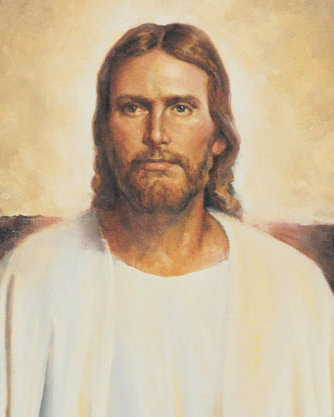
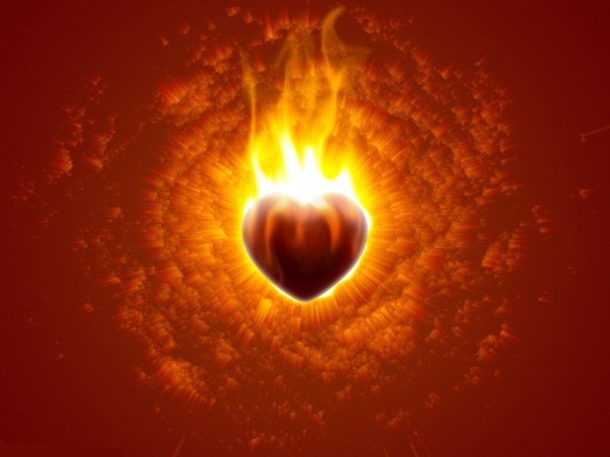
We Believe
“One of the true sign of conversion is an intelligent acceptance of the words of the Lord’s anointed.”
JFM and RLM
“Man or woman is not truly converted unless he sees the power of God resting upon the leaders of this Church and it goes down into his heart like fire.”
Harold B. Lee
Mosiah 5:2

Slide 31
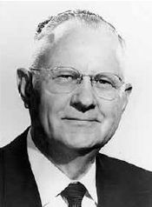
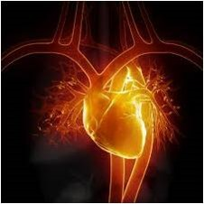
The Heart
Dictionary definition:
Heart is the enter of total personality with reference to intuition, feeling, or emotion: the center of emotion, in contrast to head as the center of the intellect.
The core of life and strength
Including:
The mind, spirit, and soul, and one’s entire emotional nature and understanding.
The central source of one’s mental faculties or capacities
“for as he (man) thinketh in his heart, so is he.”
Proverbs 23:7
The seat of one’s affection, moral life, and character
The heart is defined as having spirit, courage, and enthusiasm
Mosiah 5:2 Delbert L. Stapley

Slide 32
Inward Change
Have you ever felt that you needed to change spiritually?
What did you do about it?
If you have experienced a change, have you maintained that change to this day?
“The essence of the gospel of Jesus Christ entails a fundamental and permanent change in our very nature made possible through our reliance upon ‘the merits, and mercy, and grace of the Holy Messiah’ (2 Nephi 2:8). As we choose to follow the Master, we choose to be changed—to be spiritually reborn”
David A. Bednar
As our hearts are changed through the Spirit of the Lord, we lose the desire to do evil and gain the desire to do good continually
Mosiah 5:1-4

Slide 33
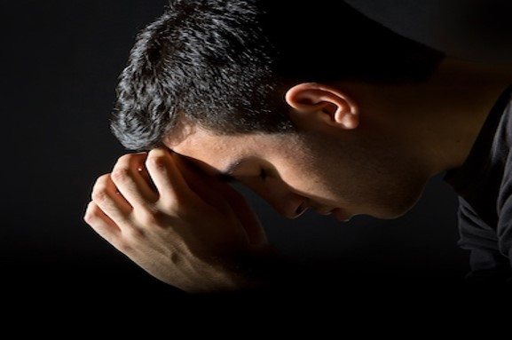
As our hearts are changed through the Spirit of the Lord, we lose the desire to do evil and gain the desire to do good continually
“Becoming Christlike is a lifetime pursuit and very often involves growth and change that is slow, almost imperceptible. …
“… True repentance involves a change of heart and not just a change of behavior. … Most repentance does not involve sensational or dramatic changes, but rather is a step-by-step, steady, and consistent movement toward godliness.” Ezra Taft Benson
Mosiah 5:1-4

Slide 34
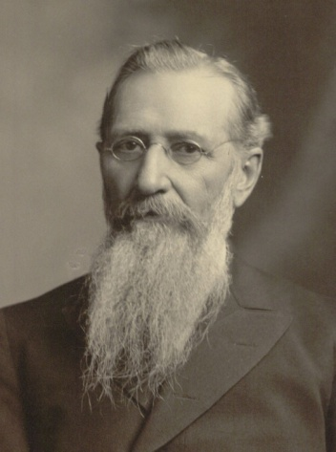
The Power of the Holy Spirit Within
“What a glorious condition was this! A condition in which the Lord God Omnipotent, by the power of His Spirit, had wrought a mighty change in the hearts of that people, that they no longer had any desire to do evil, but were filled only with a fervent desire to do that which was good.”
…the influence and power of the Holy Spirit…the feeling that came upon me was that of pure peace, of love and of light…
…I felt as though I wanted to do good everywhere to everybody and to everything.
…I felt a newness of life, a newness of desire to do that which was right.
There was not one particle of desire for evil left in my soul.”
Joseph F. Smith--Speaking of his baptism
Mosiah 5:2

Slide 35
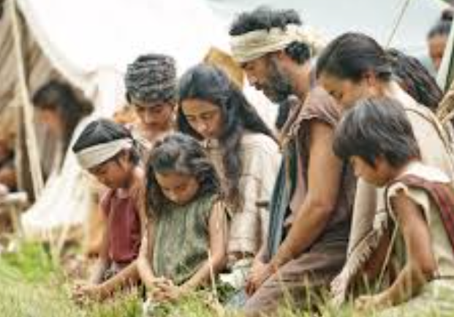
Disposition
An individual’s nature—his or her desires and temperament.
King Benjamin’s people did not have the desire to do evil anymore
Nephi’s Cry:
“O Lord, wilt thou redeem my soul? Wilt thou deliver me out of the hands of mine enemies? Wilt thou make me that I may shake at the appearance of sin?”
2 Nephi 4:31
Mosiah 5:2

Slide 36
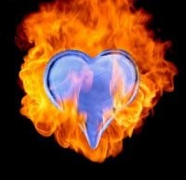
What Brings About a Change of Heart?
A change of heart is more than just a change of behavior.
When we experience a change of heart, we become new people, changed through the power of the Savior’s Atonement.
“The gospel of Jesus Christ encompasses much more than avoiding, overcoming, and being cleansed from sin and the bad influences in our lives; it also essentially entails doing good, being good, and becoming better. … This mighty change is not simply the result of working harder or developing greater individual discipline. Rather, it is the consequence of a fundamental change in our desires, our motives, and our natures made possible through the Atonement of Christ the Lord. Our spiritual purpose is to overcome both sin and the desire to sin, both the taint and the tyranny of sin”
David A. Bednar
Why do you think we need the Atonement of Jesus Christ in order to truly change?
Mosiah 5:2

Slide 37
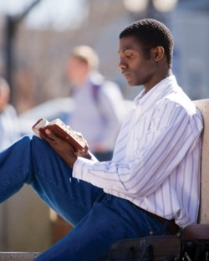
Spirit of Prophecy For The Faithful Servants
“The spirit of revelation is the spirit of prophecy.
That same spirit by which one gains a remission of sins, by which he loses all desire for future sin—
that same spirit grants to faithful men and women “great views of that which is to come,” allowing them when appropriate, to “prophesy of all things.”
Faith brings knowledge, a knowledge which everlastingly enriches the soul.
The command of the Lord is always to seek learning, even by study and by faith
D&C 88:118
Mosiah 5:3 JFM and RLM

Slide 38
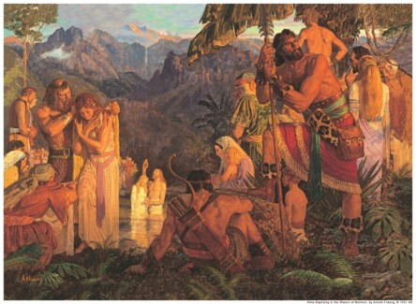
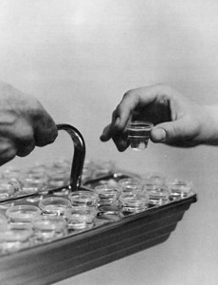
A Renewal of Covenants
King Benjamin’s people were already baptized.
“They had been baptized at their initial conversion or as they arrived at the years of accountability, they had previously taken upon themselves the name of Christ; and they now renewed those commitment to keep the commandments of God the remainder of their days”
True saints:
“live by every word that proceedeth forth from the mouth of God”
D&C 84:44
Salvation is not found in partial truths or in partial acceptance of the truth— “it is in all things and all the remainder of our days”
Mosiah 5:5 JFM and RLM

Slide 39
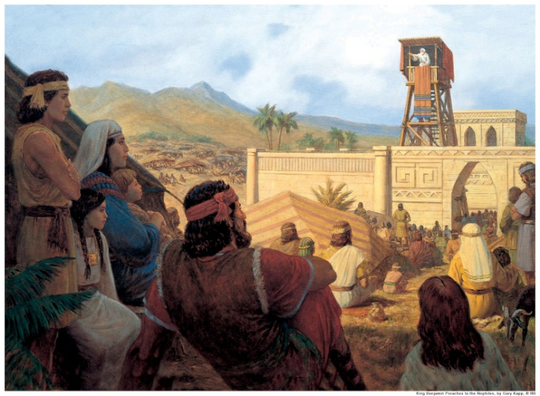
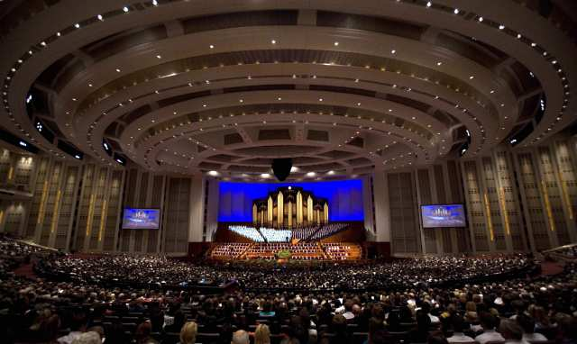
The Power of the Spoken Words
“And now, these are the words which king Benjamin desired of them; and therefore he said unto them: Ye have spoken the words that I desired; and the covenant which ye have made is a righteous covenant.”
“The gospel teacher (King Benjamin) labors with all his soul to present a message which would please God and would edify and motivate his listeners to righteousness. No greater reward could be presented him than a congregation who feels the spiritual power of his words, and believes and acts upon them.”
JFM and RLM
As we make and keep sacred covenants, we take upon ourselves the name of Jesus Christ
Mosiah 5:6

Slide 40
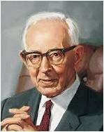
A New Name
What name did King Benjamin give his people?
The name of Christ
When do we take upon ourselves the name of Jesus Christ?
We take upon ourselves the name of Jesus Christ when we make and keep sacred covenants
“Jesus Christ also “becomes our Father” because He “offers us life, eternal life, through the atonement which he made for us.
…We become the children, sons and daughters of Jesus Christ, through our covenants of obedience to him”
Joseph Fielding Smith
Mosiah 5:8

Slide 41
Elohim—Our Heavenly Father
We were born of an eternal Heavenly Father.
We acquired spiritual qualities and characteristics from God
All of us are now spirit sons or daughters of God and have part of his divine nature in us
Can you see the reasonable basis for the belief that you can become a god like his is by progressing here and hereafter?
Our Earthly Father
Each of us had an earthly father who gave us mortal life and thus became our physical father
We have acquired earthly qualities and characteristics from him
We bear his name and have part of his nature in us
Consider the reasonable truth that you possess many of his characteristics and can become like him
Jesus Christ—Our Savior and Spiritual Father
Jesus Christ is he who gives us immortality beyond the grave through the Resurrection. Since that is true for all men, he is the Father of all the family of God
We can be spiritually reborn through the sanctifying influence of the Atonement; hence, for all who will repent, be baptized, and endure faithfully to the end by following the spirit, Christ becomes their father
Through rebirth we acquire distinct Chrislike qualities, partake of his divine nature, and become his son or daughter
We now take upon ourselves a new name, even the name of Jesus Christ.
Do you understand that you have the qualities and power to become like him through this “mighty change” called spiritual rebirth?
How are we Children of God, the Father, and Jesus Christ?
Mosiah 5:7-12 Book of Mormon Student Manual 2013

Slide 42
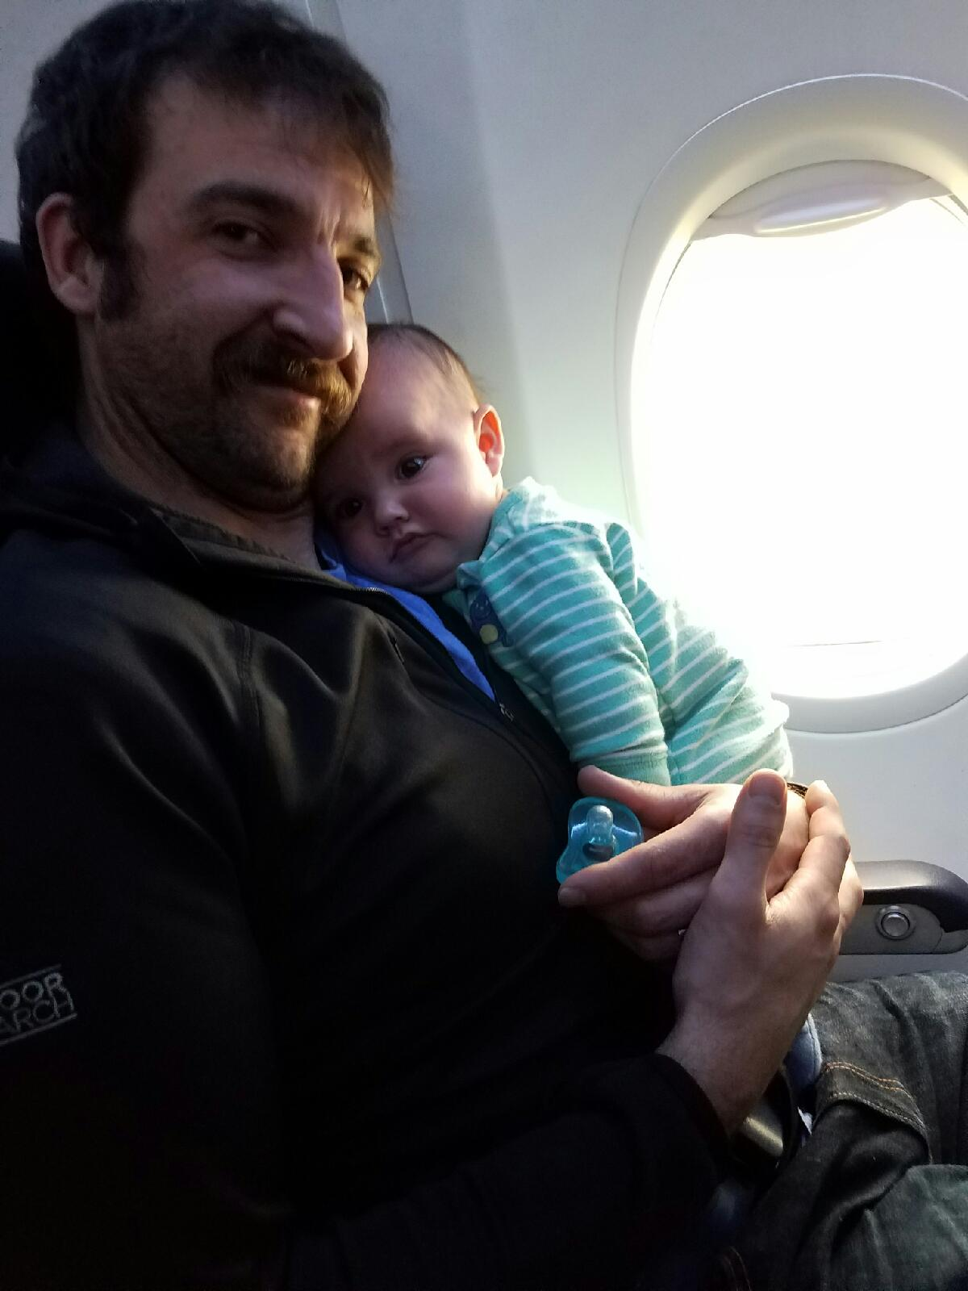
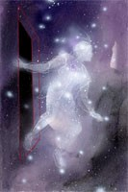
Process of Becoming Like God
Requires three fathers
Our Heavenly Father, who gave us our spirit body
Our earthly father, who gave us a physical, mortal body
Our Savior-Father, who gives us a resurrected, eternal body, which will be a celestial body if we accept him and faithfully live by his every word. Also, he gives us a remission of our sins and enables us to develop a celestial spirit
Mosiah 5:7-12 Book of Mormon Student Manual

Slide 43
The Right Hand of God
Sinister—left side
Something unfavorable
Sheep—Matthew 25:33
The Lord has frequently utilized this distinction to contrast the blessed state of those who are loyal to him and keep the commandments
Dexter—right side
Something favorable
Goats—Matthew 25:33
“Fear thou not; for I am with thee: be not dismayed; for I am thy God: I will strengthen thee; yea, I will help thee; yea, I will uphold thee with the right hand of my righteousness.”
Isaiah 41:10
Those found on the right hand of Christ “know the name by which (they are) called;…the name of Christ
Mosiah 5:9-10

Slide 44
Some Other Name
Spiritual orphans:
Those who are not adopted into the family of the Lord Jesus Christ
Those who choose not to align themselves with him and his case
Simon Dewey
“Behold, I say unto you, that the good shepherd doth call you; yea, and in his own name he doth call you, which is the name of Christ; and if ye will not hearken unto the voice of the good shepherd, to the name by which ye are called, behold, ye are not the sheep of the good shepherd.
And now if ye are not the sheep of the good shepherd, of what fold are ye? Behold, I say unto you, that the devil is your shepherd, and ye are of his fold; and now, who can deny this? Behold, I say unto you, whosoever denieth this is a liar and a child of the devil.”
Alma 5:38-39
Mosiah 5:10

Slide 45
Take Upon Ourselves
What do you think it means to have the name of Christ written in your heart?
What blessings come to those who have the name of Christ written in their hearts?
How do those who honor the name of Christ show reverence and love for the name of Christ?
How well have we taken upon ourselves the name of Christ?
Mosiah 5:11-15

Slide 46
Never Blotted Out And Know the Lord
“Birthrights can be lost. One can be disinherited, can lose the privileges and blessings of membership in the royal family. Neither men nor demons can rob one of the rightful family ties; on the other hand, impurity and disloyalty can sever one from the honors of heirship.”
JFM and RLM
King Benjamin pleads with his people to be spiritually alert and avoid transgression
Jesus taught that his sheep knew his voice—To know the Lord is to recognize the voice of Christ in this life
King Benjamin reminds us that we come to know the Lord through serving others (Mosiah 2:17).
Mosiah 5:11-15

Slide 47
“The word ‘steadfast’ is used to suggest fixed in position, solid and firm, unshaken and resolute (Oxford English Dictionary Online,2nd ed. [1989], “Steadfast”). The word ‘immovable’ is used to indicate that a person or thing is unalterable, firmly secured, and not subject to change.
It also signifies the quality of being unyielding and incapable of being diverted from one’s purpose (Oxford English Dictionary Online, “Immovable”). Thus, a person who is steadfast and immovable is solid, firm, resolute, firmly secured, and incapable of being diverted from a primary purpose or mission”
David A. Bednar
Mosiah 5:15

Slide 48
Mosiah I and Mosiah II
It was Mosiah I who was commanded of the Lord to depart into the wilderness because of the wickedness of the Nephites (Omni 1:12)
King Benjamin named his son Mosiah after his own father.
The book of Mosiah is name after Mosiah II, for he is the one who kept the record
Mosiah 6:4-7

Slide 49
Last Words of King Benjamin
It was important for King Benjamin to keep a record of the names of those who entered into a covenant with the Lord
Everyone except little children entered into the covenant and had taken upon them the name of Christ
King Benjamin consecrated his son Mosiah to be a ruler and a king over his people
He also appointed priests to teach the people and to remind them of their covenants
He dismissed each family to return to their own houses
Mosiah 6:1-3

Slide 50
Mosiah’s Reign
Mosiah was 30 years old when he began to reign
It was 466 years from the time that Lehi left Jerusalem
King Benjamin lived 3 more years then died
King Mosiah did “walk in the ways of the Lord, and did observe his judgments and his statutes, and did keep his commandment in all things”
King Mosiah had his people till the earth and produce things for themselves like his father had done
Mosiah started the “Judges program” having elected Alma as chief judge
He reigned for 33 years and died about 92 BC at the age of 63

Slide 51
Sources:
Delbert L. Stapley Conf. Report Oct. 1968 pg. 27-28 or quoted in Book of Mormon Student Manual Religion 121-122 p 166
Joseph Fielding McConkie and Robert L. Millet Doctrinal Commentary on the Book of Mormon Vol. 2 p. 175-176
Harold B. Lee Be Loyal to the Royal Within You p 90
David A. Bednar (“Clean Hands and a Pure Heart,” Ensign or Liahona, Nov. 2007, 81–82).
(“Ye Must Be Born Again,” Ensign or Liahona, May 2007, 20).
(“Steadfast and Immovable, Always Abounding in Good Works,” New Era, Jan. 2008, 2)
Ezra Taft Benson, “A Mighty Change of Heart,” Ensign, Oct. 1989, 5
Joseph Fielding Smith (Doctrines of Salvation, comp. Bruce R. McConkie, 3 vols. [1954–56], 1:29).
Book of Mormon Student Manual Religion 121-122 p 168
Joseph F. Smith Speaking of his baptism—Conf. Report April 1898 p 65-66
Presentation by ©http://fashionsbylynda.com/blog/

Slide 52
Elohim—Our Heavenly Father
We were born of an eternal Heavenly Father.
We acquired spiritual qualities and characteristics from God
All of us are now spirit sons or daughters of God and have part of his divine nature in us
Can you see the reasonable basis for the belief that you can become a god like his is by progressing here and hereafter?
Our Earthly Father
Each of us had an earthly father who gave us mortal life and thus became our physical father
We have acquired earthly qualities and characteristics from him
We bear his name and have part of his nature in us
Consider the reasonable truth that you possess many of his characteristics and can become like him
Jesus Christ—Our Savior and Spiritual Father
Jesus Christ is he who gives us immortality beyond the grave through the Resurrection. Since that is true for all men, he is the Father of all the family of God
We can be spiritually reborn through the sanctifying influence of the Atonement; hence, for all who will repent, be baptized, and endure faithfully to the end by following the spirit, Christ becomes their father
Through rebirth we acquire distant Chrislike qualities, partake of his dive nature, and become his son or daughter
We now take upon ourselves a new name, even the name of Jesus Christ.
Do you understand that you have the qualities and power to become like him through this “mighty change” called spiritual rebirth?
Mosiah 7-12 Book of Mormon Student Manual Religion 121-122 pg. 168

