Slide 1
Mosiah 7-10

Slide 2
The Journey of Ammon
Mosiah 7-8

Slide 3
Mosiah I
He was a descendent of Lehi
He lived in the southern area of the country where Lehi and his group first settled
Animosity continued between the Nephites and the Lamanites for many generations.
The Lord warned Mosiah to flee into the wilderness (Omni 1:13)
He and his people fled to a land called Zarahemla
His people discovered a group of people who were descendants of Mulek, the lone surviving son of king Zedekiah of Judah (Omni 1:15)
He had taken records before fleeing the land of Nephi and preserved the written language of his forebears…he taught the people
He was appointed King
His son was King Benjamin and grandson, Mosiah II
He was active for about 279 BC to 130 BC
He interpreted a large stone, the stone told of the days of Coriantumr, the final Jaredite ruler
Who’s Who

Slide 4
Ammon
A decendent of Zarahemla of Mulekite lineage
He was a leader of a group sent out around 121 BC by Mosiah II to find the colonists led by Zeniff that left 80 years before from Zarahemla
He discovered Limhi (Zeniff’s grandson) and his followers, in bondage to the Lamanites
He and Gideon, a strong soldier in Limhi’s army, were able to escape and return safely to Zarahemla
Who’s Who

Slide 5
Search Party
King Mosiah II authorized Ammon to search for Zeniff’s group that left from Zarahemla 80 years previous
Mosiah 7:1-5

Slide 6
40 Days in Wilderness
Ammon and 16 soldiers pitched tents at land of Shilom
Ammon takes Amaleki, Helem, and Hem to meet with King Limhi
Mosiah 7:5-6

Slide 7
King Limhi
He was the son of King Noah and grandson of Zeniff
He was appointed king by the voice of the people around 145 BC, but ascension to power began around 150 BC
He was the last of the Nephite kings in the colony established by Zeniff among the Lamanites in the land of Nephi
He did not search after the wicked ways of his father, Noah
He served as a spiritual guide for his people
He sought to escape the bondage his people were in with the Lamanites and ruled in an atmosphere of constant fear of Lamanite attack and retribution
Who’s Who

Slide 8
Surrounded by Guards
Then put them in prison
Mosiah 7:7

Slide 9
Two Days in Prison
“And it came to pass when they had been in prison two days they were again brought before the king, and their bands were loosed; and they stood before the king, and were permitted, or rather commanded, that they should answer the questions which he should ask them.”
Mosiah 7:8

Slide 10
An Explanation
“For I am assured that if ye had known me ye would not have suffered that I should have worn these bands. For I am Ammon, and am a descendant of Zarahemla, and have come up out of the land of Zarahemla to inquire concerning our brethren, whom Zeniff brought up out of that land.”
Mosiah 7:13

Slide 11
Exceedingly Glad
For behold, we are in bondage to the Lamanites, and are taxed with a tax which is grievous to be borne. And now, behold, our brethren will deliver us out of our bondage, or out of the hands of the Lamanites, and we will be their slaves; for it is better that we be slaves to the Nephites than to pay tribute to the king of the Lamanites.
Go to the hill of Shilom and bring back your brethren and eat and drink
Mosiah 7:16

Slide 12
Proclamation
“And now, it came to pass on the morrow that king Limhi sent a proclamation among all his people, that thereby they might gather themselves together to the temple, to hear the words which he should speak unto them.”
Mosiah 7:17

Slide 13
King Limhi Speaks
Rejoice and trust in God
The same God of Abraham and Moses has brought our brothers out of Jerusalem
Zeniff, being over zealous to inherit this land, entered into a treaty with King Laman and bringing us into bondage
That we pay taxes—tributes to King Laman
We have great reason to mourn
Many of our brethren have been slain
Our people have transgressed and suffered because of it and we have contention one with another
What is the main reason why these Nephites had been brought into bondage?
If we choose to sin, then we will experience bondage and sorrow
Mosiah 7:18-25

Slide 14
Prophecy Has Been Fulfilled
A Prophet has been slain—Abinadi—a chosen man of God
Abinadi prophesied of Christ—His mortal birth, and His atonement and that is why they burned Abinadi
What is the main cause of us to be in bondage and suffer?
Our iniquities and sin
Mosiah 7:26-28

Slide 15
The Law of the Harvest
“Who am I that made man, saith the Lord, that will hold him guiltless that obeys not my commandments?
Who am I, saith the Lord, that have promised and have not fulfilled?
I command and men obey not; I revoke and they receive not the blessing.”
D&C 58:30-32
There is a connection between people’s sins and people’s sorrow
Reap the chaff -- the leftover debris after the grain has been separated from wheat stalks—to get something useless
Mosiah 7:29-33

Slide 16
Winds of the East
An Old World cultural symbol. The people of the Bible recognized the existence of four prevailing winds as issuing, broadly speaking, from the four cardinal points: north, south, east and west.
Four winds = four quarters of the earth
Ezekiel 37:9, Daniel 8:8, Zechariah 2:6, Matthew 24:31
The north is cold
The west is moist from the Mediterranean Sea
The south, warm
The east, which crosses the sandy wastes of the Arabian Desert before reaching Palestine can be violent and destructive…the wind of the wilderness
Job 1:19, Psalm 78:26
JFM and RLM
N
W
E
S
How can recognizing the consequences of our sins be helpful to us?
Recognizing and feeling sorrow for our sins can lead us to turn to the Lord for deliverance
Mosiah 7:29-33

Slide 17
Delivered From Bondage
What did Limhi exhort his people to do in order to be delivered from bondage?
If we turn to the Lord with full purpose of heart, trust in Him, and serve Him with all diligence of mind, then He will deliver us from the bondage of sin
Mosiah 7:33

Slide 18
24 Gold Plates
The group wandered in the wilderness, and instead of finding Zarahemla, they found the remains of a destroyed civilization.
“Limhi had sent an expedition to get help from Zarahemla sometime before Ammon’s arrival.
There they discovered 24 gold plates with engravings on them. The ruins discovered by Limhi’s people were all that remained of the Jaredite civilization. A record of the Jaredites, taken from the 24 gold plates, is included in the Book of Mormon as the Book of Ether
Mosiah 8:5-10

Slide 19
Understanding
Yes, in the Land of Zarahemla there is our king who can translate the records. He can translate all records that are ancient, this is his gift from God. He is a seer.
Do you know of anyone that can translate these plates?
Mosiah 8:11-12

Slide 20
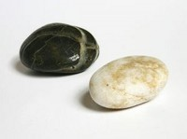
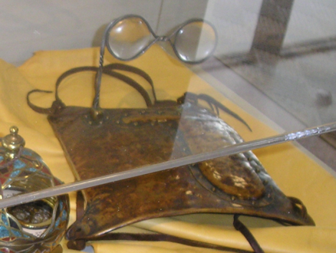
The Holy Instruments
Interpreters—
Urim and Thummim
The Urim and Thummin consists of two special stones.
Hebrew words associated with lights and perfection.
These devices are used in receiving revelations and in translating ancient scriptural records which have been written in languages unknown to the translators.
Thus, the content of such records can be manifest only as the Lord wills and only through his appointed prophet and seer.
It appears that the Urim and Thummin in King Mosiah’s possession trace back to his grandfather Mosiah I, to when the Jaredite record on stone was brought for translation
Omni 1:20-21
The Urim and Thummim delivered to Joseph Smith for use in translating the Book of Mormon, however, was the same one the brother of Jared had
Ether 3:22-28
D&C 17:1
JFM and RLM
To Joseph Smith
“And gave him power from on high, by the means which were before prepared, to translate the Book of Mormon;”
D&C 20:8
Mosiah 8:13

Slide 21
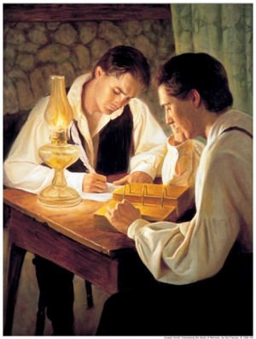
A Seer—a Foreteller
The word prophet as found in the Old Testament—Hebrew—nabi
Meaning to bubble or spring forth
Noun—one in who the message of God springs forth or one to whom anything is secretly communicated.
Nabi—generally defined as speaker or spokesman for God, and carries the idea of “one who is called.”
Book of Mormon Prophets were:
Understood to be a man “chosen of God” (Helaman 9:16)
To speak his words (Alma 5:11)
To whom God had given great power and authority (Helaman 11:18)
To act in his name (Alma 19:4)
In the earliest Old Testament times a prophet was called a seer
Hebrew—ro’eh—one who sees
Samuel 9:9
The idea of seeing that which was hidden to others.
Hebrew—hozen—one who sees a vision has also been translated as seer—to tell, to declare, or make known
Mosiah 8:15-17

Slide 22
A Revelator and a Prophet
A seer is a revelator and a prophet also; and a gift which is greater can no man have, except he should possess the power of God, which no man can; yet a man may have great power given him from God.
A Seer is greater than a prophet
The Lord provides prophets, seers, and revelators to benefit mankind
But a seer can know of things which are past, and also of things which are to come, and by them shall all things be revealed, or, rather, shall secret things be made manifest, and hidden things shall come to light, and things which are not known shall be made known by them, and also things shall be made known by them which otherwise could not be known.
Mosiah 8:15-17

Slide 23
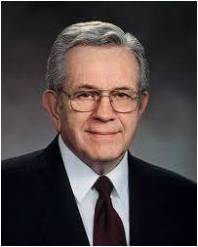
“The scriptures speak of prophets as ‘watch[men] upon the tower’ who see ‘the enemy while he [is] yet afar off’ and who have ‘beheld also things which were not visible to the natural eye … [for] a seer hath the Lord raised up unto his people.’
“[Many years ago] the Brethren warned us of the disintegration of the family and told us to prepare. … The weekly family home evening was introduced by the First Presidency. …
Parents are provided with excellent materials for teaching their children, with a promise that the faithful will be blessed.
“While the doctrines and revealed organization remain unchanged, all agencies of the Church have been reshaped in their relationship to one another and to the home. …
The entire curriculum of the Church was overhauled—based on scriptures. … And years were spent preparing new editions of the Bible, the Book of Mormon, the Doctrine and Covenants, and the Pearl of Great Price. …
“We can only imagine where we would be if we were just now reacting to this terrible redefinition of the family. But that is not the case. We are not casting frantically about trying to decide what to do. We know what to do and what to teach. …
“The course we follow is not of our own making. The plan of salvation, the
great plan of happiness, was revealed to us, and the prophets and
Apostles continue to receive revelation as the Church and its members
stand in need of more”
Boyd K. Packer

Slide 24
Known to Us
How many seers do we have on the earth today?
Fifteen—the members of the First Presidency and the Quorum of the Twelve Apostles
What are some things that prophets, seers, and revelators make known to us?
The importance of marriage and family, education, entertainment and media, or sexual purity, etc (see latest General Conference Reports)
How has your life been blessed by modern-day prophets, seers, and revelators?

Slide 25
Sources:
Who’s Who (Book of Mormon) Ed J. Pinegar and Richard J. Allen pg 20, 114, 131-132, 194
Joseph Fielding McConkie and Robert L. Millet Doctrinal Commentary on the Book of Mormon Vol. 2 pg.187, 190-191
Boyd K. Packer (“The Father and the Family,” Ensign, May 1994, 20).
Presentation by ©http://fashionsbylynda.com/blog/

Slide 26
Mosiah 8:16. “A seer is a revelator and a prophet also”
Elder John A. Widtsoe of the Quorum of the Twelve Apostles explained the meaning of the title “prophet, seer, and revelator”:
“The three separate titles in the general title have much the same meaning in popular usage, yet there are differences sufficiently important to justify their use.
“A prophet is a teacher. That is the essential meaning of the word. He teaches the body of truth, the gospel, revealed by the Lord to man; and under inspiration explains it to the understanding of the people. He is an expounder of truth. Moreover, he shows that the way to human happiness is through obedience to God’s law. He calls to repentance those who wander away from the truth. He becomes a warrior for the consummation of the Lord’s purposes with respect to the human family. The purpose of his life is to uphold the Lord’s plan of salvation. All this he does by close communion with the Lord, until he is ‘full of power by the spirit of the Lord.’ (Micah 3:8; see also D. & C. 20:26; 34:10; 43:16) …
“In the course of time the word ‘prophet’ has come to mean, perhaps chiefly, a man who receives revelations, and directions from the Lord. The principal business of a prophet has mistakenly been thought to foretell coming events, to utter prophecies, which is only one of the several prophetic functions.
“In the sense that a prophet is a man who receives revelations from the Lord, the titles ‘seer and revelator’ merely amplify the larger and inclusive meaning of the title ‘prophet.’ Clearly, however, there is much wisdom in the specific statement of the functions of the prophet as seer and revelator, as is done in the conferences of the Church.
“A prophet also receives revelations from the Lord. These may be explanations of truths already received, or new truths not formerly possessed by man. Such revelations are always confined to the official position held. The lower will not receive revelations for the higher office.
“A seer is one who sees with spiritual eyes. He perceives the meaning of that which seems obscure to others; therefore he is an interpreter and clarifier of eternal truth. He foresees the future from the past and the present. This he does by the power of the Lord operating through him directly, or indirectly with the aid of divine instruments such as the Urim and Thummim. In short, he is one who sees, who walks in the Lord’s light with open eyes. (Book of Mormon, Mosiah 8:15–17)
“A revelator makes known, with the Lord’s help, something before unknown. It may be new or forgotten truth, or a new or forgotten application of known truth to man’s need. Always, the revelator deals with truth, certain truth (D. & C. 100:11) and always it comes with the divine stamp of approval. Revelation may be received in various ways, but it always presupposes that the revelator has so lived and conducted himself as to be in tune or harmony with the divine spirit of revelation, the spirit of truth, and therefore capable of receiving divine messages.
“In summary: A prophet is a teacher of known truth; a seer is a perceiver of hidden truth; a revelator is a bearer of new truth. In the widest sense, the one most commonly used, the title, prophet, includes the other titles and makes of the prophet, a teacher, perceiver, and bearer of truth” (Evidences and Reconciliations, arr. G. Homer Durham, 3 vols. in 1 [1960], 257–58; emphasis added).

Slide 27
Journey 1. Zeniff and other Nephites traveled from Zarahemla to the land of Nephi (or Lehi-Nephi), which had become occupied by Lamanites. These Nephites fought among themselves, and the survivors returned to Zarahemla. (See Omni 1:27–28; Mosiah 9:1–2.)
Journey 2. Zeniff and others left Zarahemla and settled in the land of Nephi (see Omni 1:29–30; Mosiah 9:3–7).
After Zeniff died, his son Noah reigned in wickedness. The Lord sent the prophet Abinadi to warn the people to repent. Alma, one of King Noah’s priests, obeyed Abinadi’s message and taught it to others. (See Mosiah 11–18.)
Journey 3. Alma escaped to the Waters of Mormon and later led a group of believers to the land of Helam (see Mosiah 18:4–5, 32–35; 23:1–5, 19–20).
The Lamanites attacked Noah’s people in the land of Nephi. Noah was later killed, and his son Limhi reigned. The people of Limhi were in bondage to the Lamanites. (See Mosiah 19–20.)
Journey 4. Limhi sent a group of Nephites to find Zarahemla. After becoming lost in the wilderness, the group discovered the ruins of a destroyed nation and a record written on 24 gold plates. (See Mosiah 8:7–9; 21:25–27.)
Journey 5. Ammon and 15 others journeyed from Zarahemla to find those who had returned to the land of Nephi (see Mosiah 7:1–6; 21:22–24).
Journey 6. Limhi and his people escaped from the Lamanites and were led by Ammon and his brethren to Zarahemla (see Mosiah 22:10–13).
After Limhi’s people escaped, the Lamanites sent an army after them. The army was lost in the wilderness when they discovered Alma and his people in the land of Helam. The Lamanites brought them into bondage. Alma’s people prayed to the Lord for support. (See Mosiah 22–24.)
Journey 7. The Lord delivered Alma and his people and guided them to Zarahemla (see Mosiah 24:20–25).
Journey 1. Zeniff and other Nephites traveled from Zarahemla to the land of Nephi (or Lehi-Nephi), which had become occupied by Lamanites. These Nephites fought among themselves, and the survivors returned to Zarahemla. (See Omni 1:27–28; Mosiah 9:1–2.)
Journey 2. Zeniff and others left Zarahemla and settled in the land of Nephi (see Omni 1:29–30; Mosiah 9:3–7).
After Zeniff died, his son Noah reigned in wickedness. The Lord sent the prophet Abinadi to warn the people to repent. Alma, one of King Noah’s priests, obeyed Abinadi’s message and taught it to others. (See Mosiah 11–18.)
Journey 3. Alma escaped to the Waters of Mormon and later led a group of believers to the land of Helam (see Mosiah 18:4–5, 32–35; 23:1–5, 19–20).
The Lamanites attacked Noah’s people in the land of Nephi. Noah was later killed, and his son Limhi reigned. The people of Limhi were in bondage to the Lamanites. (See Mosiah 19–20.)
Journey 4. Limhi sent a group of Nephites to find Zarahemla. After becoming lost in the wilderness, the group discovered the ruins of a destroyed nation and a record written on 24 gold plates. (See Mosiah 8:7–9; 21:25–27.)
Journey 5. Ammon and 15 others journeyed from Zarahemla to find those who had returned to the land of Nephi (see Mosiah 7:1–6; 21:22–24).
Journey 6. Limhi and his people escaped from the Lamanites and were led by Ammon and his brethren to Zarahemla (see Mosiah 22:10–13).
After Limhi’s people escaped, the Lamanites sent an army after them. The army was lost in the wilderness when they discovered Alma and his people in the land of Helam. The Lamanites brought them into bondage. Alma’s people prayed to the Lord for support. (See Mosiah 22–24.)
Journey 7. The Lord delivered Alma and his people and guided them to Zarahemla (see Mosiah 24:20–25).

Slide 28
© 2017 by Intellectual Reserve, Inc. All rights reserved

Slide 29
Land of Zarahemla
24 Gold plates (Book of Ether)
Jaradite ruins
Land of Helam
Land of Nephi
Waters of Mormon
Presentation by ©http://fashionsbylynda.com/blog/

Slide 30
The Wandering Nephites
200 B.C. to 121 B.C.
Destroyed Jaredite Nation
Land of Zarahemla
Mulek 589 BC
Mosiah l
King Benjamin
Mosiah ll
Jaredite plates discovered and returned to Limhi…5
Alma & his people escape back to Zarahemla…8
2
Ammon and Limhi escape to Zarahemla…7
Mosiah I…1
Zeniff…3
Ammon…6
Jerusalem
Lehi & Nephi 600 BC
Mosiah 1 and righteous Nephites
Zeniff
King Noah
King Limhi
Land of Lehi-Nephi
City of Helam
About 200 BC
Alma escapes…4
Waters of Mormon
1. Mosiah I leads the few remaining righteous Nephites from the original land settled by Lehi to the Land of Zarahemla (Omni 1:3)
2. (About 200 BC ill fated expedition to return to Lehi-Nephi. Contention and infighting. All slain in the wilderness except 50 who return to Zarahemla (Omni 1:28) (Mosiah 9:1-3)
3. Zeniff leads a second expedition (abt. 200 BC) to Lehi-Nephi and settles there with the permission of King Laman (Mosiah 9: 3-10)
4. (about 148 BC) Alma flees King Noah to the Waters of Mormon (Mosiah 17 and 18)
5. (about 121 BC) King Limhi sends expedition of 43 men to find Zarahemla in hopes of escaping Lamanite bondage. They find remnants of Jaredites and 24 gold plates and return to Land of Lehi-Nephi (Mosiah 6: 7-8)
6. (About 121 BC) Ammon’s expedition (16 “Strong Men”) to find Zeniff’s colony (Mosiah 7)
7. (About 121-120 BC) King Limhi’s people get the Lamanites drunk and escape back to Zarahemla (Mosiah 22)
8. (Between 145 and 121 BC) Alma and his people escape Lamanites and return to Zarahemla (Mosiah 24)

Slide 31
Zeniff Leaves Zarahemla
Mosiah 9-10

Slide 32
Zeniff
He was taught in all the language of the Nephites and knew of the Land of Nephi where their ancestors first landed
During King Benjamin’s reign Zeniff led a group of Nephites from Zarahemla to settle among the Lamanites in the land of Nephi
He was a spy and King Laman ordered that his life be taken
After surviving, Zeniff returned to Zarahemla and recruited more people to return to the Land of Nephi
He was a man who wanted something so intensely that he failed to see the possible consequences of his desires
He made a treaty with the Lamanites
The king of the Lamanites allowed Zeniff’s people to settle among them because he secretly planned to bring them into bondage
Mosiah 9:1-2 Who’s Who

Slide 33
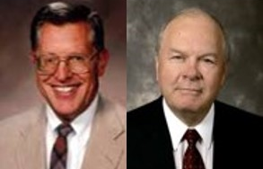
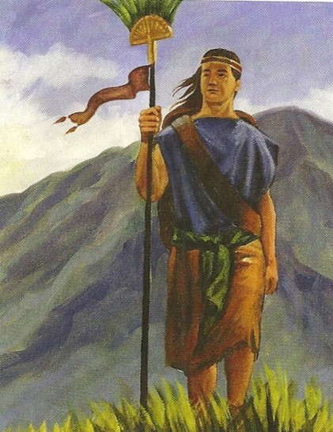
Overzealous
To be overly eager or excessively interested in the pursuit of something
“There is no suggestion in the scriptural text that the Lord approved of this venture.
The spirit was bad among those in the first group attempting to recolonize the land.
An attempt was made to kill Zeniff.
Zeniff suggested that they make a treaty with the Lamanites rather than attack and kill them.
This divided colonizers into two warring factions and resulted in the death of the greater part of their people.
JFM and RLM
Being overzealous and slow to remember the Lord can lead us to make choices that result in negative consequences
James H. Fullmer
Mosiah 9:2-3

Slide 34
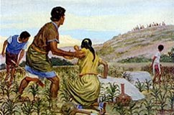
Slow to Remember the Lord
Zeniff returns to Zarahemla to recruit another group
These, we are told “were smitten with famine and sore affliction” because they were slow to remember God, and they and their families were to know little but bondage, death, and difficulty until the time of their repentance and their return to the land of Zarahemla.
Mosiah 9:2-3

Slide 35
Laman
He was king of the Lamanites at the time Zeniff and his followers came up (southward) from Zarahemla around 200 BC
He allowed Zeniff permission to occupy the territory by covenant (Mosiah 9:6)
He held a secret agenda
His people were lazy and idolatrous (Mosiah 9:12)
After 12 years and Zeniff’s people were prosperous, Laman broke his covenant and stirred up his people to war
He died around 178 BC and his son, also named Laman, succeeded him
Mosiah 9:2-3
Who’s Who

Slide 36
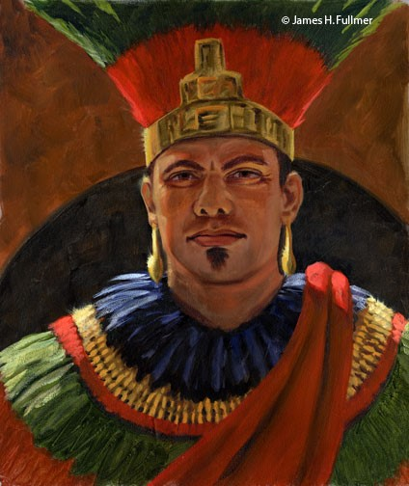
Possession of Land
“And it came to pass that I went again with four of my men into the city, in unto the king, that I might know of the disposition of the king, and that I might know if I might go in with my people and possess the land in peace.”
James H. Fullmer
The King allows Zeniff and his people to posses the land of Lehi-Nephi and the land of Shilom
Mosiah 9:5

Slide 37
Overly Eager
What are the dangers of being overly eager when making decisions?
What are the dangers of making decisions without counseling with the Lord?
Mosiah 9:3

Slide 38
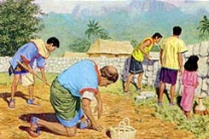
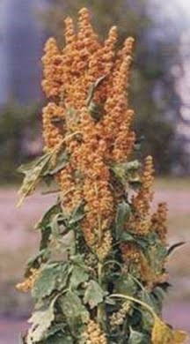
Lamanites Leave, Nephites Build
“And he (Laman) also commanded that his people should depart out of the land, and I and my people went into the land that we might possess it.”
“And we began to build buildings, and to repair the walls of the city, yea, even the walls of the city of Lehi-Nephi, and the city of Shilom.”
“And we began to till the ground, yea, even with all manner of seeds, with seeds of corn, and of wheat, and of barley, and with neas, and with sheum, and with seeds of all manner of fruits; and we did begin to multiply and prosper in the land.”
Neas and sheum: These two grains found in Peru and Ecuador, are indigenous to the region and have been cultivated there for more than 4,000 years, and today are considered nutritionally as supergrains.
Mosiah 9:7-9

Slide 39
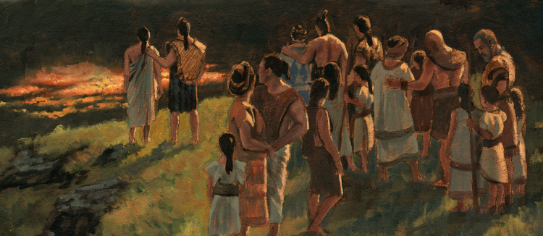
Twelve Years of Prosperity
Zeniff’s people had grown so prosperous that the Lamanite king grew nervous that he wouldn’t be able to bring them into bondage, so he “began to stir up his people that they should contend with [Zeniff’s] people.
Mosiah 9:11-13

Slide 40
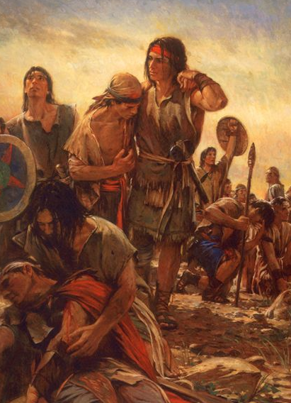
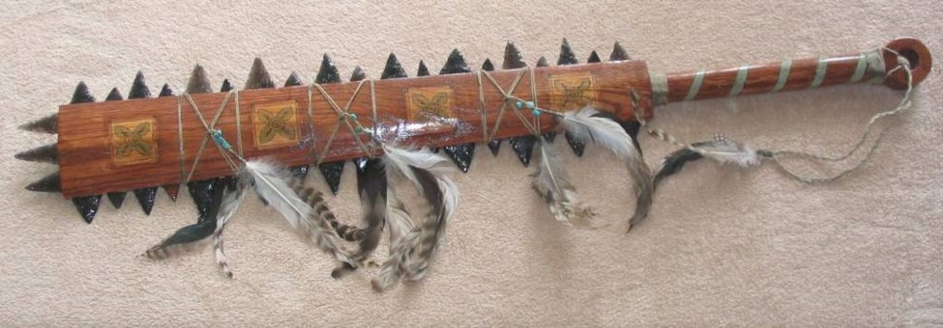
Lamanites Desire What Nephites Have
Zeniff calls the Lamanites: Lazy and idolatrous
They desired the flocks and food the Nephites had which started in warring
In the 13th year of Zeniff’s reign when they were watering and feeding their flocks and tilling their land, the Lamanites came upon them and began to kill them and take their flocks and corn
The people fled to Zeniff for protection
Zeniff armed them with bows, arrows, swords, and cimeters (all manner of weapons) and they went to battle
Mosiah 9:12-16

Slide 41
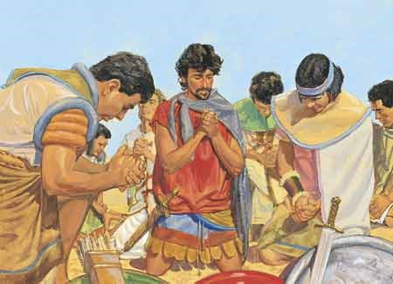
A Key to Victory
“Yea, in the strength of the Lord did we go forth to battle against the Lamanites; for I and my people did cry mightily to the Lord that he would deliver us out of the hands of our enemies, for we were awakened to a remembrance of the deliverance of our fathers.”
The Lord heard their prayers
The Nephites were able to drive the Lamanites back out of their land
They slayed 3,043
Zeniff helped to bury their dead--279
Mosiah 9:17-19

Slide 42
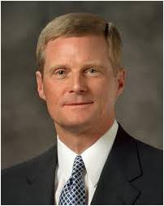
If we pray and go forth in faith, we can face our challenges in the strength of the Lord
“Blessings require some effort on our part before we can obtain them, and prayer, as ‘a form of work, … is an appointed means for obtaining the highest of all blessings’
We press forward and persevere in the consecrated work of prayer, after we say ‘amen,’ by acting upon the things we have expressed to Heavenly Father”
David A. Bednar

Slide 43
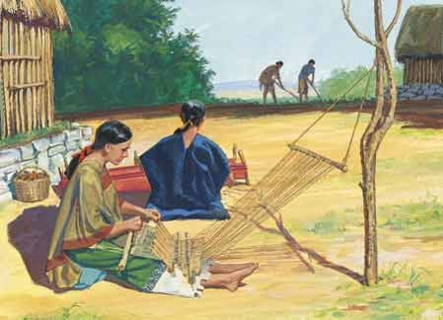
Establishing the Kingdom
Not the Kingdom of God but the community being reestablished by Zeniff in the Land of Lehi-Nephi
Setting guards
Inherit the Land—possessed the land 22 years
Clothed in nakedness—Zeniff’s people clothed themselves in by their own industry; spinning cloth
Laman’s people, who were indolent and idle, ran naked
Mosiah 10:1-5

Slide 44
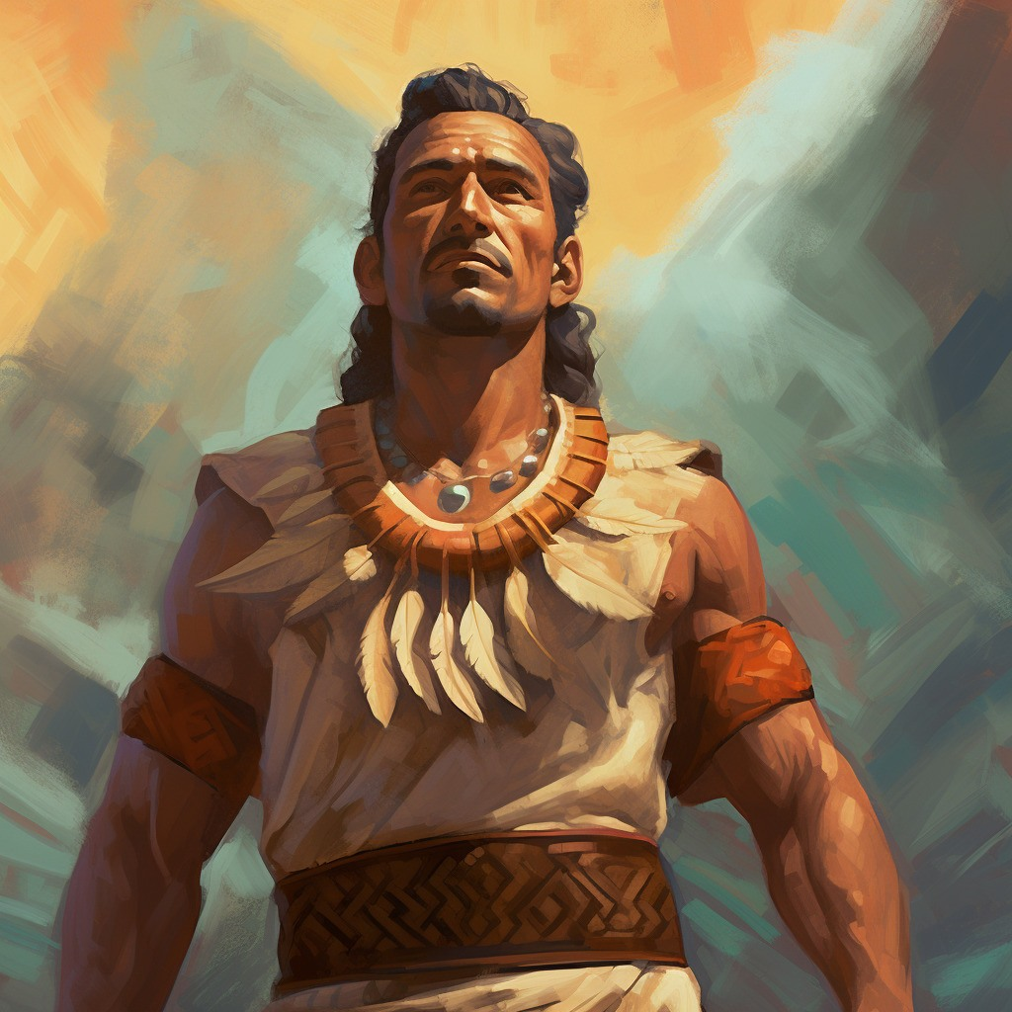
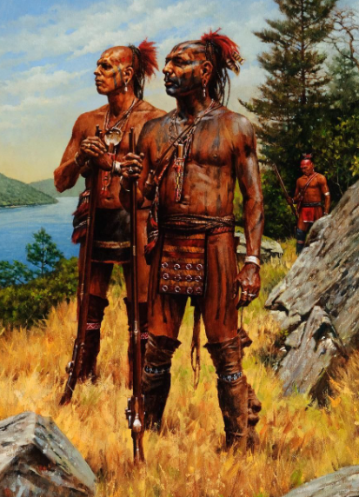
2nd War Against Zeniff’s People
Laman dies and his son, Laman reigned in his stead
Lamanites had all manner of weapons, their heads shaved, and naked with a girdle about their loins
Zeniff hides the women and children in the wilderness
Zeniff prepares the old men (who were able) and the young men to gather together to battle
Zeniff also battles and is of old age
Ranks—according to age
They went up with the strength of the Lord
Mosiah 10:6-10

Slide 45
Laman, Son of King Laman
He was the son of King Laman during the time when Zeniff’s Nephite colony was among the Lamanites at its peak of prosperity
He went up to do battle, but his forces were driven out by the Nephites
Zeniff began to get old, and the kingdom was conferred upon his son, Noah around 160 BC
Noah was wicked and caused that the Nephites be put in bondage and oppression with the Lamanites
Laman brought his forces against the Nephites again after the death of Noah, his son Limhi (who was righteous)
Laman was wounded in the battle, and left for dead
The Nephites bound up his wounds…the two sides returned in peace to their own lands
Who’s Who

Slide 46
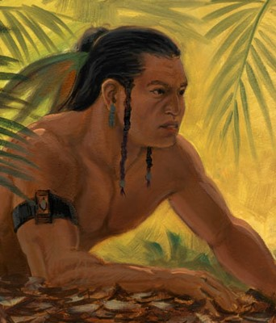
Lamanite’s Wroth
They knew nothing about the Lord
They depended on their own strength
They were wild, ferociaous, blood-thirsty people
Believed in their own traditions
Lamanite perspective against the Nephites:
Taking offense and holding on to anger can prevent individuals and their children from knowing the Lord and His strength
They had been wrongly deprived of their inheritance in Jerusalem
They had been wronged in transit to the New World and during the initial settlement period when Nephi wrested from them their right to leadership
They had been robbed of the plates of brass
Who’s Who
They taught their children to hate the Nephites…do all they can do to destroy them
Mosiah 10:11-18

Slide 47
Those Who Take Offense
As a stake president Elder Bednar would visit people who had stopped coming to church because they had taken offense at the words or actions of another person.
“As we talked, eyes often were moist with tears as these good people recalled the confirming witness of the Holy Ghost and described their prior spiritual experiences. … However, they were not presently participating in Church activities and meetings.
“And then I would say something like this. ‘Let me make sure I understand what has happened to you. Because someone at church offended you, you have not been blessed by the ordinance of the sacrament. You have withdrawn yourself from the constant companionship of the Holy Ghost.
Because someone at church offended you, you have cut yourself off from priesthood ordinances and the holy temple. You have discontinued your opportunity to serve others and to learn and grow. And you are leaving barriers that will impede the spiritual progress of your children, your children’s children, and the generations that will follow.’”
David A. Bednar

Slide 48
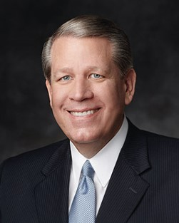
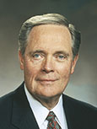
Whom does it hurt when we are angry or refuse to forgive?
How can a person’s anger affect his or her family, now and in the future?
“If you feel you have been wronged, be ready to forgive. If there is, for some reason, an unpleasant memory, let it go. Where necessary, talk to your bishop; talk to your stake president.
“To all, but especially to those who some day will be great-grandfathers and great-grandmothers, your eternal blessings and those of your posterity are far more important than any prideful reason which would deny you and so many others of such important blessings.”
Harold G. Hillam
“If you feel you have been wronged—by anyone (a family member, a friend, another member of the Church, a Church leader, a business associate) or by anything (the death of a loved one, health problems, a financial reversal, abuse, addictions)—deal with the matter directly and with all the strength you have. … And, without delay, turn to the Lord. Exercise all of the faith you have in Him. Let Him share your burden. Allow His grace to lighten your load. … Never let an earthly circumstance disable you spiritually.”
Donald L. Hallstrom

Slide 49
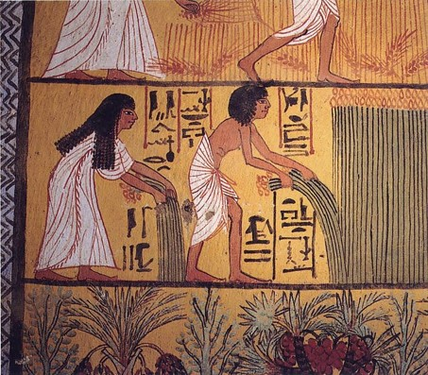
Victory Once Again
They did drive the Lamanites out of their land
They slew a great many of them—so many that they did not number them
They returned to their land and began to take care of their flocks and till their ground
Zeniff is old and confers the kingdom upon one of his sons (Noah)
Mosiah 10:19-22

Slide 50
Sources:
The Book of Mormon Who’s Who by Ed J. Pinegar and Richard J. Allen pg 101-102, 195
Joseph Fielding McConkie and Robert L. Millet Doctrinal Commentary on the Book of Mormon Vol. 2 pg. 194
David A. Bednar, “Ask in Faith,” Ensign or Liahona, May 2008, 95;
“And Nothing Shall Offend Them,” Ensign or Liahona, Nov. 2006, 89
Donald L. Hallstrom (“Turn to the Lord,” Ensign or Liahona, May 2010, 80).
Harold G. Hillam, “The Worth of Souls,” Ensign or Liahona, May 2005, 32

Slide 51
 | ZENIFF AND HIS PEOPLE | THE LAMANITES
What did the people do to prepare? | Mosiah 9:14–16; 10:1–2, 7, 9–10 (They armed themselves and went to battle.) | Mosiah 10:6–8 (They armed themselves and went to battle.)
What did they do to put their trust in the Lord? | Mosiah 9:17 (They prayed and remembered that the Lord had delivered their ancestors.) | Mosiah 10:11 (Nothing. They relied on their own strength.)
What was the result? | Mosiah 9:18; 10:20 (The Lord strengthened them, and they were successful in driving the Lamanites out of their land.) | Mosiah 10:19–20 (The Lamanites were driven from the land with a great slaughter.)
 | ZENIFF AND HIS PEOPLE | THE LAMANITES
What did the people do to prepare? | Mosiah 9:14–16; 10:1–2, 7, 9–10 (They armed themselves and went to battle.) | Mosiah 10:6–8 (They armed themselves and went to battle.)
What did they do to put their trust in the Lord? | Mosiah 9:17 (They prayed and remembered that the Lord had delivered their ancestors.) | Mosiah 10:11 (Nothing. They relied on their own strength.)
What was the result? | Mosiah 9:18; 10:20 (The Lord strengthened them, and they were successful in driving the Lamanites out of their land.) | Mosiah 10:19–20 (The Lamanites were driven from the land with a great slaughter.)

Slide 52
The Wandering Nephites
200 B.C. to 121 B.C.
Destroyed Jaredite Nation
Land of Zarahemla
Mulek 589 BC
Mosiah l
King Benjamin
Mosiah ll
Jaredite plates discovered and returned to Limhi…5
Alma & his people escape back to Zarahemla…8
2
Ammon and Limhi escape to Zarahemla…7
Mosiah I…1
Zeniff…3
Ammon…6
Jerusalem
Lehi & Nephi 600 BC
Mosiah 1 and righteous Nephites
Zeniff
King Noah
King Limhi
Land of Lehi-Nephi
City of Helam
About 200 BC
Alma escapes…4
Waters of Mormon
1. Mosiah I leads the few remaining righteous Nephites from the original land settled by Lehi to the Land of Zarahemla (Omni 1:3)
2. (About 200 BC ill fated expedition to return to Lehi-Nephi. Contention and infighting. All slain in the wilderness except 50 who return to Zarahemla (Omni 1:28) (Mosiah 9:1-3)
3. Zeniff leads a second expedition (abt. 200 BC) to Lehi-Nephi and settles there with the permission of King Laman (Mosiah 9: 3-10)
4. (about 148 BC) Alma flees King Noah to the Waters of Mormon (Mosiah 17 and 18)
5. (about 121 BC) King Limhi sends expedition of 43 men to find Zarahemla in hopes of escaping Lamanite bondage. They find remnants of Jaredites and 24 gold plates and return to Land of Lehi-Nephi (Mosiah 6: 7-8)
6. (About 121 BC) Ammon’s expedition (16 “Strong Men”) to find Zeniff’s colony (Mosiah 7)
7. (About 121-120 BC) King Limhi’s people get the Lamanites drunk and escape back to Zarahemla (Mosiah 22)
8. (Between 145 and 121 BC) Alma and his people escape Lamanites and return to Zarahemla (Mosiah 24)

