Slide 1
Enos, Jarom, Omni, and Words of Mormon

Slide 2
And My Soul Did Hunger
Enos

Slide 3
Enos
He was the grandson of Sariah and Lehi, and the son of Jacob
He was a nephew of Nephi
He lived about 544 to 421 BC
He was a Nephite
He kept the records handed down to him by Jacob
He demonstrated an important lesson on prayer, repentance, and revelation
He heard the voice of the Lord
He prayed earnestly for his brethren the Lamanites and the Nephites
The Book of Enos is the first to describe in detail the apostate condition of the descendants of Laman and Lemuel (see Enos 1:20).
The Small Plates

Slide 4
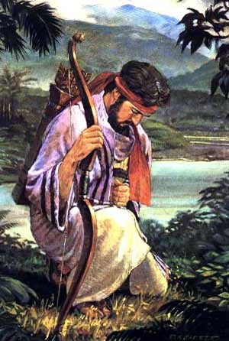
The Book of Enos—Small Plates
The Book of Enos illustrates the power of the Atonement of Jesus Christ to cleanse people from sin and make them whole. Enos wrestled before God in mighty prayer before his sins were forgiven.
He then prayed for the spiritual welfare of the Nephites and the Lamanites, and he spent the remainder of his life laboring for their salvation.
The Book of Enos

Slide 5
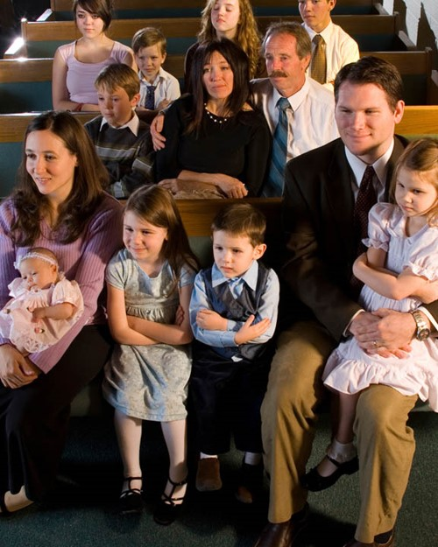
Who Are These Records For?
When Enos received the small plates from his father, he promised to engrave only the writings that he considered to be most precious, which included sacred teachings, revelation, and prophecy.
Enos knew that his people, the Nephites, eventually would be destroyed.
He prayed that the Lord would preserve a record of the Nephites “that it might be brought forth at some future day unto the Lamanites, that, perhaps, they might be brought unto salvation” (Enos 1:13).
Enos 1:1; Jacob 1:1-4; 7:27

Slide 6
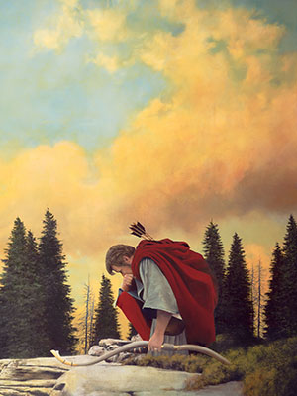
“Wrestle With God”
Enos did not physically wrestle with God.
The record states that Enos wrestled before God in prayer.
Such wrestling is the struggle to find and express one’s real desires under the inspiration of the Holy Ghost.
Praying in this manner requires that a person eliminate vain, trite, or insincere repetitions and to pour the deepest desires of his or her heart into words.
…an expression of yearning and desire to do God’s will.
“for we know not what we should pray for as we ought: but the Spirit itself maketh intercession for us with groanings which cannot be uttered”
(Romans 8:26).
Enos 1:2-4
Book of Mormon Student Manual

Slide 7
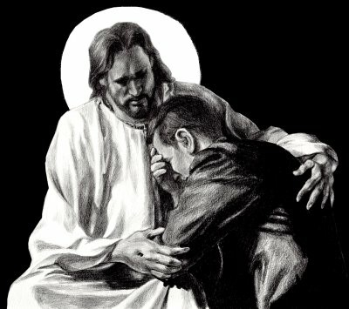
My Soul Hungered
Spiritual Emptiness:
Anxious feeling
Questionable testimony
Knowing that repentance is required
Longing for a spiritual experience
Physical Hunger:
A Feeling of emptiness
Pain
Weakness
A desire to be full
Enos 1:4

Slide 8
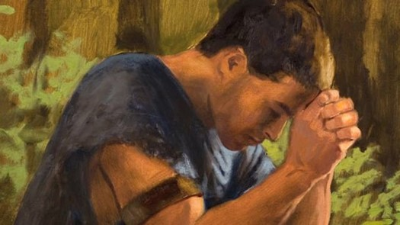
A Desire
What Enos Desired
Enos 1:2
Enos 1:3
What Enos Did
Enos 1:2
Enos 1:4
Enos 1:8
Results of what Enos Did
Enos 1:5
Enos 1:6
Enos 1:8
Remission of Sins
Eternal Life
Joy of the Saints
Wrestled--prayed
Kneeled down before his Maker
Prayed all day long
Raised his voice to the heavens
Had faith in the Lord
His sins were forgiven
His guilt was swept away
His faith had made him whole
Enos 1:2-8

Slide 9
Desires Today
Our Desires
What Can We Do?
What will be the results?
Remission of Sins
Eternal Life
Joy for our families and friends
Pray with real intent
Kneel down in private
Submit your will to the Lord
Pray out loud
Praise Him in song
Have Faith in the Lord
Our sins will be forgiven
We will no longer feel guilty
Through our faith in Jesus Christ we will be made whole
Enos 1:2-8

Slide 10
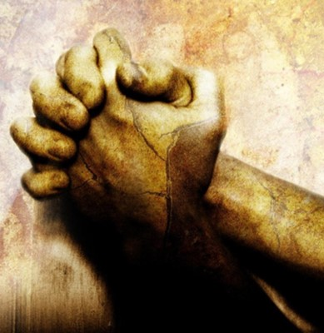
Spiritually Empty and Seeking Forgiveness
Why does sin cause us to feel spiritually empty?
Sin causes the Holy Ghost to withdraw from us and we feel distanced from the Lord.
In what ways can we show our sincerity as we seek the Lord’s forgiveness?
Our prayers may not need to be as long as Enos’, but they need to be sincere.

Slide 11
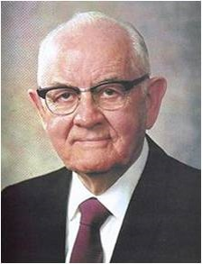
Remission of Sins
Enos did not mention the nature or extent of his sins, but rather described the process of repentance that we must each undertake to receive divine forgiveness.
President Spencer W. Kimball taught:
“I have always loved the story of Enos, who had great need. Like all of us—for none of us is perfect—he had strayed. How dark were his sins I do not know, but he wrote, ‘I will tell you of the wrestle which I had before God, before I received a remission of my sins’. …
“What a blessing and a joy for each of us to know that our Father lives and that he loves us, that he forgives us when repentance is forthcoming, that he is ever willing to help and give love to his beloved children.”
As we exercise faith in Jesus Christ, our sins can be forgiven of our sins, and we can be made whole
Enos 1:2

Slide 12
“Once we have truly repented, Christ will take away the burden of guilt for our sins. We can know for ourselves that we have been forgiven and made clean. The Holy Ghost will verify this to us; He is the Sanctifier. No other testimony of forgiveness can be greater.”
Enos 1:2
Dieter F. Uchtdorf

Slide 13
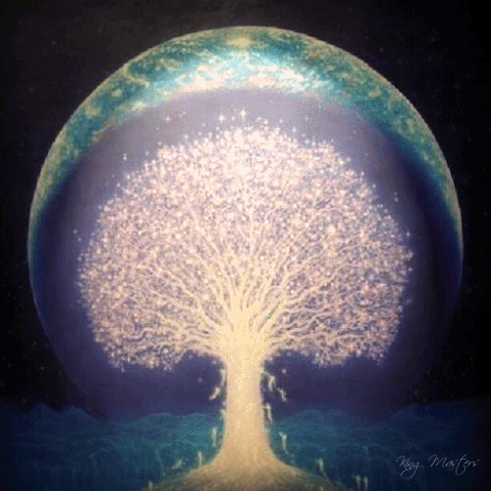
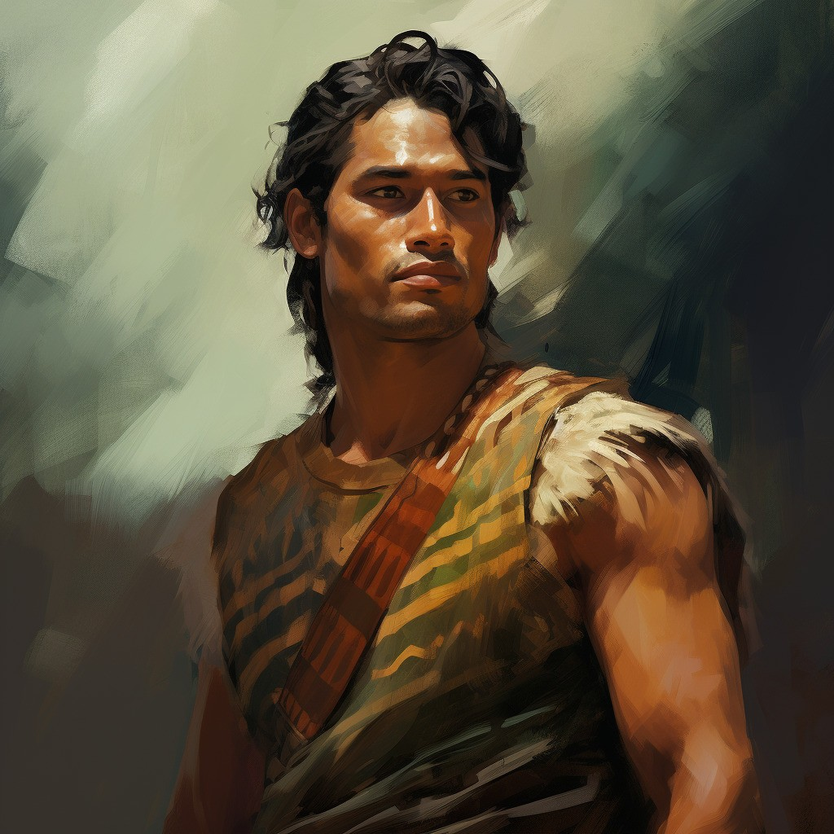
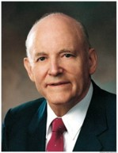
The Welfare of My Brethren
When Lehi partook of tree of life—his thought
went immediately to his family, he was
desirous for them also to have the fruit (truth).
When Enos tasted of the goodness of God, he sought above all else that the promise given Joseph be given him that his brethren may share in the goodness of God also.
“Any time we experience the blessings of the Atonement in our lives, we cannot help but have a concern for the welfare of our brethren. …
“A great indicator of one’s personal conversion is the desire to share the gospel with others”
Howard W. Hunter
Enos 1:9-10; 1 Nephi 8:12

Slide 14
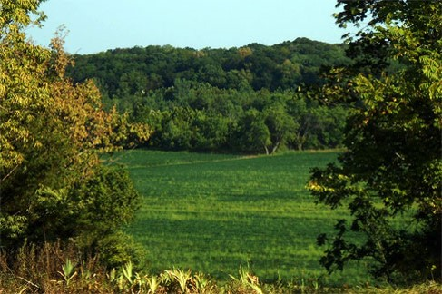
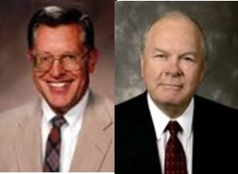
Voice—Revelation—of the Lord’s Promise
Holy Land—the promised land a land which is consecrated, dedicated, and set apart, a land blessed by the hand of the Lord for his service and his purposes.
JFM and RLM
Adam-ondi-Ahman—a place of New Jerusalem.
The birthplace of the book of Mormon and Restoration
JFM and RLM
Enos 1:11

Slide 15
Labor—the Power in Prayer
“There is a power in the prayer of the humble and diligent servant never to be known by the great master of eloquence who has not learned the grace of service and humility.”
JFM and RLM
The Savior taught:
“‘When thou prayest, thou shalt not be as the hypocrites are: for they love to pray standing in the synagogues and in the corners of the streets, that they may be seen of men. …
“‘But thou, when thou prayest, … pray to thy Father which is in secret; and thy Father which seeth in secret shall reward thee openly. …”
Matthew 6:5-6
“Those who obtain the promise of the Lord that they will receive according to their desires are those who have so attuned themselves with the mind and will of God”
JFM and RLM
Enos 1:12

Slide 16
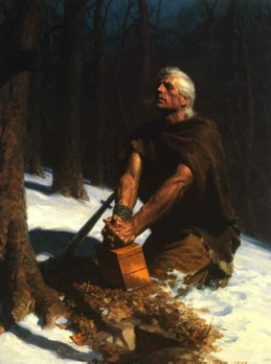
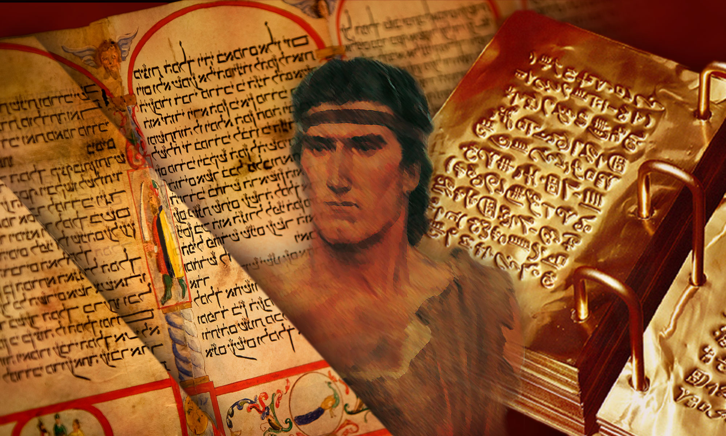
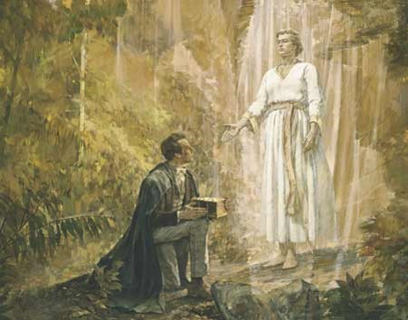
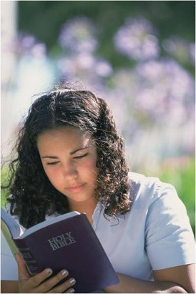
The Gift by the Power of God
The Book of Mormon declares itself to have come forth by the “gift and power of God.”
This is a treasure to those descendants of Lehi and the family of Joseph
The book comes by the power of God
It is written by the power of God
It is preserved by the power of God
It is brought forth by the power of God
And it is only understood by the power of God
The Promise:
Read D&C 10:47-52
Enos 1:13-18

Slide 17
Like Enos…
Enos prayed for the Lamanites, who were considered his enemies.
The Lord answers our prayers according to our faith and diligence
I desire to receive a remission of my sins. I will show the Lord that I am sincere in this desire by…
I desire to help my family members and friends come unto Christ. One person I will seek to help is…I will seek to help this person by…
I want to show the Lord’s love toward those who are unkind to me. One way I will do this is…

Slide 18
Faithfully Taught—and Testimony
Throughout all his days Enos taught and prophesied to a ‘stiffnecked’ people (Enos 1:26)
His joy was full
He had been true and faithful in all things
He magnified his calling
“Then shall I see his face with pleasure, and he will say unto me: Come unto me, ye blessed, there is a place prepared for you in the mansions of my Father” (Enos 1:27).
Before his death, Enos passed the small plates of Nephi to his son Jarom (Jarom 1:1).
The Small Plates
Enos 1:19-27

Slide 19
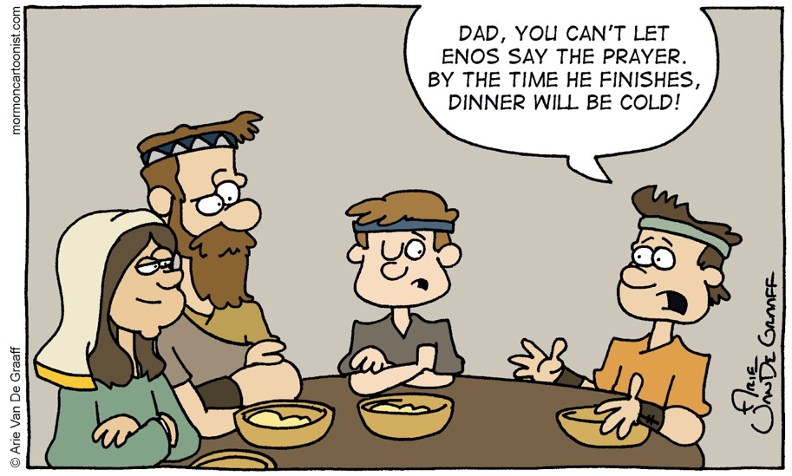
Sources:
Book of Mormon Student Manual, (2009), 130–35
Spencer W. Kimball Pray Always Ensign, Oct. 1981, 6.
Dieter F. Uchtdorf, “Point of Safe Return,” Ensign or Liahona, May 2007, 101).
Joseph Fielding McConkie and Robert L. Millet Doctrinal Commentary on the Book of Mormon Vol. 2 pg. 98-99
The Teachings of Howard W. Hunter, ed. Clyde J. Williams [1997], 248–49).
Presentation by ©http://fashionsbylynda.com/blog/

Slide 20
Faith in the Lord is trust in the Lord. We cannot have true faith in the Lord without also having complete trust in the Lord’s will and in the Lord’s timing. As a result, no matter how strong our faith is, it cannot produce a result contrary to the will of Him in whom we have faith. Remember that when your prayers do not seem to be answered in the way or at the time you desire. The exercise of faith in the Lord Jesus Christ is always subject to the order of heaven, to the goodness and will and wisdom and timing of the Lord. When we have that kind of faith and trust in the Lord, we have true security and serenity in our lives. (Dallin H. Oaks, “The Atonement and Faith” [address given at the seminar for new mission presidents, June 2001])
The object of our prayers should not be to present a wish list or a series of requests but to secure for ourselves and for others blessings that God is eager to bestow, according to His will and timing. Every sincere prayer is heard and answered by our Heavenly Father, but the answers we receive may not be what we expect or come to us when we want or in the way we anticipate. …
Prayer is a privilege and the soul’s sincere desire. We can move beyond routine and “checklist” prayers and engage in meaningful prayer as we appropriately ask in faith and act, as we patiently persevere through the trial of our faith, and as we humbly acknowledge and accept “not my will, but Thine, be done.” (David A. Bednar, “Ask in Faith,” Ensign or Liahona, May 2008, 97)

Slide 21
Jarom and Omni

Slide 22
Jarom
He was the great grandson of Sariah and Lehi
He was the grandson of Jacob and son of Enos
He was a record keeper of the small plates of Nephi around 420 to 361 BC
Jarom is the shortest book in the Book of Mormon
He declines his own personal words of inspiration
(Jarom 1:2)
He described the ‘hardness of hearts’ of the people
He had the spirit of prophecy and revelation
He counsels Omni, his son, to read large plates for further history of the people

Slide 23
Book of Jarom
Written in commandment from his father.
Written for the benefit of his brethren the Lamanites.
Jarom did not record his own prophecies and revelations because he felt that his father’s revelations were sufficient.
He described labors of the Nephite leaders during the time of his ministry.
Jarom observed that when the people chose to follow the counsel of their righteous leaders, they prospered and were able to fortify themselves against the Lamanites.
The Book of Jarom
Jarom’s Testimony:
“The word of the Lord was verified, which he spake unto our fathers, saying that: Inasmuch as ye will keep my commandments ye shall prosper in the land” (Jarom 1:9)

Slide 24
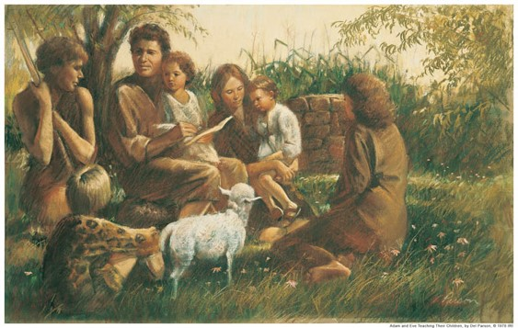
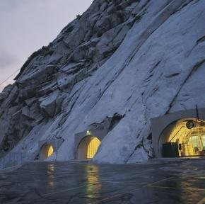
Records
Adam—kept a record of faithful descendants =
A Book of Remembrance
The Nephites who kept the record even at this early period understood that it would be for the benefit of the Lamanites
The Church keeps similar records today D&C 85
The Church urges us to keep our own personal family records
Jarom 1:2 Book of Mormon Student Manual and JFM and RLM

Slide 25
Apostasy
Apostasy was rampant among the Nephites
Hardness of Hearts
Deafness of Ears
Blindness of Mind
Stiffness of Necks
However:
God is merciful and hasn’t swept them off the face of the earth yet
Jarom 1:3 Book of Mormon Student Manual and JFM and RLM

Slide 26
Believers
200 years had past
There was a strong group of believers who communed with the Holy Spirit and kept the commandments.
The faithful will not be without revelation
Without the Spirit we can neither preach or teach the gospel.
Without revelation there can be no religion
Jarom 1:4-5 Book of Mormon Student Manual and JFM and RLM

Slide 27
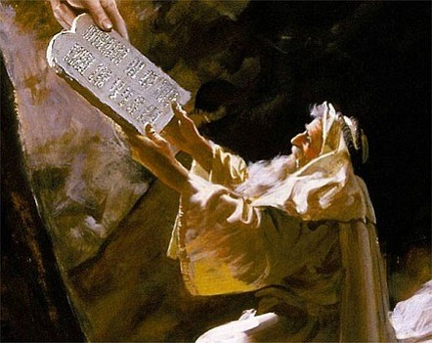
Law of Moses Kept
The Nephite laws were exceedingly strict
Our obligation to keep the Sabbath holy is a part of the fulness of the gospel (D&C 59:9-14)
“Some have falsely supposed that Sabbath observance commenced with the law of Moses. This is not the case. The commandment given on Sinai was to “remember the sabbath day” –beginning on the 7th day. (Genesis 2:2-3)
To profane is to pollute…to violate…to desecrate that which is sacred
Jarom 1:5 Book of Mormon Student Manual and JFM and RLM

Slide 28
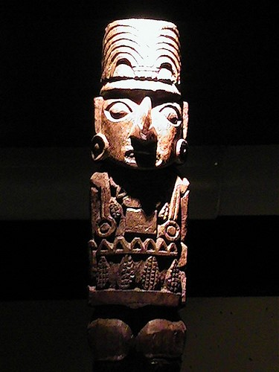
Idolatry
Drink the Blood of their beasts--The Lamanites were worshiping physical idols and images of their own making
The Lamanites were more numerous than the Nephites and had degenerated into a primitive state of existence.
“To create one’s own god is to have control over the demands, and appetites of that god. It is said that religion is the system in which man serves a higher will, while magic is a system whereby man attempts to control higher powers. Such is the distinction that exists between true religion and idolatry.”
Jarom 1:6 Book of Mormon Student Manual and JFM and RLM

Slide 29
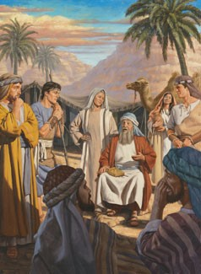
Great Leaders
“…it was not mighty warriors, men mighty in strength, but men mighty in the faith of the Lord that consistently led the Nephites to victory over their enemies, the Lamanites.”
The Nephites were led by men of great righteousness and thus prevailed in battle
Faith in God is a weapon more to be feared than the sharpness of a sword or the muscle and sinew that wields it (3 Nephi 3:19)
Jarom 1:7, 10-12 Book of Mormon Student Manual and JFM and RLM

Slide 30
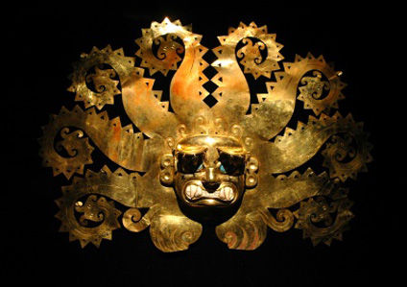
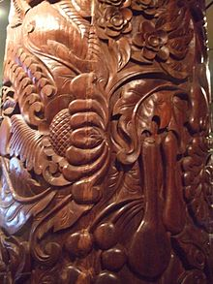
Exceedingly Rich
The Nephites expanded far beyond a simple agricultural form of society
Rich in gold and silver
Precious things
Fine workmanship of wood
Building and machinery
Tools (iron, copper, brass and steel) for the ground and for war
Those who are a righteous people will prosper in the land…
“And inasmuch as ye shall keep my commandments, ye shall prosper, and shall be led to a land of promise; yea, even a land which I have prepared for you; yea, a land which is choice above all other lands.” 1 Nephi 2:20
Jarom 1: 8 Book of Mormon Student Manual and JFM and RLM

Slide 31
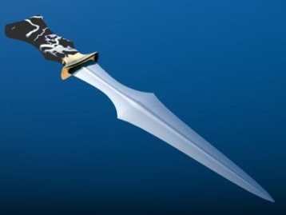
The Word of God
Only constant preaching kept the Nephites from being destroyed by the Lamanites.
Jarom says that their prophets “did prick their hearts with the word”
Prick:
The word of God is “quick and powerful, sharper than a two-edged sword, to the dividing asunder of both joints and marrow” (D&C 6:2)
It was this principle that later motivated Alma to resign the position of chief judge in order to preach the gospel
(Alma 4:19; 31:5)
Jarom 1:12 Book of Mormon Student Manual and JFM and RLM

Slide 32
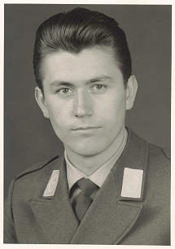
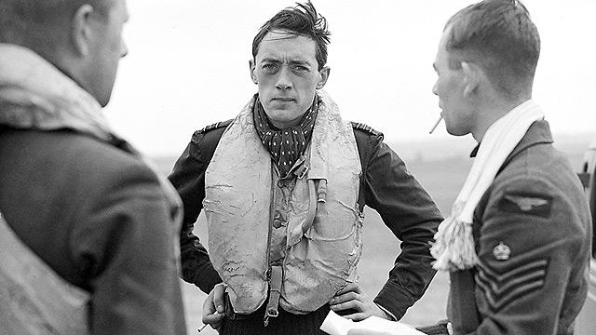
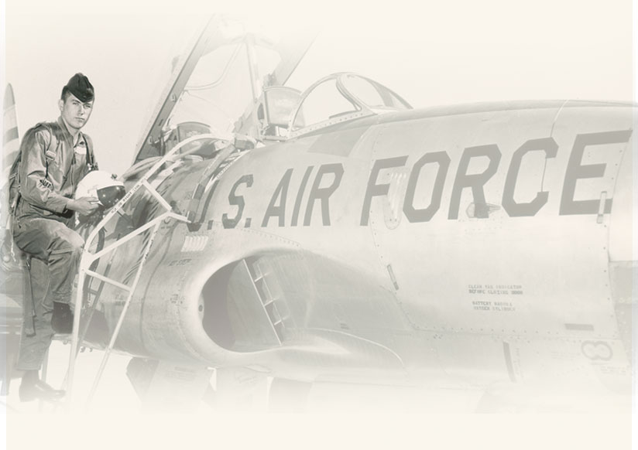
Dieter F. Uchtdorf
“I remember when I was preparing to be trained as a fighter pilot. We spent a great deal of our preliminary military training in physical exercise. I’m still not exactly sure why endless running was considered such an essential preparatory part of becoming a pilot. Nevertheless, we ran and we ran and we ran some more.
“As I was running I began to notice something that, frankly, troubled me. Time and again I was being passed by men who smoked, drank, and did all manner of things that were contrary to the gospel and, in particular, to the Word of Wisdom.
“I remember thinking, ‘Wait a minute! Aren’t I supposed to be able to run and not be weary?’ But I was weary, and I was overtaken by people who were definitely not following the Word of Wisdom. I confess, it troubled me at the time. I asked myself, was the promise true or was it not?”

Slide 33
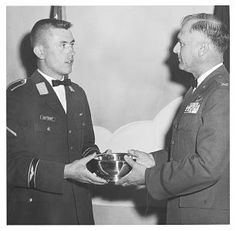
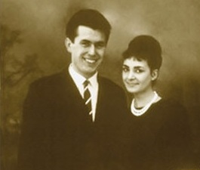
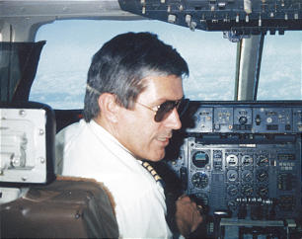
Dieter F. Uchtdorf Story Continues….
“The answer didn’t come immediately. But eventually I learned that God’s promises are not always fulfilled as quickly as or in the way we might hope; they come according to His timing and in His ways.
Years later I could see clear evidence of the temporal blessings that come to those who obey the Word of Wisdom—in addition to the spiritual blessings that come immediately from obedience to any of God’s laws.
Looking back, I know for sure that the promises of the Lord, if perhaps not always swift, are always certain.”
Dieter F. Uchtdorf—actual pictures

Slide 34
Omni
He was the grandson of Enos and son of Jarom
His record was recorded around 361 BC
He preserved the genealogy and records for 44 years during turmoil and warfare
He had not ‘kept statutes and commandments’ as he should have
He was a defender of his people

Slide 35
Records Handed Down
Son of Omni
Brother of Amaron
The Small Plates of Nephi
The Small Plates of Nephi
Amaron
Son of Chemish
Chemish
Son of Abinadom
Abinadom
Approximately between 500 – 130 BC
Amaleki

Slide 36
Book of Omni
The book of Omni was written by five different men:
Omni, Amaron, Chemish, Abinadom, and Amaleki.
Each added small entries and the last entry of the small plates
Omni spans a longer period of time than any other book in the small plates.
Abinadom’s son Amaleki wrote most of the book of Omni and was the last person to write on the small plates of Nephi. He entrusted the plates to King Benjamin.
Omni wrote for the benefit of his descendants. The next three writers in the book of Omni do not address a particular audience or state a purpose for their writing. But Amaleki’s invitation for all people to “come unto Christ … and partake of his salvation” (Omni 1:26) indicates that he was concerned about the salvation of those who would read his words.
The Book of Omni

Slide 37
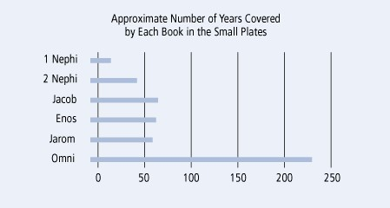
The Small Plates of Nephi

Slide 38
Other Facts on the Book of Omni
Omni is the first book in the Book of Mormon to mention the Jaredites. It also mentions that some Nephites left Zarahemla to return to the land of Nephi, foreshadowing the events recounted in Mosiah 7–24.
The Book of Omni also provides details about the reign of the first King Mosiah, who was the father of King Benjamin and grandfather of the second King Mosiah.
The first King Mosiah led the righteous Nephites out of the land of Nephi and united them with the people of Zarahemla.
The Book of Omni relates that the Lord guided the people of Zarahemla (also known as the Mulekites) from Jerusalem to the land of promise not long after Lehi and his family departed from Jerusalem.
The Book of Omni
Finally, the Book of Omni introduces King Benjamin and explains why Amaleki entrusted him with the sacred records.
Omni 1:12–23, 25; Mosiah 7-24

Slide 39
Omni Writes
Omni writes only the first 3 verses:
He refers to himself as “a wicked man” because he had not kept the statues and commandments of the Lord
“It need not be supposed from such an admission that he was guilty of any gross immorality, but rather that he was not zealous in honoring the law of Moses and in keeping other religious obligation.”
Not living by the Spirit will cause you to not be prepared to teach or write after the manner of the Spirit…therefore he found it necessary to pass the plates to his son, Amaron
Omni 1:1-3 JFM and RLM

Slide 40
Amaron and Chemish Write
Amaron writes of the destruction of the more wicked part of the Nephites.
Amaron understood that:
Those who acknowledge the hand of the Lord in all things find evidence of His word in all things.
Chemish was the Brother of Amaron.
Chemish watched as Amaron wrote on the same day that Amaron turned the plates to Chemish.
Chemish also keeps the record according to the commandments of our fathers
Omni 1:4-9 JFM and RLM

Slide 41
Abinadom Writes
Abinadom announced that the other authors were sufficient and passed the plates to his son Amaleki
Abinadom was saying that there had been no revelation given at this time period.
Would you hand down information or records that you haven’t written about?
The tradition to hand down records was still in effect with Abinadom even though nothing was added spirituality to it.
Omni 1:10-11 JFM and RLM

Slide 42
Amaleki Writes
Mosiah’s discovery of the Mulekites, a people who had fled Jerusalem in the days of King Zedekiah
Mosiah’s kingship over the Land of Zarahemla
Amaleki introduces a new epoch in the history of the Nephite peoples.
Taking refuge in the wilderness—a clear separation from the powers, authorities, and influences of worldly societies
Symbolic—among the children of God might find it necessary to leave the refinements of the world and find refuge in the simplicity of that which God created
How can you take yourself “away from it all”?
Omni 1:12-24 JFM and RLM

Slide 43
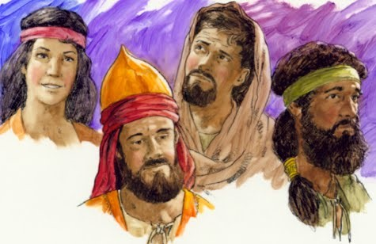
Zarahemla
Zarahemla was a descendant of Mulek, son of Zedekiah
Mosiah 25:2
They brought no records with them
They were taught in the language of Mosiah and Zarahemla gave him his genealogy of his fathers and are written on the large plates
The people of Zarahemla and the people of Mosiah joined together, and Mosiah was appointed King.
Omni 1:14-19 JFM and RLM

Slide 44
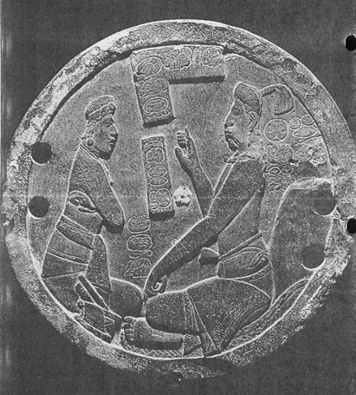
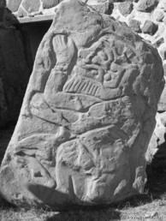
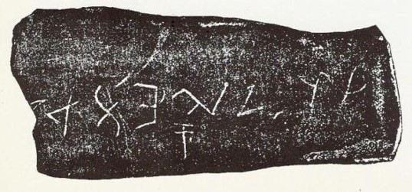
The Stone
“And it came to pass in the days of Mosiah, there was a large stone brought unto him with engravings on it; and he did interpret the engravings by the gift and power of God.”
Mosiah, by the power of the Holy Spirit, was able to read this stone.
Omni 1:20 JFM and RLM

Slide 45
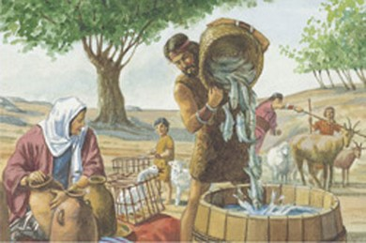
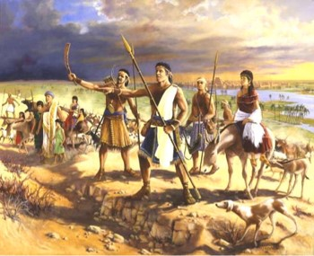
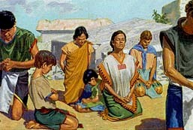
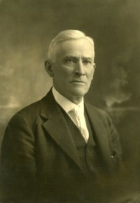
Peoples in Americas
After King Mosiah and his followers fled the land of Nephi, they discovered a group of people who were called the people of Zarahemla (also called the Mulekites).
Besides the Mulekites, Lehi’s group, and the Jaredites, there were likely other groups of people who came to the American continent.
“We must be careful in the conclusions that we reach. The Book of Mormon teaches the history of three distinct peoples … who came from the old world to this continent. It does not tell us that there was no one here before them. It does not tell us that people did not come after. And so if discoveries are made which suggest differences in race origins, it can
very easily be accounted for, and reasonably, for we do believe that other people came to this continent.”
Anthony W. Ivins
Omni 1:14-19

Slide 46
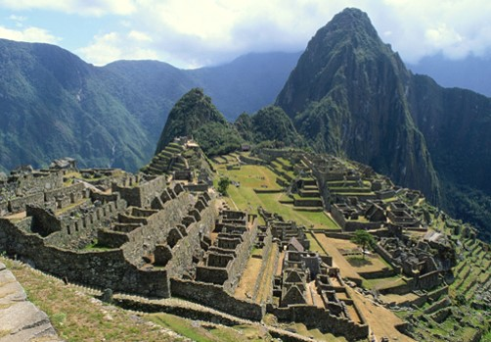
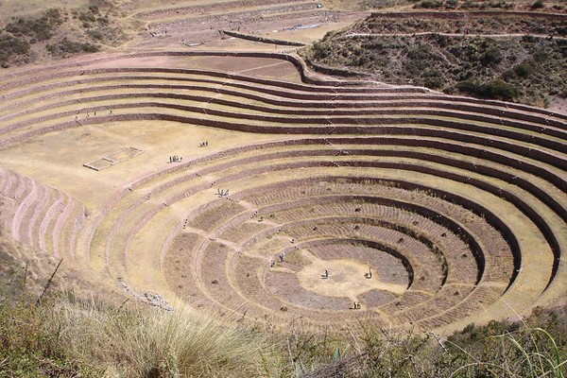
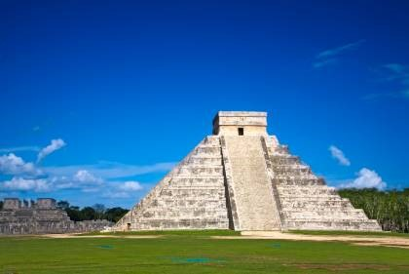
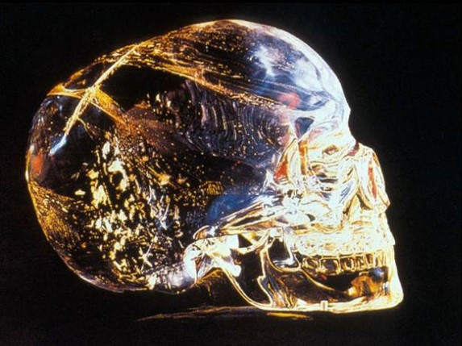
The Book of Mormon does not claim to be the record of all peoples who inhabited the ancient Americas. Besides the Jaredites, Mulekites, and Lehi’s group, there were likely other groups of people who came to the American continent.
Omni 1:14-19

Slide 47
Coriantumr
Land of Desolation
The people of Zarahemla encountered Coriantumr, who was one of the last two survivors of the Jaredite nation (the other was the prophet Ether).
Land of Desolation= “bones lay scattered”—Jaradite People—they were destroyed
There were two groups from Zarahemla who attempted to return to the land of Nephi.
The first group failed and went back to Zarahemla.
As Amaleki closed his record, he mentioned that he did not know the fate of the second group.
Land of Zarahemla
West Sea
Land of Nephi
Land of First Inheritance
Omni 1:20-22, 29-30

Slide 48
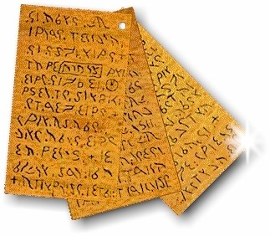
An Invitation
Amaleki concluded his record.
He wrote an important invitation to those who would read his words.
Believe in the prophesying…
revelation…
ministering of angels…
gift of speaking with tongues…
gift of interpreting languages….
believing all things which are good…
All Good comes from the Lord
“And now, my beloved brethren, I would that ye should come unto Christ, who is the Holy One of Israel, and partake of his salvation, and the power of his redemption. Yea, come unto him, and offer your whole souls as an offering unto him, and continue in fasting and praying, and endure to the end; and as the Lord liveth ye will be saved.”
Omni 1:25-26

Slide 49
Come Unto Him
If we come unto Christ and offer our whole souls unto Him, we will be saved.
Partake of His Salvation
The Power of Redemption
“When we covenant to live the law of sacrifice we are announcing that our sacrifice will in like manner be one of complete submission and total dedication.”
JFM and RLM

Slide 50
Sources:
Book of Mormon Student Manual Religion 121-122 pg. 147
Joseph Fielding McConkie and Robert L. Millet Doctrinal Commentary on the Book of Mormon Vol. 2 pg. 106-110
Dieter F. Uchtdorf (“Continue in Patience,” Ensign or Liahona, May 2010, 58
Anthony W. Ivins (in Conference Report, Apr. 1929, 15).
Presentation by ©http://fashionsbylynda.com/blog/

Slide 51
Come Unto Christ:
Each of us is to come to Christ with … uncompromised commitment to His gospel. … In the vernacular of today’s youth, we are to declare ourselves “all in.” (Jeffrey R. Holland, “The Greatest Possession,” Liahona, Nov. 2021, 8)
Sacrifice:
\Real, personal sacrifice never was placing an animal on the altar. Instead, it is a willingness to put the animal in us upon the altar and letting it be consumed! (Neal A. Maxwell, “Deny Yourselves of All Ungodliness,” Ensign, May 1995, 68)
Giving our Will to the Lord:
Giving our will to the Lord is something we do every day. It is not an isolated act. It is not the end, but just the beginning. We can say what He wants said. We can do what He wants done. We can be a witness to the world of God’s Beloved Son—all because we want to do these things. When this change happens in our heart, our gratitude for the Atonement increases so much that we are strengthened by it continually. (Russell T. Osguthorpe, “I Will Give Myself to Him” [Church Educational System devotional for young adults, Nov. 3, 2013])
Submit to God:
As you submit your wills to God, you are giving Him the only thing you can actually give Him that is really yours to give. (Neal A. Maxwell, “Remember How Merciful the Lord Hath Been,” Ensign, May 2004, 46)

Slide 52
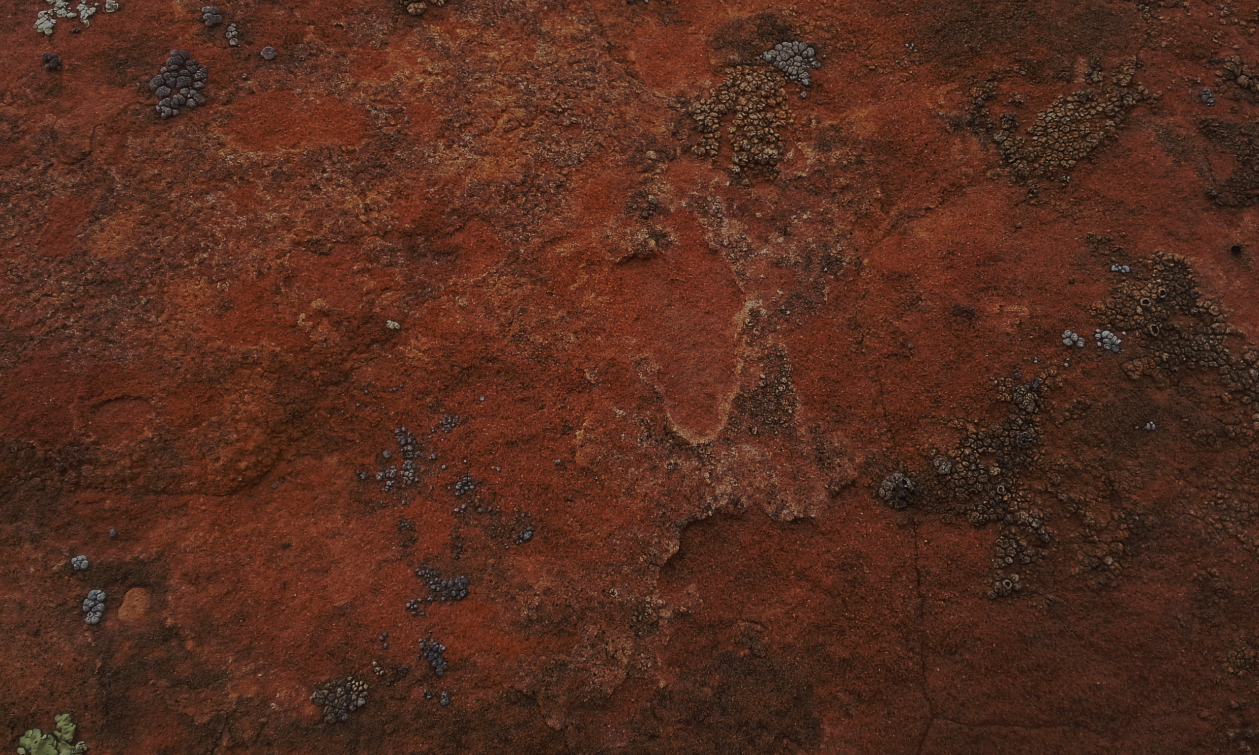
Words of Mormon
A Bridge Between the Small and Large Plates
The Small Plates of Nephi
The Large Plates of Nephi
Mormon discovered the small plates of Nephi after he had already made an abridgment of part of the Nephite records.

Slide 53
This Book
Serves as a bridge between the small plates of Nephi (1 Nephi–Omni) and Mormon’s abridgment of the large plates of Nephi (Mosiah–4 Nephi).
An understanding of which records Mormon abridged as he compiled the Book of Mormon.
This Book also introduces the faith and accomplishments of King Benjamin.
Who wrote this book?
Mormon
He was a prophet, a record keeper, and the abridger and compiler of the Book of Mormon.
He was also a righteous father and a military
leader among the Nephites.
The prophet Moroni was his son.

Slide 54
On a Scale of 1-10
1
10
I believe in God.
I believe that He knows all things and has all power.
I believe that He prepares a way for me to succeed in my life.
I feel I can trust the counsel and promptings He gives me through the Holy Ghost.

Slide 55
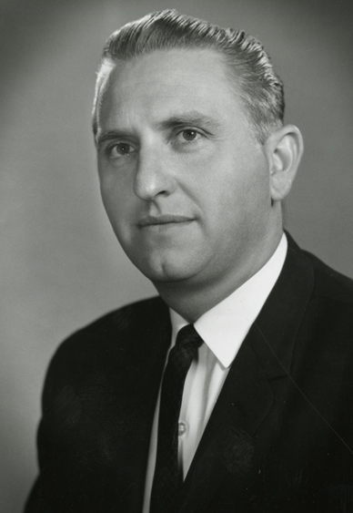
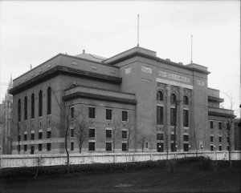
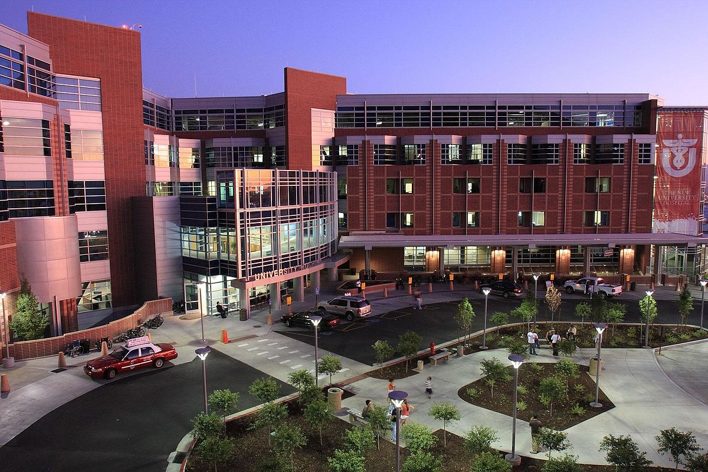
A Prompting
“On one occasion many years ago, I was swimming laps at the old Deseret Gym in Salt Lake City when I felt the inspiration to go to the University Hospital to visit a good friend of mine who had lost the use of his lower limbs because of a malignancy and the surgery which followed.
I immediately left the pool, dressed, and was soon on my way to see this good man…” Thomas S. Monson

Slide 56
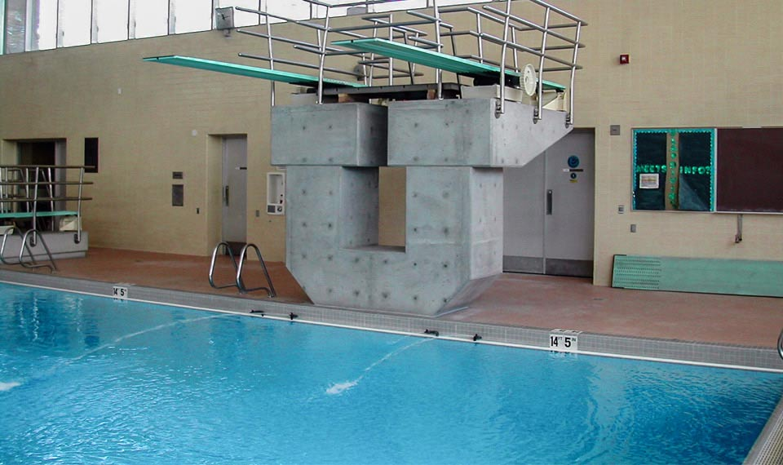
“When I arrived at his room, I found that it was empty. Upon inquiry I learned that I would probably find him in the swimming pool area of the hospital, an area which was used for physical therapy.
Such turned out to be the case. He had guided himself there in his wheelchair and was the only occupant of the room. He was on the far side of the pool, near the deep end. I called to him, and he maneuvered his wheelchair over to greet me. We had an enjoyable visit, and I accompanied him back to his hospital room, where I gave him a blessing.
“I learned later from my friend that he had been utterly despondent that day and had been contemplating taking his own life. He had prayed for relief but began to feel that his prayers had gone unanswered. He went to the pool with the thought that this would be a way to end his misery—by guiding his wheelchair into the deep end of the pool. I had arrived at a critical moment, in response to what I know was inspiration from on high.
“… How pleased I am to have been an instrument in the Lord’s hands on that critical day at the swimming pool.”
Thomas S. Monson

Slide 57
Spiritual promptings are often quiet feelings or thoughts and that it may sometimes be difficult to know whether thoughts that we have come from us or from the Holy Ghost. Either way, if we have a thought or feeling to do something good, we should do it.
Mormon followed a prompting from the Spirit even though he did not understand all the reasons why he needed to do it.

Slide 58
Future Audience
Mormon addressed a future audience, with hope that his writings and the writings of his son Moroni “may profit them” (Words of Mormon 1:2).
Specifically, he wrote for the benefit of the Lamanites.
“My prayer to God is concerning my brethren, that they may once again come to the knowledge of God, yea, the redemption of Christ; that they may once again be a delightsome people”
Mormon wrote this book in about AD 385, after having “witnessed almost all the destruction of [his] people, the Nephites”
Mormon did not record where he was when he wrote this book.
Words of Mormon
Words of Mormon 1:1-2, 8

Slide 59
500 Years After Amaleki
This short book interrupts the chronological order of books at the beginning of the Book of Mormon.
In this book, Mormon briefly explains his compilation and abridgment of the records of his people.
Remember that the Lord commanded Nephi to make two sets of plates for a “special” and “wise” purpose (see 1 Nephi 9:3, 5). One set of plates, often called the large plates, contained the secular history of the Nephites, while the other set, often called the small plates, contained a sacred record of the Nephites’ preaching, revelations, and prophecies (see 1 Nephi 9:2–4; Jacob 1:3–4).
Mormon discovered the small plates of Nephi after he had already made an abridgment of part of the large plates (see Words of Mormon 1:3).
Guided by the Spirit of the Lord, Mormon included the small plates with his abridgment of the large plates. He did this “for a wise purpose,” according to the Lord’s will (see Words of Mormon 1:4–7).
The Small Plates of Nephi
The Large Plates of Nephi

Slide 60
Joseph Smith Translated the Book
Joseph Smith started with Mormon’s abridgment of the large plates of Nephi—the secular history.
Martin Harris, who was the Prophet’s scribe for this portion of the translation, lost 116 pages of the manuscript.
The Lord revealed to Joseph Smith that wicked men had obtained those pages and changed the words (see D&C 10:8–10).
If Joseph had translated the same material again, those men would have claimed that he was not a prophet because he could not translate the book the same way twice (see D&C 10:11–19).
The Lord told Joseph not to translate that part again but to translate the small plates of Nephi that Mormon had included with his abridgment of the large plates (see D&C 10:30–45).
Thus, Words of Mormon helps us see how the Lord prepared a way to frustrate the
plan of wicked men and to include scripture that not only covered the same time
period as the lost manuscript but provided “greater views upon
[the Lord’s] gospel” (D&C 10:45).
The Large Plates of Nephi

Slide 61
Mormon
He was born around AD 310
At 10 years of age, he was visited by Ammaron (the Prophet who had the responsibility of the records) and gave Mormon the records (Mormon 1:2)
The following year Mormon was taken to Zarahemla by his father, also called Mormon
At age 15 he was visited by Jesus (Mormon 1:15)
He commanded the Nephite forces from the time he was sixteen until the final battle at Cumorah (Mormon 2:1-2)
At age 24 he went and got the plates and started to abridge the Nephite records
He was chosen to finalize the ultimate structure and content of the Book of Mormon, with the help of his son, Moroni
He witnessed the destruction of nearly a half million of his people
(Mormon 6)
Mormon was killed by the Lamanites around AD 385 (Mormon 8:3,5) leaving Moroni to finish the work of the Lord
Who’s Who

Slide 62
From Lehi to Benjamin
Two Assignments
Continue to record his own days on the large plates
He was to abridge the large plates themselves, writing this abridged record on what we now call the plates of Mormon
Words of Mormon 1:1-3

Slide 63
Intent and Choice
These things--Small Plates
To persuade men and women to come unto the God of their fathers and be saved.
The details of the story of the Nephites from the days of Amaleki to the end of Benjamin’s reign (and the coronation of his son, Mosiah) are on the large plates
100th part
Choosing those principles which are most important
When someone writes in their journal and records how they felt, they usually write what is most important to them
Words of Mormon 1:4-5

Slide 64
A Wise Purpose--Influence of the Holy Ghost
Mormon included prophecies and revelations with his collection for “a wise purpose” in the Lord
The Lord Knows all things, has all power, and prepares a way to accomplish His works.
Book of Lehi
The Lord instructed Nephi to begin the small plates and Mormon to include the small plates, this because He knew that through the machinations (schemes) of the ungodly the 116 pages of manuscript would be lost to the Prophets Joseph Smith.
Mormon had perfect confidence in the power of the Book of Mormon to turn men to Christ; to touch the hearts of sincere reader; to make all men “a delightsome people”
Words of Mormon 1:6-8

Slide 65
Records Preserved--Men Judged
Mormon knew that records had been preserved and that they would be preserved in the future
Mormon testifies that his brethren will be judged in the last days
“Men are judged according to the light and knowledge they have received”
D&C 20:13-14
Members of the Church
In the dispensation of the fulness of times will be judged by the doctrines and standards set forth in the Bible, the Book of Mormon, The Doctrine and Covenants, the Pearl of Great Price, and words of the living oracles
JMF and RLM
Words of Mormon 1:11

Slide 66
King Benjamin
Mormon said a few things about King Benjamin:
The contentions with his own people
The contentions with the Lamanites
King Benjamin is best remembered as a powerful spiritual figure and also a courageous defender of the liberties of his people.
The Sword of Laban
King Benjamin led armies to battle against the Lamanites and wielded the sword with his own arm in their defense
Words of Mormon 1:12-14

Slide 67
False Christs
“A false Christ is not a person. It is a false system of worship; a false church…”
Bruce R. McConkie
The Savior warns us against false Christs:
“…there shall arise false Christs, and false prophets, and shall shew great signs and wonders; insomuch that, if it were possible, they shall deceive the very elect.”
Matthew 24:24
Mormon recognizes that through all of King Benjamin’s labors the people did once again establish peace in the land
Words of Mormon 1:15-18

Slide 68
Sources:
Thomas S. Monson, “Consider the Blessings,” Ensign or Liahona, Nov. 2012, 87
Joseph Fielding McConkie and Robert L. Millet Doctrinal Commentary on the Book of Mormon Vol. 2 pg. 123
Bruce R. McConkie Millennial Messiah pg 47-48
Who’s Who (Book of Mormon) Ed J. Pinegar and Richard J. Allen pg 122-123
Presentation by ©http://fashionsbylynda.com/blog/

Slide 69
Increasing a desire to respond to spiritual promptings:
We must be confident in our first promptings. Sometimes we rationalize; we wonder if we are feeling a spiritual impression or if it is just our own thoughts. When we begin to second-guess, even third-guess, our feelings—and we all have—we are dismissing the Spirit; we are questioning divine counsel. …
If we pay attention to the promptings that come to us, we will grow in the spirit of revelation and receive more and more Spirit-driven insight and direction. The Lord has said, “Put your trust in that Spirit which leadeth to do good” [Doctrine and Covenants 11:12]. (Ronald A. Rasband, “Let the Holy Spirit Guide,” Ensign or Liahona, May 2017, 95–96)

Slide 70
Mosiah 1
Were it Not For These Plates

Slide 71
Mosiah
Mosiah was the father to King Benjamin and grandfather to Mosiah II and a descendent of Lehi
He lived in the southern area of the country where Lehi and his group from Jerusalem had first settled in the Promised Land.
He was warned of the Lord to leave the land (the land of Nephi) and fled north to Zarahemla
He and his followers discovered a people who were descendants of Mulek, the lone surviving son of King Zedekiah of Judah (Omni 1:16)
Mosiah carried the sacred records to preserve the written language of his forebears and the record of God’s dealing with His people
He was active around 279 BC to 130 BC and the people brought to him a “large stone” displaying engravings that Mosiah was able to interpret. The stone told of the last days of Coriantumr, the final Jaredite ruler, who had been discovered by the people of Zarahemla and dwelt among them for the better part of a year
He was appointed king over the people and his son, King Benjamin, was his successor
Who’s Who

Slide 72
King Benjamin
He was the son of the first Mosiah who was commanded of the Lord to depart from the land of Nephi.
He received custody of the sacred records from Amaleki and established peace in the land of Zarahemla
He taught his three sons, Mosiah II, Helorum, and Helaman the importance of the scriptures
He led armies to battle against the Lamanites and wielded the sword (the sword of Laban) with his own arm in their defense
He was one of the most beloved and oft-quoted personalities in the Book of Mormon
His discourse to his people, given about 124 BC, describes a Christ-centered life of service and spiritual integrity
Through revelation, his discourse is one of the most celebrated gospel sermons ever recorded (Mosiah 2:17)
Before his death he appointed Mosiah II to be king of the land and he gave the people a new name: “The name of Christ”
Who’s Who

Slide 73
Mosiah ll
Mosiah was a son of King Benjamin.
He was named after his grandfather Mosiah, who was also a king of Zarahemla (see Omni 1:12–13, 19).
He was 30 years old when he began his reign as king, and he was the last of the Nephite kings.
He was taught by his father in the ways of the Lord
Mosiah was a prophet, seer, revelator, and king who ruled in Zarahemla from approximately 124 to 91 BC
Because of his gift to translate ancient records his people benefited from the history of God’s peoples over the ages
He gave authority to Alma the Elder to organize 7 congregations in Zarahemla (Mosiah 25:19-24)
He had 4 sons—Ammon, Aaron, Omner, and Himni
He originated the program to have governing judges instead of kings
He died at age 63 (Mosiah 29:46)

Slide 74
Book of Mosiah
The book is named for Mosiah, who was a son of King Benjamin.
Mormon compiled and abridged the records of several other writers to create
the Book of Mosiah.
Mormon drew from a number of records to compile the Book of Mosiah. He abridged and quoted from the record kept by Mosiah on the large plates of Nephi, which detailed the history of the Nephite’s in the land of Zarahemla (see Mosiah 1–7; 25–29).
He also drew from the record of Zeniff, which recounts the history of Zeniff’s people from the time they left Zarahemla until they returned (see Mosiah 7–22).
Mormon quoted from and abridged portions of the writings of Alma, who preserved the words of Abinadi and kept a record of his own people (see Mosiah 17:4; 18; 23–24).
The Book of Mosiah
Written about 200 to 91 BC

Slide 75
The Mission Statement
The book of Mosiah includes two discourses on the mission of Jesus Christ:
The words of King Benjamin in Mosiah 2–5
and the words of Abinadi in Mosiah 12–16.
Mosiah is the first book that is an abridgement from the large plates of Nephi
The Book of Mosiah teaches about the abilities of a seer
The Book of Mosiah teaches about separate Nephite groups—those in Zarahemla, and in the Land of Nephi—Zeniff, Noah, Limhi, Alma, and Abinidi
The Book of Mosiah introduces the “Reign of the Judges”

Slide 76
What would your life be like without the scriptures?
The Holy Bible
The
Book
of
Mormon
ANOTHER TESTAMENT
OF JESUS CHRIST
Mosiah 1:2

Slide 77
“Don’t yield to Satan’s lie that you don’t have time to study the scriptures.
Choose to take time to study them.
Feasting on the word of God each day is more important than sleep, school, work, television shows, video games, or social media.
You may need to reorganize your priorities to provide time for the study of the word of God. If so, do it!”
Richard G. Scott
If we do not read the scriptures continually, then we can gradually lose our faith. We will profit by searching the scriptures diligently
Mosiah 1:2

Slide 78
King Benjamin Teaches His Sons
To learn from the scriptures in the language of his fathers
To learn about the commandments of God
That the records are true
To search them diligently
Keep the commandments and
Prosper in the land
The Brass Plates
The Best Memory is no match for the written word
Mosiah 1:2-8

Slide 79
Responsibility of Parents
Teach their children the commandments of God
“Parenting is a godly responsibility necessary for the salvation of Father’s children and important for our preparation for eternal blessings.”
Patricia P. Pinegar
“You need more than your own wisdom in rearing [your children]. You need the help of the Lord. Pray for that help and follow the inspiration which you receive”
Gordon B. Hinckley
“And they shall also teach their children to pray, and to walk uprightly before the Lord”
(D&C 68:28).
“But ye will teach them to walk in the ways of truth and soberness; ye will teach them to love one another, and to serve one another”
(Mosiah 4:15).
Our Family Book
Passing the torch:
Each generation passes the “truth and light” to their children
Mosiah 1:4

Slide 80
Before I Die
Three years prior to his death Adam called the righteous of his posterity to a grand council
“…he called Seth, Enos, Cainan, Mahalaleel, Jared, Enoch, and Methuselah, who were all ªhigh priests, with the residue of his posterity who were righteous, into the valley of ^{b}Adam-ondi-Ahman, and there bestowed upon them his last blessing.”
D&C 107:53
“And Jacob (Israel)called unto his sons, and said, Gather yourselves together, that I may tell you that which shall befall you in the last days.”
Genesis 49
“And Joseph said unto his brethren, I die, and go unto my fathers; and I go down to my grave with joy. …” JTS Genesis 50:24

Slide 81
Last Blessings
“And this is the blessing, wherewith Moses the man of God blessed the children of Israel before his death.”
Deut. 33
“…that he waxed old, and he saw that he must very soon go the way of all the earth; therefore, he thought it expedient that he should confer the kingdom upon one of his sons.
Therefore, he had Mosiah brought before him; and these are the words which he spake unto him, saying: My son, I would that ye should make a proclamation throughout all this land among all this people, or the people of Zarahemla,…”
Mosiah 1:9-10

Slide 82
To Be A King and A Ruler
Mosiah is asked to make a proclamation to all his people—the people of Zarahemla
He was asked to gather all the people in the land
Then Mosiah was designated a king and a ruler
Mosiah 1:10

Slide 83
A Name Be Given
A name that they may be distinguished above all the people
Christ—
”anointed one”
Those upon whom the title is properly conferred are rightful heirs of the powers and privileges associated with the name
Conditions of acquiring this name:
Those who are righteous and keep the law of all covenant, contracts, bonds, etc that are sealed by the Holy Spirit of promise.
See D&C 132:7
Mosiah 1:11-12

Slide 84
Christ—
”anointed one”
“As his followers, we cannot do a mean or shoddy or ungracious thing without tarnishing his image. Nor can we do a good and gracious and generous act without burnishing more righty the symbol of him whose name we have taken upon ourselves.”
Gordon B. Hinckley
Mosiah 1:11-12

Slide 85
Questions Mosiah 1:10-18
What announcement did King Benjamin plan to make about his son Mosiah?
To make Mosiah a King and a Ruler over the people
What did King Benjamin say about “a name” to distinguish the people?
That they were diligent in keeping the commandments
Why hadn’t the Nephites been destroyed by the Lamanites?
The Lord had ‘extended his arm’ in the preservation of their fathers and they had been faithful
What objects did King Benjamin ask Mosiah to take care of?
The plates of Nephi, the Sword of Laban, and the ball or director (Liahona)
Mosiah 1:10-18

Slide 86
Sources:
Patricia P. Pinegar Caring for the Souls of Children April 1997 Gen. Conf
Gordon B. Hinckley (“The Fabric and Faith of Testimony,” Ensign, Nov. 1995, 89).
Be Thou An Example pg 90
Who’s Who in the Book of Mormon by Ed J. Pinegar and Richard J. Allen
Richard G. Scott, “Make the Exercise of Faith Your First Priority,” Ensign or Liahona, Nov. 2014, 93).
Presentation by ©http://fashionsbylynda.com/blog/

