Slide 1

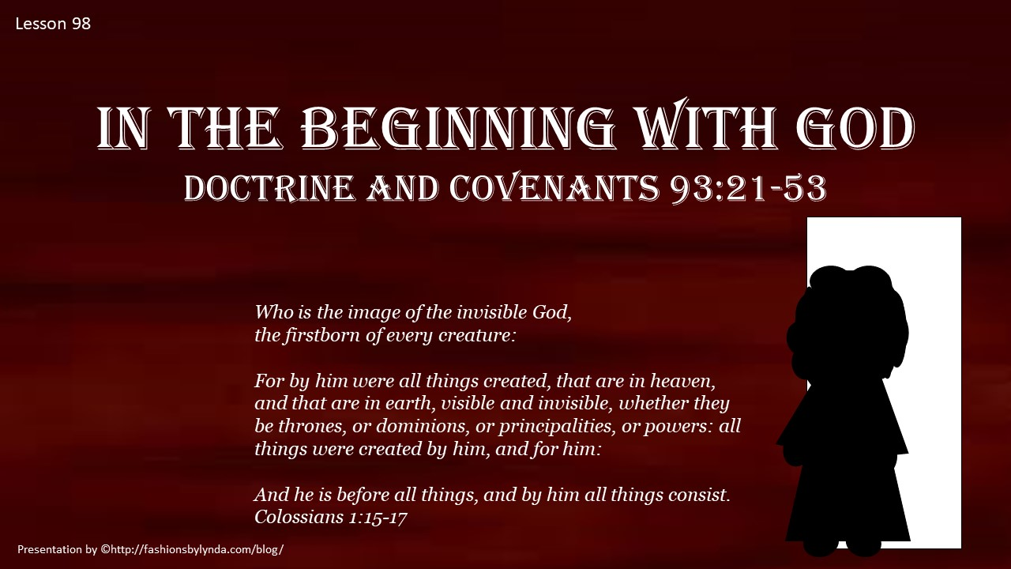
Doctrine and Covenants 93:19-53
In the Beginning With God
Presentation by http://fashionsbylynda.com/blog/

Slide 2
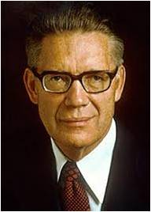
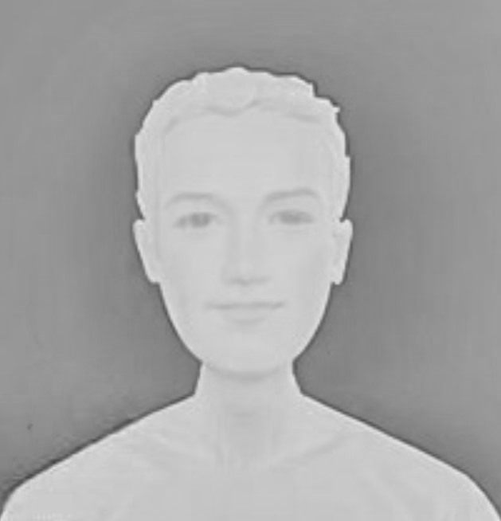

Know How and What to Worship
“Perfect worship is emulation.
We honor those whom we imitate.
The most perfect way to worship is to be holy as Jehovah is holy. It is to be pure as Christ is pure.
It is to do the things that enable us to become like the Father.
The course is one of obedience.”
Bruce R. McConkie
The Savior teaches that men and women must also receive “grace for grace,” the Savior is teaching that humanity is an embryonic form of divinity—and that all men and women have the potential to become like God.
D&C 93:19 Casey Paul Griffiths

Slide 3
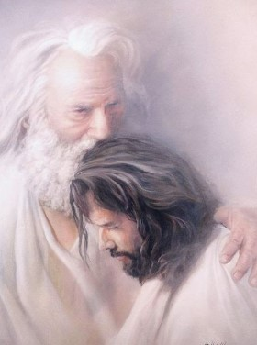
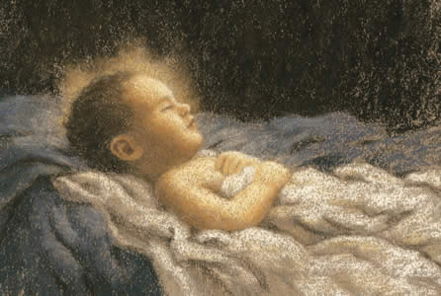

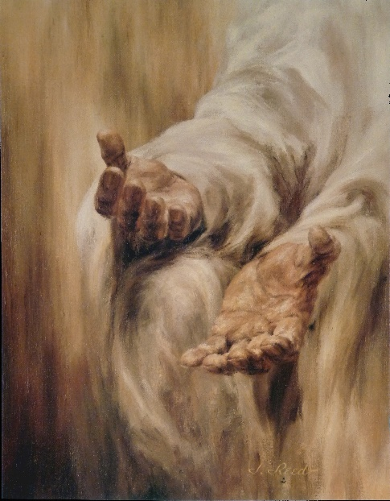
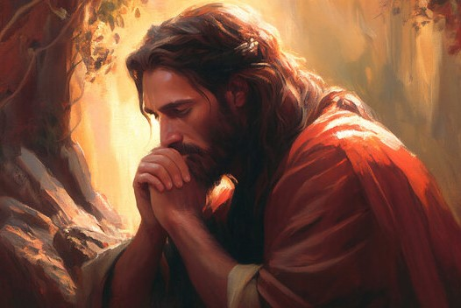
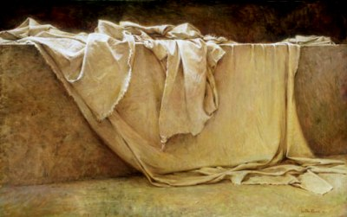
Grace for Grace
Christ was “in the beginning” with the Father; that he is “the Redeemer of the world,” and the light and life of men; that he “dwelt in the flesh” as “the Only Begotten of the Father”; that in his mortal progression “he received not of the fulness at the first, but continued from grace to grace”; and that finally, in the resurrection, “he received a fulness of the glory of the Father; And he received all power, both in heaven and on earth, and the glory of the Father was with him, for he dwelt in him.”
Bruce R. McConkie
D&C 93:20

Slide 4
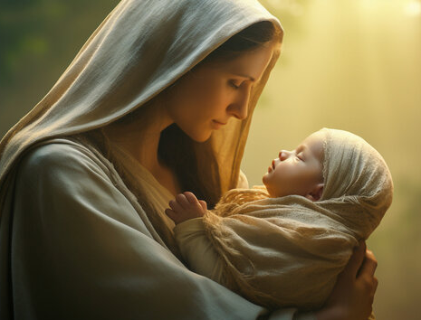
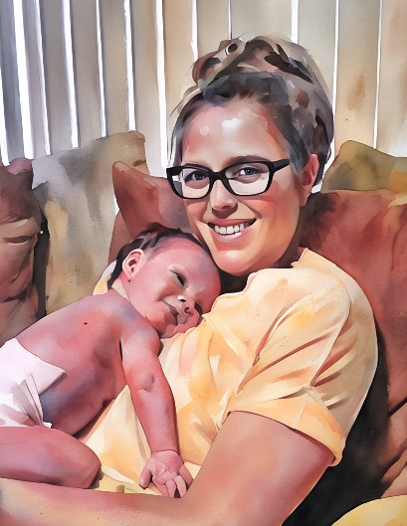
Jesus is the First Born
1901—Church Presidency
“Jesus…is the firstborn among all the sons of god—the first begotten in the spirit, and the only begotten in the flesh. He is our elder brother, and we, like him are in the image of God.”
Who is the image of the invisible God, the firstborn of every creature:
Colossians 1:15
Not only that He was in the beginning with God but also that we were in the beginning with God.
Ye were also in the beginning with the Father; that which is Spirit, even the Spirit of truth;
D&C 93:21-23

Slide 5


Ye—All Heavenly Father’s Children
The word beginning may refer to the time when we began as the spirit offspring of God or to the time when the earth began as a temporal sphere.
The Lord used the word beginning only because finite mortals cannot grasp completely that all things are eternal.
The Prophet Joseph Smith taught that the intelligent part of man has always existed: “The spirit of man is not a created being; it existed from eternity, and will exist to eternity. Anything created cannot be eternal.”
“Clearly, Man was in the beginning “with the Father.” as was the Son.”
Smith and Sjodahl
D&C 93:23 Student Manual

Slide 6
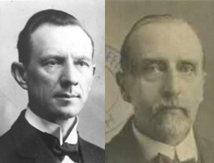

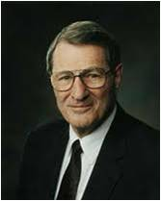
What is Truth?
“To know things as they are, as they were, and as they will are to come”
Smith and Sjodahl
“The definition of truth given in 1833 about things ‘as they are,’ ‘as they were,’ and ‘as they are to come’ is related to another scripture: ‘… for the Spirit speaketh the truth and lieth not.
Wherefore, it speaketh of things as they really are, and of things as they really will be … plainly, for the salvation of our souls. …’
Jacob 4:13.
The gospel of Jesus Christ and The Church of Jesus Christ of Latter-day Saints deal plainly with realities—‘things as they really are,’ and ‘things as they really will be.’”
Neil A. Maxwell
D&C 93:24

Slide 7

The Liar
“whatsoever is more or less than this” -- Satan seeks to distort and diminish our knowledge of the truth
Wherefore, because that Satan rebelled against me, and sought to destroy the agency of man, which I, the Lord God, had given him, and also, that I should give unto him mine own power; by the power of mine Only Begotten, I caused that he should be cast down; Moses 4:3
Heavenly Father allows Satan and Satan's followers to tempt us as part of our experience in mortality—but who allows us to be deceived? We Do!
D&C 93:25

Slide 8


The Spirit of truth
The Savior is the Spirit of Truth
“The fullness of truth—man may also receive truth and light, until he is glorified in truth and like the Lord, eventually may know all things.
For those only who keep the full law and are obedient to all covenants and commandments.”
The fullness of truth cannot come to the inhabitants of the terrestrial or the telestial world.”
D&C 93:26 Smith and Sjodahl

Slide 9
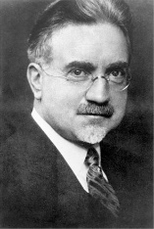


Intelligence of Man
“Intelligence as used by Latter-day Saints has two chief meanings. …
First, a man who gathers knowledge and uses it in harmony with the plan of salvation is intelligent. He has intelligence. …
Second, the word when preceded by the article an, or used in the plural as intelligences, means a person, or persons, usually in the spiritual estate. Just as we speak of a person or persons, we speak of an intelligence, or intelligences.”
Elder John A. Widtsoe
Now the Lord had shown unto me, Abraham, the intelligences that were organized before the world was; and among all these there were many of the noble and great ones;
And God saw these souls that they were good, and he stood in the midst of them, and he said: These I will make my rulers; for he stood among those that were spirits, and he saw that they were good; and he said unto me: Abraham, thou art one of them; thou wast chosen before thou wast born.
Abraham 3:22-23
D&C 93:29

Slide 10


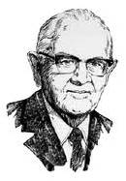
In That Sphere
“We learn about these absolute truths by being taught by the Spirit. These truths are ‘independent’ in their spiritual sphere and are to be discovered spiritually, though they may be confirmed by experience and intellect.
“The Gods organized and gave life to man and placed him on the earth. This is absolute. It cannot be disproved.
“Experience in one field does not automatically create expertise in another field. Expertise in religion comes from personal righteousness and from revelation.”
D&C 93:30 President Spencer W. Kimball

Slide 11

Absolute Truths
“One might be a great authority on the hydrogen bomb and yet know nothing of banking.
One might be a noted theologian and yet be wholly untrained in watchmaking.
One might be the author of the law of relativity and yet know nothing of the Creator who originated every law. I repeat, these are not matters of opinion..
Absolute truths are available to every soul.
D&C 93:30 President Spencer W. Kimball

Slide 12

Acquiring knowledge
“Any intelligent man may learn what he wants to learn.
He may acquire knowledge in any field, though it requires much thought and effort.
It takes more than a decade to get a high school diploma; it takes an additional four years for most people to get a college degree; it takes nearly a quarter-century to become a great physician.”
Man cannot discover God or his ways by mere mental processes. One must be governed by the laws which control the realm into which he is delving.
D&C 93:30 President Spencer W. Kimball

Slide 13
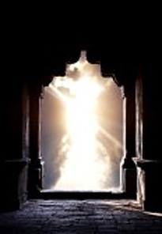
Tabernacle of God
“God dwells in the material universe, as a king in his palace.”
Know ye not that ye are the temple of God, and that the Spirit of God dwelleth in you?
If any man defile the temple of God, him shall God destroy; for the temple of God is holy, which temple ye are.
1 Corinthians 3:16-17
Destruction means banished…the body cannot be permanently destroyed because through the atonement of Jesus Christ every spirit and body shall receive the resurrection
D&C 93:34 Smith and Sjodahl

Slide 14


Light VS Dark
Without warning, the lights [in the cave] suddenly went completely out.
Suspended above the abyss, we were engulfed in a darkness so profound that we could not even see our hands on the ropes in front of us.
A voice instantly called out, “Dad, Dad, are you there?”
“I’m here, Son; I’m right here,” I responded.
The unexpected loss of light was designed to show that without electricity, the darkness of the cavern was impenetrable.
It succeeded; we “felt” the darkness.
Timothy J. Dyches

Slide 15
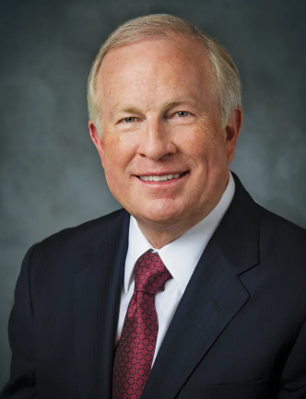
When the lights did return, the darkness instantly surrendered, as darkness must always surrender, to even the faintest light.
My sons and I have been left with a memory of a darkness we had never known, a greater appreciation for light we will never forget, and the assurance that we are never all alone in the dark.
Our descent into that cavern in some ways parallels our journey through mortality.
D&C 93:36

Slide 16
Receiving Light and Truth
We receive truth and light as we keep the commandments
We increase the Savior’s light and truth in our lives as we keep His commandments
Disobedience and false traditions cause us to lose light and truth
How does obeying the commandments help us receive truth and light?
D&C 93:36-37

Slide 17

A choice to obey
Maria prays each morning and evening. She feels joy giving service, keeping her covenants, and searching the scriptures daily. She regularly helps gather her family together for family scripture study and prayer. She looks forward to partaking of the sacrament each week at church.
Maria prays and studies the scriptures often but not every day. She attends church most of the time and usually listens to those who speak and teach. She goes to Young Women activities if she knows that her friends will be there.
Maria never prays, reads the scriptures, or attends Church meetings. The bishop has asked to see her, but she will not speak to him. She often breaks the Word of Wisdom. She argues constantly with family members. She feels distant from Heavenly Father.
Maria prays if she is not tired or in a hurry. She helps around the house reluctantly and reads scriptures with the family only if it is convenient. She usually skips church and Young Women activities. She occasionally breaks the Word of Wisdom.
How would you summarize the importance of our daily decisions and their effect on the light and truth we receive?

Slide 18
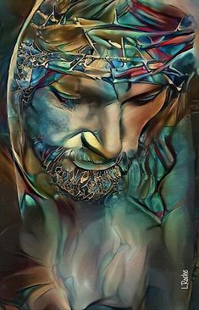

Born innocent
‘Every spirit of man was innocent in the beginning’—meaning that spirits started out in a state of purity and innocence in preexistence—‘and God having redeemed man from the fall, men became again, in their infant state, innocent before God’ -- meaning that all children start out their mortal probation in purity and innocence because of the atonement.
Our revelations also say, ‘The Son of God hath atoned for original guilt, wherein the sins of the parents cannot be answered upon the heads of the children, for they are whole from the foundation of the world.’”
D&C 93:38 Bruce R. McConkie

Slide 19

Loss of Truth and Light
Outward signs of light are easy to recognize: respect, dependability, dedication to duty, modesty, obedience, and reverence for the things of God.
Disobedience can cause us to lose the Savior’s light and truth from our lives
When light is diminished in our lives, motivation toward spiritual things also diminishes to one degree or another.
See Romans 13:12
D&C 93:39 Student Manual

Slide 20


Set Your Homes in order
First Presidency message
“We call upon parents to devote their best efforts to the teaching and rearing of their children in gospel principles which will keep them close to the Church. The home is the basis of a righteous life, and no other instrumentality can take its place or fulfill its essential functions in carrying forward this God-given responsibility.
“We counsel parents and children to give highest priority to family prayer, family home evening, gospel study and instruction, and wholesome family activities. However worthy and appropriate other demands or activities may be, they must not be permitted to displace the divinely-appointed duties that only parents and families can adequately perform.”
D&C 93:40-50

Slide 21
Sources:
Videos:
“Choose the Light” from time code 2:05 to 7:02
“Why We Need a Savior” (2:15)
Light and Truth, Part 2 (6:51)
More Diligent and Concerned at Home (1:27)
Casey Paul Griffiths Doctrine and Covenants Central Section 93
Bruce R. McConkie “How to Worship” Oct. General Conf. 1971; The Promised Messiah, 1978, 568
Hyrum M. Smith and Janne M. Sjodahl Doctrine and Covenants Commentary p. 593-599
Church Presidency (Clark, Messages, 4:203) Joseph Fielding McConkie and Craig J. Ostler Revelations of the Restoration pg. 675
Prophet Joseph Smith (History of the Church, 3:387.)
Presentation by ©http://fashionsbylynda.com/blog/
Doctrine and Covenants Student Manual Religion 324-325 Section 93
Neil A. Maxwell (“Eternalism vs. Secularism,” Ensign, Oct. 1974, 71.)
Elder John A. Widtsoe (Evidences and Reconciliations, 3:74
President Spencer W. Kimball (“Absolute Truth,” Ensign, Sept. 1978, pp. 3–5.)
Bruce R. McConkie (“The Salvation of Little Children,” Ensign, Apr. 1977, p. 4.)
Dennis L. Largey The Armour of Light February 12, 2002 BYU Devotional
(First Presidency letter, Feb. 11, 1999, quoted in Handbook 2: Administering the Church [2010], 1.4.1).
Timothy J. Dyches, “Light Cleaveth unto Light,” Liahona, May 2021, 113
Presentation by http://fashionsbylynda.com/blog/

Slide 22
Knowing Truth:
President Spencer W. Kimball stated: “If we live in such a way that the considerations of eternity press upon us, we will make better decisions. Perhaps this is why President Brigham Young once said that if he could do but one thing to bless the Saints, he believed it would be to give them ‘eyes with which to see things as they are.’ (Journal of Discourses, 3:221; italics added.) It is interesting to note how those last words reflect the words of the scripture in which truth is described as ‘knowledge of things as they are, and as they were, and as they are to come.’ (D&C 93:24.) Jacob reminds us also that ‘the Spirit speaketh the truth … of things as they really are, and of things as they really will be.’ [Jacob 4:13.]
“The more clearly we see eternity, the more obvious it becomes that the Lord’s work in which we are engaged is one vast and grand work with striking similarities on each side of the veil.” (“The Things of Eternity—Stand We in Jeopardy?” Ensign, Jan. 1977, p. 3.)
Because Satan “seeketh that all men might be miserable like unto himself” (2 Nephi 2:27), he and his followers try to lead us away from righteousness. He directs his most strenuous opposition at the most important aspects of Heavenly Father's plan of happiness. For example, he seeks to discredit the Savior and the priesthood, to cast doubt on the power of the Atonement, to counterfeit revelation, to distract us from the truth, and to contradict individual accountability. He attempts to undermine the family by confusing gender, promoting sexual relations outside of marriage, ridiculing marriage, and discouraging childbearing by married adults who would otherwise raise children in righteousness.
Individuals do not have to give in to Satan's temptations. Each person has the power to choose good over evil, and the Lord has promised to help all who seek Him through sincere prayer and faithfulness.
lds.org SATAN
Intelligence:
We know very little about the concept of intelligence. President Joseph Fielding Smith said: “Some of our writers have endeavored to explain what an intelligence is, but to do so is futile, for we have never been given any insight into this matter beyond what the Lord has fragmentarily revealed. We know, however, that there is something called intelligence which always existed. It is the real eternal part of man, which was not created or made. This intelligence combined with the spirit constitutes a spiritual identity or individual.” (Progress of Man, p. 11.)
Elder John A. Widtsoe explained:
“Among the many great truths revealed to the Prophet Joseph Smith, none is more beloved by the Church than ‘The Glory of God is intelligence. The word intelligence, as used in common speech, means readiness in learning, quickness of mind. Its higher Gospel meaning is more profound. The intelligent man is he who seeks knowledge and uses it in accordance with the plan of the Lord for human good. This is implied in the revelation from which the quotation is made, for the full sentence reads, ‘The glory of God is intelligence, or in other words, light and truth.’ When men follow the light their knowledge will always be well used.
“Intelligence, then, becomes but another name for wisdom. In the language of mathematics we may say that knowledge, plus the proper use of knowledge, equals intelligence, or wisdom. In this sense intelligence becomes the goal of the successful life. Knowledge is one of the means by which such intelligence is attained; the use of knowledge is equally as important, for it gives life and direction to knowledge. … Thus it often happens that a person of limited knowledge but who earnestly and prayerfully obeys the law, rises to a higher intelligence or wisdom, than one of vast Gospel learning who does not comply in his daily life with the requirements of the Gospel. Obedience to law is a mark of intelligence.” (In Conference Report, Apr. 1938, p. 50.)
Truth is Truth:
Some things are simply true. The arbiter of truth is God—not your favorite social media news feed, not Google, and certainly not those who are disaffected from the Church.
President Spencer W. Kimball taught that absolute truth cannot be “altered by the opinions of men. … If men are really humble, they will realize that they discover, but do not create, truth” [Spencer W. Kimball, “Absolute Truth,” BYU devotional address, 6 September 1977; emphasis in original].
Many now claim that truth is relative and that there is no such thing as divine law or a divine plan. Such a claim is simply not true. There is a difference between right and wrong. Truth is based upon the laws God has established for the dependability, protection, and nurturing of His children. Eternal laws operate in and affect each of our lives, whether we believe them or not. (Russell M. Nelson, “The Love and Laws of God,” Brigham Young University devotional, Sept. 17, 2019, 1–2)

Slide 23
Absolute Truth--The Whole Article:
President Spencer W. Kimball taught: “The earth is spherical. If all the four billion people in the world think it flat, they are in error. That is an absolute truth, and all the arguing in the world will not change it.
“We learn about these absolute truths by being taught by the Spirit. These truths are ‘independent’ in their spiritual sphere and are to be discovered spiritually, though they may be confirmed by experience and intellect. (See D&C 93:30.) The great prophet Jacob said that ‘the Spirit speaketh the truth. … Wherefore, it speaketh of things as they really are, and of things as they really will be.’ (Jacob 4:13.) We need to be taught in order to understand life and who we really are.
“The Gods organized and gave life to man and placed him on the earth. This is absolute. It cannot be disproved. A million brilliant minds might conjecture otherwise, but it is still true. And having done all this for his Father’s children, the Christ mapped out a plan of life for man—a positive and absolute program whereby man might achieve, accomplish, and overcome and perfect himself. Again, these vital truths are not matters of opinion. If they were, then your opinion would be just as good as mine, or better. But I give you these things, not as my opinion—I give them to you as divine truths which are absolute.
“Some day you will see and feel and understand and perhaps even berate yourself for the long delay and waste of time. It is not a matter of if. It is a matter of when.
“Experience in one field does not automatically create expertise in another field. Expertise in religion comes from personal righteousness and from revelation. The Lord told the Prophet Joseph Smith: ‘All truth is independent in that sphere in which God has placed it.’ (D&C 93:30.) A geologist who has discovered truths about the structure of the earth may be oblivious to the truths God has given us about the eternal nature of the family.
“If I can only make clear this one thing, it will give us a basis on which to build. Man cannot discover God or his ways by mere mental processes. One must be governed by the laws which control the realm into which he is delving. To become a plumber, one must study the laws which govern plumbing. He must know stresses and strains, temperatures at which pipes will freeze, laws which govern steam, hot water, expansion, contraction, and so forth. One might know much about plumbing and be a complete failure in training children or getting along with men. One might be the best of bookkeepers and yet not know anything of electricity. One might know much about buying and selling groceries and be absolutely ignorant of bridge building.
“One might be a great authority on the hydrogen bomb and yet know nothing of banking. One might be a noted theologian and yet be wholly untrained in watchmaking. One might be the author of the law of relativity and yet know nothing of the Creator who originated every law. I repeat, these are not matters of opinion. They are absolute truths. These truths are available to every soul.
“Any intelligent man may learn what he wants to learn. He may acquire knowledge in any field, though it requires much thought and effort. It takes more than a decade to get a high school diploma; it takes an additional four years for most people to get a college degree; it takes nearly a quarter-century to become a great physician. Why, oh, why do people think they can fathom the most complex spiritual depths without the necessary experimental and laboratory work accompanied by compliance with the laws that govern it? Absurd it is, but you will frequently find popular personalities, who seem never to have lived a single law of God, discoursing in interviews on religion. How ridiculous for such persons to attempt to outline for the world a way of life!” (“Absolute Truth,” Ensign, Sept. 1978, pp. 3–5.)

