Slide 1
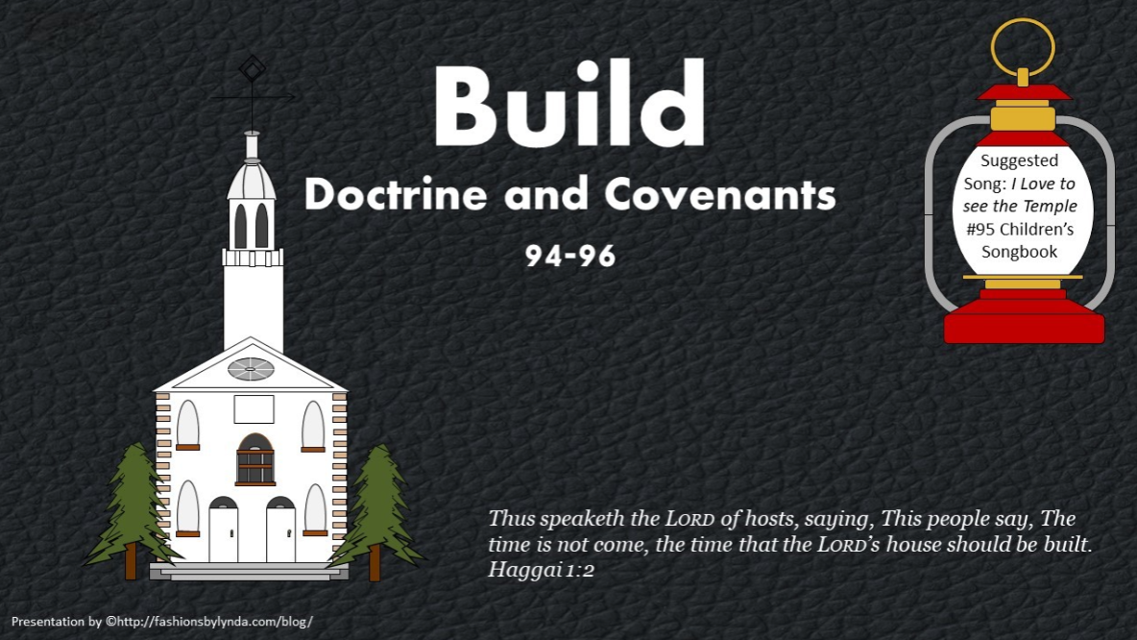

Slide 2

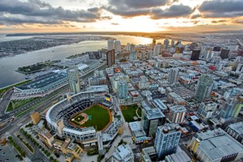
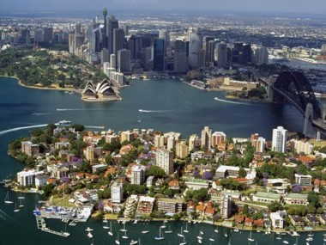
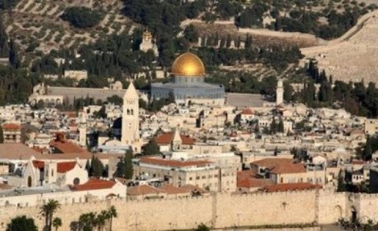
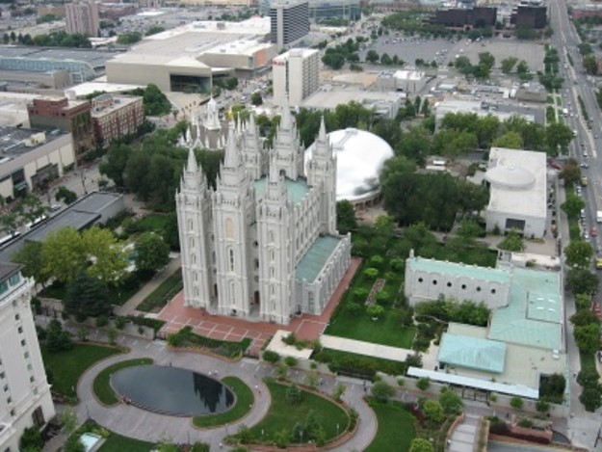
The Center of a Town
If you were to design a city, what would you place at the center of that city?

Slide 3
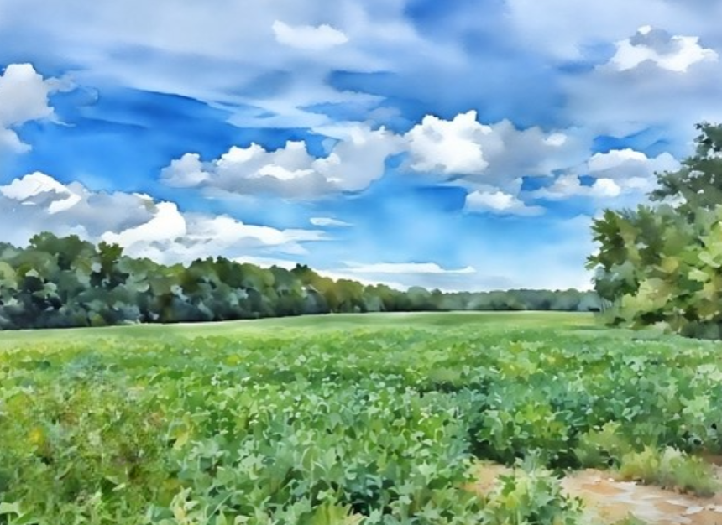
If You Build It… They Will Come
Unto Thee
As part of the Restoration of His gospel, Jesus Christ commanded the Saints to build a temple in Kirtland, Ohio.
Months later, when the Saints still had not started construction, the Savior lovingly chastened them and restated His commandment to build His house.
Obediently, the Saints labored diligently to construct the Kirtland Temple.

Slide 4
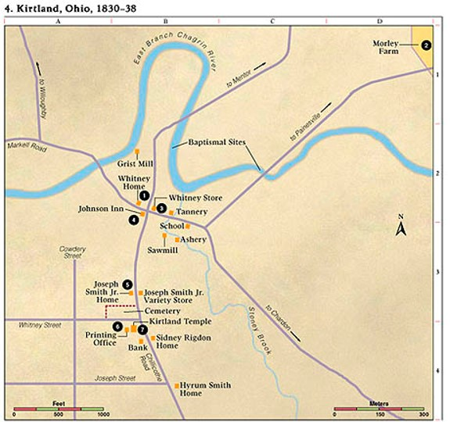
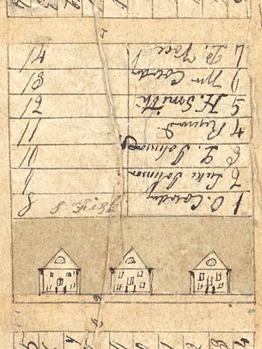
Three Buildings
August 2, 1833
Kirtland, Ohio
A city of the Stake of Zion—to be laid out with the temple
A lot was set out for the work of the Presidency
A lot was set out for printing
The three buildings represent the Kirtland Temple, a house in which the Presidency could do their work, and a printing office.
D&C 94:1,3,10

Slide 5
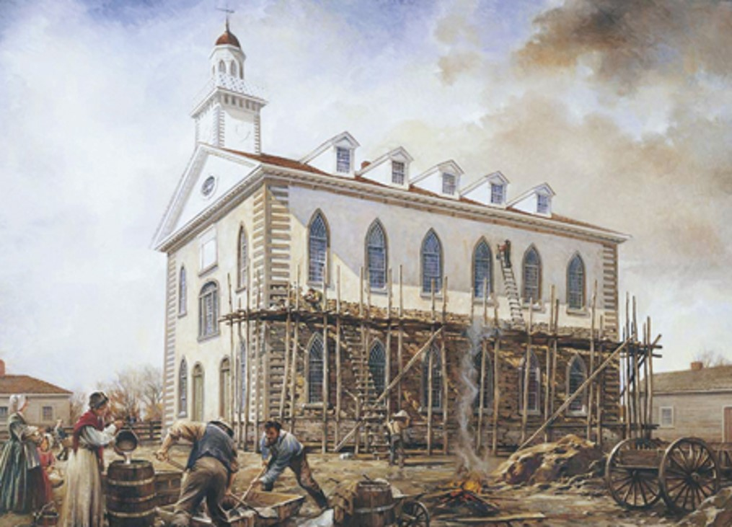
Why are These Buildings Important?
Temple ordinances.
The work of the First Presidency in obtaining revelation and ministering to the Church.
The printing of scriptures and other works the Lord commands.
D&C 94:1,3,10

Slide 6
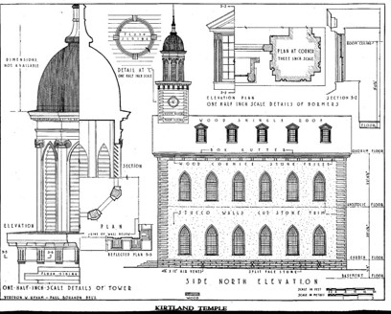
A Committee
Hyrum Smith, Reynolds Cahoon, and Jared Carter were appointed as a committee to oversee the completion of certain buildings in Kirtland. To aid them in their assignment, the Lord gave them land adjacent to the temple lot.
As it happened, the building of the Kirtland Temple took all the energy and finances of the Church. By the time it was completed, the faithful in Kirtland were compelled to leave for Missouri, so the other two buildings were not completed.
Student Manual
D&C 94:13-17

Slide 7

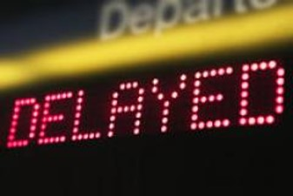
Chastening Out of Love
A Discipline or Correction
If we love someone in the highest sense of the word, we are deeply concerned for that person’s eternal as well as temporal welfare.
The Lord chastened the brethren for their delay in building the House of the Lord
D&C 95:1-3

Slide 8
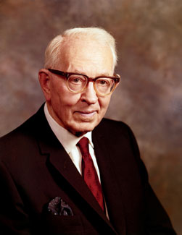
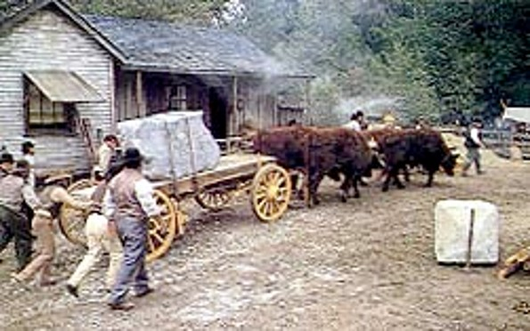
Commencement
“Four days after the Lord had rebuked the brethren for their neglect, without waiting for subscriptions, the brethren went to work on the Temple.
Elder George A. Smith, a recent convert, hauled the first load of stone for the Temple.
Hyrum Smith and Reynolds Cahoon commenced digging the trench for the walls, and they finished the same with their own hands.”
President Joseph Fielding Smith
Jesus Christ commands His people to build temples to fulfill Heavenly Father’s promise to endow them with power
D&C 95:1-3

Slide 9
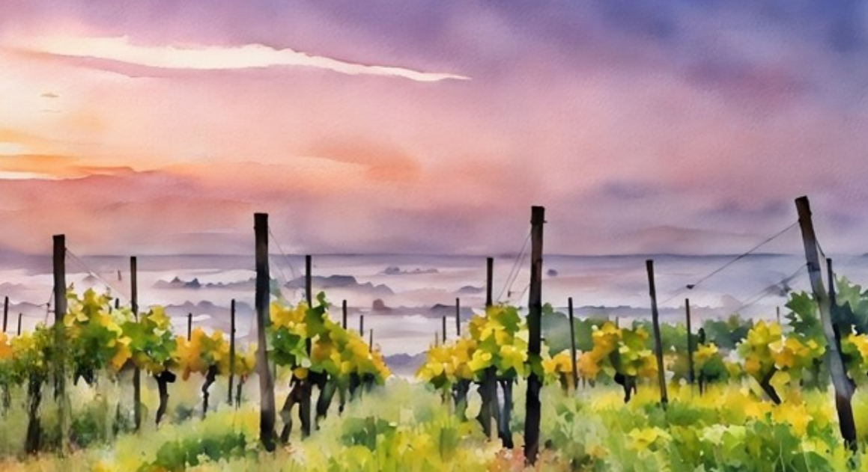
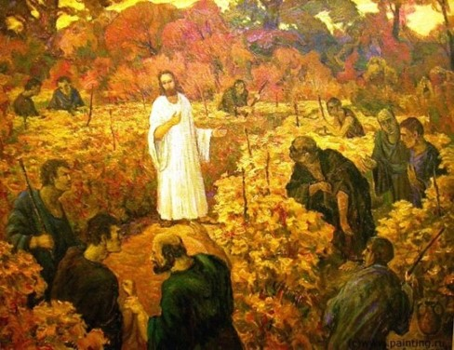
The Vineyard
“The vineyard is the harvest symbol usually used to represent the world—the earth and all of the people who live on the earth
Pruning--calling out or separating the righteous from among the wicked or by the actual destruction of the wicked.
The Lord instructs his servants (missionaries) to prune his vineyard.
However, the Lord has also warned that when the pruning process is completed, the vines that continue to bring forth bad fruit will be burned.
This evidently refers to the burning of the wicked, which will take place at the second coming when Jesus Christ will come in power and great glory.
D&C 95:4 Ludlow

Slide 10
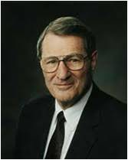
My Strange Act
“A fresh view is not always welcomed … ; it can be jarring to those who are intensely set in their ways
Even the remarkable Enoch was not welcomed by many of his contemporaries. Of him and his labors it was said anciently,
Fresh and striking truths were necessary so that mortals could ‘hear and know that which they have never considered’
For the Lord shall rise up as in mount Perazim, he shall be wroth as in the valley of Gibeon, that he may do his work, his strange work; and bring to pass his act, his strange act.
Isaiah 28:21
And they came forth to hear him, upon the high places, saying unto the tent-keepers: Tarry ye here and keep the tents, while we go yonder to behold the seer, for he prophesieth, and there is a strange thing in the land; a wild man hath come among us.
Moses 6:38
That wise men and rulers may hear and know that which they have never considered;
D&C 101:94
D&C 95:4 Neal A. Maxwell

Slide 11


Go Against the Grain
“Having described the Restoration as his ‘strange act,’ and ‘my strange work,’ the Lord indicated that it would go against the grain of much of society.
Yet restitution of the unfamiliar, the uncommon, the unusual, and the unique would actually aid mortals by providing fresh, divine standards and help them in discerning between righteousness and wickedness, as God ‘poured out [His] Spirit upon all flesh.’
With values otherwise shorn of true perspective, the inversions of certain of them become almost inevitable. Finally, evil can end up being called good, and good evil.
D&C 95:4 Neal A. Maxwell

Slide 12
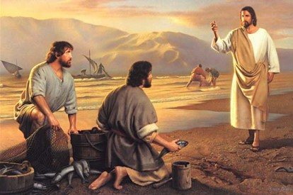
Many Called—Few Chosen
It is one thing to be called to labor in the vineyard and another to be faithful in the performance of that work.
Only those who faithfully fill their callings are chosen by the Lord for exaltation in the kingdom of God.
Those who are called but not chosen “have sinned a very grievous sin, in that they are walking in darkness at noon-day” for they do not respond to the light of the restored gospel that surrounds them.
D&C 95:5-6 Student Manual

Slide 13
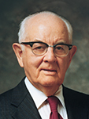
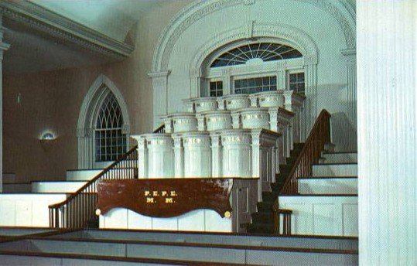
Solemn Assemblies
“Solemn assemblies have been known among the Saints since the days of Israel.
They have been of various kinds but generally have been associated with the dedication of a temple or a special meeting appointed for the sustaining of a new First Presidency or a meeting for the priesthood to sustain a revelation, such as the tithing revelation to President Lorenzo Snow. …
“Joseph Smith and Brigham Young were first sustained by a congregation, including a fully organized priesthood. Brigham Young was sustained on March 27, 1846, and was ‘unanimously elected president over the whole Camp of Israel …’ by the council.”
D&C 95:7 President Spencer W. Kimball

Slide 14
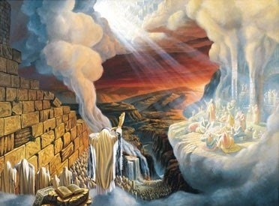
Bible Solemn Assemblies
Such assemblies are sacred meetings attended by the priesthood or those who seek to separate themselves from the world by keeping God’s commands.
Leviticus 23:36
Numbers 29:35
Deuteronomy 16:8
2 Chronicles 7:9
Nehemiah 8:18
Isaiah 1:10-14
Ezekiel 45:17; 46:11
The purpose for the assembly was to help the elders spiritually prepare to continue their missionary work among the people of the world.
D&C 95:7 Student Manual

Slide 15
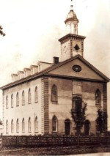
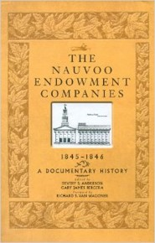
Endowment
A gift or a bequest
In the Church it usually refers to a temple ordinance in which members make certain promises and receive a gift of knowledge and spiritual power in return.
The endowment spoken of here, however, is not the same as the ceremony administered in later temples.
Priesthood members in Kirtland did participate in a “partial endowment, the full ordinance being reserved for a future performance when a temple designed for ordinance work itself should be built” Bruce R. McConkie
The first complete endowment in this dispensation was given by Joseph Smith in Nauvoo on 4 May 1842.
The endowment received in Kirtland included washings and anointings, as well as the washing of feet for official priesthood brethren. The Lord also poured out His Spirit, or in other words endowed them with spiritual power, and many received revelations or other gifts-- HC
D&C 95:8-9 Student Manual

Slide 16
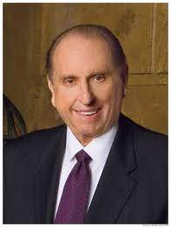
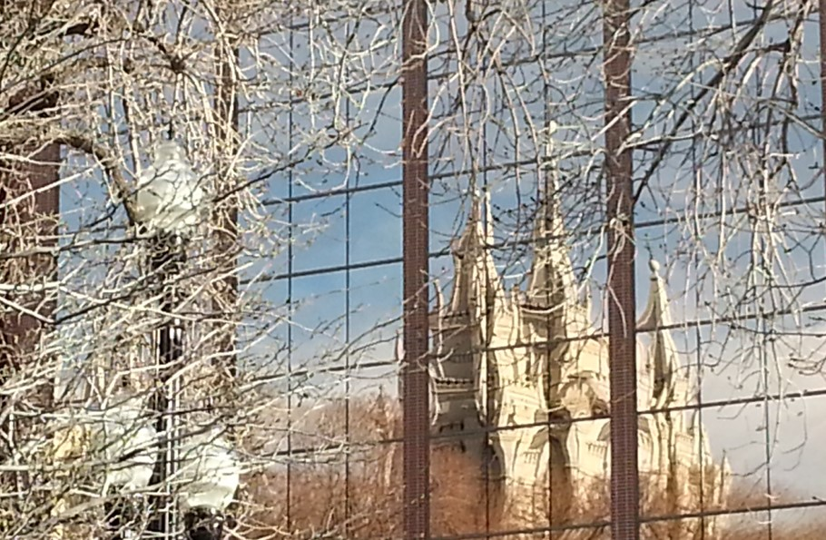
Spiritual Power and Knowledge
“Until you have entered the house of the Lord and have received all the blessings which await you there, you have not obtained everything the Church has to offer. The all-important and crowning blessings of membership in the Church are those blessings which we receive in the temples of God”
President Thomas S. Monson
What are two saving ordinances that we can receive only in the temples of God?
The temple endowment and the marriage sealing
D&C 95:8-9 Student Manual

Slide 17
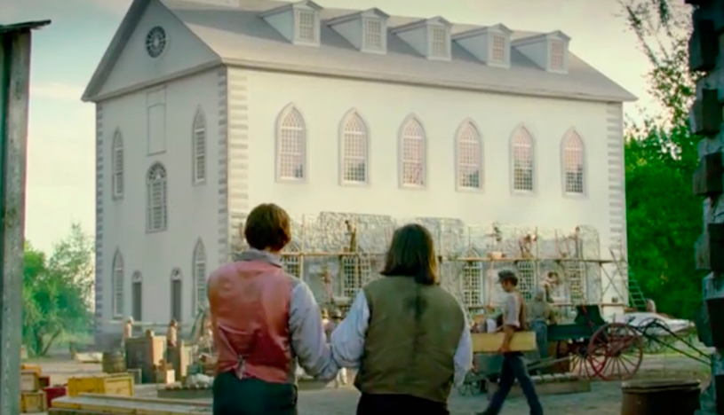

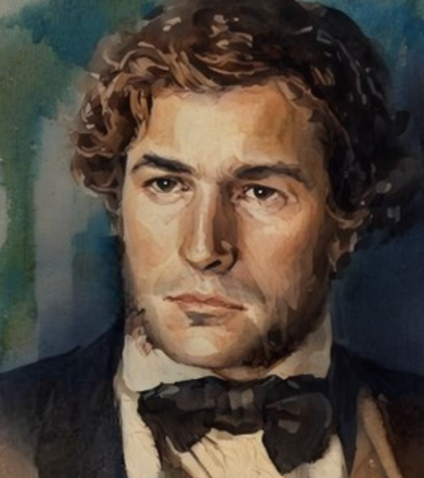
Proceeding With Faith
Immediately after section 95 was received, Hyrum Smith began clearing the field where the temple would be built. Building the temple was a difficult challenge.
There were only about 150 Church members in the area.
They did not have the experience or skills to oversee such a large building.
Constructing the temple would also put a financial strain on the Church and the members. Nevertheless, they went to work, and the Lord fulfilled His promise to give them “power to build it”.
Artemus Millet, a convert from Canada and an experienced masonry builder, moved to Kirtland and supervised the construction.
Another convert, John Tanner, provided financial assistance at a critical moment. Men, women, and children in the area donated, time, labor, and resources to build the temple.
Lisa Olsen Tait and Brent Rogers
Artemus Millet
Movie photo of John Tanner
D&C 95:11-12

Slide 18
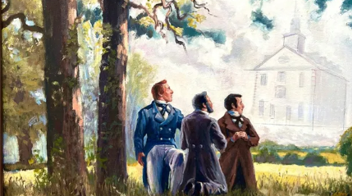
Specific Design of the Temple
Joseph Smith, Sidney Rigdon, and Frederick G. Williams prayed together and saw the temple in a vision.
After viewing the exterior in detail, “the building seemed to come right over [them]” and they saw the interior of the building as if they were actually inside the building.
Later, when the temple was nearing completion, Frederick G. Williams said it looked like the model he had seen in vision to the smallest detail, and he could not tell the difference between it and the temple as built.
D&C 95:13-17

Slide 19
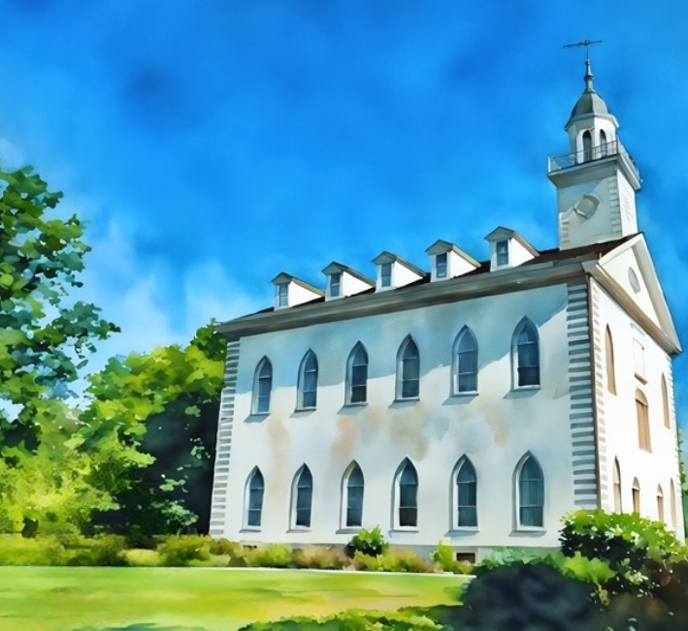
History of Kirtland Temple
The ordinances received in the Kirtland Temple were only a partial endowment. The full endowment would not be received until the Saints settled in Nauvoo.
Two years after the dedication of the Kirtland Temple, the Saints had largely abandoned Kirtland, and the temple became the venue of both private worship and public function.
The temple was later leased for many years as a public school.
In 1880, Community of Christ (formerly known as the Reorganized Church of Jesus Christ of Latter-Day Saints) reestablished ownership of the Kirtland Temple and restored it as closely as possible to its original condition.
On March 5, 2024, ownership of the Kirtland Temple was transferred from Community of Christ to The Church of Jesus Christ of Latter-day Saints for an agreed-upon amount.
The building was closed for 20 days to prepare it for reopening to public tours on Monday, March 25, 2024.
https://churchofjesuschristtemples.org/kirtland-temple/

Slide 20
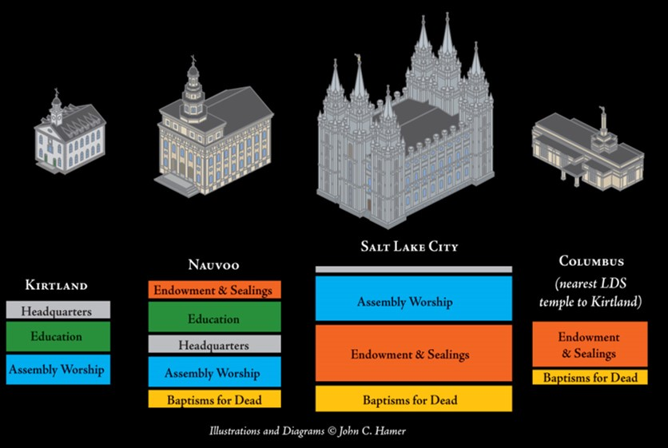
Functions of the Temple Over the Years

Slide 21
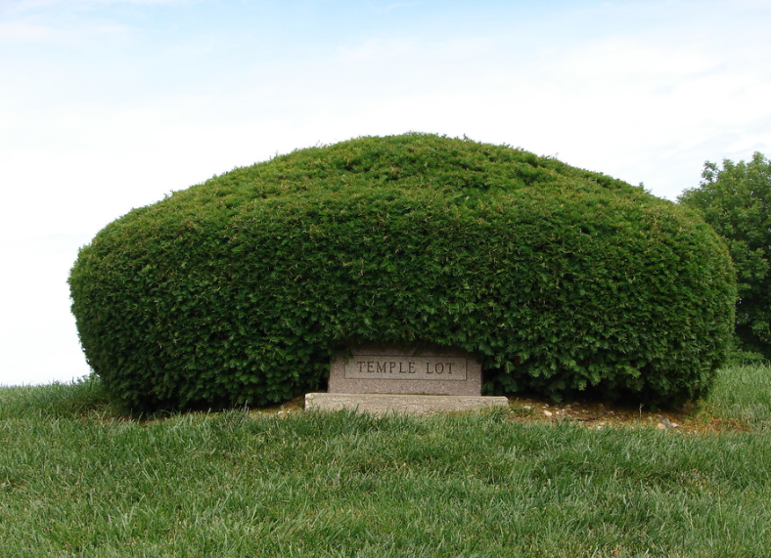
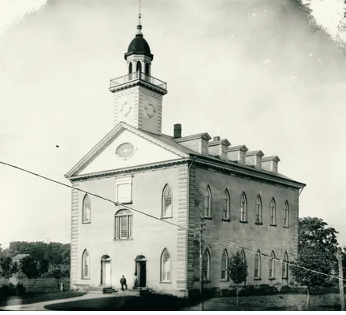
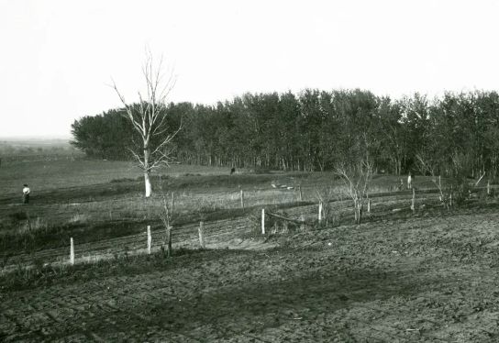
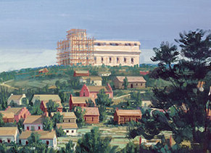
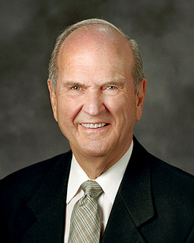
The Prophet dedicated four temple sites during his lifetime—in Kirtland, Ohio; Independence, Missouri; Far West, Missouri; and Nauvoo, Illinois. Of these temples two were completed—Kirtland in 1836 and Nauvoo in 1847. As Joseph explained, “We need the temple more than anything else.”
HC
Independence, Missouri Temple Site
Kirtland Temple
Far West Temple site
The Lord is indeed hastening His work.
Why are we building temples at such an unprecedented pace? Why? Because the Lord has instructed us to do so. The blessings of the temple help to gather Israel on both sides of the veil. These blessings also help to prepare a people who will help prepare the world for the Second Coming of the Lord!
Russel M. Nelson
Nauvoo Temple Site

Slide 22
D&C 96:1 This Stake
To pitch a tent, one drives stakes into the ground to secure it. The deeper the stakes, the stronger and more stable the tent. The revelations of the Lord compare Zion to a great tent, whose stakes are its support and therefore must be strong.
“The expression ‘stake of Zion,’” wrote President Joseph Fielding Smith, “is taken from the expression in Isaiah: ‘Look upon Zion, the city of our solemnities; thine eyes shall see Jerusalem a quiet habitation, a tabernacle that shall not be taken down; not one of the stakes thereof shall ever be removed, neither shall any of the cords thereof be broken.’ Again: ‘Enlarge the place of thy tent and let them stretch forth the curtains of thine habitation: spare not, lengthen thy cords, and strengthen thy stakes.’
Isaiah speaks of Zion as a tent, or tabernacle, having in mind the Tabernacle which was built and carried in the wilderness in the days of Moses, and the cords are the binding cables that extend from the tent, or tabernacle, to the stakes which are fastened in the ground. Now the Lord revealed that Zion was to be built and surrounding her would be the stakes helping to bind and keep her in place.
This figure of speech has almost been lost through the intervening years, but it retains its significance, or beauty. To speak of Zion, the New Jerusalem, or even that section where the city will be built, as a stake of Zion, is a sad mistake. Zion is the tent, the stakes of Zion are the binding pegs that support her. Zion, therefore, cannot be a stake, it would be as improper to call a tent a stake as to apply this term to Zion.” HC
D&C 96:1

Slide 23
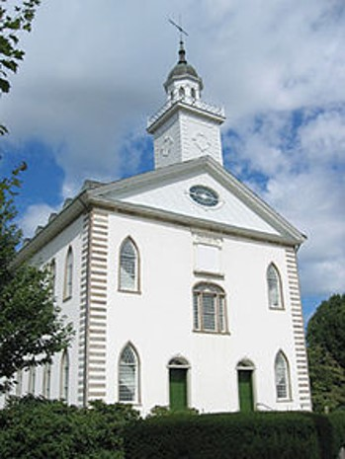
Who’s In Charge of the Property?
The Lord instructed that Bishop Newel K. Whitney should take charge of the property held by the Church.
The temple would be built on the place designated by the Lord, and Bishop Whitney would divide the remainder of the property into lots for those who would seek an inheritance.
Some of these lots were designated for Church leaders responsible for the publication of the revelations.
Receiving this inheritance would help them devote their time to doing the work of the Lord, which included publishing the word of God.
John Johnson should be admitted as a member of the United Firm, which oversaw the Church’s financial, publishing, and mercantile operations.
D&C 96

Slide 24
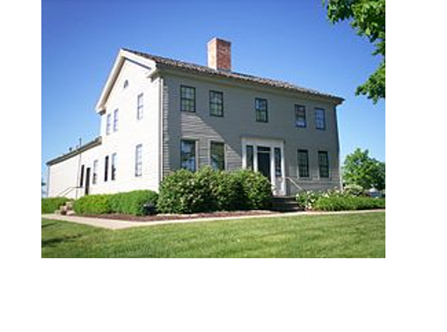
John Johnson
He was born April 11, 1778, in Chesterfield, New Hampshire and the son of Israel Johnson and Abigail Higgins
He moved to Hiram, Ohio in 1818 and purchased 100 acres and by 1830 he had 304 acres
He was affiliated with the Methodist Church, upon investigation with Ezra Booth of the Mormon Church, and when Joseph Smith healed his wife’s lame arm, he and his wife were converted to the Church
In 1831 the Prophet and his family moved in with the Johnson’s in Hiram
In March 1832 when a mob had taken Joseph and Sidney Rigdon to tar and feather them, he called for his shot gun but was knocked down and his collarbone was broken. David Whitmer healed it immediately with a Priesthood blessing
He soon moved into Kirtland, Ohio and in 1833 he was ordained an Elder and called as a member of the United Order, then ordained a High Priest
In 1836 he went into financial difficulties, and he was a member of the Kirtland Safety Society which failed in 1837
His financial and legal issues combined with the loss of eternal truths led to his apostasy in 1837
He died on July 30, 1843, and buried near the Kirtland Temple at the age of 65
http://scottwoodward.org/churchhistory_johnson_john.html

Slide 25
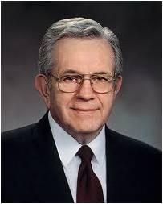

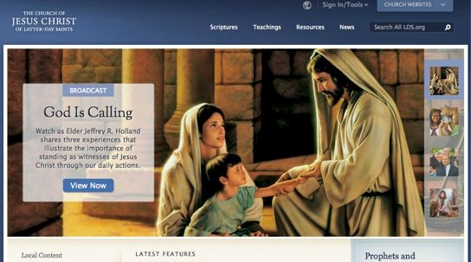
Go To the World
“One day all the standard works will be so organized and prepared, to make them one monumental testimony that Jesus is the Christ, the Son of God, the Only Begotten of the Father. The doctrines of salvation must be available to all mankind, not just in their hands, but in their heads and hearts.”
Boyd K. Packer
D&C 96: 4-5

Slide 26
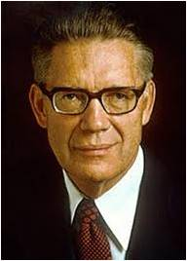

Subduing Your Hearts
Although some resist and even fight against the gospel’s influence, others are tempered and influenced for good by its power and the example of those who have received it.
“Build up Zion, but build it up in the area where God has given you birth and nationality. Build it up where he has given you citizenship, family, and friends. … The Saints who comprise … Zion are and should be a leavening influence for good in all these nations.
“And know this: God will bless that nation which so orders its affairs as to further his work.”
Elder Bruce R. McConkie
D&C 96:5

Slide 27
Sources:
Videos:
“Temples Are A Beacon” (2:50)
Treasure in Heaven: The John Tanner Story (20:31)
The Will of God (3:02)
The Crowning Blessings of Church Membership (0:26)
Doctrine and Covenants Student Manual Religion 324-325 Section 94
President Joseph Fielding Smith Church History and Modern Revelation, 1:406–7
(Ludlow, Companion, 2:318.)
Neal A. Maxwell (A Wonderful Flood of Light, 9.)
President Spencer W. Kimball (B. H. Roberts, A Comprehensive History of the Church, vo. 3, p. 52.)
(Bruce R. McConkie, “A New Commandment: Save Thyself and Thy Kindred!” Ensign, Aug. 1976, p. 10).
(“Come: Let Israel Build Zion,” Ensign, May 1977, p. 118.)
HC (see History of the Church, 2:308–10). (Church History and Modern Revelation, 1:321–22.)
President Thomas S. Monson (“The Holy Temple—a Beacon to the World,” Ensign or Liahona, May 2011, 93).
Teachings of Presidents of the Church: Joseph Smith [2007], 271
Boyd K. Packer, “Teach the Scriptures” [address to religious educators], 14 Oct. 1977, p. 6.
History of the Church—Temple Builder
Presentation by ©http://fashionsbylynda.com/blog/
Russel M. Nelson “The Lord Jesus Christ Will Come Again” October 2024 Gen. Conf.
Lisa Olsen Tait and Brent Rogers, “A House for Our God,” in Revelations in Context [2016], 167; Saints, vol. 1, The Standard of Truth, 210–11
Presentation by ©http://fashionsbylynda.com/blog/

Slide 28
President Joseph Fielding Smith explained:
“A lot was set apart for the building of a house for the use of the First Presidency and where revelation could be given and all matters pertaining to the progress of the Church could receive proper attention. … It was to be dedicated unto the Lord from the foundation thereof, according to the order of the Priesthood. There is no question that the First Presidency needed a place where they could attend to the matters of Church government. This was to be a sacred house; no unclean thing was to be permitted to enter it, and if the builders would remember this the presence of the Lord should be in the building.
“The second lot south of this building was to be dedicated for the building of another house where the printing for the Church could be done and the translation of the scriptures, on which the Prophet had been working off and on for many months, could be published. … This house also was to be dedicated to the service of the Lord, and set apart for the printing.” (Church History and Modern Revelation, 1:404.)
Chastisement:
“We are concerned that too many times the interviewing leader in his personal sympathies for the transgressor, and in his love perhaps for the family of the transgressor, is inclined to waive the discipline which that transgressor demands.
“Too often a transgressor is forgiven and all penalties waived when that person should have been disfellowshipped or excommunicated. Too often a sinner is disfellowshipped when he or she should have been excommunicated. …
“Do you remember what was said by the prophet Alma? ‘Now,’ he said, ‘repentance could not come unto men except there were a punishment.’ [Alma 42:16.]
“Ponder on that for a moment. Have you realized that? There can be no forgiveness without real and total repentance, and there can be no repentance without punishment. This is as eternal as is the soul. …
“Please remember these things when somebody comes before you who has broken the laws of God.
“It is so easy to let our sympathies carry us out of proportion; and when a man has committed sin, he must suffer. It’s an absolute requirement—not by the bishop—but it’s a requirement by nature and by the very part of a man.” (In Conference Report, Apr. 1975, p. 116; or Ensign, May 1975, p. 78.) President Spencer W. Kimball
The Building:
Church leaders held a conference to discuss the construction of the temple. “Some were in favor of building a frame house, but others were of a mind to put up a log house. Joseph reminded them that they were not building a house for a man, but for God; ‘and shall we, brethren,’ said he, ‘build a house for our God, of logs? No, I have a better plan than that. I have a plan of the house of the Lord, given by himself.’” After Joseph explained the full pattern of the temple, all the brethren were excited. They traveled to the building site, removed a fence, and leveled a field of wheat that had previously been planted by the Smith family. After the grain was cleared, Hyrum Smith “commenced digging a trench for the wall.” (Lucy Mack Smith, History of Joseph Smith by His Mother, ed. Preston Nibley [1958], 230, 231.)
My Strange Act 95:4:
The phrase “my strange act” comes from Isaiah 28:21, where the Lord said He would correct a people who did not believe they had any need to repent. The Restoration of the gospel and the establishment of the true Church upon the earth is a strange occurrence to people who consider belief in revelation, heavenly visitations, and other spiritual matters to be foolishness. The message of the Restoration of the gospel is preached to many who believe they already have the truth. Some of these people may consider our efforts strange.

Slide 29
Joseph Smith Quotes
“What was the object of gathering the . . . people of God in any age of the world? . . . The main object was to build unto the Lord a house whereby He could reveal unto His people the ordinances of His house and the glories of His kingdom, and teach the people the way of salvation; for there are certain ordinances and principles that, when they are taught and practiced, must be done in a place or house built for that purpose” (History of the Church, 5:423; paragraph divisions altered).
“The Church is not fully organized, in its proper order, and cannot be, until the Temple is completed, where places will be provided for the administration of the ordinances of the Priesthood” (History of the Church, 4:603).
“That they may build a house which shall be accepted by the Almighty, and in which His power and glory shall be manifested[,] . . . let those who can freely make a sacrifice of their time, their talents, and their property . . . unite with us in the great work of the last days, and share in the tribulation, that they may ultimately share in the glory and triumph” (History of the Church, 4:273).
Joseph Smith’s commitment to build temples was his response to a divine mandate: “Establish a house, even a house of prayer, a house of fasting, a house of faith, a house of learning, a house of glory, a house of order, a house of God” (Doctrine and Covenants 88:119). His personal testimony about temple work is apparent in his last general conference address. “Every man who wishes to save his father, mother, brothers, sisters and friends,” he testified, “must go through all the ordinances for each one of them separately, the same as for himself, from baptism to ordination, washings and anointings, and receive all the keys and powers of the Priesthood, the same as for himself” (History of the Church, 6:319).
According to Wilford Woodruff, Joseph Smith gave the following prophecy in 1834: “This people will go into the Rocky Mountains; they will there build Temples to the Most High” (in Conference Report, Apr. 1898, 57). Subsequent Presidents of the Church saw the fulfillment of that prophecy and extended the work around the world. As the number of temples worldwide approached 100, President Gordon B. Hinckley reaffirmed: "This is a great era of temple-building. We are reaching out everywhere that we can go to build the House of the Lord" (Teachings of Gordon B. Hinckley [1997], 641).
Interesting stories from the builders of the Kirtland Temple
Story of John Tanner
https://earlymormonsaints.blogspot.com/2014/08/the-story-of-john-tanner.html
Artemus Millet Biography
https://www.josephsmithpapers.org/person/artemus-millet

