Slide 1


Doctrine and Covenants 97
Sacrifice For Zion
Who shall ascend into the hill of the Lord? or who shall stand in his holy place?
He that hath clean hands, and a pure heart; who hath not lifted up his soul unto vanity, nor sworn deceitfully.
He shall receive the blessing from the Lord, and righteousness from the God of his salvation.
Psalm 24:3-5
Presentation by ©http://fashionsbylynda.com/blog/

Slide 2
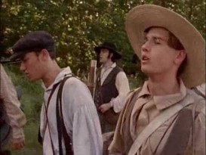
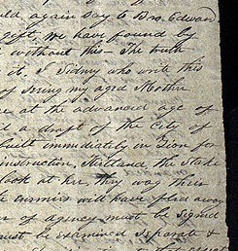
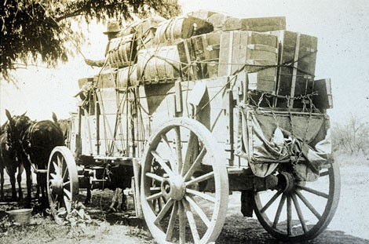
Background
June 1833—George A. Smith hauled the first load of stone for the Kirtland Temple
April 1833—the Saints in Missouri celebrated the 3rd anniversary of the organization of the church…the gospel had been preached to most of the States of the Union
June 25, 1833— The First Presidency sent a letter of instruction to the brethren the plans for the future city of Zion and its temples
Smith and Sjodahl

Slide 3
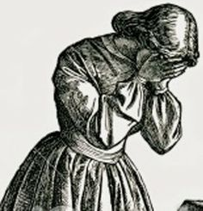
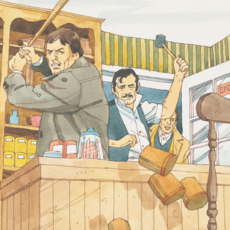
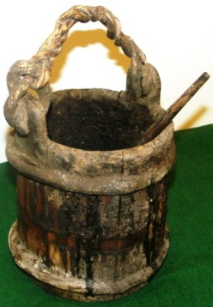
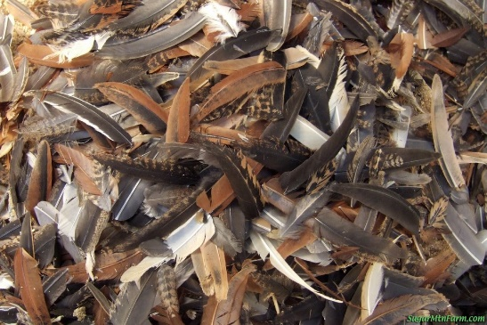
Mob Violence
July 1833—a mob led by Rev. Pixley had published some false stories about the Saints called “Beware of False Prophets” which led to a manifesto against the Saints
July 20, 1833—the mass meeting commenced and they demanded the printing office to be discontinued…The brethren refused to comply and the mob “broke down the printing establishment, seized Edward Partridge and Charles Allen, daubed them with tar from head to foot and covered them with feathers, on the public square.”
July 23, 1833—the very day the cornerstones were laid for the Kirtland Temple, the saints in Missouri, in order to prevent bloodshed, signed an agreement with the mob leaders to leave the county before April 1, 1834
The revelation in Section 97 was received before Joseph Smith got word of the troubles the Saints were having in Missouri

Slide 4
The School in Zion
I go to school because…
I go to church because…
In the summer of 1833, a “school of Elders” began in Zion with Parley P. Pratt as its teacher. Its main purpose was to prepare the brethren living there to go forth as missionaries during the coming winter.
Student Manual
Parley P. Pratt presided over a school in Independence, Missouri—a school for the elders
D&C 97:1-4

Slide 5
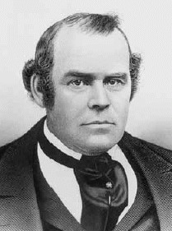
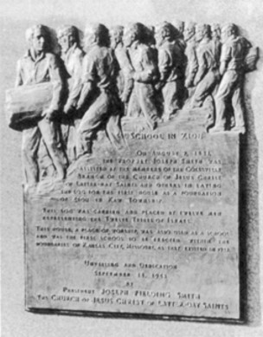
School of Elders
”I devoted almost my entire time in ministering among the churches; holding meetings; visiting the sick; comforting the afflicted, and giving counsel. A school of Elders was also organized, over which I was called to preside. This class, to the number of about sixty, met for instruction once a week. The place of meeting was in the open air, under some tall trees, in a retired place in the wilderness, where we prayed, preached and prophesied, and exercised ourselves in the gifts of the Holy Spirit. Here great blessings were poured out, and many great and marvelous things were manifested and taught.
“The Lord gave me great wisdom, and enabled me to teach and edify the Elders, and comfort and encourage them in their preparations for the great work which lay before us. I was also much edified and strengthened. To attend this school I had to travel on foot, and sometimes with bare feet at that, about six miles. This I did once a week, besides visiting and preaching in five or six branches a week.”
A monument to
School of Elders
Autobiography of Parley P. Pratt, pp. 93–94

Slide 6
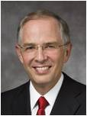
The Promise
“…in our age of information and knowledge, we must seek after wisdom. Wisdom is multidimensional and comes in different sizes and colors. Wisdom gained early brings enormous blessings. Wisdom in one area may not be transferable to another. And finally, the wisdom of the world, while in many cases very valuable, is most valuable when it humbly bows to the wisdom of God.”
Elder Neil L. Andersen
If we humble ourselves and seek diligently to learn, we will obtain wisdom and truth
D&C 97:1-4

Slide 7
The Tree—Members of the Church
Works or actions
Many members of the school of elders were humble and faithful.
However, others had become prideful and disobedient.
The phrase “the ax is laid at the root of the trees” evokes a vivid image. Generally, one touches the ax to the spot chosen for the first blow before delivering the blow.
Figuratively speaking, a tree that saw an ax laid at its root might be motivated to change its ways and bring forth good fruit so as not to be hewn down. Even as this revelation was given, the mobs were gathering for their initial blow in Jackson County. Student Manual
D&C 97:6-7

Slide 8
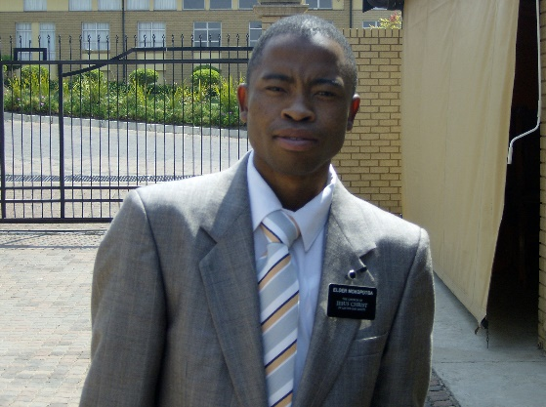
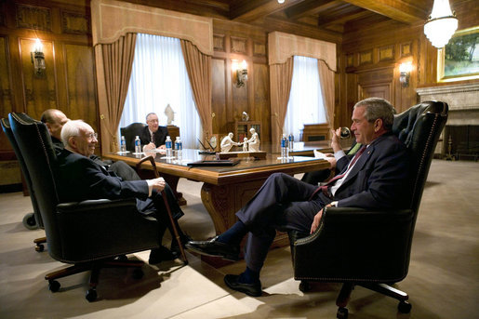

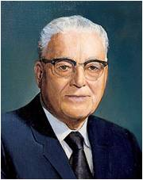
Principles of Sacrifice
To sacrifice, deny yourself all ungodliness.
To sacrifice, be willing to serve a mission.
To sacrifice, solemnize your marriage in the house of the Lord
To sacrifice, serve with your time and means to build the kingdom of God on earth.
“I [am] persuaded of one great truth: Whenever the Lord has a great blessing for one of his children, he puts that son or daughter in the way to make a great sacrifice.” Harold B. Lee
D&C 97:8-9 Ezra Taft Benson

Slide 9

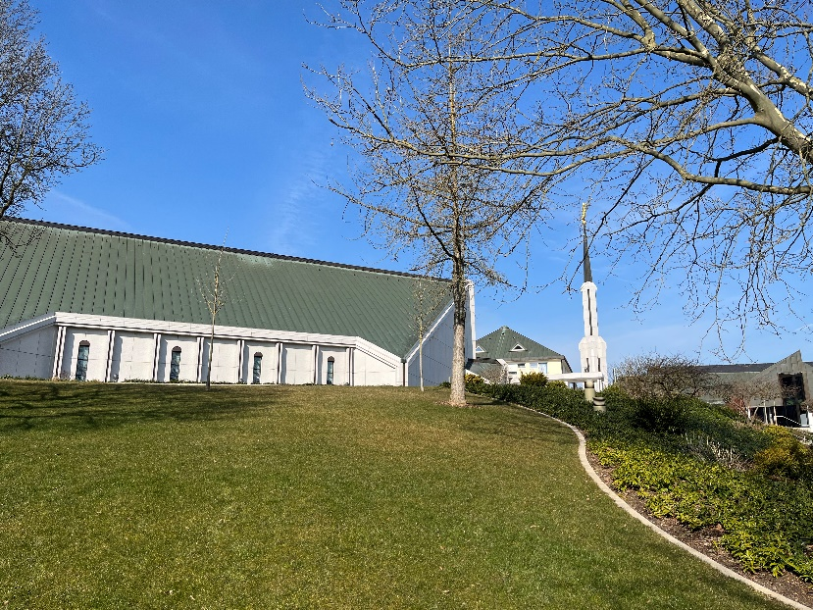
Sacrifice—Build a Temple
Tithe
The dictionary defines tithing as a tenth part of something paid as a voluntary contribution. In section 97 the word tithing is equated with sacrifice, specifically the sacrifice necessary to build a temple in Zion.
The Lord later defined tithing for the Saints as “one-tenth of all their interest annually” (D&C 119:4).
Today tithing is a tenth of one’s annual increase, or income.
A place of thanksgiving
The temple is a place where the Saints “may be perfected in the understanding of their ministry, in theory, in principle and in doctrine, in all things pertaining to the kingdom of God”
Student Manual
D&C 97:10-14
Friedrichsdorf, Germany Temple

Slide 10
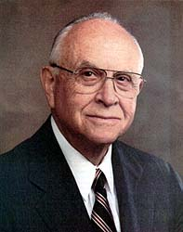
His Presence is Manifested
“It is true that some have actually seen the Savior, but when one consults the dictionary, he learns that there are many other meanings of the word see, such as coming to know Him, discerning Him, recognizing Him and His work, perceiving His importance, or coming to understand Him”
Elder David B. Haight
In the temple, God will manifest Himself to those who are pure in heart
D&C 97:15-16

Slide 11
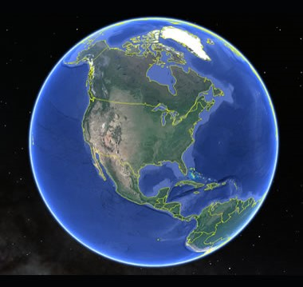
Destiny of Zion
“You know there has been great discussion in relation to Zion—where it is, and where the gathering of the dispensation is, and which I am now going to tell you.
The prophets have spoken and written upon it; but I will make a proclamation that will cover a broader ground.
The whole of America is Zion itself from north to south, and is described by the Prophets, who declare that it is the Zion where the mountain of the Lord should be, and that it should be in the center of the land.
When Elders shall take up and examine the old prophecies in the Bible, they will see it.”
HC
D&C 97:15-17

Slide 12

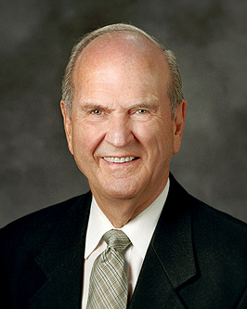
Something Pure
What are some benefits to having clean and pure water?
When water is impure, what are some ways to purify it?
How might pure water be compared to a pure heart?
The Lord does not expect perfection from us at this point in our eternal progression. But He does expect us to become increasingly pure. Daily repentance is the pathway to purity, and purity brings power.
Russell M. Nelson
D&C 97:21

Slide 13
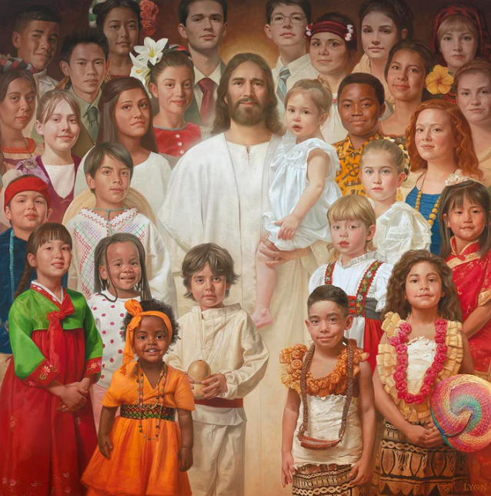
Zion and the Pure in Heart
Zion is not only a location but a condition as well. The Lord declares that a person worthy of Zion is one who is “pure in heart”.
Hyrum Smith described Zion as “the honest and pure in heart that will harken to the everlasting covenant”
HC
Howard Lyon
D&C 97:21

Slide 14
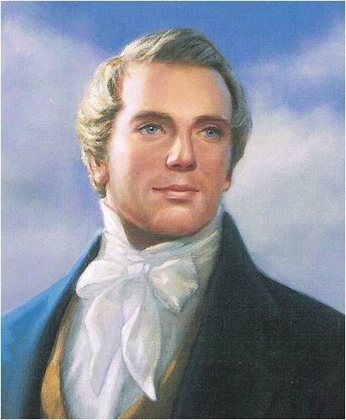
The Whirlwind
“If Zion will not purify herself, so as to be approved of in all things, in His sight, He will seek another people; for His work will go on until Israel is gathered, and they who will not hear His voice, must expect to feel His wrath. Let me say unto you, seek to purify yourselves, and also the inhabitants of Zion, lest the Lord’s anger be kindled to fierceness.
“Repent, repent, is the voice of God to Zion; and strange as it may appear, yet it is true, mankind will persist in self-justification until all their iniquity is exposed, and their character past being redeemed, and that which is treasured up in their hearts be exposed to the gaze of mankind.
Whirlwinds occur all over the world. Strong whirlwinds can turn into violent tornadoes that cause terrible damage.
“I say to you (and what I say to you I say to all), hear the warning voice of God, lest Zion fall, and the Lord swear in His wrath the inhabitants of Zion shall not enter into His rest.”
Joseph Smith
D&C 97:22

Slide 15
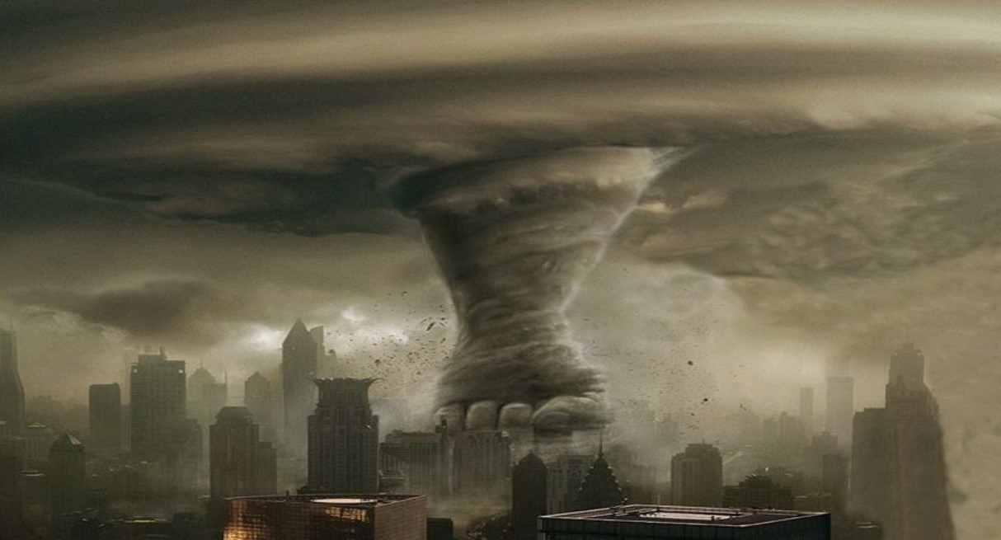
Escaping
Vengeance--consequences of disobeying the Lord.
What must we do to escape the Lord’s vengeance and receive His blessings?
If we are obedient, we will escape the vengeance of the Lord and receive a multiplicity of His blessings.
By November 1833, the Saints were expelled from Jackson County, Missouri, and they continued to face persecution in Missouri until they were driven from the state in 1838 and 1839.
D&C 97:24-28

Slide 16
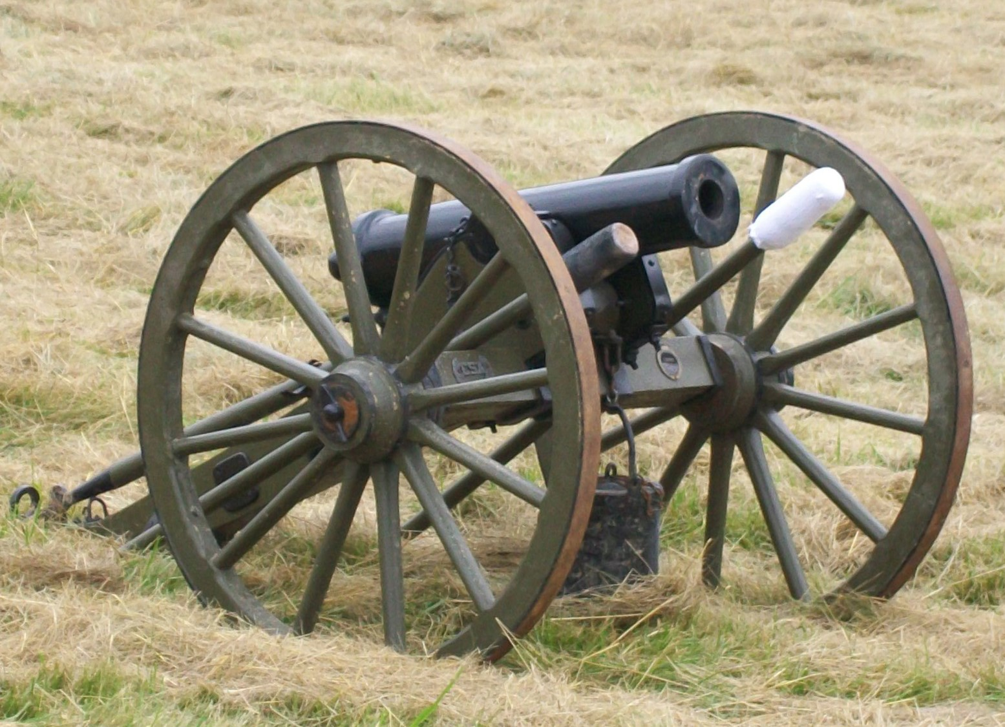
Another Escape
The Latter-day Saints, from this experience in the Eastern States, learned the necessity of obedience to the Word of the Lord.
They followed their divinely-appointed leaders into the Valleys of the Mountains, and, as a consequence, they have had blessings showered upon them, as a people and as individuals.
They did escape the scourge of the Civil War
Smith and Sjodahl
The Saints started their migration west in 1846
The Civil War started in 1861

Slide 17
Sources:
Hyrum M. Smith and Janne M. Sjodahl Doctrine and Covenants Commentary pgs. 608-610
Doctrine and Covenants Student Manual Religion 324-325 Section 97
Presentation by ©http://fashionsbylynda.com/blog/
Elder Neil L. Andersen Reverence for God Is the Beginning of Wisdom January 2013 Ensign
Ezra Taft Benson, of the Council of Twelve This Is a Day of Sacrifice April 1979 Gen. Conf.
Elder David B. Haight Temples and Work Therein Ensign, Nov. 1990, 61
History of the Church, 6:318–19; 6:320).
Joseph Smith (Teachings, pp. 18–19.)
Harold B. Lee (In Conference Report, Apr. 1947, p. 50.)
Russell M. Nelson, “We Can Do Better and Be Better,” Ensign or Liahona, May 2019, 68
Presentation by ©http://fashionsbylynda.com/blog/

Slide 18
Breakdown Of Church History http://beardall.tripod.com/dc/dc29.html
Section 97.
Historical Background.
On July 20, 1831, the Prophet Joseph received Section 57 wherein the Lord declared that Independence, Missouri is the place for the building of the city of Zion.
From this time on, the Church began to grow in Zion.
This can sometimes be a confusing period in Church history due to the fact that the Church is now focused in two centers, western Missouri and Kirtland.
In May 1832, Bishop Edward Partridge, bishop in Zion, dedicated the printing office run by W.W. Phelps. The first publication of the Church, the Evening and Morning Star, came of the press in June 1832.
It was here that Phelps began the task of printing 3,000 copies of the Book of Commandments (the earliest version of the D&C). Oliver Cowdery, John Whitmer, and W.W. Phelps reviewed and prepared the revelations for publication.
The Saints in Zion were bound by the law of consecration - they consecrated their money & possessions toward the purchase of land.
This consecration was not compulsory, yet failure to comply erased the offenders' names from the records of the Church.
Growth in Zion:
In 1832 (according to the Star) their were 830 souls in the new settlements.
Migration during the spring of 1833 raised the total to near 1200.
During the summer of 1833 the ten settlements in Zion were organized into branches with a president over each.
The Saints & their Missouri neighbors:
When the Saints first arrived in Jackson County they didn't warrant much attention from their neighbors. They were just a few more immigrants.
As the Saints began to increase in number, their Missouri neighbors were concerned about the beliefs of the Church and their increasing political clout.
The concept of "Zion" was a major factor in arousing the Missourians against them.
Discord among the Saints.
Many were striving toward the ideal of Zion, but still discord entered in among some of the Saints.
Some were disappointed the Prophet had not moved to Zion and began to criticize him.
There were those who were jealous of those who remained in Kirtland to live near the Prophet.
Some elders and high priests ignored the authority of those in charge and took it upon themselves to set the branches in order.
Almost every branch had problems:
One branch was disrupted by the teachings of the Hulet brothers who taught that "the devil and his angels and the sons of perdition should be restored."
In the Colesville branch, Newel Knight's aunt contradicted a revelation for the temporal welfare of Zion. Discord rocked this branch before priesthood leaders were successful in rebuking this spirit.
Joseph wrote a letter reproving the saints: "Our hearts our greatly grieved at the spirit,...the very spirit which is wasting the strength of Zion like a pestilence. ... If Zion will not purify herself, so as to be approved in all things, in His sight, He will seek another people; for His work will go on until Israel is gathered. Wo unto them that are at ease in Zion."
A council of high priests in Kirtland appointed Hyrum Smith and Orson Hyde to write another letter of reproof: "Repent, repent, or Zion must suffer, for the scourge and judgment must come upon her."
This letter was read to the members in all the branches and had some effect.
A solemn assembly was called at which sincere and humble repentance was manifested. A letter was sent to the authorities in Kirtland expressing the Saints' repentance and determination to keep God's commandments in the future.
90:34:"I say unto you that your brethren in Zion begin to repent, and the angels rejoice over them."
All was not entirely well. Continuing on in Section 90:35-36: "Nevertheless, I am not well pleased with many things; and I am not well pleased with my servant William E. McLellin, neither with my servant Sidney Gilbert; and the bishop also, and others have many things to repent of. "But verily I say unto you, that I, the Lord, will contend with Zion, and plead with her strong ones, and chasten her until she overcomes and is clean before me."

Slide 19
Tribulations in Zion.
In April 1833 a mob of 300 men met in Independence to consult on ways to expel the Mormons from Jackson County.
Church leaders gathered and prayed. The mob could not agree upon any scheme. The mob became drunk and broke up in "a regular Missouri row."
On July 1, 1833 the Reverend Benton Pixley penned a slanderous tract entitled "Beware of False Prophets".
He read this to the residents of each house in Jackson County "to incense the inhabitants against the Church, to mob them and drive them away."
Others joined Pixley in a published statement: "The Mormons are the common enemies of mankind and ought to be destroyed."
By the middle of July the Saints became aware of "The secret constitution". This document was signed by many notables in Jackson County.
It declared that the Mormons had become so obnoxious to the old settlers that civil law was insufficient to deal against this evil.
The signers intended to rid themselves of these objectionable persons "peaceably if we can, forcibly if we must."
On July 20, five hundred men met at the courthouse . A committee was formed and they drafted a report. It declared five restrictions on the Mormons.
No Mormon in the future could move and settle in the county.
The Mormons already in the county should pledge to move out of the county as soon as they can sell their property and conclude business. They would be left unmolested if they did so.
That the editor of the Evening and Morning Star discontinue publication and close his office. All other Mormon business in Jackson County were to discontinue business. If they failed to comply, measures would be resorted to in order to close those businesses.
Mormon leaders were to use their influence to stop further migration and encourage the Saints to comply with the above items.
Those who failed to respond were to be severely dealt with.
The crowd at the courthouse approved of these restrictions and appointed a committee of twelve to visit the Mormon leaders.
The committee was authorized to tell the Mormons that the mob would adopt rigid means of forcing the Mormons to leave the county.
The elders (W.W. Phelps, Edward Partridge, A. Sidney Gilbert, John Corrill, Isaac Morley, John Whitmer) asked for 3 months to consider the proposition and consult with leaders in Ohio. This was no small request.
Ten days were asked for and that was denied.
They were granted 15 minutes to make a decision.
The committee returned to the courthouse and a resolution was passed that the Star printing office should be razed to the ground and the type and press secured.
The mob then proceeding to the printing office and house of William W. Phelps.
One among the mob slipped out and warned the Phelps of the mobs approach.
He hitched a team to a wagon and assisted her and her sick baby into the seat. He encouraged them to get as far away, as fast as possible.
Phelps also escaped and hid.
The mob entered the living quarters of the Phelps and threw their furniture in the yard.
They rushed upstairs and threw the press out the window, destroyed the type, and burned most of the written revelations, bookwork, and papers.
They then demolished the brick structure.
John Taylor risked his life to retrieve some unbound copies of the Book of Commandments from a stable where they had been dumped.
Two teenage girls also saved a few copies from a pile of papers that were to be burned. These two girls rushed out, filled their aprons with the books, and fled to a corn field nearby. Some of the mob saw them and yelled for them to halt. One of the girls wrote: "...But we ran as fast as we could. Two of them started after us. Seeing a gap in a fence, we entered into a large cornfield, laid the papers on the ground, and hid them with our persons. The corn was from five to six feet high, and very thick; they hunted around considerable, and came very near to us but did not find us." (Joseph Smith & The Restoration, p.251)
The mob then destroyed the store of Gilbert, Whitney, and company. The mob stopped when Gilbert assured the mob that the goods would be packed by July 23.
They then broke into the houses of the Saints, searching for the leading elders. They caught Bishop Partridge and Charles Allen and dragged them a half mile to the public square where they were given two alternatives: deny the Book of Mormon or consent to leave the county. They would consent to neither.
Bishop Partridge and Allen were stripped and then tarred and feathered.
Partridge and Allen endured this indignity with such resignation and meekness that the mob seemed to become ashamed and they permitted them to retire in silence.
One of those encouraging and supporting the mob secretly was the lieutenant governor, Lilburn W. Boggs.
Oliver Cowdery was dispatched immediately back to Ohio to inform the Prophet and secure his counsel. Oliver arrived in Kirtland on August 21.
Section 97 was given on August 2, 1833. This revelation was given 19 days before Oliver arrived in Kirtland with details of the tribulations in Zion.

Slide 20
97:1-2 Those who participated in the school
Elder Parley P. Pratt described the school of the elders in Zion and his labors during the summer of 1833:
“This class, to the number of about sixty, met for instruction once a week. The place of meeting was in the open air, under some tall trees, in a retired place in the wilderness, where we prayed, preached and prophesied, and exercised ourselves in the gifts of the Holy Spirit. Here great blessings were poured out, and many great and marvelous things were manifested and taught. The Lord gave me great wisdom, and enabled me to teach and edify the Elders, and comfort and encourage them in their preparations for the great work which lay before us. I was also much edified and strengthened. To attend this school I had to travel on foot, and sometimes with bare feet at that, about six miles. This I did once a week, besides visiting and preaching in five or six branches a week” (Autobiography of Parley P. Pratt, ed. Parley P. Pratt Jr. [1938], 93–94; see also Doctrine and Covenants Student Manual, 2nd ed. [Church Education System student manual, 2001], 228).
Those who participated in the school of the elders studied scriptures, doctrine, and subjects like English grammar, other languages, history, literature, philosophy, arithmetic, and penmanship.
John A. Widtsoe “Temple work … gives a wonderful opportunity for keeping alive our spiritual knowledge and strength. … The mighty perspective of eternity is unraveled before us in the holy temples; we see time from its infinite beginning to its endless end; and the drama of eternal life is unfolded before us. Then I see more clearly my place amidst the things of the universe, my place among the purposes of God; I am better able to place myself where I belong, and I am better able to value and to weigh, to separate and to organize the common, ordinary duties of my life, so that the little things shall not oppress me or take away my vision of the greater things that God has given us.” (In Conference Report, Apr. 1922, pp. 97–98.)
A temple of God is a place of purity and holiness. Those who enter it must be worthy, so interviews for temple recommends are held yearly to determine worthiness. The Saints are under the Lord’s command not to “suffer any unclean thing to come into it, that it be not defiled” (D&C 97:15). If this requirement is met, the Lord promises that He “will come into it, and all the pure in heart that shall come into it shall see God” (v. 16).
Elder Henry D. Taylor commented on the responsibility of the President of the Church: “In general terms, and this is something that pertains to all of us, it is the Lord’s plan that no unrepentant sinner enter the temple, for the Lord has declared that he will not abide in temples that have been defiled by any unclean thing. (See D&C 97:15–19.) The President of the Church, President Spencer W. Kimball, is directly responsible to the Lord to see that the sacredness of the temples and the ordinances performed therein are maintained. I can assure you that President Kimball takes that stewardship most seriously.” (“I Have a Question,” Ensign, Feb. 1976, p. 34.)
ZION
President Brigham Young said: “This American continent will be Zion; for it is so spoken of by the prophets. Jerusalem will be rebuilt and will be the place of gathering, and the tribe of Judah will gather there; but this continent of America is the land of Zion.” (In Journal of Discourses, 5:4.)
Terrible is used to describe Zion because the basic meaning of the word is “something that causes terror.” Zion’s glory will be such that it will strike terror into the hearts of the wicked (see D&C 45:70; 105:31; see also Enrichment B in the Appendix).

