Slide 1
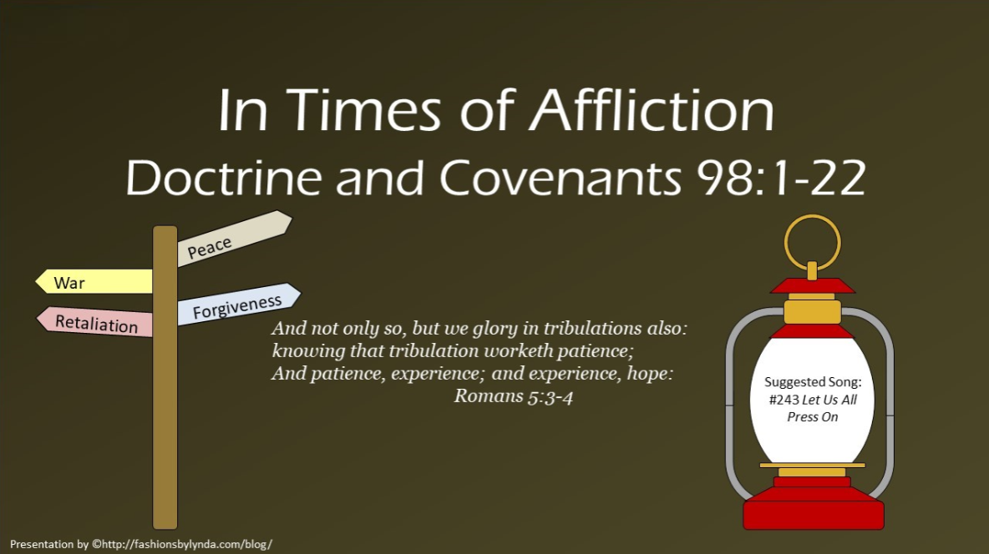

Slide 2
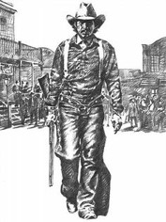
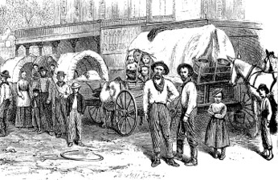
Background
They demanded that no more Latter-day Saints be allowed to move to Jackson County and said that those already living there must pledge to leave as soon as possible.
In addition, they demanded that the Church newspaper stop publication.
On Saturday, July 20, 1833, between 400 and 500 angry Missouri citizens met at the courthouse in Independence, Missouri. They chose a committee to draft a document outlining their demands of the Mormons.
When these demands were presented to the Church leaders in Missouri, the Church leaders were startled and asked for three months to consider the proposition and to consult with Church leaders in Ohio.
The group of Missouri citizens presenting the demands denied the Church leaders’ request.
The Saints then asked for 10 days, but they were allowed only 15 minutes to respond.
Fulness of Times Student Manual

Slide 3
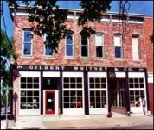
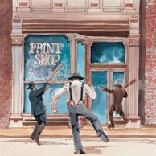

The Missourians at the meeting in the Independence courthouse quickly turned into a mob and decided to destroy the printing office and the press.
They broke into the printing office, threw the furniture into the street and garden, broke the press, scattered the type, and destroyed nearly all the printed work, including most of the unbound sheets of the Book of Commandments.
The mob next went to destroy the Gilbert and Whitney Store. However, Sidney Gilbert met the mob before they could carry out their plan and promised that he would pack the goods and leave in three days.
Fulness of Times Student Manual

Slide 4
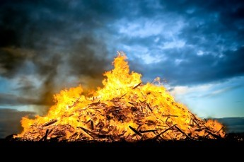

Three days later, on July 23, a mob appeared again in Jackson County, Missouri, this time armed with rifles, pistols, whips, and clubs. They set fire to haystacks and grain fields and destroyed several homes, barns, and businesses.
They eventually confronted six Church leaders who, seeing that the property and lives of the Saints were in jeopardy, offered their lives as a ransom.
Rejecting this offer, the mob leaders threatened that every man, woman, and child would be whipped unless they consented to leave the county.
Edward Partridge, William Phelps,
Isaac Morley, A. Sidney Gilbert, John Whitmer, and John Corrill
Under pressure, the brethren signed an agreement to leave Jackson County.
Half of the Church members and most of the leaders would leave by January 1, 1834, and the rest would leave by April 1, 1834.
The mob allowed John Corrill and Sidney Gilbert to remain to sell the property of the Saints who had been driven out.
Fulness of Times Student Manual

Slide 5



Also, during the summer of 1833, vigilante groups gathered to drive the Saints from Jackson County by force.
Bishop Edward Partridge and Charles Allen were beaten, tarred, and feathered.
Vienna Jaques, along with sisters Mary and Caroline Rollins, bravely grabbed as many pages of the revelations as they could before they were ruined.
They ran and hid themselves and the revelations from the mob. In the attack, many Saints were forced to leave their homes at gunpoint.
Saints: The Story of the Church of Jesus Christ in the Latter Days, vol. 1, The Standard of Truth, 1815–1846 [2018], 172–181).

Slide 6
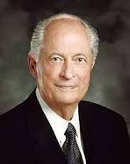
Sabaoth
Hebrew word meaning “hosts” or “armies.”
What, then, does it mean to wait upon the Lord?
In the scriptures, the word wait means to hope, to anticipate, and to trust. To hope and trust in the Lord requires faith, patience, humility, meekness, long-suffering, keeping the commandments, and enduring to the end”
Robert D. Hales
If we give thanks in all things and wait patiently on the Lord, then the Lord can make our afflictions work together for our good
D&C 98:1-2

Slide 7
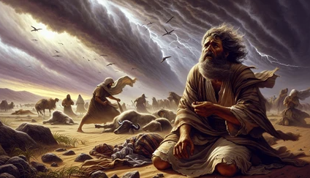
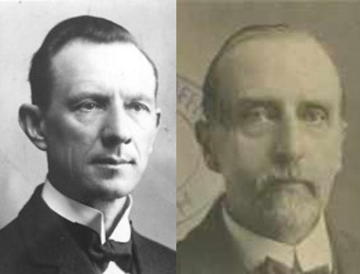
A Call To Show Great Faith
Example:
The Trials of Job
“Even the evil designs of men, in the hands of the Masterworkman, will turn out for the benefit of the people of God, and for His glory.
The divine Will overrules all things for the final good of His children.”
Smith and Sjodahl
Though he slay me, yet will I trust in him: but I will maintain mine own ways before him.
Job 13:15
D&C 98:3

Slide 8


Law of Forgiveness
“It is natural for people’s feelings to be aroused when they suffer unjust abuses. …some felt a desire to retaliate.
“…The law of forgiveness and retribution depicted in the latter half of this revelation is most worthy of careful study. This law applies to individuals and to families, as well as to the Church at large.”
Joseph Fielding Smith
For the eyes of the Lord are over the righteous, and his ears are open unto their prayers: but the face of the Lord is against them that do evil
1 Peter 3:12
D&C 98:4

Slide 9
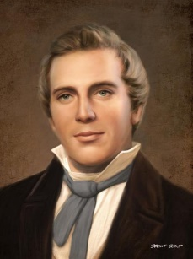
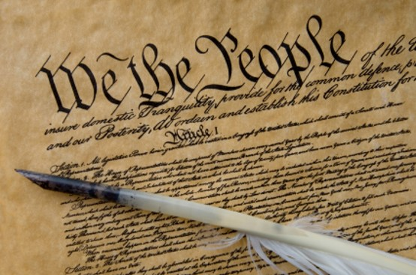
Principle of Freedom
Constitutional Law of the Land
“that principle of freedom in maintaining rights and privileges” and belonged “to all mankind”
We believe in being subject to kings, presidents, rulers, and magistrates, in obeying, honoring, and sustaining the law.
“It is one of the first principles of my life, and one that I have cultivated from my childhood, having been taught it by my father, to allow every one that liberty of conscience. I am the greatest advocate of the Constitution of the Untitled States there is on the earth. In my feelings I am always ready to die for the protection of the weak and oppressed in their just rights”
Joseph Smith
D&C 98:4-10

Slide 10
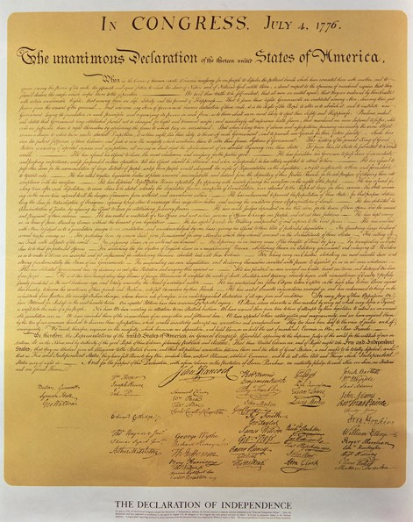
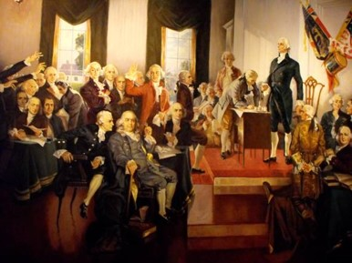
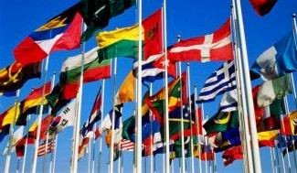
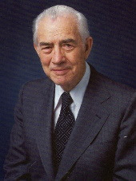
Purpose of the Law
“Without the Constitution there would be no government such as the Lord had in mind.
“The Lord gave us that government by providing the Constitution written by the hands of wise men whom he raised up for this very purpose.
“It was an act of God. It was another step in establishing the free conditions under which the gospel could be restored and then taken by the believing Gentiles to all other nations.”
Elder Mark E. Petersen
D&C 98:8

Slide 11
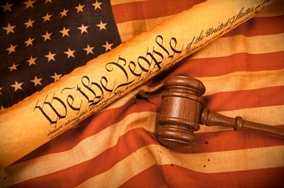
Benefits of the Law
“All the laws of god and the laws of nature and the laws of the land are made for the benefit of man, for his comfort, enjoyment, safety, and well-being; and it is up to the individual to learn these laws and to determine whether or not he will enjoy these benefits by obeying the law and keeping the commandments.
President N. Eldon Tanner
How do I know that a given law is constitutional and justifiable before the Lord?
“Any law that supports the principle of freedom in maintaining the rights and privileges, of mankind is constitutional in the eyes of the Lord”
“Any law that restricts or diminishes the right of agree agency of an individual is not constitutional.”
(see comment of Elder Marion G. Romney)
D&C 98:5-6

Slide 12

When Wicked Rules—Others Mourn
“However, constitutional laws alone do not necessarily insure a righteous environments as a blessing for the people.”
“The Lord expects His people to be righteously involved in the political process.”
We must seek and uphold honest and righteous men to administer righteous laws
D&C 98:9-10 Otten and Caldwell

Slide 13
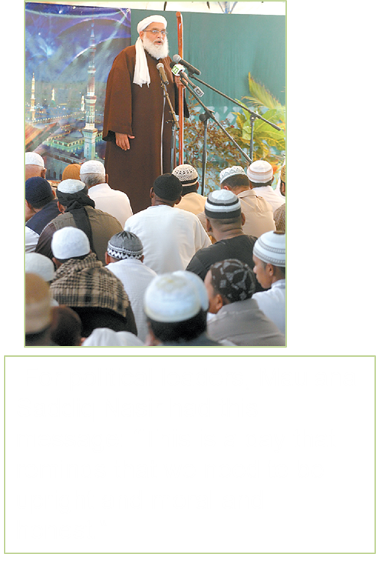
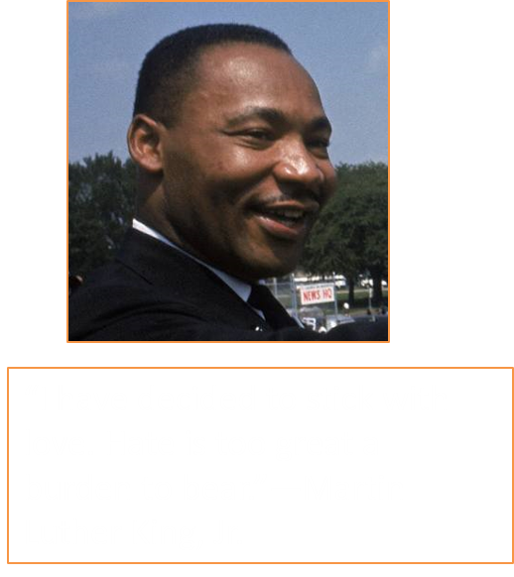
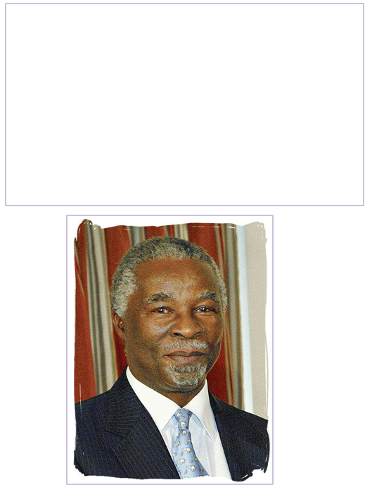
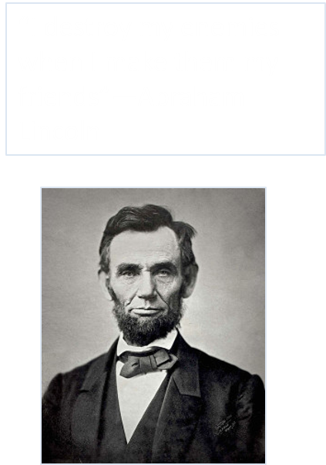
Men of Honor

Slide 14
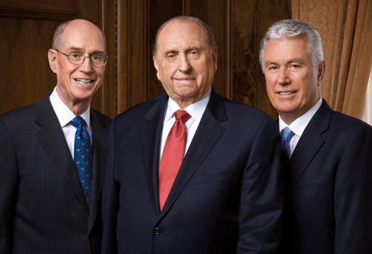
The following letter was issued by the First Presidency of The Church of Jesus Christ of Latter-day Saints on September 11, 2008, to be read to Church congregations throughout the United States:
Political Participation, Voting, and the Political Neutrality of the Church
As citizens we have the privilege and duty of electing office holders and influencing public policy. Participation in the political process affects our communities and nation today and in the future.
Latter-day Saints as citizens are to seek out and then uphold leaders who will act with integrity and are wise, good, and honest. Principles compatible with the gospel may be found in various political parties.
Therefore, in this election year, we urge you to register to vote, to study the issues and candidates carefully and prayerfully, and then to vote for and actively support those you believe will most nearly carry out your ideas of good government.
The Church affirms its neutrality regarding political parties, platforms, and candidates. The Church also affirms its constitutional right of expression on political and social issues.
Sincerely yours,
Thomas S. Monson Henry B. Eyring Dieter F. Uchtdorf The First Presidency (2016)

Slide 15
Forsake All Evil
Everything that is contrary to the will of God
All good includes all that is in harmony with the will of God
The Lord will test us to see if we will keep our covenants even when it is difficult to do so
Obedience to the commandments of God opens a door to the revelations of God
D&C 98:11

Slide 16
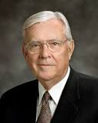

I Will Try You…
Waiting upon the Lord implies continued obedience and spiritual progress toward Him. Waiting upon the Lord does not imply biding one’s time. You should never feel like you are in a waiting room.
Waiting upon the Lord implies action. I have learned over the years that our hope in Christ increases when we serve others. Serving as Jesus served, we naturally increase our hope in Him.
The personal growth one can achieve now while waiting upon the Lord and His promises is an invaluable, sacred element of His plan for each one of us.
M. Russell Ballard
D&C 98:12

Slide 17
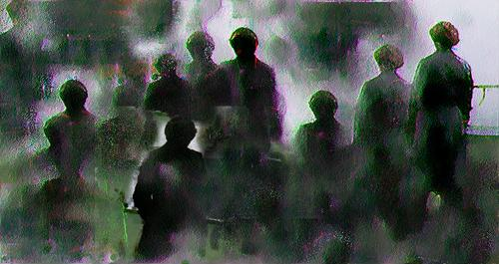

Eternal Life After Death
The great and final unknowable factor in this life is death and what happens after it. But regarding this mystery that all men and women must face, the Savior provides an assurance that death is not the end.
The Savior assures the Saints that if they are asked to lay down their life for His cause, there will be a place prepared for them.
For those who die sincerely engaged in a noble cause, death is not the end of their existence but a gateway into eternal life.
Being faithful to the gospel does not come with an assurance that you will be free from trials, but it does allow you to make choices about what your future state after this life will be.
Casey Paul Griffiths
D&C 98:13-14,18

Slide 18

Fear Not Your Enemies
Live to be immune from the world
Be in the line of duty
Be worthy of the Fellowship with God
Stand spotless before the world—without blemish or transgression
Be ready, in frame of understanding, mind, and conduct
D&C 98:14-15 President Joseph F. Smith (excerpt from)

Slide 19

Proclaim Peace
There is no blessing greater than peace
There is no greater evil than war
Our righteous attitudes are pre-requisite to our righteous relationship to the Lord
An evil reaction is not in harmony with the godliness required of the Saints
D&C 98:16-22

Slide 20
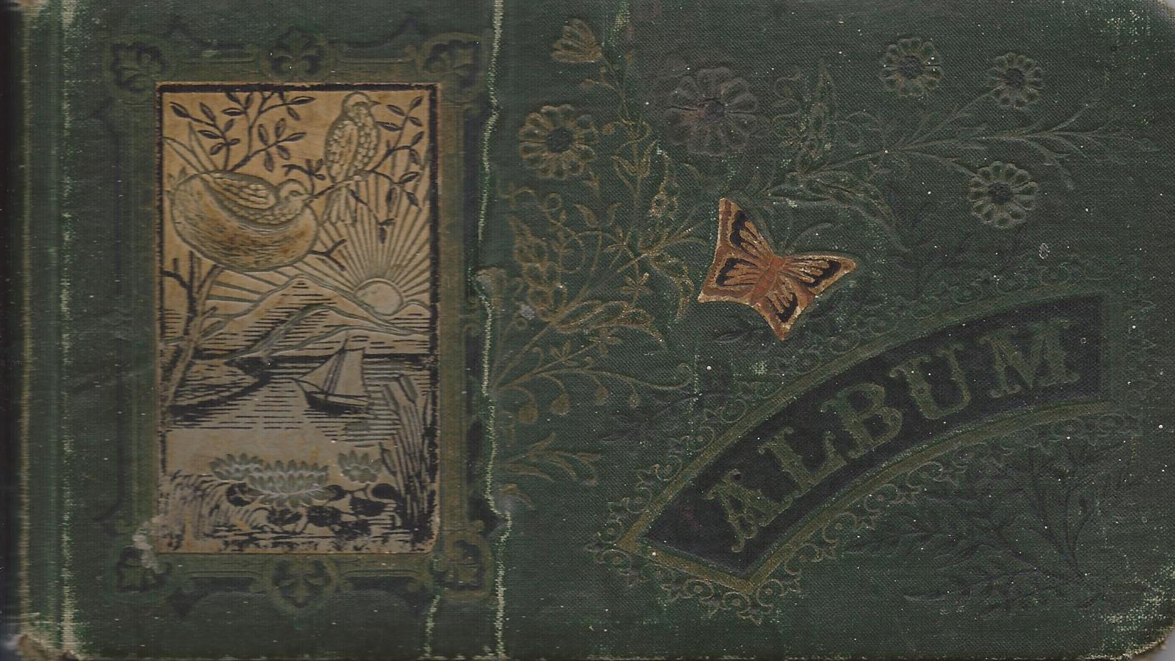
Turn the Hearts of the Children
This is the great mission of the Church of Jesus Christ of Letter-day Saints. War is one with the evils they must forsake; peace is one of the blessings they must cleave to. For they are to link together the hearts of the ancestors and their descendants.”
Smith and Sjodahl
D&C 98:16-22

Slide 21
Sources:
Videos:
Afflictions Can Be For Our Good (1:44)
Prayers Feel Unanswered (You Tube) Michael S. Wilcox (1:00:00)
God Will Lift Us Up (4:59)
Legacy Video (time codes: 5:39 and 7:45
“ Mountains to Climb” (5:05)
(See Church History in the Fulness of Times Student Manual, 2nd ed. [Church Educational System manual, 2003], 132–34.)
Robert D. Hales (“Waiting upon the Lord: Thy Will Be Done,” Ensign or Liahona, Nov. 2011, 72).
Presentation by ©http://fashionsbylynda.com/blog/
Hyrum M. Smith and Janne M. Sjodahl Doctrine and Covenants Commentary pg. 616, 621
Joseph Fielding Smith CHMR, Vol. 2, p. 191
Joseph Smith Teachings of the Prophet Joseph Smith p. 326
Elder Mark E. Petersen (Great Prologue, pp. 74–75, 78.)
President N. Eldon Tanner April 1970 Conf. Report
L.G. Otten and C.M. Caldwell Sacred Truths of the Doctrine and Covenants pg. 166
President Joseph F. Smith The Gospel a Shield from Terror, Improvement Era, July 1917, p. 827
M. Russell Ballard, “Hope in Christ,” Liahona, May 2021, 55
Casey Paul Griffiths “Doctrine and Covenants Central” section 98
Presentation by ©http://fashionsbylynda.com/blog/

Slide 22
Elder Mark E. Petersen explained:
“When the Kirtland Temple was to be dedicated and the Prophet Joseph sought direction from the Lord in accomplishing this important responsibility, the Lord gave to the Prophet the dedicatory prayer for the occasion. It was revelation—the word of the Lord—and not of man. Yet in it, the Lord directed the prophet to pray: "… may those principles, which were so honorably and nobly defended, namely, the Constitution of our land, by our fathers, be established forever.’ (D&C 109:54.) This is significant!
“Let us recall again the words of the Lord to the Nephites. Said he, in speaking of this mighty nation of the Gentiles that he said would be established on this land in latter days: ‘For it is wisdom in the Father that they should be established in this land, and be set up as a free people by the power of the Father. …’ (3 Nephi 21:4. Italics added.)
“Without the Constitution there would be no government such as the Lord had in mind. The Lord gave us that government by providing the Constitution written by the hands of wise men whom he raised up for this very purpose. It was an act of God. It was another step in establishing the free conditions under which the gospel could be restored and then taken by the believing Gentiles to all other nations.
“As the Lord indicated so plainly through Nephi and likewise in his own declaration to the Nephites after his resurrection as quoted above, it was a giant step in the divine plan to fulfill the promise made to Abraham, that God would recover his scattered seed by the preaching of the gospel. (See 1 Nephi 22:7–11; 3 Nephi 21:4.) His sheep would know his voice.
“This, then, is why there is a United States.
“The Prophet Joseph Smith said that ‘the Constitution of the United States is a glorious standard; it is founded in the wisdom of God. It is a heavenly banner. …’ (Teachings of the Prophet Joseph Smith, p. 147. Italics added.)
“He also said, ‘I am the greatest advocate of the Constitution of the United States there is on earth.’ (Ibid., p. 326.)
“The Constitution provided freedom of religion, speech, press, and assembly. Therefore, under the Constitution the Lord could restore the gospel and reestablish his church. The preparation of the Constitution was the work of his own hand. The restoration of the gospel was likewise his work. Both were part of a greater whole. Both fit into his pattern for the latter days.
“There would be no state church in America to interfere. All men in this land now were given the right to worship God according to the dictates of their own conscience, and that included Joseph Smith and his followers. It is true they were persecuted, as the people of God always have been, but the law—the Constitution—provided the very thing the Lord had in mind: freedom to reestablish his work in these last days, for he had so arranged it. …
“For years the Church has held that the Constitution is an inspired document. But how many know why it was inspired and what the Almighty had in mind in giving such inspiration?
“May we never forget the underlying reasons for it all: to provide a proper place for the restoration of the gospel and to allow for the worldwide preaching of that sacred word.
“Let us always remember that its formation was one of the vital steps preparatory to the second coming of the Savior.” (Great Prologue, pp. 74–75, 78.)

Slide 23
Elder Marion G. Romney
“We who hold the Priesthood must beware concerning ourselves, that we do not fall into the traps he (Satan) lays to rob us of our freedom. We must be careful that we are not led to accept or support in any way any organization, cause, or measure which, in its remotest effect, would jeopardize free agency, whether it be in politics, government, religion, employment, education, or any other field. It is not enough for us to be sincere in what we support. We must be right?” (CR October 1960 p. 75)
Edward Partridge:
Before tarring and feathering me, I was permitted to speak. I told them that the Saints had had to suffer persecution in all ages of the world; that I had done nothing which ought to offend anyone; that if they abused me, they would abuse an innocent person; that I was willing to suffer for the sake of Christ; but to leave the country, I was not then willing to consent to it. …
… I bore my abuse with so much resignation and meekness that it appeared to astound the multitude, who permitted me to retire in silence, many looking very solemn, their sympathies having been touched as I thought; and as to myself, I was so filled with the Spirit and love of God, that I had no hatred towards my persecutors or anyone else. (Edward Partridge, in History, 1838–1856 [Manuscript History of the Church], volume A-1, 327–28, josephsmithpapers.org; spelling, capitalization, and punctuation standardized)
The Rescued Pages:
Elder Steven E. Snow of the Presidency of the Seventy shared the story of Mary Elizabeth and Caroline Rollins:
“After moving with their mother to Independence, Missouri, in the fall of 1831, young sisters Mary Elizabeth and Caroline Rollins soon learned of the hardship and persecution the Saints faced there. One night an angry mob attacked their home; on another occasion, they witnessed an attack on the newly constructed printing office located on the upper floor of the William W. Phelps residence.
“During the attack on the printing office [on July 20, 1833], the mob forced the Phelps family from their home and threw their belongings into the street. Mobsters then went to work destroying the printing equipment upstairs and throwing unbound manuscripts from the building. Some brought out large sheets of paper and declared, ‘Here are the Mormon Commandments!’ [“Mary Elizabeth Rollins Lightner,”
The Utah Genealogical and Historical Magazine,July 1926, 196]. By this time, the Prophet Joseph Smith had received many sacred revelations, some as early as 1823, when the angel Moroni appeared to the boy prophet. Joseph had recorded numerous revelations in his own handwriting, but no text had been prepared and distributed for the benefit of members of the Church. With much excitement, the Saints in Missouri anticipated the publication of these revelations as a ‘Book of Commandments.’ This work was under way at the printing office when the mob struck. Mary Elizabeth, then 15, described what happened:
“‘My sister Caroline [age 13] and myself were in a corner of a fence watching them; when they spoke of the commandments I was determined to have some of them. Sister said if I went to get any of them she would go too, but said “they will kill us”’ [“Mary Elizabeth Rollins Lightner,” 196].
“While the mob was busy at one end of the house, the two girls ran and filled their arms with the precious sheets. The mob saw them and ordered the girls to stop. Mary Elizabeth recalled: ‘We ran as fast as we could. Two of them started after us. Seeing a gap in a fence, we entered into a large cornfield, laid the papers on the ground, and hid them with our persons. The corn was from five to six feet high, and very thick; they hunted around considerable, and came very near us but did not find us’ [“Mary Elizabeth Rollins Lightner,” 196]” (“Treasuring the Doctrine and Covenants,” Ensign, Jan. 2009, 50).
Waiting on the Lord D&C 98:13:
There will be times in our lives when even our best spiritual effort and earnest, pleading prayers do not yield the victories for which we have yearned, whether that be regarding the large global matters or the small personal ones. So while we work and wait together for the answers to some of our prayers, I offer you my apostolic promise that they are heard and they are answered, though perhaps not at the time or in the way we wanted. But they are always answered at the time and in the way an omniscient and eternally compassionate parent should answer them. My beloved brothers and sisters, please understand that He who never sleeps nor slumbers cares for the happiness and ultimate exaltation of His children above all else that a divine being has to do. He is pure love, gloriously personified, and Merciful Father is His name. (Jeffrey R. Holland, “Waiting on the Lord,” Liahona, Nov. 2020, 115–116)

