Slide 1
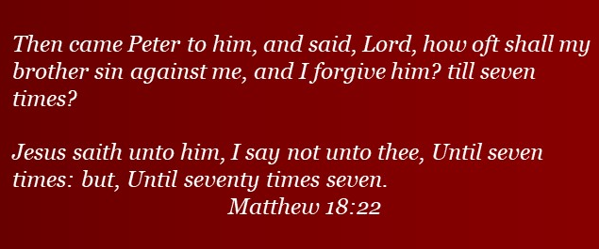
Doctrine and Covenants 98:23-48
Proclaim Peace
Presentation by ©http://fashionsbylynda.com/blog/

Slide 2

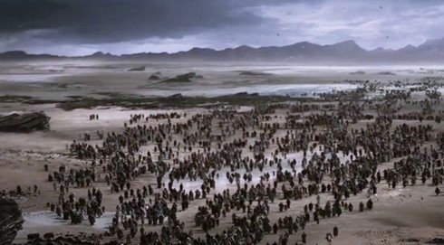
The Lord’s Law On Retaliation
Under the Mosaic Law--lex talionis or the law of talion -- ‘An eye for an eye and a tooth for a tooth,’
The highest ideal of justice to which the majority of the Children of Israel could rise
If we bear mistreatment patiently and without retaliating, the Lord will reward us.
D&C 98:23-32 Student Manual

Slide 3
Biblical-An Eye For An Eye
Legal codes following the principle of lex talionis have one thing in common: prescribed 'fitting' counter punishment for an offence.
In the famous legal code written by Hammurabi, the principle of exact reciprocity is very clearly used. For example, if a person caused the death of another person, the killer would be put to death.
And if a man cause a blemish in his neighbour; as he hath done, so shall it be done to him;
Breach for breach, eye for eye, tooth for tooth: as he hath caused a blemish in a man, so shall it be done to him again.
And he that killeth a beast, he shall restore it: and he that killeth a man, he shall be put to death.
Leviticus 24:19-21
And if any mischief follow, then thou shalt give life for life,
Eye for eye, tooth for tooth, hand for hand, foot for foot,
Burning for burning, wound for wound, stripe for stripe.
Exodus 21:23-25
D&C 98:23-32 Wikipedia

Slide 4

The Higher Law
38 Ye have heard that it hath been said, An eye for an eye, and a tooth for a tooth:
39 But I say unto you, That ye resist not evil: but whosoever shall smite thee on thy right cheek, turn to him the other also.
40 And if any man will sue thee at the law, and take away thy coat, let him have thy cloak also.
41 And whosoever shall compel thee to go a mile, go with him twain.
42 Give to him that asketh thee, and from him that would borrow of thee turn not thou away.
43 Ye have heard that it hath been said, Thou shalt love thy neighbour, and hate thine enemy.
44 But I say unto you, Love your enemies, bless them that curse you, do good to them that hate you, and pray for them which despitefully use you, and persecute you;
45 That ye may be the children of your Father which is in heaven: for he maketh his sun to rise on the evil and on the good, and sendeth rain on the just and on the unjust.
46 For if ye love them which love you, what reward have ye? do not even the publicans the same?
47 And if ye salute your brethren only, what do ye more than others? do not even the publicans so?
48 Be ye therefore perfect, even as your Father which is in heaven is perfect.
The gospel of Jesus Christ
Matthew 5:38-48
D&C 98:23-32 Wikipedia

Slide 5
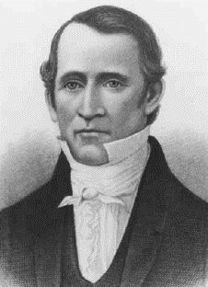
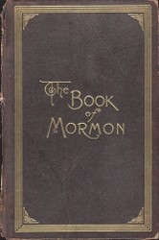
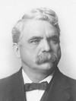
“The mob caught Bishop Edward Partridge and Charles Allen, and dragged them through the maddened crowd, which insulted and abused them along the road to the public square.
Here two alternatives were presented them; either they must renounce their faith in the Book of Mormon or leave the county.
The Book of Mormon they would not deny, nor consent to leave the county.
Bishop Partridge, being permitted to speak, said that the saints had to suffer persecution in all ages of the world, and that he was willing to suffer for the sake of Christ, as the saints in former ages had done; that he had done nothing which ought to offend anyone, and that if they abused him, they would injure an innocent man.
Here his voice was drowned by the tumult of the crowd, many of whom were shouting: ‘Call upon your God to deliver you … !’
D&C 98:23-32 B.H. Roberts

Slide 6
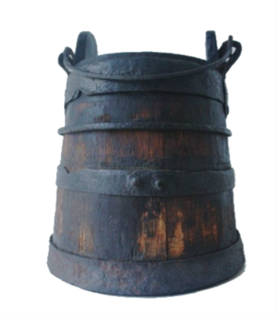


The two brethren, Partridge and Allen, were stripped of their clothing, and bedaubed with tar, mixed with lime, or pearl-ash, or some other flesh-eating acid, and a quantity of feathers scattered over them.
They bore this cruel indignity and abuse with so much resignation and meekness that the crowd grew still, and appeared astonished at what they witnessed.
The brethren were permitted to retire in silence.”
B. H. Roberts
“Revile it not”
The Lord counseled the Saints that if an enemy had harmed them three times without incurring the vengeance of God, they should warn the enemy in the name of the Lord not to harm them again.
“Bear it”
If the enemy continued to harm them after this warning, the Saints were justified in “reward[ing] him according to his works.” However, the Saints were also told that if they spared their enemies even though they were justified in retaliating, they would be rewarded for their righteousness.
D&C 98:23-32

Slide 7

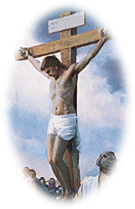
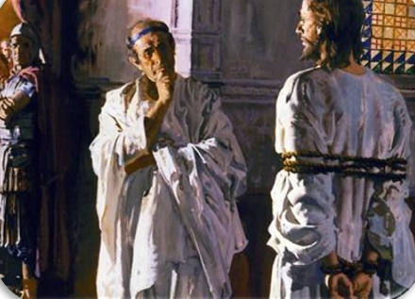
Love Returned For A Wrong
“As the world is constituted at present, it is impossible to live in it without being wronged some time. What to do, when wronged, is one of the great problems of a Christian life.
The world says, ‘Get even!’
The Master said, ‘Forgive!’…
Christ bids us remember that our worst enemy is, after all, one of God’s children whom Christ came to save, and that we ought to treat him as we would an erring brother.
Very often Christian love in return for a wrong proves the salvation of the wrongdoer.
It always has a wonderful effect upon those who practice it. It makes them strong, beautiful and God-like, whereas hatred and revenge stamp, upon the heart in which they dwell, the image of the devil. …
D&C 98:23-32 Smith and Sjodahl

Slide 8
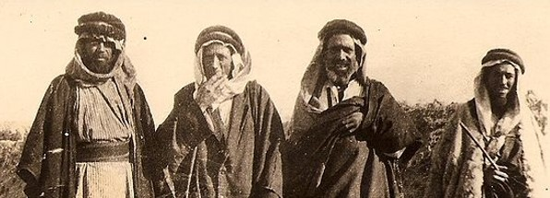

Israel—War Cradled Nation
The Lord gave this law specifically to people who lived in a different time and in a different culture.
Although the principle of the law is true, today we are also subject to the laws of the nations in which we live
All men 21 years of age, and capable went into military service
Numbers 1:3
Those Exempt from War
A man building a house that had not been dedicated
One who had planted a vineyard
One who was engaged to be married
Deuteronomy 20:5-7
One who was newly married for 1 year
Deut. 24:5
All priests and Levites engaged in Temple service were exempt
Numbers 1:47
Anyone who was afraid, ‘faint-hearted’
Deut. 20:8
By these sweeping restrictions, the Temple service, industrial and agricultural pursuits, and domestic happiness were exalted above militarism, at a time when the military cast wielded the predominating influence in many countries.
D&C 98:33-38 Smith and Sjodahl

Slide 9
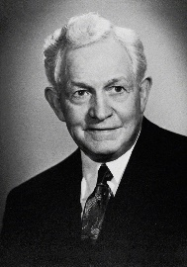
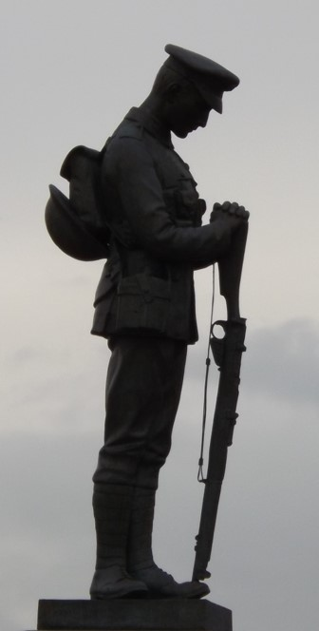
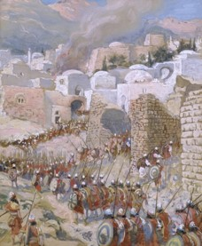
War Inevitable
“There are … two conditions which may justify a truly Christian man to enter—mind you, I say enter, not begin—a war:
An attempt to dominate and to deprive another of his free agency,
(2) Loyalty to his country. Possibly there is a third, viz., Defense of a weak nation that is being unjustly crushed by a strong, ruthless one.
“Paramount among these reasons, of course, is the defense of man’s freedom. An attempt to rob man of his free agency caused dissension even in heaven. …
“To deprive an intelligent human being of his free agency is to commit the crime of the ages. …” David O. McKay
“Israel was enjoined from going to war with any city or nation, until a peace-offer had been refused (Deut. 20:10)
When war became inevitable, the Israelites were expressly commanded not to cut down the fruit trees in the territory of the enemy (Deut. 20:19).
Unnecessary vandalism was prohibited.
D&C 98:33-38

Slide 10
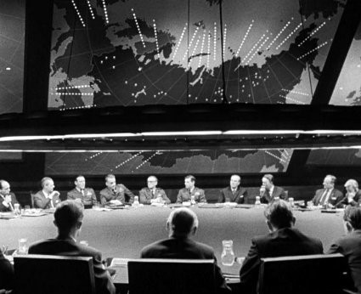
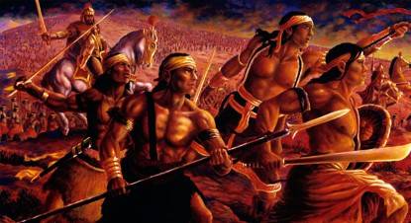
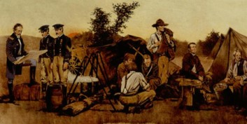
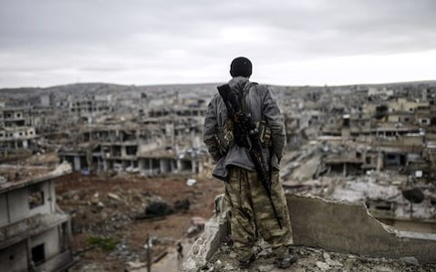
War can be justified under circumstances prescribed by the Lord
D&C 98:35-38

Slide 11

The Lord’s Law On War
If we would have peace, we must make up our minds to pay the price of peace.
Such is the word of God, and such is the verdict of six thousand years of human history.
We should seek peaceful resolutions to our disagreements
Even as we try to teach the gospel of peace, we see that most people would prefer to focus on other aspects of the problem.
Even so, we should not live a life of despair and gloom. We should enjoy life in the light of revealed truth. Keep ourselves advised as to what the Lord has said about the price of peace.
D&C 98:33-38 President Marion G. Romney

Slide 12
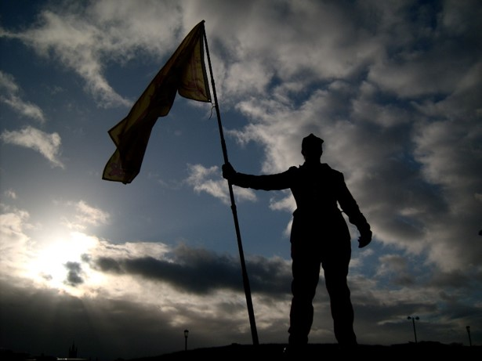
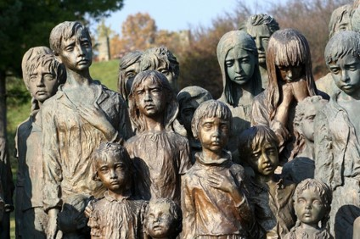

The Right To Freedom
“So fundamental in man’s eternal progress is his inherent right to choose, that the Lord would defend it even at the price of war.
Without freedom of thought, freedom of choice, freedom of action within lawful bounds, man cannot progress. …
“The greatest responsibility of the state is to guard the lives, and to protect the property and rights of its citizens; and if the state is obligated to protect its citizens from lawlessness within its boundaries, it is equally obligated to protect them from lawless encroachments from without—whether the attacking criminals be individuals or nations.”
President David O. McKay
D&C 98:33-38

Slide 13
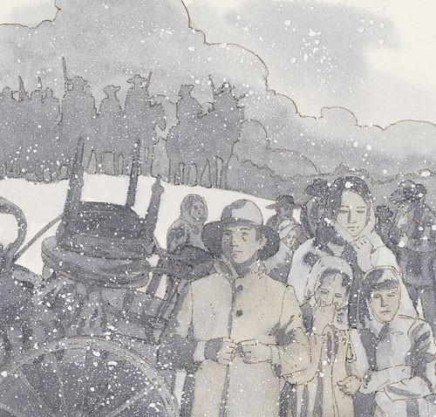
The Lord’s Law On Forgiveness
The Saints are taught to bear persecution patiently, and not to seek revenge;
Here they are instructed to go still farther, and forgive an enemy as often as he repents of his evil-doing, and a stated number of times, even if he does not repent
If, however, he continues to trespass and does not repent, the case is to be brought before the Lord, in the hope that the sinner may be brought to repentance; when that object is gained, he is to be forgiven;
if there is no repentance, the matter is to be left entirely in the hands of the Lord.
D&C 98:39-48 Smith and Sjodahl

Slide 14


Abuse
Although we are to bear mistreatment patiently and without retaliating, this does not mean we should allow others to abuse or harm us.
Handbook 2: Administering the Church says that “abuse cannot be tolerated in any form.
Those who abuse or are cruel to their spouses, children, other family members, or anyone else violate the laws of God and man”

Slide 15
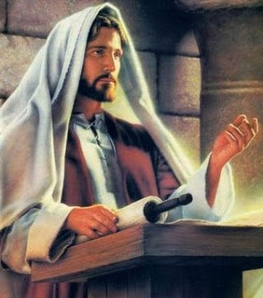
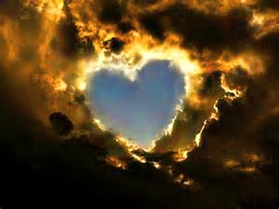
Seventy Times Seven
“In the days of our Lord, the Rabbis taught that no one was under obligation to forgive a neighbor more than three times. Peter, asking the Master for a ruling on that question, suggested that perhaps seven times would be a liberal improvement on the rule of the Jewish teachers, but our Lord answered, ‘seventy times seven.’ …
“The gospel teaches us that if we have a grudge against any man, in our hearts, we should drive it out.
It teaches us to do good to all, even to enemies, and thereby it makes us as happy as only a heart full of sunshine can be.”
D&C 98:39-48 Smith and Sjodahl

Slide 16
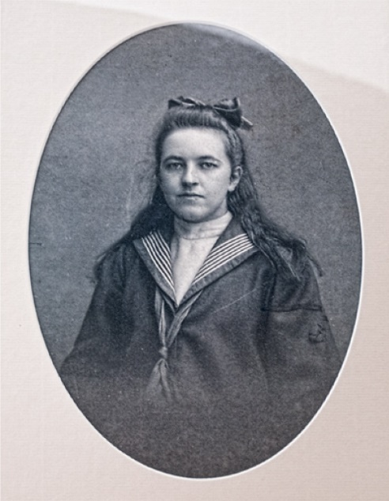
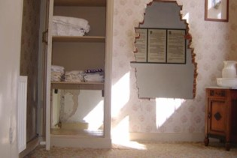

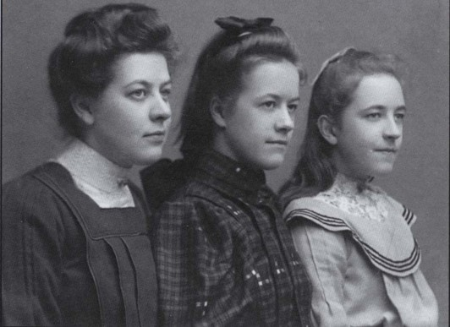
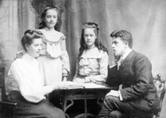
Corrie ten Boom
“In Holland during World War II, the Casper ten Boom family used their home as a hiding place for those hunted by the Nazis. This was their way of living out their Christian faith. Four members of the family lost their lives for providing this refuge.
Corrie ten Boom and her sister Betsie spent horrific months in the infamous Ravensbrück concentration camp. Betsie died there—Corrie survived.
“In Ravensbrück, Corrie and Betsie learned that God helps us to forgive.

Slide 17
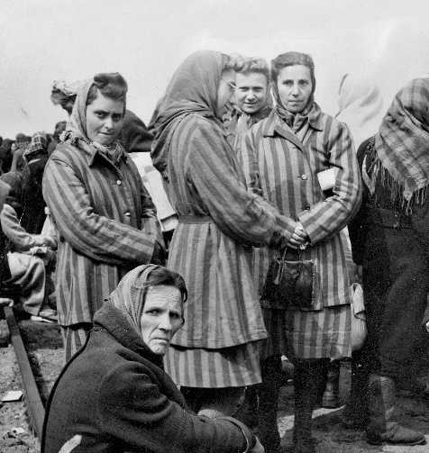
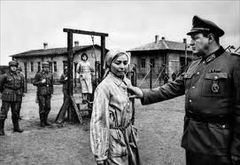
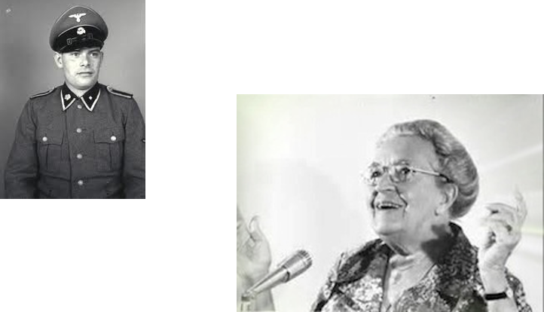

Following the war, Corrie was determined to share this message. On one occasion, she had just spoken to a group of people in Germany suffering from the ravages of war. Her message was ‘God forgives.’ It was then that Corrie ten Boom’s faithfulness brought forth its blessing.
“A man approached her. She recognized him as one of the cruelest guards in the camp. ‘You mentioned Ravensbrück in your talk,’ he said. ‘I was a guard there. … But since that time, … I have become a Christian.’ He explained that he had sought God’s forgiveness for the cruel things he had done. He extended his hand and asked, ‘Will you forgive me?’
“Corrie ten Boom then said:
“‘It could not have been many seconds that he stood there—hand held out—but to me it seemed hours as I wrestled with the most difficult thing I had ever had to do.

Slide 18
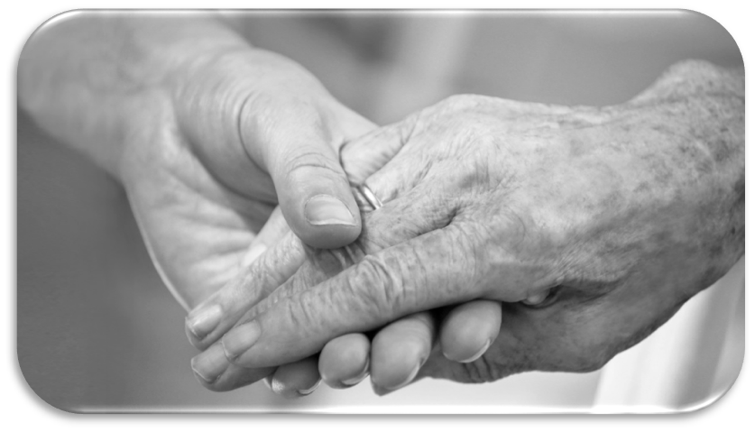
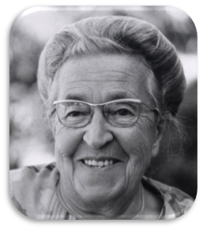
“‘… The message that God forgives has a … condition: that we forgive those who have injured us. …
“… ‘Help me!’ I prayed silently. ‘I can lift my hand. I can do that much. You supply the feeling.’
“‘… Woodenly, mechanically, I thrust my hand into the one stretched out to me. As I did, an incredible thing took place. The current started in my shoulder, raced down my arm, sprang into our joined hands. And then this healing warmth seemed to flood my whole being, bringing tears to my eyes.
“‘I forgive you, brother!’ I cried. ‘With all my heart.’
“For a long moment we grasped each other’s hands, the former guard and the former prisoner. I had never known God’s love so intensely, as I did then.’

Slide 19
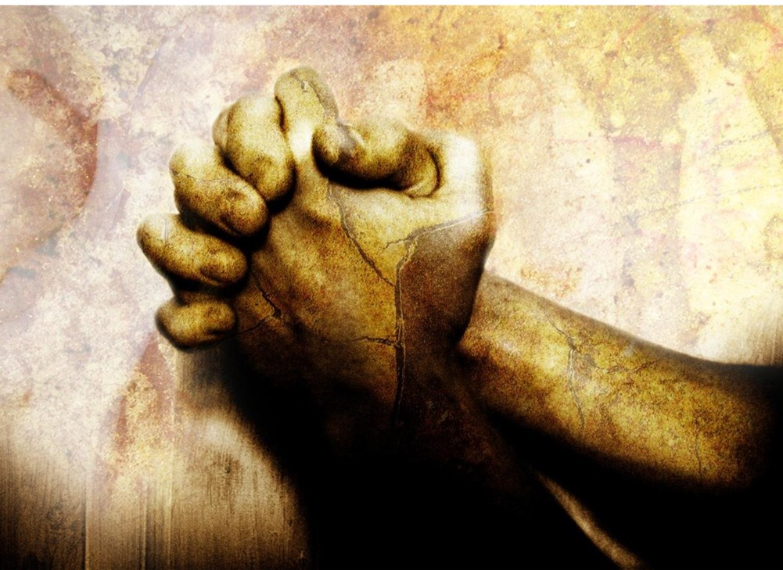
Forgive To Be Forgiven
--President Spencer W. Kimball
The Lord has commanded us to forgive our enemies
For if ye forgive men their trespasses, your heavenly Father will also forgive you:
Matthew 6:14
D&C 98:44-48

Slide 20
Sources:
Videos:
“That We Might Be One: The Story of the Dutch Potato Project” (11:57)
Proclaim Peace (1:44)
We Must Forgive (2:43)
Doctrine and Covenants Student Manual Religion 324-325 Section 98
(B. H. Roberts, A Comprehensive History of the Church, 1:333; see also Church History in the Fulness of Times Student Manual, 2nd ed. [Church Educational System manual], 2003, 133).
Hyrum M. Smith and Janne M. Sjodahl Doctrine and Covenants Commentary pg. 623-626
President David O. McKay (In Conference Report, Apr. 1942, pp. 72–73.)
President Marion G. Romney The Price of Peace Oct. 1993 Gen. Conf.
Corrie ten Boom, Tramp for the Lord (1974), 54–55.]” (Keith B. McMullin, “Our Path of Duty,” Ensign or Liahona, May 2010, 13).
Presentation by ©http://fashionsbylynda.com/blog/
Handbook 2: Administering the Church [2010], 21.4.2).
Presentation by ©http://fashionsbylynda.com/blog/

