Slide 1

Doctrine and Covenants 99-100
Family Sacrifice and Missions
Go ye therefore, and teach all nations, baptizing them in the name of the Father, and of the Son, and of the Holy Ghost:
Matthew 28:19
Presentation by ©http://fashionsbylynda.com/blog/

Slide 2
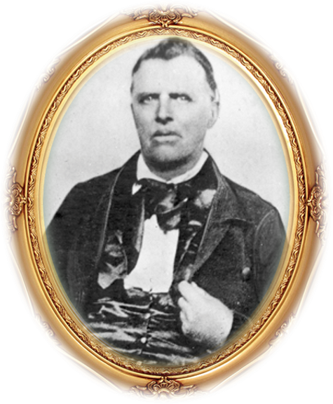
Background
August 24, 1832 at Hiram, Ohio
“This is a Revelation calling Elder John Murdock to go on a mission to the Eastern States.
He was one of the men who received the gospel in Kirtland when Oliver Cowdery and companions passed through that city on the first western journey to the Lamanites, and together with Sidney Rigdon, Edward Partridge, Isaac Morley, Lyman Wight, and others, he was called to the ministry at that time.
He held many important positions in the Church and discharged his duties faithfully.”
Smith and Sjodahl
John Murdock was called on another mission 2 months after his return from his first mission

Slide 3
John Murdock
He was born July 15, 1792, at Kortright, New York and the son of John Murdock Sr. and Eleanor Riggs
He joined the Lutheran Dutch Church around 1817, the Presbyterian Church shortly after. Later he was baptized into the Baptist church in Orange, Ohio, then the reformed Baptist (later Disciples of Christ or Campbellite) around 1827
He married Julia Clapp of Mentor, Ohio on December 14, 1823. They had five children
He was baptized into the church of Jesus Christ of Latter-day Saints by Elder Parley P. Pratt on Nov. 5, 1830, in Kirtland, Ohio and ordained an elder by Oliver Cowdery
His wife died following the birth of twins on April 30, 1831, and Joseph Emma Smith adopted the twins, Joseph and Julia
He serve many missions for the church, was president of Zion high council, participated in the School of the Prophets and the Camp of Israel expedition to Missouri
He went with the saints to Utah in 1847 and was a member of the Salt Lake High council and bishop in 14th ward. He served in the Utah territorial legislation
He served a mission to Australia, then moved to Lehi, Utah and became patriarch, moved to Beaver, Utah and died December 23, 1871
He had dedicated his life to the church
Joseph Smith Papers

Slide 4
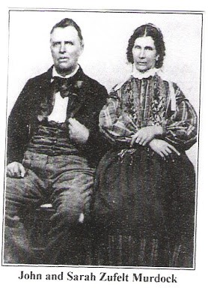
The Missions of John Murdock
Date | Places Served | Companion
1831 | Missouri, Michigan | Hyrum Smith
1832 | Missouri, Ohio, Virginia
1833 | Eastern States | Zebedee Coltrin
1835-1836 | Vermont, New York
1844-1845 | Indiana
1851-1853 | Australia | Charles Wandell
Wives:
Married first Julia Clapp of Mentor, Geauga Co., Ohio, 14 Dec. 1823. Wife died following birth of twins, 30 Apr. 1831, at Warrensville.
(5 Children)
Married second Amoranda Turner, 4 Feb. 1836; she died, 1837.
Married third Electra Allen, 3 May 1838. (3 Children)
Married fourth Sarah Zufelt, 13 Mar. 1846, in Fulton Co., Illinois
Married fifth May McEwan, 27 Jan 1857, Salt Lake City, Salt Lake, Utah
The Joseph Smith Papers

Slide 5
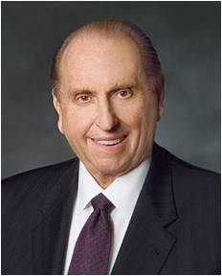
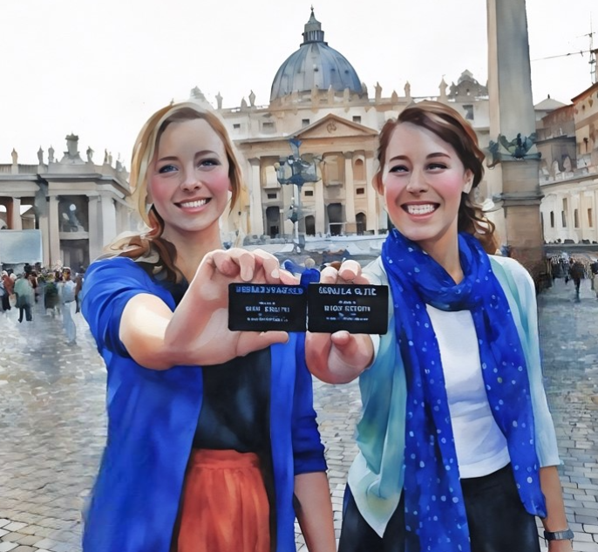
Power to Declare
To those who will receive the message
“Every worthy, able young man should prepare to serve a mission. Such service is a priesthood duty—an obligation the Lord expects of us who have been given so very much. Young men, I admonish you to prepare for service as a missionary.
Keep yourselves clean and pure and worthy to represent the Lord. Maintain your health and strength. Study the scriptures. Where such is available, participate in seminary and institute. Familiarize yourself with the missionary handbook Preach My Gospel.”
We represent the Lord when we serve missions.
“Sisters, while you do not have the same priesthood responsibility as do the young men to serve as full-time missionaries, you also make a valuable contribution as missionaries, and we welcome your service.”
D&C 99:2-3 President Thomas S. Monson

Slide 6
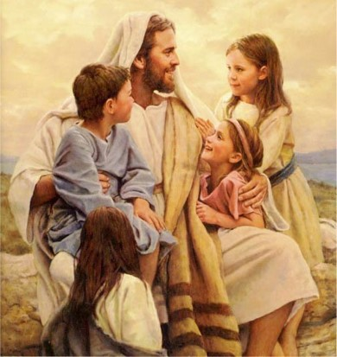
Receive as Little Children
Children are willing to learn…they are full of trust and hope for the future
And Jesus called a little child unto him, and set him in the midst of them,
And said, Verily I say unto you, Except ye be converted, and become as little children, ye shall not enter into the kingdom of heaven.
Whosoever therefore shall humble himself as this little child, the same is greatest in the kingdom of heaven.
Matthew 18:2-4
D&C 99:2-3

Slide 7
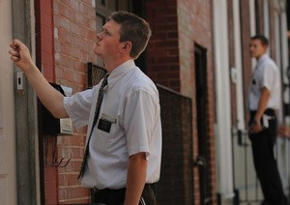
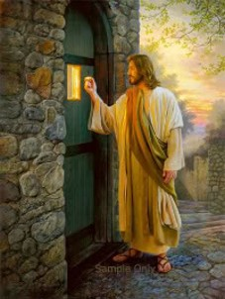
Cleanse Your Feet
The act of cleansing the feet as a testimony against those who reject the servants of the Lord is an ordinance of cursing and is not just a demonstration that a witness of the truth has been given and has been rejected.
Through this cleansing ordinance, those who rejected the truth are on their own, and those who preached the gospel to them are no longer responsible for them before the Lord.
D&C 99:4-5 Student Manual

Slide 8
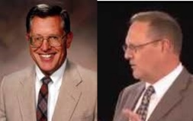
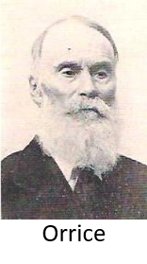
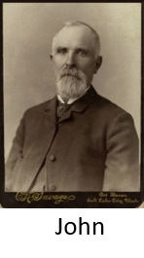
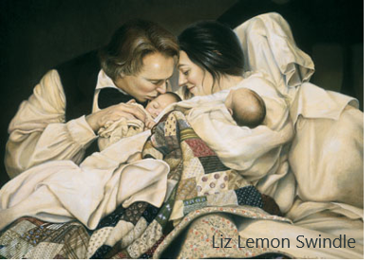
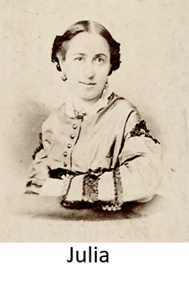
Mission Postponed
John Murdock, at the time of this missionary call, was a widower left to bring up five children at the death of his wife, Julia, who had died in giving birth to twins (Joseph and Julia).
About this same time, Emma Smith had also given birth to twins, both of whom died within hours.
John, having no relatives …to entrust the babies, took his motherless twins to Emma for her to nurse and rear as her own.
The babies had become ill with the measles and during a mob rampage, where upon they took Joseph and left the door open to the cold winds, baby Joseph died on March 29th 1832.
John Murdock needed time to make sure his children were cared for.
His eldest children went to Missouri
Orrice, John, and Phebe, who died at age of 6, stayed with various church members
Julia Murdock Smith remained with Joseph and Emma in Ohio.
John reunited with his children…Orrice and John served in the Mormon Battalion
D&C 99:6-8 McConkie and Ostler

Slide 9
Sacrifice and Family
In the early days
Today in the lives of a missionary
Men and families are in the Lords care
Some were asked to leave their families in the hands of the Lord
The Lord helps those who make sacrifices to keep their missionaries in the field
Since they had left their families behind before embarking on their mission, it was only natural that Joseph Smith and Sidney Rigdon should feel some concern
Some were asked to provide for their families before they left on missions
“The Lord does bless His missionaries just as surely as they bless the lives of those they teach and baptize. Difficult languages are learned with astonishing speed and skill. Financially strapped families back home find unforeseen means to support their missionaries. Weaknesses become strengths, challenges become opportunities, trials become triumphs, and adversity becomes an adventure in the service of the Lord—another fruit of gospel living”
Russell M. Ballard
D&C 100:1 Student Manual

Slide 10
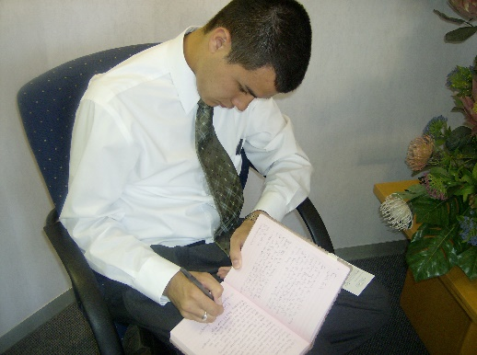
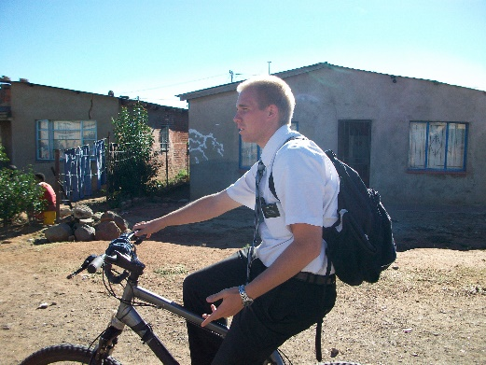
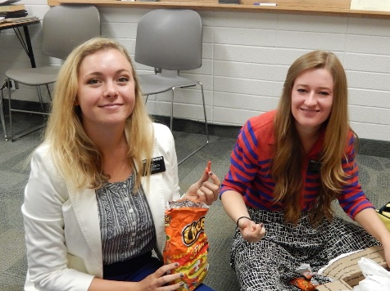
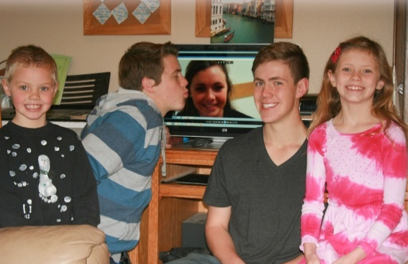
Words of Comfort
Greater love hath no man than this, that a man lay down his life for his friends.
John 15:13
His Friends--The friend of God is the one for whom the Savior died
Questions a missionary might ask himself
How will I find people to teach?
How will I know what to say?
Will I get along with my companions?
Will my family be okay while I am gone?
D&C 100:1-2

Slide 11
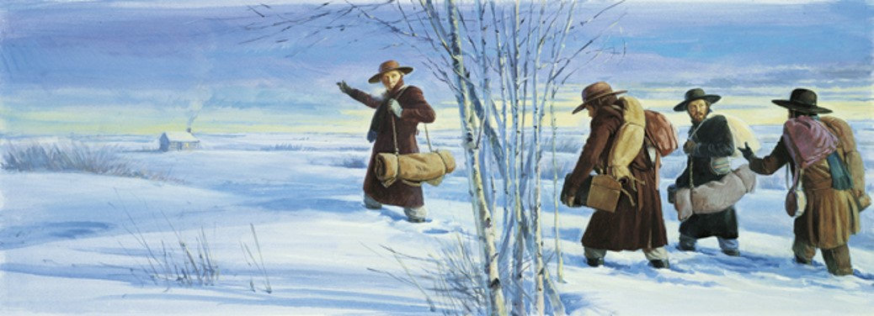
In April 1833 a man named Freeman Nickerson joined the Church in New York and came to Kirtland, Ohio. When Freeman met Joseph Smith, he asked the Prophet to visit the Nickerson family in New York and Canada. Joseph Smith and Sidney Rigdon agreed to his proposal, and they left Kirtland with him on October 5, 1833.
Along the way, they preached the gospel. After they arrived at the Nickerson home in Perrysburg, New York, Joseph received the revelation recorded in Doctrine and Covenants 100.

Slide 12
Freeman Nickerson
He was born on February 5, 1779, in South Dennis, Massachusetts and moved to Vermont in 1800 and married Huldah Chapman
He served in the war of 1812 as a lieutenant in the Untied States military
He moved to Springville, Pennsylvania and in 1824 moved to Perrysburg, New York and worked on the construction of the Erie Canal
He was baptized in April 1833 by Zerubbabel Snow
He served a mission in western New York and Upper Canada with Joseph Smith, Jr. and Sidney Rigdon in the fall of 1833
Joseph Smith received a revelation at the Nickerson’s home (Section 100)
He was a member of Zion’s Camp in 1834 and served as branch president in New York
In 1835-1836 he served on a mission to Cape Cod and baptized about 40 people in Pennsylvania in 1839, establishing the first branch of the church in that city
In 1840 he settled in Nauvoo, Illinois and served a mission to Peoria, Illinois, and Boston in 1847
He died in 1847 along the banks of the Chariton River in Iowa as the Latter-day Saints were moving west.
Wikipedia

Slide 13
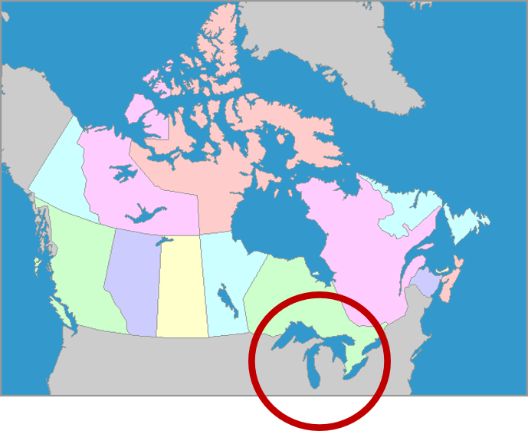
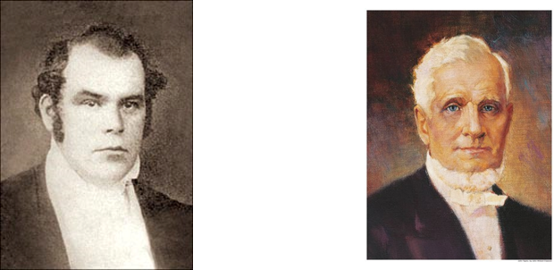
Effectual Door
To produce a desired or intended result
Joseph Smith and Sidney Rigdon went on a mission as far as Canada
The Lord promised that if they would lift up their voices and “speak the thoughts” he put into their hearts “an effectual door” to missionary labor would be opened unto them.
Thus began the labor in Canada that was to result in the conversion of so many souls.
It was through this “door” that Parley P. Pratt walked two years later to contact John Taylor, future President of the Church. When we place themselves in the Lord’s hands, as did Joseph and Sidney, we cannot help but succeed.
While the enemies were gathering against the Saints the Lord was preparing the hearts of others to receive the gospel
D&C 100:3-5 Student Manual

Slide 14
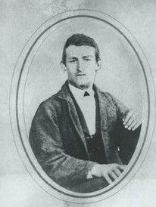
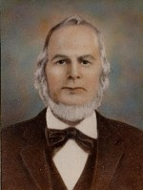
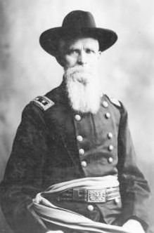
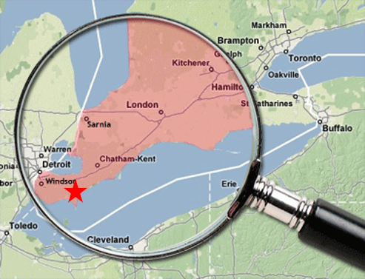
Missionaries In Canada
Zerah Pulsipher and Jesse Baker
The meeting was held in the home of Samuel and Hannah Burton—the family was converted, and later Robert Taylor Burton was baptized in 1838
1837—
“When but a boy of sixteen, two strangers came to my home, and they were indeed strangers, and very unwelcome ones in the section of the country as the prejudice of the people was great against them.
They sought the privilege of holding meetings, to present their strange doctrine. We were indeed entire strangers and none of our neighbors would give shelter to these men. I prevailed upon my father to invite them to our home, and to give them an opportunity to be hears. He did so, and they held meetings in the place.”
“The Lord showed me
by unmistakable evidence
that this doctrine taught by the Latter Day Saints, was correct, and so sure was my conversion that it has never left me to this day.” --1903
D&C 100:3-5 Robert Taylor Burton

Slide 15
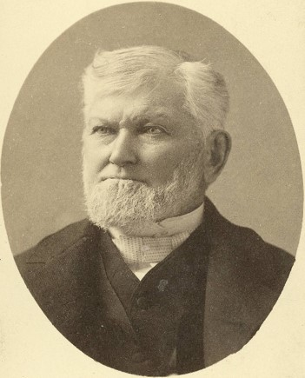
Lead By the Spirit
And I was led by the Spirit, not knowing beforehand the things which I should do.
1 Nephi 4:6
But the things of God are sacred “and must be spoken with care, and by constraint of the Spirit” D&C 63:64
“I will say as Paul did, ‘Woe be unto me if I preach not the Gospel’ [1 Corinthians 9:16]. I will say the same for the Apostles, the High Priests, the Seventies, and the Elders, so far as they are called to declare the words of life and salvation to this generation; the judgments of God will rest upon us if we do not do it.
You may ask why. I answer, because a dispensation of the Gospel of Jesus Christ has never been given to man in ancient days or in this age, for any other purpose than for the salvation of the human family.”
President Wilford Woodruff
If we will lift up our voices to share the gospel, then the Lord will help us know what to say
D&C 100:6-8

Slide 16
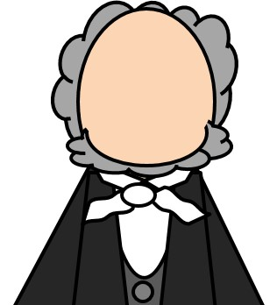

Spokesman
Sidney Rigdon, like Aaron in an earlier time (see Exodus 4:16), was appointed a spokesman for the Prophet Joseph Smith.
Blessed with great gifts as an orator and student of scripture, Sidney was promised “power to be mighty in testimony”
While Sidney was to be a spokesman for Joseph Smith, the Prophet was to “be a revelator” unto Sidney. In this way Brother Rigdon was to “know the certainty of all things pertaining to the things of my kingdom on the earth”.
Sidney, because of his call to be a spokesman for the Prophet Joseph Smith, claimed to be guardian of the Church after Joseph’s death. To lead the Church, however, was not within the scope of his calling.
D&C 100:9-11 Student Manual

Slide 17
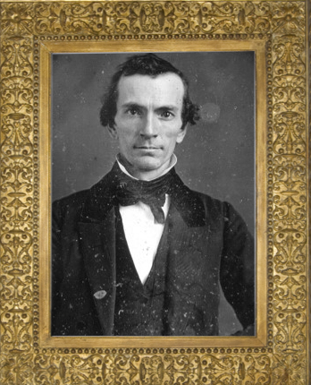
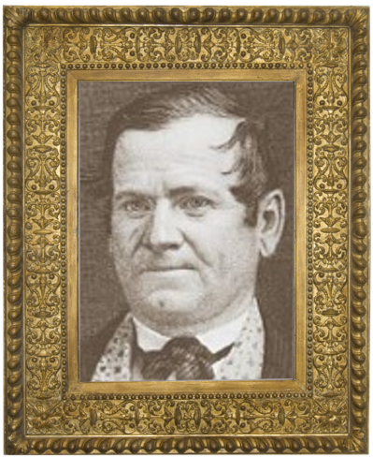
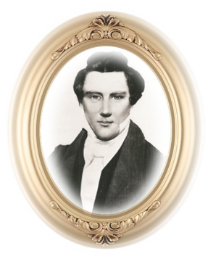
Reassurance
Just before starting for Canada, Oliver Cowdery brought word to the Prophet that enemies of Zion were working to destroy the Church.
Joseph sent Orson Hyde and John Gould from Kirtland to Jackson County, Missouri, “with advice to the Saints in their unfortunate situation.” HC
This journey would be very hazardous because they would be traveling near anti-Mormon mobs.
The Lord assured them that He would be with them so long as they kept His commandments.
Joseph also received a promise from the Lord concerning Zion’s future state: Zion would be redeemed after a season.
Such a delay was the means of purifying a people who would serve the Lord in righteousness. Serving in righteousness is a prerequisite for building Zion.
D&C 100:13-17

Slide 18
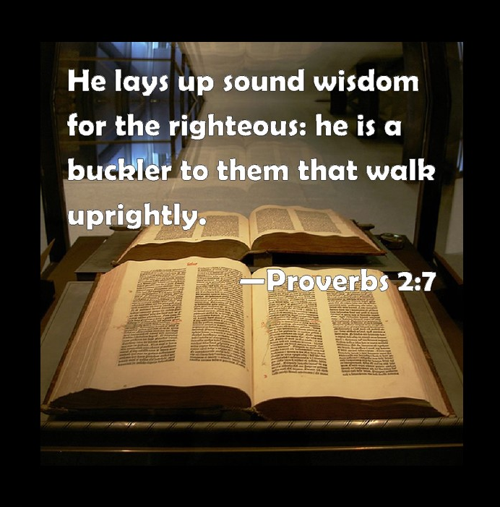
Walk Uprightly
All things will work together for our good if we walk uprightly before the Lord
D&C 100:15

Slide 19
Sources:
Doctrine and Covenants Who’s Who by Ed J. Pinegar and Richard J. Allen pgs. 103-104
Hyrum M. Smith and Janne M. Sjodahl Doctrine and Covenants Commentary p. 629
L.G. Otten and C.M Caldwell Sacred Truths of the Doctrine and Covenants p. 172
http://josephsmithpapers.org/person/john-murdock
President Thomas S. Monson The Lord Needs Missionaries January Ensign 2011 Presidency Message
Doctrine and Covenants Student Manual Religion 324-325 Section 24 (D&C 24:15)
Presentation by ©http://fashionsbylynda.com/blog/
Joseph Fielding McConkie and Craig J. Ostler Revelations of the Restoration pg. 720-721
Russell M. Ballard (Our Search for Happiness, p. 108).
Presentation by ©http://fashionsbylynda.com/blog
Robert Taylor Burton The Life Story of Robert Taylor Burton by Janet Burton Seegmiller pg. 15,20
President Wilford Woodruff (In Journal of Discourses, 22:204.)
(History of the Church, 1:407).
Presentation by ©http://fashionsbylynda.com/blog/

Slide 20
John Murdock investigated many churches and concluded that all religions had lost their way. However, in late 1830, he read the Book of Mormon and felt the Holy Ghost bear witness of its truth. He was baptized on November 5, 1830. Shortly thereafter, he served a mission, baptizing about 70 people in four months in Orange, Ohio, and Warrensville, Ohio.
On April 30, 1831, shortly after Brother Murdock returned from his mission, his wife, Julia, died after giving birth to twins. In June 1831, the Lord called him to go to Missouri and preach the gospel along the way (see D&C 52:8–9). Before he could go, he needed to make sure his five children, all under the age of seven, were provided for. He arranged for several individuals to care for his older children, and Joseph and Emma Smith adopted the infant twins. For the rest of 1831 and the first half of 1832, John Murdock preached in Michigan Territory, Indiana, Missouri, and Ohio. When he returned to Hiram, Ohio, in June 1832, he was suffering from the effects of a long illness. He learned that one of his twins had been sick and had died because of exposure to the cold during an attack on Joseph Smith.
The Role of the Holy Ghost D&C 100:5-8
Elder D. Todd Christofferson of the Quorum of the Twelve Apostles explained the role of the Holy Ghost in our efforts to preach the gospel:
“It is the Holy Ghost that bears witness of your words when you teach and testify. It is the Holy Ghost that, as you speak in hostile venues, puts into your heart what you should say and fulfills the Lord’s promise that ‘you shall not be confounded before men’ (D&C 100:5)” (“The Power of Covenants,” Ensign or Liahona, May 2009, 22).
For John Murdock Biography:
https://www.boap.org/LDS/Early-Saints/JMurdock.html
“Those who knew Sidney Rigdon, know how wonderfully God inspired him, and with what wonderful eloquence he declared the word of God to the people. He was a mighty man in the hands of God, as a spokesman, as long as the prophet lived, or up to a short time before his death. Thus you see that even this which many might look upon as a small matter, was predicted about 1,700 years before the birth of the Savior [see 2 Nephi 3:18], and was quoted by Lehi 600 years before the same event, and about 2,400 years before its fulfillment, and was translated by the power of God, through his servant Joseph, as was predicted should be the case.” (In Journal of Discourses, 25:126.)

