Slide 1
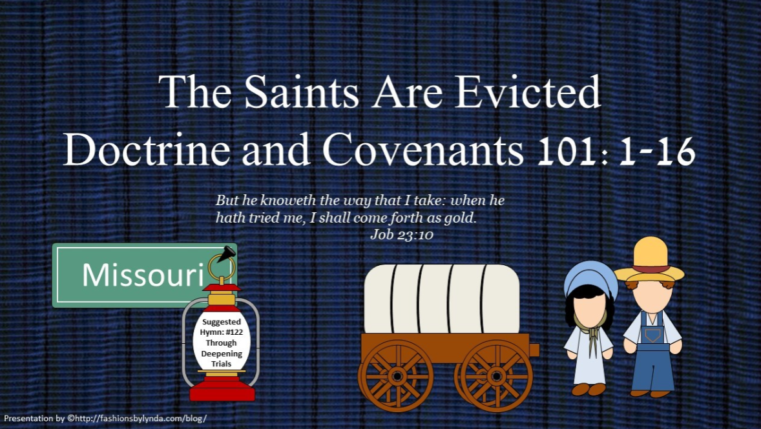

Slide 2

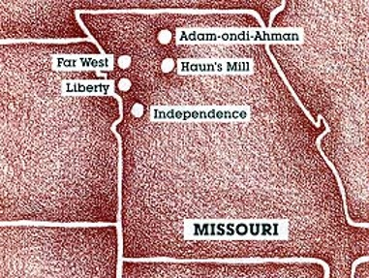

Background
December 16, 1833
The Lord, prior to this revelation, had warned the Saints that they must keep His commandments and do His will, or they would suffer affliction, pestilence, plague, sword, vengeance, and devouring fire (D&C 97:26)
At the time the revelation was given, the Saints in Missouri had been driven from Jackson County to Clay County. Their homes destroyed and their property taken from them by the mobs in Jackson County, the Saints were suffering greatly

Slide 3
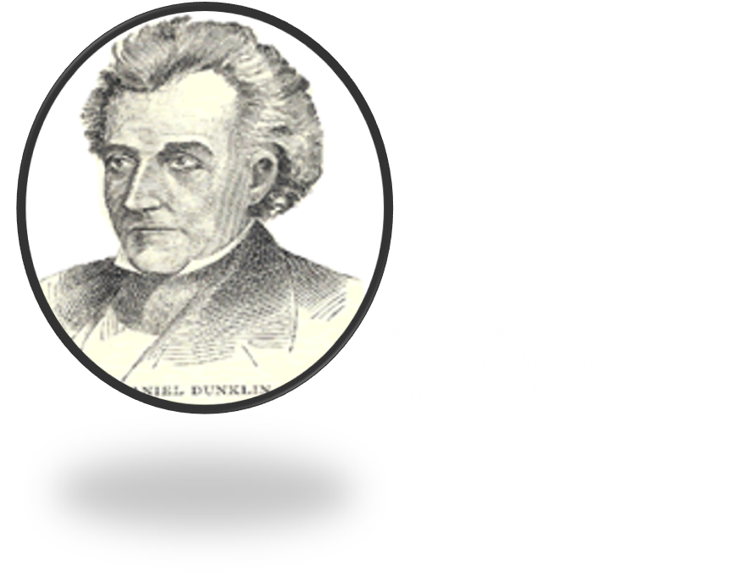
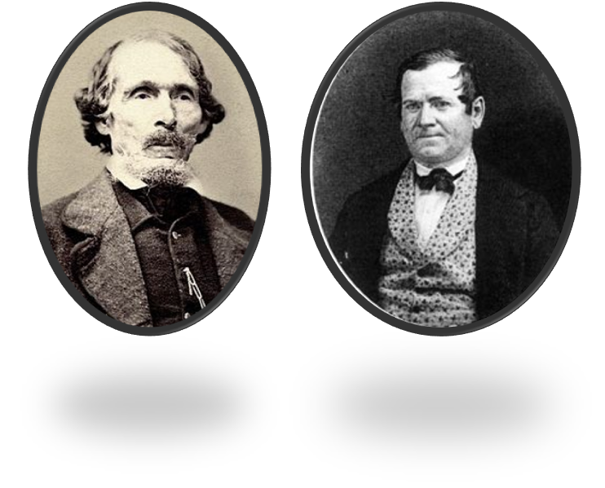
Petition to the Governor
August 1833
The Saints tried to get help from the governor of Missouri. William Phelps and Orson Hyde went to see the governor.
Church leaders petitioned the government and used available legal channels to maintain their lands in Missouri and seek justice for those responsible for the violence. After hearing of these actions and believing that the Saints were not planning to leave as expected, non–Latter-day Saint settlers attacked the Saints again.

Slide 4
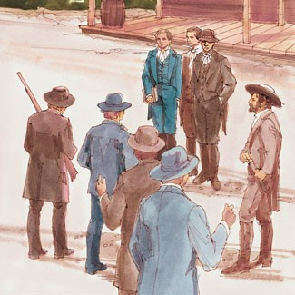
Mob Attacks
October 31, 1833
A mob of about 50 horsemen raided the Whitmer Settlement, west of Independence.
They unroofed 13 houses and whipped several men, almost killing them.
These attacks continued for the next two nights in Independence and other places where the Saints lived. Men were beaten, and women and children were terrorized.

Slide 5
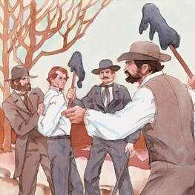
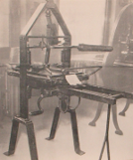
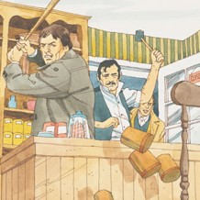
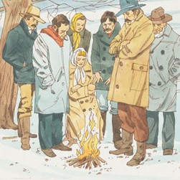
Destruction in Missouri
The mob attacked the Saints for six days. They shot guns at the buildings. They destroyed the printing shop. They tore down homes, hurt the men, and broke into a store and threw everything on the floor.
The mob caught Bishop Partridge and Charles Allen and put tar and feathers on their skin. The mob also beat some of the other Saints.
The mob made the Saints leave their homes. It was winter, and many people died because they were homeless in the cold, wet weather. The Saints went to other parts of Missouri to get away from the mob.

Slide 6

Revelation D&C 101
The Prophet Joseph Smith was in Kirtland, Ohio, at this time but was being updated on the condition of the Saints.
Knowing of their pain and distress, the Prophet prayed to ask Heavenly Father if they could be restored to their homes in Missouri.
He received a revelation now known as Doctrine and Covenants 101.

Slide 7
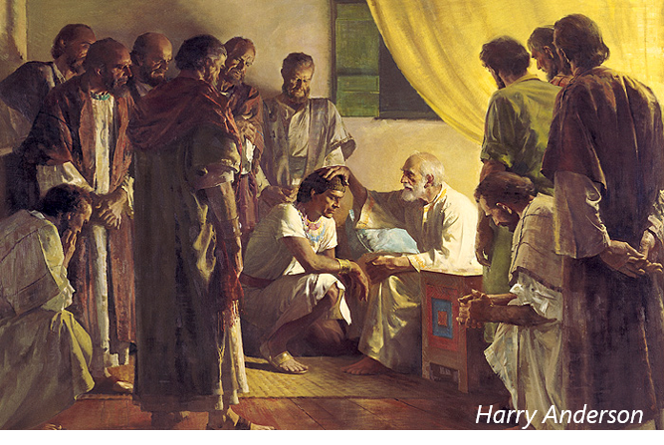
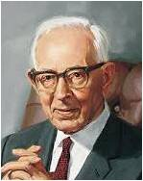
Land Of Inheritance
Anciently the Lord blessed Joseph, the son of Jacob, with the blessings of Abraham, which included a land of promise for his posterity.
His descendants were to receive an inheritance in the land of America.
“Every person who embraces the gospel becomes of the house of Israel. In other words, they become members of the chosen lineage, or Abraham’s children through Isaac and Jacob unto whom the promises were made. The great majority of those who become members of the Church are literal descendants of Abraham through Ephraim, son of Joseph. Those who are not literal descendants of Abraham and Israel must become such, and when they are baptized and confirmed they are grafted
into the tree and are entitled to all the rights
and privileges as heirs.” Joseph Fielding Smith
D&C 101:1 Student Manual

Slide 8
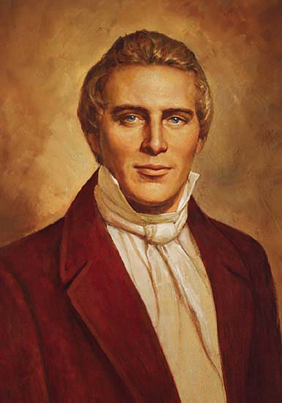
Forfeit Claim
“I cannot learn from any communication by the Spirit to me, that Zion has forfeited her claim to a celestial crown, notwithstanding the Lord has caused her to be thus afflicted, except it may be some individuals, who have walked in disobedience, and forsaken the new covenant; all such will be made manifest by their works in due time. I have always expected that Zion would suffer some affliction, from what I could learn from the commandments which have been given.
“But I would remind you of a certain clause in one which says, that after much tribulation cometh the blessing. By this, and also others, and also one received of late, I know that Zion, in the due time of the Lord, will be redeemed; but how many will be the days of her purification, tribulation, and affliction, the Lord has kept hid from my eyes and when I inquire concerning this subject, the voice of the Lord is: Be still, and know that I am God; all those who suffer for my name shall reign with me, and he that layeth down his life for my sake shall find it again.”
D&C 101:3 Joseph Smith

Slide 9
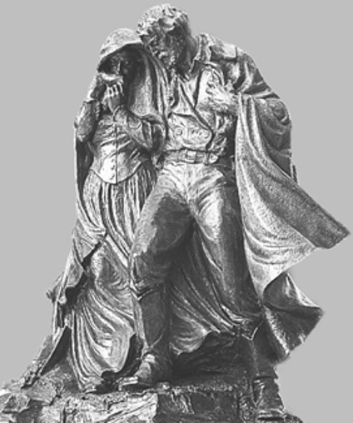
Afflictions Are Allowed By the Lord
“Now, there are two things of which I am ignorant; and the Lord will not show them unto me, perhaps for a wise purpose in Himself—I mean in some respects—and they are these:
Why God has suffered so great a calamity to come upon Zion, and what the great moving cause of this great affliction is; and again, by what means He will return her back to her inheritance, with songs of everlasting joy upon her head.
These two things, brethren, are in part kept back that they are not plainly shown unto me; but there are some things that are plainly manifest which have incurred the displeasure of the Almighty.”
Although many Saints in Missouri were faithful and obedient, they still suffered because of persecution
D&C 101:4 Joseph Smith

Slide 10
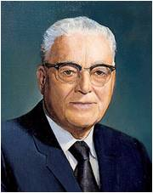

Violation of the Commandments
“Some of us have been tried and have been tested until our very heart strings would seem to break.
I have heard of persons dying with a broken heart, and I thought that was just a sort of a poetic expression, but I learned that it could be a very real experience.
I came near to that thing; but when I began to think of my own troubles, I thought of what the apostle Paul said of the Master, ‘Though he were a Son, yet learned he obedience by the things which he suffered; And being made perfect, he became the author of eternal salvation unto all them that obey him.’
President Harold B. Lee
D&C 101:5

Slide 11

Chastening To Be Sanctified
Let us therefore come boldly unto the throne of grace, that we may obtain mercy, and find grace to help in time of need.
Hebrews 4:16
“Don’t be afraid of the testing and trials of life. Sometimes when you are going through the most severe tests, you will be nearer to God than you have any idea, for like the experience of the Master himself in the temptation on the mount, in the Garden of Gethsemane, and on the cross at Calvary, the scriptures record, ‘And, behold, angels came and ministered unto him.’
Sometimes that may happen to you in the midst of your trials.”
President Harold B. Lee
D&C 101:5

Slide 12
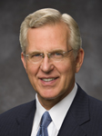
Cleansing--Repentance
Chastening may lead to forgiveness of sins
Chastening teaches us obedience
Chastening refines us as pure gold
Verily, thus saith the Lord unto you whom I love, and whom I love I also chasten that their sins may be forgiven, for with the chastisement I prepare a way for their deliverance in all things out of temptation, and I have loved you—D&C 95:1
And my people must needs be chastened until they learn obedience, if it must needs be, by the things which they suffer. D&C 105:6
Chastening is a cleansing process
But he knoweth the way that I take: when he hath tried me, I shall come forth as gold.
Job 23:10
But verily I say unto you, that I, the Lord, will contend with Zion, and plead with her strong ones, and chasten her until she overcomes and is clean before me.
D&C 90:36
“In addition to stimulating our repentance, the very experience of enduring chastening can refine us and prepare us for greater spiritual privileges”
Elder D. Todd Christofferson
D&C 101:5

Slide 13
Jarrings-
strong emotional reactions
Covetous desires-
A craving for possessions
Contentions
Disagreements, arguments, disputes
Polluted Their Inheritance
Lustful-
having or showing strong feelings of sexual desire
Envyings-
Desire to have a quality, possession, or other desirable attributes belonging to
(someone else).
Strife-
an act of contention or bitter feelings
D&C 101:6

Slide 14

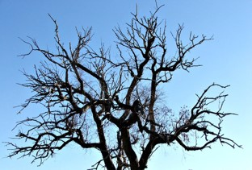
Slow to Hear
One of the great problems recorded in scripture is mankind’s indifference to God in times of prosperity.
Too often they forget their Creator, who is the giver of all good things. In times of trouble, however, they remember God and turn to Him for mercy and help in their afflictions, but He is slow to help them.
These verses show that the Saints were guilty of this offense. Therefore, the Lord did not support them in their day of affliction. He will not support any who claim His promises but do not keep their covenants.
D&C 101:7 Student Manual

Slide 15
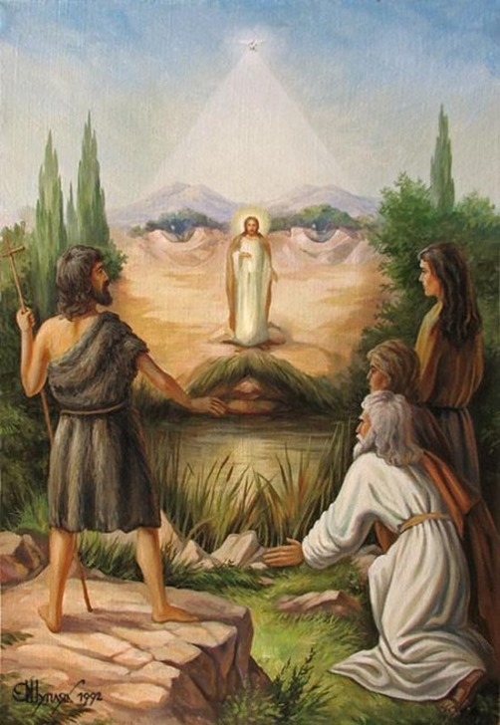
Remember Mercy
The Saints had not been cast off they had been cast out of Zion
Even when we have sinned, the Lord will have compassion toward us
“When the Saints were exiled and scattered, it appeared to human eye as if they had been utterly cast off by their Heavenly father; but in the very day of wrath he would remember mercy. He would turn the curse of man into a blessing to His people.” Smith and Sjodahl
D&C 101:9

Slide 16


Sword of Mine Indignation
An instrument of war, connotes power and retribution
“While there was punishment in the suffering the saints had to endure and that because they were slow to hear the Lord, nevertheless the actions of their enemies were not justifiable; and therefore the Lord promised that he would let fall the sword of his indignation in behalf of his people.
The sword of indignation commenced to fall upon the enemies of the saints shortly after the saints were driven from Missouri, and from time to time it has fallen, both in this land and in foreign lands.”
Joseph Fielding Smith
D&C 101:10-12

Slide 17
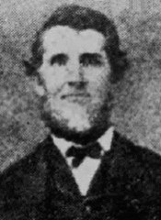
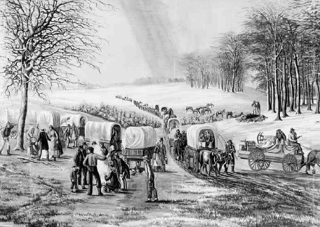
Until They Are Gone
The mob in Jackson County continued persecuting the Saints until all members of the Church were driven out of the county
“I saw one hundred and ninety women and children driven thirty miles across the prairie, with three decrepit men only in their company, in the month of November, the ground thinly crusted with sleet; and I could easily follow on their trail by the blood that flowed from their lacerated feet on the stubble of the burnt prairie!”
Lyman Wight
D&C 101:10-11

Slide 18
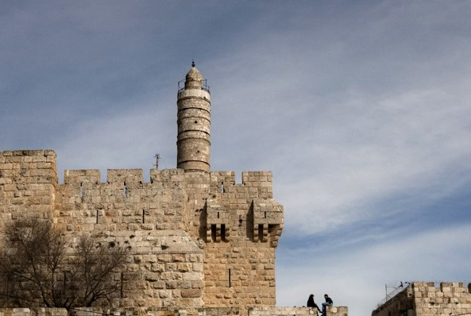
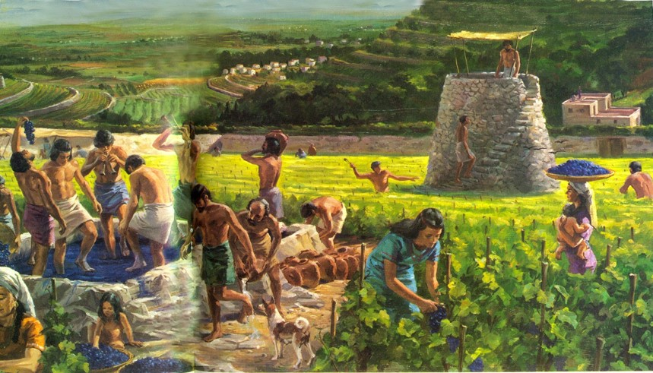
Watch-tower
In ancient Israel walls were built around cities, and towers were erected in key places along the walls. Watchmen, or lookouts, kept watch in these towers day and night to warn the people if an enemy came.
A watchman’s responsibility was great, because if he was negligent, his sloth could cost the lives of others.
The Greek word most frequently used in the New Testament to convey the idea of watching “means to keep awake, to watch, and so to take heed lest through remissness and indolence some destructive calamity suddenly overtake one” (Unger, Bible Dictionary)
D&C 101:12-16

Slide 19
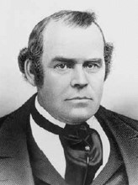
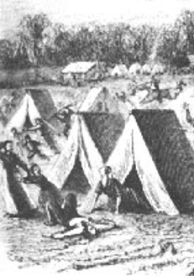
To the North
Most of the Saints fled north, where they had to cross the Missouri River.
The shores of the river near the ferry were lined with refugees. Some people were fortunate enough to escape with some of their household goods, but many lost everything.
“Hundreds of people were seen in every direction, some in tents and some in the open air around their fires, while the rain descended in torrents. Husbands were inquiring for their wives, wives for their husbands; parents for children, and children for parents. …
The scene was indescribable, and, I am sure, would have melted the hearts of any people on the earth, except our blind oppressors, and a blind and ignorant community”
Parley P. Pratt
Vineyard--Earth
D&C 101:12-16

Slide 20
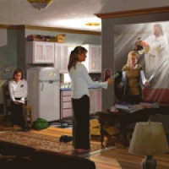
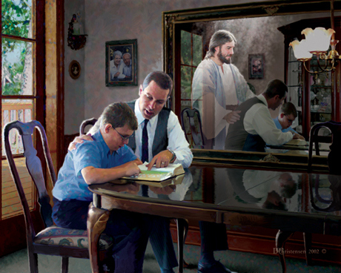
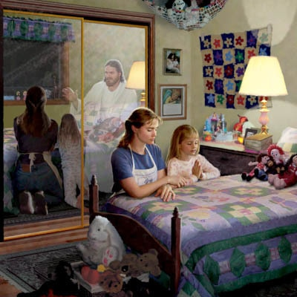
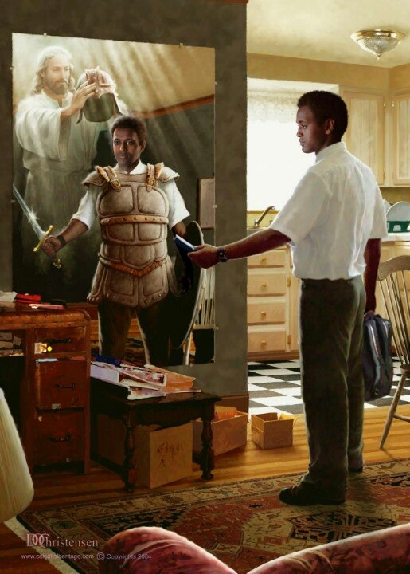
The Lord’s Promise
When we live righteously, we can find comfort in the knowledge that all people are in the Lord’s hands
Vineyard--Earth
D&C 101:12-16
Artist Doc Christensen

Slide 21
Sources:
Video:
The Will of God (3:02)
Finding the Incredible: What Cancer and Trials Can Teach Us(5:33)
Doctrine and Covenants Student Manual Religion 324-325 Section 101
Joseph Fielding Smith (Doctrines of Salvation, 3:246.)
Church History and Modern Revelation, 1:460
Joseph Smith (Teachings, p. 34)
President Harold B. Lee (In Conference Report, Munich Germany Area Conference 1973, p. 114.)
Elder D. Todd Christofferson As Many as I Love, I Rebuke and Chasten Ensign or Liahona, May 2011, 98
Hyrum M. Smith and Janne M. Sjodahl Doctrine and Covenants Commentary pg. 638-639
Presentation by ©http://fashionsbylynda.com/blog/
Lyman White (in History of the Church, 3:439).
(Unger, Bible Dictionary, s.v. “watch”).
Parley P. Pratt (Autobiography of Parley P. Pratt, ed. Parley P. Pratt Jr. [1938], 102).
Presentation by ©http://fashionsbylynda.com/blog/

Slide 22
Governor Dunklin 1833:
One area of controversy during Dunklin's administration was the treatment of Mormon settlers in the state. In 1831, Joseph Smith had established an outpost of the Church of Christ (Latter Day Saints) in Jackson County, Missouri, stating that the City of Zion would be established there near the town of Independence. Alarmed at the large influx of new residents and fearful of losing political influence, a series of vigilante incidents by non-Mormons led to the forced expulsion of the Mormon pilgrims to nearby Clay County, Missouri in 1833. Smith petitioned Governor Dunklin for assistance in the matter. However Dunklin suggested that the Mormons seek redress to their issues in the court system., stating in an October, 1833 letter "make a trial of the efficacy of the laws; the judge of your circuit is a conservator of the peace. If an affidavit is made before him by any of you, that your lives are threatened and you believe them in danger, it would be his duty to have the offenders apprehended and bind them to keep peace." The Mormon issue would continue to be a problem in Missouri politics for Dunklin's successor, Lilburn Boggs, until Boggs issued Missouri Executive Order 44 the so-called "Extermination Order".
Governor Daniel Dunklin resigned his position three months early in the summer of 1836. He had been granted a Federal appointment by President Andrew Jackson as Surveyor General for Missouri and Illinois.
Later in life--Dunklin was caught out in the open during a severe storm. Soaked to the bone, he developed pneumonia and died shortly after on August 25, 1844. Governor Dunklin was buried in a field near his home. However, his children were not as successful in business and were forced to sell their estate. Wikipedia
Before the Saints were driven from Jackson County, Missouri, they had received several warnings that they would suffer afflictions if they did not repent. For example, in January 1833, Joseph Smith chastised William W. Phelps and Sidney Gilbert for “the spirit which [was] breathed” in letters they had written, stating that such a spirit was “wasting the strength of Zion” and would “ripen Zion for the threatened Judgments of God.” Orson Hyde and Hyrum Smith, writing to Bishop Edward Partridge, his counselors, and a conference of high priests, sent a letter of warning to Church leaders in Missouri. They referred to a letter from Sidney Gilbert that contained “low, dark, & blind insinuations.” They also condemned another letter that had implied that the Prophet was “seeking after Monarchal power and authority.” Because of these transgressions and others, Orson Hyde and Hyrum Smith warned that the Saints in Missouri would face “a scourge & a judgment” (see Documents, Volume 2: July 1831–January 1833, volume 2 of the Documents series of The Joseph Smith Papers [2013], 367, 373–74).

