Slide 1
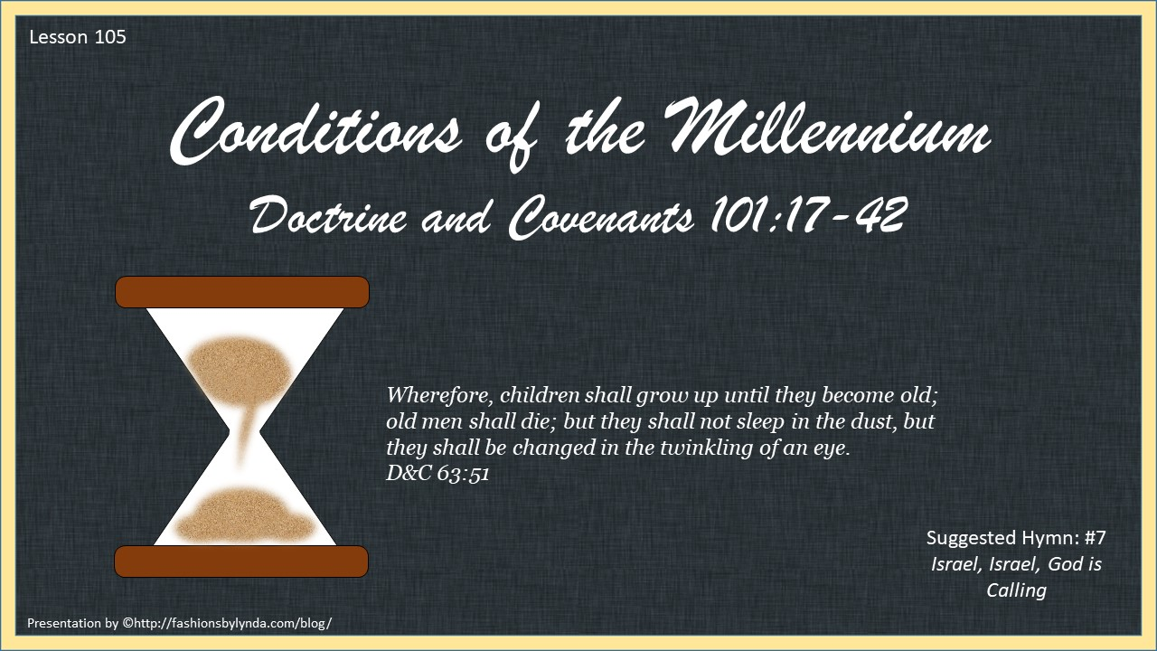

Slide 2

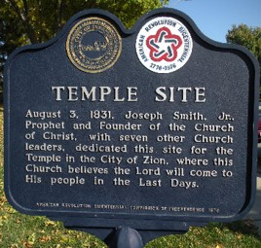
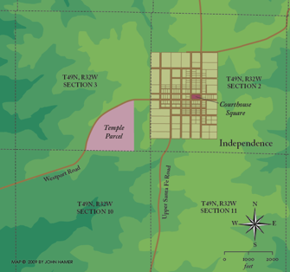
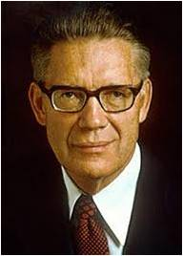
Lands of Inheritance Are Everlasting
Even though the Saints were driven out of Missouri the place of Zion remains the same, and in some future day the Saints of will posses it.
“…but still there is a center place, a place where the chief temple shall stand, a place to which the Lord shall come, a place whence the law shall go forth to govern all the earth in that day…
And center place is what men now call Independence in Jackson County, Missouri, but which in a day to come will be the Zion of our God and the city of Holiness of His people.
Elder Bruce R. McConkie
D&C 101:17-18

Slide 3
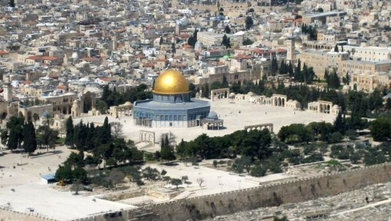
Temple in Zion
“Among all houses of the Lord, the temple to be built at the center place of Zion will stand supreme. It is destined to consist of a complex of 24 buildings, all dedicated as houses of the Lord.”
And it shall come to pass in the last days, that the mountain of the Lord’s house shall be established in the top of the mountains, and shall be exalted above the hills; and all nations shall flow unto it.
Isaiah 2:2
“Along with the companion temple to be built in the Jerusalem of old, this is the temple in which Isaiah’s words will find fulfillment.”
Elder Bruce R. McConkie
D&C 101:17-20

Slide 4
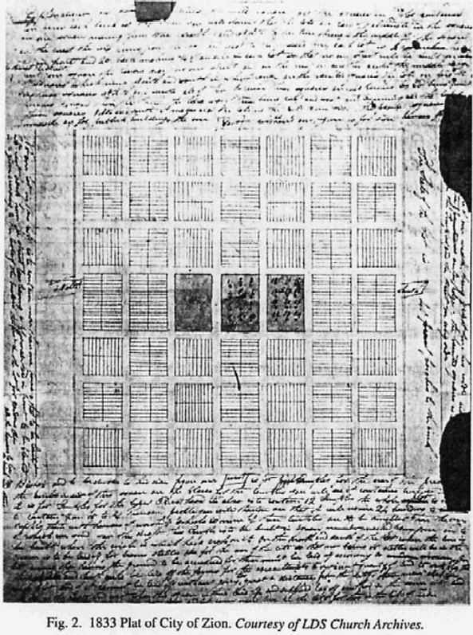
Plat of City of Zion
A Plat is a map, drawn to scale, showing the divisions of a piece of land
TEMPLE NUMBERS AND NAMES | PULPITS
10-12 House of the Lord, for the Presidency of the High and most Holy Priesthood, after the order of Melchizedek. | West: Melchizedek Presidency
7-9 Sacred Apostolic Repository, for the use of the Bishop. | Bishopric
4-6 Holy Evangelical House, for the High Priesthood of the High Priests Holy Order of God. | High Priests
1-3 House of the Lord, for the Elders of Zion, and Ensign Elders of the Nations. | Elders East: Aaronic
22-24 House of the Lord for the Presidency of the High Presidency Priesthood, after the Order of Aaron. | Presidency
19-21 House of the Lord, Law of the Kingdom of Heaven, Messenger to the People; for the Highest Priesthood after the Order of Aaron. | Priests
16-18 House of the Lord for the Teachers in Zion, Messenger to the Church. | Teachers
13-15 House of the Lord for the Deacons in Zion, Helps in Government. | Deacons
The 24 buildings aforementioned were located on a map of the future city of Zion.”
Bruce R. McConkie
Joseph Smith’s Plan---Richard O. Cowan

Slide 5
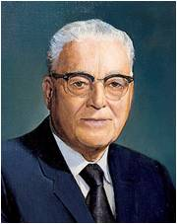
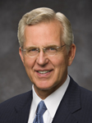
Where is Zion?
Zion is both a place and a people
Zion was the name given to the ancient city of Enoch in the days before the Flood
The Lord called Enoch’s people Zion
The antithesis and antagonist of Zion is Babylon
Zion is Zion because of the character, attributes, and faithfulness of her citizens.
One Heart One Mind (Mosiah 7:18)
“As one studies the commandments of God, it seems crystal clear that the all-important thing is not where we live, but whether or not our hearts are pure.”
Elder Harold B. Lee
We can prepare for the Savior’s Second Coming by calling on His name, living according to gospel principles, gathering together, and standing in holy places
D&C 101:20-22 Excerpts from Elder D. Todd Christofferson

Slide 6
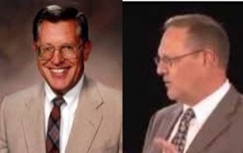
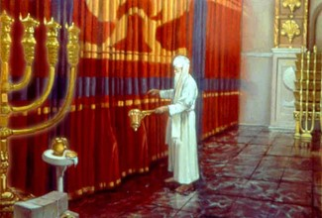
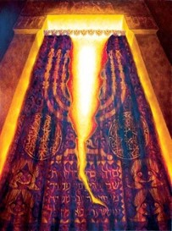
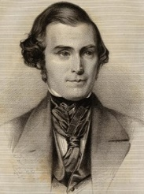
Veil of the Covering
“Anciently, a veil hung between the two holy chambers of the tabernacle (Exodus 26:31)
Its presence in Herod’s temple is supported by the statement in each of the synoptic gospels that at the time of Christ’s death the veil of the temple was rent from top to bottom
Christ, by his sacrificial death, opened a way for the faithful to enter the holiest place, meaning the celestial kingdom. (Hebrews 10:20)
The veil separating us from the presence of the Lord will be rent, and all will be able to see what otherwise would remain hidden to them.”
McConkie and Ostler
“…it will be an event that will be seen by all—all flesh shall see the glory of the Lord; when he reveals himself the second time, every eye, not only those living at that time in the flesh, in mortality on the earth, but also the very dead themselves”
Elder Orson Pratt
D&C 101:23

Slide 7
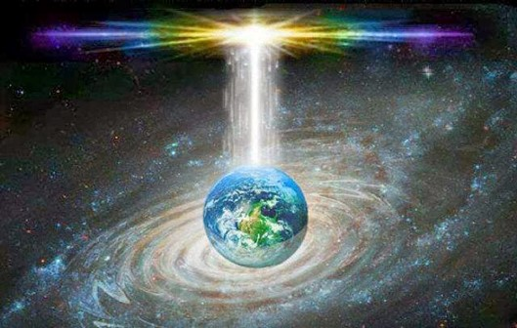
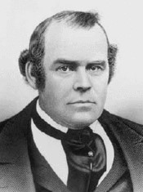
Renewal of the Earth
For, behold, I create new heavens and a new earth: and the former shall not be remembered, nor come into mind.
Isaiah 65:17
“All that is corruptible—everything of a telestial order—will be destroyed, for terrestrial or Edenic law will rule during the Millennium.
With the return of Christ all things will return to a state like that known in Eden.”
McConkie and Ostler
“A new heaven and a new earth are promised by the sacred writers. Or, in other words, the planetary systems are to be changed, purified, refined, exalted and glorified, in the similitude of the resurrection, by which means all physical evil or imperfections will be done away.”
Elder Parley P. Pratt
D&C 101:24-25

Slide 8

Men Will Learn Peace
All will live together, animal and man in harmony
“The coyote will not stalk the deer, and the wolf will not kill the sheep, and all forms of life will be the friends and servants of men.”
Elder Bruce R. McConkie
The wolf also shall dwell with the lamb, and the leopard shall lie down with the kid; and the calf and the young lion and the fatling together; and a little child shall lead them.
They shall not hurt nor destroy in all my holy mountain: for the earth shall be full of the knowledge of the Lord, as the waters cover the sea.
Isaiah 11:6,9
D&C 101:26

Slide 9
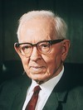
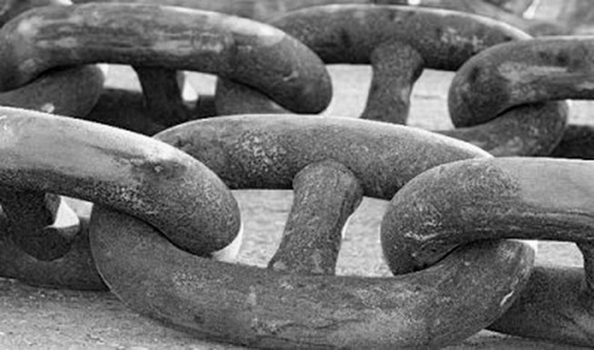
No More Temptation From Satan
And because of the righteousness of his people, Satan has no power; wherefore, he cannot be loosed for the space of many years; for he hath no power over the hearts of the people, for they dwell in righteousness, and the Holy One of Israel reigneth.
1 Nephi 22:26
“A change will come to the inhabitants of the earth similar to that experienced by the three Nephite disciples who were translated.
By revelation Mormon learned that “there was a change wrought upon them, insomuch that Satan could…not tempt them and they were sanctified in the flesh, that they were holy.” (3 Nephi 28:39)
“There are many among us who teach that the binding of Satan will be merely the binding which those dwelling on the earth will place upon him by their refusal to hear his enticings.
This is not so. He will not have the privilege during that period of time to tempt any man.”
President Joseph Fielding Smith
D&C 101:28

Slide 10

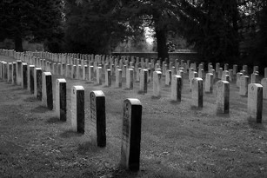
Death Will Vanish
During the Millennium, death will cease among the righteous inhabitants of the earth. They will live to be very old, and when the time for the change known as death arrives, they will “be changed in the twinkling of an eye” from mortality to immortality and their “rest shall be glorious”.
Among those that have “kept the faith” there will not be a separation of the spirit and body where the spirit passes into the spirit world and the body is laid in the ground to await the Resurrection. Instead, at the appropriate time, there will be an instantaneous change from a mortal to a resurrected, immortal condition.
D&C 101:29 Student Manual

Slide 11

Age of the Tree
There shall be no more thence an infant of days, nor an old man that hath not filled his days: for the child shall die an hundred years old; but the sinner being an hundred years old shall be accursed.
Isaiah 65:20
Children will live to be 100 years old and when the time comes for men to die, it will be in the twinkling of an eye…Elder Joseph Fielding Smith
D&C 101:30

Slide 12

Twinkling of an Eye
“No grave will be dug during the Millennium. Death and suffering as we now know them will not exist.
The body and the spirit will no longer separate for a long period of time.
For now the body and the dust while the spirit awaits in the world of spirits for the day of its reunion with a perfected body.
McConkie and Ostler
And ye shall never endure the pains of death; but when I shall come in my glory ye shall be changed in the twinkling of an eye from mortality to immortality; and then shall ye be blessed in the kingdom of my Father.
3 Nephi 28:8
D&C 101:31

Slide 13
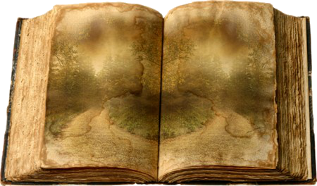
Mysteries Revealed
The Millennium is the time when the Savior will personally work with the faithful, obedient members of His Church who have lived on the earth since the days of Adam.
One can only imagine the blessings that are in store for those who have been faithful. For example, the first ten chapters (about fifteen pages) in the book of Genesis cover approximately two thousand years of history.
The amount of knowledge that has been lost concerning just this period is astounding. In the Millennium all that knowledge, and more, will be restored. It is of little wonder, then, that Saints have longed for the day when Christ would be in their midst, a day in which He will make all things known.
D&C 101:32-34 Student Manual

Slide 14
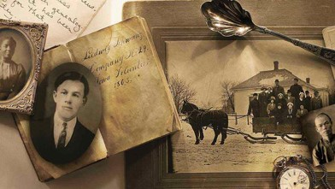
Enduring to the End
The Lord urged the Saints in these verses to place more attention on eternal life than on the pursuits of mortal life. He indicates that those who had lost their lives in Jackson County (there were some), and those who would do so in future persecutions (six thousand lost their lives while crossing the plains to Utah) need not fear. Those who are faithful have the hope of a glorious resurrection and the blessings of eternal life with God.
Those who suffer persecution for the name of the Savior and endure in faith will partake of God’s glory
D&C 101:35-38 Student Manual

Slide 15
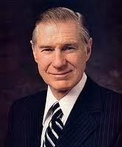
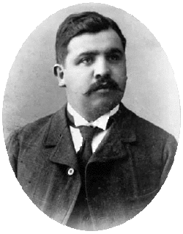
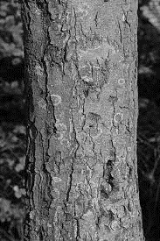
“Rafael Monroy was the president of the small San Marcos Mexico Branch, and Vicente Morales was his first counselor. … They were told they would be spared if they would give up their weapons and renounce their strange religion. Brother Monroy told his captors that he did not have any weapons and simply drew from his pocket his Bible and Book of Mormon. He said, ‘Gentlemen, these are the only arms I ever carry; they are the arms of truth against error.’
“When no arms were found, the brethren were cruelly tortured to make them divulge where arms were hidden. But there were no arms. They were then taken under guard to the outskirts of the little town, where their captors stood them up by a large ash tree in front of a firing squad. The officer in charge offered them freedom if they would forsake their religion and join the [soldiers], but Brother Monroy replied, ‘My religion is dearer to me than my life, and I cannot forsake it.’
D&C 101:35-38 James E. Faust

Slide 16
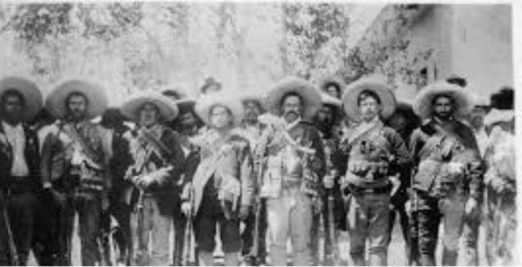
“They were then told that they were to be shot and asked if they had any request to make. Brother Rafael requested that he be permitted to pray before he was executed. There, in the presence of his executioners, he kneeled down and, in a voice that all could hear, prayed that God would bless and protect his loved ones and care for the little struggling branch that would be left without a leader. As he finished his prayer, he used the words of the Savior when He hung upon the cross and prayed for His executioners: ‘Father, forgive them; for they know not what they do.’ [Luke 23:34.] With that the firing squad shot both Brother Monroy and Brother Morales.”
D&C 101:35-38 James E. Faust

Slide 17
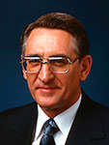

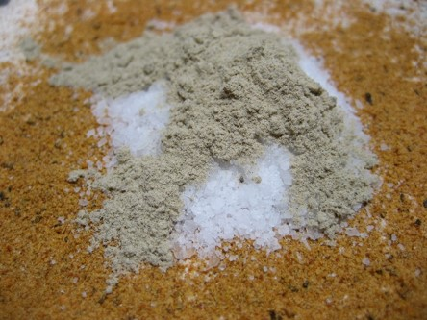
The Salt of the Earth
Salt can be used to flavor and preserve food and to heal wounds as a disinfectant
“When the Lord used the expression ‘savor of men,’ he was speaking of those who represent him. He was referring to those who have repented, who have been washed clean in the waters of baptism, and who have covenanted to take upon them his name and his cause. Moreover, he was speaking of those who would share by covenant his priesthood power. He was speaking of you and me”
Elder Carlos E. Asay
Salt does not lose its savor when it ages. It loses its savor when it is mixed with other substances and contaminated by them.
D&C 101:35-38 Student Manual

Slide 18
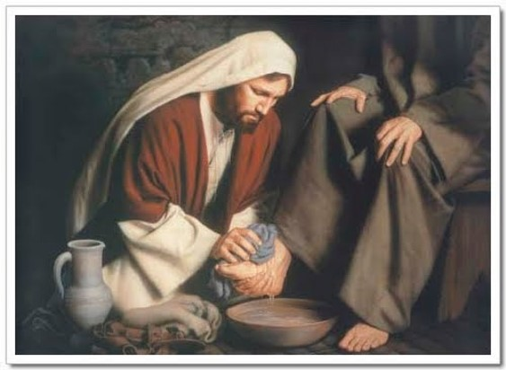
To help the people of the earth receive God’s blessings, we must repent of our sins and be humble
D&C 101:40-42

Slide 19
Sources:
Videos:
Gather in Stakes (1:17)
Latter-day Martyrs (2:03)
The Savor of Men (0:31)
Bruce R. McConkie New Witness pg. 595
Millennial Messiah, pg. 658
Richard O. Cowan Regional Studies in Latter-day Saint History: Missouri, 1994 p. 138-152
Elder Harold B. Lee (Stand Ye in Holy Places, pp. 21–24.)
Elder D. Todd Christofferson Come to Zion October 2008 Gen. Con.
Elder Orson Pratt (in Journal of Discourses,18:170).
Presentation by ©http://fashionsbylynda.com/blog/
Joseph Fielding McConkie and Craig J. Ostler Revelations of the Restoration pg. 733, 735
Elder Parley P. Pratt (Key to the Science of Theology, p. 61.)
President Joseph Fielding Smith (Church History and Modern Revelation, 1:192.)
Elder Joseph Fielding Smith Doctrines of Salvation 1:86-87
Doctrine and Covenants Student Manual Religion 324-325 Section 101
President James E. Faust (“Discipleship,” Ensign or Liahona, Nov. 2006, 21–22; based on Rey L. Pratt, “A Latter-day Martyr,” Improvement Era, June 1918, 720–26).
Elder Carlos E. Asay (“Salt of the Earth: Savor of Men and Saviors of Men,” Ensign, May 1980, 42).
Presentation by ©http://fashionsbylynda.com/blog/

Slide 20
D&C 101:17-21 Zion:
“There is no occasion for uncertainty or anxiety about the building up of Zion—meaning the New Jerusalem—in the last days. The Lord once offered his people the chance to build that Zion from which the law shall go forth to all the world. They failed. Why? Because they were unprepared and unworthy, as is yet the case with those of us who now comprise the kingdom. When we as a people are prepared and worthy, the Lord will again command us and the work will go forward—on schedule, before the Second Coming, and at the direction of the President of the Church. Until then, none of us need take any personal steps toward gathering to Missouri or preparing for a landed-inheritance there. Let us, rather, learn the great concepts involved and make ourselves worthy for any work the Lord may lay upon us in our day and time. Some things must yet precede the building up of Jackson County” Bruce R. McConkie (A New Witness for the Articles of Faith [1985], 586).
Three World Wide Signs Associated With the Coming of the Savior
“All flesh shall see [Him] together” (D&C 101:23). Elder Orson Pratt of the Quorum of the Twelve Apostles said: “The second advent of the Son of God is to be something altogether of a different nature from anything that has hitherto transpired on the face of the earth, accompanied with great power and glory, something that will not be done in a small portion of the earth … and seen only by a few; but it will be an event that will be seen by all, all flesh shall see the glory of the Lord; when he reveals himself the second time every eye, not only those living at that time in the flesh, in mortality on the earth, but also the very dead themselves … will also see him at that time” (in Deseret News: Semi-Weekly, Apr. 25, 1876, 1).
“Every corruptible thing … shall be consumed” (D&C 101:24). Elder Bruce R. McConkie of the Quorum of the Twelve Apostles explained: “Incident to the commencement of the millennial era, the earth (the Lord’s vineyard) will be burned. Every corruptible thing will be consumed (D. & C. 101:24); all the proud and they that do wickedly shall be burned as stubble (Mal. 4:1; D. & C. 29:9; 64:23–25; 133:63–64); the sinners will be destroyed (Isa. 13:9–14); and there will be an entire separation of the righteous and the wicked. (D. & C. 63:54.) Those only shall be able to abide that day who are worthy to live on a paradisiacal or terrestrial sphere” (Mormon Doctrine, 2nd ed. [1966], 494).
“All things shall become new” (D&C 101:25). Of this newness Elder Parley P. Pratt of the Quorum of the Twelve Apostles wrote: “A new heaven and a new earth are promised by the sacred writers. Or, in other words, the planetary systems are to be changed, purified, refined, exalted and glorified, in the similitude of the resurrection, by which means all physical evil or imperfection will be done away” (Key to the Science of Theology, 10th ed. [1965], 61.)

Slide 21
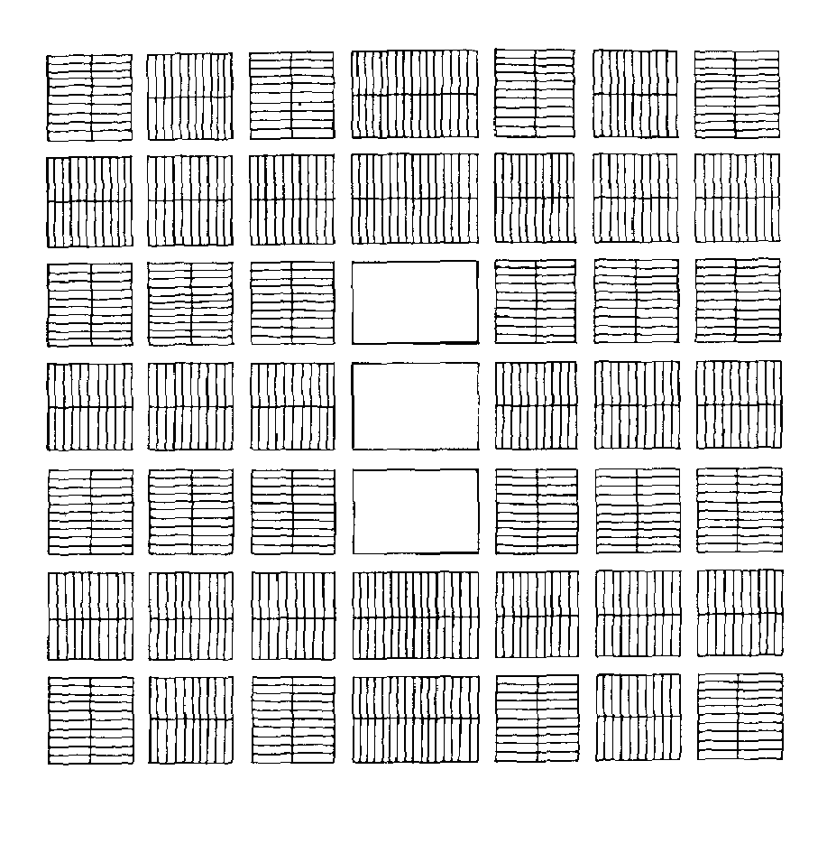
TEMPLE NUMBERS AND NAMES | PULPITS
10-12 House of the Lord, for the Presidency of the High and most Holy Priesthood, after the order of Melchizedek. | West: Melchizedek Presidency
7-9 Sacred Apostolic Repository, for the use of the Bishop. | Bishopric
4-6 Holy Evangelical House, for the High Priesthood of the High Priests Holy Order of God. | High Priests
1-3 House of the Lord, for the Elders of Zion, and Ensign Elders of the Nations. | Elders East: Aaronic
22-24 House of the Lord for the Presidency of the High Presidency Priesthood, after the Order of Aaron. | Presidency
19-21 House of the Lord, Law of the Kingdom of Heaven, Messenger to the People; for the Highest Priesthood after the Order of Aaron. | Priests
16-18 House of the Lord for the Teachers in Zion, Messenger to the Church. | Teachers
13-15 House of the Lord for the Deacons in Zion, Helps in Government. | Deacons
Plat of City of Zion
This plan for the city of Zion came at a time when the organization of priesthood quorums was still being unfolded. Significantly, the names to be given to the 24 temples emphasize the roles of various priesthood officers in these sacred structures. These officers corresponded precisely to those who were to occupy the tiered pulpits at the two ends of the temple's main rooms. Richard O. Cowan
Regional Studies in Latter-day Saint History: Missouri, 1994 p. 138-152

Slide 22
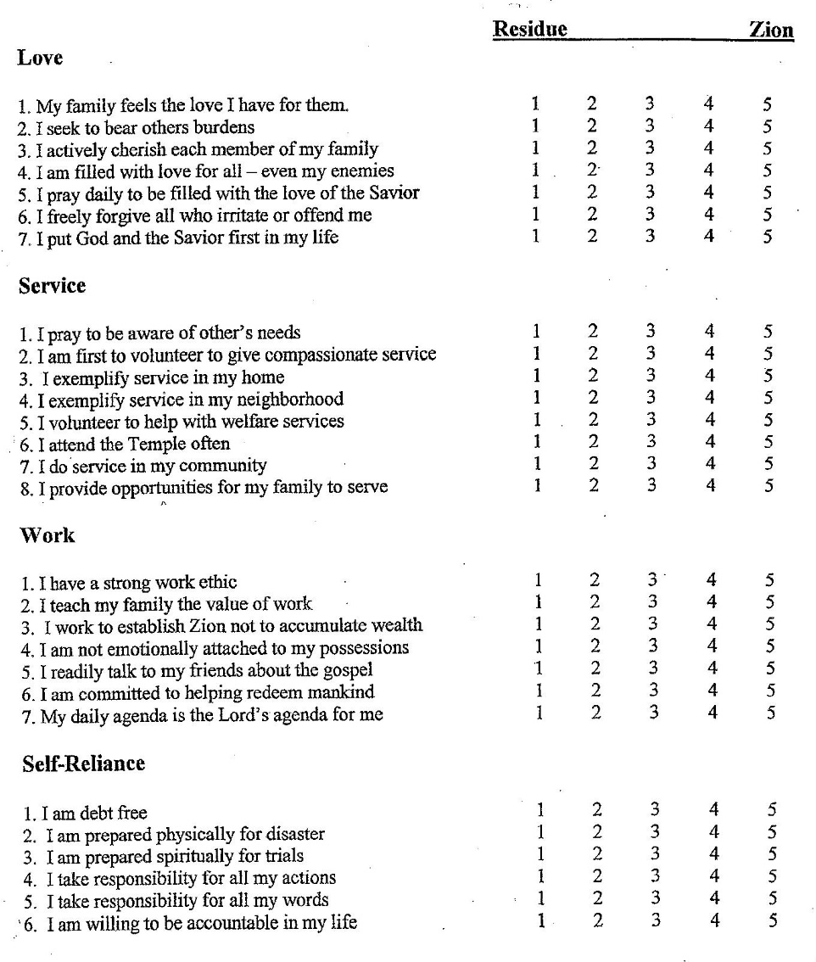
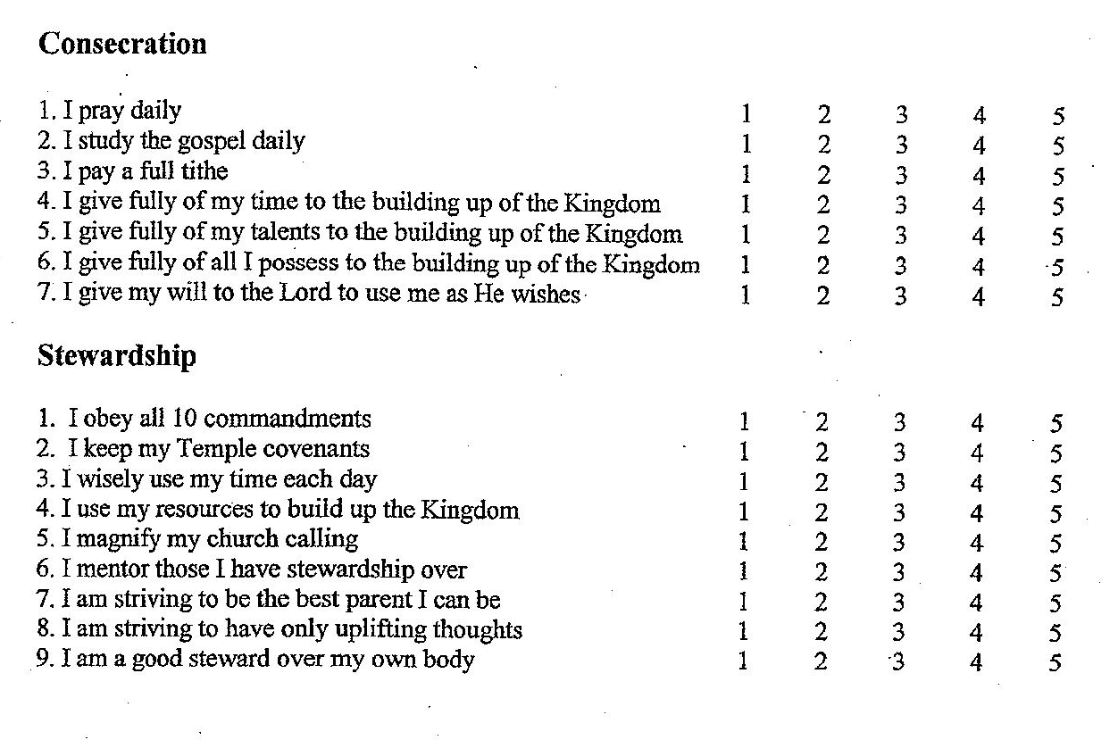
How Am I Doing In Zion?

Slide 23
To read more about Rafael Monroy and Vicente Morales:
https://www.lds.org/ensign/1997/07/los-primeros-mexicos-pioneer-saints?lang=eng
http://www.ldsliving.com/Why-Two-Members-of-a-Branch-Presidency-Were-Executed/s/88602

