Slide 1
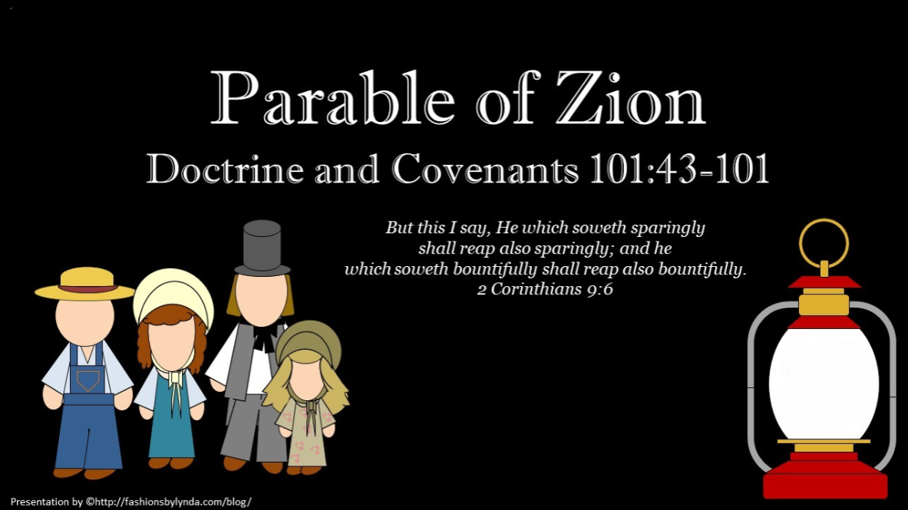

Slide 2
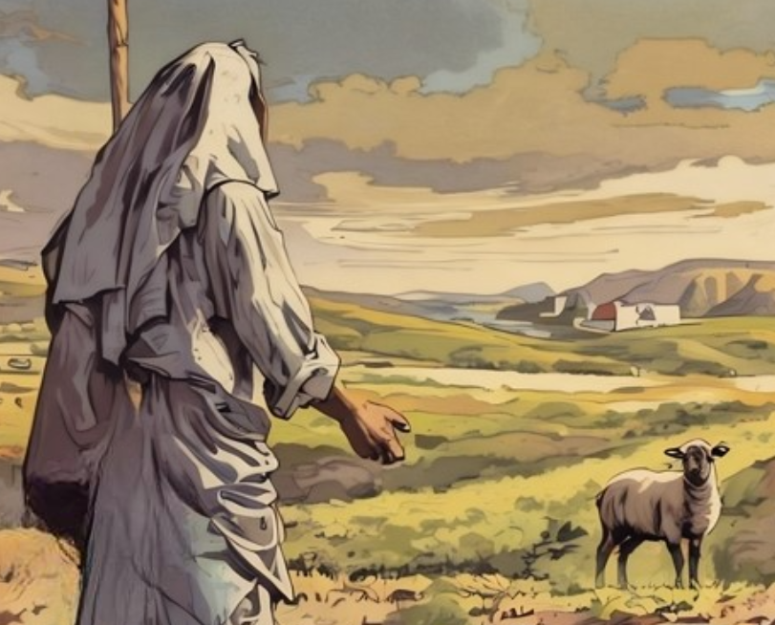

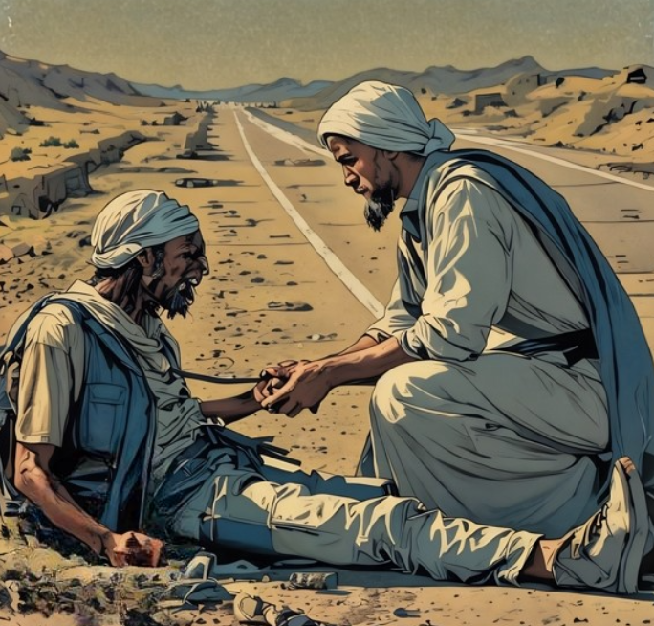
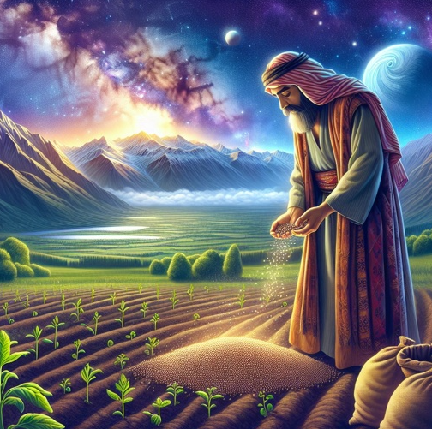
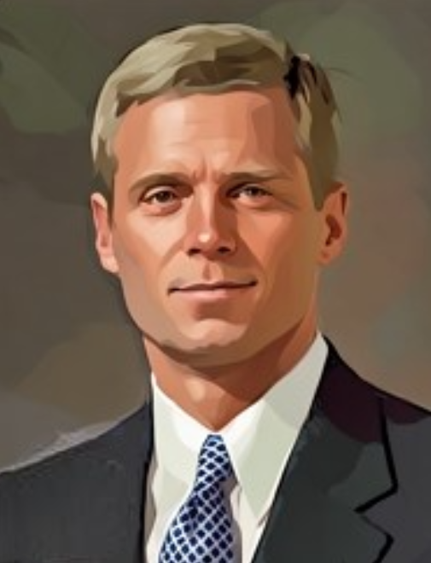
Parables
The intended meaning or message of a parable typically is not expressed explicitly.
Rather, the story only conveys divine truth to a receiver in proportion to his or her faith in God, personal spiritual preparation, and willingness to learn.
Thus, an individual must exercise moral agency and actively “ask, seek, and knock” to discover the truths embedded in a parable.
David A. Bednar
Matthew 18:10-14; Luke 15:1-7
Matthew 13:45-46
Luke 10:29-37
Matthew 7:7–8; Luke 11:9–10
Matthew 13:1-23

Slide 3


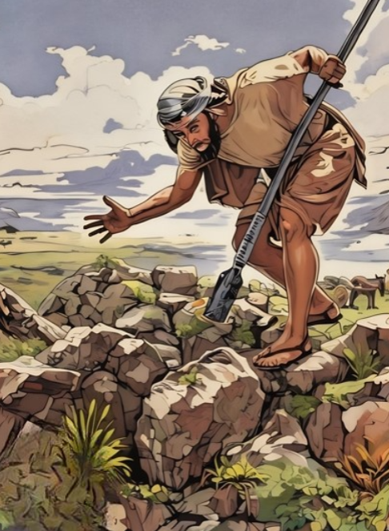
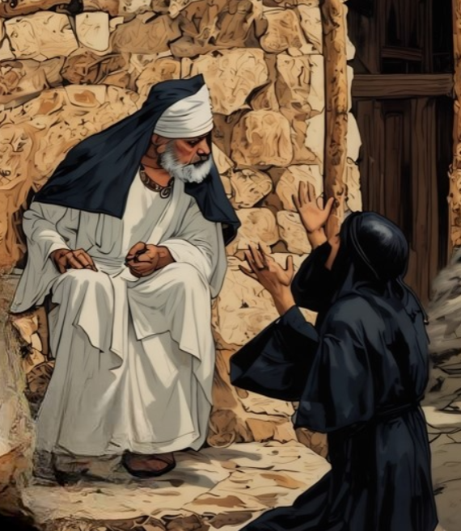
How to Study Parables
Find important details. These details could include people, places, objects, actions, or events.
Make comparisons. Determine what each of the details in the parable could represent or symbolize. Contextual clues, scripture-study aids, and pondering can be helpful.
Discover valuable lessons. After making comparisons, seek help from the Holy Ghost to discover valuable lessons the Savior was teaching in the parable.
Determine personal application. Seek help from Heavenly Father and the Holy Ghost to know what you can do to personally apply the lessons you discover.
Matthew 13:45-46
Luke 13:6-9
Luke 18:1-8
Matthew 13:44

Slide 4
Parable of the Nobleman
The Olive Trees are the settlements of the Saints
Zion is the Choice land in His vineyard—Jackson County, Missouri
The Nobleman
Savior
D&C 101:44

Slide 5
The Servants are the members of the Church
The watchmen are the Officers of the Church
D&C 101:45
Prophets serve as watchmen on the tower, giving us warnings from the Lord of coming dangers.

Slide 6
Had they built it as directed, it would have been a spiritual refuge for them, for from it the Lord’s watchmen could have seen by revelation the movements of the enemy from afar.
While yet building in Zion, they become at variance with each other and do not build the tower or Temple whose site had been dedicated as early as August 3, 1831.
The Tower is the Temple of the Lord
D&C 101:45

Slide 7
The members of the Church begin to build the temple--1833
D&C 101:46

Slide 8
The members decided that since all was peaceful there was no need to build a Temple and wanted to use the money for other purposes
?
D&C 101:47-50

Slide 9
The enemy—mobbers-- came at night and destroyed the foundations of the Temple
The members of the Church fled
D&C 101:51
Through temple work, the Savior prepares us to withstand the adversary.

Slide 10
Go to Zion with Joseph Smith—redeem the purchased lands—do not start a war
The Lord rebuked the members for not building and watching over the Church
D&C 101:53-55
When we obey the Lord’s commandments, He strengthens us to withstand spiritual and physical enemies.

Slide 11
There were 204 men, 10 women, and 7 children who participated in Zion’s Camp
Zion’s Camp—Joseph Smith gathered up men as directed by the revelation from the Lord
D&C 101:57-62

Slide 12
Redemption
Though Joseph Smith followed the Lord’s instructions to gather together the “strength of my house” by organizing Zion’s Camp to redeem Zion, the Lord’s purpose in sending them and His will concerning the redemption of Zion were not fully understood by His people.
The redemption of Zion did not take place at that time. When the servant in the parable asked when the land would be possessed, the Lord responded, “When I will”.
D&C 101:60

Slide 13
Continue to Build But Not With Haste
Even though the Saints in Jackson County, Missouri, had been expelled from their homes, the Lord commanded them to continue to build His kingdom.
Part of the difficulty experienced in the original attempt to establish Zion was caused by many Saints’ coming to Zion ill-prepared.
They apparently felt that the Lord would care for their needs rather than have them do it themselves.
This idea was contrary to the Lord’s counsel from the very beginning of Zion’s founding, for He said:
“And let the work of the gathering be not in haste, nor by flight” (D&C 58:56).
D&C 101:67-76 Student Manual

Slide 14
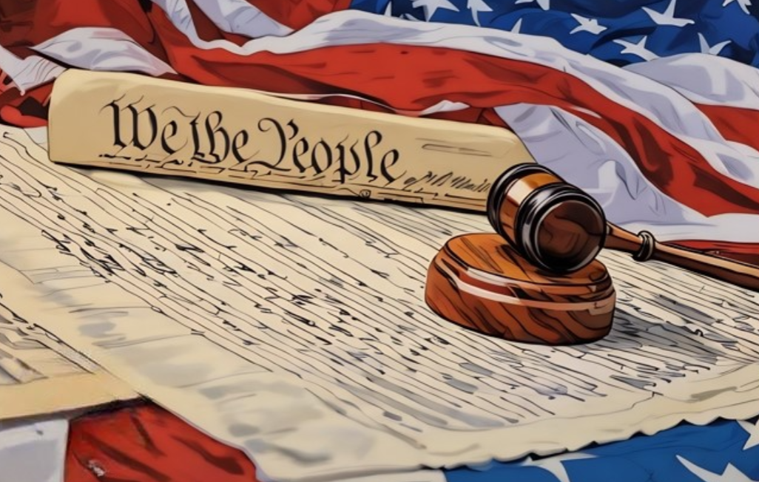
Constitutional Laws
One purpose of government is to protect individuals “in their inherent and inalienable rights”, including ”the free exercise of conscience, the right and control of property, and the protection of life”.
The Saints in Zion were denied all these rights. The Constitution of the United States guarantees individuals the right to apply for redress when denied their rights.
The Lord urged the Saints in Zion “to importune for redress, and redemption” at the hands of the constituted authorities.
“In section 101 the Lord speaks about the constitution of this land. He says it was framed by wise men whom he raised up for that very purpose.
What for? To maintain the rights and privileges ‘of all flesh.’ Not alone the people of this land.
The principles of that great instrument are to go forth to the nations, and the time will come when they will prevail, just as sure as the sun shines even when it appears to be in darkness and the clouds are over it.” President Charles W. Penrose
D&C 101:77-79 Student Manual

Slide 15
God’s Constitutional Law
“To me … that statement of the Lord, ‘I have established the Constitution of this land,’ puts the Constitution of the United States in the position in which it would be if it were written in the book of Doctrine and Covenants itself.
Doctrine
And
Covenants
This makes the Constitution the word of the Lord to us. That it was given, not by oral utterance, but by the operation of his mind and spirit upon the minds of men, inspiring them to the working out of this great document of human government, does not alter its authority.”
J. Reuben Clark Jr.
D&C 101:80 Student Manual

Slide 16
Proper Tribunals
“The saints were also to carry their grievances to the proper tribunals and seek for redress of their wrongs.
This was a very necessary step, and when the Saints did this and were denied their civil and religious rights, those officials were left without excuse, and the judgments of the Almighty which later came upon them during the Civil War, were justified. …
“Since there is a just law of retribution, as fixed and eternal as are other laws of the Almighty the day must come when there shall be adjustments made before a Just Magistrate who will not be cowed by the threats of mobs.”
D&C 101:81-95 President Joseph Fielding Smith

Slide 17


Hold Claim
“Let your sufferings be what they may, it is better in the eyes of God that you should die, than that you should give up the land of Zion, the inheritances which you have purchased with your moneys; for every man that giveth not up his inheritance, though he should die, yet, when the Lord shall come, he shall stand upon it, and with Job, in his flesh he shall see God.
Therefore, this is my counsel, that you retain your lands, even unto the uttermost, and employ every lawful means to seek redress of your enemies; and pray to God, day and night, to return you in peace and in safety to the lands of your inheritance: and when the judge fail you, appeal unto the executive; and when the executive fail you, appeal unto the president; and when the president fail you, and all laws fail you, and the humanity of the people fail you, and all things else fail you but God alone, and you continue to weary Him with your importuning's, as the poor woman did the unjust judge, He will not fail to execute judgment upon your enemies, and to avenge His own elect that cry unto Him day and night.”
“I would inform you that it is not the will of the Lord for you to sell your lands in Zion, if means can possibly be procured for your sustenance without. Every exertion should be made to maintain the cause you have espoused.”
D&C 101:81-95 Prophet Joseph Smith

Slide 18
Power to Choose
Sidney Gilbert is instructed not to sell the Lord’s storehouse, and the Saints are directed not to give up their claims.
The Lord promises them that they shall come into possession of them in the Millennium, if not before.
All things will finally be adjusted, Wrongs will be righted and all injustice removed.
Then, and not till the, will there be lasting peace on Earth.
Smith and Sjodahl
God has given us moral agency, the power to choose, but we are accountable for our choices.
D&C 101:96-101

Slide 19
Sources:
Video:
“Agency” (6:20)
God Raised Up Wise Men to Establish the Constitution (1:49) Verse 77
David A. Bednar, “Put On Thy Strength, O Zion,” Liahona, Nov. 2022, 92
Doctrine and Covenants Student Manual Religion 324-325 Section 101
President Charles W. Penrose (In Conference Report, Apr. 1917, p. 20.)
J. Reuben Clark Jr., in Conference Report, Apr. 1935, p. 93.
Presentation by ©http://fashionsbylynda.com/blog/
President Joseph Fielding Smith (Church History and Modern Revelation, 1:462, 469).
Prophet Joseph Smith (Teachings, p. 31, 35-36.)
Hyrum M. Smith and Janne M. Sjodahl Doctrine and Covenants Commentary pg. 653
Presentation by ©http://fashionsbylynda.com/blog/

Slide 20
President Brigham Young spoke of some of these “wise men” raised up by God:
“We believe that the Lord has been preparing that when he should bring forth his work, that, when the set time should fully come, there might be a place upon his footstool where sufficient liberty of conscience should exist, that his Saints might dwell in peace under the broad panoply of constitutional law and equal rights. In this view we consider that the men in the Revolution were inspired by the Almighty, to throw off the shackles of the mother government, with her established religion. For this cause were Adams, Jefferson, Franklin, Washington, and a host of others inspired to deeds of resistance to the acts of the King of Great Britain, who might also have been led to those aggressive acts, for aught we know, to bring to pass the purposes of God, in thus establishing a new government upon a principle of greater freedom, a basis of self-government allowing the free exercise of religious worship.
“It was the voice of the Lord inspiring all those worthy men who bore influence in those trying times, not only to go forth in battle but to exercise wisdom in council, fortitude, courage, and endurance in the tented field, as well as subsequently to form and adopt those wise and efficient measures which secured to themselves and succeeding generations, the blessings of a free and independent government.” (Discourses of Brigham Young, pp. 359–60.)
What was God’s purpose in establishing the United States Constitution? We see it in the doctrine of moral agency. In the first decade of the restored Church, its members on the western frontier were suffering private and public persecution. Partly this was because of their opposition to the human slavery then existing in the United States. In these unfortunate circumstances, God revealed through the Prophet Joseph Smith eternal truths about His doctrine.
God has given His children moral agency—the power to decide and to act. The most desirable condition for the exercise of that agency is maximum freedom for men and women to act according to their individual choices. Then, the revelation explains, “every man may be accountable for his own sins in the day of judgment” (Doctrine and Covenants 101:78). “Therefore,” the Lord revealed, “it is not right that any man should be in bondage one to another” (Doctrine and Covenants 101:79). (Dallin H. Oaks, “Defending Our Divinely Inspired Constitution,” Liahona, May 2021, 106)
Elder D. Todd Christofferson of the Quorum of the Twelve Apostles taught why the term moral agency is preferred over the term free agency:
“In years past, we generally used the term free agency. That is not incorrect, but more recently we have taken note that free agency does not appear as an expression in the scriptures. They talk of our being ‘free to choose’ and ‘free to act’ for ourselves and of our obligation to do many things of our own ‘free will.’ But the word agency appears either by itself or, in Doctrine and Covenants, section 101, verse 78, with the modifier moral: ‘That every man may act in doctrine and principle … according to the moral agency which I have given unto him, that every man may be accountable for his own sins in the day of judgment’ (emphasis added). When we use the term moral agency, then, we are appropriately emphasizing the accountability that is an essential part of the divine gift of agency. We are moral beings and agents unto ourselves, free to choose but also responsible for our choices” (“Moral Agency” [Brigham Young University devotional address, Jan. 31, 2006], 1,speeches.byu.edu).

Slide 21
