Slide 1
Doctrine and Covenants 103
Camp of Zion
And behold, this people will I establish in this land, unto the fulfilling of the covenant which I made with your father Jacob; and it shall be a New Jerusalem. And the powers of heaven shall be in the midst of this people; yea, even I will be in the midst of you.
3 Nephi 20-22
Presentation by ©http://fashionsbylynda.com/blog/

Slide 2
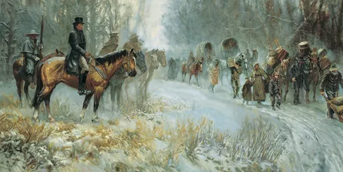
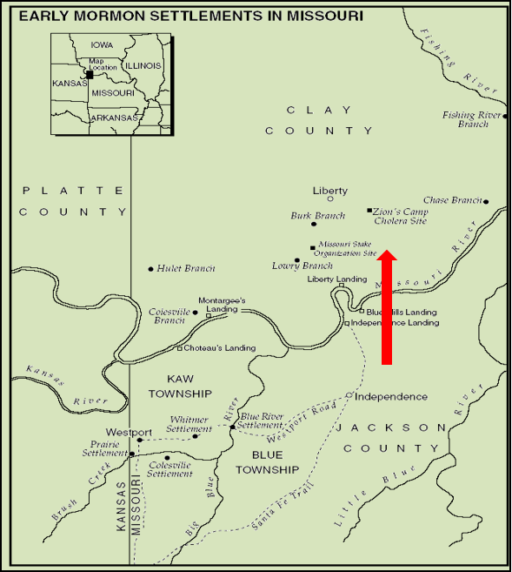
Background
Recap:
Saints Driven from Home November 1833 in Jackson County, Missouri to Clay County, Missouri
February 1834
A High council met in Kirtland, Ohio to plan to organize an army to help the Missouri Saints.
In a Revelation (D&C 103) to Joseph Smith the Lord directed the Church leaders to gather resources and recruits---known as Zion’s Camp.

Slide 3
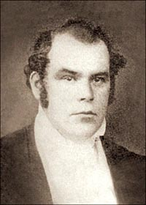
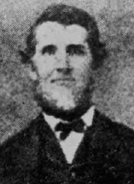
Parley P. Pratt and Lyman Wight
“We travelled every day, whether through storm or sunshine, mud, rain or snow; except when our public duties called us to tarry. We arrived in Kirtland early in the spring, all safe and sound; we had lacked for nothing on the road, and now had plenty of funds in hand.
President Joseph Smith and the Church in Kirtland received us with a hospitality and joy unknown except among the Saints; and much interest was felt there, as well as elsewhere, on the subject of our persecution.”
Parley P. Pratt

Slide 4
Lyman Wight
He was born on May 9, 1796, at Fairfield, New York
He moved to Ohio and became affiliated with the communal group on the Isaac Morley farm in Kirtland
He embraced the restored gospel and was baptized on November 14, 1830, by Oliver Cowdery
At the 4th conference of the Church in June 1831 he was the first man ordained a high priest by Joseph Smith
He was called on a Mission by revelation (D&C 52:7) to Missouri and later became a resident of Jackson County
He witnessed the violent treatment of the Saints
He traveled with Parley P. Pratt to inform the Prophet of the crisis and marched with Joseph Smith as deputy to Zion’s Camp
He was called as a counselor in the Adam-0ndi-Ahman stake on June 28, 1838
He was seized by a mob who offered him his life if he would testify against the Prophet. He refused and was sent along with Joseph Smith at Richmond, then later Liberty Jail
In January 19, 1841, he was commissioned to assist in the building of the Nauvoo House and in August he was ordained to the apostleship
He failed to support Brigham Young as successor after the Martyrdom of Joseph Smith and went to Texas to start his own colony. His fellowship was withdrawn in 1848, and he passed away suddenly in Texas on March 31, 1858
Who’s Who

Slide 5




Enemies of the Righteous
Get
Out
Those who persuade
Those who persecute
What are some obstacles or barriers that people might allow to get in the way of their pursuit of eternal life?
D&C 103:1-2

Slide 6
A Little Season
To allow the persecutors to “fill up the measure of their iniquities, that their cup might be full”—in other words, to justify His judgments on the wicked.
2 reasons why the Lord allowed His enemies to persecute the Saints
To chasten the disobedient Saints
They were not completely obedient to the Lord
Remember in 1833 the Lord warned that the people of Zion would receive His protection only if they were obedient. If they were not, His judgments would come upon them as well as upon the wicked. Student Manual
D&C 103:3-4

Slide 7
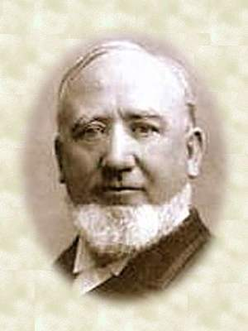
To Prevail
To be stronger than an opponent or to be victorious
“When they [the Saints] have been faithful in keeping the commandments of God they have prospered and they have had deliverance. When they have been unfaithful they met with trouble and serious difficulty. It is necessary that the wicked should have the opportunity to exercise their agency in relation to the work of God; for they have an agency as well as we. It is their privilege to assist in building up the word of God, or they can exercise their agency in fighting the work of God.
They have the privilege to do
everything in their power to
destroy it, and they will be
permitted to do this until the
cup of their iniquity is full.”
President George Q. Cannon
When we begin to follow the Lord’s counsel, we receive strength to begin to prevail against the world
D&C 103:5-8

Slide 8
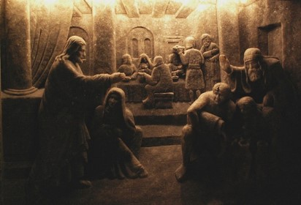

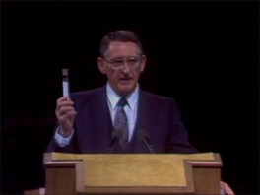
Salt of the Earth
“Saviors of Men”
“Salt at one time had religious significance, and was a symbol of purity. … Among many peoples, salt is still used as a sign of honor, friendship and hospitality. The Arabs say ‘there is salt between us,’ meaning ‘we have eaten together, and are friends’”
“The word savor (s-a-v-o-r) denotes taste, pleasing flavor, interesting quality, and high repute.
…it is clean, pure, uncontaminated, and useful. In this state or condition, salt will preserve, flavor, heal, and perform other useful functions.”
“When the Lord used the expression “savor of men,” he was speaking of those who represent him. He was referring to those who have repented, who have been washed clean in the waters of baptism, and who have covenanted to take upon them his name and his cause. Moreover, he was speaking of those who would share by covenant his priesthood power. He was speaking of you and me.”
D&C 103:9-10 Carlos E. Asay

Slide 9

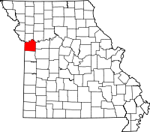
Redeemed By His Power
The Lord intended to restore His people to their lands, and that they would “no more be thrown down”
That this restoration would not happen until after “much tribulation”
The Lord warned the Saints that, even though He had promised they could return to the land of Zion, if they “pollute[d] their inheritances” through sin, they would lose the Lord’s support and be “thrown down”.
Since this revelation was given, many leaders of the Church have discussed the future return to Jackson County, Missouri.
Elder Orson F. Whitney said: “Will our mission end here [in Utah]? Is the State of Utah the proper monument of the ‘Mormon’ People? No. … The monument to ‘Mormonism’ will stand in Jackson County, [Missouri]. There the great City will be built: There Zion will arise and shine, ‘the joy of the whole Earth,’ and there the Lord will come to His temple in His own time, when His people shall have made the required.”
D&C 103:11-14 Smith and Sjodahl

Slide 10
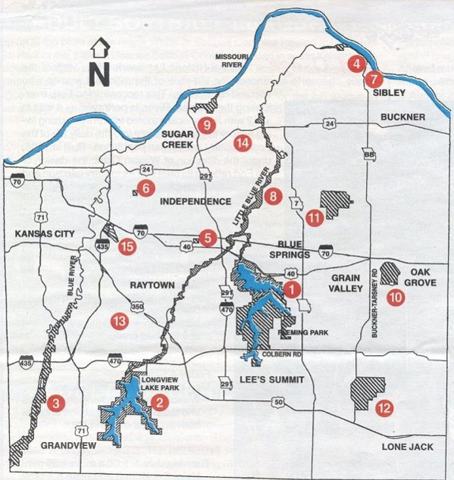
The Center Place of Zion
“The center place where the City New Jerusalem is to be built, is in Jackson County, Missouri. It was never the intention to substitute Utah or any other place for Jackson County.”
President Joseph Fielding Smith
“Are we going back to Jackson County?
Yes.
When?
As soon as the way opens up.
Are we all going?
O no! of course not. The country is not large enough to hold our present numbers.”
“A portion of the Priesthood will go and redeem and build up the centre Stake of Zion”
President Brigham Young
D&C 103:11-14

Slide 11
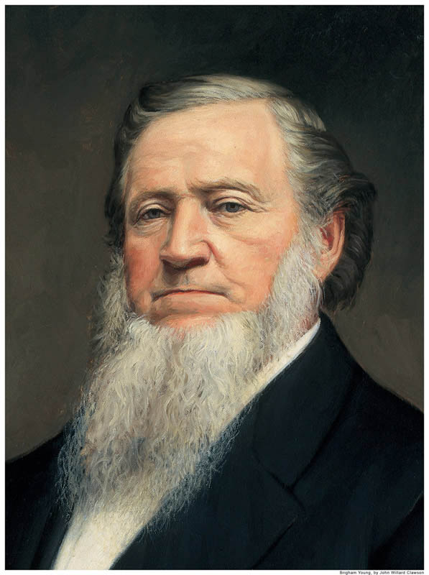
He Knows
The Lord knows in advance what is in store for the Saints.
Some members of the Church in early Utah were so anxious to return to Jackson County they were reluctant to make improvements to homes and lands they assumed they would abandon.
“Remarks have been made as to our staying here. I will tell you how long we shall stay here. If we live our religion, we shall stay here in these mountains forever and forever, worlds without end, and a portion of the Priesthood will go and redeem and build up the centre Stake of Zion.”
“Before we were driven out of Missouri I had a vision, … and saw that the people would go to the east, to the north and to the west; but we should go back to Jackson County from the west.
When this people return to the Centre Stake of Zion, they will go from the west.”
While it is important to look forward to building up Zion in Jackson County, Missouri, we must at the same time labor to build up Zion wherever we are.
D&C 103:15-20 Brigham Young

Slide 12
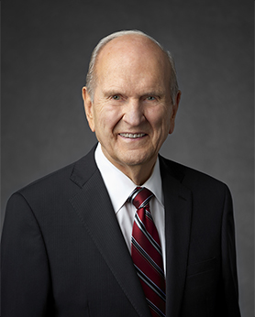
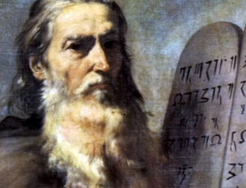

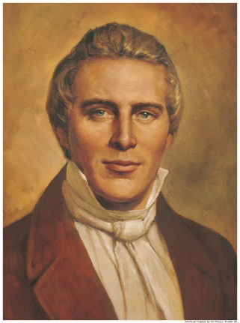
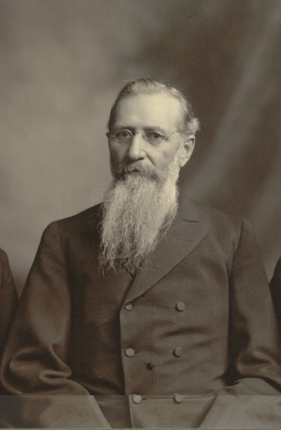
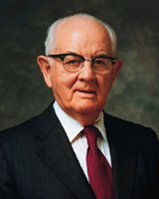
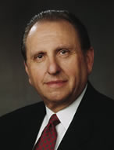
Like Moses
There have been many conjectures concerning “The leader”.
There have even been misguided men who have declared themselves to be this man ‘like as Moses.’
“Yet, the meaning as set forth in the scriptures, is very simple. In modern revelation the President of the Church is frequently compared to Moses. Soon after the organization of the Church, the Lord said, ‘no one shall be appointed to receive commandments and revelations in this church excepting my servant Joseph Smith, Jun., for he receiveth them even as Moses’.
In one of the great revelations upon Priesthood, this is more specifically expressed: ‘the duty of the President of the office of the High Priesthood is to preside over the whole church, and to be like unto Moses’. …
“The man like unto Moses in the Church is the President of the Church.”
D&C 103:16 Elder John A. Widtsoe

Slide 13
Fellow Saints in Jackson County, Missouri, have been forcibly driven from their lands by ruthless mobs. Join in bringing relief to these Saints and helping protect them as they regain and maintain their lands in Zion. Depart from Kirtland, Ohio, on May 1, 1834.
Volunteers
Needed
D&C 103:21-23

Slide 14
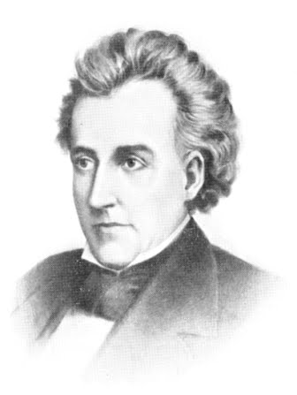
Zion’s Camp
The group of men whom Joseph Smith would lead to Missouri came to be known as Zion’s Camp.
Camp is another word for army
Purpose
First, they were to bring resources to the Saints in Missouri to provide relief and enable them to return to their homes and purchase additional land
Second, as authorized by Governor Daniel Dunklin of Missouri, after the Missouri state militia had escorted the Saints back to Jackson County, the members of Zion’s Camp would be left to help maintain order and peace there
D&C 103:21-23

Slide 15
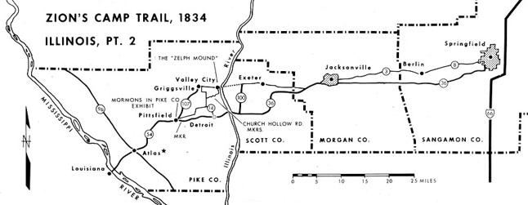
Requirements of the Men
Joining Zion’s Camp required leaving family and work responsibilities to march about 900 miles (1,450 kilometers) through grueling conditions into a hostile and dangerous environment.
Many of the men in Zion’s Camp left families with little or no money and no source of income. To prevent undue hardships, members of the Church planted gardens so the women and children could harvest corn and other crops during the army’s absence.
The volunteers also gathered supplies and teams for their journey, as well as clothing, bedding, food, and arms for the Saints in Missouri. A few elders, including Oliver Cowdery and Sidney Rigdon, were left behind to supervise the ongoing construction of the temple and to direct the other affairs of the Church in Kirtland.
For the Saints in Zion’s Camp, the possibility of losing their lives was real.
D&C 103:21-23 Church History In The Fulness Of Times Student Manual, (2003), 141–152

Slide 16
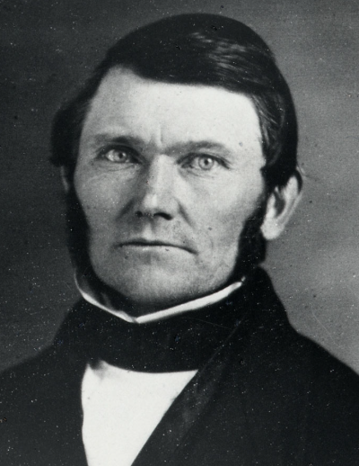
I was called to take my life in my hands and go up to Missouri, and a little handful of us went up to redeem our brethren. We certainly had to go by faith.
My neighbors called upon and pled with me not to go; said they—“Do not go, if you do you will lose your life.” I said to them—“If I knew that I should have a ball [shot] through my heart the first step I took in the State of Missouri I would go.” …
That is the way I felt in those days with regard to the work of God, and that is the way I feel today. I am after salvation and eternal life, and I do not want anything to stand between me and that which I am in pursuit of. (Wilford Woodruff, in Journal of Discourses, 17:246; spelling modernized)

Slide 17

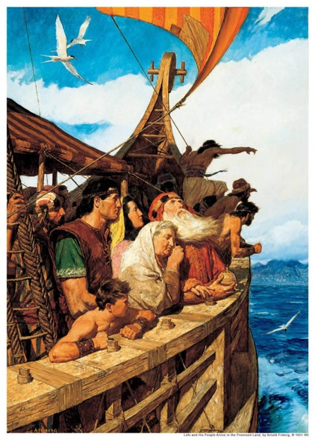
A Small Moment in Time
“The testing processes of mortality are for all men, saints and sinners alike. Sometimes the tests and trials of those who have received the gospel far exceed any imposed upon worldly people. Abraham was called upon to sacrifice his only son. Lehi and his family left their lands and wealth to
live in a wilderness.
Saints in all ages have
been commanded to lay
all that they have upon
the altar, sometimes even
their very lives.”
“But come what may, anything that befalls us here in mortality is but for a small moment, and if we are true and faithful God will eventually exalt us on high.
All our losses and sufferings will be made up to us in the resurrection.”
D&C 103:27 Elder Bruce R. McConkie

Slide 18
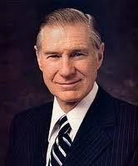
Live For It
“For most of us … what is required is not to die for the Church but to live for it. For many, living a Christ like life every day may be even more difficult than laying down one’s life.”
President James E. Faust
Disciples of Jesus Christ are willing to give their lives for His sake
D&C 103:27-28

Slide 19
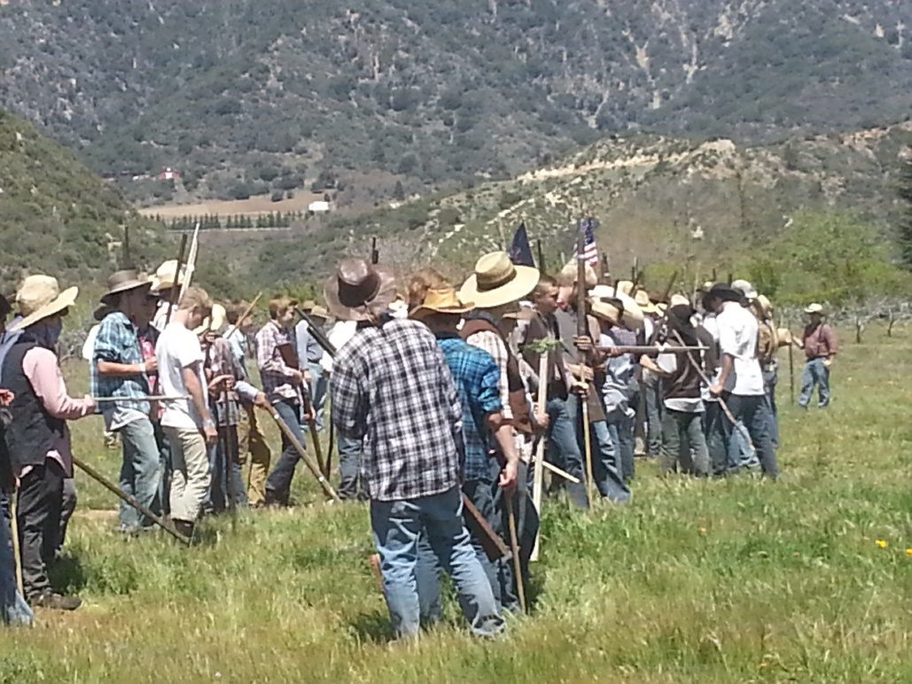
Organize
The Lord commanded individuals to organize in companies of tens, twenties, fifties, and hundreds. He called for five hundred but required no less than one hundred men to participate.
In total, a little over two hundred men ended up participating in the group known as the Camp of Israel, later referred to as Zion’s Camp.
Doctrine and Covenants 103:29–34

Slide 20
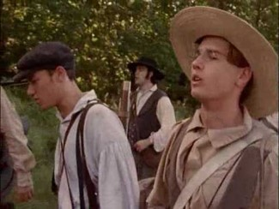
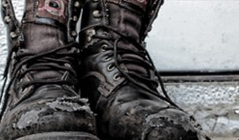
The Volunteers
The Lord desired 500 Volunteers
The Minimum number was 100
Approximately 30 or 40 of the men present at the High Council Meeting also volunteered.
The Lord assigned 8 men to go throughout congregations of the Church to recruit volunteers for Zion’s Camp and to seek contributions of provisions and money for the Saints in Missouri.
About 200 people went with Zion’s Camp, including some women and children.
The average age of the recruits was twenty-nine, the age of their leader, Joseph Smith.
George A. Smith, cousin of the Prophet, was the youngest at age sixteen, and Samuel Baker was the oldest at seventy-nine.
D&C 103:30-34

Slide 21
Obtaining Victory
First the Lord said that Zion must be redeemed by His power.
Then He called on the Saints to use their own power, even to armed conflict and loss of life if necessary, to redeem Zion.
This is characteristic of how God works with His children.
All victory and glory is brought to pass unto us through our diligence, faithfulness, and prayers of faith
Only His power is sufficient to save. And yet He withholds that power until we make the effort He requires.
D&C 103:35-36

Slide 22
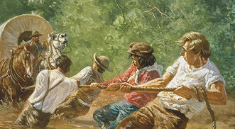
Sources:
Video:
Keep All the Commandments(0:53)
What Is Discipleship? (2:25)
Parley P. Pratt (Autobiography of Parley P. Pratt, pp. 107–9.)
Who’s Who in the Doctrine and Covenants by Ed. J. Pinegar and Richard J. Allen pgs. 171-172
Doctrine and Covenants Student Manual Religion 324-325 Section 103
President George Q. Cannon (In Conference Report, Oct. 1899, p. 48.)
Carlos E. Asay Salt of the Earth: Savor of Men and Saviors of Men April 1980 Gen. Conf.
Hyrum M. Smith and Janne M. Sjodahl Doctrine and Covenants Commentary pg. 147
Presentation by ©http://fashionsbylynda.com/blog/
President Joseph Fielding Smith (Doctrines of Salvation, 3:72.)
President Brigham Young Journal of Discourses, 6:16–17; 11:16; 18:355
Elder John A. Widtsoe (Evidences and Reconciliations, 1:197.)
[see Noah Webster, An American Dictionary of the English Language, facsimile of the first edition (1828; repr., 1967), “Camp”].
For More information on Zion’s Camp: Church History In The Fulness Of Times Student Manual, (2003), 141–152 Chapter 12
President James E. Faust (“Discipleship,” Ensign or Liahona, Nov. 2006, 22).
Elder Bruce R. McConkie (In Conference Report, Oct. 1976, pp. 158–60; or Ensign, Nov. 1976, pp. 106, 108.)
Presentation by ©http://fashionsbylynda.com/blog/

Slide 23
Build up the City of Zion
“I expect that when the Lord leads forth his people to build up the city of Zion, his presence will be visible. When we speak of the presence of the Lord we speak of an exhibition of power. …
“We shall go back to Jackson County. Not that all this people will leave these mountains, or all be gathered together in a camp, but when we go back there will be a very large organization consisting of thousands, and tens of thousands, and they will march forward, the glory of God overshadowing their camp by day in the form of a cloud, and a pillar of flaming fire by night, the Lord’s voice being uttered forth before his army. Such a period will come in the history of this people. … And his people will go forth and build up Zion according to celestial law.
“Will not this produce terror upon all the nations of the earth? Will not armies of this description, though they may not be as numerous as the armies of the world, cause a terror to fall upon the nations? The Lord says the banners of Zion shall be terrible. … When the Lord’s presence is there, when his voice is heard, and his angels go before the camp, it will be telegraphed to the uttermost parts of the earth and fear will seize upon all people, especially the wicked, and the knees of the ungodly will tremble in that day, and the high ones that are on high, and the great men of the earth.” 1973 Elder Orson Pratt(In Journal of Discourses, 15:364.)
On 8 May(1834) the army of Israel resumed its long march west. Throughout its journey the camp was gradually strengthened with additional volunteers, arms, supplies, and money. Officers continued to recruit help from Latter-day Saints living in Ohio, Indiana, and Illinois. By the time Zion’s Camp crossed the Mississippi River into Missouri, it numbered 185 individuals. On 8 June at the Salt River in Missouri, where Joseph Smith had arranged to meet Hyrum Smith’s company from Pontiac, Michigan, the army was at its largest: 207 men, 11 women, 11 children, and 25 baggage wagons.
In many respects the daily routine of Zion’s Camp was similar to that of other armies. Most able-bodied men walked beside the heavily loaded wagons along the muddy and dusty trails. Many of them carried knapsacks and held guns. It was not unusual for them to march thirty-five miles a day, despite blistered feet, oppressive heat, heavy rains, high humidity, hunger, and thirst. Armed guards were posted around the camp at night. At 4:00 A.M.the trumpeter roused the weary men with reveille on an old, battered French horn. Each company gathered for prayer, then went to work at their respective assignments. Some members of the company gathered firewood, others carried water, cooked breakfast, and took down tents. Wagon wheels had to be greased and horses fed and groomed before being hitched up for the day’s journey.
Feeding the camp was one of the most persistent problems. The men were often required to eat limited portions of coarse bread, rancid butter, cornmeal mush, strong honey, raw pork, rotten ham, and maggot-infested bacon and cheese. George A. Smith wrote that he was frequently hungry: “I was so weary, hungry and sleepy that I dreamed while walking along the road of seeing a beautiful stream of water by a pleasant shade and a nice loaf of bread and a bottle of milk laid out on a cloth by the side of the spring.”
On occasion the men strained swamp water to remove wigglers (mosquito larvae), before drinking it. Milk and butter was often obtained from local farmers under unsanitary conditions, which raised fears among the camp of milk sickness, puking fever, or even death. But Joseph Smith advised them that unless they were told the milk was contaminated, “use all they could get from friend or enemy, it should do them good, and none be sick in consequence of it; and although we passed through neighborhoods where many of the people and cattle were infected with the sickness, yet my words were fulfilled.”
Church History In The Fulness Of Times Student Manual, (2003), 141–152 Chapter 12

Slide 24
Missouri Governor Daniel Dunklin
As the Saints endured anti-Mormon hostilities in Missouri in 1833 and 1834, Church leaders repeatedly sought help from state and federal government leaders, including Missouri Governor Daniel Dunklin. Governor Dunklin offered little help in response to the Saints’ petitions. In October 1833 he advised Church leaders to seek redress and protection through the courts in Jackson County. He promised that if these efforts failed, he would use other means to enforce the law. Governor Dunklin’s advice proved ineffective and impractical, however, for several officers of the court in Jackson County were among those who were trying to force the Mormons out. (See Church History in the Fulness of Times Student Manual,2nd ed. [Church Educational System manual, 2003], 134–35.)
In the late fall of 1833, the Saints were forcefully expelled from Jackson County. Most of them found temporary shelter in neighboring Clay County, while the rest found accommodation in other nearby counties. The following spring, as Zion’s Camp was formed and began its march toward Missouri, Church leaders continued to petition Governor Dunklin for assurance that he would provide support to help the Saints regain their homes and property and live in peace in Jackson County. The governor acknowledged that the Saints had been wronged, and he recognized that an armed force sent by the state would be needed to restore the Mormons to their lands and protect them while the courts decided the legal issues involved. (See Church History in the Fulness of Times, 135–37, 146.)
However, in June 1834, Governor Dunklin changed his position. He claimed that calling out the militia would likely plunge the state into open war. Instead of offering support, he advised the Saints that to avoid bloodshed they should relinquish their rights, sell their lands, and settle someplace else. He also advised them again to make an appeal to the courts. These suggestions were unacceptable to Church leaders, and their hopes that the Saints might be allowed to return to their homes peacefully were dashed. (See Church History in the Fulness of Times, 146–47.)
The purpose of Zion’s Camp was not to regain possession of the Saints’ land in Jackson County by military power, though some members of the camp believed that was the case. The men were prepared to fight if their lives were threatened, but the Lord does not need to rely on the power of man to redeem Zion.
President Joseph Fielding Smith wrote of the power by which Zion will be redeemed:
“The redemption of Zion must needs come by power. Not the power of arms and the shedding of blood; but the power of the Lord” (Church History and Modern Revelation [1953], 1:484).
The Lord referenced the role of His power in the redemption of Zion when He said the Saints would be “led out of bondage by power, and with a stretched-out arm” (D&C 103:17). “Stretched-out arm” is a symbolic term that refers to God using His power (symbolized by His arm) in behalf of His people. The Saints will gain victory in redeeming Zion only through the power of God, and they can obtain this power by obeying all of His words.

Slide 25
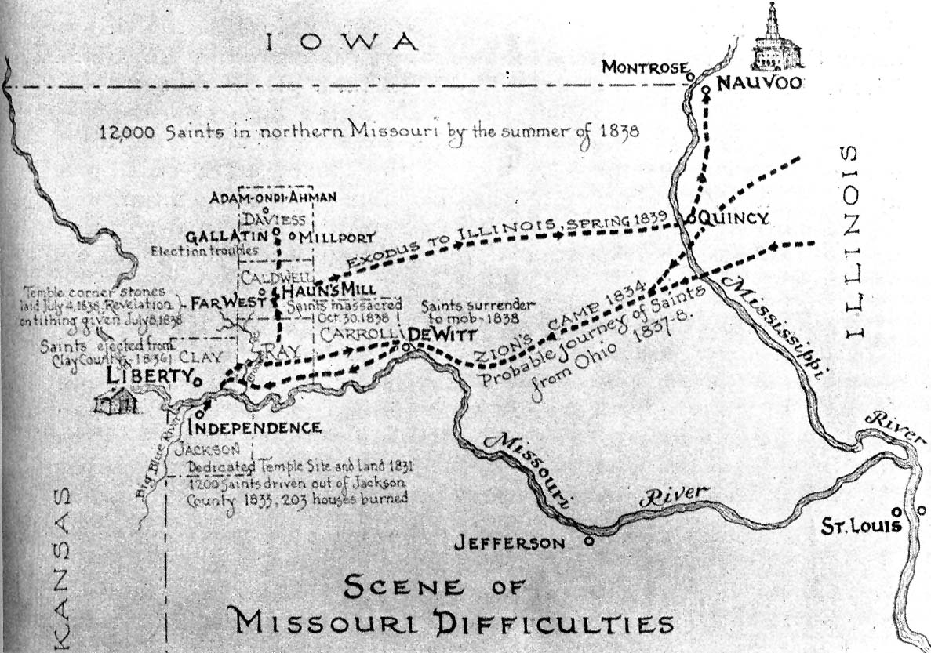

Slide 26
Zion’s Camp Timeline
Feb. 1834 | High council in Kirtland sanctioned plan to organize army to help Missouri Saints
Mar.–May 1834 | Members recruited for Zion’s Camp
May 1834 | Zion’s Camp began march
8 June 1834 | Zion’s Camp obtained maximum numerical strength of 207 people
9–15 June 1834 | Governor Dunklin refused to cooperate with Zion’s Camp
19 June 1834 | Violent storm protected Zion’s Camp from enemies
22 June 1834 | The Lord set forth conditions for future redemption of Zion
21–29 June 1834 | Cholera attacked Zion’s Camp
3 July 1834 | Presidency and stake high council were created in Clay County

