Slide 1

Camp of Israel
Doctrine and Covenants 105
Revelation at Fishing River
and the March to Zion’s Camp
Presentation by ©http://fashionsbylynda.com/blog/

Slide 2
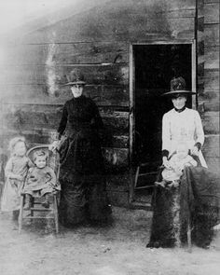
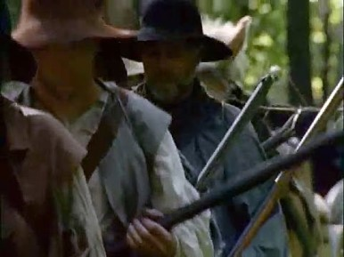
Previously…Those Who Went to Zion’s Camp
Many of the men in Zion’s Camp left families with little or no money and no source of income.
To prevent undue hardships, members of the Church planted gardens so the women and children could harvest corn and other crops during the army’s absence.
The average age of the men in the camp was 29 years old. The Prophet’s cousin George Albert Smith was 16 years old, and Addison Greene was 14 years old. The oldest was 79. Joseph Smith, who had been selected to be the “commander-in-chief of the armies of Israel,” was only 28 years old.
D&C 105:15-17 Church History

Slide 3
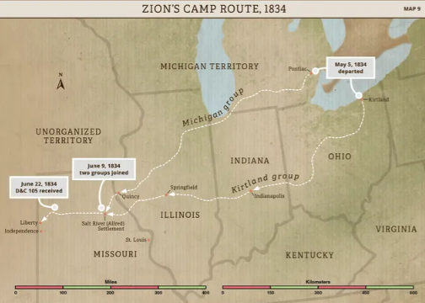
Marching with Camp of Israel
The Camp of Israel left Kirtland, Ohio, in May 1834 to begin a journey of over 800 miles (1,280 kilometers) on foot.
Although members of the camp faced many difficulties and hardships along the way, they also experienced many blessings.
In May 1834, members of the Camp of Israel began their journey of over 800 miles (1,280 kilometers) toward Missouri.
Two contingents of the camp left at the same time from Kirtland, Ohio, and from Pontiac, Michigan Territory.
The two groups eventually joined in Missouri.
The Camp of Israel, later known as Zion’s Camp, consisted of approximately 200 men, 12 women, and 10 children.
Their purpose was to help restore the Saints in Missouri to their lands that had been unfairly taken from them.

Slide 4
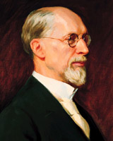
Experience 1 at Camp
The Prophet Joseph took a full share of the fatigues of the entire journey. In addition to the care of providing for the Camp and presiding over it, he walked most of the time and had a full proportion of blistered, bloody, and sore feet, which was the natural result of walking from 25 to 40 miles a day in a hot season of the year. But during the entire trip he never uttered a murmur or complaint, while most of the men in the Camp complained to him of sore toes, blistered feet, long drives, scanty supply of provisions, poor quality of bread, bad [corn bread], [spoiled] butter, strong honey, maggoty bacon and cheese, etc. …
Yet we were the Camp of Zion, and many of us were prayerless, thoughtless, careless, heedless, foolish, or devilish, and yet we did not know it. Joseph had to bear with us and tutor us like children. There were many, however, in the Camp who never murmured and who were always ready and willing to do as our leader desired.
George A. Smith

Slide 5
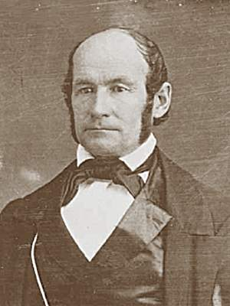
Experience 2 at Camp
Notwithstanding our enemies were continually breathing threats of violence, we did not fear, neither did we hesitate to prosecute our journey, for God was with us, and His angels went before us, and the faith of our little band was unwavering. We know that angels were our companions, for we saw them.
Heber C. Kimball

Slide 6
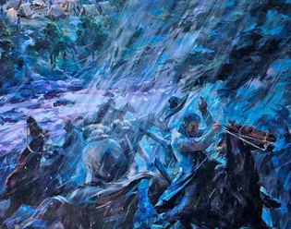
Experience 3 at Camp
When the Camp of Israel was only a day’s journey from Jackson County, five men with weapons approached them. The men boasted that more than three hundred others were on their way to attack the camp. As camp members discussed what to do, the Prophet Joseph Smith said, “Stand still and see the salvation of God.”
Twenty minutes later, a heavy rainstorm ripped through the camp. The storm caused the waters of a nearby river to rise significantly, preventing their enemies from crossing and attacking. Many members of the Camp of Israel found shelter in a small church nearby. After a moment, a rain-soaked Joseph Smith entered the church and exclaimed, “God is in this storm!”
The morning after the storm, members of the camp found their tents and supplies soaked and scattered, but no men had attacked. (quoted and summarized from
Saints: The Story of the Church of Jesus Christ in the Latter Days, vol. 1, The Standard of Truth, 1815–1846 [2018], 203–04).

Slide 7
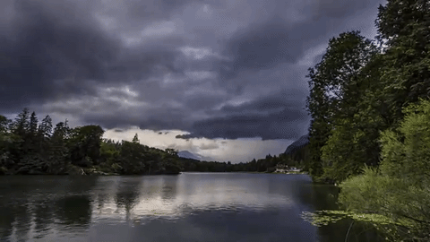

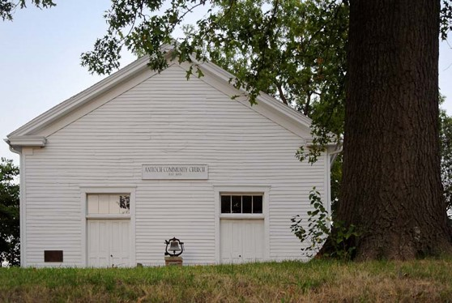
Background-Fishing River
Zion’s Camp arrived at Fishing River, Missouri, on 19 June 1834.
A group of Missourians were waiting to launch an assault in response to the perceived threat.
Around the time of the attack on the Mormons, a violent storm with torrential rains, wind and lightning swept in on the site. This caused Fishing River to rise and swell way beyond its normal level.
Because the Missourians were unable to cross the swollen river under such conditions, some members of Zion's Camp believed that the river, as a barrier, prevented the impending battle from taking place.
Joseph and some of the Zion's Camp members found shelter in an old church building and sang hymns as they waited out the storm.
Deseret News

Slide 8
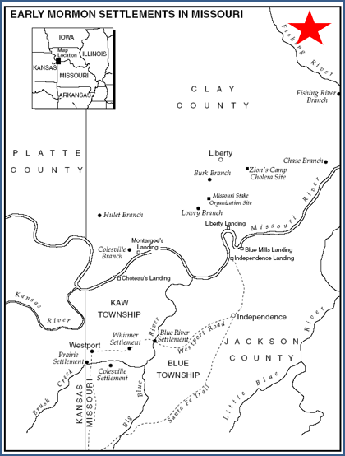
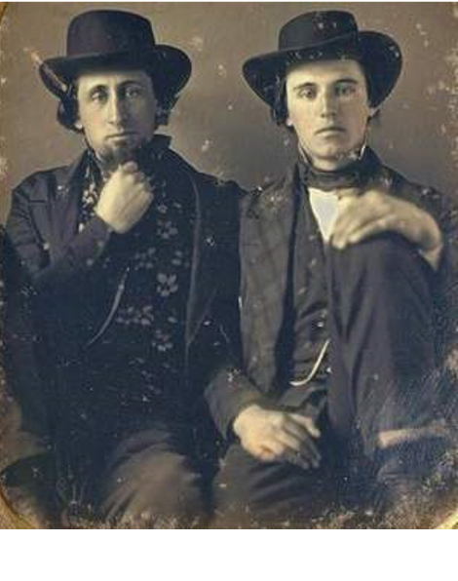
Almighty Power
Two days later, “on Saturday, the 21st of June, Colonel Scounce and two other leading men of Ray County visited Joseph, and begged to know his intentions, stating:
‘We see that there is an Almighty Power that protects this people.’
Colonel Scounce confessed that he had been leading a company of armed men to fall upon the Prophet, but had been driven back by the storm.
The Prophet with all the mildness and dignity which ever sat so becomingly upon him, and which always impressed his hearers, answered that he had come to administer to the wants of his afflicted friends and did not wish to molest or injure anybody. He then made a full and fair statement of the difficulties as he understood them; and when he had closed the three ambassadors, melted into compassion, offered their hands and declared that they would use every endeavor to allay the excitement.” (Cannon, Life of Joseph Smith, p. 180.)
Student Manual

Slide 9


Practicing Truth in Unity
“We shall not be permitted to enter the land from whence we were expelled, till our hearts are prepared to honor this law, and we become sanctified through the practice of the truth.” President Lorenzo Snow
“The miracle of unity is being granted to us as we pray and work for it in the Lord’s way. Our hearts will be knit together in unity. God has promised that blessing to His faithful Saints whatever their differences in background and whatever conflict rages around them.”
President Henry B. Eyring
D&C 105:1-4

Slide 10

Chastened to Learn
The Saints in Missouri were not successful in living a celestial law and so were not qualified to establish Zion.
Failure to control their hearts cut them off from God’s full power and kept them from prevailing over their enemies.
This is the concept the Lord tried to teach them when He said, “This is Zion—THE PURE IN HEART” (D&C 97:21).
D&C 105:4-5

Slide 11
Response to Volunteer
The response to the Prophet Joseph Smith and others’ efforts to recruit volunteers and resources for Zion’s Camp was not as successful as hoped for.
By the time the camp, or army, began its march in the beginning of May 1834, only 122 people had volunteered to go. Zion’s Camp recruited additional volunteers along the way to Missouri.
When the group that Hyrum Smith and Lyman Wight had recruited from Michigan Territory met up with Joseph Smith’s company in early June 1834, Zion’s Camp consisted of just over 200 men, 12 women, and 9 children
Alexander L. Baugh
D&C 105:5-6

Slide 12
Those who are prepared for celestial glory have learnt, somewhere, somehow, to live in accordance with celestial law
Smith and Sjodahl
To help build up Zion, we must be united and obedient to all that God asks
D&C 105:5-6

Slide 13
Doubt Among The Saints
“Some of the Saints were full of unbelief.
They saw their brethren scattered and tormented, and they asked, “Where is their God?’
If He will not deliver them, we will keep our money and not spend a cent on relief work.
They were doubting.
They had no faith.
That was the reason why Zion could not be redeemed at that time”
Smith and Sjodahl
Why do you think unity and obedience are required for Zion to be built up?
What experiences have helped you understand the importance of Church members being united?
D&C 105:7-8

Slide 14
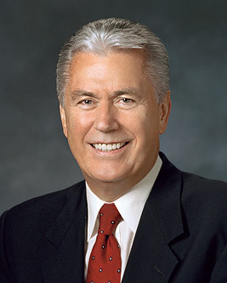
Doubt Your Doubts Before You Doubt Your Faith
“Sometimes questions arise because we simply don’t have all the information and we just need a bit more patience. When the entire truth is eventually known, things that didn’t make sense to us before will be resolved to our satisfaction.
Sometimes there is a difference of opinion as to what the “facts” really mean. A question that creates doubt in some can, after careful investigation, build faith in others.”
President Dieter F. Uchtdorf

Slide 15
How Long Before The Saints Are Redeemed?
He wanted His leaders to be prepared.
He wanted the Saints to be taught more perfectly what He requires of them.
He wanted the Saints to gain experience. No one can know the things of God without doing them.
He wanted the Saints to know their duty more perfectly.
He wanted the Saints to be endowed with power from on high.
He wanted the Saints to be faithful, enduring in humility to the end.
The Lord works through His children and honors their agency, so their wickedness or righteousness can impede or accelerate His work.
D&C 105:9-12 Student Manual

Slide 16
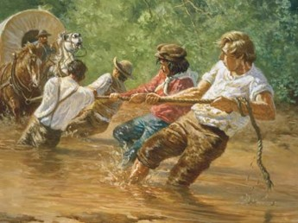
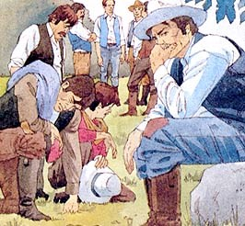
Challenges of Zion’s Camp
Zion’s Camp marched about 900 miles (1,450 kilometers) through 4 states, traveling between 20 and 40 miles (about 30–60 kilometers) a day for 45 days.
Camp members experienced blistered feet, hot and humid weather conditions, food shortages, and unhealthy food.
On occasion, intense thirst moved some camp members to drink swamp water from which mosquito larvae had been strained out (sometimes using their teeth as strainers) or to drink water out of horse tracks after a rainstorm.
Throughout the expedition, Zion’s Camp was also often threatened with violence from others.
D&C 105:15-17 Church History

Slide 17
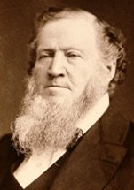
Experience of Brigham Young
On my return many friends asked me what profit there was in calling men from their labor to go up to Missouri and then return, without apparently accomplishing anything. “Who has it benefited?” asked they. “If the Lord did command it to be done, what object had he in view in doing so?”
… I told those brethren that I was well paid—paid with heavy interest—yea that my measure was filled to overflowing with the knowledge that I had received by traveling with the Prophet.
Brigham Young

Slide 18
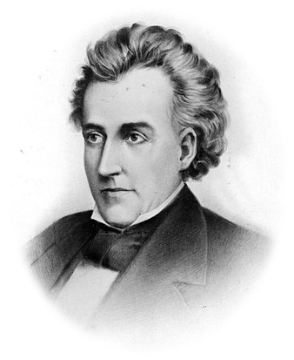
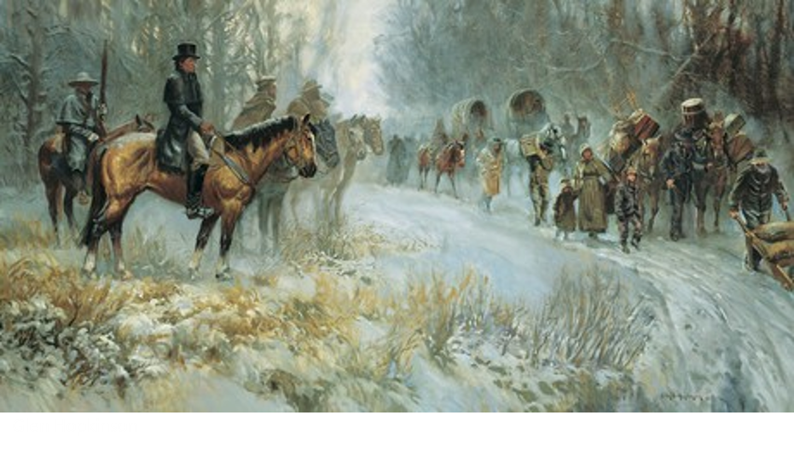
Promises Broken
The members of Zion’s Camp arrived in Missouri, they learned that Daniel Dunklin, the governor of Missouri, would not keep his promise to help the Saints return to their lands in Jackson County.
Despite this discouraging news, Zion’s Camp continued on toward Jackson County, awaiting additional direction from the Lord.
The following direction came in a revelation from the Lord on June 22, 1834, after Zion’s Camp had been traveling for nearly seven weeks and was only 10–20 miles (about 15–30 kilometers) from Jackson County.
D&C 105:15-17 Church History

Slide 19
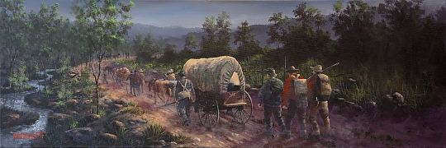
Not Yet Time
Why did the Lord command Zion’s Camp to travel all the way to Missouri and then reveal that Zion would not yet be redeemed?
A trial of faith = a trial of faith can refer to a test of whether we will choose to trust and obey the Lord no matter what the circumstances are.
God has prepared great blessings for those who are faithful through their trials
D&C 105:18-19

Slide 20
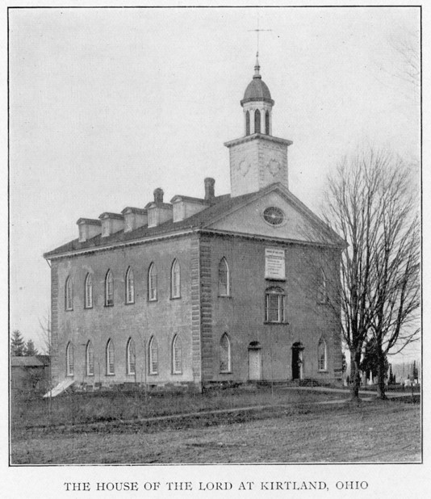
Promised Endowment
1834-The full ordinance of the endowment was not administered in the Kirtland Temple, as the Lord had not yet revealed it.
Later--1836
The Kirtland Saints experienced just such an outpouring at the dedication of the Kirtland Temple on 27 March 1836 which helped give them the spiritual strength they needed to build the Lord’s kingdom.
This includes also the ordinances of washing and anointing.
Church History
D&C 105:18-19

Slide 21

Blessings of Those Who Served in Zion’s Camp
Many men who had served with Zion’s Camp were blessed with opportunities to serve in the Lord’s kingdom.
In February 1835, the Quorum of the Twelve Apostles and the First Quorum of the Seventy were organized.
Nine of the original Apostles and all of the members of the Quorum of the Seventy served in Zion’s Camp.
Church History
Name | Age at Call
Thomas B. Marsh* | 35
David W. Patten | 35 (Zion’s Camp)
Brigham Young | 33 (Zion’s Camp)
Heber C. Kimball | 33 (Zion’s Camp)
Orson Hyde | 30 (Zion’s Camp)
William E. McLellin | 29
Parley P. Pratt | 27 (Zion’s Camp)
Luke S. Johnson | 27 (Zion’s Camp)
William B. Smith | 23 (Zion’s Camp)
Orson Pratt | 23 (Zion’s Camp)
John F. Boynton | 23
Lyman E. Johnson | 23 (Zion’s Camp)
D&C 105:18-19

Slide 22
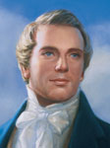
“God did not want you to fight. He could not organize His kingdom with twelve men to open the Gospel door to the nations of the earth, and with seventy men under their direction to follow in their tracks, unless He took them from a body of men who had offered their lives, and who had made as great a sacrifice as did Abraham”
History of the Church

Slide 23
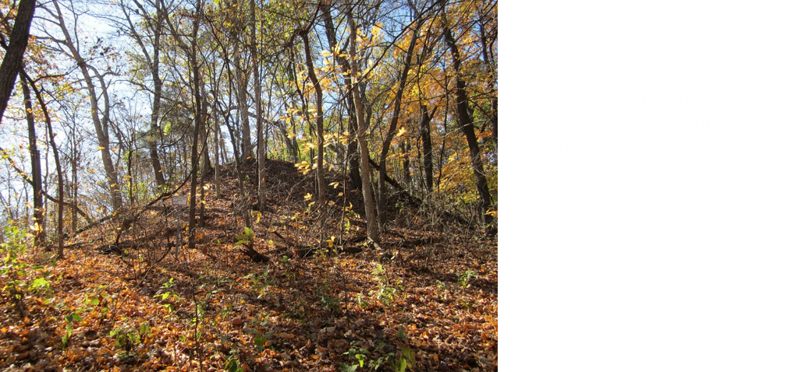
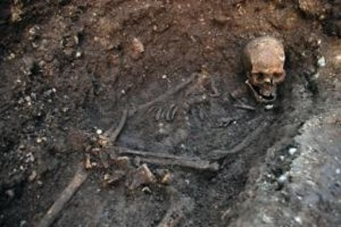
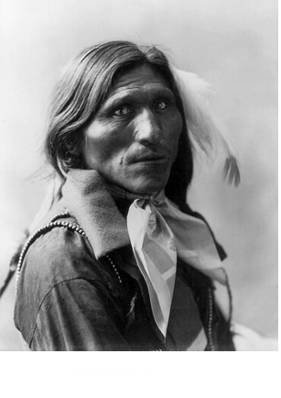
Human Skeleton
On 2 June 1834 the army crossed the Illinois River at Phillips Ferry.
The Prophet and a few others walked along the bluffs and found a huge mound with human bones scattered about and what appeared to be the remains of three ancient altars.
A hole was dug and a large human skeleton was discovered with a stone arrowhead between its ribs.
As the brethren left the hill, the Prophet inquired of the Lord and learned in an open vision that the remains were those of a man named Zelph, a former Lamanite warrior chieftain who was killed “during the last great struggle of the Lamanites and Nephites.”
History of the Church

Slide 24

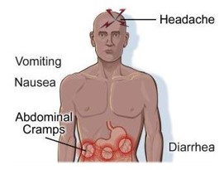
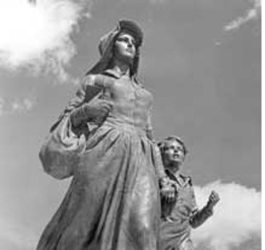
Cholera Attacks
The day before the revelation was given two men contracted cholera. Three days later several more were struck with the dreaded disease, which was carried in contaminated water.
The epidemic spread, causing severe diarrhea, vomiting, and cramps. Before it ended, about sixty-eight people, including Joseph Smith, were stricken by the disease, and fourteen members of the camp died, one of whom was a woman named Betsy Parrish
D&C 105:19

Slide 25
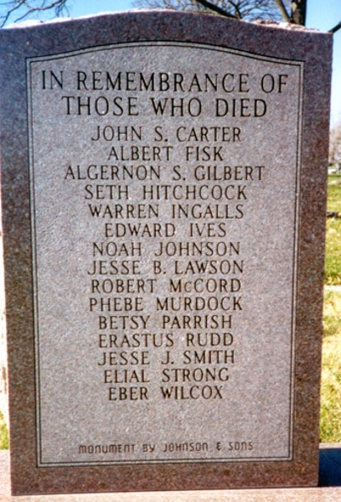
Disbanding the Camp
Before it ended, about 68 people, including Joseph Smith, were stricken with the disease, and 13 camp members and 2 local members died.
Joseph Smith said that on July 2, he “told them that if they would humble themselves before the Lord and covenant to keep His commandments and obey my counsel, the plague should be stayed from that hour, and there should not be another case of the cholera among them.
The brethren covenanted to that effect with uplifted hands, and the plague was stayed”
The Lord accepted the sacrifices of the camp members and blessed them for what they were willing to do.
In July 1834 the Prophet Joseph Smith disbanded Zion’s Camp.
While some did not pass the test of their faith and left the Church, those who were faithful were strengthened by the experience.
D&C 105:20-22 Church History

Slide 26
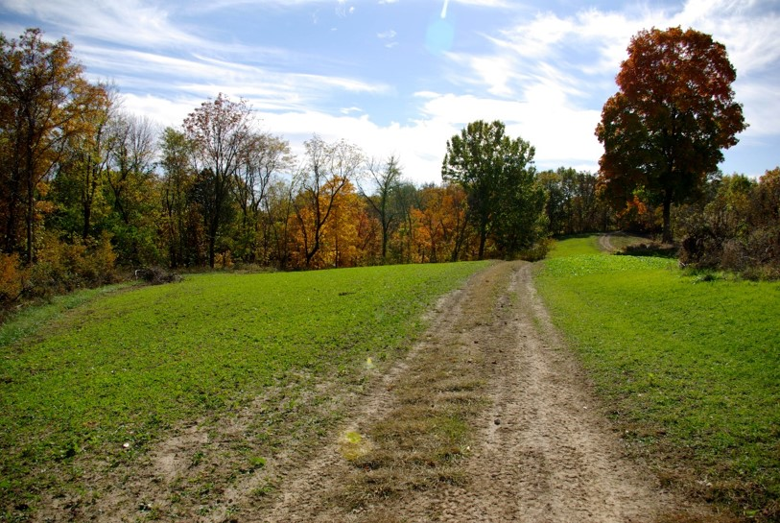
Failure to Regain Lands
Zion’s Camp failed to help the Missouri Saints regain their lands and was marred by some dissension, apostasy, and unfavorable publicity, but a number of positive results came from the journey.
By volunteering, the members demonstrated their faith in the Lord and his prophet and their earnest desire to comply with latter-day revelation.
They showed their concern for the exiled Saints in Missouri by their willingness to lay down their lives if necessary to assist them.
D&C 105:24-40 Church History

Slide 27
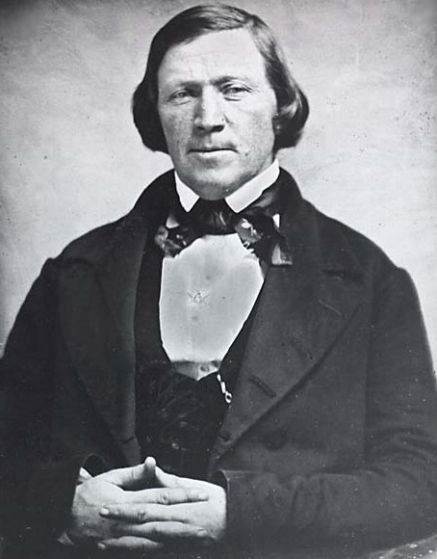
Failure to Regain Lands
Zion’s Camp chastened, polished, and spiritually refined many of the Lord’s servants. The observant and dedicated received invaluable practical training and spiritual experience that served them well in later struggles for the Church.
The hardships and challenges experienced over its thousand miles provided invaluable training for Brigham Young, Heber C. Kimball, and others who led the exiled Saints from Missouri to Illinois and from Nauvoo across the plains to the Rocky Mountains. When a skeptic asked what he had gained from his journey, Brigham Young promptly replied, “I would not exchange the knowledge I have received this season for the whole of Geauga County
D&C 105:24-40 Church History

Slide 28
Sources:
Video:
“Zion’s Camp” (21:29) from time code 19:16 to 21:29.
Brigham Young, “Discourse,” Deseret News, Dec. 3, 1862, 177
Deseret News By Kenneth Mays, For the Deseret News Published: Wednesday, Jan. 9, 2013 5:00 a.m. MST
President Lorenzo Snow (In Journal of Discourses, 16:276; see also Notes and Commentary on D&C 101:1–8; 96:1.)
President Henry B. Eyring Our Hearts Knit as One Oct. 2008 Gen. Conf.
Alexander L. Baugh, “Joseph Smith and Zion’s Camp,” Ensign, June 2005, 45).
Hyrum M. Smith and Janne M. Sjodahl Doctrine and Covenants Commentary pg. 681
Presentation by ©http://fashionsbylynda.com/blog/
President Dieter F. Uchtdorf Come, Join with Us October 2013 General Conference
Doctrine and Covenants Student Manual Religion 324-325 Section 105
Church History in the Fulness of Times Student Manual, 2nd ed. [Church Educational System manual, 2003], 143–45.)
Zion’s Camp Chapter 12 Church History In The Fulness Of Times Student Manual, (2003), 141–152
Church History in the Fulness of Times, pp. 151, 164–67),
History of the Church 2:182
George A. Smith, in Teachings of Presidents of the Church: Joseph Smith [2007], 287–88
Heber C. Kimball, in Teachings of Presidents of the Church: Joseph Smith [2007], 288–89)
Presentation by ©http://fashionsbylynda.com/blog/

Slide 29
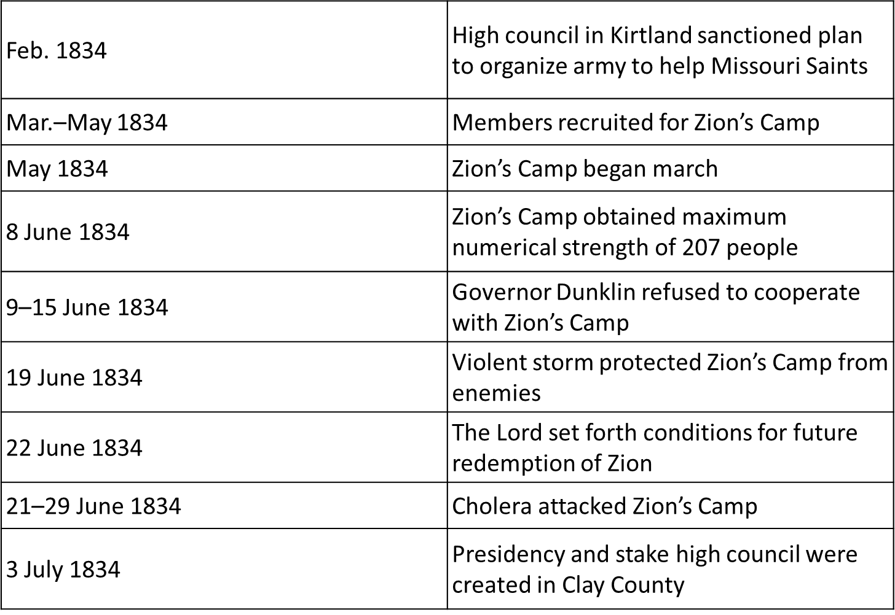
Celestial Laws:
Elder Joseph F. Smith explained: “Those who profess to be Latter-day Saints must become acquainted with the laws of the celestial kingdom, must abide by them, must comply with the requirements of heaven and hearken to the word of the Lord, in order that Zion may be built up acceptably, and that we may partake of the benefits and blessings of this labor. For it is a labor which devolves upon those who have been called out from the midst of the world in this dispensation. We have been called, and so far as we will be faithful we are chosen to do this work. But notwithstanding we have been called, if we do not prove faithful we will be rejected. I do not speak this in reference to the whole Church, but in reference to individual members of the Church.” (In Conference Report, Apr. 1880, p. 34; see also Smith, Church History and Modern Revelation, 2:3–4.)
Promised Endowment:
President Joseph Fielding Smith wrote: “In January1836, over two months before the dedication, the first ceremonies of endowment were given in the temple. They were not as complete as are the ceremonies today, but nevertheless, it was the beginning of the revealing and bestowing of the heavenly blessings in this dispensation. Washings and anointings were given, and the Prophet saw wonderful visions of the celestial kingdom” (Doctrines of Salvation, 2:241).
The promise of endowment in these verses was also realized in the restoration of keys. President Joseph Fielding Smith noted that the Kirtland Temple “was built primarily for the restoration of keys of authority. In the receiving of these keys the fulness of gospel ordinances is revealed” (Doctrines of Salvation, 2:242). These keys included those for performing additional priesthood ordinances that became available in the Nauvoo Temple.
Cholera is an infection of the small intestine caused by the bacterium Vibrio cholerae.
The main symptoms are watery diarrhea and vomiting. This may result in dehydration and in severe cases grayish-bluish skin. Transmission occurs primarily by drinking water or eating food that has been contaminated by the feces (waste product) of an infected person, including one with no apparent symptoms.
The severity of the diarrhea and vomiting can lead to rapid dehydration and electrolyte imbalance, and death in some cases. The primary treatment is oral rehydration therapy, typically with oral rehydration solution, to replace water and electrolytes. If this is not tolerated or does not provide improvement fast enough, intravenos fluids can also be used. Antibacteril drugs are beneficial in those with severe disease to shorten its duration and severity.
wikipedia

Slide 30
Accounts of Zelph, the Lamanite:
Heber C. Kimball wrote in 1841 that several of the group, along with Joseph Smith, walked to the top of a mound that they had located on the bank of the Illinois river. Kimball states that "[o]n the top of this mound there was the appearance of three altars, which had been built of stone, one above another, according to the ancient order; and the ground was strewn over with human bones." This prompted Kimball and the others to dig into the mound after sending for a shovel and a hoe. "At about one foot deep we discovered the skeleton of a man, almost entire; and between two of his ribs we found an Indian arrow, which had evidently been the cause of his death. We took the leg and thigh bones and carried them along with us to Clay county. All four appeared sound."
After continuing on their journey, Kimball reports that "[i]t was made known to Joseph that he had been an officer who fell in battle, in the last destruction among the Lamanites, and his name was Zelph. This caused us to rejoice much, to think that God was so mindful of us as to show these things to his servant. Brother Joseph had enquired of the Lord and it was made known in a vision.“
Reuben McBride’s journal account states that "His name was Zelph a war[r]ior under the Prophet Onandagus Zelph a white Laman[i]te." McBride also wrote that "an arrow was found in his Ribs…which he said he sup[p]osed oc[c]aisoned his death." McBride wrote that Zelph "was known from the atlantic to the Rocky Mountains.“ Moses Martin stated "Soon after this Joseph had a vision and the Lord shewed him that this man was once a mighty Prophet and many other things concerning his dead which had fal[l]en no doubt in some great bat[t]les.“ Martin also described the skeleton "to be eight or nine feet tall because of the size of the thigh bone."
Levi Hancock's journal also refers to "Onendagus," stating that "Zelf he was a white Lamanite who fought with the people of Onendagus for freedom." Onandaga is the name of a county in New York state as well as the name of a tribe of the Iroquois Confederacy that once occupied the area.
Wilford Woodruff's journal mentions that the bones were "probably" from the Lamanites and Nephites, even though the printed vision omitted the "probably." After comparing the various accounts Williams Hamblin argued that "there are many difficulties that make it nearly impossible for us to know exactly what Joseph Smith said in 1834 as he reflected on the ruins his group encountered in Illinois.“
wikipedia
After Zion’s Camp:
The camp dispersed after being released by the Prophet. Some people remained in Missouri in accordance with the Fishing River revelation (see D&C 105:20), and some returned to the mission field, but most of them returned to their families in the East. On that same day, 3 July, the Prophet organized a presidency and high council in Missouri to help Bishop Edward Partridge administer the affairs of the Church in that area. Joseph Smith discouraged the Missouri Saints from holding Church meetings, however, in an attempt to allay the fears of local citizens.
Life in Clay County was easier for the Saints throughout the rest of 1834 and during 1835. This period was relatively free from persecution, and the Saints enjoyed some prosperity. Most of the non-Mormons in Clay County were cordial. The spirit of good will, however, began to change when Saints continued to migrate to Missouri in anticipation of returning to Jackson County and when some members of the Church bought property in Clay County. Unfortunately, a few of the members had not learned from the persecutions of Jackson County, and they incited the old settlers with talk that their lands would eventually belong to the Saints. Collectively the members failed to observe the Lord’s counsel:

