Slide 1
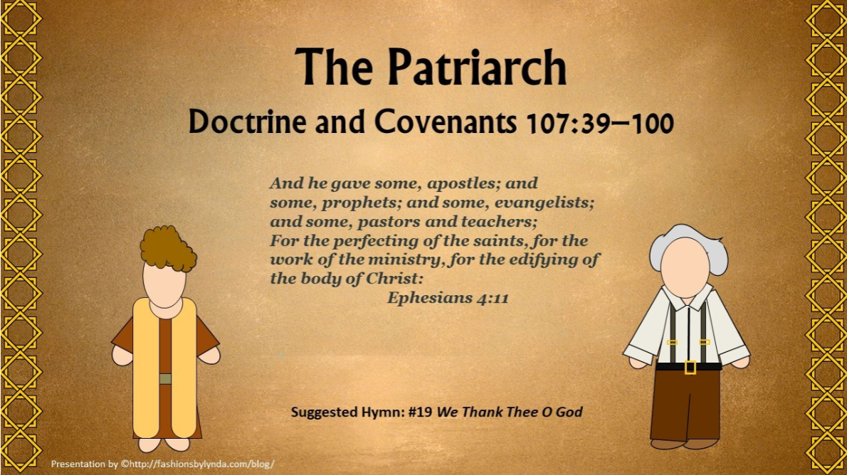

Slide 2

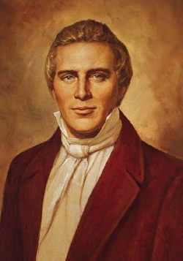
Background
The revelation was recorded in 1835, but “the historical records affirm that most of verses 60 through 100 incorporate a revelation given through Joseph Smith on November 11, 1831”

Slide 3
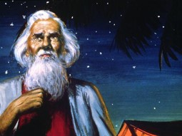
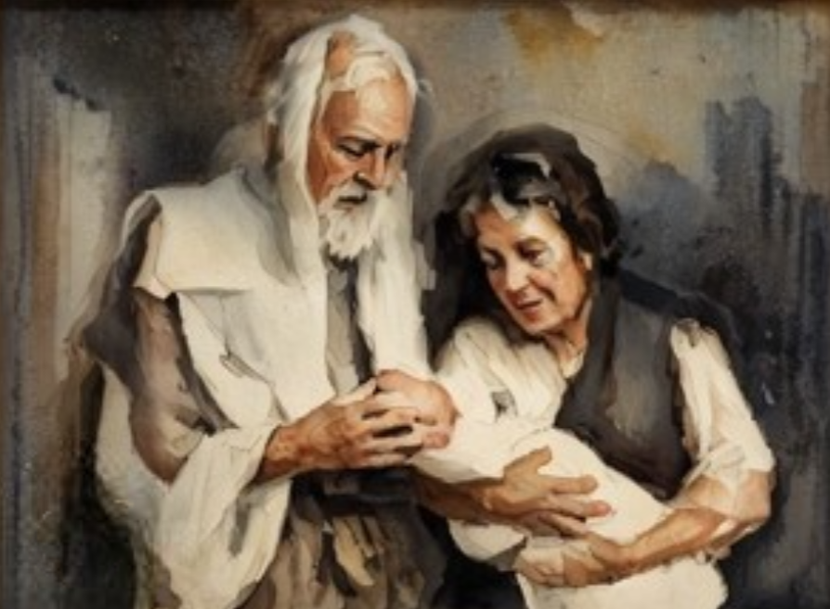
Evangelical Ministers
Those who hold the office of patriarch in the Melchizedek Priesthood
“An Evangelist is a Patriarch, even the oldest man of the blood of Joseph or of the seed of Abraham. Wherever the Church of Christ is established in the earth, there should be a Patriarch for the benefit of the posterity of the Saints.”
Joseph Smith
One who bears or proclaims the good news of the gospel of Jesus Christ. Joseph Smith taught that an evangelist was a patriarch. Patriarchs are called and ordained under the direction of the Twelve Apostles to give special blessings called patriarchal blessings.
D&C 107:39-40

Slide 4
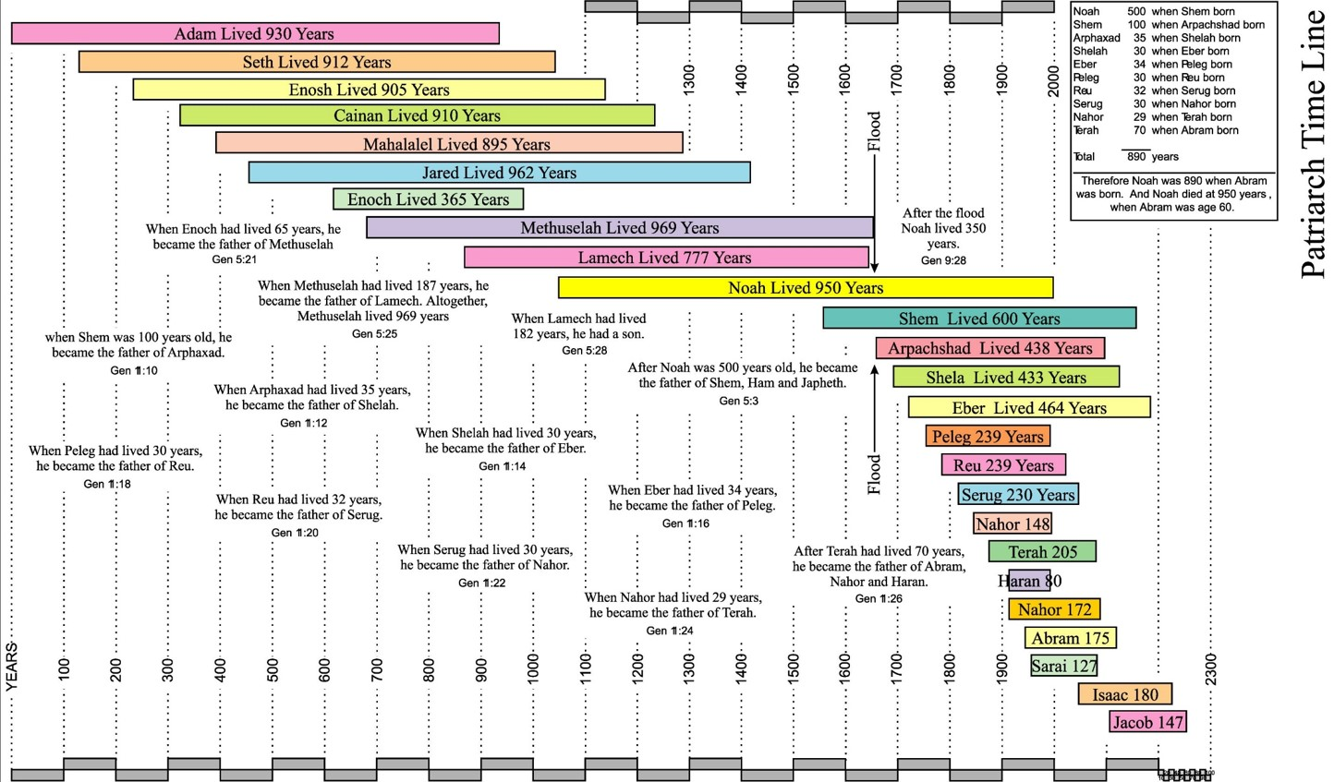
Evangelical Ministers
D&C 107:41-53

Slide 5
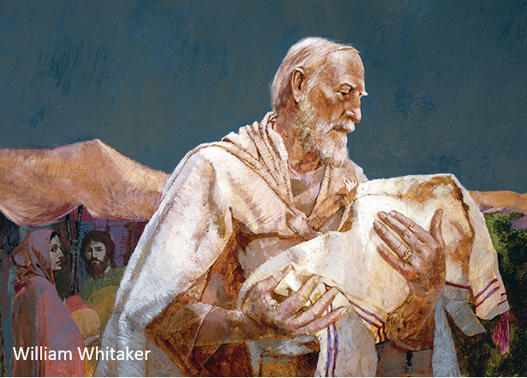
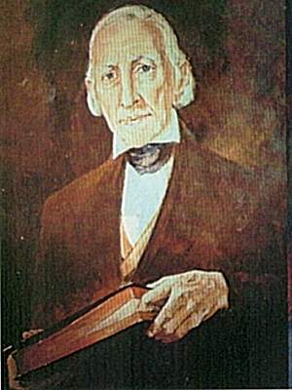
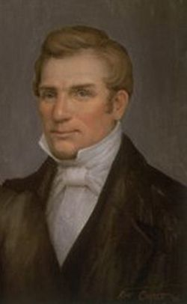
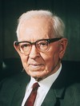
Patriarchs
The patriarchal priesthood is passed by ordination from father to son.
“… From Abraham the birthright went to Isaac and from him to Jacob, who was named Israel. From Israel it went to Joseph, the firstborn son of Rachel. … Therefore, the birthright and the Patriarchal Priesthood continued through the seed of Joseph.
Just why it was continued through Ephraim rather than through Manasseh, his older brother, we have not been informed, but we may be sure that the Lord had sufficient reason. From that time until now, this birthright has been vested in the descendants of Ephraim.
“In the Dispensation of the Fulness of Times in which we live, the Lord revealed that this birthright of the first-born in Israel belonged to Joseph Smith, the father of the Prophet, and he was the first patriarch ordained in this dispensation. After his death the office and priesthood was conferred upon Hyrum Smith, the Prophet’s oldest living brother.”
Joseph Fielding Smith
D&C 107:39-52

Slide 6
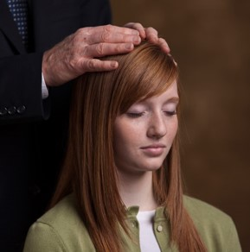
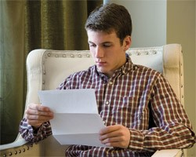
A Patriarch’s Calling
Responsibility to bestow blessings on members
Most stakes of the Church have one worthy Melchizedek Priesthood bearer who is called and ordained under the direction of the Quorum of the Twelve to be the stake patriarch.
As a high priest, he has the authority to perform any duty a high priest can perform; but because he is a patriarch, he also has the specific responsibility to bestow blessings on members of the stake who seek patriarchal blessings.
Patriarchs have the right and are inspired to give patriarchal blessings in the name of the Lord. These blessings can bring comfort in hours of sorrow or trouble, can strengthen faith, and can help motivate us to live worthy of the blessings the Lord has in store for us.
Joseph Fielding Smith
Basic Manual for Priesthood Holders

Slide 7
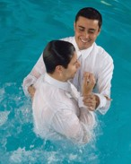
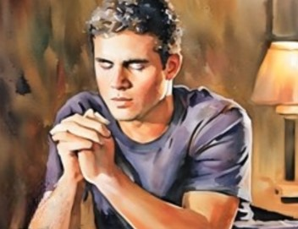

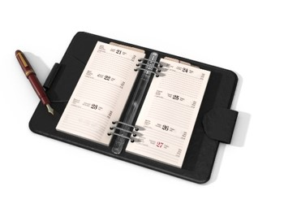
Receiving a Patriarchal Blessing
1. Be worthy, baptized members of the Church.
2. Have a desire to receive direction from the Lord.
3. Have studied the gospel and know the purpose of patriarchal blessings.
4. Be mature enough to appreciate the significance of and receive encouragement from the blessing.
5. Receive a recommend from our bishop or branch president.
6. Make an appointment with the stake patriarch to receive our patriarchal blessing.
Before we go to receive our blessing, we should pray to prepare ourselves spiritually, and we should pray for the patriarch that he may be inspired on our behalf. We may also fast to prepare ourselves.
Basic Manual for Priesthood Holders

Slide 8
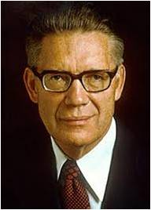
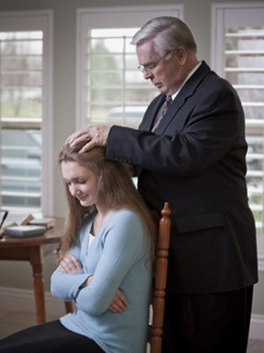
Patriarchs--Today
“Today the patriarchal order does not determine the organization of the Church as it did in earlier times, but in the celestial kingdom “the patriarchal order will be the order of government and rule”
Elder Bruce R. McConkie
Patriarchs are ordained in each stake to give patriarchal blessings to the Saints living within the boundaries of that stake or to members who do not have a stake patriarch of their own.
Student Manual
D&C 107:39-52

Slide 9








Patriarchs in the Latter-days
Hyrum Smith
Oldest surviving son of Joseph Smith, Sr.
Sept. 14, 1840-June 27, 1844
John Smith
Brother of Joseph Smith Sr.
Jan. 1, 1849-May 23, 1854
Joseph Smith, Sr.
Father of Joseph Smith, Jr.
Dec. 18, 1833- Sept. 14, 1840
William Smith
Oldest surviving son of Joseph Smith, Sr. *See note
May 24, 1845- Oct. 1845
Frank B. Woodbury
(acting Presiding Patriarch)
Unrelated to Smith Family
* See Note
1934-Oct. 8, 1937
Hyrum G. Smith
Grandson of John Smith
Great-grandson of Hyrum Smith
May 9, 1912-Feb. 4, 1932
Nicholas G. Smith
(acting Presiding Patriarch)
Son of Apostle John Henry Smith *See Note
Feb. 4 1932-1934
John Smith
Son of Hyrum Smith
Feb. 18, 1855-Nov. 6, 1911

Slide 10
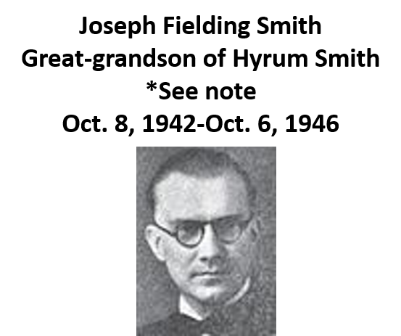
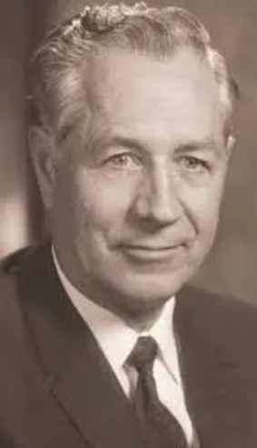
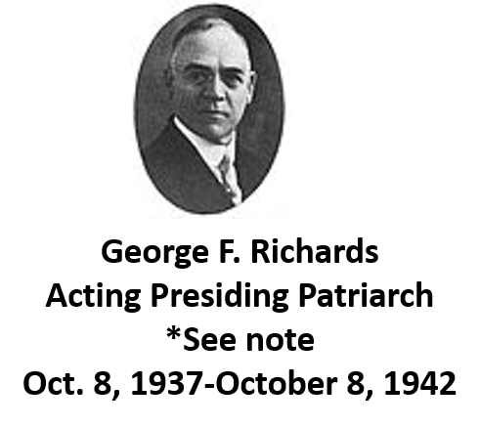
Patriarchs in the Latter-days
Eldred G. Smith
Sone of Hyrum G. Smith
Great-great-grandson of Hyrum Smith
*see note
April 10, 1947-Oct. 4, 1979
The Church of Jesus Christ of Latter-day Saints discontinued the office of Presiding Patriarch in 1979, indicating enough local patriarchs existed so that the church-wide position was no longer needed. Until that time, the role and duties of the office had varied.
The Presiding Patriarch sometimes appointed local patriarchs in the stakes of the church and presided over them as a loose "Quorum of Patriarchs." Like the local patriarchs, the Presiding Patriarch was also empowered to give patriarchal blessings.

Slide 11
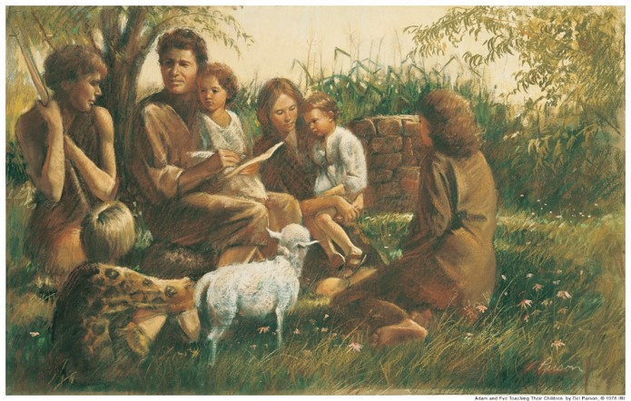
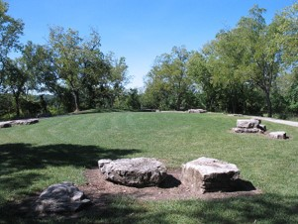
The Grand Council
One of the greatest meetings ever held was the meeting Adam called of his righteous posterity.
Sometime prior to the Second Coming of the Savior, a similar meeting will again be held in the valley of Adam-ondi-Ahman.
Adam ordained his worthy male descendants to offices in the priesthood, and he blessed them.
Adam blessed all his righteous posterity, including daughters.
D&C 107:53-57

Slide 12
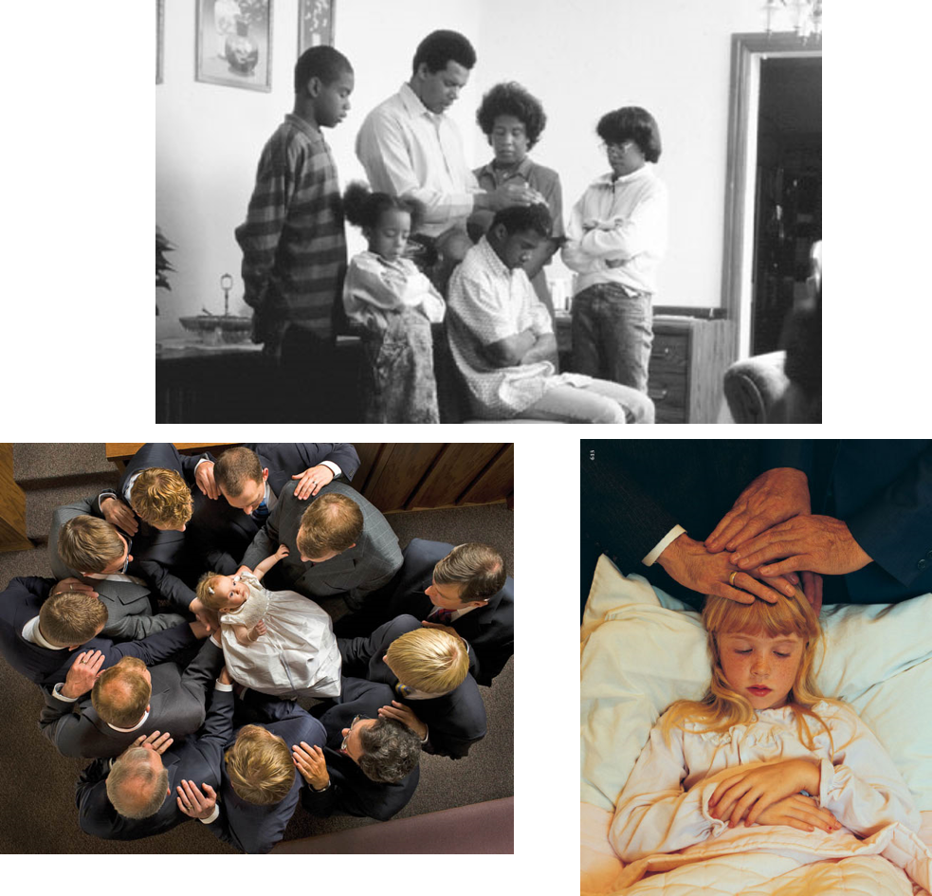
A Father’s Blessing
Fathers who hold the Melchizedek Priesthood have authority to bless their children
D&C 107:53-57

Slide 13
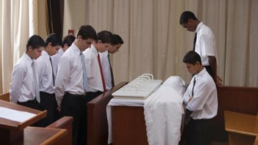
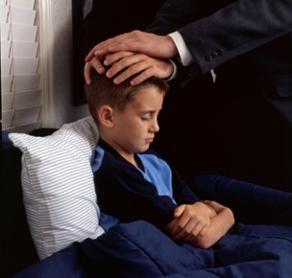
Priesthood in the Home
“Any elder holds as much priesthood as does the President of the Church or as I do as an Apostle—different offices. But the priesthood is not delegated out and parceled a little here and a little there. It is given all at once.
In the ordinance where ordinations take place, the priesthood is conferred, and then the office is conferred. So a young man as young as 18 planning to go on a mission has this ordinance, and they first say, “We confer upon you the Melchizedek Priesthood” and then ordain you to the office of elder in that priesthood.”
“Homes without the priesthood are to be watched over and ministered to by the quorums of the priesthood.
In this manner no blessings will be found wanting in any dwelling within the Church”
President Boyd K. Packer

Slide 14
Quorums
Melchizedek Priesthood
Aaronic Priesthood
Elder
High Priest
Patriarch
Seventy
Apostle
Deacon
Teacher
Priest
Bishop
Priesthood Quorum
An organized group of brethren who hold the same priesthood office
Each stake has one high priests quorum, with the stake president as the quorum president. In each ward, high priests are organized into a high priests group
D&C 107:58-100

Slide 15
Bishop
1st Counselor
2nd Counselor
The bishop is the presiding high priest in the ward. He and his counselors work closely with the elders quorum president and the high priests group leader in watching over quorum and group members and their families, building strength in the quorum and group, and ensuring that the work of the priesthood is accomplished.
High Priest Group Leader
Elders Quorum
The elders quorum presidency and high priests group leadership preside over, sit in council with, and teach quorum and group members. They direct the efforts of quorum and group members to advance the work of salvation in the ward. They receive instruction from the stake presidency, assigned members of the high council, and the bishop.
D&C 107:58-100 handbook 2

Slide 16
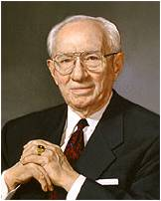
Learning Your Duty
Slothful:
Those who neglect their priesthood responsibilities will not be counted among the righteous who are worthy to stand in God’s presence. Student Manual
“Your obligation is as serious in your sphere of responsibility as is my obligation in my sphere. No calling in this church is small or of little consequence. All of us in the pursuit of our duty touch the lives of others”
President Gordon B. Hinckley
The Lord asks us to learn our duty and act in all diligence to fulfill it.
D&C 107:100

Slide 17
Sources:
Videos: The Office of Patriarch (4:24) Boyd K. Packer 2005 Worldwide Leadership Training
Dayton’s Legs (3:02)
Hope of Israel (1:01:35) timecode 25:39 to 29:08
The Priesthood Can Strengthen Our Families in Trial (1:25)
The Priesthood Is a Commission to Serve (2:45)
Joseph Smith (HC 3:381)
Lesson 10: Patriarchs and Patriarchal Blessings
Duties and Blessings of the Priesthood: Basic Manual for Priesthood Holders, Part A, (2000), 69–76
Joseph Fielding Smith “The Patriarchal Priesthood,” Improvement Era, Nov. 1956, pp. 789, 852
Doctrines of Salvation, comp. Bruce R. McConkie, 3 vols. [1954–56], 3:170.)
Elder Bruce R. McConkie, Mormon Doctrine, p. 559
Doctrine and Covenants Student Manual Religion 324-325 Section 107
Patriarch Sources gathered from B. H. Roberts, Journal of Mormon History by Gary E. Smith, Lost Legacy, and Wikipedia
Presentation by ©http://fashionsbylynda.com/blog/
President Boyd K. Packer (“The Power of the Priesthood,” Ensign or Liahona, May 2010, 9).
Priesthood Power in the Home Broadcast
President Gordon B. Hinckley (“This Is the Work of the Master,” Ensign, May 1995, 71).
Presentation by ©http://fashionsbylynda.com/blog/

Slide 18
* Note: William Smith was patriarch to the church until his name and positions were read at the 19 October 1845 general conference. Those attenders unanimously voted against Smith being retained as both an apostle and the patriarch. He then lost both offices and was disfellowshipped from the church.
* Note: Nicholas G. Smith
Son of Apostle John Henry Smith; grandson of Apostle George A. Smith; great-grandson of former Presiding Patriarch "Uncle" John Smith; was never officially called, set apart, or sustained as the Acting Presiding Patriarch, but carried out the functions of the office
*Note: Frank B. Woodbury
Unrelated to Smith family; was never officially called, set apart, or sustained as the Acting Presiding Patriarch, but carried out the functions of the office
*Note: Joseph Fielding Smith
Great-grandson of Hyrum Smith; not a descendant of previous Presiding Patriarch Hyrum G. Smith; released by President George Albert Smith amid reports of homosexual activity. Restored to "priesthood status" in 1957.
*Note: George F. Richards
Unrelated to Smith family; unlike Nicholas G. Smith and Frank B. Woodbury, was officially called, set apart, and sustained as the Acting Presiding Patriarch
*Note: Eldred G. Smith
Son of former Presiding Patriarch Hyrum G. Smith; great-great-grandson of Hyrum Smith. Patriarch emeritus from 4 October 1979 to his death on 4 April 2013.

Slide 19
Patriarch: Patriarch to the Church
Author: STEPHENS, CALVIN R.
Before 1979, Patriarch to the Church was a Church officer whose chief duty was to confer patriarchal blessings on Church members who generally did not have the service of stake Patriarchs readily available to them. The Prophet Joseph Smith explained that an "evangelist" (as in Ephesians 4:11) is a "patriarch" (TPJS, p. 151); that is, he confers the blessings of a patriarch upon members of the Church. Patriarchs are currently ordained in individual stakes of the Church, but for many years there was a patriarch to the entire Church. He was considered one of the General Authorities.
On December 18, 1833, in Kirtland, Ohio, Joseph Smith, Sr., was ordained the first Patriarch to the Church (D&C 107:39-56), with jurisdiction throughout the Church. Upon his death, he was succeeded by his oldest living son, Hyrum Smith, who served until he was martyred on June 27, 1844. William Smith, a younger brother, was ordained Patriarch to the Church on May 24, 1845, by the Quorum of the Twelve Apostles, but William was rejected by the Church on October 6, 1845, for misconduct. The office was vacant until January 1, 1849, when John Smith, brother of Joseph Smith, Sr., was called. He served until his death on May 23, 1854.
A second John Smith, son of Hyrum Smith, was Patriarch to the Church from February 18, 1855, until November 6, 1911. Hyrum Gibbs Smith, grandson of the second John Smith, then served from May 9, 1912, until February 4, 1932. For ten years Acting Patriarchs were called who were not in the direct hereditary line. They included Nicholas G. Smith (October 1932 to October 1934), Frank B. Woodbury (June 1935 to October 1937), and George F. Richards (October 1937 to October 1942).
The call returned to the hereditary line on October 3, 1942, with the call of Elder Joseph Fielding Smith (1899-1964), a great-grandson of Hyrum Smith. He was released at his own request on October 7, 1946, because of poor health. Eldred G. Smith, eldest son of Hyrum Gibbs Smith, was called in April 1947.
In 1979 the office of Patriarch to the Church was retired "because of the large increase in the number of stake Patriarchs and the availability of patriarchal service throughout the world." Eldred G. Smith was designated "a Patriarch Emeritus, which means that he is honorably relieved of all duties and responsibilities pertaining to the office of Patriarch to the Church" (CR [Oct. 1979]:25).
President Ezra Taft Benson wrote about the importance of asking fathers for priesthood blessings:
“A young man came to my office a short time ago for a blessing. He had problems—not moral problems, but … he was confused; he was concerned and worried. And so we talked for a few minutes and I said to him, ‘Have you ever asked your father for a blessing?’ ‘Oh,’ he said, ‘I don’t know that Dad would do a thing like that. He is not very active.’ I said, ‘But he’s your father.’ ‘Yes.’ ‘Does he hold the priesthood?’ ‘Yes, he is an inactive elder.’ I said, ‘Do you love him?’ And he said, ‘Yes, I love him. He is a good man, he’s good to the family, good to the children.’ I said, ‘Do you ever have family prayer?’ He said, ‘It has been a long time since we had family prayer.’ I said, ‘All right, would you be willing to go home and watch for an opportunity, and ask your father if he will give you a blessing? And if it doesn’t work out, you come back, and I will be glad to help you.’
“So he left, and in about three days he came back. ‘Brother Benson, this has been the sweetest thing that’s happened in our home,’ he said. ‘Mother and the children sat there, my younger brothers and sisters, with my mother wiping the tears from her eyes. She expressed her gratitude later. Father gave me a lovely blessing.’ He added, ‘I could tell it came from his heart.’
“There are a lot of fathers who would enjoy giving their own children blessings, if they had a little encouragement. As patriarchs of their families, that is one of their obligations and duties, responsibilities, and, of course, opportunities” (God, Family, Country: Our Three Great Loyalties [1974], 184).

Slide 20
President Spencer W. Kimball said of the bishop’s role:
“By virtue of his call and ordination and setting apart, he also becomes a judge in Israel and has the responsibility of making many decisions for his people which affect their progress and development and their life. He has control over their spiritual activities so that he can give them opportunities for growth and judge their accomplishments. He decides as to their worthiness and eligibility for certain blessings and privileges. He holds the key to all temples in the world and it is he who must turn that key to open the doors thereof to his members and through eternal marriage to life eternal. …
“It is said: ‘God’s ways are not man’s ways.’ This man, the bishop, need not be schooled in all the fields of education, for he has access to the fountain of all knowledge. There is revelation, not only for the prophet, but for every worthy and righteous man. He is entitled to divine guidance in his own jurisdiction. …
“… the bishop may draw on this limitless reservoir of knowledge and wisdom if he is in tune with his Maker.” (New Era, Sept. 1978, pp. 16–17.)
Patriarch: Stake Patriarch
Author: BALLIF, ARIEL S.
Each stake in the Church has at least one patriarch ordained, as the Prophet Joseph Smith wrote, "for the benefit of the posterity of the Saints as it was with Jacob in giving his patriarchal blessing unto his sons" (WJS, p. 6). Age is not a factor, and the call, which is for voluntary service in giving patriarchal blessings to stake members, may come to any worthy, spiritually mature high priest.
The fathers from Adam to Jacob are seen as Patriarchs of this order. The word "patriarch" is often used in the Bible as a title of honor for the early leaders of the Israelites. It is perhaps in this sense that Peter spoke of "the patriarch David" (Acts 2:29). Stephen spoke of the sons of Jacob as "the Twelve Patriarchs" (Acts 7:8-9). These men may have been natural Patriarchs, being fathers, and some of them may also have been ordained to the patriarchal priesthood. By right of this priesthood and under inspiration, they could confer upon their sons and daughters promises, privileges, and duties like unto those of the family of Abraham.
The Doctrine and Covenants speaks of "evangelical ministers," which is understood to refer to Patriarchs. The Council of the Twelve Apostles has the responsibility of calling and ordaining stake Patriarchs "as they shall be designated unto them by revelation" (D&C 107:39). This responsibility is now generally delegated to stake presidents. A stake patriarch may also give patriarchal blessings outside his stake to members of his own family. If he moves to another stake, his jurisdiction there requires approval through the Council of the Twelve.
The training and preparation of Patriarchs includes spiritual enhancement through prayer and righteous living, constant study of the scriptural and historical heritage of the calling, and occasional meetings where they are instructed by their leaders.
Members of the Church receive a blessing from a stake patriarch only on a bishop's recommendation following an interview. Approval is based on a desire and readiness to receive the blessing, and on personal worthiness as shown by faithfulness in the gospel and Church service. The blessing is given in a quiet setting, usually a room in the stake center or the home of the patriarch. Parents, a spouse, or other immediate family members may be invited to witness the blessing.
The recipient is seated. The patriarch lays his hands on the head of the person and invokes the inspiration of the Holy Ghost. In the spirit of fasting and prayer all present are united in faith to seek inspired insight into the birthright blessings and destinies of the recipient. The patriarch also seeks inspiration to specify the dominant family line that leads back to Abraham. Then, as manifested by the Spirit, the patriarch gives admonitions, promises, and assurances.
The stake patriarch always records and transcribes the blessings he gives.
The original copy is sent to the patriarchal division of the Church Historical Department. A copy given to the individual becomes a permanent record that is held sacred. It is usually available only to the recipient, or later to his family and descendants.
The appointment of stake Patriarchs does not preempt the calling and right of every father in the Church who holds the Melchizedek Priesthood also to give each of his children father's blessings. Both ordained Patriarchs and priesthood-bearing fathers have the power, through spiritual inspiration, to give a priesthood blessing that will look down the corridor of time and expand the vision, strengthen the faith, and clarify the life mission of the one receiving the blessing.
http://eom.byu.edu/index.php/Patriarch
“The bishop is a common judge in Israel, and members are amenable to his jurisdiction. In case of an accusation made against one of the First Presidency, the case would be tried before the presiding bishop and a council of high priests.” (Smith, Church History and Modern Revelation,2:21.)
Elder John A. Widtsoe said this disciplinary council would consist “of the Presiding Bishop with his two counselors, and twelve High Priests especially chosen for the purpose. It is a tribunal extraordinary, from which there is no appeal, to be convened if it should be necessary to try a member of the First Presidency for crime or neglect of duty.” (Priesthood and Church Government, p. 212.)
Duties of the Quorums
Elder David O. McKay said: “Presidents of quorums: The Lord has said to you, as you will read in the 107th section of the Doctrine and Covenants, that it is your duty to meet with your quorum. If you are the president of a deacon’s quorum, you are to meet with twelve deacons, and preside over them, to sit in counsel with them, and to teach them their duties. O, deacons, throughout the world! respond to that call. Do your duty, Bishops, you who hold the presidency of the Aaronic Priesthood; guide the young men in this activity. Are they slothful? Are they inactive? If they are, some of the results of inactivity mentioned before as befalling the idle individual will afflict the quorum in your ward. Mark it, it will not fulfill its place in the councils of the Church, unless it be active as a council, as a quorum. This is true of the Teachers, of the Priests, the Elders, the Seventies, the High Priests, and all.” (In Conference Report, Oct. 1909, p. 92.)

