Slide 1


Blessings in Obedience
Doctrine and Covenants 108
Suggested Hymn: #237 Do What Is Right
And the peace of God, which passeth all understanding, shall keep your hearts and minds through Christ Jesus.
Philip 4:7
Presentation by ©http://fashionsbylynda.com/blog/

Slide 2
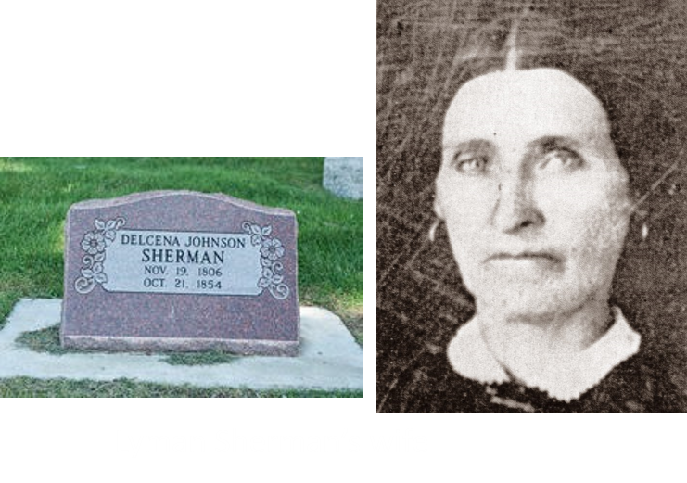
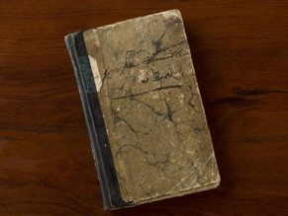
Background
When the First Quorum of the Seventy was organized on 28 February 1835, many of its members were drawn from the group of men known as Zion’s Camp, the body that in 1834 had gone to help the afflicted Saints in Missouri. Lyman Sherman, whose loyalty and faith had been proven in the Zion’s Camp expedition, was called to be one of the Seven Presidents of the First Quorum of the Seventy.
The day after Christmas 1835, the Prophet Joseph Smith recorded in his journal that “Brother Lyman Sherman came in, and requested to have the word of the Lord through me; ‘for,’ said he, ‘I have been wrought upon to make known to you my feelings and desires, and was promised that I should have a revelation which should make known my duty’” HC

Slide 3
Lyman Royal Sherman
He was born on May 22, 1804, at Monkton, Vermont and married Delcena Johnson and had 6 children
Through his interest in the Book of Mormon, he became a member of the Church and was ordained a high priest
He was part of Zion’s camp
He was called to be a Seventy on February 28, 1835, and served as the President of the Seventies for a time and sought direction from the Prophet about his duties
His counsel was received in Section 108
He participated in the dedication of the Kirtland Temple in 1836 and was called to be a member of the Kirtland High Council
He defended the Church and its leaders
He moved to Missouri in 1838 and became a member of the Far West High Council
On January 16, 1839, while the Prophet was in Liberty jail, he received a letter calling him to the apostleship to replace Orson Hyde
He passed away a few days later on January 27, 1839
Who’s Who

Slide 4
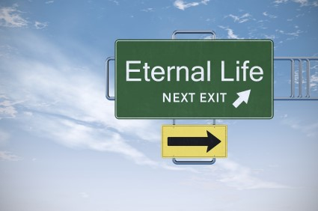
Spiritually Clean
The Lord assured Lyman Sherman that he was spiritually clean before the Lord at that time
Thus, he was worthy to be ordained as a member of the Quorum of Twelve Apostles
Because he died before he could be ordained, his name is not on the list who had served as one of the Twelve Apostles
Priesthood callings are eternal—
Death does not diminish nor take away a man’s priesthood calling in the Lord’s Kingdom
D&C 108:1 Otten and Caldwell

Slide 5
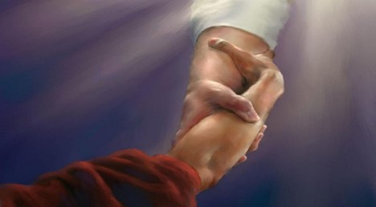
Full Obedience
“Full obedience brings the complete power of the gospel into your life, including increased strength to overcome your weaknesses.
This obedience includes actions you might not initially consider part of repentance, such as attending meetings, paying tithing, giving service, and forgiving others.
The Lord promised, ‘He that repents
and does the commandments of
the Lord shall be forgiven’
True to the Faith
As we obey the Lord’s voice, we invite His forgiveness
D&C 108:1

Slide 6
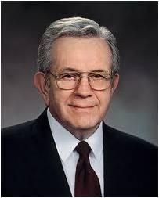
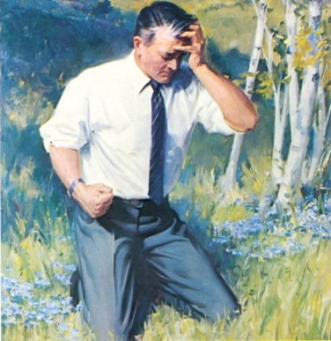

Rest To Souls
“[The] great morning of forgiveness may not come at once.
Do not give up if at first you fail.
Often the most difficult part of repentance is to forgive yourself. Discouragement is part of that test.
Do not give up. That brilliant morning will come.
“Then ‘the peace of God, which passeth … understanding’ comes into your life once again.
Then you, like Him, will remember your sins no more. How will you know? You will know!”
And it came to pass that after they had spoken these words the Spirit of the Lord came upon them, and they were filled with joy, having received a remission of their sins, and having peace of conscience, because of the exceeding faith which they had in Jesus Christ who should come, according to the words which king Benjamin had spoken unto them.
Mosiah 4:3
D&C 108:2 President Boyd K. Packer

Slide 7
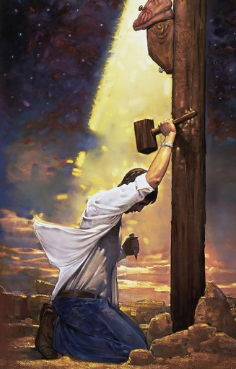
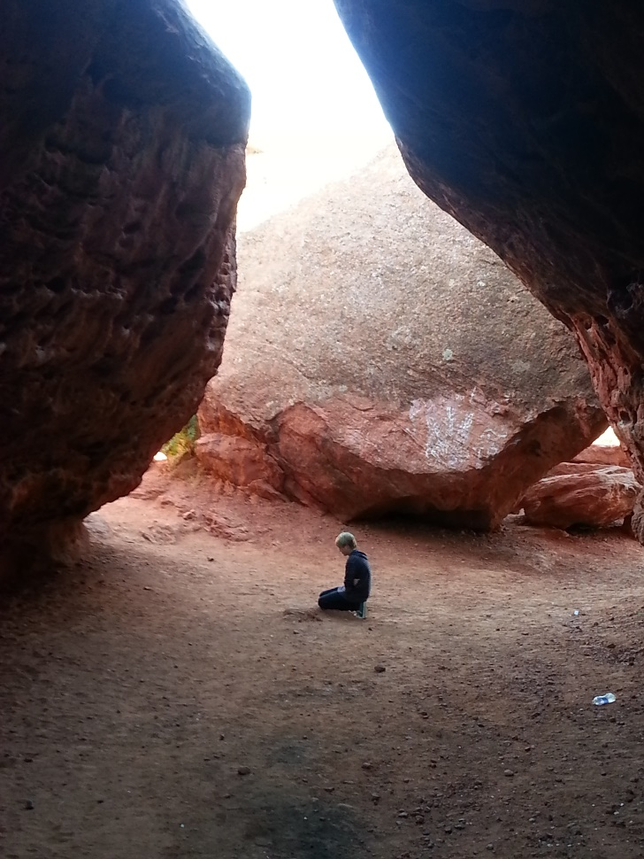
The Lord’s forgiveness brings rest to our souls
Ron DiCianni

Slide 8
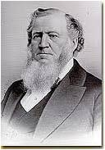
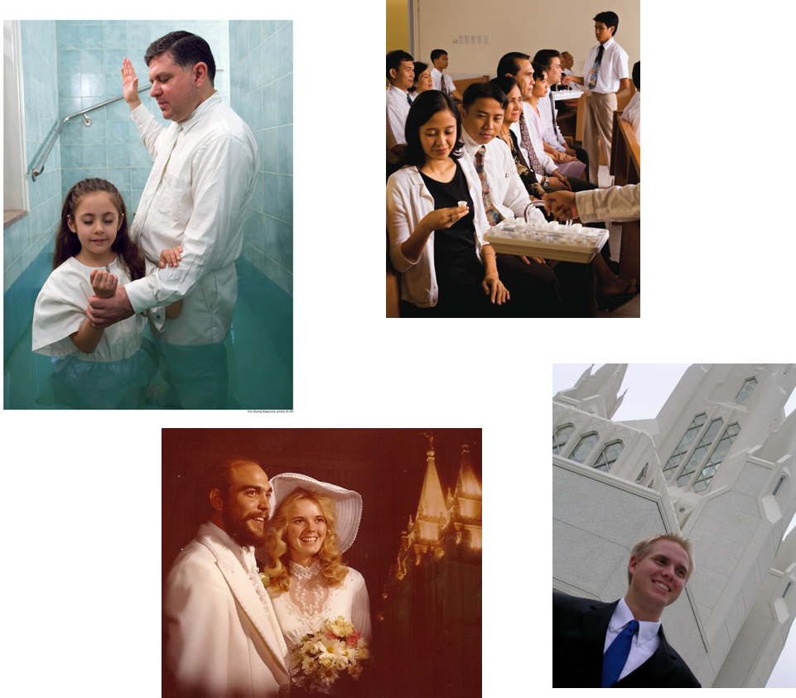
Vows
A promise or a covenant
“All that the Lord requires of us is strict obedience to the laws of life.”
“All the sacrifice that the Lord asks of his people is strict obedience to our own covenants that we have made with our God, and that is to serve him with an undivided heart.”
President Brigham Young
D&C 108:3

Slide 9
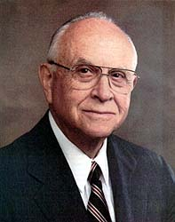
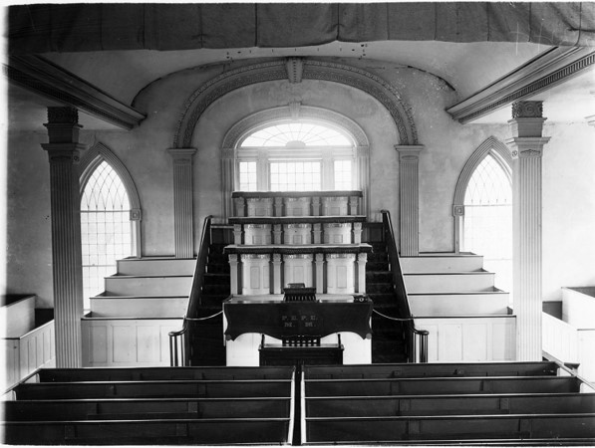
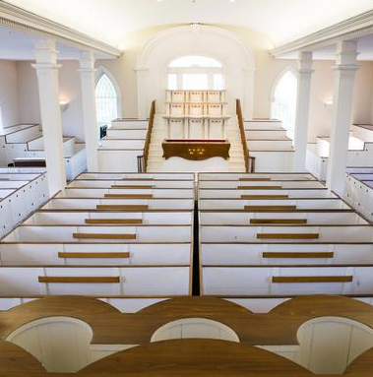
Solemn Assembly
A special gathering for “the dedication of temples, special instruction to priesthood leaders, and sustaining a new President of the Church.”
David B. Haight
D&C 108:4
Kirtland Temple Today

Slide 10
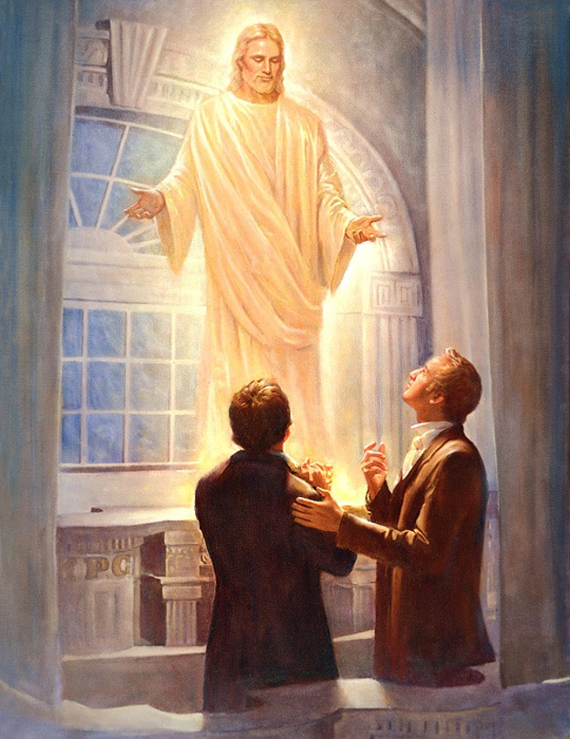
Receiving Revelations
The Kirtland Temple was near completion when section 108 was given.
Beginning on 13 January 1836 and continuing until shortly after the dedication, meetings were held in the Kirtland Temple at which there was a great outpouring of the Spirit.
Many of the Saints received revelations and saw heavenly personages.
Each of these meetings could appropriately be called a solemn assembly.
D&C 108:4-6

Slide 11
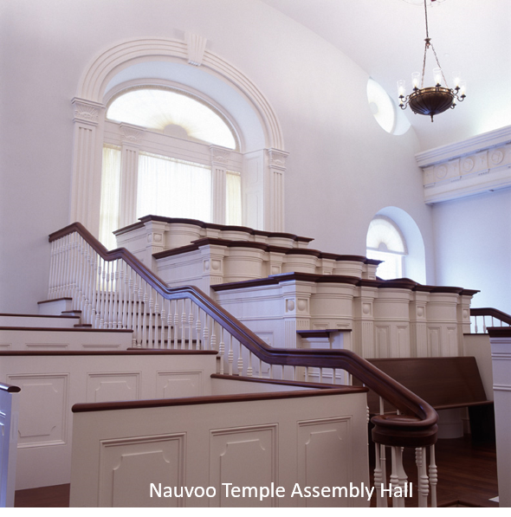
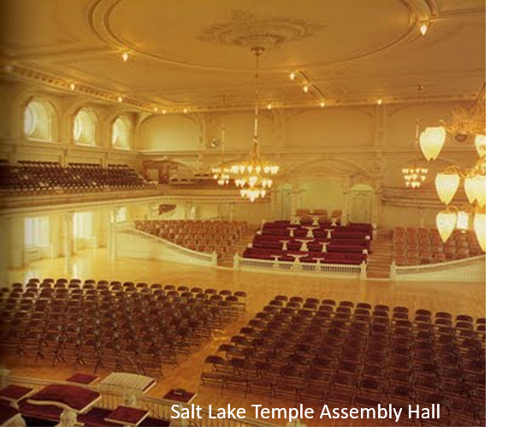
January 21, 1836
“At early candle-light I met with the Presidency at the west school room, in the Temple, to attend to the ordinance of anointing our heads with holy oil; also the Councils of Kirtland and Zion met in the two adjoining rooms, and waited in prayer while we attended to the ordinance. …
“Many of my brethren who received the ordinance with me saw glorious visions. … Angels ministered unto them as well as to myself, and the power of the Highest rested upon us, the house was filled with the glory of God, and we shouted Hosanna to God and the Lamb. …
Prophet Joseph Smith

Slide 12
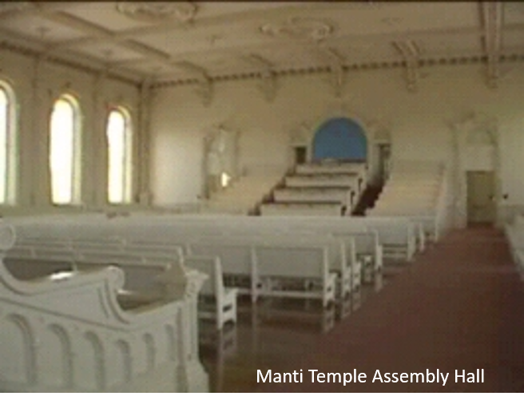
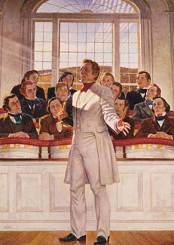
January 22, 1836
“Friday 22.—Attended at the school room at the usual hour, but instead of pursuing our studies, we spent the time in rehearsing to each other the glorious scenes that occurred on the preceding evening, while attending to the ordinance of holy anointing.
“In the evening we met at the same place, with the Council of the Twelve, and the Presidency of the Seventy, who were to receive this ordinance [of anointing and blessing]. The High Councils of Kirtland and Zion were present also.
“After calling to order and organizing, the Presidency proceeded to consecrate the oil. …
“The Twelve then proceeded to anoint and bless the Presidency of the Seventy, and seal upon their heads power and authority to anoint their brethren.”
Prophet Joseph Smith

Slide 13
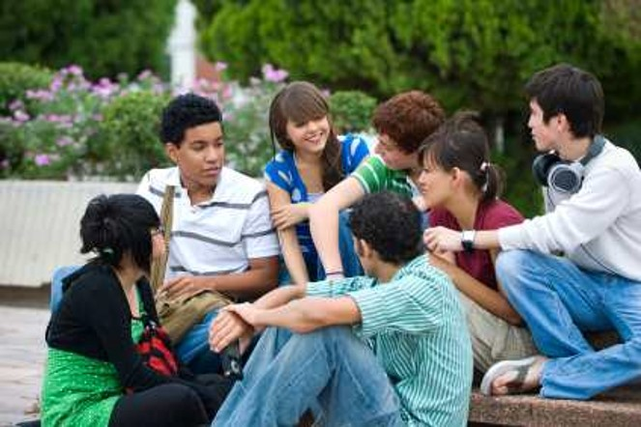
All Conversation
An influence on someone by the way we speak
“When we say anything bad about the leaders of the church, whether true or false, we tend to impair their influence and their usefulness and are thus working against the Lord and his cause.
When we speak well of our leaders, we tend to increase their influence and usefulness in the service of the Lord.
The Lord needs the help of all of us.
Are we helping or are we hindering?”
D&C 108:7-8 Elder George F. Richards

Slide 14
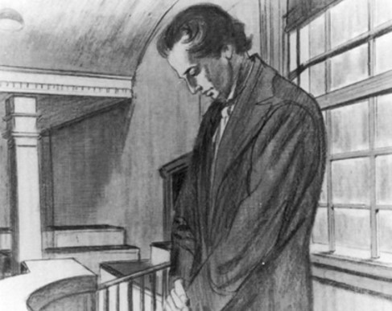
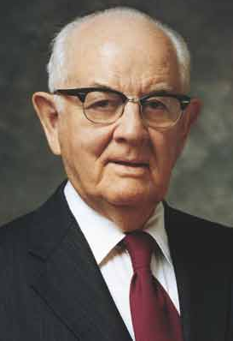
All Prayers
People can be strengthened by other’s prayers.
Leaders who pray, pray with a united faith for the welfare of the Saints.
“I have all my life sustained my leaders, praying for their welfare, and I have in these past ears felt a great power coming to me from similar prayers of the saints, raised to heaven on my behalf.”
D&C 108:7-8 President Spencer W. Kimball

Slide 15
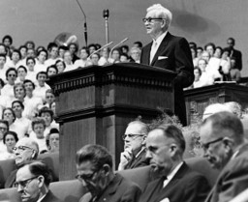
All Exhortations
All teachings--
“As members of the Lord’s church we are responsible to teach what the presiding brethren teach.
We have no right to interpret or teach anything contrary to what they have said.”
“We can strengthen the brethren by teaching and stressing that which they have declared to be true.
Through our teaching, their witness is extended by repetition to additional listeners.
Thus, their strength and effectiveness is increased.”
D&C 108:7-8 Otten and Caldwell

Slide 16
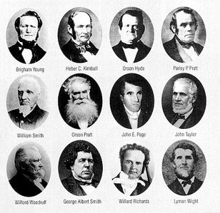
All Doings
“When our actions, or doings, are in harmony with what the presiding brethren counsel, we are strengthening their position as well as our own.”
The Counsel of Church Authorities
Strong leadership from our support
Mortal Men:
The Lord works through these men to bless and strengthen the members of the Church—
regardless of their human weaknesses
Look past the human weakness of the leadership and render obedience to their counsel
D&C 108:7-8 Otten and Caldwell

Slide 17
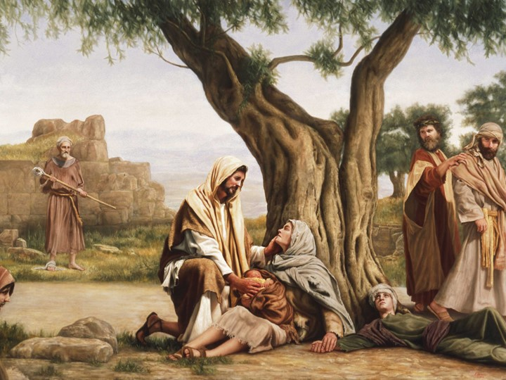
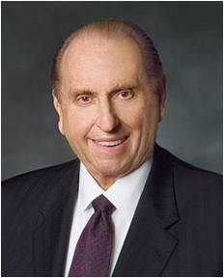
We are to strengthen others in all our conversations and actions
“…today there are hearts to gladden, there are deeds to be done—even precious souls to save. The sick, the weary, the hungry, the cold, the injured, the lonely, the aged, the wanderer—all cry out for our help.“
Thomas S. Monson
D&C 108:7-8

Slide 18
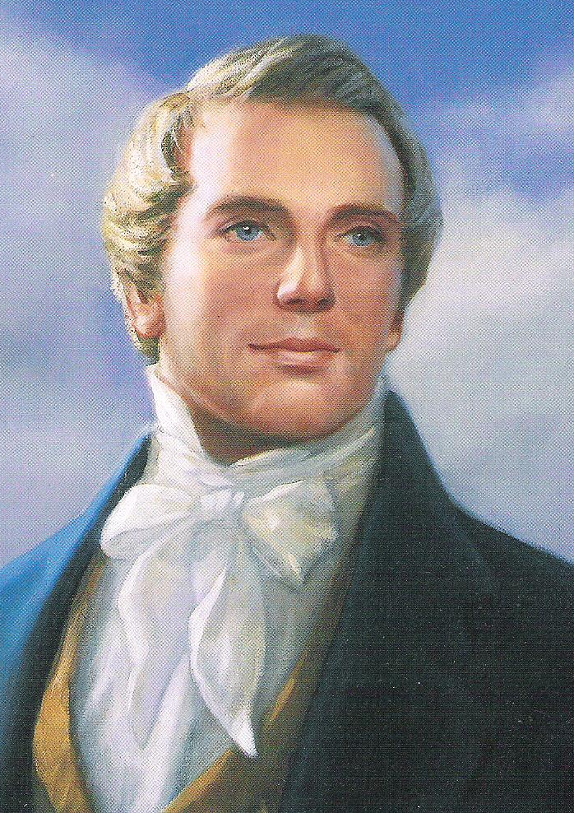
“I showed them that it was generally in consequence of the brethren disregarding or disobeying counsel that they became dissatisfied and murmured; and many when they arrive here, were dissatisfied with the conduct of some of the Saints, because everything was not done perfectly right, and they get angry, and thus the devil gets advantage over them to destroy them.
I told them I was but a man, and they must not expect me to be perfect; if they expected perfection from me, I should expect it from them, but if they would bear with my infirmities and the infirmities of the brethren, I would likewise bear with their infirmities.”
Joseph Smith

Slide 19
Sources:
Video:
Windows of Heaven Open to Obedient (0:35)
Sisters in Zion (2:48)
(History of the Church, 2:345).
Doctrine and Covenants Who’s Who by Ed J. Pinegar and Richard J. Allen pgs. 130-131
L.G. Otten and C.M. Caldwell Sacred Truths of the Doctrine and Covenants pg. 236-238
True to the Faith: A Gospel Reference [2004], 135
President Boyd K. Packer (“The Brilliant Morning of Forgiveness,” Ensign, Nov. 1995, 20).
Presentation by ©http://fashionsbylynda.com/blog/
President Brigham Young (In Journal of Discourses, 18:246.)
David B. Haight, “Solemn Assemblies,” Ensign, Nov. 1994, 14
Prophet Joseph Smith (History of the Church, 2:379, 381–83.) (TPJS, p. 268)
Elder George F. Richards Conf. Report April 1974
President Spencer W. Kimball BYU Speeches of the Year, 1979. p. 164
Thomas S. Monson (Your Jericho Road, April 1977 General Conference
Presentation by ©http://fashionsbylynda.com/blog/

Slide 20
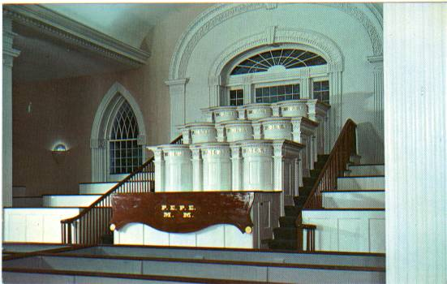
LDS Temple Assembly Halls:
These are also known as solemn assembly halls, assembly rooms, priesthood assembly halls, priesthood assembly rooms, or priesthood rooms and were a part of the first 5 temples built and several built since.
The Kirtland Ohio Temple (1836) was essentially two assembly halls, one on top of the other. The only other rooms were a few small ones in the attic area. The lower room was designated for sacrament, preaching, fasting and praying. The upper room was used for the school of the prophets, a school for LDS apostles dealing with secular and religious subjects. Both assembly halls had very unique architecture. The rooms had pulpits in the front and back. One set was for the Melchizedek Priesthood leadership and the other was for the Aaronic Priesthood leadership. The pulpits on each side consisted of 12 pulpits arranged in 4 rows of 3 pulpits. Each pulpit had three letter initials on it designating who sat there. The three pulpits on each row had the same initials. These initials on the western Melchizedek Priesthood side are from top to bottom:
M.P.C. (Melchizedek Presiding Council) – First Presidency of church or stake
P.M.H. (Presiding Melchizedek High Priesthood) – Quorum of 12 Apostles or Stake High Council
M.H.P. (Melchizedek High Priesthood) – High Priests Quorum
P.E.M. (Presiding or Presidency Elders Melchizedek) – Elders Quorum Presidency
On the eastern Aaronic Priesthood side the initials are from top to bottom:
B.P.A. (Bishop Presiding over Aaronic Priesthood) – Presiding Bishopric of the church or local Bishopric
P.A.P. (Presiding or Presidency Aaronic Priests) – Priest’s Quorum Reps
P.T.A. (Presiding or Presidency Teachers Aaronic Priesthood) – Teachers Quorum Presidency
P.D.A. (Presiding or Presidency Deacons Aaronic Priesthood) – Deacons Quorum Presidency
The bottom pulpits on both sides included collapsible sacrament tables so the sacrament could be administered.
In the Kirtland Temple the assembly halls were extremely important because they are where Jesus Christ appeared, stood on the breastwork of a pulpit, and accepted the temple. Then Moses, Elias, and Elijah came as angels and gave the priesthood keys of the gathering of Israel, the dispensation of the gospel of Abraham and “this dispensation”, and the sealing keys that allow ordinances to have power even beyond death allowing baptisms for the dead and eternal marriages to be performed, among other things. See Doctrine and Covenants Section 110.
The Kirtland Temple assembly halls are also notable because each could be divided into 4 sections by dropping curtains allowing for 8 meetings to take place simultaneously. The pulpits could also be separated from the rest of the room by curtains, functioning as a sort of Holy of Holies. The seats were also reversible so the congregation could face either the Aaronic or Melchizedek Priesthood side depending on who was speaking or if the room was divided by curtains. About 900 to 1000 people could fit in the lower assembly hall. I’ve been in the Kirtland Temple and the craftsmanship is incredible. Some people notice that the pews have doors on the row ends. This isn’t unique to Latter-day Saints, but is actually a common feature of New England architecture. The doors cut down on drafts in the room in winter time.
http://thetrumpetstone.blogspot.com/2010/11/lds-temple-assembly-halls.html

Slide 21
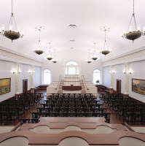
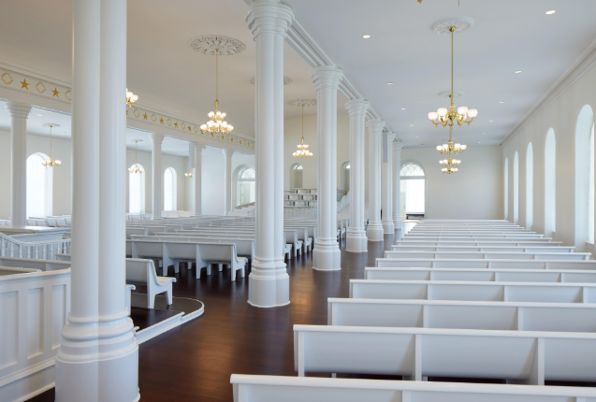
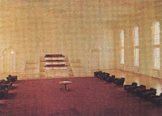
The Nauvoo Temple (1846) was essentially a larger version of the Kirtland Temple, again with two assembly halls. The upper assembly room may not have ever been finished (In the rebuilt temple this floor is filled with the endowment rooms and celestial room). In the original Nauvoo Temple the endowment was presented in the attic level with the space divided into endowment “rooms” using curtains. Baptisms for the dead were performed in the basement font. The rebuilt Nauvoo Temple includes the first floor assembly hall, although it is a little smaller width wise. I’ve seen the assembly room in the Nauvoo Temple on my visits there and it is beautiful. The pulpits are very similar to those in Kirtland. The original assembly room could seat about 3,500 people, although in the rebuilt temple the room is smaller and seat less people. The words "The LORD Has Seen Our Sacrifice - Come After Us" were originally inscribed in gilded letters along the ceiling arch behind the east Melchizedek Priesthood pulpits on the first floor assembly hall. I've noticed that the new temple has transmitters in the ceiling like those used for headsets used to listen to the endowment in another language. I assume from this that meetings are broadcast to this temple with translations when needed.
The St. George Utah Temple (1877) was constructed similar to the Nauvoo Temple with two assembly halls. Originally the lower hall was divided with curtains to make endowment "rooms". In 1938 the lower assembly room was converted with walls dividing the space into endowment rooms and a celestial room. The upper assembly hall is left intact and has Aaronic and Melchizedek Priesthood pulpits but instead of permanent pews it has removable chairs.
The Logan Utah Temple (1884) was build with endowment rooms on the lower floors and a single assembly hall on the top floor. This one also has chairs instead of pews. Although the Logan Temple was gutted and a new steel frame temple was built inside the stone exterior destroying the original pioneer craftsmanship and layout, it is my understanding that the assembly hall was left intact during the remodel and still occupies the top floor. I know for a fact that you can see all the way through the temple on the top row of windows, so if they removed the assembly hall, they can't have replaced it with anything.
http://thetrumpetstone.blogspot.com/2010/11/lds-temple-assembly-halls.html

Slide 22
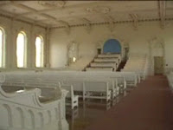
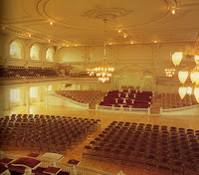
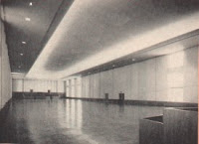
The Manti Utah Temple (1888) is similar to Logan with an assembly hall on the top floor. This time pews are present. The room has a seating capacity of 1,500 people according to the Millenial Star volume 50 printed in 1888. Because the temple is on a hill, the east doors of the temple lead into this room whereas the west doors enter the endowment and sealing section of the temple several floors below.
The Salt Lake Temple (1893) contains a large assembly hall on the top two floors which seats about 2,200 people. The top two rows of windows on the temple main body (an arched row and an elliptical row) give light to the room. The pulpit design breaks away from the Kirtland model (curved breastwork) and instead has podium style pulpits with 12 on each side. Above the pulpits there is a canopy labeled "Aaronic" and "Melchizedek" on the respective sides (I think it also says Priesthood). The hall also has a large balcony with spiral staircases. This room is regularly used for meetings of General Authorities of the church (every Thursday I’ve heard) as well as occasionally for special temple worker meetings and meetings for bishops, etc.. The assembly hall was also temporarily used as a studio to film the endowment when it was first converted to a film format for the Bern Switzerland Temple. Before the Missionary Training Center was built in Provo, missionaries were trained in Salt Lake City and had special devotionals usually led by an apostle or member of the first presidency in the temple assembly room before leaving on missions. Here's a cool picture of the room under construction.
After the completion of the Salt Lake Temple, temples were built without assembly halls to save money as most temples don’t need them. This was new as every temple up to this point had an assembly hall. Another temple wouldn’t be built with an assembly hall for 63 years.
The Los Angeles California Temple (1956) was a very large temple with more square feet than the Salt Lake Temple at the time of its construction (additions have made Salt Lake larger) and it included a priesthood assembly hall (because WWII delayed the groundbreaking an assembly hall was added to the plans). The assembly hall has a very sleek modern design and is a very large room occupying the entire top floor of the temple. It is 300 ft long so the same length as a football field.
For 18 years after the LA Temple was completed temples were built without assembly halls.
http://thetrumpetstone.blogspot.com/2010/11/lds-temple-assembly-halls.html

Slide 23
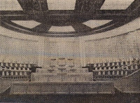
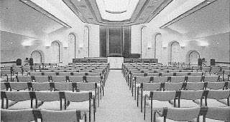
The Washington D.C. Temple (1974) again had a priesthood assembly hall. This one is a modern interpretation of the Salt Lake Temple priesthood assembly room with podium style pulpits. This temple calls the room "the priesthood room" and it is located on the top floor of the temple.
The Portland Oregon Temple (1989) was the nest temple containing an assembly hall. According to ldschurchtemples.com the top floor contains an assembly hall and sealing rooms. I’ve been in this temple and the celestial room has a staircase and upper level. The upper level has a door that apparently leads to the sealing rooms and assembly hall.
The Boston Massachusetts Temple(2000) was originally designed as a much larger structure complete with an assembly hall. I talked with someone involved in the construction and was told that the plans were changed so the basement cafeteria rooms can be used as an assembly hall. I don’t think there are pulpits there (I’ve been in the cafeteria but haven’t seen all the rooms in it) so I assume this hall would simply have solemn assemblies broadcast from other temples with pulpits. I did notice that the cafeteria ceiling contained transmitters like those used for headsets used to listen to the endowment in another language, so I assume meetings are transmitted to the temple and translated if needed.
http://thetrumpetstone.blogspot.com/2010/11/lds-temple-assembly-halls.html

