Slide 1

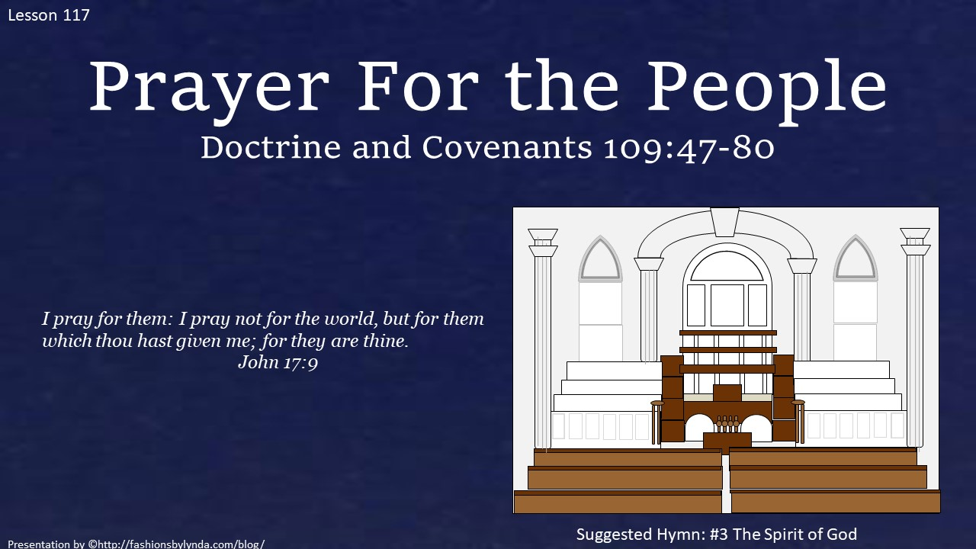
Doctrine and Covenants 109:47-80
Prayer for the People
Presentation by ©http://fashionsbylynda.com/blog/

Slide 2
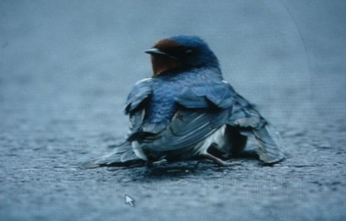
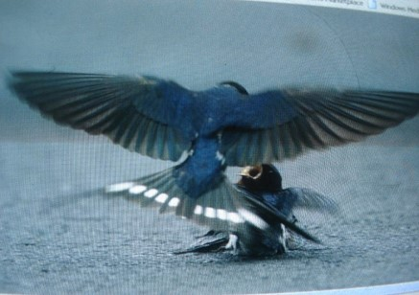
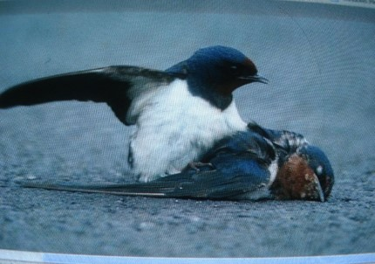
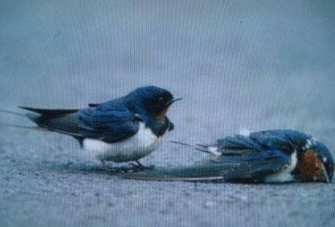
Someone you love has suffered
You feed and nurture them
You give them support and comfort
But somehow there is nothing you can do
Source: Idea from…

Slide 3
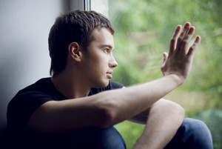
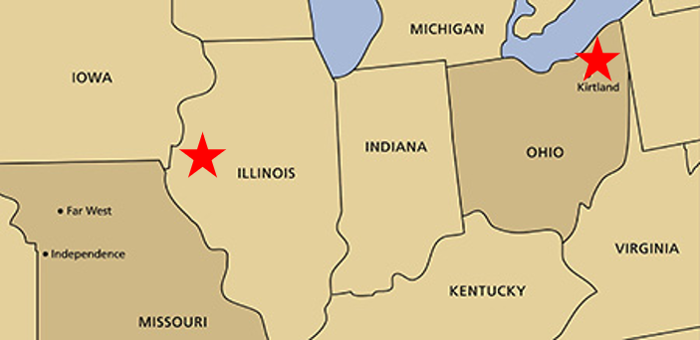
When There’s Nothing You Can Do
In what ways can you help relieve someone’s suffering, even when there is nothing you can do personally?
Saints in Missouri Suffered---Prophet in Ohio
Although at the time the Prophet was unable to do anything personally to relieve the suffering of the Saints in Missouri, he did something during the dedication of the Kirtland Temple to help strengthen them

Slide 4
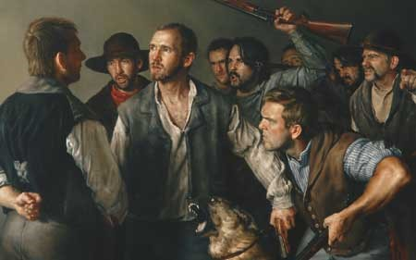
Pray For Those In Need
As part of the dedicatory prayer, the Prophet Joseph Smith pleaded with the Lord to remember the Saints in Missouri in their afflictions. He beseeched the Lord to have mercy on the mobs so that they might repent
Our prayers can bring help and strength to those who are in need
“…praying for others with all of the energy of our souls increases our capacity to hear and to heed the voice of the Lord.”
Elder David A. Bednar
D&C 109:47-49

Slide 5
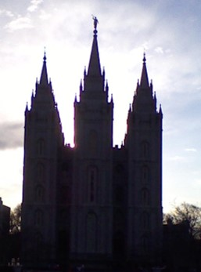
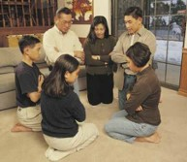
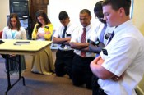
A Prayer For Others
Where do we hear a prayer for others?
Family Prayers
Church Sacrament Meetings
Temple Prayers
“Pray in your families unto the Father, always in my name, that your wives and your children may be blessed.”
(3 Ne. 21.)
Now Peter and John went up together into the temple at the hour of prayer, being the ninth hour.
Acts 3:1
Nevertheless the children of God were commanded that they should gather themselves together oft, and join in fasting and mighty prayer in behalf of the welfare of the souls of those who knew not God. Alma 6:6
Your Own Personal Prayers
Missionary Prayers
And again, O God, when I did turn to my house thou didst hear me in my prayer.
Alma 33:6
Pray for people by name and consider their needs?
Preach My Gospel Chapter 4
D&C 109:47-49

Slide 6

Pray For Repentance
What if the people we pray for choose not to repent?
Heavenly Father has given us agency, the ability to choose right from wrong and to act for ourselves
While we are free to choose our course of action, we are not free to choose the consequences.
Taken from “For the Strength of Youth” Pamphlet (Agency and Accountability
Our prayers can help influence people to repent
Jesus Taught
And forgive us our debts, as we forgive our debtors. (Matthew 6:12)
And forgive us our sins; for we also forgive every one that is indebted to us (Luke 11:4)
D&C 109:50-53

Slide 7
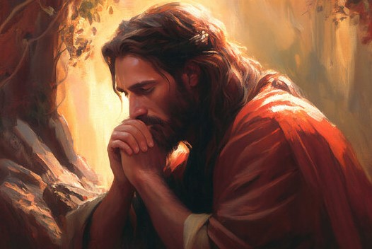
Those Who Do Repent--Mercy
God’s wrath is often expressed in the punishment or suffering we experience because of our sins, according to His justice.
“when thou lookest upon the face of thine Anointed”—
Heavenly Father’s willingness to grant mercy because of the atoning sacrifice of His Son, Jesus Christ.
Because of Jesus Christ’s atoning sacrifice, Heavenly Father’s wrath will be turned away from those who repent
D&C 109:53

Slide 8
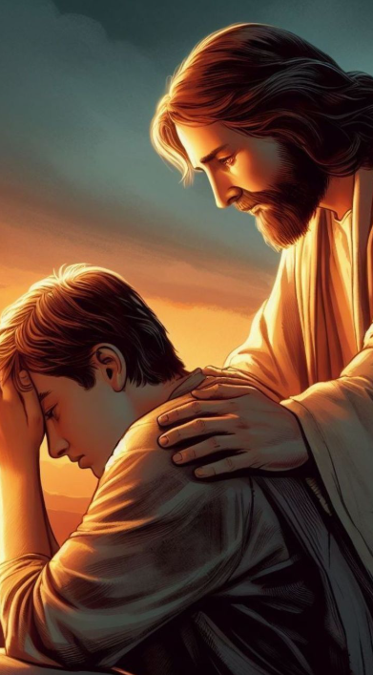
Conditions of Repentance
Mercy is available only upon conditions of repentance. Divine justice cannot be denied for the wicked that drove the Saints from their homes in Missouri
Mercy is the compassionate treatment of a person greater than what is deserved, and it is made possible through the Atonement of Jesus Christ.
Our Heavenly Father knows our weaknesses and sins.
He shows mercy when He forgives us of our sins and helps us return to dwell in His presence.
Blessed are the merciful: for they shall obtain mercy
Matthew 5:7
D&C 109:53

Slide 9

Have You…
Prayed for the full-time missionaries
Prayed for people investigating the Church
Prayed for people who have not yet heard the gospel
D&C 109:54

Slide 10
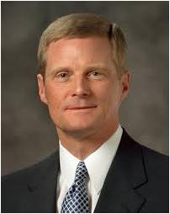
“We properly pray for the safety and success of the full-time missionaries throughout the world. And a common element in many of our prayers is a request that the missionaries will be led to individuals and families who are prepared to receive the message of the Restoration.
But ultimately it is my responsibility and your responsibility to find people for the missionaries to teach.
Missionaries are full-time teachers; you and I are full-time finders. And you and I as lifelong missionaries should not be praying for the full-time missionaries to do our work!
D&C 109:54-58

Slide 11
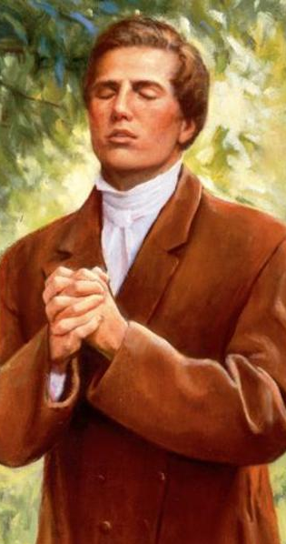
“If you and I would truly pray and ask in faith, as did Joseph Smith—if we would pray with the expectation to act and not just to express—then the work of proclaiming the gospel would move forward in a remarkable way. Such a prayer of faith might include some of the following elements:
Elder Bednar

Slide 12
P
“Thanking Heavenly Father for the doctrines and ordinances of the restored gospel of Jesus Christ, which bring hope and happiness into our lives.
“Asking for courage and boldness to open our mouths and share the gospel with our family and friends.
“Entreating Heavenly Father to help us identify individuals and families who will be receptive to our invitation to be taught by the missionaries in our homes.
“Pledging to do our part this day and this week and petitioning for help to overcome anxiety, fear, and hesitation.
“Seeking for the gift of discernment—for eyes to see and ears to hear missionary opportunities as they occur.
“Praying fervently for the strength to act as we know we should”
R
A
Y
E
R
Elder Bednar

Slide 13
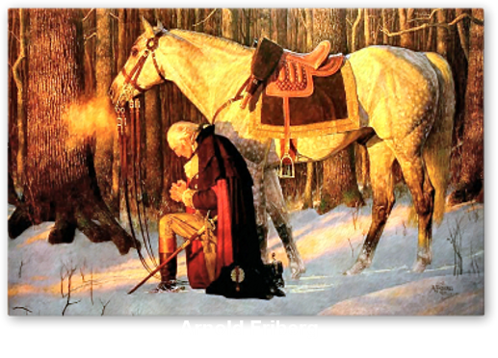
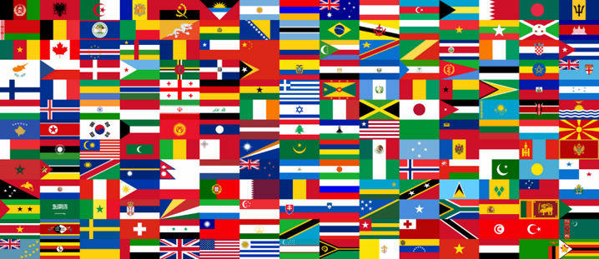
Soften the Hearts of the Leaders
Prejudice—a preconceived judgment that closes the hearts and minds of people to light and truth
“The prayer recognizes that leaders of nations are the gates through which missionaries must pass to enter their countries.”
McConkie and Ostler
We are counseled to pray for the Leaders of the Nation—that their hearts will be softened
“Others may not agree with us, but I am confident that they will respect us. We will not be left alone. There are many not of our faith but who feel as we do. They will support us. They will sustain us in our efforts.”
“While we cannot agree with others on certain matters, we must never be disagreeable. We must be friendly, soft-spoken, neighborly, and understanding.”
D&C 109:54-58 President Gordon B. Hinckley

Slide 14
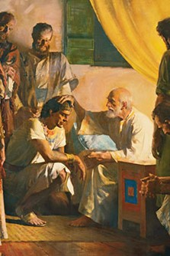
A Prayer For The Future
Jacob was a great prophet who lived hundreds of years before the time of Christ.
Because Jacob was faithful, the Lord gave him the special name of Israel, which means “one who prevails with God” or “let God prevail”.
Jacob had twelve sons. These sons and their families became known as the twelve tribes of Israel, or Israelites.
See notes on their scattering*
Bible Dictionary and Genesis 49:28
Joseph Smith prayed that the Lord would establish more stakes of Zion so people throughout the world could gather to them.
He specifically prayed for the descendants of the prophet Jacob (Israel) to come to know the truth and be converted to the fulness of the gospel.
This is an important way that Israel is gathered in the latter days.
D&C 109:59-67

Slide 15
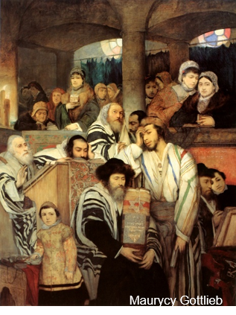
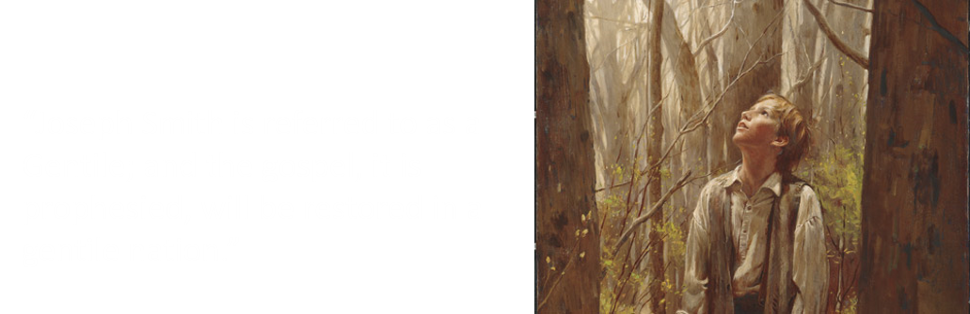
Joseph—the Gentile
Gentile—Nation—a collective body
“As a Jew is a Jewish national, so is a Gentile a citizen of a gentile nation.”
And then shall the work of the Father commence at that day, even when this gospel shall be preached among the remnant of this people. Verily I say unto you, at that day shall the work of the Father commence among all the dispersed of my people, yea, even the tribes which have been lost, which the Father hath led away out of Jerusalem.
3 Nephi 21:26
“By this definition Latter-day Saints are Israelites by descent but Gentile by culture.”
“Any nation that does not have prophets at its head, revelation as its constitution, and the Messiah as its king is a gentile nation.”
D&C 109:54-58 McConkie and Ostler

Slide 16
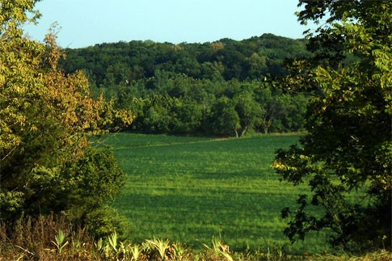
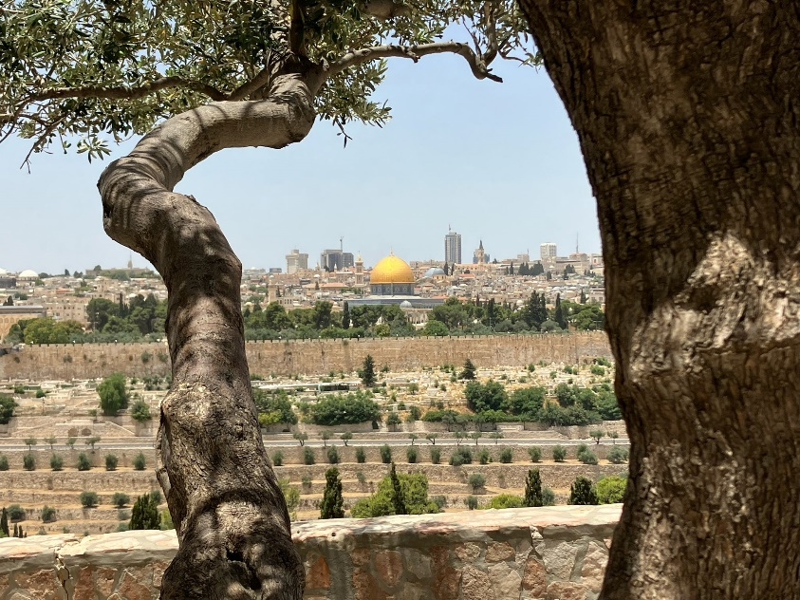
Western Tribes of Indians
Descendants from Joseph who was sold in Egypt
The Prophet Joseph Smith wrote that in reading the Book of Mormon
“…and that the land of America is a promised land unto them, and unto it all the tribes of Israel will come, with as many of the Gentiles as shall comply with the requisitions of the new covenant.
But the tribe of Judah will return to old Jerusalem.”
Student Manual
Let them, therefore, who are among the Gentiles flee unto Zion.
D&C 133:12
And let them who be of Judah flee unto Jerusalem, unto the mountains of the Lord’s house.
D&C 133:13
D&C 109:61-67

Slide 17
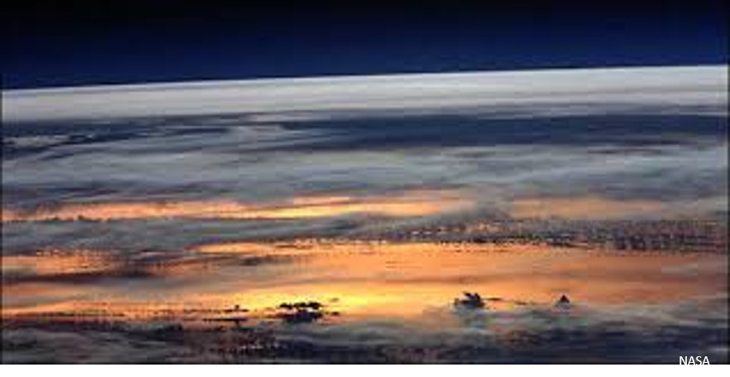
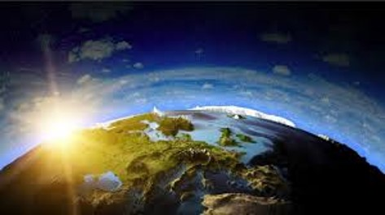
When Will the Mountains Flow Down?
“In the resurrection which now approaches…and in connection with the glorious coming of Jesus Christ, the earth will undergo a change in its physical features, climate, soil, productions, and in its political, moral and spiritual government.
“Its mountains will be levelled, its valleys exalted, its swamps and sickly places will be drained and become healthy, while its burning deserts and its frigid polar regions will be redeemed and become temperate and fruitful.”
Elder Parley P. Pratt
D&C 109:74

Slide 18
The Spirit of God
HYMNS
A choir sang it immediately after the dedicatory prayer
1. The Spirit of God like a fire is burning!
The latter-day glory begins to come forth;
The visions and blessings of old are returning,
And angels are coming to visit the earth.
(Chorus]
We'll sing and we'll shout with the armies of heaven,
Hosanna, hosanna to God and the Lamb!
Let glory to them in the highest be given,
Henceforth and forever, Amen and amen!
2. The Lord is extending the Saints' understanding,
Restoring their judges and all as at first.
The knowledge and power of God are expanding;
The veil o'er the earth is beginning to burst.
3. We'll call in our solemn assemblies in spirit,
To spread forth the kingdom of heaven abroad,
That we through our faith may begin to inherit
The visions and blessings and glories of God.
4. How blessed the day when the lamb and the lion
Shall lie down together without any ire,
And Ephraim be crowned with his blessing in Zion,
As Jesus descends with his chariot of fire!
This Hymn continues to be sung at temple dedications today.
William W. Phelps

Slide 19
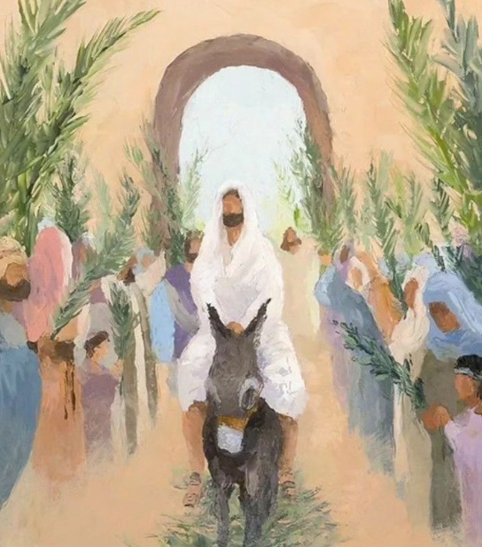
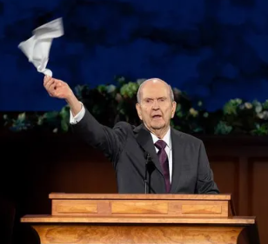
Hosanna Shout
Those who attend a temple dedication participate in the Hosanna Shout. This shout is reminiscent of the praise offered by followers of Jesus Christ at His triumphal entry into Jerusalem.
The congregation stands, waves white handkerchiefs, and unites in shouting three times the words, “Hosanna, Hosanna, Hosanna to God and the Lamb.” The shout concludes with “Amen, Amen, and Amen.”
Church History Topics
D&C 109:79-80; Matthew 21:1, 8-9; Mark 11:8-10; John 12:12-13

Slide 20
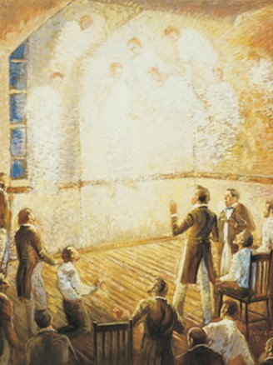
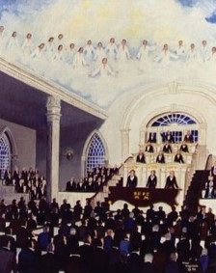
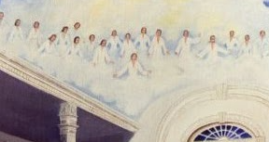
After the Temple Dedication
Evening of March 27, 1836
That evening, priesthood quorums met in the temple. Joseph Smith said that he “gave them instructions in relation to the spirit of prophecy, and called upon the congregation to speak. …
George A. Smith arose and began to prophesy, when a noise was heard like the sound of a rushing mighty wind, which filled the Temple, and all the congregation simultaneously arose, being moved upon by an invisible power; many began to speak in tongues and prophesy; others saw glorious visions; and I beheld the Temple was filled with angels, which fact I declared to the congregation.
The people of the neighborhood came running together (hearing an unusual sound within, and seeing a bright light like a pillar of fire resting upon the Temple), and were astonished at what was taking place.
Some people saw angels above the temple and heard singing.
History of the Church

Slide 21
Sources:
Video:
An Answer to Prayer (4:21)
Hosanna Shout; https://www.churchofjesuschrist.org/study/general-conference/2020/04/46nelson?lang=eng (2:28)
Elder David A. Bednar Pray Always April 2008 Gen. Conf.. And (“Ask in Faith,” Ensign or Liahona, May 2008, 95–96).
Joseph Fielding McConkie and Craig J. Ostler Revelations of the Restoration pg. 878
President Gordon B. Hinckley An Ensign to the Nations, a Light to the World Oct. 2003 Gen. Conf.
Doctrine and Covenants Student Manual Religion 324-325 Section 109
Elder Parley P. Pratt (Key to the Science of Theology, p. 132
Presentation by ©http://fashionsbylynda.com/blog/
Text: William W. Phelps, 1792-1872. Included in the first LDS hymnbook, 1835. Sung at the Kirtland Temple dedication in 1836.
Music: Anon., ca. 1844
(in History of the Church, 2:428). Some people saw angels above the temple and heard singing (see Church History in the Fulness of Times Student Manual, 2nd ed. [Church Educational System manual, 2003], 167).
Idea from: http://www.chess.com/blog/amrita1/love-amp-sorrow
Church History Topics, “Temple Dedications and Dedicatory Prayers,” ChurchofJesusChrist.org/study/history/topics)
Presentation by ©http://fashionsbylynda.com/blog/

Slide 22
Arnold Friberg (December 21, 1913 – July 1, 2010) was an American illustrator and painter noted for his religious and patriotic works. He is perhaps best known for his 1975 painting The Prayer at Valley Forge, a depiction of George Washington praying at Valley Forge.
He also did a series of paintings depicting scenes from the Book of Mormon for Adele Cannon Howells, the Primary President of The Church of Jesus Christ of Latter-day Saints.
Some of his most LDS famous paintings:
Abinadi Before the King Noah
Alma baptizes in the waters of Mormon
Ammon Defends the Flocks
Christ Appears Among the Nephites
The Finger of the Lord
Lehi and his people arrive in the Promised Land
The Liahona
Samuel the Lamanite on the Wall
Two Thousand Young Warriors
Wikipedia
The House of Israel Was Scattered
Again and again prophets of the Lord warned the house of Israel what would happen if they were wicked. Moses prophesied, “And the Lord shall scatter thee among all people, from the one end of the earth even unto the other” (Deuteronomy 28:64).
Despite this warning, the Israelites consistently broke the commandments of God. They fought among themselves and split into two kingdoms: the Northern Kingdom, called the kingdom of Israel, and the Southern Kingdom, called the kingdom of Judah. Ten of the twelve tribes of Israel lived in the Northern Kingdom. During a war they were conquered by their enemies and carried away into captivity. Some of them later escaped into the lands of the north and became lost to the rest of the world.
About 100 years after the capture of the Northern Kingdom, the Southern Kingdom was conquered. The capital city of Jerusalem was destroyed in 586 B.C., and many members of the remaining two tribes of Israel were taken captive. Later, some of the members of these tribes returned and rebuilt Jerusalem. Just before Jerusalem was destroyed, Lehi and his family, who were members of the house of Israel, left the city and settled in the Americas.
After the time of Christ, Jerusalem was again destroyed, this time by Roman soldiers. The Jews were scattered over much of the world. Today Israelites are found in all countries of the world. Many of these people do not know that they are descended from the ancient house of Israel.
The Kirtland Temple was dedicated in an eight-hour service on March 27, 1836. A reported "one thousand persons" attended the gathering, which introduced such traditional dedication rites as the Hosanna Shout and singing of W. W. Phelps's hymn "The Spirit of God Like a Fire Is Burning." Following a two-and-a-half hour sermon given by Church leader Sidney Rigdon, Smith offered a dedicatory prayer that had been prepared by a committee of church leaders, which he indicated was given to him by revelation. Two other church leaders, Brigham Young and David W. Patten, were reported to have been inspired to speak in tongues following the prayer.
It is often told that angels and religious manifestations occurred there and were witnessed by the congregations. It is also told that much wine was consumed there by the congregation.
Visions and Miracles
So what happened? If the faithful accounts are correct, then many glorious, angelic visitations occurred at the temple that day and witnessed by hundred of saints. If the critics are correct then the stories are either untrue or exaggerations - perhaps fueled by the intense fasting and the wine that was given to the saints to commemorate the occasion.

Slide 23
Accounts supporting the angelic manifestations
There are many accounts that suggest something of a Pentecostal nature happened at the Kirtland Temple dedication. Here's several prominent accounts:
Joseph Smith, Jr. "Brother George A. Smith arose and began to prophesy, when a noise was heard like the sound of a rushing mighty wind, which filled the Temple, and all the congregation simultaneously arose, being moved upon by an invisible power; many began to speak in tongues and prophesy; others saw glorious visions; and I beheld the Temple was filled with angels, which fact I declared to the congregation. The people of the neighborhood came running together (hearing an unusual sound within, and seeing a bright light like a pillar of fire resting upon the Temple), and were astonished at what was taking place."
Reference: Joseph Smith, History of The Church of Jesus Christ of Latter-day Saints, 7 vols., introduction and notes by B. H. Roberts (Salt Lake City: The Church of Jesus Christ of Latter-day Saints, 1932-1951), 2:428.
Oliver Cowdery "Sunday, the 27th attended on the dedication of the Lord's house. For the particulars of this great event see my account written by myself, and printed in the March No. of The Messenger and Advocate, signed C. In the evening I met with the officers of the church in the Lord's house. The Spirit was poured out--I saw the glory of God, like a great cloud, come down and rest upon the house, and fill the same like a mighty rushing wind. I also saw cloven tongues, like as of fire rest upon many, (for there were 316 present,) while they spake with other tongues and prophesied."
Reference: Leonard J. Arrington, "Oliver Cowdery's Kirtland Ohio 'Sketch Book,'" BYU Studies, Volume 12, (Summer 1972), 426.
Heber C. Kimball "During the ceremonies of the dedication, an angel appeared and sat near President Joseph Smith, Sen., and Frederick G. Williams, so that they had a fair view of his person. He was a very tall personage, black eyes, white hair, and stoop shouldered; his garment was whole, extending to near his ankles; on his feet he had sandals. He was sent as a messenger to accept of the dedication...While these things were being attended to the beloved disciple John was seen in our midst by the Prophet Joseph, Oliver Cowdery and others."
Reference: Journal of Discourses, 26 vols. (London: Latter-day Saints' Book Depot, 1854-1886), 9: 376.
George A. Smith "There were great manifestations of power, such as speaking in tongues, seeing visions, administration of angels. Many individuals bore testimony that they saw angels, and David Whitmer bore testimony that he saw three angels passing up the south aisle, and there came a shock on the house like the sound of a mighty rushing wind, and almost every man in the house arose, and hundreds of them were speaking in tongues, prophecying or declaring visions, almost with one voice."
Reference: Ibid, 11:10.
Eliza R. Snow "One striking feature of the ceremonies, was the grand shout of hosanna, which was given by the whole assembly, in standing position, with uplifted hands. The form of the shout is as follows: 'Hosanna-hosanna-hosanna-to God and the Lamb-amen-amen, and amen.' The foregoing was deliberately and emphatically pronounced, and three times repeated, and with such power as seemed almost sufficient to raise the roof from the building.
Reference: Edward W. Tullidge, The Women of Mormondom (New York: Tullidge &amp; Crandall, 1877), 95.
Benjamin Brown "There the Spirit of the Lord, as on the day of Pentecost, was profusely poured out. Hundreds of Elders spoke in tongues. We had a most glorious and never-to-be-forgotten time. Angels were seen by numbers present. It was also at this time that Elijah the Prophet appeared, and conferred upon Joseph the keys of turning the hearts of the fathers to the children, previous to the re-institution of the ordinance of baptism for the dead."
Reference: Benjamin Brown, "Testimony for the Truth," Gems for the Young Folks (Salt Lake City: Juvenile Instructor Office, 1881), 65.
Truman Angell "When about midway during the prayer, there was a glorious sensation passed through the house [Kirtland Temple]; and we, having our heads bowed in prayer, felt a sensation very elevating to the soul. At the close of the prayer, F. [Frederick] G. Williams being in the upper east stand- -Joseph being in the speaking stand next below--rose and testified that midway during the prayer an holy angel came and seated himself in the stand. When the afternoon meeting assembled, Joseph, feeling very much elated, arose the first thing and said the personage who had appeared in the morning was the Angel Peter come to accept the dedication."
Reference: Truman Angell, Autobiography, Our Pioneer Heritage, Writings of Early Latter-day Saints, 198.
http://mormonthink.com/glossary/kirtlandtemplededication.htm

