Slide 1
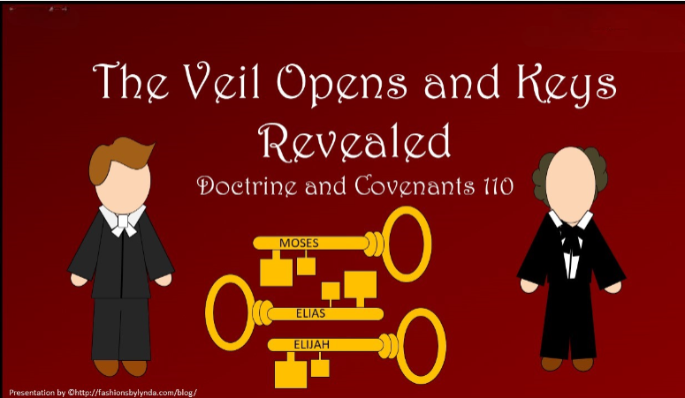

Slide 2

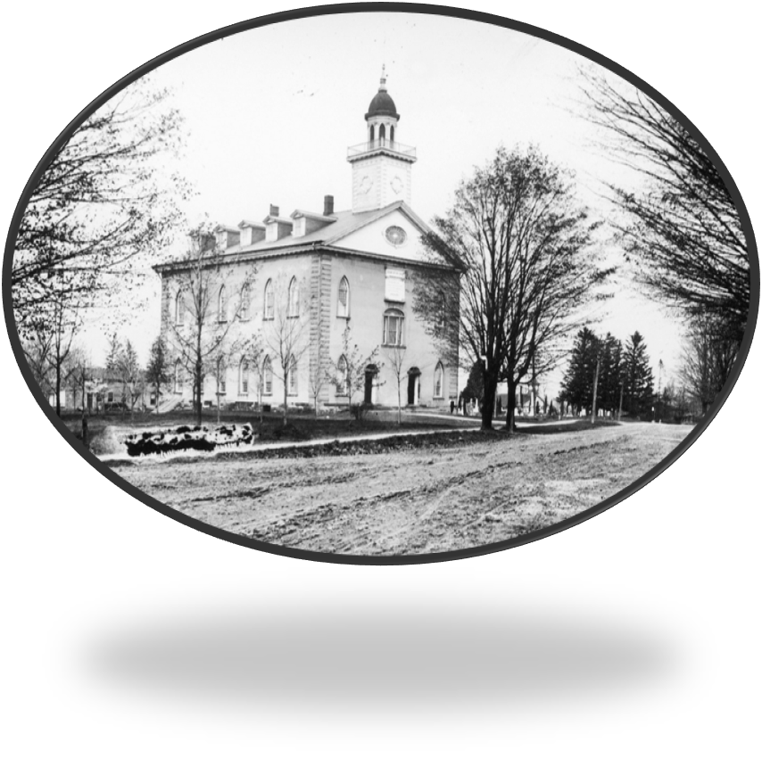
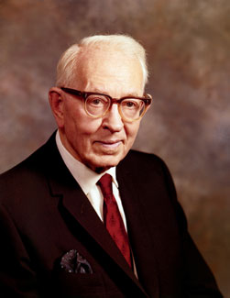
Background
April 3, 1836
One week after dedication of Kirtland Temple
The Lord was pleased with the sacrifices made by the Saints to complete “a house of prayer, a house of fasting, a house of faith, a house of learning, a house of glory, a house of order, a house of God” D&C 88:119
“After the dedication of the Kirtland Temple, council and spiritual meetings were held in the building almost daily. Sunday, April 3, 1836, was one of the most eventful days in the history of the Church”
Joseph Fielding Smith

Slide 3
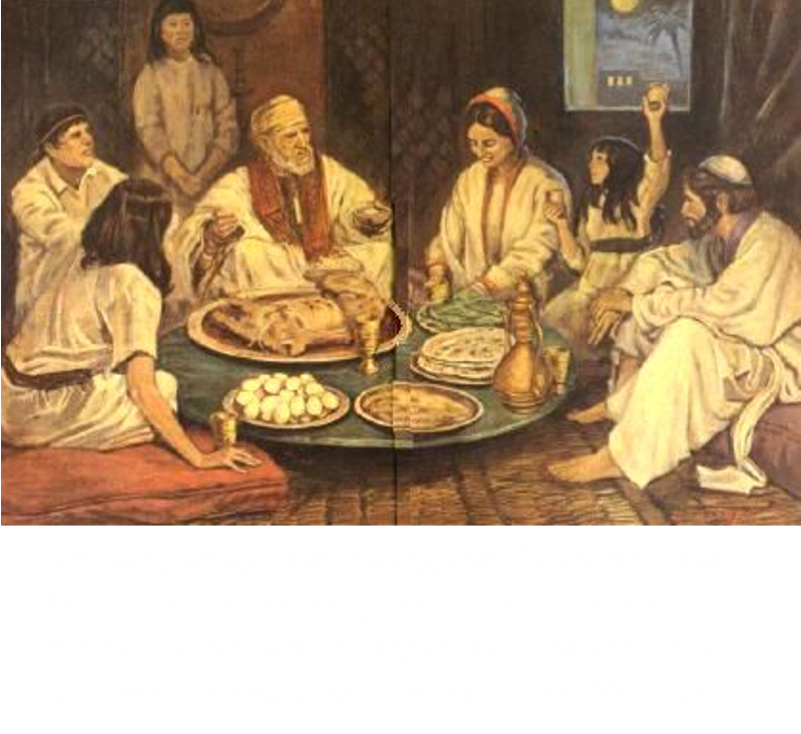
In Israel
“It is interesting to know that on the third day of April 1836, the Jews were celebrating the feast of the Passover, and were leaving the doors of their homes open for the coming of Elijah.”
Joseph Fielding Smith

Slide 4
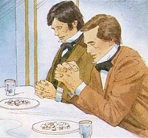
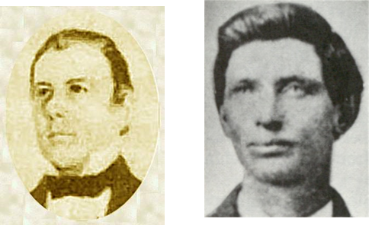
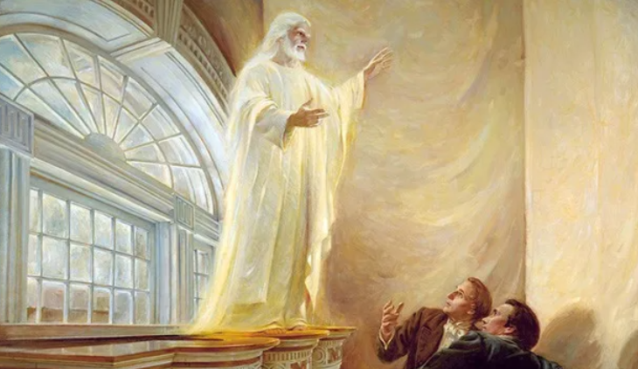
During a Sacrament Meeting
Thomas B. Marsh and David W. Patten spoke in the forenoon to an attentive audience of about one thousand persons
A meeting was being held in the Temple in which Joseph along with the Twelve ‘distributed the Lord’s Supper to the Church’
“After having performed this service to my brethren, I retired to the pulpit, the veils being dropped, and bowed myself, with Oliver Cowdery, in solemn and silent prayer. After rising from prayer, the following vision was opened to both of us.”
Joseph Smith
Doctrine and Covenants 110 records the vision and visitations received on that day.
Student Manual

Slide 5
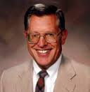
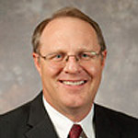


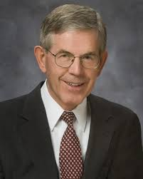
The Veil
“When the spirit children of God leave the realms of heaven and come to the earth to obtain a body, a veil is drawn across their minds, taking from them both the memory of their divine origin and the ability to see and comprehend the things of heaven.”
McConkie and Ostler
“Not only does the veil keep us from remembering our past, which we call the preexistence, but also it keeps us from seeing many things that are going on at the present—for God, his angels, and their activities are hidden from our sight.”
Elder Bruce C. Hafen
D&C 110:2

Slide 6
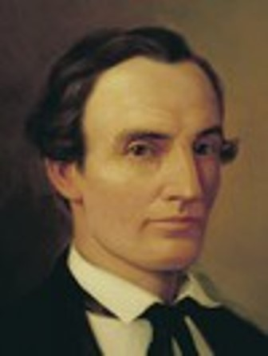
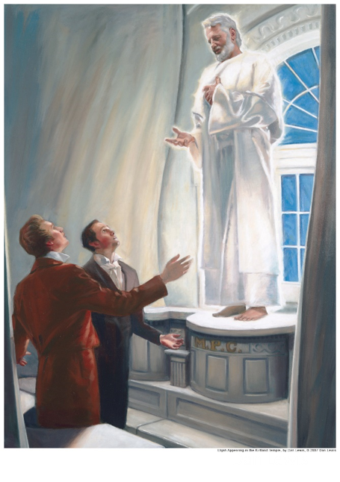
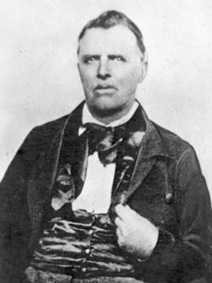
The Veil Opened
Besides Oliver Cowdery and Joseph Smith seeing the Lord, John Murdock also saw
"I saw the glory of God, like a great cloud, come down and rest upon the house…. I also saw cloven tongues like as of fire rest upon many…while they spake with other tongues and prophesied“ Oliver Cowdery
“The visions of my mind were opened, and the eyes of my understanding were enlightened, and I saw the form of a man, most lovely!
The visage of his face was sound and fair as the sun. His hair, a bright silver gray, curled in most majestic form. His eyes, a keen penetrating blue, and the skin of his neck a most beautiful white, and He was covered from the neck to the feet with a loose garment, pure white, whiter than any garment I have seen before. ”
John Murdock
D&C 110:1

Slide 7
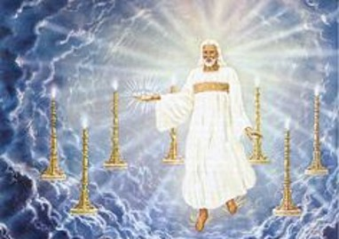
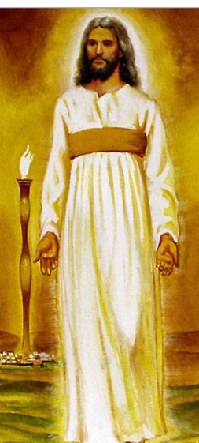
Similar Visions
Joseph
We saw the Lord standing upon the breastwork of the pulpit, before us; and under his feet was a paved work of pure gold, in color like amber.
His eyes were as a flame of fire; the hair of his head was white like the pure snow; his countenance shone above the brightness of the sun; and his voice was as the sound of the rushing of great waters, even the voice of Jehovah, saying:
Daniel
John, the Revelator
And in the midst of the seven candlesticks one like unto the Son of man, clothed with a garment down to the foot, and girt about the paps with a golden girdle.
His head and his hairs were white like wool, as white as snow; and his eyes were as a flame of fire;
And his feet like unto fine brass, as if they burned in a furnace; and his voice as the sound of many waters.
Revelation 1:13-15
His body also was like the beryl, and his face as the appearance of lightning, and his eyes as lamps of fire, and his arms and his feet like in colour to polished brass, and the voice of his words like the voice of a multitude.
Daniel 10:6
D&C 110:2-3

Slide 8
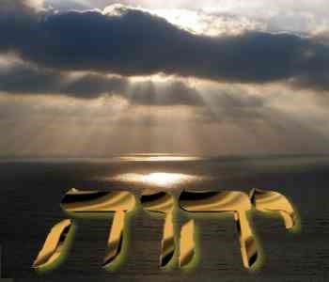
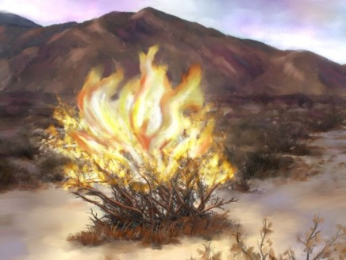
Identified As Jehovah
The God of the Old Testament
Hebrewיְהֹוָה
יהוה YHWH—proper name of God of Israel
This vocalization has been transliterated as "Yehowah", while YHWH itself has been transliterated as "Yahweh".
D&C 110:4 Wikipedia

Slide 9
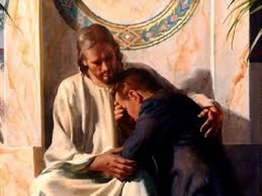
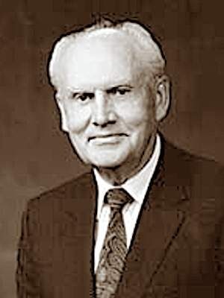
To Be Clean Before Me
To Be Clean--He whose sins are forgiven
But that ye may know that the Son of man hath power on earth to forgive sins,
Matthew 9:6
“It is evident to each of us that we cannot live in this world and be surrounded by its negative influences and remain untouched.
There is a spirit of evil that can creep into our thoughts and hearts and that will tend to cloud our vision and the reception of spiritual guidance.”
Gerald E. Melchin
D&C 110:5

Slide 10
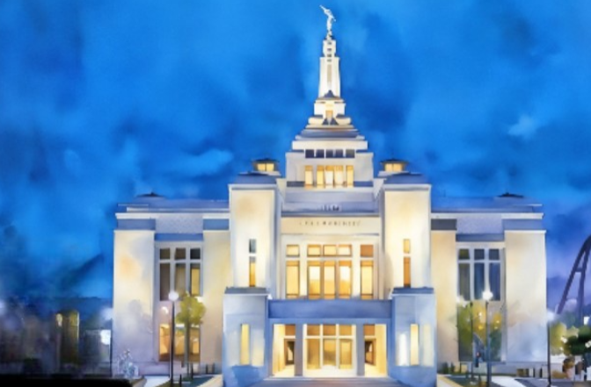
If we keep the commandments and strive to be clean before the Lord, He will manifest Himself to us in His temple.
Sapporo Japan Temple

Slide 11
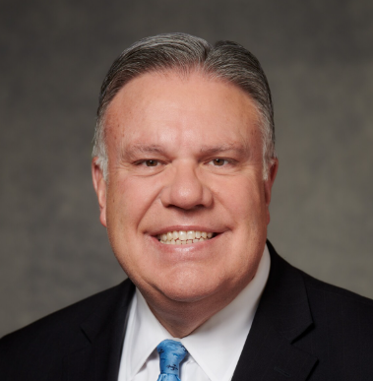
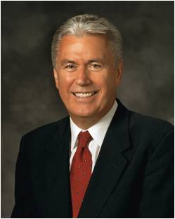

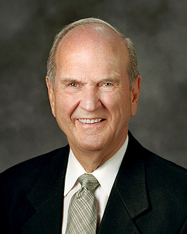
Clean and Worthy
God’s message is that worthiness is not flawlessness.
Worthiness is being honest and trying.
“God does not need people who are flawless. He seeks those who will offer their ‘heart and a willing mind’
Elder Dieter F. Uchtdorf
… When you bring your temple recommend, a contrite heart, and a seeking mind to the Lord’s house of learning, He will teach you.
Russell M. Nelson
Bradley R. Wilcox

Slide 12
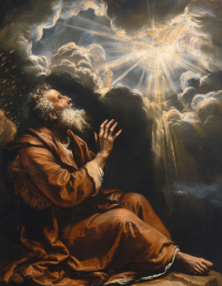
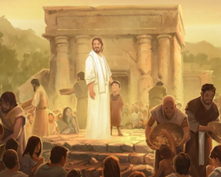
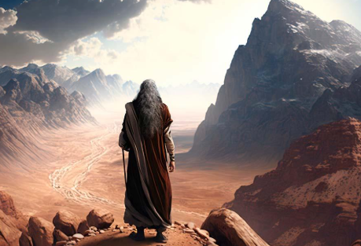
Other Visits From the Lord
3 Nephi 11:8-10
Isaiah 6:1-9
Ether 3:1-16;
Moses 1 1-4
Lamont Jones

Slide 13
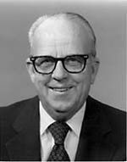
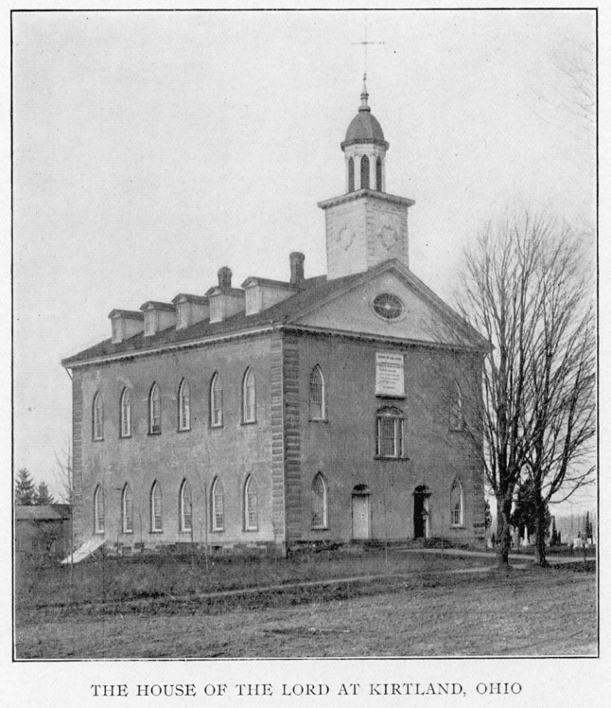
The Lord Accepted This House
“The Saints did all the work they could on the building, and then went out and obtained work here and there, and with the money they earned they purchased those things that were necessary for its completion.
It was done by sacrificing all that they had; and when we had done all that we could do, Oh! how joyous it was to know the Lord accepted the work, when He stood upon the breastwork of the Temple, conversed with the Prophet Joseph and Oliver, and revealed to them their duties, and informed them that the Gospel should go from there and be preached throughout the nations of the earth.”
Elder Franklin D. Richards
If we obey the Lord’s commandments and keep His house pure, He will manifest Himself to us in His temples
D&C 110:7-10

Slide 14
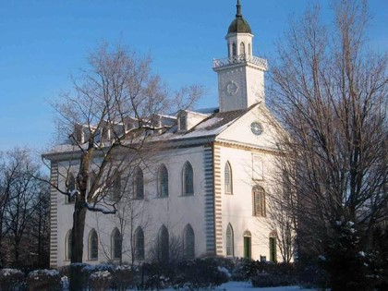
A Polluted Temple
After the Saints left Ohio, the dissenters of the Church, such as Warren Parrish and others, too control of the Kirtland Temple in 1838
“It is not a sacred temple today—not by any means. It is no more a temple than an adobe building, and is not recognized by the Lord any more. It fill the measure of its creation, then fell into the hands of wicked men, and the Lord ceased to consider that building a house built unto his name.”
See D&C 124
Joseph Fielding Smith
D&C 110:8

Slide 15

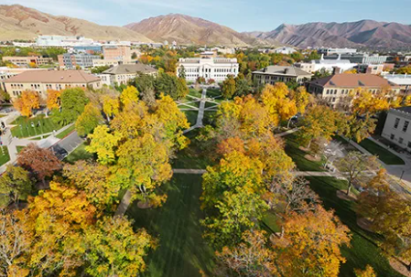
A Sacred Place
Because a temple is sacred, the Lord asks that it be protected from desecration. Anyone may enter who is willing to prepare well for that privilege.
The concept of preparation prevails in other fields of endeavor.
I remember when I was but a young boy, I told my parents I wanted to attend the university.
They said I could, but only if I worked hard in preliminary schooling and met all the requirements for admission to the university.
Similarly, we must qualify for admission to the temple. We prepare physically, intellectually, and spiritually. Eligibility is determined individually for each person applying for a recommend. …

Slide 16
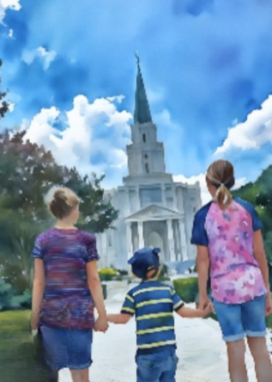
Enter the Temple As A Guest
… The requirements are simple. Succinctly stated, an individual is required to keep the commandments of Him whose house it is. He has set the standards. We enter the temple as His guests.
Russell M. Nelson

Slide 17
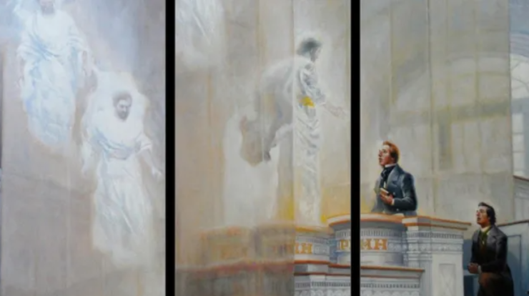
Heavens Open Again
After the vision of Jesus Christ in the Kirtland Temple on April 3, 1836, “the heavens were again opened” to Joseph Smith and Oliver Cowdery.
Three ancient prophets appeared and committed essential priesthood keys to them.
D&C 110:11

Slide 18
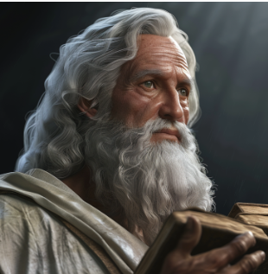
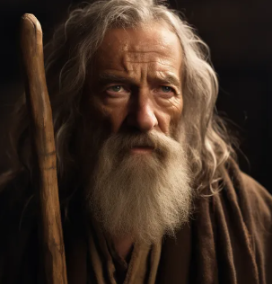
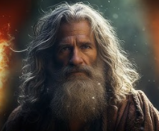
Heavens Open Again
Doctrine and Covenants 110:11
Doctrine and Covenants 110:12
Doctrine and Covenants 110:13
Moses
Abraham
Elijah
Gathering Israel
Dispensation of gospel of Abraham and restoration of the Abrahamic Covenant
Restored the sealing keys for families to be sealed in the temple
D&C 110:11

Slide 19
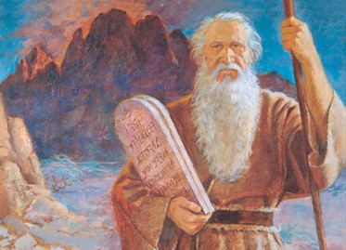
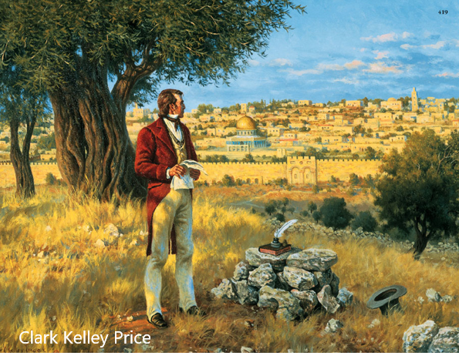
Key To Gathering Israel
“Moses held the keys of the gathering of Israel. He led Israel out of Egypt into the land of Canaan. It was his appointment in this dispensation to come and restore those keys for the modern gathering”
Joseph Fielding Smith
Soon after this vision in the Kirtland Temple, the Prophet Joseph Smith exercised these keys to begin gathering Israel from all parts of the world.
For example, in 1837 Elder Heber C. Kimball, Elder Orson Hyde, and other missionaries were sent to England, where they helped gather nearly 2,000 souls to the restored Church of Jesus Christ through their preaching.
D&C 110:11

Slide 20
Missionary Work
“Missionary work is crucial to the gathering of Israel. … In many nations our missionaries have searched for those of scattered Israel”
Elder Russell M. Nelson
How does missionary work prepare people for the Lord’s Second Coming?
How does the promise of eternal marriage and families prepare people for the Lord’s Second Coming?
How does temple work prepare people for the Lord’s Second Coming?
The keys of missionary work, eternal families, and temple work help us to prepare for the Lord’s Second Coming
D&C 110:11

Slide 21
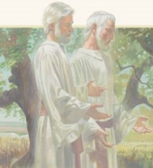
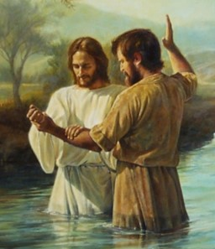
Who Was/Is Elias
Elias is the New Testament (Greek) form of Elijah (Hebrew)
In these instances, Elias was the ancient prophet Elijah whose ministry is recorded in 1 and 2 Kings.
And, behold, there appeared unto them Moses and Elias talking with him.
Then answered Peter, and said unto Jesus, Lord, it is good for us to be here: if thou wilt, let us make here three tabernacles; one for thee, and one for Moses, and one for Elias.
Matthew 17:3-4
Elias was a man subject to like passions as we are, and he prayed earnestly that it might not rain: and it rained not on the earth by the space of three years and six months.
James 5:17
Elias is also a title for one who is a forerunner. For example, John the Baptist was an Elias because he was sent to prepare the way for Jesus
…That Elias is come already, and they knew him not, but have done unto him whatsoever they listed. Likewise shall also the Son of man suffer of them.
Then the disciples understood that he spake unto them of John the Baptist. Matthew 17:12-13
D&C 110:12 Guide to the Scriptures

Slide 22
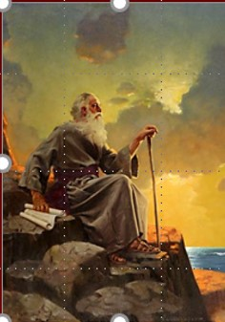
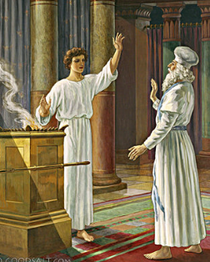
Elias Who Lived in the Days Of Abraham
The title Elias has also been applied to others who had specific missions to fulfill, such as John the Revelator
…little book which was eaten by John, as mentioned in the 10th chapter of Revelation? A. We are to understand that it was a mission, and an ordinance, for him to gather the tribes of Israel; behold, this is Elias, who, as it is written, must come and restore all things.
D&C 77:14
And the angel answering said unto him, I am Gabriel, that stand in the presence of God; and am sent to speak unto thee, and to shew thee these glad tidings.
Luke 1:19 (to Zacharias)
Gabriel
D&C 110:12 Guide to the Scriptures

Slide 23
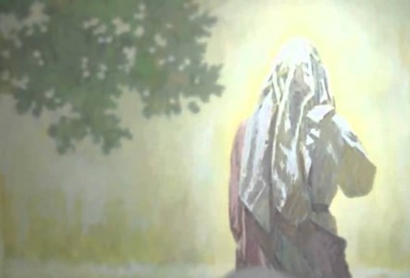
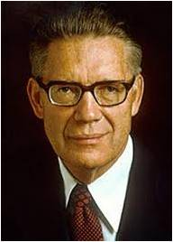
Dispensation of the Gospel of Abraham
Celestial Marriage and Eternal Posterity
“Elias brings back ‘the gospel of Abraham,’ the great Abrahamic covenant whereby the faithful receive promises of eternal increase, promises that through celestial marriage their eternal posterity shall be as numerous as the sands upon the seashore or as the stars in heaven for multitude. Elias gives the promise—received of old by Abraham, Isaac, and Jacob—that in modern men and in their seed all generations shall be blessed. And we are now offering the blessings of Abraham, Isaac, and Jacob to all who will receive them”
Elder Bruce R. McConkie
D&C 110:12

Slide 24
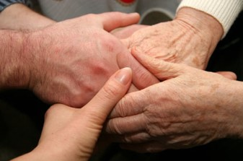
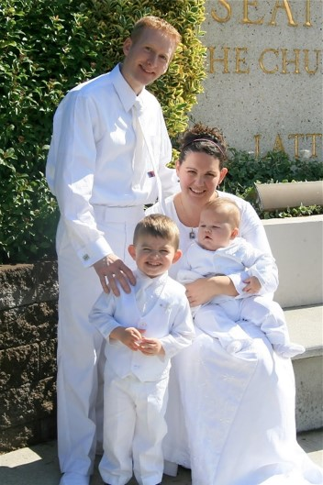
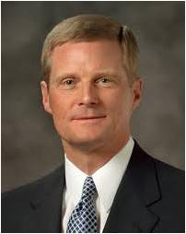
The Keys of This Dispensation
Sealing power, including temple and family history work
“This sealing power bestowed upon Elijah, is the power which binds husbands and wives, and children to parents for time and eternity. It is the binding power existing in every Gospel ordinance. … It is by this power that all the ordinances pertaining to salvation are bound, or sealed, and it was the mission of Elijah to come, and restore it.”
President Joseph Fielding Smith
“As members of Christ’s restored Church, we have the covenant responsibility to search out our ancestors and provide for them the saving ordinances of the gospel. … For these reasons we do family history research, build temples, and perform vicarious ordinances.
For these reasons Elijah was sent to restore the sealing authority that binds on earth and in heaven.”
Elder David A. Bednar
D&C 110:13-16

Slide 25
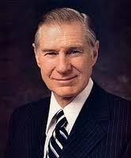
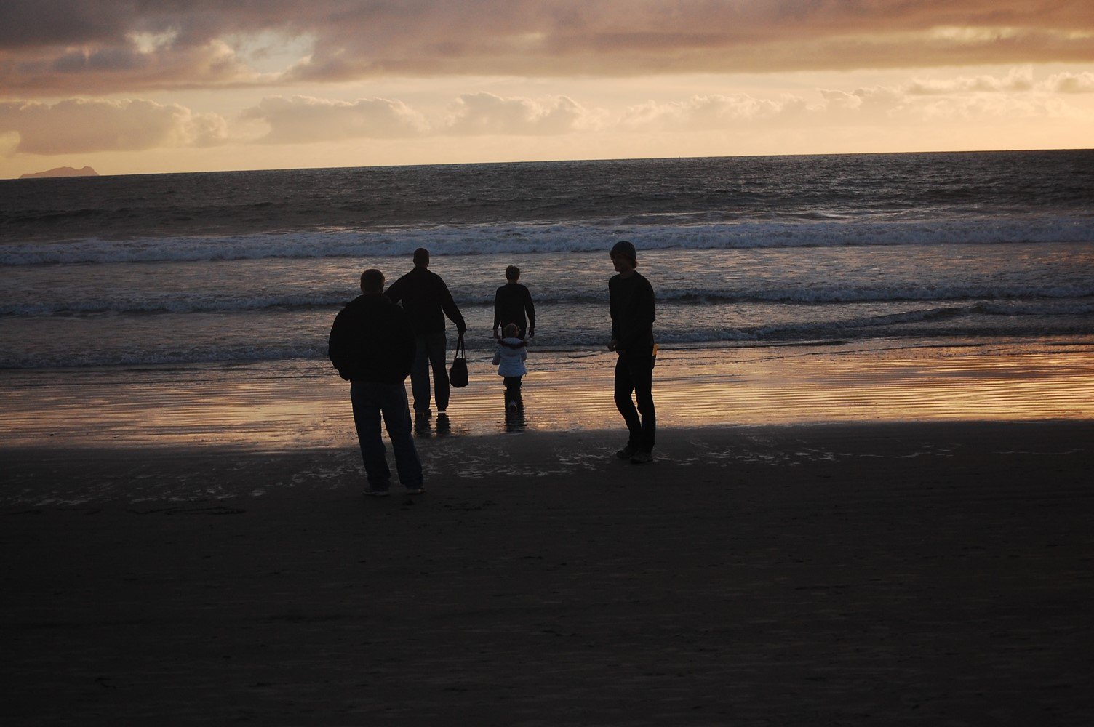
“Malachi said that the power of Elijah would turn the hearts of the fathers and the children to each other.
The heart is the seat of the emotions and a conduit for revelation. This sealing power thus reveals itself in family relationships, in attributes and virtues developed in a nurturing environment, and in loving service. These are the cords that bind families together” President James E. Faust

Slide 26

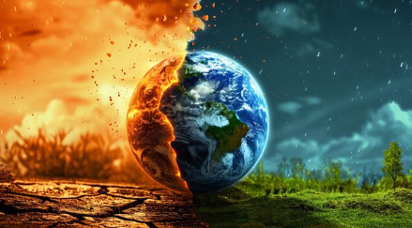
Before the Great and Dreadful Day
Great: A day that will be good and desirable for the righteous
Dreadful: a day that will be destructive for the wicked
Behold, I will send you Elijah the prophet before the coming of the great and dreadful day of the Lord:
And he shall turn the heart of the fathers to the children, and the heart of the children to their fathers, lest I come and smite the earth with a curse.
Malichi 4:5-6
D&C 110:14-16

Slide 27
Sources:
Videos:
Priesthood Keys Restored in Kirtland Temple (2:12)
Their Hearts Are Bound To You(3:15)
“Jesus Christ Appears in the Ancient Americas” from time code 11:52 to 14:05.
Hope of Israel (1:01:34)
Joseph Fielding Smith Church History and Modern Revelation, 2:46, Vol. 3 pp. 78,84; 2 vols. [1953], 2:48
Doctrines of Salvation 2:242-43
Elijah the Prophet and His Mission [1957], 5
Joseph Smith (History of the Church, 2:434–35.)
Doctrine and Covenants Student Manual Religion 324-325 Section 110
Joseph Fielding McConkie and Craig J. Ostler Revelations of the Restoration pg. 885
Elder Bruce C. Hafen The Value of the Veil June 1977 Ensign
Presentation by ©http://fashionsbylynda.com/blog/
Oliver Cowdery (Arrington, p. 426). BYU Studies Author: Anderson, Richard Lloyd
John Murdock quoted in Anderson Joseph Smith's Kirtland, 109-10 (McConkie and Ostler’s book pg. 885
Gerald E. Melchin “Thy Sins Are Forgiven” January 1995 Ensign
Elder Franklin D. Richards (In Conference Report, Apr. 1898, p. 17.)
Elder Russell M. Nelson (“The Gathering of Scattered Israel,” Ensign or Liahona, Nov. 2006, 81).
Illustration of John the Revelator © Review and Herald Publ. Assoc… also Posted in Daily Photos & Art
Elder Bruce R. McConkie(“The Keys of the Kingdom,” Ensign, May 1983, 22).
” Elder David A. Bednar (“The Hearts of the Children Shall Turn,” Ensign or Liahona, Nov. 2011, 25–26).
President James E. Faust (“Father, Come Home,” Ensign, May 1993, 37).
Presentation by ©http://fashionsbylynda.com/blog/

Slide 28
More Sources:
(Bradley R. Wilcox, “Worthiness Is Not Flawlessness,” Liahona, Nov 2021, 62, 67)
(Russell M. Nelson, “The Temple and Your Spiritual Foundation,” Liahona, Nov. 2021, 93–95; “Prepare for the Blessings of the Temple,” Ensign or Liahona, Oct. 2010, 42–43)

Slide 29
Keys Restored to Joseph Smith and Oliver Cowdery
 | D&C 110:11 | Elias D&C 110:12 | Elijah D&C 110:13–16
Priesthood keys restored | The keys of the gathering of Israel | The dispensation of the gospel of Abraham | The keys of this dispensation
What these keys direct | Missionary work | Celestial marriage and eternal posterity | Sealing power, including temple and family history work

Slide 30
Keys Restored to Joseph Smith and Oliver Cowdery
 | D&C 110:11 | Elias D&C 110:12 | Elijah D&C 110:13–16
Priesthood keys restored
What these keys direct

Slide 31
The Passover feast centered on the paschal lamb, which was a sacrificial lamb, a male without blemish and with no broken bone, even after death. (See Ex. 12:5, 46.) Likewise, Jesus was the "Passover," the "Lamb of God" (1 Cor. 5:7; John 1:29), a male without blemish and with no broken bone, even after death (John 19:36). He was the Firstborn of God in the premortal existence (D&C 93:21), sanctified in the flesh as were the firstborn of Israel (Ex. 12:23-24), and slain even as were the firstborn of Egypt (Ex. 12:29).
The Passover lamb was to be chosen on 10 Nisan, the tenth day of the Jewish lunar month Nisan. It was to be killed by "the whole assembly of the congregation of Israel" on 14 Nisan (Ex. 12:6), which was usually the day of the first full moon of spring. Jewish sources state that the lamb was sacrificed between 3:00 and 5:00 P.M. on that day.
Jesus, too, was "chosen" on 10 Nisan at his triumphal entry into Jerusalem, when he was hailed as the Messiah (see Matt. 21:1-9; Mark 11:1-11; Luke 19:37-40; John 12:12-16), which had been prophesied by Zechariah (Zech. 9:9). The multitude who had assembled in Jerusalem for Passover later consented to his death when they "all" cried out on 14 Nisan, "Let him be crucified." (Matt. 27:20-23.) The Lamb of God died about 3:00 P.M. (Matt. 27:46) on the day of preparation for Passover (John 19:14), 14 Nisan, just when the paschal lambs were also being slain.
Of course, at the triumphal entry the multitude did not understand that they were choosing the Lamb of God to sacrifice, but believed they were choosing a king (Luke 19:38) whom they expected to liberate them from Roman rule. And at the Crucifixion they were unaware that they were sacrificing the Lamb of God, but believed they were slaying an imposter who could not even save his own life. (Matt. 27:41-44.)
The preparation of the lamb for the feast had to be hurriedly completed before sunset, after which would begin the first day of Passover, 15 Nisan, a day sanctified as a special Sabbath day. After sunset, the lamb was eaten with bitter herbs, unleavened bread, and wine. This ritualized Passover meal was also called the feast of unleavened bread; it began a week in which no leavened bread was eaten, symbolic of the haste of preparation which did not allow enough time for bread dough to rise. (Ex. 12:18-20, 34, 39; Lev. 23:6-8.)
Likewise, the body of Jesus had to be hurriedly prepared for burial before the sunset would commence the Sabbath, which would be a "high day" (John 19:31) because it was not only Saturday, the weekly Sabbath, but also 15 Nisan, the first day of Passover.
It was on 15 Nisan, after the slaying of the first-born, that Pharaoh declared liberty to the captive Israelites. After their long period of bondage in Egypt, it must have been a day of great rejoicing. One reason that 15 Nisan was sanctified as an annual feast day was to commemorate that day on which the Lord brought Israel out of bondage and released them from the chains of slavery. (See Ex. 12:14-17, 29-31; 13:3, 14-15.)
Similarly, on 15 Nisan A.D. 33, the Passover feast day, the Savior declared liberty to the captives in the spirit prison after their long period of bondage. (See D&C 138:18, 31, 42.) Before the Savior arrived, they had been "assembled awaiting the advent of the Son of God into the spirit world, to declare their redemption from the bands of death." In fact, they were already "rejoicing in the hour of their deliverance from the chains of death." (D&C 138:16, 18.) The fact that they were assembled, rejoicing in the hour of their deliverance, suggests that they expected his arrival on the Passover feast day, the day of liberation.
The law of Moses states that "on the morrow after the sabbath" of Passover, the priest should wave before the Lord a sheaf of the firstfruits of the harvest. (See Lev. 23:10-12.) On Easter Sunday, 16 Nisan, the morning after the Jewish Sabbath, the Savior, through his resurrection, became "the firstfruits of them that slept." (1 Cor. 15:20, 36-38.) Jesus had already taught that he was like a kernel of grain which must abide alone until it dies in the ground, whereupon it can bring forth much fruit. (See John 12:23-24.) Lehi also explained that the Savior, "being the first that should rise . . . is the firstfruits unto God, inasmuch as he shall make intercession for all the children of men; and they that believe in him shall be saved." (2 Ne. 2:8-9.)
Thus, the carefully prescribed elements of the Passover ceremony precisely foreshadowed both the events of the Atonement and the time each would occur. The annual sacrifice of the paschal lamb on 14 Nisan was not only in remembrance of the Israelites' having been saved by the blood of the lamb on the houses in Egypt (Ex. 12:13), it was also anticipating the 14 Nisan when the great sacrifice of the Lamb of God would occur. The feast on 15 Nisan celebrated not only the liberation of the captives of Egypt; that day would also be the time of even more rejoicing when the Savior would declare liberation to the captives in the spirit prison. And the third day, 16 Nisan, was not only the time when the firstfruits of the harvest of barley were presented to the Lord, it was also the glorious day of the Resurrection ­the firstfruits of the harvest of souls.
http://www.johnpratt.com/items/docs/lds/easter/elijah.html

Slide 32
A Polluted Temple: Lorenzo Snow Biography
Warren Parrish, who had been a humble, successful preacher of the Gospel, was the ringleader of this apostate party. One Sabbath morning, he, with several of his party, came into the Temple armed with pistols and bowie-knives, and seated themselves together in the Aaronic pulpits, on the east end of the Temple, while Father Smith and others, as usual, occupied those of the Melchizedek Priesthood on the west. Soon after the usual opening services, one of the brethren on the west stand arose, and just after he commenced to speak, one on the east interrupted him. Father Smith, presiding, called order—he told the apostate brother that he should have all the time he wanted, but he must wait his turn—as the brother on the west took the floor and commence first to speak, he must not be interrupted. A fearful scene ensued—the apostate speaker becoming so clamorous, that Father Smith called for the police to take that man out of the house, when Parrish, John Boynton, and others, drew their pistols and bowie-knives, and rushed down from the stand into the congregation; J. Boynton saying he would blow out the brains of the first man who dared to lay hands on him. Many in the congregation, especially women and children, were terribly frightened—some tried to escape from the confusion by jumping out of the windows. Amid screams and shrieks, the policemen, in ejection the belligerents, knocked down a stovepipe, which fell helter-skelter among the people; but, although bowie-knives and pistols were wrested from their owners, and thrown hither and thither to prevent disastrous results, no one was hurt, and after a short, but terrible scene to be enacted in a Temple of God, order was restore, and the services of the day proceeded as usual.
But the next day Father Smith, and sixteen others, were arrested on complaint of the apostate party, charged with riot, and bound over for their appearance in court to answer to the charge. With other, I was subpoenaed as a witness, and I found the court scene as amusing as the Temple scene was appalling. (cited in Smith, Biography and Family Record of Lorenzo Snow)
Fame of the Temple:
President Boyd K. Packer of the Quorum of the Twelve Apostles explained:
“[In 1836] the Lord prophesied that the ‘fame of this house shall spread to foreign lands.’ (D&C 110:10.) That, under the circumstances then existing, was at best improbable. The Church members were but a handful of Saints living and scattered in the rural areas of a new land. But despite the persecution and struggles and trials of those early days, there are congregations now spread literally across the world, and tens of thousands of missionaries bear witness at every door where they are welcome” (The Holy Temple [1980], 135).
“The spirit of Elias is first, Elijah second, and Messiah last. Elias is a forerunner to prepare the way, and the spirit and power of Elijah is to come after, holding the keys of power, building the Tempe to the capstone, placing the seals of the Melchizedek Priesthood upon the house of Israel, and making all things ready; then Messiah comes to His Temple, which is last of all. Messiah is above the spirit and power of Elijah, for He made the world, and was the spiritual Rock unto Moses in the wilderness. Elijah was to come and prepare the way and build up the kingdom before the coming of the great day of the Lord, although the spirit of Elias might begin it.”
Joseph Smith History of the Church Vol. VI p. 254

Slide 33
Worth and Worthiness:
Let me point out the need to differentiate between two critical words: worth and worthiness. They are not the same. Spiritual worth means to value ourselves the way Heavenly Father values us, not as the world values us. Our worth was determined before we ever came to this earth. “God’s love is infinite and it will endure forever.”
On the other hand, worthiness is achieved through obedience. If we sin, we are less worthy, but we are never worth less! We continue to repent and strive to be like Jesus with our worth intact. As President Brigham Young taught: “The least, the most inferior spirit now upon the earth … is worth worlds.” No matter what, we always have worth in the eyes of our Heavenly Father. (Joy D. Jones, “Value beyond Measure,” Ensign or Liahona, Nov. 2017, 14)
Seeing More of Jesus in Your Life:
As covenant children of God, we have been uniquely blessed with a rich supply of divinely appointed tools to improve our spiritual vision. The words and teachings of Jesus Christ as recorded in scripture and messages from His chosen prophets and His Spirit received through daily prayer, regular temple attendance, and the weekly ordinance of the sacrament can help to restore peace and provide the necessary gift of discernment that brings Christ’s light and His understanding to the corners of our life and in a world that may be cloudy. The Savior can also be our compass and our pilot as we steer through both the calm and the turbulent waters of life. He can make plain the correct path that leads us to our eternal destination. So what would He have us see, and where would He have us go? (Tracy Y. Browning, “Seeing More of Jesus Christ in Our Lives,” Liahona, Nov. 2022, 13–14)
D&C 110:11
When we speak of gathering Israel on both sides of the veil, we are referring, of course, to missionary, temple, and family history work. We are also referring to building faith and testimony in the hearts of those with whom we live, work, and serve. (Russell M. Nelson, “Let God Prevail,” Ensign or Liahona, Nov. 2020, 92)
D&C 11:12:
The covenant God made with Abraham … contained several promises, including … all nations of the earth would be blessed by his seed. …
… We have received, as did they of old, the holy priesthood and the everlasting gospel. We have the right to receive the fulness of the gospel, enjoy the blessings of the priesthood, and qualify for God’s greatest blessing—that of eternal life. (Russell M. Nelson, “Covenants,” Ensign or Liahona, Nov. 2011, 87–88)
D&C 110:13:
Sealing keys, restored by the Old Testament prophet Elijah, enable ordinances to take place in holy temples. Ordinances performed in these temples enable individuals and families to return to the presence of our heavenly parents. (Gary E. Stevenson, “Where Are the Keys and Authority of the Priesthood?,” Ensign or Liahona, May 2016, 31)

