Slide 1
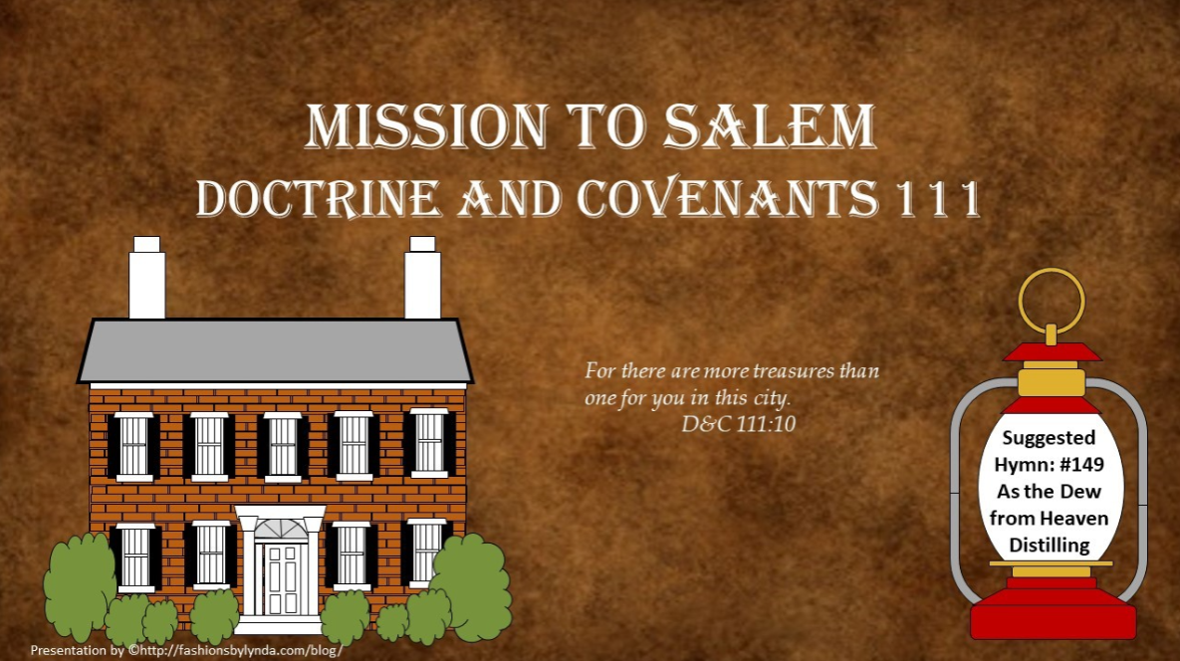

Slide 2

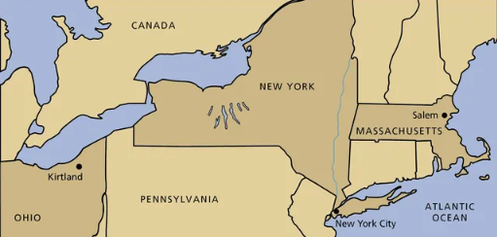
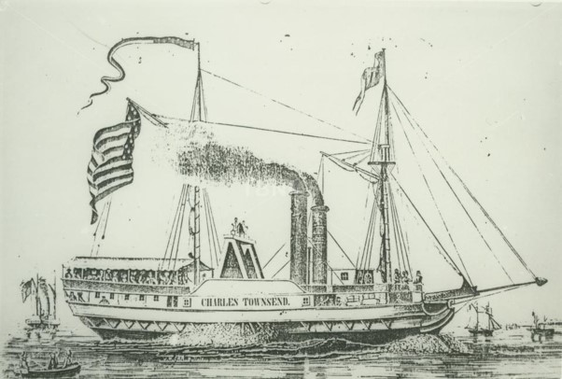
Background
July 25, 1836
In 1836, the Church was deeply in debt. The Prophet Joseph Smith and other Church leaders traveled to Salem, Massachusetts, where they hoped to obtain money to pay the Church’s debts.
Joseph Smith, Hyrum Smith, Sidney Rigdon, and Oliver Cowdery left Kirtland on the Charles Townsend steamer bound for the east…and then onto Salem, Massachusetts.
In August while in Salem, Massachusetts Joseph Smith received a revelation recorded in Doctrine and Covenants 111
HC

Slide 3

Church Debt
D&C 104:78
In the summer of 1836, Joseph Smith and other Church leaders were experiencing concern over the Church’s finances. In the preceding years, the Church had incurred a large amount of debt as Church leaders had obeyed the Lord’s commands to build the Kirtland Temple, purchase lands in Ohio and Missouri, and fund Zion’s Camp. The Church also needed funds to buy land for the Saints in Missouri who had been forced from their homes.
In 1834, the Lord had instructed Joseph Smith and other Church leaders to “pay all [their] debts”
However, their efforts to pay these debts had been hampered by the loss of income-producing businesses in Missouri. Thus, Church leaders did not have sufficient funds to meet the demands of the Church’s creditors.
HC

Slide 4
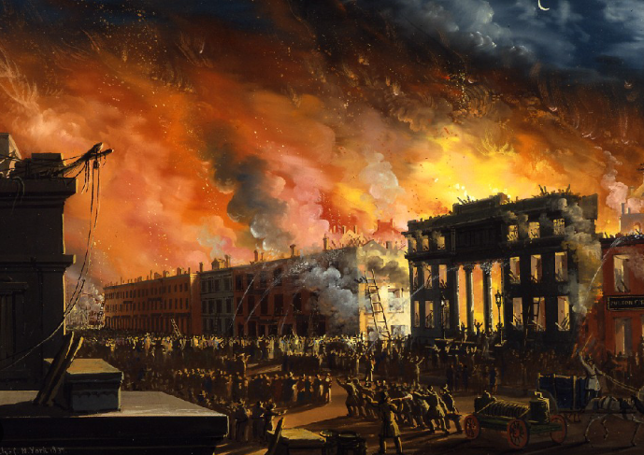
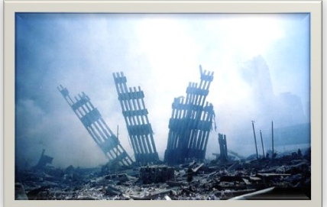
New York—The Last Days
July 30, 1836
Reported that the cause of the fire was a gas pipe that had burst and ignited by a coal stove.
17 blocks of the city had been destroyed and between 530 and 700 buildings. The estimated damage at the time is valued at twenty million dollars, and twenty people were also killed. (The Great Fire of New York-1835)
Wikipedia
"While here I visited the burnt district-that part of the city where it was estimated fifteen millions of property were consumed by fire on the 16th of December 1835”. . . .
Joseph noted the prophecies of the ancient Prophets
And I will shew wonders in heaven above, and signs in the earth beneath; blood, and fire, and vapour of smoke:
Acts 2:19
HC
9/11/2001

Slide 5
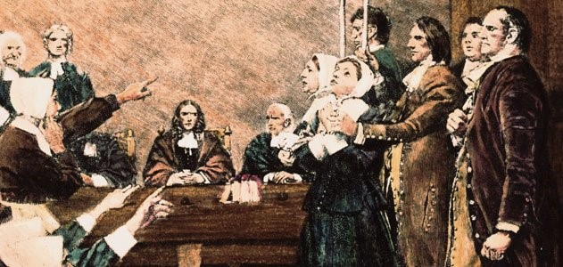
Salem, Massachusetts
August 1836 Joseph writes his feelings about Salem
"The early settlers of Boston (the Emporium of New England), who had fled from their mother country to avoid persecution and death, soon became so lost to principles of justice and religious liberty as to whip and hang the Baptist and the Quaker, who, like themselves, had fled from tyranny to a land of freedom; and the Fathers of Salem from 1691 to 1693, whipped, imprisoned, tortured, and hung many of their citizens for supposed witchcraft;…”
HC

Slide 6


Follies—Honest Mistakes
“Folly—could be described as an honest mistake, an unwise decision, or a sincere error in judgment”
Otten and Caldwell
God is merciful with our follies
“A merciful God overlooks the follies of His children, when the motives are pure…
The Lord assured them that He was not displeased with them.”
Smith and Sjodahl
D&C 111:1

Slide 7
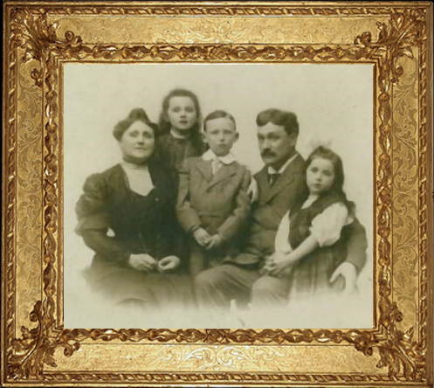
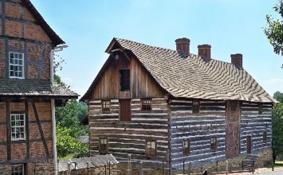
Treasure in the City
While the reason for their trip is not certain, they may have been acting on information they thought could help them relieve the debt of the Church. One account states that a Church member had told Joseph Smith about a house in Salem in which was hidden a large amount of money.
(Joseph Smith Papers)
“The hidden treasure in Salem, that which is of greatest worth to god, was his children.”
McConkie and Ostler
The most valuable treasure on this earth is the soul of a man. Apparently, Joseph Smith had allowed his concern for the church’s financial need to, momentarily , take precedence.
Priorities were reestablished by the Savior
For the Lord hath chosen Jacob unto himself, and Israel for his peculiar treasure.
Psalm 135:4
D&C 111:1-2

Slide 8
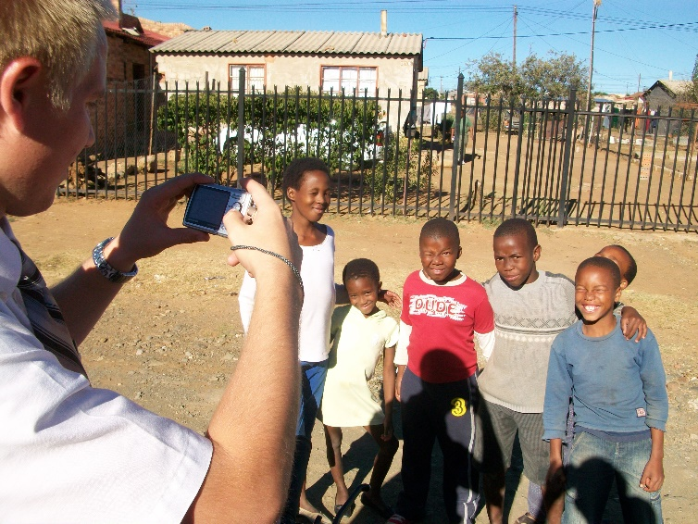
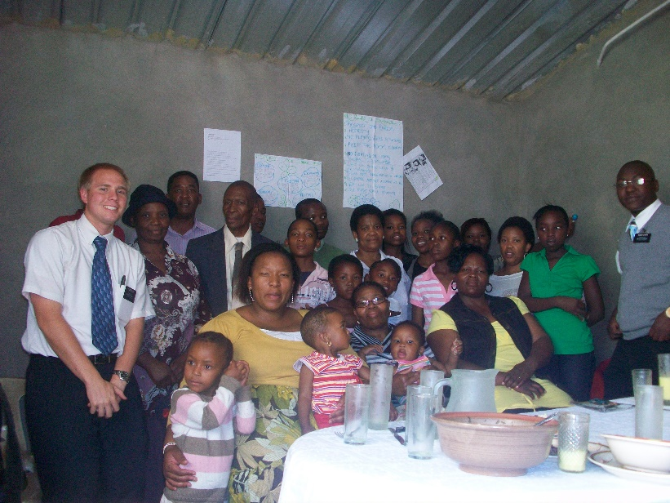
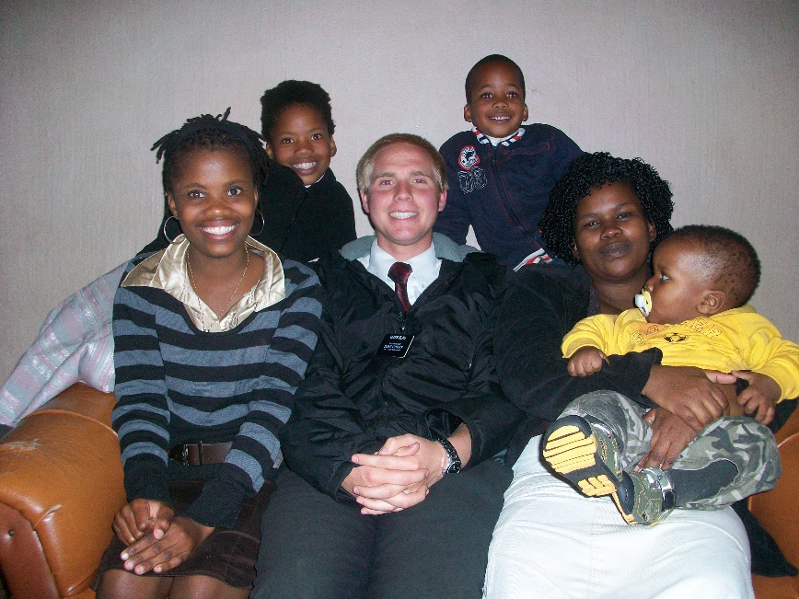
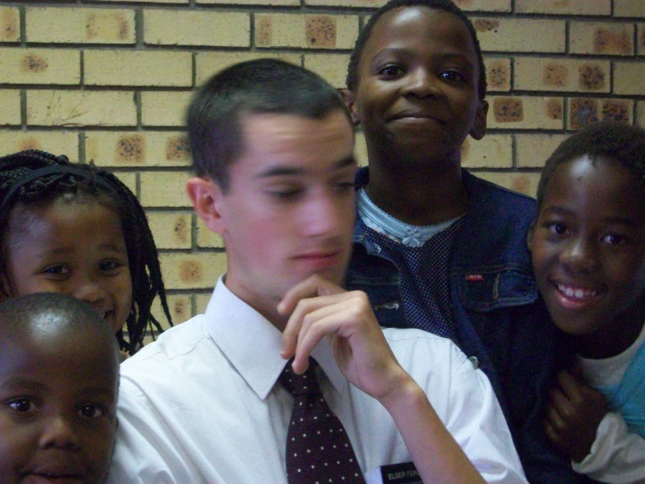
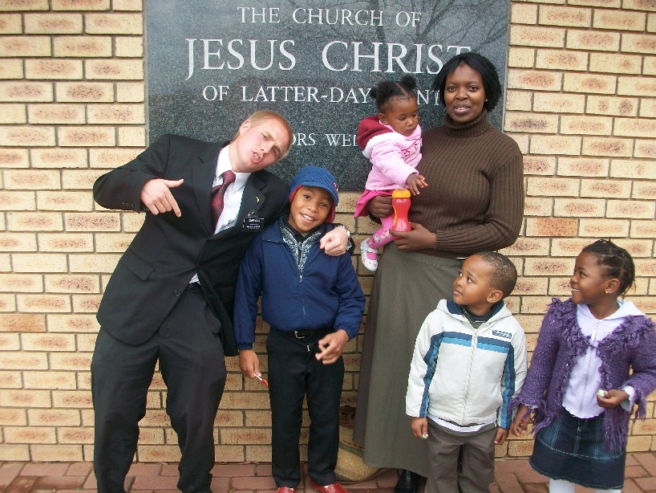
Form Acquaintances
“A successful missionary has the faculty of making friends.”
Smith and Sjodahl
D&C 111:3

Slide 9

A Quick Fix
The leaders of the Church may have seen the rumors of treasure in Salem as a quick answer to their prayers and sincerely desired a quick end to their troubles. However, the path to overcoming difficulty often requires extended effort and sacrifice over a long period of time.
Quick fixes for our problems are rare—problems are normally overcome with sustained effort and the assistance of the Lord.
Secret Parts
A Hebrew idiom for being publicly. The brethren may have been worried about embarrassment linked to the failure of their plan to find treasure in Salem. In context, the journey to Salem demonstrates the sincere desire of Joseph and the other leaders to follow the Lord’s command to pay their debts (D&C 104:78) and deal justly with their creditors.
Concern not yourselves about your debts, for I will give you power to pay them.
Therefore the Lord will smite with a scab the crown of the head of the daughters of Zion, and the LORD will discover their secret parts.
Isaiah 3:17
D&C 111:4-5 Casey Paul Griffiths

Slide 10
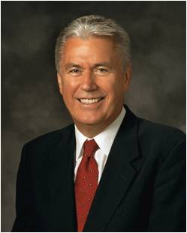

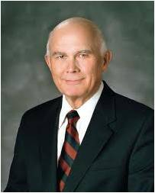
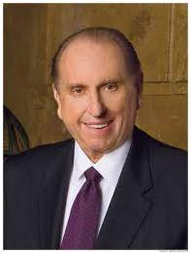
Concern Not…
DEBT
ZION
“Pause for a moment and check where your own heart and thoughts are. Are you focused on the things that matter most? How you spend your quiet time may provide a valuable clue. Where do your thoughts go when the pressure of deadlines is gone? Are your thoughts and heart focused on those short-lived fleeting things that matter only in the moment or on things that matter most?”
President Dieter F. Uchtodorf
“What is important in the end is what we have become by our labors.”
Elder Dallin H. Oaks
“Find joy in the journey—now.”
Thomas S. Monson
D&C 111:5-6

Slide 11
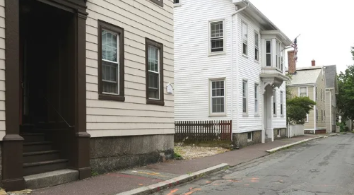
Where to Stay?
They rented a house, preached publicly, and went from house to house to teach the gospel.
When did the Lord say He would gather out the people He had in Salem?
In due time
D&C 111:7-9

Slide 12
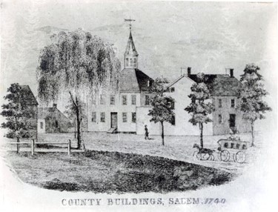
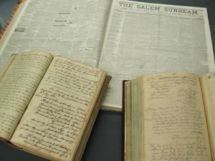
The County Seat
“At Salem, the County seat of Essex County, Massachusetts, the records for all the towns in the county were kept.”
Smith and Sjodahl
Robert Smith, the first of the Prophet Joseph Smith’s family in America, had settled in Massachusetts. Also, many of the ancestors of the Saints had originated in the new found colonies
D&C 111:8-9

Slide 13
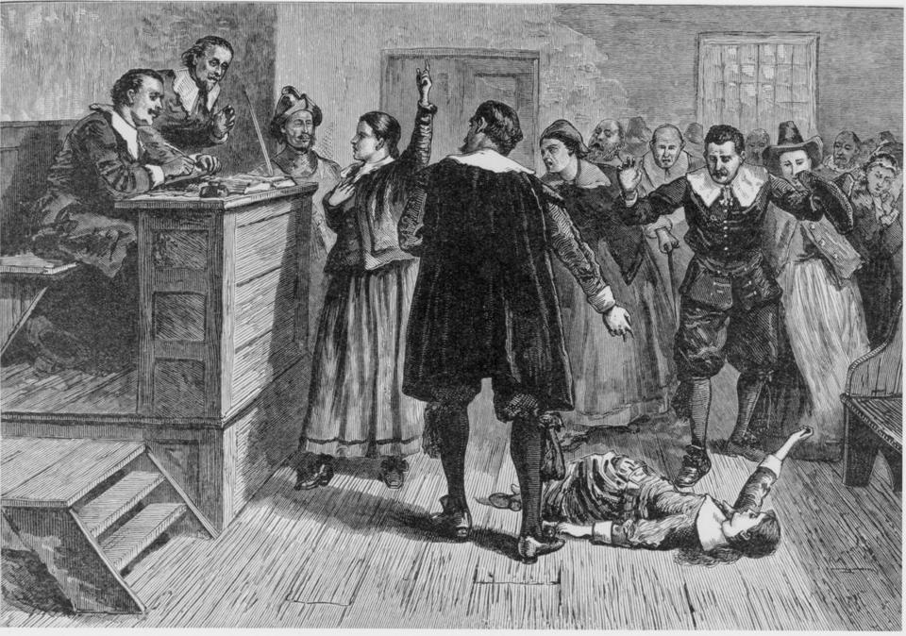
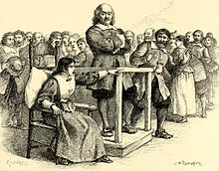
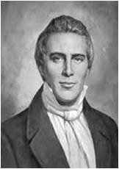
Persecution
They visited historical sites while they were in Salem. From these visits they learned that some residents of Salem, Massachusetts, and the surrounding New England area had been persecuted and killed as a result of religious intolerance and bigotry.
“When will man cease to war with man, and wrest [or take] from him his sacred rights of worshiping his God according as his conscience dictates?”
Later, the Prophet reiterated the importance of allowing all people to exercise the right of religious liberty.
See Articles of Faith 1:11
D&C 111:9 HC

Slide 14
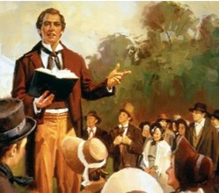
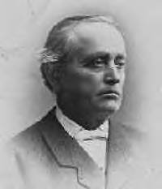
From Door to Door
There were many souls in Salem whom the Lord knew would accept the gospel. Their conversion would greatly benefit the Lord’s work because these new members of the Church would unite their efforts with those of the Saints and contribute generously to the cause of Zion.
Later entries in his journal show that Elder Snow baptized over one hundred people from the time he arrived in Salem until he returned to Nauvoo on 11 April 1843. For example, Elder Snow indicated that there were ninety members in the Salem Branch on 28 May 1842
Student Manual
Five years later, Erastus Snow was called on a mission to Salem, where he organized a branch of 120 members
Church History in the Fulness of Times Student Manual
D&C 111:10

Slide 15
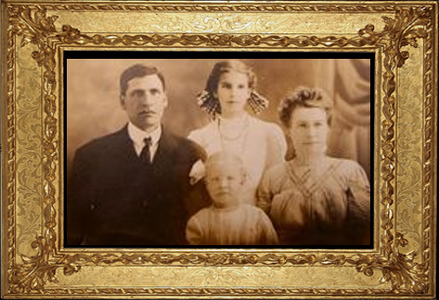
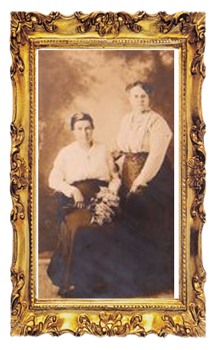
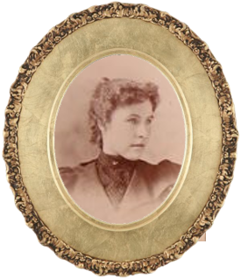
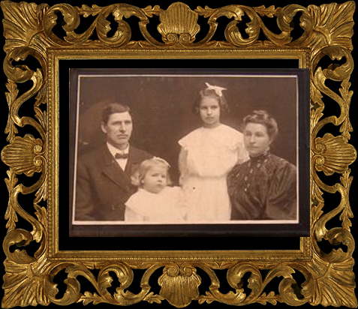
Obtaining Treasures
Although Joseph Smith and his companions did not obtain the money they thought they might find in Salem, they obtained other treasures from this journey, including treasures of knowledge.
If we are wise and avoid sin, then the Lord will arrange all things for our good
D&C 111:9-11

Slide 16



Work Together for Good
D&C 90:24
Search diligently, pray always, and be believing, and all things shall work together for your good, if ye walk uprightly and remember the covenant wherewith ye have covenanted one with another.
Romans 8:28
Romans 8:28
Therefore, let your hearts be comforted; for all things shall work together for good to them that walk uprightly, and to the sanctification of the church.
And we know that all things work together for good to them that love God, to them who are the called according to his purpose.
D&C 111:11

Slide 17
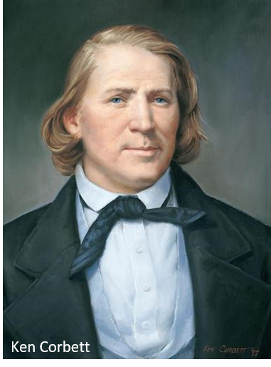
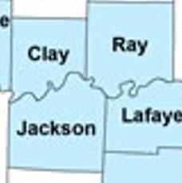
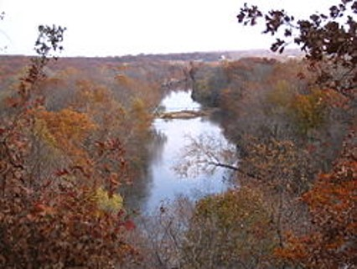
Brigham Young and L.C. Johnson
“While there, Brothers Brigham Young and L. C. Johnson arrived. Brother Young had been through New York, Vermont, and Massachusetts, in company with his brother, Joseph Young, having visited their connection in this country, and baptized a good number into the church. They staid [stayed] in Boston two or three weeks, and baptized seventeen persons. We had a good visit with the brethren, for which I feel very thankful.”
Joseph returned to Kirtland, sometime in the month of September.
During this month the church in Clay County, Missouri, commenced removing to their newly selected location on Shoal Creek, in the territory attached to Ray County

Slide 18
Brigham Young
He was born on June 1, 1801, at Whittingham, Vermont to John and Abigail “Nabby” Young
He worked as a traveling carpenter and blacksmith along with other trades
He first married Miriam Angeline Works in 1824, but later died in 1832
He was of the Methodist faith in 1823, but after reading the Book of Mormon in 1830, he officially joined the Church in 1832 and joined the Saints in Kirtland, Ohio
He was a missionary in Upper Canada, and ordained a member of the original Quorum of the Twelve Apostles in 1835
He was the successor of the Prophet Joseph Smith following the Martyrdom in 1844
Many of Young's followers would later reminisce that while Young spoke to the congregation, he looked or sounded exactly like Smith, to which they attributed the power of God
He was the leader of the exodus of the Saints from Nauvoo to the Rocky Mountains in 1846-1847, and was the founder of Salt Lake City
He was ordained the Prophet and President of the Church in December 27, 1847
The Salt Lake, St. George, and Logan Temples were under his direction, and brought the telegraph and the railroad to Utah
He died August 29, 1877

Slide 19
Sources:
I'm a Mormon, Addict Caretaker, and Voice for the Homeless (2:10)
Joseph Smith History of the Church Vol. 2 pg. 463
L.G. Otten and C.M. Caldwell Sacred Truths of the Doctrine and Covenants Vol. 2 pg. 253
Hyrum M. Smith and Janne M. Sjodahl Doctrine and Covenants Commentary pg. 728-729
Joseph Fielding McConkie and Craig J. Ostler Revelations of the Restoration pg. 896
Church History in the Fulness of Times Student Manual, 2nd ed. [Church Educational System manual, 2003], 170–71
Doctrine and Covenants Student Manual Religion 324-325 Section 111
History of the Church 2:464–65.
President Thomas S. Monson Finding Joy in the Journey Oct. 2008 Gen. Conf.
Elder Dallin H. Oaks The Challenge to Become Oct. 2000 Gen. Conf.
President Dieter F. Uchtodorf We Are Doing a Great Work and Cannot Come Down April 2009
Historical introduction to “Revelation, 6 August 1836 [D&C 111],” 35, josephsmithpapers.org.)
Casey Paul Griffiths Doctrine and Covenants Central 111:1-5
Presentation by ©http://fashionsbylynda.com/blog/
Brigham Young https://www.lds.org/churchhistory/presidents/controllers/potcController.jsp?leader=2&topic=facts
Wikipedia
Presentation by ©http://fashionsbylynda.com/blog/

Slide 20
Salem County Records:
Our Archives Room is a repository for archival volumes and documents dating from the late 1600s and newspapers dating back to the early 1800s.
The Archives houses indexes for marriages, naturalization records, Civil War soldiers and more. Historians find the Archives of great interest in their studies of Salem County.
We have records dating as far back as 1698
Birth records are kept in the Vital Statistics office of the municipality where born. Marriage Certificates are in the municipality where the marriage was held.
For those genealogy enthusiasts
http://salemcountyclerk.org/archives-room/
Ancient Inhabitants of Salem:
Elder B. H. Roberts said that the Lord’s instructions to learn about the ancient inhabitants of Salem were given, “doubtless having in view the securing of their genealogies and redemption of the past generations of men who had lived there; so that if for a moment the weakness of men was manifested in this journey, we see that fault reproved and the strength and wisdom of God made manifest by directing the attention of his servants to the real and true treasures that he would have them seek, even the salvation of men, both the living and the dead” (Comprehensive History of the Church, 1:412).
After Joseph Smith and his companions arrived in Salem, Massachusetts, they leased a house. This was not the house that supposedly had money in the cellar. It was this leased house that the Lord referred to when He said, “This place you may obtain by hire” (D&C 111:9).
D&C 111:4
“In due time the Almighty will give Salem into ‘your’ hands (vs. 4), that the Elders shall have power over it, insomuch that ‘they,’ probably meaning the people of the city, shall not discover ‘your secret parts’. (Cf. Isa. 3:17, ‘shame.’) Not only that, but also the wealth of the city, its gold and silver, shall be in possession of the brethren. This verse is obviously a prophecy of some future happening, even yet future, and evidently looks forward to a day when the Lord’s Kingdom will be established upon the earth, when towns, cities, and nations will be governed under his direction by brethren holding the Priesthood.
When that day comes, the Elders of the Church will govern even Salem without being shamed by the people of the city. Its wealth will also be theirs. The meaning here is that it will be used, not so much for their own personal desires, as for righteous purposes.” (Sperry, Compendium, pp. 609–10.)
Wise as Serpents D&C 111:11:
When the Savior sent His disciples out to preach the gospel, He told them to be “wise as serpents, and harmless as doves” (Matthew 10:16). In modern times, the Savior gave similar counsel to His disciples, declaring, “Be ye as wise as serpents and yet without sin” (D&C 111:11). Both accounts teach that the Savior’s disciples should combine wisdom with innocence and purity. The Joseph Smith Translation emphasizes the importance of being a wise servant of the Master: “Be ye therefore wise servants, and as harmless as doves” (Joseph Smith Translation, Matthew 10:14; compare Matthew 10:16). (New Testament Student Manual [2018], 36–37)
Follies D&C 111:1:
Mistakes are inevitable in the process of growth in mortality. To avoid all possibility of error is to avoid all possibility of growth. In the parable of the talents, the Savior told of a servant who was so anxious to minimize the risk of loss through a mistaken investment that he hid up his talent and did nothing with it. That servant was condemned by his master (see Matt. 25:24–30).
If we are willing to be corrected for our mistakes, … innocent mistakes can be a source of growth and progress. (Dallin H. Oaks, “Sins and Mistakes,” Ensign, Oct. 1996, 67)

Slide 21
BIOGRAPHY Erastus Fairbanks Snow
Erastus Snow, son of Levi and Lucina Snow, was born November 19, 1818, in St. Johnsbury, Vermont.
When he was fourteen years old, two missionaries from the Church of Jesus Christ of Latter-day Saints visited his family and taught them the principles of salvation as outlined by the Prophet Joseph Smith and found in the Book of Mormon. After listening to their message, most of the family (excluding the father and two sons) eventually joined the Church. Erastus Snow was baptized on February 3, 1833, by his older brother William. Erastus Snow developed a great love for the gospel and studied the scriptures diligently to become more conversant with Church doctrine. In addition to his studies, he eagerly served the Church by spending a great amount of time sharing his testimony with others.
On June 28, 1834, when 16 years old, he was ordained to the office of a Teacher in the Aaronic Priesthood and less than five months later to the office of Priest. On August 16, 1835, he was ordained an elder in the Melchizedek Priesthood and from that time forward became very active in missionary work, preaching the gospel in many part of the United State and Europe. Many people accepted Mormonism as a result of his labors.
In addition to his missionary work, Snow participated in several significant events in early Church history. In 1835, he met the Prophet Joseph Smith in Kirtland Ohio, and while there attended a special Elder's School with 300 other elders.
When persecution increased in Kirtland, he helped relocate the Church to Far West, Missouri, where he later married his first wife, Artemesia Beman, on December 3, 1838.
With the intensification of anti-Mormon persecution in Far West, the saints were forced to flee again, this time to Nauvoo. While residing in Nauvoo, Snow married a second wife, Minerve White, in January of 1846 in compliance with the doctrine of plural marriage as instituted by Joseph Smith. Later he married a third wife, Elizabeth R. Ashby, on December 19, 1847, and a fourth wife, Julia Josephine Spencer, on April 11, 1856.
Under the leadership of Brigham Young, Joseph Smith's successor, Erastus Snow and his family left their home in Nauvoo to migrate to the Great Basin where the Saints hoped to find rest from the continued persecution. In his move he organized and led various parties of the saints.
After their arrival in the Salt Lake Valley, he was called to serve in a Stake Presidency, and in 1849 he was ordained a member of the Quorum of the Twelve Apostles. As an apostle he served a mission to Denmark and was responsible for the translation of the Book of Mormon, the Doctrine and Covenants, and other Church literature into the Danish language.
After returning, he was appointed to organize and supervise the settlement of Church members in Southern Utah. He was the presiding Mormon leader during the colonization of St. George.
In these and many other assignments he served efficiently and enthusiastically until his death in Salt Lake City on May 27, 1888.
http://wchsutah.org/people/erastus-snow.php

