Slide 1
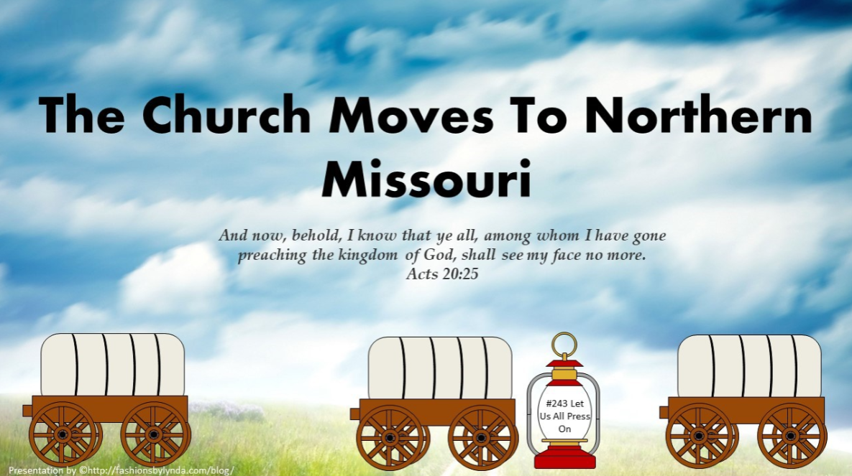

Slide 2

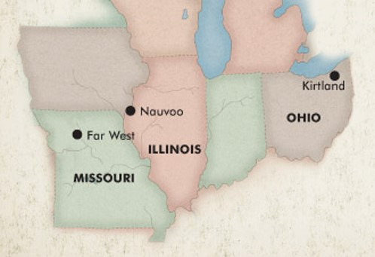
Difficult Season
was emotionally disastrous and ended in apostasy and division
1838 in Missouri was militarily disastrous and ended in pain and suffering
Economic Distress
Greed
Faultfinding
Persecution
As a result 10 to 15 percent of the Saints in Kirtland, Ohio, and northern Missouri apostatized, including some prominent Church leaders. Faithful Saints in Ohio began moving to join those in northern Missouri.

Slide 3
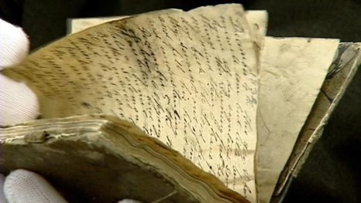
The Diary of Joseph Smith
Joseph Smith kept a wonderful diary from the fall of 1835 into the spring of 1836.
It ended on April 3, 1836, with the coming of Elijah, Elias, and Moses to the Kirtland Temple.
That closed his best diary of the 1830s, although we have a pretty decent one for part of 1838 in Missouri.
But from early April 1836 through all of 1837 and well into 1838, we have no Joseph Smith diary. Not until March 13, 1838, when he arrived in Far West, Missouri, did the Prophet begin a new diary.
Not only do we not have any diary from Joseph Smith, we do not have any from his closest associates.

Slide 4
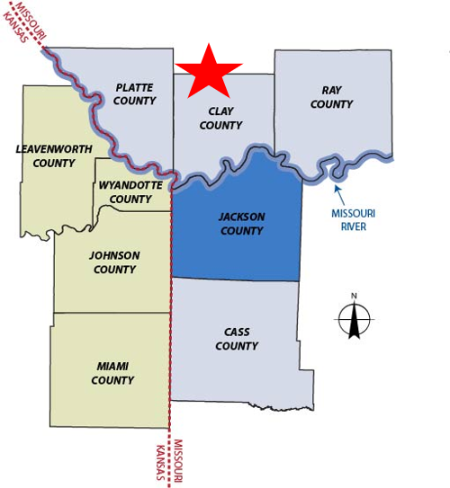
The Missouri Saints
When the Saints were driven from Jackson County, Missouri, in 1833, the citizens of neighboring Clay County welcomed many of them and gave them relief, anticipating that the Saints would stay only temporarily.
However, after the Saints had lived there for almost three years, these citizens began pressuring them to leave the county.

Slide 5
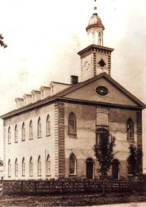
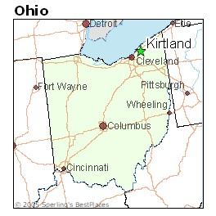
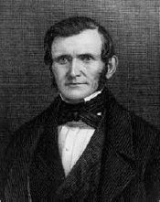
The Ohio Saints
The year after the Kirtland Temple was dedicated, the Saints experienced trials that tested their faith. A number of Saints apostatized and left the Church, including some prominent Church leaders.
“I went up to the house of God to worship & O what a meeting. May it be Printed upon my heart as a memorial forever. For on this day the God of Israel Sharply reproved this stake of Zion (Kirtland) through the Prophets & Apostles for all our sins & backslidings & also a timely warning that we may escape the Judgments of God that otherwise will fall upon us.”
Wilford Woodruff
Wilford did not mention what the failings were, but he did record that Joseph Smith and other Church leaders pointedly chastised the Saints and warned them to repent and mend their ways or face the consequences. BYU Study

Slide 6
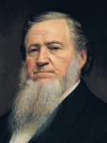
Murmuring
This undercurrent of murmuring emerged early in the year (1837) while there was still a feeling of prosperity. Before the bank failed, before the severe economic downturn, the murmuring had already begun.
A spirit of apostasy and faultfinding spread among many of the Saints. Brigham Young described an occasion when some of the Church leaders and Saints met to renounce Joseph Smith and appoint a new prophet:
“Several of the Twelve, the witnesses to the Book of Mormon, and others of the Authorities of the Church, held a council in the upper room of the Temple. The question before them was to ascertain how the Prophet Joseph could be deposed, and David Whitmer appointed President of the Church. … I rose up, and in a plain and forcible manner told them that Joseph was a Prophet, and I knew it, and that they might rail and slander him as much as they pleased, they could not destroy the appointment of the Prophet of God, they could only destroy their own authority, cut the thread that bound them to the Prophet and to God and sink themselves to hell.”
Brigham Young

Slide 7
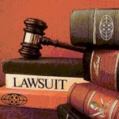

Negative Feelings in Missouri
1838 some citizens of Missouri had negative feelings toward Latter-day Saints.
In 1837 and 1838, some disaffected and excommunicated members of the Church living among the Saints in Far West began to bring lawsuits against the Church and its leaders and to harass the Church.
Some of the Saints began to grow impatient with these dissenters.

Slide 8
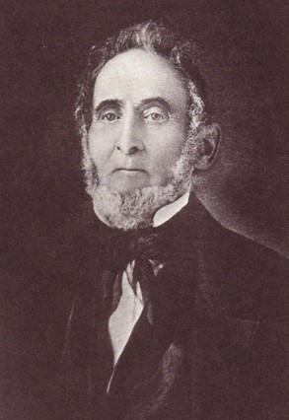

The Salt Sermon
In June 1838, Sidney Rigdon spoke heatedly in what has become known as the “Salt Sermon.”
He referenced Matthew 5:13 and said that if the salt loses its savor, it is good for nothing and should be cast out, implying that those who had left the Church should be cast out from among the Saints. Additionally, 84 Church members signed a document ordering the apostates to leave the county.
Two weeks later, on July 4, Sidney Rigdon gave a speech in which he promised that the Saints would defend themselves even if it came to a “war of extermination.”
Though both of these speeches seemed to contradict the Lord’s instruction to “sue for peace” (D&C 105:38), both speeches were published and caused great alarm among non–Latter-day Saints.
Church History

Slide 9
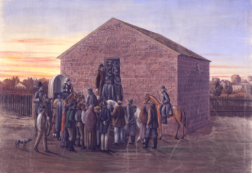
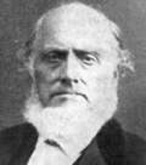
Misunderstandings
On August 6, 1838, as a group of Saints tried to vote in Gallatin, Missouri, they were pushed aside by a group of Missourians, and one local man hit one of the Saints. The Saints fought back, and a number of men were injured on both sides. This incident led to additional conflicts and threats and increased the misunderstanding between the Latter-day Saints and their neighbors in Missouri.
During this time, a convert named Sampson Avard administered secret oaths to those who would join him in forming a band of marauders called the Danites.
Avard instructed them to rob and plunder the Missourians, saying that this would help build up the kingdom of God. Avard convinced his followers that his directions were coming from the First Presidency.
The truth was later discovered, and Avard was excommunicated. Avard’s actions caused significant damage to the image of the Church and helped lead to the Prophet’s imprisonment in Liberty Jail.

Slide 10
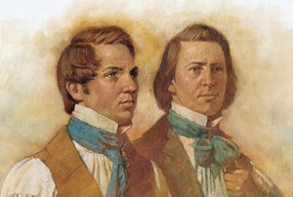
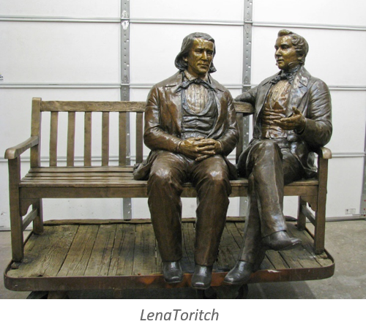
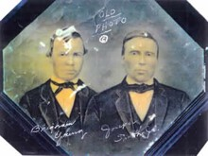
Defending Joseph
“At this time the spirit of speculation, disaffection and apostasy imbibed by many of the Twelve, and which ran through all the Quorums of the Church, prevailed so extensively that it was difficult for any to see clearly the path to pursue.”
… This was a crisis when earth and hell seemed leagued to overthrow the Prophet and Church of God. The knees of many of the strongest men in the Church faltered.”
During this siege of darkness I stood close by Joseph, and, with all the wisdom and power God bestowed upon me, put forth my utmost energies to sustain the servant of God and unite the quorums of the church.”
Brigham Young

Slide 11
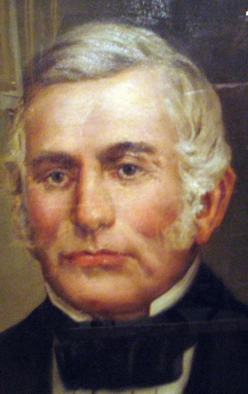
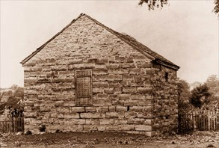
Extermination Order
In October 1838, a battle between some members of the Church and Missouri militiamen left a few men dead on each side. Exaggerated reports of the battle reached Governor Lilburn W. Boggs, governor of the state of Missouri, who then issued what has become known as the extermination order: “The Mormons must be treated as enemies and must be exterminated or driven from the state, if necessary for the public good” History of the Church
Soon, the city of Far West was surrounded by a militia that outnumbered the Saints’ forces five to one. Joseph Smith and other Church leaders were imprisoned in Liberty Jail, where they remained all winter. The rest of the Saints were forced to leave the state.

Slide 12
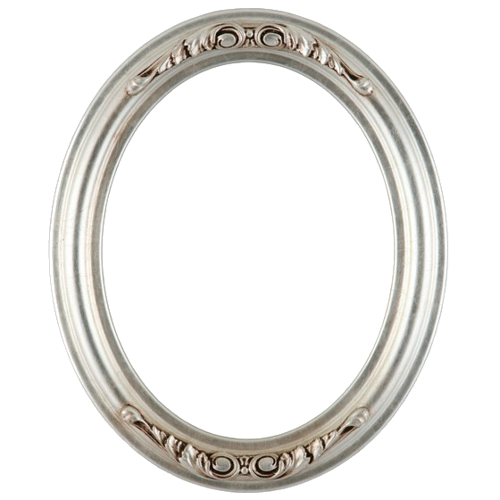
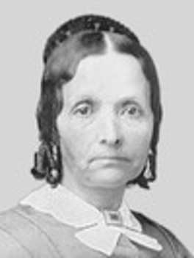
Eliza R. Snow
Eliza R. Snow, who was living in Kirtland at this time and later served as the second president of the Relief Society, described this period in Kirtland:
“Many who had been humble and faithful to the performance of every duty—ready to go and come at every call of the Priesthood, were getting haughty in their spirits, and lifted up in the pride of their hearts.
As the Saints drank in the love and spirit of the world, the Spirit of the Lord withdrew from their hearts, and they were filled with pride and hatred toward those who maintained their integrity.”

Slide 13
Sources:
Video:
“Required to Forgive.” (7:25)
Trial of Your Faith (0:52)
BYU Religious Study Center
Brigham Young (Manuscript History of Brigham Young 1801–1844,ed. Elden Jay Watson [1968], 15–16-17)
Church History in the Fulness of Times, 191–92.
Presentation by ©http://fashionsbylynda.com/blog/
History of the Church, 3:175
Eliza R Snow (Biography and Family Record of Lorenzo Snow[1884], 20).
Presentation by ©http://fashionsbylynda.com/blog/

Slide 14
Group 1:
To help the Saints be more self-sufficient in their finances, Joseph Smith and other Church leaders established a company similar to a bank and called it the Kirtland Safety Society.
Because of a widespread economic depression during this time, many banks failed throughout the nation. The Kirtland Safety Society also failed in the fall of 1837. Two hundred investors in the bank lost almost everything, with Joseph Smith sustaining the greatest losses. Even though the Kirtland Safety Society was not funded by the Church, some of the Saints considered it a Church bank or the Prophet’s bank and blamed Joseph Smith for their financial problems. Some even began calling him a fallen prophet. But despite the bank’s failure, many others who lost money continued in the faith and stayed true to the Prophet. (See Church History in the Fulness of Times Student Manual [Church Educational System manual, 2003], 171–73.)
By June 1838, approximately 200 or 300 apostates had left the Church, including four Apostles, the Three Witnesses of the Book of Mormon, and a member of the First Presidency (see Church History in the Fulness of Times, 177). However, most of the Saints responded to this period of testing with faith, much like Brigham Young did. They were strengthened by the Lord, and they remained true to their testimonies. Several of those who left the Church during this period of apostasy later returned and requested that they be reunited again with the Lord’s Church. Among them were Oliver Cowdery, Martin Harris, Luke Johnson, and Frederick G. Williams.
In the midst of these struggles in Kirtland, a few apostates sought to kill Joseph Smith. Warned by the Spirit, he and Sidney Rigdon left during the night on January 12, 1838. Their enemies pursued them for days, but the Lord protected them. They arrived with their families in Far West, Missouri, on March 14, 1838.
Discuss the following questions as a group:
• What principles can we learn from these historical events?
• What would you have done to remain faithful to the Prophet during this time of faultfinding?
• When has enduring a trial with faith strengthened your faith in the Savior?
• In what ways has following the prophet been a spiritual protection for you?
Black Sheep:
The term originated from the occasional black sheep which are born into a flock of white sheep due to a genetic process of recessive traits. Black wool was considered commercially undesirable because it could not be dyed. In 18th and 19th century England, the black color of the sheep was seen as the mark of the devil.

Slide 15
Group 2:
In the summer of 1836, when citizens of Clay County, Missouri, were pressuring the Saints to find a more permanent home, John Whitmer and William W. Phelps, the two counselors in the Missouri stake presidency, used Church money to purchase land in a place known as Far West in northern Missouri. However, when they offered parcels of land to incoming Saints, they sold the land for a small profit, which they kept for themselves. Upset by this and other offenses, the high council in Missouri removed the stake presidency from office.
Joseph Smith upheld the council’s action, and William W. Phelps was offended. In November 1838, Brother Phelps signed an affidavit against the Prophet. This affidavit contributed to Joseph Smith and others being arrested and thrown into Liberty Jail for the winter. Brother Phelps was excommunicated from the Church shortly thereafter.
In jail, Joseph Smith and those with him suffered immensely, not only from the brutal conditions of their imprisonment but also from reports of the Saints being driven from their homes and abused in many ways. The Missouri mobs, unchecked by the governor, destroyed property and lives, including the massacre of 17 people at a mill owned by a man named Jacob Haun.
William W. Phelps suffered spiritually for his actions, and he wrote Joseph Smith a letter asking for forgiveness a year later.
The Prophet wrote back:
“It is true, that we have suffered much in consequence of your behavior. …
“However, the cup has been drunk, the will of our Father has been done, and we are yet alive, for which we thank the Lord. …
“Believing your confession to be real, and your repentance genuine, I shall be happy once again to give you the right hand of fellowship, and rejoice over the returning prodigal. …
“‘Come on dear brother, since the war is past,
“‘For friends at first, are friends again at last’” (in History of the Church, 4:163, 164).
Discuss the following questions as a group:
• Why is it difficult to forgive a friend who has betrayed you and caused you to suffer?
• What principles can we learn from Joseph Smith’s example?
• What other lessons can we learn from this experience?

Slide 16
Even though 1837 was a difficult, sometimes discouraging year, it is one we need to understand. Exploring it helps us to understand Joseph Smith, but there are also lessons we can learn. One is that we are all susceptible to what may be called the cycle of prosperity, also known as the Nephite disease. President Brigham Young, a year after Joseph Smith’s death, gave an interesting sermon in Nauvoo, one of his best before he went west, in which he said essentially that for twelve years under Joseph Smith the Saints had suffered through adversity and were still fine spiritually. Despite setbacks, they had made it through; they had done what they needed to do. Not so in prosperity, he concluded—one year of prosperity had almost killed them. Since Joseph’s death, they had had some peace, some good times, and it had been too much. Adversity is a better environment for making Saints, perhaps. Another thing we can learn is how adversity tries men and women, revealing character as they make decisions in difficult circumstances. The 1837 Kirtland crisis, or Kirtland apostasy as it is sometimes known, cost us perhaps a third of the leadership—not a third of the members, but some of the elite, some of the well-educated, some of the more prosperous. And it happened so suddenly that it is a lesson for all of us.
Another lesson of 1837 is the importance of having our loyalties in the right place. There was a cultural war going on in the Church in 1837 over what Joseph Smith was trying to introduce: a new way of thinking about society and religion based on ancient scripture models and modern revelation. This was the model of Enoch leading his people or Moses at the head of the children of Israel, where a religious leader had a great deal to say about everyday life and about how society was organized. This model was not the American way, nor is it today. People had to look into their hearts and decide what they were willing to do at the behest of a religious leader. Some liked the American civil religion, as it has sometimes been called. They liked the idea that they were free as Americans to do their business six days a week and on the seventh day go to church where a preacher would teach them morals and maybe a little doctrine. But they did not expect this preacher to interject himself into their politics, their property, or their economic organization. This was the Protestant model, the model most early Latter-day Saints grew up with. Yet little by little, Joseph Smith was trying to teach them the model of Enoch and of Moses, of organizing society around religious principles and around religious leaders. So one of the lessons we learn is that if we are in a situation where much is demanded, ultimately we will have to decide where our loyalties are. Very good people, including some leaders who left for a while and came back, had difficulty with that. For a while they thought their real loyalty was what they had done as “Sons of ‘76.” They wanted to live life as Americans and not as Latter-day Saints or as children of Israel. Think of these lessons as we see how 1837 unfolds.
BYU Religious Education
In 1838, Oliver Cowdery was excommunicated. He was charged, among other things, with virtually denying the faith by declaring that he would not be governed by any ecclesiastical authority nor revelation whatever in his temporal affairs. He was essentially asked, “If your church organization and ecclesiastical leaders offered guidance to help organize your temporal life, would you submit to their guidance?” Oliver Cowdery said he would not. He answered by paraphrasing in writing a central charge against him: “I will not be influenced, governed, or controlled, in my temporal interests by any ecclesiastical authority or pretended revelation whatever, contrary to my own judgment.” He said, “Such being still my opinion [I] shall only remark that the three great principles of English liberty, as laid down in the books, are ‘the right of personal security, the right of personal liberty, and the right of private property.’” He continued: “My venerable ancestor was among the little band, who landed on the rocks of Plymouth in 1620. . . . I am wholly unwilling to exchange [his American principles] for anything less liberal, less benevolent, or less free.” BYU Studies

Slide 17
During 1837 a dark spirit afflicted some members of the Church in Kirtland, Ohio:
“At this time the spirit of speculation in lands and property of all kinds, which was so prevalent throughout the whole nation, was taking deep root in the Church. As the fruits of this spirit, evil surmisings, fault-finding, disunion, dissension, and apostasy followed in quick succession, and it seemed as though all the powers of earth and hell were combining their influence in an especial manner to overthrow the Church at once, and make a final end” (History of the Church, 2:487).
Eliza R. Snow, who was living in Kirtland at this time and later served as the second president of the Relief Society, described this period in Kirtland:
“Many who had been humble and faithful to the performance of every duty—ready to go and come at every call of the Priesthood, were getting haughty in their spirits, and lifted up in the pride of their hearts. As the Saints drank in the love and spirit of the world, the Spirit of the Lord withdrew from their hearts, and they were filled with pride and hatred toward those who maintained their integrity” (Biography and Family Record of Lorenzo Snow [1884], 20).
Brigham Young described the climate in the Church during 1837 and his efforts to defend the Prophet Joseph Smith:
“At this time the spirit of speculation, disaffection and apostasy imbibed by many of the Twelve, and which ran through all the Quorums of the Church, prevailed so extensively that it was difficult for any to see clearly the path to pursue.
“… This was a crisis when earth and hell seemed leagued to overthrow the Prophet and Church of God. The knees of many of the strongest men in the Church faltered.
“During this siege of darkness I stood close by Joseph, and, with all the wisdom and power God bestowed upon me, put forth my utmost energies to sustain the servant of God and unite the quorums of the church” (Manuscript History of Brigham Young 1801–1844, ed. Elden Jay Watson [1968], 15, 16–17).
Factors contributing to the financial troubles in Kirtland
In 1837, greed took hold of the hearts of some Church members and even some prominent Church leaders in Kirtland. Gold and silver money was scarce. People used paper money from a number of banks in the area. To help the Saints be more financially self-sufficient, Joseph Smith and other Church leaders established a bank-like company called the Kirtland Safety Society. Many Saints bought stock in the new bank. Within a few months of the company opening its doors, a financial crisis, later called the panic of 1837, began in New York City and swept westward, resulting in the failure of hundreds of banks, including the Kirtland Safety Society.
Other factors contributed to the instability of the Kirtland Safety Society. Many other banks refused to accept the Safety Society’s notes as legal tender, and the anti-Mormon newspapers branded the currency as worthless. Furthermore, the society’s capital was primarily in the form of land; it did not possess much hard currency, such as gold and silver, for satisfying any large demands for redemption of its paper currency. Enemies of the Church obtained enough notes to initiate a run on the bank, forcing the society to suspend payment in gold and silver to its customers only a few weeks after the first notes were issued. As a result, Joseph Smith and Sidney Rigdon were charged with violating the banking statutes of Ohio and brought to trial. Joseph and Sidney were each fined $1,000.
Joseph Smith did all he could to persuade investors to give more funds to sustain the bank, but he finally turned its operation over to others. However, this failed to solve the problem. Inexperienced and dishonest managers further destabilized the bank. Warren Parrish, the bank’s cashier and Joseph’s personal scribe, stole over 20,000 dollars.
A growing spirit of speculation in Kirtland also added to the Church’s economic problems. With the availability of supposed money, which they borrowed from the bank, many people went into debt to purchase land for resale at a substantial profit.
By the fall of 1837, the Kirtland Safety Society had to close its doors. Hundreds of individuals lost almost everything they had invested, with Joseph Smith sustaining the greatest losses. Because the Safety Society was considered by many to be a Church bank or the Prophet’s bank, some of the Saints blamed Joseph Smith for their financial problems and even began calling him a fallen prophet. Others who also lost money continued in the faith and stayed true to the Prophet. (See Church History in the Fulness of Times Student Manual [Church Educational System manual, 2003], 171–73.)

