Slide 1
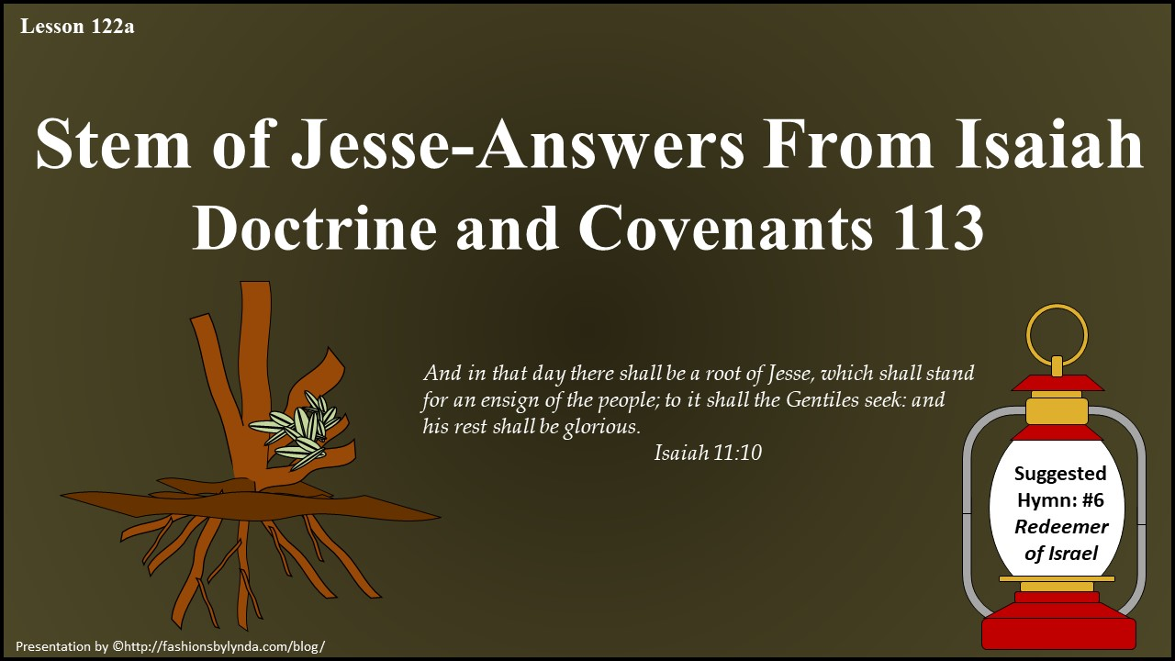

Slide 2
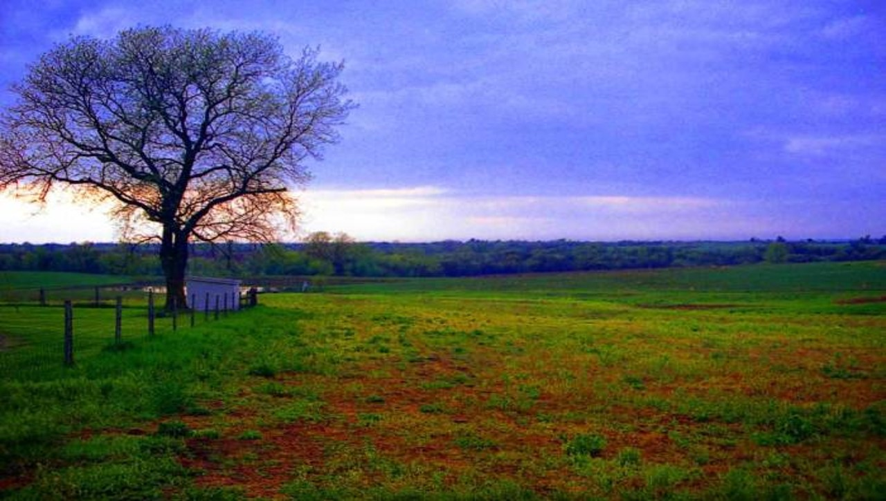
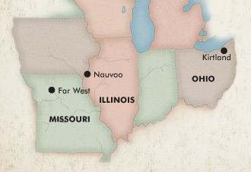
Background
The opening of the year 1838 can best be told in the language of Joseph Smith. He writes:
"A new year dawned upon the church in Kirtland in all the bitterness of the spirit of apostate mobocracy; which continued to rage and grow hotter and hotter, until Elder Rigdon and myself were obliged to flee from its deadly influence, as did the apostles and prophets of old,…
… the 12th of January, about ten o'clock, we left Kirtland, on horseback, to escape mob violence, which was about to burst upon us under the color of legal process to cover their hellish designs and save themselves from the just judgment of the law…
…On the 14th as we were about entering Far West, many of the brethren came out to meet us, who also with open arms welcomed us to their bosoms.”
But when they persecute you in this city, flee ye into another:
Matthew 10:23
History of the Church

Slide 3
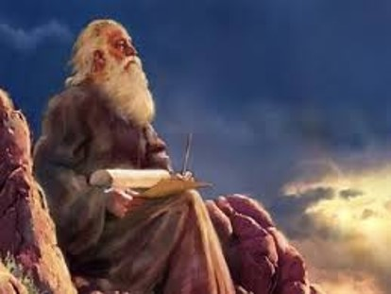
Questions About the Writings of Isaiah
March 1838
The Prophet included in his history some answers from the Lord to questions on the book of Isaiah. It is not known who asked the first questions—it may be that the Prophet asked them on his own behalf. The final questions came from Elias Higbee.
Section 113 was first published in the 1876 edition of the Doctrine and Covenants.
Student Manual

Slide 4
Elias Higbee
He was born October 23, 1795, at Galoway, New Jersey to Isaac Higbee and Sophia Somers
His wife was Sarah Elizabeth Ward and they had 12 children
He joined the Church in Ohio and moved his family to Missouri, where he held various Church positions
He was elected judge in Caldwell County and was a leading officer in the Church’s Missouri militia
While in office he issued an order for the sheriff to call out the militia to disperse the mobs acting against the Saints and the Battle of Crooked River was the result
He asked the Prophet, Joseph Smith, to explain some passages of Isaiah
Having been forced by mobs to leave Missouri, he moved to Illinois and continued his ecclesiastical and civic duties
He accompanied Joseph Smith to Washington D.C. to seek redress from President Martin Van Buren for the acts committed against the Saints
He was on the committee for the Nauvoo Temple, and died of cholera on June 7, 1843, and buried at the old Nauvoo burial grounds
v
Who’s Who and Wikipedia

Slide 5
Jesse pronounced yee-shaw-ee, which meant to hold out, as in to extend
He was of the line of Judah’s son, (son of Leah and Jacob) Pharez, the elder of the twin sons of Judah with his former daughter-in-law Tamar (Genesis 29:32-35)
Grandson of Ruth (Ruth 4:18-22)
Son of Obed
From Bethlehem (1 Samuel 17:58)
Father of David, the boy who would slay Goliath and become King of Israel
Jesse became renowned throughout the land because of David’s heroic act
His direct line of descents leads to Christ (Matthew 1:5-6)

Slide 6
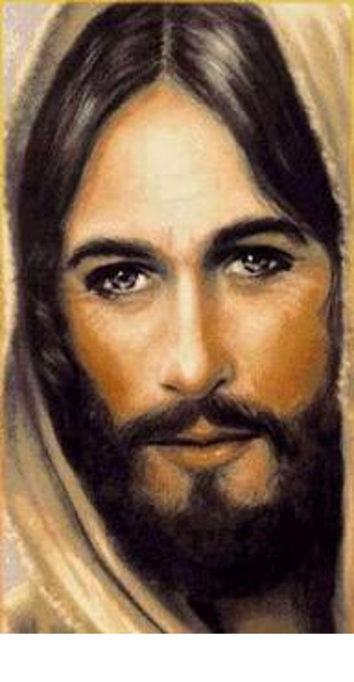
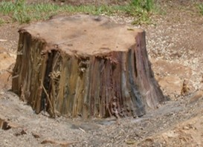
Question 1—The Stem
Who is the Stem of Jesse spoken of in the 1st, 2d, 3d, 4th, and 5th verses of the 11th chapter of Isaiah?
Stem—Stock, the remains in the earth after the tree is cut down
Stem of Jesse—Hebrew word for stump (Root word—geza)
D&C 113:1-2

Slide 7

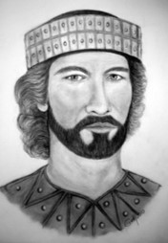
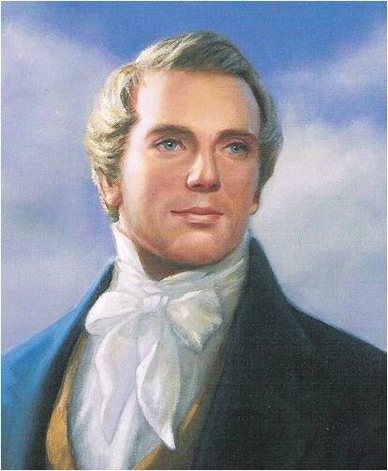
Question 2—The Rod
What is the rod spoken of in the first verse of the 11th chapter of Isaiah, that should come of the Stem of Jesse?
This branch will be a man of great power—a servant of Christ
Behold, the days come, saith the Lord, that I will raise unto David a righteous Branch, and a King shall reign and prosper, and shall execute judgment and justice in the earth.
In his days Judah shall be saved, and Israel shall dwell safely: and this is his name whereby he shall be called, THE LORD OUR RIGHTEOUSNESS.
Jeremiah 23:5-6
Rod—shoot or branch coming out of the stem
Branch—Hebrew—natzar—a word found in:
Daniel 11:7
Jeremiah 23:5-6
Hosea 3:5
Rod=The great prophet of the Restoration- a servant in the hands of the Lord
McConkie and Ostler
D&C 113:3-4

Slide 8

Question 3—The Root
Descendant of Jesse
What is the root of Jesse spoken of in the 10th verse of the 11th chapter?
One who has a great mission to gather the remnant of Israel and who holds the priesthood and the keys of the kingdom
Improvement Era
Descendant of Ephraim, of the house of Joseph. A man who rightly hold the keys
Joseph Smith received the keys of the kingdom for the gathering of Israel in the last days.
D&C 113:5-6

Slide 9
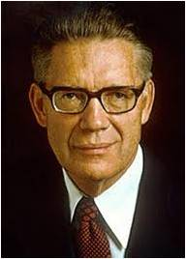
“Are we amiss in saying that the prophet here mentioned is Joseph Smith, to whom the priesthood came, who received the keys of the kingdom, and who raised the ensign for the gathering of the Lord’s people in our dispensation?
And is he not also the ‘servant in the hands of Christ, who is partly a descendant of Jesse as well as of Ephraim, or of the house of Joseph, on whom there is laid much power’?
Those whose ears are attuned to the whisperings of the Infinite will know the meaning of these things.”
Elder Bruce R. McConkie
D&C 113:5-6

Slide 10
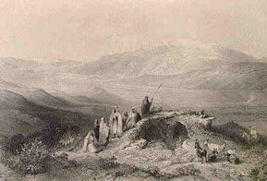
Question 4—Elias Higbee
What is meant by the command in Isaiah, 52nd chapter, 1st verse, which saith: Put on thy strength, O Zion—and what people had Isaiah reference to?
“…Promises connected to priesthood blessings, especially associated with the temple.
“…Putting on the power and authority of the priesthood.”
“Foretells a triumphant time when the people of Zion and Jerusalem will be restored to power, particularly priesthood power, and will be free from oppression through the redeeming powers of Christ.”
The authority of the priesthood is the strength of Zion.
D&C 113:7-8 Victor L. Ludlow

Slide 11
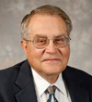
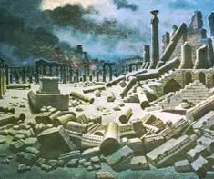
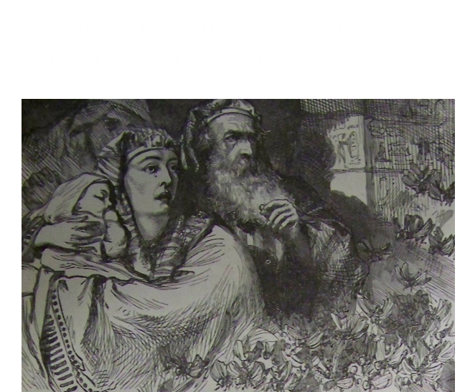
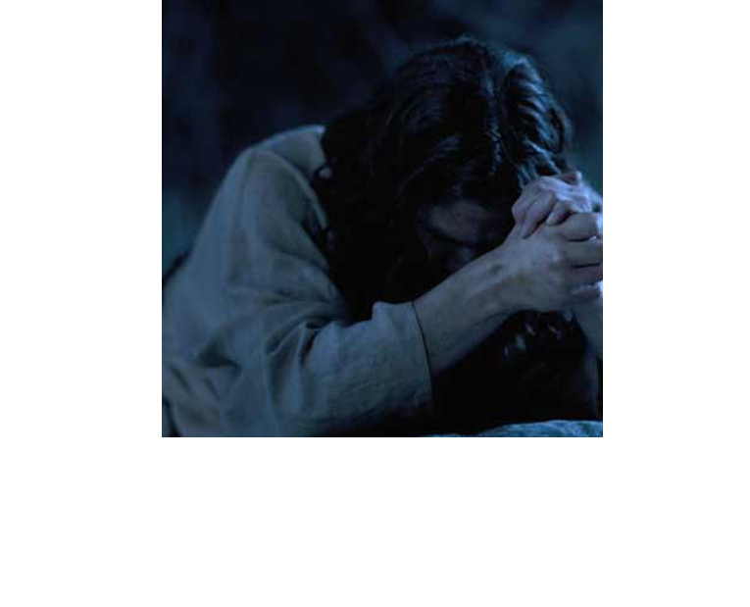
Question 5
During its long history, Jerusalem has been destroyed twice, besieged 23 times, attacked 52 times, and captured and recaptured 44 times.
The oldest part of the city was settled in the 4th millennium BCE, making Jerusalem one of the oldest cities in the world. Wikipedia
What are we to understand by Zion loosing herself from the bands of her neck; 2nd verse?
“…not just a literal freeing from their political captors, and scattered condition but also the spiritual freeing of all mankind through the atonement of the Savior.”
D&C 113:9-10 Victor L. Ludlow

Slide 12
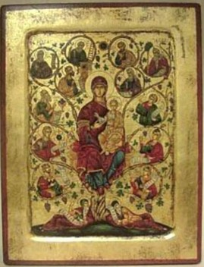
Sources:
History of the Church Vol. 3 pgs. 1-2
Doctrine and Covenants Student Manual Religion 324-325 Section 113
Doctrine and Covenants Who’s Who by Ed J. Pinegar and Richard J. Allen pgs. 45-46
Presentation by ©http://fashionsbylynda.com/blog/
Improvement Era Oct. 1966 pp. 869, 914-15
Joseph Fielding McConkie and Craig J. Ostler Revelations of the Restoration pg.911
Elder Bruce R. McConkie (The Millennial Messiah: The Second Coming of the Son of Man[1982], 339–40).
Victor L. Ludlow Unlocking Isaiah in the Book of Mormon pg. 234-35
Presentation by ©http://fashionsbylynda.com/blog/

Slide 13
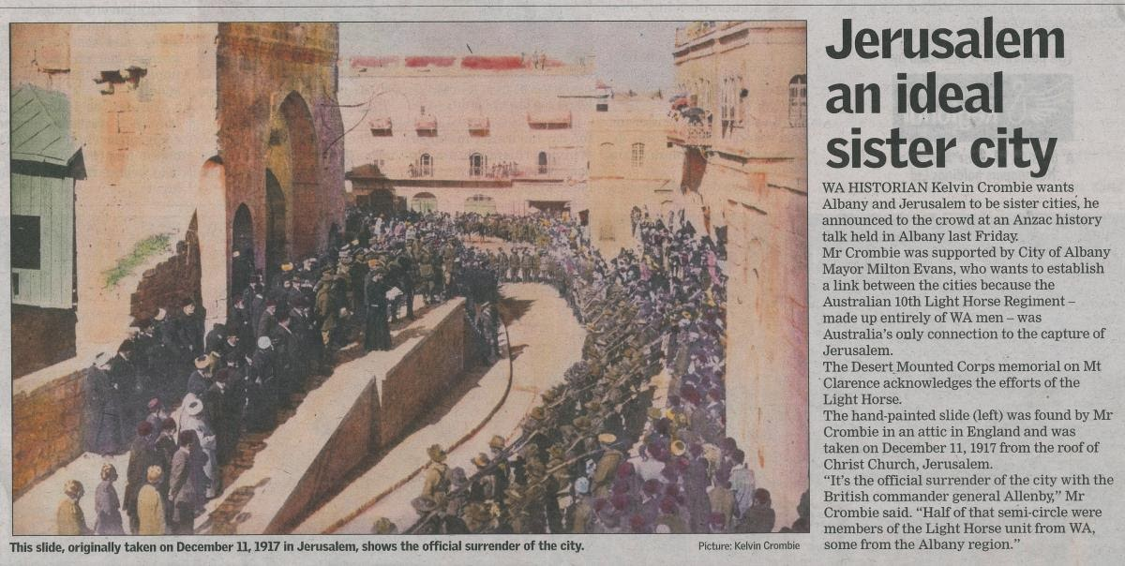
The Rod:
One might assume “that the ‘rod’ was Joseph Smith, believing that the Prophet, out of modesty, hesitated to name himself directly. None of us would question that Joseph was destined to become a great ‘servant in the hands of Christ’. Moreover, if we assume that he was the ‘rod’ or ‘servant’, observe how very well such an identification fits in with Moroni’s mission of explaining to the latter-day Prophet his part in Isaiah’s great vision of the future. As the ‘rod’ or ‘servant in the hands of Christ’, Joseph Smith fits naturally into Isaiah’s prophecy, and it is easy to understand why Moroni quoted and explained Isaiah 11 to him. [See JS—H 1:40.]
David:
“Although David was a king, he never did obtain the spirit and power of Elijah and the fullness of the Priesthood…the throne and kingdom of David is to be taken from him and given to another by the name of David in the last days.”
Joseph Smith Church History 6:253
The Root
The explanation of Isaiah 11:10 given in Doctrine and Covenants 113 implies that while Christ is the root of David, he is not the root of Jesse mentioned by Isaiah. There are two reasons for this conclusion. First, the Lord through the Prophet Joseph Smith in verse 2 identifies Christ as the stem of Jesse; he does not identify Christ as the root of Jesse. Second, verse 6 indicates that the root of Jesse is a servant of Christ to whom keys are given “in the last days” to gather Christ’s people. Student Manual section 113
This series of battles was successfully fought by the British Empire's XX Corps, XXI Corps, and the Desert Mounted Corps against strong opposition from the Yildirim Army Group's Seventh Ary in the Judean Hills and the Eighth Army north of Jaffa on the Mediterranean coast.
As a result of these victories, British Empire forces captured Jerusalem and established a new strategically strong fortified line. This line ran from well to the north of Jaffa on the maritime plain, across the Judean Hills to Bireh north of Jerusalem, and continued eastwards of the Mount of Olives. With the capture of the road from Beersheba to Jerusalem via Hebron and Bethlehem, together with substantial Ottoman territory south of Jerusalem, the city was secured. On 11 December, General Edmund Allenby humbly entered the Old City on foot through the Jaffa Gate instead of horse or vehicles to show respect for the holy city. He was the first Christian in many centuries to control Jerusalem.
http://en.wikipedia.org/wiki/Battle_of_Jerusalem

