Slide 1

Doctrine and Covenants 114
David W. Patten
Presentation by ©http://fashionsbylynda.com/blog/

Slide 2
David W. Patten
He was born November 14, 1799, in Theresa, Indian River Falls to(Benoni Patten and Abagail (Edith) Cole
He moved from his home at a very early age to Michigan and later became acquainted with the church through his brother John
In 1828 he married Phoebe Ann Babcock. They had no children
He was baptized June 15, 1832, and 2 days later ordained an Elder
He served many short missions to the eastern and southern states and called as one of the Twelve Apostles on February 15, 1835
He had a gift for healing and was known throughout the community as “Captain Fear Not” *(See Story)
In October 1838 he led a charge against the mobs in defense of the Saints in the Battle of Crooked River and died with a gunshot wound on October 25, 1838, and buried in an unmarked grave in Far West
Wilford Woodruff said, "Thus fell the noble David W. Patten as a martyr for the cause of God and he will receive a martyr's crown.”
Wilson, Who’s Who, and Wikipedia

Slide 3
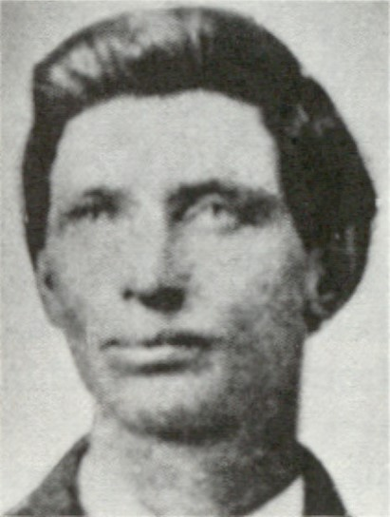
Background
Elder Patten was one of the original Apostles and “had for some time been located in Missouri and with Elder Thomas B. Marsh was maintaining a steady influence amidst the opposition of disaffected brethren, including the three who had been appointed to preside, David Whitmer, William W. Phelps and John Whitmer.
The Lord called upon Elder Patten to settle up his business as soon as possible, make a disposition of his merchandise, and prepare to take a mission the following spring, in company with others to preach the Gospel to all the world.
Elder Patten asked Joseph Smith to seek a revelation on his behalf

Slide 4
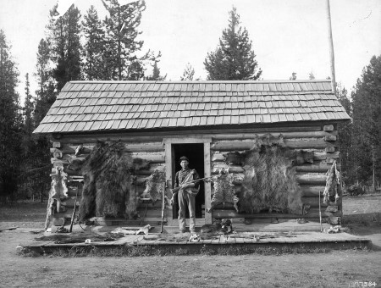
Three Taken Captive
In October 1838 the persecutions of mobs in Missouri threatened not only the property of the Saints but also their lives.
A group took three prisoners and promised to murder them, saying they would come the next morning to burn the Saints out.
The Prophet Joseph Smith appointed Elder Patten to lead seventy-five volunteers against the mob of thirty or forty, hoping to rout them without bloodshed and free the three prisoners. In the confrontation Elder Patten was shot in the stomach and died that night.
“He was one of the Twelve Apostles, and died as he had lived, a man of God, and strong in the faith of a glorious resurrection, in a world where mobs will have no power or place” Joseph Smith
Section 114 was added to the Doctrine and Covenants in 1876 under the direction of President Brigham Young.

Slide 5
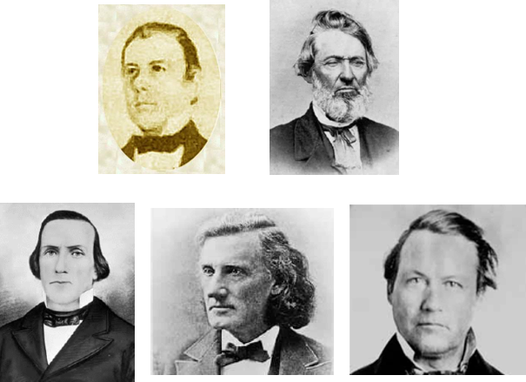
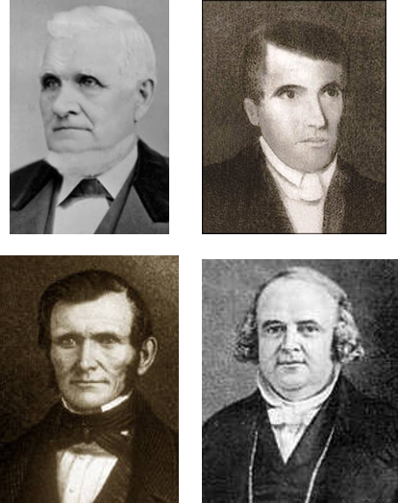

The Mission
The Twelve were to leave Far West on 26 April 1839 for England.
David W. Patten was supposed to be one among them.
Thomas B. Marsh, William E. McLellin, Luke S. Johnson, John F. Boynton, and Lyman E. Johnson had all apostatized and lost their membership in the Quorum, and in the church.
The tragedy occurred six months after the revelation to David Patten was given.
The newly called members of the Twelve were John Taylor, John E. Page, Wilford Woodruff, and Willard Richards.
(D&C 118:6)
D&C 114:1

Slide 6
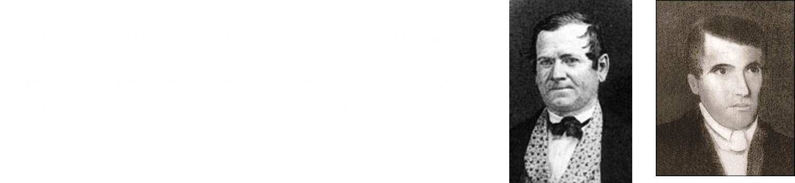
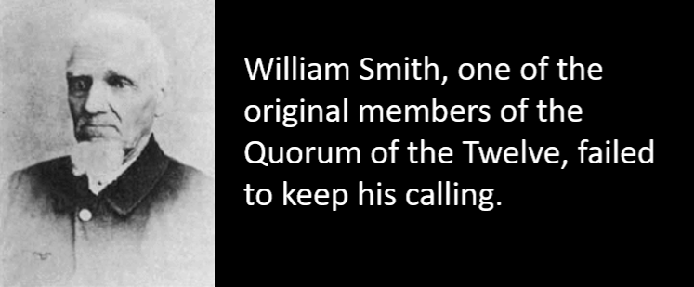
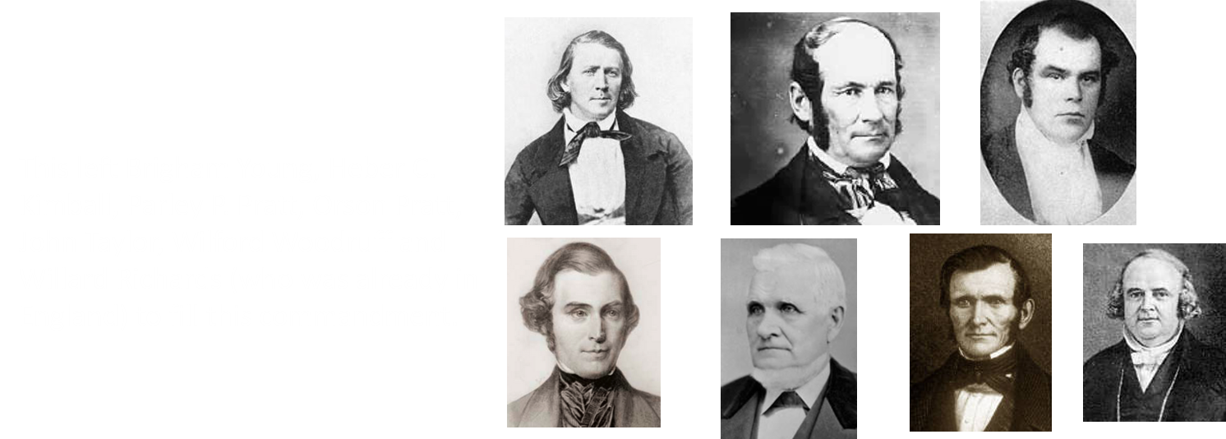
The Mission to Great Britain
D&C 114:1 McConkie and Ostler

Slide 7
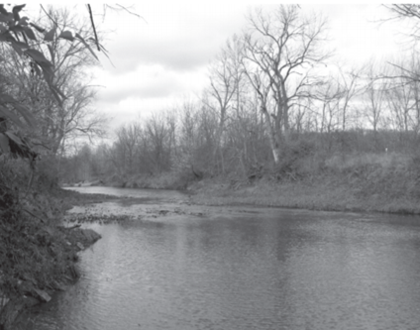
Battle at Crooked River
Shortened Version
Patten died due to wounds received in the Battle of Crooked River. This conflict was primarily caused by deteriorating conditions between Mormon settlers and other religious groups in Missouri. As tensions between Mormon and non-Mormon groups increased, a group of men from the state militia abducted three Mormon men on October 24, 1838.
In response, Patten led a group of Mormon men to rescue the men. Before daybreak on the 25th, as the Mormon militia approached the ford where the state militia was camped, a non-Mormon guard, John Lockhart, called out, "Who goes there?" and immediately fired at the Mormons.
Fighting in the resulting battle led to 16 casualties and four fatalities, among them Patten, who was serving as commander of the Mormon militia group and was shot in the bowels.
https://alchetron.com/David-W-Patten

Slide 8
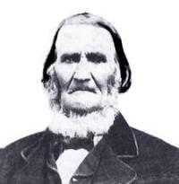
At the Home of Stephen Winchester Sr.
The wounded Patten was carried from the battlefield to the home of Stephen Winchester, four miles distant.
En route he was visited by Joseph Smith, Hyrum Smith, and his wife. Patten reiterated his testimony of the church to his visitors.
Upon seeing her husband dying, (Phoebe) Ann Patten exclaimed, "Oh God! Oh my husband! How pale you look."
His final words to his wife were, "Whatever you do else, O do not deny the faith,"
https://alchetron.com/David-W-Patten

Slide 9

D&C 124:19
That when he shall finish his work I may receive him unto myself, even as I did my servant David Patten, who is with me at this time, and also my servant Edward Partridge, and also my aged servant Joseph Smith, Sen., who sitteth with Abraham at his right hand, and blessed and holy is he, for he is mine.

Slide 10

If we heed the Lord’s direction, we will be prepared for whatever He has planned for us

Slide 11
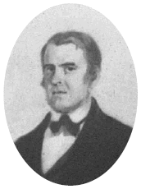
On His Deathbed
“O that they were in my situation! For I feel that I have kept the faith, I have finished my course, henceforth there is laid up for me a crown, which the Lord, the righteous Judge, will give me.”
Patten

Slide 12
Sources:
Video:
Courage (3:19)
Doctrine and Covenants Who’s Who by Ed J. Pinegar and Richard J. Allen pgs. 111-12
Life of David W. Patten: The First Apostolic Martyr by Lycurgus Arnold Wilson…1856 page 15
Presentation by ©http://fashionsbylynda.com/blog/
Joseph Smith History of the Church, 3:171
Joseph Fielding McConkie and Craig J. Ostler Revelations of the Restoration pgs. 914-15
Patten: quoted by Heber C. Kimball, in Life of David W. Patten, 69).
Presentation by ©http://fashionsbylynda.com/blog/

Slide 13
Patten died due to wounds received in the Battle of Crooked River. This conflict was primarily caused by deteriorating conditions between Mormon settlers and other religious groups in Missouri. As tensions between Mormon and non-Mormon groups increased, a group of men from the state militia abducted three Mormon men on October 24, 1838. In response, Patten led a group of Mormon men to rescue the men. Before daybreak on the 25th, as the Mormon militia approached the ford where the state militia was camped, a non-Mormon guard, John Lockhart, called out, "Who goes there?" and immediately fired at the Mormons. The shot hit Patrick O'Bannion, one of Patten's guides, and mortally wounded him. Crying, "God and liberty," Patten ordered a charge and led the Mormon militia in the attack. Fighting in the resulting battle led to 16 casualties and four fatalities, among them Patten, who was serving as commander of the Mormon militia group and was shot in the bowels. The three men kidnapped by the state militia were rescued.
The wounded Patten was carried from the battlefield to the home of Stephen Winchester, four miles distant. En route he was visited by Joseph Smith, Hyrum Smith, and his wife. Patten reiterated his testimony of the church to his visitors. Upon seeing her husband dying, Ann Patten exclaimed, "Oh God! Oh my husband! How pale you look.“ His final words to his wife were, "Whatever you do else, O do not deny the faith," after which he addressed the others in the room saying, "I feel that I have kept the faith, I have finished my course, henceforth there is laid up for me a crown, which the Lord will give me.“ Moments after this, about 10 p.m., he died. Regarding Patten's death, Joseph Smith said, "There lies a man who has done just as he said he would—he has laid down his life for his friends.“ Patten was buried in an unmarked grave on October 27, 1838, in Far West, Missouri.
^{Wikipedia}
*While on his third mission, he and Reynolds Cahoon had an appointment to preach at the house of Father Bosley, at Avon, Ohio.
Several meetings had been held here before by other Elders, and among the assembled neighbors, was a man known as the “County Bully,” who was the source of a great deal of annoyance to the speakers.
Sitting by the door in the hallway, this man would every little while, contradict the speaker, or call out some irreverent suggestion, or ask for a sign. He boisterously refused to be quiet, and on the evening of David’s meeting at the house, was particularly noisy, asking David, among other things, to cast the devil out. Whether it was from a sense of humor at the fellow’s unlucky remark, or because he was tired of the disturbance, we cannot say, but David finally determined to silence his persecutor.
Walking to the hallway, he quietly picked the man up bodily, carried him to the outside door, and with a swing sent the fellow about ten feet onto the wood pile. There was no more disturbance that night, and the saying was the current mirth provoker of the neighborhood for weeks afterward, “Patten cast out one devil, soul and body.”
Life of David W. Patten: The First Apostolic Martyr by Lycurgus Arnold Willson…1856 page 15
Joseph Smith said, "There lies a man who has done just as he said he would—he has laid down his life for his friends.“
Flake, Lawrence R., ed. (2001), Prophets and Apostles of the Last Dispensation, Salt Lake City, UT: Deseret Book Co., ISBN 1-57345-797-3

