Slide 1
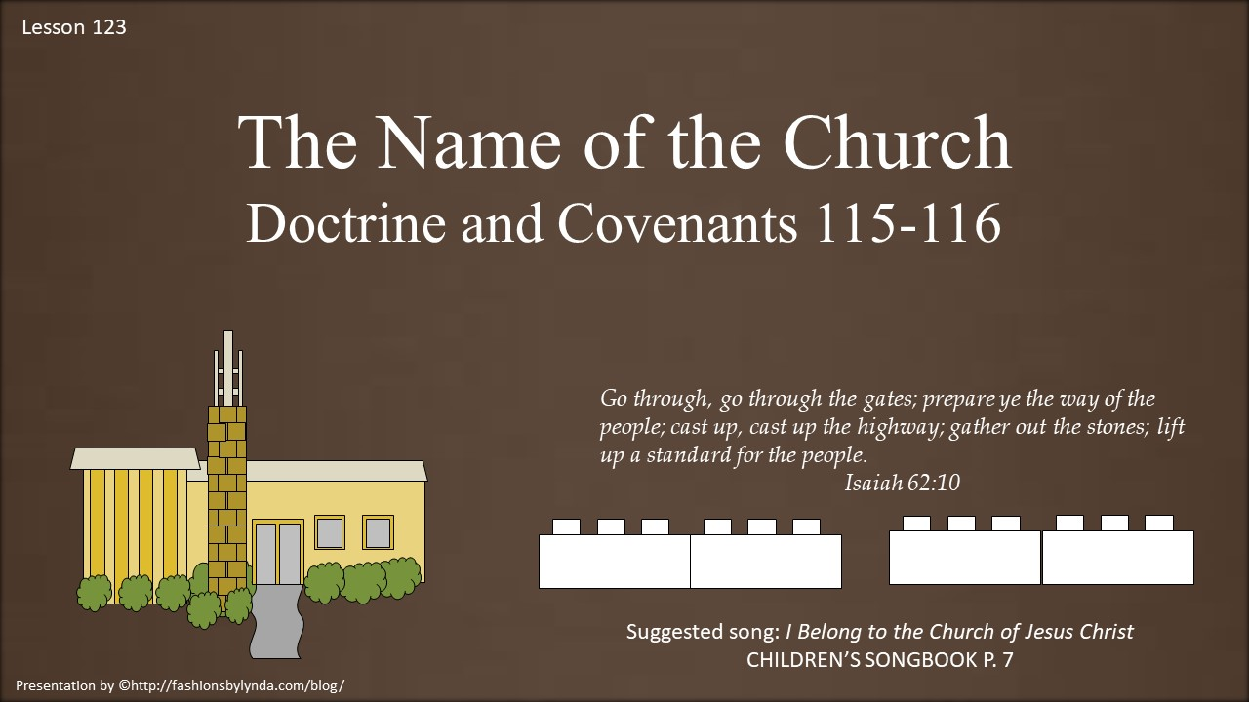

Slide 2




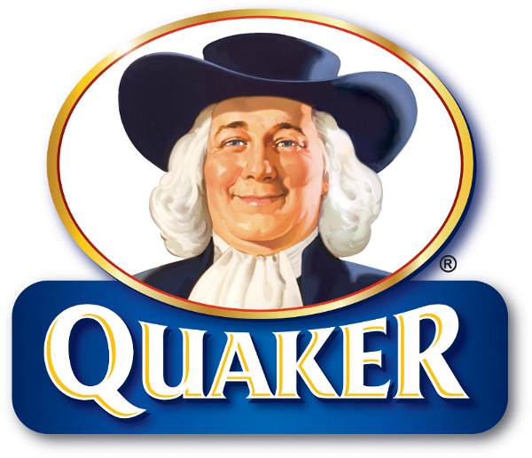

What does the name of the organization communicate?
Who leads the organization?
What does the organization do?

Slide 3

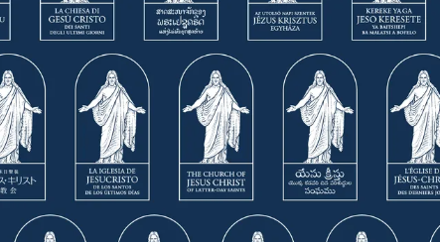
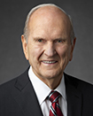
April 2020 General Conference.
Jesus stands under an arch as a reminder of His Resurrection. He is a living Savior who reaches out to embrace all who will come unto Him.
As President Russell M. Nelson announced a new symbol to identify The Church of Jesus Christ of Latter-day Saints, he emphasized how it depicts the central place of the Savior in His Church.
The center is a representation of Thorvaldsen’s marble statue, the Christus.
The name of the Church within a rectangular shape represents a cornerstone. Jesus Christ is the chief cornerstone.
(Ephesians 2:20)
The symbol is a representation, not a logo.
The symbol is a visual identifier for the Church.
The symbol represents Christ as the foundation of the Church and His Resurrection.
3 Key Aspects...

Slide 4
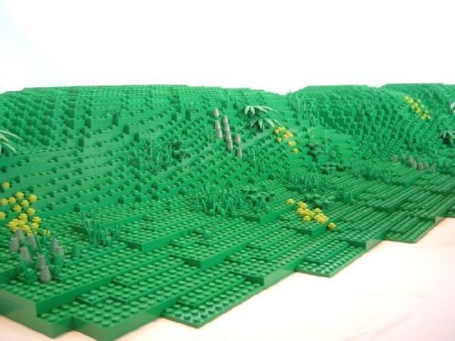

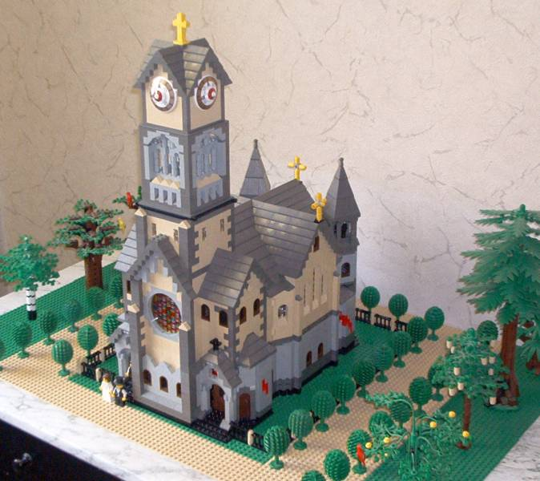
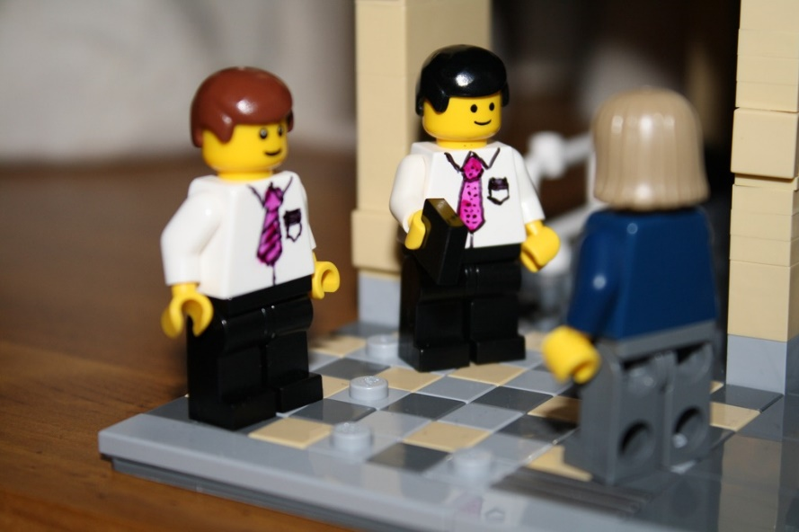
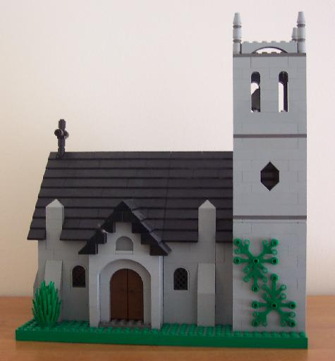
To escape persecution in Jackson County, Missouri, thousands of Saints gathered about 50 miles (80 km) north and created a new settlement called Far West on April 26, 1838.
“This caused some problems for missionaries because many congregations used these names.”
McConkie and Ostler
The Lord reveals the name of the Church
The names of the Church that existed in the early years were:
“The Church of Christ”,
“The Church of Jesus Christ”,
“The Church of God”,
and “The Church of Latter-day Saints”
In order to distinguish between the Churches, the name needed to be changed

Slide 5

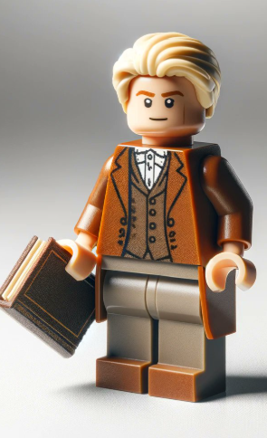
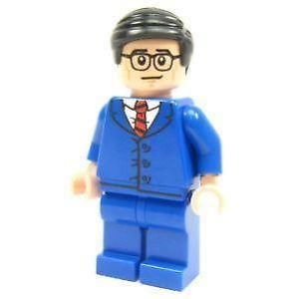
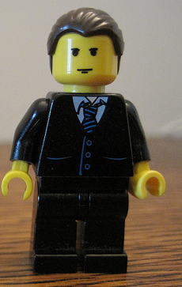
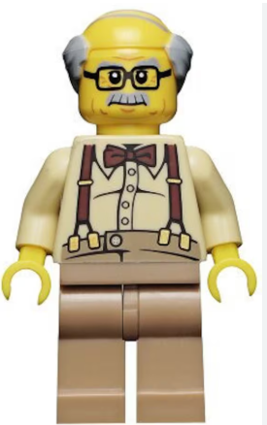

Hyrum Smith was set apart as second counselor in the First Presidency on November 7, 1837, in the place of Frederick G. Williams and Oliver Cowdery who had lost their membership in the Church.
History of the Church
The Presiding Bishop--Edward Partridge
The Assistant Counselors:
Joseph Smith Sr. and John Smith
D&C 115:1-2

Slide 6

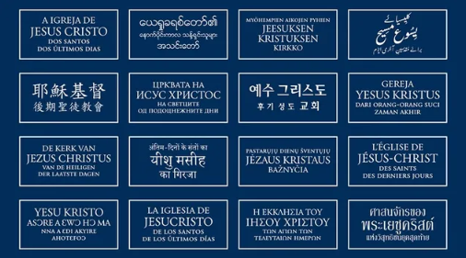
What does the name of the organization communicate?
Who leads the organization?
What does the organization do?

Slide 7
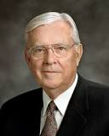

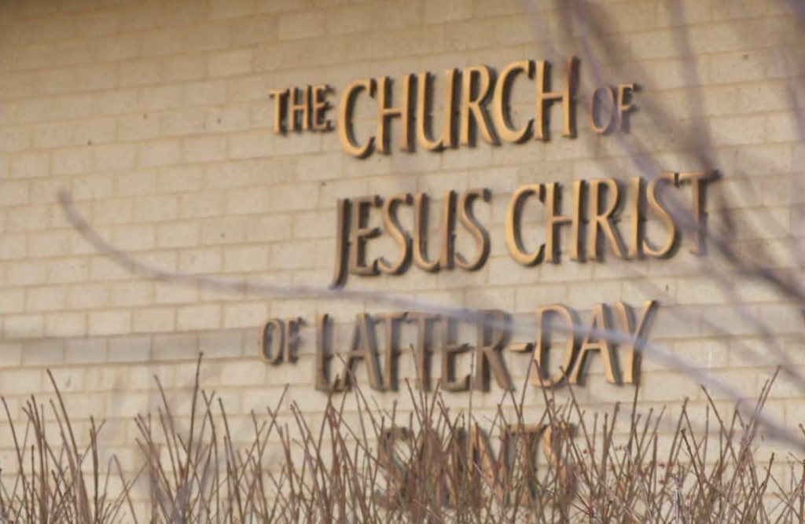
“The word The indicates the unique position of the restored Church among the religions of the world.
“The words Church of Jesus Christ declare that it is His Church. …
“Of Latter-day explains that it is the same Church as the Church that Jesus Christ established during His mortal ministry but restored in these latter days. …
“Saints … simply refers to those who seek to make their lives holy by covenanting to follow Christ.”
Elder M. Russell Ballard
D&C 115:3-4

Slide 8
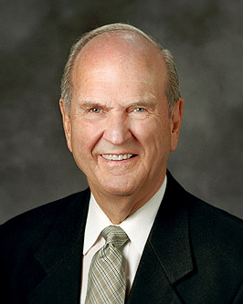
The name of the Church is not negotiable. When the Savior clearly states what the name of His Church should be and even precedes His declaration with, “Thus shall my church be called,” He is serious. …
My dear brothers and sisters, I promise you that if we will do our best to restore the correct name of the Lord’s Church, He whose Church this is will pour down His power and blessings upon the heads of the Latter-day Saints, the likes of which we have never seen.
We will have the knowledge and power of God to help us take the blessings of the restored gospel of Jesus Christ to every nation, kindred, tongue, and people and to prepare the world for the Second Coming of the Lord.
Russell M. Nelson
Jesus Christ declared that the name of His Church is The Church of Jesus Christ of Latter-day Saints.

Slide 9

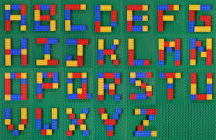
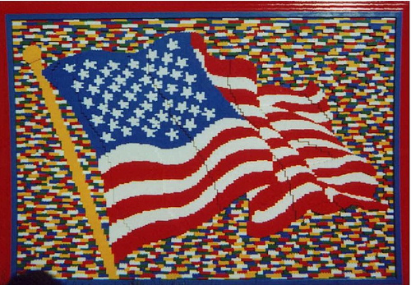
D&C 115:5
“…the Church of itself cannot be this standard. Since the Church is made up of individuals, it becomes an individual responsibility to make the Church a standard for the nations. It must be a standard in my life. I must so conduct myself that I may be a standard worthy of being followed by those who seek the greater joy in life.”
Elder John A. Widtsoe
“Standard for the nations”
A standard is a flag or banner that serves as a rallying point or inspirational symbol. Our example as Church members can inspire others and draw them to the Lord.
If
we arise
and shine
forth,
our light
will be a
a standard
for the
nations

Slide 10

What do we need to defend ourselves against?
What do we need refuge from?
In what ways have you seen that gathering together as Saints helps us defend ourselves and find refuge?
D&C 115:6

Slide 11

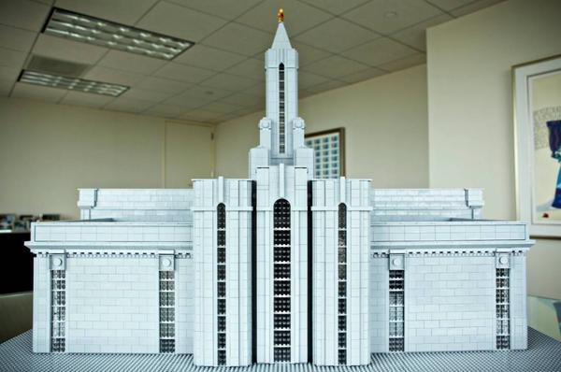
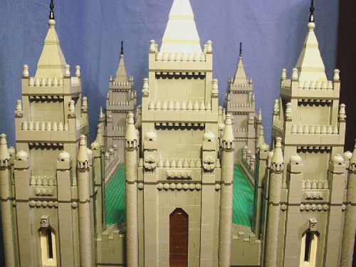
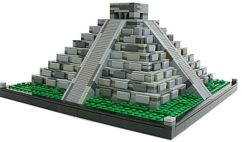
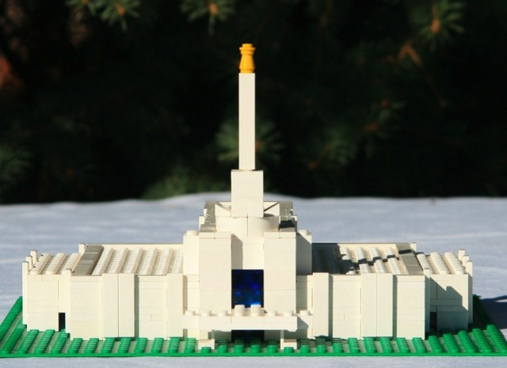
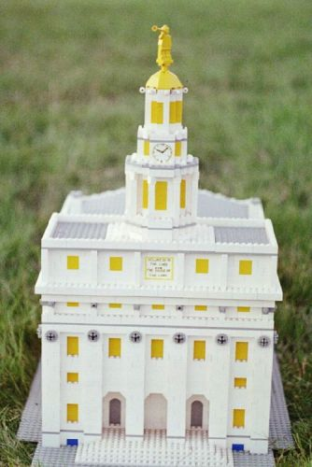
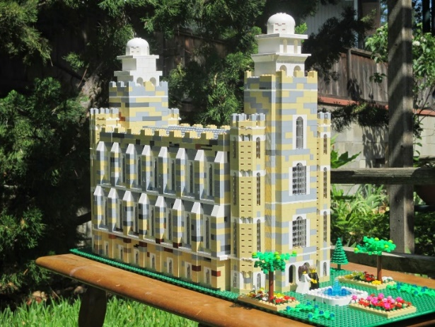
D&C 115:6
“As the stakes of Zion spread across the face of the earth, we expect temples to follow. The hope is…every faithful Latter=day Saint will find themselves within some reasonable proximity of a temple”
McConkie and Ostler
We gather
to the
Stakes of
Zion for
defense and
For refuge

Slide 12

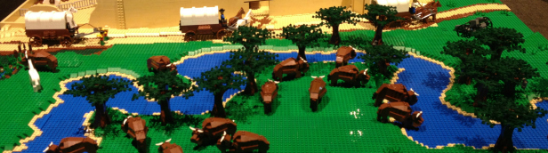
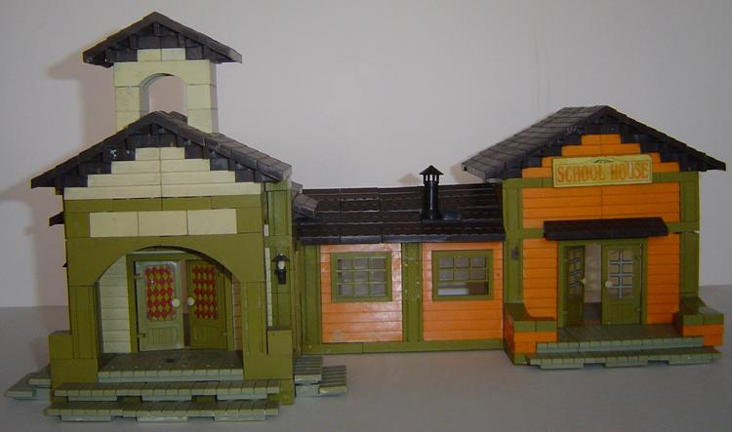
May 19, 1838
The Lord reveals His will concerning a temple in Far West
After the Saints began moving to Far West, Missouri, in 1836, Church leaders made plans to build a temple similar to the one in Kirtland, Ohio. Even though some preliminary excavation was done, further construction was suspended until Joseph Smith could receive additional instruction from the Lord.
“At this time there were about 150 houses at Far West, and among them were stores, hotels, and a fine schoolhouse.
The city had sprung up, as by magic, in the midst of a rolling prairie.”
Smith and Sjodahl
D&C 115:7-19

Slide 13


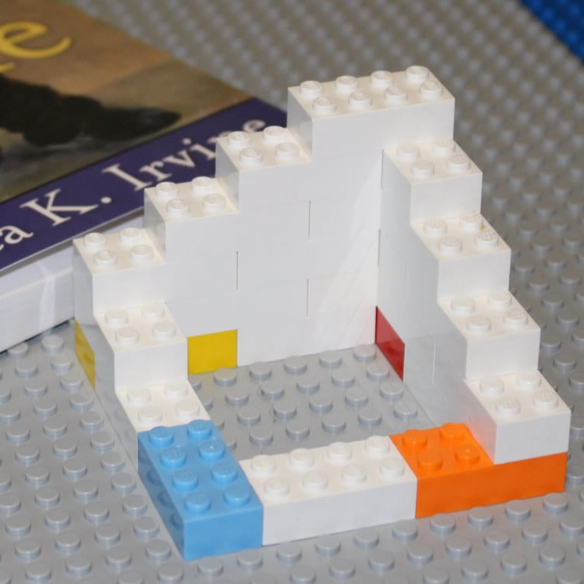
“The corner stones of the Temple were laid on the 4th of July, 1838. The excavation, one historian says, 120 by 80 feet in area, and 5 feet in depth was completed in half a day, more than 500 men being employed in the work.
Little else was done, however, for the storm of persecution broke loose in all its fury, and the Saints at that place went into exile again.”
Smith and Sjodahl
“It is quite probable that if the Saints had gathered in greater numbers and built up their Stakes and cities more rapidly, the enemies would have had less power to execute their designs. That they did not do their duty in this respect, (may be inferred from Section 117:1–6).”
Smith and Sjodahl
D&C 115:10-16

Slide 14

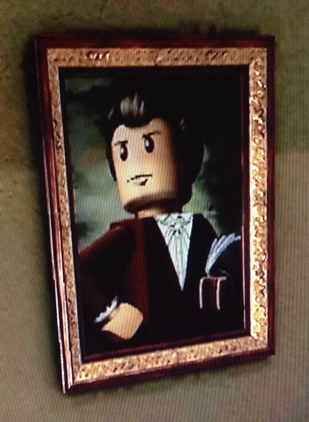
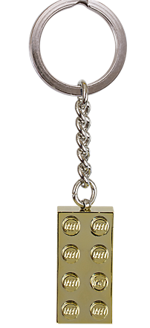
The President of the Church holds the keys to direct the Lord’s work upon the earth.
“The Prophet Joseph Smith, received revelation explain the proper order for organizing a stake of Zion”
McConkie and Ostler
D&C 115:18-19

Slide 15
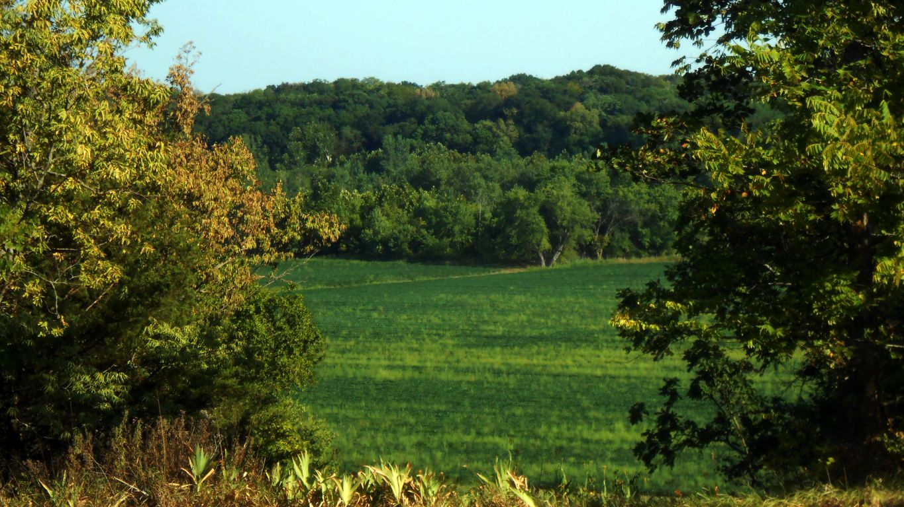
Adam-ondi-Ahman
Spring Hill, Missouri.
“Ahman is one of the names by which God was known to Adam.Adam-ondi-Ahman, a name carried over from the pure Adamic language into English, is one for which we have not been given a revealed, literal translation.
As near as we can judge—and this view comes down from the early brethren who associated with the Prophet Joseph Smith, who was the first one to use the name in this dispensation—Adam-ondi-Ahman means the place or land of God where Adam dwelt”
Elder Bruce R. McConkie
D&C 116:1

Slide 16
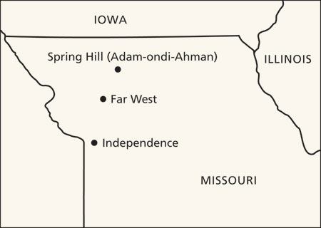
“He [Christ] will come in private to his prophet and to the apostles then living. Those who have held keys and powers and authorities in all ages from Adam to the present will also be present. And further, all the faithful members of the Church then living and all the faithful saints of all the ages past will be present. It will be the greatest congregation of faithful saints ever assembled on planet earth. It will be a sacrament meeting. It will be a day of judgment for the faithful of all the ages. And it will take place in Daviess County, Missouri, at a place called Adam-ondi-Ahman.”
Elder Bruce R. McConkie
D&C 116:1

Slide 17

Sources:
Videos:
Introduction to the Theme (4:04)
Light in Their Eyes (2:29)
195 Dresses (5:10)
Russell M. Nelson, “The Correct Name of the Church,” Ensign or Liahona, Nov. 2018, 87, 89
History of the Church, 2:509; Smith, Essentials in Church History, p. 569
Elder M. Russell Ballard (“The Importance of a Name,” Ensign or Liahona, Nov. 2011, 80)
Joseph Fielding McConkie and Craig J. Ostler Revelations of the Restoration pg. 916
Presentation by ©http://fashionsbylynda.com/blog/
Elder John A. Widtsoe (In Conference Report, Apr. 1940, p. 35.)
Hyrum M. Smith and Janne M. Sjodahl Doctrine and Covenants Commentary pgs. 742-43
Elder Bruce R. McConkie (Mormon Doctrine, 2nd ed. [1966], 19–20).
(The Millennial Messiah: The Second Coming of the Son of Man [1982], 578–79).
3 Key aspects: https://www.churchofjesuschrist.org/church/news/3-key-aspects-of-the-new-church-symbol-its-purpose-and-use?lang=eng
THANK YOU TO ALL THE LEGO FANS
Presentation by ©http://fashionsbylynda.com/blog/

Slide 18
The Logo of the Church:
With the recent releases of the logo of the Church in Bosnian, Macedonian, Montenegrin, Persian, Tshiluba, and Yapese, the Church identifier has now been published in more than 100 languages.
The growing number of languages into which the Church's logo has been translated is simply a reflection of the Church's growth around the world.
The project began in December 1995, when President Gordon B. Hinckley (1910–2008) directed that a new Church logo be adopted. The logo was designed so that the name of the Savior was the most prominent feature in the Church’s official name and has been translated into various languages since.
Because the Church’s name and logotype are important identifiers—and because they are registered trademarks or otherwise protected worldwide—the Church has created guidelines for appropriately using the name and logotype of the Church.
Because the Church’s name and logotype are important identifiers—and because they are registered trademarks or otherwise protected worldwide—the Church has created guidelines for appropriately using the name and logotype of the Church.
Local units may use the written name of the Church (not the logotype) when all of the following conditions are met:
The activity or function with which the name is associated is officially sponsored by the unit—for example, in a sacrament meeting program.
The name of the local unit is used as a prelude to the name of the Church.
The typeface does not imitate or resemble that of the official Church logotype.
The Church’s official logotype is to be used only for items approved by the Correlation Department at Church headquarters, such as the following:
Official Church publications and stationery
Missionary name tags
Meetinghouse exterior signs
The logotype may not be used as a decorative element or a computer screensaver. It also cannot be used in any personal, commercial, or promotional way.
The importance of the Church's name stems from the fact that it was given to Joseph Smith through revelation in 1838. The revelation can be found in Doctrine and Covenants 115:4.
Church Logo Published in More Than 100 Languages
Contributed By Chelsee Niebergall, Church News and Events
23 MAY 2011
President Joseph Fielding Smith taught about the time when Adam will come to visit his people:
“This gathering of the children of Adam, where the thousands, and the tens of thousands are assembled in the judgment, will be one of the greatest events this troubled earth has ever seen. At this conference, or council, all who have held keys of dispensations will render a report of their stewardship. Adam will do likewise, and then he will surrender to Christ all authority. Then Adam will be confirmed in his calling as the prince over his posterity and will be officially installed and crowned eternally in this presiding calling. Then Christ will be received as King of kings, and Lord of lords. We do not know how long a time this gathering will be in session, or how many sessions may be held at this grand council. It is sufficient to know that it is a gathering of the Priesthood of God from the beginning of this earth down to the present, in which reports will be made and all who have been given dispensations (talents) will declare their keys and ministry and make report of their stewardship according to the parable. Judgment will be rendered unto them for this is a gathering of the righteous, those who have held and who hold keys of authority in the Kingdom of God upon this earth. It is not to be the judgment of the wicked. When all things are prepared and every key and power set in order with a full and perfect report of each man’s stewardship, then Christ will receive these reports and be installed as rightful Ruler of this earth. At this grand council he will take his place by the united voice of the thousands who by right of Priesthood are there assembled. This will precede the great day of destruction of the wicked and will be the preparation for the Millennial Reign” (The Progress of Man[1952], 481–82).

Slide 19
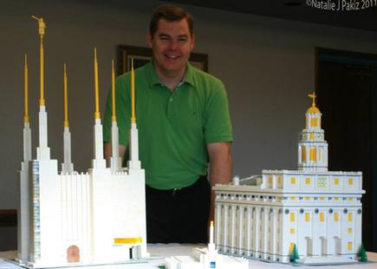
Andrew H. Johnson shows his Lego replicas of the Washington D.C. and Nauvoo Illinois temples.
Natalie J. Pakiz
DENVER — Andrew H. Johnson has four models of Mormon temples in his home.
James Holmes has one of the Salt Lake Temple he built as a freshman in his high school geometry class. It took him and a partner 40 hours to fashion since it had to meet strict geometric standards as well as resemble a world famous icon.
It resides in the library of East Lincoln High School in Denver, N.C.
And while the replicas were built to meet different goals, they all represent the faith and love of temples of their builders.
Holmes found building a wooden temple an opportunity to let his classmates know about his faith and what he believes in. Between the project and playing high school soccer, he is now well known as the "Mormon," said his mother. The family lives outside Charlotte, N.C.
Johnson, of Denver, Colo., had always wanted to be an architect. Growing up, he dreamed that one day he would design and build a series of temples representing the buildings sacred to members of The Church of Jesus Christ of Latter-day Saints.
In 1999, he found himself unemployed with time on his hands so he decided to get rid of his stress by devoting himself to building an authentic model of an existing temple.
"At that time, the Nauvoo Temple had not been announced as a rebuild, so I found the original blueprints and built it from those," Johnson said. "My family loved it and forbade me from ever taking it apart. It's still sitting on our entertainment center in our home."
After that, Johnson built the Denver Colorado Temple, the Salt Lake Temple and the Washington D.C. Temple.
The Nauvoo Illinois Temple was built with Lego building bricks Johnson had on hand. (He soon starting shopping on bricklink.com to find his material.)
"That's a lot of white," Johnson said, "Then when I got to the top, my wife found a submarine model with the right pieces. I then blew $35 to get four yellow dome pieces.“
The Salt Lake Temple took 22,500 bricks, five years and took over the Johnson's son's room.
The iconic Mormon temple is the largest of Johnson's models at 3 1/2 feet square. There are wires threaded through the six towers so it can be lighted.
"I still look at it today and ask myself, 'How did I get that done?' It's a monster," Johnson said.
"I kept track of every single brick and kept a journal so if I had to rebuild it I could."
The Nauvoo Illinois Temple measures 1 1/2 feet by 2 feet and has no Moroni. The other three have little yellow figures for the
familiar gold angel atop the steeple.
The Denver Colorado Temple was built as a template for a future temple kit.
"The smaller ones are actually harder to create because they need to retain the look of the actual temple," Johnson said.
"The larger it is, the easier to build," he said.
As far as paying for the building the temples, Johnson built the first one a little at a time (hence the five-year build time).
The others average about a dime per brick.
Fortunately, Johnson said, his wife doesn't keep strict track of the cost involved.
"It can get way expensive," Johnson said. "Look at the towers, for them we need hexagonal pieces and borders for all four corners.“
Johnson said before starting a temple project he looks at his arsenal of bricks and tries to envision what he'll use for each area
such as the moonstones, Moroni, the cornices and ledges. He knows he has to get the base right so it will be stable.
(He doesn't glue anything together.)
He tries to visualize the end result.
"You do that enough, you get excited."
By Sharon Haddock, For the Deseret News
Published: Monday, Jan. 9 2012 5:00 a.m. MST

