Slide 1
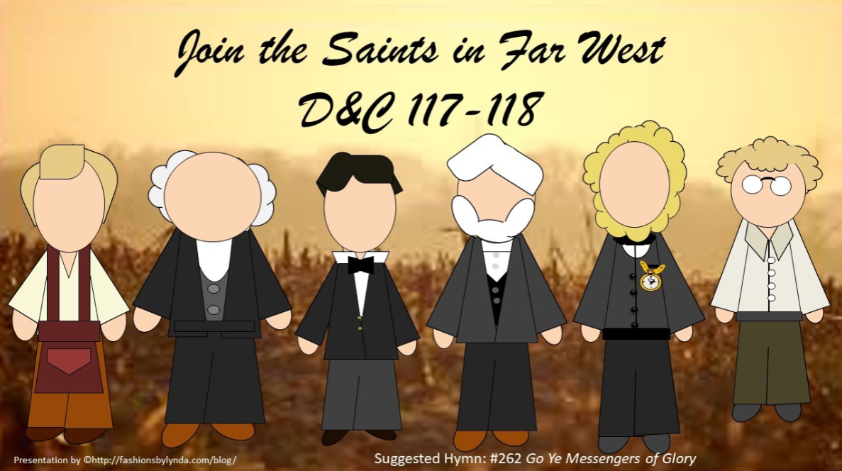

Slide 2
Newel K. Whitney
Recap
He was born February 5, 1795, in Marlborough, Vermont
He settled in Ohio as a merchandiser and worked with Sidney Gilbert as a clerk and bookkeeper
Both him and his wife, Elizabeth, were taught the gospel and baptized in November 1830
In 1838, as tensions were rising between members and their neighbors in Kirtland, the Whitney family moved to Far West, Missouri. He was called to serve as the bishop of the stake in Adam-ondi-Ahman. But the Saints in the area were violently persecuted and driven to Illinois.
He was called to be a bishop in December of 1831 and later presiding Bishop of the Church after the martyrdom of Joseph Smith
He and his family joined the westward trek in 1848
He passed away with chest pains on September 23, 1850, in Salt Lake City, Utah
He is mentioned in the Doctrine and Covenants 13 times
Who’s Who--Mormonwiki

Slide 3
William Marks
He was born on November 15, 1792, in Rutland, Virginia to Cornwall (or Cornell) Marks and Sarah Goodrich. He married Rosannah Robinson on May 2, 1813, and was the father of five children
He joined the Church in New York, ordained a priest, and moved his family to Kirkland and opened a bookstore
He was called serve on the high council on September 3, 1837, and soon became an agent working with Bishop Newel K. Whitney
He was called to complete his business in Kirtland and move to Far West
While he was preparing to leave, the Saints left Missouri for Nauvoo, so he moved to Commerce, then later Nauvoo and filled a number of Church and civic callings
He was serving as president of the stake and helping the church with land dealings, specifically being a stockholder in the planned Nauvoo House
His testimony began to waver in 1844, and he allied himself with the enemies of the Church after Joseph was martyred
He supported Sidney Rigdon’s claim of succession of leadership
He later retracted his support and returned to fellowship for a time, but left the Church again and became associated with other religious groups, one of which was the Reorganized Church of Jesus Christ of Latter-Day Saints
He moved to Little Rock, Illinois and died May 22, 1872 (Joseph Smith Papers say he died in June 1870 in Plano, Illinois)
Who’s Who--Wikipedia

Slide 4

Oliver Granger
He was born Phelps, New York, to Pierce Granger and Clarissa Trumbull and a member of the Methodist Church and a licensed preacher
On September 8, 1813, Granger married Lydia Dibble
During the 1820s, Granger was a sheriff in Ontario County, New York
In 1827, Granger lost most of his vision due to cold and exposure
He and his wife obtained a Book of Mormon and was baptized by Brigham Young and Joseph Young in 1832, and moved to Kirtland, Ohio in 1833
He served a mission to the eastern states with Samuel Newcomb, then served another mission to New York with John P. Greene in 1836
He was appointed to Kirtland high council in October 1837
He left Kirtland for Far West in June 1838 but returned to Kirtland to settle his and Joseph Smith’s affairs. However, in October 1838 he and his family attempted to go to Far West but was turned back by the mobs in Missouri. He later moved to Commerce (later Nauvoo, Illinois) in the spring of 1839
He was called, by revelation, to help settle the financial affairs of the Church in Kirtland
He continued his service for the Church as a land agent in Illinois and Iowa before passing away on August 25, 1841, in Kirtland, Ohio
Who’s Who—Wikipedia—Joseph Smith Papers

Slide 5
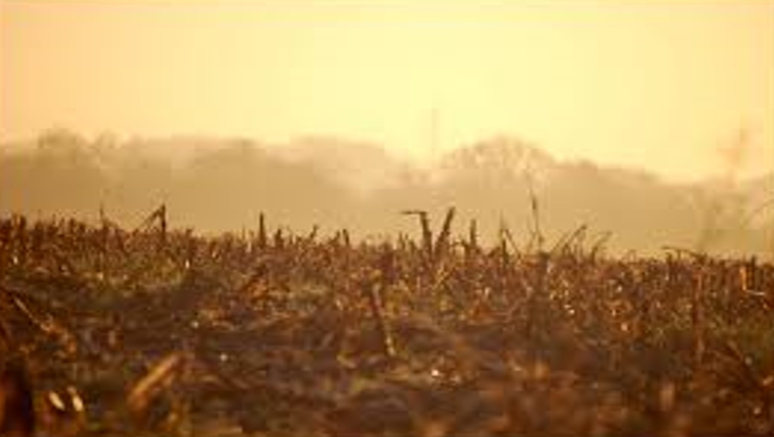
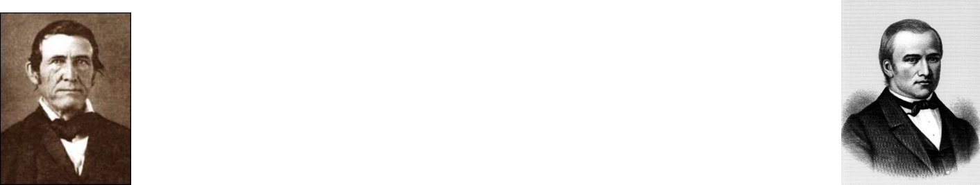
Background
July 8, 1838—Far West
“The Lord had commanded the Saints to gather and build up Far West speedily (See Sec. 115:17).
A company of 515 souls, known as the Kirtland Camp, left Kirtland on the 6th of July 1838, for Zion.
Neither Marks, Whitney, nor Granger were members of this company.
“Granger was already in Far West. He carried this revelation to Marks and Whitney in Kirtland and was instructed to return speedily to the land of Zion.
Joseph Smith at Far West had no means of knowing, at that time, who had, or who had not, left for Zion; but the Lord knew. Hence this Revelation in which He … calls William Marks and Newel K. Whitney to come to Zion and instructs the Saints concerning the property in Kirtland.” Smith and Sjodahl
On the 14th of September, it appears only 260 members were left, the others having been scattered ‘to the four winds.’
The camp arrived in Adam-ondi-Ahman on the 4th of October.

Slide 6
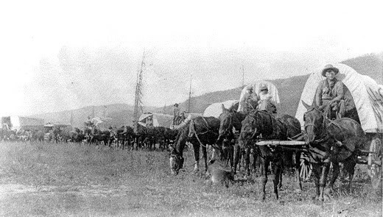
Speedily—Do Not Tarry
On 6 July 1838, a mile-long wagon train moved slowly southward along the old Chillicothe Road in northern Ohio. Over five hundred disheartened Saints were leaving homes, businesses, and a beautiful temple to embark on an arduous three-month journey to join the Prophet and the Saints in northern Missouri.
One of the Saints recalled, “We turned the key and locked the door of our homes, leaving our property and all we possessed in the hands of enemies and strangers, never receiving a cent for anything we owned.”
Shurtleff and Cahoon

Slide 7
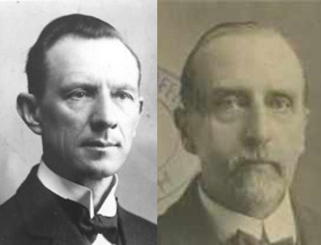
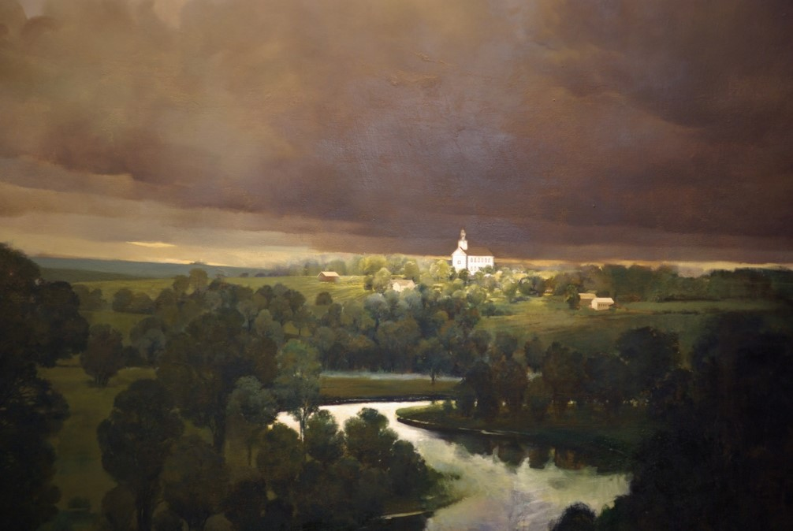
Kirtland Camp
The Saints had property in Kirtland, and there was property belonging to the church. Many of them lingered there, reluctant to sacrifice their temporal interests.
He calls the people to repent and to let the property go for the liquidation of debt.”
Smith and Sjodahl
D&C 117:1-6

Slide 8
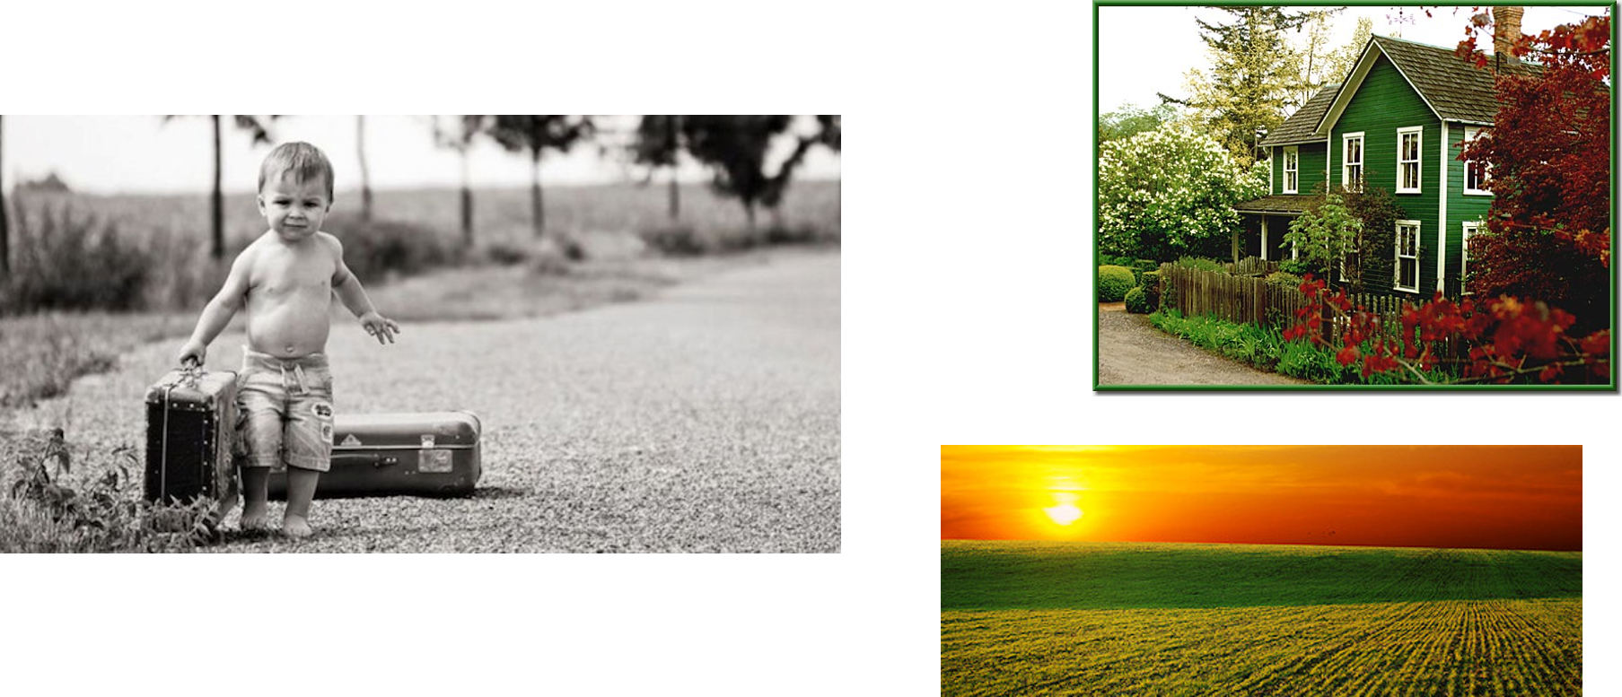
Reluctance
Why someone might be hesitant to obey a commandment from the Lord?
D&C 117:1-6

Slide 9

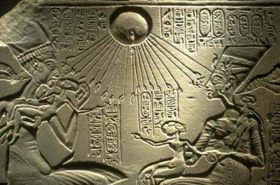
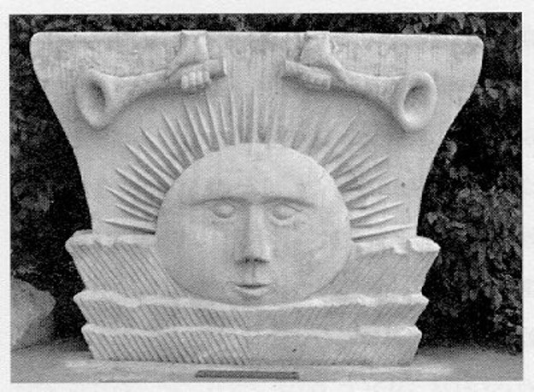
Blessed Is This Land
Wherever the Saints have settled, the land has been blessed
Shinehah—Sun
Olahah Shinehah—A place where Adam dwelt
And he said unto me: This is Shinehah, which is the sun. And he said unto me: Kokob, which is star. And he said unto me: Olea, which is the moon. And he said unto me: Kokaubeam, which signifies stars, or all the great lights, which were in the firmament of heaven.
Abraham 3:13
D&C 117:8

Slide 10
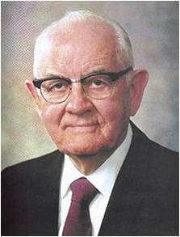
Covert That Which is But the Drop
“One man I know of was called to a position of service in the Church, but he felt that he couldn’t accept because his investments required more attention and more of his time than he could spare for the Lord’s work. He left the service of the Lord in search of Mammon, and he is a millionaire today.”
“But I recently learned an interesting fact: If a man owns a million dollars worth of gold at today’s prices, he possesses approximately one 27-billionth of all the gold that is present in the earth’s thin crust alone. This is an amount so small in proportion as to be inconceivable to the mind of man. But there is more to this:
The Lord who created and has power over all the earth created many other earths as well, even ‘worlds without number’; and when this man received the oath and covenant of the priesthood, he received a promise from the Lord of ‘all that my Father hath’.
To set aside all these great promises in favor of a chest of gold and a sense of carnal security is a mistake in perspective of colossal proportions. To think that he has settled for so little is a saddening and pitiful prospect indeed; the souls of men are far more precious than this.”
President Spencer W. Kimball
D&C 117:8

Slide 11
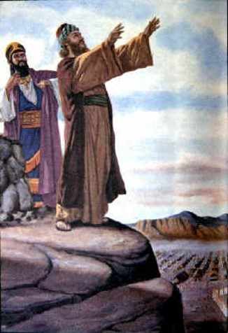

Nicolaitane Band
Many scholars believe that the Nicolaitans in New Testament times were followers of Nicolas. He was one of the seven appointed by the Church at Jerusalem to supervise the distribution of food and goods. Nicolas was believed by some of the early Church fathers to have apostatized from the true gospel and then to have established a sect of his own—the Nicolaitans
Dictionary of the Bible
And the saying pleased the whole multitude: and they chose Stephen, a man full of faith and of the Holy Ghost, and Philip, and Prochorus, and Nicanor, and Timon, and Parmenas, and Nicolas a proselyte of Antioch:
Acts 6:5
“Nicolaitans today are “members of the Church who [are] trying to maintain their church standing while continuing to live after the manner of the world. … The designation has come to be used to identify those who want their names on the records of the Church, but do not want to devote themselves to the gospel cause with full purpose of heart.” Elder Bruce R. McConkie
D&C 117:11

Slide 12
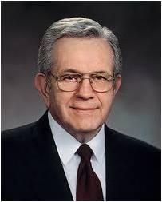
The Business Agent
Oliver Granger was a man of faith and business ability…
He firmly believed that God would bless that endeavor.
When the Prophet fled from Kirtland, he appointed Granger his business agent.
His name is to be held in remembrance for his faithful services as a man of business, having sanctified his talent to the service of the Lord.
The sacrifices we make in the service of the Lord are sacred to Him
“What did Oliver Granger do that his name should be held in sacred remembrance? Nothing much, really. It was not so much what he did as what he was. …
“The Lord did not expect Oliver to be perfect, perhaps not even to succeed. …
“We cannot always expect to succeed, but we should try the best we can.”
Elder Boyd K. Packer
D&C 117:12-16

Slide 13
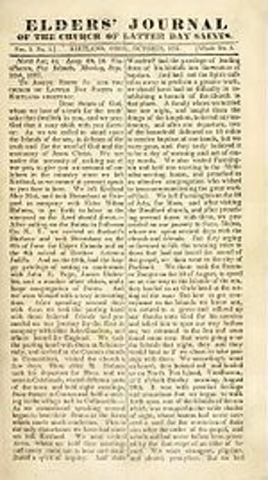
Minutes of the Meeting
“Far West, July 9, 1838, a conference of the Twelve Apostles assembled at Far West, agreeable to the revelation, given July 8, 1838 [section 118]. Present, Thomas B. Marsh, David W. Patten, Brigham Young, Parley P. Pratt and William Smith: T. B. Marsh, presiding.
“Resolved 1st. That the persons who are to fill the places of those who are fallen, be immediately notified to come to Far West; as also, those of the Twelve who are not present.
“Resolved 2nd. That Thomas B. Marsh notify Wilford Woodruff, that Parley P. Pratt notify Orson Pratt, and that President Rigdon notify Willard Richards, who is now in England.
“Voted that President Marsh publish the same in next number of The Elders’ Journal.
“President Rigdon gave some counsel concerning the provisions necessary to be made for the families of the Twelve, while laboring in the cause of their Redeemer, advising them to instruct their converts to move without delay to the places of gathering, and there to strictly attend to the law of God.” HC
The minutes were signed by T. B. Marsh, president, and G. W. Robinson, clerk.
D&C 118—Student Manual

Slide 14
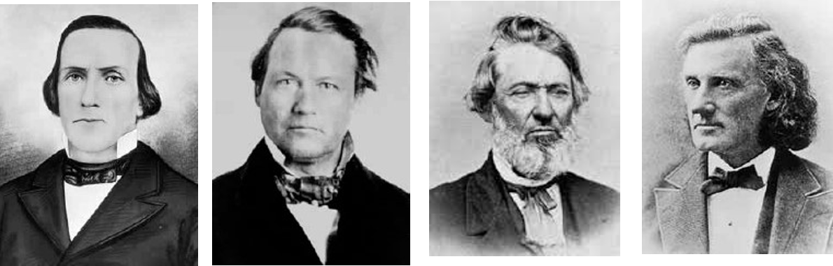
The Lord’s Way
July 8, 1838, the Lord called four new Apostles to replace Luke Johnson, Lyman E. Johnson, William E. McLellin, and John F. Boynton, who had apostatized.
If we preach the gospel in the Lord’s way, He will provide for our families. If we preach the gospel in the Lord’s way, He will prepare others to receive His message
D&C 118:3

Slide 15
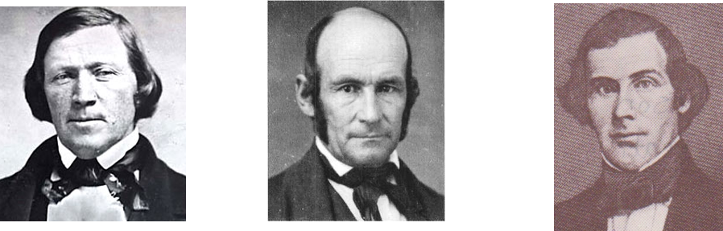
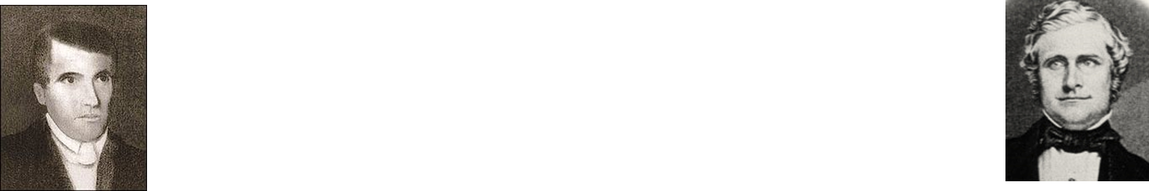
Leaving When Planned
In the months following this revelation, persecution increased in Missouri. Eventually the Saints were expelled from that state. These conditions made it dangerous for the Twelve to fulfill the Lord’s command to meet in Far West.
Many Missourians openly boasted that they would prevent the fulfillment of the revelation. But the Twelve were determined to obey the Lord’s command.
On the morning of April 26, 1839, Elders Brigham Young, Heber C. Kimball, and Orson Pratt, along with Elders John E. Page and John Taylor, who had recently been ordained Apostles went to the Far West temple site.
(Not all faithful members of the quorum could be there. For example, Elder Parley P. Pratt had been arrested and imprisoned on false charges.)
D&C 118:4-5

Slide 16
John Taylor
He was born on November 1, 1808, at Milnthorpe, England to James and Agnes Taylor
He apprenticed as a cooper (barrel maker)
He left the Church of England at age 16, and became a lay preacher for the Methodist Church
In 1830 his family immigrated to Toronto, Canada, while he attended to some business in England. In 1832 he journeyed through New York to join his family in Canada and met Leonora Cannon and married
In 1836 he learned about of the restored Church through Parley P. Pratt and was baptized by Parley P. Pratt on May 9, 1836, and ordained an elder and then a high priest.
He was called by revelation on July 8, 1838, to be a member of the Quorum of the Twelve
He served a mission in Great Britain and filled important civic offices in Nauvoo
He was a firsthand witness of the martyrdom of the Prophet Joseph at Carthage on June 27, 1844, and survived 4 musket balls* (see story)
He had a marvelous singing voice, according to Joseph Smith, and wrote several hymns
“Joseph the Seer” and “Go Ye Messengers of Glory" (no. 262)
In 1846, he and Brigham Young led 1500 Saints to the Utah Valley
He served as a Mission President in two Missions: France, and Eastern States, based in New York
With the death of Brigham Young in 1877, he became the 3rd President of the Church and sustained in 1880
He died of heart failure on July 25, 1887, in Kaysville, Utah and buried in Salt Lake Cemetery
Who’s Who—Karla C. Erickson

Slide 17
Wilford Woodruff
He was born March 1, 1807, at Farmington, Connecticut to Aphek Woodruff and Beulah Thompson who died of "spotted fever” when Wilford was fifteen months old.
He was raised by his step-mother Azubah Hart. He worked at a sawmill and a flour mill owned by his father.
He learned of the Church in 1833 and was baptized on December 31, 1833
He journeyed to Kirtland to meet the Prophet Joseph in April 1834 and joined Zion’s Camp.
He married Phoebe Carter on April 13, 1837—she was one of the leading ladies who helped organize the Relief Society in Utah
He served on a mission to the southern states, and then to the eastern states
He was called to the Quorum of the Twelve Apostles (while on a mission) and ordained to that position on April 26, 1839, at the Far West temple site. (D&C 124:129)
He served a mission to England and brought more than 1,800 souls into the Church
He was serving on a mission to the eastern states while the Martyrdom took place
He served again in Great Britain, then helped organize the Saints on their exodus to Utah
Following the death of John Taylor, Wilford Woodruff became the 4th President of the Church, on September 24, 1890, and sustained at the general conference on October 6, 1890
He was known as “Wilford the Faithful”
He died in San Francisco at age 91 on September 2, 1898, and buried in the Salt Lake Cemetery
Who’s Who--Wikipedia

Slide 18
Willard Richards
He was born on June 24, 1804, at Hopkinton, Massachusetts to Joseph Richards and Rhoda Howe
At the age of four, he injured his head in a fall and was left with some residual muscle tremor and paralysis
He was an educator and pursued additional studies in physical mechanics, science, and studied the clarinet, then later a physician, and established a medical practice in Boston
When he acquired a copy of the Book of Mormon, he journeyed to Kirtland in 1836 and was baptized by his cousin, Brigham Young, on December 31, 1836
He served a mission in the British Isles and married one of his converts, Jennetta Richards, in 1838
He learned of his call the Quorum of Twelve while on his mission (D&C 118:6)
He was appointed private secretary to the Prophet Joseph Smith in April 1841, while in Nauvoo
He escaped “without even a hole in his robe” (D&C 135:2) during the Martyrdom of Joseph Smith
He accompanied Brigham Young to the Salt Lake Valley in 1847
He helped establish the Desert News
He served as Second Counselor to President Young from 1847 until his death on March 11, 1854, and buried in the Salt Lake Cemetery
Who’s Who--Wikipedia

Slide 19
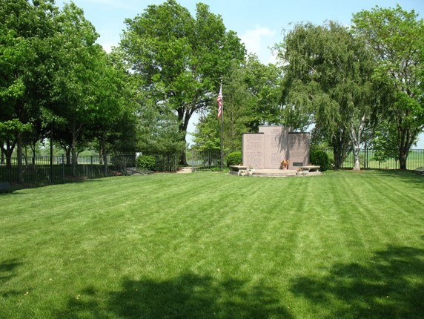
Placing a Large Stone—Prophecy Fulfilled
Near the southeast corner of the lot.
Ordained new Apostles: Elders Wilford Woodruff and George A. Smith, to fill vacancies in the Quorum of the Twelve.
“In the early morning hours [on April 26, 1839, after the Quorum of the Twelve Apostles met at the Far West temple site,] Theodore Turley (from Canada), one of the Saints who had been at Far West with the Twelve, went to the home of apostate Isaac Russell to say goodbye. Russell was astounded that his friend was in Far West with members of the Twelve and speechless upon learning that the prophecy was fulfilled.”
Church History
D&C 118:6

Slide 20
Sources:
Video:
Moments That Matter Most (3:11)
Doctrine and Covenants Who’s Who by Ed J. Pinegar and Richard J. Allen pg. 37-38, 94-95,159, 169-171
Hyrum M. Smith and Janne M. Sjodahl Doctrine and Covenants Commentary p. 744
Stella Cahoon Shurtleff and Brent Farrington Cahoon, comps., Reynolds Cahoon and His Stalwart Sons (n.p.: Stella Cahoon Shurtleff, 1960), p. 28.
President Spencer W. Kimball (“The False Gods We Worship,” Ensign, June 1976, p. 5.)
Interpreter’s Dictionary of the Bible, 3:548
Elder Bruce R. McConkie (Doctrinal New Testament Commentary, 3:446.)
Presentation by ©http://fashionsbylynda.com/blog/
Elder Boyd K. Packer (“The Least of These,” Ensign or Liahona, Nov. 2004, 86).
Elder Boyd K. Packer (“The Least of These,” Ensign or Liahona, Nov. 2004, 86).
(History of the Church,3:47.)
(Church History in the Fulness of Times Student Manual, 2nd ed. [Church Educational System manual, 2003], 226).
Presentation by ©http://fashionsbylynda.com/blog/

Slide 21
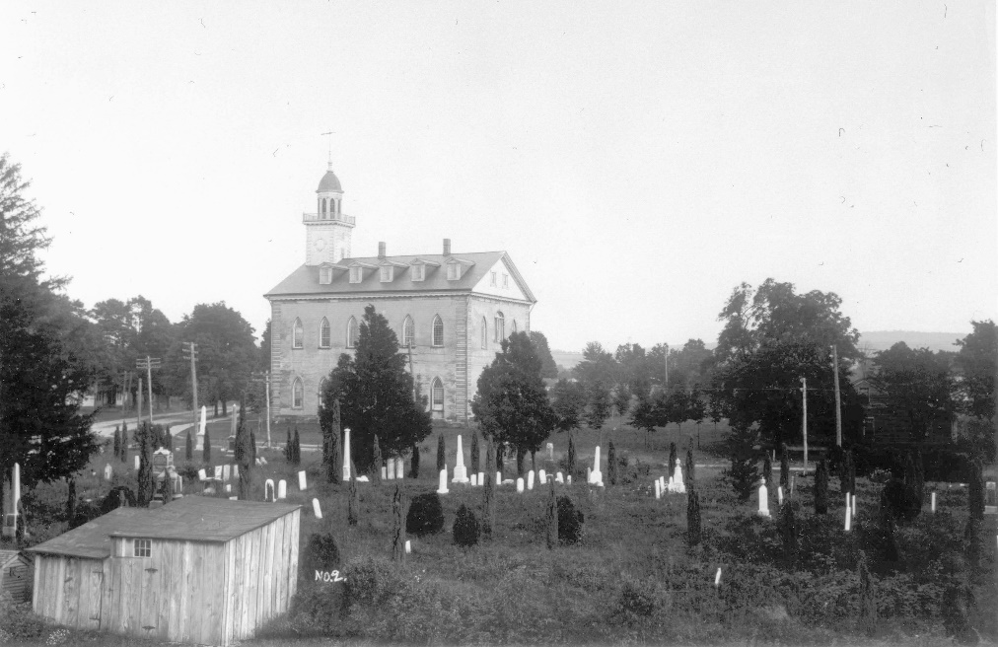
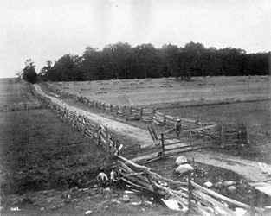

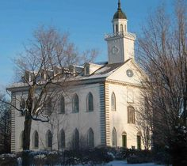
Palmyra--Originally known as Swift or Swift's Landing, the town became the District of Tolland soon after settlement began. However, a meeting was held in January 1796 for the purpose of deciding upon an official name for the town. The historic name "Palmyra" was proposed and adopted without dissent.
The first settler in Palmyra was John Swift in 1789. John Swift built the first grist mill in the town, held the first militia training, organized and donated land for the first church, the first schoolhouse and the first burial ground.
A commercial building, a general store, erected in the late 1820s, Now the William W. Phelps Museum
Palmyra in 1820
Kirtland is named for Turhand Kirtland, a principal of the Connecticut Land Company and judge in Trumbull County.
Being less well suited to agriculture, the densely forested, clay soiled, high, hilly, land of Kirtland was settled later than surrounding townships.
From 1831 to 1838 Kirtland was the headquarters for the Latter Day Saint movement. Joseph Smith moved the church to Kirtland in 1831, shortly after its formal organization in April 1830 in Palmyra, New York. Latter Day Saints built their first temple there, a historic landmark that is now owned and operated by the Community of Christ
1907
Palmyra Now
Today

Slide 22
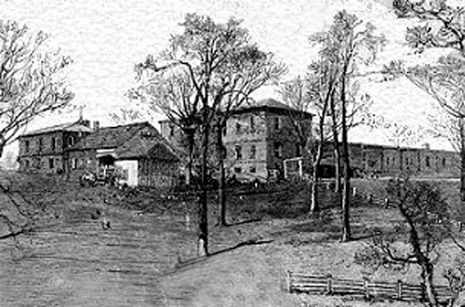
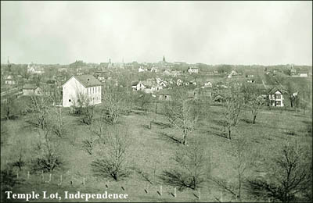
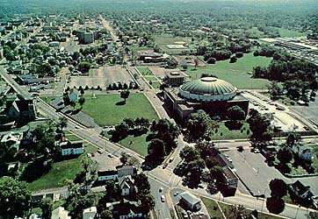
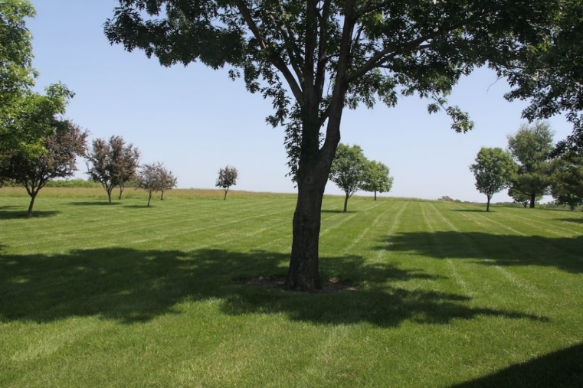
Independence, Missouri was originally inhabited by Missouri and Osage Indians, followed by the Spanish and a brief French tenure. It became part of the United States with the Louisiana Purchase of 1803. Lewis and Clark recorded in their journals that they stopped in 1804 to pick plums, raspberries, and wild apples at a site that would later form part of the city.
Named after the Declaration of Independence, Independence was founded on March 29, 1827, and quickly became an important frontier town.
Independence saw great prosperity from the late 1830s through the mid-1840s, while the business of outfitting pioneers boomed.
Between 1848 and 1868, it was a hub of the California Trail.
Far West, Missouri
The town was founded by Missouri Mormon leaders, W. W. Phelps and John Whitmer in August 1836 shortly before the county's creation. The town was platted originally as a 1-mile (1.6 km) square area, centered on a public square which was to house a temple.
Towards the end of 1836, Caldwell County was created specifically for Mormon settlement to recompense Mormon losses in Jackson County. Shortly after the creation of Caldwell County, Far West was made the county seat.
Latter Day Saints poured into Far West for protection and found themselves under siege. Joseph Smith Jr., Sidney Rigdon and others surrendered at the end of October, 1838, and were put on trial by the state for treason. The main body of the Mormons were then forced to sign over their property in Far West and Caldwell County to pay for the militia muster and then leave the state. The main body later settled in Nauvoo, Illinois.
1830
1870
1979
Temple Site Today

Slide 23
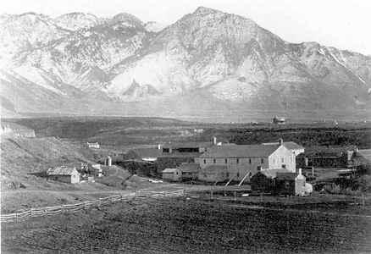
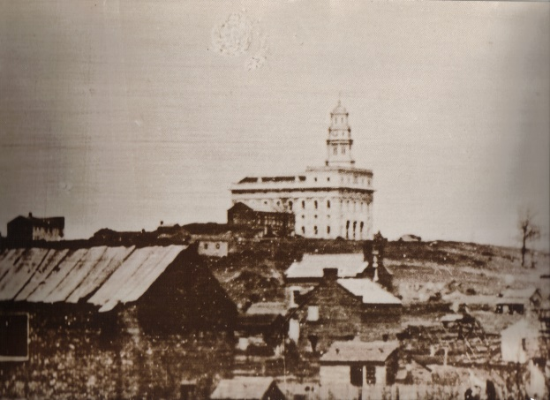
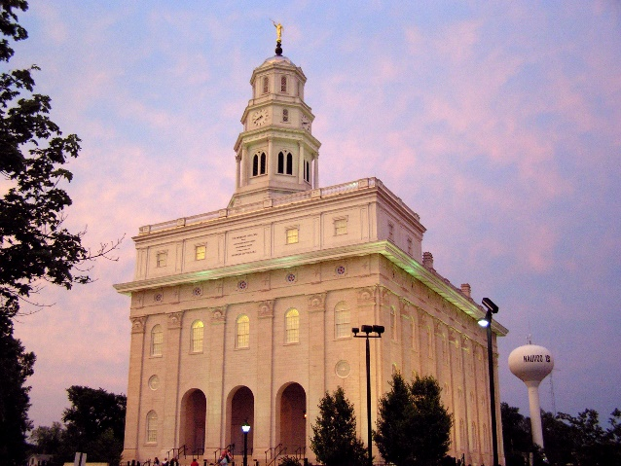
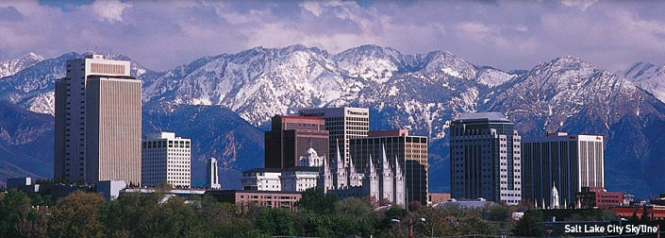
The area of Nauvoo was first called Quashquema, named in honor of the Native American chief who headed a Sauk and Fox settlement numbering nearly 500 lodges. By 1827, white settlers had built cabins in the area. By 1829 this area of Hancock County had grown sufficiently so that a post office was needed and in 1832 the town, now called Venus, was one of the contenders for the new county seat. However, the honor was awarded to a nearby city, Carthage. In 1834 the name Venus was changed to Commerce because the settlers felt that the new name better suited their plans.
In late 1839, arriving Mormons bought the small town of Commerce and in April 1840 it was renamed Nauvoo by Joseph Smith, who led the Latter Day Saints to Nauvoo to escape religious persecution in Missouri. The name Nauvoo is derived from the traditional Hebrew language with an anglicized spelling. The word comes from Isaiah 52:7, “How beautiful upon the mountains...” It is notable that “by 1844 Nauvoo's population had swollen to 12,000, rivaling the size of Chicago” at the time.
On the city’s higher ground are the temple, residential areas, and the business district along Mulholland Street (Illinois Route 96), much of it devoted to the needs of tourists and those interested in Latter Day Saint history. The flatlands are occupied by a small number of 19th-century brick houses and other buildings that have survived the city’s vicissitudes, with large empty spaces between them where houses and whole neighborhoods have entirely disappeared.
Community of Christ owns much of the southern end of the flatlands and maintains several key historic sites located in and around Nauvoo, including the Joseph Smith Homestead, the Nauvoo House, the Red Brick Store, the Mansion House, and the Smith Family Cemetery.
The LDS Church owns most of the other historic sites in Nauvoo, including the homes of Brigham Young, Heber C. Kimball, and other early members of the church, as well as other significant buildings.
Originally, the Salt Lake Valley was inhabited by the Shoshone, Paiute, Goshute and Ute Native American tribes. At the time of the founding of Salt Lake City the valley was within the territory of the Northwestern Shoshone, who had their seasonal camps along streams within the valley and in adjacent valleys.The land was treated by the United States as public domain; no aboriginal title by the Northwestern Shoshone was ever recognized by the United States or extinguished by treaty with the United States.
On July 24, 1847 143 men, three women and two children founded Great Salt Lake City several miles to the east of the Great Salt Lake, nestled in the northern most reaches of the Salt Lake Valley. At the time of its founding there were no Indians present in the Salt Lake valley. The first two in this company to enter the Salt Lake valley were Orson Pratt and Erastus Snow.
Thousands of Mormon pioneers would arrive in Salt Lake in the coming months and years.
Upon arrival to the Salt Lake valley, Young had a vision by saying, "It is enough. This is the right place. Drive on." (This is commonly shortened to, "This is the place"). There is a state park in Salt Lake City known as This Is The Place Heritage Park commemorating the spot where Young made the famous statement.
1863
Around 1845-46
Today
Today

Slide 24
“The plains of Olaha Shinehah, or the place where Adam dwelt,” wrote President Joseph Fielding Smith, “must be a part of, or in the vicinity of Adam-ondi-Ahman. This name Olaha Shinehah, may be, and in all probability is, from the language of Adam. We may without great controversy believe that this is the name which Adam gave to this place, at least we may venture this as a probable guess. Shinehah, according to the Book of Abraham, is the name given to the sun. (Abraham 3:13.) It is the name applied to Kirtland when the Lord desired in a revelation to hide its identity. President Joseph Fielding Smith (Church History and Modern Revelation, 2:97–98.)
The Elders' Journal of the Church of Jesus Christ of Latter-Day Saints (usually shortened to Elders' Journal) was an early Latter-Day Saint periodical edited by Don Carlos Smith, younger brother of Joseph Smith. It was the successor to the Latter-Day Saints' Messenger and Advocate and was eventually replaced by the Times and Seasons.
Two issues of the Elders' Journal were published in Kirtland, Ohio in 1837. The newspaper was then relocated to Far West, Missouri where two more issues were printed. The first two issues were published on the press that had previously been used to publish the Messenger and Advocate — but this press fell into the hands of Warren Parrish's schismatic "Church of Christ" and a new press had to be obtained before printing could continue. Joseph Smith, Jr. and Sidney Rigdon relocated to a new headquarters in Far West and continued to publish the Elders' Journal until the events of the 1838 Mormon War in Missouri prevented further operations in the state. The press of the Elders' Journal in Far West, was used by the LDS Church to publish Sidney Rigdon's July 4th oration, which was one of the factors that increased tensions between Latter Day Saints and non-Mormons in northwestern Missouri. Wikipedia
One Bible scholar wrote the following about the beliefs of the Nicolaitans: “They seem to have held that it was lawful to eat things sacrificed to idols, and to commit fornication, in opposition to the decree of the Church rendered in Acts 15:20, 29. … In a time of persecution, when the eating or not eating of things sacrificed to idols was more than ever a crucial test of faithfulness, they persuaded men more than ever that it was a thing indifferent. Rev. 2:13, 14. This was bad enough, but there was a yet worse evil. Mingling themselves in the orgies of idolatrous feasts, they brought the impurities of those feasts into the meetings of the Christian Church. And all this was done, it must be remembered, not simply as an indulgence of appetite, but as a part of a system, supported by a ‘doctrine,’ accompanied by the boast of a prophetic illumination.” (Smith, Dictionary of the Bible, p. 447.)
Wilford Woodruff
From the year 1834 to the close of 1895 he traveled 172,269 miles, held 7,555 meetings, attended 75 semi-annual conferences and 344 quarterly conferences; preached 3,526 discourses, established 77 preaching places in the missionary field; organized 51 branches of the church; received 18,9777 letters; wrote 11,519 letters, assisted in the confirmation into the church of 8,952 persons, and in addition to his work in the St. George temple, labored 603 days in the Endowment House in Salt Lake City. He traveled through England, Scotland, Wales, six islands of the sea, and 23 States and 5 Territories of the United States. Who’s Who

Slide 25
John Taylor--The Martyrdom of Joseph
On 27 June 1844 Elder Taylor, Elder Willard Richards, also of the Quorum of the Twelve Apostles, the Prophet Joseph Smith, and the Prophet’s brother Hyrum were in Carthage Jail awaiting word from the governor. While the four friends waited in prison, Elder Taylor sang the hymn “A Poor Wayfaring Man of Grief.” The mood was somber and melancholy. “Shortly Hyrum asked him to sing the song again, to which he replied:
“‘Brother Hyrum, I do not feel like singing.’
“‘Oh, never mind; commence singing and you will get the spirit of it.’
“Soon after finishing the song the second time, as he was sitting at one of the front windows of the jail, he saw a number of men, with painted faces. … The mob reaching the landing in front of the door, and thinking it was locked, fired a shot through the key hole. Hyrum and Doctor Richards sprang back, when instantly another ball crashed through the panel of the door and struck Hyrum in the face; at the same instant a ball … entered his back, and he fell exclaiming, ‘I am a dead man!’ …
“… Elder Taylor took his place next [to] the door, and with a heavy walking stick … parried the guns as they were thrust through the doorway and discharged. …
“… Streams of fire as thick as a man’s arm belched forth from the ever increasing number of guns in the door-way, yet calm, energetic and determined, Elder Taylor beat down the muzzles of those murderous guns.
“‘That’s right, Brother Taylor, parry them off as well as you can,’ said Joseph, as he stood behind him.”
But as the gunfire continued and more mobbers pushed their way up the stairs, Elder Taylor sprang for the open window.
“As [Elder Taylor] was in the act of leaping from the window, a ball fired from the door-way struck him about midway of his left thigh. He fell helpless on the window sill and would have dropped on the outside of the jail—when another shot from the outside, striking the watch in his vest pocket, threw him back into the room. … He drew himself as rapidly as possible in his crippled condition under the bedstead that stood near the window.
“While on his way three other bullets struck him; one a little below the left knee—it was never extracted; another tore away the flesh to the size of a man’s hand from his left hip and spattered the wall with blood and the mangled fragments; another entered the forepart of his left arm, a little above the wrist, and, passing down by the joint, lodged in the palm of his left hand.”
While he lay in pain, he heard the mob shout that the Prophet had leaped from the window.
“Dr. Richards … confirmed his worst fears—the Prophet was dead!
“‘I felt,’ says Elder Taylor, ‘a dull, lonely, sickening sensation at the news.’”
Several days later, Elder Taylor discovered that one ball of shot, aimed at his heart, had smashed into the crystal of his pocket watch, preventing him from falling from the jail window. He said, “I felt that the Lord had preserved me by a special act of mercy; that my time had not yet come, and that I had still a work to perform upon the earth.”
As a witness to the Martyrdom, Elder Taylor wrote the powerful and eloquent words that are now section 135 of the Doctrine and Covenants: “Joseph Smith, the Prophet and Seer of the Lord, has done more, save Jesus only, for the salvation of men in this world, than any other man that ever lived in it” (D&C 135:3).
John Taylor: Defender of Truth
By Karla C. Erickson January 2003 Ensign

Slide 26
Two Minutes in Jail as told by Willard Richards Times and Seasons, Vol.5, No.14, (1. Aug. 1844) pp.598-9 From the Nauvoo Neighbor. Possibly the following events, occupied near three minutes, but I think only about two, and have penned them for the gratification of many friends. Carthage, June 27th, 1844 A shower of musket balls were thrown up the stair way against the door of the prison in the second story, followed by many rapid footsteps. While Generals Joseph and Hyrum Smith, Mr. Taylor, and myself, who were in the front chamber, closed the door of our room against the entry at the head of the stairs, and placed ourselves against it, there being no lock on the door and no ketch that was useable. The door is a common panel, and as soon as we heard the feet at the stairs head, a ball was sent through the door, which passed between us, and showed that our enemies were desperadoes, and we must change our position. Gen. Joseph Smith, Mr. Taylor, and myself sprang back to the front part of the room, and Gen. Hyrum Smith retreated two thirds across the chamber directly in front of and facing the door. A ball was sent through the door which hit Hyrum on the side of his nose when he fell backwards extended at length without moving his feet. From the holes in his vest, (the day was warm and no one had their coats on but myself,) pantaloons, drawers and shirt, it appears evident that a ball must have been thrown from without, through the window, which entered his back on the right side and passing through lodged against his watch, which was in his right vest pocket completely pulverizing the crystal and face, tearing off the hands and mashing the whole body of the watch, at the same instant the ball from the door entered his nose. As he struck the floor he exclaimed emphatically; "I'm a dead man." Joseph looked towards him and responded, "O dear! Brother Hyrum!" and opening the door two or three inches with his left hand, discharged one barrel of a six shooter (pistol) at random in the entry from whence a ball grazed Hyrum's breast, and entering his throat passed into his head, while other muskets were aimed at him, and some balls hit him. Joseph continued snapping his revolver, round the casing of the door into the space as before, three barrels of which missed fire, while Mr. Taylor with a walking stick stood by his side and knocked down the bayonets and muskets, which were constantly discharging through the door way, while I stood by him, ready to lend any assistance, with another stick, but could not come within striking distance, without going directly before the muzzle of the guns. When the revolver failed, we had no more firearms, and expecting an immediate rush of the mob, and the door way full of muskets halfway in the room, and no hope but instant death from within: Mr. Taylor rushed into the window, which is some fifteen or twenty feet from the ground. When his body was nearly on a balance, a ball from the door within entered his leg, and a ball from without struck his watch, a patent lever, in his vest pocket, near the left breast, and smashed it in "pie," leaving the hands standing at 5 o'clock, 16 minutes, and 26 seconds -- the force of which ball threw him back on the floor, and he rolled under the bed which stood by his side, where he lay motionless, the mob from the door continuing to fire upon him, cutting away a piece of flesh from his left hip as large as a man's hand, and were hindered only by my knocking down their muzzles with a stick; while they continued to reach their guns into the room, probably left handed, and aimed their discharge so far around as almost to reach us in the corner of the room to where we retreated and dodged, and then I re-commenced the attack with my stick again. Joseph attempted as the last resort, to leap the same window from whence Mr. Taylor fell, when two balls pierced him from the door, and one entered his right breast from without, and he fell outward exclaiming, "O Lord my God!" As his feet went out of the window my head went in, the balls whistling all around. He fell on his left side a dead man. At this instant the cry was raised, "He's leaped the window," and the mob on the stairs and in the entry ran out. I withdrew from the window, thinking it of no use to leap out on a hundred bayonets, then around Gen. Smith's body. Not satisfied with this I again reached my head out of the window and watched some seconds, to see if there were any signs of life, regardless of my own, determined to see the end of him I loved; being fully satisfied, that he was dead, with a hundred men near the body and more coming round the corner of the jail, and expecting a return to our room I rushed towards the prison door, at the head of the stairs, and through the entry from whence the firing had proceeded, to learn if the doors into the prison were open. -- When near the entry, Mr. Taylor called out, "take me" I pressed my way till I found all doors unbarred, returning instantly caught Mr. Taylor under my arm, and rushed by the stairs into the dungeon, or inner prison, stretched him on the floor and covered him with a bed in such a manner, as not likely to be perceived, expecting an immediate return of the mob. I said to Mr. Taylor, this is a hard case to lay you on the floor, but if your wounds are not fatal I want you to live to tell the story. I expected to be shot the next moment, and stood before the door awaiting the onset.
http://www.mormonismi.net/artikkelit/richards_2_minutes_in_jail.shtml

