Slide 1

Doctrine and Covenants 119-120
The Law of Tithing
For all these have of their abundance cast in unto the offerings of God: but she of her penury hath cast in all the living that she had.
Luke 21:4

Slide 2
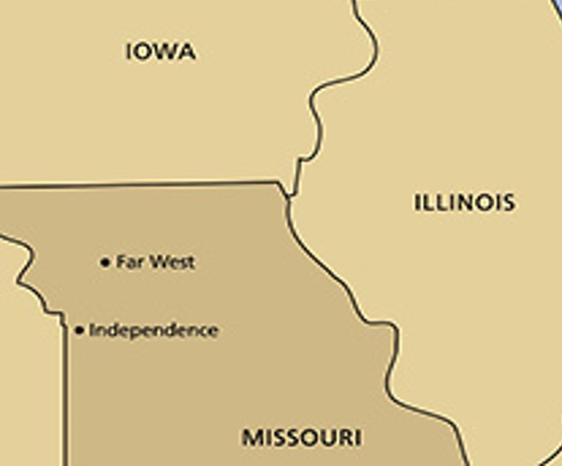
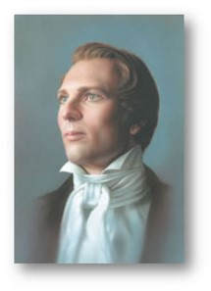
Background
The summer of 1838
The Saints were experiencing significant financial difficulties as they attempted to build up the Church in northern Missouri.
The Church members had been instructed to relocate to northern Missouri and build a temple in Far West
“O Lord! Show unto thy servant how much thou requirest of the properties of thy people for a tithing.” Joseph Smith

Slide 3
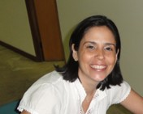
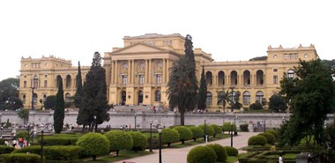

Sao Paulo, Brazil
“A woman in São Paulo, Brazil … worked while going to school to provide for her family. I use her own words in telling this story. She says:
“‘The university in which I studied had a regulation that prohibited the students that were in debt from taking tests.’ …
“‘I remember a time when I … faced serious financial difficulties. … When I figured the monthly budget, I noticed that there wouldn’t be enough to pay [both] my tithing and my university. I would have to choose between them.
The bimonthly tests would start the following week, and if I didn’t take them I could lose the school year. I felt great agony. … I had a painful decision before me, and I didn’t know what to decide.’”
President Gordon B. Hinckley

Slide 4

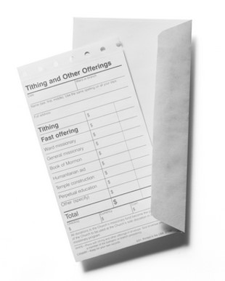
“‘This feeling consumed my soul and remained with me [for days]. It was then that I remembered that when I was baptized I had agreed to live the law of tithing.
I had taken upon myself an obligation, not with the missionaries, but with my Heavenly Father. At that moment, the anguish started to disappear, giving place to a pleasant sensation of tranquility and determination. …
“‘That night when I prayed, I asked the Lord to forgive me for my indecision. On Sunday, … with great pleasure I paid my tithing and offerings. That was a special day. I felt happy and peaceful within myself and with Heavenly Father’”
President Gordon B. Hinckley

Slide 5
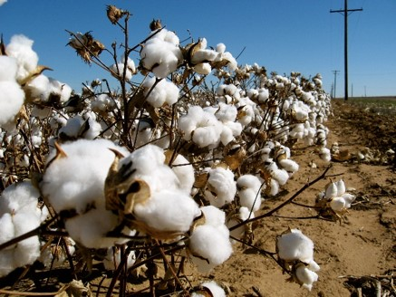
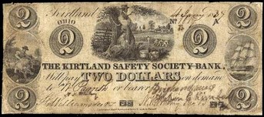
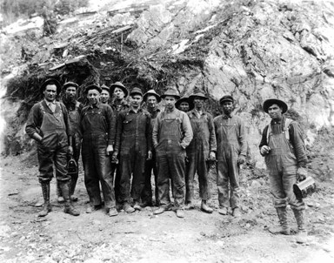
Economic Depression
The Panic of 1837 was a financial crisis in the United States that touched off a major recession that lasted until the mid-1840s.
Profits, prices and wages went down while unemployment went up.
A sharp decline in cotton prices, a collapsing land bubble, international specie flows, and restrictive lending policies in Great Britain were all to blame.
On May 10, 1837, banks in New York City suspended specie payments, meaning that they would no longer redeem commercial paper in specie at full face value.
Despite a brief recovery in 1838, the recession persisted for approximately seven years. Banks collapsed, businesses failed, prices declined, and thousands of workers lost their jobs.
Unemployment may have been as high as 25% in some locales. The years 1837 to 1844 were, generally speaking, years of deflation in wages and prices
Wikipedia Panic of 1837

Slide 6
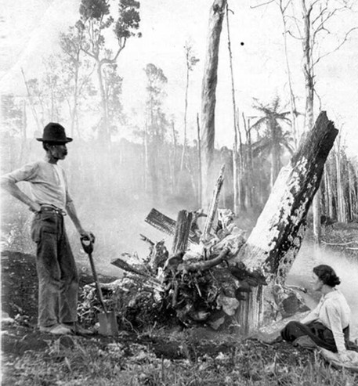
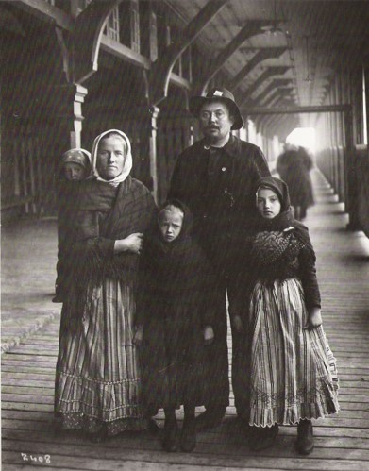
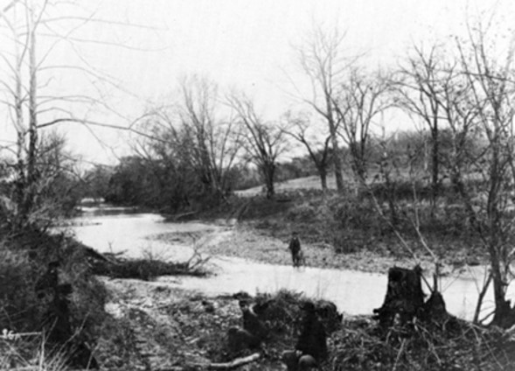
Saints Gathering
By 1838, with more Saints gathering to Caldwell County, Missouri, the Church needed money to accomplish what the Lord had commanded them to do, such as the building of the temple in Far West.
The bishops in Ohio and Missouri had been encouraging the Saints to bring their tithes and offerings to the storehouse.
July 25, 1838
Approximately one hundred families of immigrating Saints were camped on the Crooked River in lower Ray County…. “To prevent mobbing and confusion, and pestilence and death,” Church leaders advised the immigrants to “scatter among the people” in the settlements and find temporary lodgings and work.
Student Manual

Slide 7
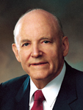
Tithing of the People
One-Tenth
“The law is simply stated as ‘one-tenth of all their interest.’ Interest means profit, compensation, increase. It is the wage of one employed, the profit from the operation of a business, the increase of one who grows or produces, or the income to a person from any other source. The Lord said it is a standing law ‘forever’ as it has been in the past”
President Howard W. Hunter
The Lord commands us to pay one-tenth of our increase to Him as tithing
D&C 119

Slide 8
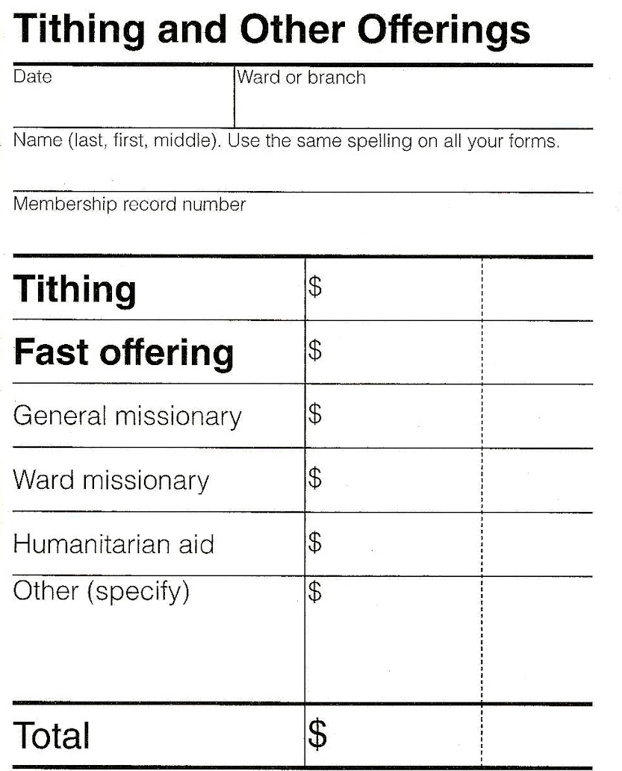
Tithing Slip
Ten percent of income
In the Church today, one Sabbath day each month is set aside for the purpose of fasting. Members of the Church go without food and water for two consecutive meals in a 24-hour period and then contribute the money that would have been spent for that food to those in need
Not all (those who want to serve a mission) have the financial resources, however, to fully fund a full-time mission. Generous donors provide needed funding so that all who want to serve a full-time mission may do so.
Donations to those who want to serve a mission specifically from your ward
Donating to a specific group or individual
Donations to the Humanitarian Aid Fund allows the Church to help people throughout the world by providing relief and help, especially during disasters.
D&C 119

Slide 9
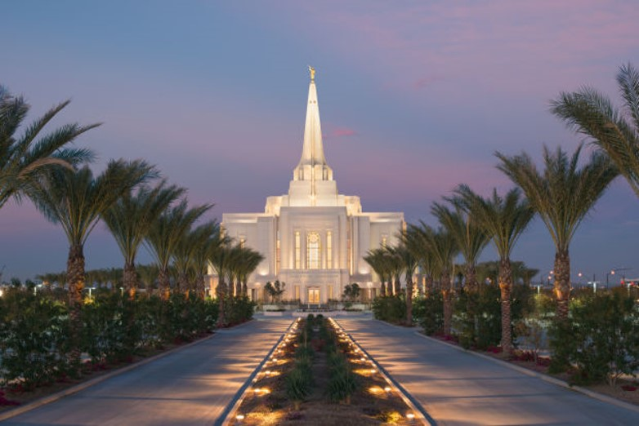
What Does Tithing Go To?
Tithing is used “for the building of [the Lord’s] house” [building temples] and “for the laying of the foundation of Zion and for the priesthood” [financing other aspects of the Lord’s work, such as building and maintaining meetinghouses, translating and publishing the scriptures, and supporting missionary and family history work throughout the world]
D&C 119

Slide 10
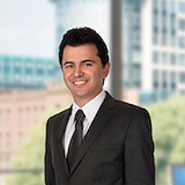
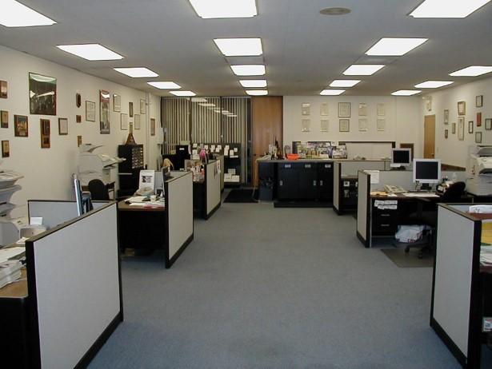
The Rest of the Story
“The next day I was in my office; I tried to find a way to be able to take the tests that would begin on Wednesday. The more I thought, the further I felt from a solution. At that time I worked in an attorney’s office, and my employer was the most strict and austere person I had ever met.
“The working period was ending when my employer approached and gave the last orders of the day. When he had done so, with his briefcase in his hand he bid farewell.
… Suddenly, he halted, and looking at me he asked, ‘How is your college?’ I was surprised, and I couldn’t believe what I was hearing. The only thing I could answer with a trembling voice was, ‘Everything is all right!’ He looked thoughtfully at me and bid farewell again. …
President Gordon B. Hinckley

Slide 11


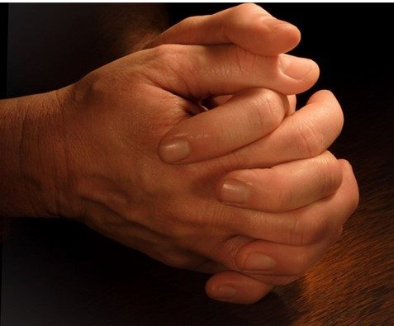
“Suddenly the secretary entered the room, saying that I was a very fortunate person! When I asked her why, she simply answered: ‘The employer has just said that from today on the company is going to pay fully for your college and your books.
Before you leave, stop at my desk and inform me of the costs so that tomorrow I can give you the check.’
“After she left, crying and feeling very humble, I knelt exactly where I was and thanked the Lord for His generosity.
President Gordon B. Hinckley

Slide 12
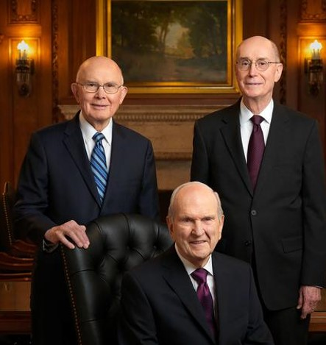
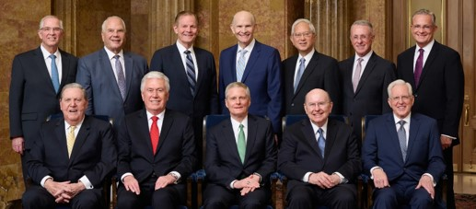
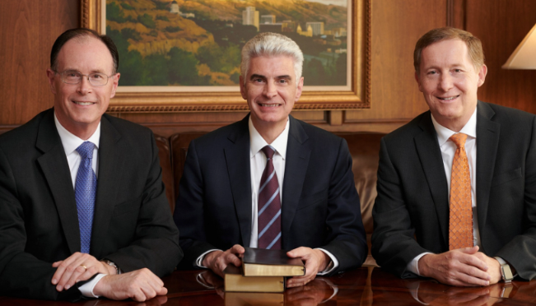
The Council of the Disposition
of the Tithes
The council is composed of the First Presidency, the Quorum of the Twelve Apostles, and the Presiding Bishopric.
How are the members of this council to decide how to use tithing funds?
By the Savior’s “own voice unto them.” In other words, by revelation
2024

Slide 13
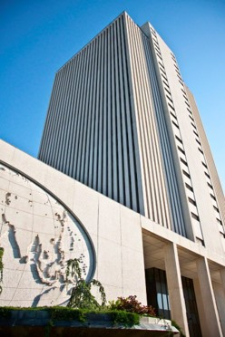
Collection of Tithing Funds
Each ward or branch submits its collected tithing funds to Church headquarters.
Local leaders do not determine how these sacred funds are used.
The Council on the Disposition of the Tithes makes those decisions under the direction of the Lord.
The Lord directs the use of tithing funds through His chosen servants
D&C 120

Slide 14
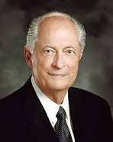
“It is remarkable to witness this council heed the Lord’s voice.
Each member is aware of and participates in all the council’s decisions.
No decision is made until the council is unanimous.
All tithing funds are spent for the purposes of the Church, including welfare—care for the poor and needy—temples, buildings and upkeep of meetinghouses, education, curriculum—in short, the work of the Lord. …
“To Church members and others throughout the world, I bear my testimony of the Council on the Disposition of the Tithes. I have sat on this council … as the Presiding Bishop of the Church and now as a member of the Quorum of the Twelve Apostles. Without exception, the tithing funds of this Church have been used for His purposes.”
Elder Robert D. Hales

Slide 15
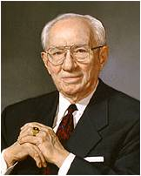
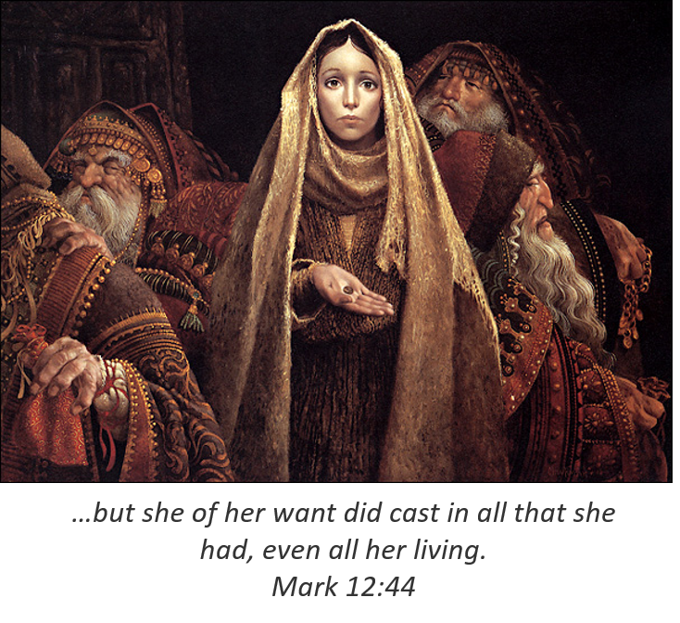
“I keep on the credenza behind my desk a widow’s mite that was given me in Jerusalem many years ago as a reminder, a constant reminder, of the sanctity of the funds with which we have to deal.
They come from the widow, they are her offering as well as the tithe of the rich man, and they are to be used with care and discretion for the purposes of the Lord. We treat them carefully and safeguard them and try in every way that we can to see that they are used as we feel the Lord would have them used for the upbuilding of His work and the betterment of people”
President Gordon B. Hinckley
Art by James C. Christensen

Slide 16
Sources:
Videos: Tithing Funds the Lord's Work (0:41)
A Standing Law unto the Church (5:16)
The Miracle of Tithing (1:22)
“Tithing: I Will Make a Leap of Faith” (4:47)
“The Language of the Gospel” (12:27)
Joseph Smith (History of the Church, 3:44.)
Presentation by ©http://fashionsbylynda.com/blog/
President Gordon B. Hinckley (“We Walk by Faith,” Ensign, May 2002, 73).
(“This Thing Was Not Done in a Corner,” Ensign, Nov. 1996, 50).
Church History In The Fulness Of Times Student Manual, (2003), 181–192
President Howard W. Hunter (in Conference Report, Apr. 1964, 35).
Elder Robert D. Hales (“Tithing: A Test of Faith with Eternal Blessings,” Ensign, Nov. 2002, 28).
Presentation by ©http://fashionsbylynda.com/blog/

Slide 17
An honest Tithe:
Elder John A. Widtsoe explained: “Tithing means one-tenth. Those who give less do not really pay tithing; they are lesser contributors to the Latter-day cause of the Lord. Tithing means one-tenth of a person’s income, interest, or increase. The merchant should pay tithing upon the net income of his business, the farmer upon the net income of his farming operations; the wage earner or salaried man upon the wage or salary earned by him. Out of the remaining nine-tenths he pays his current expenses … etc. To deduct living costs … and similar expenses from the income and pay tithing upon the remainder does not conform to the Lord’s commandment. Under such a system most people would show nothing on which to pay tithing. There is really no place for quibbling on this point. Tithing should be given upon the basis of our full earned income. If the nature of a business requires special interpretation, the tithe payer should consult the father of his ward, the bishop.” (Evidences and Reconciliations,2:86.)
The Presiding Bishopric consists of three men, the Presiding Bishop and his two counselors, who comprise one of the presiding councils of The Church of Jesus Christ of Latter-day Saints. These General Authorities, who each hold the office of bishop, serve in their positions under the direct supervision of the First Presidency. Since its formation, the Presiding Bishopric has been responsible for many of the temporal affairs of the Church. These have included involvement in receiving, distributing, and accounting for member tithes, offerings, and contributions; administration of programs to assist the poor and needy; design, construction, and maintenance of places of worship; and auditing and transferring records of membership. Men chosen to be Presiding Bishops have been recognized for their business and management skills as well as their religious commitment.
Presiding Bishopric of the Church, Bishop Gérald Caussé, first counselor; Presiding Bishop Gary E. Stevenson; Bishop Dean M. Davies, second counselor
The Law of the tithe:
Elder Robert D. Hales of the Quorum of the Twelve Apostles explained some of the spiritual purposes of paying our tithing:
“The foundation of provident living is the law of the tithe. The primary purpose of this law is to help us develop faith in our Heavenly Father and His Son, Jesus Christ. Tithing helps us overcome our desires for the things of this world and willingly make sacrifices for others. Tithing is the great equitable law, for no matter how rich or poor we are, all of us pay the same one-tenth of our increase annually (see D&C 119:4), and all of us receive blessings so great ‘that there shall not be room enough to receive [them]’ (Malachi 3:10)” (“Becoming Provident Providers Temporally and Spiritually,” Ensign or Liahona, May 2009, 9).
James C. Christensen (born September 26, 1942) is a popular American artist of religious and fantasy art and formerly an instructor at Brigham Young University. Christensen says his inspirations are myths, fables, fantasies, and tales of imagination.
Christensen was raised in Culver City, California and attended UCLA. He then moved to Utah to finish his higher education at Brigham Young University. He taught art for over 20 years at Brigham Young University until the late 1990s.
Something of Interest
Lower Canada in 1837: Rebellion Power Pt presentation http://www.slideshare.net/norm52/rebellions-of-1837-1838-power-point

