Slide 1

Expulsion From Missouri
Presentation by http://fashionsbylynda.com/blog/

Slide 2
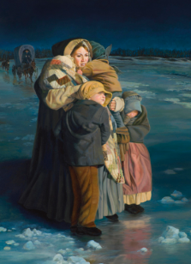
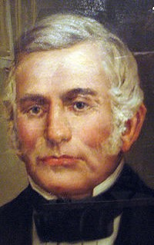
Extreme Hardship
The fall and winter of 1838–39 was a time of extreme hardship for the Saints in Missouri.
As tensions escalated between Church members and other Missouri residents,
Governor Lilburn W. Boggs ordered that the Saints be driven from the state.
During these difficulties, many turned to God and received His help.

Slide 3
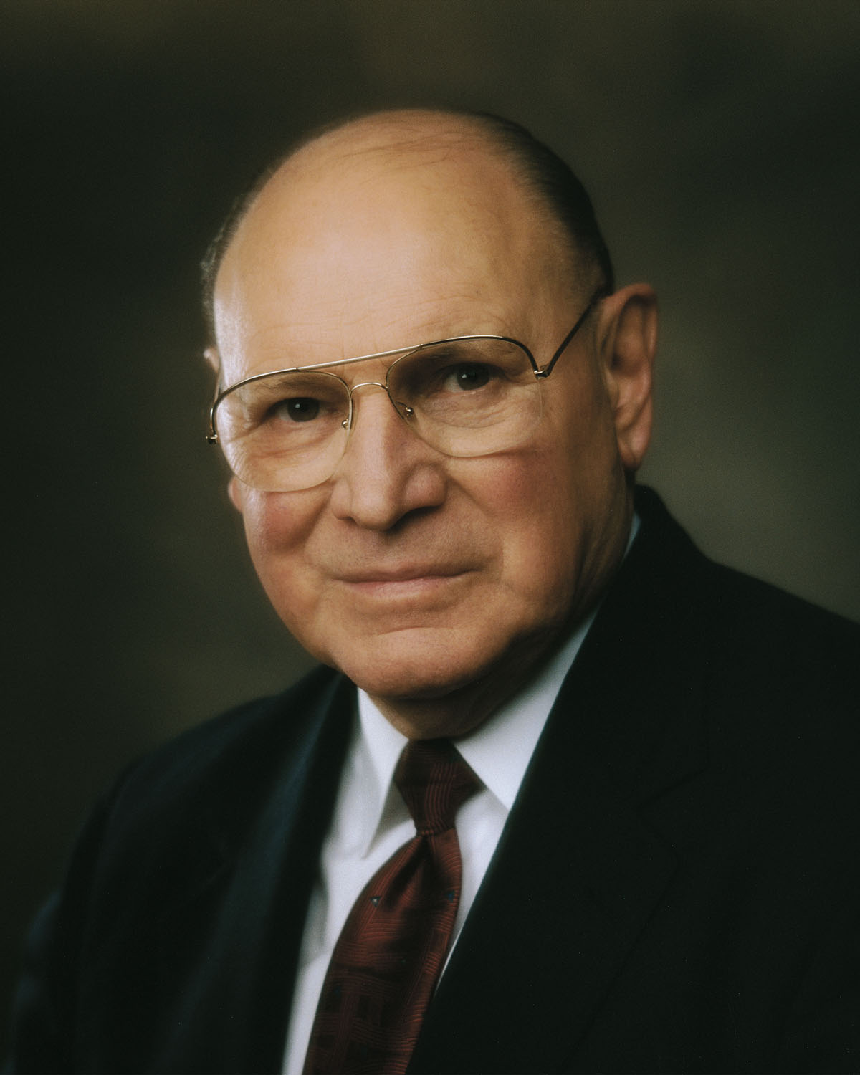
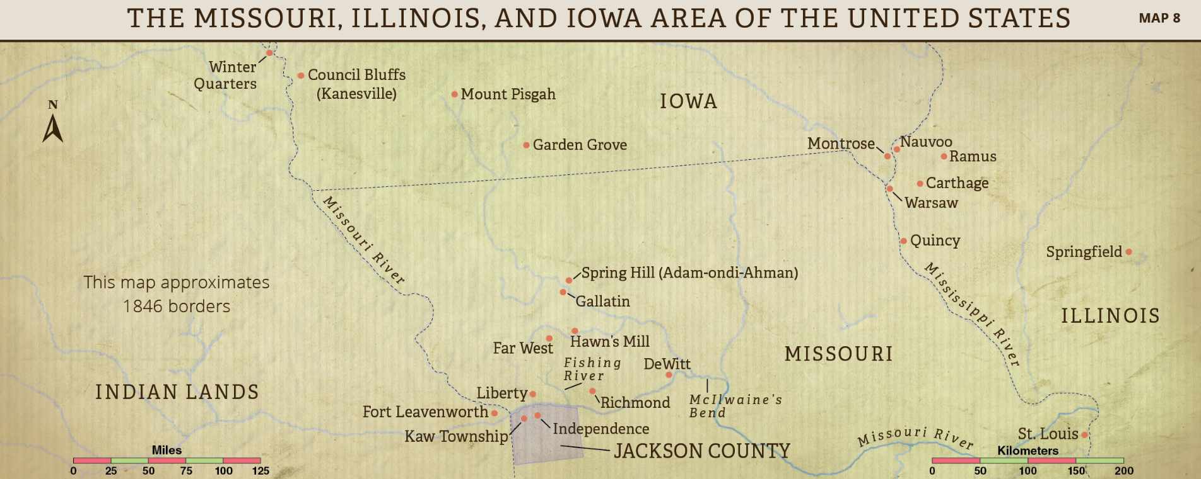
Where Do You Turn?
The way we react to adversity can be a major factor in how happy and successful we can be in life.
Joseph B. Wirthlin
In 1839, approximately 8,000 to 10,000 Saints were living in northern Missouri.
Between January and March, most were forced to leave their lands and homes.

Slide 4
Timeline- 1838
6 August
7 Sept.
1-7 Oct.
18-19 Oct.
25 Oct.
27 Oct.
30 Oct.
30 Oct.-6 Nov.
Election Day Battle at Gallatin
Governor Boggs’s Extermination Order
Siege Far Westof
Battle at Dewitt
Battle at Crooked River
Hawn’s Mill Massacre
Joseph Smith and Lyman Wight were tried before Judge Austin King
Guerrilla warfare in Daviess County
Church History in the Fulness of times Student Manual Chapter 16

Slide 5
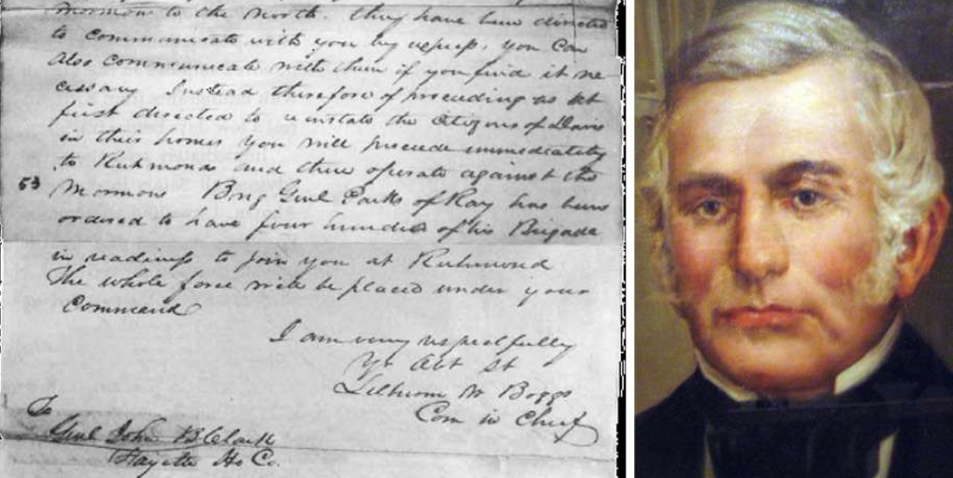
Executive Order
Missouri Governor Lilburn W. Boggs received highly exaggerated reports claiming that 50 to 60 Missourians had been killed in the battle.
The governor also received sworn statements from angry former Church leaders who falsely testified against Joseph Smith. On October 27, 1838,
Governor Boggs issued an executive order, declaring
“The Mormons must be treated as enemies and must be exterminated or driven from the state”

Slide 6
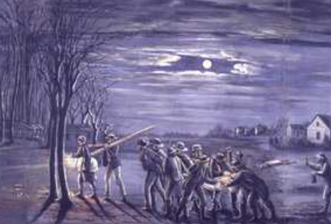
Arrest and Attack
After Governor Boggs issued his order, the Prophet Joseph Smith and other Church leaders were arrested by members of the Missouri militia.
Mobs attacked the town of Far West and other Latter-day Saint settlements

Slide 7
Timeline 1838-1839
December 1, 1838
January 16, 1839
January 26, 1839
February 1839
February 27, 1839
Joseph Smith and five other Church members were imprisoned in Liberty Jail.
A Church committee was formed to help the poor evacuate from Missouri.
A committee of citizens of Quincy, Illinois, passed a resolution to provide assistance and employment to the Saints.
Most Saints began to evacuate from Missouri
In a letter from Liberty Jail, the First Presidency appointed the Quorum of the Twelve Apostles to temporarily manage Church affairs.
Teacher Manual lesson 18

Slide 8
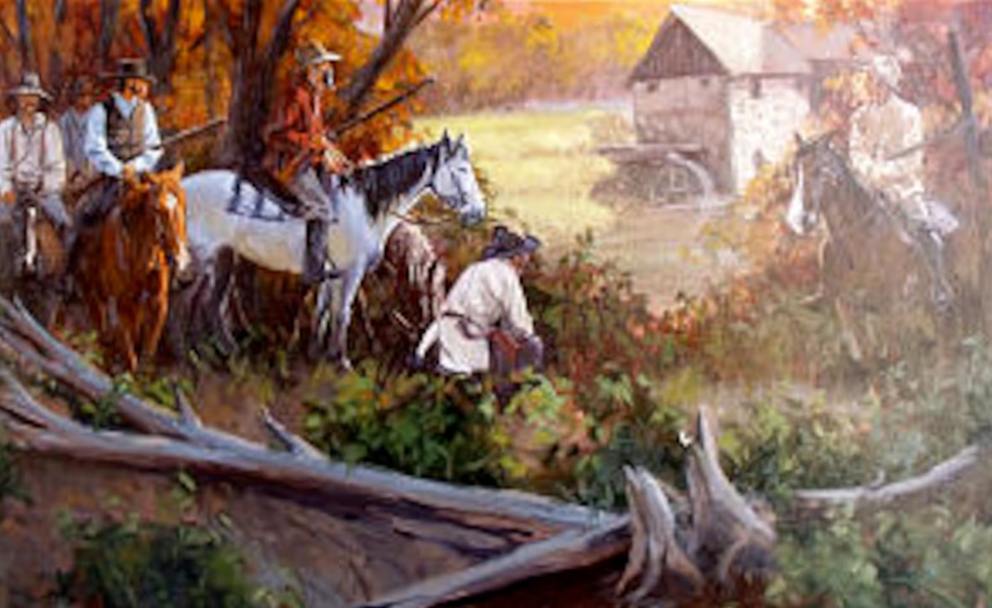
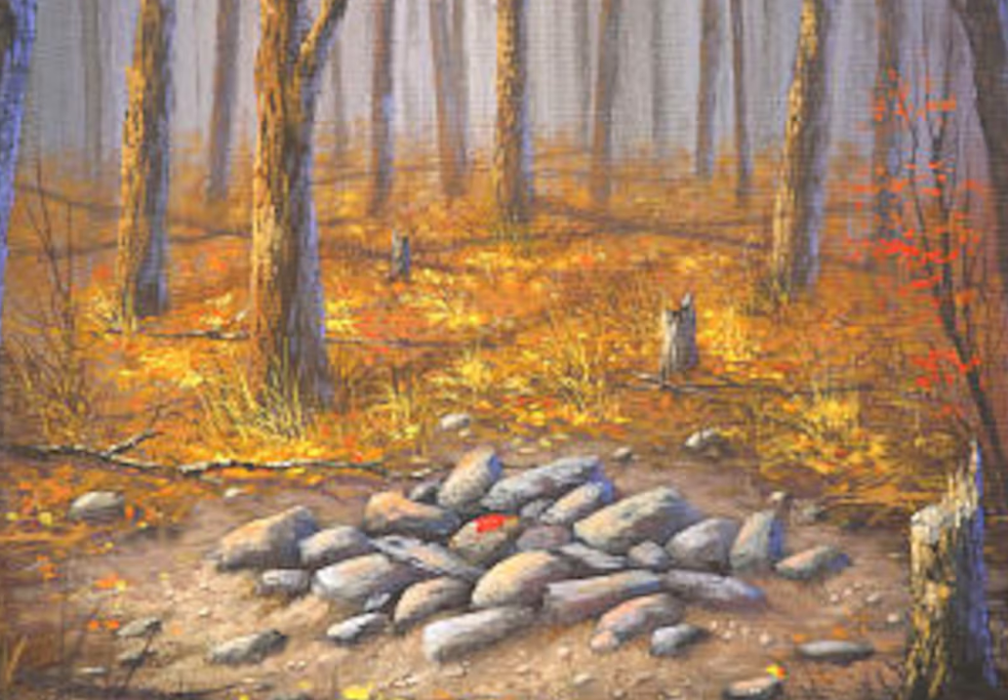
Hawn’s Mill
On October 30, 1838, Missouri mobs attacked a Latter-day Saint settlement known as Hawn’s Mill.
The mob shot at men and boys who had entered a blacksmith shop to seek shelter and defend their people.
Seventeen Latter-day Saints were killed in the attack, and more than a dozen were injured.

Slide 9
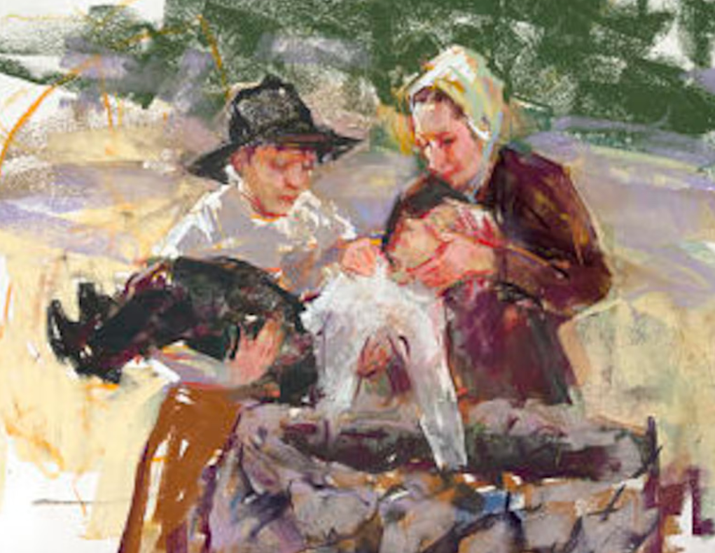
Amanda Barnes Smith
Among the injured was six-year-old Alma Smith, whose entire hip joint was gone after he had been shot. Alma’s mother,
Amanda Barnes Smith, was distraught when she found him. She also mourned for her husband and her 10-year-old son, who were both killed in the attack.
With nobody available to help her, Amanda gathered her remaining children together and prayed for guidance. “Oh, my Heavenly Father,” she prayed, “Thou seest my poor wounded boy and knowest my inexperience. Oh, Heavenly Father, direct me what to do.”

Slide 10
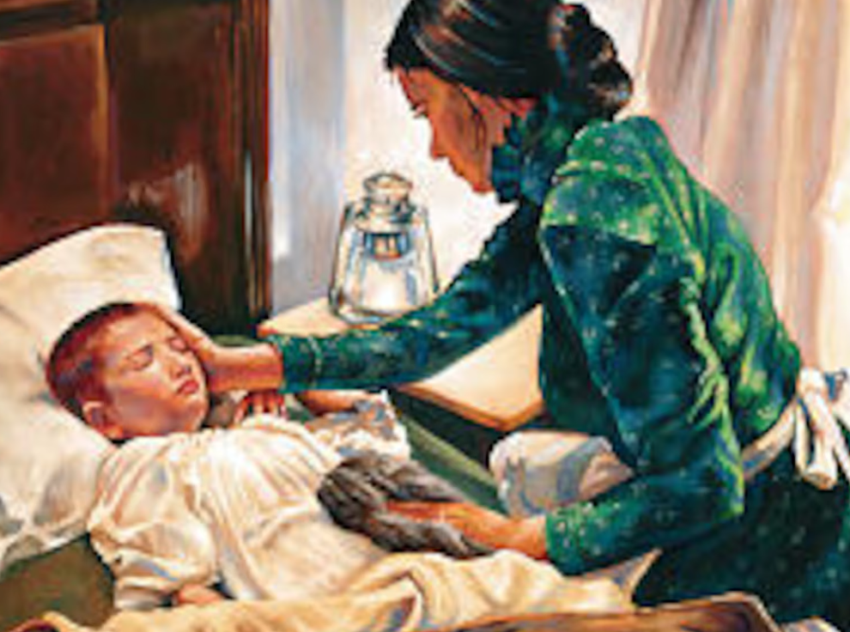
Alma’s Wound
As Amanda finished her prayer, she heard a voice direct her to mix ashes with water. She used the solution to wash Alma’s wound until it was clean. Next, Amanda felt prompted to take roots from an elm tree and grind them to a pulp. She put the pulp on Alma’s wound and wrapped it with linen.
“Now you lie like that, and don’t move,” she told her son, “and the Lord will make you another hip.”
Alma’s wound prevented Amanda and her family from evacuating after the attack. As weeks passed, the mob set a deadline for her and other remaining Saints to leave.

Slide 11


“How Firm A Foundation”
Amanda’s fear increased as the deadline came. She hid in a bundle of cornstalks so she could pray aloud without being heard. She then heard a voice that repeated these words:
The soul that on Jesus hath leaned for repose,
I will not, I cannot desert to his foes;
That soul, though all hell should endeavor to shake,
I’ll never, no never, no never forsake!”
Not long after, Amanda was outside when she heard her children screaming inside her house. She rushed to the house and saw Alma running around the room. “I’m well, Ma, I’m well!” he cried. Amanda and her children left Hawn’s Mill soon after.

Slide 12


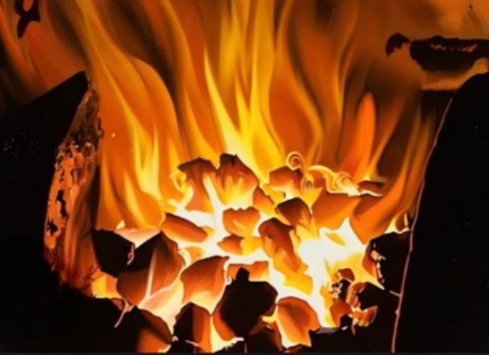
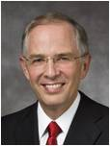
Trials of Your Faith
By definition, trials will be trying.
There may be anguish, confusion, sleepless nights, and pillows wet with tears.
But our trials need not be spiritually fatal.
They need not take us from our covenants or from the household of God. …
Like the intense fire that transforms iron into steel, as we remain faithful during the fiery trial of our faith, we are spiritually refined and strengthened. Neil L. Andersen

Slide 13
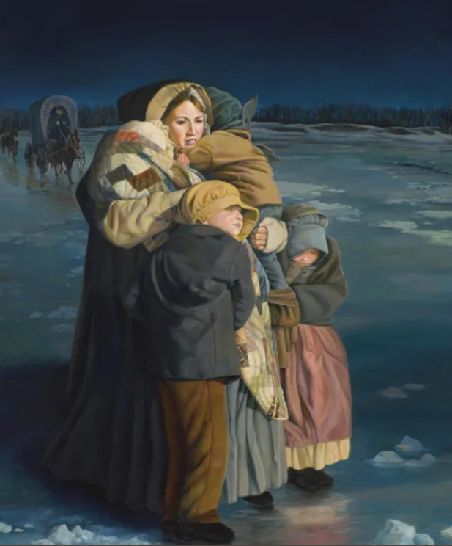
Emma Smith
In early February (1839), Emma left Far West with her four children—eight-year-old Julia, six-year-old Joseph III, two-year-old Frederick, and seven-month-old Alexander.
Almost everything she and Joseph owned had been stolen or left behind in Far West, so she traveled with friends who supplied a wagon and horses for the journey.
Joseph, her husband, had been arrested at this time.
She walked across the Mississippi River while it was icy carrying Alexander and the other 3 children by her side.

Slide 14
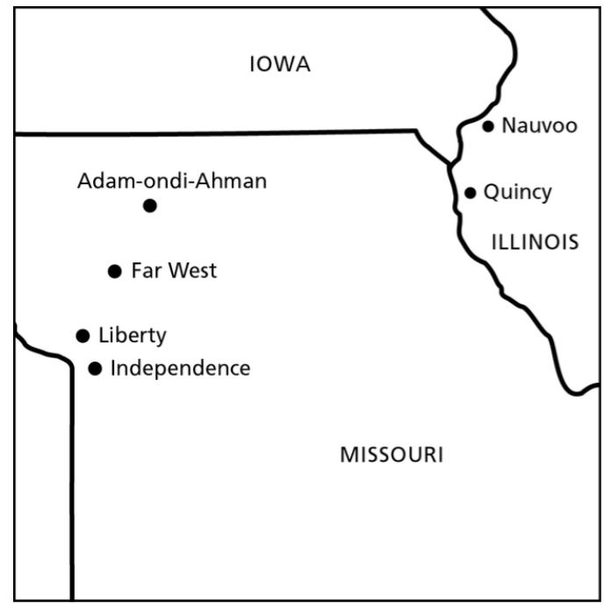
Quincy, Illinois
Many found temporary refuge across the Mississippi River in Quincy, Illinois, a small town of about 1,600 settlers located about 170 miles (275 km) from Far West. This was in the winter of 1839.

Slide 15
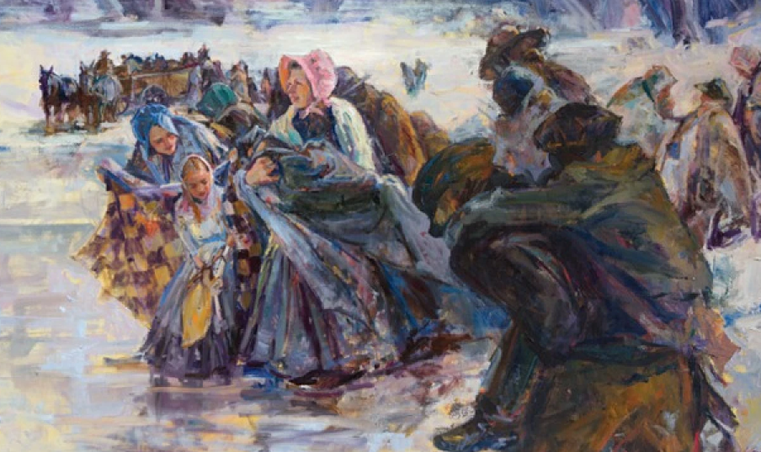
Kindness from the Citizens of Quincy, Illinois
March 16, 1839
“The strangers recently arrived here from the State of Missouri, known by the name of the Latter Day Saints, are entitled to our sympathy and kindest regard, and … we recommend to the Citizens of Quincy, to extend to them all the kindness in their power to bestow, as persons who are in affliction. …
… We recommend to all the citizens of Quincy, that in all their intercourse with the strangers, that they … be particularly careful not to indulge in any conversation or expressions calculated to wound their feelings, or in any way to reflect upon those, who by every law of humanity, are entitled to our sympathy. “
Quincy Argus

Slide 16
Sources:
Video: https://www.churchofjesuschrist.org/media/video/2010-07-0102-hauns-mill?lang=eng
Joseph B. Wirthlin, “Come What May, and Love It,” Ensign or Liahona, Nov. 2008, 26)
Saints 1:347-78
Presentation by http://fashionsbylynda.com/blog/
Other information for this section:
Timeline of Oct. 1838:
https://www.churchofjesuschrist.org/study/manual/church-history-in-the-fulness-of-times/chapter-sixteen?lang=eng
“Mormon-Missouri War of 1838,” ChurchofJesusChrist.org/study/history/topics.War of 1838,” ChurchofJesusChrist.org/study/history/topics.
Neil L. Andersen, “Trial of Your Faith,” Ensign or Liahona, Nov. 2012, 41–42
Quincy Argus, Mar. 16, 1839, [1]; spelling standardized)
Town of Quincy, Illinois https://www.ldsliving.com/the-quincy-miracle-how-one-town-saved-thousands-of-mormon-refugees/s/83610

