Slide 1
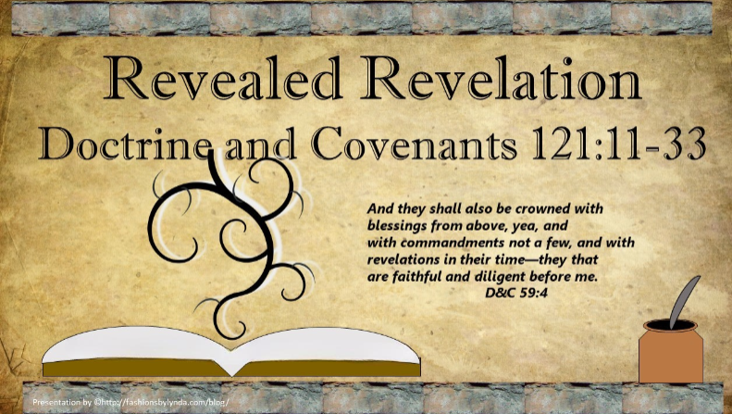

Slide 2


Would you be afraid to leave your home?
How would you feel if you found out the declaration was influenced by some of your former friends?
“The Mormons must be treated as enemies and must be exterminated.”
October 27, 1838
Where would you turn for help?

Slide 3
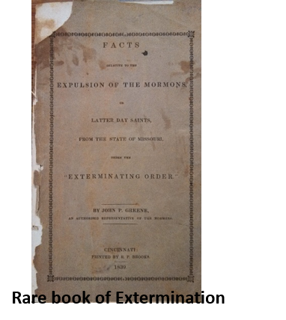
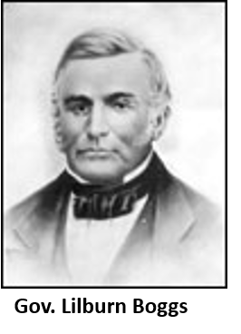
Friends Betray
Some of Joseph Smith’s once loyal friends had turned against him.
Thomas B. Marsh and Orson Hyde, were members of the Quorum of the Twelve Apostles. Both of these men signed an affidavit (a sworn statement) falsely accusing Joseph Smith and other Church members of planning to drive their enemies out by burning and destroying their property.
Thomas B. Marsh was excommunicated on March 17, 1839, and rebaptized on July 16, 1857.
Orson Hyde was removed from the Quorum of the Twelve on May 4, 1839, and restored to the quorum on June 27, 1839.
This affidavit influenced the governor of Missouri to issue a statement, known as the extermination order, declaring that all Mormons must be exterminated or driven from the state.

Slide 4
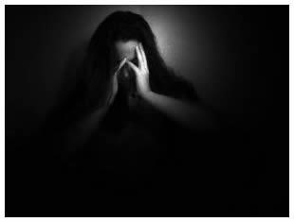
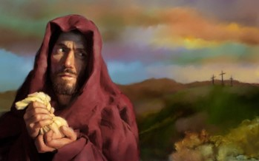
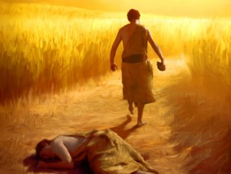
Those Who Accuse
“Judas was rebuked and immediately betrayed his Lord into the hands of his enemies because Satan entered into him…
“When once that light which was in them is taken from them, they become as much darkened as they were previously enlightened, and then, no marvel, if all their powers should be enlisted against the truth and they, Judas like, seek the destruction of those who were their greatest benefactors.”
Teachings of the Prophet Joseph Smith, 67
“Like Cain, the wicked are deceived into believing that they are so intelligent and crafty that they can hide their abominations and outwit the laws of justice.”
D&C 121:11-17

Slide 5

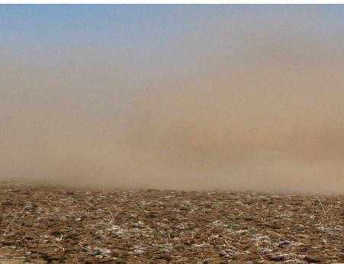
Melted Away
Those who fight against the Lord’s servants ultimately will not succeed in their designs
“As usual, there will be much said and written to discredit him [Joseph Smith]. There always were, are now, and ever will be those who stir into 200-year-old dust, hoping to find something Joseph is alleged to have said or done in order to demean him.
The revelations tell us of ‘those that shall lift up the heel against mine anointed, saith the Lord, and cry they have sinned when they have not sinned before me, saith the Lord, but have done that which was meet in mine eyes, and which I commanded them’. They face very stern penalties, indeed.”
President Boyd K. Packer
Hoar Frost—The moisture that gathers on the ground during the cool of the evening to form a thin white covering. Color—greyish white
D&C 121:11-17

Slide 6
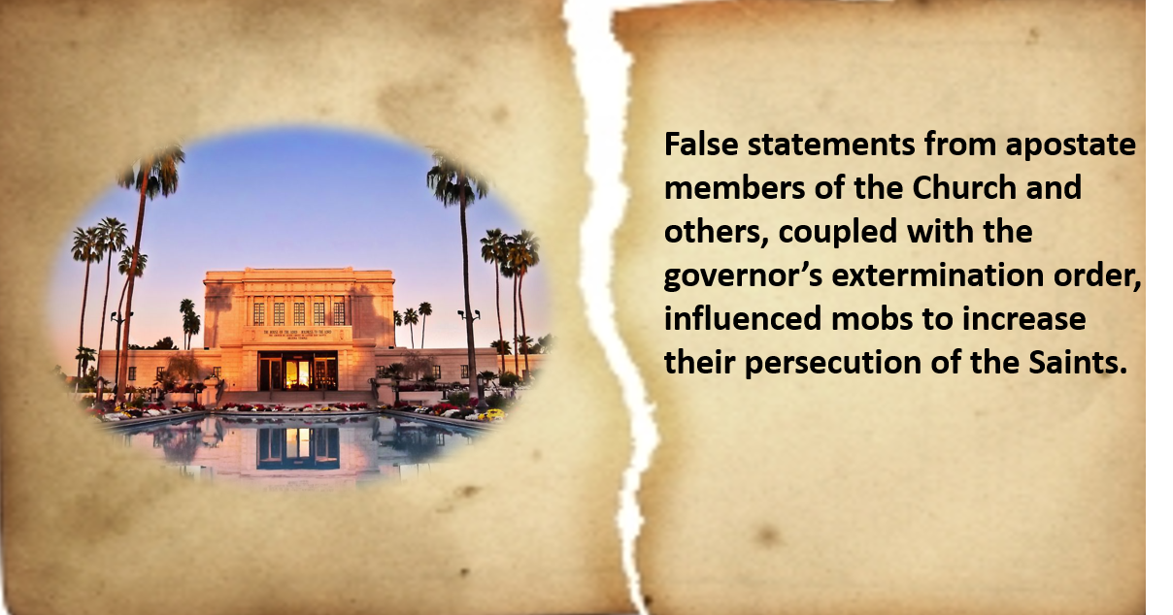
Consequences of Those Who Accuse
Severed—
to lose or be separated from the blessings associated with temple ordinances.
D&C 121:18-19

Slide 7
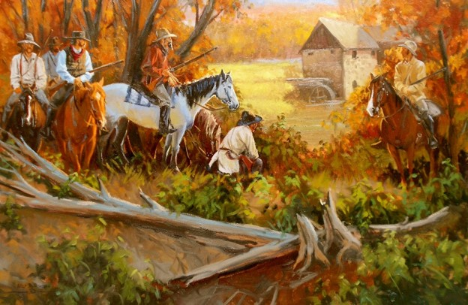
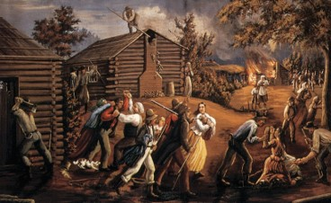
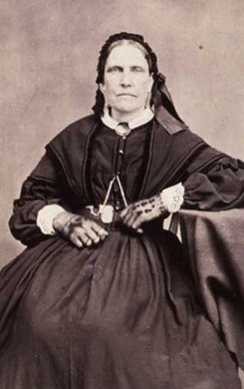
Recap-Hawn’s Mill
On October 30, 1838, just three days after the extermination order was issued, approximately 240 men approached a Mormon settlement at a place called Haun’s Mill.
The women and children fled into the woods, while the men sought protection in the blacksmith shop. One of the Saints’ leaders, David Evans, swung his hat and cried for peace. The sound of a hundred rifles answered him, most of them aimed at the blacksmith shop.
The mobbers shot mercilessly at everyone in sight, including women, elderly men, and children.
Amanda Smith seized her two little girls and ran with Mary Stedwell across the millpond on a walkway. Amanda recalled, “Yet though we were women, with tender children, in flight for our lives, the demons poured volley after volley to kill us.”
Andrew Jenson

Slide 8
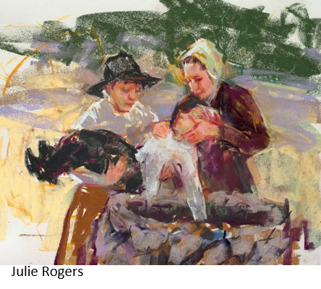
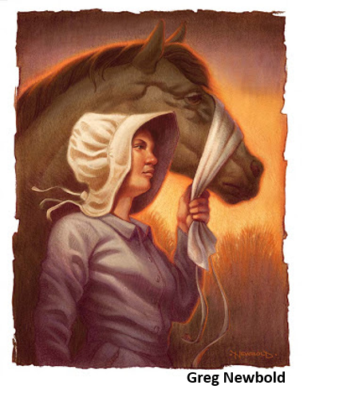
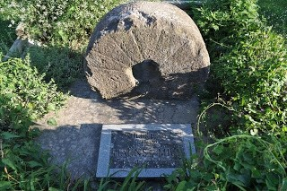
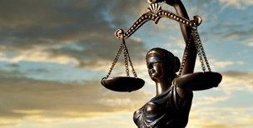
Members of the mob entered the blacksmith shop and found and killed 10-year-old Sardius Smith, son of Amanda Smith, hiding under the blacksmith’s bellows. The man later explained, “Nits [young lice] will make lice, and if he had lived he would have become a Mormon.”
Alma Smith, Sardius’s seven-year-old brother, witnessed the murder of his father and brother and was himself shot in the hip. He was not discovered by the mob and was later miraculously healed through prayer and faith. Although a few men along with women and children escaped across the river into the hills, at least 17 people were killed, and about 13 were wounded.
No one in the violent mob was brought to justice for their crimes in the courts of Missouri or by federal authorities.
Andrew Jenson

Slide 9
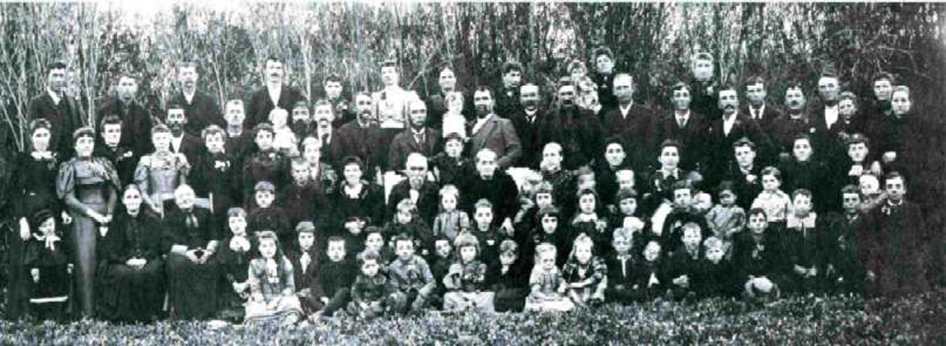
Posterity
“The infidel will impart infidelity to his children if he can. The whoremonger will not raise a pure, righteous posterity. He will impart seeds of disease and misery, if not of death and destruction, upon his offspring, which will continue upon his children and descend to his children’s children to the third and fourth generation. It is perfectly natural that the children should inherit from their fathers, and if they sow the seeds of corruption, crime and loathsome disease, their children will reap the fruits thereof.
Not in accordance with God’s wishes for His wish is that men will not sin and therefore will not transmit the consequences of their sin to their children, but that they will keep His commandments, and be free from sin and from entailing the effects of sin upon their offspring; but inasmuch as men will not hearken unto the Lord, but will become a law unto themselves, and will commit sin they will justly reap the consequences of their own iniquity, and will naturally impart its fruits to their children to the third and fourth generation.”
D&C 121:21 Joseph F. Smith

Slide 10

Breaking the Cycle
Alvah D. Boggs—Great-grandson of Governor Lilburn W. Boggs
Alvah D. Boggs, a resident of St. Louis, Missouri, was baptized into the church in March of 1956.
“There has been quite a bit of interest in my conversion to the Church, because I am a direct descendent of Governor Boggs, the governor that issued the most infamous proclamation any governor regardless of any place, to deny a people their right to worship God according to the dictates of their heart. This I have never found any justification for. I am not trying to condemn, to council or to condone my parental lineage. I am not imbued with that much wisdom. But I have a right of free agency to my opinion, and I am opinionated to the idea that this was wrong and a mistake. That the governor of the state of Missouri, my grandfather, should have done everything in his power to protect any group of people or persons, who wanted to worship God in any manner that they cared to worship him. This he certainly denied the Church of Jesus Christ of Latter-day Saints. I feel very remorseful for my parental lineage for that particular thing.”
“…I joined the Church because I believed in my heart, this is the Church of God. They (his friends) have accepted me and have accepted my family a long time before me…” Alvah D. Boggs
March 11, 1956 district conference St. Louis, Missouri

Slide 11
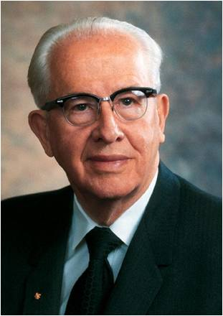
Accountable For Our Actions
The Lord sees and knows all our works. Those who fight against the Lord and His people will receive God’s judgment at His appointed time
Have you ever seen someone do something wrong and escape punishment?
Have you ever done something wrong and there was no punishment for it?
“Not only will you be held accountable for the things you do, but you will be held responsible for the very thoughts you think.”
President Ezra Taft Benson
D&C 23-25

Slide 12
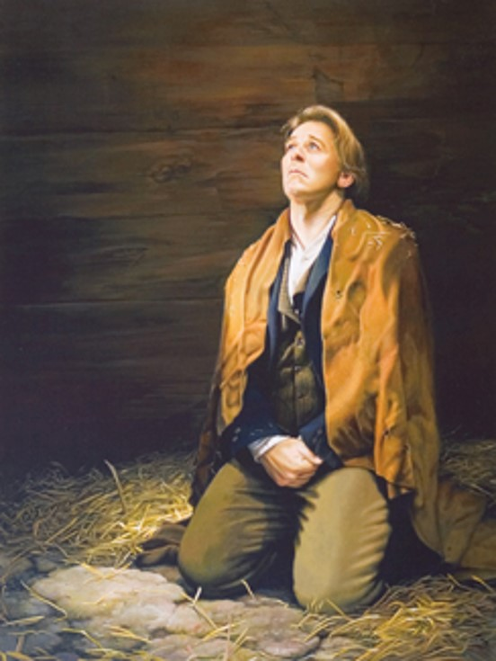
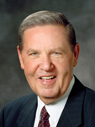
Hardships in Liberty Jail
God shall give unto you knowledge by his Holy Spirit, yea, by the unspeakable gift of the Holy Ghost, that has not been revealed since the world was until now
“You can have sacred, revelatory, profoundly instructive experiences with the Lord in the most miserable experiences of your life—in the worst settings, while enduring the most painful injustices, when facing the most insurmountable odds and opposition you have ever faced.”
Elder Jeffrey R. Holland
Liz Lemon Swindle
D&C 121:26

Slide 13
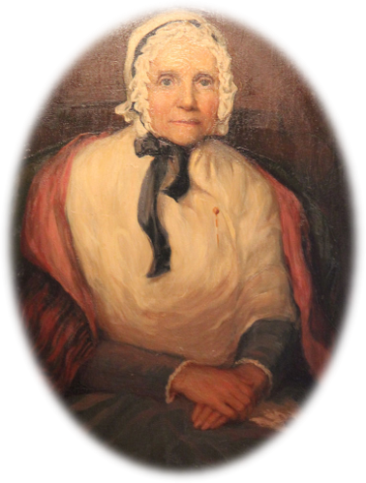
Account by Lucy Mack Smith
She received knowledge and comfort through the Holy Ghost after Joseph and Hyrum were taken as prisoners and threatened with death:
“In the midst of my grief, I found consolation that surpassed all earthly comfort. I was filled with the Spirit of God, and received the following by the gift of prophecy:
‘Let your heart be comforted concerning your children, they shall not be harmed by their enemies. …’ This relieved my mind, and I was prepared to comfort my children. I told them what had been revealed to me, which greatly consoled them.”
D&C 121:26

Slide 14
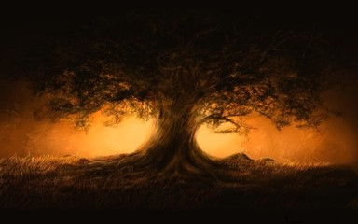
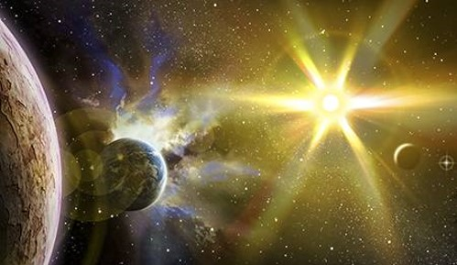
From the Letter
The Lord promised to reveal knowledge that had “not been revealed since the world was” and to bestow glorious blessings upon all who would endure “valiantly for the gospel of Jesus Christ”
“It has been the plan of the devils to hamper me and distress me from the beginning, to keep me from explaining myself to them (the Saints); and I never have had opportunity to give them the plan that God has revealed to me.”
HC
D&C 121:26-29

Slide 15
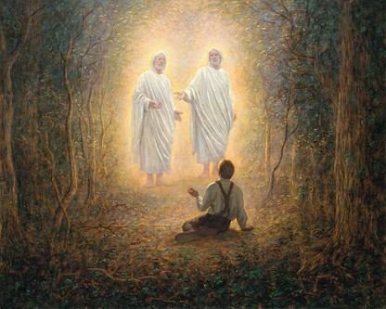
One God or Many Gods
Joseph Smith taught the nature of God
In the First Vision, where the Father and the Son stood separate and distinct as exalted men. That we can become as God was affirmed in Joseph’s final public remarks as he challenged the Saints to “hold out to the end, and we shall be resurrected and become like Gods, and reign in celestial kingdoms, principalities, and eternal dominions.”
HC
D&C 121:28 McConkie and Ostler

Slide 16


Rolling Waters
The Missouri River is a large and powerful river that many of the early Saints had lived near and were familiar with.
Nothing can stop the Lord’s work from going forward
D&C 121:33

Slide 17
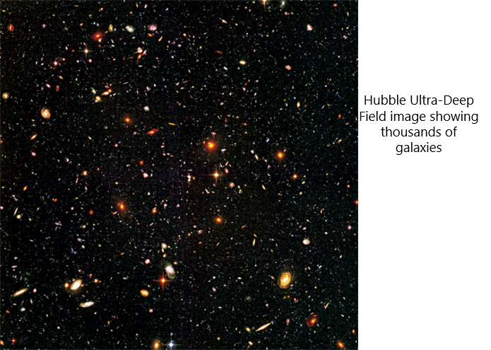
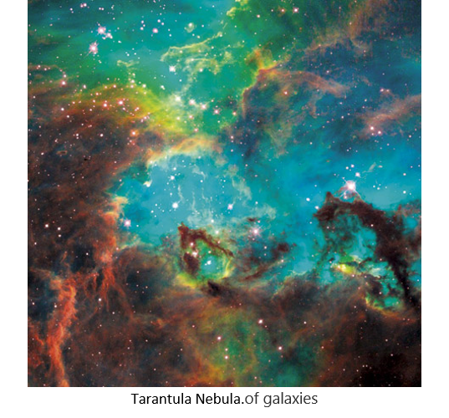
God’s Power
Most stars are grouped into communities called galaxies. Our own, the Milky Way, is a medium-sized spiral galaxy more than 100 thousand light-years in diameter. It has between 200 and 400 billion stars. Yet it is only one of billions of galaxies—estimates range from 100 billion to 500 billion. The largest galaxy discovered so far has 100 trillion stars…
And God controls it all
Together, all the galaxies in the visible universe contain an estimated 30 billion trillion stars. Yet that number may be a small fraction of all there are. Evidence suggests that we can see only about 5 percent of all there is (the rest is “dark matter” and “dark energy,” so called because it can’t be seen or detected directly by the instruments we have). The universe, in fact, may be infinite in size.”
D&C 121:33

Slide 18

Pouring Down Knowledge
“The Lord has given to the Church knowledge and guidance constantly suited to their advancement. There is much that is still held in store, many great and important truths, when we are prepared to receive them. The Lord has promised to give revelation ‘and commandments not a few,’ to the faithful who are diligent before the Lord.”
And they shall also be crowned with blessings from above, yea, and with commandments not a few, and with revelations in their time—they that are faithful and diligent before me.
D&C 59:4
D&C 121:33 President Joseph Fielding Smith

Slide 19
Sources:
Video: Move This Work Forward (0:49)
President Boyd K. Packer (“The Book of Mormon: Another Testament of Jesus Christ—Plain and Precious Things,” Ensign or Liahona, May 2005, 9).
Haun’s Mill Accounts:
Andrew Jenson, The Historical Record, July 1886, 84
Dec. 1888, 673; see also James B. Allen and Glen M. Leonard, The Story of the Latter-day Saints [1976], 127–28).
Church History in the Fulness of Times Student Manual [Church Educational System manual, 2003], 201, 203–4;
see also History of the Church 3:183–87.
Joseph F. Smith In Conference Report, Oct. 1912, p. 9; see also D&C 124:50
President Ezra Taft Benson BYU Speeches Think On Christ Oct. 11, 1993
Presentation by ©http://fashionsbylynda.com/blog
Alvah D. Boggs The Refiner’s Fire by Alvin R. Dyer
Elder Jeffrey R. Holland (“Lessons from Liberty Jail,” Ensign, Sept. 2009, 28).
History of Joseph Smith by His Mother, ed. Preston Nibley [1958], 291
History of the Church 3:286, Gods: 6:500
Joseph Fielding McConkie and Craig J. Ostler Revelations of the Restoration pg. 951
R. Val Johnson Worlds without Number August 2013 Ensign
President Joseph Fielding Smith (Church History and Modern Revelation, 2:177.)
Presentation by ©http://fashionsbylynda.com/blog/

Slide 20
Enemies of the Church:
Elder Heber J. Grant said: “Our enemies have never done anything that has injured this work of God, and they never will. I look around, I read, I reflect, and I ask the question, Where are the men of influence, of power and prestige, who have worked against the Latter-day Saints? Where is the reputation, for honor and courage, of the governors of Missouri and Illinois, the judges, and all others who have come here to Utah on special missions against the Latter-day Saints? Where are there people to do them honor? They can not be found. … Where are the men who have assailed this work? Where is their influence? They have faded away like dew before the sun. We need have no fears, we Latter-day Saints. God will continue to sustain this work; He will sustain the right. If we are loyal, if we are true, if we are worthy of this Gospel, of which God has given us a testimony, there is no danger that the world can ever injure us. We can never be injured … by any mortals, except ourselves.” (In Conference Report, Apr. 1909, p. 110.)
Amanda Barnes Smith lost her husband, and second son at the hands of violent mobsters during the Haun's Mill Massacre, one of the most violent acts of persecution in Mormon church history. During the raid, the hip of one of her six year old twin son's was also blown away by a gunshot. In the midst of this crisis, having lost everything and being forced from the state of Missouri by the mob, Smith found the mob leader's home. You see, he had stolen Amanda Smith's horse and she wanted it back. Banging on the door, she resolutely demanded back her property. The mobster told her she must pay for his having fed the animal. She declined, since he had already stolen all she had. "It's my horse. I need it. I'll take it now." she said and calmly retrieved it from the stable. Smith reportedly used her apron as a lead rope as she took the horse.
Greg Newbold
Joseph Smith:
“The things of God are of deep import; and time, and experience, and careful and ponderous and solemn thoughts can only find them out. Thy mind, O man! if thou wilt lead a soul unto salvation, must stretch as high as the utmost heavens, and search into and contemplate the darkest abyss, and the broad expanse of eternity—thou must commune with God. How much more dignified and noble are the thoughts of God, than the vain imaginations of the human heart! None but fools will trifle with the souls of men.
“How vain and trifling have been our spirits, our conferences, our councils, our meetings, our private as well as public conversations—too low, too mean, too vulgar, too condescending for the dignified characters of the called and chosen of God, according to the purposes of His will, from before the foundation of the world! We are called to hold the keys of the mysteries of those things that have been kept hid from the foundation of the world until now. Some have tasted a little of these things, many of which are to be poured down from heaven upon the heads of babes; yea, upon the weak, obscure and despised ones of the earth. Therefore we beseech of you, brethren, that you bear with those who do not feel themselves more worthy than yourselves, while we exhort one another to a reformation with one and all, both old and young, teachers and taught, both high and low, rich and poor, bond and free, male and female; let honesty, and sobriety, and candor, and solemnity, and virtue, and pureness, and meekness, and simplicity crown our heads in every place; and in fine, become as little children, without malice, guile or hypocrisy.
“And now, brethren, after your tribulations, if you do these things, and exercise fervent prayer and faith in the sight of God always, [D&C 121:26–32].” (History of the Church, 3:295–96.)
Why is the ‘Lady Justice’ Blind?
Since the 15th century, Lady Justice has often been depicted wearing a blindfold. The blindfold represents objectivity, in that justice is or should be meted out objectively, without fear or favour, regardless of money, wealth, power, or identity; blind justice and impartiality.
List of those murdered at Haun’s Mill: October 30, 1838
Thomas McBride, Levy N. Merrick, Elias Benner, Josiah Fuller, Benjamin Lewis, Alexander Campbell, Warren Smith, Sardius Smith, George S. Richards, Mr. William Napier, Augustine Harmer, Simon Cox, Mr. Hiram Abbott, John York, Charles Merrick, (a boy eight or nine years old). (John Lee, John Byers,) and three or four others (names unknown). Joseph Young
Because there was not much time to bury the bodies, the Saints put them into a large unfinished well, then a layer of some hay or straw, and then a thin layer of dirt thrown on the hay. The Refiner’s Fire by Aldin R. Dyer pgs. 247, 251-52
Hawn’s Mill:
Jacob Haun sold the mill to the Fryer Brothers, who placed their brother-in-law, Charles R. Ross, in charge from 1839-1845, when the mill was torn down. When historian Andrew Jenson visited the site in 1888, there was not trace of the old “Mormon-town.”
Colonel Wm. O. Jennings, who commanded the mob at the massacres, was assassinated at Chilicothe, Livingston County, Missouri, on January 30, 1862 by an unknown person, who shot him in the street with a revolver or musket after dark. He died the next day.
Nehemiah Comstock, another leader of the mob, expired as a “good-for-nothing drunkard.”

