Slide 1

Powers of Heaven
Doctrine and Covenants 121:34-46
For many are called, but few are chosen.
Matthew 22:14
Presentation by ©http://fashionsbylynda.com/blog/

Slide 2
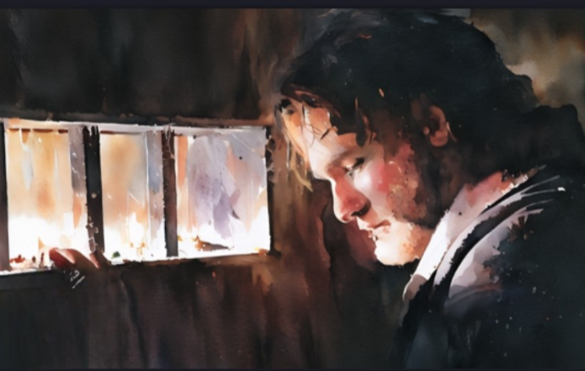
Background
While Joseph Smith was imprisoned in Liberty Jail, the Lord taught him the importance of our personal connection to heavenly power.

Slide 3

Powers of Heaven
Principles of Righteousness
Priesthood
Holder
Priesthood Authority
Light from the lamp represents blessings people can receive from God through the service of a priesthood holder.

Slide 4
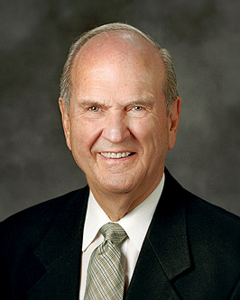

Hinderance
We know what will give us greater access to the powers of heaven. We also know what will hinder our progress—what we need to stop doing to increase our access to the powers of heaven.
Russell M. Nelson
Priesthood Authority

Slide 5
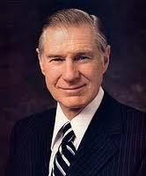
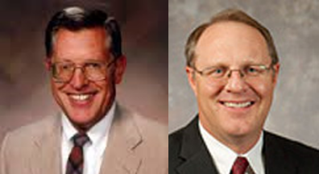
Priesthood Righteousness
How does a priesthood holder’s personal righteousness affect his ability to help other people to receive the blessings of the priesthood?
“We are called when hands are laid upon our heads and we are given the priesthood, but we are not chosen until we have demonstrated to God our righteousness, our faithfulness, and our commitment”
President James E. Faust
“To be chosen is to have chosen to honor every opportunity to serve the Lord and to stand in defense of the gospel cause.”
McConkie and Ostler
D&C 121:34

Slide 6
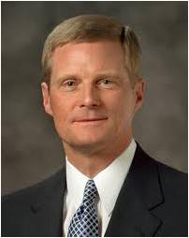
To Be Called—To Be Chosen
To become one of God’s “Chosen,’ a priesthood holder must live in a way that enables him to draw on the powers of heaven to help others receive the blessings of the priesthood.
To the Guys:
“The power of the priesthood is God’s power operating through men and boys like us and requires personal righteousness, faithfulness, obedience, and diligence. A boy or a man may receive priesthood authority by the laying on of hands but will have no priesthood power if he is disobedient, unworthy, or unwilling to serve. …
“… Priesthood holders young and old need both authority and power—the necessary permission and the spiritual capacity to represent God in the work of salvation”
Elder David A. Bednar
D&C 121:34

Slide 7
Priesthood holders can draw upon the powers of heaven only if they live righteously

Slide 8
Doctrinal Mastery
That the rights of the priesthood are inseparably connected with the powers of heaven, and that the powers of heaven cannot be controlled nor handled only upon the principles of righteousness.
No power or influence can or ought to be maintained by virtue of the priesthood, only by persuasion, by long-suffering, by gentleness and meekness, and by love unfeigned;
By kindness, and pure knowledge, which shall greatly enlarge the soul without hypocrisy, and without guile—
D&C 121:34, 41-42

Slide 9
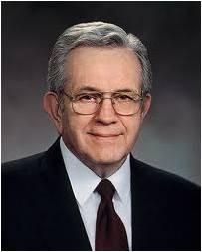
“Authority in the priesthood comes by way of ordination; power in the priesthood comes through faithful and obedient living in honoring covenants. It is increased by exercising and using the priesthood in righteousness.”

Slide 10
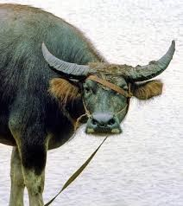
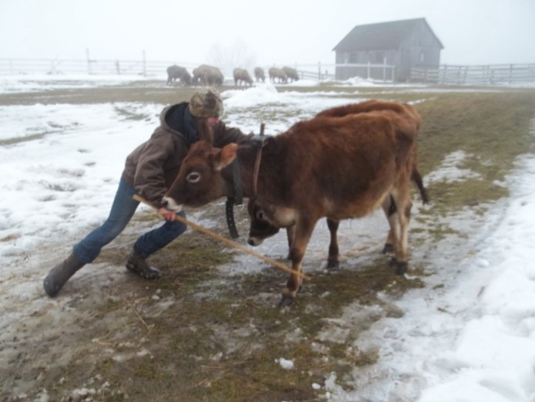

Unrighteousness Priesthood Holders
Kick against the pricks
The powers of heaven withdraw, and his authority becomes useless.
An animal resisting a sharp stick used to guide it toward a desired destination
For us—resisting direction from the Lord or His servants
D&C 121:38

Slide 11
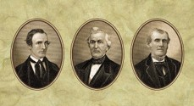
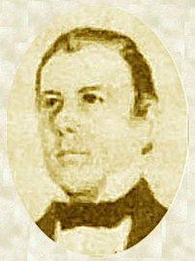
Those Who Lost Site of the Authorship
The Three Witnesses to the Book of Mormon
The Presidency of the Church in Missouri
Six members of the Quorum of the Twelve Apostles
And Thomas B. Marsh –the President of the Quorum of Twelve Apostles
However:
After the Saints had been driven from Nauvoo, Illinois, and settled in the Rocky Mountains, he went to Sal Lake City, where he confessed to the wrongs he had committed and pleaded for Forgiveness.
All lost their rights to and the authority of the priesthood

Slide 12
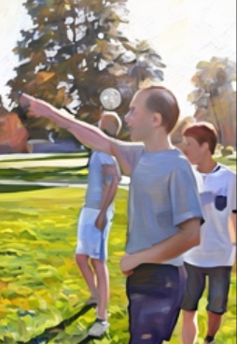

Unrighteousness Attitudes and Actions
A teachers quorum president loves sports, and he refuses to participate in the planning of any quorum activity that does not involve soccer or basketball. Whenever the quorum participates in an activity or gives service, he demands that the other young men do as he says because he is the quorum president.
What are some examples of people trying to cover their sins?
What are some examples of people setting their hearts on the things of the world and aspiring to the honors of men?
Why do you think these attitudes and actions prevent priesthood holders from drawing on the powers of heaven?
To fit in with some of his popular peers, a priesthood holder joins them in making fun of a classmate at school.
D&C 121:35-39

Slide 13
Unrighteous Dominion
Why do some people exercise unrighteous dominion?
Something to hide?
Pride?
D&C 121:39-40

Slide 14


Cause of Unrighteous Attitudes and Actions
These actions cause—
1. The heavens to withdraw themselves.
2. The Spirit of the Lord to be grieved.
3. A withdrawal of power and authority.
If a priesthood holder senses this power withdrawing because of the presence of compulsion, contention, disunity, or rebellion, he should immediately evaluate his actions to be sure he has not been exercising unrighteous dominion.
D&C 121:39

Slide 15
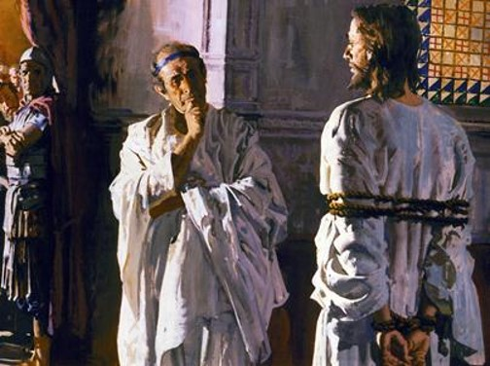
Qualities of a Righteous Priesthood Holder
“Truly the kingdom of the Christ is not of this world. If it were of this world its reliance would be upon effective government, the government which rests on force…not of physical force, but of moral persuasion.” B.H. Roberts
Kind
Knowledgeable in the things of God
Honest
Virtuous
Long suffering
Those who maintain these qualities, will retain the Holy Spirit
Jesus answered, My kingdom is not of this world: if my kingdom were of this world, then would my servants fight, that I should not be delivered to the Jews: but now is my kingdom not from hence.
John 18:36
D&C 121:41-42

Slide 16
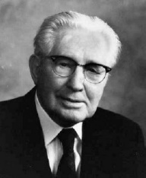
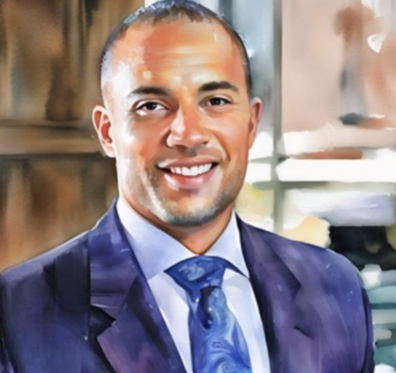
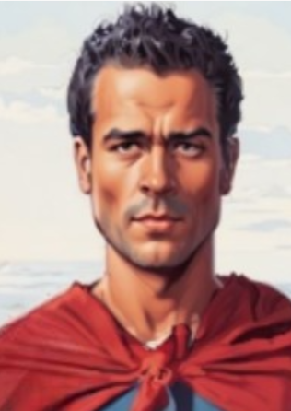
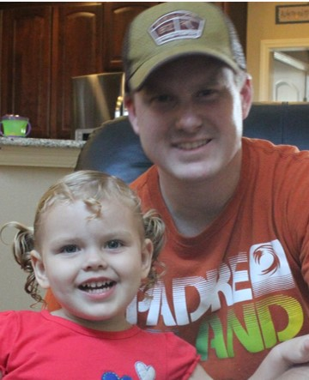
Between Home and Priesthood Duties
“I should like to say to you fathers tonight that our conduct in our homes determines in large measure our worthiness to hold and exercise the priesthood, which is the power of God delegated to man.
Almost any man can make a good showing when on parade before the public, but one’s integrity is tested when ‘off duty.’
The real man is seen and known in the comparative solitude of the home.
An office or title will not erase a fault nor guarantee a virtue.”
And though these verses refer to the priesthood, their principles apply to all who serve in the Church, family, or society at large.
D&C 121:41-42 President Hugh B. Brown

Slide 17

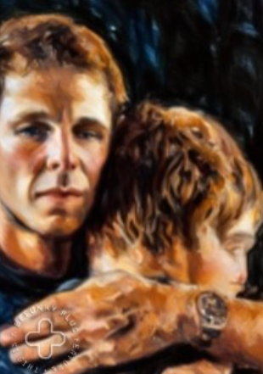

Reproving With Increased Love
Reproving -- the act of telling someone that he or she is doing something wrong, usually in a gentle or kind manner.
Betimes -- “early” or “in a timely manner.”
Sharpness could refer to the need to express ourselves clearly
Why do you think it is important for a priesthood leader to reprove clearly, at the right time, and according to the guidance of the Holy Ghost?
Why do you think it is important to show increased love after reproving someone?
D&C 1221:43

Slide 18
Drawing on the Powers of Heaven
Scepter of Righteousness:
Scepter is a staff carried by a king or queen. It is a symbol of authority and power
Bowels of Charity
Keep our thoughts pure and lofty and our words and actions selfless and loving
Dews from Heaven:
Dew appears when the temperature cools and water forms out of the air from condensation. It forms quietly and accumulates gradually
D&C 121:45-46

Slide 19
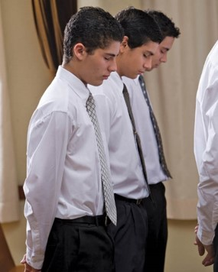
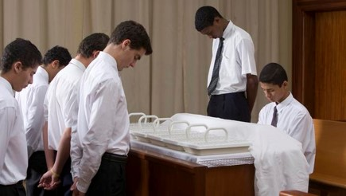
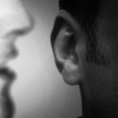

Developing Charity and Virtue
1. Our confidence in our ability to perform spiritual duties will increase.
2. We will gain a testimony of the priesthood and will receive inspiration to help us fulfill our callings.
3. We will have the constant companionship of a member of the Godhead.
4. Those we lead will follow us willingly, without our exercising any degree of force.
D&C 121:45-46 Student Manual

Slide 20
Sources:
Videos:
Many Called; Few Chosen (1:18)
“The Powers of Heaven” (9:14)
Our Constant Companion (1:37)
The Power of the Priesthood in the Family:
Priesthood Power and Priesthood Authority (1:49)
President James E. Faust (“Called and Chosen,” Ensign or Liahona, Nov. 2005, 55).
Elder Boyd K. Packer (“The Power of the Priesthood,” Ensign or Liahona, May 2010, 9).
Joseph Fielding McConkie and Craig J. Ostler Revelations of the Restoration pg. 953
Presentation by ©http://fashionsbylynda.com/blog/
Elder David A. Bednar(“The Powers of Heaven,” Ensign or Liahona, May 2012, 49).
B.H. Roberts The History of the Church 1:528-29
Presentation by ©http://fashionsbylynda.com/blog/
President Hugh B. Brown (In Conference Report, Apr. 1962, p. 88.)
Doctrine and Covenants Student Manual Religion 324-325 Section 121
Russell M. Nelson, “We Can Do Better and Be Better,” Ensign or Liahona, May 2019, 68
Presentation by ©http://fashionsbylynda.com/blog/

Slide 21
To Be Called to the Priesthood:
Elder Bruce R. McConkie indicated:
“To be called is to be a member of the Church and kingdom of God on earth; it is to be numbered with the saints; it is to accept the gospel and receive the everlasting covenant; it is to have part and lot in the earthly Zion; it is to be born again, to be a son or a daughter of the Lord Jesus Christ; to have membership in the household of faith; it is to be on the path leading to eternal life and to have the hope of eternal glory; it is to have a conditional promise of eternal life; it is to be an inheritor of all the blessings of the gospel, provided there is continued obedience to the laws and ordinances thereof.
“Within this over-all framework, there are individual calls to positions of trust and responsibility, but these are simply assignments to labor on the Lord’s errand, in particular places, for a time and a season. The call itself is to the gospel cause; it is not reserved for apostles and prophets or for the great and mighty in Israel; it is for all the members of the kingdom.” (Doctrinal New Testament Commentary, 3:326.)
Kicking against the pircks:
Elder Howard W. Hunter explained: “This proverbial expression of kicking against the pricks usually refers to the ox goad which was a piece of pointed iron stuck in the end of a stick used to urge the ox while drawing the plow. Sometimes a stubborn ox will kick back against the goad only to receive its sharpness more severely. It has become a proverb to signify the absurdity of rebelling against lawful authority.” (In Conference Report, Oct. 1964, p. 108.)
Elder Orson F. Whitney noted: “All men who hold position(s) do not abuse its privileges, and the man who serves God humbly and faithfully never will, for the moment he yielded to the temptation so to do, that moment would he cease to serve the Lord; but there are many, alas! who sadly misuse the functions of their office, and prostitute every power and privilege to the gratification of self and the injury and embarrassment of their fellow men. It is dangerous to put some men into power. They swell up and become so distended with the ideas of their greatness and importance, that we are forcibly reminded of so many inflated toy balloons, which the slightest prick of a pin would burst and ruin forever. A very small office and a very little authority is sufficient to intoxicate some men and render them entirely unfit for duty.” (In Rich, Scrapbook of Mormon Literature, 2:511–12.)
When the hearts of men:
Are set on the things of the world, or aspire to the honors of men
They will act in ways detrimental to spiritual growth, including:
Covering their sins
Gratifying their pride and vain ambitions
Exercising unrighteous dominion over others
These actions cause:
The heavens to withdraw themselves
The Spirit of the Lord to be grieved
A withdrawal of power and authority
When the hearts of men:
Are set on the things of God, and aspire to God’s approval
They will act in ways beneficial to spiritual growth, including:
Repenting of their sins
Humbling themselves
Seeking the kingdom of God first
Exercising love and charity toward others
These actions cause:
The heaven to draw near
The Sprit of the Lord to be near
An increase in power and authority

Slide 22
Falling Away Martin Harris
From a position of great influence and authority, all three witnesses fell, each in his own way. During 1837 there were intense financial and spiritual conflicts in Kirtland, Ohio. Martin Harris later said that he “lost confidence in Joseph Smith” and “his mind became darkened” (quoted in Anderson, Investigating the Book of Mormon Witnesses, 110). He was released from the high council in September 1837 and three months later was excommunicated.
When most of the Saints moved on—to Missouri, to Nauvoo, and to the West—Martin Harris remained in Kirtland. There he was rebaptized by a visiting missionary in 1842. In 1856 Caroline and their four children took the long journey to Utah, but Martin, then 73 years of age, remained on his property in Kirtland. In 1860 he told a census taker that he was a “Mormon preacher,” evidence of his continuing loyalty to the restored gospel. Later he would tell a visitor, “I never did leave the Church; the Church left me” (quoted in William H. Homer Jr., “‘Publish It Upon the Mountains’: The Story of Martin Harris,” Improvement Era, July 1955, 505), meaning of course that Brigham Young led the Church west and the aging Martin remained in Kirtland.
During part of his remaining years in Kirtland, Martin Harris acted as a self-appointed guide-caretaker of the deserted Kirtland Temple, which he loved. Visitors reported his alienation from the leaders of the Church in Utah but also his fervent reaffirmation of his published testimony of the Book of Mormon.
Finally, in 1870, Martin’s desire to be reunited with his family in Utah resulted in a warm invitation from Brigham Young, a ticket for his passage, and an official escort from one of the Presidents of Seventy. A Utah interviewer of the 87-year-old man described him as “remarkably vigorous for one of his years, … his memory being very good” (Deseret News, 31 Aug. 1870). He was rebaptized, a common practice at that time, and spoke twice to audiences in this Tabernacle.
One reported Martin saying, “It is not a mere belief, but is a matter of knowledge. I saw the plates and the inscriptions thereon. I saw the angel, and he showed them unto me” (quoted in Anderson, Investigating the Book of Mormon Witnesses, 116).
When he reiterated his testimony of the Book of Mormon in the closing days of his life, Martin Harris declared, “I tell you of these things that you may tell others that what I have said is true, and I dare not deny it; I heard the voice of God commanding me to testify to the same” (quoted in Anderson, Investigating the Book of Mormon Witnesses, 118).
Martin Harris died in Clarkston, Utah, in 1875, at age 92. His life is commemorated in the memorable pageant, Martin Harris: The Man Who Knew, produced each summer in Clarkston, Utah.
Dallin H. Oaks The Witness: Martin Harris April 1999 Gen. Conf.

Slide 23
The Falling Away of Oliver Cowdery:
Oliver Cowdery was excommunicated from the church on April 11, 1838 in Far West, Missouri. Neither the prophet nor Oliver was not in attendance at his excommunication. The decision was made by the high council of the church at Far West.
Oliver had exhibited the spirit of apostasy. He disagreed with the prophet regarding the rights of the church to advise the members on the handling of their property, etc.
"Upon carefully inquiring as to his long absence from the body of the Church, he stated that he had never met the Prophet Joseph, after his expulsion from the Church, while he lived, apparently feeling that the Prophet could with equal propriety inquire after him as for him to visit the Prophet, and as his pride would seemingly not allow him to become suppliant without that inquiry, it was never made; while he felt quite sure that had he ever met the Prophet there would have been no difficulty in cheering a reconciliation, as a feeling of jealousy towards him, on the part of his accusers, had entered largely into their purpose of having him removed, which he thought Joseph must have discovered after going up to Missouri." (Samuel W. Richards, "Oliver Cowdery," The Improvement Era, p. 94 as taken from The Case of the Book of Mormon Witnesses by Eldin Ricks, p. 11)
In spite of the fact that no resolution between Oliver and the church came for another 10 years, during that interval, he remained true to the testimony he gave regarding the plates. The following incident is instructive:
"A gentleman in Michigan said to him, when he was pleading law, 'Mr. Cowdery, I see your name attached to this book; if you believe it to be true, why are you in Michigan?' The gentleman read over the names of the witnesses, and said, 'Mr. Cowdery, do you believe this book?' 'No, sir,' replied Oliver Cowdery. 'That is very well, but your name is attached to it, and you say that you saw an angel, and the plates from which this book is said to be translated, and now you say that you do not believe it. Which time was you right?' Mr. Cowdery replied, 'There is my name attached to that book, and what I have there said that I saw, I know that I saw, and belief has nothing to do with it, for knowledge has swallowed up the belief that I had in the work, since I know it is true.'" (Brigham Young, Journal of Discourses, 2:257-8 as taken from Testimony of the Book of Mormon Witnesses by Preston Nibley)
"In October 1848, Oliver Cowdery, with his wife and daughter, arrived at Council Bluffs, Iowa, the gathering place of the Saints who were preparing to make the long journey across the plains to Utah. Here he requested of Orson Hyde, who was presiding over that branch at the time, the privilege of again being baptized into the Church. At a special conference of the members held on October 21st [1848], the request was granted and shortly afterwards Oliver Cowdery was baptized by Orson Hyde. (Preston Nibley, Testimony of the Book of Mormon Witnesses, p.41)
"...Oliver Cowdery just before breathing his last, asked his attendants to raise him up in bed that he might talk to the family and his friends, who were present. He then told them to live according to the teachings contained in the Book of Mormon, and promised them, if they would do this, that they would meet him in heaven. He then said, 'Lay me down and let me fall asleep.' A few moments later he died without a struggle."

Slide 24
The Falling Away of David Witmer:
The year 1837 was a time of disillusion and financial trial for the Saints in Kirtland. To help shore up the local economy, Joseph Smith and other leaders organized a banking society (see Kirtland Economy). When it failed, many members who lost their savings were embittered.
Even earlier, in February 1837, some dissenters wanted to depose Joseph Smith and replace him with David Whitmer. Whitmer, a proud and stubborn man, was still smarting from conflicts over his leadership in Missouri. In the disciplinary council that excommunicated Whitmer, on April 13, 1838, one of the main charges brought against him was "possessing the same spirit with the Dissenters" (Donald Q. Cannon and Lyndon W. Cook, eds., Far West Record, Minutes of The Church of Jesus Christ of Latter-day Saints, 1830 -1844, Salt Lake City, 1983, p. 177; see Disciplinary Procedures).
His call to separate himself from the Saints:
“If you believe my testimony to the Book of Mormon; if you believe that God spake to us three witnesses by his own voice, then I tell you that in June, 1838, God spake to me again by his own voice from the heavens, and told me to "separate myself from among the Latter Day Saints, for as they sought to do unto me, should it be done unto them.“ (David Whitmer, An Address to All Believers in Christ by a Witness to the Divine Authenticity of The Book of Mormon (David Whitmer: Richmond, Virginia, 1887)
After Whitmer left the Church, he moved to Richmond, Missouri, and opened a livery stable, which he ran until 1888. A respected citizen in the community, he served on fair boards, was a member of the city council, and was elected mayor. Over his lifetime, hundreds of visitors inquired about and heard his testimony of the Book of Mormon.
A year before his death Whitmer wrote a pamphlet, An Address to All Believers in Christ (1887), apparently to justify his separation from the Church. In the pamphlet, he again gave witness to the truth of the Book of Mormon, but claimed that Joseph Smith drifted into errors after completing the translation. Whitmer rejected many later developments in the Church, such as the offices of high priest and prophet, seer, and revelator; the Doctrine and Covenants; and the doctrines of gathering and of plural marriage.
Shortly before his death, Whitmer repeated once more, for the Richmond Conservator, what he had written in the Address: "I have never at any time denied that testimony or any part thereof, which has so long since been published with that Book, as one of the three witnesses. Those who know me best, well know that I have always adhered to that testimony." He died in Richmond, Missouri, on January 25, 1888, bearing testimony again on his deathbed of the authenticity of the Book of Mormon.
Author: Perkins, Keith W. BYU Harold B. Lee Library

