Slide 1
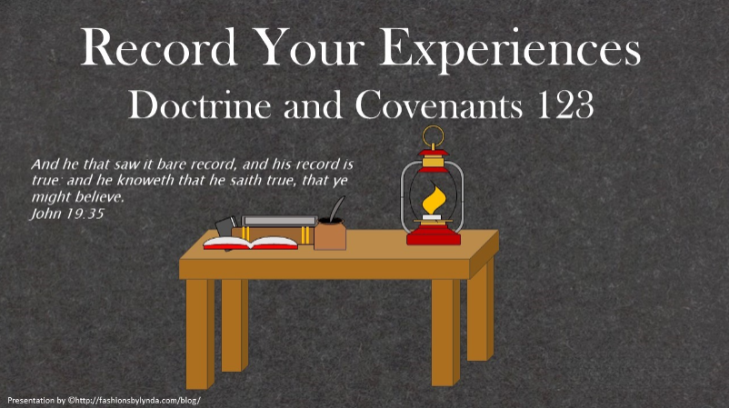

Slide 2

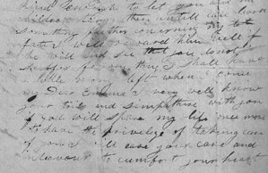
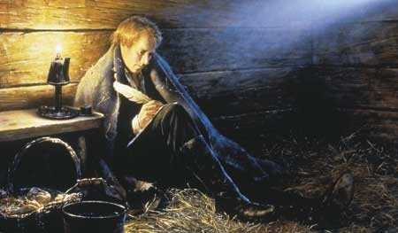
Background
While the Prophet Joseph Smith was imprisoned in Liberty Jail from December 1, 1838, to April 6, 1839, he wrote letters of comfort and counsel to the Saints.
The letter dated March 20, 1839 is included in Doctrine and Covenants Section 123.
Joseph Smith ask the Saints to collect and publish the accounts of the persecutions they had faced.

Slide 3
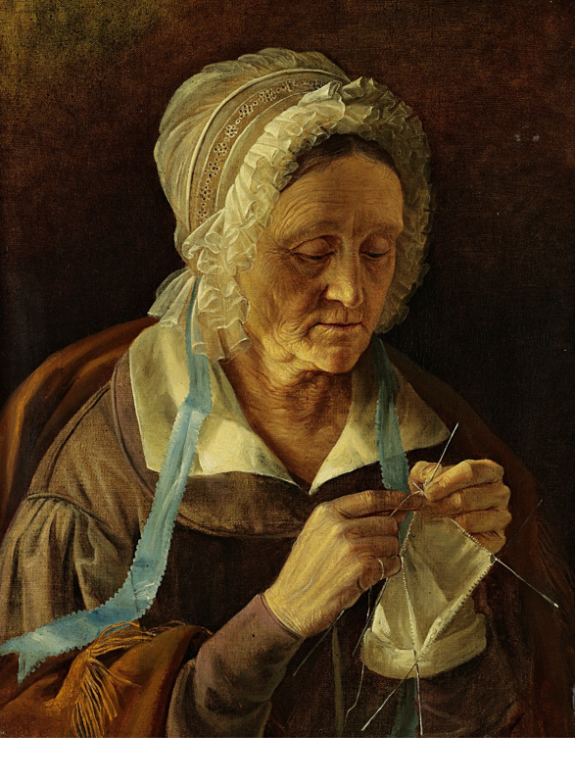
Delia Reed
“This may certify that I, Delia Reed, moved to Missouri in the year 1836. My husband died soon after we arrived and left me with seven small children. … When the troubles came on between the inhabitants and the Mormons, I, with the rest of our society, was obliged to leave the state. … I was obliged to sacrifice the most of my property [and] my family [became] scattered, and I had to gain a daily pittance among strangers.”
Delia Reed
There are many who are kept from the truth because they do not know where to find it
This was an official statement Sister Reed gave to a judicial official.

Slide 4
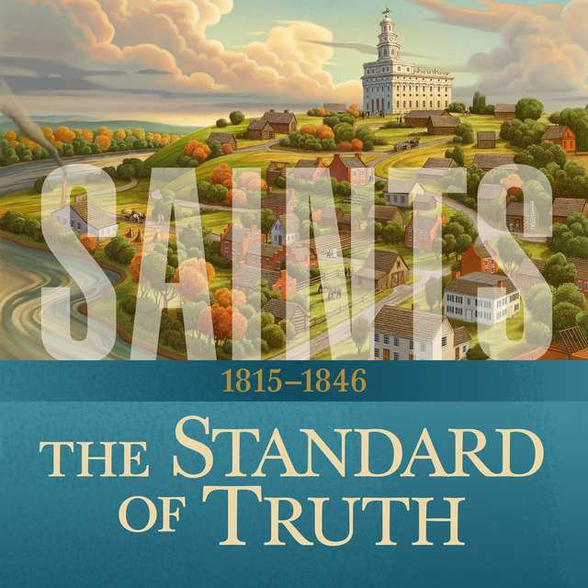
Collecting Accounts
That we may not only publish to all the world, but present them to the heads of government in all their dark and hellish hue, as the last effort which is enjoined on us by our Heavenly Father, before we can fully and completely claim that promise which shall call him forth from his hiding place; and also that the whole nation may be left without excuse before he can send forth the power of his mighty arm.
The Lord will fulfill His promises after we have done our part
D&C 123:6

Slide 5
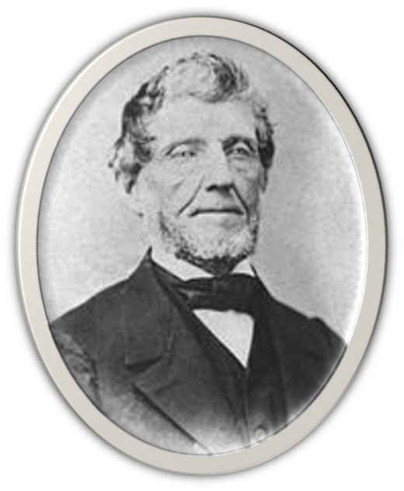
Gathering Knowledge and Facts
“The Spirit of Revelation prompted the Prophet to suggest that all the facts be ascertained and placed on record.”
Smith and Sjodahl
Joseph Young’s account of the Haun’s Mill Massacre was noted in the State of Illinois, County of Adams:
“I hereby certify that Joseph Young this day came before me and made oath in due form of law, that the statements contained in the foregoing sheet are true, according to the best of his knowledge and belief. In testimony whereof I have hereunto set my hand and affixed the seal of the Circuit Court at Quincy, the fourth day of June, in the year of our Lord one thousand eight hundred and thirty-nine.”
C.M. Woods,
Clerk Circuit Court, Adams co., Ill.
D&C 123:1-6

Slide 6
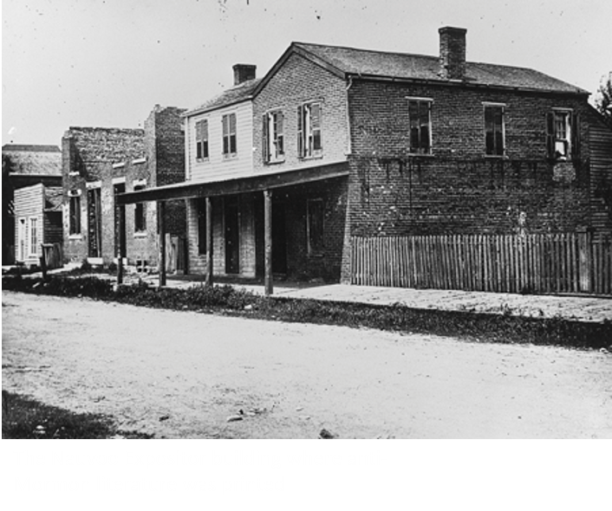
Libelous Histories
Libel--to publish in print (including pictures), writing or broadcast through radio, television or film, an untruth about another which will do harm to that person or his/her reputation, by tending to bring the target into ridicule, hatred, scorn or contempt of others
The Saints took every precaution to send sworn, legal documents authenticated by the seals of local government official's They even sent documents authenticating the officials themselves. During the ensuing years the Mormons presented these documents to the federal government in an effort to obtain reparation for their sufferings in Missouri.”
McConkie and Ostler
D&C 123:1-6

Slide 7

Purpose of Gathering Information
That they might publish such information to the heads of government and to all the world.
That the nation might be left without excuse.
That the saints might be justified in calling upon the Lord to send forth His power in their behalf.
That the saints might fulfill their duty before the Lord, angels, wives, children, and the rising generations.
Otten and Caldwell
The Great Seal of the United States is used to authenticate certain documents issued by the United States federal government. It was first used publicly in 1782.
D&C 123:6-13

Slide 8
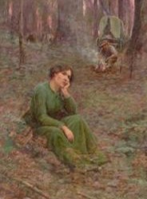
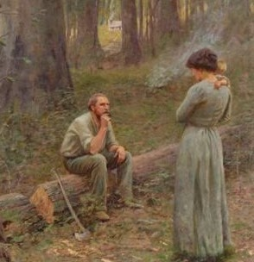
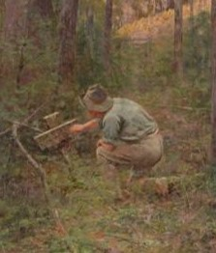
Imperative Duty
“God knew that the Saints were not guilty of the crimes charged to them by enemies, and that they did not hold the doctrines credited to them, but inasmuch as they claimed to be the people of God, their vindication was, in a sense, the vindication of the Deity.”
“The angels who are sent to administer to the Saints have a right to know whether such accusations are true or false.”
Our wives and children— “Silence is sometimes more eloquent than words; but at this time it was necessary to place the accusers and persecutors in the limelight of public opinion, because wives and children had a right to know the full truth.”
D&C 123:7 Smith and Sjodahl “The Pioneer” by Frederick McCubbin

Slide 9

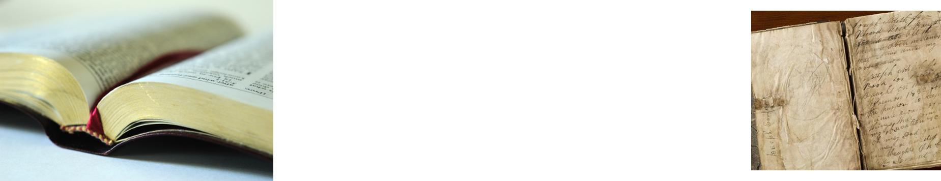
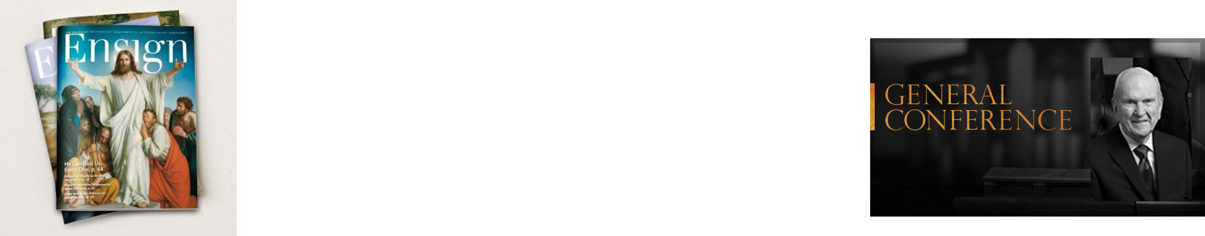
Assignment—a paper on the Church
What sources might you use for your paper?
Why does it matter what sources you use to write about the Church?
How do you know which sources accurately describe the Church?

Slide 10
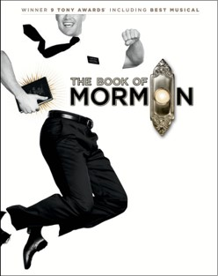

Falsehoods of the Church
Many through the years, whether through malice or ignorance, have given false reports of the Church.
Great numbers of honest people have believed and passed on these falsehoods because they had no better information.
The Saints have a duty to keep the name of the Church unsullied, to defend its reputation, and to correct misrepresentations, so the pure in heart will have the information they need.
While we should oppose evil, the Lord has directed the Saints to show love for enemies of the Church.
D&C 123:11-14 Student Manual

Slide 11
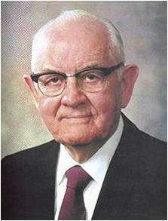
“Brothers and sisters, pray for the critics of the Church; love your enemies.
Keep the faith and stay on the straight and narrow path.
Use wisdom and judgment in what you say and do, so that we do not give cause to others to hold the Church or its people in disrepute.
Do not be surprised or dismayed if trials and challenges come upon us.
This work, which Satan seeks in vain to tear down, is that which God has placed on earth to lift mankind up!”
President Spencer W. Kimball
D&C 123:11-14

Slide 12
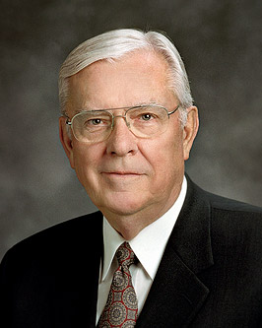
“Far too many people have a poor understanding of the Church because most of the information they hear about us is from news media reports that are often driven by controversies. Too much attention to controversy has a negative impact on peoples’ perceptions of what The Church of Jesus Christ of Latter-day Saints really is.”
Elder M. Russell Ballard
There are many who are kept from the truth because they do not know where to find it
D&C 123:12

Slide 13
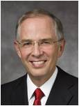

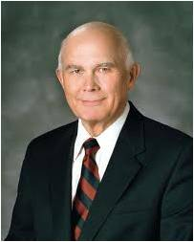
“There have always been a few who want to discredit the Church and to destroy faith. Today they use the Internet.
Some of the information about the Church, no matter how convincing, is just not true.”
Elder Neil L. Andersen
Some authors who write about the Church and its history present information out of context or include partial truths that can be misleading. The intent of some of these writings is to destroy faith in the Church and its leaders.
“We need to remember that the Spirit of the Lord will not guide us if our own attitude is one of faultfinding. That principle applies to readers and writers. …
“Our individual, personal testimonies are based on the witness of the Spirit, not on any combination or accumulation of historical facts.”
Elder Dallin H. Oaks
D&C 123:12-14

Slide 14



“Now, may I ask that you join the conversation by participating on the Internet to share the gospel and to explain in simple and clear terms the message of the Restoration. …
This, of course, requires that you understand the basic principles of the gospel. It is essential that you are able to offer a clear and correct witness of gospel truths”
Elder M. Russell Ballard
Where can you find truthful sources for your blog?
D&C 123:12

Slide 15
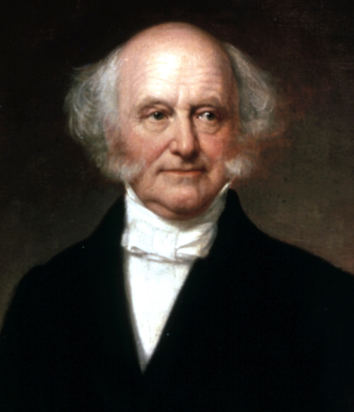
President Van Buren
The Lord commanded the Saints to bring the accounts of their suffering and persecution to the attention of government leaders, including the president of the United States. On November 29, 1839, the Prophet Joseph Smith and Elias Higbee, a judge, met with the president of the United States, Martin Van Buren.
“At first Van Buren was inconsiderate of the Prophet’s plea. However, as the discussion progressed, the president promised to reconsider his position and ‘felt to sympathize with [the Mormons], on account of [their] sufferings’
“After their visit with President Van Buren, the Prophet and Elias Higbee stayed two months in the East, trying to gain support from senators and representatives who might be willing to espouse their cause.
They met with President Van Buren again in February 1840. By this time, Van Buren had lost any sympathetic feelings he might have had for the Church.
According to the Prophet, the president treated them rudely and declared: ‘Gentlemen, your cause is just, but I can do nothing for you. … If I take up for you I shall lose the vote of Missouri’
HC
D&C 123:17

Slide 16
Sources:
Video: Many Seek the Truth (1:17)
Flecks of Gold (3:15)
(Delia Reed, in Mormon Redress Petitions: Documents of the 1833–1838 Missouri Conflict, ed. Clark V. Johnson [1992], 523; punctuation, capitalization, and spelling standardized).
Hyrum M. Smith and Janne M. Sjodahl Doctrine and Covenants Commentary pg. 763-765
Joseph Fielding McConkie and Craig J. Ostler Revelations of the Restoration pg. 961
L.G. Otten and C.M. Caldwell Sacred Truths of the Doctrine and Covenants pg. 307
Doctrine and Covenants Student Manual Religion 324-325 Section 123
Presentation by ©http://fashionsbylynda.com/blog/
Elder M. Russell Ballard (“Sharing the Gospel Using the Internet,” Ensign, July 2008, 62).
President Spencer W. Kimball (In Conference Report, Apr. 1980, p. 6; or Ensign, May 1980, p. 6.)
Elder Neil L. Andersen (“Trial of Your Faith,” Ensign or Liahona, Nov. 2012, 41).
Elder Dallin H. Oaks(“Reading Church History,” in Symposium Speeches [symposium on the Doctrine and Covenants and Church history, Aug. 14–16, 1985], 4, 5).
History of the Church, 4:40-43; 4:80]” (Arnold K. Garr, “Joseph Smith: Campaign for President of the United States,” Ensign, Feb. 2009, 49).
Presentation by ©http://fashionsbylynda.com/blog/

Slide 17
For Joseph Young’s Affidavit visit:
https://ojs.lib.byu.edu/spc/index.php/BYUStudies/article/viewFile/6551/6200
President Joseph Fielding Smith wrote: “The law of retribution is often slow, but it is sure. The Lord promised to punish his enemies and mete out to them suitable reward for all the evil they had heaped upon his servants. Punishment for sin does not always follow in this mortal life; the greater part of it quite generally is held in reserve for a future day. That records might be kept on earth as well as in heaven, the Lord commanded (Sec. 123) that there be gathered all the knowledge of all the acts, and sufferings and the abuses put upon the members of the Church by the State of Missouri. Also a record should be kept of all the property destroyed, the damages sustained, both to the character and the personal injuries and to the real property of the saints. The names of those who were engaged in this wickedness and these murders and drivings were also to be gathered and preserved. A committee was appointed to gather this evidence that it might be on file. This information would be of value when presented before the Government of the United States when the Church should seek justice at the seat of government. If redress could not be obtained there, then the evidence would stand against those who were guilty, before the Eternal Tribunal which will try all men and all things.
“This gathering of information was not to be confined to the deeds committed in Missouri, but should reach out to embrace the wickedness, falsehoods and deeds of those who fought the truth throughout all time. Magazine articles, writings in encyclopedias, all libelous histories, and other writings and ‘the whole concatenation of diabolical rascality and nefarious and murderous impositions that have been practiced upon this people,’ were to be gathered that they might be published to the world, sent to the heads of government ‘in all the dark and hellish hue, as the last effort which is enjoined on us by our Heavenly Father, before we can fully and completely claim that promise which shall call him forth from his hiding place; and also that the whole nation may be left without excuse before he can send forth the power of his mighty arm.’” (Church History and Modern Revelation, 2:182–83.)
Extermination Order 44 Lifted:
As the years have come and gone, and the terrible injustices of Missouri have been revealed by the records and by the patience and righteousness of the Saints of God, the tardy remorse of that state is felt in a statement President Spencer W. Kimball delivered to the membership of the Church:
“Since our last conference we have had a delightful message from Christopher S. Bond, governor of the state of Missouri, who advised us that he has rescinded the 138-year-old executive order of Governor Lilburn W. Boggs calling for the extermination or expulsion of the Mormons from the state of Missouri. Governor Bond, present Missouri governor, writes:
“‘Expressing on behalf of all Missourians our deep regret for the injustice and undue suffering which was caused by this 1838 order, I hereby rescind Executive Order No. 44 dated October 27, 1838, issued by Governor Lilburn W. Boggs.’
“To Governor Bond and the people of Missouri, we extend our deep appreciation for this reversal and for the present friendly associations between the membership of The Church of Jesus Christ of Latter-day Saints and the people of Missouri as it is now in effect.
“In Missouri now we have five stakes in fifty-one communities, with approximately 15,000 members of the Church, who, we are confident, are law-abiding citizens of the state of Missouri. Thank you, Governor Bond.” (In Conference Report, Oct. 1976, p. 4–5; or Ensign, Nov. 1976, p. 4.)
(By the year 2001 there was a temple in St. Louis and over 50,000 members of the Church in Missouri.)
The Extermination Order was finally rescinded on June 25, 1976 by Governor Christopher Samuel "Kit" Bond
Elder Dallin H. Oaks ”If we are so grounded, no alteration of historical facts can shake our testimonies. Our Heavenly Father gave us powers of reason, and we are expected to use them to the fullest. But he also gave us the Comforter, who he said would lead us into truth and by whose power we may know the truth of all things. That is the ultimate guide for Latter-day Saints who are worthy and willing to rely on it” (“Reading Church History,” in Symposium Speeches [symposium on the Doctrine and Covenants and Church history, Aug. 14–16, 1985], 4, 5).

