Slide 1

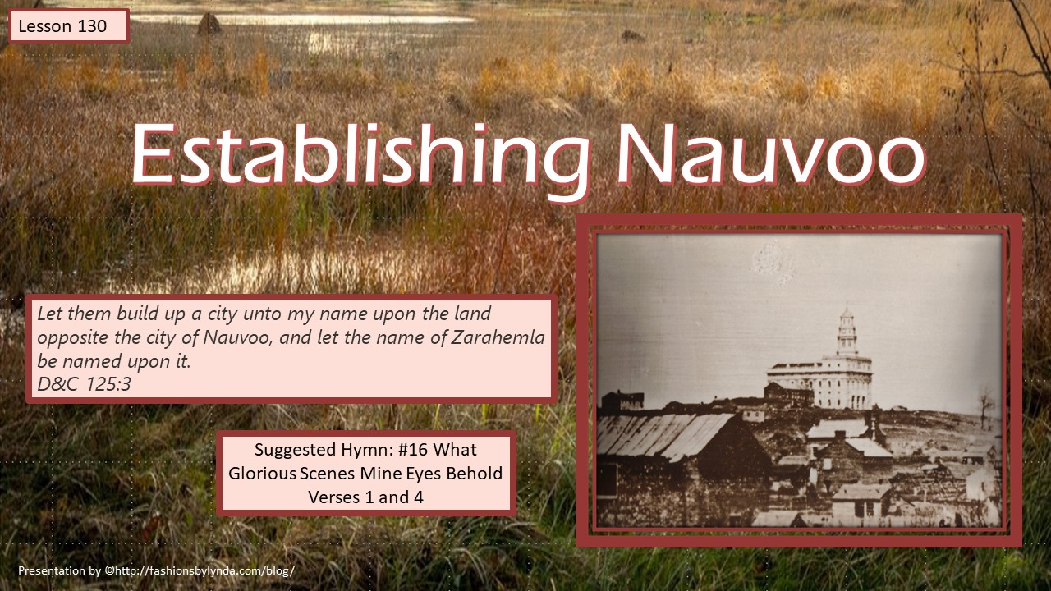
Establishing Nauvoo

Slide 2
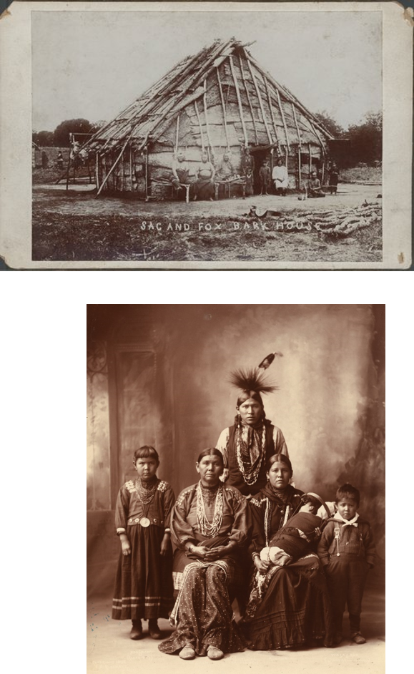
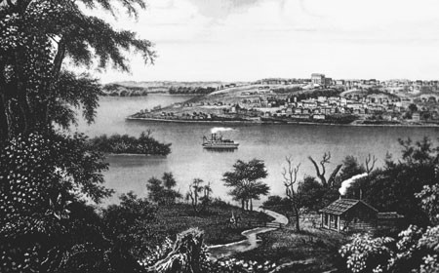
Nauvoo
1839-1846
Situated on the horseshoe bend of the Mississippi, Nauvoo is nearly surrounded by the river. The Sac and Fox Indians settled in the area first. Later Captain James White traded two hundred sacks of corn for the Indians' vast acreage. Captain White established a fur-trading village on the banks of the river--Wikipedia

Slide 3
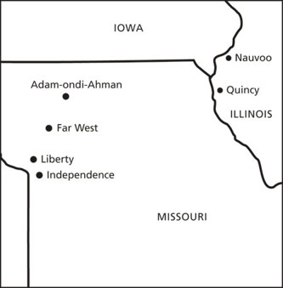
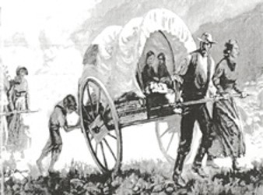
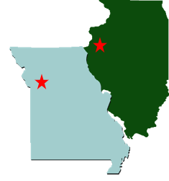
Move From Missouri To Illinois
Following the Saints’ expulsion from Missouri, they found refuge in Quincy, Illinois, and other small communities.
1838-39 Winter
They turned swampland along the Mississippi River into the city of Nauvoo, a place of beauty.

Slide 4
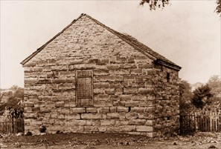
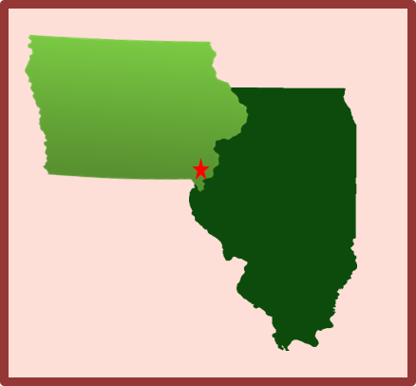
Allowed to Escape
On April 15, 1839, Joseph Smith and his fellow prisoners were told they would be transferred to another location. On the way to the new location, their guards allowed them to escape, acknowledging the injustice of holding them any longer
About a week later, Joseph Smith was reunited with his family in Quincy.
Under Joseph Smith’s direction, the Church purchased land on both sides of the Mississippi River north of Quincy.
The west side of the river was part of Iowa Territory, and the east side was part of the state of Illinois

Slide 5
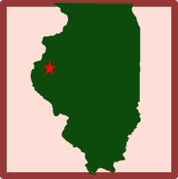

Headquarters of the Church
The Lord directed the Saints to buy and gather inexpensive swampland near the edge of the Missouri River. They lived in tents and wagons while they began to build a city.
Much of the land was a swamp and infested with mosquitos. The mosquitos carried a disease called malaria, which caused severe fevers and chills and could result in death.
Many of the Saints were infected and became ill.
Some of the afflicted were so sick that they could only crawl around as they tried to help each other, and some died. Church History
Nauvoo-- a Hebrew word that means beautiful.
יפה
The new place was called ‘Commerce’ then was changed to ‘Nauvoo’
This was the Church’s headquarters from 1839 to 1846

Slide 6
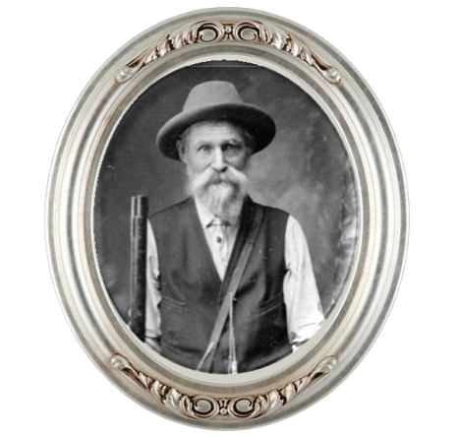
Blessing the Sick
Joseph Smith also contracted malaria, but after several days of sickness, he arose on July 22, 1839, and was filled with the Spirit of God. He blessed many of the sick near his home.
In one instance, Joseph approached a tent belonging to a Church member named Henry G. Sherwood, who was near death. When the Prophet commanded him to rise and come out of the tent, Brother Sherwood obeyed and was healed.
Unknown Photo

Slide 7
Henry Garlick Sherwood
He was born on April 20, 1785, in Kingsbury, New York to Newcomb Sherwood and ( ) Tolman
He was baptized in August 1832 and ordained an elder that same month
He married first Jane J. McManagal (McMangle) of Glasgow, Lanark, Scotland, in 1824, then Marcia Abbott of Windham Co., Vermont, in 1835
He moved to Kirtland soon thereafter and engaged in missionary work for the Church
Between 1836-1837 along with Abraham O. Smoot, they brought about 200 people from Tennessee to Far West
In 1837 he was appointed to the Kirtland high council
He moved with the Saints to Nauvoo where his life was saved, from malaria, miraculously through a blessing by the Prophet Joseph Smith in 1839
He was the first marshal of Nauvoo and a stockholder in the Nauvoo House project
In 1847, with Brigham Young’s company, he journeyed west, then served on a colonizing mission to San Bernardino, Los Angeles Co., California, 1852.
He made the initial drawing of the survey plan for Salt Lake City where there was a dispute with Church leaders in 1855, which led to his departure from the Church
He passed away in California on November 24, in 1862 (some records say 1867)
Who’s Who—Blog—Joseph Smith Papers

Slide 8

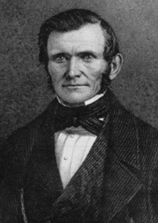
The Red Silk Scarf
Joseph crossed to the Iowa side of the river and continued to bless the sick. As Joseph was preparing to return to the Illinois side, a man who was not a member of the Church asked the Prophet if he would come bless his twin babies about two miles away.
“Joseph said he could not go, but he gave Wilford Woodruff a red silk handkerchief and told him to administer to them, promising that when he wiped their faces with it they would be healed”
Wilford followed this instruction, and the children were healed. Wilford called that day “a day of God’s power”
HC

Slide 9
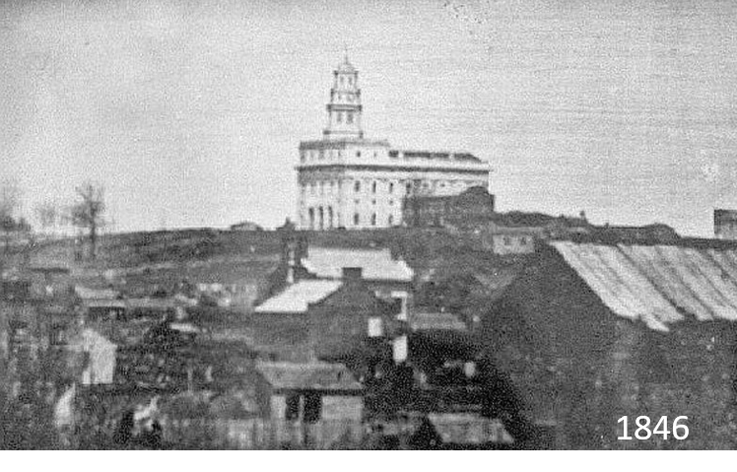
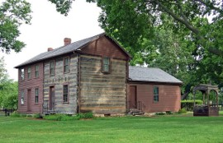
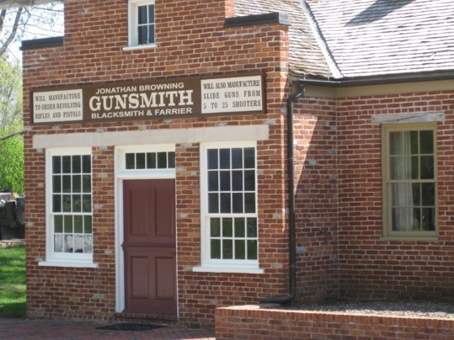
Building Their New Homes
Despite the faith and power of that day, sickness continued among the Saints for the next several months.
However, they continued to care for one another and worked to build their new home. They dug ditches to drain water from the swamps to the river, which made the land more usable and reduced the mosquito problem.
Eventually they built many homes and other structures, including the Nauvoo Temple, which was considered by some to be one of the finest buildings in the country.

Slide 10






Improving Your Circumstances
As we seek to improve the circumstances around us, we also improve ourselves

Slide 11


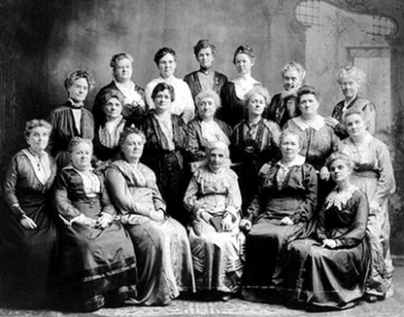
The Relief Society
In 1842 some women in Nauvoo assembled to discuss ways they could assist with the construction of the Nauvoo Temple.
They formed a society and wrote a constitution and bylaws to govern their work.
They presented their constitution and bylaws to the Prophet Joseph Smith, who said they were “the best he had ever seen.” But then he said that the Lord had “something better for them than a written constitution.”
He invited them to meet with him within the next week, when he would “organize the women under the priesthood after the pattern of the priesthood.”
Sarah M. Kimball
Relief Society is an inspired part of the Restoration of the Church of Jesus Christ.

Slide 12
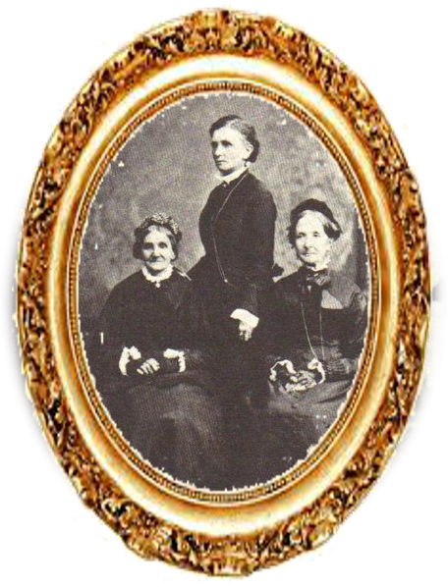
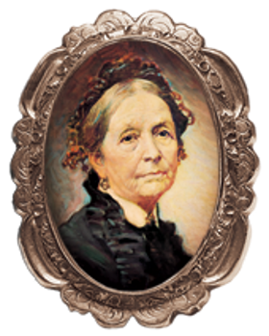
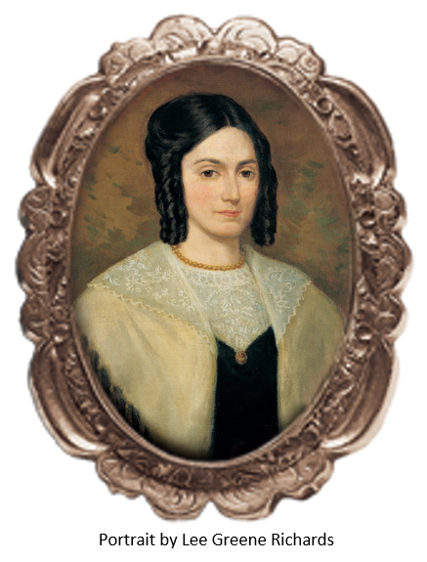
The Presidency
Emma Smith was called to be the first general president of the Relief Society.
Eliza R. Snow, the secretary of the Relief Society in Nauvoo.
Elizabeth Ann Whitney, Emmeline B. Wells (standing), and Eliza R. Snow.
They directed the work of Relief Society in the 1870s and 1880s. (From Women of Covenant)
The second general president of the Relief Society, taught: “Although the name [Relief Society] may be of modern date, the institution is of ancient origin.
We were told by [the Prophet Joseph Smith] that the same organization existed in the church anciently”
Deseret News

Slide 13
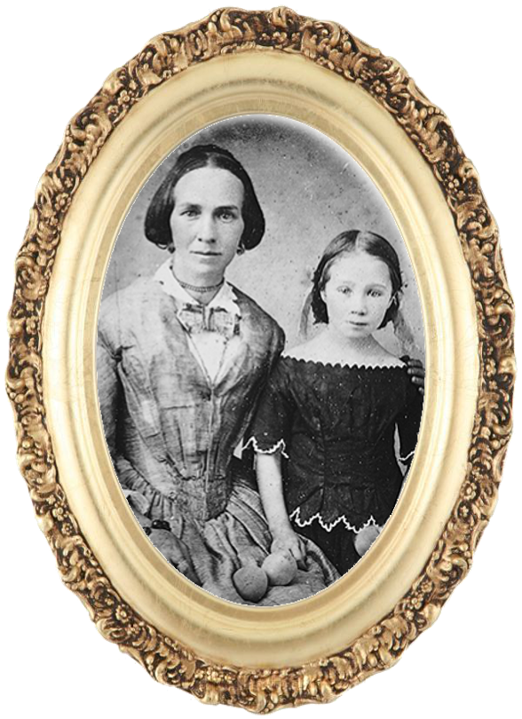

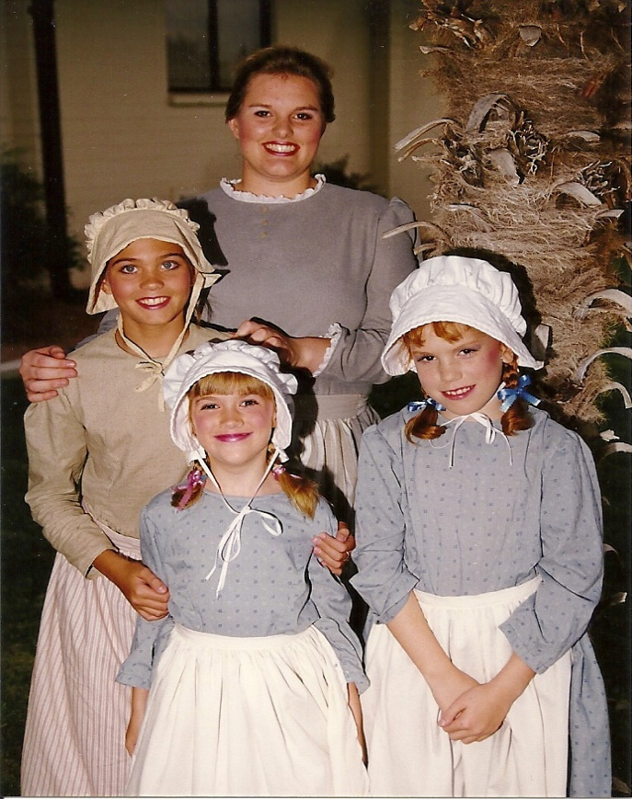
Preparing the Daughters of God
“Relief Society was established to help prepare daughters of God for the blessings of eternal life. The purposes of Relief Society are to increase faith and personal righteousness, strengthen families and homes, and provide relief by seeking out and helping those in need.”
(Daughters in My Kingdom, xi).

Slide 14

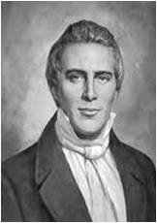
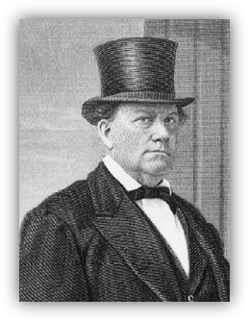
Adding Fuel to the Flame
“Persecution has not stopped the progress of truth, but has only added fuel to the flame. …
“… The Standard of Truth has been erected; no unhallowed hand can stop the work from progressing; persecutions may rage, mobs may combine, armies may assemble, calumny may defame, but the truth of God will go forth boldly, nobly, and independent, till it has penetrated every continent, visited every clime, swept every country, and sounded in every ear, till the purposes of God shall be accomplished, and the Great Jehovah shall say the work is done.”
HC
Prophet Joseph Smith wrote in a letter to a newspaper editor named John Wentworth on March 1, 1842:
Nothing will stop the progress of God’s work throughout the earth.

Slide 15
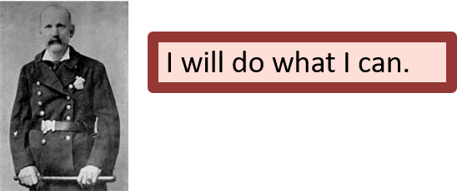
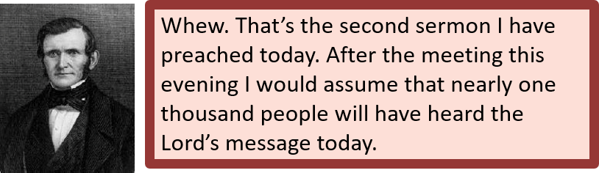

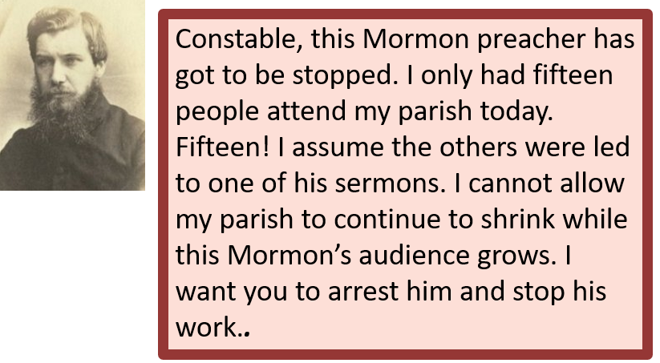
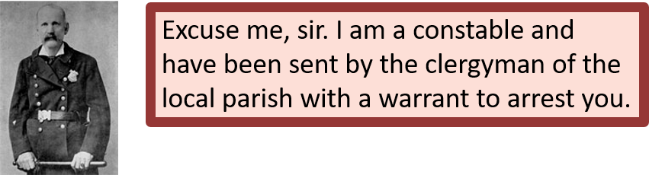
Wilford Woodruff—preaching in Herefordshire, England
1840

Slide 16

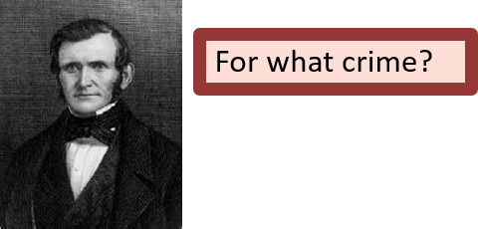
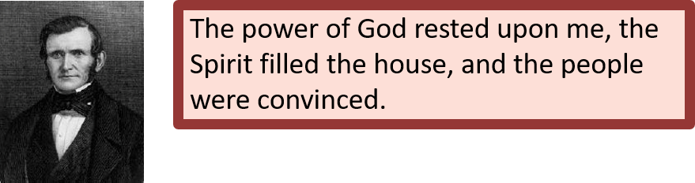
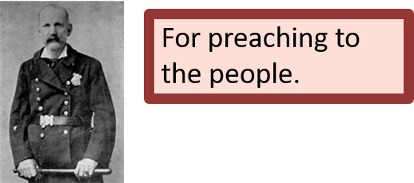

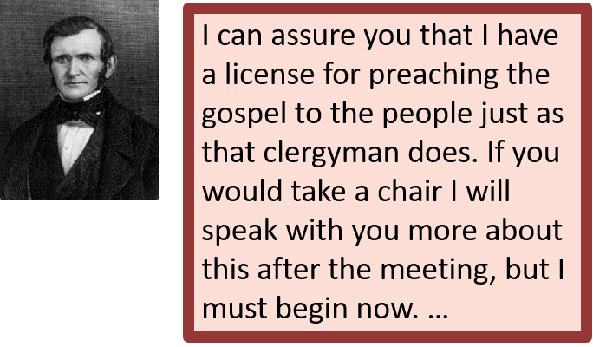
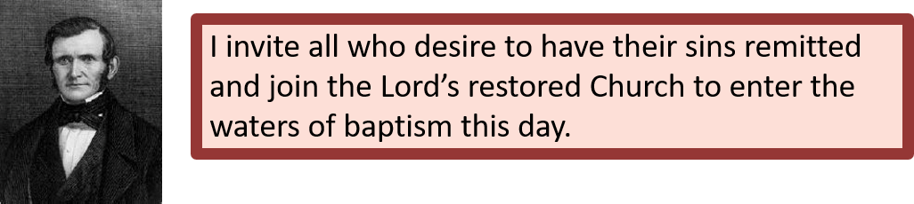

Slide 17
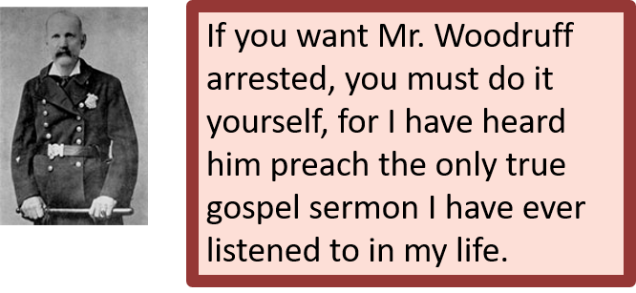
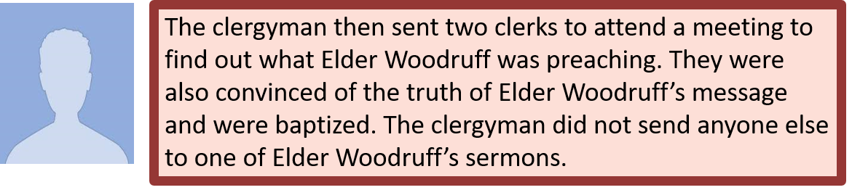
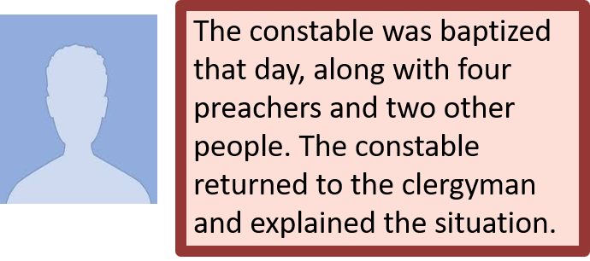
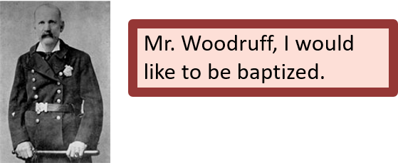
Story:
(Adapted from Wilford Woodruff, Leaves from My Journal[1881], 80–81.)

Slide 18
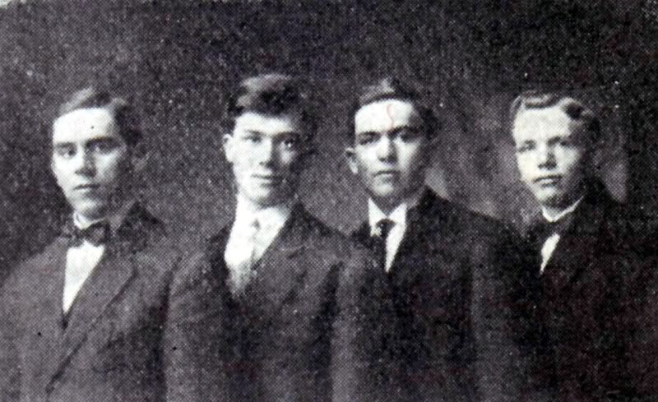
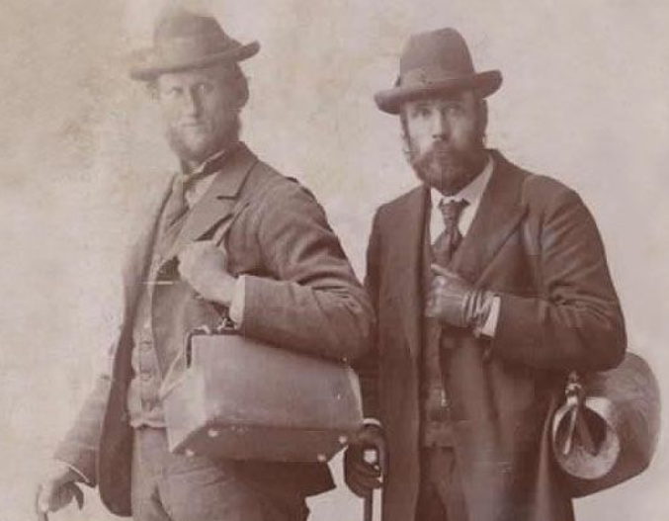
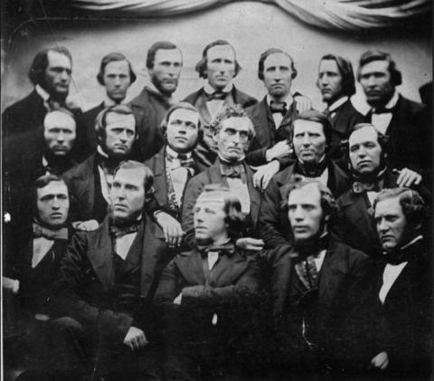
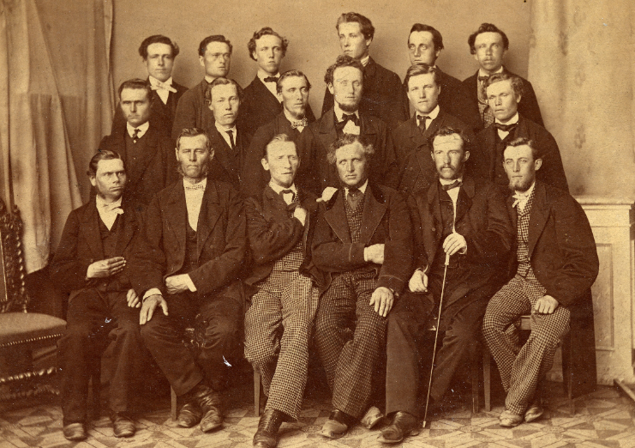
According to our records, it is estimated that between 7,500 and 8,000 were baptized during the two missions of the Twelve to the British Isles. This laid the foundation for missionary work in Europe.
By the end of the 19th century, some 90,000 had gathered to America, with the most of these coming from the British Isles and Scandinavia.
The Lord had inspired Joseph and those faithful missionaries who went to work to achieve a harvest that must have, at the time, seemed beyond them.
But the Lord, with His perfect foresight and preparation, made it possible.
Henry B. Eyring

Slide 19
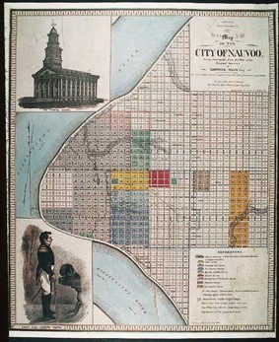
Revelations Revealed in Nauvoo
Ongoing revelations occurred as the Saints labored to build the Nauvoo Temple, in which the Lord promised to reveal ordinances and knowledge that had “been kept hid from before the foundation of the world”
During this time, the Lord revealed the ordinances of baptism for the dead, the temple endowment, and the marriage sealing. He also revealed more about the nature of the Godhead.
From 1842 to 1844, the Prophet Joseph Smith wrote the Articles of Faith and published the book of Abraham, which clarified difficult passages in other scriptural texts and revealed truths of the gospel of Jesus Christ that had been previously unknown or little understood.
The Prophet also conferred the keys of the kingdom upon the Quorum of the Twelve Apostles so they would be prepared to lead the Church after his death.

Slide 20
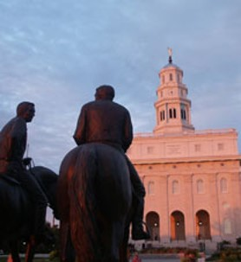
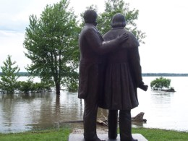
Ascend the Throne of Eternal Power
“Here, then, is eternal life—to know the only wise and true God; and you have got to learn how to be gods yourselves, and to be kings and priests to God, … by going from one small degree to another, and from a small capacity to a great one; from grace to grace, from exaltation to exaltation, until you attain to the resurrection of the dead, and are able to dwell in everlasting burnings, and to sit in glory, as do those who sit enthroned in everlasting power. …
“… [The righteous who have died] shall rise again to dwell in everlasting burnings in immortal glory, not to sorrow, suffer, or die any more, but they shall be heirs of God and joint heirs with Jesus Christ. What is it? To inherit the same power, the same glory and the same exaltation, until you arrive at the station of a god, and ascend the throne of eternal power, the same as those who have gone before”
Teachings of Joseph Smith

Slide 21
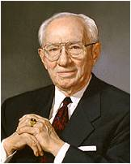
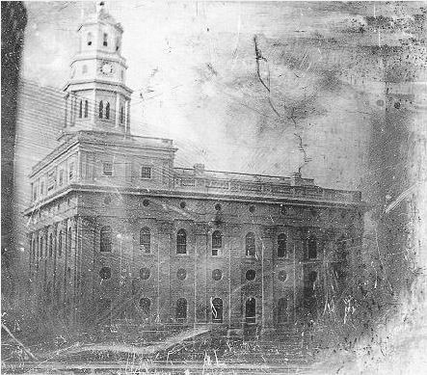
Construction of the Nauvoo Temple
“This building [the Nauvoo Temple] was to be concerned with the things of eternity. It was to stand as a witness to all who should look upon it that those who built it had a compelling faith and a certain knowledge that the grave is not the end, but that the soul is immortal and goes on growing. In March of the year he died—1844—the Prophet had amplified this doctrine in a monumental address which he delivered in the grove which was just below the temple site. The text of that address has become an important doctrinal document in the theology of the Church. It is known as the King Follett Sermon”
President Gordon B. Hinckley

Slide 22
Sources:
Videos:
Relief Society: An Enduring Legacy (3:17)
Society: “The Nauvoo Female Relief Society” (7:19).
“The Heart and a Willing Mind,” from time code 4:00 to 7:57
Church History in the Fulness of Times Student Manual, 2nd ed. [Church Educational System manual, 2003], 217–18; 4:540
http://amateurmormonhistorian.blogspot.com/2012/05/henry-g-sherwood-and-200-saints-from.html
Doctrine and Covenants Who’s Who by Ed J. Pinegar and Richard J. Allen pg. 131
Sherwood, Henry Garlick—Joseph Smith Papers
(Church History in the Fulness of Times,219). Wilford Woodruff Journals, July 22, 1839, quoted in Church History in the Fulness of Times, 218).
Sarah M. Kimball, “Auto-biography,” Woman’s Exponent, Sept. 1, 1883, 51; quoted in Daughters in My Kingdom: The History and Work of Relief Society [2011], 12.
Presentation by ©http://fashionsbylynda.com/blog/
(“Female Relief Society,” Deseret News, Apr. 22, 1868, 1; see also Daughters in My Kingdom, 7).
Map of Nauvoo with profile of Joseph Smith Lithograph, John Childs, 1844, from a plat by Gustavus Hills, 1842; insert of temple by William Weeks, 1842; insert of Joseph Smith by Sutcliffe Maudsley, 1842. (Church History Library, Salt Lake City.)
(Teachings: Joseph Smith, 221–22).’
President Gordon B. Hinkley (“Nauvoo’s Holy Temple,” Ensign, Sept. 1994, 62).
Henry B. Eyring, “He Goes before Us,” Ensign or Liahona, May 2020, 68
Presentation by ©http://fashionsbylynda.com/blog/

Slide 23
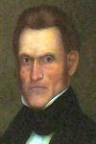
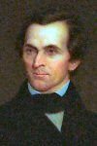
Governors during the Mormon’s Settlement in Nauvoo
Thomas Ford, Democratic --- 1842–1846 [wife: Frances Hambaugh Ford]
Ford was born in Uniontown, Fayette County, Pennsylvania in 1800. His widowed mother took him and his siblings west in hopes of crossing the Mississippi River in 1804 to buy cheap land. At St. Louis she was told about the Louisiana Purchase and that land was no longer cheap there because it now belonged to America. So she settled in Illinois instead. Ford was the half-brother to George Forquer, who later became the state's attorney general. The two would eventually share a law office together, and Forquer aided Ford in his early years as a lawyer and judge. But, he took a brief time away from the law to become a spy against Black Hawk shortly before the Black Hawk War in 1832.
He was the state's attorney in Western Illinois, then was elected as a state court judge in the north in 1836. He later served as a municipal judge in Chicago, before becoming a state court judge again. This led to his joining the Supreme Court of Illinois as an associate justice, 1841-42. Elected as governor, he inherited a financial crisis. When he took office in 1842, the cost of building the Illinois-Michigan Canal and a disastrous public railroad project had put Illinois $15 million in debt. The state was so broke it couldn't buy postage stamps, and many citizens wanted to renege on the debt. Instead, Ford got some of the debt cancelled, then persuaded the legislature to pass a property tax. The tax enabled the state to pay back its debt, finish the Illinois-Michigan Canal and begin the industrial age with a good credit rating.
http://genealogytrails.com/ill/governors.html Constitutionally prohibited from succeeding himself, Ford retired when his term of office ended in 1846. He was remembered largely for the Illinois Mormon War.
Ford married Frances Hambaugh in 1828 and had five children by her. His wife died of cancer in 1850 at the age of 38, and he followed her in death three weeks later from tuberculosis. Of his three daughters, two were said to have died young. His two sons were both lynched as outlaws in Kansas in the 1870s, one dying under mysterious circumstances. Ford died in Peoria, Illinois. Interment was at Springdale Cemetery, Peoria. Ford County, Illinois is named for him.
Thomas Carlin, Democratic --- 1838–1842 [wife: Rebecca Huitt Carlin ]
Thomas Carlin, the founder of Carrollton Illinois, county seat Greene, was born near Shelbyville, Kentucky in 1786. In 1803 the family moved to Missouri where his father died. Thomas Carlin served as a ranger during the War of 1812. In 1814 he owned a ferry crossing the Mississippi near the present site of Edwardsville Junction with his brother James and William Carlin 1814 . While living there he married Miss Rebecca Huitt, (sister of John Wilkinson Huitt) in 1818.
He was first sheriff of the county his commission dated dated April 14, 1821. He served as state senator in fourth and fifth general assemblies (1824 - 1828) In the Black Hawk was he commanded a spy battalion. He was elected the sixth governor of Illinois in 1838 serving until 1842. when he returned to Carrollton, He was elected to the legislature in 1849
http://genealogytrails.com/ill/governors.html

Slide 24
Wilford Woodruff:
While serving a mission in England, Wilford Woodruff received an impression from the Spirit to leave where he was preaching and go to another part of England. Elder Woodruff ended up in Herefordshire, where he found numerous souls who were ready to receive the restored gospel. “Through the efforts of Wilford Woodruff and others, some eighteen hundred people were converted in the three-county area of Hereford, Worcester, and Gloucester. … Reflecting on this extraordinary period of his life, Wilford Woodruff wrote, ‘The whole history of this Herefordshire mission shows the importance of listening to the still small voice of the spirit of God, and the revelations of the Holy Ghost. The people were praying for light and truth, and the Lord sent me to them’ [in Matthias F. Cowley, ed., Wilford Woodruff (1979), 120]” (Church History in the Fulness of Times Student Manual, 2nd ed. [Church Educational System student manual, 2003], 231).
On January 26, 1839, Brigham Young created the Committee on Removal to facilitate the exodus.
“Throughout the winter and spring this committee arranged to feed, clothe, and transport the poor. By formal resolution nearly four hundred Latter-day Saints covenanted to place all of their available property at the disposal of the committee ‘for the purpose of providing means for the removing from this state of the poor and destitute who shall be considered worthy, till there shall not be one left who desires to remove from the state’ [in History of the Church, 3:251]. …
“By mid-February conditions were such that a large scale migration of the Saints began. Wagons and teams, although not of the best quality, had been acquired; food reserves were in place along the migration route; and there was a temporary break in the weather. Nevertheless, leaving Missouri was not easy for the refugees. Many people sold precious possessions and lands at unreasonably low prices to obtain means to flee the state” (Church History in the Fulness of Times, 212).
In the King Follett sermon, delivered at the funeral of a man named King Follett, the Prophet Joseph Smith explained that we lived with Heavenly Father before we came to earth and that God instituted laws to allow us to progress:
“God himself, finding he was in the midst of spirits and glory, because he was more intelligent, saw proper to institute laws whereby the rest could have a privilege to advance like himself. The relationship we have with God places us in a situation to advance in knowledge. He has power to institute laws to instruct the weaker intelligences, that they may be exalted with himself” (Teachings of Presidents of the Church: Joseph Smith [2007], 210).
“Here, then, is eternal life—to know the only wise and true God; and you have got to learn how to be gods yourselves, and to be kings and priests to God, … by going from one small degree to another, and from a small capacity to a great one; from grace to grace, from exaltation to exaltation, until you attain to the resurrection of the dead, and are able to dwell in everlasting burnings, and to sit in glory, as do those who sit enthroned in everlasting power. …
“… [The righteous who have died] shall rise again to dwell in everlasting burnings in immortal glory, not to sorrow, suffer, or die any more, but they shall be heirs of God and joint heirs with Jesus Christ. What is it? To inherit the same power, the same glory and the same exaltation, until you arrive at the station of a god, and ascend the throne of eternal power, the same as those who have gone before” (Teachings: Joseph Smith, 221–22).

