Slide 1
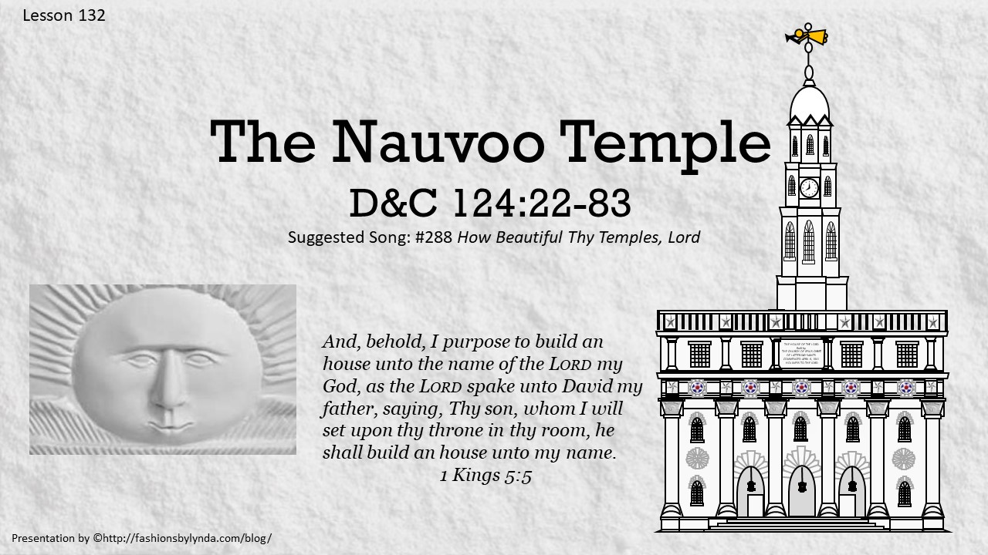

Slide 2

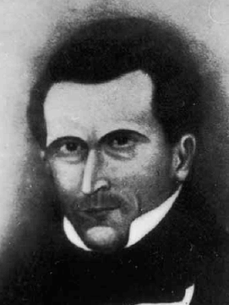
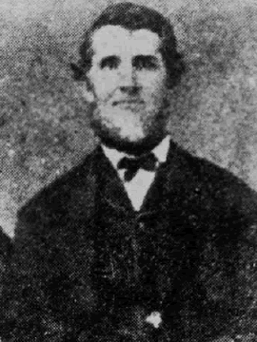
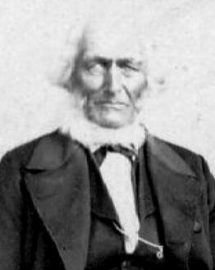
To Build
In a general conference held in October 1840 the Saints appointed a committee to build the House of the Lord
HC
The Lord revealed more about the purpose of temples as a place to receive sacred ordinances.
Lyman Wight
John Snider
George Miller

Slide 3
John Snider (Snyder)
He was born on February 11, 1800, in Pleasant Valley, New Brunswick, Nova Scotia. He was the son of Martin Snyder and Sarah Armstrong and married Mary Heron, 28 Feb. 1822, and had three children
Having heard the preaching of John Taylor and Parley P. Pratt, he joined the Church in June 1836.
He served a mission to the British Isles in 1837 and in 1838 resided in Far West
He was with the other Saints in leaving Missouri to Illinois
In 1841 he was on the personal staff of the Prophet Joseph Smith and was in the Nauvoo Legion
He was a mason by trade and called by revelation in January 1841 to assist with the construction of the Nauvoo House
He was sent to England to help raise funds for the construction of the Nauvoo House and the Nauvoo Temple
He later served as one of the bodyguards accompanying the body of the martyred Prophet to Nauvoo
He and his family traveled with the Lorrin W. Babbitt Company in 1851 and settled in the Salt Lake Valley where he earned a living in constructing homes.
He died on December 18, 1875, and was buried, by his wife Mary, in the Salt Lake Cemetery
Who’s Who—Pioneers and Prominent Men

Slide 4
Peter Haws
He was born on February 17, 1795, in Young Township, Ontario, Canada. He was the son of Edward Haws and Polly ( ). He married Charlotte Harrington
After joining the Church in Canada, he moved to Nauvoo and became a prominent landholder known for his generosity to the poverty-stricken Saints
He was appointed by revelation to assist with building of the Nauvoo House (D&C 124:62, 70)
In 1843 he went on a mission to help raise funds for the Nauvoo House and the Nauvoo Temple with Amasa Lyman
He served a mission with George Miller to Mississippi and Alabama in Sept- Oct in 1843
He remained faithful to the Church until his post-Nauvoo years in Iowa when he developed disaffection toward the leaders of the Church
He became entangled with apostate Lyman Wight in Texas and later cut off from the Church for speaking against Brigham Young and the Twelve in 1849
He later moved to Nevada and then California where he died in 1862
Who’s Who

Slide 5
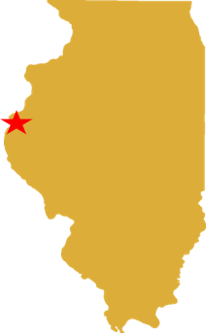
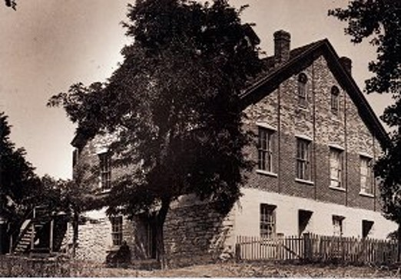
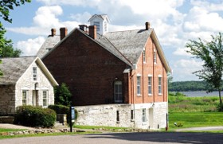
Resting Place for the Weary Traveler
By 1841 a large portion of the Saints had relocated to Nauvoo, Illinois.
Construction began in late 1841
The Nauvoo House was to be built for visitors and to provide them with comfortable lodgings in the city
“It is important that the Nauvoo House should be finished, that we may have a suitable place wherein to entertain the great ones of the earth, and teach them the truth.”
HC
“The Nauvoo House was never completed as originally designed. After the martyrdom of the Prophet, his wife, Emma, inherited the unfinished wing of the Nauvoo House to complete a smaller two-story house on the southwest corner of the original building.”
McConkie and Ostler
Resources were pulled away so they could complete the Nauvoo Temple in 1844
D&C 124:23-24

Slide 6
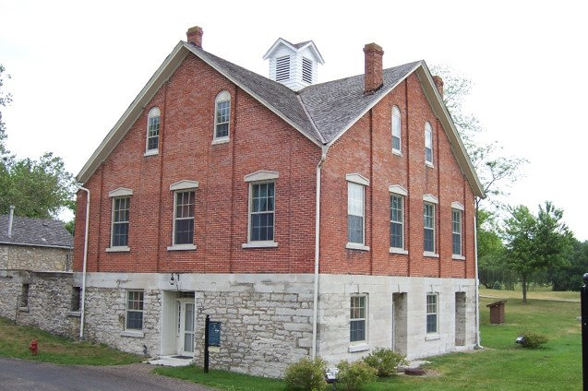
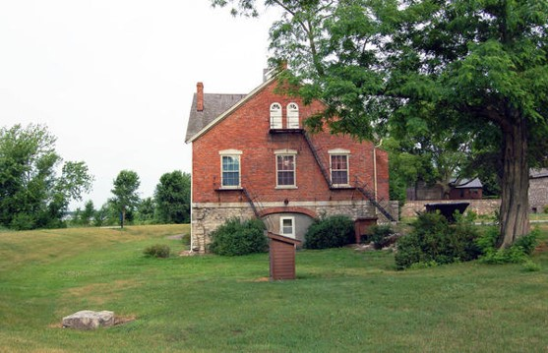
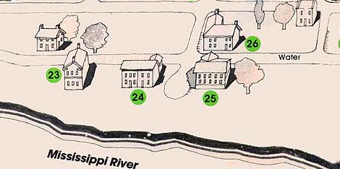
Nauvoo House
By 1841 a large portion of the Saints had relocated to Nauvoo, Illinois.
Construction began in late 1841
The Prophet Joseph Smith placed the original manuscript of the Book of Mormon in this cornerstone at the southeast corner of the Nauvoo House.
Desert News
After the Martyrdom of Joseph and Hyrum Smith their bodies were secretly buried in the cellar of the unfinished house to prevent their bodies from being stolen. Later, their bodies were removed and buried close to the Mansion House.
Joseph Smith Homestead
Mansion House
Nauvoo House
D&C 124:23-24, 56-83

Slide 7
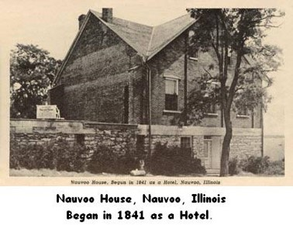
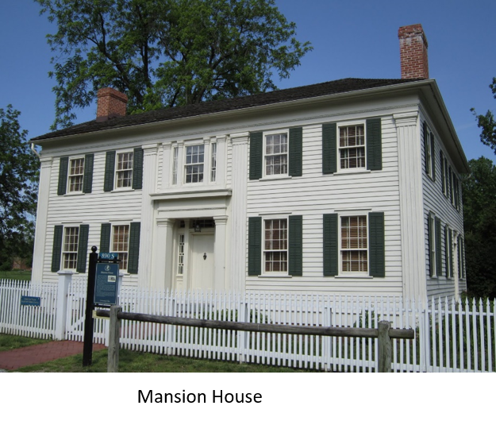
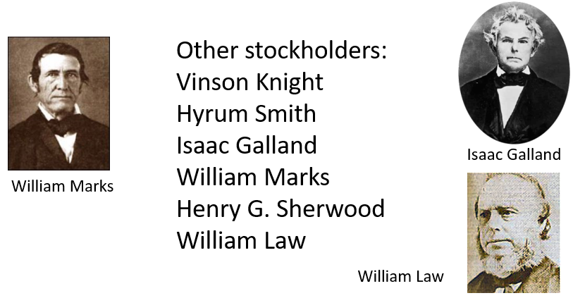
Instructions for the Nauvoo House
This home was also dedicated to the Lord
The Prophet Joseph owned a portion(share) of the stock that was transferable property (from one generation to another)
There was a building committee appointed and a constitution for that corporation
D&C 124: 56-83

Slide 8
Command to Build
The Lord commands us to build temples “for the Most High to dwell therein”
To “restore again that which was lost”
As a place “for refuge”
“that I may bless you, and crown you with honor, immortality, and eternal life”
The Lord commands us to build temples so we can receive sacred ordinances

Slide 9

We do not build or enter holy temples solely to have a memorable individual or family experience.
Rather, the covenants received and the ordinances performed in temples are essential to the sanctifying of our hearts and for the ultimate exaltation of God’s sons and daughters.
David A. Bednar

Slide 10







In the Kirtland Temple, the Savior and other heavenly messengers appeared (D&C 110).
The Kirtland Temple was also a place of inspiration and learning.
In Nauvoo, the Lord revealed additional ordinances that take place in temples today.
THE HOUSE OF THE LORD
Built by
THE CHURCH OF JESUS CHRIST OF LATTER-DAY SAINTS
COMMENCED APRIL 6, 1841
HOLINESS TO THE LORD

Slide 11
Today in temples, faithful members of the Church perform baptisms for the dead, receive endowments (including washings and anointings), and participate in temple sealings.

Slide 12
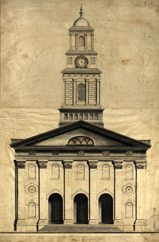
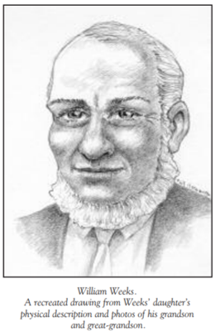
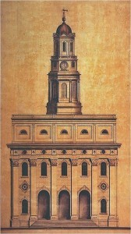
A House to My Name
The building of the Nauvoo Temple was the fifth attempt by the Latter-day Saints to build a house of the Lord.
The other attempts include Jackson County, Missouri; Kirtland, Ohio; and Far West and Adam-ondi-Ahman, Missouri. Only the Kirtland Temple was completed before the one in Nauvoo, and it was desecrated,
Original design for the Nauvoo Temple by William Weeks with pediment, Corinthian entablature, and square bell-tower base.
William Weeks Nauvoo Temple architectural plan
William Weeks (March 11, 1813 – March 8, 1900), was the first church architect of the Church of Jesus Christ of Latter-Day Saints
D&C 124:25-27

Slide 13
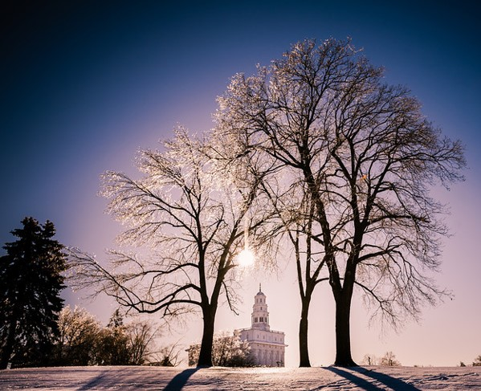
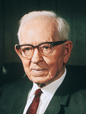
Fulness of the Priesthood
“Every man who is faithful and will receive these ordinances and blessings obtains a fulness of the priesthood, and the Lord has said that ‘he makes them equal in power, and in might, and in dominion’. …
The Lord has made it possible for every man in this Church, through his obedience, to receive the fulness of the priesthood through the ordinances of the temple of the Lord. This cannot be received anywhere else.”
President Joseph Fielding Smith
The restoration of temple ordinances and covenants began in the Kirtland Temple but had not been completed.
Building a temple in Nauvoo would allow the restoration of temple ordinances and covenants to continue.
D&C 124:28

Slide 14

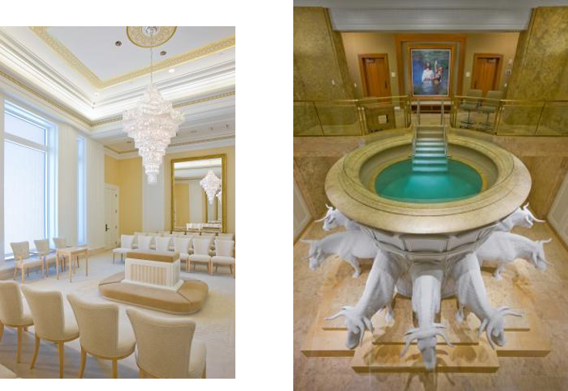
Ordinances
A sacred, formal act preformed by the authority of the Priesthood
Some ordinances are essential to exaltation, and many of these saving ordinances can be performed only in temples.
The first is baptism for the dead, mentioned by Paul in the New Testament — “Else what shall they do which are baptized for the dead, if the dead rise not at all? why are they then baptized for the dead.” (1 Corinthians 15:29)
D&C 124:28

Slide 15
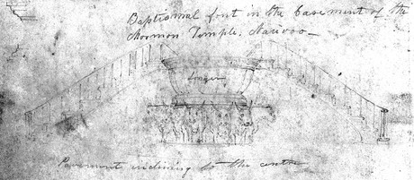
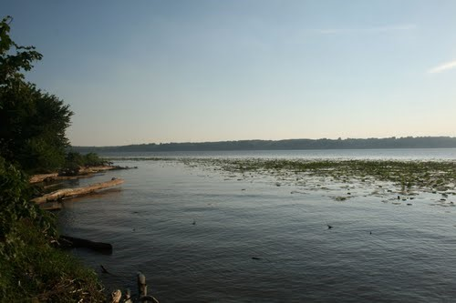
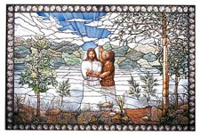
On Behalf of Their Deceased
August 15, 1840, the Prophet Joseph Smith first taught that the Saints could perform saving ordinances like baptism on behalf of their deceased family members and friends who had not had the opportunity to receive the gospel.
Teachings
After this announcement, many baptisms for the dead were performed in the Mississippi River or in nearby streams.
Jesus answered, Verily, verily, I say unto thee, Except a man be born of water and of the Spirit, he cannot enter into the kingdom of God.
John 3:5
Nauvoo today
D&C 124:29

Slide 16
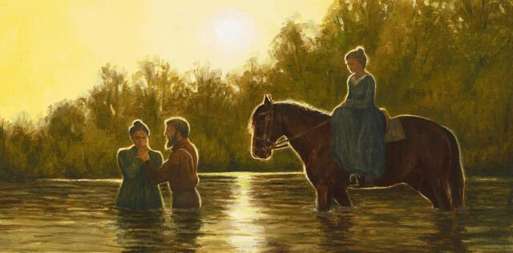
First Person to Baptize for the Dead
In August 1840, a grieving Jane Neyman listened to the Prophet Joseph speak at the funeral of his friend Seymour Brunson. Jane’s own teenage son Cyrus had also recently passed away.
Jane worried what this would mean for his eternal soul.
The Prophet decided to share with Jane, and everyone else at the funeral, what the Lord had revealed to him about those who had died without receiving the ordinances of the gospel
Nauvoo today
The first recorded baptism was performed by Harvey Olmstead, who baptized Jane Neyman in behalf of her recently departed son, Cyrus. The baptism took place in the Mississippi River and was witnessed by Vienna Jacques, who had waded on horseback into the river to hear the prayer.

Slide 17
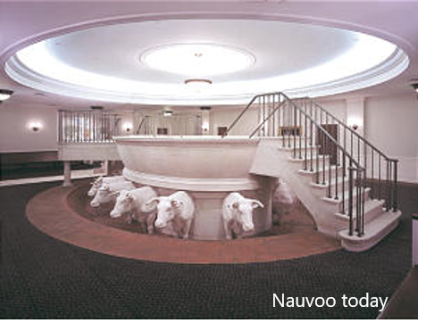
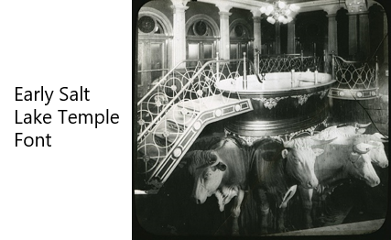
Baptism For the Dead
The revelation explains that the ordinance of baptism for the dead is to be done only in a place designated by the Lord.
Performing the ordinance was acceptable outside the temple only under special circumstances, and before the completion of the Nauvoo Temple the Lord permitted the ordinance to be performed in the Mississippi River. In October 1841 the Prophet announced that no more baptisms for the dead would be administered until the temple’s font was completed.
It was finished in November, and baptisms recommenced on the twenty-first.
The baptismal font was built in the basement of the unfinished temple and dedicated on November 8, 1841, by Brigham Young.
Baptisms for the dead are performed in a baptistry that is below ground level, symbolizing being buried, thus death and spiritual rebirth
D&C 124:30-34

Slide 18
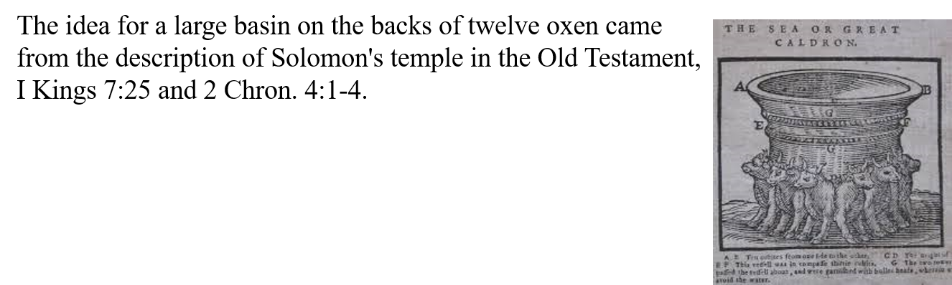
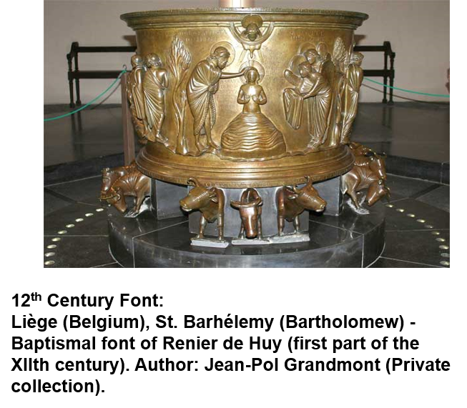
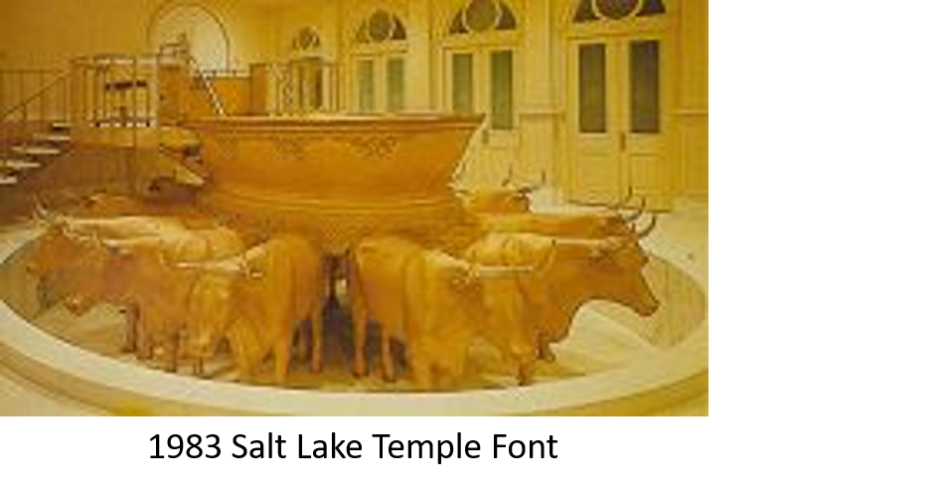
12 Oxen—12 Tribes of Ancient Israel
The temple is the only place where we can obtain the fulness of the priesthood ordinances for the redemption of the living and the dead.
D&C 124:30-34

Slide 19
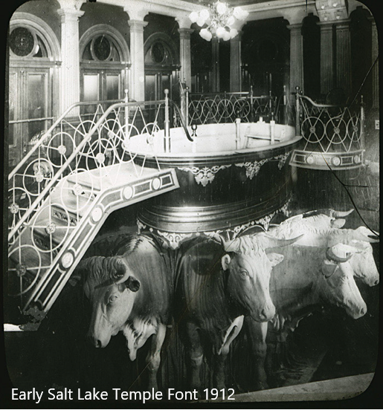
Free Agency
Some people have misunderstood that when baptisms for the dead are performed, deceased persons are baptized into the Church against their will.
This is not the case. Each individual has agency, or the right to choose.
The validity of a baptism for the dead depends on the deceased person accepting it and choosing to accept and follow the Savior while residing in the spirit world.
The names of deceased persons are not added to the membership records of the Church.
Lds.org Baptisms for the Dead

Slide 20
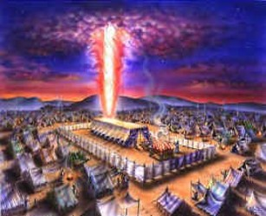
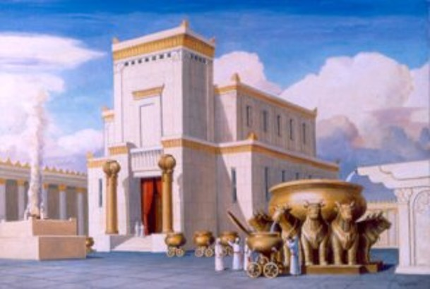
Ancient Temples
“What was the object of gathering the Jews, or the people of God in any age of the world? …
“The main object was to build unto the Lord a house whereby He could reveal unto His people the ordinances of His house and the glories of His kingdom, and teach the people the way of salvation: for there are certain ordinances and principles that, when they are taught and practiced, must be done in a place or house built for that purpose.”
“It was the design of the councils of heaven before the world was, that the principles and laws of the priesthood should be predicated upon the gathering of the people in every age of the world. Jesus did everything to gather the people, and they would not be gathered, and He therefore poured out curses upon them. Ordinances instituted in the heavens before the foundation of the world, in the priesthood, for the salvation of men, are not to be altered or changed. All must be saved on the same principles.”
D&C 124:38-41 HC

Slide 21
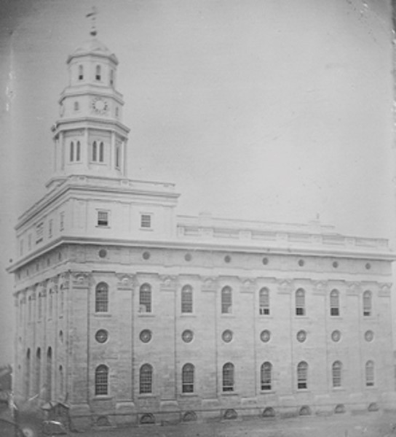
Nauvoo Temple
“It is for the same purpose that God gathers together His people in the last days, to build unto the Lord a house to prepare them for the ordinances and endowments, washings and anointings, etc.
One of the ordinances of the house of the Lord is baptism for the dead. God decreed before the foundation of the world that that ordinance should be administered in a font prepared for that purpose in the house of the Lord.”
HC
The Nauvoo Temple was the first ordinance temple built in the last dispensation..

Slide 22


When you join the Church, you receive two ordinances:
baptism and confirmation.
Likewise, the temple endowment is received in two parts.

Slide 23
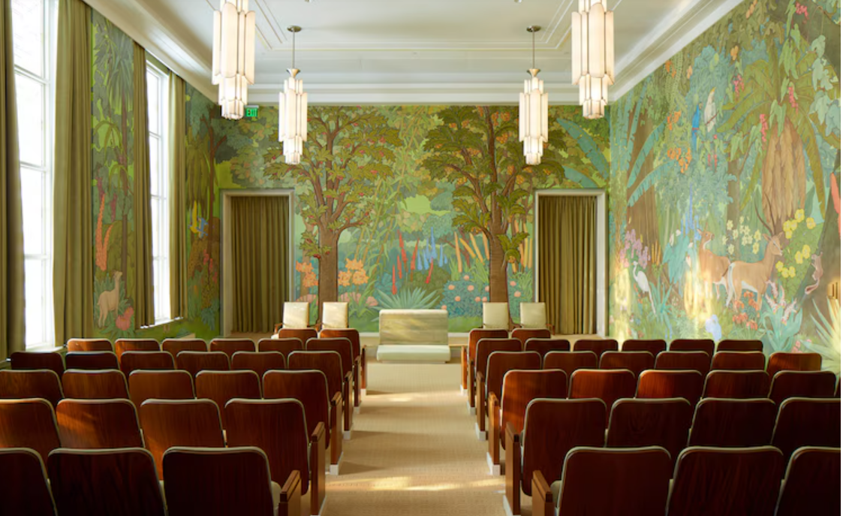
Initiatory and Endowment
In the first part, you will privately and individually receive what are called the “initiatory” ordinances. These ordinances include special blessings regarding your divine heritage and potential. As part of these ordinances, you will also be authorized to wear the sacred temple garment. be invited to make certain covenants with God.
In the second part, you will receive the rest of your endowment in a group setting.
This takes place in an instruction room with others who are attending the temple.
Events that are part of the plan of salvation are presented. They include the Creation, the Fall of Adam and Eve, the Atonement of Jesus Christ, the Apostasy, and the Restoration.
You will also learn more about the way all people can return to the presence of the Lord. Some of the endowment is presented through video and some by temple officiators.
Idaho Falls Temple

Slide 24
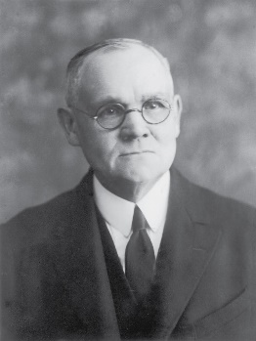
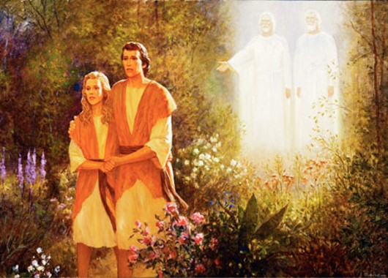
The Temple Endowment
“The Temple Endowment, as administered in modern temples, comprises instruction relating to the significance and sequence of past dispensations, and the importance of the present as the greatest and grandest era in human history.
This course of instruction includes a recital of the most prominent events of the creative period, the condition of our first parents in the garden of Eden, their disobedience and consequent expulsion from the blissful abode, their conditions in the lone and dreary world when doomed to live by labor and sweat, the plan of redemption by which the great transgression may be atoned, the period of the great apostasy, the restoration of the Gospel with all its ancient powers and privileges, the absolute and indispensable condition of personal purity and devotion to the right in present life, and a strict compliance with Gospel requirements.” Elder James E. Talmage

Slide 25
Covenants
Law of obedience, which includes striving to keep God’s commandments
Law of consecration, which involves dedicating our time, talents, and everything with which the Lord has blessed us to building up Jesus Christ’s Church on the earth
Law of sacrifice, which involves doing all we can to support the Lord’s work and repenting with a broken heart and contrite spirit
Law of chastity, which involves having sexual relations only with the person to whom we are legally and lawfully wedded according to God’s law
Law of the gospel, which is the higher law that Jesus taught while He was on the earth

Slide 26
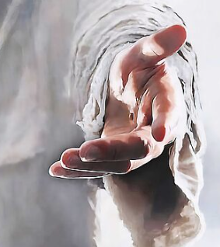
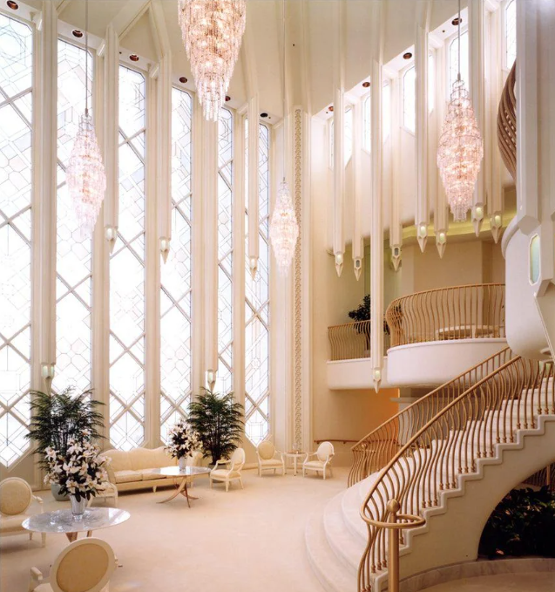
When you keep your covenants, you come closer to the Savior and your relationship with Him grows more powerful.
God promises that those who keep their covenants will receive blessings in this life and the opportunity to return to live with Him forever.
At the end of the endowment, participants symbolically return to the Lord’s presence as they enter the celestial room.
There you can take time to ponder, pray, read the scriptures, or quietly share your thoughts with family and friends. It is a place of peace, where you can also find comfort and divine guidance.
San Diego Temple
“About the Temple Endowment,” temples.ChurchofJesusChrist.org.)

Slide 27
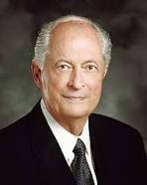

The primary purpose of the temple is to provide the ordinances necessary for our exaltation in the celestial kingdom. Temple ordinances guide us to our Savior and give us the blessings that come to us through the Atonement of Jesus Christ.
Robert D. Hales

Slide 28



Become a Covenant People
“…We are not simply a community of covenant individuals. We do not work out our salvation separately and singly but rather together. If one man chooses to pollute the water it is not he alone who suffers.
All who drink it, regardless of how innocent they may be, will be poisoned.
While if another man choose to raise the blinds so that the light of heaven might enter…all within the room are thereby enabled to see.”
“Nauvoo is to be a place of refuge and safety if the Saints abide in the counsels of the Lord, but if some of their number choose to pursue another course, all will suffer, and again as history attests such was the case.”
D&C 124:45-48 McConkie and Ostler

Slide 29
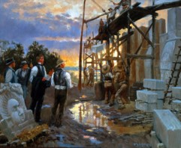
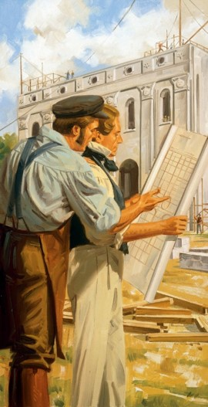
Those Who Hear
“What can we do better than to show respect to our God by listening to His servant, by treating him with reverence, asking his counsel and seeking for his guidance?
“…You cannot get away from this authority and remain Latter-day Saints, for you sever yourselves from the Church of God, because everything you have is based on the recognition of this authority.”
“Though Zion and its temple were not built within the appointed generation, and though the early Saints were excused from this labor, these things will yet come to fruition. On 8 March 1833, the Lord promised…
D&C 124:45-48 George Q. Cannon

Slide 30
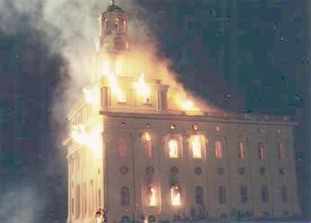
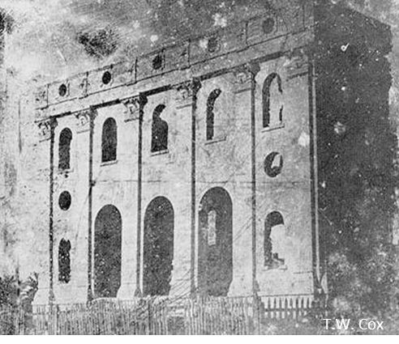
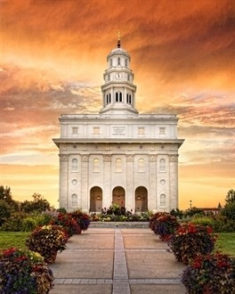
Destruction of the Nauvoo Temple
Nauvoo Patriot, November 19, 1848
On Monday the 19th of November, our citizens were awakened by the alarm of fire, which, when first discovered, was bursting out through the spire of the Temple, near the small door that opened from the east side to the roof, on the main building. The fire was seen first about three o'clock in the morning, and not until it had taken such hold of the timbers and roof as to make useless any effort to extinguish it.*see rest of story
But verily I say unto you, that I, the Lord, will contend with Zion, and plead with her strong ones, and chasten her until she overcomes and is clean before me.
For she shall not be removed out of her place. I, the Lord, have spoken it. Amen. D&C 90:36-37
In 1937, The Church of Jesus Christ of Latter-day Saints reacquired the lot on which the original temple had stood. In 2000, the Church began to build a temple on the original site whose exterior is a replica of the first temple, but whose interior is laid out like a modern Latter-day Saint temple.
On 27 June 2002, a date that coincided with the 158th anniversary of the deaths of Joseph and Hyrum Smith, the temple was dedicated as the Nauvoo Illinois Temple. Wikipedia
D&C 124:45-48 George Q. Cannon

Slide 31
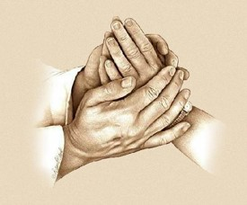

When Enemies Hinder the Work
“The Lord says that whenever he gives a commandment, no matter what it is about, to the children of man, and they go to with their might and endeavor to fulfil his commandment, and do that which is required of them, and they are prevented by their enemies, or by any other means, from accomplishing it, he does not require it any more at their hands.
He accepts of their offering.
That has applied in the past, and will apply in the future, and we should remember it. If God gives a commandment, and we do not obey it, why he revokes it, and he revokes the blessings.”
“If he gives us a commandment to do certain things, and we find ourselves unable to do them either by restricted laws or any other obstacles in the way of physical force, the Lord requires them no more but accepts our offering, and he will visit his wrath and indignation upon those who prevent his people from accomplishing that which he required at their hands.”
D&C 124:49-55 President Charles W. Penrose

Slide 32

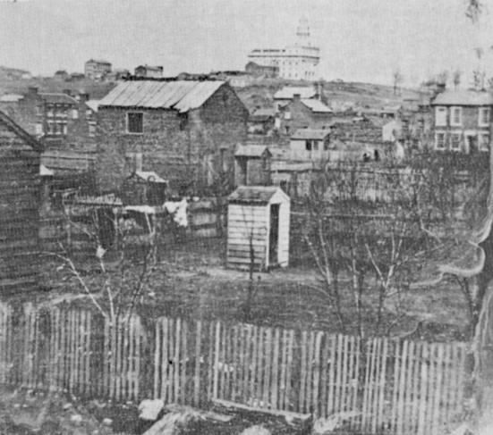
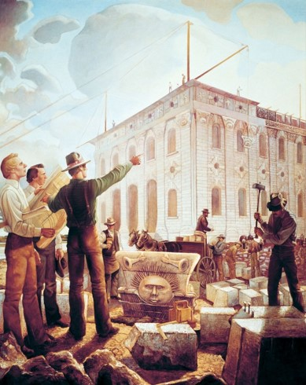
Diligent in Building
By obeying the Lord’s commandments, we prove our faithfulness.
1845—the first conference was held.
The temple was five years in the planning and building and was only used one year before the Saints were driven out of their city in 1846
“The structure cost more than one million dollars; the Saints were poor, and a great deal of the time (while the temple was being built) they were harassed by their enemies. The Prophet Joseph was forced into exile to avoid his enemies who tried to drag him into Missouri.”
“There were no iron foundries…but every detail had to be performed by the Saints. The timber had to be hewed in the far off forests of Wisconsin, carried to Nauvoo, and cut. The stone had to be cut and polished from the quarries, and the whole work had to be supplied out of the tithing of the people.”
D&C 124:49-55 Joseph Fielding Smith

Slide 33

“Those who understand the eternal blessings which come from the temple know that no sacrifice is too great, no price too heavy, no struggle too difficult in order to receive those blessings.
There are never too many miles to travel, too many obstacles to overcome, or too much discomfort to endure.
They understand that the saving ordinances received in the temple that permit us to someday return to our Heavenly Father in an eternal family relationship and to be endowed with blessings and power from on high are worth every sacrifice and every effort.”
President Thomas S. Monson

Slide 34
Sources:
Videos:
Temple Blessings—Worth Every Sacrifice (1:51)
Endowed With Power (12:17)
The Time is Now (3:19)
Temples are a Beacon (1:47)
“What Is a Temple Endowment?” (1:59)
“Welcome to the Washington D.C. Temple” (11:45)
“Sacred Temple Clothing” (4:12)
History of the Church 5:137; 4:186, 205, 4:423-24
Desert News April 9, 2014
Doctrine and Covenants Who’s Who by Ed J. Pinegar and Richard J. Allen pg. 44, 149-150
Pioneers and Prominent Men of Utah pg. 1173
President Joseph Fielding Smith (in Doctrines of Salvation, comp. Bruce R. McConkie, 3 vols. [1954–56], 3:132–33)
Teachings of Presidents of the Church: Joseph Smith [2007], 403
President Thomas S. Monson (“The Holy Temple—a Beacon to the World,” Ensign or Liahona, May 2011, 92).
Elder James E. Talmage House of the Lord, 83-84
Presentation by ©http://fashionsbylynda.com/blog/
Joseph Fielding McConkie and Craig J. Ostler Revelations of the Restoration pg. 977
George Q. Cannon In Conference Report, Apr. 1900, p. 13.
President Charles W. Penrose (in Conference Report), Apr. 1924
Joseph Fielding Smith Origin of the “Reorganized” Church p. 21
David A. Bednar, “Let This House Be Built unto My Name,” Ensign or Liahona, May 2020, 85)
“About the Temple Endowment,” temples.ChurchofJesusChrist.org.)
Robert D. Hales, “Blessings of the Temple,” Ensign, Oct. 2009, 48
Presentation by ©http://fashionsbylynda.com/blog/

Slide 35
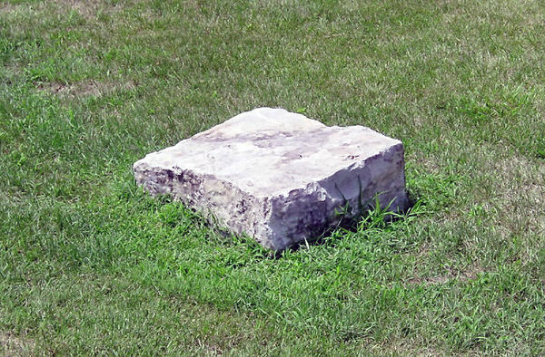
Desecration of the Kirtland Temple
“The Saints had to flee before mobocracy. And, by toil and daily labor, they found places in Missouri, where they laid the corner stones of Temples, in Zion and her Stakes, and then had to retreat to Illinois, to save the lives of those who could get away alive from Missouri, where fell the Apostle David W. Patten, with many like associates, and where were imprisoned in loathsome dungeons, and fed on human flesh, Joseph and Hyrum, and many others. But before all this had transpired, the Temple at Kirtland had fallen into the hands of wicked men, and by them been polluted, like the Temple at Jerusalem, and consequently it was disowned by the Father and the Son.” (In Journal of Discourses, 2:32.) Brigham Young
1st architectural plan of Nauvoo Temple:
The classical treatment of the "special" buildings was derived from ancient Western tradition, but it was also colored by contemporary American architectural practice. Just as was the case in other American cities, established methods of detailing and ordering buildings was found cheek-by-jowl with the latest detailing from the most fashionable architectural publications. Unlike other Midwestern and western American communities, however, Nauvoo, and later Salt Lake City, benefitted from a clearer vision of the goals of the city, the knowledgeable involvement in architectural design of the highest leaders of the church, and direct experience of the best buildings of the eastern states and England.
These elements of architectural expression were used to augment and express the community’s political order. Much of the large-scale form and detailing was based in stylish Greek Revival pattern books, but the Georgian and Federal roots of American architecture were present everywhere. As was true throughout American architectural practice, the elements were applied without close regard for their historical basis. Arches were used in connection with Greek columns (mostly represented by applied pilasters), without regard to their complete absence from ancient Greek architecture.
The designers of Nauvoo regarded the value of architectural forms to express the community’s structure as more important that any use of them as an historical reference. The idea, commonplace among historians, that the Greek Revival was used in the United States because of its association with democratic and republican "values," does not apply to the theocratic structure of the Mormon polity. The three basic classical orders, Doric, Ionic, and Corinthian, were not present in their full variety, in either their Roman or Greek forms. The hierarchy of the orders as understood in the western tradition was, however, used to emphasize the city’s internal order. In this system, Corinthian was the most delicate and expansive and was given the greatest importance and placed at the highest level. It was followed by the Ionic, midway in significance and honor between the Corinthian and the Doric, which was the plainest and sturdiest of orders, usually placed at the most basic position.
The initial design for the Nauvoo Temple was based in the Corinthian order, considered among the ancients as the highest and most beautiful order. The capitals were adapted to depict a new dawn brought about by renewed revelation. As part of a significant change to the attic story, the unadorned frieze of the Corinthian pediment, was replaced by an assembly with Doric characteristics permitting the placement of third-floor windows. The Temple has a belfry/steeple traditionally used on the most important buildings in the city, those with a role in ordering the timing of public life. All other structures were subsidiary and deferred to it.
http://urbanscalerichmondvirginia.blogspot.com/2014/06/resuscitating-urban-forms-at-historic.html
Desert News April 9, 2014 by Kenneth Mays Boarding House
In section 124 of the Doctrine and Covenants, the Lord commanded the Prophet Joseph Smith to build a “boarding house,” which was to be built unto the Lord's name and for the boarding of strangers.
This structure was to be called the Nauvoo House. Cornerstones for the building were laid on a site at the southern end of Main Street on Oct. 2, 1841. Designed in the shape of an “L,” this hotel had a cornerstone at the southeast corner in which Joseph Smith placed the original manuscript of the Book of Mormon.
Following the Prophet's death, Emma Smith married Lewis C. Bidamon. After Emma Smith's death in 1879, Bidamon opened the cornerstone and discovered that the manuscript had been severely damaged by moisture and mildew.
Many of the usable pages were acquired by The Church of Jesus Christ of Latter-day Saints.
About 27 percent of the
manuscript is in the church's
possession.

Slide 36
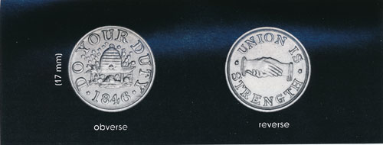
It was Peter Haws, one of seven principals of the association, who kept the beehive symbol in circulation among Latter-day Saints long after the Nauvoo Agricultural and Manufacturing Association had become defunct. While camped at Garden Grove in Iowa Territory, Peter embossed on the front side of a brass token dated 1846 an ornate beehive with the slogan “Do Your Duty.” On the obverse side, he embossed clasped hands with the motto “Union Is Strength.” His token was circulated in Garden Grove and throughout Pottawattamie County and used as a barter or exchange among Latter-day Saints. As the Nauvoo Agriculture and Manufacturing Association certificates, there was no attempt by Peter Haws to link the beehive symbol to deseret.
The Beehive and Deseret: Mormon Symbols in Salt Lake City. BYU Religious Studies
Kirtland Temple:
“The Saints had to flee before mobocracy. And, by toil and daily labor, they found places in Missouri, where they laid the corner stones of Temples, in Zion and her Stakes, and then had to retreat to Illinois, to save the lives of those who could get away alive from Missouri, where fell the Apostle David W. Patten, with many like associates, and where were imprisoned in loathsome dungeons, and fed on human flesh, Joseph and Hyrum, and many others. But before all this had transpired, the Temple at Kirtland had fallen into the hands of wicked men, and by them been polluted, like the Temple at Jerusalem, and consequently it was disowned by the Father and the Son.” (In Journal of Discourses, 2:32.)
Haws’s 1846 brass token with beehive (variety 1). (Rust, Mormon and Utah Coin and Currency, 34.)

Slide 37
William Weeks (March 11, 1813 – March 8, 1900), was the first church architect of the Church of Jesus Christ of Latter Day Saints, and is best known as the architect of the Nauvoo Temple.
Weeks was the son of James Weeks, Jr., and Sophronia Fisher and was born on March 11, 1813 on Martha's Vineyard, Massachusetts. He came from a family of builders; his father taught architectural and building skills to his two sons, William and Arwin. Raised as a Quaker, Weeks converted to Mormonism in the southeastern states. Apparently, he was in Missouri when the Mormons were driven from that state during the winter of 1838–1839, and he settled in Quincy, Illinois. There on June 11, 1839 he married Caroline Matilda Allen, youngest child of Elihu Marcellus Allen and his first wife Laura Foote. Caroline was ten years his junior. Their marriage lasted sixty-one years and produced ten children, seven of whom died in early infancy.
In 1840 Weeks relocated to Nauvoo, where he built a new brick home, which still stands. When Joseph Smith, Jr., called for architects to submit designs for the Nauvoo Temple, he was so impressed with Weeks' drawings that he hugged him, exclaiming, “You are the man I want!” While Weeks was the temple’s architect, final decisions about the building design were made by Smith, who overruled Weeks on occasions. Most famous is Smith’s insistence that circular windows, instead of oval, be used in the temple, although Weeks insisted that such windows were a violation of all known rules of architecture. Smith did not extend such latitude over Weeks to others. When the Temple Building Committee got into an argument with Weeks, Smith prepared a certificate for Weeks that stated that “no person or persons shall interfere with him or his plans in building the temple.”
When Smith was killed in June 1844, Brigham Young assumed Smith’s role as the church’s leader, which included oversight of the temple’s construction; Young even made his own changes to Smith’s design. Weeks did not see the temple completed, because Young insisted that he accompany the Mormon migration west so that he could design a new temple when the Mormons found a place to settle. On February 13, 1846, Brigham Young turned the final completion of the Nauvoo Temple over to Truman O. Angell.
Weeks arrived in Salt Lake City in September 1847. He soon became disaffected with the church, and took his family east the next summer, taking all of the Nauvoo Temple plans with him. For a time Weeks settled in Wisconsin and Iowa. While in Iowa, he learned of Nauvoo Temple’s arson. He returned to Utah in 1852, apparently seeking reconciliation and reinstallation as the architect for the Salt Lake Temple. However, Young used Angell as the architect of the building. After his work as architect on the Nauvoo Temple, Weeks never worked as an architect again. By 1857 he had settled in San Bernardino, California, where he severed all contact with the LDS Church, although he remained an admirer of Joseph Smith all his life. He stayed in California the rest of his life.
Weeks did not pursue work as an architect in California, but moved to El Monte, where he worked as a carpenter and later ran a gristmill for a Mr. Temple. He purchased a herd of cows and opened a 160-acre (0.65 km²) dairy in Hollywood, providing milk to Los Angeles groceries. He later moved the dairy to Green Meadow, six miles north of Los Angeles. When he became too old to run the dairy, he purchased a small ranch and built a house in Palms, where he and Caroline lived the rest their lives. Weeks died on March 8, 1900.
Weeks’ drawings of the Nauvoo Temple remained with his descendants, passing from Weeks to his daughter Caroline F. Weeks Griffin, who passed them to her son, Leslie Griffin. In 1948 two Mormon missionaries, Frank Gifford and Vern Thacker, contacted Griffin while tracting door to door in Boron, California. Griffin and the two missionaries became friends, and, when Griffin learned that Thacker was returning to Salt Lake City, he gave him Weeks' drawings to donate to the LDS Church. Thacker did as Griffin requested, and Weeks’ original drawings proved invaluable in the later reconstruction of the Nauvoo Illinois Temple.
The Isaac Chase Mill, designed by Weeks and built in 1852, now part of Liberty Park, 6th East Salt Lake City, UT, is listed on the U.S. National Register of Historic Places. Wikipedia
Truman O. Angell went on to work on the Nauvoo Temple, having been appointed superintendent of joiner work under church architect William Weeks, carrying out the architect's designs in the construction of that temple.
On the construction of the Nauvoo Temple, Angell served as the superintendent of the joiners. He would then be the Church Architect for Brigham Young in building the S.L. Temple in 1950.

Slide 38
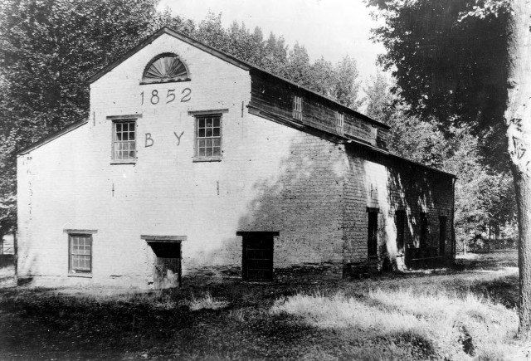
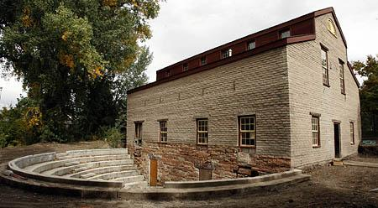

The mill is one of the oldest surviving architect-designed buildings in the city. The mill was designed by architect William Weeks. Constructed by Frederick Kesler and/or Phares Wells, Sr. A row of windows built into the sloped roof is a signature of Kesler's mill designs.
By 1860, Young took control of the mill. More efficient mills in the area led to the closure of Chase Mill in 1879.
Other owners included Salt Lake City, which bought the mill, and its associated farm, in 1882.
The mill served to winter animals and once was used as a tool house, but later was abandoned.
A member of the Chase family in 1898 persuaded the city not to tear it down.
From the late 1920s to the 1950s, the Daughters of Utah Pioneers raised money for several renovation efforts and put pioneer artifacts on display.
The assorted collection of users over the years have left their marks on the old mill, including an ill-advised English Tudor makeover in the 1920s.
"Some of the preservation work did more damage than good," Knight said.
In 2002, Tracy Aviary stepped in and spent $850,000 to stabilize the building, which had been abandoned for decades, and perform seismic upgrades before running out of money for the project.
The aviary spent $500,000 to finish the project this year.
Salt Lake Tribune Oct. 2006
Renovated
The Isaac Chase Mill, Liberty Park, Salt Lake City, Ut
Utah Heritage Foundation

Slide 39

Fulness of the Priesthood—Temple Ordinances:
“I do not care what office you hold in this Church, you may be an apostle, you may be patriarch, a high priest, or anything else, and you cannot receive the fulness of the Priesthood unless you go into the temple of the Lord and receive these ordinances of which the Prophet speaks. No man can get the fulness of the Priesthood outside of the temple of the Lord. There was a time when that could be done, for the Lord could give these things on the mountain tops—no doubt that is where Moses got it, that is no doubt where Elijah got it—and the Lord said that in the days of poverty, when there was no house prepared in which to receive these things, that they can be received on the mountain tops. But now you will have to go into the house of the Lord, and you cannot get the fulness of the priesthood unless you go there.” President Joseph Fielding Smith (Elijah the Prophet, pp. 45–46.)
*Destruction of the Nauvoo Temple:
Nauvoo Patriot, November, 19, 1848
On Monday the 19th of November, our citizens were awakened by the alarm of fire, which, when first discovered, was bursting out through the spire of the Temple, near the small door that opened from the east side to the roof, on the main building. The fire was seen first about three o'clock in the morning, and not until it had taken such hold of the timbers and roof as to make useless any effort to extinguish it. The materials of the inside were so dry, and the fire spread so rapidly, that a few minutes were sufficient to wrap this famed edifice in a sheet of flame.
It was a sight too full of mournful sublimity. The mass of material which had been gathered there by the labor of many years afforded a rare opportunity for this element to play off some of its wildest sports. Although the morning was tolerably dark, still, when the flames shot upwards, the spire, the streets, and the houses for nearly a mile distant were lighted up, so as to render even the smallest objects discernible. The glare of the vast torch, pointing skyward, indescribably contrasted with the universal gloom and darkness around it: and men looked on with faces sad as if the crumbling ruins below were consuming all their hopes.
It was evidently the work of an incendiary. There had been, on the evening previous. a meeting in the lower room: but no person was in the upper part where the fire was first discovered. Who it was, and what could have been his motives, we have now no idea. Some feeling infinitely more unenviable than that of the individual who put the torch to the beautiful Ephesian structure of old, must have possessed him. To destroy a work of art, at once the most elegant and the most renowned in its celebrity of any in the whole west, would, we should think, require a mind of more than ordinary depravity: and we feel assured that no one in this community could have been so lost to every sense of justice, and every consideration of interest as to become the author of the deed.
http://users.marshall.edu/~brown/nauvoo/NT-fire.html
Warnings: D&C 124:45 President Boyd K. Packer of the Quorum of the Twelve Apostles said:
“During a very difficult time, the Lord gave the sternest warning that I know of in all scripture. It had to do with the building of the Nauvoo Temple. The Saints knew from experience that to proceed to build a temple would bring terrible persecution, so they delayed. The Lord extended the time and said, ‘If you do not these things at the end of the appointment ye shall be rejected as a church, with your dead, saith the Lord your God’ [D&C 124:32].
“Often overlooked in that revelation is a marvelous promise: ‘If my people will hearken unto my voice, and unto the voice of my servants whom I have appointed to lead my people, behold, verily I say unto you, they shall not be moved out of their place’ [D&C 124:45].
“Remember this promise; hold onto it. It should be a great comfort to those struggling to keep a family together in a society increasingly indifferent to, and even hostile toward, those standards which are essential to a happy family. …
“I repeat the promise that those who hearken to the voice of these men whom the Lord has raised up ‘shall not be moved out of their place’ [D&C 124:45].
“But the promise was followed with this caution: ‘But if they will not hearken to my voice, nor unto the voice of these men whom I have appointed, they shall not be blest’ [D&C 124:46)” (“The Twelve Apostles,” Ensign, Sept. 2005, 20).
Federick Piercy drawing

Slide 40


KNIGHT, Vinson. Son of Rudolphus Knight and Rizpah Lee. Born 14 March 1804 in Chester, Washington County, New York. Married Martha McBride (Picture below}(born 1805 in New York). Six known children. Residing in Perrysburg, New York, at time of conversion 1834. Moved to Kirtland by 1835. Owned home and property in Kirtland. Druggist. Ordained elder 2 January 1836. Charter member of and owned stock in Kirtland Safety Society January 1837. Participated in dedication of Kirtland Temple. Traveled to Far West, Missouri, with Joseph Smith September-December 1837. Moved to Missouri 1839. Located temporarily in Quincy, Illinois, 1839. As church land agent, assisted in purchasing thousands of acres of land in Lee County, Iowa, May-June 1839. Appointed to assume full title of bishop 4 May 1839. Appointed bishop of Lower Ward in Nauvoo 6 October 1839. Designated by revelation 19 January 1841 as Presiding Bishop of Church. Elected to Nauvoo City Council 1 February 1841. Initiated into Masonary 9 April 1842. Took plural wife before death. Possibly received endowment before death. Died in Nauvoo, Hancock County,Illinois,3 July 1842.(Cook). A sudden illness took the life of Bishop Knight, in July 1843
Isaac Galland
15 May 1791 27 Sept. 1858. Merchant, postmaster, land speculator, doctor.
Born at Somerset Co., Pennsylvania. Son of Matthew Galland and Hannah Fenno.
Married first Nancy Harris, 22 Mar. 1811, in Madison Co., Ohio. Married second Margaret Knight, by 1816.
Moved to Washington Co., Indiana, by 1816.Located at Owen Co., Indiana, by 1820, and at Edgar Co., Illinois, shortly after 1820. Moved to Horselick Grove (later in Hancock Co.), Illinois, 1824.
Married third Hannah Kinney, 5 Oct. 1826.
Moved to Oquawka, Henderson Co., Illinois, 1827. Established settlement of Nashville on west bank of Mississippi River, in unorganized U.S. territory, where he practiced medicine, established trading post, and founded first school in what later became Iowa Territory.
Moved family to Fort Edwards (later Warsaw), Hancock Co., Illinois, 1832.
Served as colonel in Black Hawk War, 1832.
Married fourth Elizabeth Wilcox, 25 Apr. 1833. Platted original town of Keokuk, Lee Co., Wisconsin Territory (later in Iowa), 1837.
Moved to Commerce (later Nauvoo), Hancock Co., Illinois, winter 1838–1839.
Purchased land in Half-Breed Tract in Lee Co. and sold some nineteen thousand acres of it to Latter-day Saints, 1839.
Instructed in JS revelation to buy stock for building Nauvoo House, 19 Jan. 1841.Also sold properties in Commerce to Latter-day Saints.
Baptized into LDS church and ordained an elder by JS, 3 July 1839.
Acted as authorized agent for church in settling certain land transactions involving property exchanges by eastern Latter-day Saints moving to Nauvoo.
Withdrew from church activity, ca. 1842.
Resident of Keokuk, Lee Co., Iowa Territory, 1842–1853.
Moved to Sacramento, Sacramento Co., California, 1853; eventually settled in Petaluma, Sonoma Co., California.
Moved to Fort Madison, Lee Co., 1856. Died at Fort Madison.
The Joseph Smith Papers
Mansion House: served as Joseph and Emma’s second home in Nauvoo. The Mansion House served to entertain many individuals that came to Nauvoo. Initially, Joseph hosted guests free of charge, but was unable to continue to support himself doing so. It eventually became necessary for him to start charging guests in September 15 of 1843. Additionally, the Mansion House served as the venue where several temple ordinances were performed before the completion of the Nauvoo Temple. Joseph leased the Mansion House to Ebenezer Robinson in January of 1844 who continued to use it as a public-house.
After the martyrdom of the Prophet and his brother in Carthage, the bodies of Joseph and Hyrum were displayed in the Mansion House for the Saints to view. It is estimated that over ten-thousand people viewed Joseph and Hyrum’s bodies that day. Additionally, George Cannon made death masks of Joseph and Hyrum while at the Mansion House. Zina Jacobs, a member of the Church living in Nauvoo, described the experience of Joseph and Hyrum’s bodies being returned:
“This afternoon the bodies of the martyrs arrived in town. . . . I went into this house for the first time and saw the lifeless, speechless bodies of the two martyrs for the testimony which they held. Little did my heart ever think that mine eyes should witness this awful scene.”
Emma continued to live in the home after Joseph’s death until moving into the Nauvoo House in 1869. In the 1890s, the hotel portion of the home was removed. The Community of Christ currently maintains the home and tours are available.
http://www.mormonheritage.com/site-of-the-week-lds-church-history-tour/lds-church-history-site-of-the-week-nauvoo-mansion-house/

