Slide 1

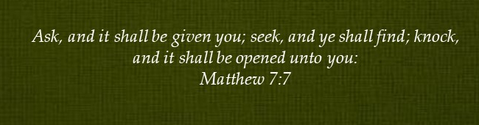
Doctrine and Covenants 125-126
Iowa-1841

Slide 2
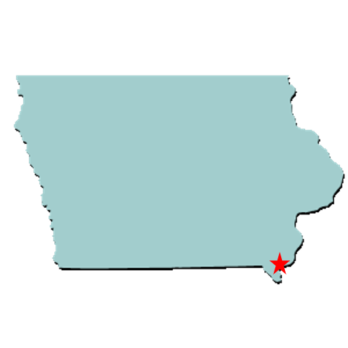
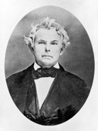
Across the River
Not all of the Saints who were driven from Missouri found refuge in Illinois.
Some settled across the Mississippi River from Nauvoo, in Iowa.
Student Manual
“Mr. Galland in a communication to David W. Rogers, suggested that the Saints locate in Iowa, which was a territory; for he thought they would be more likely to receive protection from mobs under the jurisdiction of the United States, than they would be in a state of the Union, ‘where murder, rapine and robbery are admirable (!) traits in the character of a demagogue; and where the greatest villains often reach the highest offices.’ He also wrote to Governor Robert Lucas of Iowa, who had known the ‘Mormon’ people in Ohio, and who spoke very highly of them as good citizens.” Elder Joseph Fielding Smith

Slide 3
Isaac Galland
He was born on May 15, 1792, in Somerset County, Pennsylvania, Son of Matthew Galland and Hannah Fenno. Married first Nancy Harris, 22 Mar. 1811, second Margaret Knight, by 1816, third Hannah Kinney, 5 Oct. 1826, fourth Elizabeth Wilcox, 25 Apr. 1833
He was a medical practitioner and a land dealer
He founded the first school in what later became Iowa Territory
He was a colonel in the Black Hawk War in 1832
He purchased land in Half-Breed Tract in Lee Co. and sold some 19,000 acres of it to Latter-day Saints, 1839
Having been acquainted with Joseph Smith, he had an interest in the church and was baptized by the Prophet on July 3, 1839, then ordained an elder on the same day
He encourage the Prophet to settle in Commerce, Illinois, later renamed Nauvoo
He was appointed land agent for the Church (D&C 124:78-79)
He slipped into apostasy and later moved to Iowa. He lived in Sonoma, California between 1853-1856
Moving back to Iowa, he died on September 27, 1858, at Fort Madison County, Iowa leaving writings of frontier history and other themes
Who’s Who—Joseph Smith Papers

Slide 4
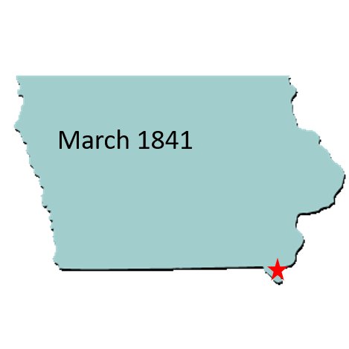

Settling in Lee County
Already settled across the Mississippi River the Saints had purchased land in Iowa
Before the Saints arrived, there were 2,839 residents in Lee County, Iowa. By 1846 the population had swelled to 12,860—many of whom were Latter-day Saints
The Church had purchased more land in Iowa than in Illinois, suggesting that Church leaders did not intend that all the Saints would settle in Nauvoo.
Doctrine and Covenants 125
revealed the will of the Lord concerning the Saints who lived in the Iowa Territory and those who planned to go there.

Slide 5
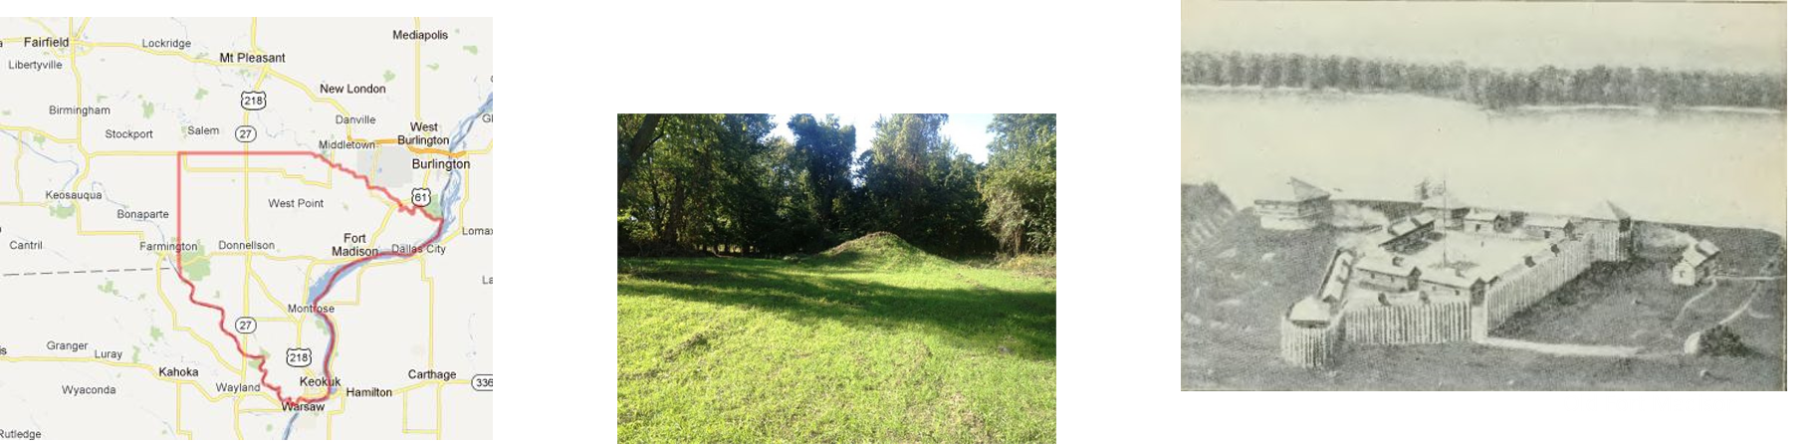
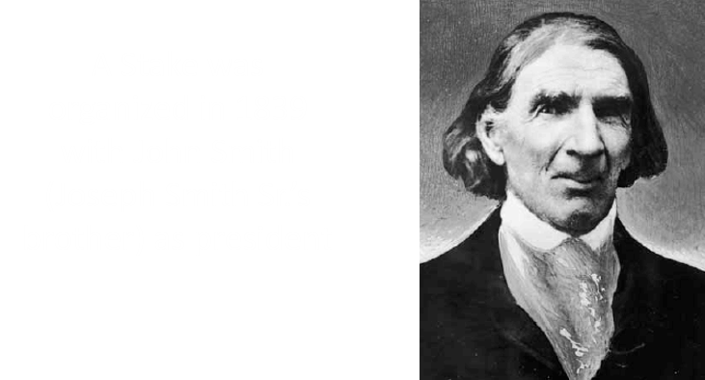
Further Light And Knowledge
Nauvoo was the central point of gathering at this time
The Saints were to gather and build cities in Iowa. They built up:
Montrose
Zarahemla
Ambrosia
Augusta
Keokuk
D&C 125:1-2

Slide 6
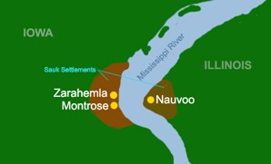
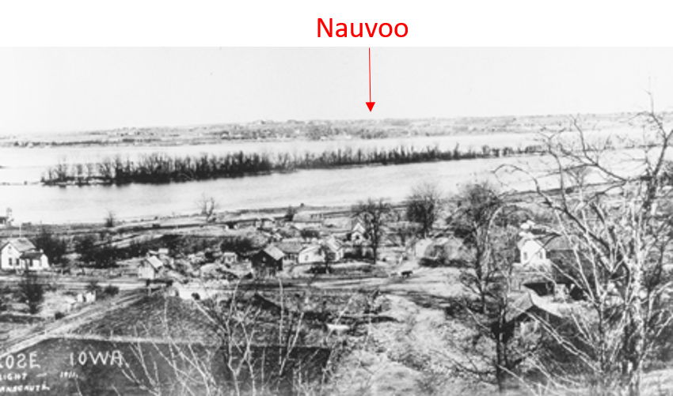
Zarahemla
In this revelation the Lord directed the Saints to gather and build up the places the Lord would appoint through the Prophet Joseph Smith, including a city in Iowa to be named Zarahemla.
Zarahemla was founded by the Saints in 1839, on the upland about a mile west of the Mississippi River, near Montrose and opposite Nauvoo, Ill.
The Church had bought an extensive tract of land here.
At a conference held at Zarahemla, August 7, 1841, 750 church members were represented, of whom 326 lived in Zarahemla. But when the Saints left for the Rocky Mountains, that city was lost sight of.
D&C 125:3

Slide 7
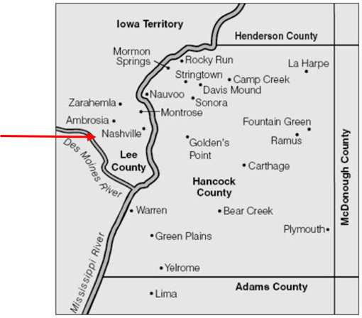
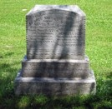
Nashville
“A little town, pleasantly situated on the Mississippi River, at the head of Des Moines Rapid, in Lee County, Iowa, three miles by rail southeast of Montrose, and 8 miles north of Keokuk, was purchased by the Church, together with 20,00 acres of land adjoining it.
June 24th 1839…it continued to exist as a “Mormon” town until the general exodus in 1846”
History Record p. 983
Settled by Isaac Galland, 1829.
Undeveloped town site purchased by LDS church, 1839.
Laid out and incorporated, 1841, but charter never adopted.
Featured one of nine branches within Iowa Stake (later Zarahemla Stake).
Branch consisted of eighty members, Aug. 1841. Joseph Smith Papers
One of the early Mormon families who settled in Nashville was that of Asahel Smith, brother to Joseph Smith Sr., with his wife Betsey and sons Elias and Silas. Other children included Esther, married to Amos Botsford Fuller, Mary Jane, married to George Washington Gee; Julia Priscilla, married to Moses Martin and Emily, married to Samuel Pierce Hoyt while in Iowa, Elias married Lucy Brown, Martha married Hiram B. Bennett and Silas married Elizabeth Orton.
Mormon Historic Sites
D&C 125:4

Slide 8
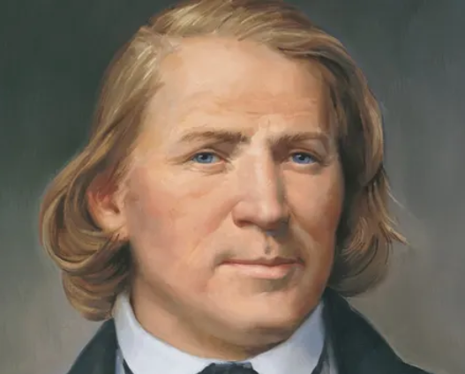
Revelation to Brigham Young
On July 9, 1841, the Lord gave a revelation to Brigham Young through the Prophet Joseph Smith.
After Brigham served multiple missions in the United States, Canada, and England, the Lord said his missionary journeys were acceptable to Him.
He said it was time for Brigham to take special care of his family.

Slide 9
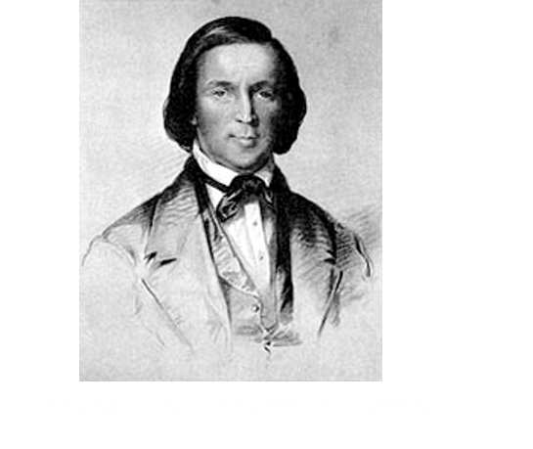
Brigham Arrives in Nauvoo
After leading the missionary work of the Church in Great Britain, Brigham Young arrived in Nauvoo, Illinois, on July 1, 1841
8 days later Joseph Smith received a revelation which is now section 126
I have seen your labor and toil in journeyings for my name.
I therefore command you to send my word abroad, and take especial care of your family from this time, henceforth and forever. Amen.
D&C 126:1-3

Slide 10

Brigham Young
He was born on June 1, 1801, at Whittingham, Vermont to John and Abigail “Nabby” Young
He worked as a traveling carpenter and blacksmith along with other trades
He first married Miriam Angeline Works in 1824, but later died in 1832
He was of the Methodist faith in 1823, but after reading the Book of Mormon in 1830, he officially joined the Church in 1832 and joined the Saints in Kirtland, Ohio
He was a missionary in Upper Canada and ordained a member of the original Quorum of the Twelve Apostles in 1835. He served 10 missions.
He was the successor of the Prophet Joseph Smith following the Martyrdom in 1844
Many of Young's followers would later reminisce that while Young spoke to the congregation, he looked or sounded exactly like Smith, to which they attributed the power of God
He was the leader of the exodus of the Saints from Nauvoo to the Rocky Mountains in 1846-1847, and was the founder of Salt Lake City
He was ordained the Prophet and President of the Church in December 27, 1847
The Salt Lake, St. George, and Logan Temples were under his direction, and brought the telegraph and the railroad to Utah
He died August 29, 1877 in Salt Lake City, Utah and buried at the City Cemetery.

Slide 11
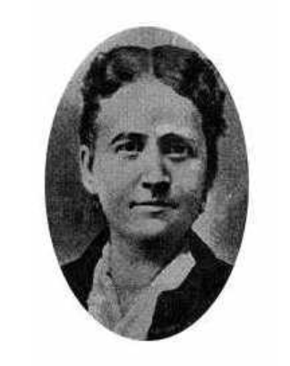
“Especial Care”
At age 23 he married Miriam Angeline Works. Two daughters were born to the young couple. Brigham supported his family by making and repairing chairs, tables, and cupboards and installing windows, doors, stairways, and fireplace mantels. …
When Miriam contracted tuberculosis, Brigham assumed much of the burden of her work in addition to his own.
As she became progressively more bedridden, he regularly prepared breakfast for the family, dressed his daughters, cleaned up the house, and “carried his wife to the rocking chair by the fireplace and left her there until he could return in the evening,” when he cooked supper, got his family into bed, and finished the household chores.
Teachings of Presidents of the Church: Brigham Young
D&C 126:3

Slide 12
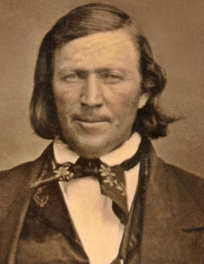
Challenges of Speaking in Public
One of Brigham Young’s greatest challenges was public speaking. He said, “I was about as destitute of language as a man could well be.
He recalled a time one week after his baptism when he expected four experienced speakers who were members of the Church to preach, but they did not.
He said:
“I was but a child, so far as public speaking and a knowledge of the world was concerned; but the Spirit of the Lord was upon me, and I felt as though my bones would consume within me unless I spoke to the people and told them what I had seen, heard and learned—what I had experienced and rejoiced in; and the first discourse I ever delivered I occupied over an hour. I opened my mouth and the Lord filled it.”
Brigham Young Journal of Discourses,

Slide 13
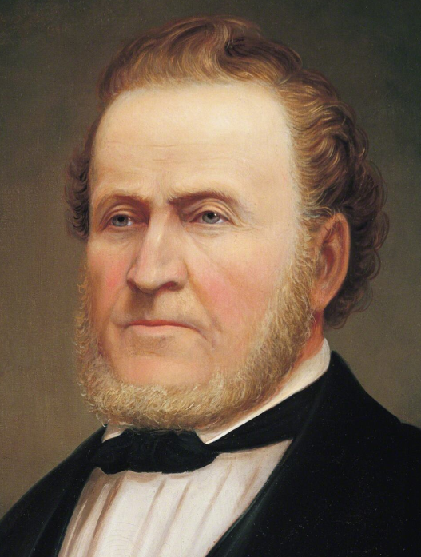
Sacrifice
The same year Brigham Young was baptized, his wife passed away.
At great sacrifice, he arranged for the care of his two children and served missions to New York and upper Canada, where he baptized several people.
After serving a mission for about a year, Brigham described his arrival in Kirtland, Ohio:
“If any man that ever did gather with the Saints was any poorer than I was—it was because he had nothing. … I had two children to take care of. … I was a widower. … [I had] not a shoe to my foot, except a pair of borrowed boots. I had no winter clothing, except a homemade coat that I had had three or four years. … I had travelled and preached and given away every dollar of my property.”
Teachings of Presidents of the Church: Brigham Young

Slide 14
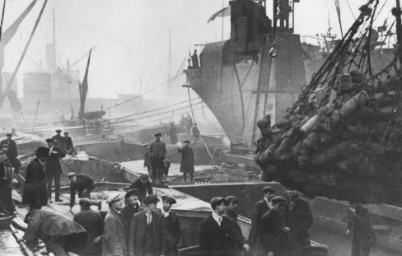
Mission to England
After remarrying and serving five other missions, Brigham was called, with other Apostles, to serve a mission to England.
Brigham described his mission:
“We landed … as strangers in a strange land and penniless, but through the mercy of God we have gained many friends, established Churches in almost every noted town and city in the kingdom of Great Britain, baptized between seven and eight thousand, printed 5,000 Books of Mormon, … and have left sown in the hearts of many thousands the seeds of eternal truth … : in all these things I acknowledge the hand of God.”
Teachings of Presidents of the Church: Brigham Young

Slide 15
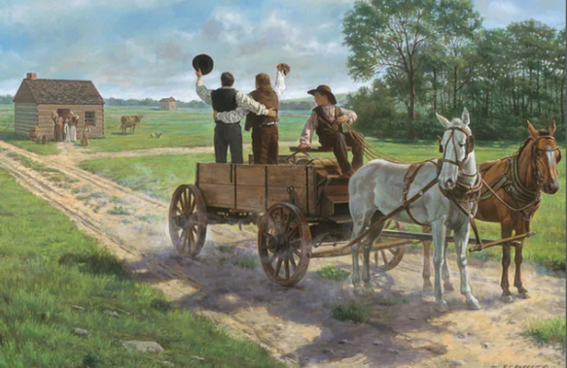
Malaria
Brigham , Heber C. Kimball, and other Apostles followed the Lord’s instructions to depart for the England mission from Far West, Missouri, on April 26, 1839.
They spent the next few months in Iowa and Illinois, making further preparations to travel to Great Britain.
An epidemic of malaria struck the area in the summer of 1839, and they became ill. Brigham was so sick, he could not get into a wagon without help. He recorded:
“I was determined to go to England or to die trying. My firm resolve was that I would do what I was required to do in the Gospel of life and salvation, or I would die trying to do it.”
Teachings of Presidents of the Church: Brigham Young
D&C 118

Slide 16
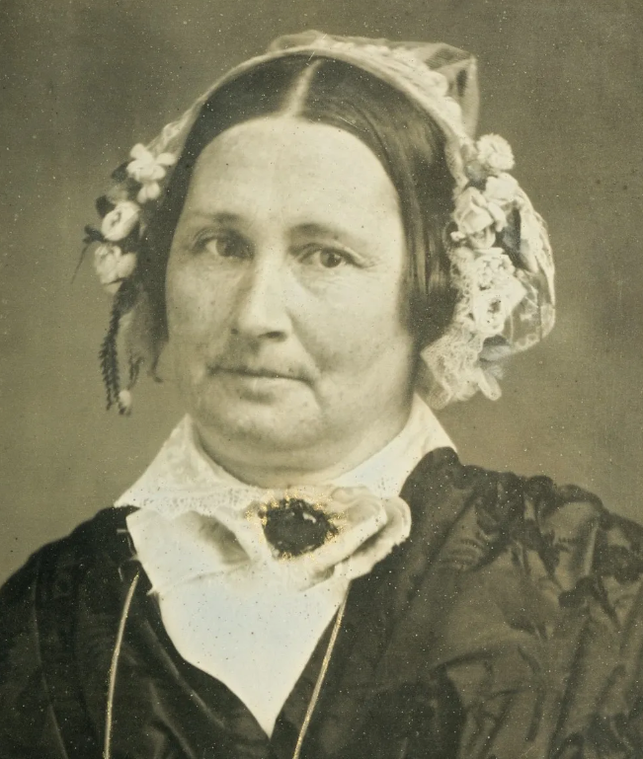

5th Mission
After his first wife’s death, Brigham married Mary Ann Angell in 1834. She supported him, though she was also sick and had a newborn baby.
This was the fifth mission Brigham served since they were married. He would serve 10 in total.
Once, while Brigham was traveling by steamboat from Fairport, Ohio, to Buffalo, New York, a storm arose that hindered the ship’s progress. He related the following:
“The wind rose about one o’clock in the morning. I went upon deck and felt impressed in spirit to pray to the Father, in the name of Jesus, for a forgiveness of all my sins, and then I felt to command the winds to cease, and let us go safe on our journey. The winds abated, and I felt to give the glory and honor and praise to that God who rules all things.”
History of Brigham Young

Slide 17
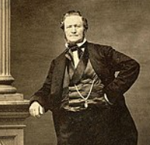
Sources:
Video:
“The Heart and a Willing Mind” from time code 4:08 to 7:57.
Doctrine and Covenants Who’s Who by Ed J. Pinegar and Richard J. Allen pg. 35
Presentation by ©http://fashionsbylynda.com/blog/
Doctrine and Covenants Student Manual Religion 324-325 Section 125
Elder Joseph Fielding Smith (Essentials in Church History, p. 220.)
Brigham Young Journal of Discourses, 5:97; 13:211
Teachings of Presidents of the Church: Brigham Young [1997], 243; Teachings of Presidents of the Church: Brigham Young [1997], 2, 5-6
“History of Brigham Young,” Millennial Star, Oct. 17, 1863, 663–64)
Presentation by ©http://fashionsbylynda.com/blog/

Slide 18
Isaac Galland:
Research confirms that Dr. Isaac Galland was clearly a Mormon benefactor. His correspondence with political leaders and his extensive landholdings combined in assisting the Saints to gather again. Joseph Smith declared that the distinguished Dr. Galland was the “instrument of the Lord” in providing a place of refuge for the homeless, persecuted Saints. Although his primary motivation for aiding the Saints appears to have been financial gain, it is quite possible that without Isaac Galland there might never have been a Nauvoo.
https://byustudies.byu.edu/showtitle.aspx?title=5376
Nashville Saints:
Samuel P. and Emily Smith Hoyt first moved to Nauvoo after they were driven from Missouri, living for one year in part of the home owned by Daniel H. Wells. In the spring of 1840, the Hoyts moved to Nashville. Emily was so ill at the time she could barely sit up, but she wanted to be near her family. Samuel built a small cabin where they lived the first year, then, as mentioned in Elias's letter, Samuel built a larger home. Emily later described her home as having ten well-finished and painted rooms; six good fireplaces; closets, cupboards, and drawers in the walls; an attic over the whole; and a cellar under the house. The house was painted white on the outside and painted and varnished on the inside. Emily's journal describes their life in Nashville, Iowa.
The Hoyt family lived peacefully among friendly non-Mormons for eleven years. Emily recorded on 23 April 1851 that upon final loading of wagons and gathering of animals, the neighbors came in to say goodbye. "They had been in the habit of coming in nearly every day for some time not knowing when we could get started. Father who was now gone, mother whom they all knew when alive, and all our folks had left from this very point Br E was an old friend whom all respected who knew him In anticipation of this time I had written some poetry."
http://mormonhistoricsites.org/wp-content/uploads/2013/05/NJ8-2_Ward.pdf
Fort Madison dates to the war of 1812. Lee County was the location of the Half-Breed Tract, established by treaty in 1824. Allocations of land were made to American Indian descendants of European fathers and Indian mothers at this tract. Originally the land was to be held in common. Some who had an allocation lived in cities, where they hoped to make better livings.
Large-scale European-American settlement in the area began in 1839, after Congress allowed owners to sell land individually. Members of the Church of Christ (Latter Day Saints) fled persecutions in Missouri to settle in Illinois and Iowa. Nauvoo, across the border in Hancock County, Illinois, became the main center of Latter-day Saints settlement, but there was also a Latter Day Saints stake organized in Lee County under the direction of John Smith, the uncle of Joseph Smith, land that was sold to them by Isaac Galland in 1839.
Lee has two county seats — Fort Madison and Keokuk. The latter was established in 1847 when disagreements led to a second court jurisdiction. Lee county was named for Marsh, Delevan & Lee, of Albany, New York, and the 'New York Land Company', who owned extensive interests in the Half-Breed Tract in the 1830s.
Lee County's population grew to about 19,000 in 1850, the first US census, to 37,0000 per the 3rd census in 1870, peaking at 44,000 people in 1960. It has continuously decreased since and as of 2010, 35,862 people lived there, comparable to the years between 1860-1870. ^{Wikipedia}

Slide 19
Excerpts from Brigham Young in Great Britain:
At the time of their arrival, there were more than sixteen hundred Latter-day Saints in Britain. More than five hundred of them were assembled to greet the members of the Twelve their first Sunday in the country. A week later, the Apostles presided over the first British general conference, where they presented for a sustaining vote an ambitious program not only of missionary labor but also of publication. The conference approved the publication of a hymnal and, after a sufficient number had subscribed, a monthly periodical, thus authorizing and agreeing to support what would become one of Elder Young’s central preoccupations in the months ahead.
By April 17, the Twelve had laid the groundwork for publishing, ordained local member Peter Melling as the first patriarch in England, concluded to quietly encourage emigration without public announcement, decided where each would begin his individual ministry, and agreed to convene a second conference July 6.
In May the Apostles first announced a policy of encouraging the Saints to emigrate to America, and on 1 June 1840, President Young and Elder Kimball organized the first of several companies of Latter-day Saints to sail for America. (Earlier two small groups of members had emigrated on their own.) For this small group of forty-six, they appointed priesthood leaders to preside at sea—a pattern that would endure for decades with the thousands of LDS emigrants to follow. President Young gathered letters from members of the Council of the Twelve to their own families and sent them with the emigrants. For his family, he prepared two letters and a box of small gifts.
Their mission concluded, all members of the Quorum of the Twelve except Elder Parley P. Pratt boarded the train for Liverpool, where they joined two hundred Saints who were immigrating to the United States. On Sunday, 19 April 1841, President Young preached to the Saints in Britain for the last time. The following day he and his associates boarded the Rochester, one of the fastest ships in the harbor, and set sail. Well-dressed, each with gold in his pockets (a gift from one of Elder Woodruff’s wealthy converts), they were a sharp contrast to the poorly dressed, penniless group that had landed the year before.
Soon after President Young’s return to Nauvoo, Joseph Smith visited him at home. Not only did he extend warm personal greetings, but he also delivered to him the word of the Lord:
“Dear and well-beloved brother, Brigham Young, verily thus saith the Lord unto you: My servant Brigham, it is no more required at your hand to leave your family as in times past, for your offering is acceptable to me. I have seen your labor and toil in journeyings for my name.” (D&C 126:1–2).
The following month the Prophet had news of a different sort for the Twelve: the time had come to expand their role within the Church. Seasoned by their English mission, the Quorum of the Twelve had come of age. Now Joseph Smith and the entire Church needed their skills and maturity. The time had come for them to take their place next to the First Presidency in governing the whole Church, whereas previously their assignment primarily had been to direct missionary work and to preside away from the headquarters of the Church.
After the success of their English mission, they took their place at the Prophet’s right hand in all matters of importance, a position that prepared them to step forward and lead the Church when the Prophet was gone.
Brigham Young in England by Ronald K. Esplin June 1987 Ensign

Slide 20
Miriam Angeline Works was born on June 7, 23-year-old to Asa Works and Abigail Marks. She grew up in Aurelius, New York and was the second of 9 children. Her father, Asa Works, enlisted as a Revolutionary War soldier under General George Washington at age 11, where he was no stranger to privation and hard labor. The life skills he gained in his youth certainly helped him in his later years as he joined the Saints in the persecutions in Illinois.
Miriam was 18 years old when she married 23-year-old Brigham Young. She is described as being gentle and having beautiful, blonde, wavy hair and blue eyes. Brigham was working at the pail factory near the Works’ home. His employer, Charles Parks, was a family friend. “Brigham and Miriam became acquainted, he walked her home, they sang together and discussed life. At the age of twenty-three Brigham borrowed a horse and carriage from William Hayden’s father, rented a house up the road, and married Miriam” . They were married October 8, 1824, in the local tavern and joined the Methodist church that same year. They led a simple, hardworking life together. Brigham supported the family with his work as a carpenter.
In 1829, Brigham, Miriam and their daughter, Elizabeth moved to Mendon, New York, just 15 miles from the home of Joseph Smith. He built them a home and woodworking shop on his father’s property next to the stream in which he and Miriam would later be baptized. Their daughter, Vilate, was born the next year.
Brigham and Miriam joined the Church of Jesus Christ of Latter-day Saints in the year 1832. Brigham was first to enter the waters of baptism in April. It was a cold, snowy day. Although she was also eager to join the Church of Jesus Christ, Miriam chose to wait an additional three weeks to be baptized on May 1. Perhaps the idea of waiting until it was a little warmer was appealing to her.
Soon after her baptism, Miriam contracted “consumption,” better known today as tuberculosis.
When Miriam got sick, much of the responsibility for caring for the home and their two daughters fell to Brigham. “As she became progressively more bedridden, he regularly prepared breakfast for the family, dressed his daughters, cleaned up the house, and carried his wife to the rocking chair by the fireplace and left her there until he could return in the evening, when he cooked supper, got his family into bed, and finished the household chores… Years later, he teasingly boasted that he could beat most of the women in the community at housekeeping”.
Miriam died at age 26, 8 Sept 1832. Elizabeth was 7 and Vilate was 2. “‘In her expiring moments,’ Brigham says in his history, ‘she clapped her hands and praised the Lord and called upon Brother Kimball and all around to praise the Lord’”.
Following her death, Elizabeth and Vilate were taken in by Brigham’s long-time friend, Heber C Kimball and his family. Brigham gave away almost all he had and left to begin preaching the Gospel of Jesus Christ.
https://www.brighamyounggranddaughters.org/bygablog/miriamworks

