Slide 1
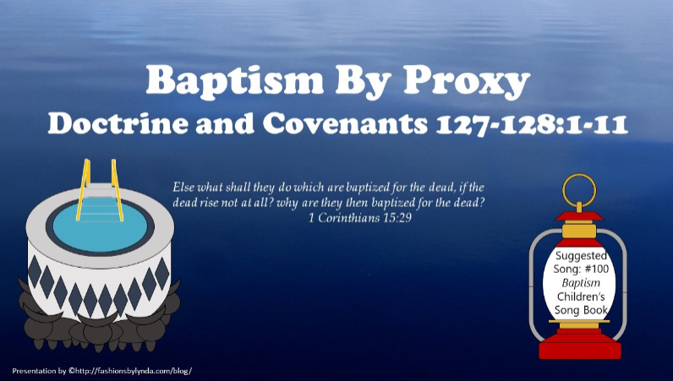

Slide 2

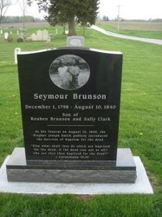
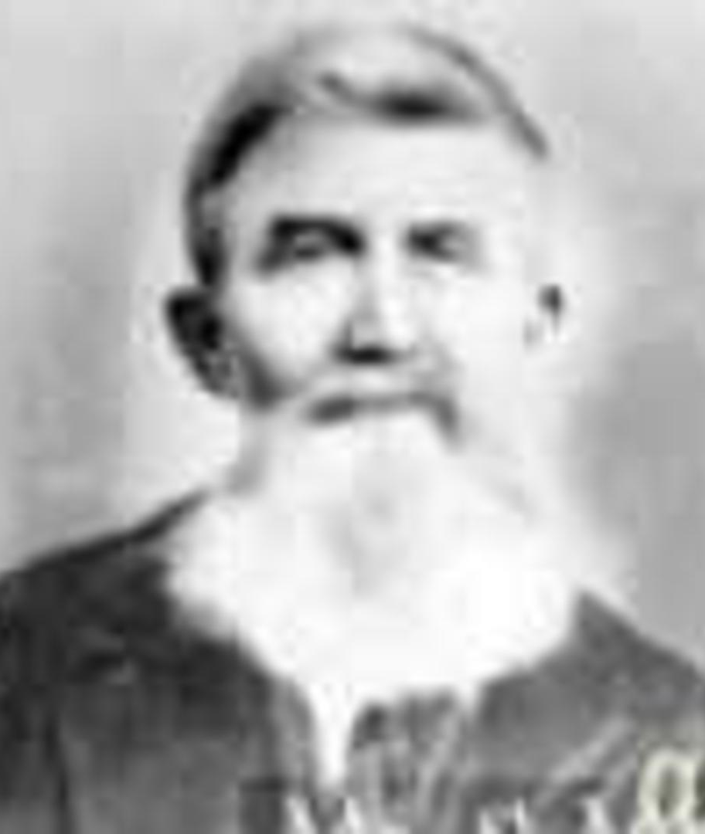
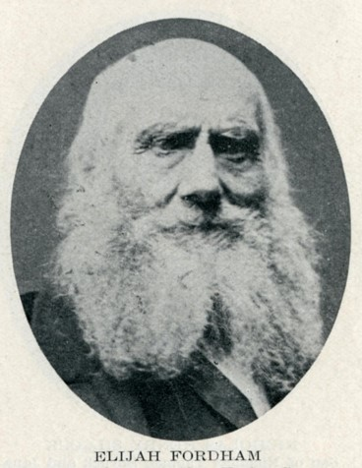
Background
September 1, 1842
As early as 10 August 1840, in an address at the funeral of Seymour Brunson, the Prophet introduced the doctrine of baptism for the dead to a startled congregation of Saints. Thereafter it was frequently a topic of addresses of the Brethren, and baptisms for the dead were performed in the nearby Mississippi River.
Joseph Smith Letter Book
According to the minutes of the general conference of the Church held in Nauvoo on 2 October 1841, the Prophet declared it was the Lord’s will that baptisms for the dead stop until they could be performed in His house.
The first baptisms for the dead in the uncompleted Nauvoo Temple were performed Sunday, 21 November 1841.
HC
Carver of Oxen in Nauvoo Temple

Slide 3
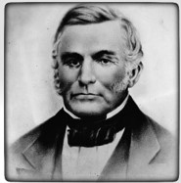
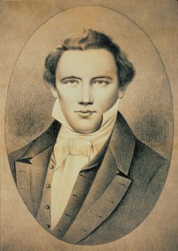
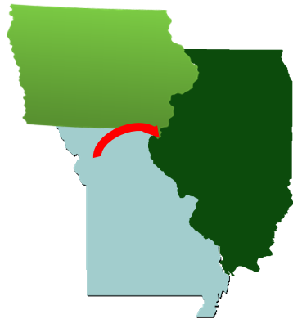
Trying to Arrest Joseph Smith
In May 1842, Lilburn W. Boggs, the former governor of Missouri who issued the extermination order against the Saints, was wounded by an unknown would-be assassin. Missouri authorities accused Joseph Smith of arranging for someone to murder Boggs and tried to bring the Prophet back to Missouri for trial.
Joseph Smith had left Missouri years earlier and was living in the area of Nauvoo, Illinois, at the time. Knowing that if he returned to Missouri he would be killed, the Prophet eluded Missouri officials for a time to avoid being illegally arrested.
In January 1843 it was determined that the proceedings to arrest Joseph Smith and extradite him to Missouri were illegal.
D&C 127:1-2 Student Manual

Slide 4
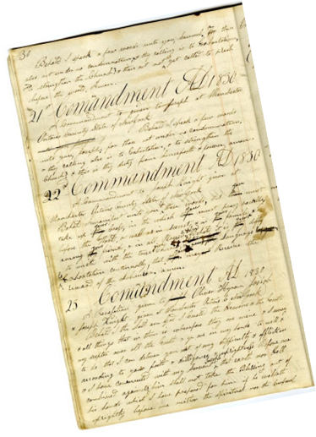
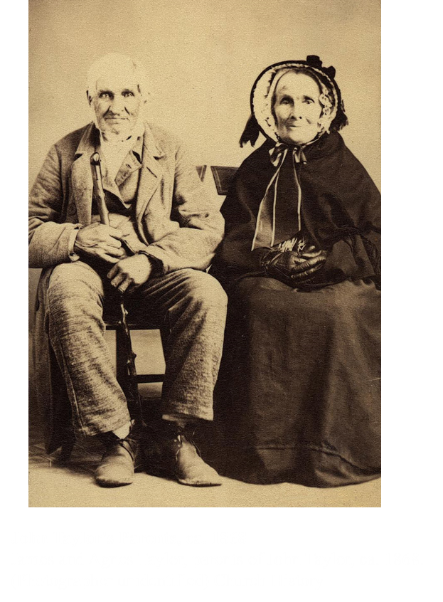

Joseph In Hiding
By the summer of 1842 persecution had grown to the point that the Prophet Joseph Smith was forced into hiding. This revelation was given while he was staying in the home of Brother Taylor, father of John Taylor.
The Prophet sent instructions by letter, as did ancient prophets, to the Saints as revelation was received, clarifying the order of baptism for the dead in the house of the Lord.
Oliver K. Granger handled the Prophet’s financial concerns after Joseph fled Kirtland in January 1838, and it is known that William W. Phelps, William Clayton, Willard Richards, and James Sloan were clerks in the Prophet’s office at this time.
Student Manual

Slide 5
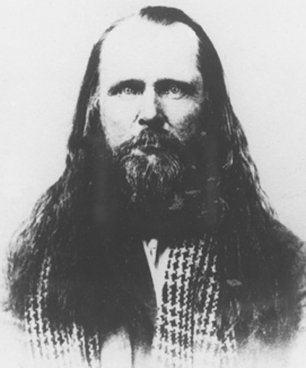
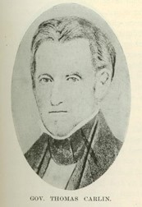
Conspiracy
Before the Prophet Joseph sent this revelation and Doctrine and Covenants 128 to the Saints, an unknown person made a serious attempt on the life of former governor Boggs of Missouri.
Orrin Porter Rockwell, a Mormon, was accused of the crime, and Joseph Smith was named as his accessory.
Residents of Missouri tried to compel the governor of Illinois, Thomas Carlin, to extradite Joseph Smith to Missouri to answer these false charges.
“This was a conspiracy to get the Prophet back into the hands of the Missourian mobbers. Governor Carlin of Illinois had joined in this conspiracy contrary to every principle of correct law, as it was later shown in the trial which was held in Springfield [Illinois]. … From his place of concealment, the Prophet wrote these two letters (Sections 127 and 128 in the Doctrine and Covenants) by revelation to the Church.” Joseph Fielding Smith
Orrin Porter Rockwell was blamed for the attempt on the life of Governor Boggs.
Student Manual

Slide 6

Tribulation
Which ball best represents Joseph Smith’s response to tribulation? Why?
How did Joseph know that he would triumph over his tribulations and perils?
According to what Joseph wrote to the Saints, what can help us endure tribulation?
Trusting in Heavenly Father can help us endure tribulation
D&C 127:1-2

Slide 7
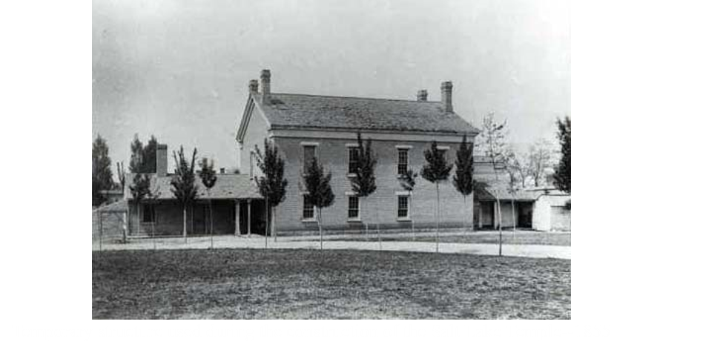
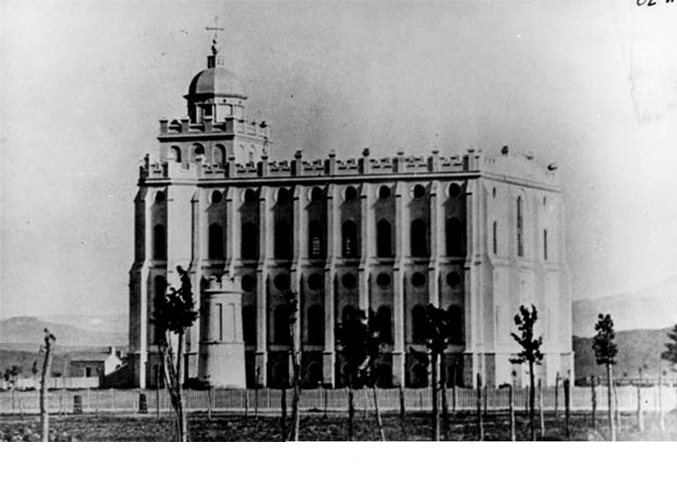
Endowment House
In 1842 the Saints were entering a time of persecution that could have given them cause to stop working on a temple that might never be used. In fact, final work was done on the temple after the decision was made to evacuate Nauvoo in 1846.
During all of the persecution, the Saints received great blessings and endowments to sustain them in the years of suffering and death that lay ahead.
In the pioneer period that followed, some of the temple ordinances were available in the Endowment House. But it would be thirty-one years before a temple of the Lord was dedicated again.
D&C 127:3-4 Student Manual

Slide 8
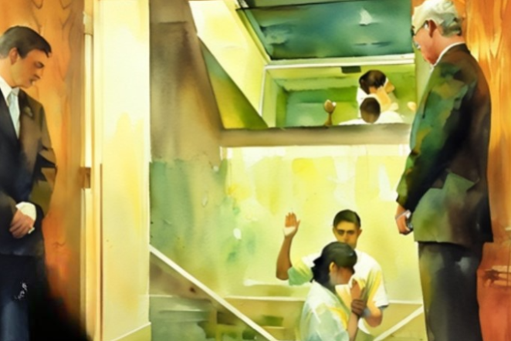
An Ordinance of Salvation
Salvation: by which men enter into the kingdom of heaven
Performed only by those who have the authority—one properly commissioned to act—and of equal necessity others sharing that same authority must act as witnesses of the event.
2 Witnesses
The Order of Heaven--They are also to see that proper records were kept
D&C 127:6

Slide 9
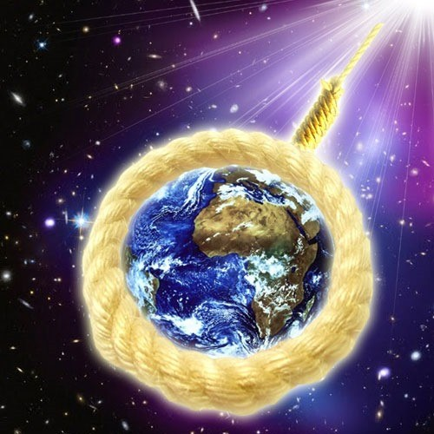
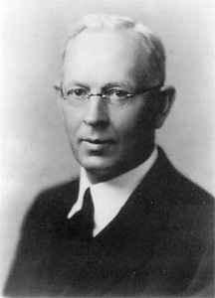
Bind on Earth—Bound in Heaven
“What is bound or sealed in the temples of the Lord is also sealed in heaven.
This is the great authority which Elijah restored.
It also covers ordinances performed for the living as well as for the dead.
The Prophet said that all of the ordinances for the living are required in behalf of all the dead who are entitled to the fulness of the exaltation.” Joseph Fielding Smith
The temple ordinances we perform on the earth are binding in heaven
D&C 127:7

Slide 10







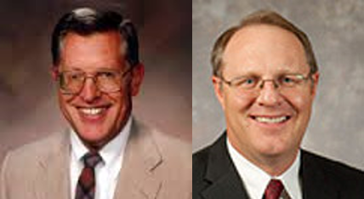
Things to Yet Be Restored
It was in Nauvoo that the fullness of the priesthood was restored
Keys were given to those who succeeded Joseph Smith in this great latter-day work
The twelve received the rights of the priesthood and all the powers and blessings of the temple
Nauvoo was a place where thousands were clothed in the blessings of the priesthood and endowed with power from on high
During the Nauvoo period the Lord bestowed knowledge and keys for marriage for time and eternity.
(D&C 132)
And temples are to house sacred ordinances, endowments, and baptism for the dead.
THE HOUSE OF THE LORD
Built by
THE CHURCH OF JESUS CHRIST OF LATTER-DAY SAINTS
COMMENCED APRIL 6, 1841
HOLINESS TO THE LORD
D&C 127:8 McConkie and Ostler/Student Manual

Slide 11

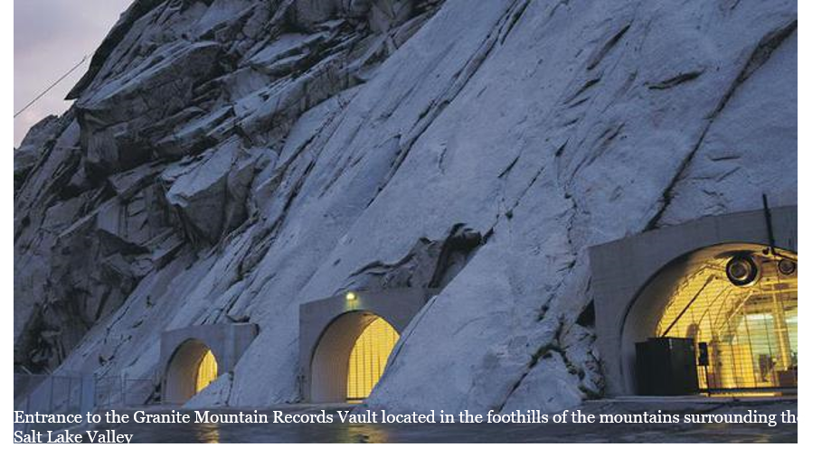
Records
Temple records contain the names and ordinance dates for all persons for whom temple work has been done in this dispensation.
This important data is stored in computers for ease of retrieval. This kind of record keeping fulfills the Lord’s requirement for “all the records [to] be had in order”
SALT LAKE CITY — A massive excavation carved 700 feet into a solid granite mountain near Salt Lake City houses millions of feet of microfilm — all historical documents The Church of Jesus Christ of Latter-day Saints has been keeping since 1938. The records are being digitized and published through FamilySearch, a genealogical resource provided free to the public.
D&C 127:9

Slide 12
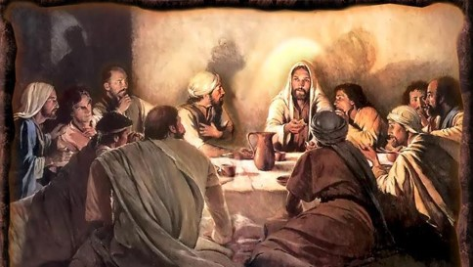
The Words of John
“The prince of this world cometh, but he hath nothing in me.”
John 14:30
These words were spoken by the Savior to disciples at the Last Supper.
JST Passage:
“For the prince of darkness, who is of this world, cometh, but hath no power over me, but he hath power over you [meaning the Twelve].”
D&C 127:11

Slide 13

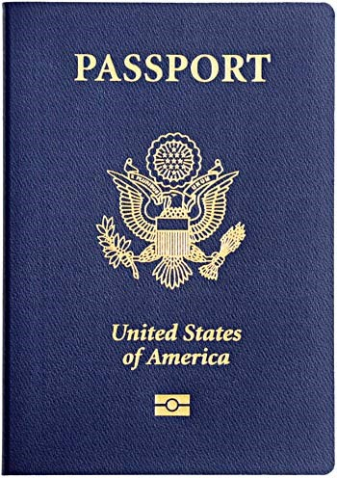
Privileges of a Passport
Why will another person’s passport not qualify you to enter another country?
What could happen if you tried to enter another country but the information inside your passport was not complete?
What do you need to do to keep your passport current?
D&C 128:1-5

Slide 14
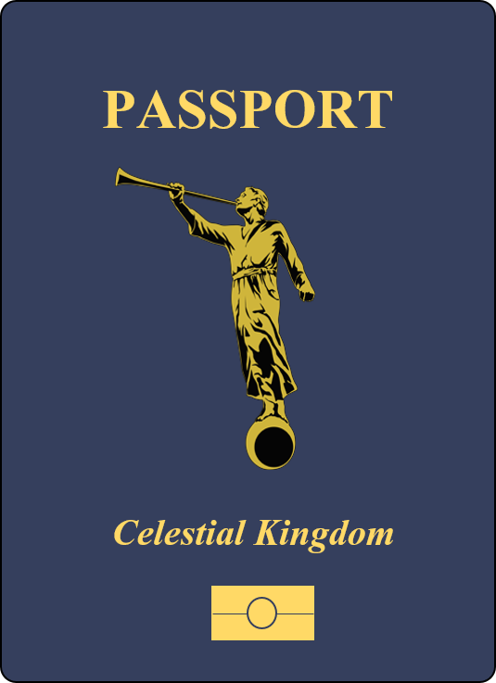
Eternal Passport
Why will another person’s passport not qualify you to enter another kingdom?
What could happen if you tried to enter another kingdom but the information inside your passport was not complete?
What do you need to do to keep your own passport current?
D&C 128:1-5

Slide 15
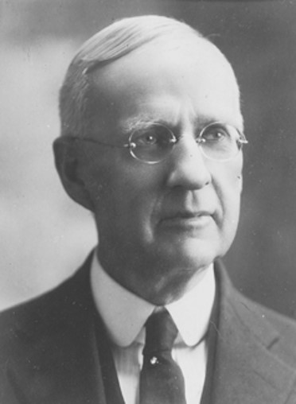
Properly Witnessed
“In the early days of the Church, some baptisms for the dead that were not properly witnessed and recorded, were rejected of the Lord, and the work had to be done over again.
Nothing that is done in the Temple will be accepted of the Lord, except it is properly witnessed and recorded.”
Rudger Clawson
D&C 128:1-5

Slide 16

Book of Life—Kept on Earth
A record kept in heaven which contains the names of the faithful and an account of their righteous covenants and deeds
And I saw the dead, small and great, stand before God; and the books were opened: and another book was opened, which is the book of life: and the dead were judged out of those things which were written in the books, according to their works.
Revelation 20:12
Notwithstanding in this rejoice not, that the spirits are subject unto you; but rather rejoice, because your names are written in heaven.
Luke 10:20
Figurative: “Our own life, and being, the record of our acts transcribed in our souls, an account of our obedience or disobedience written in our bodies. Literally, it is the record kept in heaven of the names and righteous deeds of the faithful.”
Elder Bruce R. McConkie
D&C 128:6-9

Slide 17
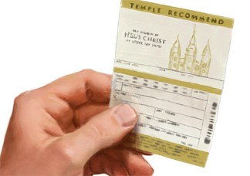
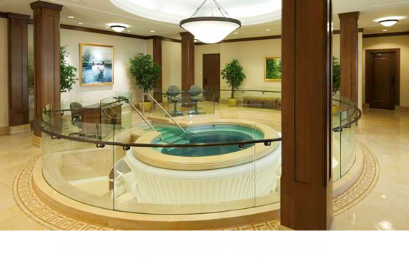
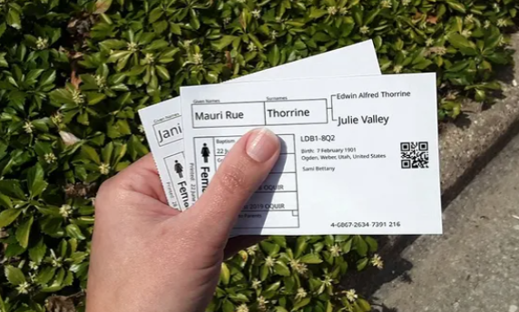
propria persona
People who are baptized for themselves and the phrase “their own agents” refers to those who are baptized as proxies
“Ordinances and covenants become our credentials for admission into [God’s] presence”
Elder Boyd K. Packer
When an ordinance is performed by priesthood authority and a proper record is kept, the ordinance is binding on earth and in heaven.
D&C 128:8

Slide 18
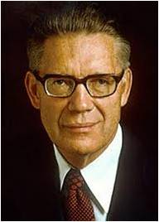


The Rock of Revelation
“Jesus is the Christ. All who legitimately profess Christ must know him to be such by the spirit of revelation.”
We should not embrace any doctrine that has not been directed to us by revelation.
“It is our testimony to all the world that to deny revelation, meaning revelation that is immediate to our day, is to deny the very foundation upon which all true Christianity must rest.”
McConkie and Ostler
“Where there is revelation, there is the kingdom of God on earth; where there is no revelation, there the kingdom of God is not.”
Bruce R. McConkie
D&C 128:10 Matthew 16:18,19

Slide 19

summum bonum
The highest good, especially as the ultimate goal according to which values and priorities are established in an ethical system.
“The man standing at the head of the Church and Kingdom of God, the prophet seer, and revelator, to whom the keys of the kingdom have been given, has the right to unlock the heavens and obtain whatever intelligence is necessary to direct the sealing work in our temples or to direct the teaching of the gospel and the performance of gospel ordinances among any who dwell upon the earth.”
McConkie and Ostler
D&C 128:11

Slide 20
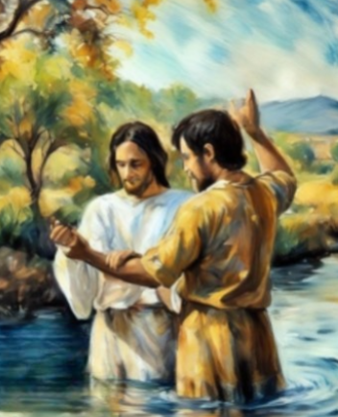
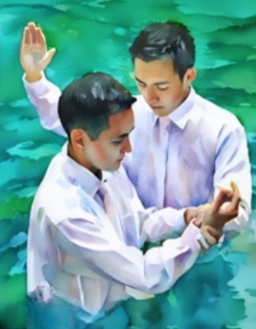
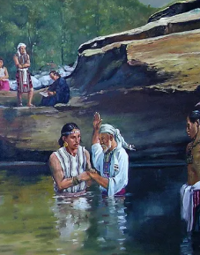
Immersed in Water
Matthew 3:13-17
John 3:5
2 Nephi 31:4-11
D&C 128:12

Slide 21
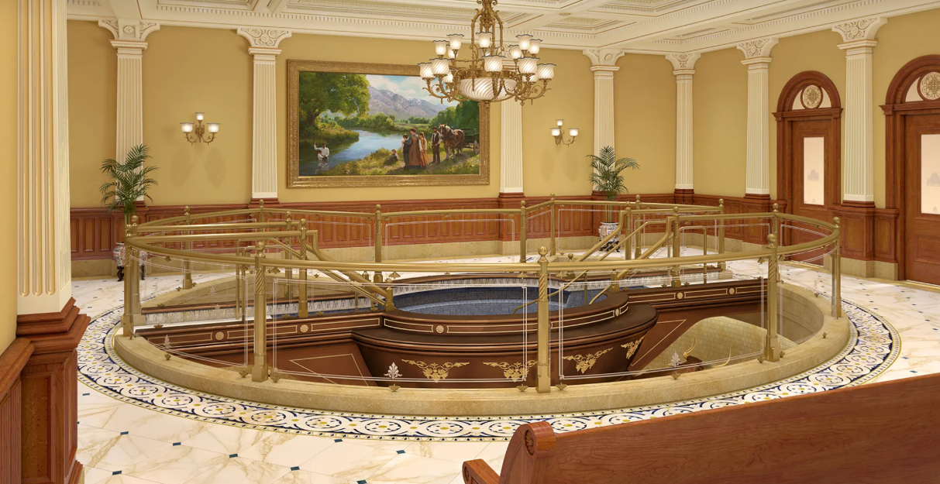
Heavenly Father’s Plan
Else what shall they do which are baptized for the dead, if the dead rise not at all? why are they then baptized for the dead?
1 Corinthians 15:29
God’s plan allowed a living person to be baptized vicariously for someone who had died.
Baptism by proxy can only be preformed in Temples.

Slide 22
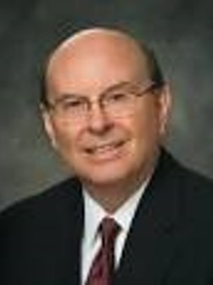
Temple and family history work is not just about us.
Think of those on the other side of the veil waiting for the saving ordinances that would free them from the bondage of spirit prison.
Quentin L. Cook
Heavenly Father prepared a way for the salvation of those who die without a knowledge of the gospel..

Slide 23
Sources:
Videos:
“What Are Baptisms for the Dead?” (1:22)
The Sealing Power Binds and Looses on Earth and in Heaven( 0:42)
Now We're Sealed—Now It's Forever (5:56)
I’m a Mormon, a Barrister, and I’m Grateful for Trials (3:41)
“Glad Tidings: The History of Baptisms for the Dead” (6:55).
Joseph Smith Letter Book, 6 November 1838–9 February 1843, Historical Department, The Church of Jesus Christ of Latter-day Saints, Salt Lake City, pp. 190–96; see also Notes and Commentary on D&C 124:29–36
History of the Church, 4:426, 454
Joseph Fielding Smith, Church History and Modern Revelation, 2:328, 329
Doctrine and Covenants Student Manual Religion 324-325 Section 127
Joseph Fielding McConkie and Craig J. Ostler Revelations of the Restoration pg. 1023, 1028, 1030
Rudger Clawson conference Report April 1900, 43-44
Elder Boyd K. Packer (“Covenants,” Ensign, May 1987, 24).
Presentation by ©http://fashionsbylynda.com/blog/
Elder Bruce R. McConkie (Mormon Doctrine, p. 97.) (Doctrinal New Testament Commentary, 1:386)
Quentin L. Cook, “Roots and Branches,” Ensign or Liahona, May 2014, 46)
Presentation by ©http://fashionsbylynda.com/blog/

Slide 24
Seymour Brunson (September 18, 1798 – August 10, 1840) was an early Mormon convert. He is most noted since it was at a speech given at his funeral that Joseph Smith first presented the doctrine of Baptism for the Dead.
Brunson was born in Orwell, Vermont. In 1813, at the age of 14, he enlisted in the United States military as a 16-year-old and served during the War of 1812.
In 1823, Brunson married Harriet Matilda Gould. They eventually had seven children.
Brunson was baptized a member of the Church of Christ in early 1831. He served as a missionary in both Ohio and Virginia and then moved to Daviess County, Missouri just south of Far West. After a year he moved into the town. In April 1838 it was Brunson who brought the charges against Oliver Cowdery that led to Cowdery's excommunication. During that fall Brunson served as a major in the Davies County militia. After this he moved to Quincy, Illinois for a short time and then on to Nauvoo, Illinois
At Nauvoo, Brunson served as a member of the High Council and as a Lieutenant Colonel in the Hancock County Militia. He also served as one of Joseph Smith's bodyguards.
Samuel Rolfe, Temple Carpenter and Assistant Doorkeeper
D&C 124:142. And again, I say unto you, Samuel Rolfe and his counselors for priests, and the president of the teachers and his counselors, and also the president of the deacons and his counselors, and also the president of the stake and his counselors.
Thomas B. Marsh, an apostle who had become a bitter apostate over a pint of cream, upon returning to the Church with a broken and repentant heart, quoted David from the Bible and said, “I would rather be a doorkeeper in the house of God than to dwell in the tents of wickedness.” (Black, p. 189) Well, Samuel Rolfe was the personification of that desire. In fact, he was not even a doorkeeper in the house of God, he was an assistant doorkeeper of the Kirtland Temple. He was not a prominent figure in church history. But he was always steadily serving where he could. When in December of 1835, the Prophet Joseph was in financial distress, several of the brethren gave him money. The Prophet was so grateful, he itemized them and their donations in his History of the Church and wrote along with it, “My heart swells with gratitude inexpressible when I realize the great condescension of the heavenly Father, in opening the hearts of these my beloved brethren to administer so liberally to my wants. And I ask God, in the name of Jesus Christ, to multiply blessings without number upon their heads…And whether my days are many or few, whether in life or in death, I say in my heart, O Lord, let me enjoy the society of such brethren.” Elijah Fordham and Samuel Rolfe are both on that list; Elijah having given $5:25, and Samuel $1.25. (Joseph Smith, History of the Church 2:327) At the time, Samuel was a carpenter, working on the Kirtland Temple.
When the saints began the Nauvoo Temple, Samuel was called to be one of the full-time carpenters there as well. The Nauvoo Temple was finished and dedicated room by room and story by story. The baptismal font, which Elijah Fordham had built, was in the basement to symbolize dying before being reborn, and therefore it was the first part completed. A very unusual blessing took place there for Samuel Rolfe. He was seriously afflicted with a “felon,” an acute and painful inflammation of the deeper tissues of a finger. This would, of course, be a real problem for a carpenter working on the temple. Samuel Rolfe apparently did not keep a journal, nor did any of his descendants write his history, as far as we know, but according to Edward Stevenson’s biography, Samuel Rolfe was promised that if he would dip his finger in the baptismal font, he would be healed, He did so, and was healed.
Just before Joseph’s death, he asked for volunteers to go west scouting for a new home for the Saints. Samuel was one of the few who volunteered. Because of the martyrdom, they did not go. Instead Samuel served as a bishop in Winter Quarters, and a captain of a pioneer company. He died in Utah at the age of 72. (Black, p. 250-251)
Elijah Fordham, Builder of the Font
July 22, 1839 was the day of miraculous healing at the site of the future town of Nauvoo. Many, many of the saints were deathly ill with malaria. Joseph Smith called upon the Lord in mighty prayer, and went forth to heal all those that he and his wife were caring for in their home and in tents in their yard. Then he continued on through the makeshift community and into Montrose. He went to Brigham Young’s and healed him, called Wilford along after passing by his door. Without a word, they crossed the city square and entered the house of Elijah Fordham. Elijah was within minutes of dead; he was speechless and unconscious. After rousing him and speaking with him briefly, Joseph commanded him in the name of Jesus of Nazareth to rise up and walk. Elijah immediately was healed, and jumped up out of bed, kicking off his foot poultices, asked for some bread and milk, and after consuming it, put on his hat and continued along with them down the street to heal others.
The baptismal font in the basement of the Nauvoo Temple was mounted on 12 oxen and built of Wisconsin pine by Elijah Fordham. Apparently his healing blessing “stuck,” as he outlived all those who were there to witness it. He died in 1879 in Wellsville, Utah.
http://gospeldoctrineplus.blogspot.com/2013/07/doctrine-and-covenants-lesson-30.html

Slide 25
Falsehoods:
President Brigham Young said of this legal harassment: “Joseph, our Prophet, was hunted and driven, arrested and persecuted, and although no law was ever made in these United States that would bear against him, for he never broke a law, yet to my certain knowledge he was defendant in forty-six lawsuits, and every time Mr. Priest [a priest or a preacher] was at the head of and led the band or mob who hunted and persecuted him. And when Joseph and Hyrum were slain in Carthage jail, the mob, painted like Indians, was led by a preacher.” (In Journal of Discourses, 14:199.)
“Joseph Smith, in forty-seven prosecutions was never proven guilty of one violation of the laws of his country. They accused him of treason, because he would not fellowship their wickedness.” (Brigham Young, in Journal of Discourses, 10:111.)
The Endowment House was used primarily for performing temple ordinances. From 1857 to 1876 the baptismal font was used to perform 134,053 baptisms for the dead. Between 1855 and 1884 54,170 persons received their washings and anointings and endowments. Between 1855 and 1889 68,767 couples were sealed in marriage—31,052 for the living and 37,715 for the dead.
The Triumph of the Nauvoo Temple
Samuel Rolfe and Elijah Fordham are two of the many, many early Saints who did a great work behind the scenes. The Nauvoo Temple itself did not last. Although ordinances were performed in each room as it was finished and dedicated, the entire temple wasn’t finally dedicated until May 1st, 1846, after most of the saints had already left Nauvoo, and as you can see by the For Sale sign, it was placed on the market that very month. A few years later, an arsonist burned it down, and the stones were gradually carted away to be used in other buildings on the area.
But it was not a tragedy, it was a triumph. Because of the temple-building efforts of Samuel and Elijah and the others, many members of the Church were able to have the great joy of receiving their temple ordinances, and being baptized for their deceased family members before they headed out west. It would be 31 years before there would be another temple on the earth. (St. George, Utah)
Endowment House Locale
Once located on the northwest corner of the temple block in Salt Lake City, the Endowment House served as a temporary temple for Church members in Utah Territory from 1855–1889 during construction of the Salt Lake Temple. The two-story adobe structure was razed in 1889, four years prior to the completion of the Salt Lake Temple.
Prior to the construction of the Endowment House, temple ordinances were being given on a regular basis in Salt Lake beginning in February 1851. This was done in a variety of locations including Brigham Young's office, the Council House, and the top of Ensign Peak.
Recognizing the need for a separate dedicated structure for the administration of the endowment, the Endowment House was built on the northwest corner of Temple Square to function during the construction of the Salt Lake Temple.
At the time of its dedication, President Brigham Young declared that the Endowment House was "The House of the Lord."
The Endowment House was designed by Church architect Truman O. Angell.
The two-story Endowment House featured a washing and anointing room, "garden room," "world room," and "terrestrial room" on the main floor with a "celestial room" on the upper floor.
A year after the Endowment House was constructed, it was enlarged to include a baptistry, which was dedicated on October 2, 1856.
Baptisms for the dead were administered in the Endowment House until 1876, the year before the St. George Utah Temple (1877) was dedicated. Endowments for the living were performed there until 1884, the year the Logan Utah Temple (1884) was dedicated. And sealings of living couples were performed there until 1889, the year after the Manti Utah Temple (1888) was dedicated.
Endowments for the dead were not performed in the Endowment House, which were reserved for the temple only.
In 1889, President Wilford Woodruff had the Endowment House razed. The Church had three operating temples by then, and the Salt Lake Temple (1893) was nearing completion.
http://www.ldschurchtemples.com/endowment/
http://gospeldoctrineplus.blogspot.com/2013/07/doctrine-and-covenants-lesson-30.html

Slide 26
More on Family Search Records: Available to All
The Granite Mountain Records Vault is the official storage unit for 2.4 million rolls of microfilm containing approximately 3.5 billion images. The information links to billions of people in over 100 countries and is recorded in 170 languages.
Information on the films is currently being digitized by use of complex computer programs which adjust for density variations in each film. The enormous collection of secured documents: unpublished records from churches and governments, parish registries, passenger lists, birth certificates, censuses, deeds, wills, family, town and county histories and even maps, requires just over 15 minutes to convert a whole microfilm into a digital file. Eventually the vast majority of the collection will be available for online research.
Not only does the Church make such vital, historical information available to genealogy researchers, but it returns a copy of the filmed records to the record custodian. In 2004, for example, a cyclone struck the tiny South Pacific island of Niue, destroying all local birth, death and court records. FamilySearch had filmed the records sometime prior for the archivist of Niue. FamilySearch was able to provide a copy of the original records to the storm-ravaged island.
“Restoring the records of the past is one part of helping this island rebuild and look to the future,” said Jay Verkler, CEO of FamilySearch.
Maintaining a records collection of such volume requires carefully controlled procedures. The vault, a total of some 65,000 square feet, operates at 55 degrees, 35 percent humidity and with a circulating fresh air system that minimizes dust. Under such conditions the vast collection can be protected against deterioration, natural disasters or man-made calamities.
Organized searching for valued records worldwide began with the 1894 establishment of the Genealogical Society of Utah, a nonprofit group founded by the Church. “Rather than expecting people to travel to original record sources, the Church organized teams to bring copies of the records back to the genealogical researchers,” Verkler explained. “Sometimes the Church copies are the only existing copies of these valuable archival records.”
Record collections continued but were expedited by the development of microfilm technology in the 1930s. A rapidly expanding collection of films, over 100,000 by the early 1950s, prodded Church leaders to create a permanent storage facility. After considering several Salt Lake City locations, the leaders settled on a location in the surrounding hillside, where a slab of solid granite was located in the mountainside nearby. Granite from that location was quarried for both the Salt Lake Temple and later the Church’s Salt Lake City Conference Center.
Construction of the vault began in 1958 and was generally completed by 1963 and considered completely operational in 1965. The site includes a network of storage rooms containing walls of steel cabinets ten feet high. A separate section houses office spaces, shipping docks and microfilm processing stations.
“Preservation and protection of the world’s valuable records has been a longtime goal of the Church,” Verkler added. “Storing the records in the mountain vault where it is already cold provides the perfect facility for safekeeping.” Such a facility provides evidence of the Church’s commitment to not only collecting, but making the collections available to researchers worldwide. Archivists can offer microfilm or digital copies of the records to their reading room patrons without damage to the original vital records.
The genealogical world recognizes the Church as a longtime resource in their work, and in that sense, they think of the vault as a bit of an icon, an icon of protection to these important and accessible records.
News Room: http://www.mormonnewsroom.org/article/familysearch-shares-plans-to-digitize-billions-of-records-stored-at-granite-mountain-records-vault

